Slide 1
2024 NABT
Modeling Infection & Immunity
A Summer Workshop
Funded by an NIH SEPA award
Tim Herman

Slide 2
There are things we know…
As we think deeply about what we know, we will begin to ask questions about things we don’t know …….
Things we don’t know…
1. There are things we know we don’t know.
2. There are things we don’t know we don’t know
A teacher’s role is to encourage students to think deeply about what they know … and identify what they don’t know.

Slide 3
Teachers should model for students….
… the joy of discovering something you didn’t know
… the joy of discovering something you didn’t even
know you didn’t know.
This discovery happens when you…
slow down, focus, think deeply…
and begin to ask questions.

Slide 4
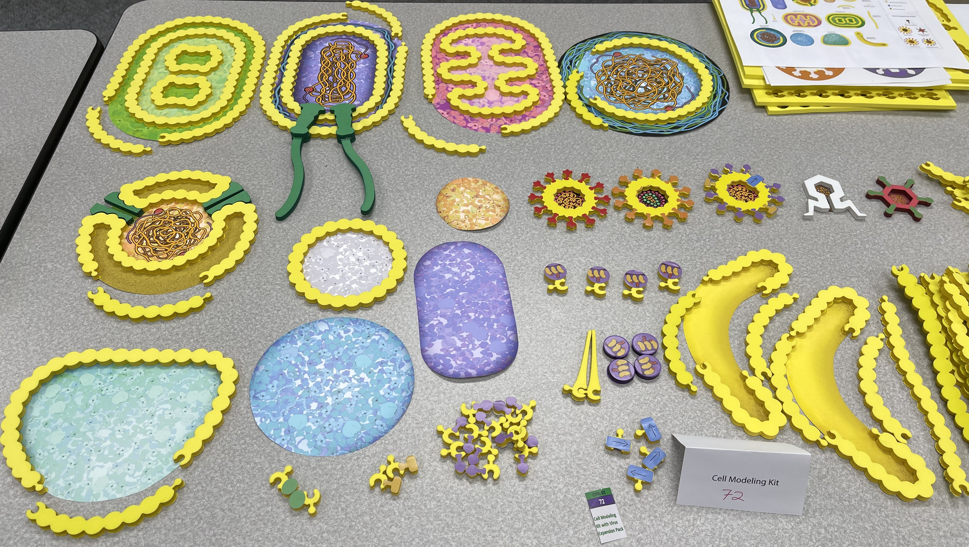
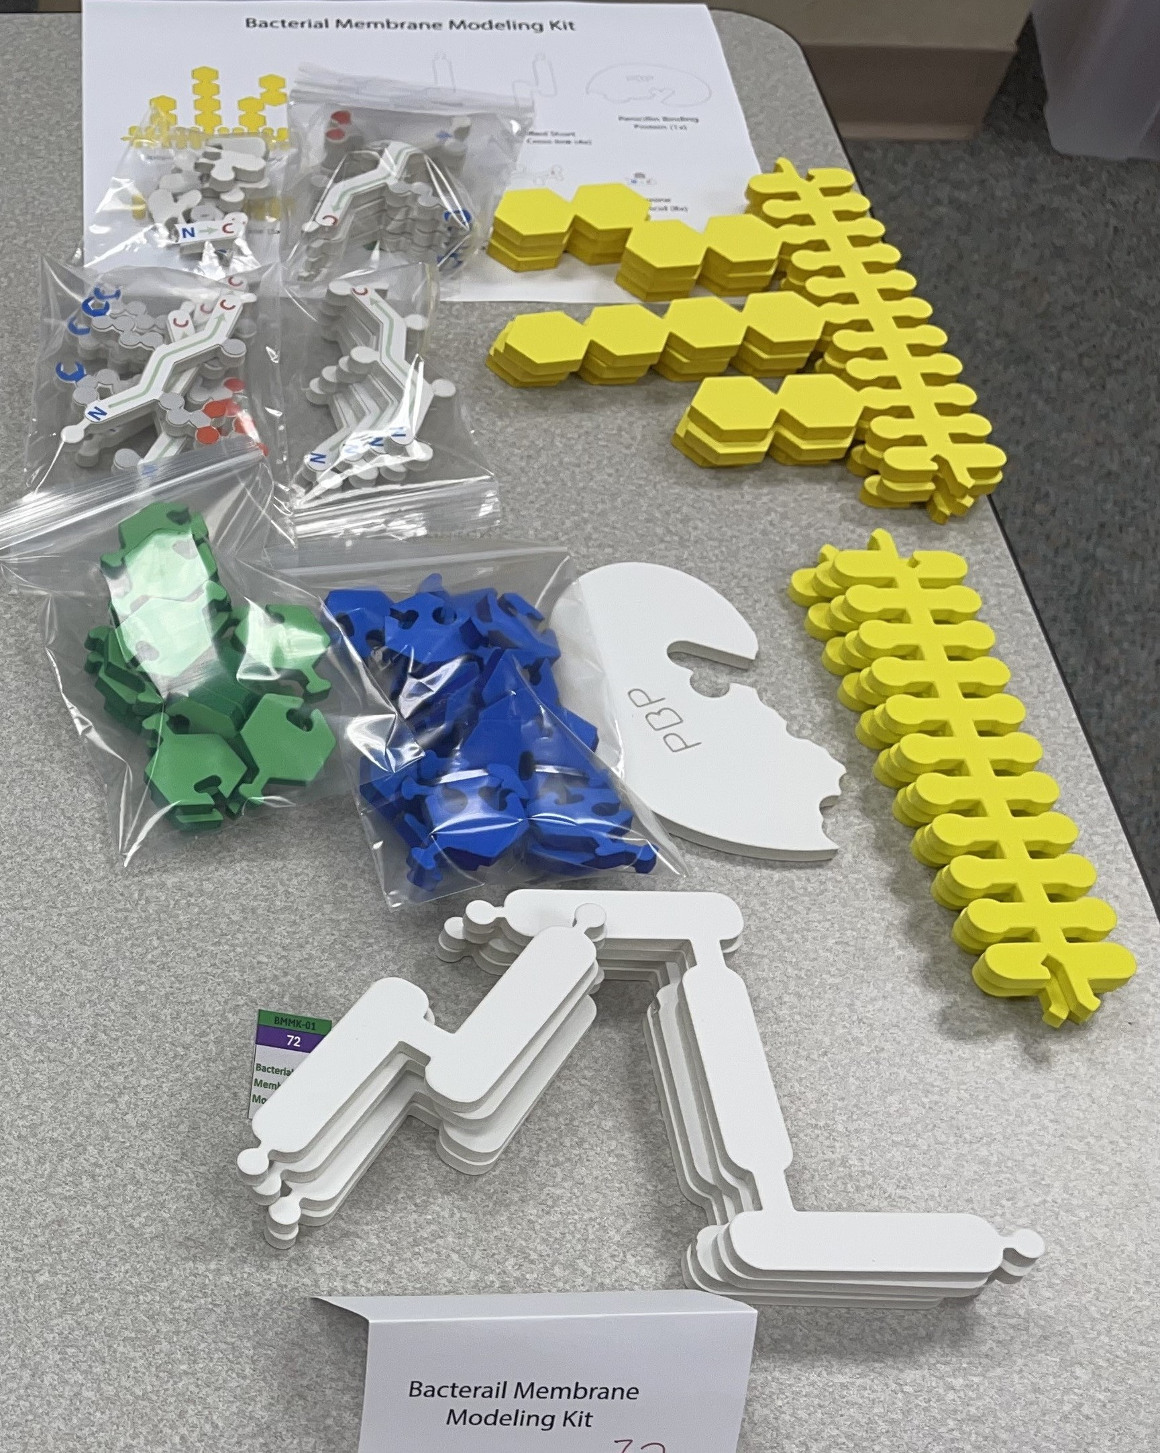
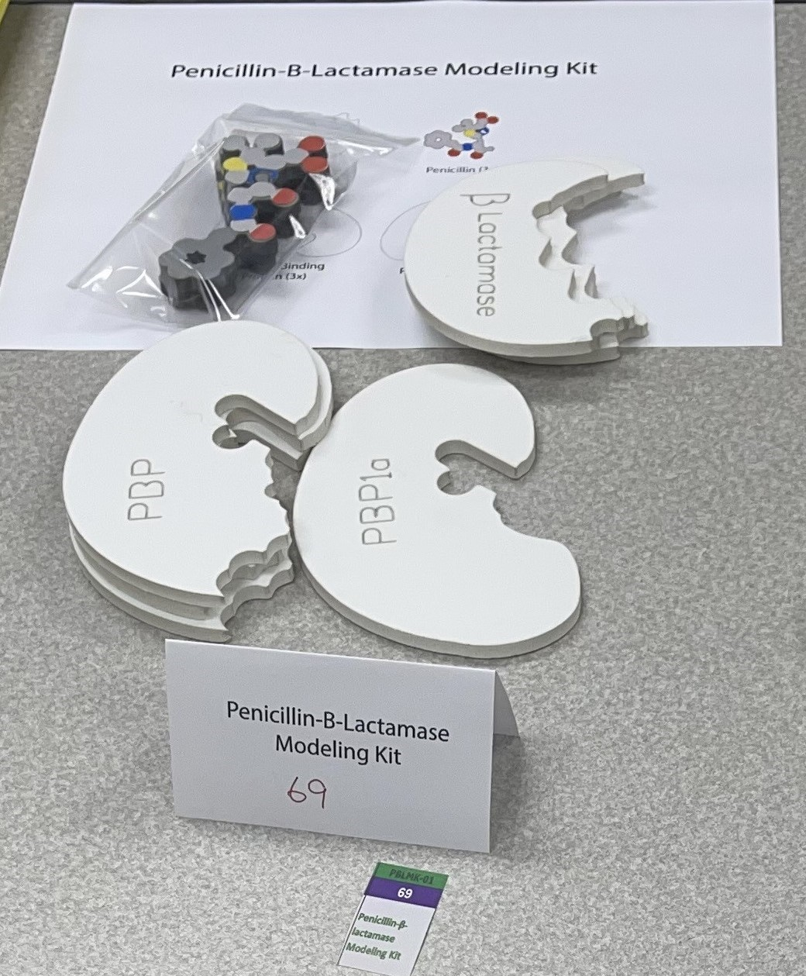
Bacterial
Membrane
Kit
Cell Modeling Kit
2024 MII Kits
Penicillin /
Beta-Lactamase
Kit

Slide 5
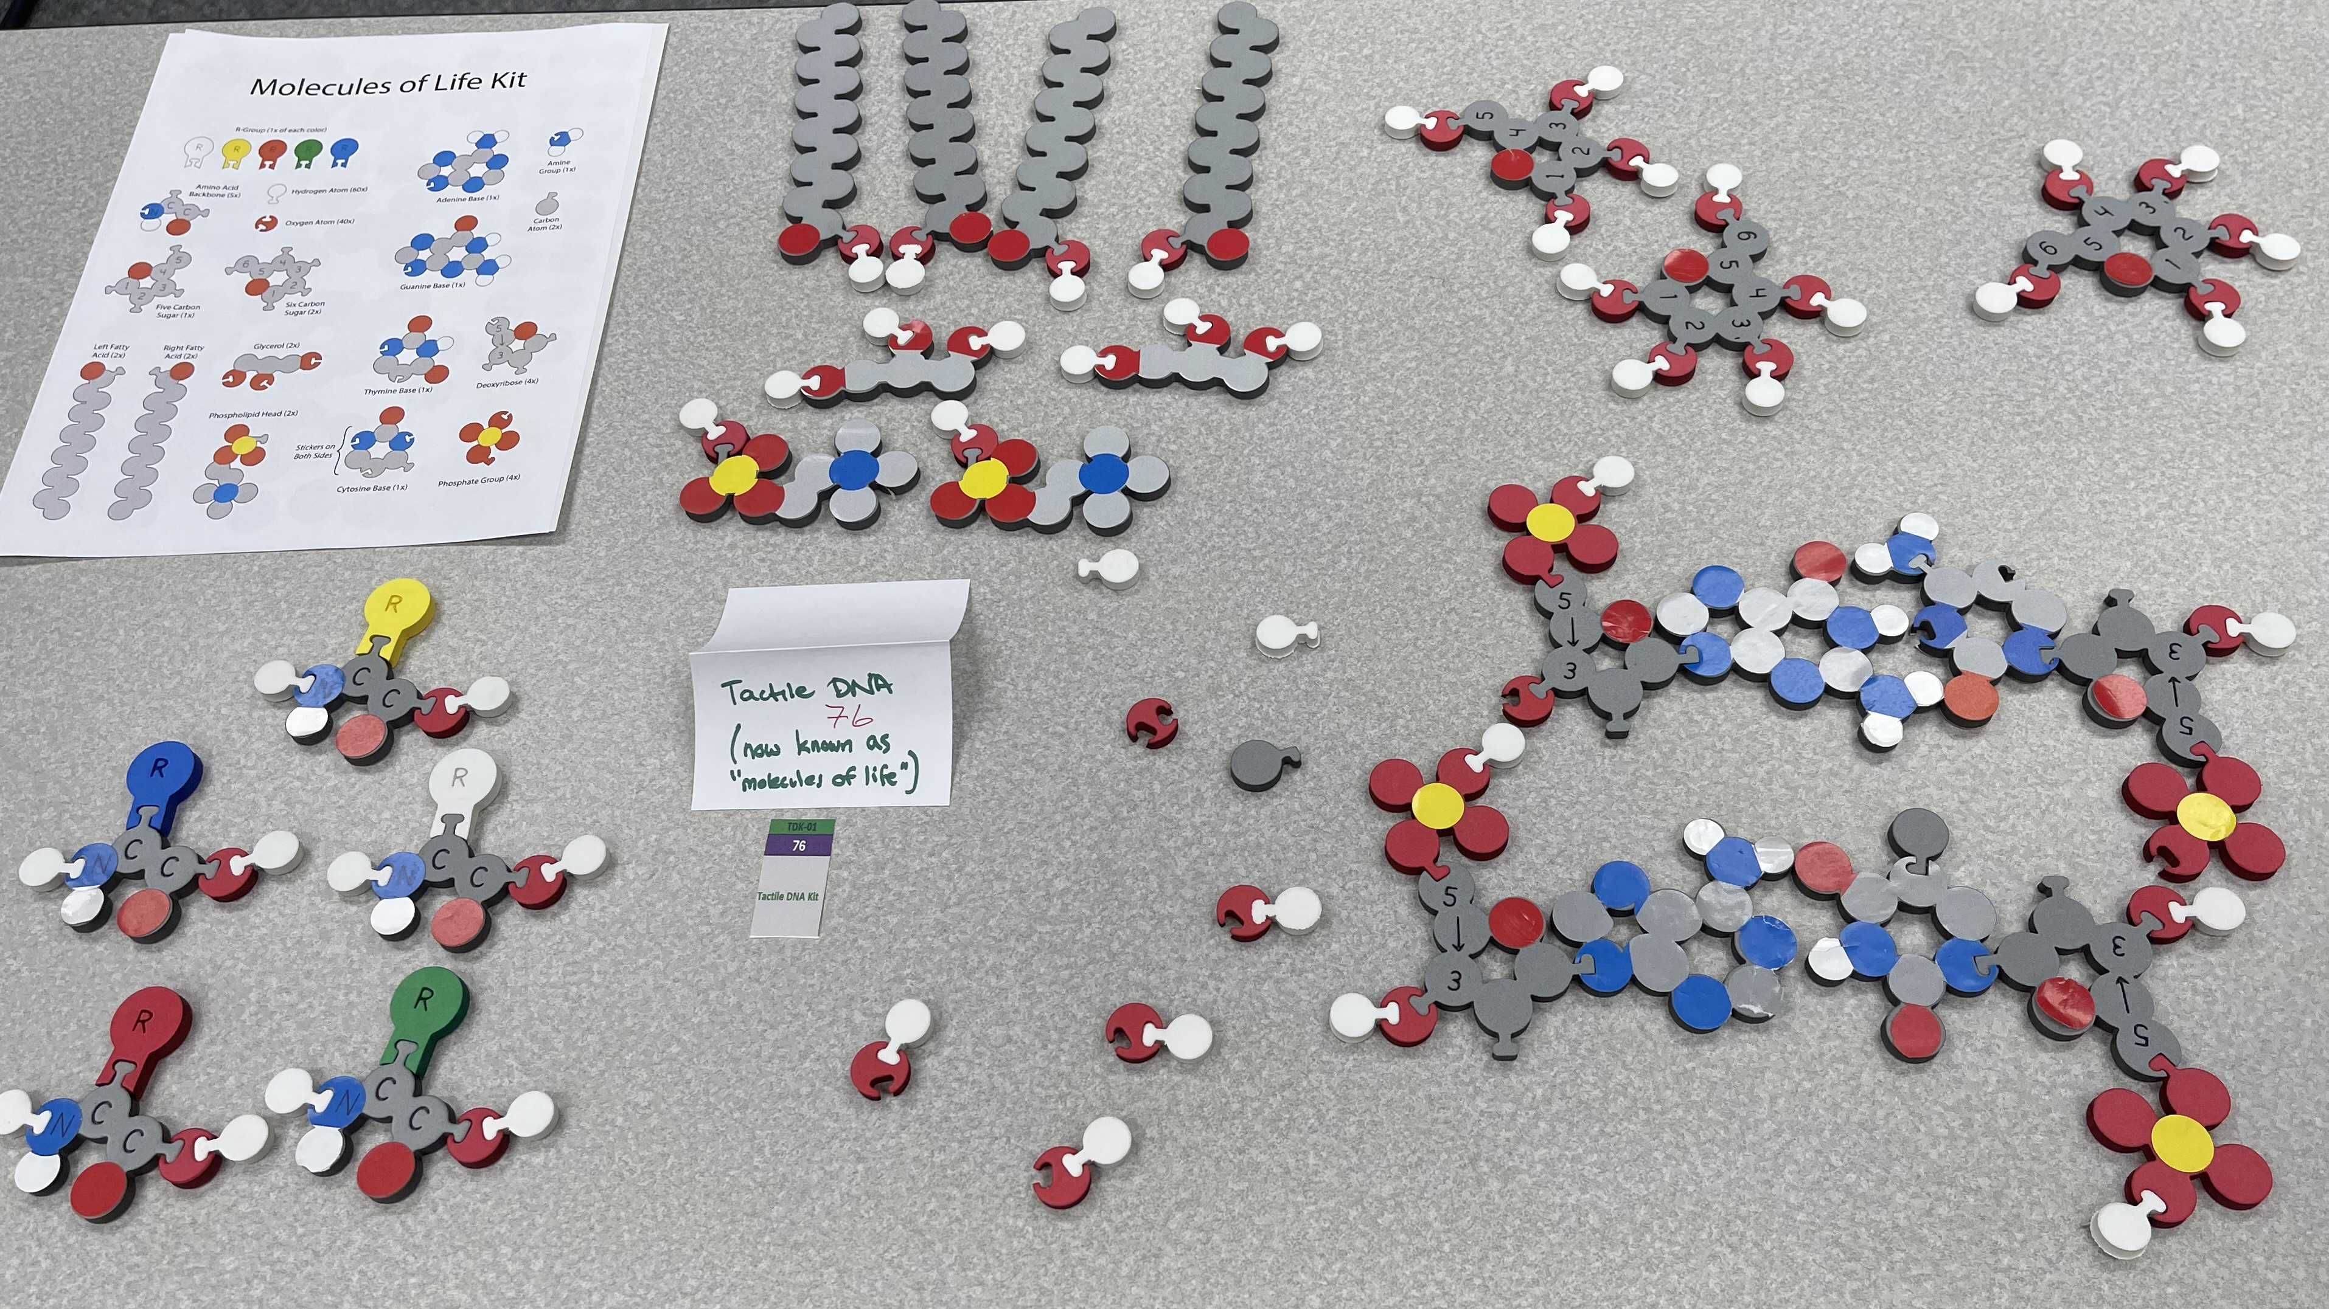
Molecules of Life / Tactile Base Pairs

Slide 6
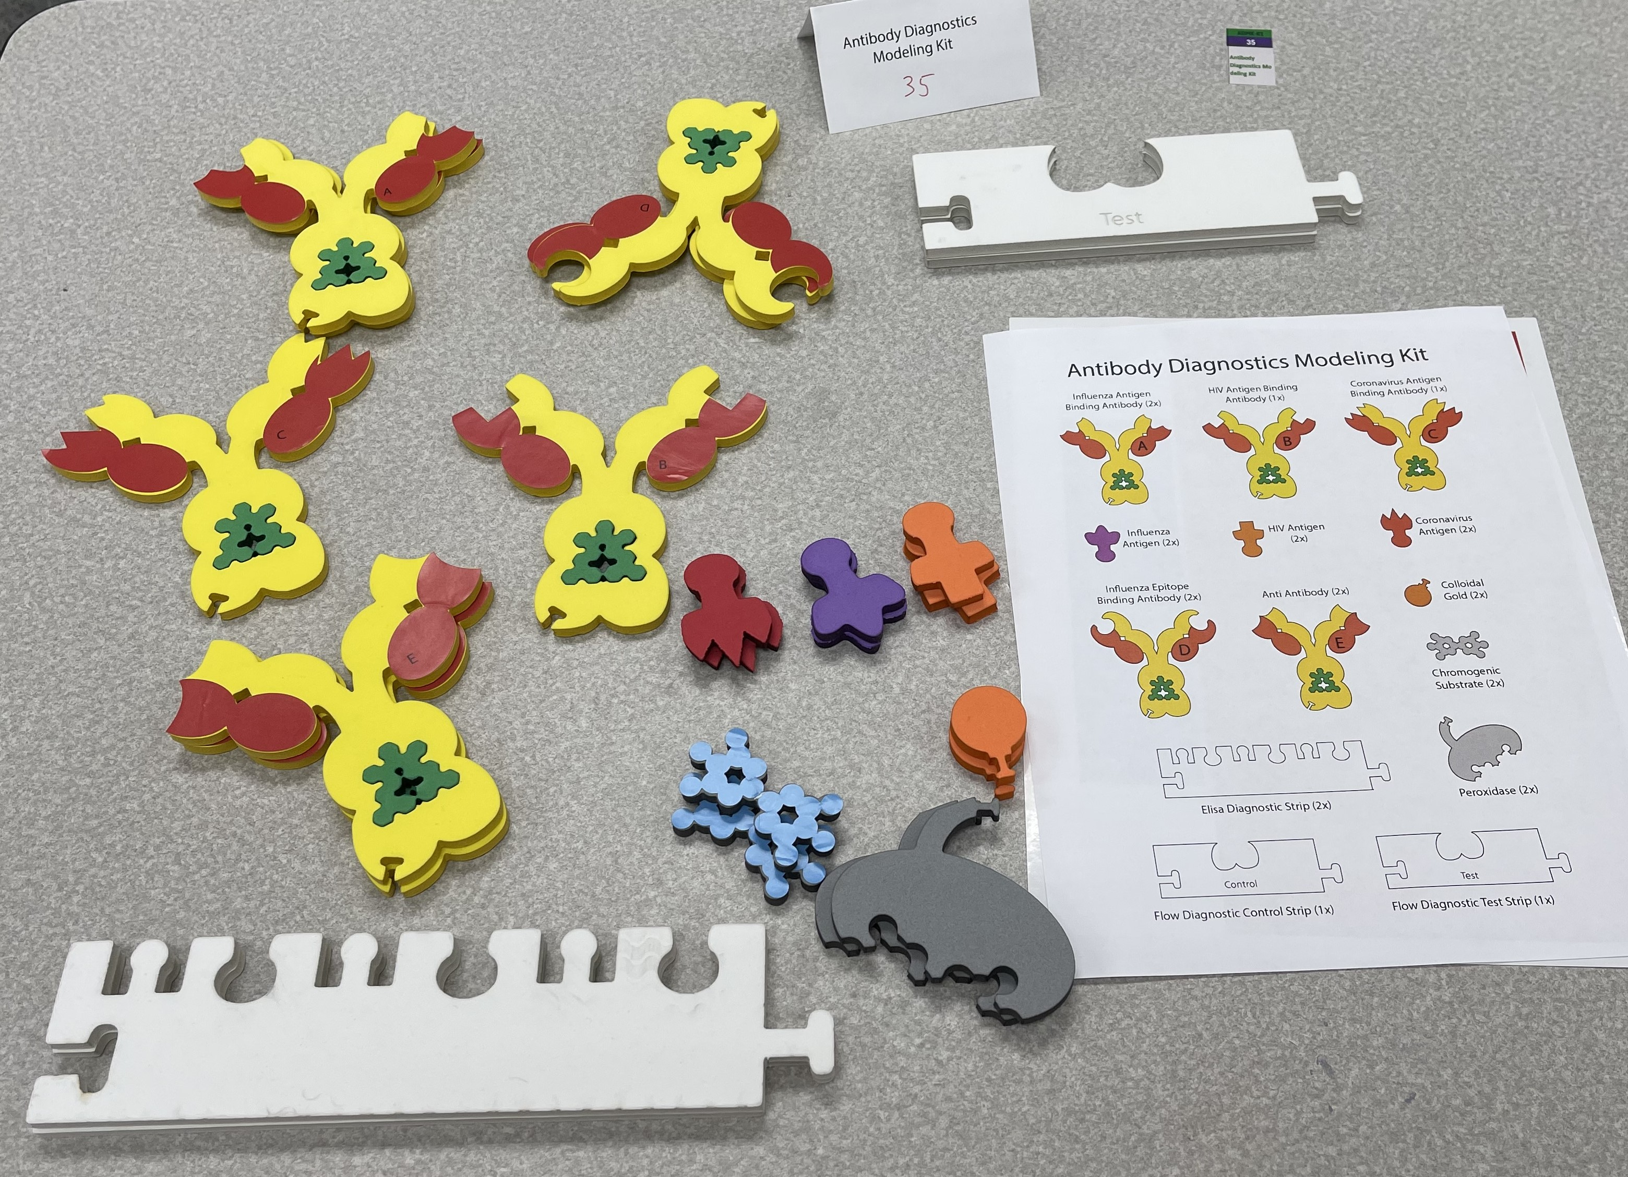
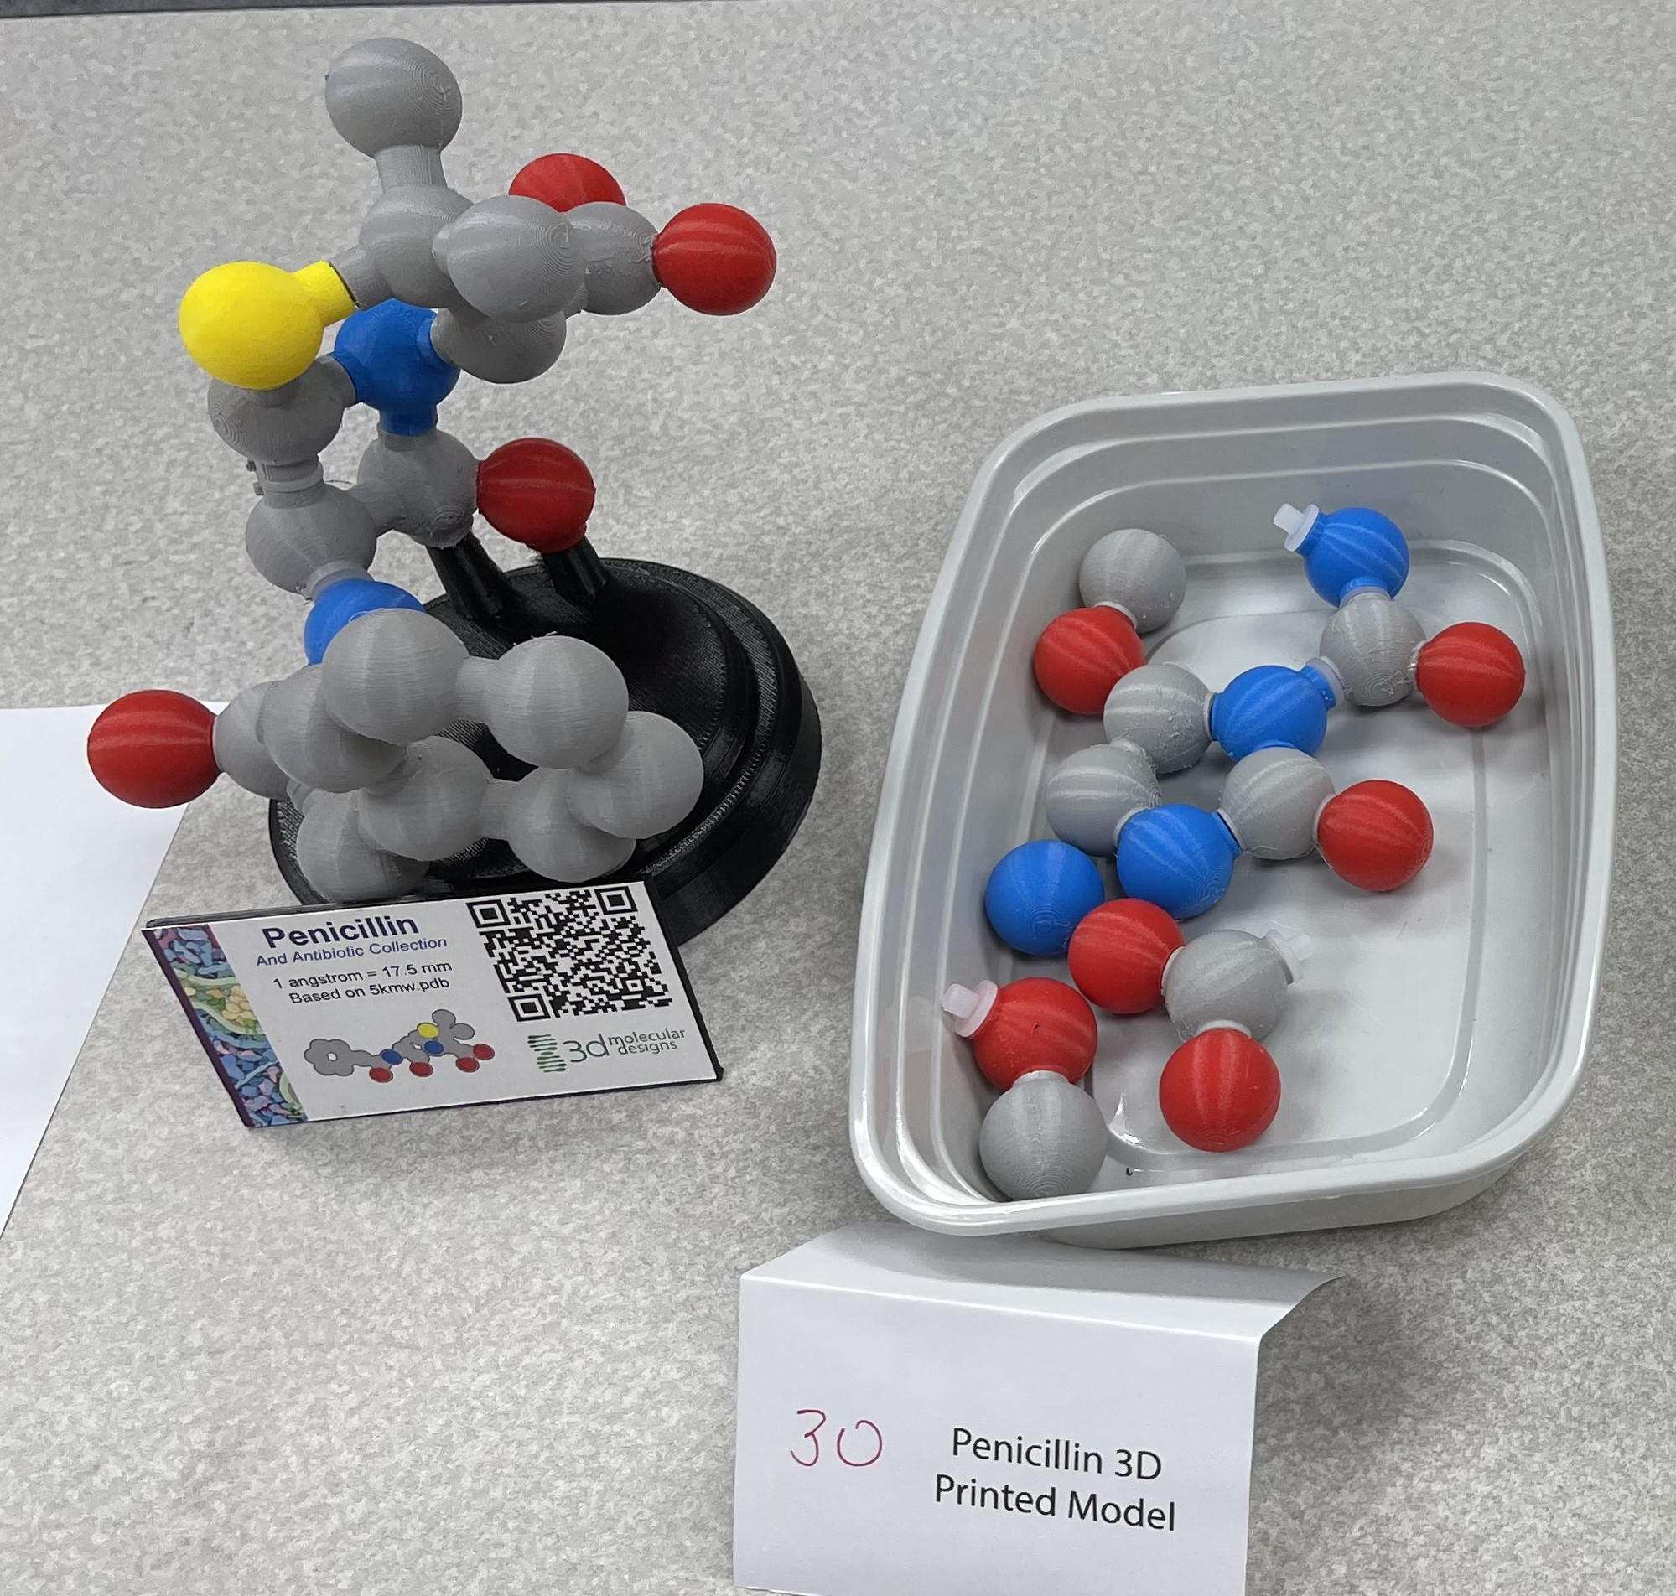
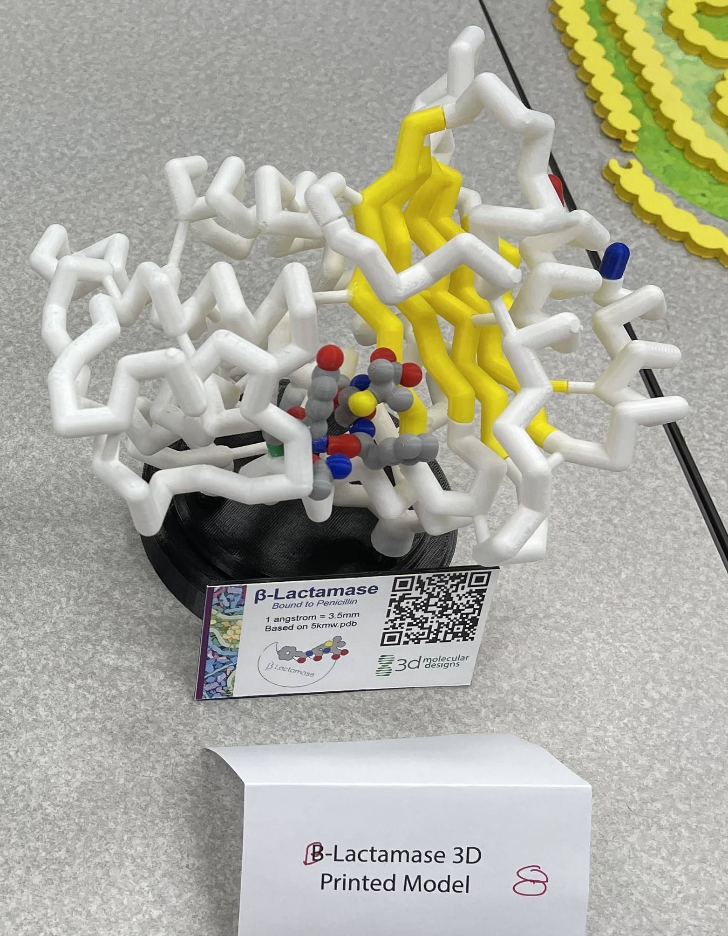
Antibody Diagnostics Kit
Penicillin Model
Beta-Lactamase Model

Slide 7
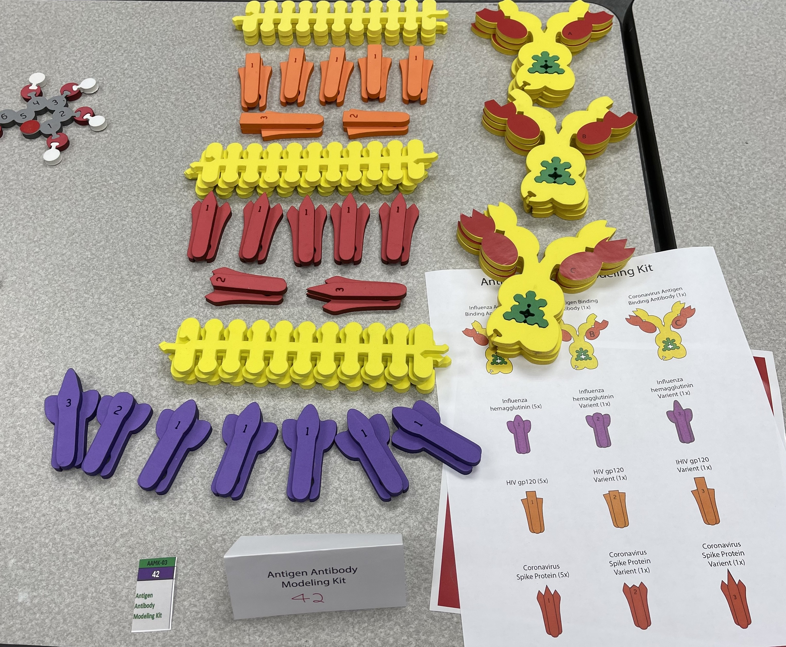
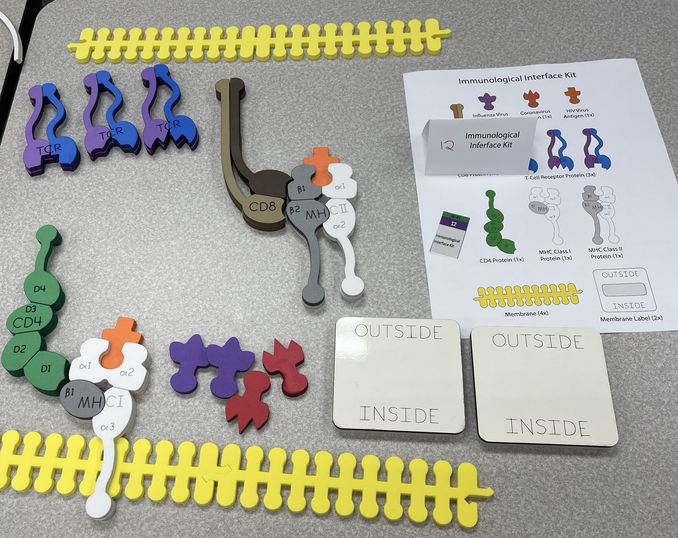
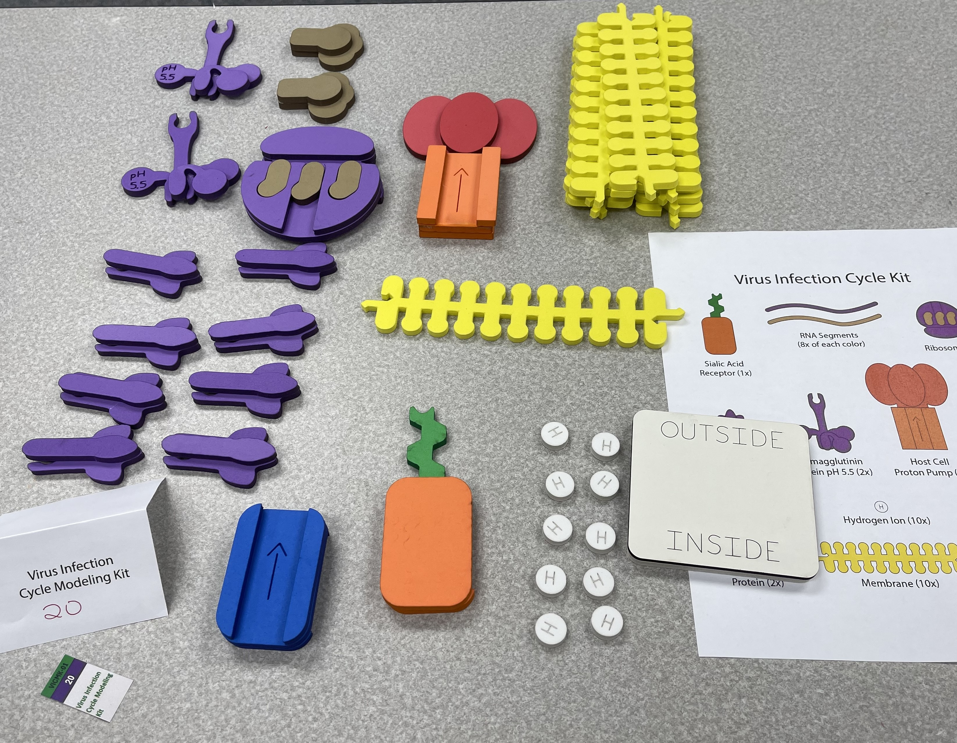
Virus Infection Cycle
Immunological Interface Kit
Antigen Antibody Kit

Slide 8
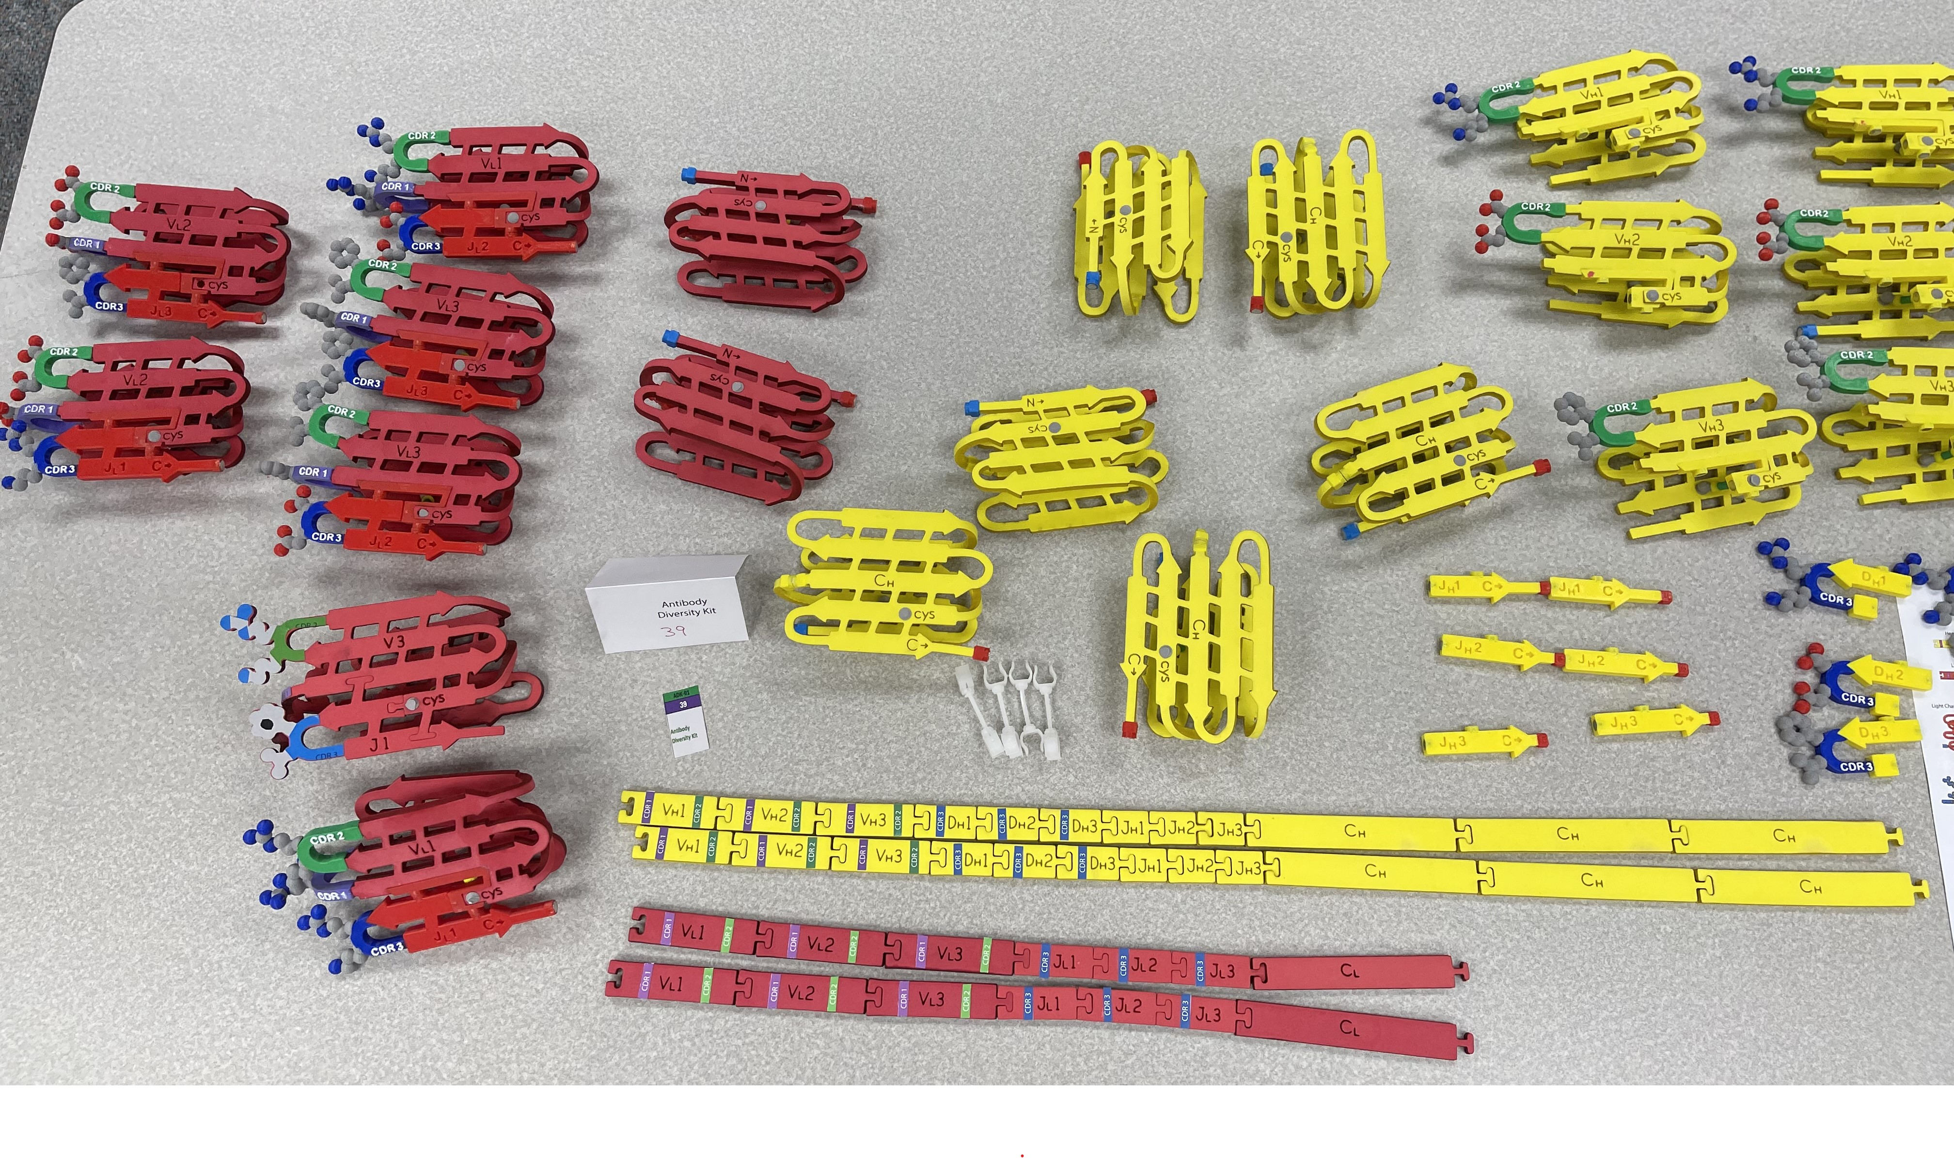
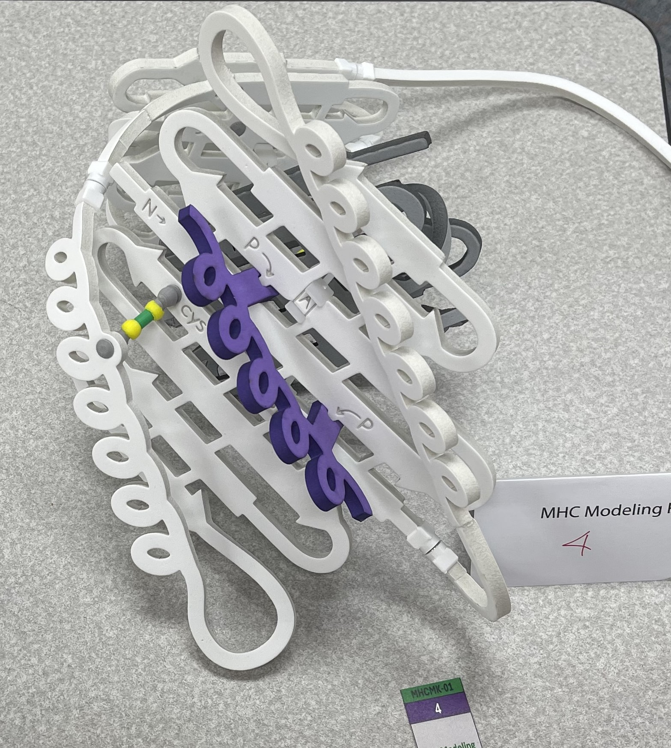
MHC Model
Antibody Diversity Kit

Slide 9
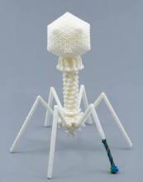
mRNA Vaccine Design Challenge
Bacteriophage T4

Slide 10
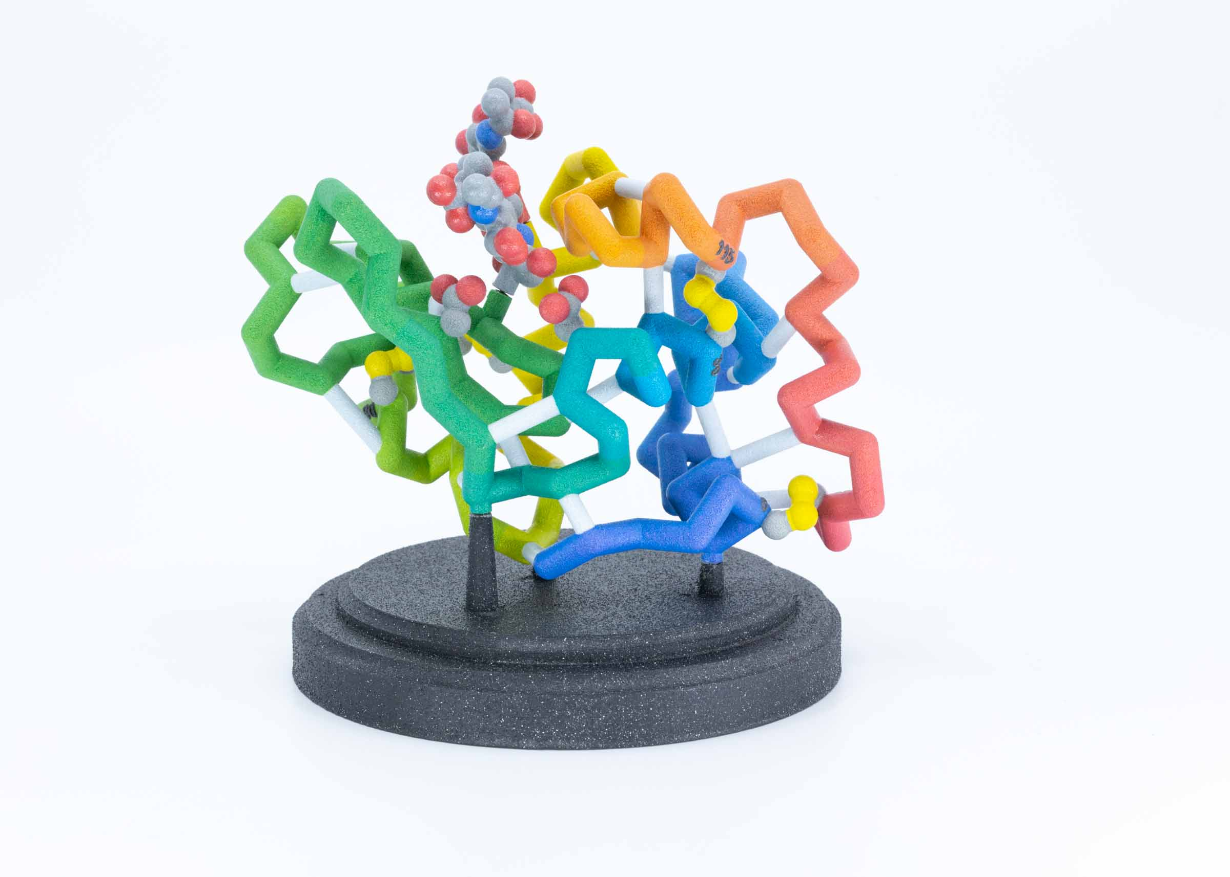
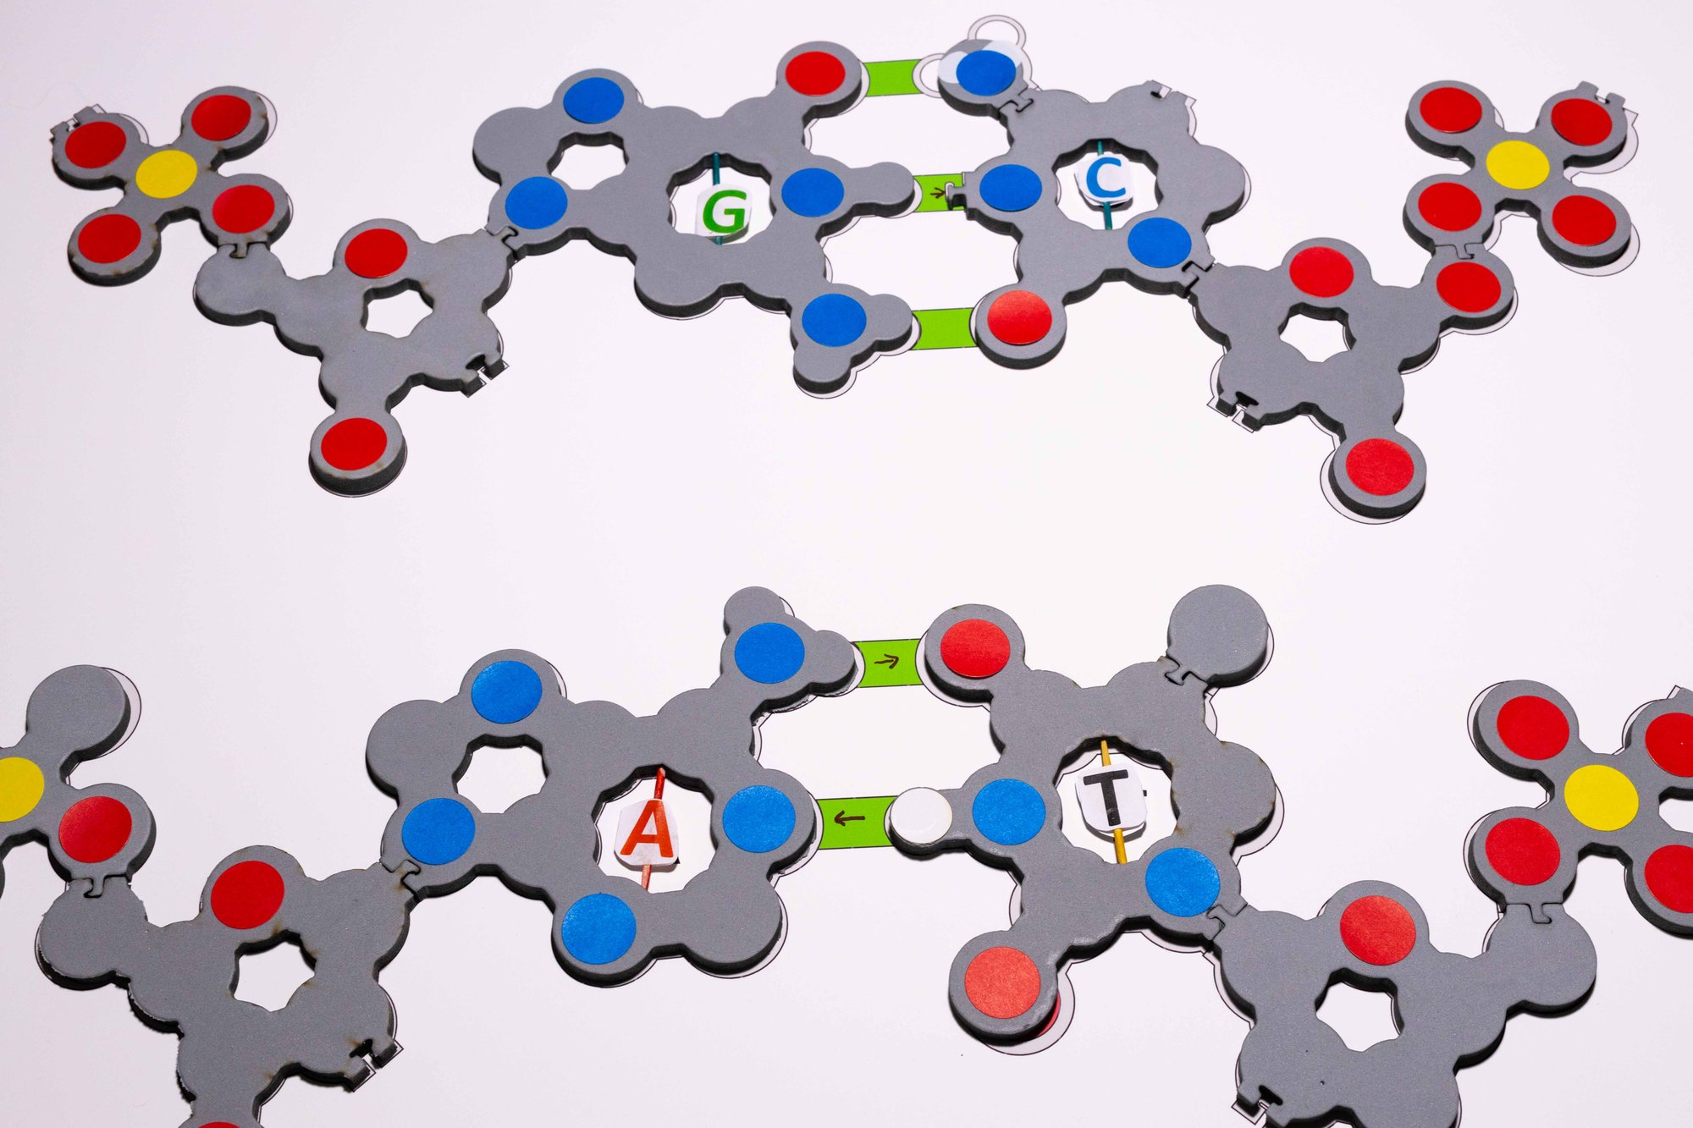
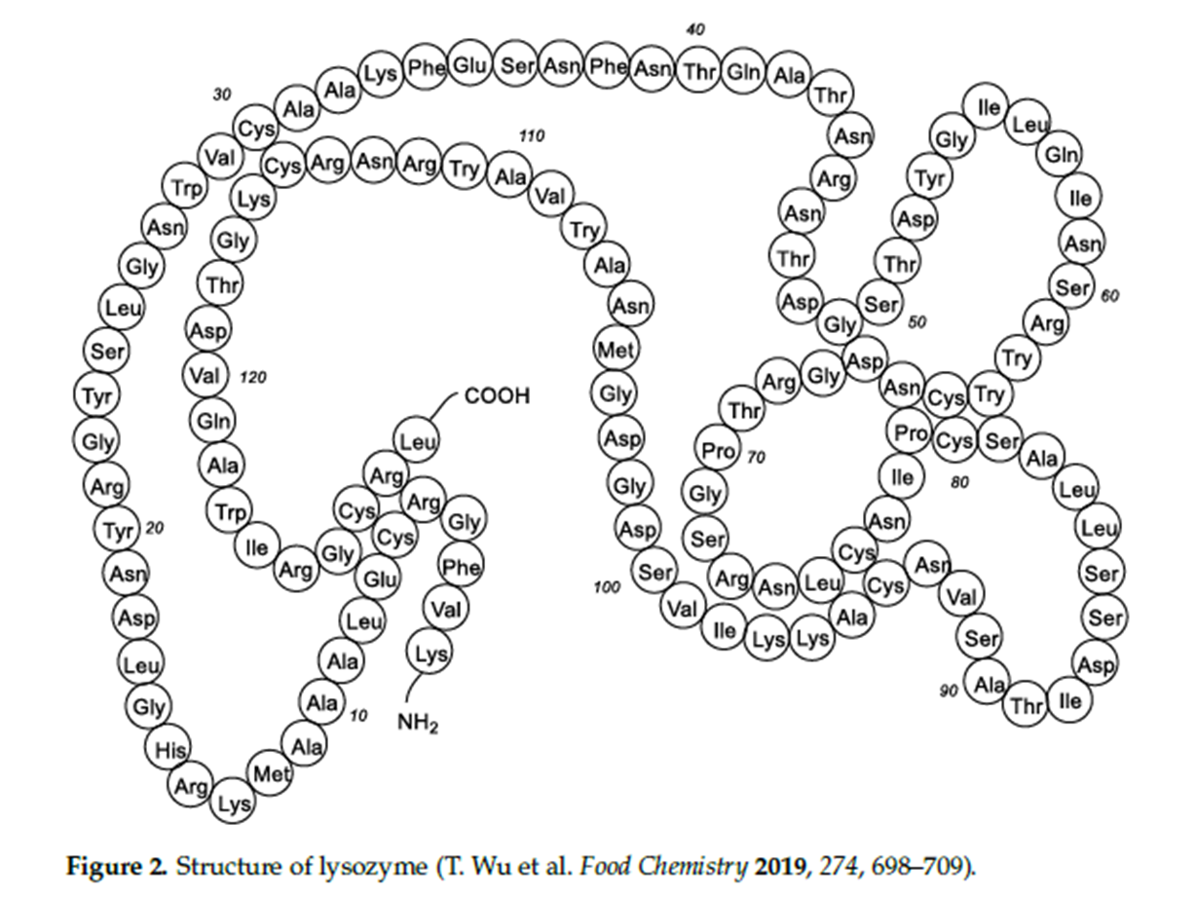
In the time that remains…….
Tactile Base Pairs
Lysozyme…
mRNA Vaccine Design Challenge

Slide 11




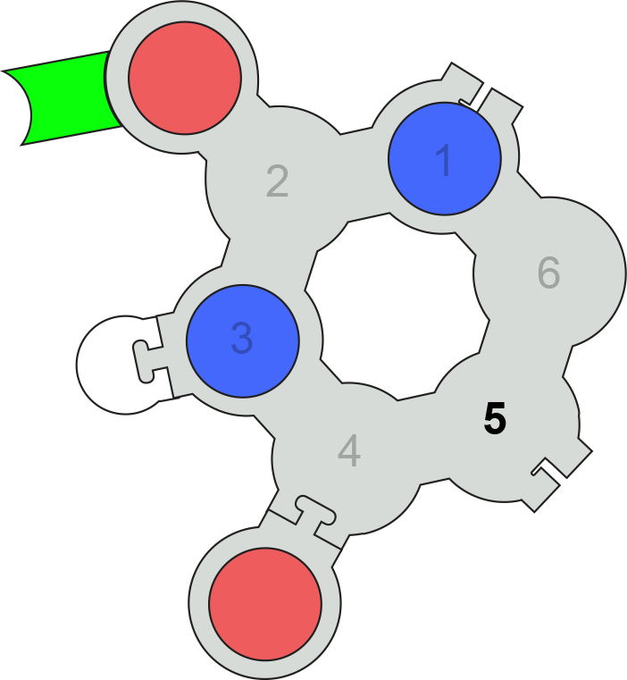
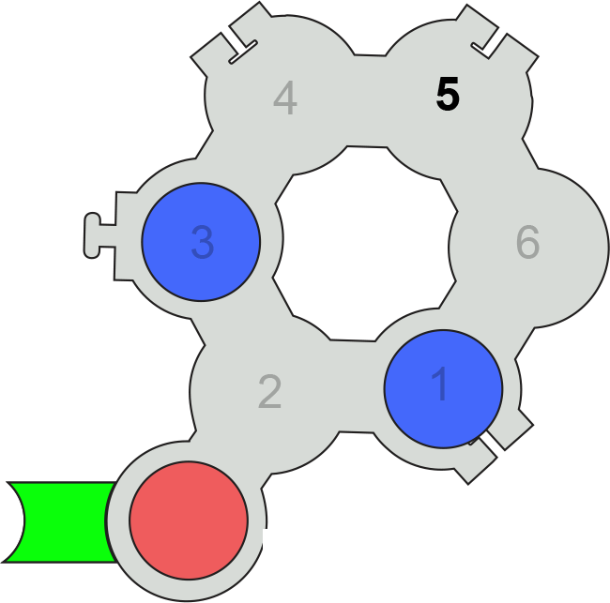
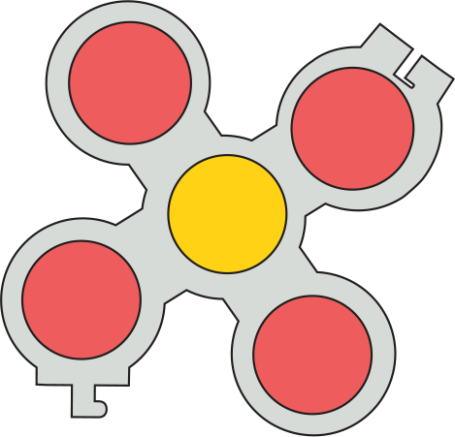

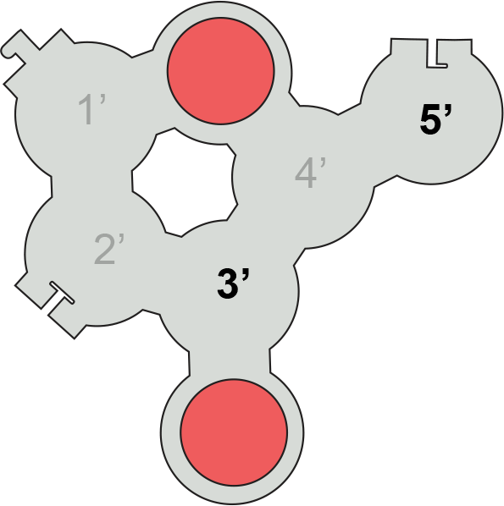
Tactile Base Pairs…
Uridine
Pseudo-Uridine

Slide 12
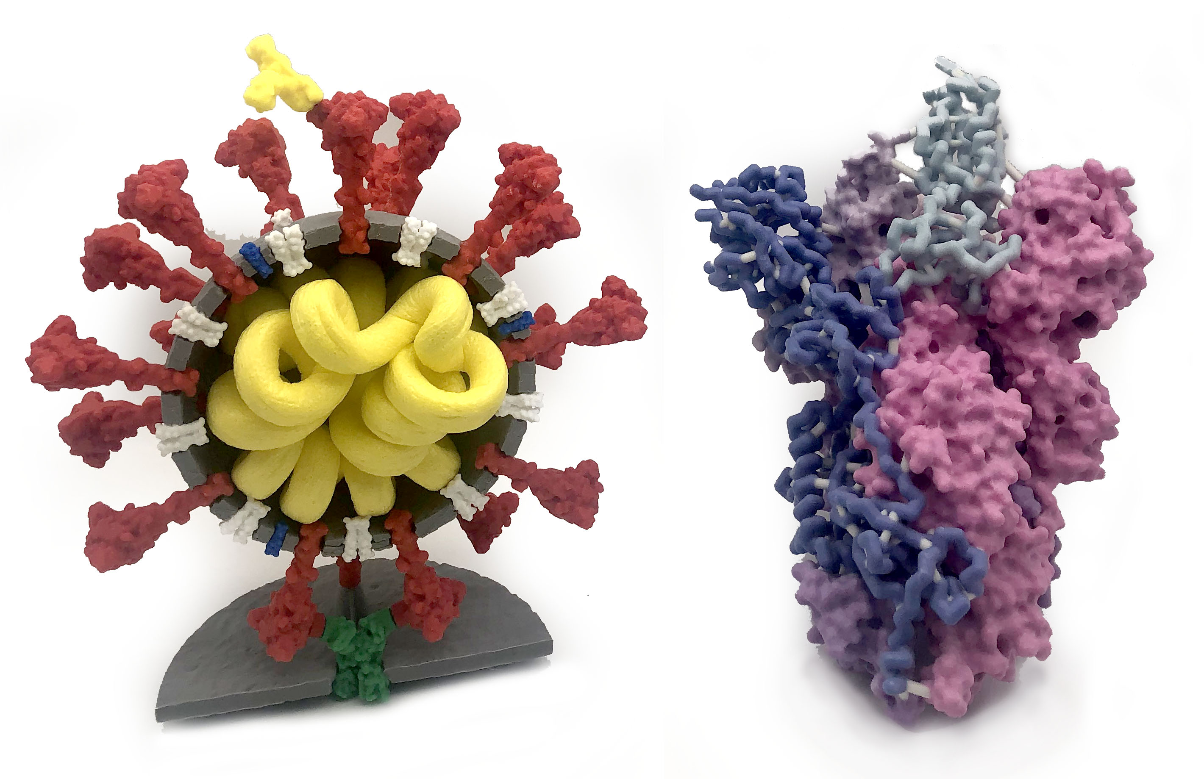
Coronavirus …and the Spike protein
The magic of models…

Slide 13
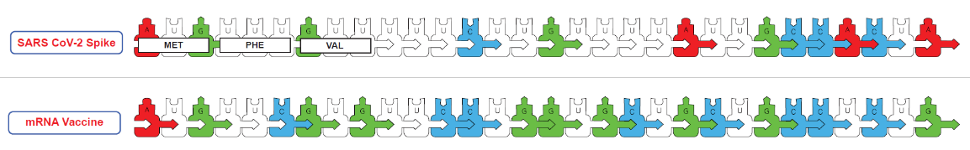
...an m-RNA Vaccine Design Challenge
Step 1 … Modify all U’s to pseudo-U’s.
Step 2 … Optimize the nucleotide sequence.

Slide 14
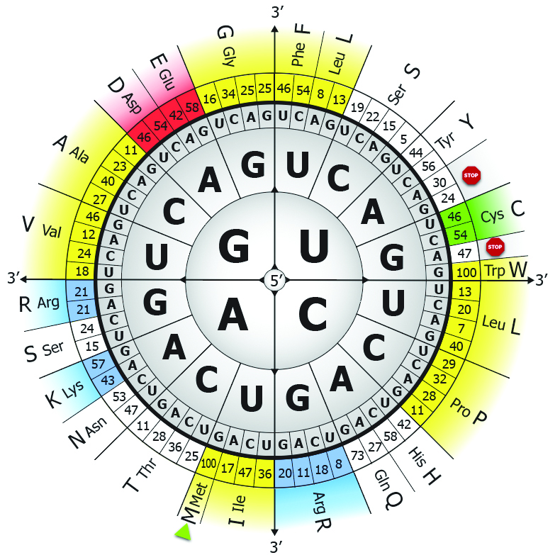
A Table of Genetic Codons….
… with human codon preferences

Slide 15
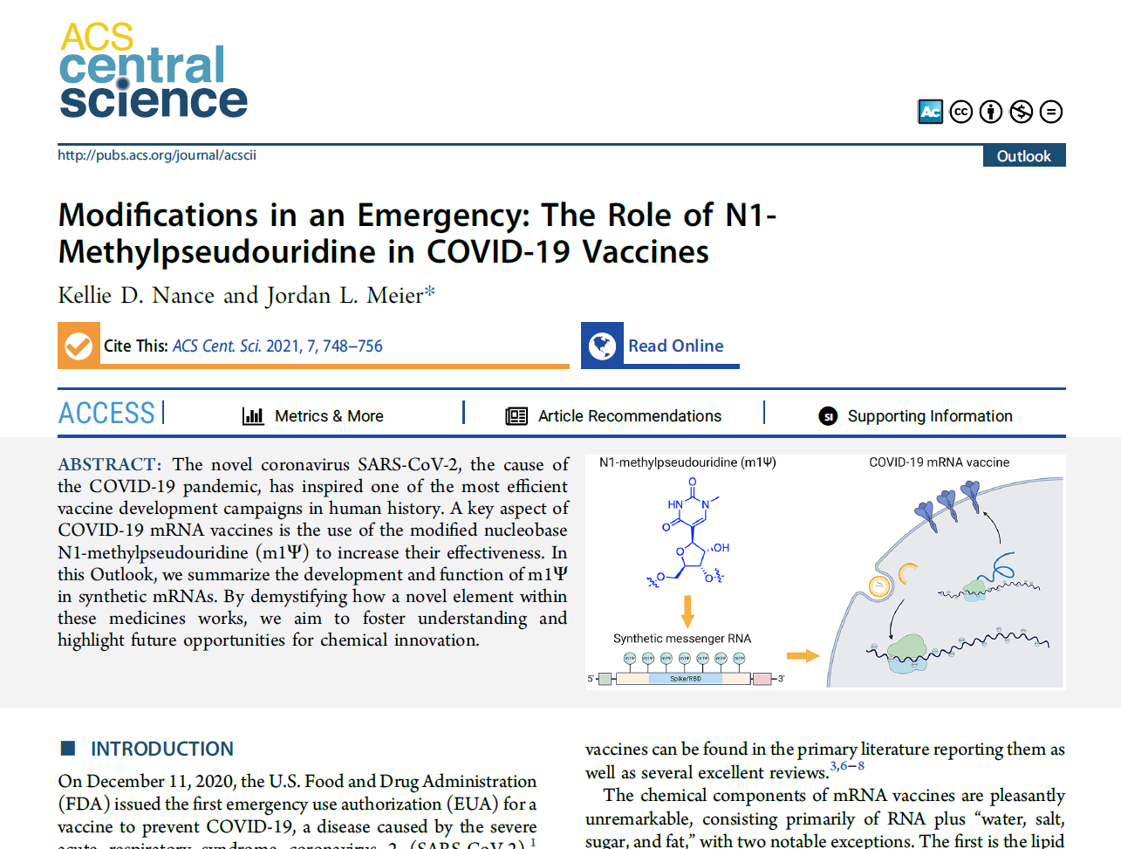

Slide 16
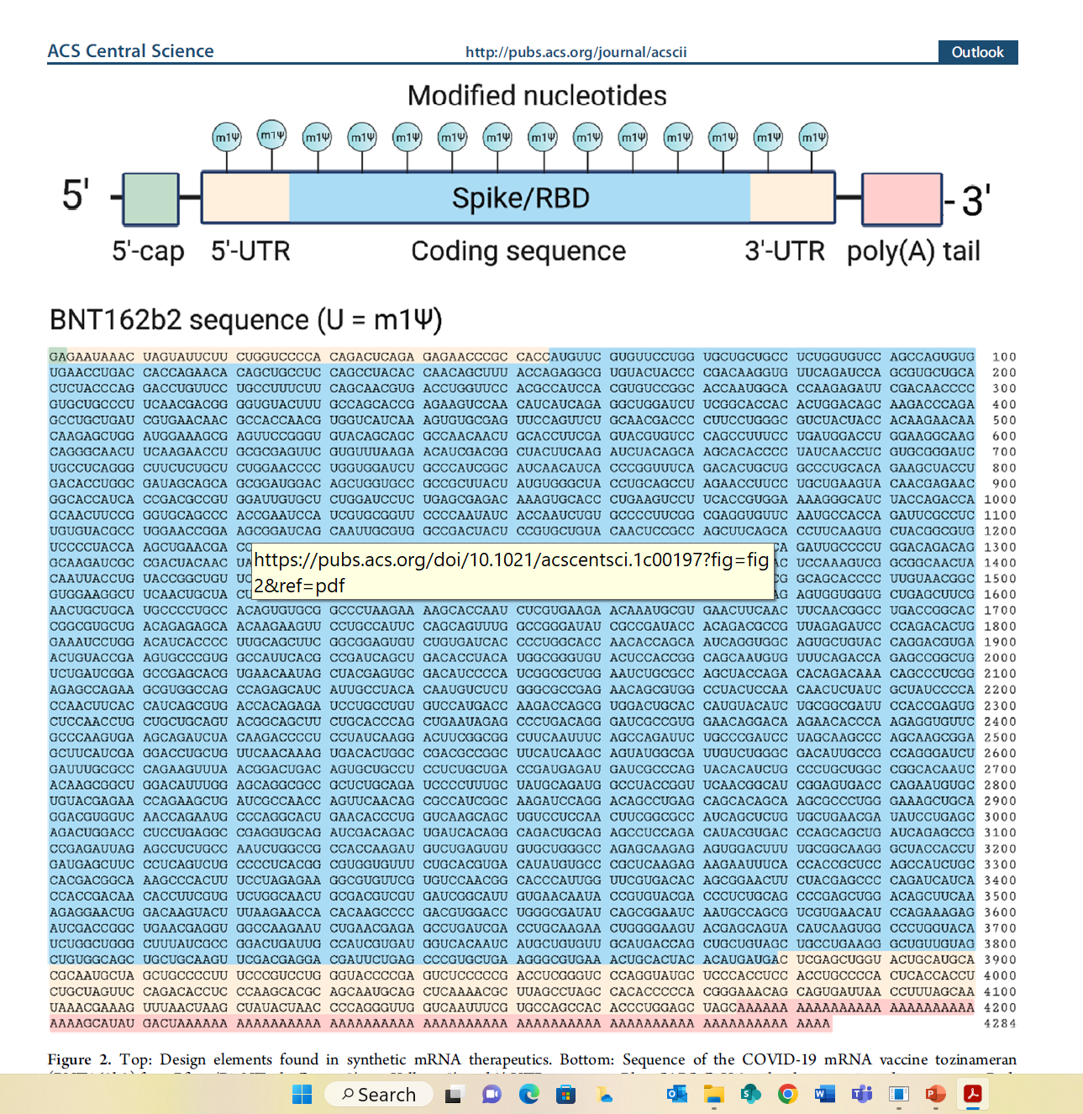

Slide 17
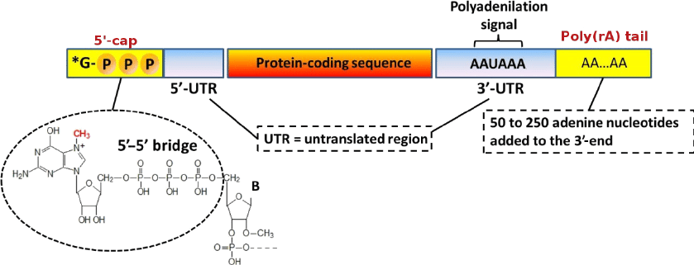
The Components of mRNA
WHY?
Protect mRNA from degradation
Ribosome engagement site…
Distinguish between viral RNA and endogenous mRNA

Slide 18
Still ahead at this conference…..
At 1:00 pm this afternoon…
Storming the Castle… how does anthrax kill you?
At 2:30 pm this afternoon…
Exploring the Properties of Water and Membranes

Slide 19
Still ahead at this conference…..
At 8:00 am tomorrow morning…
Dynamic DNA… and Epigenetics
At 1:00 pm tomorrow afternoon…
Folding and Molding: Hands-On Protein Structure
At 3:15 pm tomorrow afternoon…
Modeling the Flow of Genetic Information:
Replication, Transcription and Protein Synthesis

Slide 20
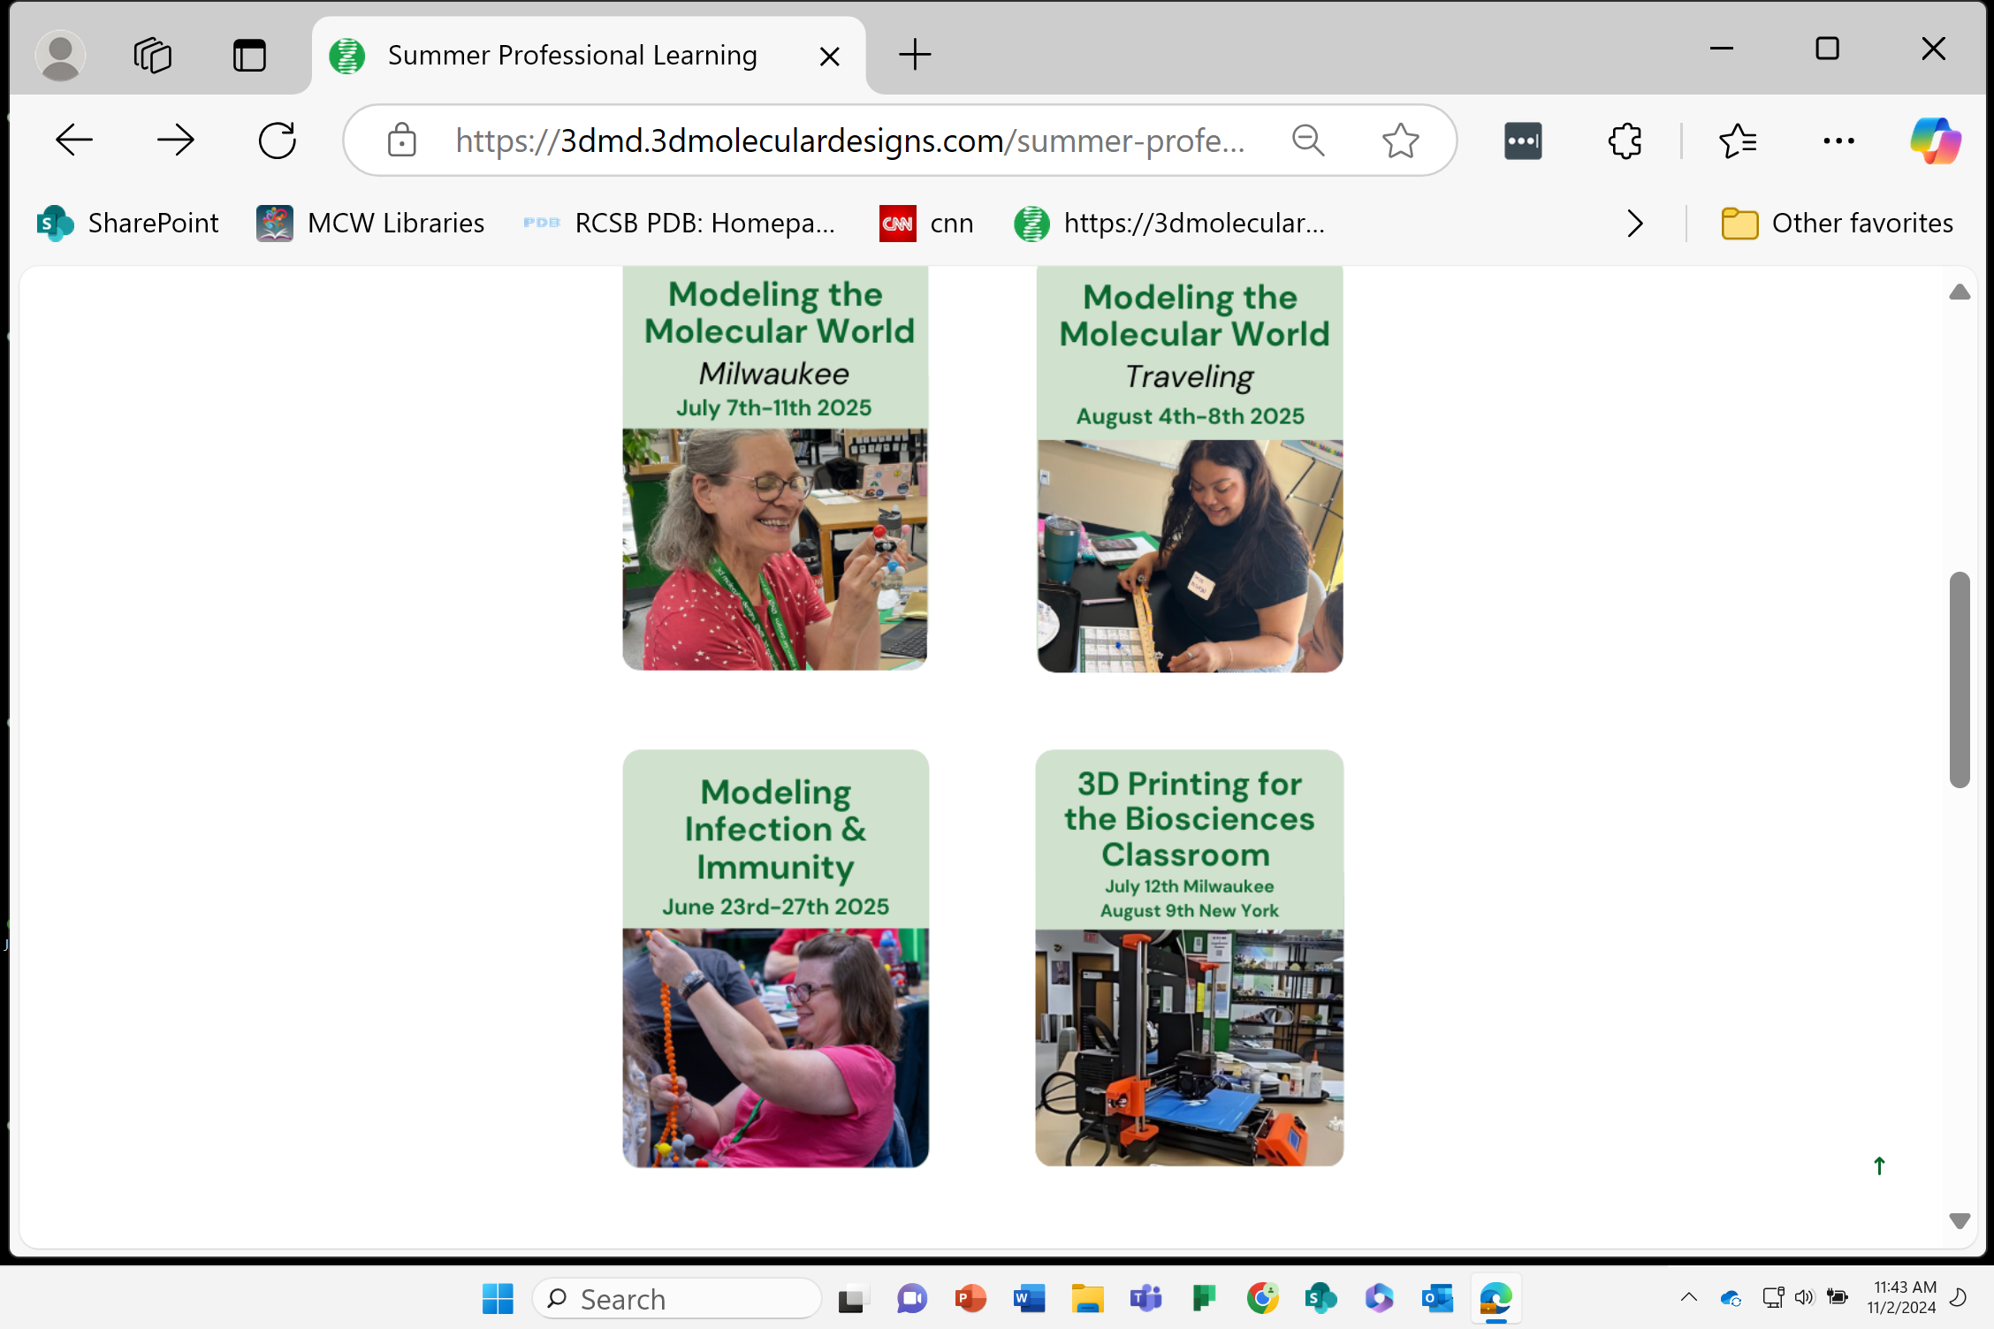
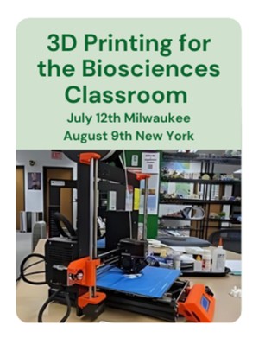
2025 Summer Workshops
…become the teacher you have always wanted to be.

Slide 21


Slide 23
Lysozyme…. an enzyme with 4 disulfide bonds.
Cys
Cys
Cys
Cys
Cys
Cys
Cys
Cys

