Slide 1
2024 NABT
Storming the Castle…
How does Anthrax kill you?
Tim Herman

Slide 2
There are things we know…
As we think deeply about what we know, we will begin to ask questions about things we don’t know …….
Things we don’t know…
1. There are things we know we don’t know.
2. There are things we don’t know we don’t know
A teacher’s role is to encourage students to think deeply about what they know … and identify what they don’t know.

Slide 3
Teachers should model for students….
… the joy of discovering something you didn’t know
… the joy of discovering something you didn’t even
know you didn’t know.
This discovery happens when you…
slow down, focus, think deeply…
and begin to ask questions.

Slide 4

For your reading enjoyment…
A sweeping look at how the major transformations in history—from the rise of Homo sapiens to the birth of capitalism—have been shaped not by humans but by germs “I love this surprising, learned, fascinating book; it brings human arrogance into sharp relief, reminding us that the real masters of the universe are microbes.”—Cal Flyn

Slide 5
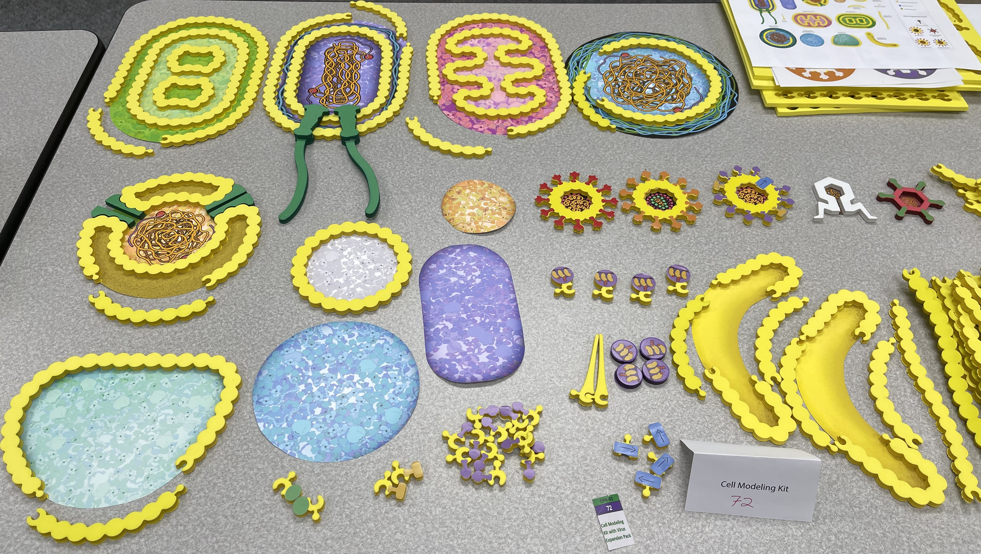
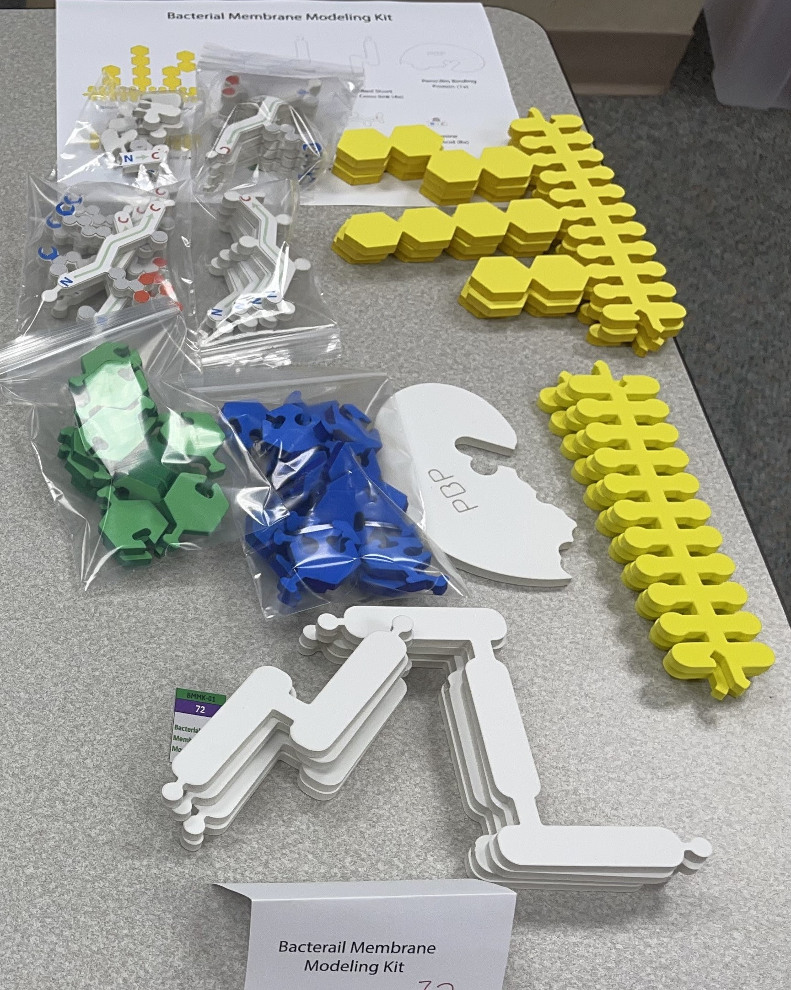
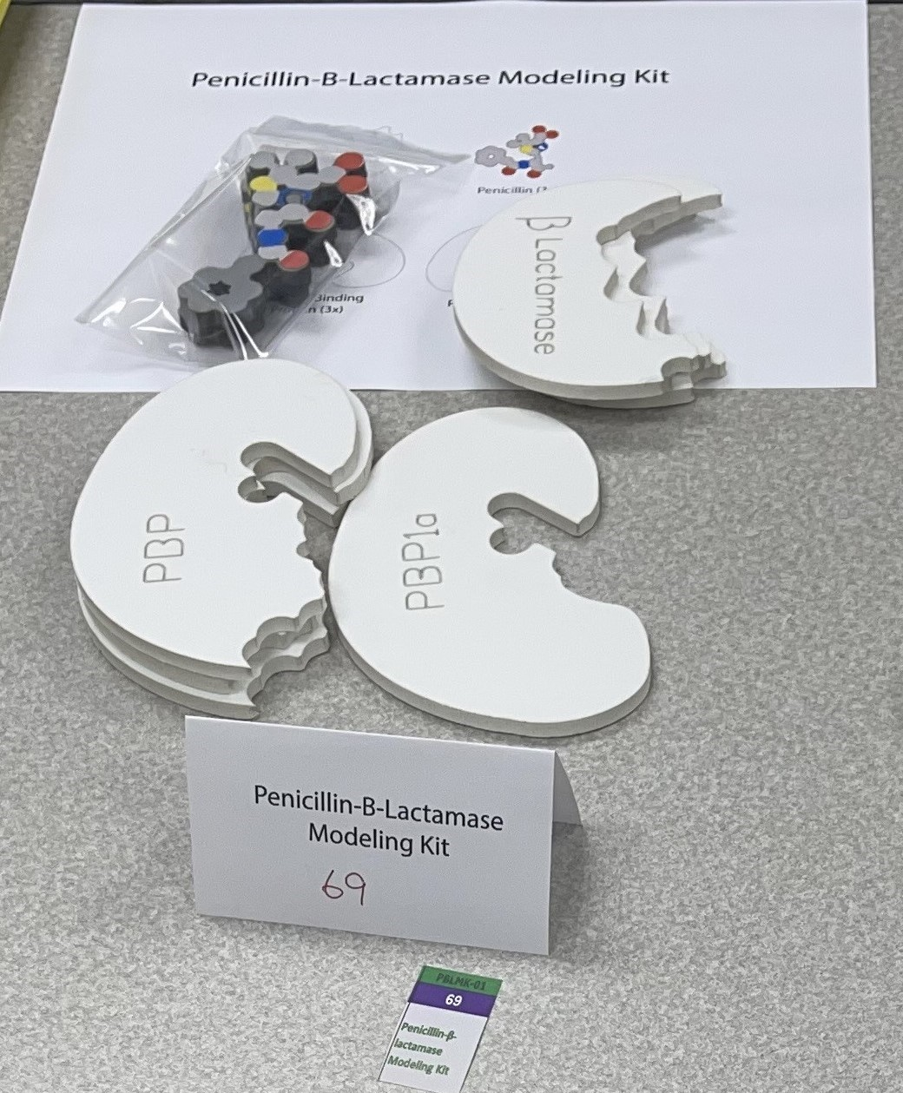
Bacterial
Membrane
Kit
Cell Modeling Kit
2024 MII Kits
Penicillin /
Beta-Lactamase
Kit

Slide 6
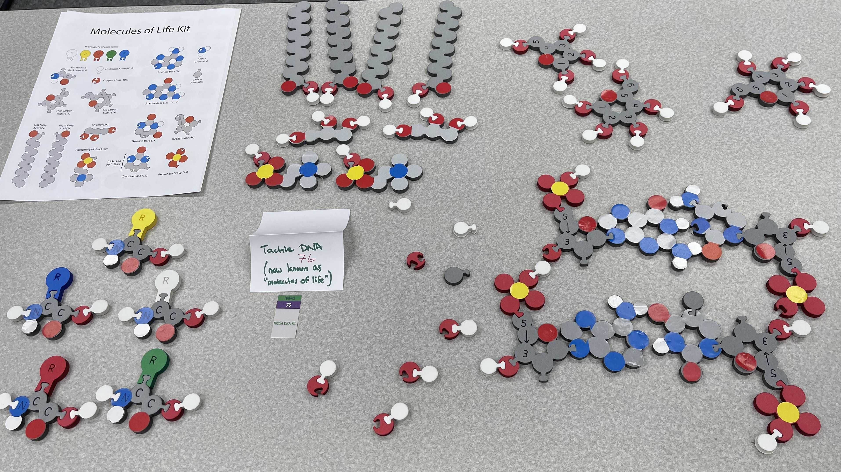
Molecules of Life / Tactile Base Pairs

Slide 7
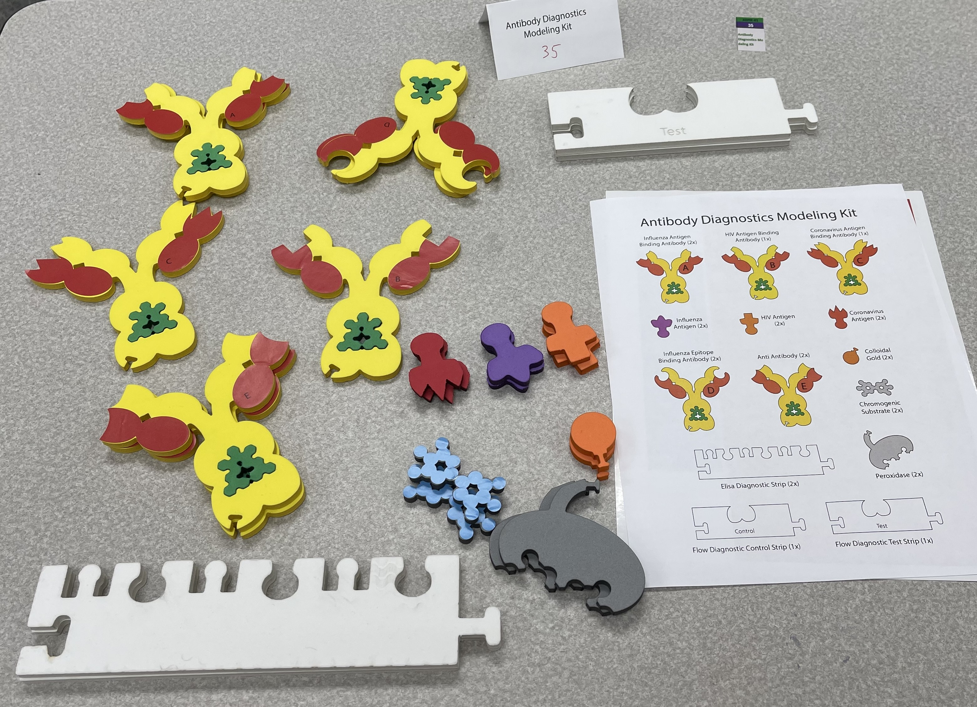
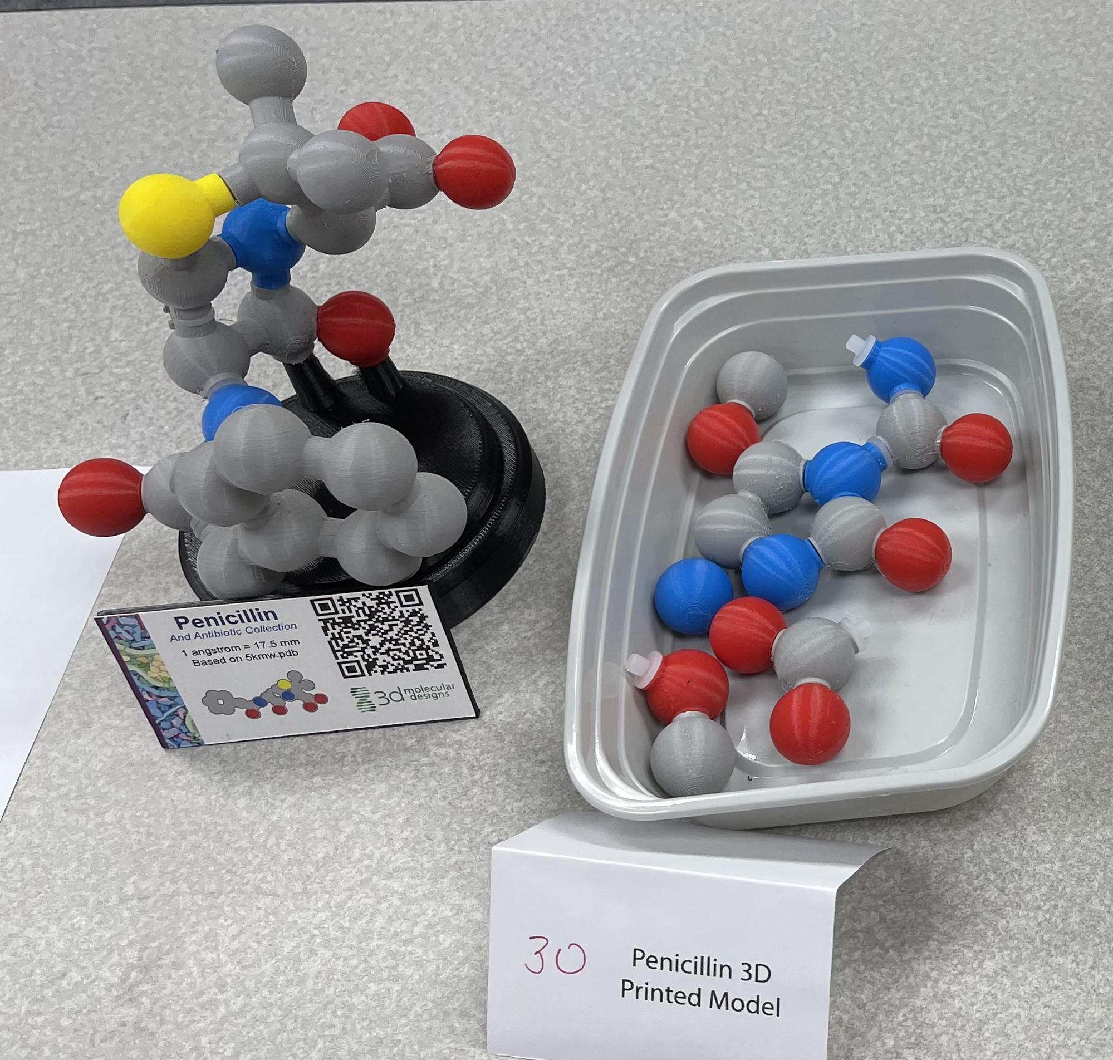
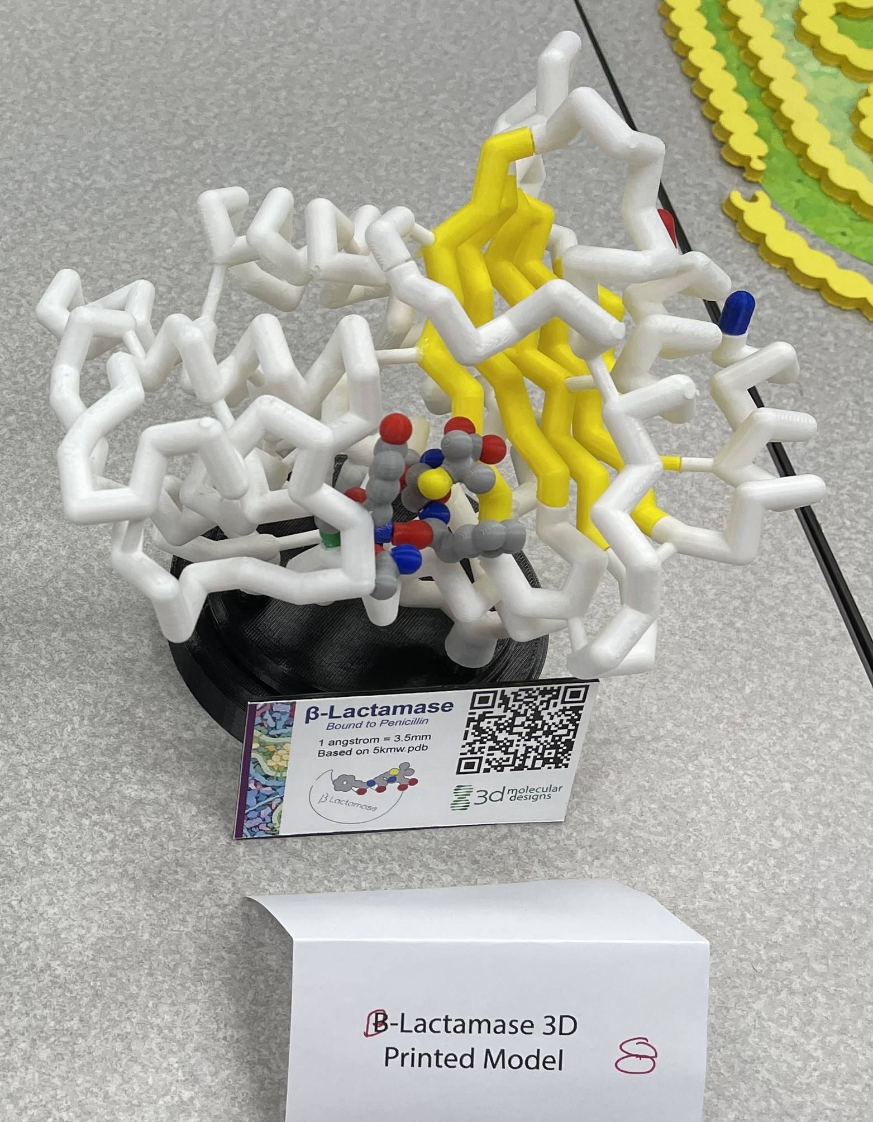
Antibody Diagnostics Kit
Penicillin Model
Beta-Lactamase Model

Slide 8
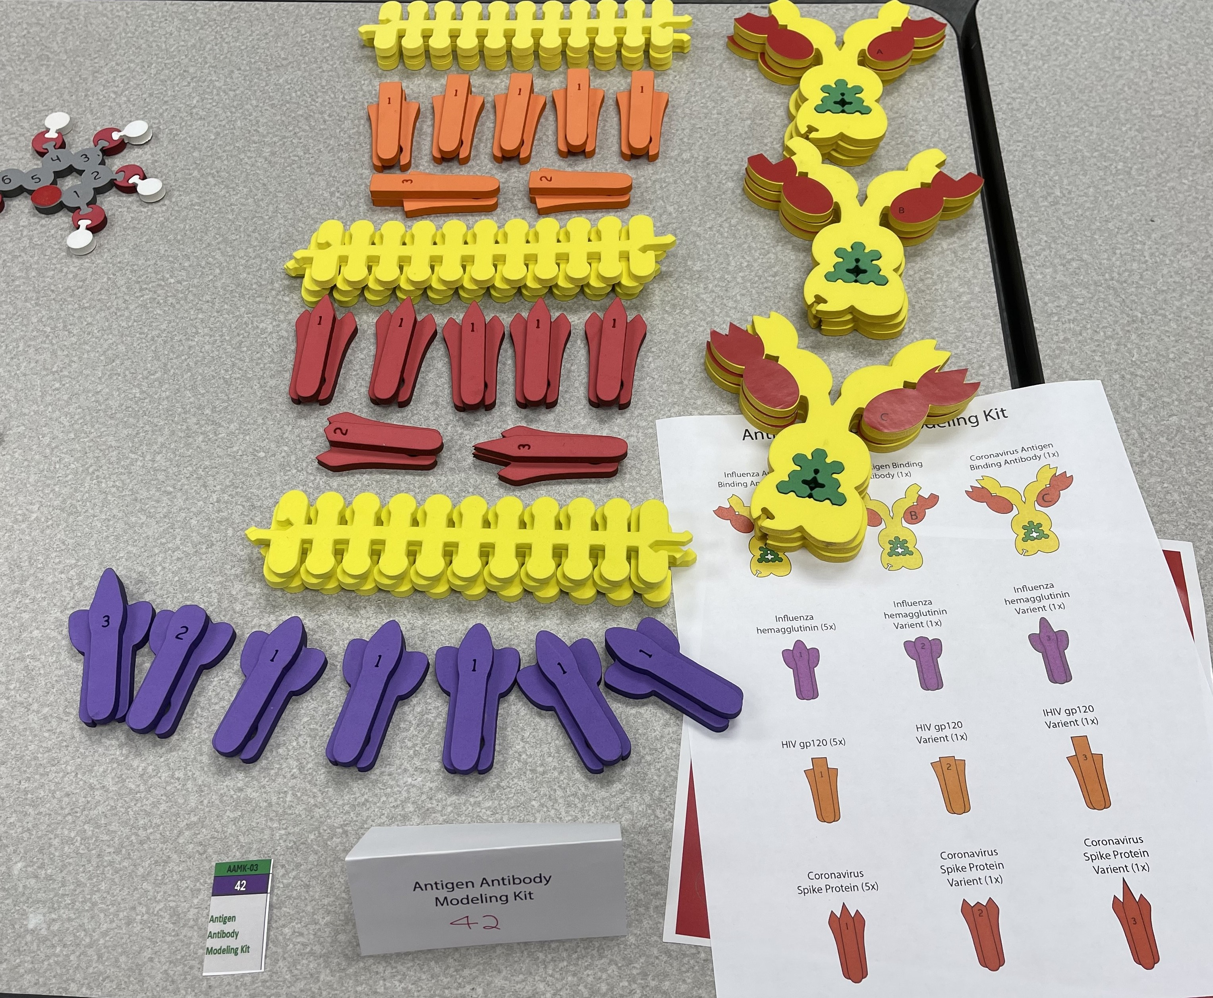
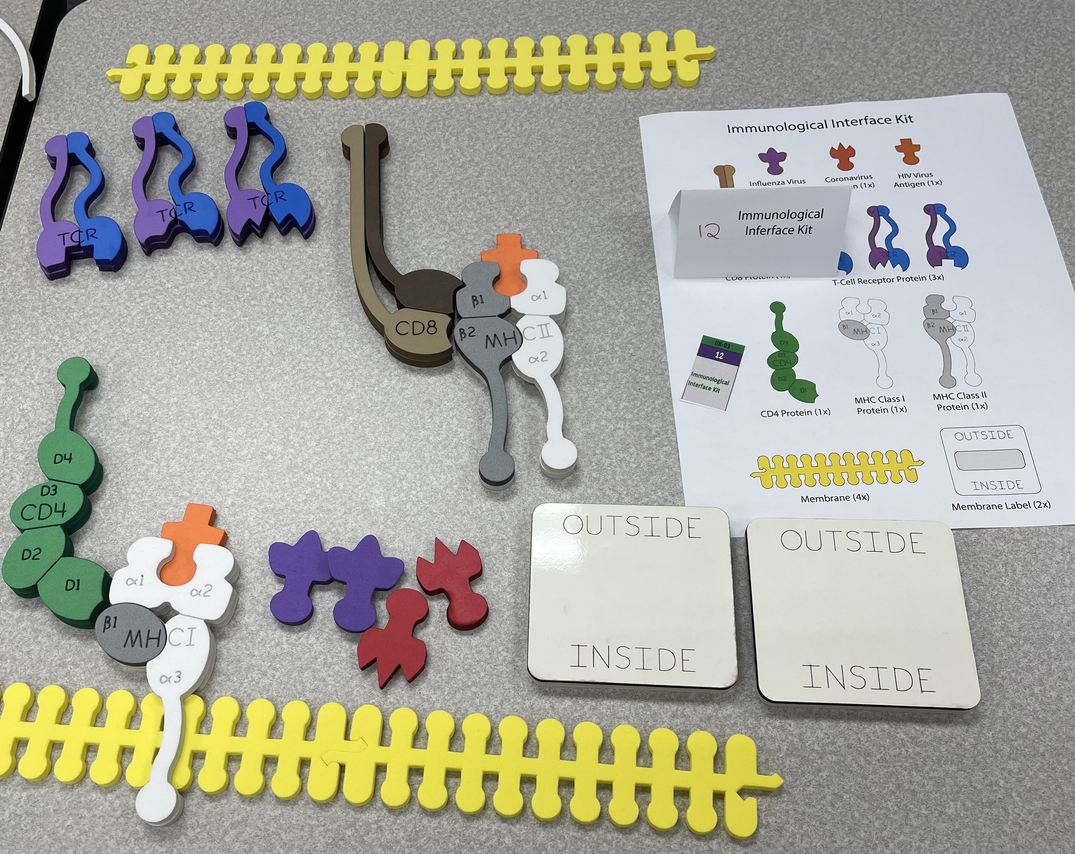
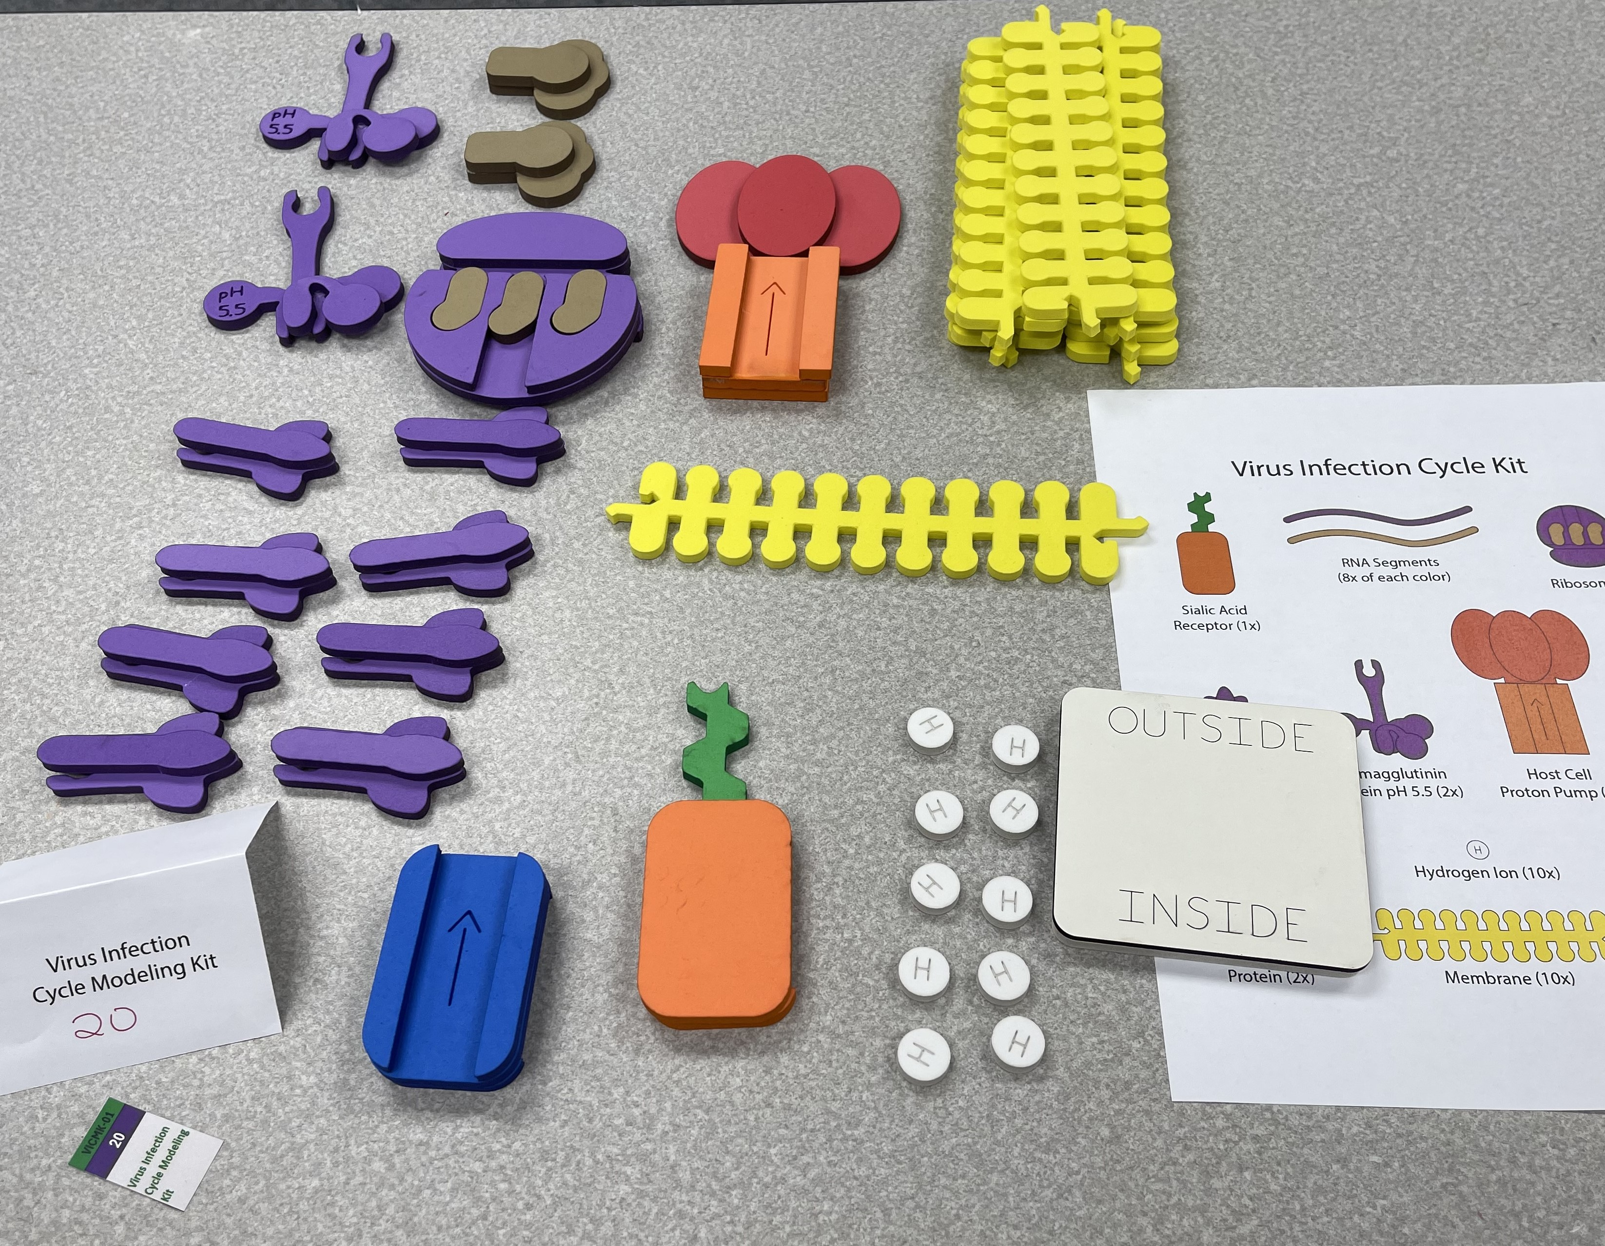
Virus Infection Cycle
Immunological Interface Kit
Antigen Antibody Kit

Slide 9
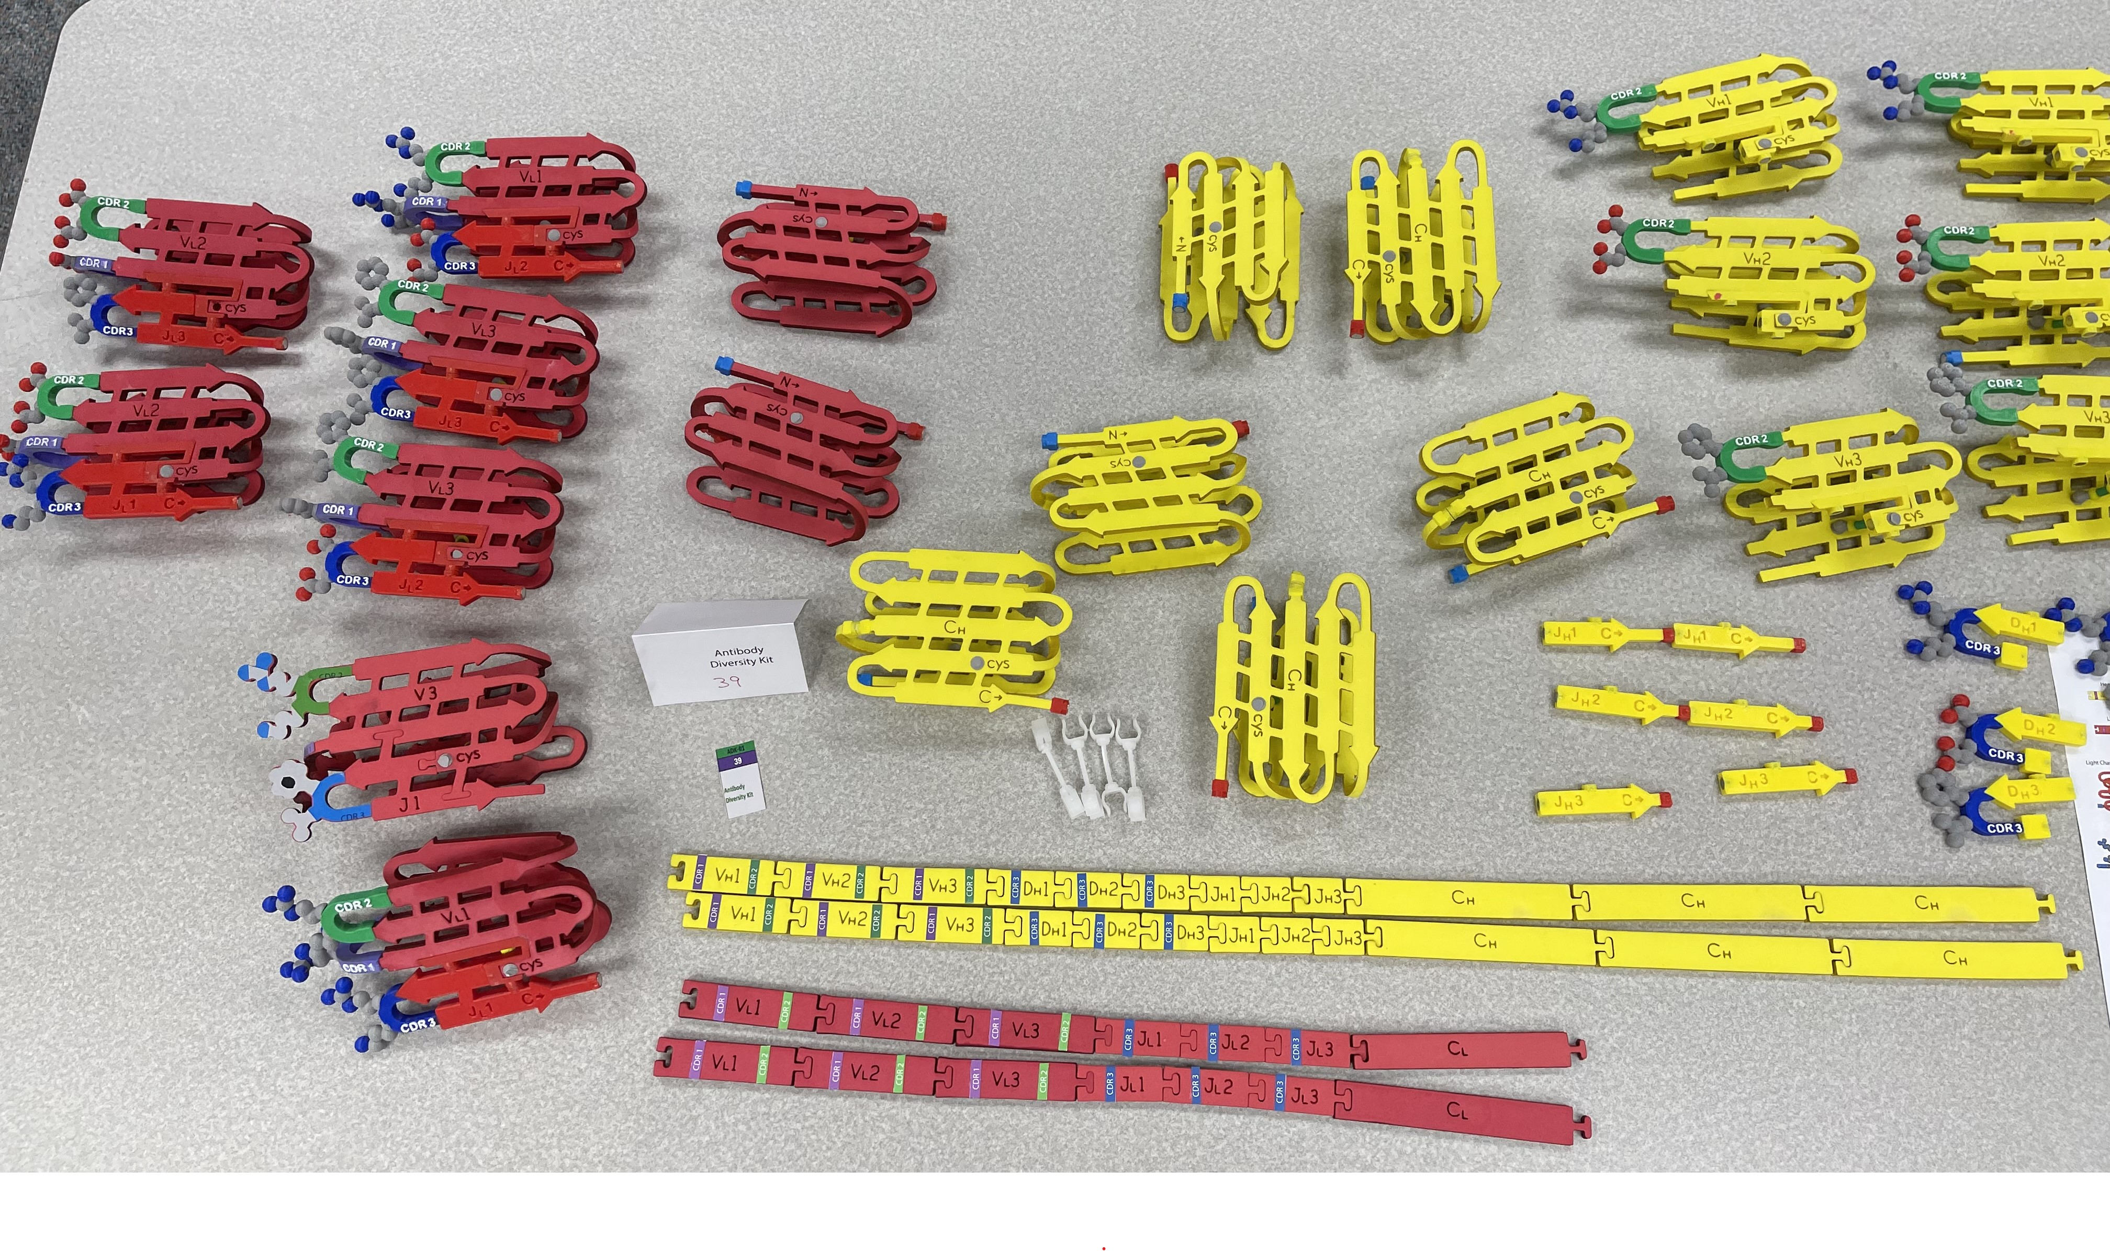
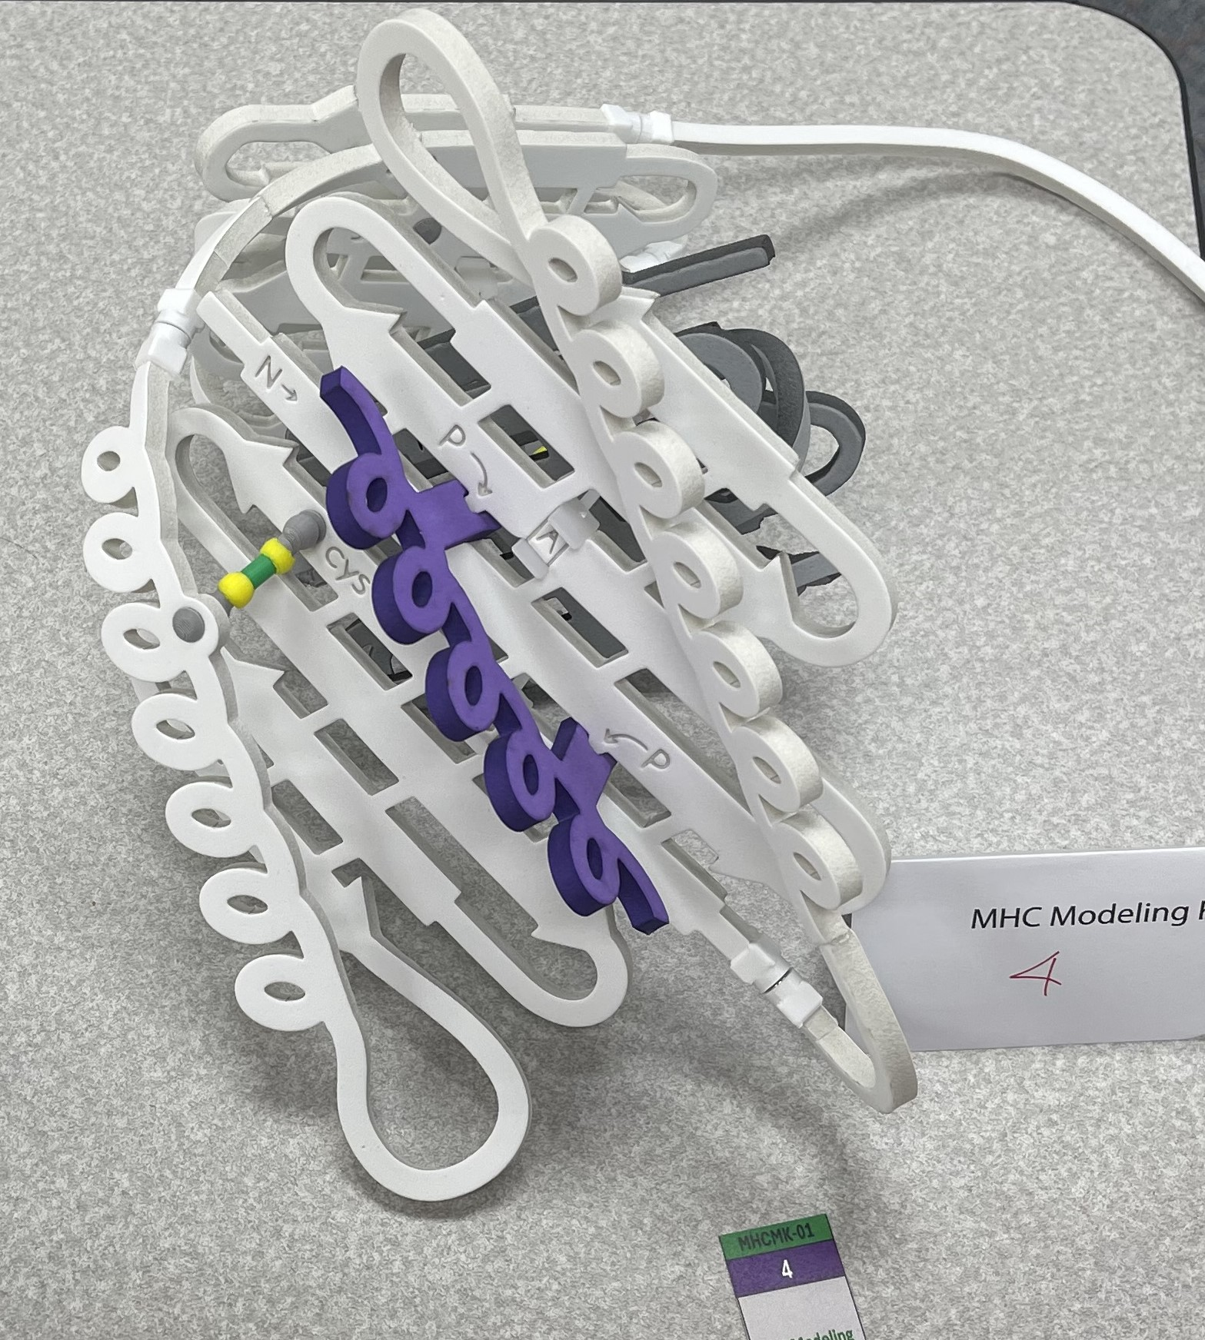
MHC Model
Antibody Diversity Kit

Slide 10
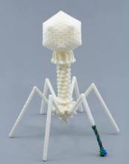
mRNA Vaccine Design Challenge
Bacteriophage T4

Slide 11
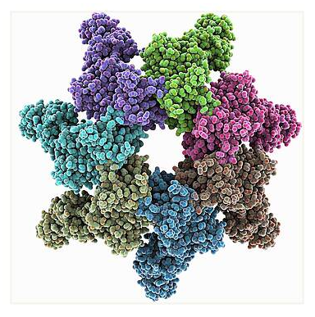
Anthrax Pathogenesis
A story about….
A bacterial toxin…..
Bioterrorism…… and
The CBM’s first SMART Team

Slide 12
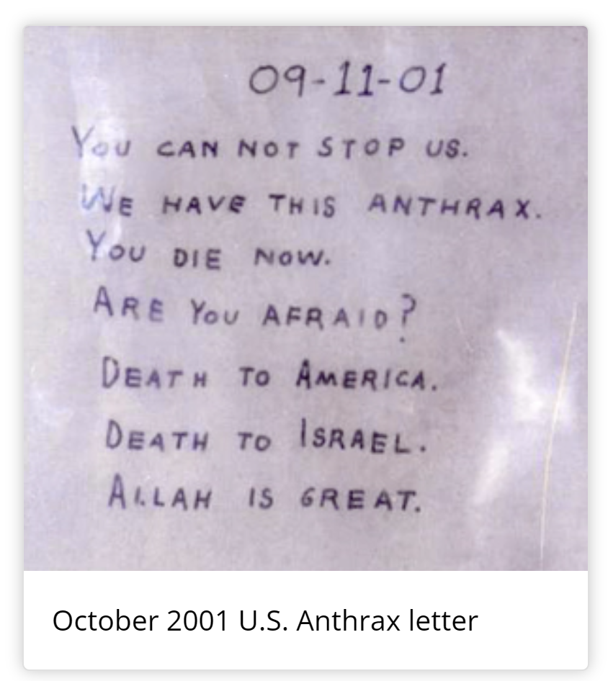
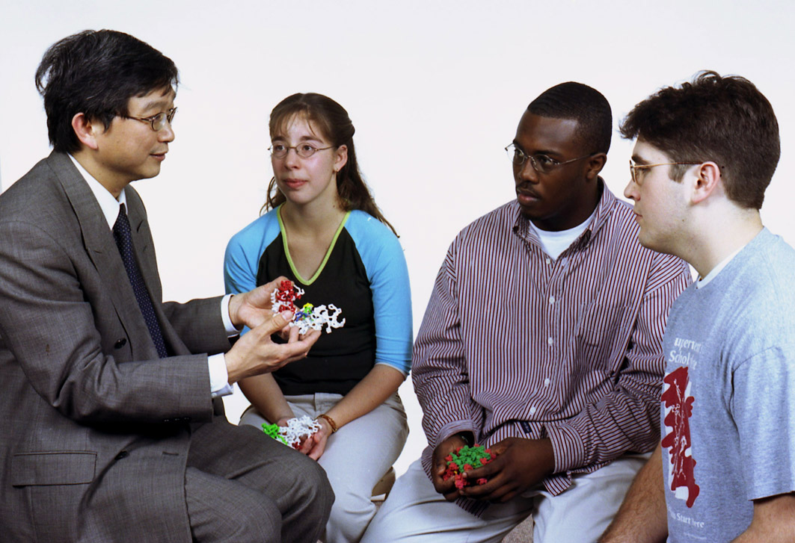
Anthrax Pathogenesis…2001
A story of bioterrorism and the CBM’s first SMART Team

Slide 13
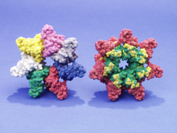
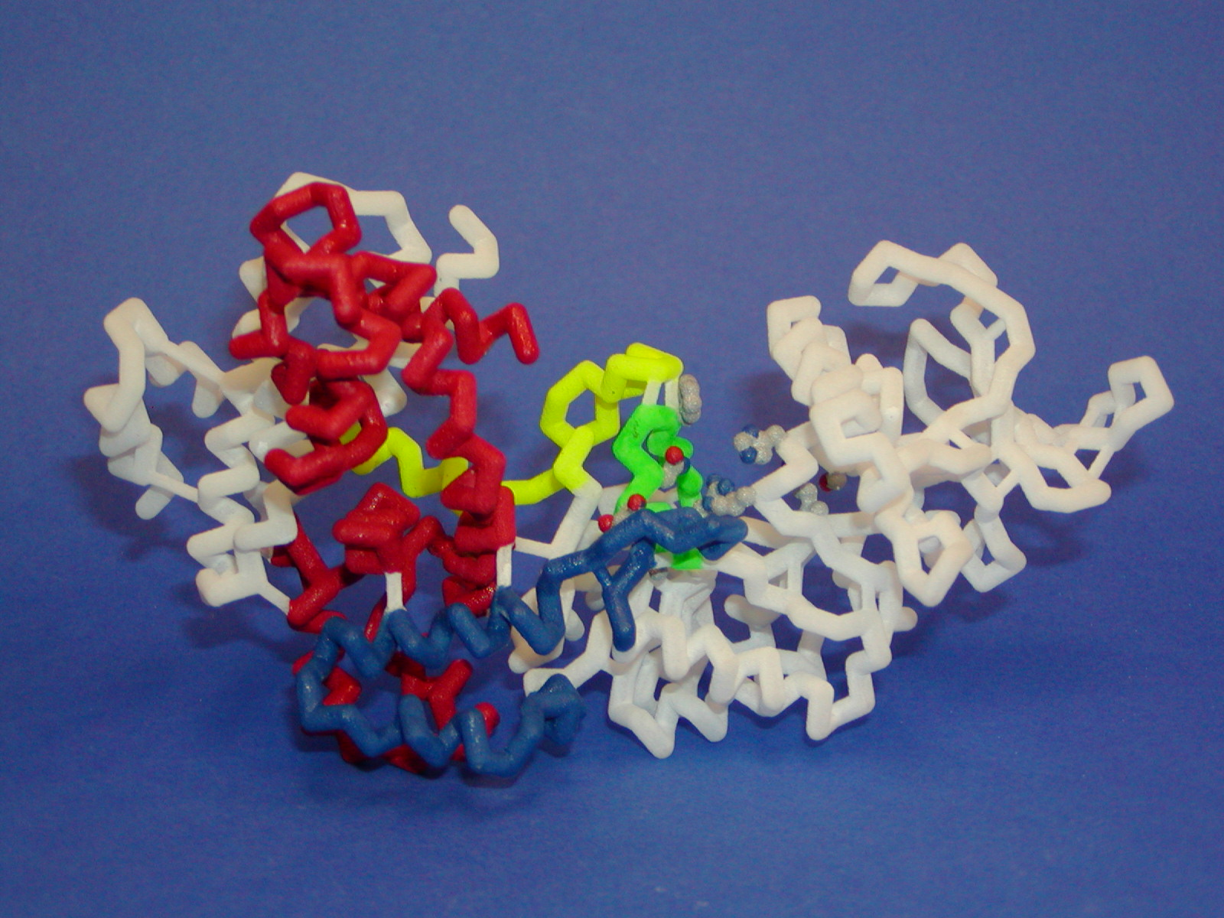
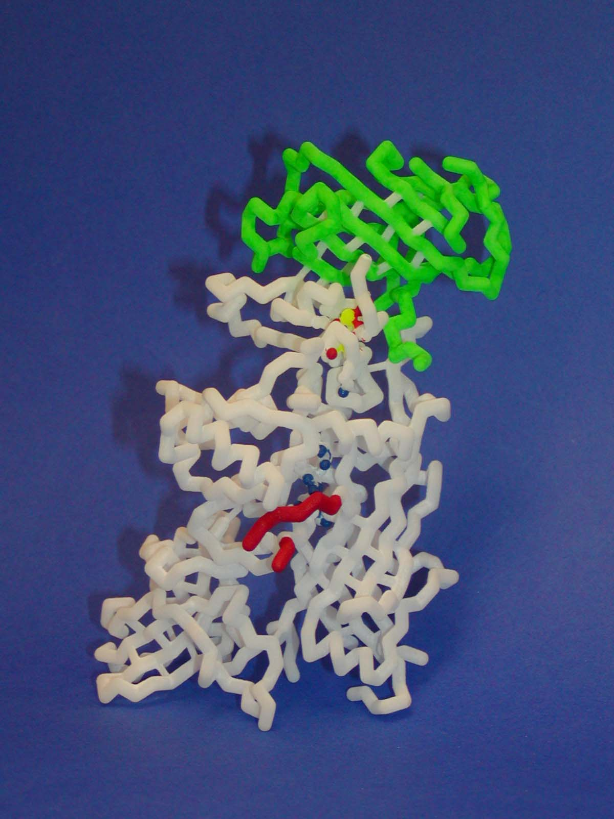
The first SMART Team… modeling Anthrax Pathogenesis (2001)
Bacillus anthracis produces an AB toxin composed of three proteins…
Protective Antigen
Protective Antigen
Edema Factor
Lethal Factor
Delivers B toxins
across membrane
Adenylate Cyclase
Tumor Necrosis Factor
Inflammation/Apoptosis
A
B

Slide 14
Storming the Castle,… an exercise in critical thinking
How does the anthrax toxin get into our cells,….and kill you?
Bacillus anthracis – hereafter known as Anthrax – produces 3 toxin proteins… Protective Antigen (PA), Lethal Factor(LF) and Edema Factor(EF).
PA is known to be necessary for either LF or EF to enter a cell:
If you inject Protective Antigen (PA) into a mouse – it has no effect.
If you inject Lethal Factor (LF) into a mouse – it has no effect.
If you inject a mixture of PA and LF into a mouse – the mouse dies.
A similar result is seen with PA and EF. The injection of either PA or EF alone has no effect. Injection of a mixture of PA and EF/LF results in a dead mouse.
THE CHALLENGE:… Consult with your group,… and suggest a molecular mechanism whereby these 3 proteins (PA, LF and EF) interact with each other
to enter your cells…..… and lead to your demise.

Slide 15
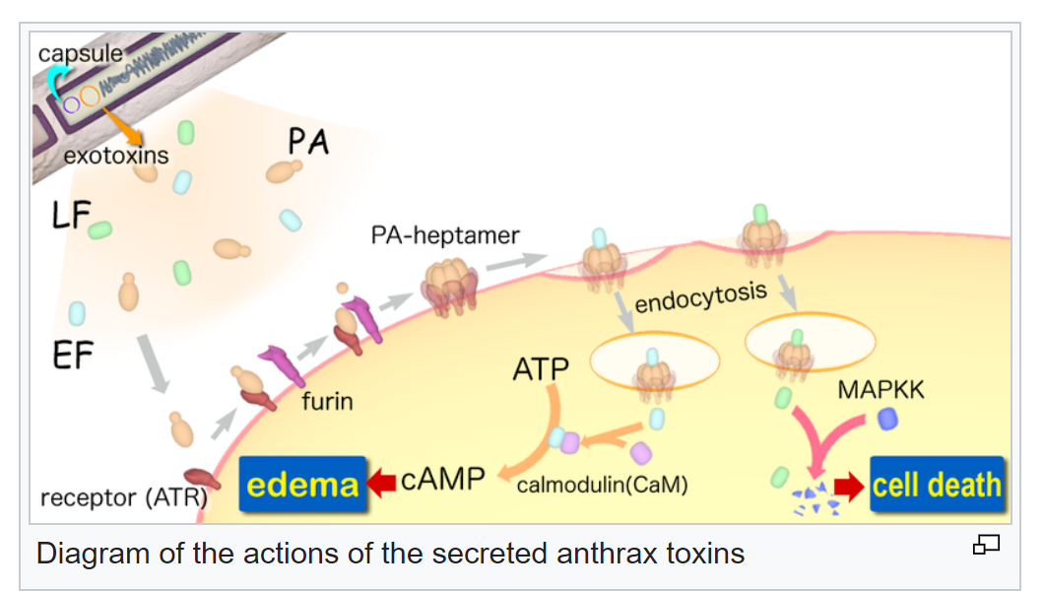
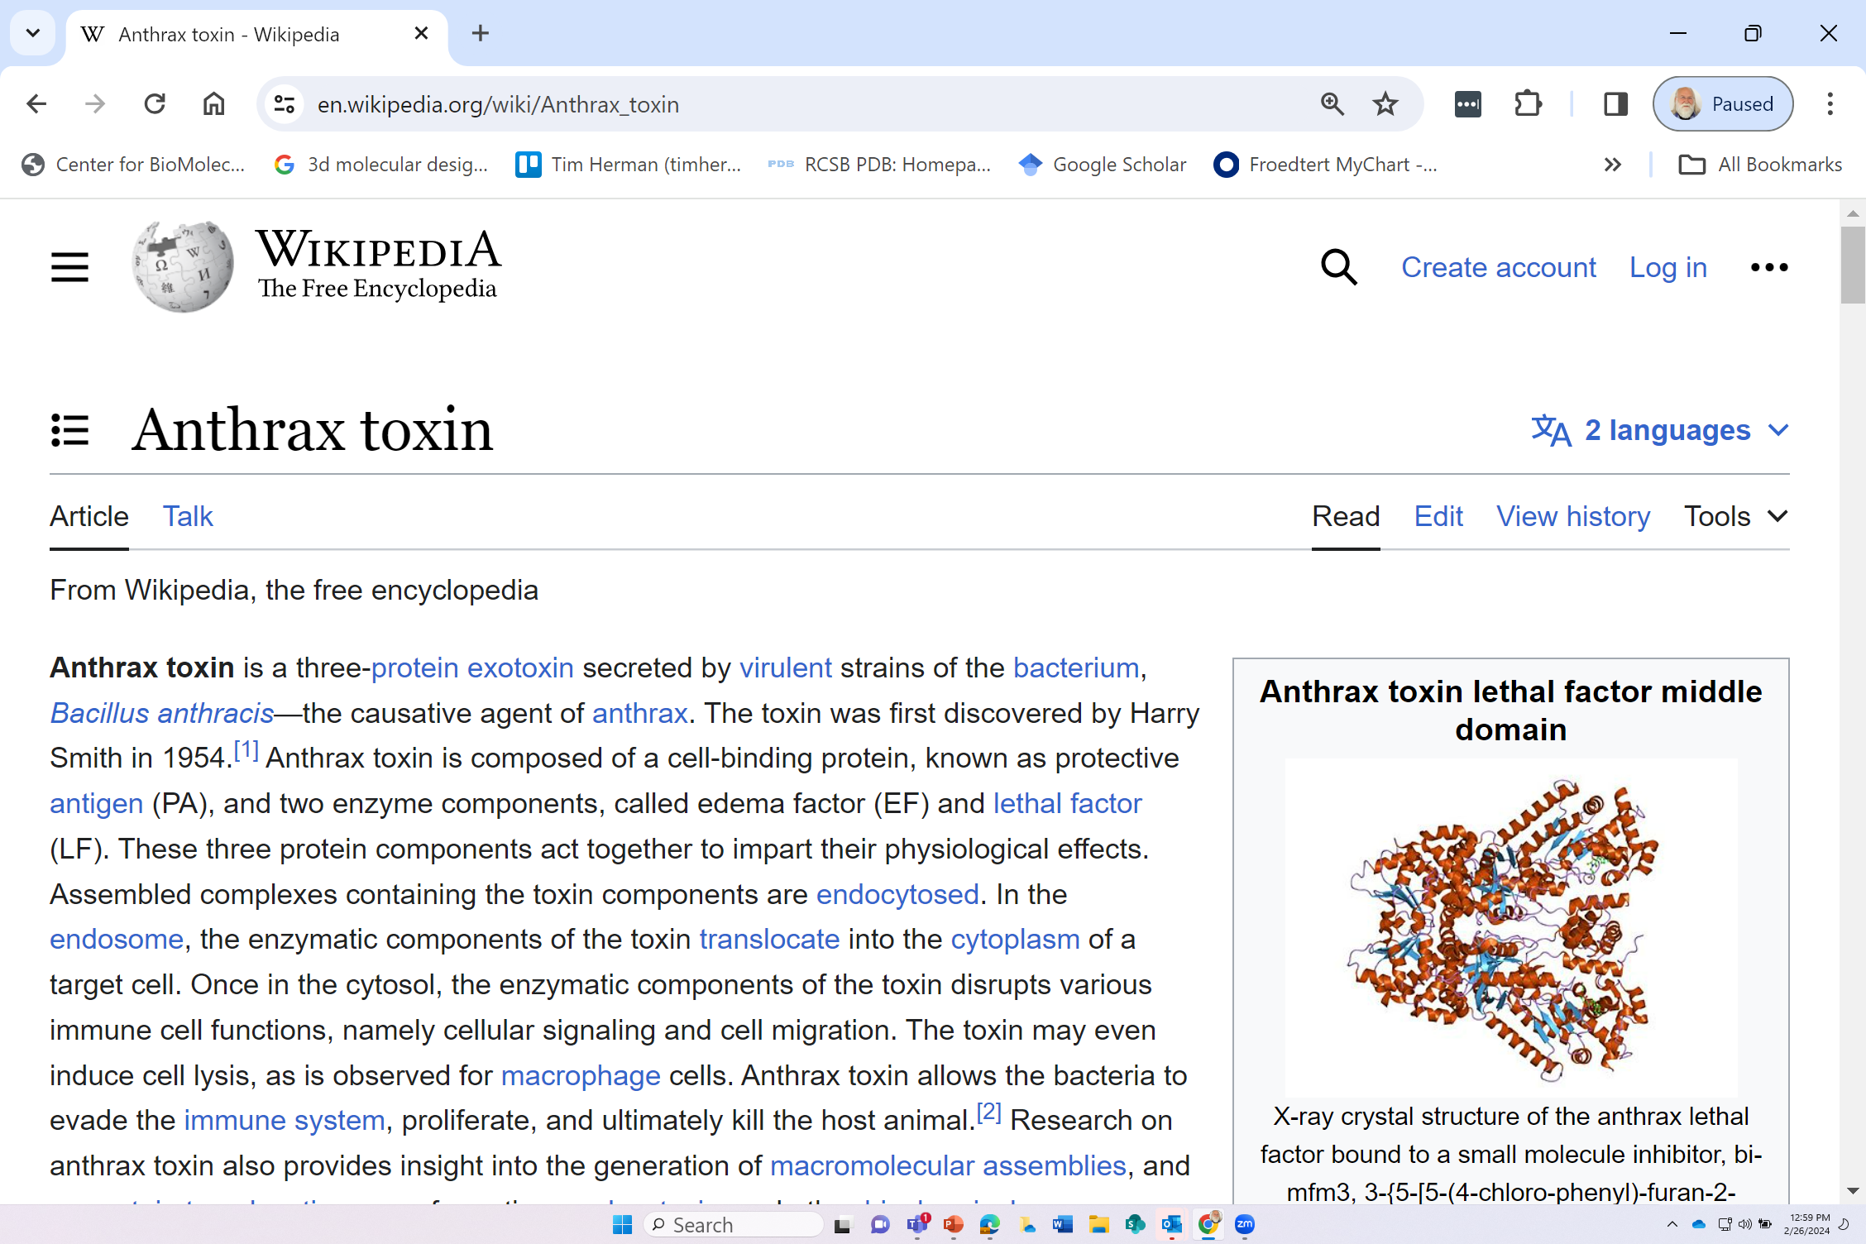
2005

Slide 16
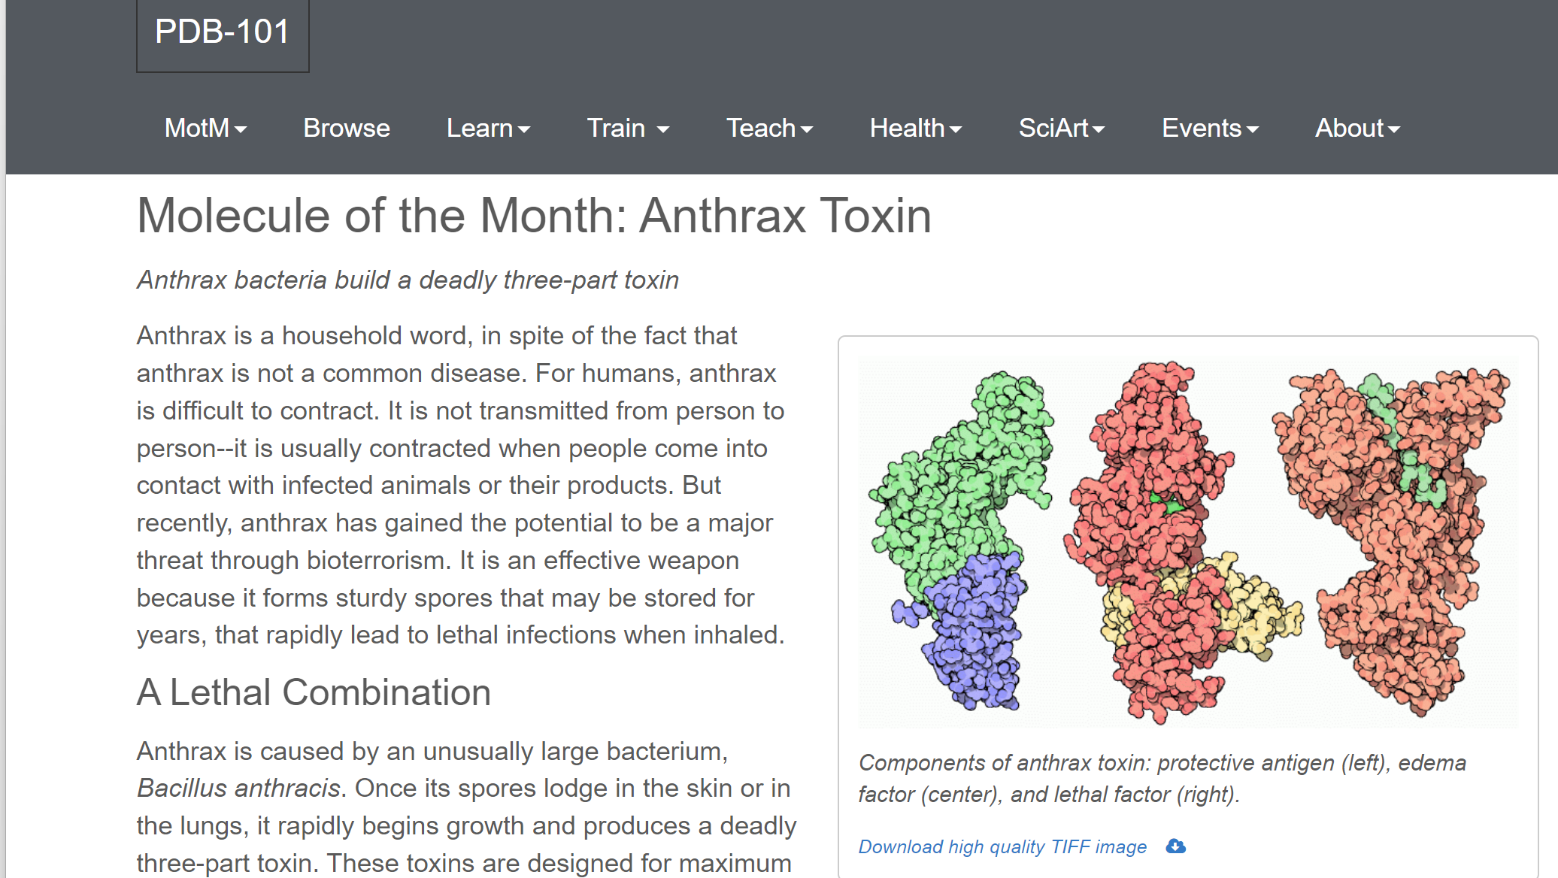
2002

Slide 17
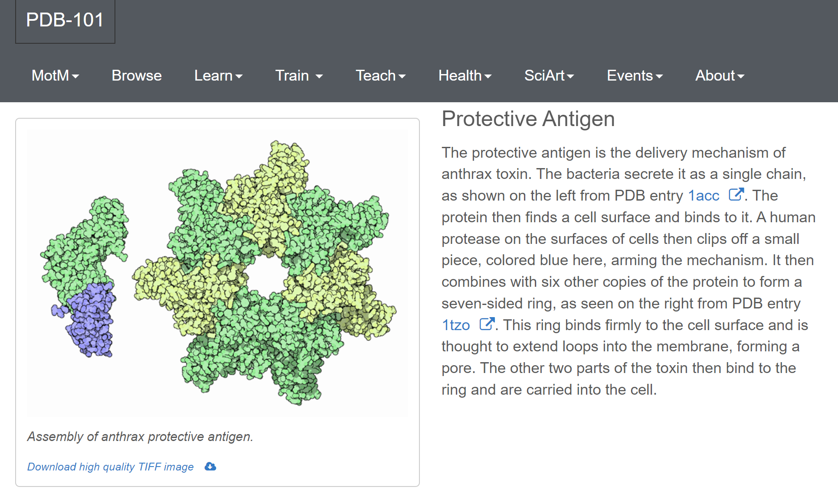
2002

Slide 18
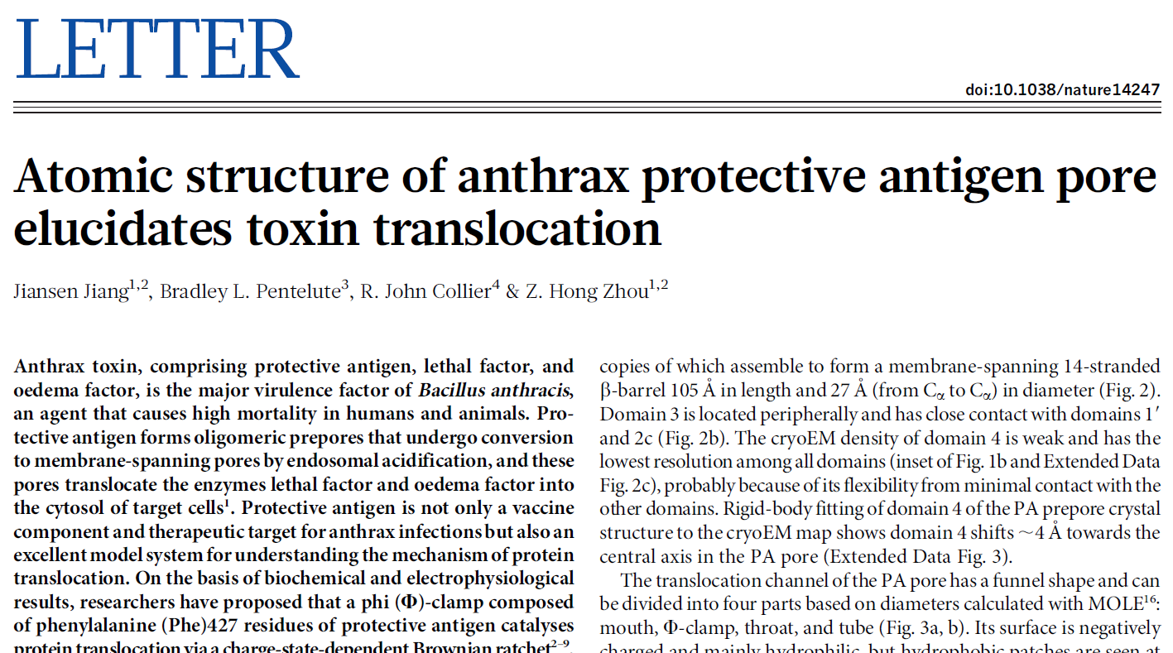
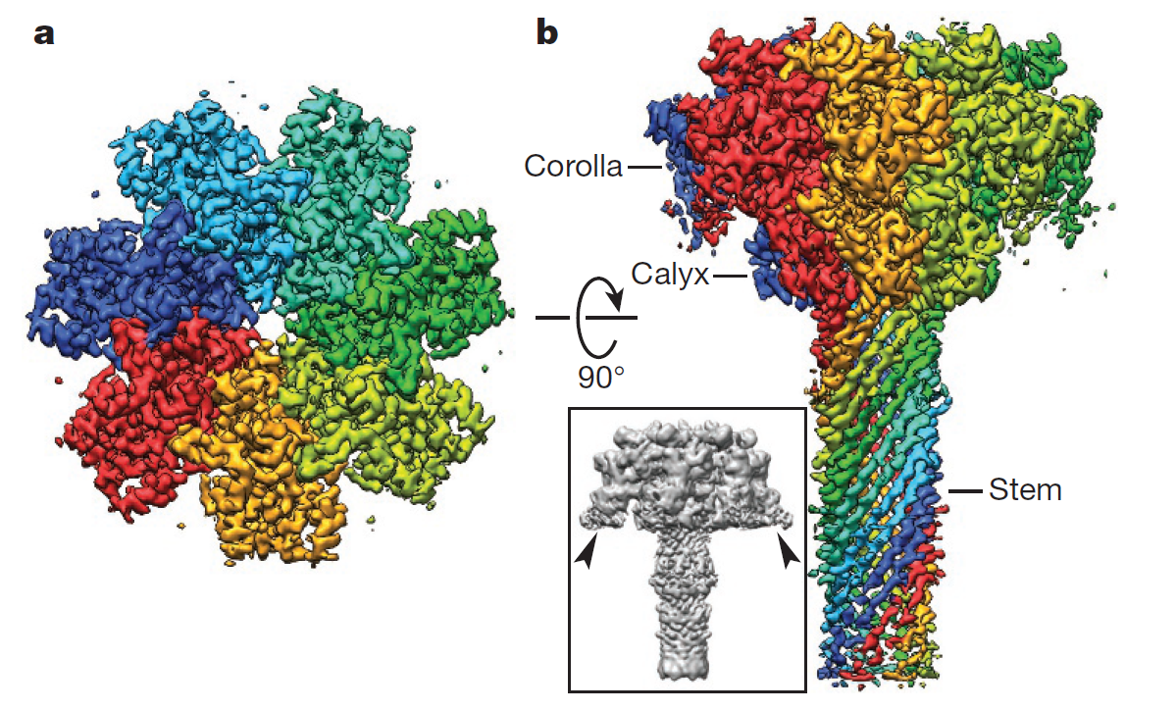
2 8 MAY 2 0 1 5 | VO L 5 2 1 | N AT U R E | 5 4 5

Slide 19
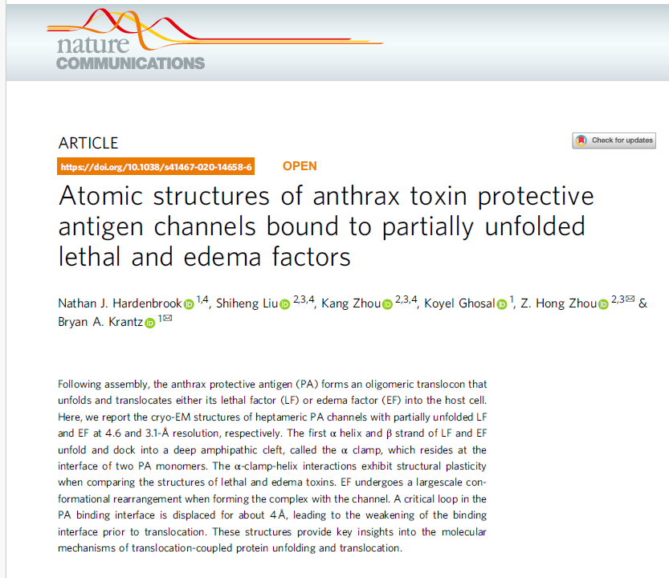
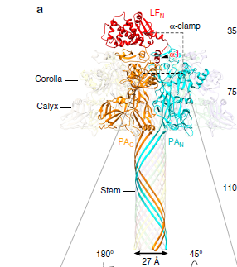
2020

Slide 20
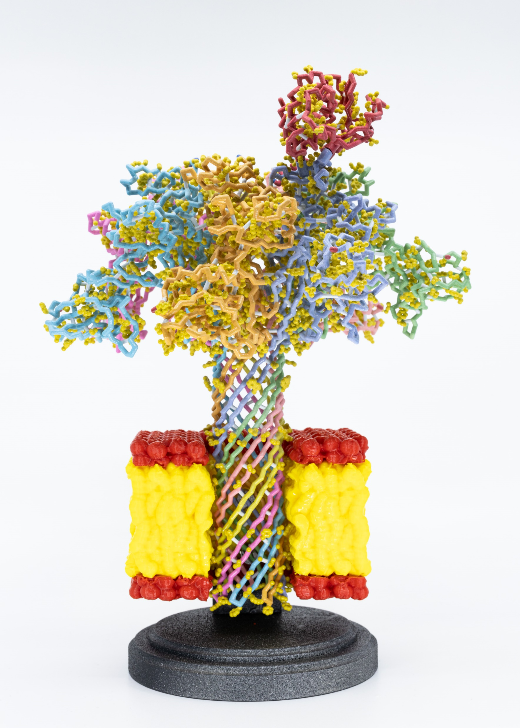
The Anthrax Protective Antigen heptamer….following receptor-mediated endocytosis… and acidification of the endosome.
The 14-stranded beta-barrel forms a tube through which the unfolded Lethal Factor is transported across the cell membrane.

Slide 21
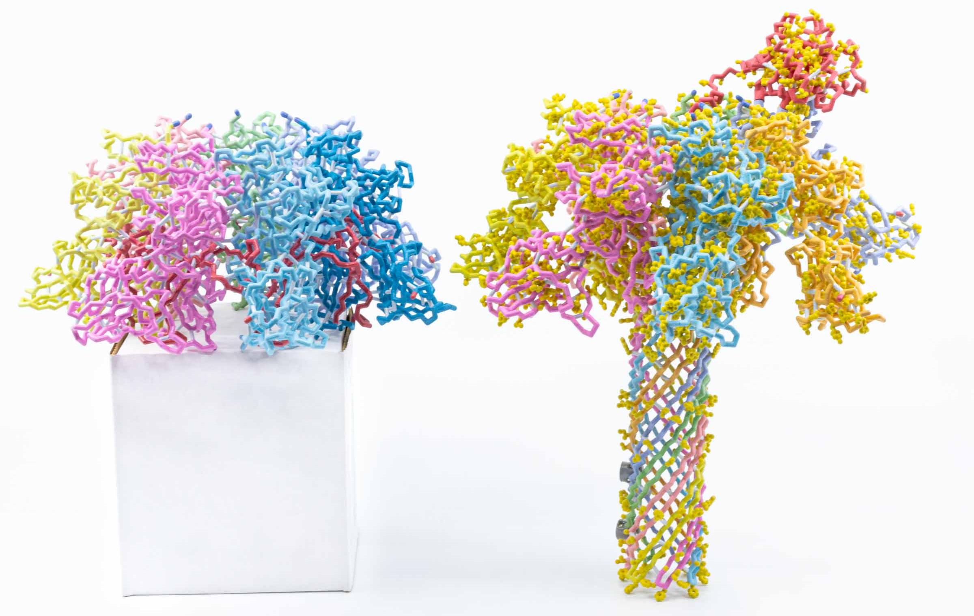

Slide 22
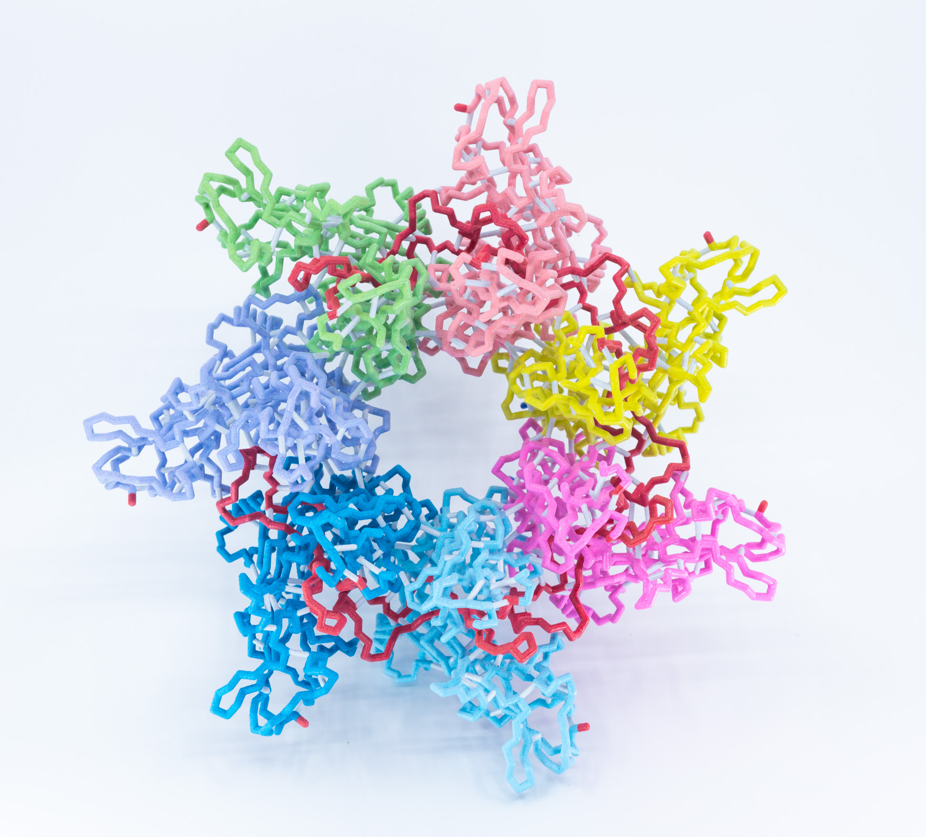
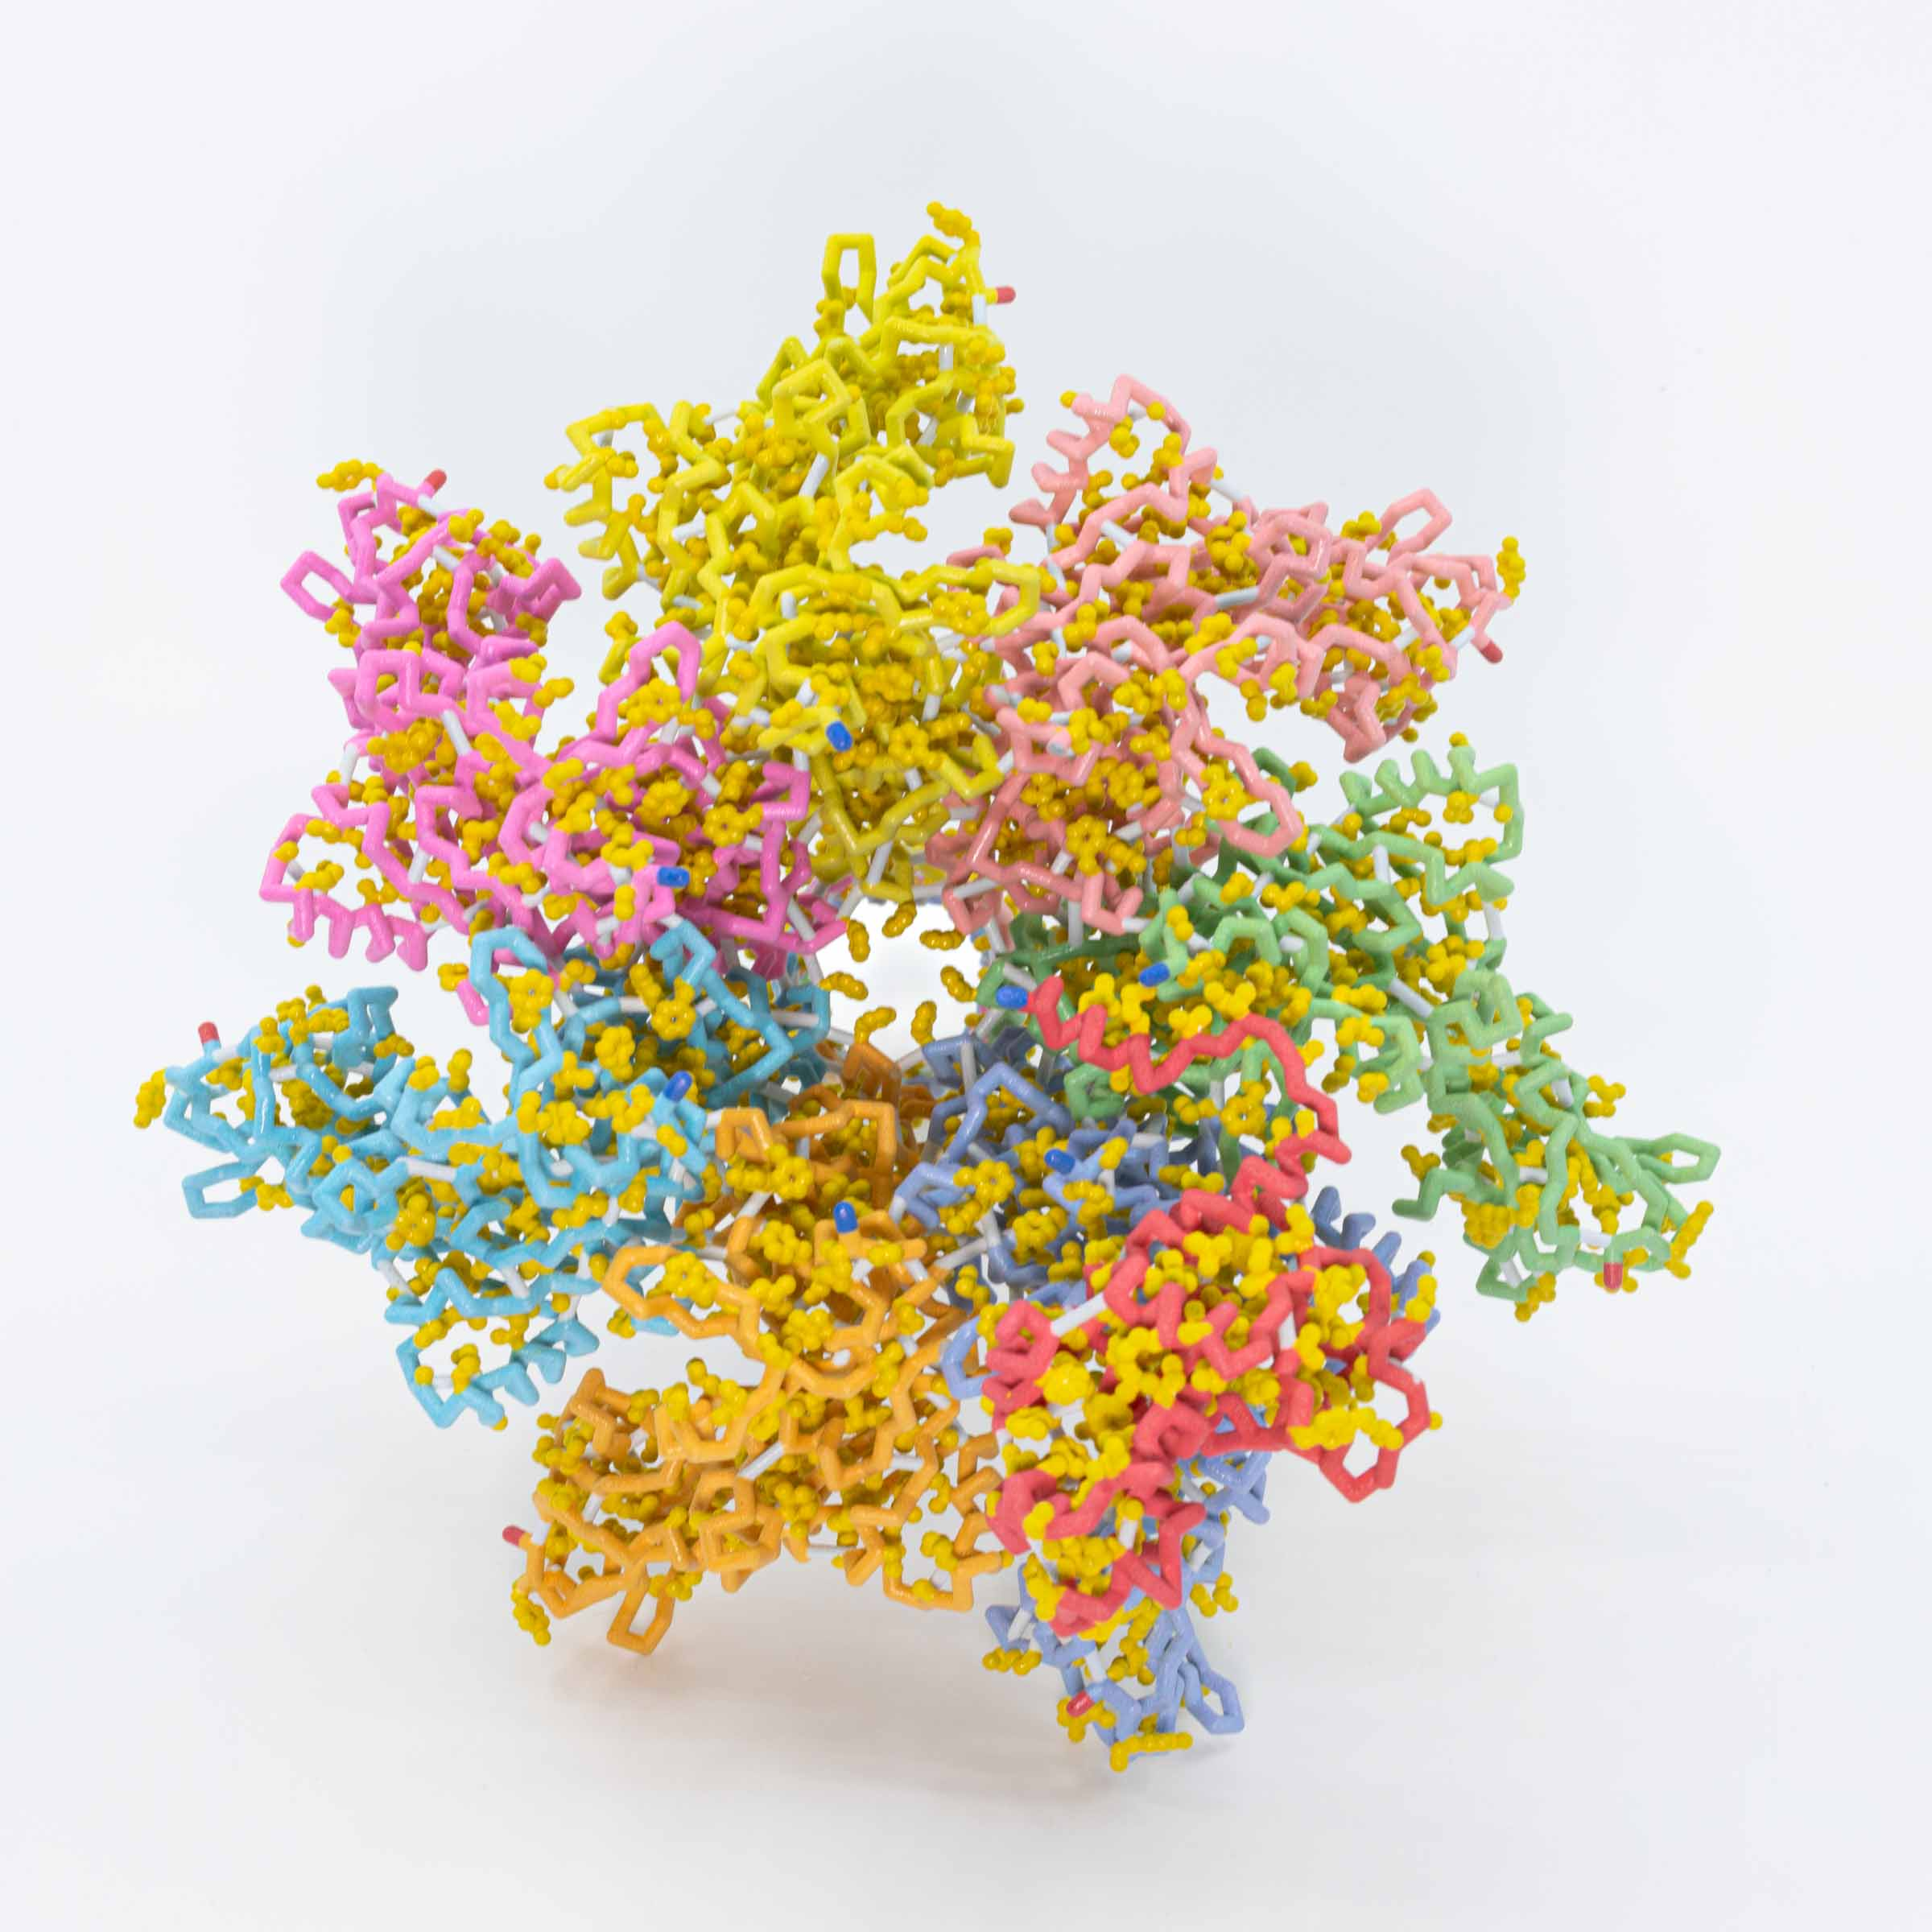

Slide 23
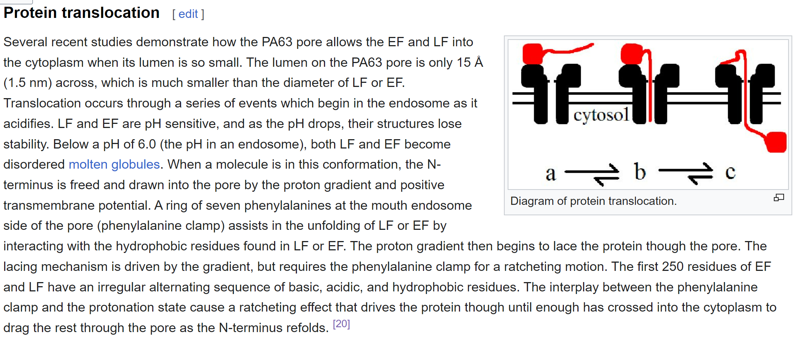

Slide 24
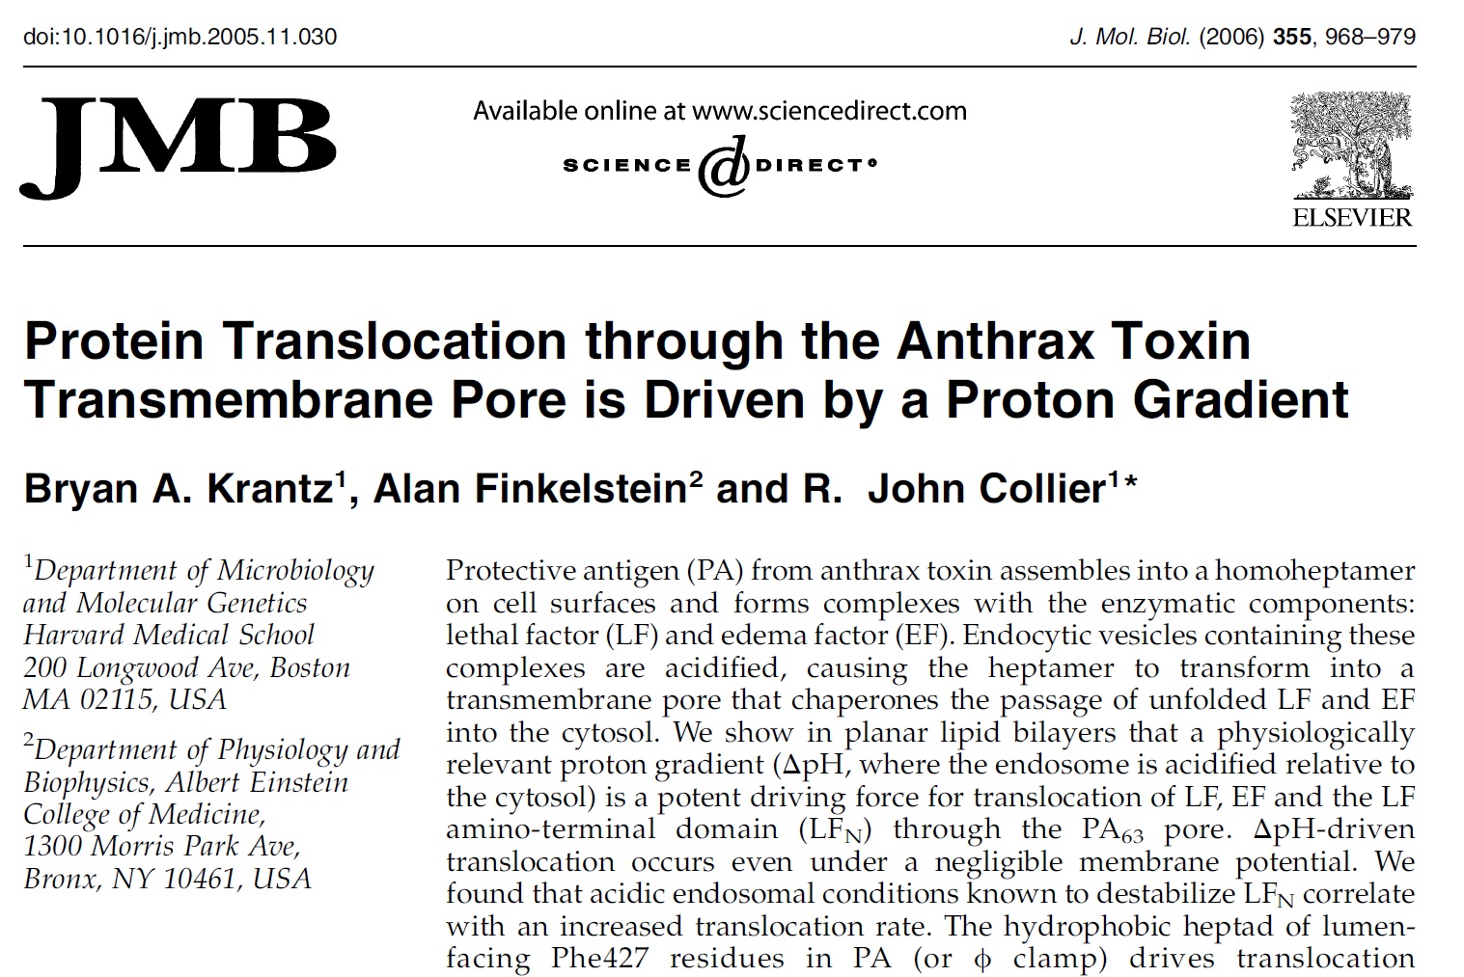

Slide 25
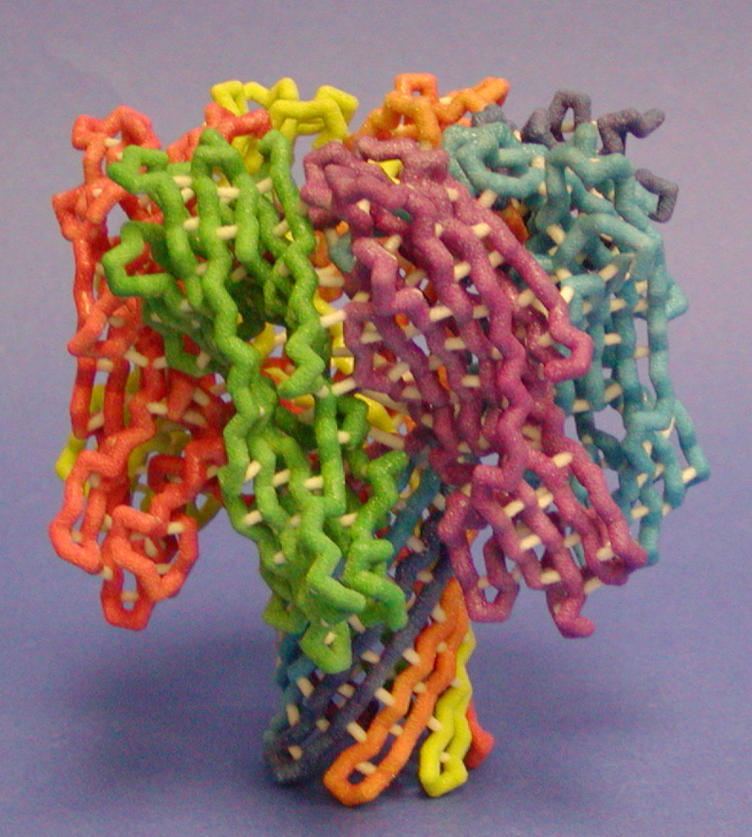
Models give meaning to words…
Until you have models,… molecular visualization software (Jmol)
is the next-best thing.
Coming soon…
The Protein Exploratorium
Hemolysin

Slide 26
Connecting the dots….
Other Protein Translocation/ Injection systems….
Bacteriophages,… delivering phage DNA into cells
Injectisomes,… June 2024 MOTM
Salmonella bacteria invade our cells and reproduce inside, causing life-threatening diseases like typhoid fever. As part of their pathogenic strategy, these bacteria inject several dozen types of effector proteins using a molecular needle called the injectisome.
Contractile Injection Systems,… introducing proteins into cells
See Feng Zhang at MIT

Slide 27
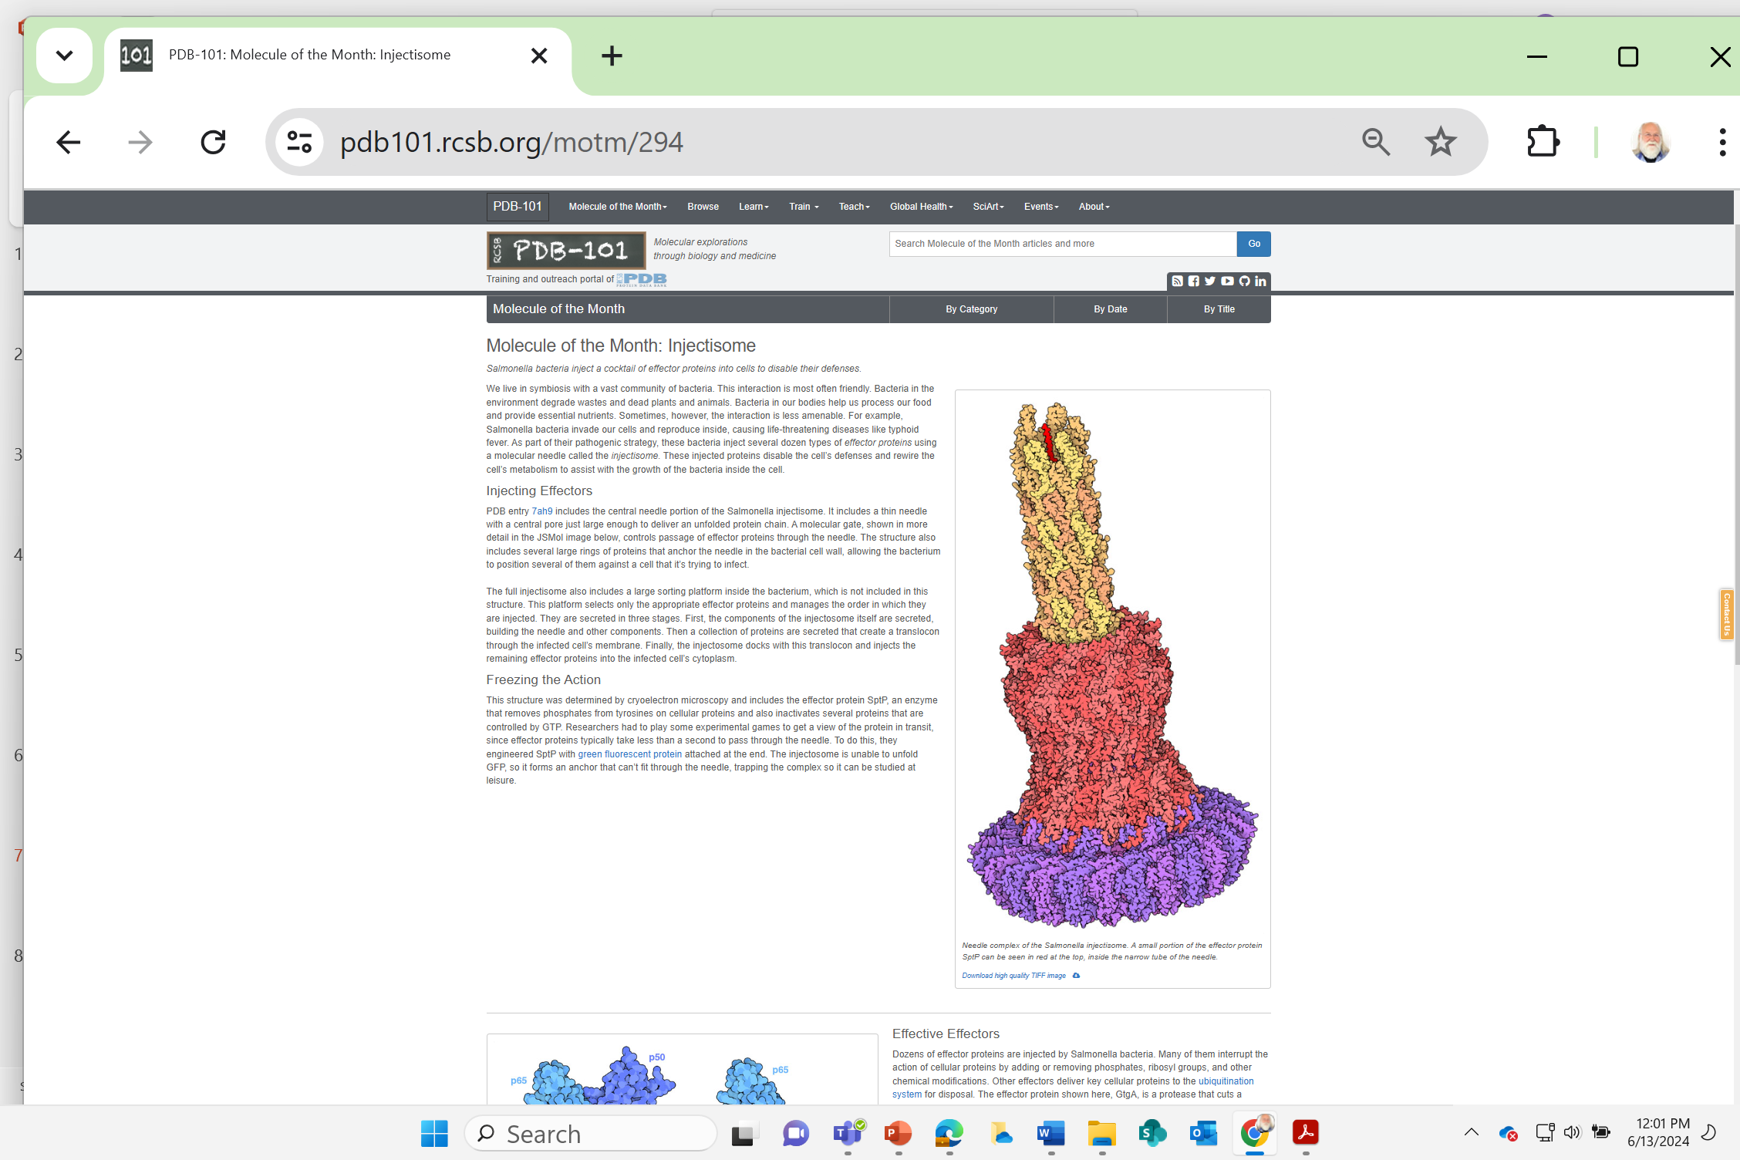
Unfolded effector protein
June, 2024

Slide 28
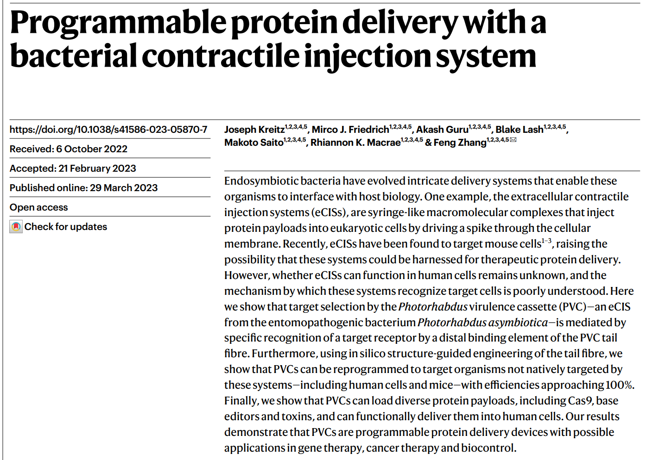
Nature | Vol 616 | 13 April 2023 | 357

Slide 29
The first paragraph of Kreitz et.al.….
For endosymbiotic bacteria, it is often advantageous to secrete factors that modulate host biology in favour of symbiont fitness4. However, many such factors cannot readily pass through cellular membranes; this has led to the development of intricate systems that actively deliver payload proteins into cells5. One example is the contractile injection systems (CISs), a class of syringe-like nanomachines resembling bacteriophage tails6,

Slide 30
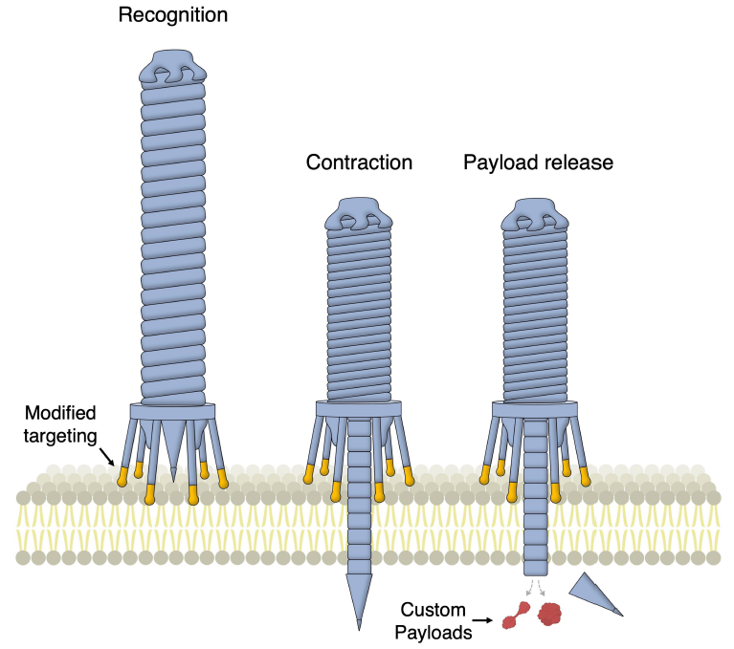
Model for protein delivery via reprogrammed CISs
Contractile
Injection
System

Slide 31
There are things we know…
As we think deeply about what we know, we will begin to ask questions about things we don’t know …….
Things we don’t know…
1. There are things we know we don’t know.
2. There are things we don’t know we don’t know
A teacher’s role is to encourage students to think deeply about what they know … and identify what they don’t know.

Slide 32
Teachers should model for students….
… the joy of discovering something you didn’t know
… the joy of discovering something you didn’t even
know you didn’t know.
This discovery happens when you…
slow down, focus, think deeply…
and begin to ask questions.

Slide 33
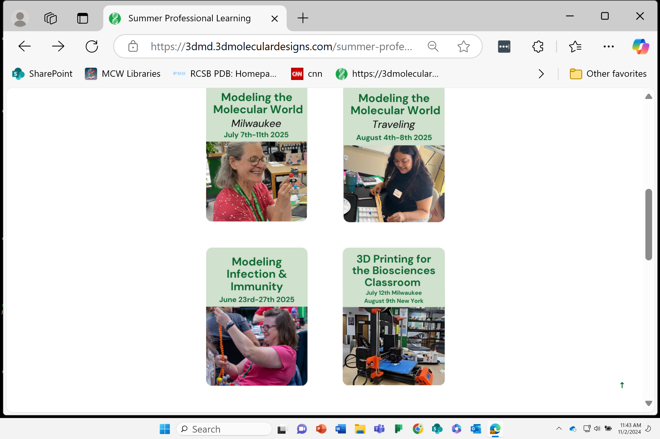
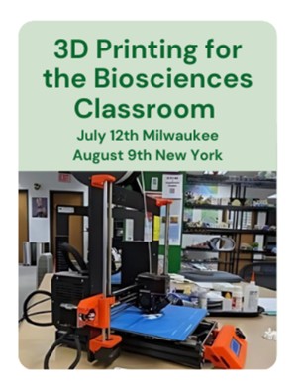
2025 Summer Workshops
Stony Brook
…become the teacher you have always wanted to be.

Slide 34


