Slide 1
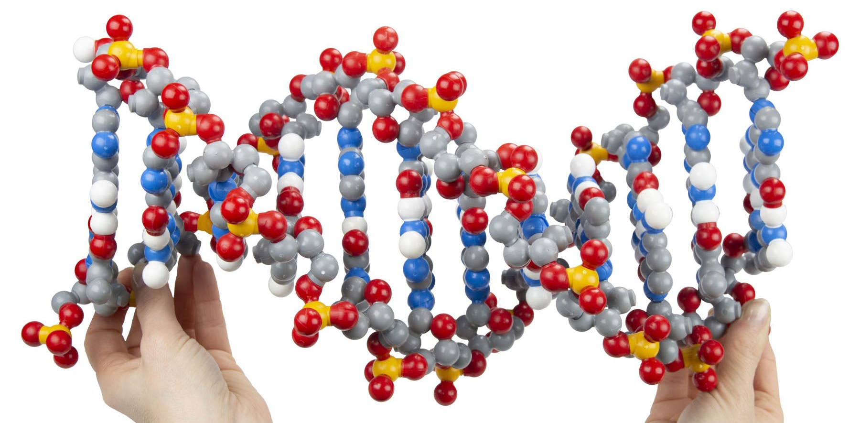
DNA… and Epigenetics
2024 CASE
Tim Herman

Slide 2
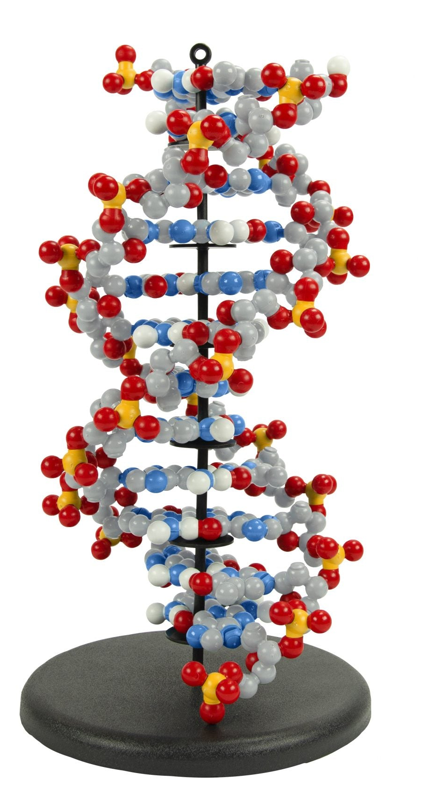
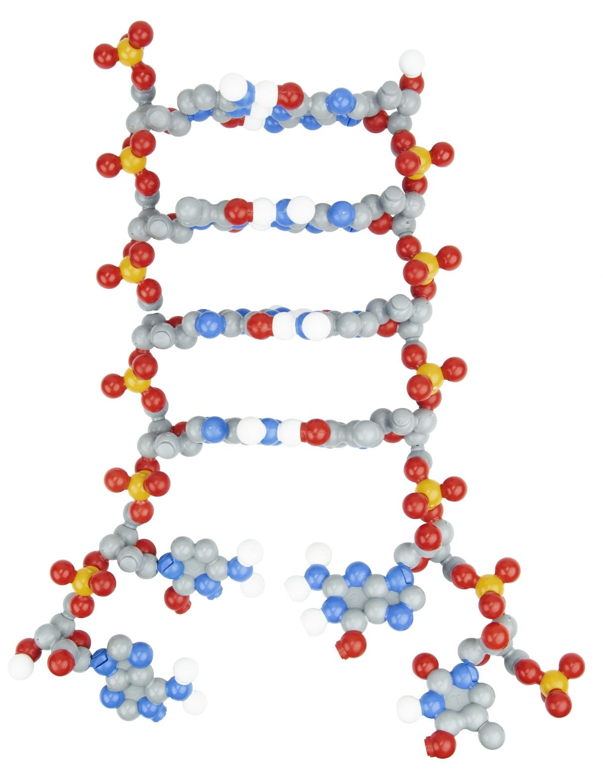
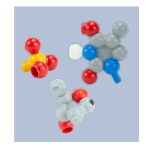
You can handle it….
You can take
it apart….
You can untwist it
& separate strands….
You can look at it….

Slide 3
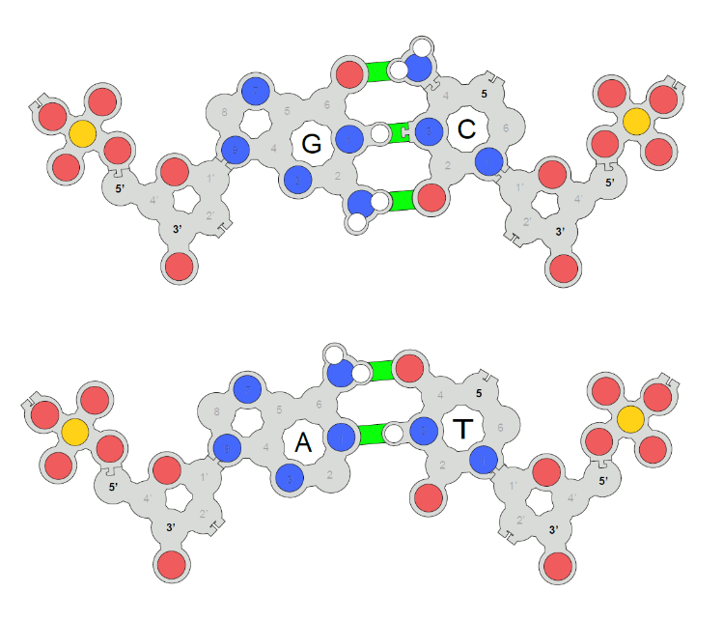
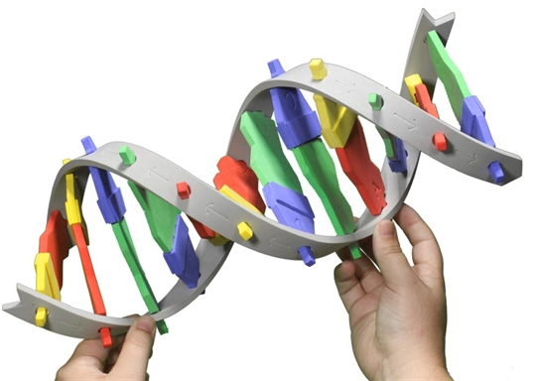
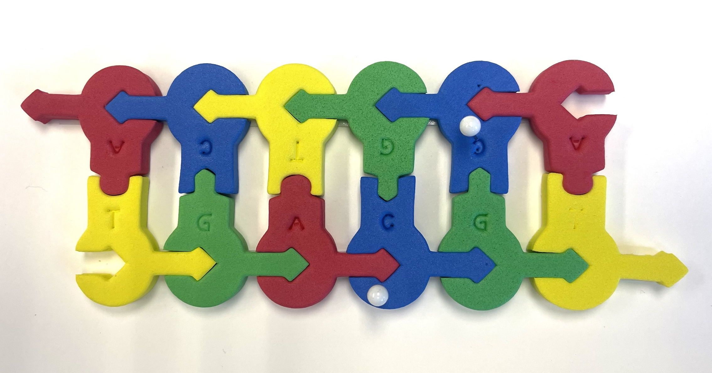
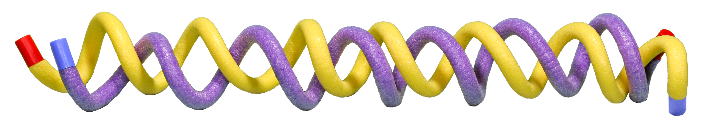
DNA Starter Kit
Tactile Base Pairs
Plectonemic DNA
Foam nucleotides

Slide 4
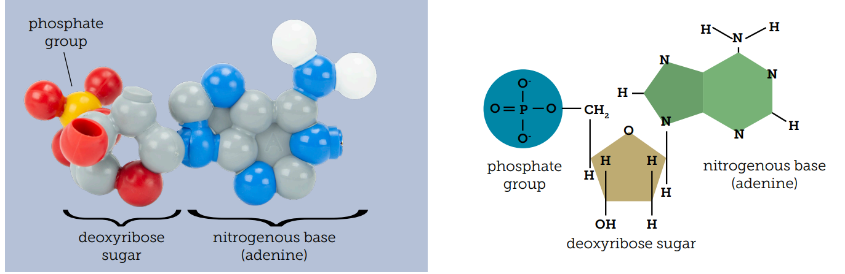

Slide 5
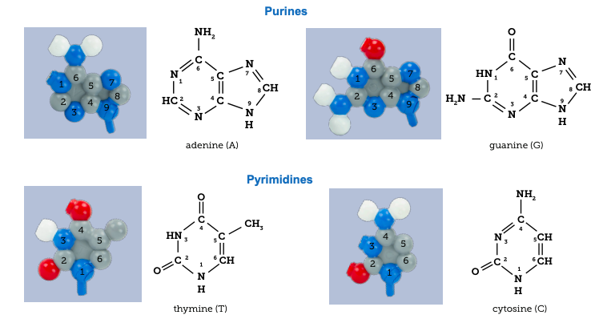
A
G
T
C

Slide 6
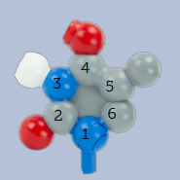
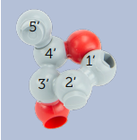
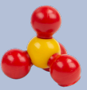
What’s the deal with
these “prime” numbers?
5’
T
3’

Slide 7
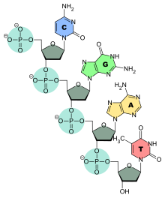
5’
All DNA/RNA polymerases synthesize new DNA/RNA in the 5’ → 3’ direction.
Polymerases add nucleotide triphosphates to a 3’-hydroxyl “primer”
3’

Slide 8
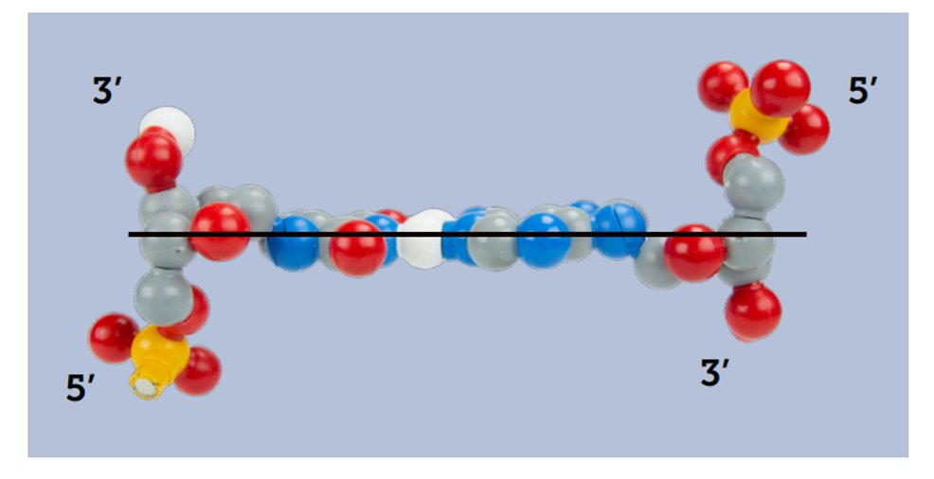
An antiparallel base pair

Slide 9
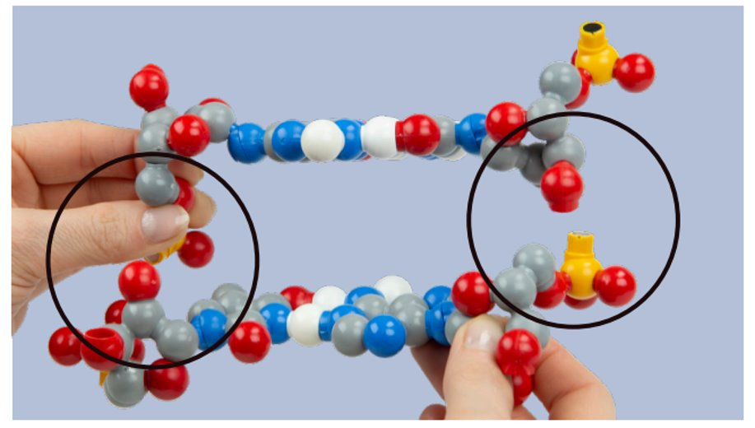

Slide 10
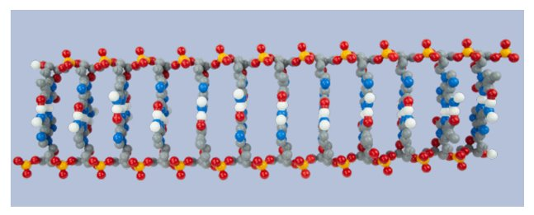

Slide 11
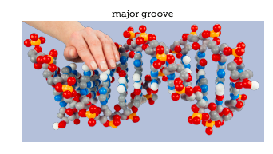
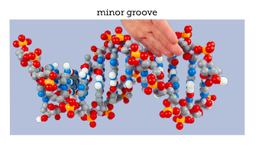
Transcription factors bind in the major groove of DNA

Slide 12
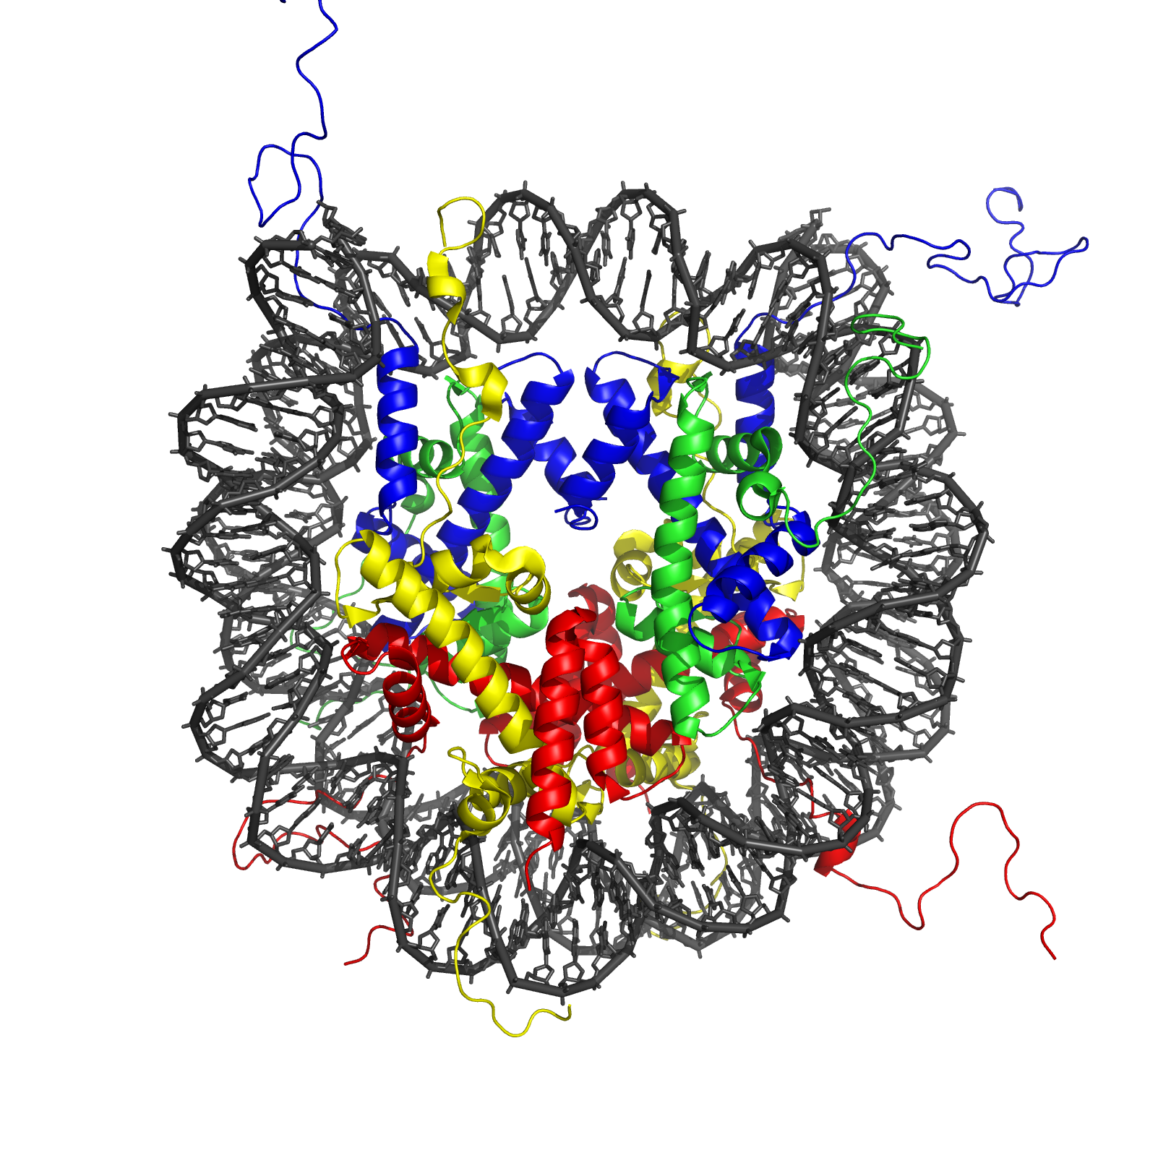
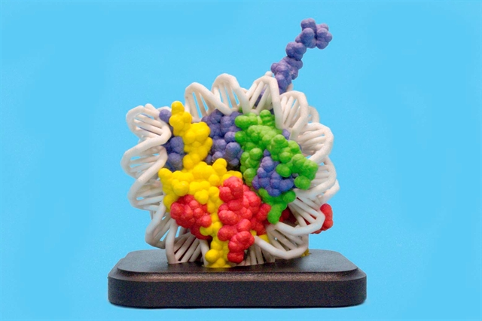
Nucleosome = histone octamer plus 145 bp of double-stranded DNA
Histones are non-sequence-specific DNA binding proteins

Slide 13
Plectonemic DNA

Slide 14
Foam Nucleotides…
…when simple is best

Slide 15
Tactile Base Pairs
What can you teach?
Why does RNA have U’s… and DNA T’s?
What is pseudouridine?,… and why should I care?
How does methylation of C regulate gene expression?
Why are there surprisingly few CpG dinucleotides in our genes?

Slide 16


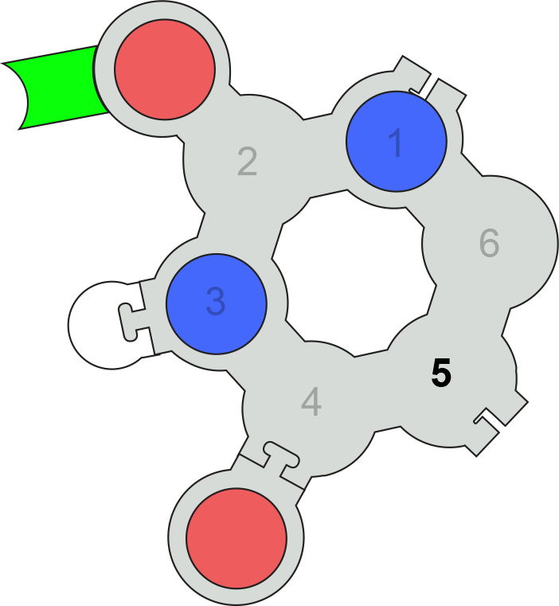
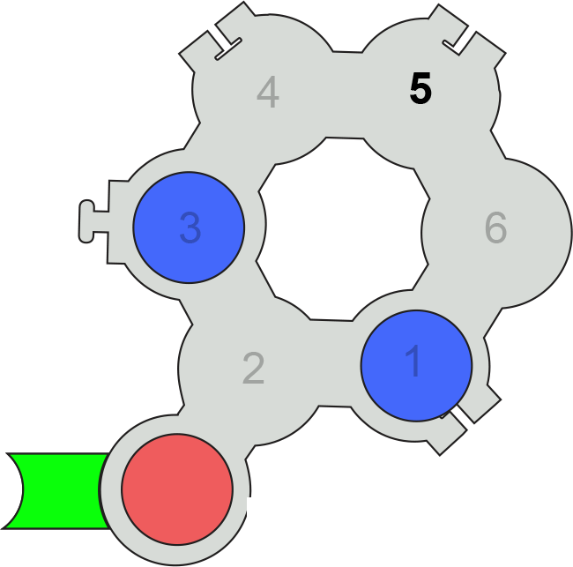
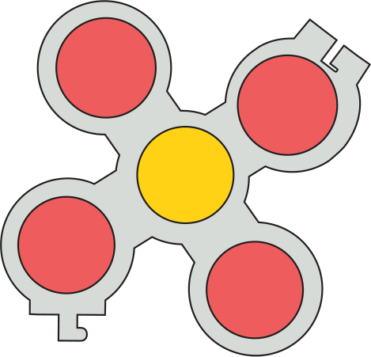

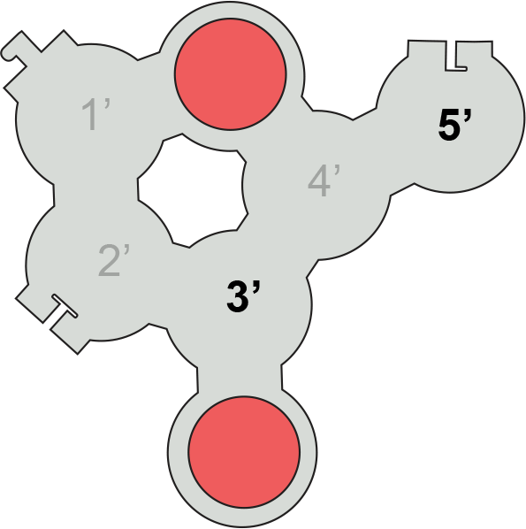
Tactile Base Pairs…
Uridine
Pseudo-Uridine

Slide 17
WHY…did T replace U in DNA?
spontaneous oxidative deamination of C
…if we had not switched…
AGUCGAAGUCAACCGAGGCUGCGCUAC
UCAGCUUCAGUUGGCUCCGACGCGAUG
U
AGUCGAAGU AACCGAGGCUGCGCUAC
x
UCAGCUUCA UUGGCUCCGACGCGAUG
G
A DNA repair system can remove “U” from DNA.
But,…how can we distinguish between a
“deaminated C” and a normal U?
ANSWER: We can’t.

Slide 18
WHY…did T replace U in DNA?
spontaneous oxidative deamination of C
…but after we switched…
AGTCGAAGTCAACCGAGGCTGCGCTAC
TCAGCTTCAGTTGGCTCCGACGCGATG
U
AGTCGAAGT AACCGAGGCTGCGCTAC
x
TCAGCTTCA TTGGCTCCGACGCGATG
G
Uracil glycosidase constantly scans the DNA….looking for U’s.
Any U … is a bad U…and should be repaired.

Slide 19
What is Epigenetics?
Epigenetics is the study of how your behaviors and environment can cause changes that affect the way your genes work. Unlike genetic changes, epigenetic changes are reversible and do not change your DNA sequence, but they can change how your body reads a DNA sequence.
NO MORE
EXCUSES
Don’t blame it on genes

Slide 20
Workshop Outline
Epigenetics…chemical modifications of your genome
  Writers / Erasers / Readers
1. Histone modifications
2. DNA modifications
  … methylation of CpG
  … a 3-D structure/function story

Slide 21
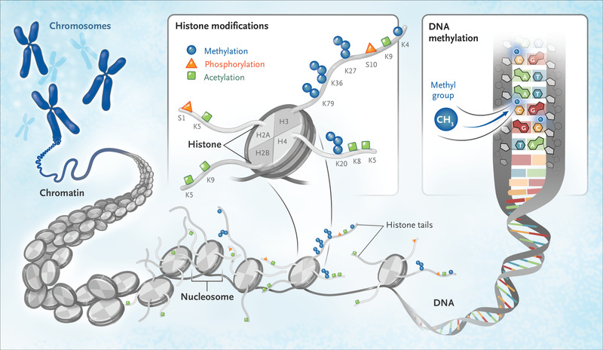
Epigenetics…

Slide 22
Post-transcriptional modification of DNA
Methylation of CpG …. to CMepG
5’- C p G – 3’

Slide 23
Looking for CpG’s….

Slide 24
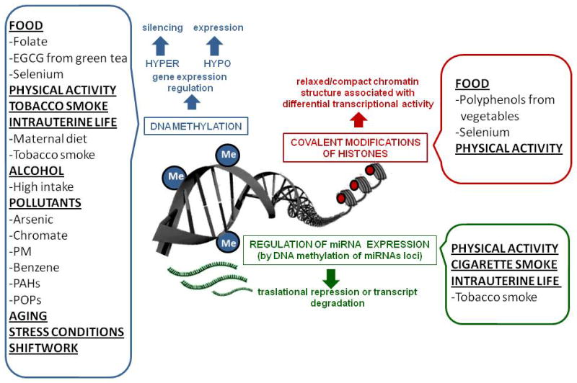

Slide 25
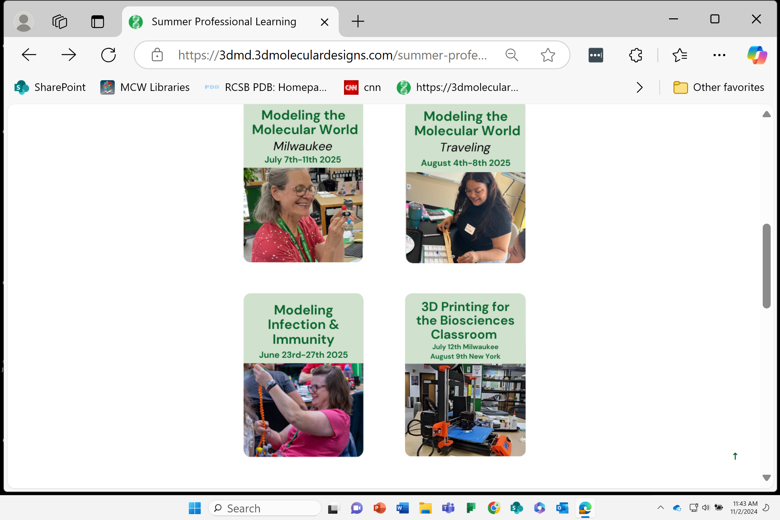
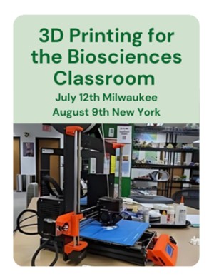
2025 Summer Workshops
…become the teacher you have always wanted to be.

Slide 26


Slide 27
It’s here!
Coming soon,… to a workshop near you.
Modeling Infectious Diseases and Immunity
An NIH SEPA project.
New Instructional Materials
  Models, models and more models….
    A Virus Collection,.. including CoV-2
    Antibodies/vaccines /and your immune system
    mRNA vaccines and multi-valent, ultra-potent vaccines…from synthetic biology.
    Stories, stories and more stories….
A Professional Learning Experience…beginning in the summer of 2024
But first,…enroll now in Modeling the Molecular World, 2024
Session 1 -- June 26-30, or
Session 2 -- July 17 - 21

