Slide 1
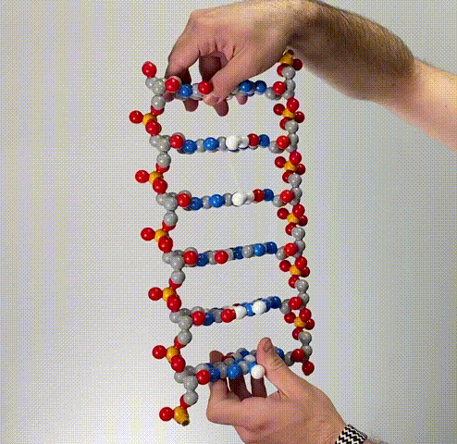
Dynamic DNA
…more than a just a bunch of
A’s, T’s, G’s and C’s
Tim Herman

Slide 2
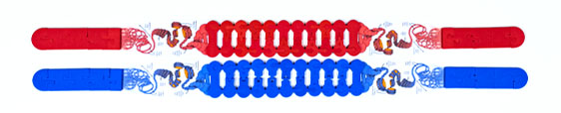
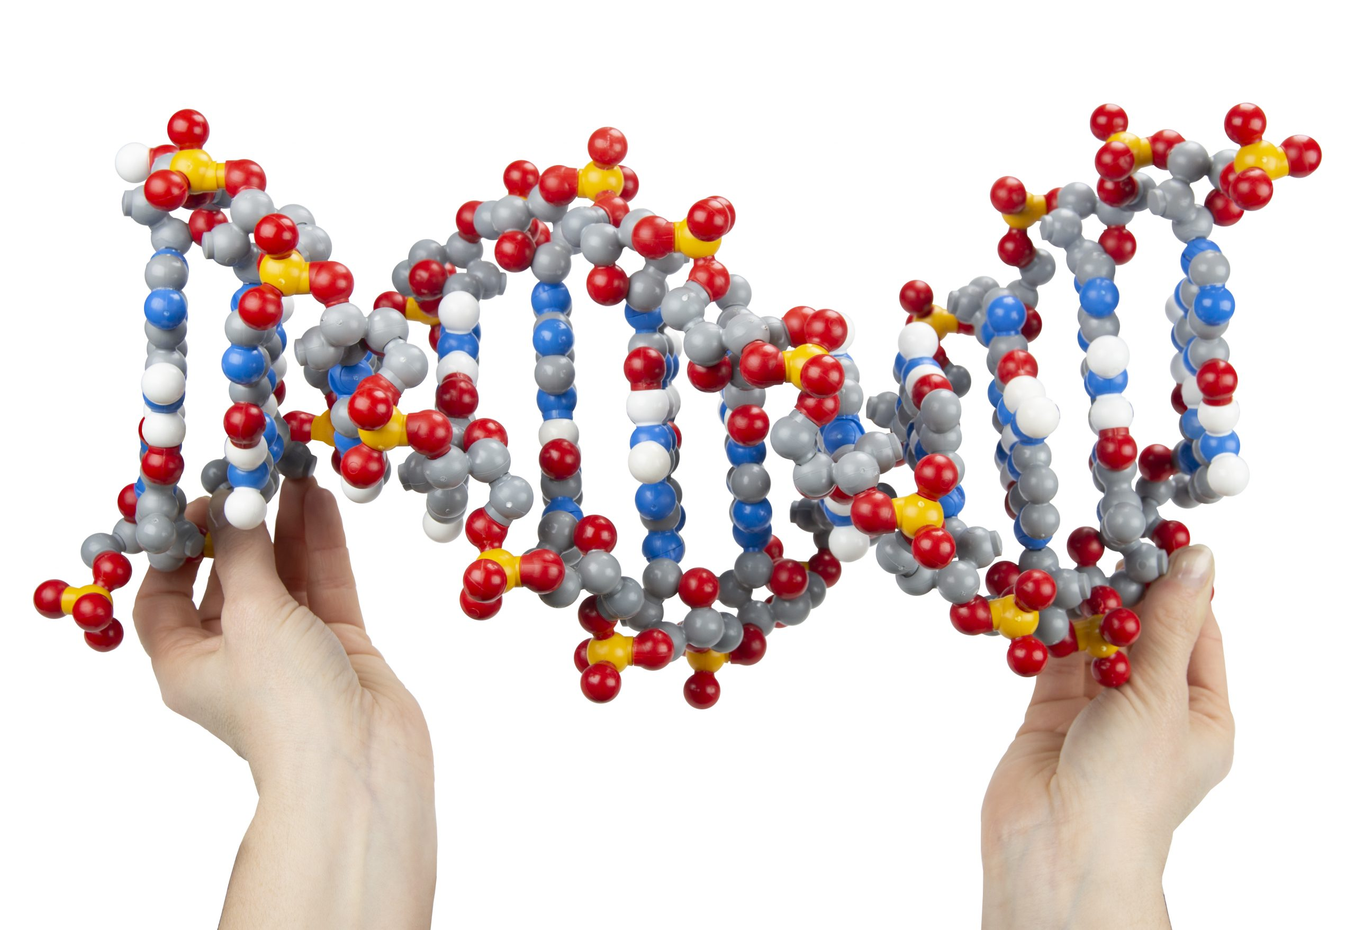
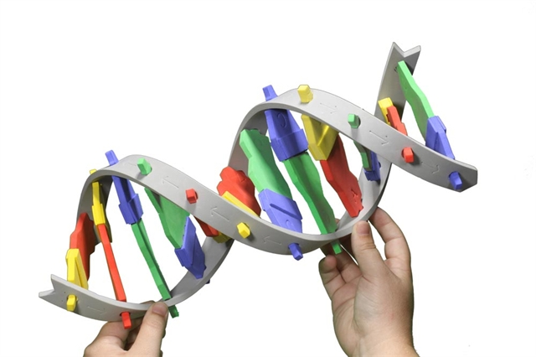
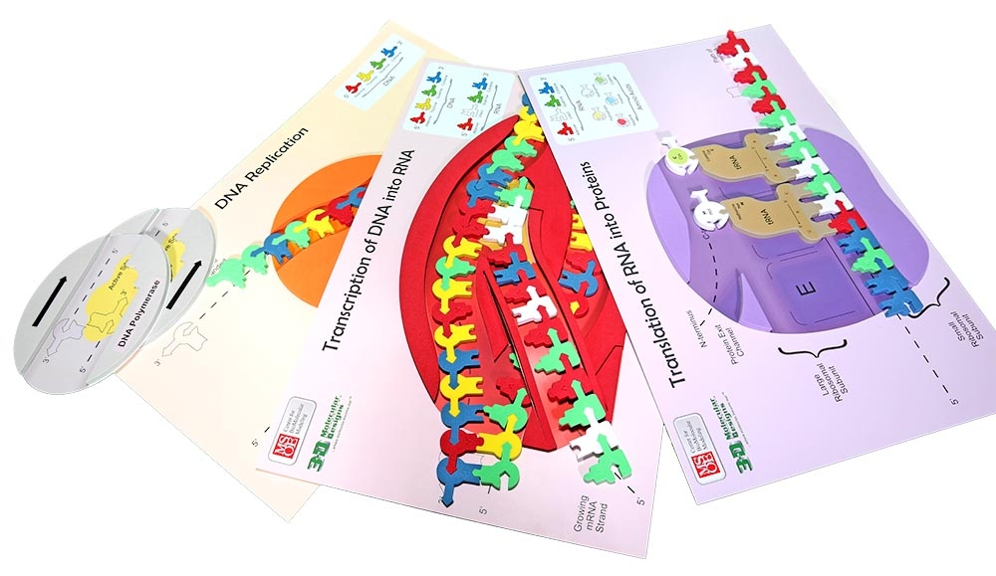
DNA… what do you teach?
Genetics
DNA Structure
The Central Dogma
DNA → RNA → Protein

Slide 3
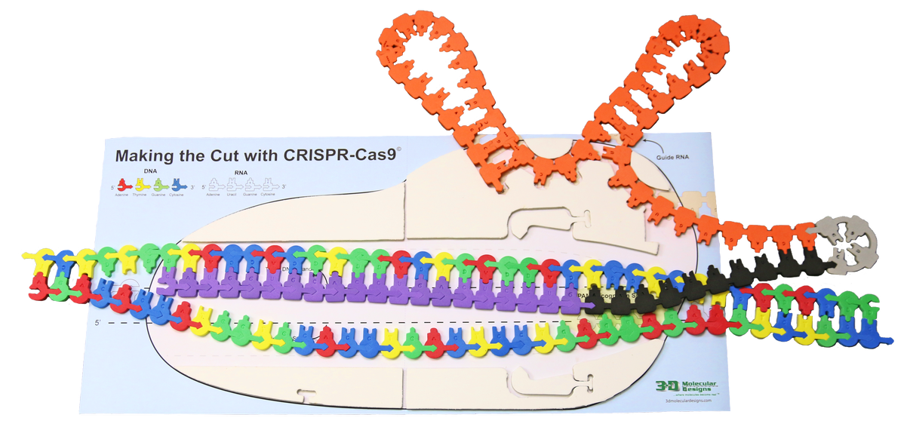
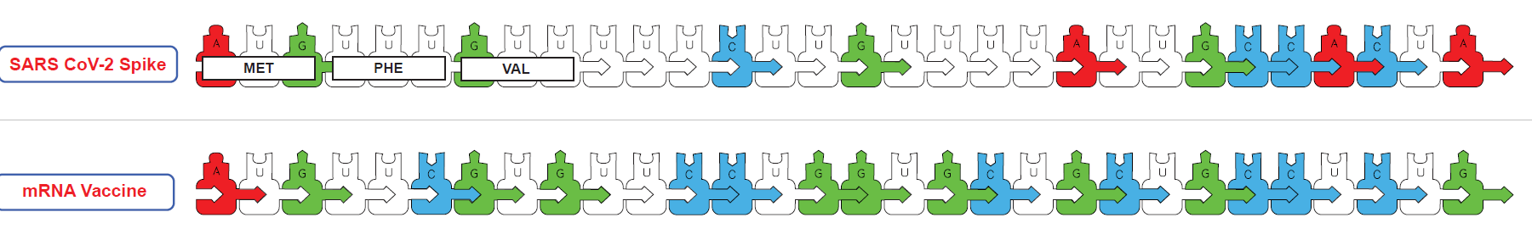
More DNA-related topics you could teach:
Bioinformatics….
Gene Maps (Paper Bio-informatics),
Data Science, AI and Alpha-Fold
Biotechnology
Recombinant DNA Technology
Sanger DNA Sequencing
PCR
CRISPR-based Genome Editing
Epi-genetics…
chemical modifications of both histones and DNA
mRNA Vaccines and Pseudouridine

Slide 4

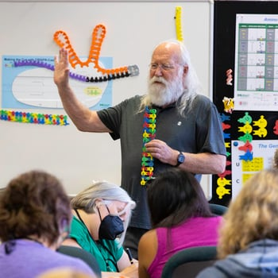
Sign-Up for a 3DMD Summer Course
Modeling the Molecular World
Modeling Infection & Immunity
Fee-based
Grant supported
Session 1: July 29 - August 2
Session 2: August 5 - August 9
June 24–28, 2024

Slide 5
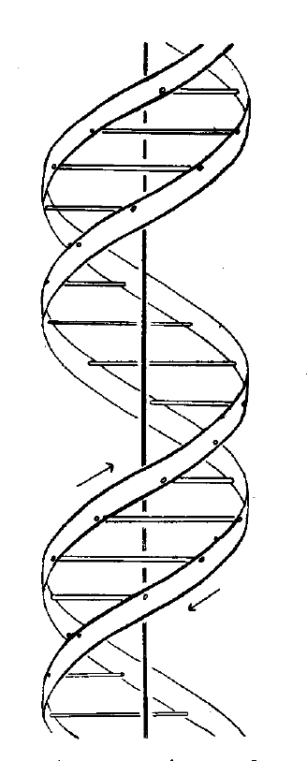
Watson and Crick,….. in 1953
2
Whether a special enzyme is required to carry out the polymerization,
or whether the single helical chain already formed acts effectively as an enzyme, remains to be seen.
Since the two chains in our model are intertwined, it is essential for them to untwist if they are to separate: As they make one complete turn around each other in 34. A., there will be about 150 turns per million molecular weight, so that whatever the precise structure of the chromosome a considerable amount of uncoiling would be necessary.
It is well known from microscopic observation that much coiling and uncoiling occurs during mitosis, and though this is on a much larger scale it probably reflects similar processes on a molecular level.
Although it is difficult at the moment to see how these processes occur without everything getting tangled, we do not feel that this objection will be insuperable.
1
It has not escaped our notice that the specific pairing we have postulated immediately suggests a possible copying mechanism for the genetic material
Nature 171,964-967 1953 (May 30) Genetical Implications of the Structure of Deoxyribonucleic Acid
Nature 171, 737-738, 1953 (April 25) Molecular Structure of Deoxypentose Nucleic Acids

Slide 6
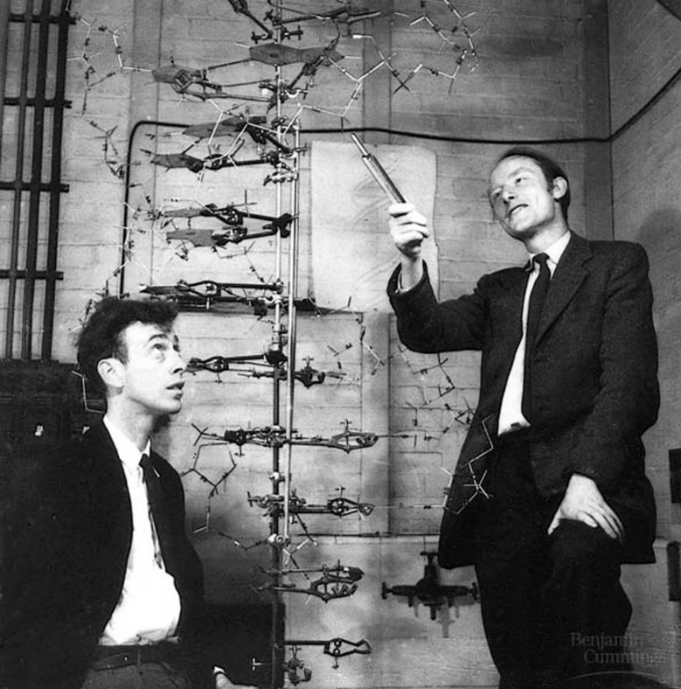
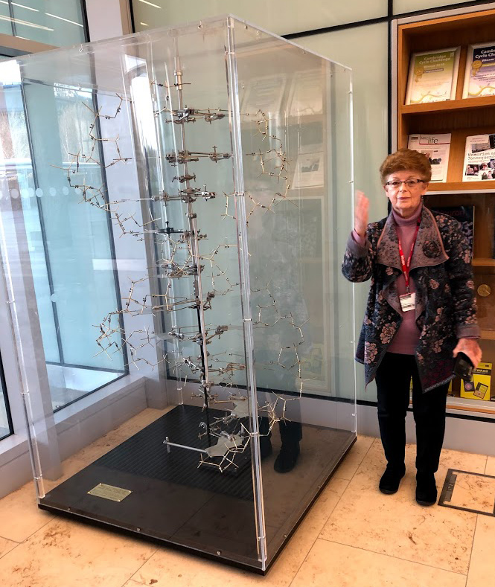
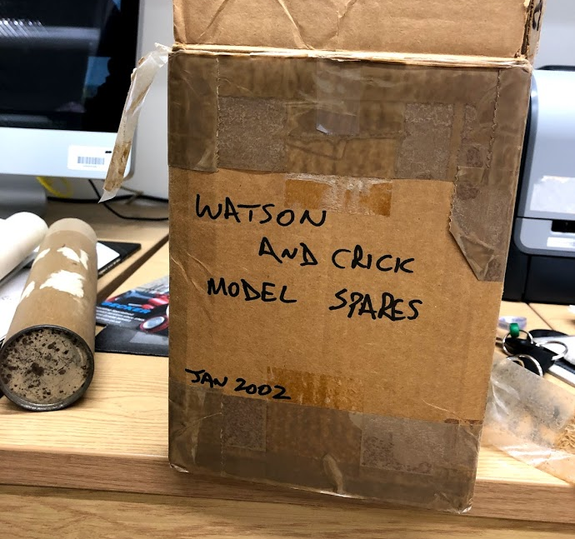
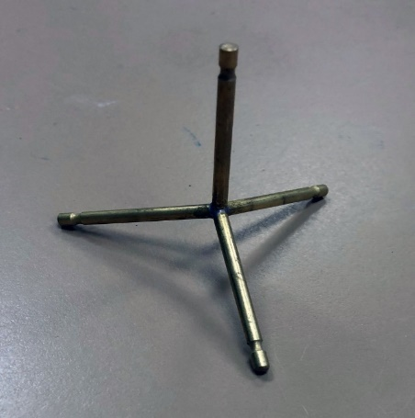
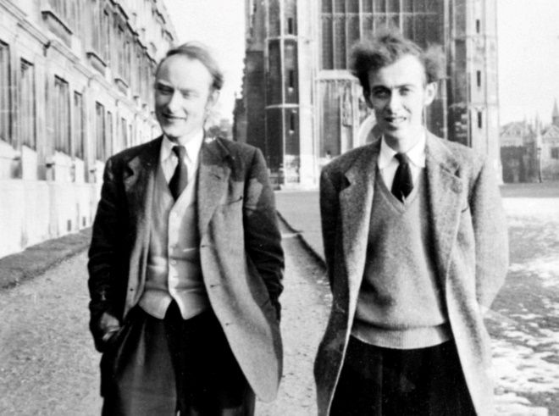
The MRC Laboratory of Molecular Biology
…. a Nobel fellow on every floor….
“We have discovered the secret of life.”

Slide 7
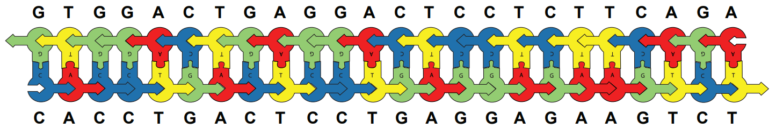

Slide 8
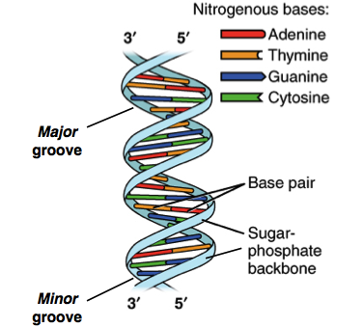

Slide 9
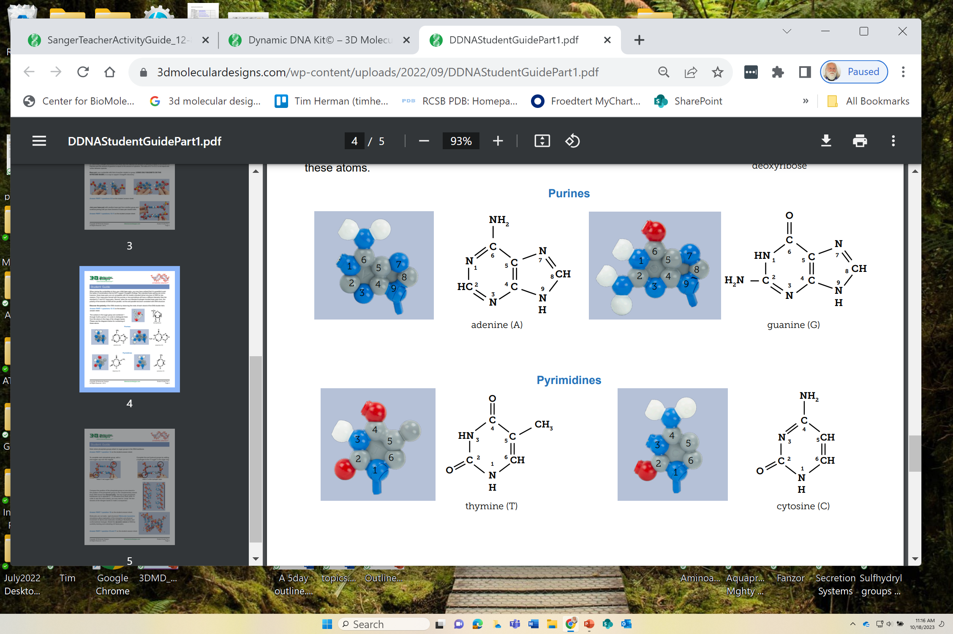

Slide 10
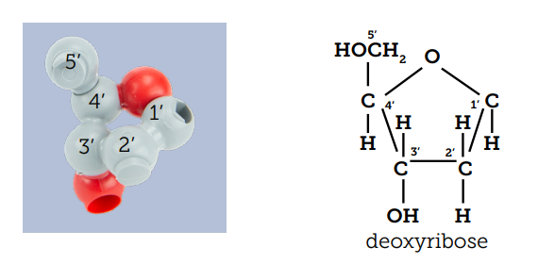

Slide 11
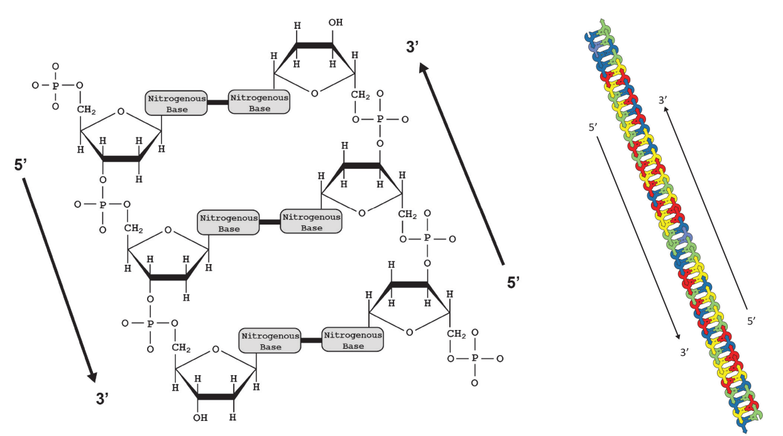
Anti-parallel DNA Strands…

Slide 12
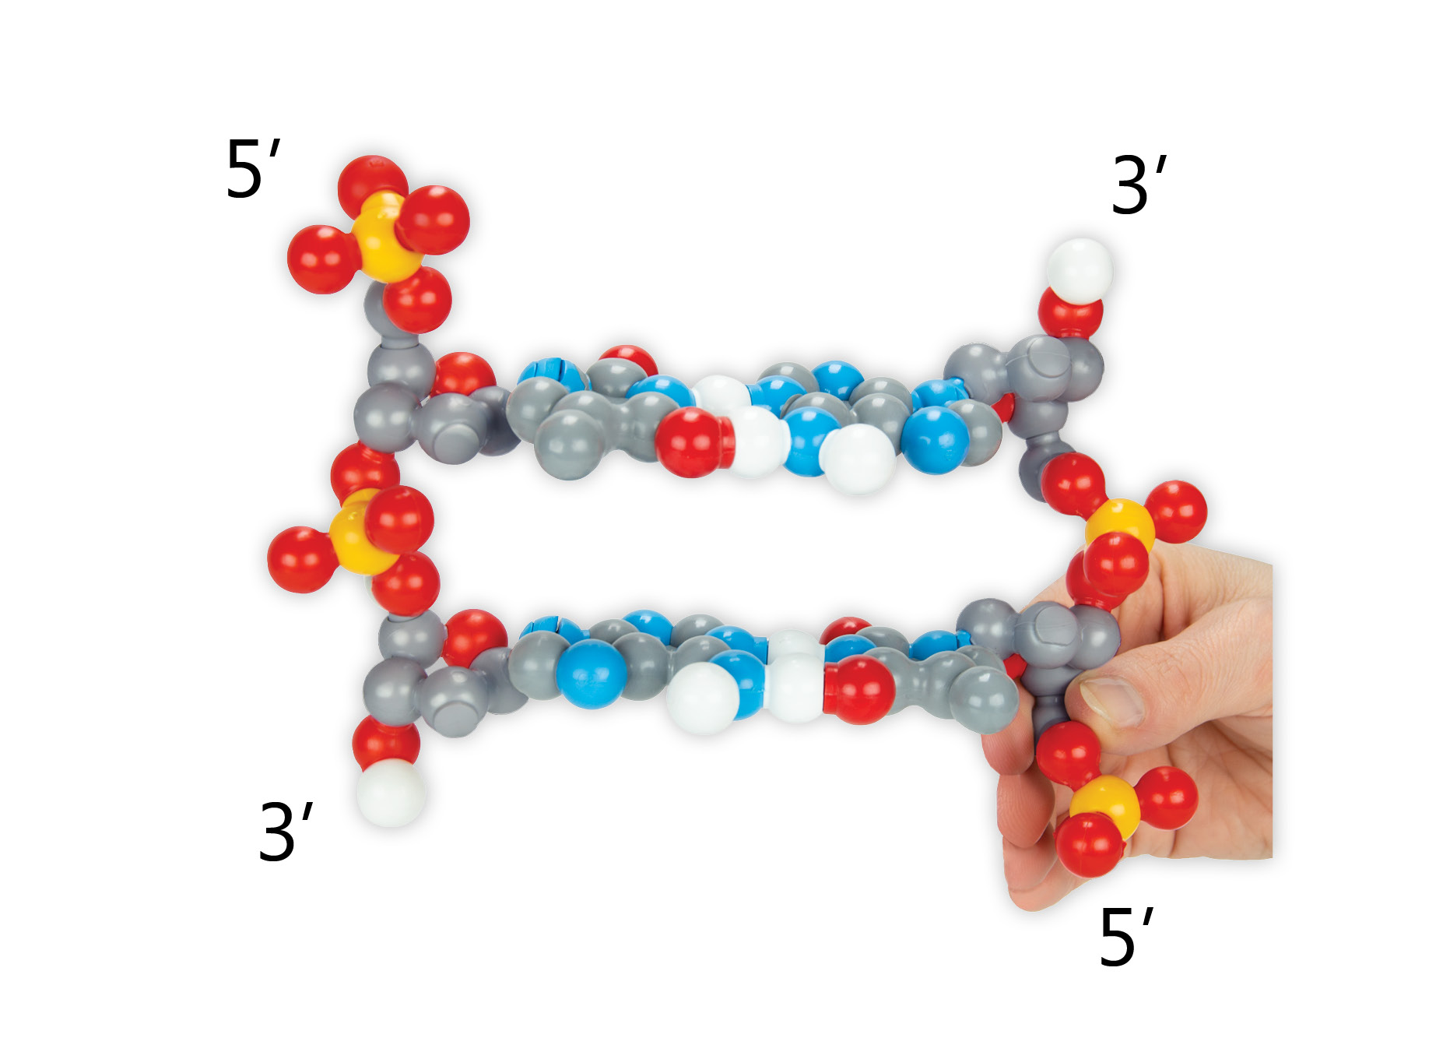
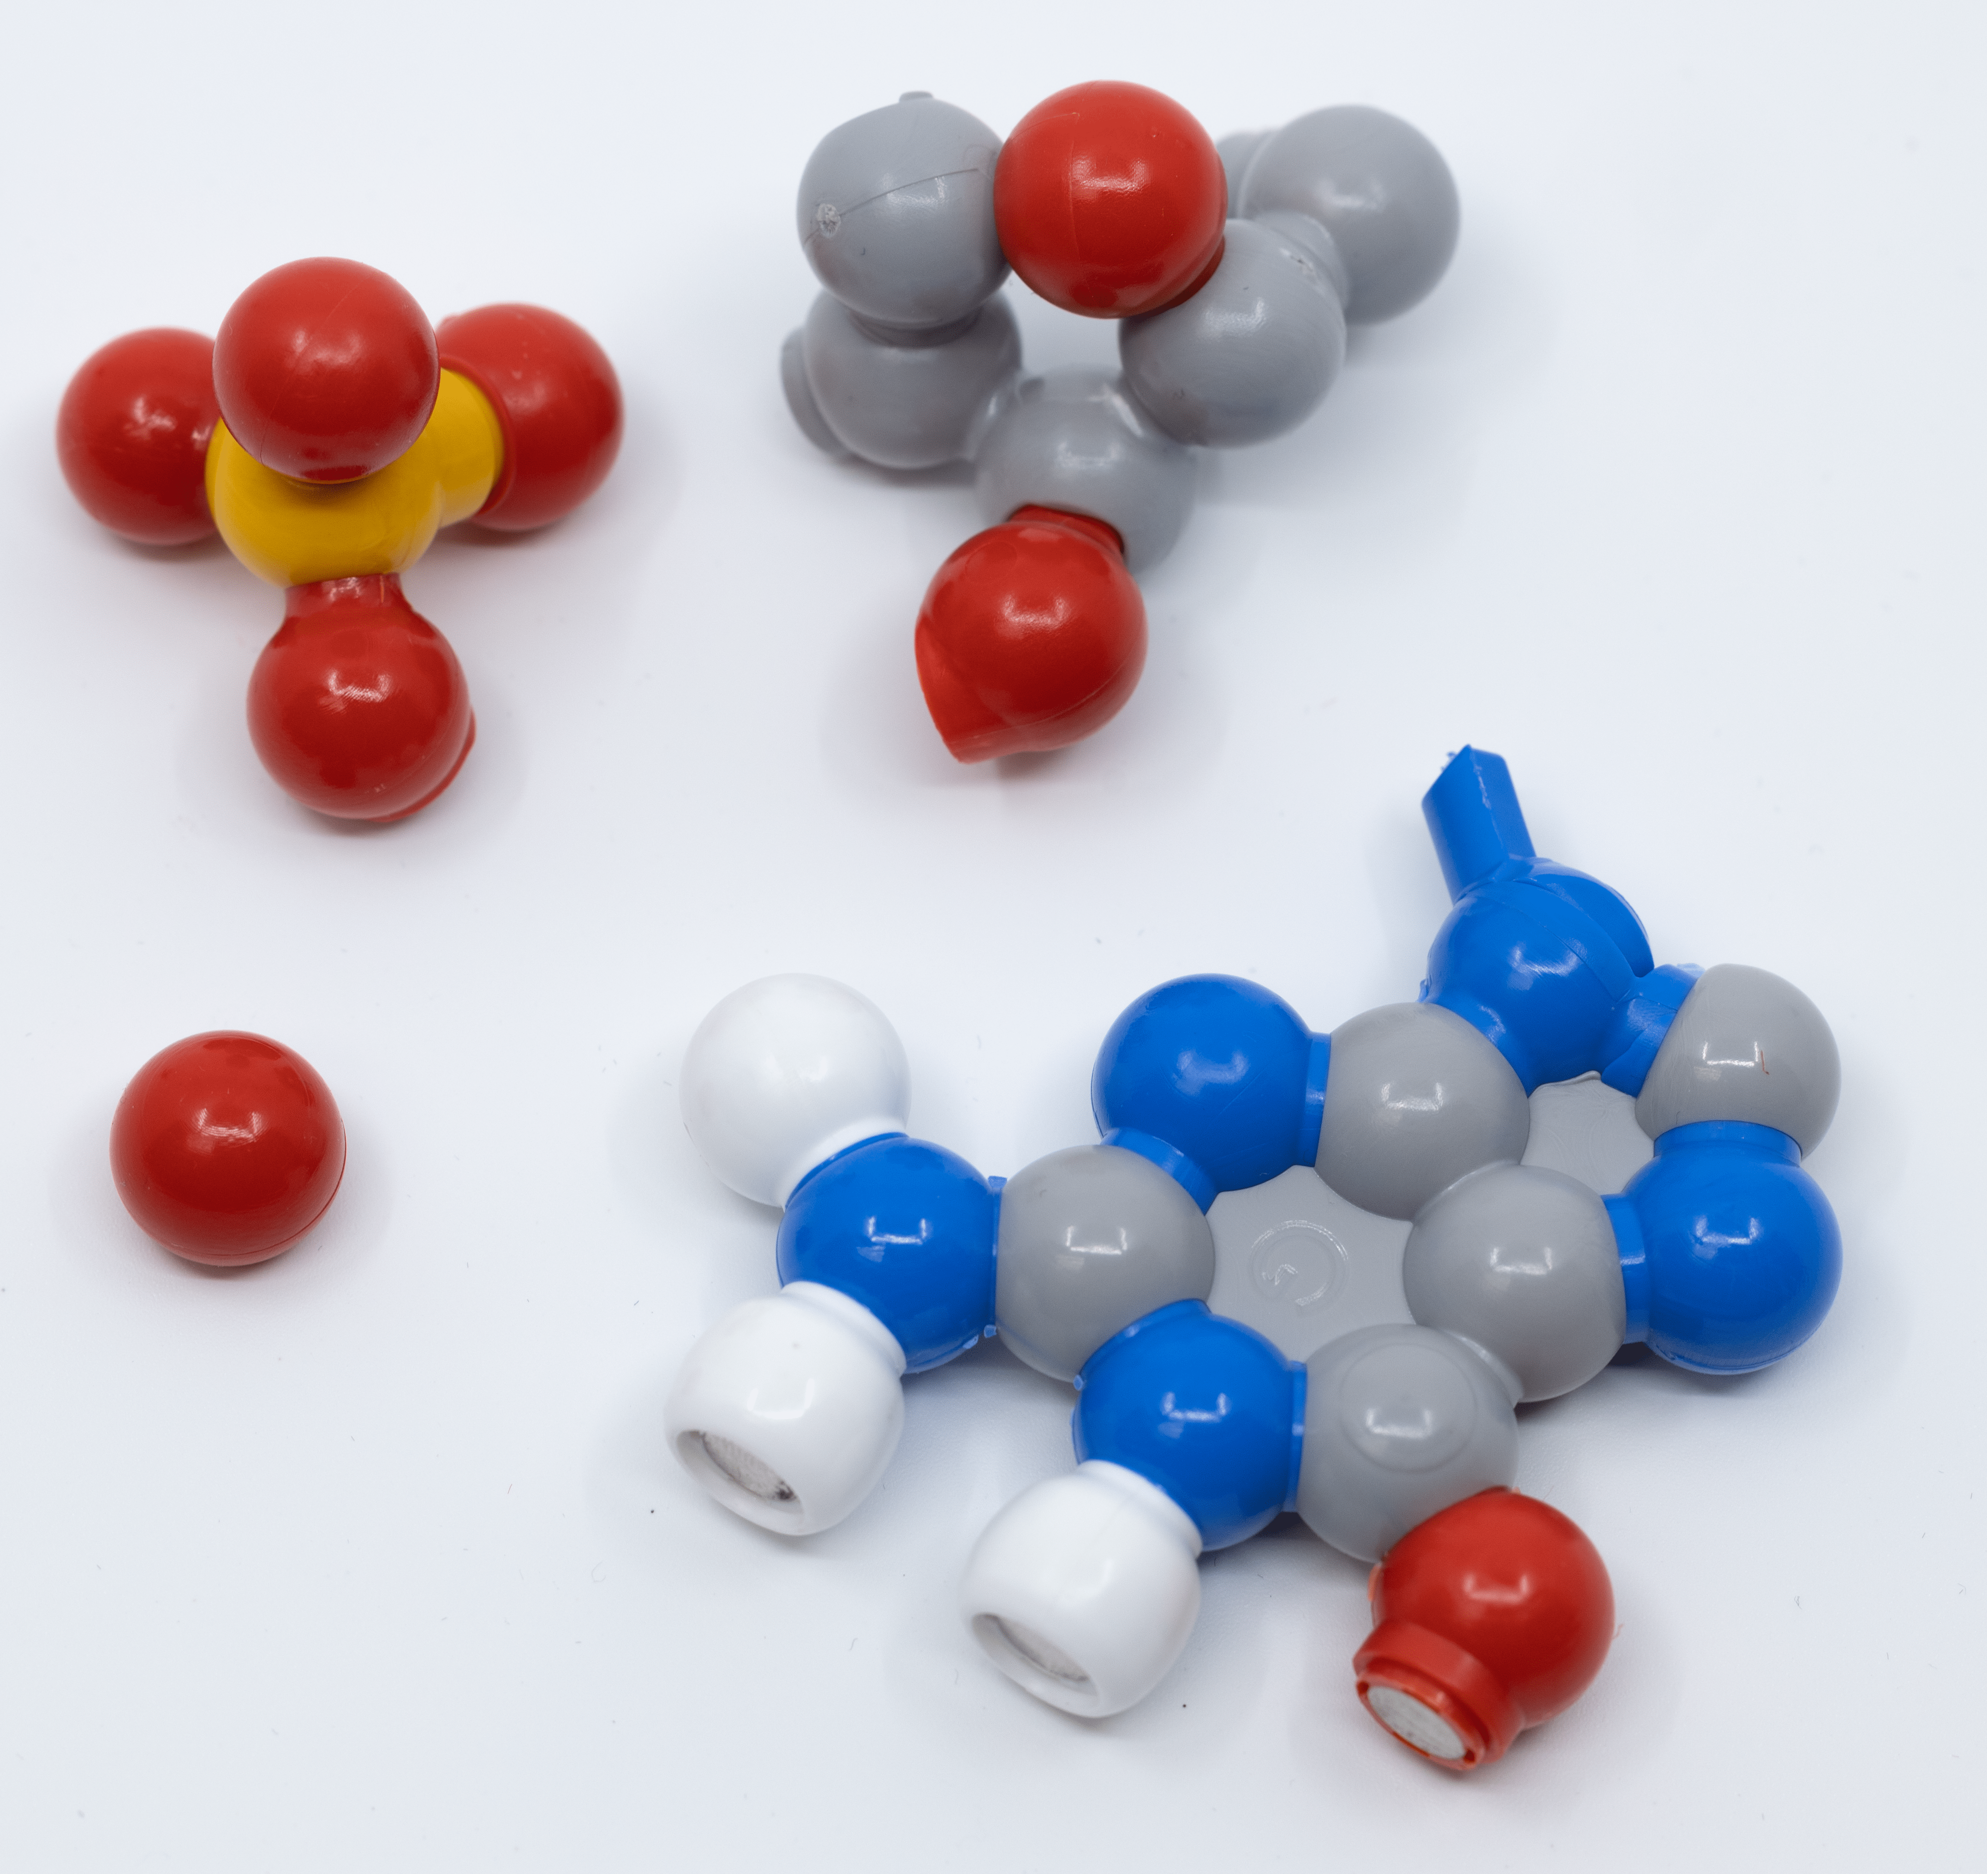

Slide 13
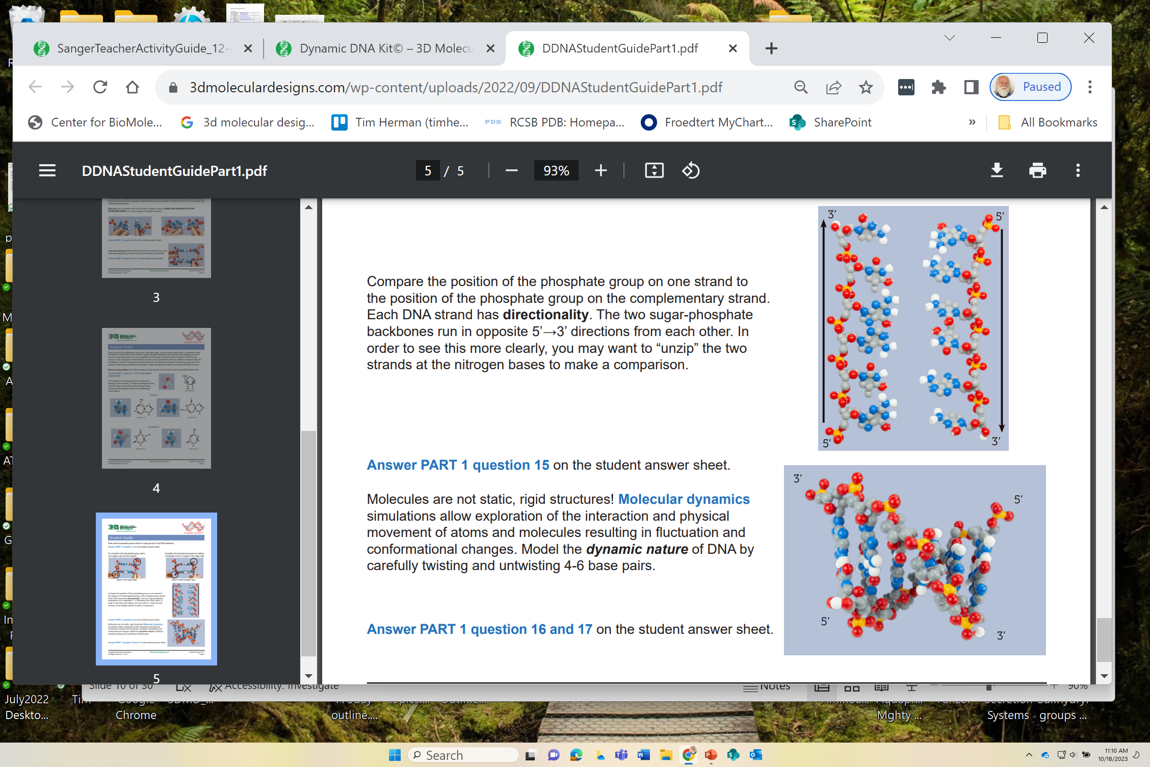

Slide 14
And now,…. EPIGENETICS
In epigenetics, both histones and DNA
are chemically modified…
…to regulate gene expression.
Cytosine (C) is methylated…
only if it is followed by Guanosine
5’…..CpG…..3’

Slide 15
Let’s go beyond teaching the WHAT….
… and start and start teaching the…
HOW? There are enzymes called methylases
WHEN? Sometimes,…. Life is complicated
WHY? To impact the binding of transcription factors and to
regulate gene expression

Slide 16
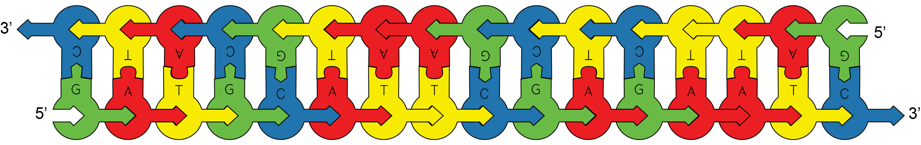
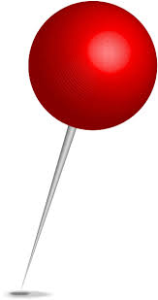
Find a 5’…CpG…3’ -- and stick a pin in the C
Then find a 5’…CpG…3’ in your Dynamic DNA model

Slide 17
In epigenetics, the #5 carbon is methylated.
Find a CpG in your Dynamic DNA … and put a methyl group (sparkly hat) on the #5 carbon.

Slide 18
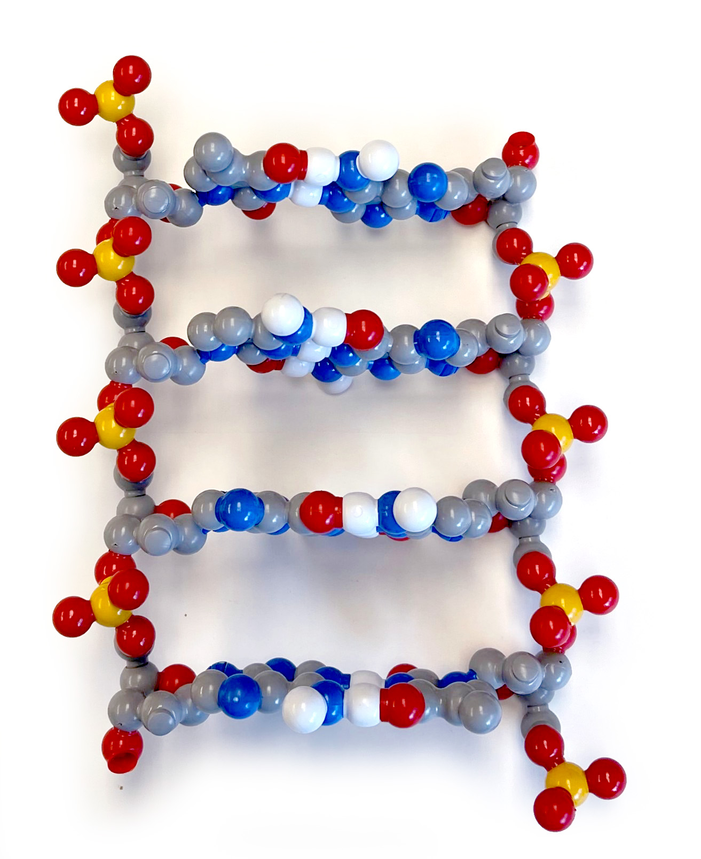
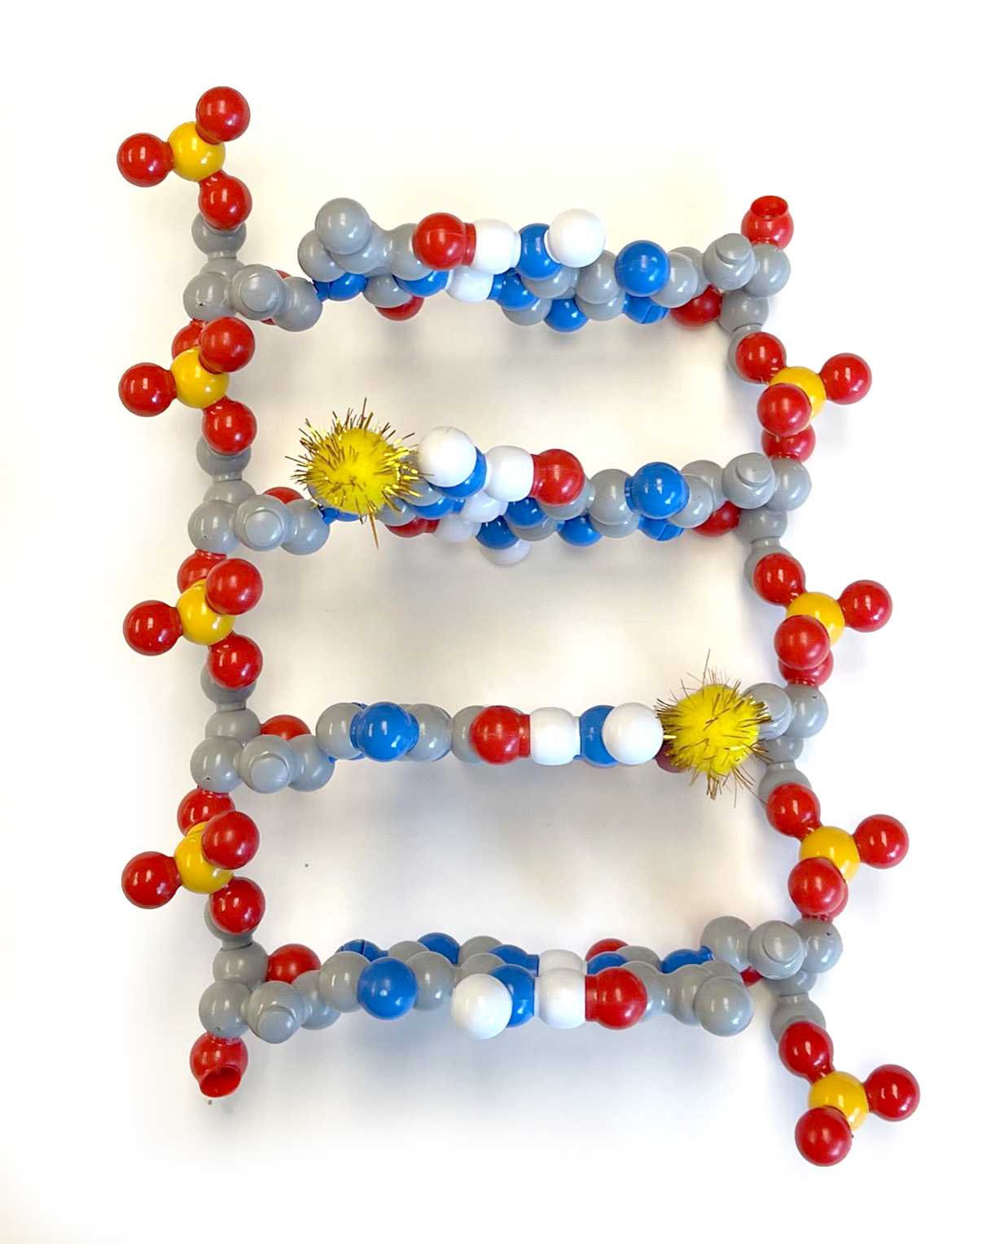
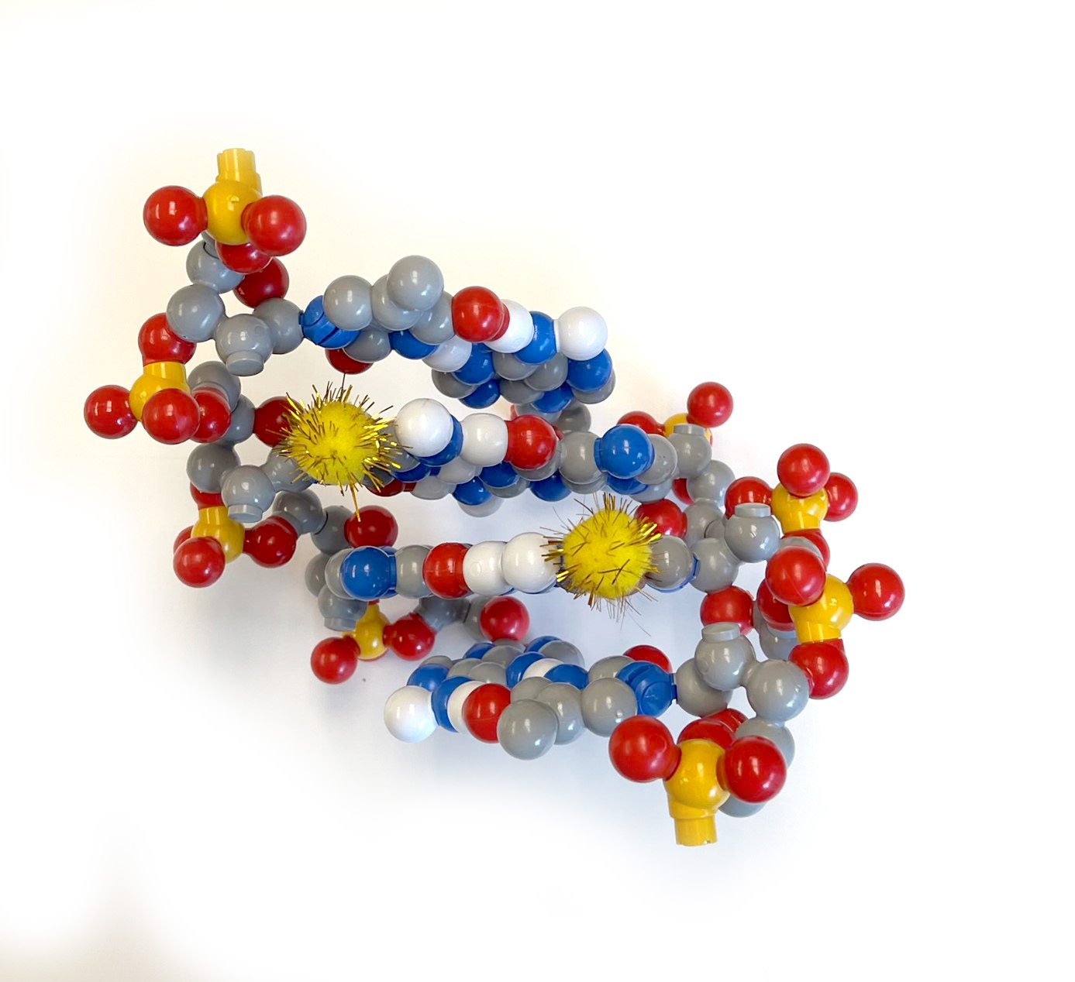
G
C
G
p
p
p
C
G
C
…and both methyl groups will end up in the major groove
Whenever you find 1 CpG…
…you will find a second
CpG in the opposite strand

Slide 19
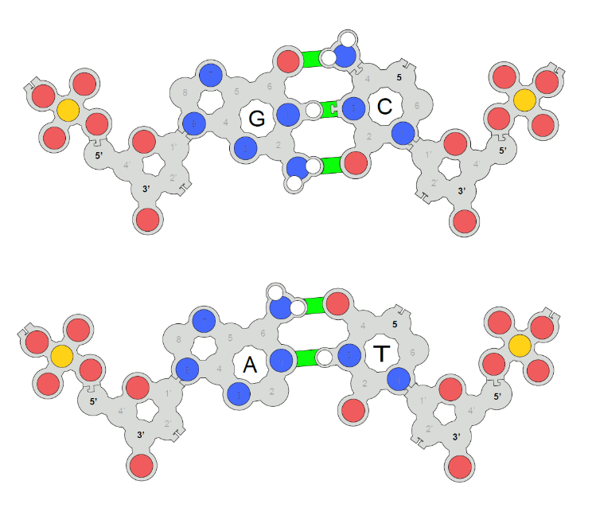
U

Slide 20
Where have all the CpG’s gone? … long time passing.
You would expect to find a CpG dinucleotide every 16 basepairs of random sequence
You actually find only 1 CpG dinucleotide every 100 base pairs in the human genome.

Slide 21
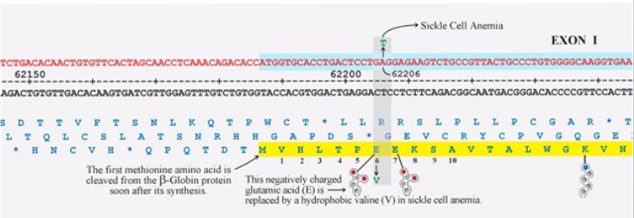

Slide 22
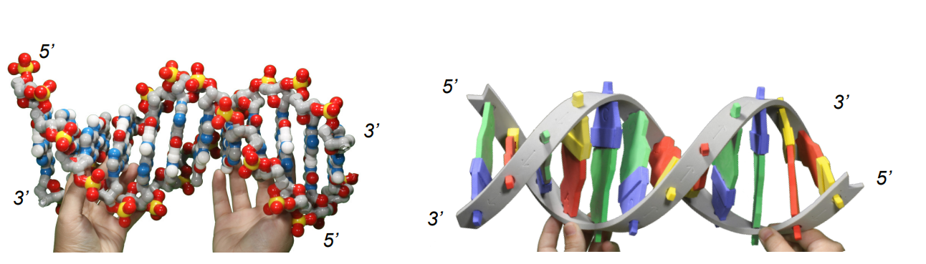

Slide 23
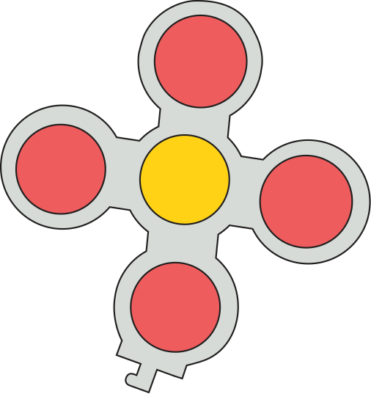
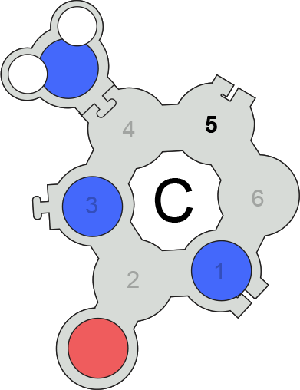
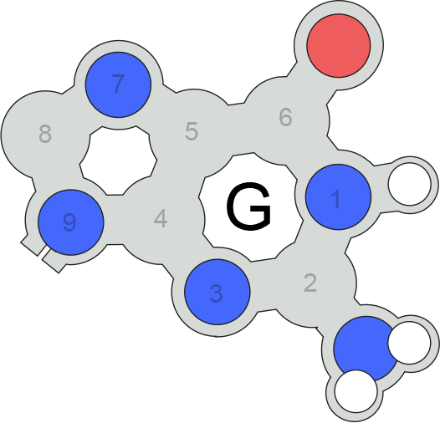
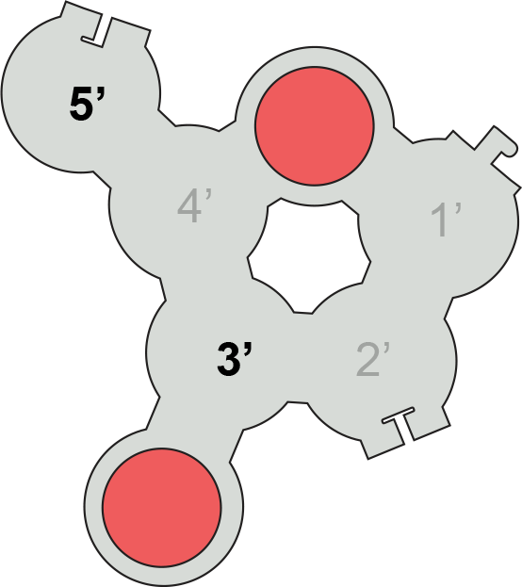
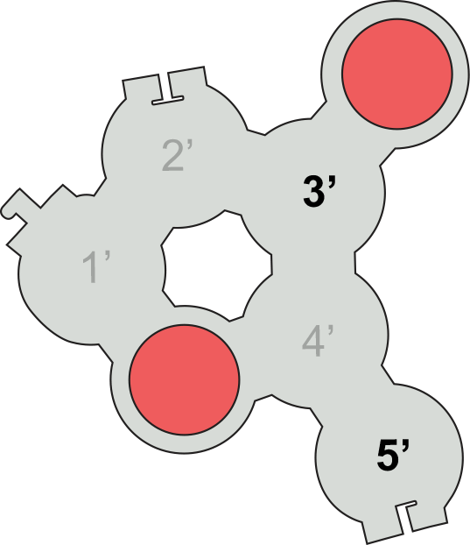
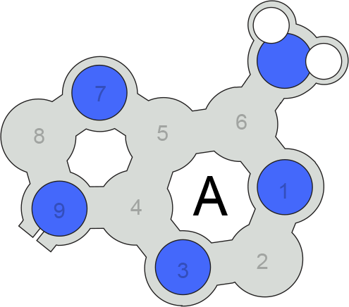
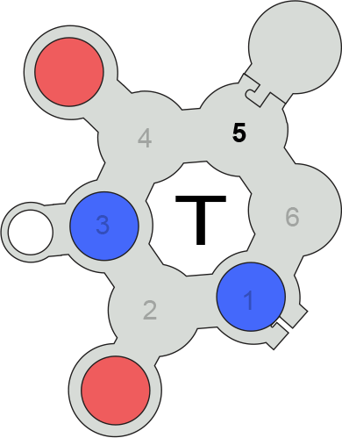
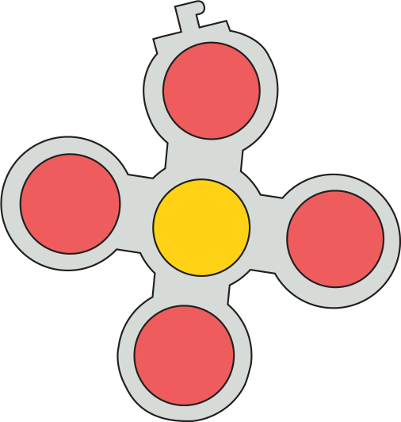

Slide 25


