Slide 1
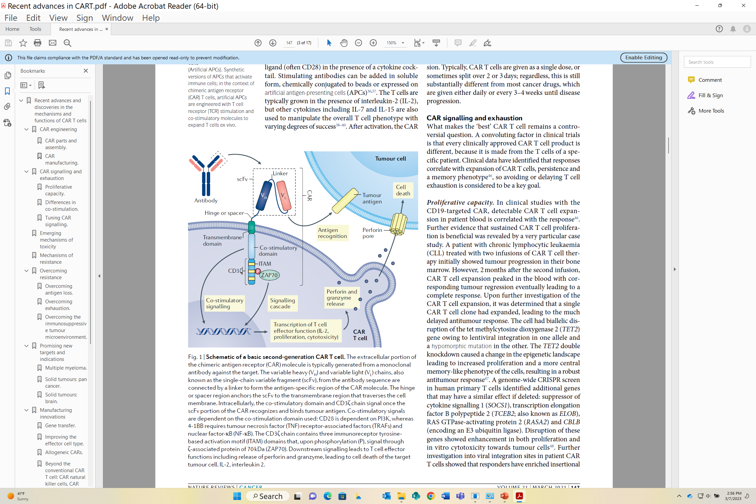
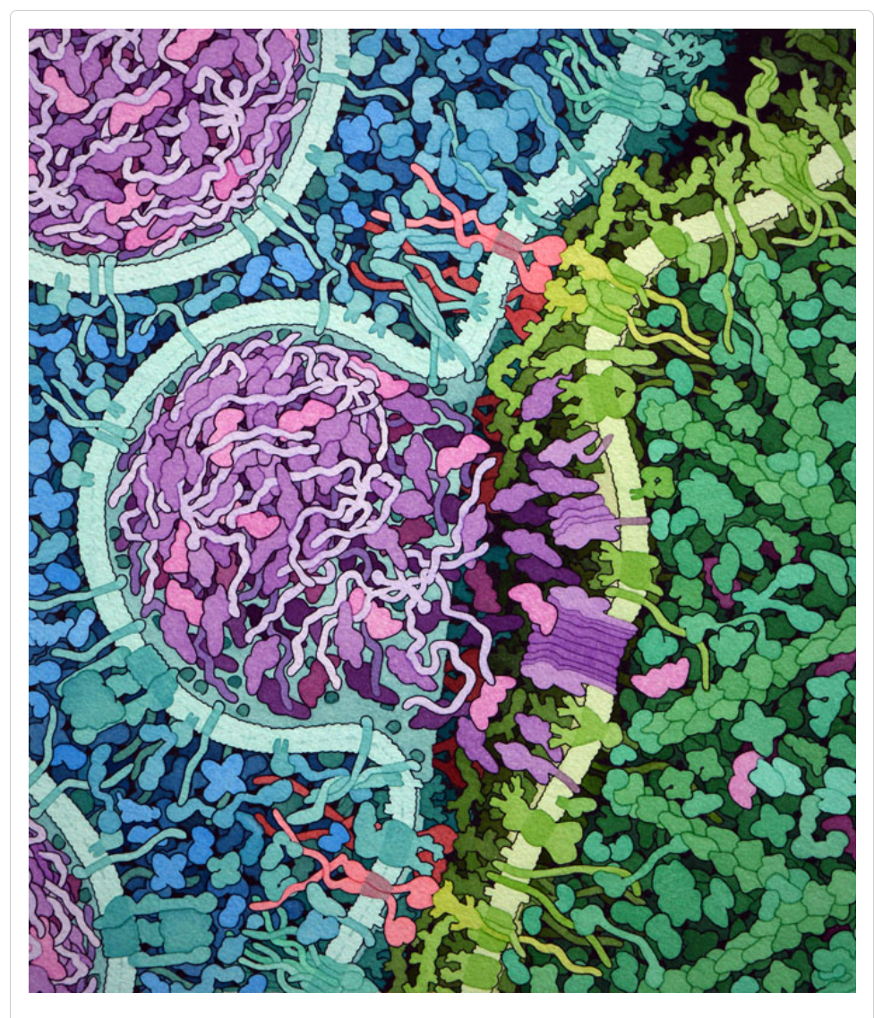
Living Drugs: fighting cancer with CRISPR-engineered CAR-T cells.
Tim Herman
3D Molecular Designs

Slide 2
Workshop Outline
Cancer Immunotherapy
Supercharging our own immune systems…
Connecting the dots…..
  CRISPR-Based Genome Editing… just finished
  Tomorrow’s Science Today… coming soon
An NIH SEPA project -- focused on infectious diseases
What is a CAR-T Cell,… and how do we make them?

Slide 3
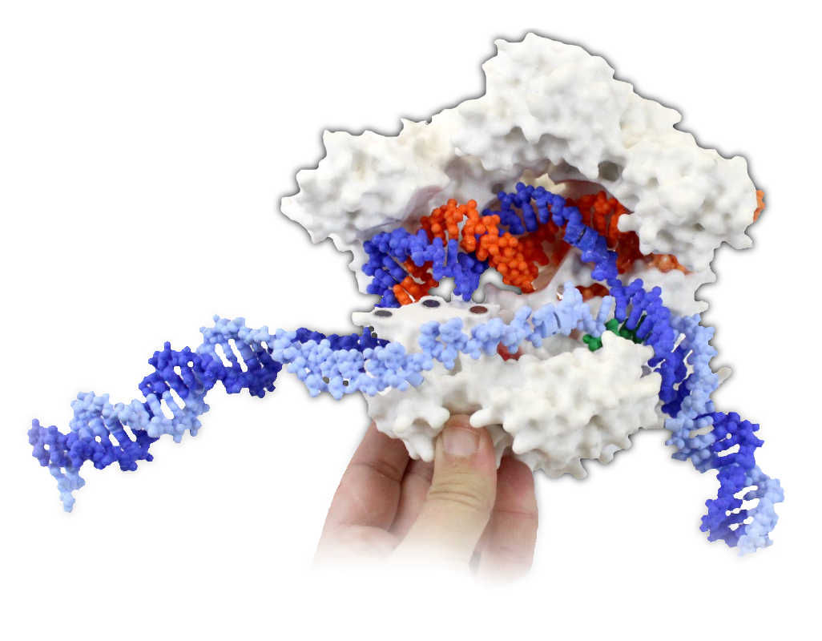
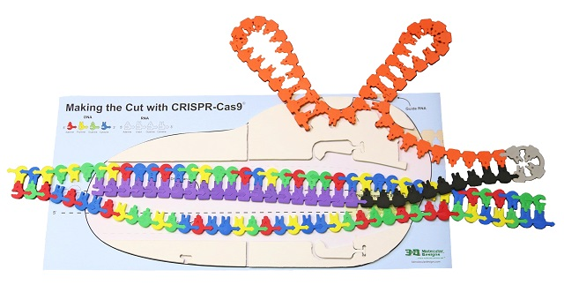
Just completed….a 5-year NIH-SEPA project focused on:
The Science and Ethics of CRISPR-based Genome Editing
New tools that will be used to engineer proteins…. and cells.
CRISPR II: Using Cas9 as a Genome Editing Tool ---- at 1:20pm on Saturday

Slide 4
Coming soon,… to a workshop near you.
Tomorrow’s Science Today: preparing for the next pandemic.
A new NIH SEPA project focused on infectious diseases
New Instructional Materials
  Models, models and more models….
    A Virus Collection,.. including CoV-2
    Antibodies/vaccines /and your immune system
    mRNA vaccines and multi-valent, ultra-potent vaccines…from synthetic biology.
T-Cells
CAR-T Cells
    Stories, stories and more stories….
A Professional Learning Experience…beginning in the summer of 2024
But first,…enroll now in Modeling the Molecular World, 2023
Session 1 -- June 26-30, or
Session 2 -- July 17 - 21

Slide 5
STEM….
Engineering… allows us to:
* design an effective mRNA vaccine for CoV-2
* design supercharged T-cells to fight cancer
Science… provided us with the nucleotide sequence of the CoV-2 spike protein…. and the field of molecular immunology
How can you incorporate principles of
engineering design into your science classroom?
Teaching mRNA Vaccines – and the future of therapeutic RNAs – Friday at 10:40 am

Slide 6
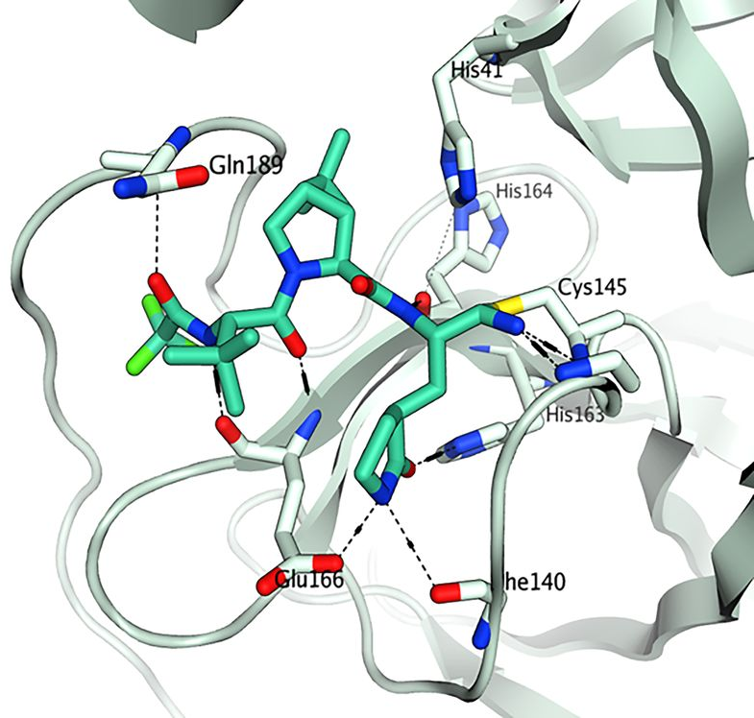
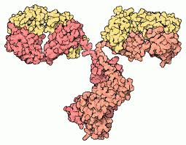
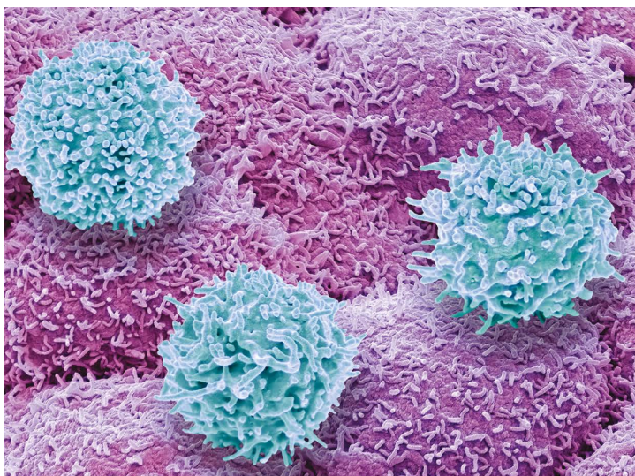

Drugs,… Yesterday,… Today,… and Tomorrow
Small Molecules
Biologics
Living Drugs

Slide 7
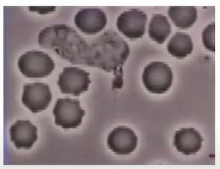
Deciphering CAR-T Cells: Exploring Functional Mechanisms to Drive Next Generation Immunotherapy
A video…featuring Wendell Lim…
https://youtu.be/EAA-aSEZasw
start viewing at 24:20 … or at 31:30
https://www.youtube.com/watch?v=EAA-aSEZasw

Slide 9
Artistic illustration of an engineered T cell (on the left side in blue) recognizing and attacking a leukemia cell (on the right side in green). The CAR molecule is shown in red, bound to CD19 on the leukemia cell. This has led to activation of the T cell, which releases perforin (purple), forming pores in the cell surface. Granzymes (magenta) then enter through the pore and initiate apoptosis to kill the cancer cell.

Slide 10
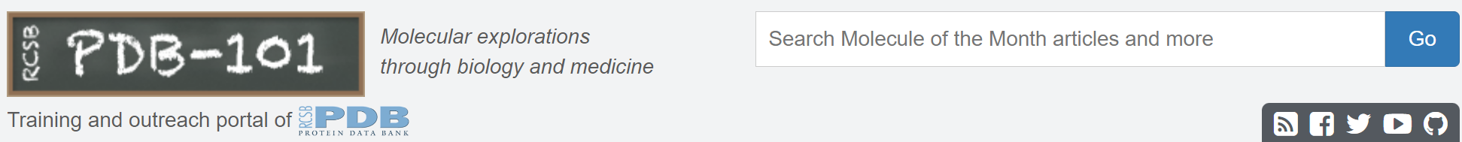
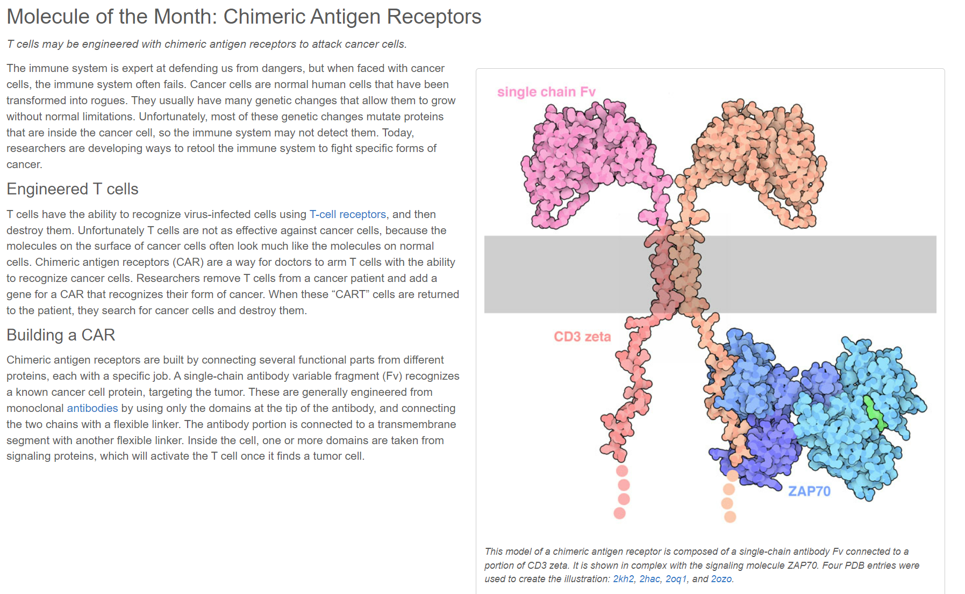

Slide 11
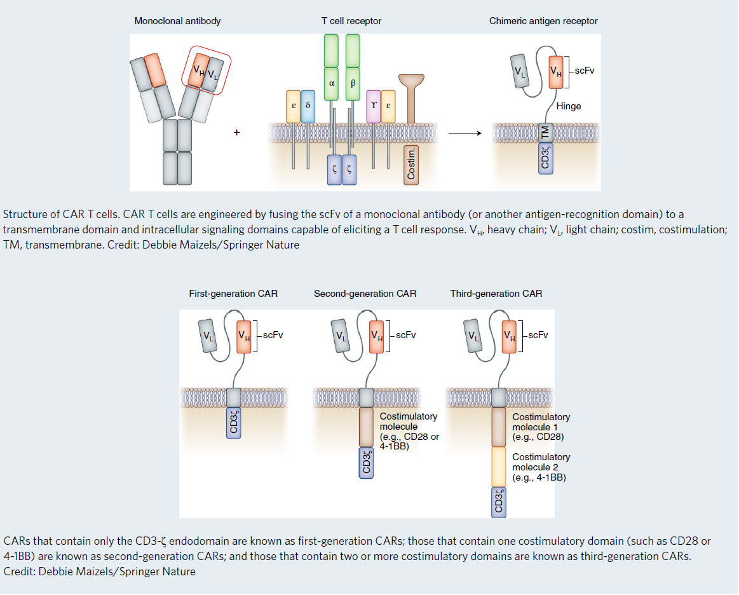

Slide 12
Perforin

Slide 13
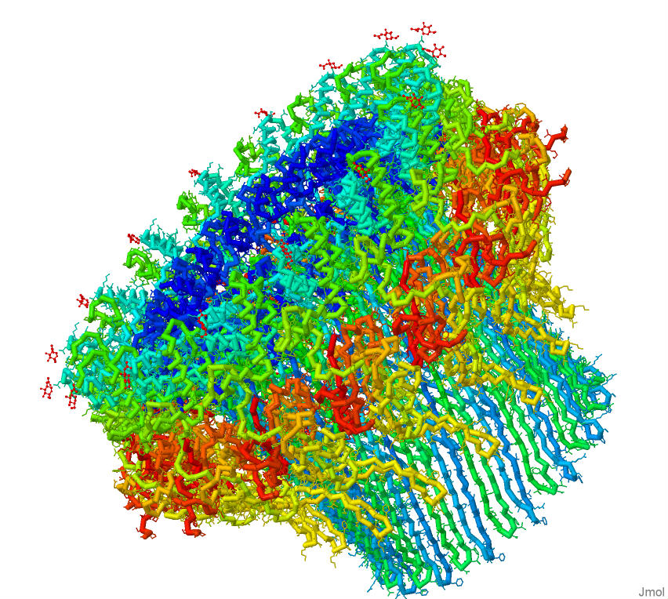
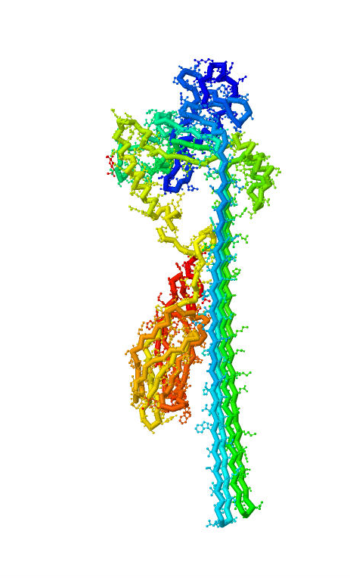
How T-cells kill….
X 17 =
Perforin
models give meaning to words…

Slide 14
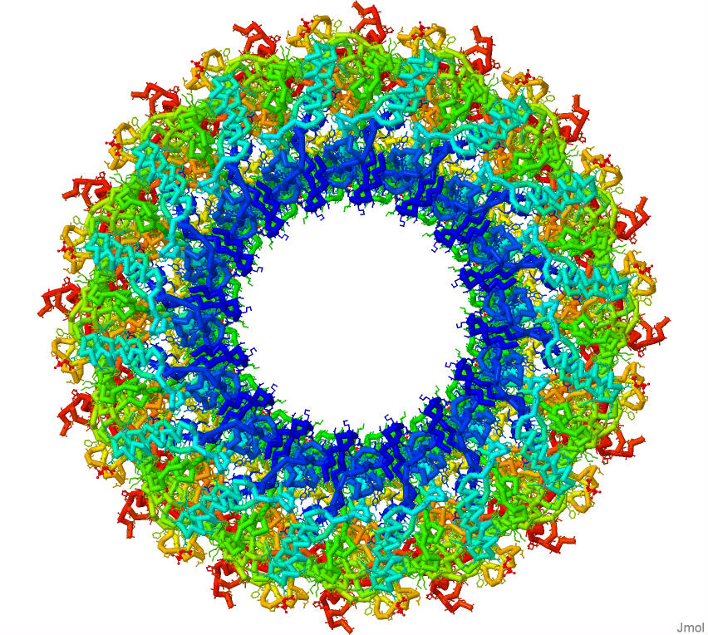
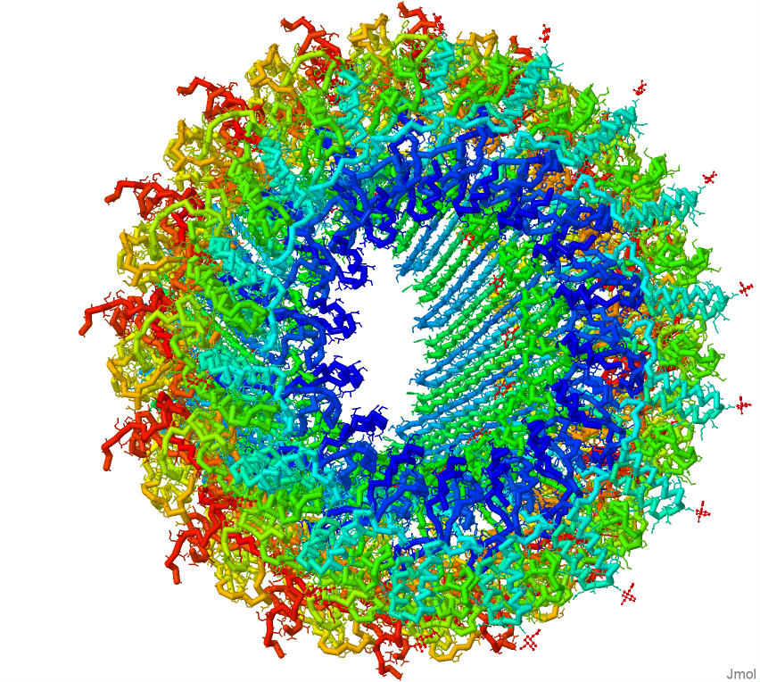
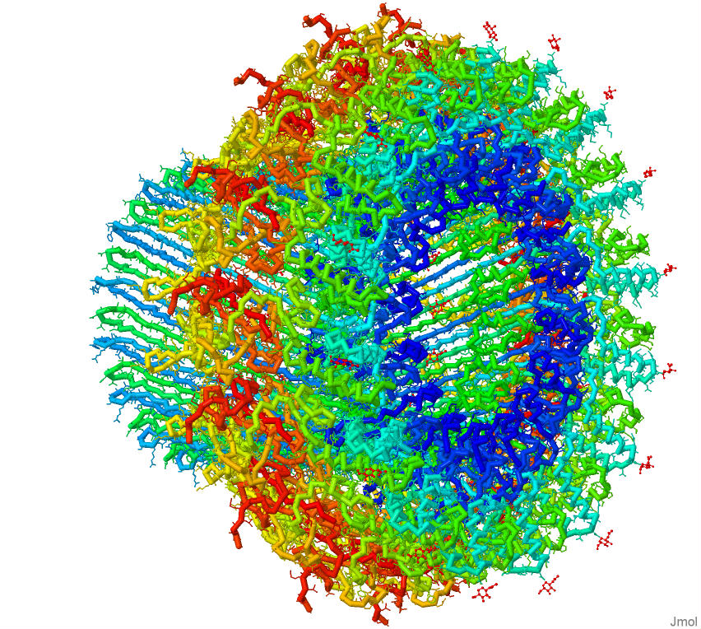
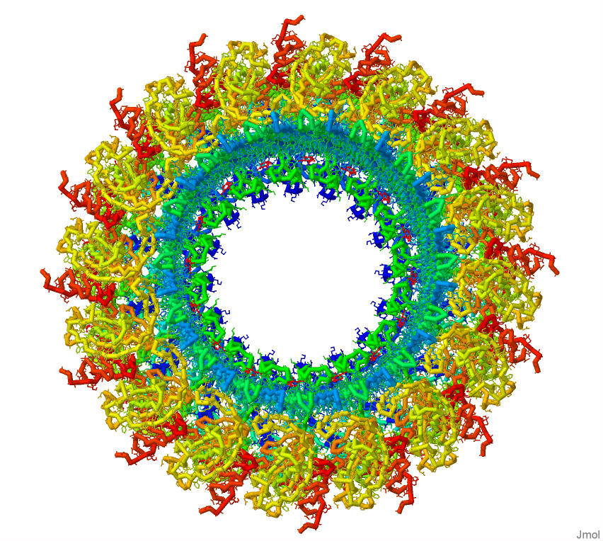
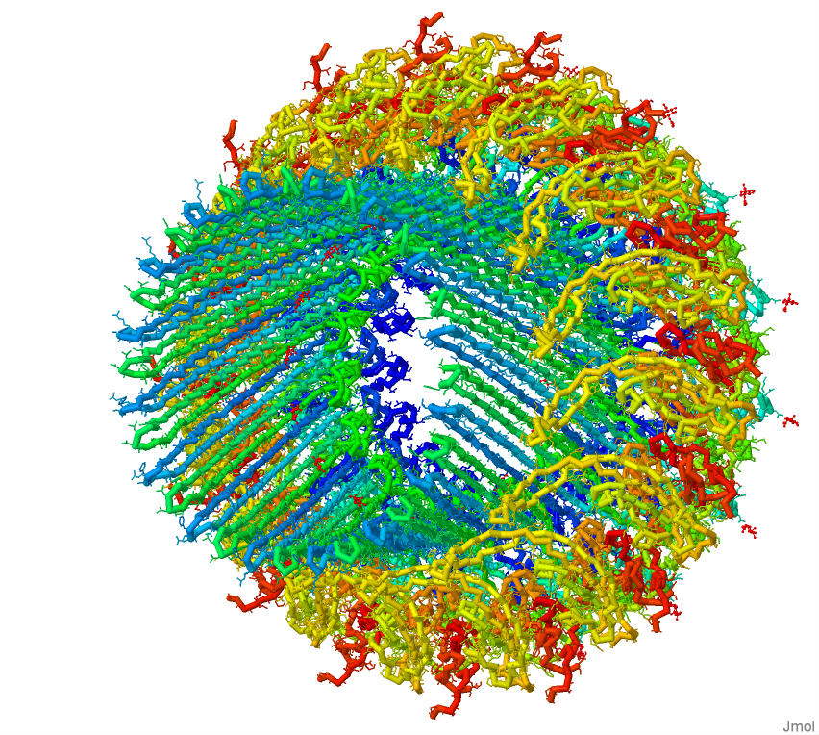
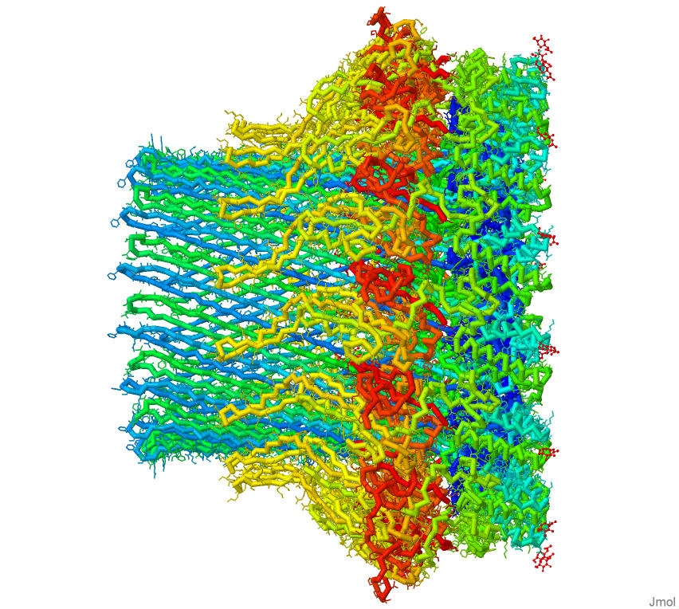

Slide 15
Models make it real….
T-cells deploy perforin … which spontaneously assembles into a tube that punches a hole in the cancer cell … through which granzymes enter to trigger apoptosis of the cancer cell.
Is science cool,… or what?

Slide 16


Slide 17
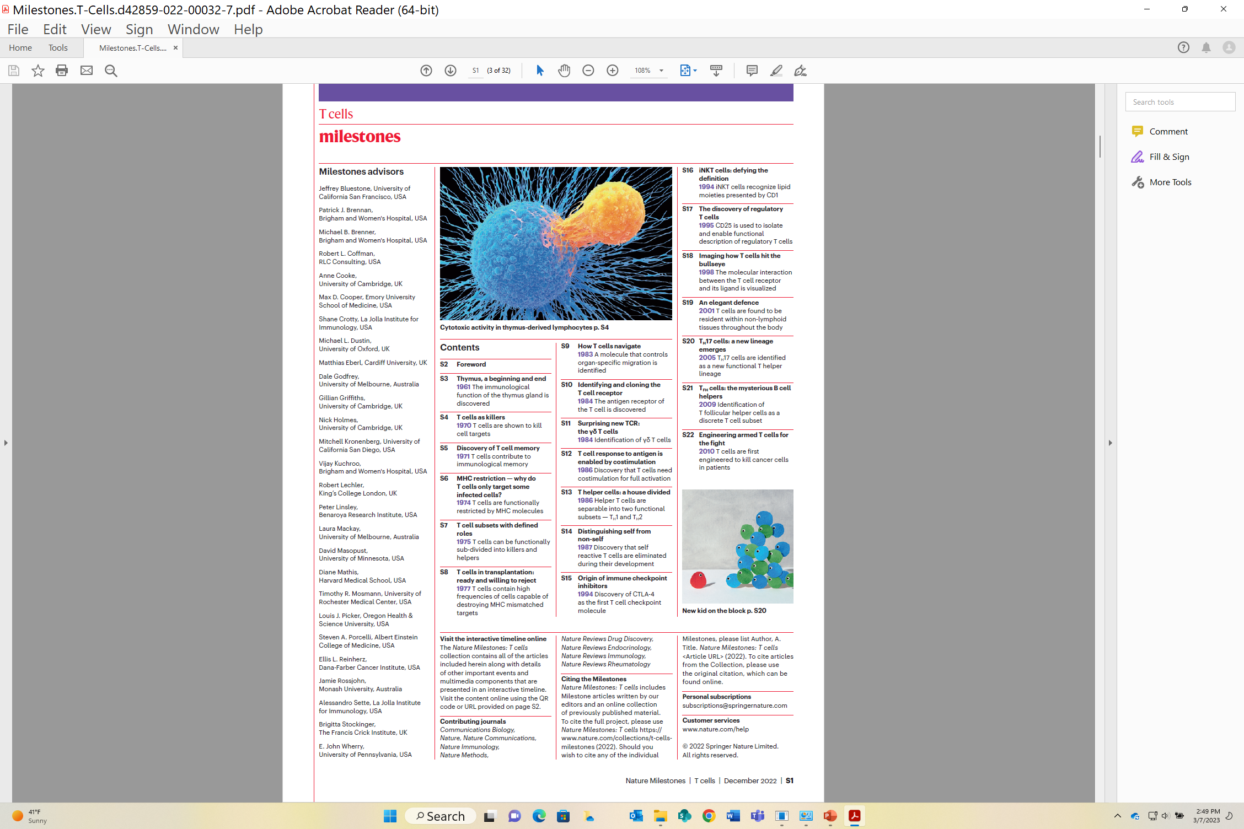

Slide 18
Coming soon,… to a workshop near you.
Tomorrow’s Science Today: preparing for the next pandemic.
An NIH SEPA project.
New Instructional Materials
  Models, models and more models….
    A Virus Collection,.. including CoV-2
    Antibodies/vaccines /and your immune system
    mRNA vaccines and multi-valent, ultra-potent vaccines…from synthetic biology.
    Stories, stories and more stories….
A Professional Learning Experience…beginning in the summer of 2024
But first,…enroll now in Modeling the Molecular World, 2023
Session 1 -- June 26-30, or
Session 2 -- July 17 - 21

Slide 19


Slide 20
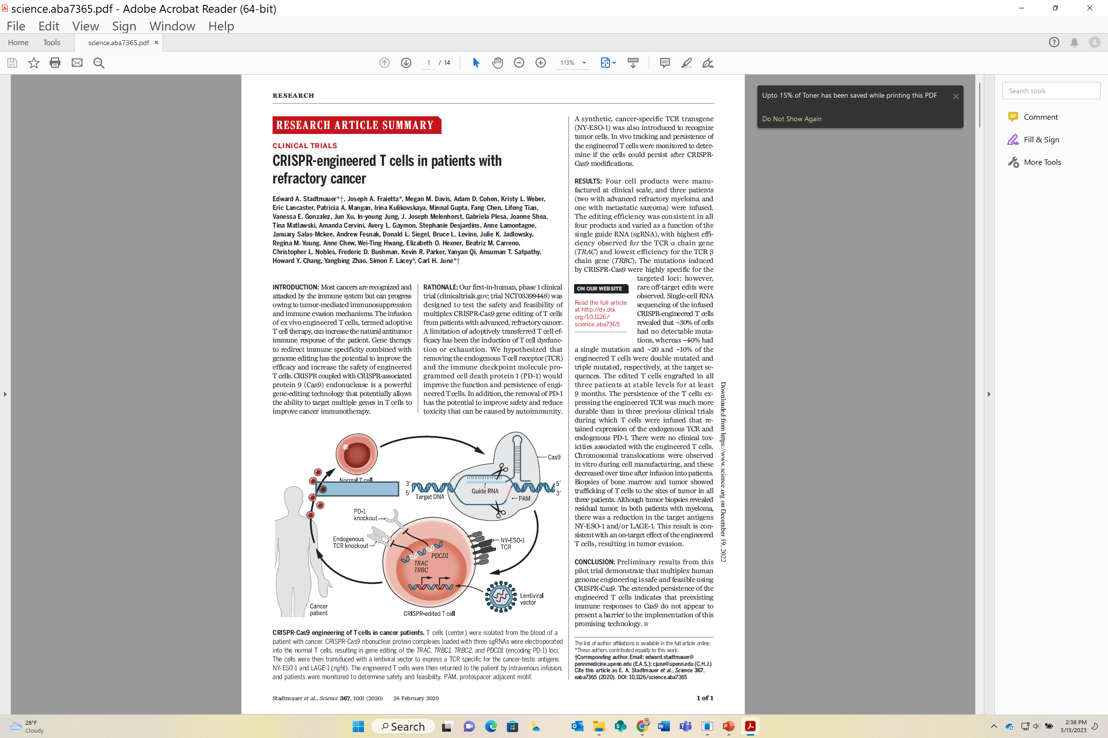

Slide 21
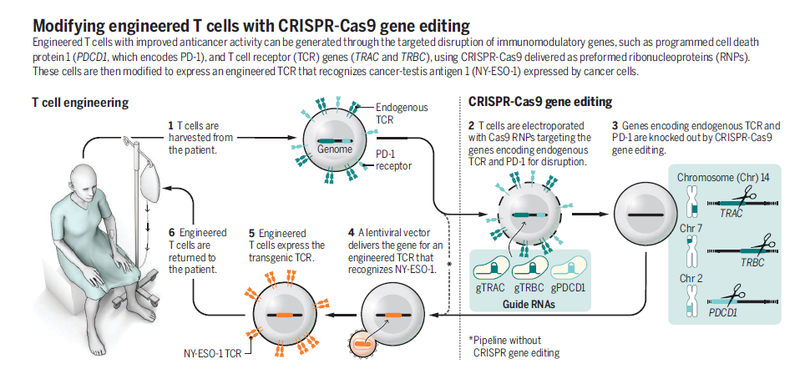

Slide 22
