Slide 1
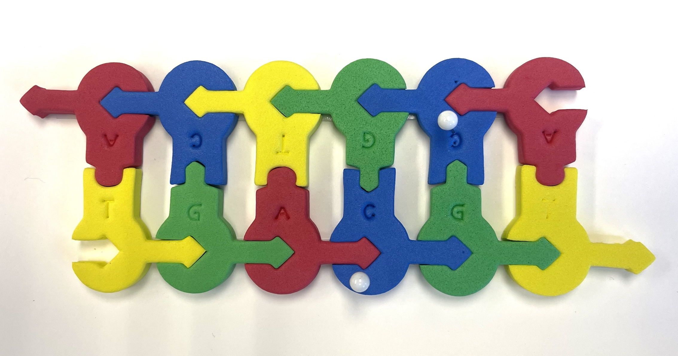
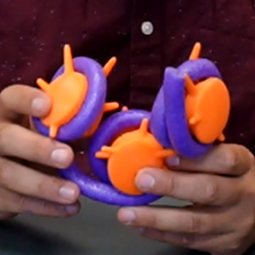
Epigenetics
… tweaking your genetic destiny
Tim Herman

Slide 2
What is Epigenetics?
Epigenetics is the study of how your behaviors and environment can cause changes that affect the way your genes work. Unlike genetic changes, epigenetic changes are reversible and do not change your DNA sequence, but they can change how your body reads a DNA sequence.
NO MORE
EXCUSES
Don’t blame it on genes

Slide 3
Workshop Outline
Epigenetics…chemical modifications of your genome
  Writers / Erasers / Readers
1. Histone modifications
2. DNA modifications
  … methylation of CpG
  … a 3-D structure/function story

Slide 5
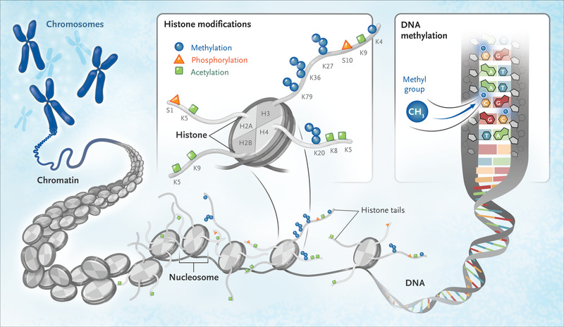

Slide 6
Post-translational modification of histones

Slide 7
Post-translational modifications of histones…
CAUTION…rabbit holes ahead!

Slide 8
Modeling chromatin….

Slide 9
Post-transcriptional modification of DNA
Methylation of CpG …. to CMepG
5’- C p G – 3’

Slide 10
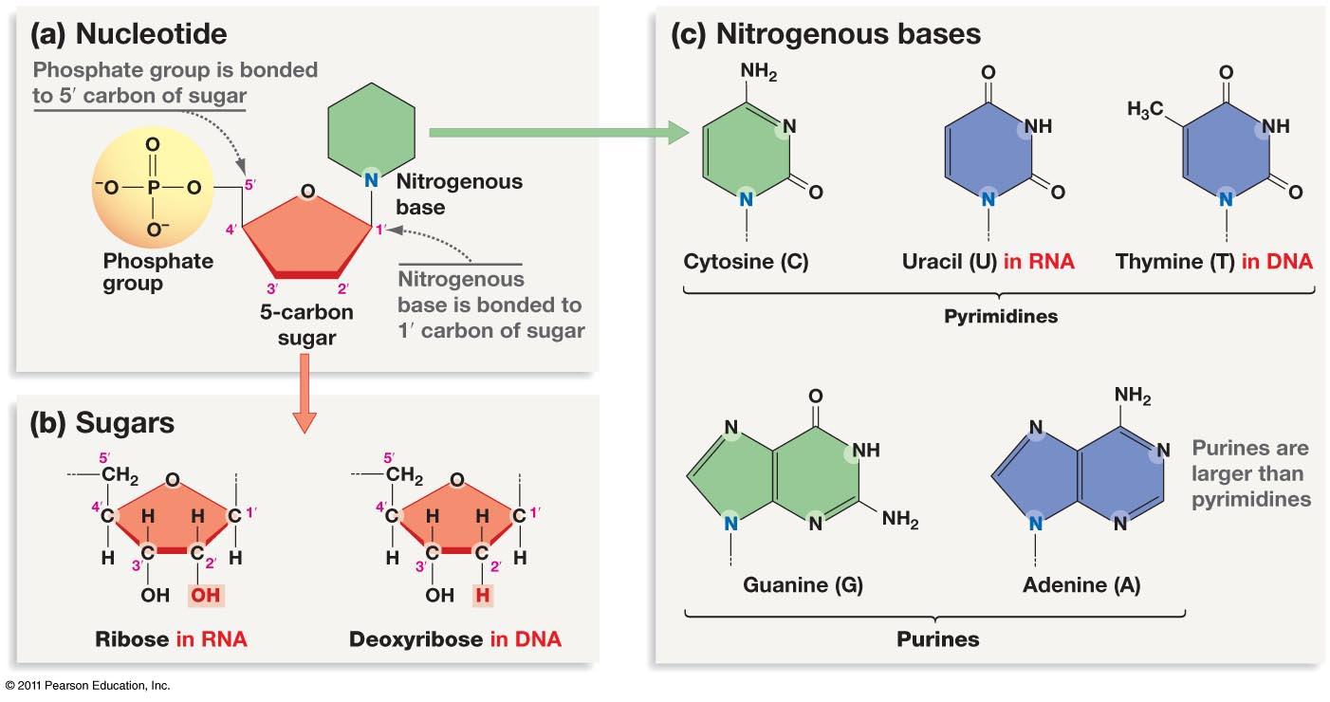

Slide 11
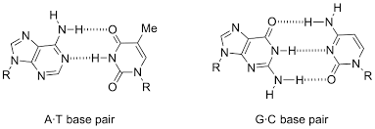
G
C
A
T

Slide 12
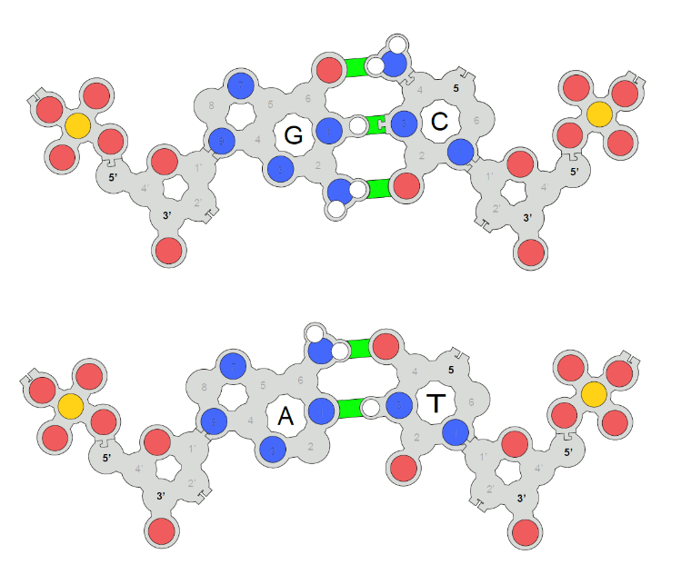

Slide 13
Looking for CpG’s….

Slide 14
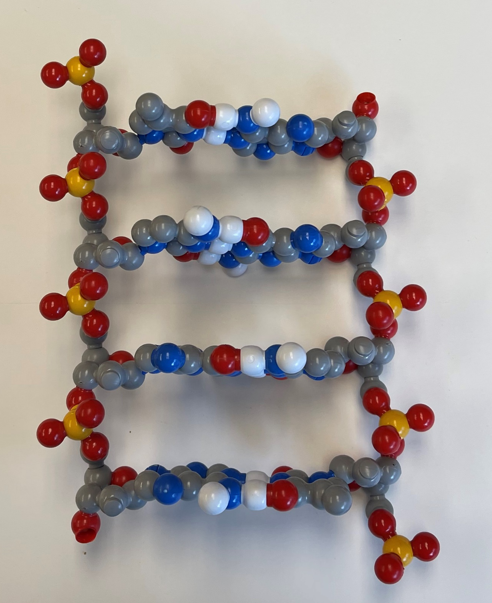
5’
3’
T
A
C
G
G
C
A
T
3’
5’

Slide 15
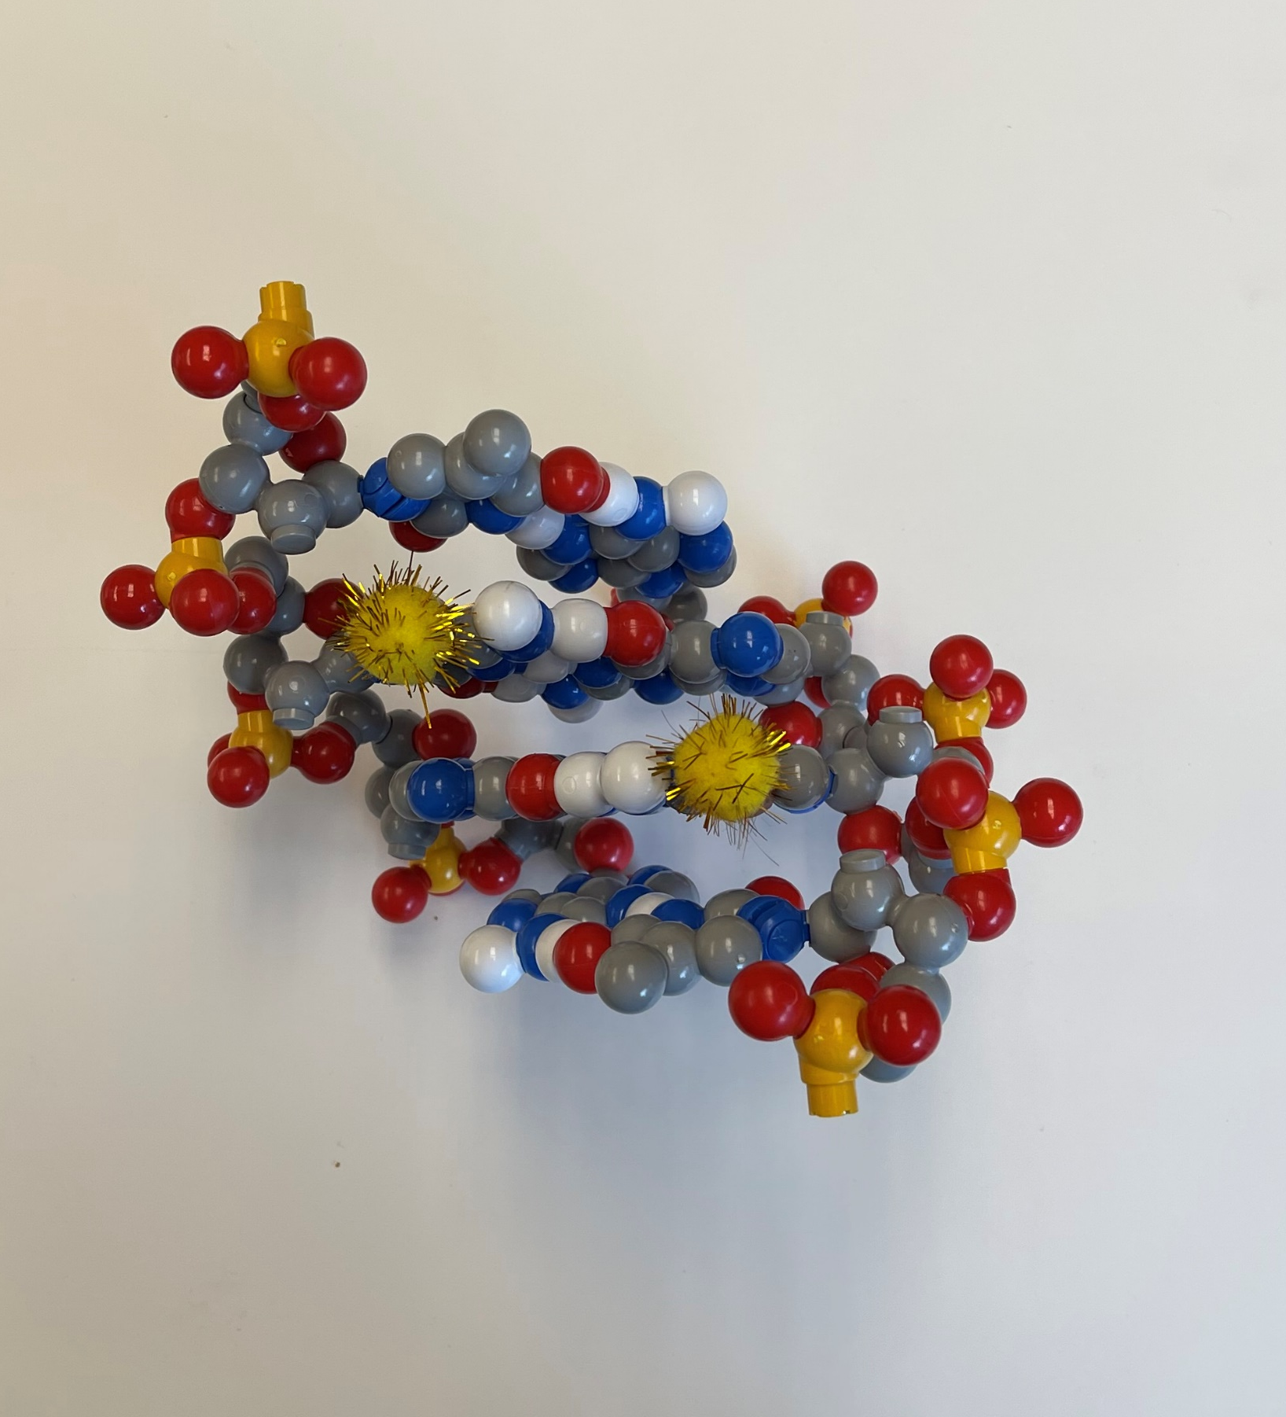
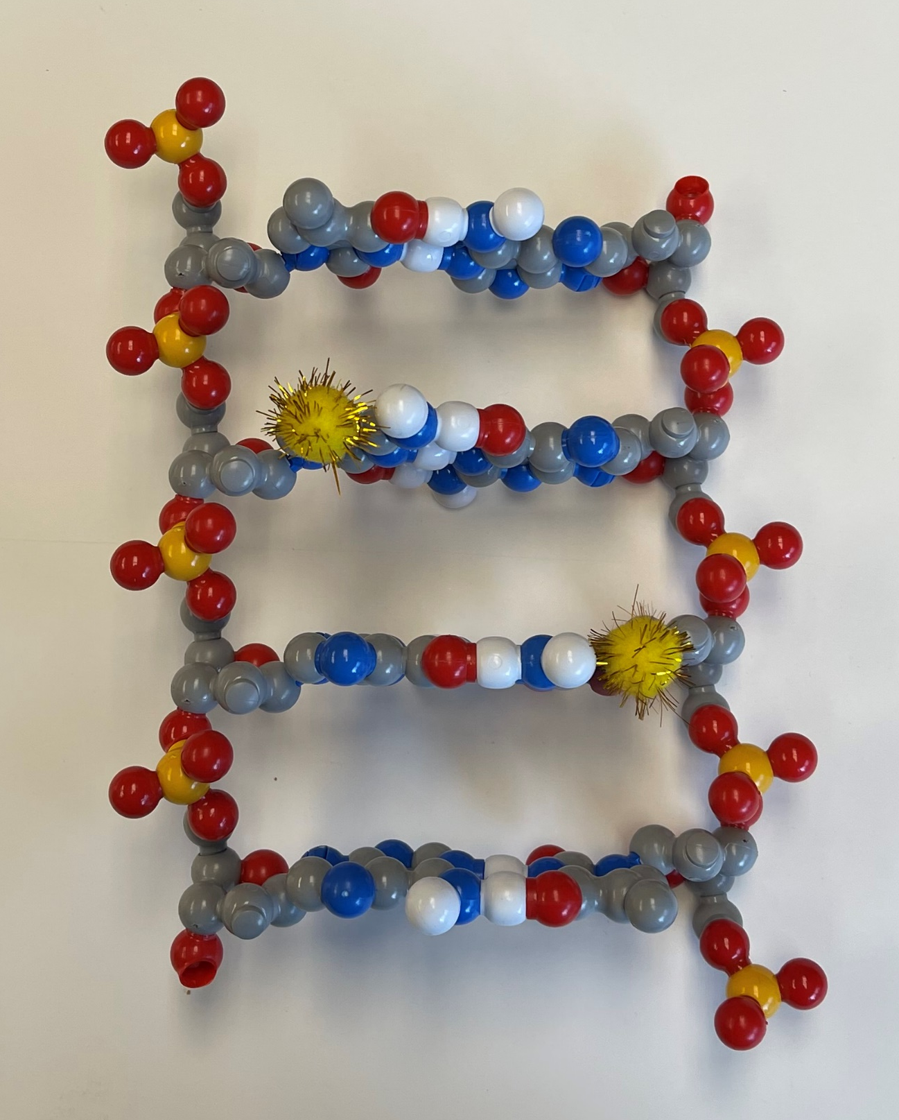

Slide 16
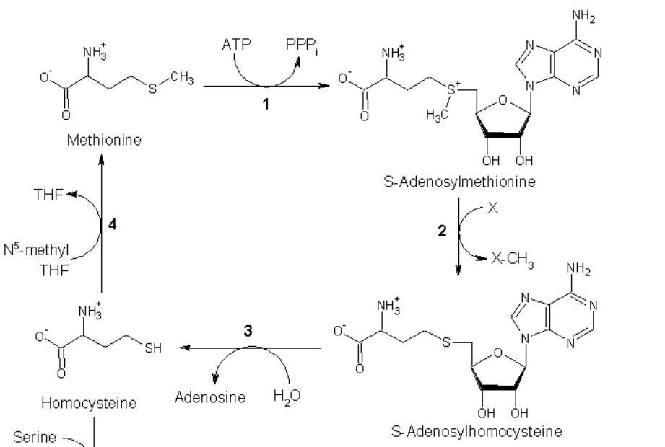
Methionine…. is a methyl-group donor

Slide 17
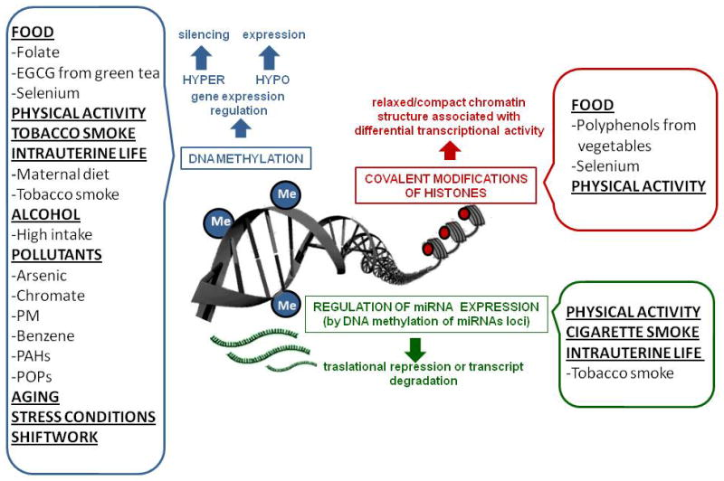

Slide 18
Fragile X Syndrome …. a genetic/epigenetic disorder??
X linked triplet repeat (CGG) expansion disorder
Fragile X patients do not express FMR1 and have cognitive/autism spectrum disabilities
All human genomes have CGG repeats in FMR1 5’ untranslated region
Cytosines tend to become methylated at high repeat number ( epigenetic modification!
Methylation of cytosines inhibits transcription of FMR1
CAUTION…rabbit hole ahead!

Slide 19
Histone / DNA cross-talk?
Yes…

Slide 20
What’s CRISPR got to do with it??
Shin H, Choi WL, Lim JY, Huh JH (March 2022). "Epigenome editing: targeted manipulation of epigenetic modifications in plants". Genes & Genomics. 44 (3): 307–315. doi:10.1007/s13258-021-01199-5. PMID 35000141. S2CID 245848779.

Slide 21
Coming soon,… to a workshop near you.
Tomorrow’s Science Today: preparing for the next pandemic.
An NIH SEPA project.
New Instructional Materials
  Models, models and more models….
    A Virus Collection,.. including CoV-2
    Antibodies/vaccines /and your immune system
    mRNA vaccines and multi-valent, ultra-potent vaccines…from synthetic biology.
    Stories, stories and more stories….
A Professional Learning Experience…beginning in the summer of 2024
But first,…enroll now in Modeling the Molecular World, 2023
Session 1 -- June 26-30, or
Session 2 -- July 17 - 21

Slide 22
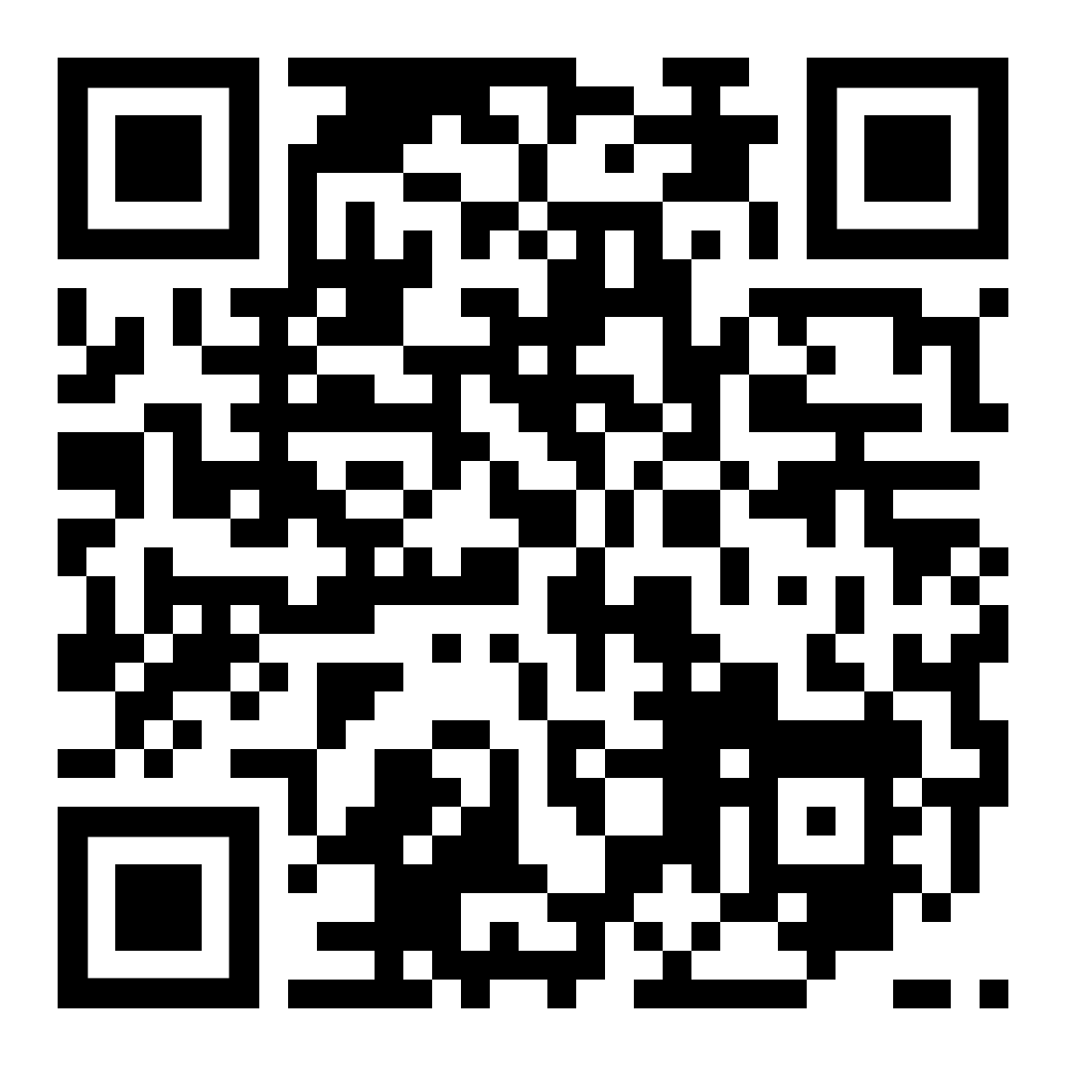

Slide 26
WHY…did T replace U in DNA?
spontaneous oxidative deamination of C
…if we had not switched…
AGUCGAAGUCAACCGAGGCUGCGCUAC
UCAGCUUCAGUUGGCUCCGACGCGAUG
U
AGUCGAAGU AACCGAGGCUGCGCUAC
x
UCAGCUUCA UUGGCUCCGACGCGAUG
G
A DNA repair system can remove “U” from DNA.
But,…how can we distinguish between a
“deaminated C” and a normal U?
ANSWER: We can’t.

Slide 27
WHY…did T replace U in DNA?
spontaneous oxidative deamination of C
…but after we switched…
AGTCGAAGTCAACCGAGGCTGCGCTAC
TCAGCTTCAGTTGGCTCCGACGCGATG
U
AGTCGAAGT AACCGAGGCTGCGCTAC
x
TCAGCTTCA TTGGCTCCGACGCGATG
G
Uracil glycosidase constantly scans the DNA….looking for U’s.
Any U … is a bad U…and should be repaired.

Slide 28
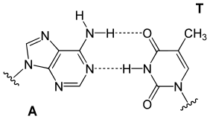
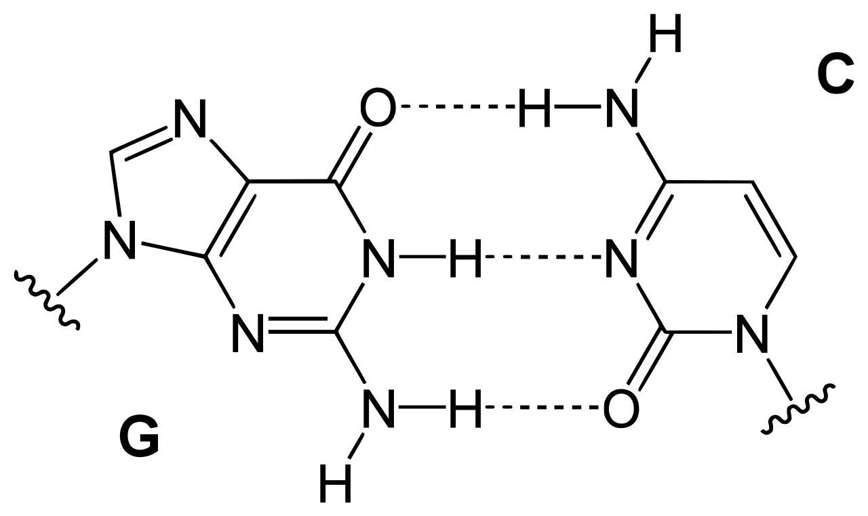
5
5
deoxyribose
deoxyribose
deoxyribose
deoxyribose

Slide 29




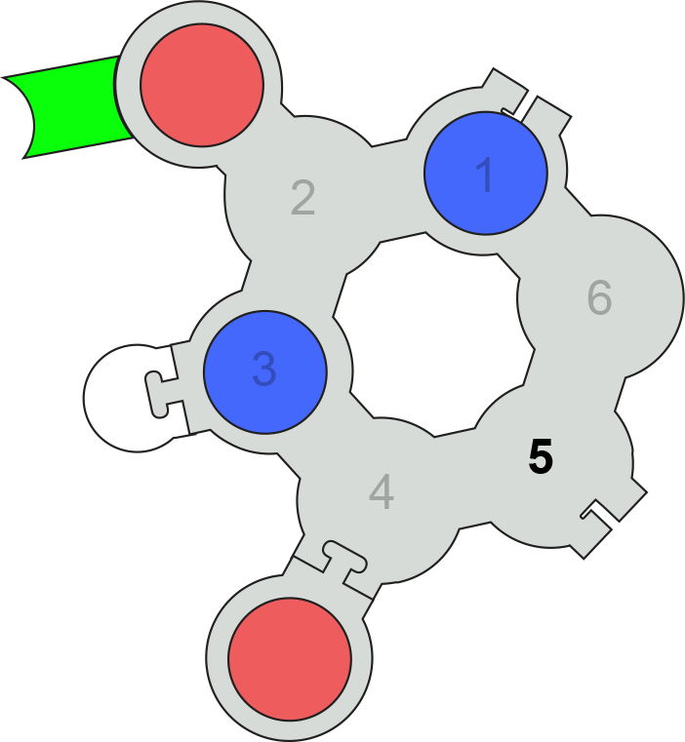
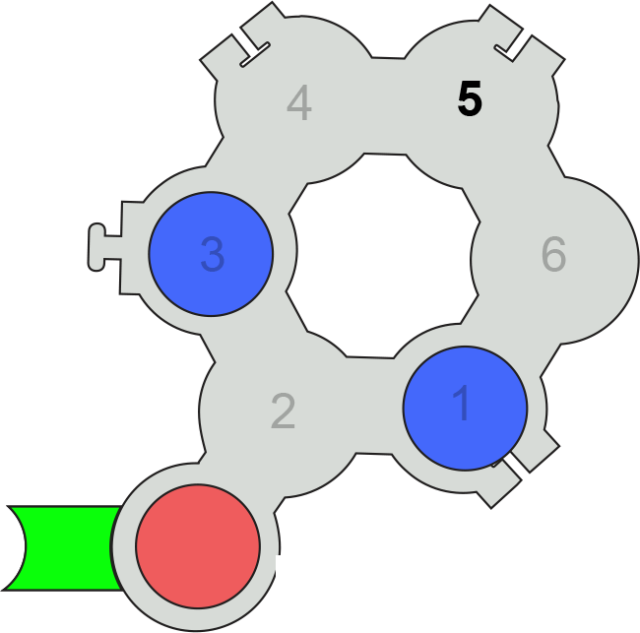
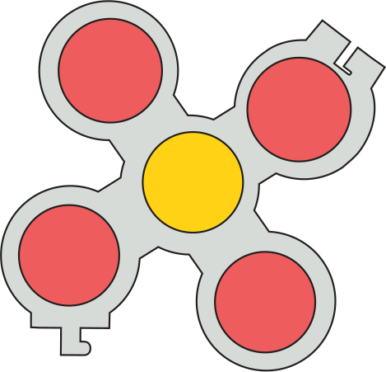

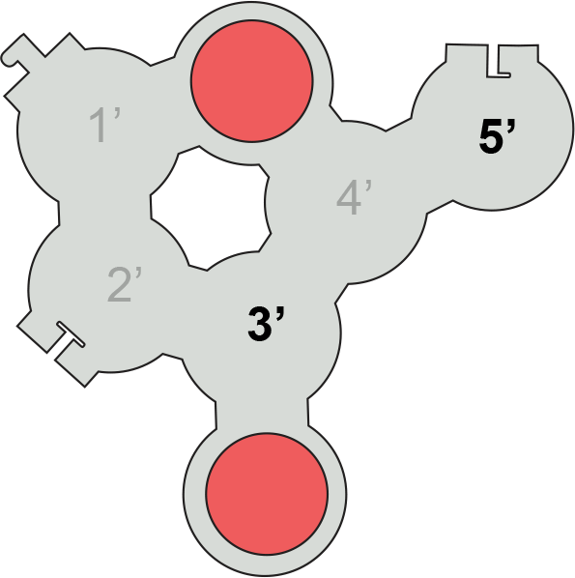
Uridine
Pseudo-Uridine

