Slide 1
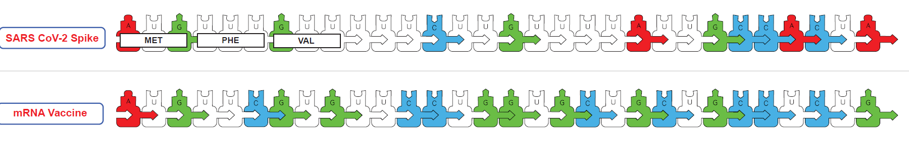
Teaching mRNA Vaccines…
…and the future of therapeutic RNAs
Tim Herman
3D Molecular Designs

Slide 2
Workshop Outline
COVID-19…. and mRNA vaccines
A story about the process of science...
Coming Soon….Tomorrow’s Science Today
An NIH SEPA project focused on infectious diseases
An mRNA Vaccine Design Activity….
Why did it take so long?... and why did it happen so fast?
Student Challenge… Can you engineer an mRNA vaccine?

Slide 3
Coming soon,… to a workshop near you.
Tomorrow’s Science Today: preparing for the next pandemic.
An NIH SEPA project.
New Instructional Materials
  Models, models and more models….
    A Virus Collection,.. including CoV-2
    Antibodies/vaccines /and your immune system
    mRNA vaccines and multi-valent, ultra-potent vaccines…from synthetic biology.
    Stories, stories and more stories….
A Professional Learning Experience…beginning in the summer of 2024
But first,…enroll now in Modeling the Molecular World, 2023
Session 1 -- June 26-30, or
Session 2 -- July 17 - 21

Slide 4
Teaching the Molecular Biosciences in a post-pandemic era
It has been the best of times,… it has been the worst of times.
The biosciences have demonstrated their considerable power and maturity by delivering an effective vaccine to protect the public from CoV-2 … in less than 1 year.
The public has been reluctant to embrace this new technology, choosing instead to question the validity of the science and the motives of big pharma.
But let’s not lose this opportunity to tell this amazing story of the process of science.

Slide 5
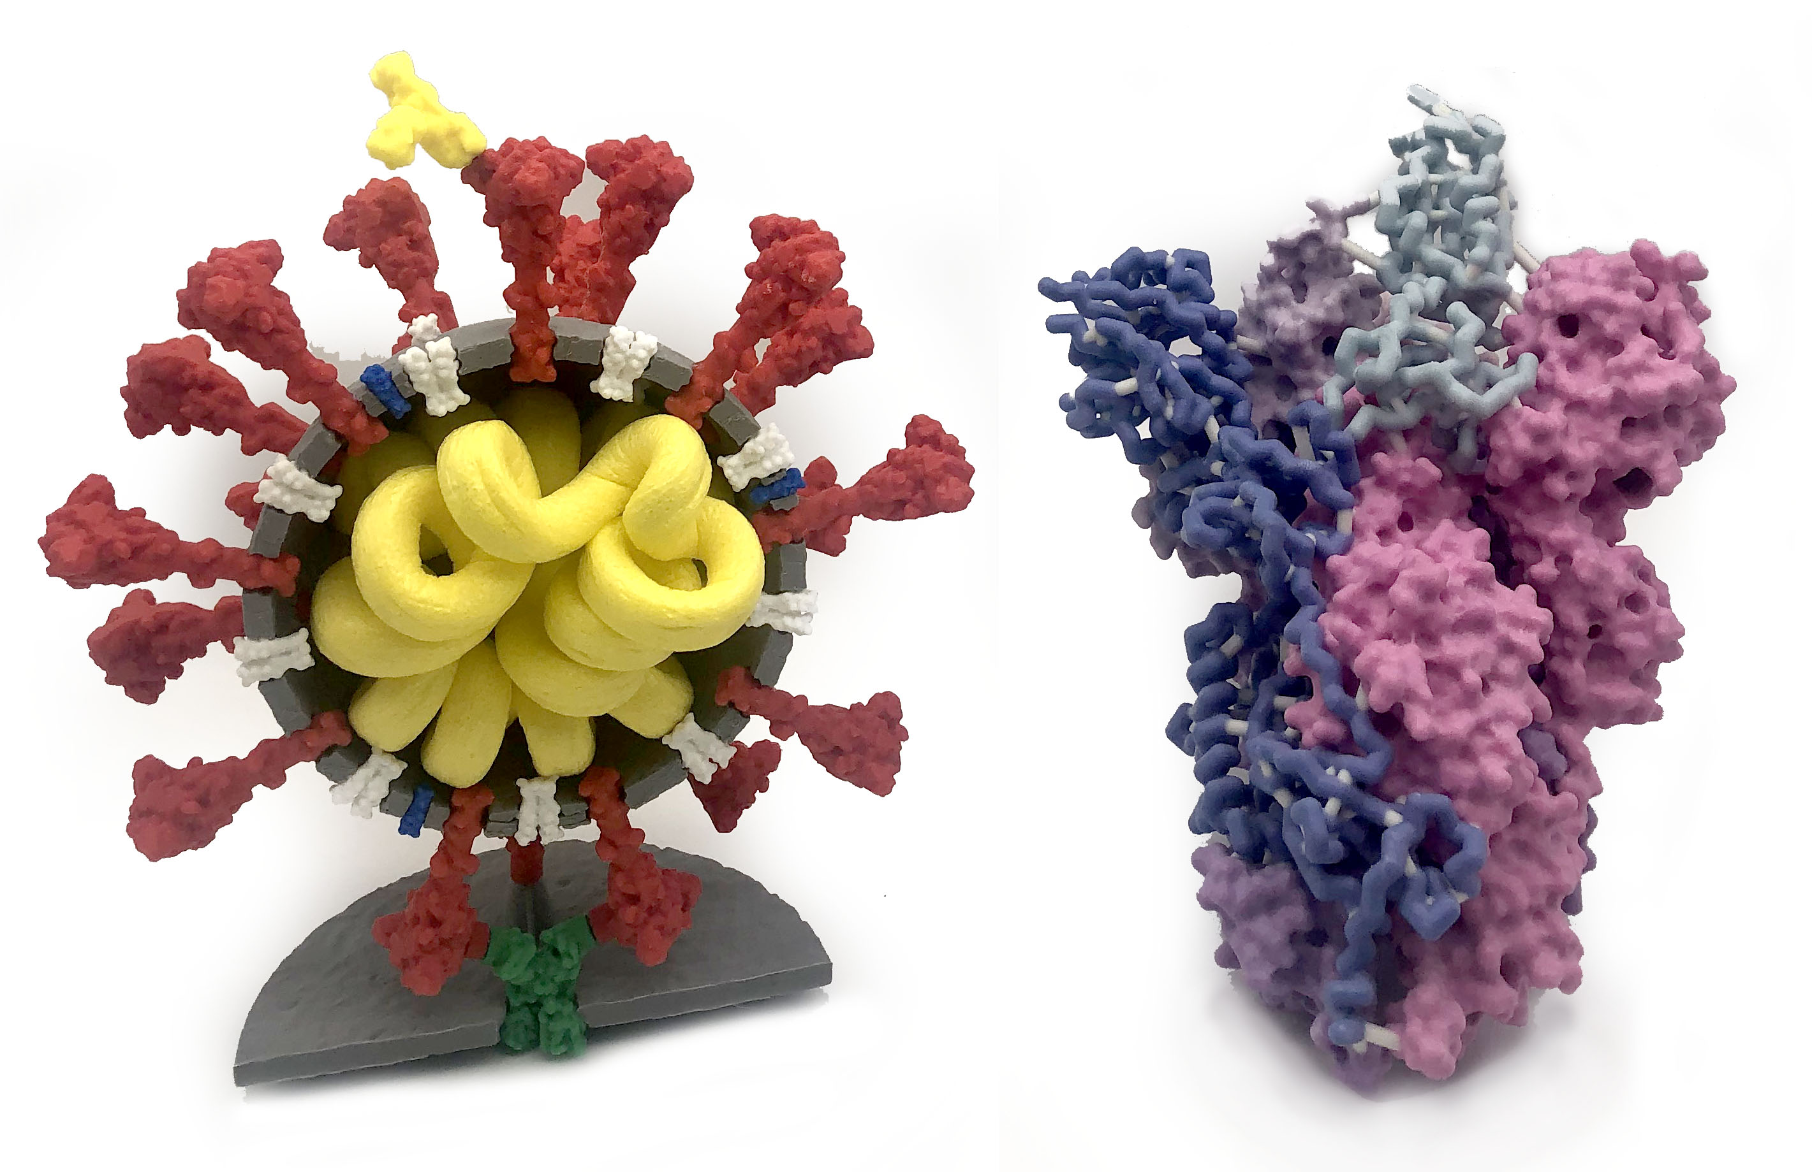
Coronavirus …and the Spike protein
The magic of models…

Slide 6
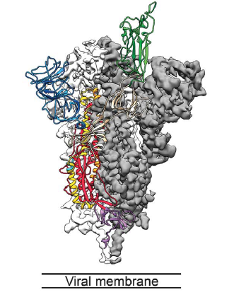
Here’s the story….SCIENCE to the rescue……
December 2019, new coronavirus (CoV-2) reported in China
January 10, 2020, nucleotide sequence of CoV-2 reported…
… and shared with the world.
January 13, 2020, optimized version of the spike gene sent to Moderna.
March 20, 2020, Jason McLellan publishes 3D structure
of CoV-2 spike protein.
Clinical Trials................................
December 18, 2020, Moderna mRNA vaccine EUA.

Slide 7
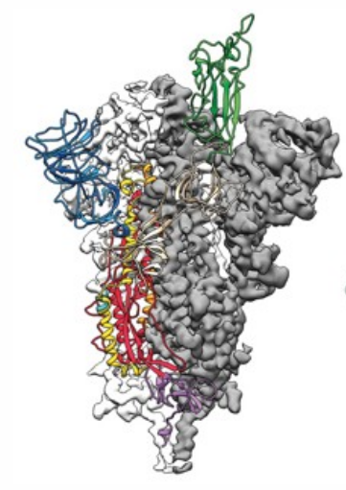
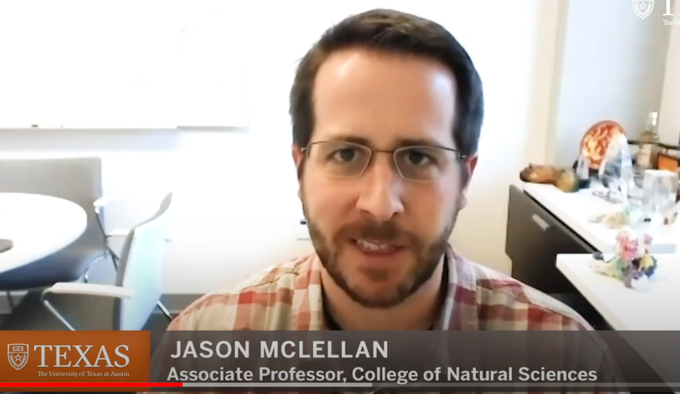
within 3 months of the CoV-2 genome being sequenced...
Key Innovations from UT Austin’s McLellan Lab Powers COVID-19 Vaccines
UT-Austin researcher explains lab’s key role in coronavirus vaccine development

Slide 8
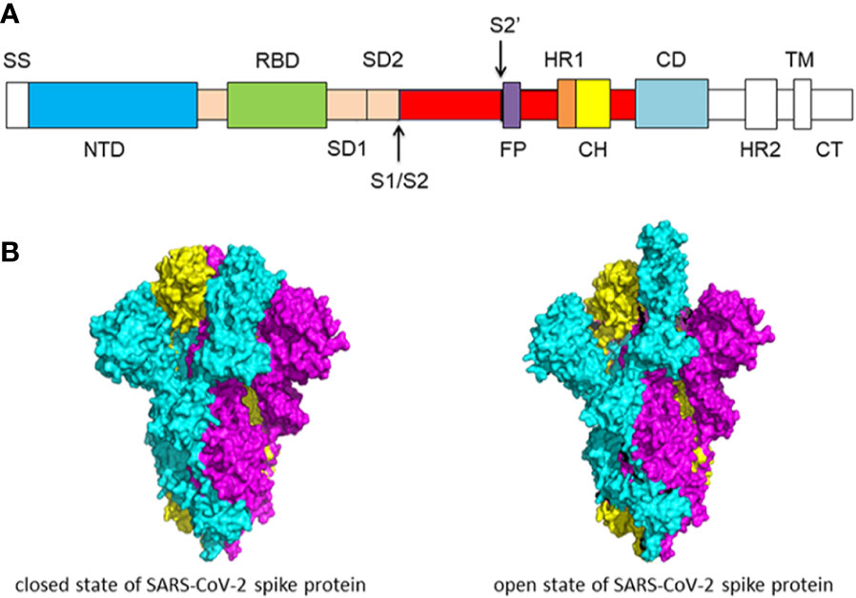

Slide 9
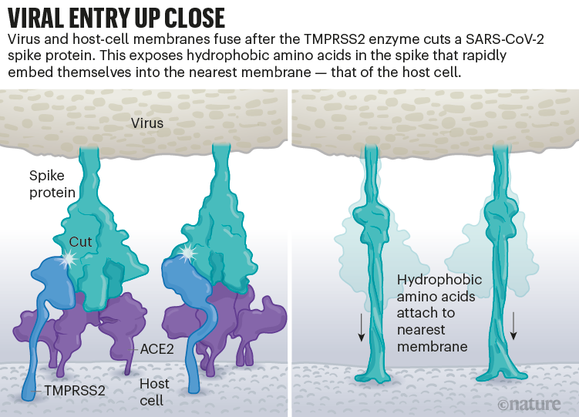

Slide 10
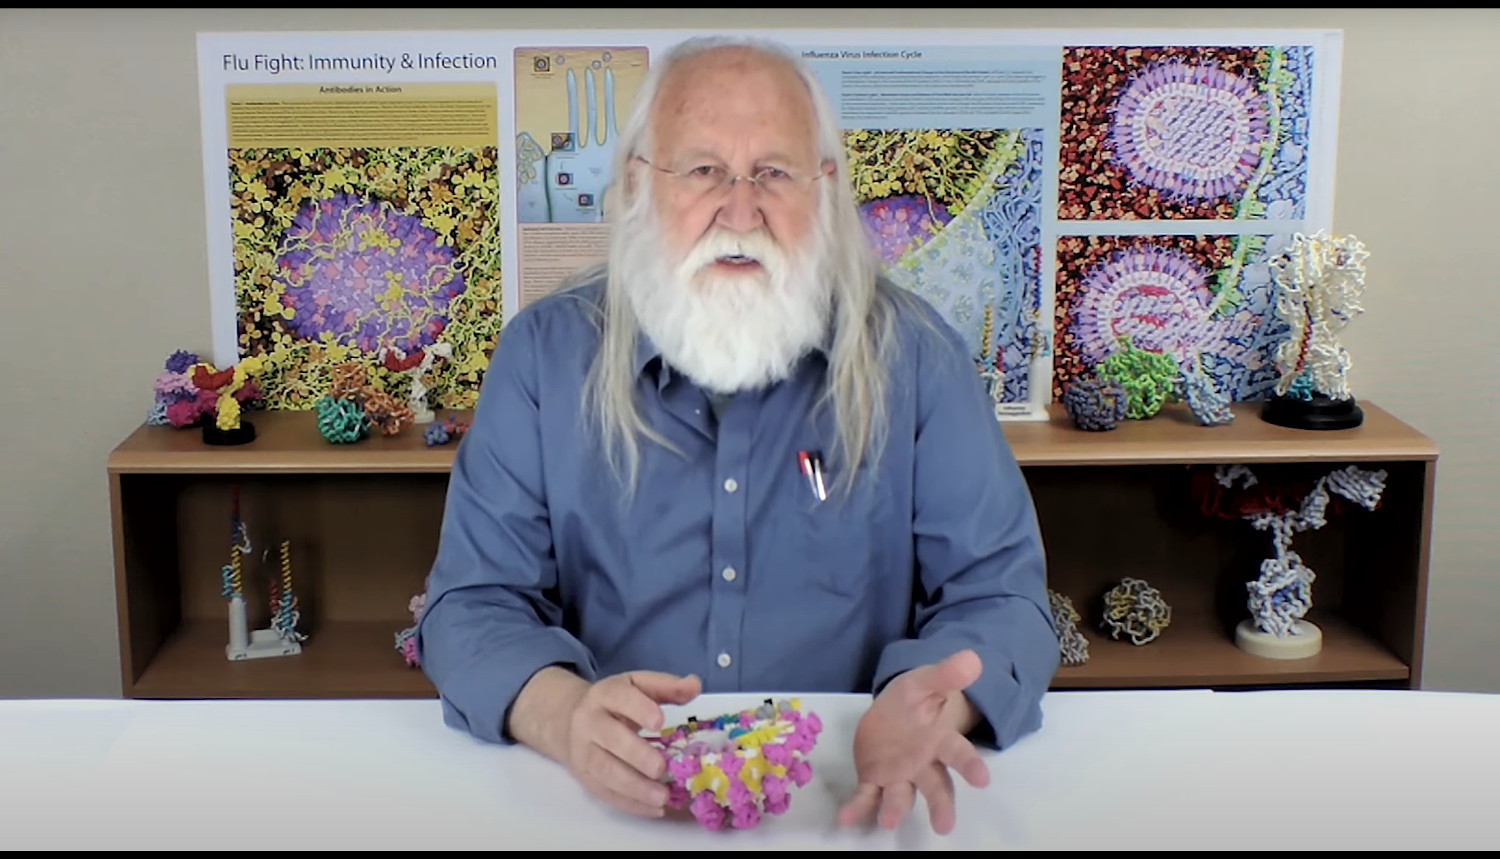
The Science of Coronavirus… a video series
https://www.3dmoleculardesigns.com/The-Science-of-Coronaviruses.htm

Slide 11
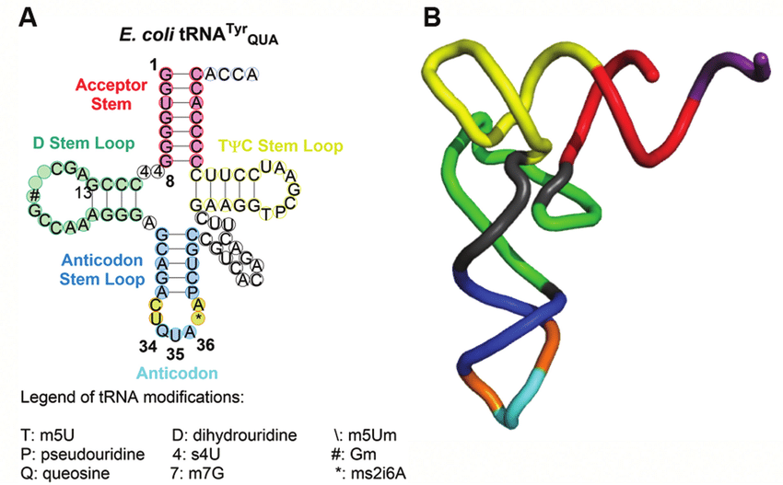
…………….WHY?
tRNA Modifications

Slide 12
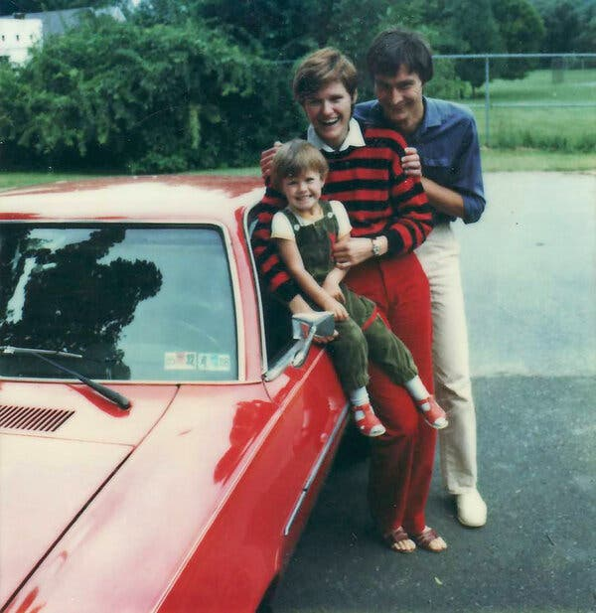
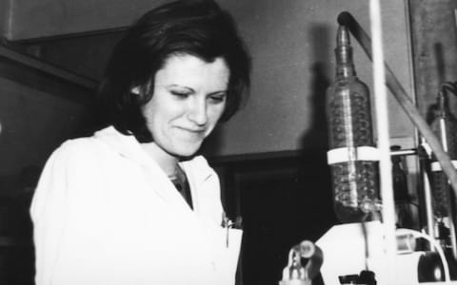
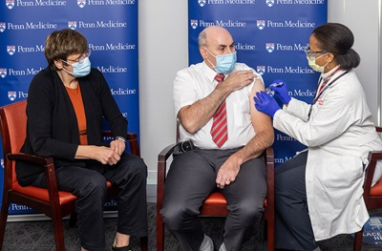
mRNA Vaccines,…yesterday’s science today!
CoV2 RNA genome published in December of 2020….
mRNA vaccine for CoV2 approved for emergency use in less than 1 year.
Kati Kariko… persistence rewarded.

Slide 13
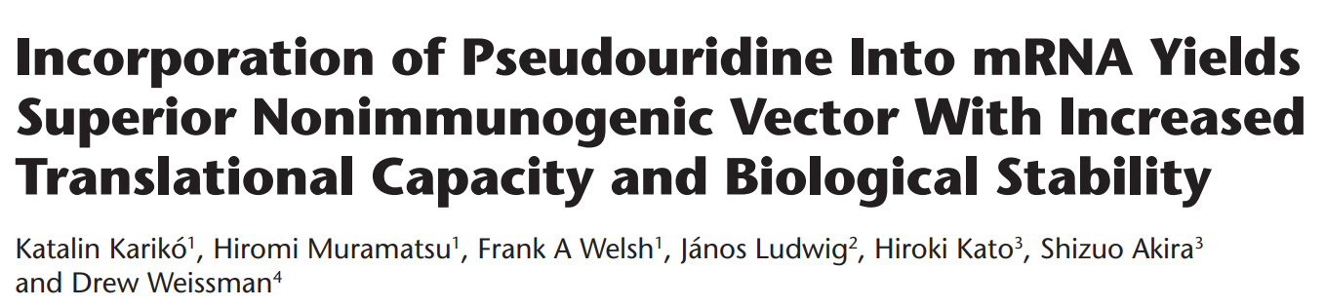
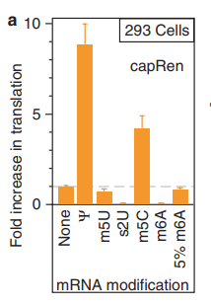
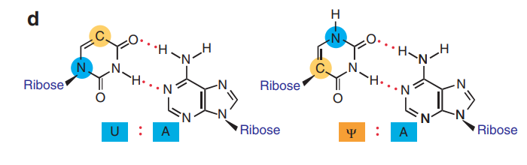
Molecular Therapy vol. 16 no. 11, 1833–1840 nov. 2008
pseudouridine
GUAACUGCAUGCUAGCUAGCUAGCUCAGUGCUGCUGCUGUAUUUGCUUGA
GΨAACΨGCAUGCΨAGCΨAGCΨAGCΨCAGΨGCΨGCΨGCΨGΨAΨΨΨGCΨΨGA

Slide 14
STEM….
Engineering…delivered to us a design for an effective mRNA vaccine for CoV-2
Science…delivered to us the nucleotide sequence encoding the spike protein of CoV-2
How can you incorporate principles of
engineering design into our science classes?

Slide 15
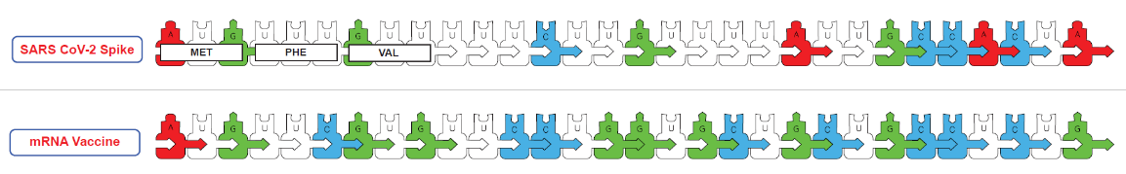
...a vaccine design activity

Slide 16
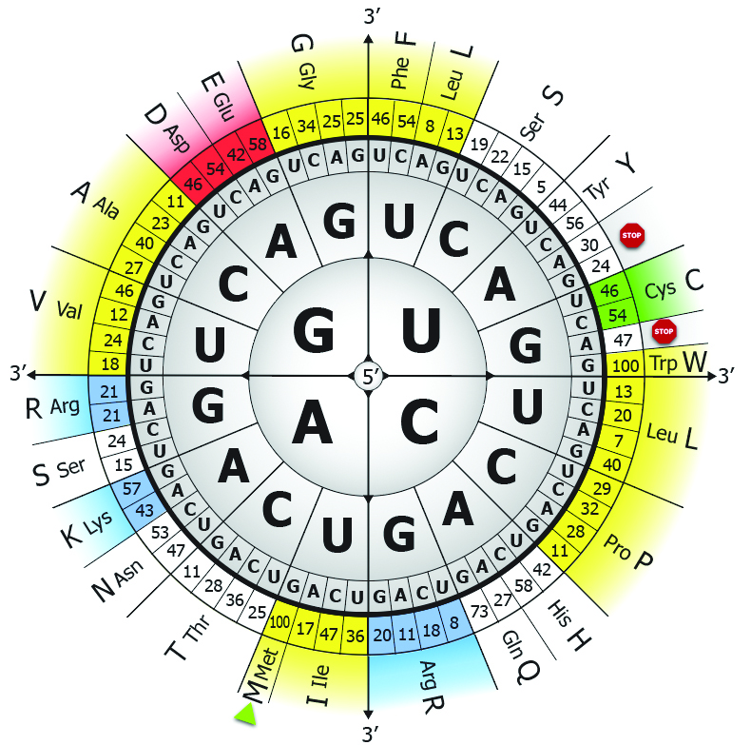
A Table of Genetic Codons….
… with human codon preferences

Slide 17
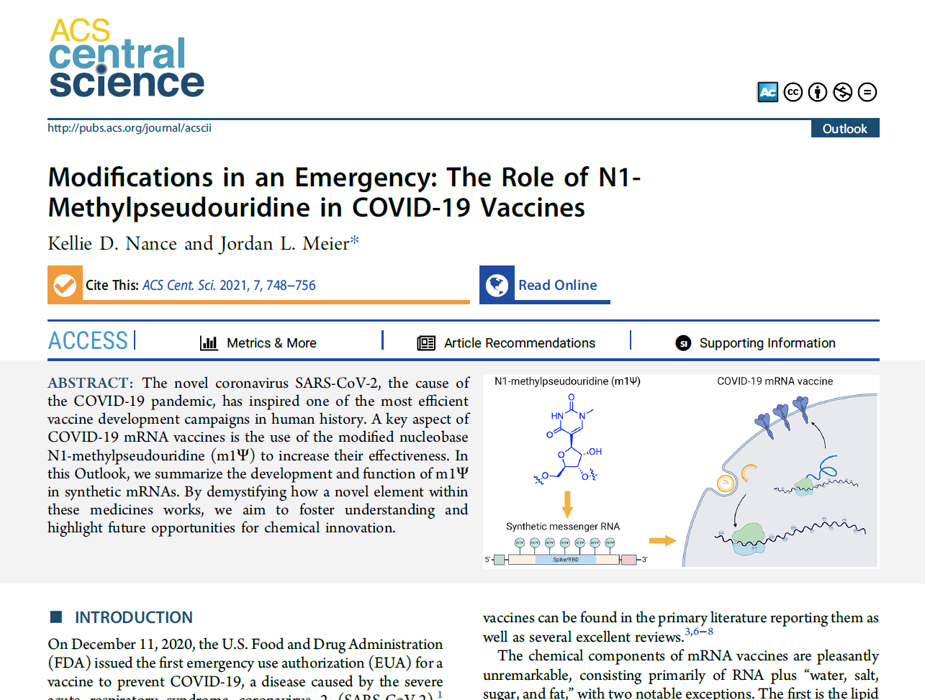

Slide 19
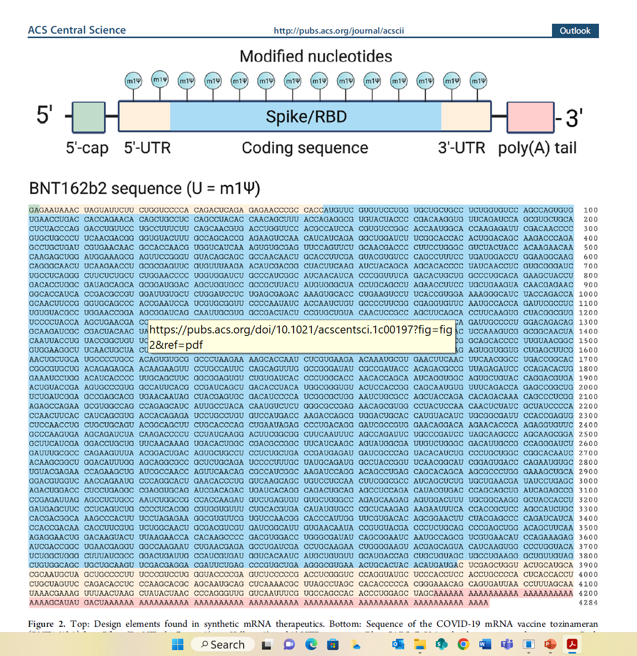

Slide 20
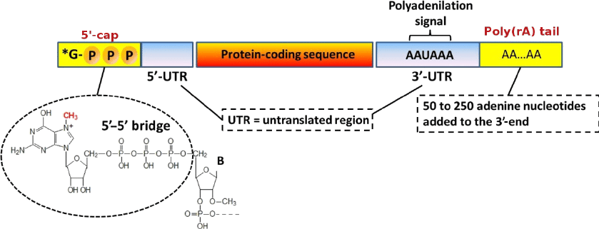
The Components of mRNA
WHY?
Protect mRNA from degradation
Ribosome engagement site…
Distinguish between viral RNA and endogenous mRNA

Slide 21




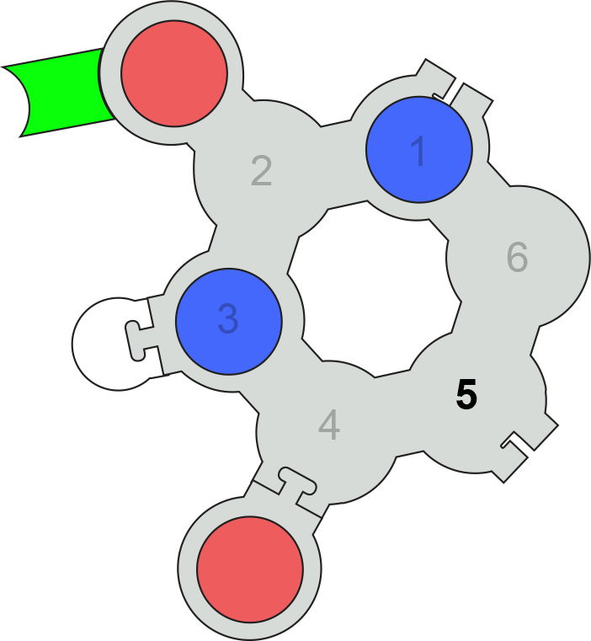
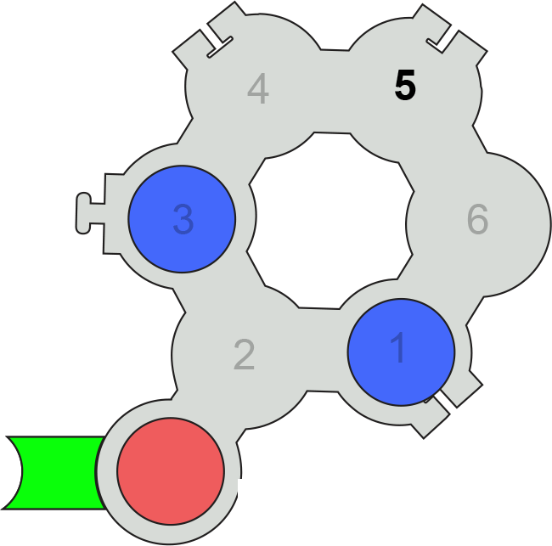
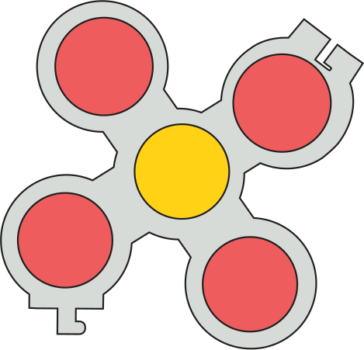

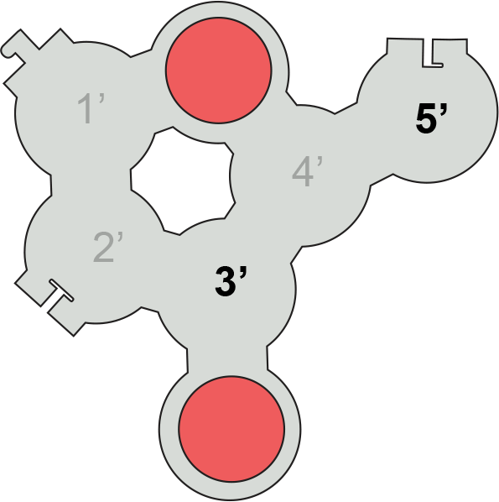
Uridine
Pseudo-Uridine

Slide 22
Coming soon,… to a workshop near you.
Tomorrow’s Science Today: preparing for the next pandemic.
An NIH SEPA project.
New Instructional Materials
  Models, models and more models….
    A Virus Collection,.. including CoV-2
    Antibodies/vaccines /and your immune system
    mRNA vaccines and multi-valent, ultra-potent vaccines…from synthetic biology.
    Stories, stories and more stories….
A Professional Learning Experience…beginning in the summer of 2024
But first,…enroll now in Modeling the Molecular World, 2023
Session 1 -- June 26-30, or
Session 2 -- July 17 - 21

Slide 23


Slide 28
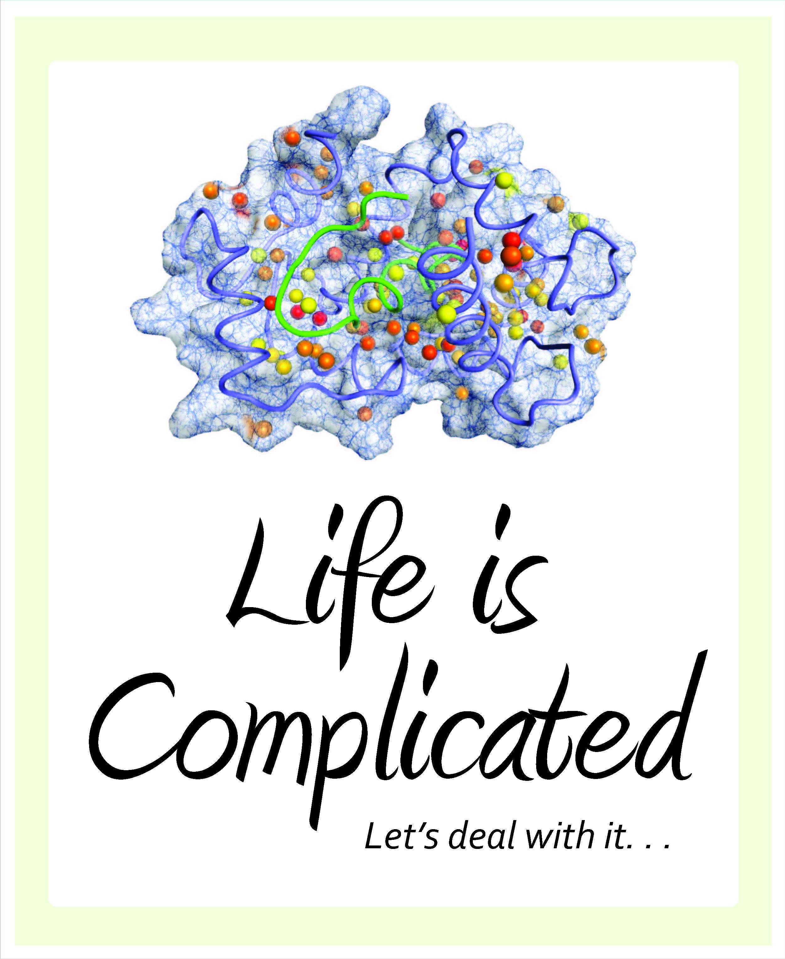
The Importance of Being Modified…
Its not just A’s and T’s and G’ and C’s….
Life as we know it only works because of many critical modifications of our 4 (5) nucleotides.
We will consider several of these modifications here….

Slide 29

Epigenetics,… the methylation of Cytidine
Epigenetics is the study of how your behaviors and environment can cause changes that affect the way your genes work. Unlike genetic changes, epigenetic changes are reversible and do not change your DNA sequence, but they can change how your body reads a DNA sequence.

Slide 30
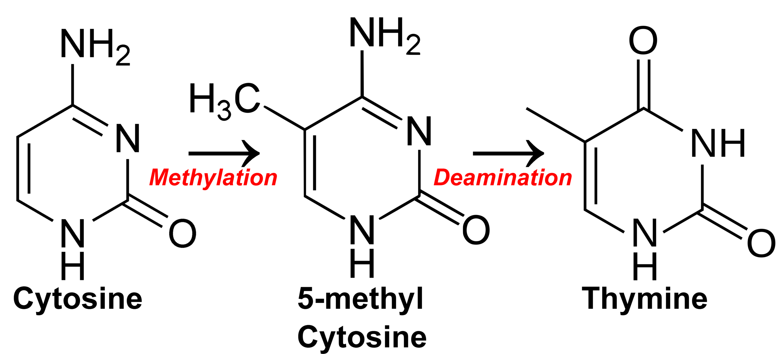
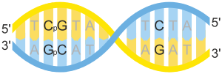
In epigenetics, the Cytosine of the dinucleotide sequence CpG …
….is methylated at the #5 carbon.
WHY?

Slide 31
Four Base Modifications… that make life even more interesting.
tRNA Modifications…..pseudouridine
5’ Cap on mRNA
Epigenetics ….. methylation of CpGs
mRNA vaccines

