Slide 1
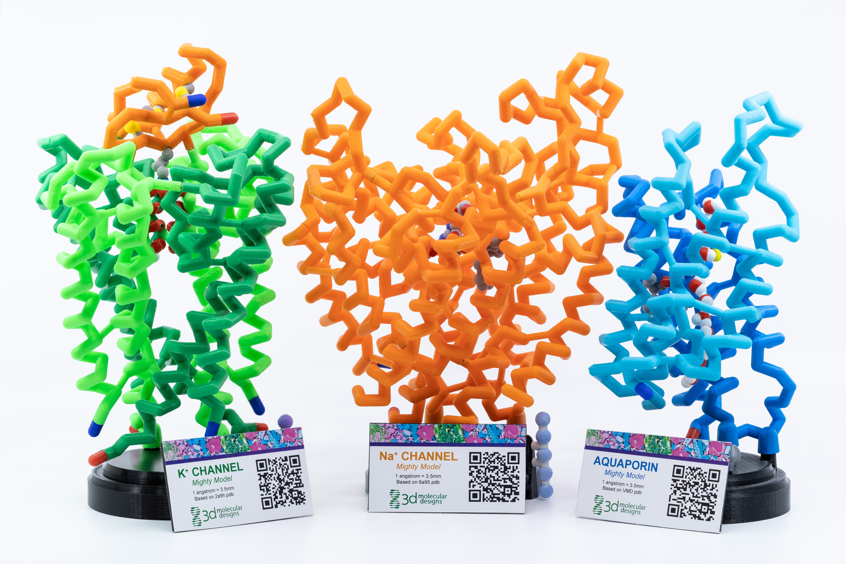
Introducing Mighty Models… …from the water channel to action potentials
Tim Herman
3D Molecular Designs

Slide 2
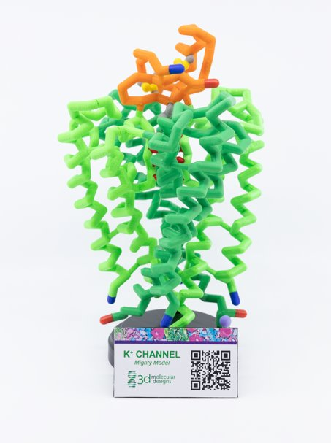
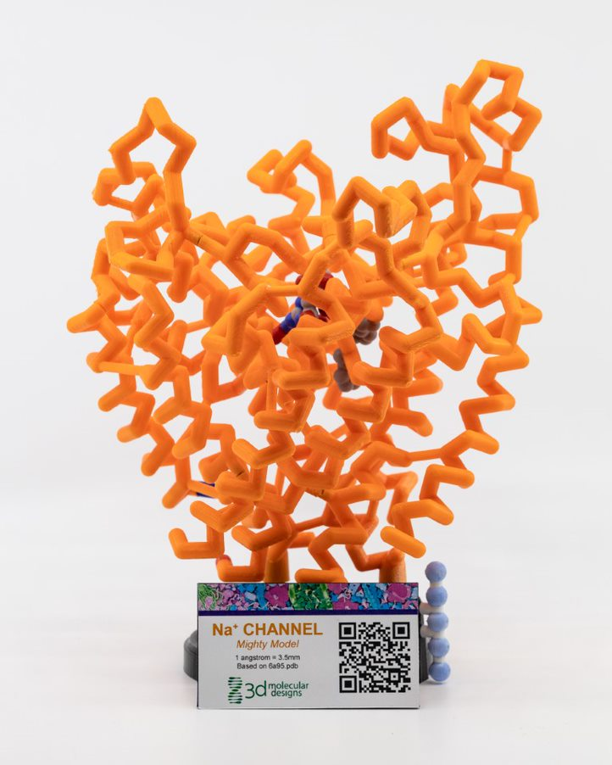
Aquaporin
Mighty Model
Potassium Channel Mighty Model
Sodium Channel
Mighty Model
Hg atom
Scorpion toxin
Small molecule inhibitor

Slide 3
The Discovery of AQP1
(…in the early 1990’s…)
“The field was essentially stuck, but following the well-known scientific approach known as sheer blind luck, we stumbled upon the protein that is the answer to the question …
Do water channels exist?”
From Peter Agre’s Nobel Lecture

Slide 4
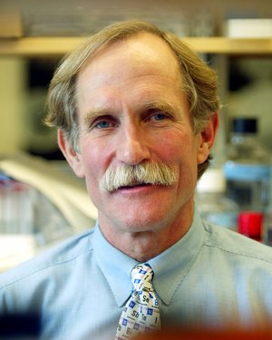
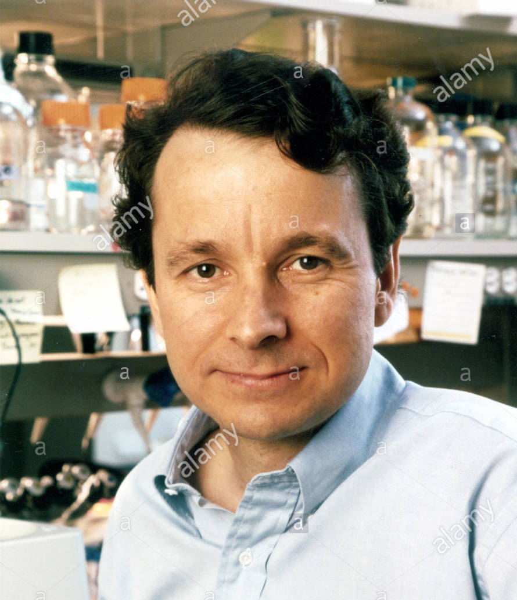
2003 Nobel Prize in Chemistry
The Nobel Prize in Chemistry 2003 was awarded "for discoveries concerning channels in cell membranes" jointly with one half to Peter Agre "for the discovery of water channels" and with one half to Roderick MacKinnon "for structural and mechanistic studies of ion channels."
Peter Agre Roderick MacKinnon

Slide 5
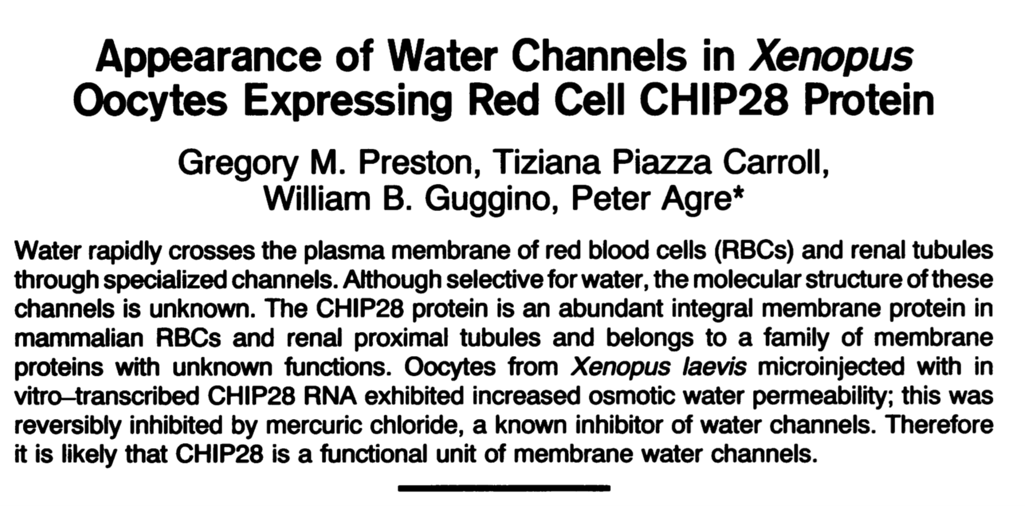
Science 256, 365-387 (1992)

Slide 6
Appearance of Water Channels in Xenopus Oocytes Expressing Red Cell CHIP28 Protein
Gregory M. Preston, Tiziana Piazza Carroll,
William B. Guggino, Peter Agre*
SCIENCE * VOL. 256 * 17 APRIL 1992

Slide 7
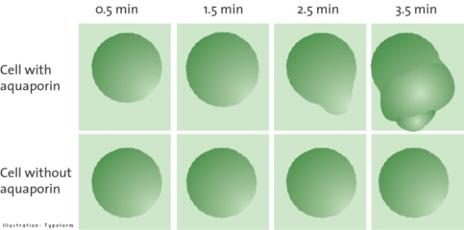
The Famous Exploding Frog Egg Experiment
Aquaporin mRNA micro-injected into Xenopus eggs

Slide 8
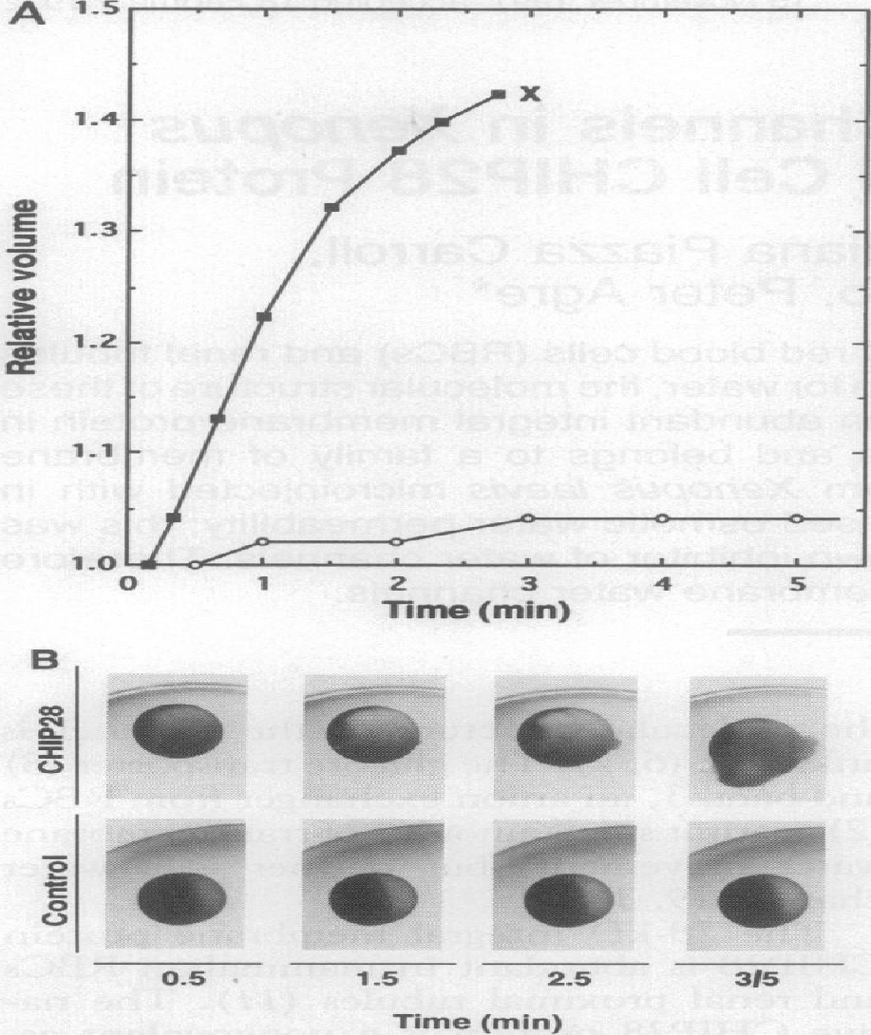
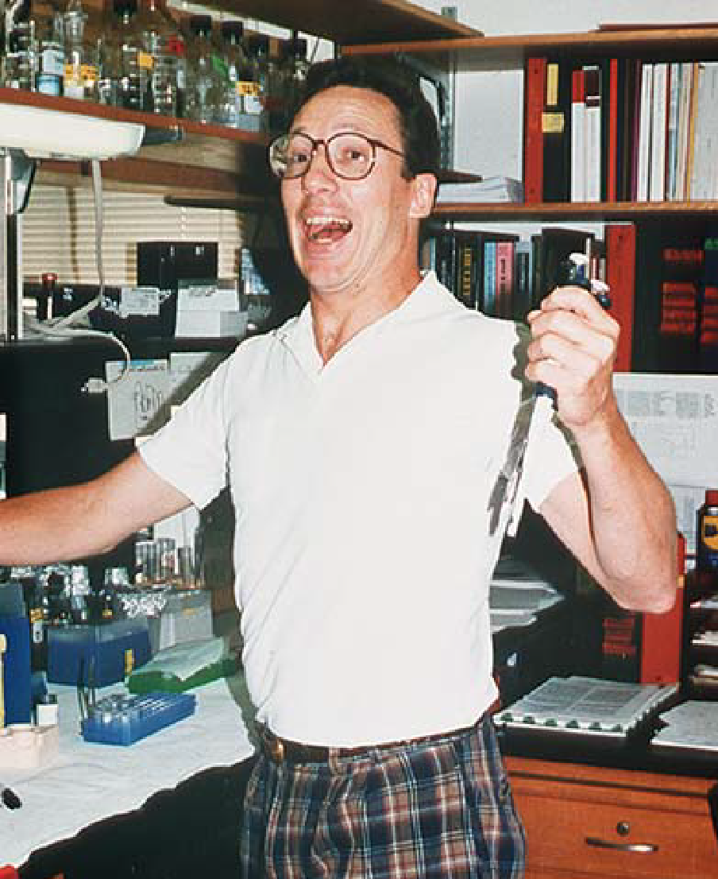
Micro-injected
CHIP28 mRNA
Micro-injected
with buffer

Slide 9
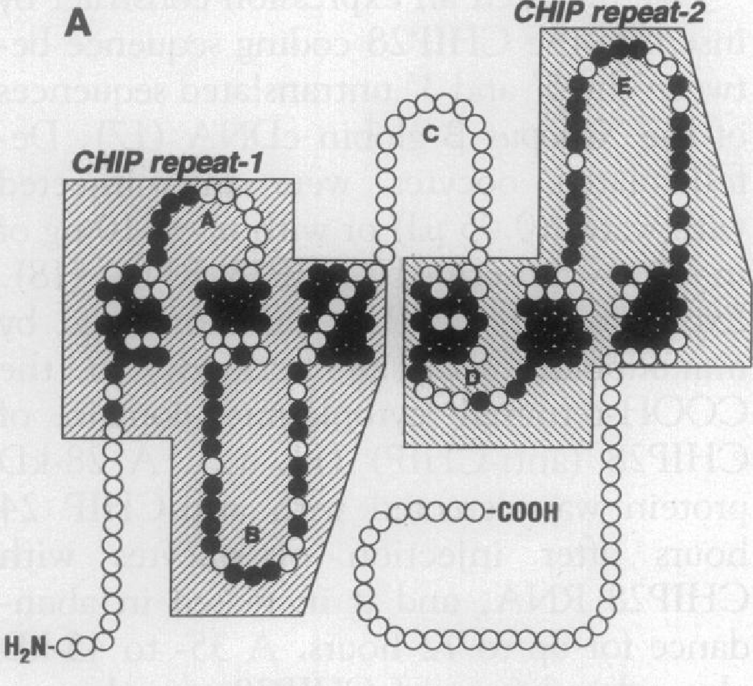
1992 “Model” of Aquaporin
Based on its Amino Acid Sequence
6 Transmembrane Helices
2-Fold Symmetry

Slide 10
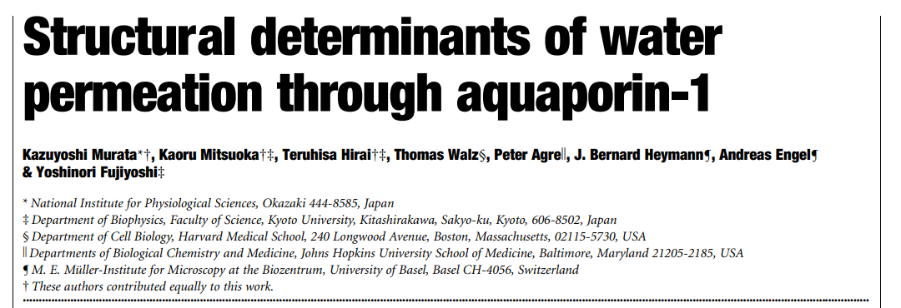
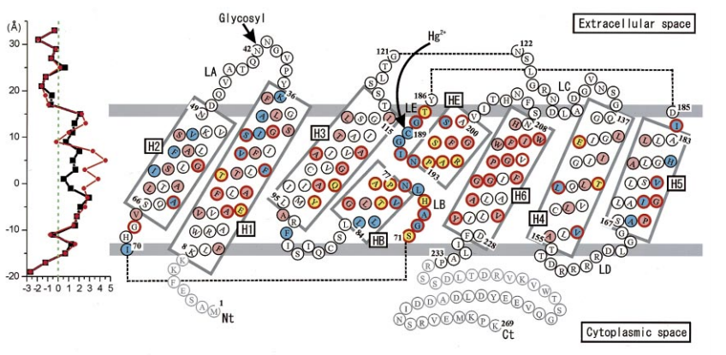
NATURE | VOL 407
5 OCTOBER 2000. pp599

Slide 11
Agre “model”, 1992
Murata model,… based on x-ray diffraction, 2000

Slide 12

Protein Exploratorium
Notes:
https://www.centerforbiomolecularmodeling.org/markMyweb/aquaporinMightyModel/

Slide 13
What is Aquaporin?
Notes:
Teacher Notes: Aid students in interpreting graphic to the right and comparing it with the model. You may wish students to open the jmol activity so they can view the protein monomer. Help students identify the specific locations labeled on the graphic to the right on the computer simulation.
Student Notes: Follow the prompts from your teacher. Use the physical model or the computer simulation to identify the six alpha helices that form a right-handed bundle: 1, 2, 3, 4, 5, and 6. In your lab notebook describe the location and orientation of these helices. Next locate loops A, B, C, D, and E. Compare length of these loops with each other. Finally, look at the tandem repeats (Repeat-1 and Repeat-2) that make the two halves of the monomer look similar.

Slide 14
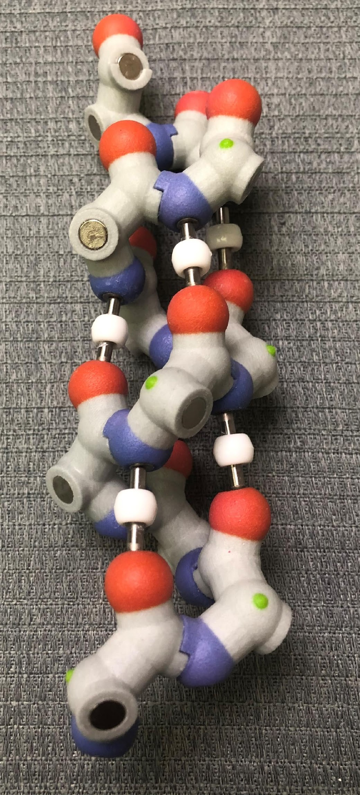
Why are transmembrane proteins often composed of bundles of alpha helices?

Slide 15
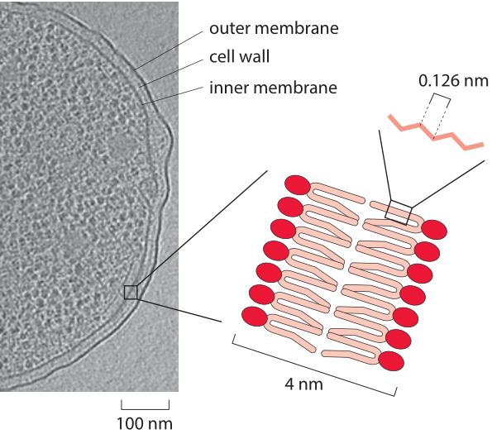
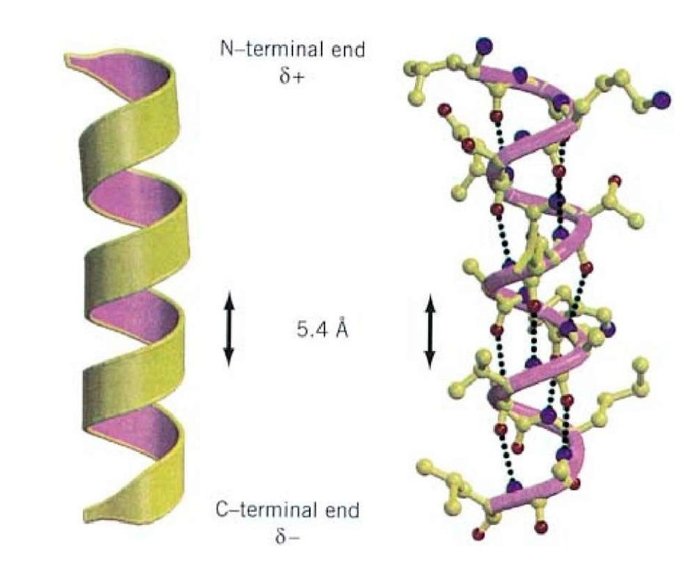
How many turns of the helix are required to span a membrane?
An alpha helix makes on complete turn in 0.54 nm
A lipid bilayer is ~ 3nm thick
3nm / .54 nm/turn = ~ 6 turns of an alpha helix to span a membrane.
(22 amino acids)

Slide 16
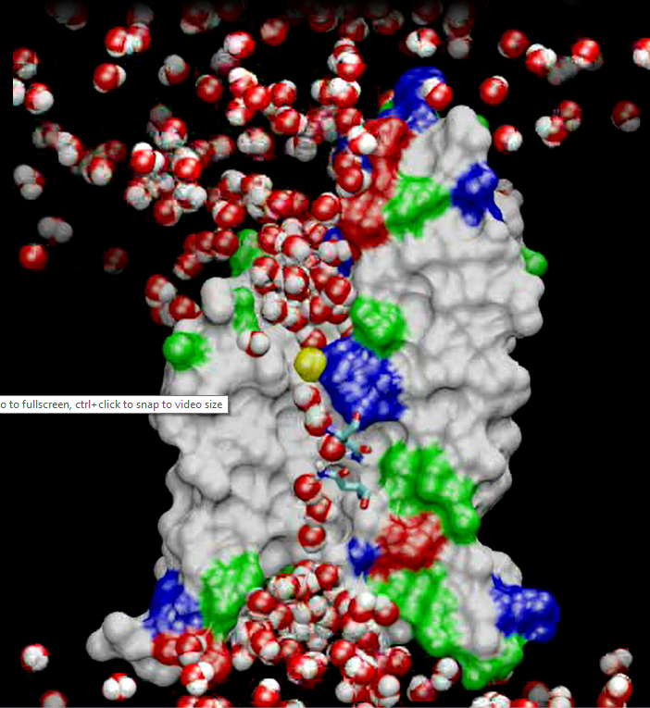
A molecular dynamics simulation from the Klaus Shulten group at UIUC
https://www.ks.uiuc.edu/Research/aquaporins/

Slide 17
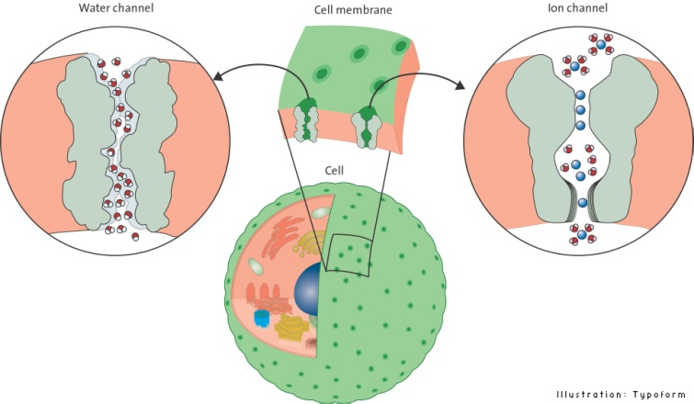
The 2003 Nobel Prize in Chemistry
Peter Agre
Johns Hopkins
Rod McKinnon
Rockefeller

Slide 18
The ion channels…. for K⁺ and Na⁺
These two ion channels are responsible for the action potentials that drive our neurons…
They are very fast…
They are very specific…
They are regulated by voltage sensor domains…
18
Notes:
Teacher Notes: Facilitate a discussion in which student develop testable questions to determine if aquaporin plays a role in the woman losing her peripheral vision.
Elemental mercury may be absorbed through eye contact. However, the face cream primarily contain mercuric salts as mercuric oxide and mercuric chloride. Inorganic mercury can get into the body through the dermal route from the use of soaps, creams, topical antiseptics, and disinfectants that contain those salts.
Some aquaporins are mercury-sensitive, while others can be insensitive to mercury. There is even one type of aquaporin that is stimulated by the presence of mercury.
Mercury appears to collect within the eye balls themselves leading to the appearance of 'floaters' (dark cloudy areas), but also adversely affects the muscles controlling focusing of the eyes and lens and the sensory nerves of the retina itself leading to: intermittent visual blurring, deteriorating peripheral vision or 'tunnel' vision, bulging eyes, sensitivity to light, difficulty focusing, poor color vision, poor night vision, and difficulty moving the eyes.
Student Notes: Develop some testable questions with your peers.

Slide 20
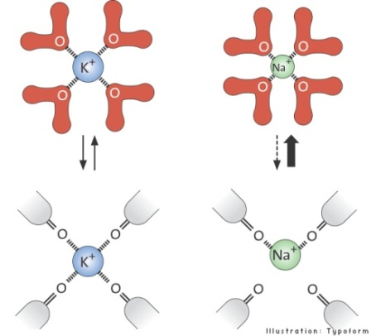
Why K⁺,… but not Na⁺

Slide 21
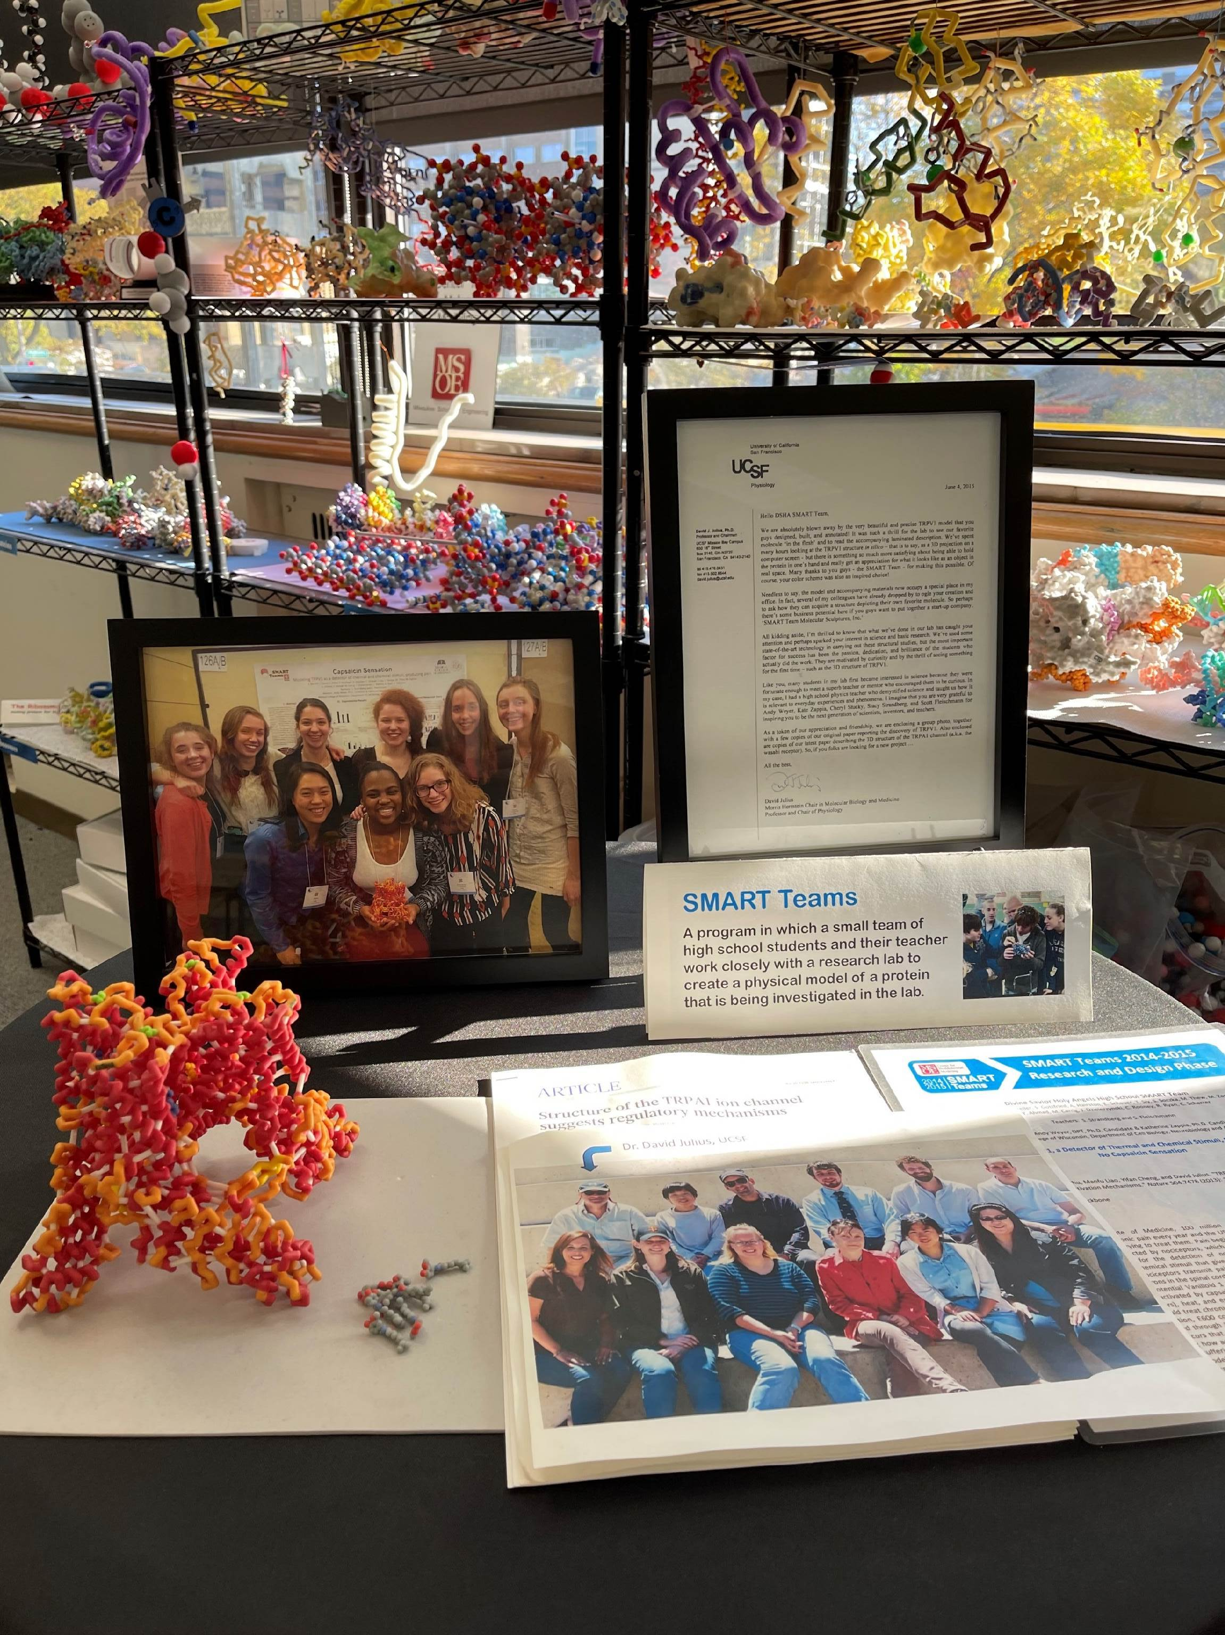
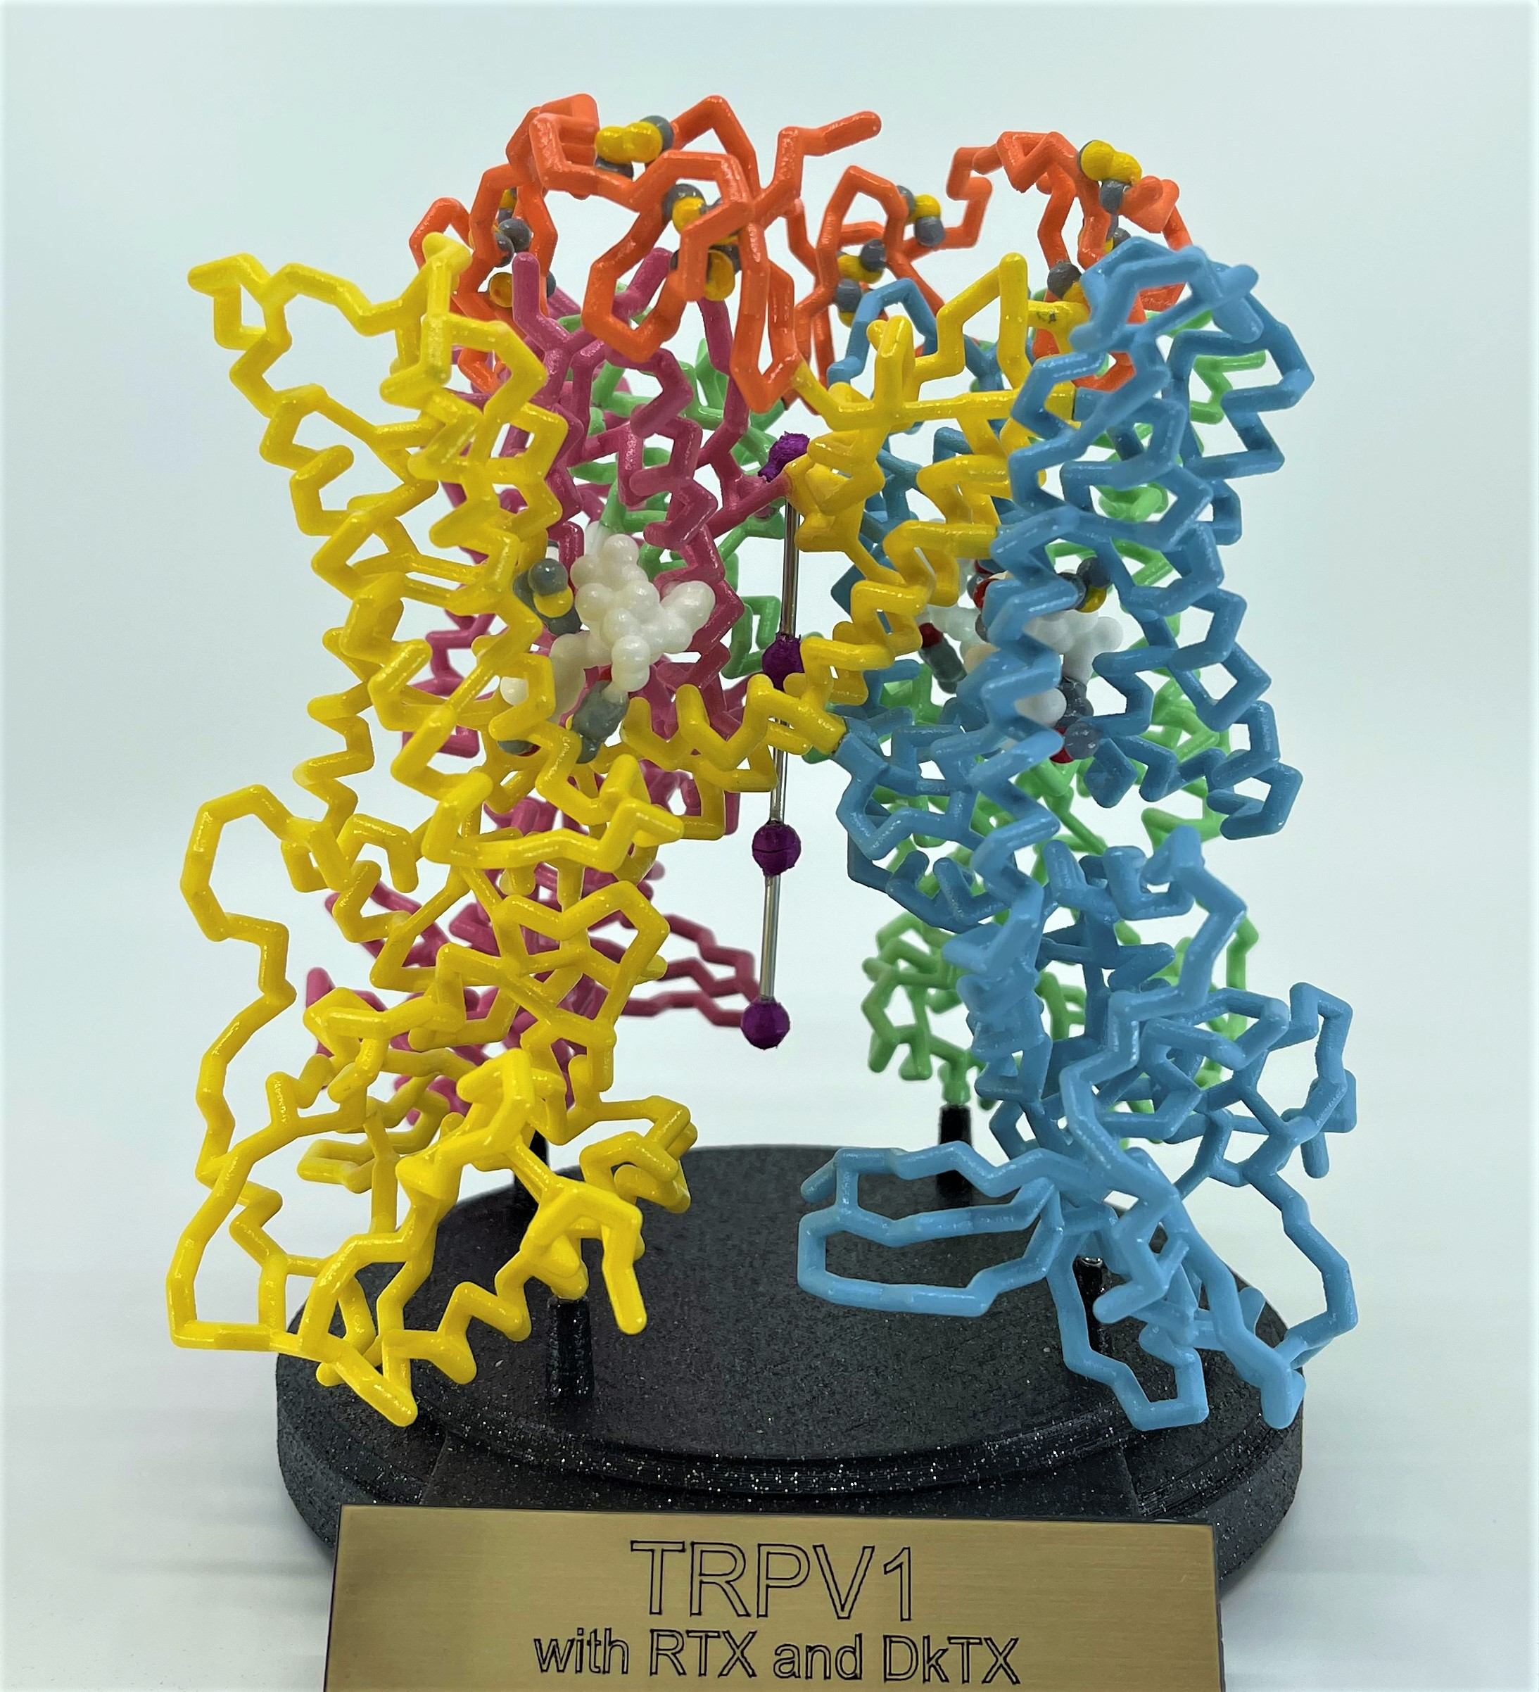
…and now,… yet another Nobel Prize-winning Channel Protein
2021 Nobel Prize in Physiology or Medicine …. to David Julius
The Pain Receptor
TRPV1
A 2015 SMART Team Project

Slide 22
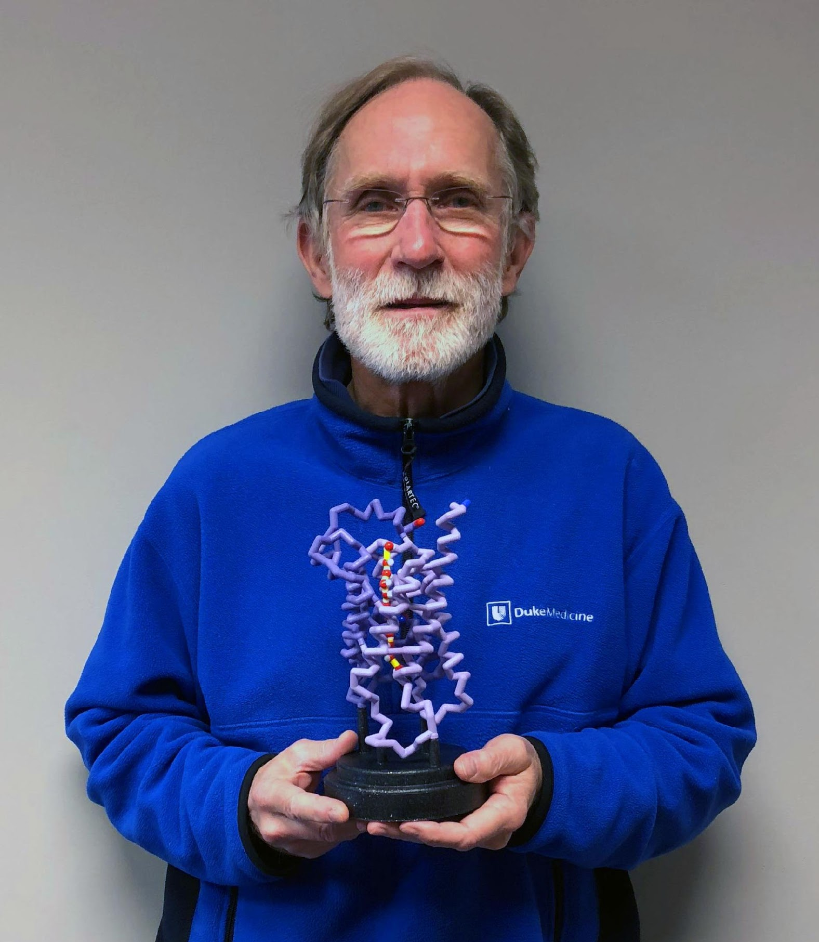
Peter Agre with Aquaporin Model

