Slide 1
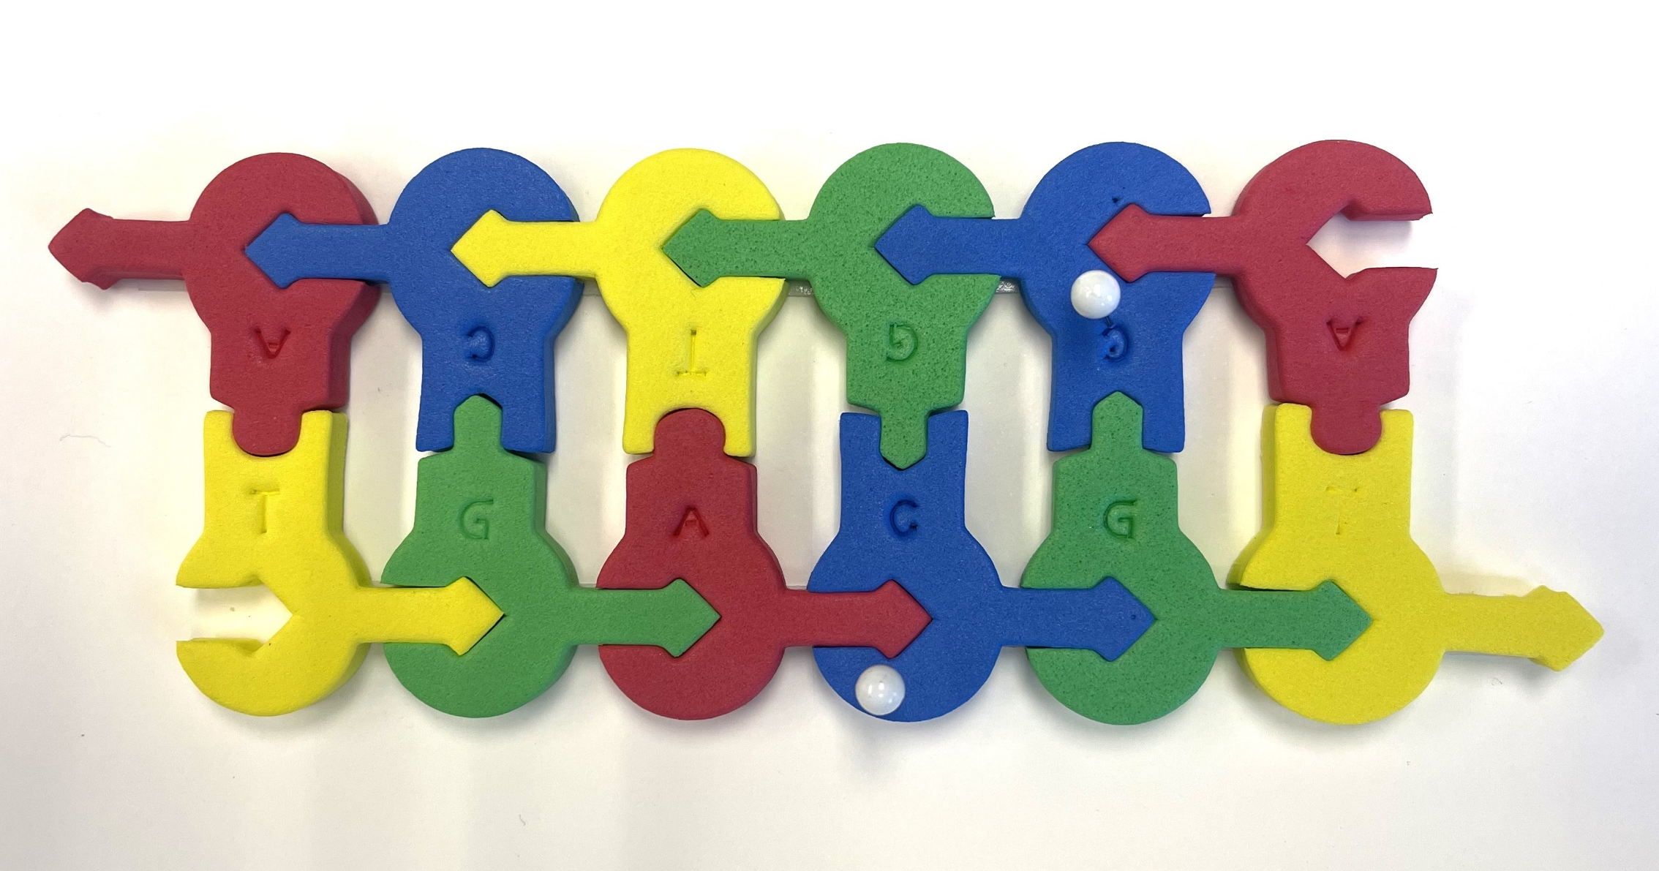
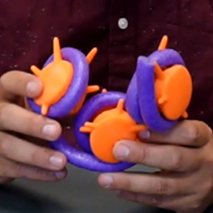
Epigenetics
… tweaking your genetic destiny
Tim Herman

Slide 2
What is Epigenetics?
Epigenetics is the study of how your behaviors and environment can cause changes that affect the way your genes work. Unlike genetic changes, epigenetic changes are reversible and do not change your DNA sequence, but they can change how your body reads a DNA sequence.
NO MORE
EXCUSES
Don’t blame it on genes

Slide 3
Workshop Outline
Epigenetics…chemical modifications of your genome
  Writers / Erasers / Readers
1. Histone modifications
2. DNA modifications
  … methylation of CpG
  … a 3-D structure/function story

Slide 5
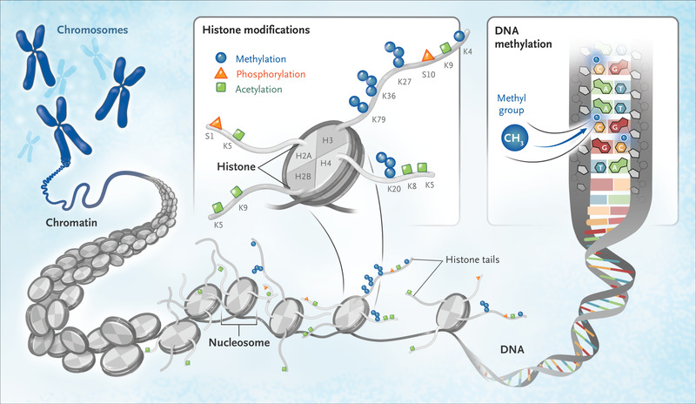

Slide 6
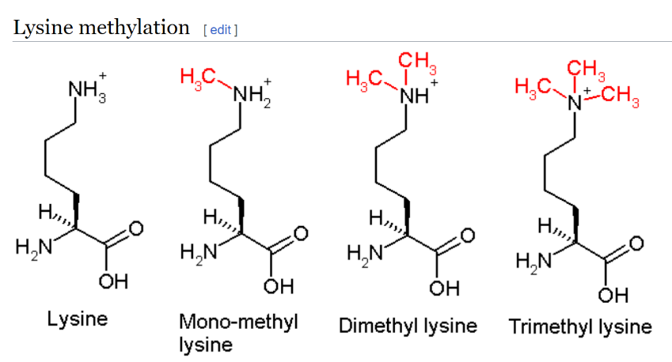
Lysine (K) #4 of histone H3 is tri-methylated….
H3K4me3 regulates RNA polymerase II promoter-proximal pause-release
https://doi.org/10.1038/s41586-023-05780-
“Trimethylation of histone H3 lysine 4 (H3K4me3) is associated with transcriptional start sites and has been proposed to regulate transcription initiation1,2.”

Slide 7
Modeling chromatin….

Slide 8
Post-transcriptional modification of DNA
Methylation of CpG …. to CMepG
5’- C p G – 3’

Slide 9
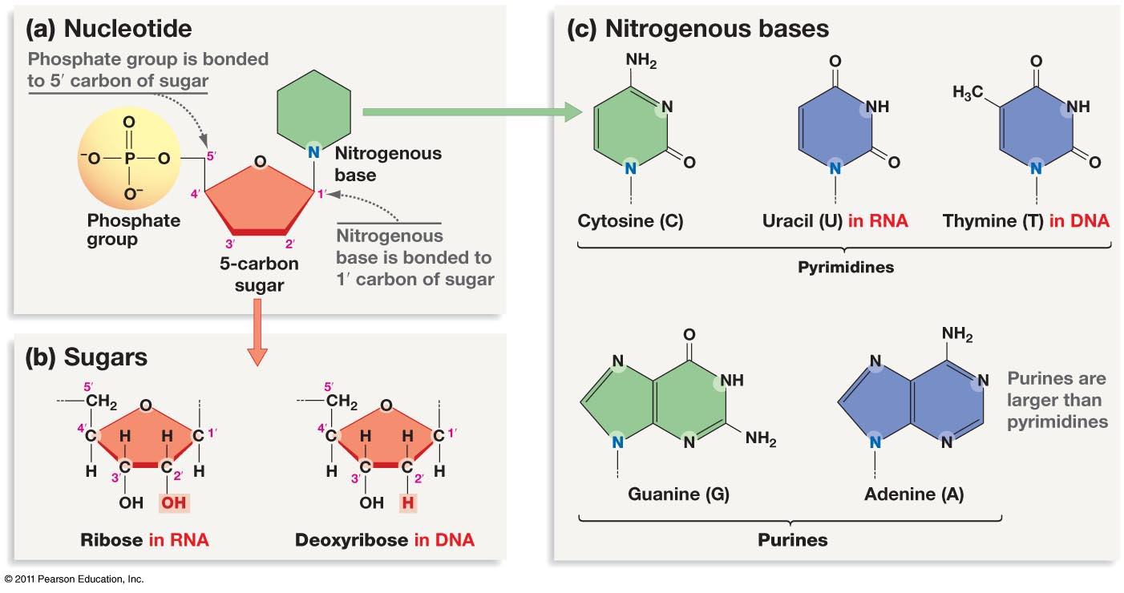

Slide 10
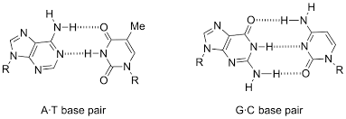
G
C
A
T

Slide 11
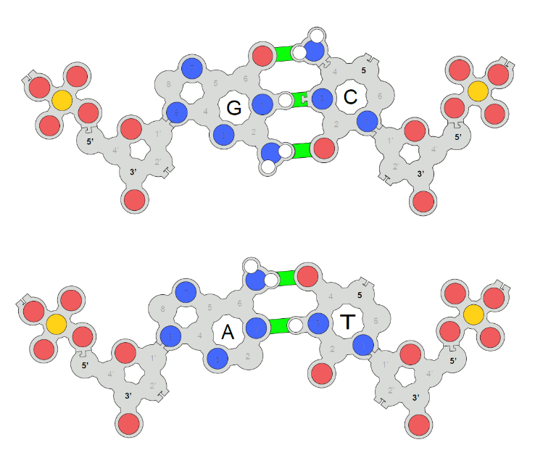
3DMD Base Pair Models
What can you teach?
Why does RNA use U’s… and DNA T’s?
What is pseudouridine?,… and why should I care?
How does methylation of C regulate gene expression?
Why are there surprisingly few CpG dinucleotides in our genes?

Slide 13
Looking for CpG’s….

Slide 14
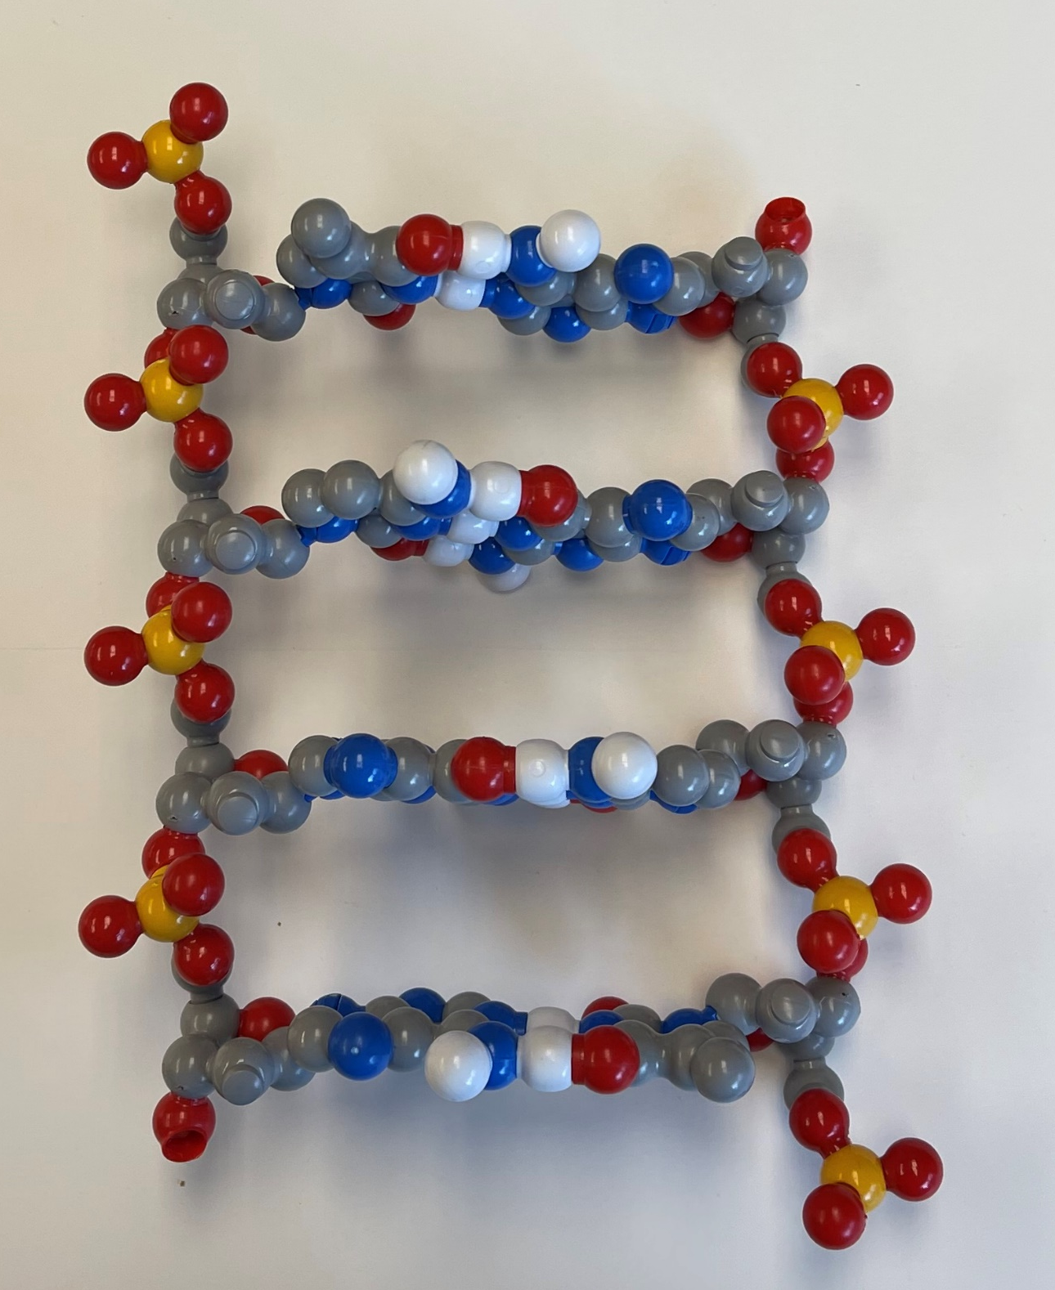
5’
3’
T
A
C
G
G
C
A
T
3’
5’

Slide 15
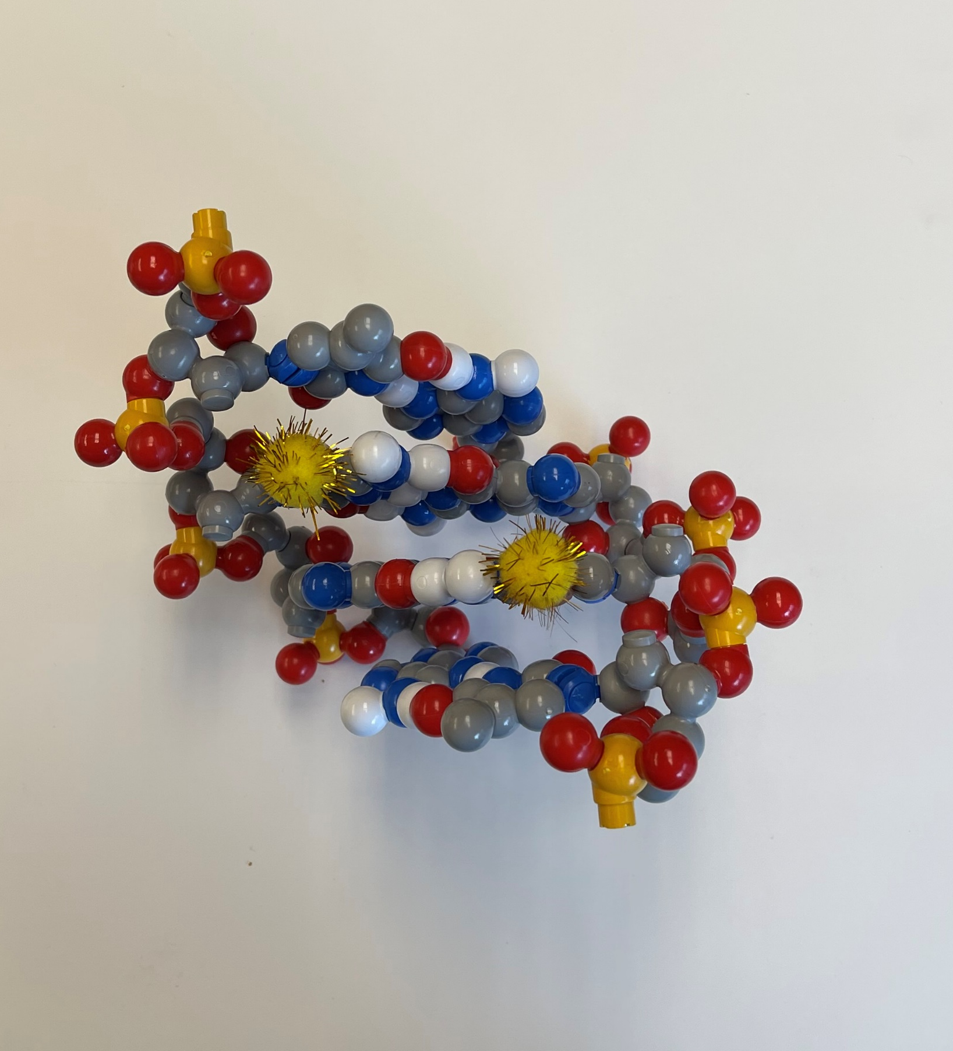
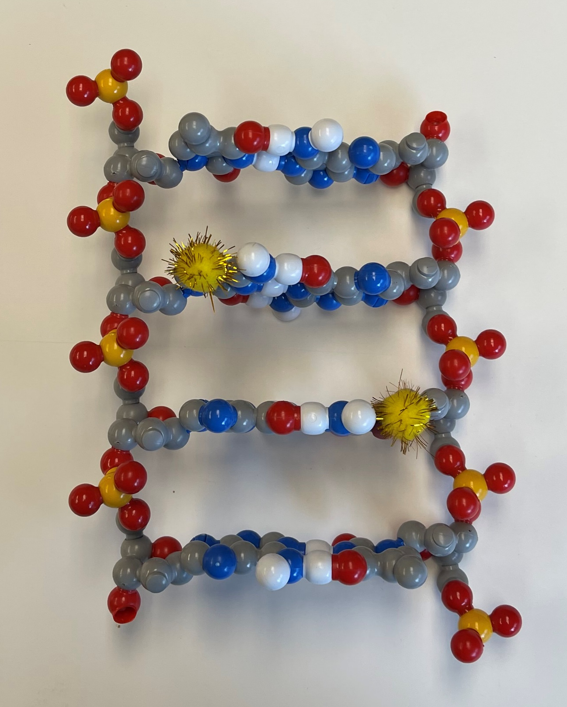

Slide 16
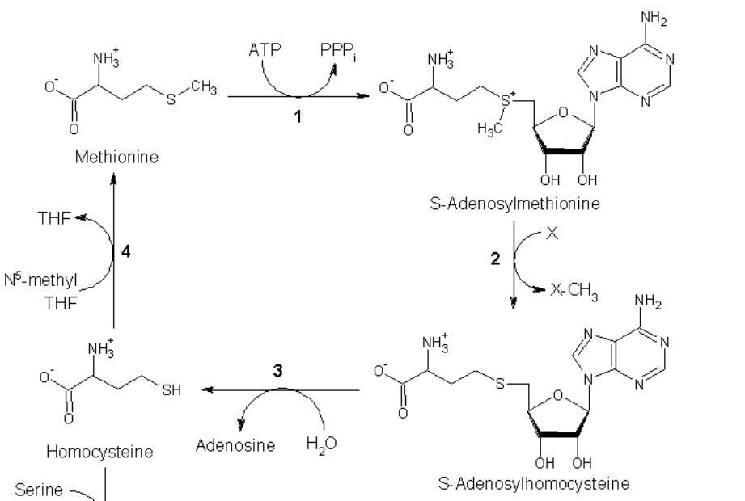
Methionine…. is a methyl-group donor
After all these years,… a kick in the pants.

Slide 17
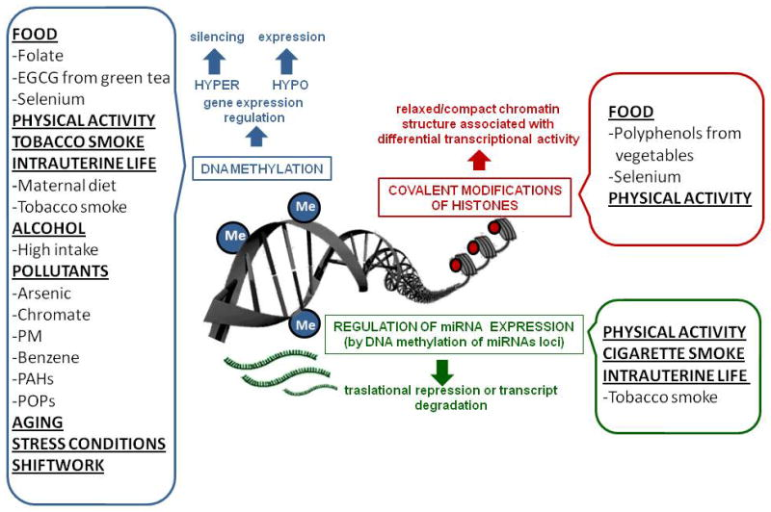

Slide 18
Fragile X Syndrome …. a genetic/epigenetic disorder??
X linked triplet repeat (CGG) expansion disorder
Fragile X patients do not express FMR1 and have cognitive/autism spectrum disabilities
All human genomes have CGG repeats in FMR1 5’ untranslated region
Cytosines tend to become methylated at high repeat number ( epigenetic modification!
Methylation of cytosines inhibits transcription of FMR1
CAUTION…rabbit hole ahead!

Slide 19
Histone / DNA cross-talk?
YES…

Slide 20
What’s CRISPR got to do with it??
Epigenome editing: targeted manipulation of epigenetic modifications in plants.
Shin H, Choi WL, Lim JY, Huh JH (March 2022).
Genes & Genomics. 44 (3): 307–315.

Slide 21
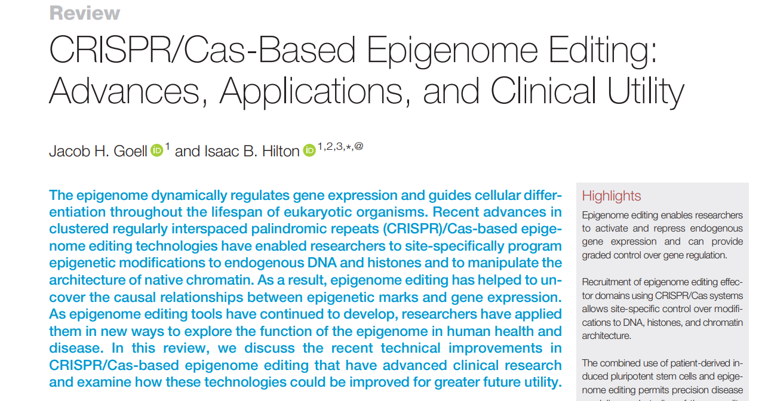
Trends in Biotechnology, July 2021, Vol. 39, No. 7 https://doi.org/10.1016/j.tibtech.2020.10.012

Slide 22
Regulation of Gene Expression and the Elucidative Role of CRISPR-Based Epigenetic Modifiers and CRISPR-Induced Chromosome Conformational Changes
Abstract
In complex multicellular systems, gene expression is regulated at multiple stages through interconnected complex molecular pathways and regulatory networks. Transcription is the first step in gene expression and is subject to multiple layers of regulation in which epigenetic mechanisms such as DNA methylation, histone tail modifications, and chromosomal conformation play an essential role. In recent years, CRISPR-Cas9 systems have been employed to unearth this complexity and provide new insights on the contribution of chromatin dysregulation in the development of genetic diseases, as well as new tools to prevent or reverse this dysregulation. In this review, we outline the recent development of a variety of CRISPR-based epigenetic editors for targeted DNA methylation/demethylation, histone modification, and three-dimensional DNA conformational change, highlighting their relative performance and impact on gene regulation. Finally, we provide insights on the future developments aimed to accelerate our understanding of the causal relationship between epigenetic marks, genome organization, and gene regulation.

Slide 23
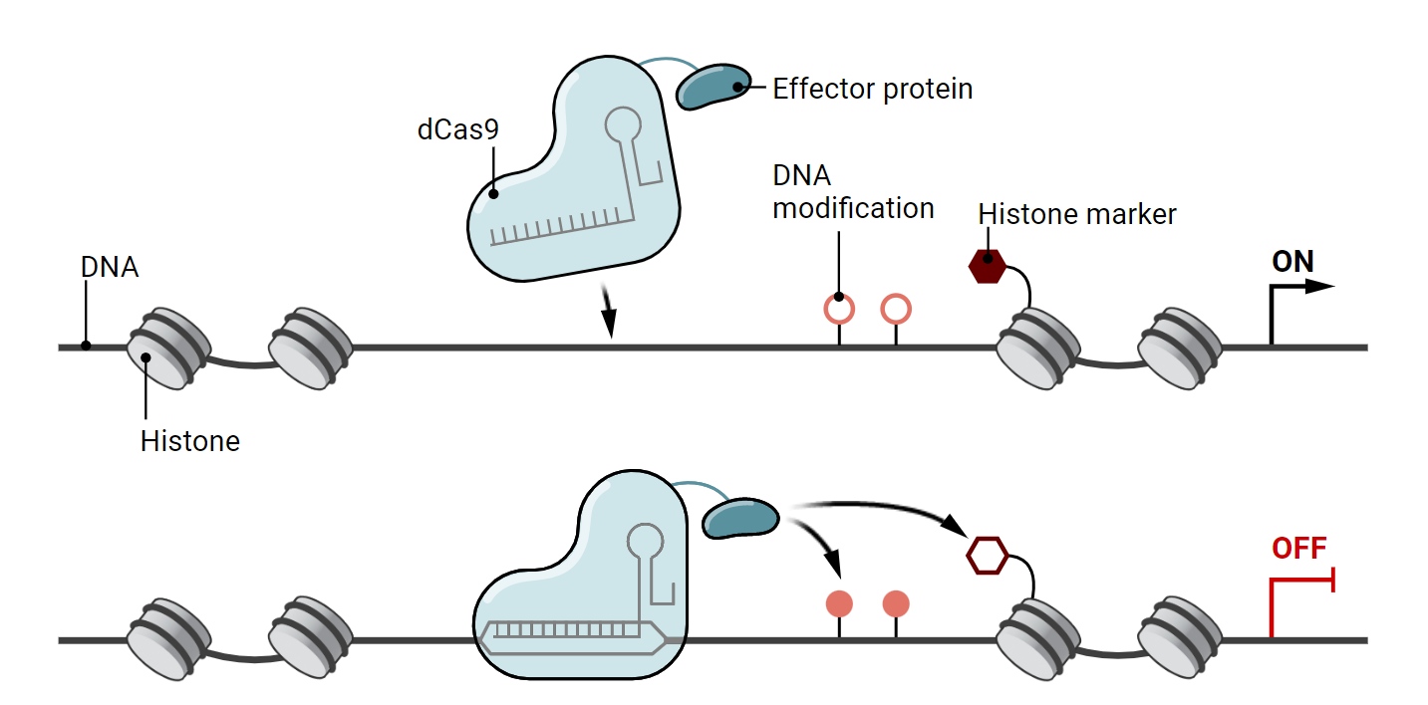

Slide 24
Coming soon,… to a workshop near you.
Tomorrow’s Science Today: preparing for the next pandemic.
An NIH SEPA project.
New Instructional Materials
  Models, models and more models….
    A Virus Collection,.. including CoV-2
    Antibodies/vaccines /and your immune system
    mRNA vaccines and multi-valent, ultra-potent vaccines…from synthetic biology.
    Stories, stories and more stories….
A Professional Learning Experience…beginning in the summer of 2024
But first,…enroll now in Modeling the Molecular World, 2023
Session 1 -- June 26-30, or
Session 2 -- July 17 - 21

Slide 25


Slide 29
WHY…did T replace U in DNA?
spontaneous oxidative deamination of C
…if we had not switched…
AGUCGAAGUCAACCGAGGCUGCGCUAC
UCAGCUUCAGUUGGCUCCGACGCGAUG
U
AGUCGAAGU AACCGAGGCUGCGCUAC
x
UCAGCUUCA UUGGCUCCGACGCGAUG
G
A DNA repair system can remove “U” from DNA.
But,…how can we distinguish between a
“deaminated C” and a normal U?
ANSWER: We can’t.

Slide 30
WHY…did T replace U in DNA?
spontaneous oxidative deamination of C
…but after we switched…
AGTCGAAGTCAACCGAGGCTGCGCTAC
TCAGCTTCAGTTGGCTCCGACGCGATG
U
AGTCGAAGT AACCGAGGCTGCGCTAC
x
TCAGCTTCA TTGGCTCCGACGCGATG
G
Uracil glycosidase constantly scans the DNA….looking for U’s.
Any U … is a bad U…and should be repaired.

Slide 31
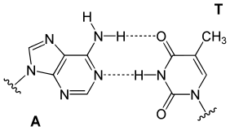
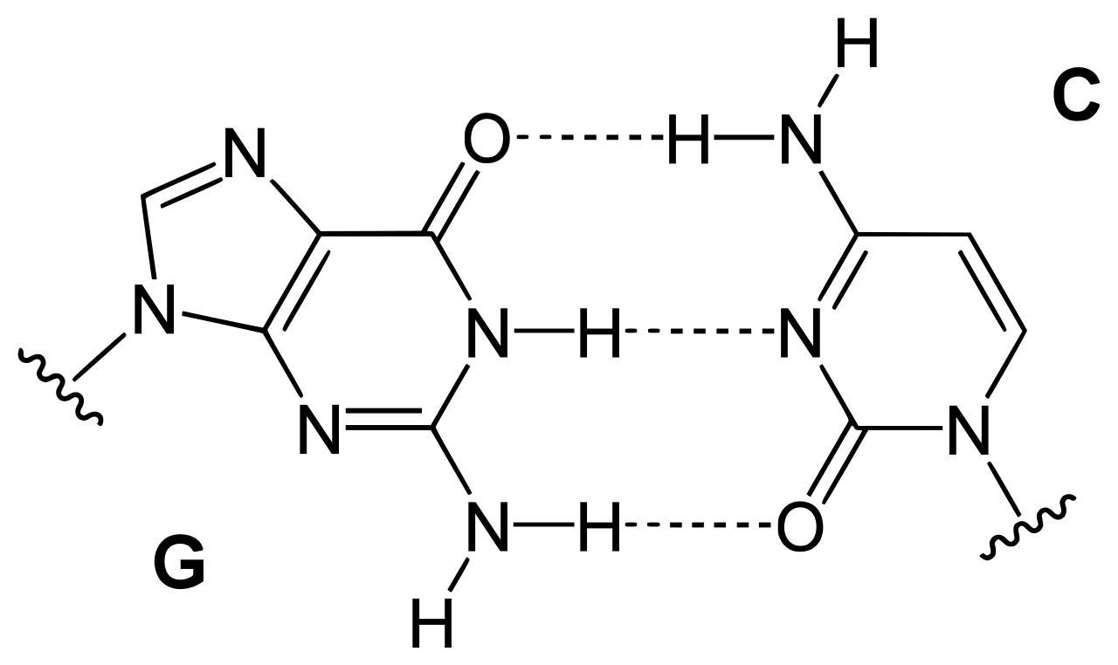
5
5
deoxyribose
deoxyribose
deoxyribose
deoxyribose

Slide 32




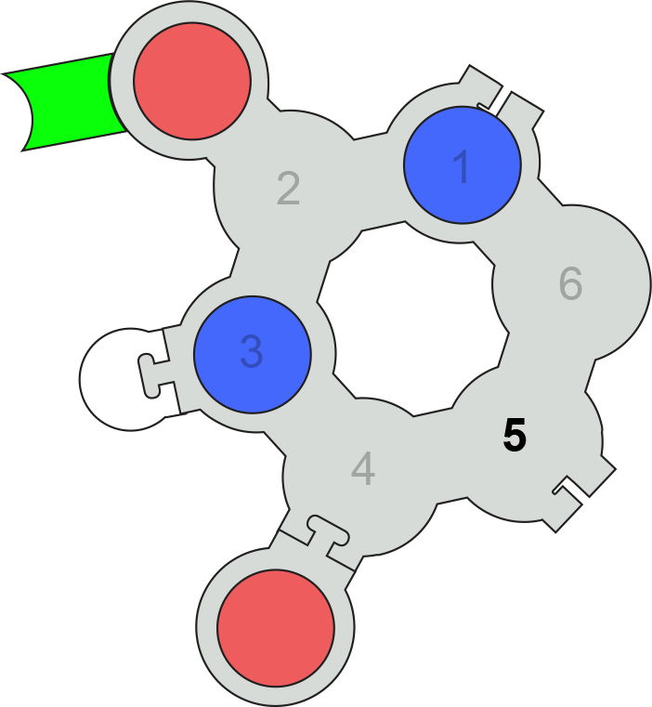
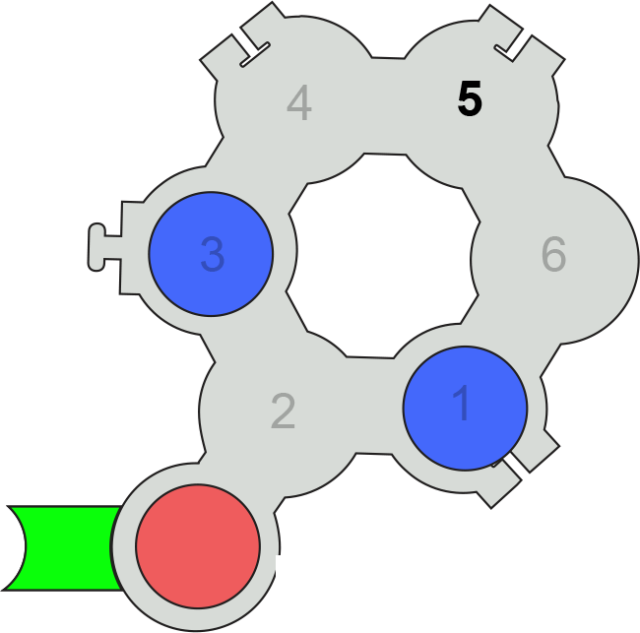
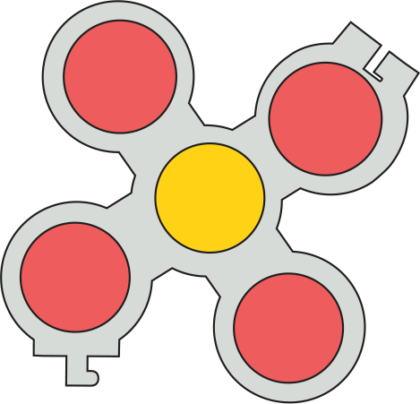

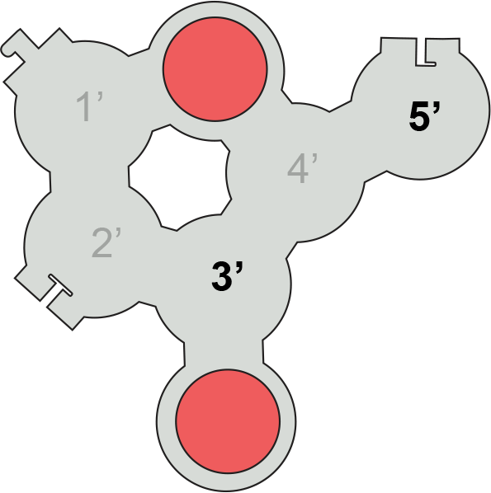
Uridine
Pseudo-Uridine

