Slide 1
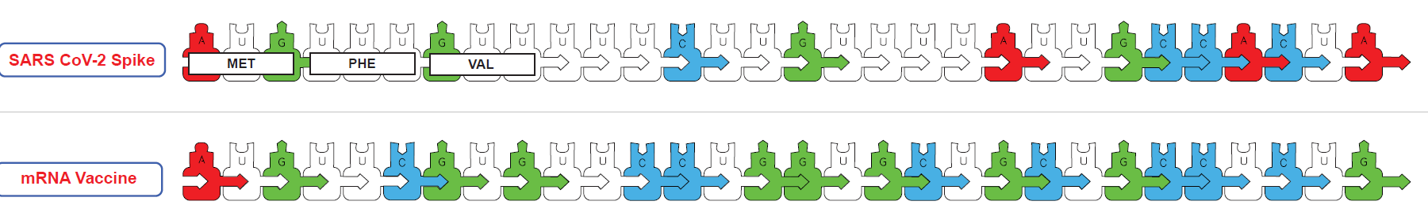
Modeling…
Infectious Diseases & Immunity
Tim Herman
3D Molecular Designs

Slide 2
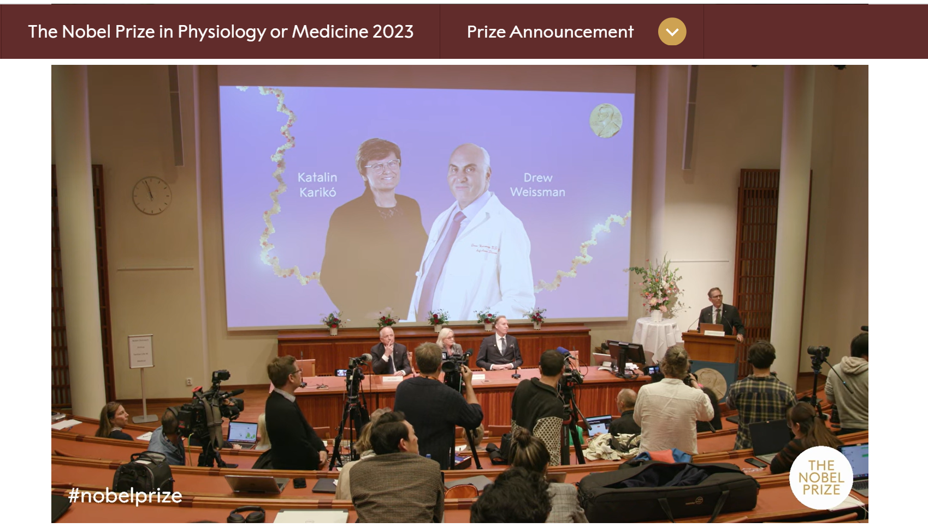
https://www.nobelprize.org/prizes/medicine/2023/prize-announcement/

Slide 3
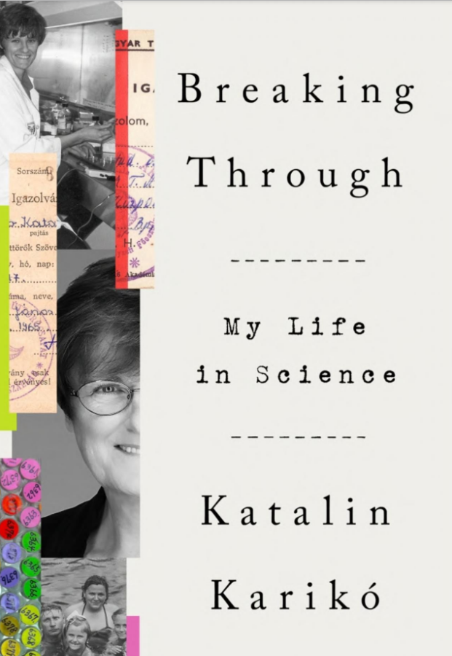
And yet she persisted…..
“…nature rarely replies to questions unless they are put to her in the form of experiments,
… to which she can say yes or no.”
Katie Kariko, F
If you torture the data long enough, nature will confess.

Slide 4
Workshop Outline
Coming Soon….Modeling Infectious Diseases and Immunity
An NIH SEPA project focused on infectious diseases
COVID-19…. and mRNA vaccines
A story about the process of science,…
…and Katie Kariko,… and pseudouridine
An mRNA Vaccine Design Activity….
Why did it take so long?... and why did it happen so fast?
Student Challenge… Can you engineer an mRNA vaccine?

Slide 5
Coming soon,… to a workshop near you.
Modeling Infectious Diseases & Immunity
An NIH SEPA project.
New Instructional Materials
  Models, models and more models….
    A Virus and Cell Modeling Collection,..
    Antibodies/vaccines /and your immune system
    mRNA vaccines and multi-valent, ultra-potent vaccines…from synthetic biology.
    Stories, stories and more stories….
A Professional Learning Experience…beginning June 24-28, 2024
But first,…enroll now in Modeling the Molecular World, 2023
Session 1 -- July 29 – Aug 2, or
Session 2 –- Aug 5 – Aug 9

Slide 6
Teaching the Molecular Biosciences in a post-pandemic era
It has been the best of times,… it has been the worst of times.
The biosciences have demonstrated their considerable power and maturity by delivering an effective vaccine to protect the public from CoV-2 … in less than 1 year.
The public has been reluctant to embrace this new technology, choosing instead to question the validity of the science and the motives of big pharma.
But let’s not lose this opportunity to tell this amazing story of the process of science.

Slide 7
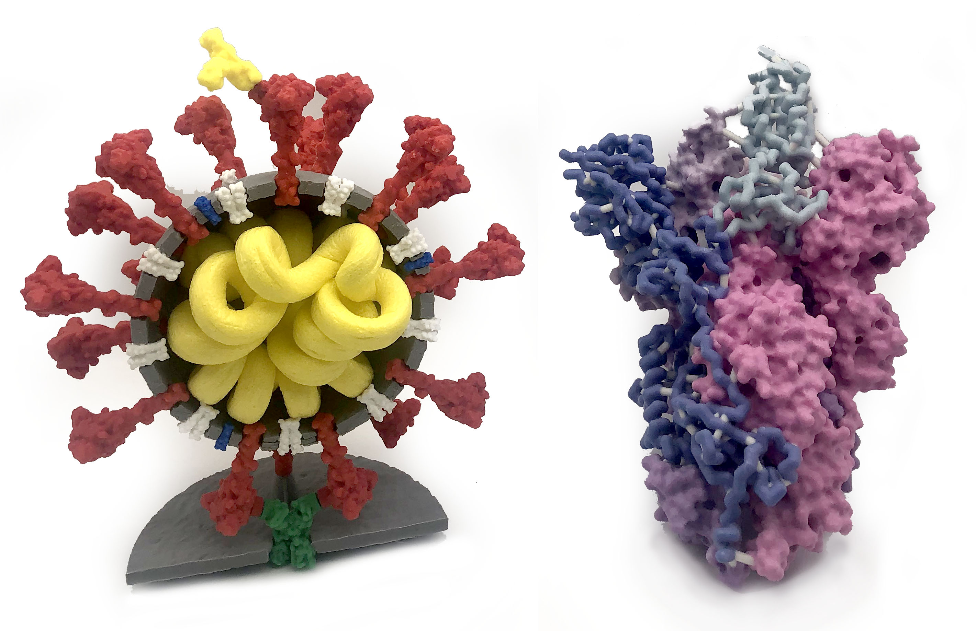
Coronavirus …and the Spike protein
Models give meaning to words….

Slide 8
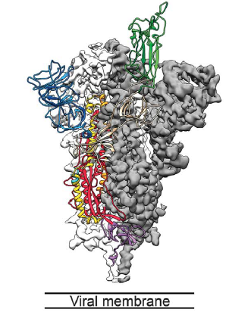
Here’s the story….SCIENCE to the rescue……
December 2019, new coronavirus (CoV-2) reported in China
January 10, 2020, nucleotide sequence of CoV-2 reported…
… and shared with the world.
January 13, 2020, optimized version of the spike gene sent to Moderna.
March 20, 2020, Jason McLellan publishes 3D structure
of CoV-2 spike protein.
Clinical Trials................................
December 18, 2020, Moderna mRNA vaccine EUA.

Slide 9
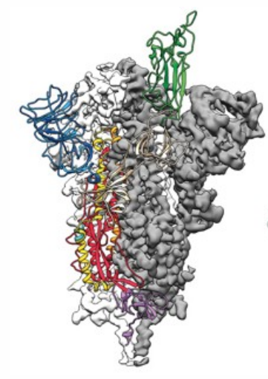
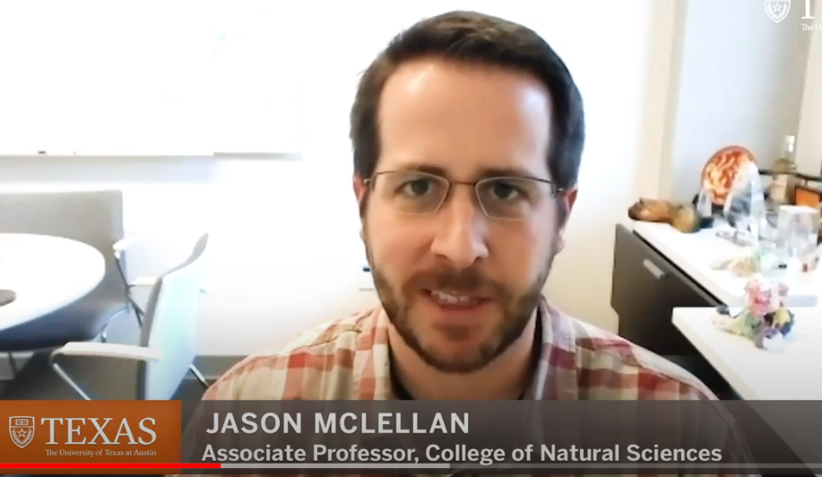
within 3 months of the CoV-2 genome being sequenced...
Key Innovations from UT Austin’s McLellan Lab Powers COVID-19 Vaccines
UT-Austin researcher explains lab’s key role in coronavirus vaccine development

Slide 10
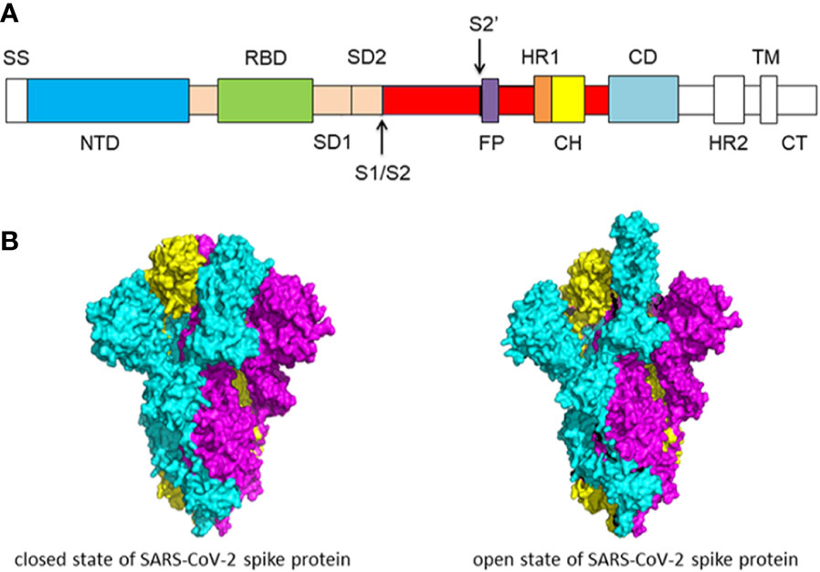

Slide 11
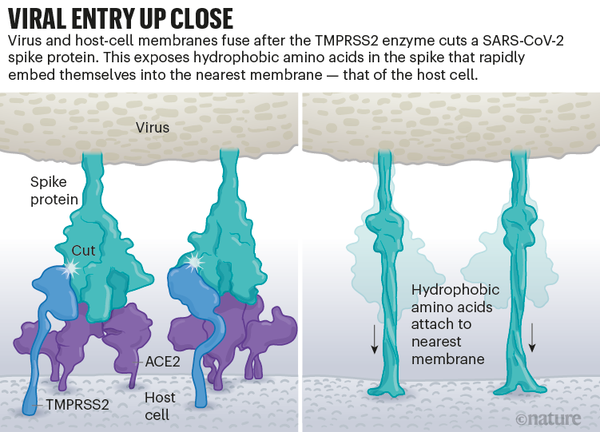
Janet Iwasa, The Animation Lab…at https://animationlab.utah.edu/cova

Slide 12
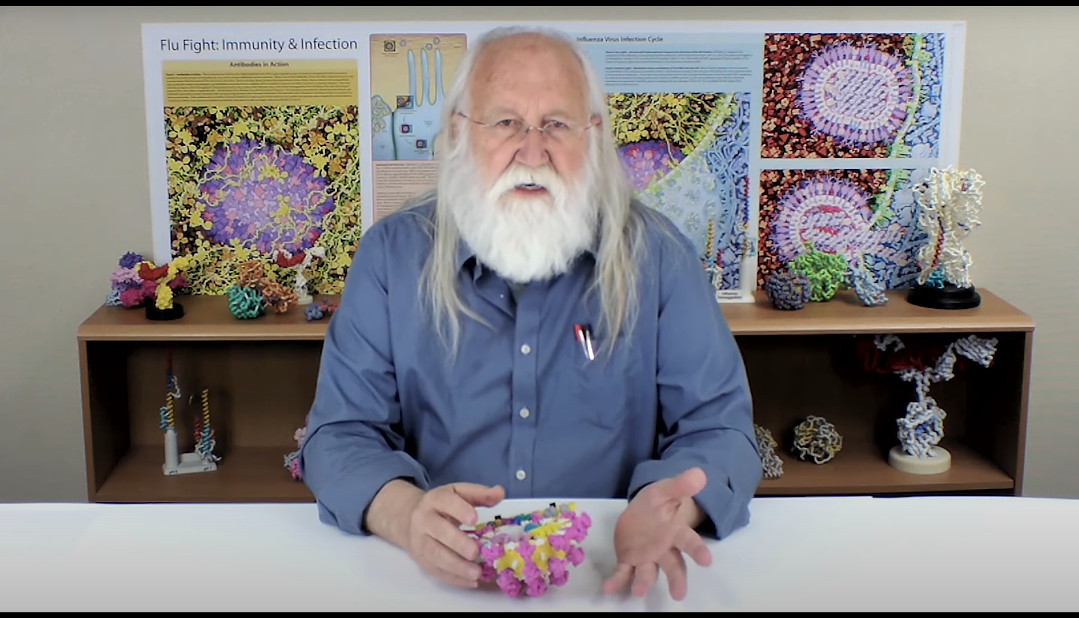
The Science of Coronavirus… a video series
https://www.3dmoleculardesigns.com/The-Science-of-Coronaviruses.htm

Slide 13
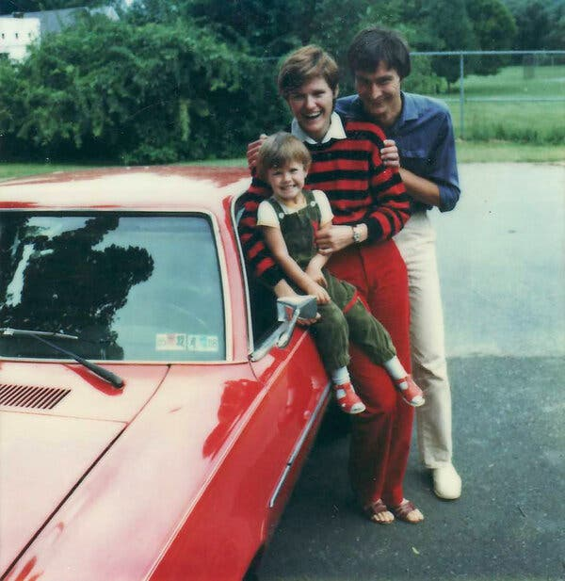
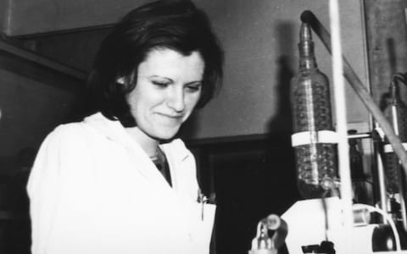
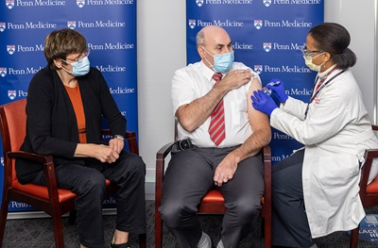
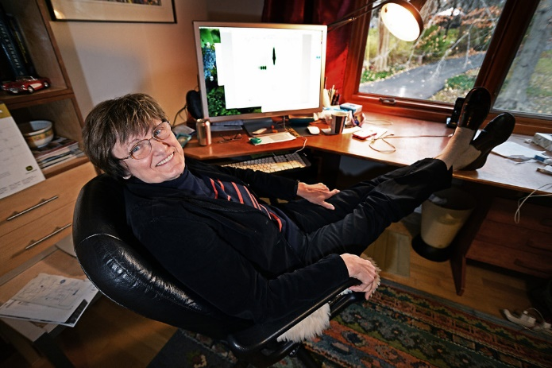
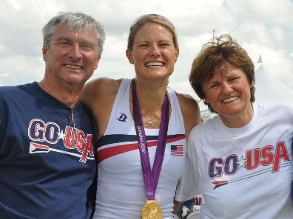
Kati Kariko,.. and the perseverance of women research associates…..
https://www.nytimes.com/2021/04/08/health/coronavirus-mrna-kariko.html
https://www.cnn.com/2020/12/16/us/katalin-kariko-covid-19-vaccine-scientist-trnd/index.html

Slide 14
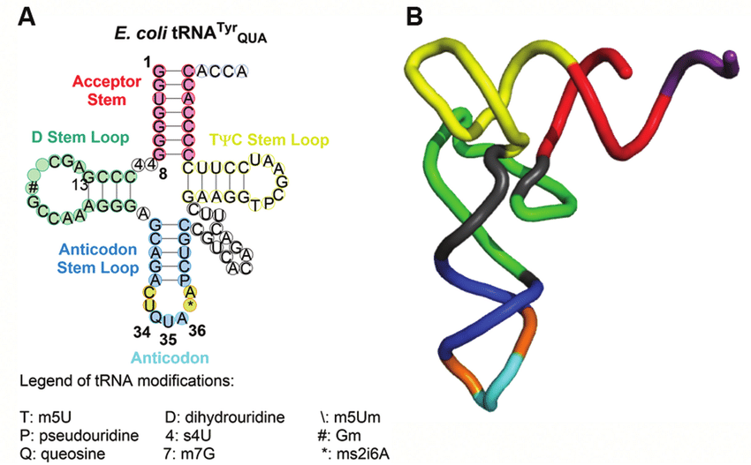
…………….WHY?
tRNA Modifications

Slide 15
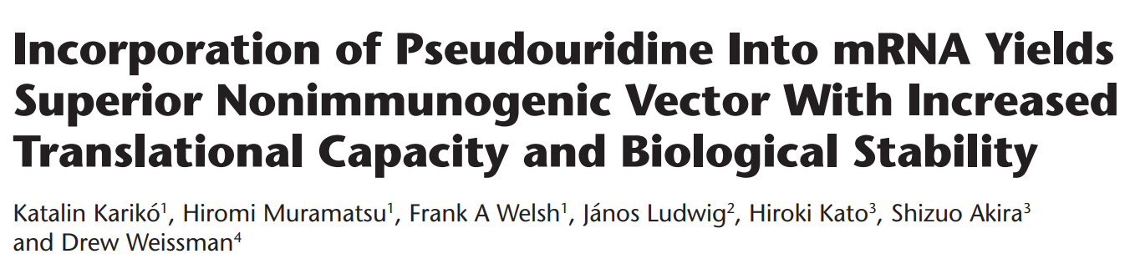
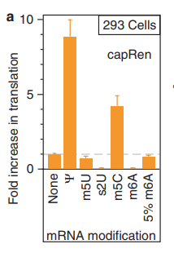
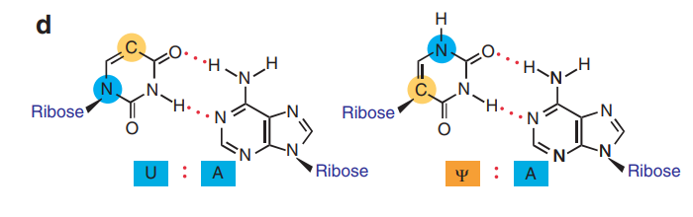
Molecular Therapy vol. 16 no. 11, 1833–1840 nov. 2008
pseudouridine
GUAACUGCAUGCUAGCUAGCUAGCUCAGUGCUGCUGCUGUAUUUGCUUGA
GΨAACΨGCAUGCΨAGCΨAGCΨAGCΨCAGΨGCΨGCΨGCΨGΨAΨΨΨGCΨΨGA

Slide 16




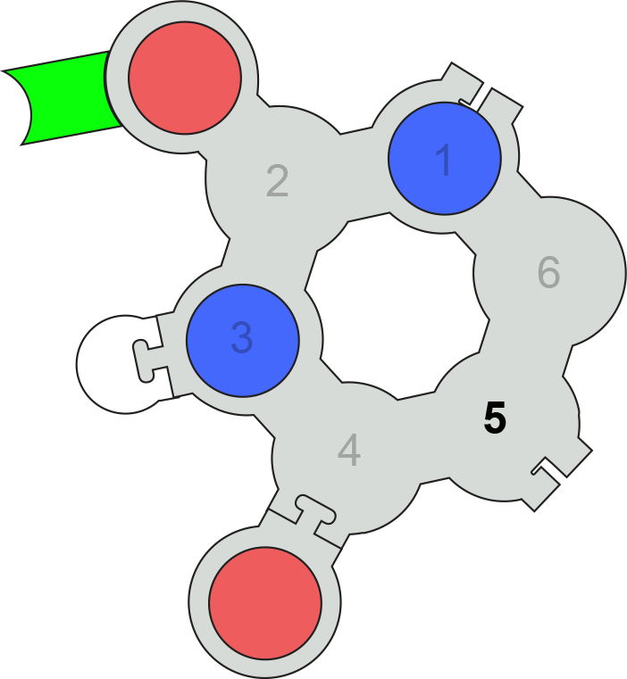
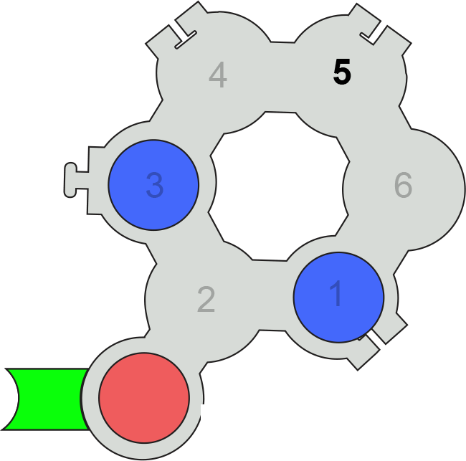
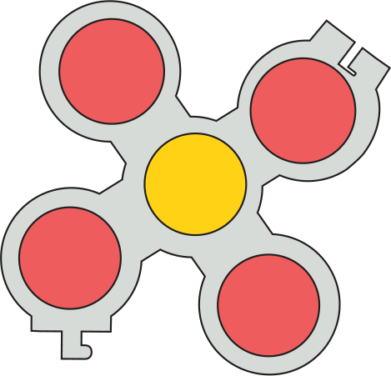

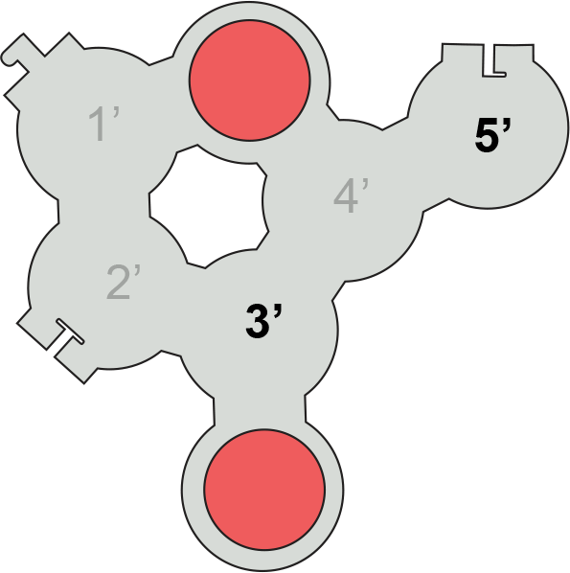

Tactile Base Pairs
Uridine
Pseudo-Uridine

Slide 18
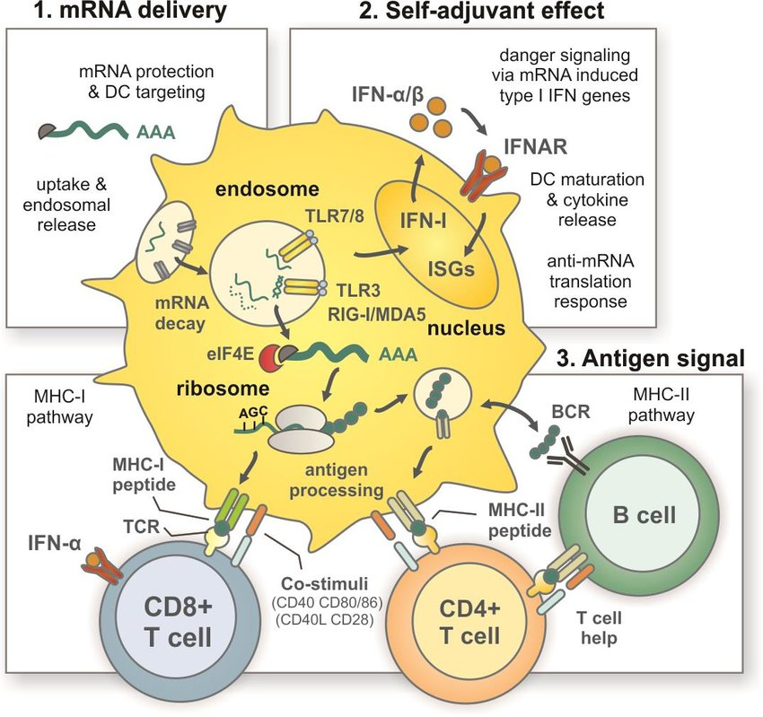

Slide 19
STEM….
Engineering…delivered to us a design for an effective mRNA vaccine for CoV-2
Science…delivered to us the nucleotide sequence encoding the spike protein of CoV-2
How can you incorporate principles of
engineering design into your science classes?

Slide 20
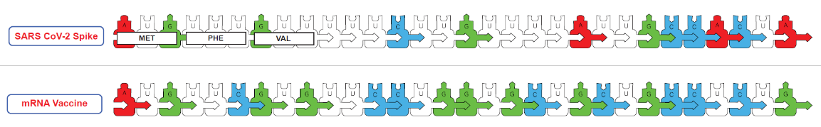
...an mRNA vaccine design activity

Slide 21
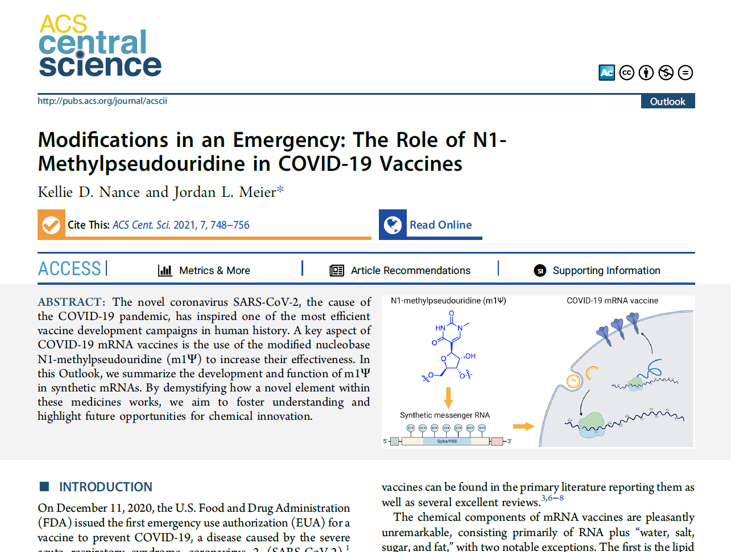

Slide 22
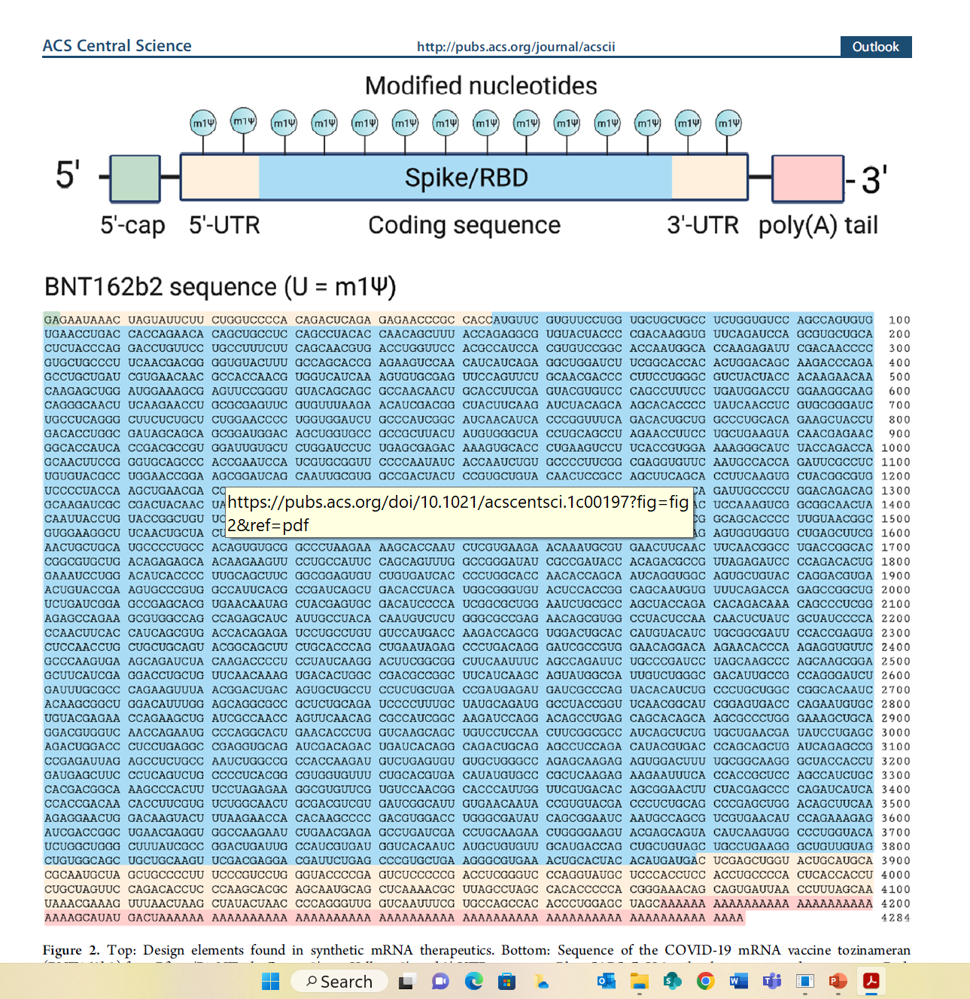

Slide 23
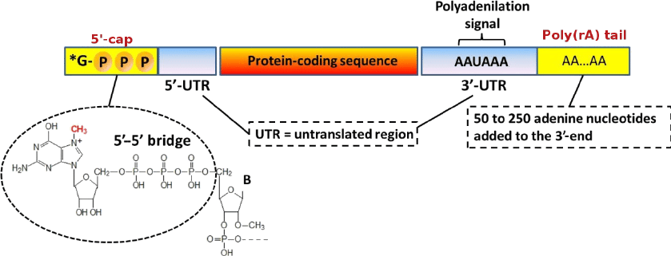
The Components of mRNA
WHY?
Protect mRNA from degradation
Ribosome engagement site…
Distinguish between viral RNA and endogenous mRNA

Slide 24
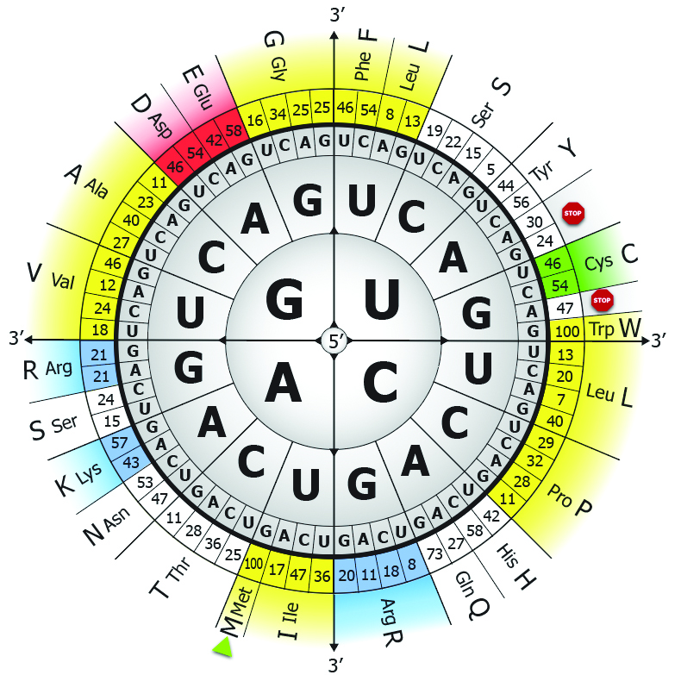
A Table of Genetic Codons….
… with human codon preferences

Slide 25
Coming soon,…
Modeling Infectious Diseases and Immunity
June 24-28
An NIH SEPA project.
A Professional Learning Experience…beginning in the summer of 2024
New Instructional Materials
  Models, models and more models….
    A Virus and Cell Modeling Collection,.. including CoV-2
    Antibodies/vaccines /and your immune system
    mRNA vaccines and multi-valent, ultra-potent vaccines…from synthetic biology.
    Stories, stories and more stories….
A Pre-requisite for this advanced course is…
Modeling the Molecular World
Session 1 -- July 29 – Aug 2,
Session 2 -- Aug 5 - 9

Slide 26
