Slide 1
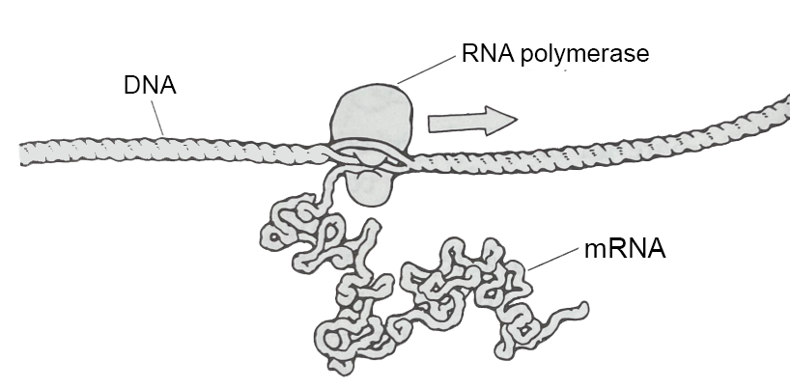
The Cellular Landscapes of David Goodsell
Tim Herman
3D Molecular Designs

Slide 2
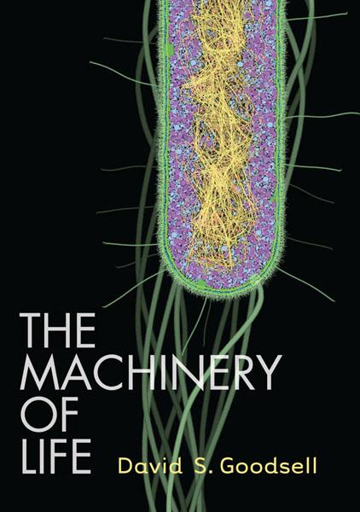

David Goodsell
Scripps Research institute
Scientist… Author… and Artist of all things small.

Slide 3
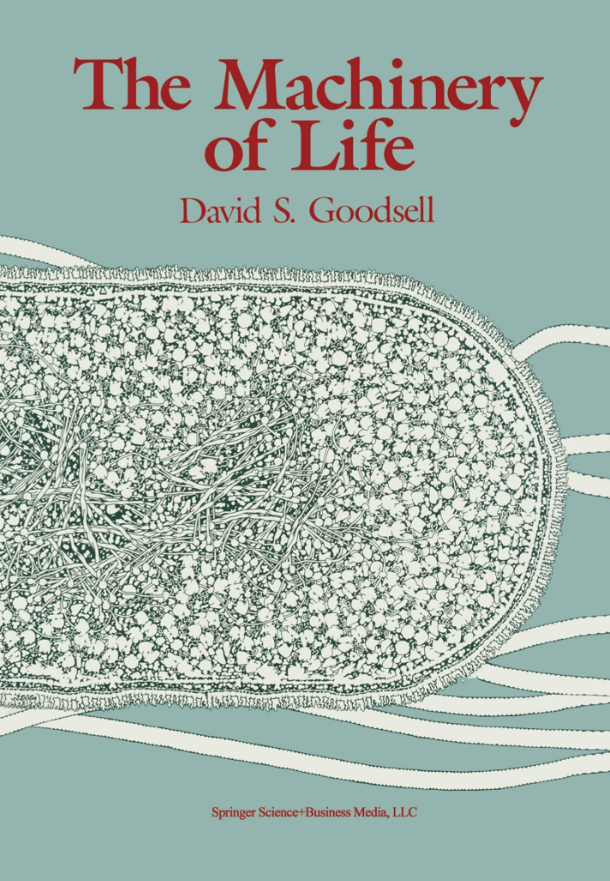
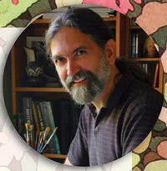
Imagine that we had some way to look directly at the molecules in our bodies…..
1993

Slide 4
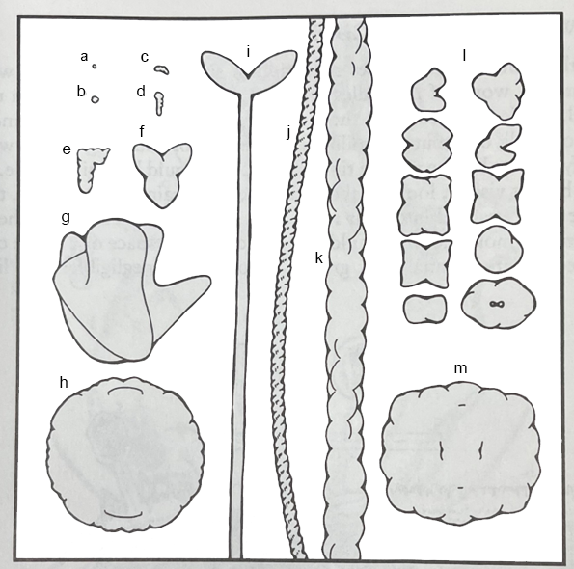
Molecules…
1,000,000 X magnification

Slide 5
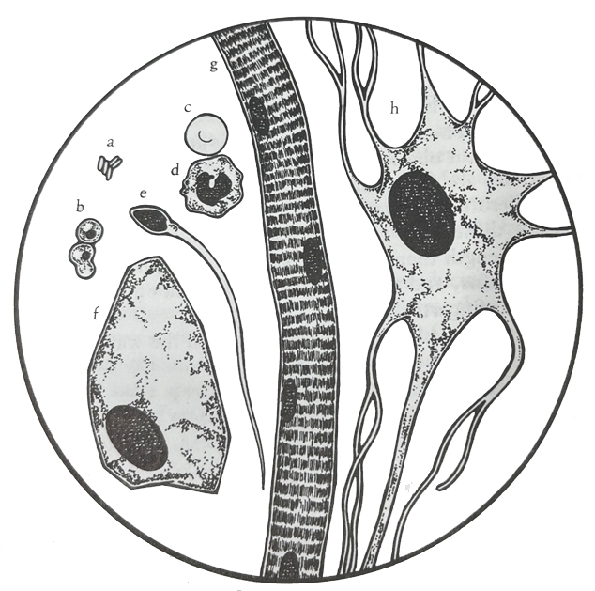
Red Blood Cell
Cells…
Neuron
Lymphocyte
1,000 X magnification
Bacteria
Sperm Cell
Yeast Cell
Human Skin Cell
Striated Muscle Cell

Slide 6
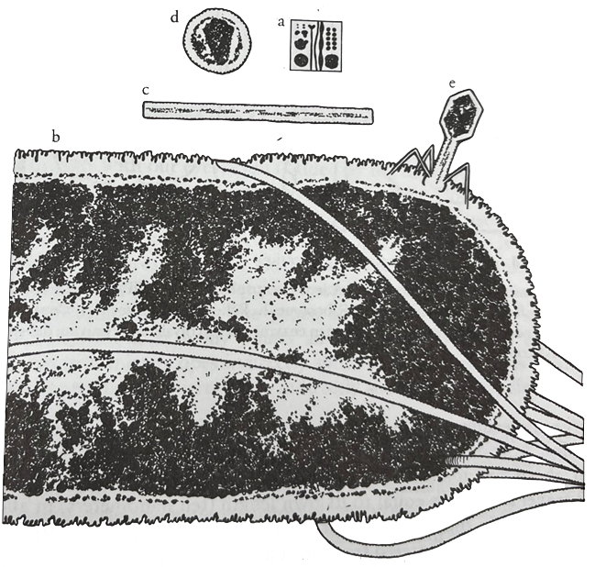
Bacteria,…
and Viruses
100,000 X magnification

Slide 8
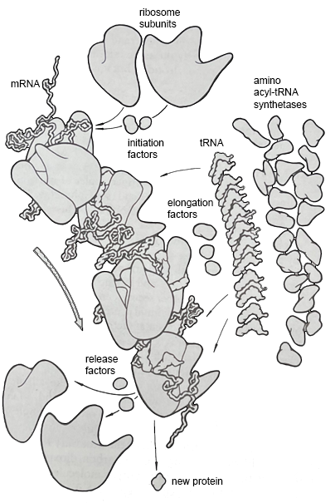

Slide 9
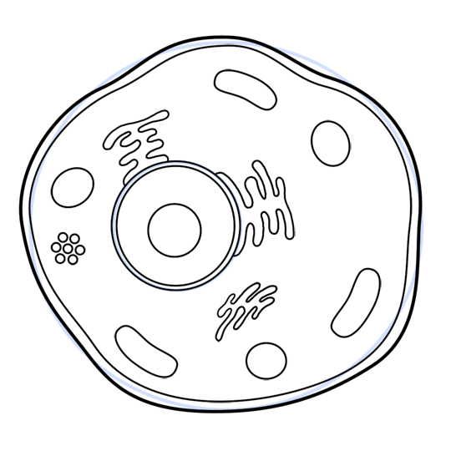
And finally... finish it off with lots of little details …..

Slide 10
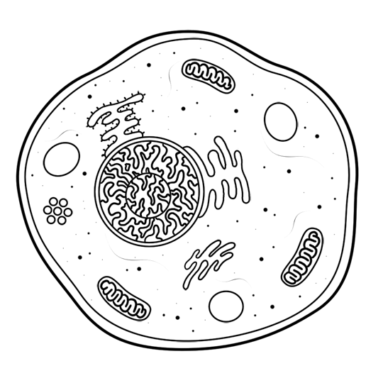
thus completing the cytoplasm

Slide 11
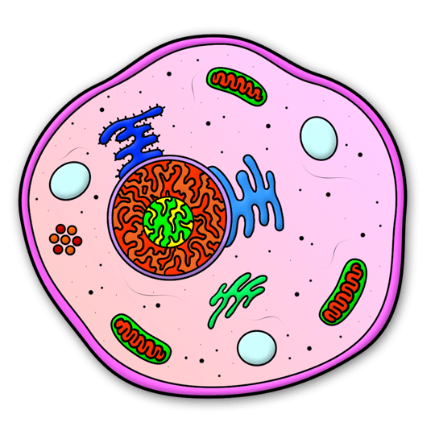
And you're done!

Slide 12
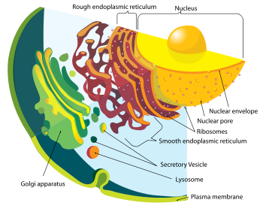
http://en.wikipedia.org/wiki/Animal_cell

Slide 13
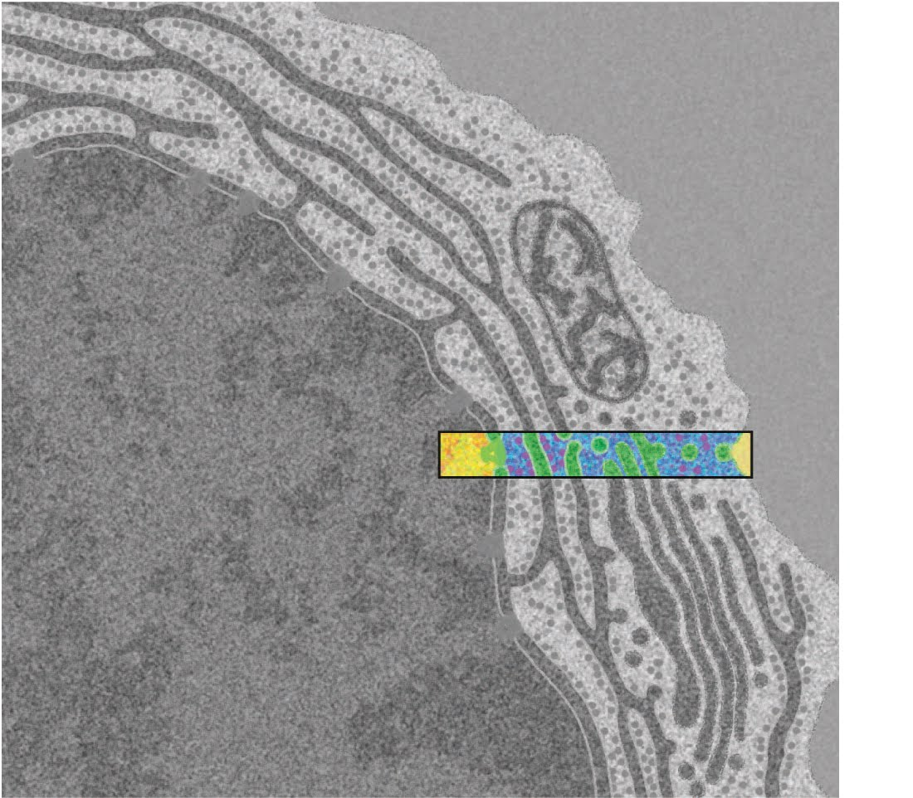
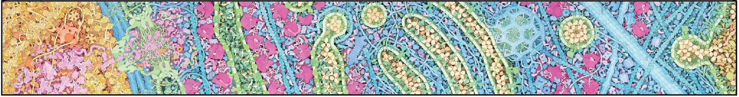
Tour of a Human Cell
An electron micrograph of an antibody-producing B-cell
Your flu/COVID-19 shot… in action.

Slide 15
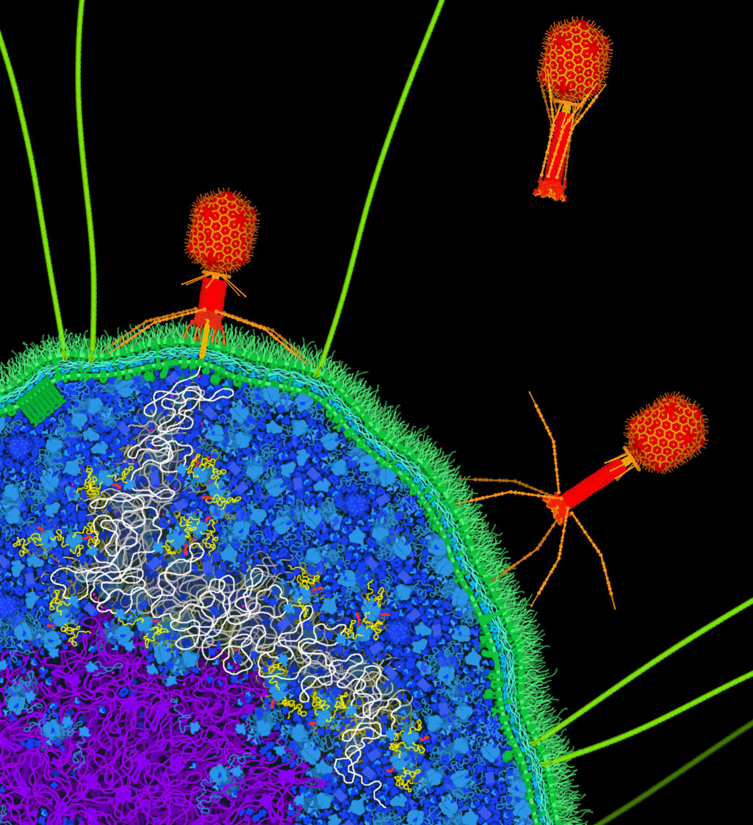
Alien Landing….!

Slide 16
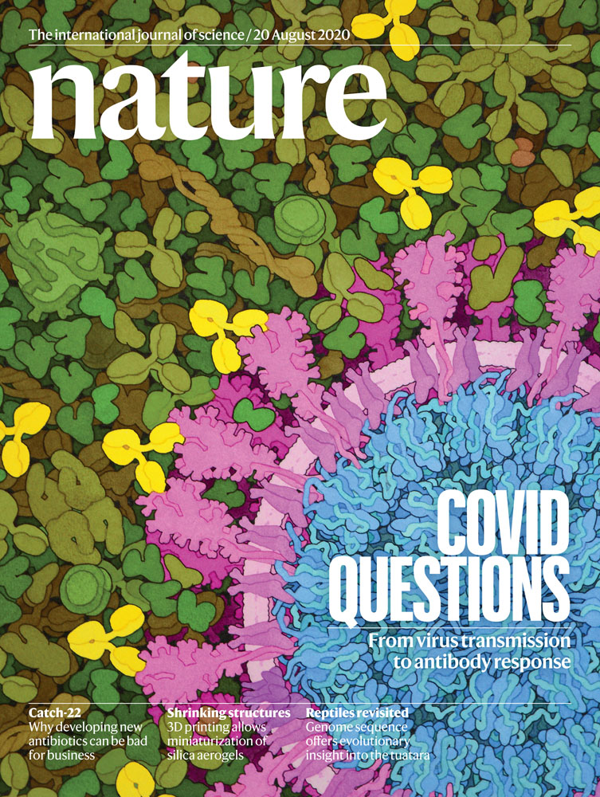

Slide 21
BAMBED … Biochemistry and Molecular Biology Education
Article
Miniseries: Illustrating the Machinery of Life
Eukaryotic Cell Panorama
Received for publication, October 7, 2010, and in revised form, December 13, 2010
David S. Goodsell‡
From the Department of Molecular Biology, The Scripps Research Institute, La Jolla, CA 92102
Diverse biological data may be used to create illustrations of molecules in their cellular context. This report describes the scientific results that support an illustration of a eukaryotic cell, enlarged by one million times to show the distribution and arrangement of macromolecules. The panoramic cross section includes eight panels that extend from the nucleus to the cell surface, showing the process of protein synthesis and export. Results from biochemistry, electron microscopy, NMR spectroscopy and x-ray crystallography were used to create the image.

Slide 22
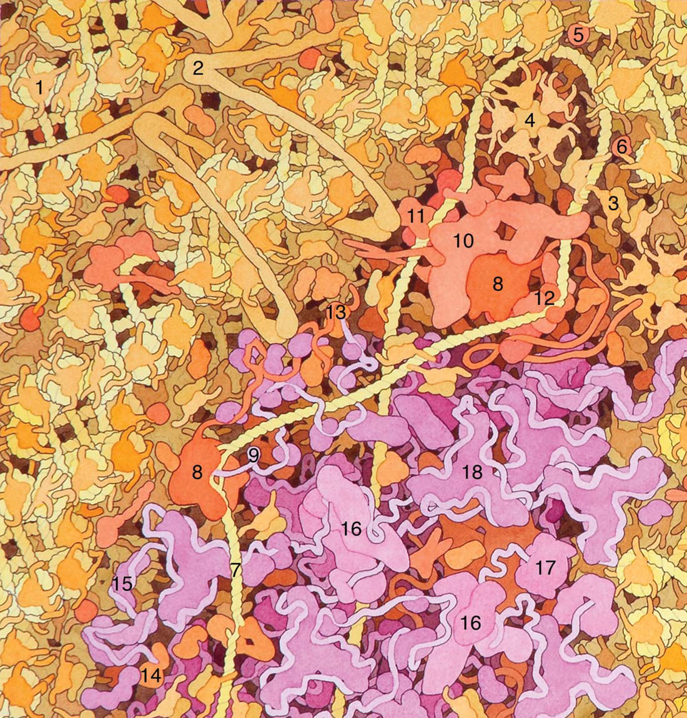

Slide 23
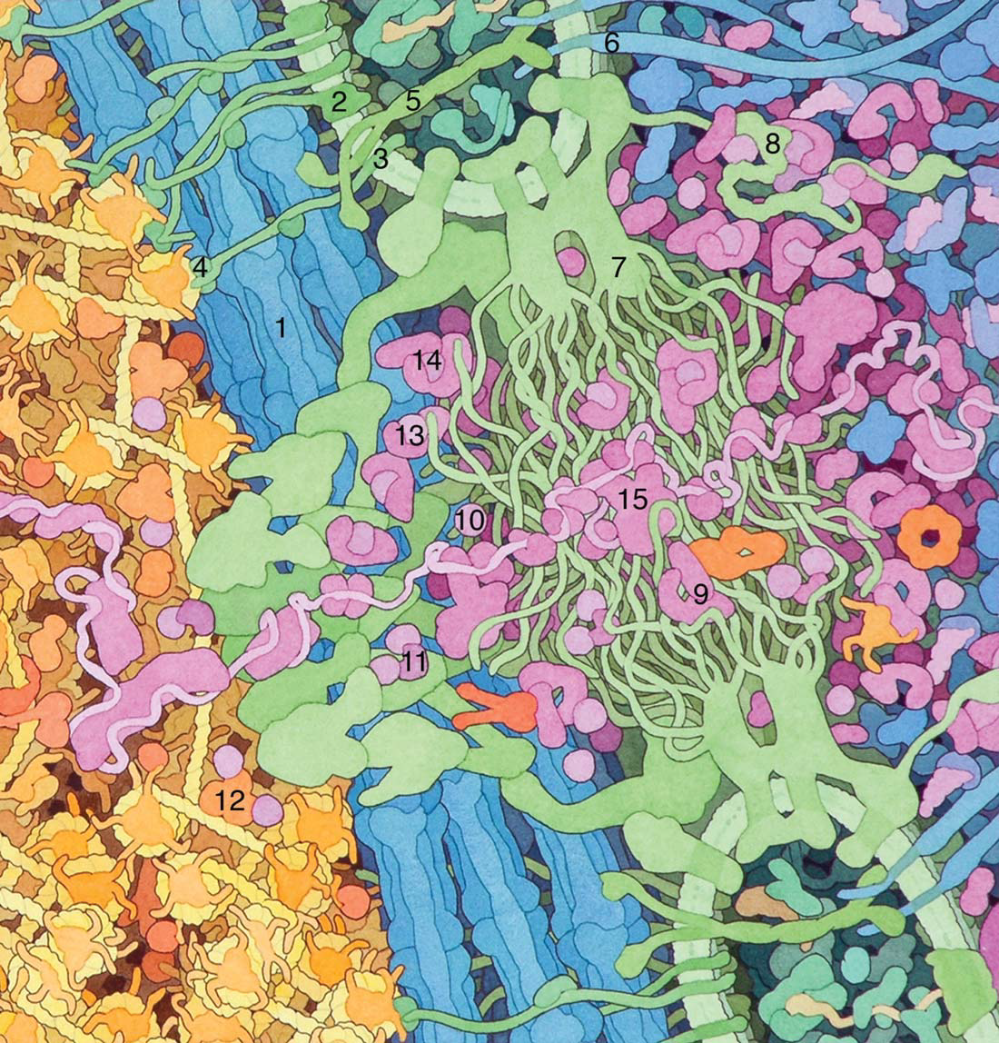

Slide 24
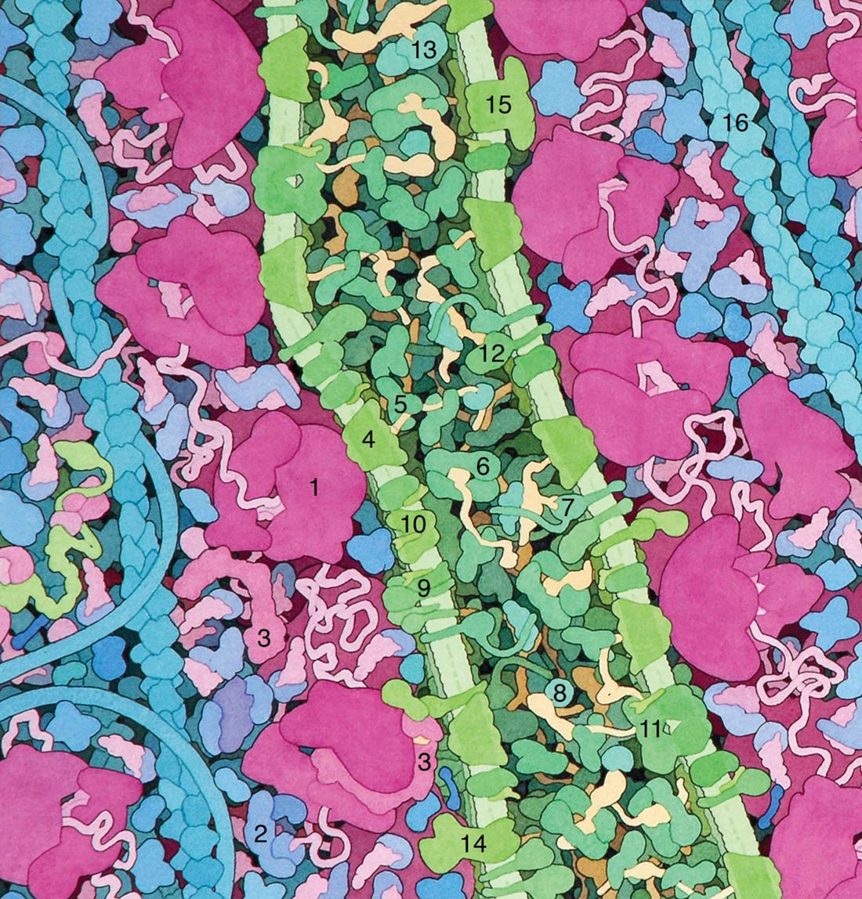

Slide 25
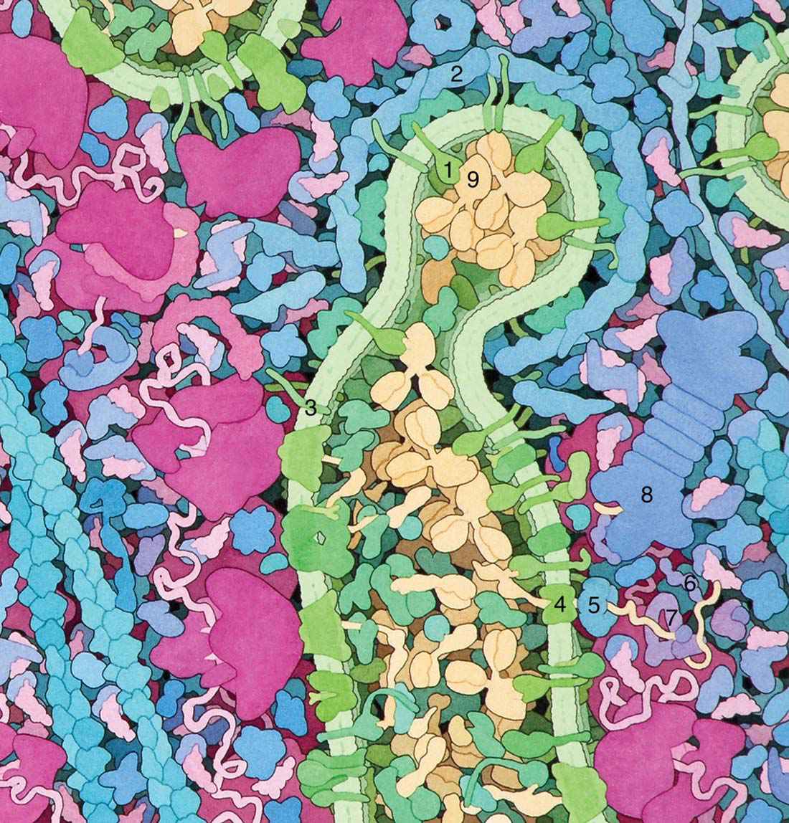

Slide 26
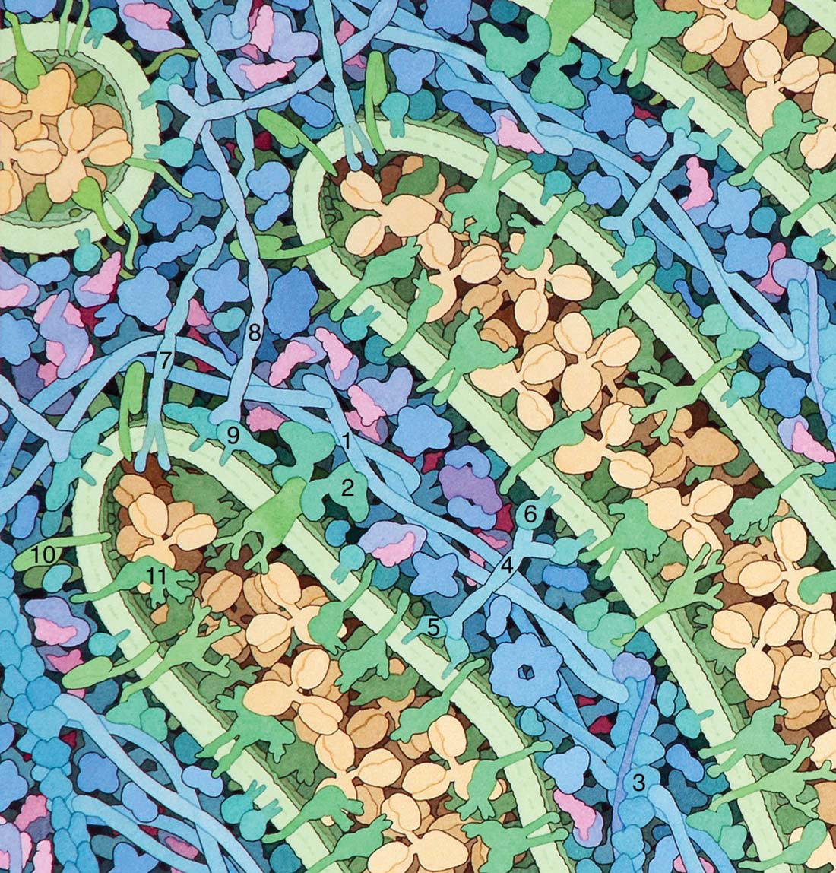

Slide 27
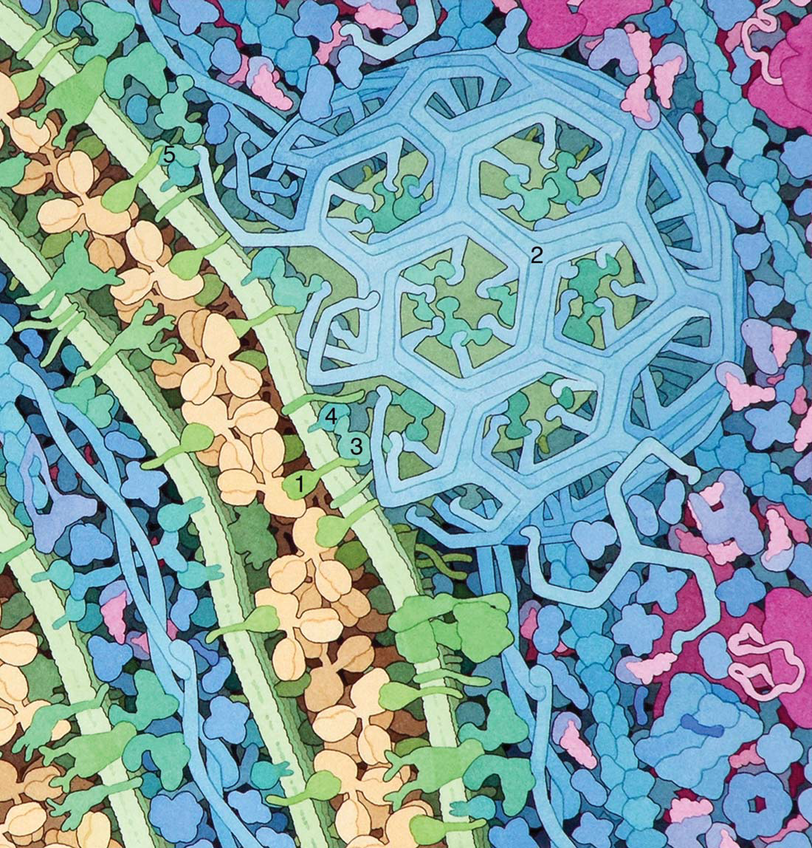

Slide 28
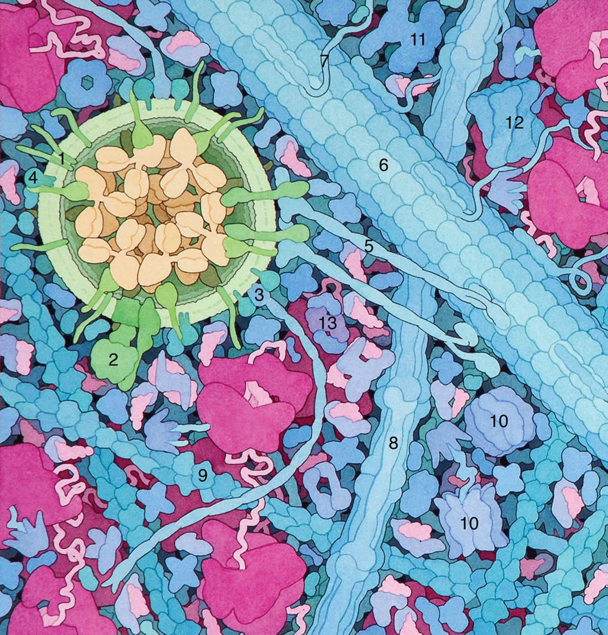

Slide 29
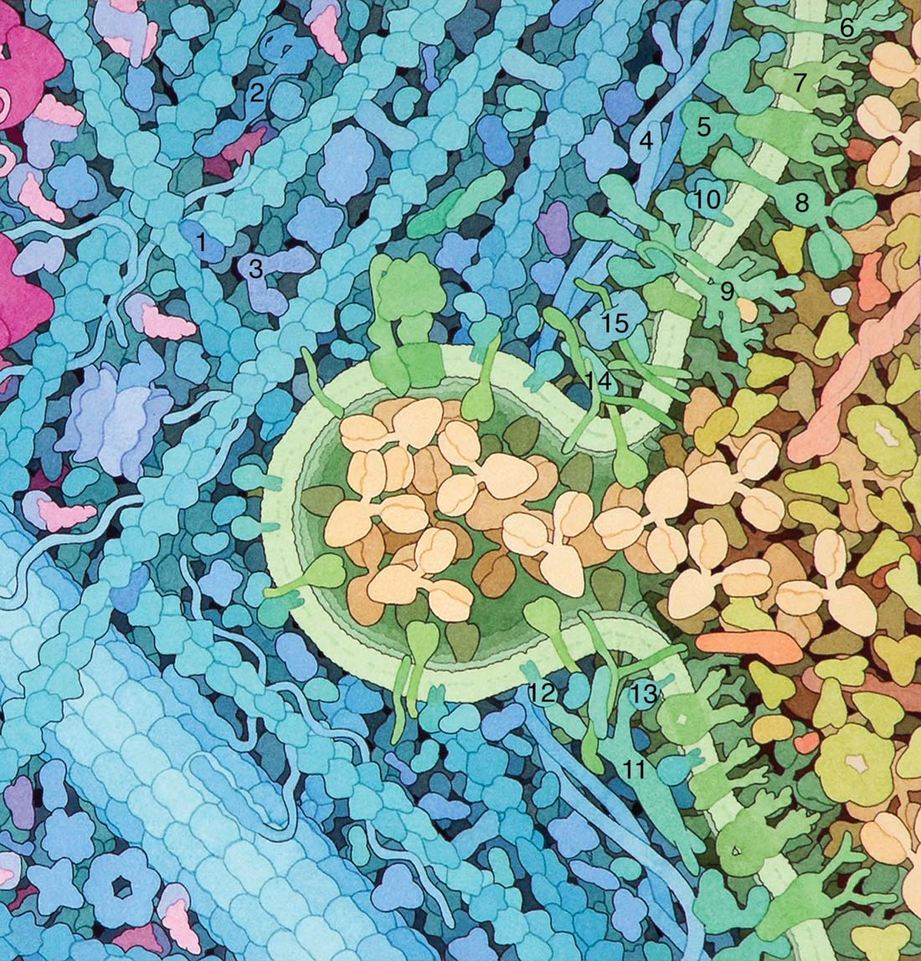

Slide 30
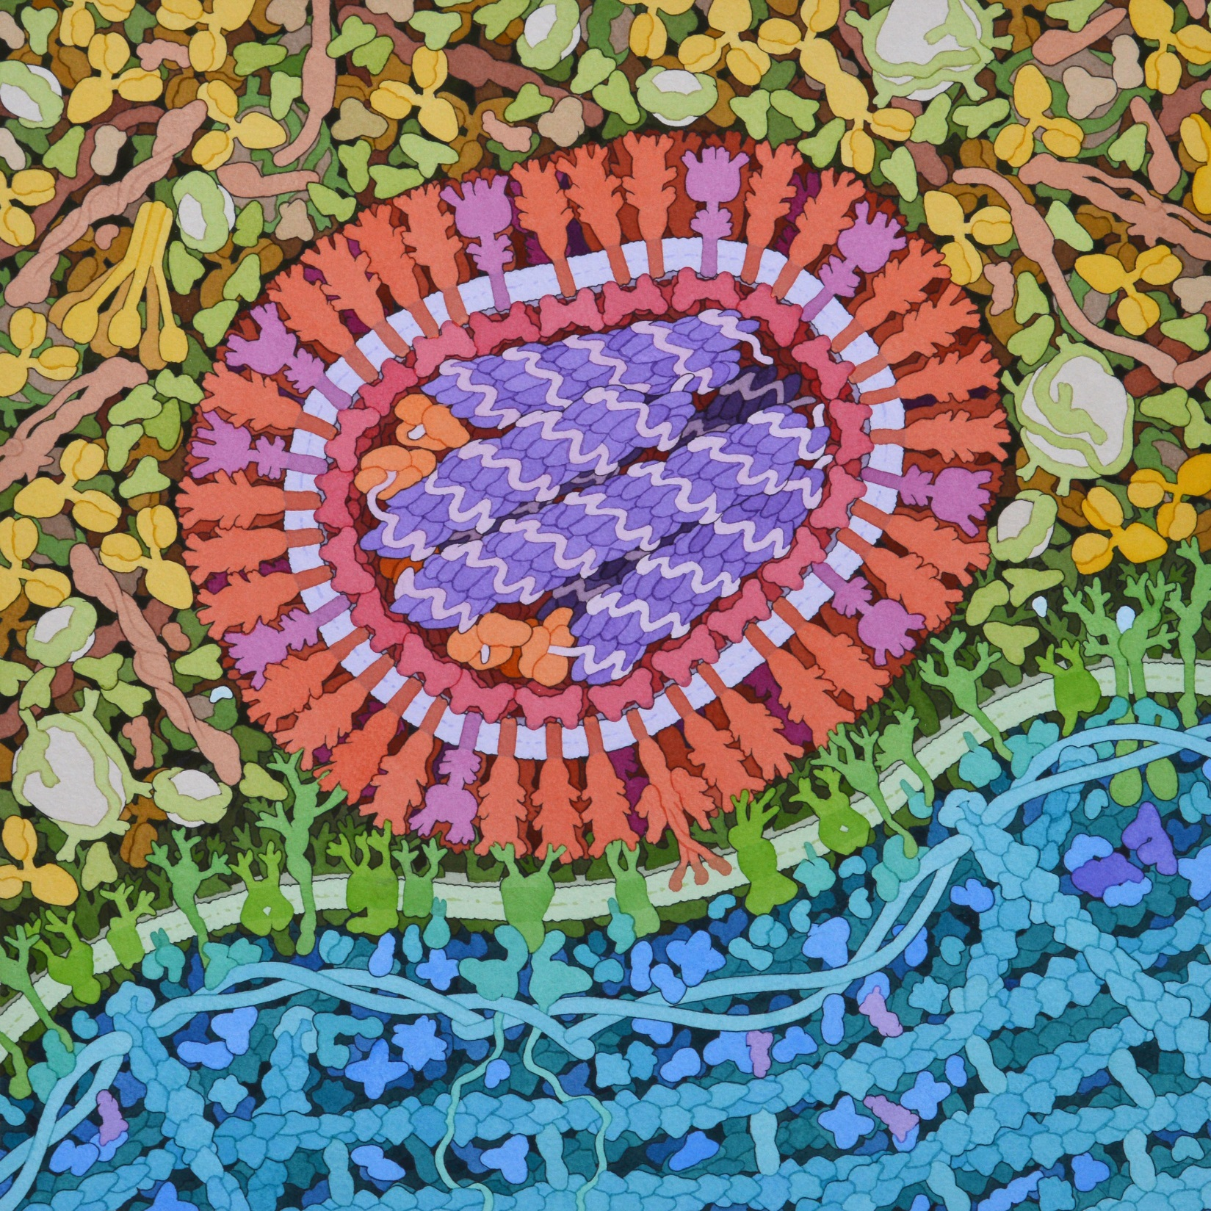

Slide 31
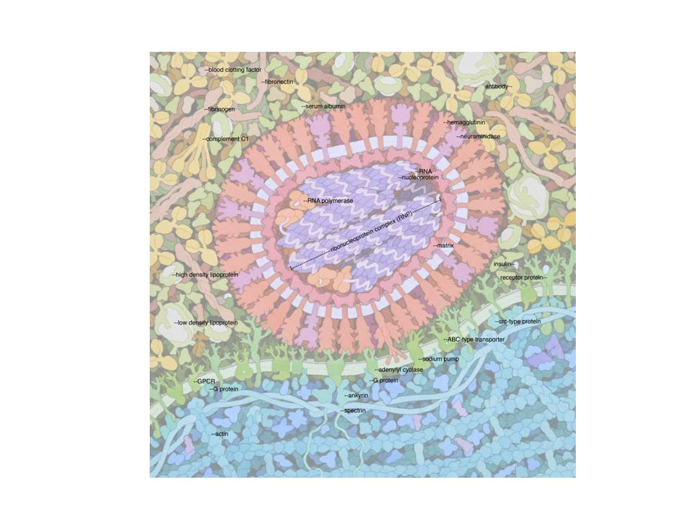

Slide 32
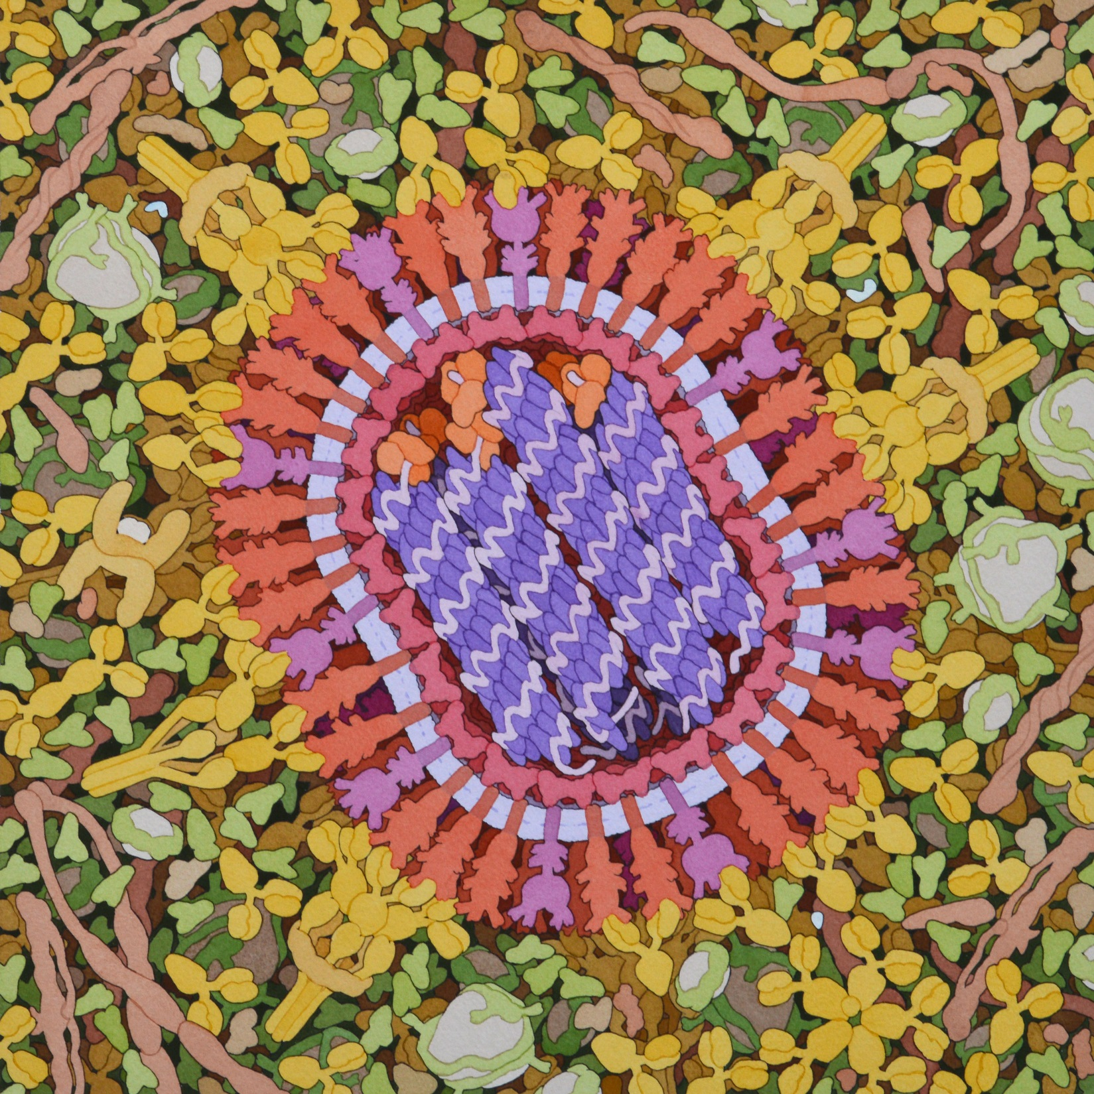

Slide 33
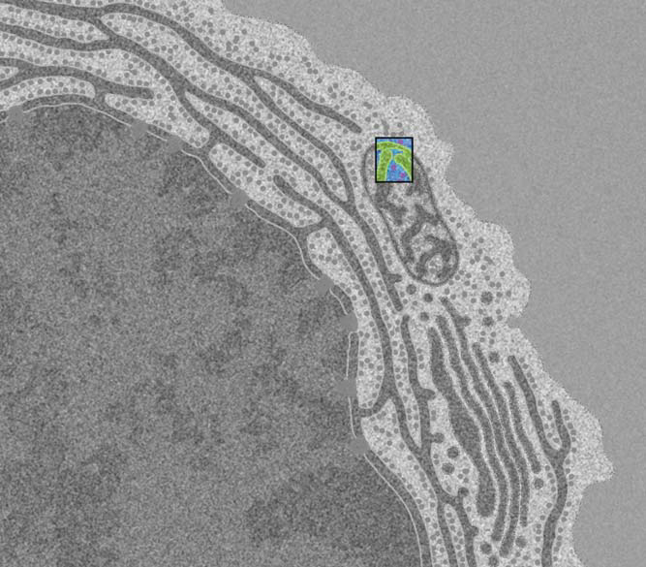

Slide 34
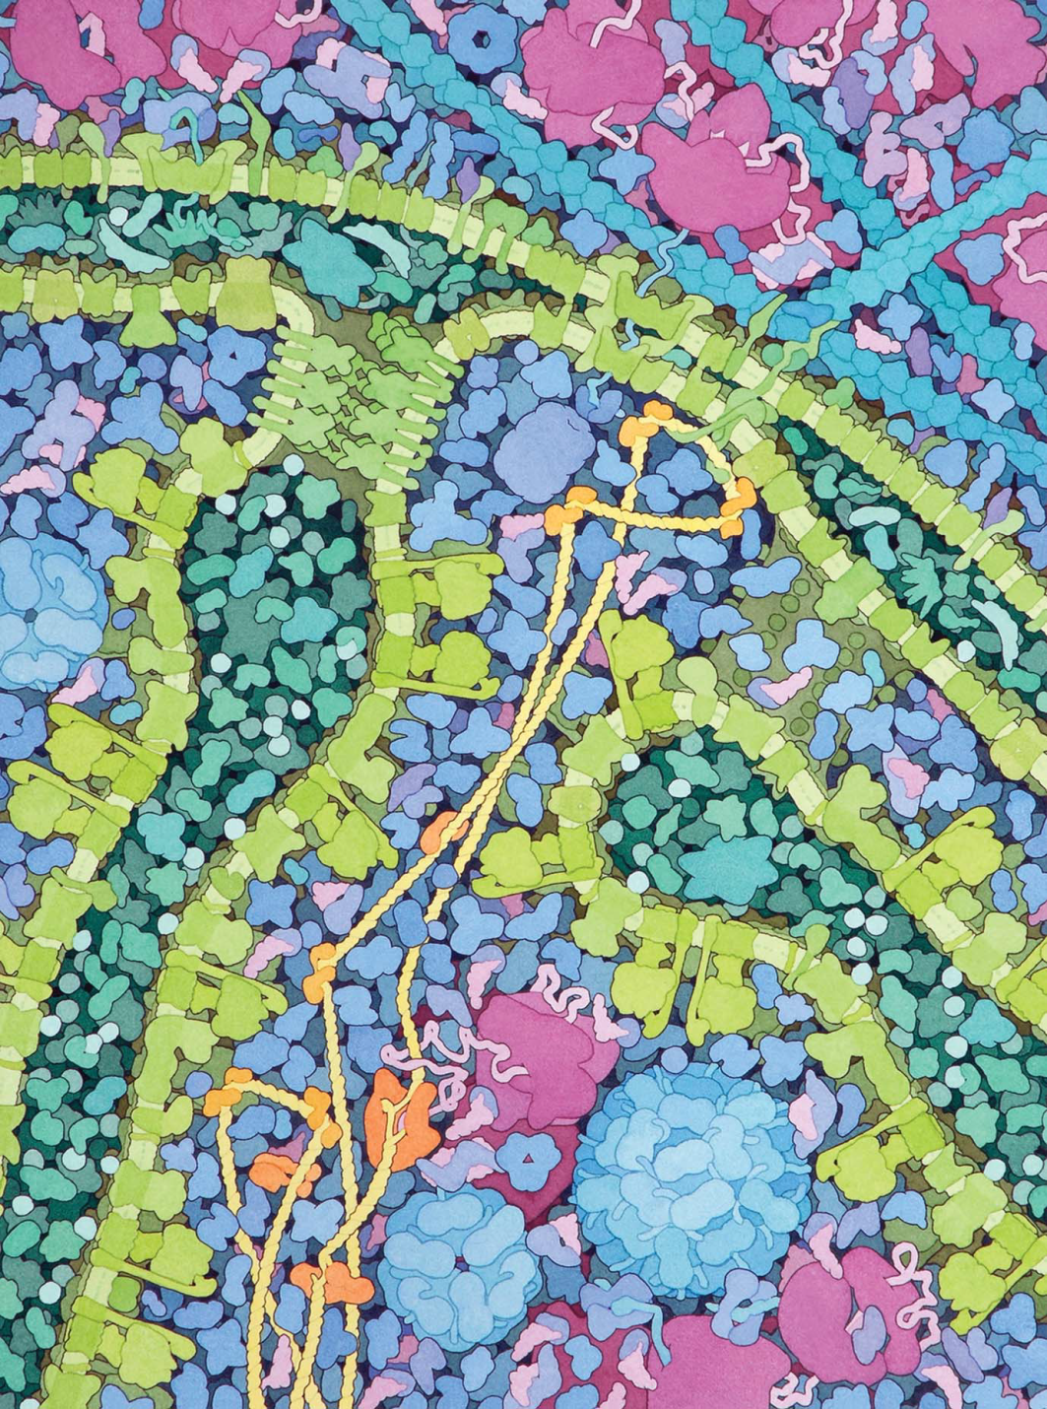

Slide 35
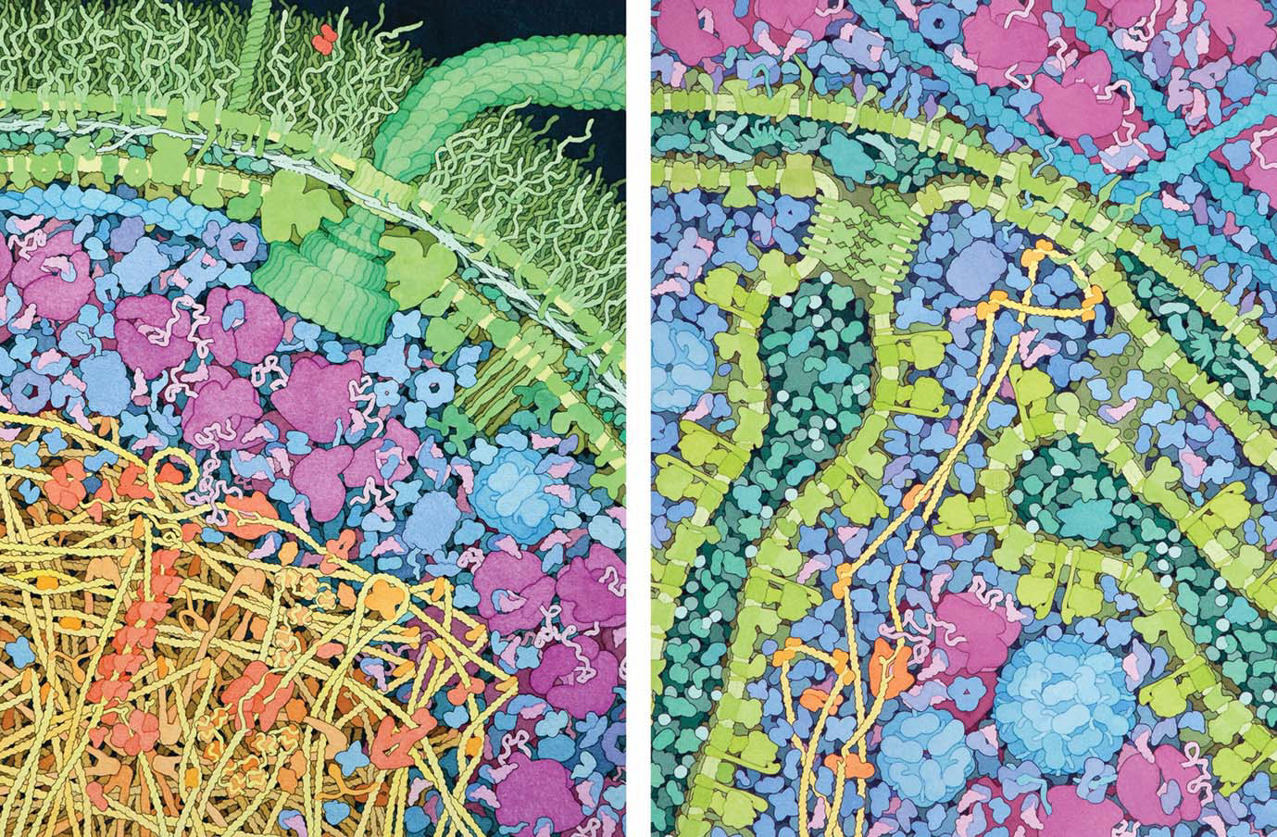
E. coli
Mitochondrion

Slide 36
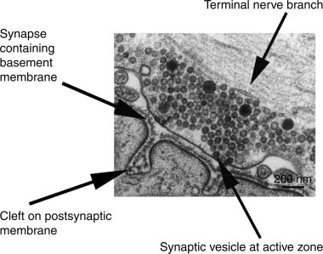

Slide 37
