Slide 1

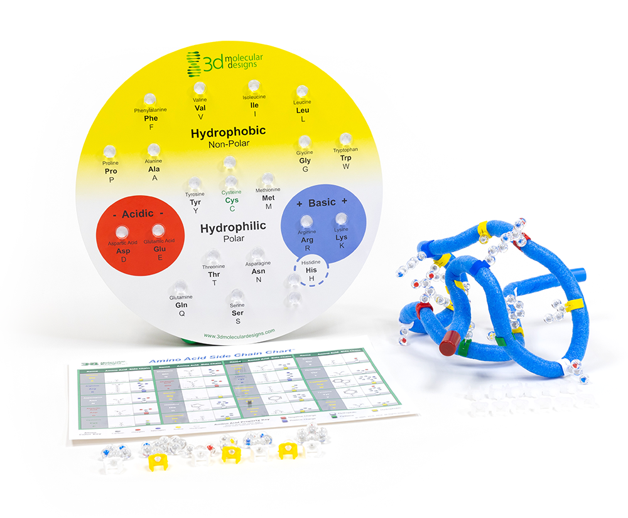
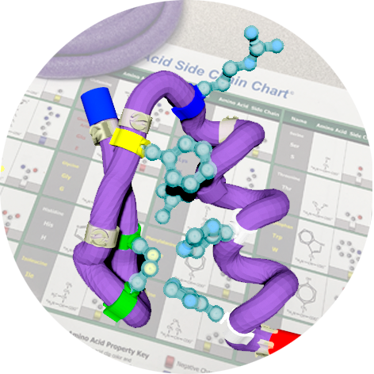

Folding Real Proteins
Zinc Fingers
“Mother Nature has been the best bioengineer in history. Why not harness the evolutionary process to design proteins?"
– Frances Arnold
Activity ID: AASK-AR2
Required Models: 1 AASK©/ Group
Required Media: 3DMD AR EDU App

Slide 2

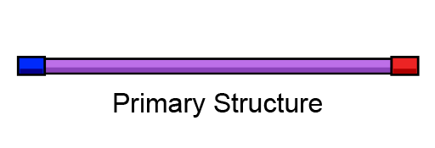
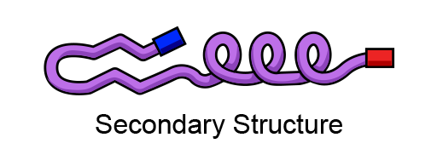
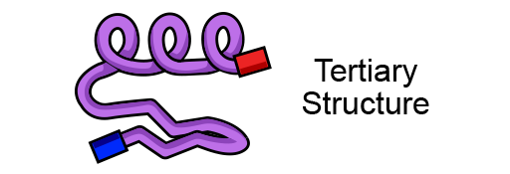
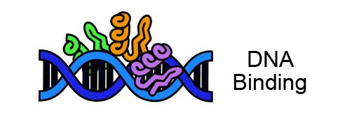
Teacher Guide – Summary
Activity Summary
This AR activity explores the levels of protein structure and challenges students to fold a real protein called a zinc finger.
This activity requires the 3DMD AR EDU application, available for download from the Google Play and Apple App stores. The activity is split into four AR scenes designed to be explored in order. Each AR scene is represented by a consistent icon in this slide deck and the 3DMD AR EDU app (see icon images below.)
Scene 1: Scanning the Amino Acid Side Chain Chart© will display the primary structure (amino acid sequence) of a zinc finger protein.
Scene 2: Using the AR overlay as a guide, students fold the secondary structures of a zinc finger protein.
Scene 3: Using the AR overlay as a guide, students fold the tertiary structure of a zinc finger protein.
Scene 4: The AR overlay shows how three zinc fingers interact with double-stranded DNA to regulate replication, transcription, and storage of DNA.

Slide 3
Teacher Guide - Overview
Activity Objectives
  Fold a mini-toober into a complex 3D shape using the rules of protein folding.
  Evaluate the levels of protein folding to understand their contribution to structure of real-world proteins.
  Estimated Class Time:
45 minutes
Required Models:
Amino Acid Starter Kit©
Amino Acid Side Chain Chart©
Required Media:
3DMD AR EDU App + subscription
Other Materials Needed:
None
Grade, Class
9-12 Biology or Chemistry
Topics
Amino acid properties
Protein folding – secondary structure
Protein folding – tertiary structure
Prerequisite Knowledge
Polarity
Properties of water

Slide 4






Teacher Guide - Using This Slide Deck
Student and Teacher Slide Deck Pages
  Slides that are meant for student viewing will feature a green top
  banner. Slides that are meant only for teacher viewing will feature a
  purple top banner and will appear hidden when in "slide show" mode.
Prompting Icons
  Each student slide will include a prompting icon in the top right corner of the slide. These icons on each slide cue your students to the type of activity they will be doing.
Turn and talk discussion
Write in your notebook
Quiet thinking time
Digital modeling
Physical modeling
Teacher Moves and Student Moves
Class slides provide notes (teacher notes below the slide) with specific information to assist you in facilitating the activity using effective modeling and education practices.

Slide 5
Teacher Guide - Standards
Next Generation Science Standards
Science and Engineering Practices | Cross Cutting Concepts | Disciplinary Core Ideas
Asking Questions and Defining Problems | Patterns | HS-LS1-1
Developing and Using Models | Structure and Function
Constructing Explanations and Designing

Slide 6
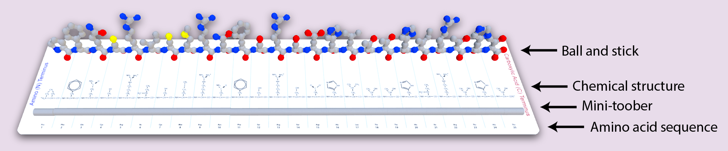
Teacher Guide – Scene 1
Scene 1: Primary Structure
Scanning the Amino Acid Side Chain Chart© will show the primary structure (amino acid sequence) of a zinc finger protein. Students compare four different representation of the zinc finger protein's primary structure, including:
Ball and Stick - Each atom is represented by a sphere or "ball" and each bond shown as a cylinder or "stick".
Chemical Structure - Each atom is represented by its periodic table abbreviation and bonds are shown as lines.
Mini-toober - The protein backbone is represented by a mini-toober and matches the length of the mini-toober included in the Amino Acid Starter Kit©.
Amino Acid Sequence - The 25 amino acid long protein sequence using the three-letter amino acid abbreviations.

Slide 7

Teacher Guide – Scene 1 (continued)
Scene 1: Primary Structure (continued)
Four different color schemes can also be explored in scene 1. Students will use the color schemes to annotate their physical mini-toober in preparation for folding a zinc finger protein.
Colored By Element - Oxygen is red, nitrogen is blue, carbon is gray, and sulfur is yellow.
Students learn that proteins are made from amino acids linked together.
Colored By Gradient - The protein is colored by rainbow gradient, with blue at the beginning (N-terminus) and red at the end (C-terminus).
Students add the blue and red endcaps to their mini-toober ends.
Colored By Secondary Structure - Alpha helices are red, beta sheets are yellow and turns are white.
Students add clear clips to their mini-toober at the start and end of each secondary structure.
Colored By Amino Acid Property - Positive amino acids are blue, negative amino acids are red, hydrophobic are yellow, hydrophilic are white and cysteine is green.
Students add seven important amino acids to their mini-toober.

Slide 8


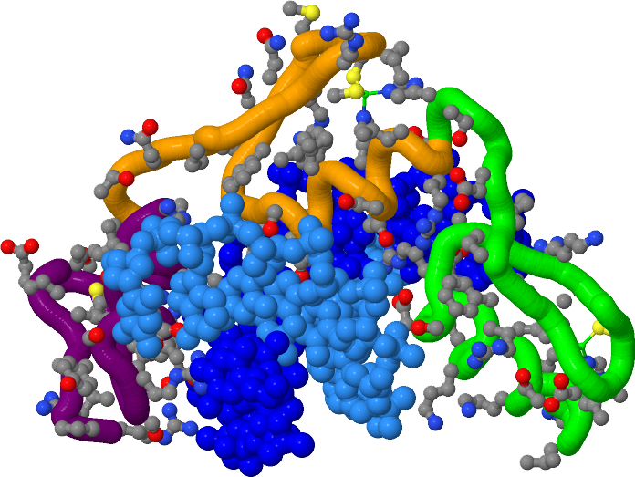
Proteins Fold into Complex 3D Shapes
This is a protein!
Proteins are large molecules made of amino acids linked together.
These linked amino acids fold into complex 3-dimensional shapes.
In this activity, you will create a physical model of a real protein called a zinc finger.
Notes:
Teacher: Life is complicated. Take a moment to appreciate the complexity of some of the structures that make life possible.
Student: Notice that these proteins are made of many repeating motifs (purple, orange, and green).

Slide 9

How Do Proteins Form Complex Structures?
Life makes some very
complex structures.
Explore the image shown to the right. Record some observations in your notebook.
What do you notice?​
What do you wonder?
Notes:
Teacher: Your students will be building part of this structure.
Student: Brainstorm how these structures might be formed.

Slide 10

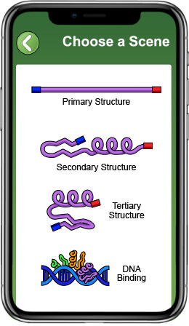
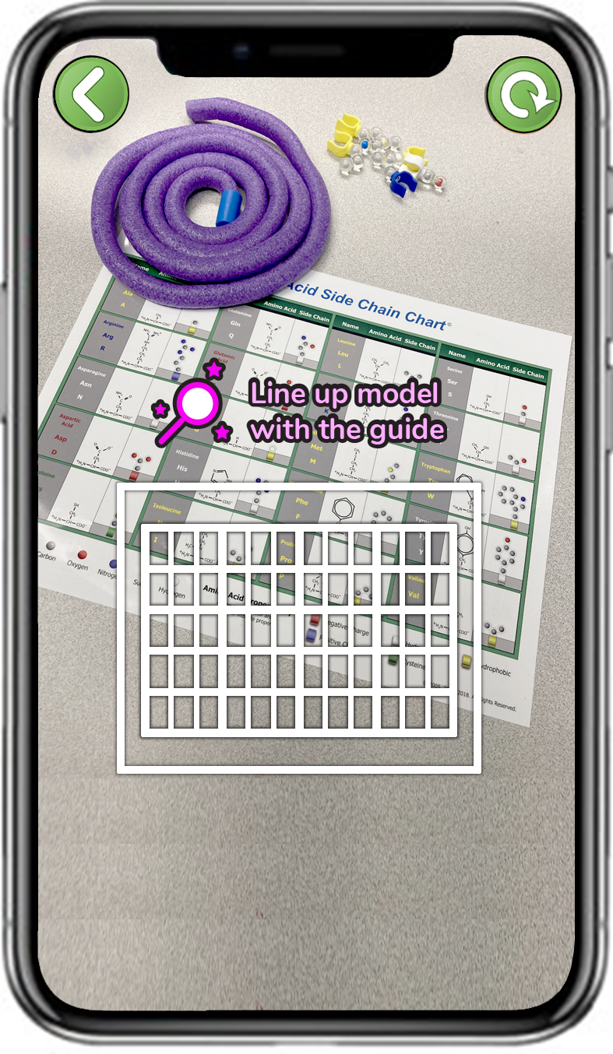
Explore Primary Structure with the 3DMD AR EDU App
Select Primary
Structure
Scan the Amino Acid Side Chain Chart©
Primary structure is the order of amino acids in a protein.
In the first AR scene, Primary Structure, will shows the order of the amino acids in a zinc finger protein.
Notes:
Teacher: Have students open the app and select the appropriate activity and scene. Move around the room and assist students with their technology.
Student: Open the app and select the appropriate activity and scene.

Slide 11
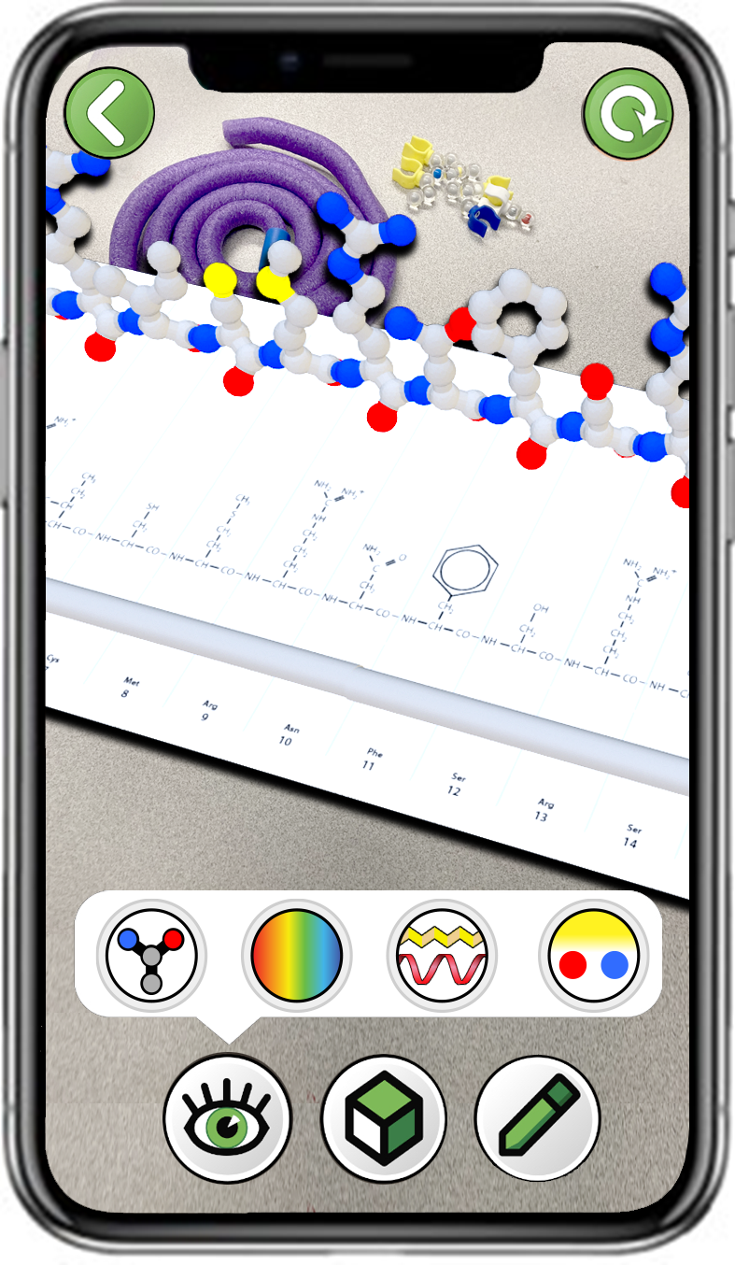
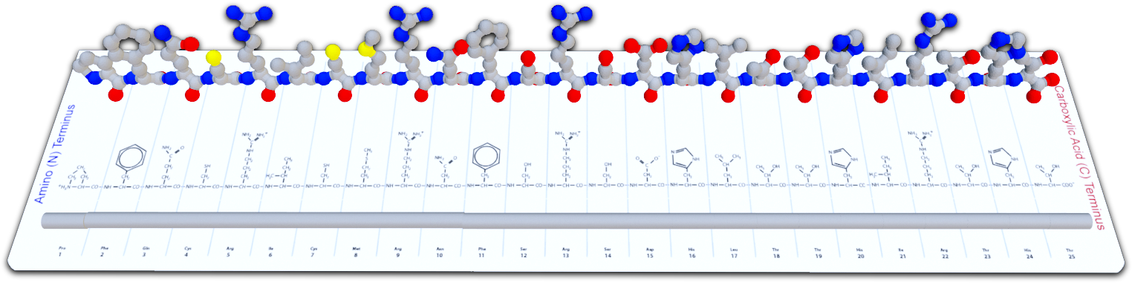
What is a Protein's Primary Structure?
Explore the
first button
What do you notice?
What is being shown in this AR overlay?
Notes:
Teacher: Point out that all three formats are different interpretations of the same protein. Do not correct your students’ initial ideas until after they have more information.
Student: Focus on model transference between the three representations of the same primary sequence.

Slide 12
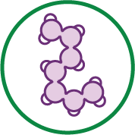

The Zinc Finger Protein's Primary Structure
The zinc finger protein is 25 amino acids long.
A variety of different amino acids in a specific order make up the zinc finger protein.
Lay out your 100 cm long mini-toober. The spacing between each amino acid will be 4 cm.
Notes:
Teacher: Students should lay the mini-toober (without caps) in their work area.
Student: Realize that the mini-toober is a representation of the backbone of a protein.

Slide 13
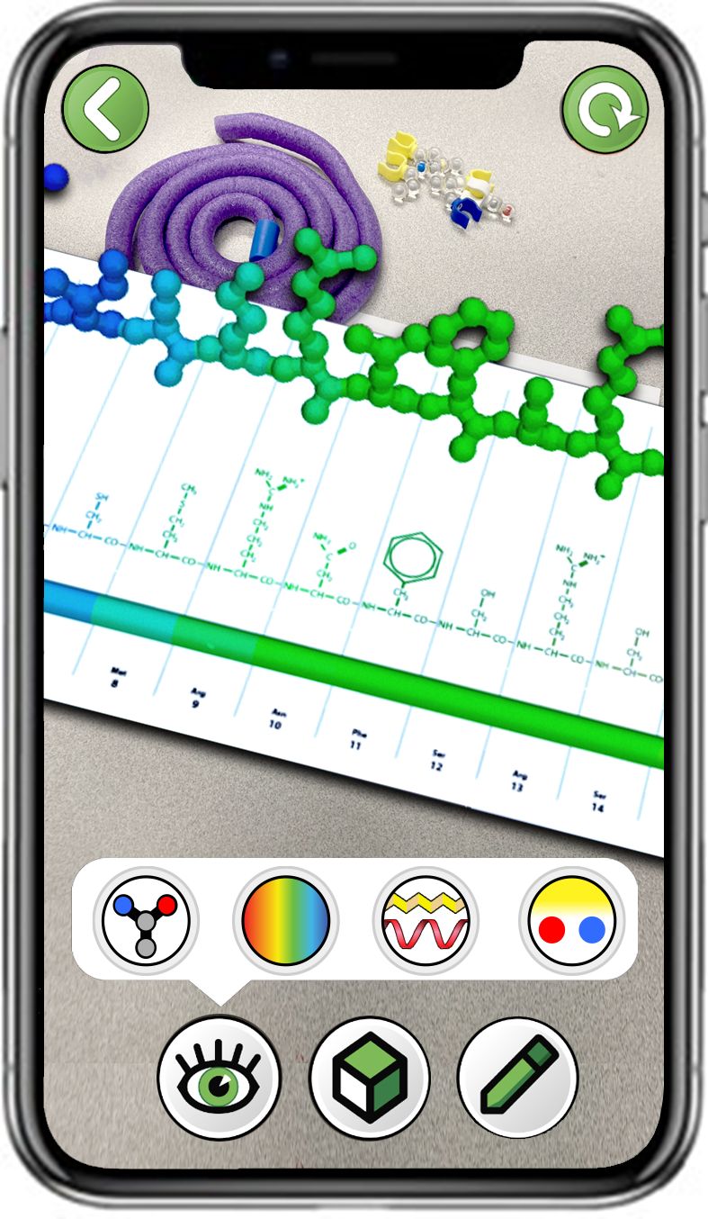
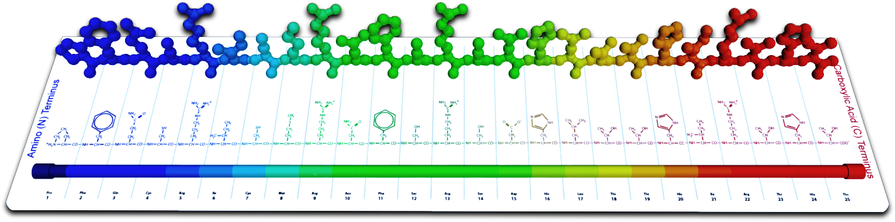
What is Protein Structure Directionality?
Explore the second button
What do you notice?
What is being shown in this AR overlay?
Notes:
Teacher: Have students open the app and select the appropriate activity and scene. Move around the room and assist students with their technology.
Student: Open the app and select the appropriate activity and scene.

Slide 14
The Zinc Finger Protein's Directionality
Proteins have directionality.
The beginning is called the Amino (N) Terminus.
The end is called the Carboxyl (C) Terminus.
Add the blue and red end caps to your mini-toober representing the N-terminus and C-terminus.
Notes:
Teacher: This is a backbone trace (or gradient) and is commonly used in protein visualization software so that you can follow the backbone from the N->C terminus.
Student: Add the caps to mark the N terminus (Start) and C terminus (End) of your protein.

Slide 15
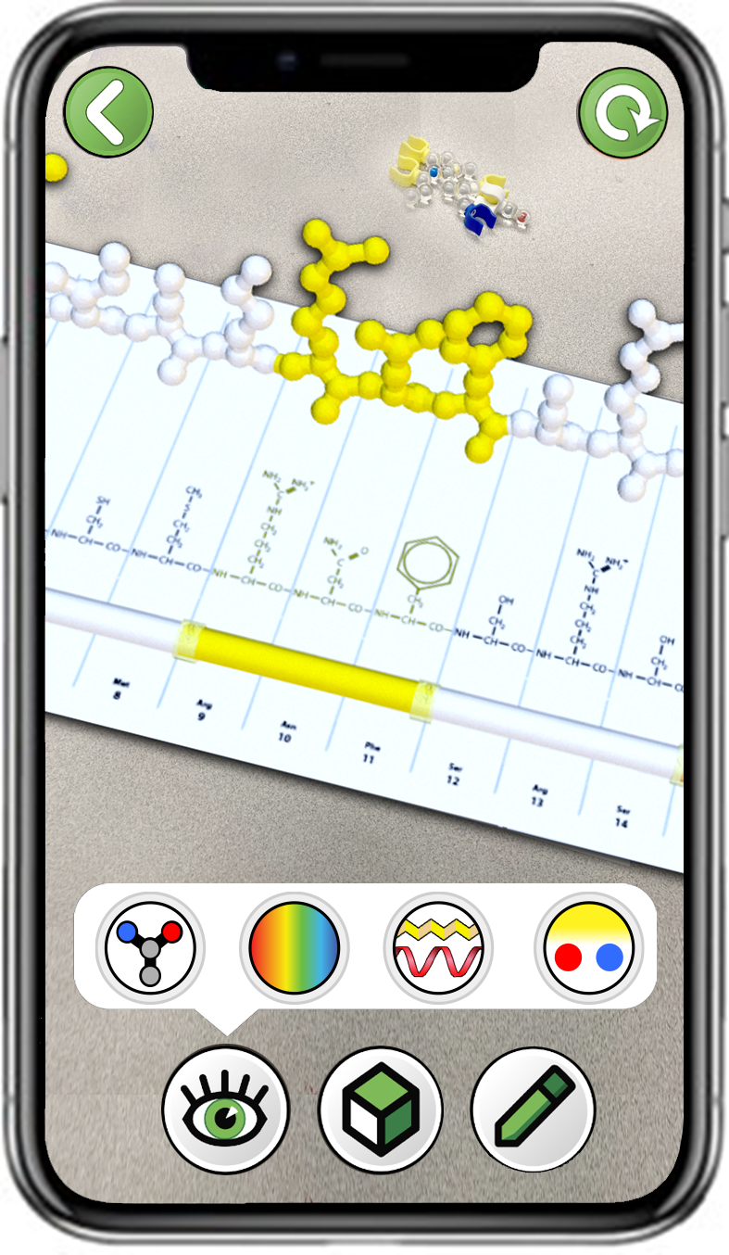
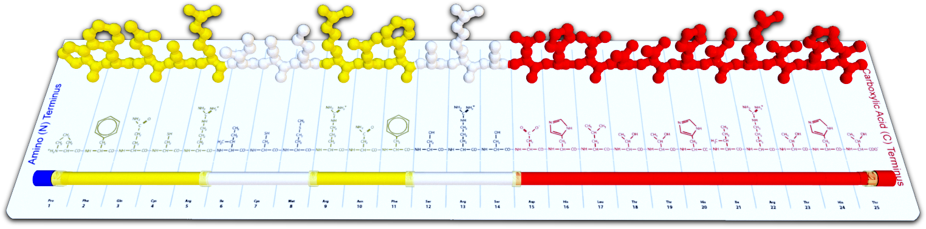
What are Protein Secondary Structures?
Explore the third button
What do you notice?
What is being shown in this AR overlay?
Notes:
Teacher: Have students open the app and select the appropriate activity and scene. Move around the room and assist students with their technology.
Student: Open the app and select the appropriate activity and scene.

Slide 16

The Zinc Finger Protein's Secondary Structures
Secondary structure is the order and length of two common shapes found in folded proteins:
alpha helices beta sheets.
Most proteins have a mixture of alpha helices and beta sheets.
Add six clear clips to your mini-toober to mark the start and end of the secondary structures.
Notes:
Teacher: Point out the shapes of a helix and a sheet. A helix looks like a corkscrew. The sheets look like a child was asked to draw a mountain range. These are imperative to the stability of a protein structure. Secondary structures are formed by interactions between amino and carboxyl groups located in the backbone of the protein. Remind students that sidechains can move around a flexible bond.
Student: Note the shapes and colors of secondary structures in a protein. Students will need to add 6 clear clips to mark the sheets and helix on the mini-toober.

Slide 17
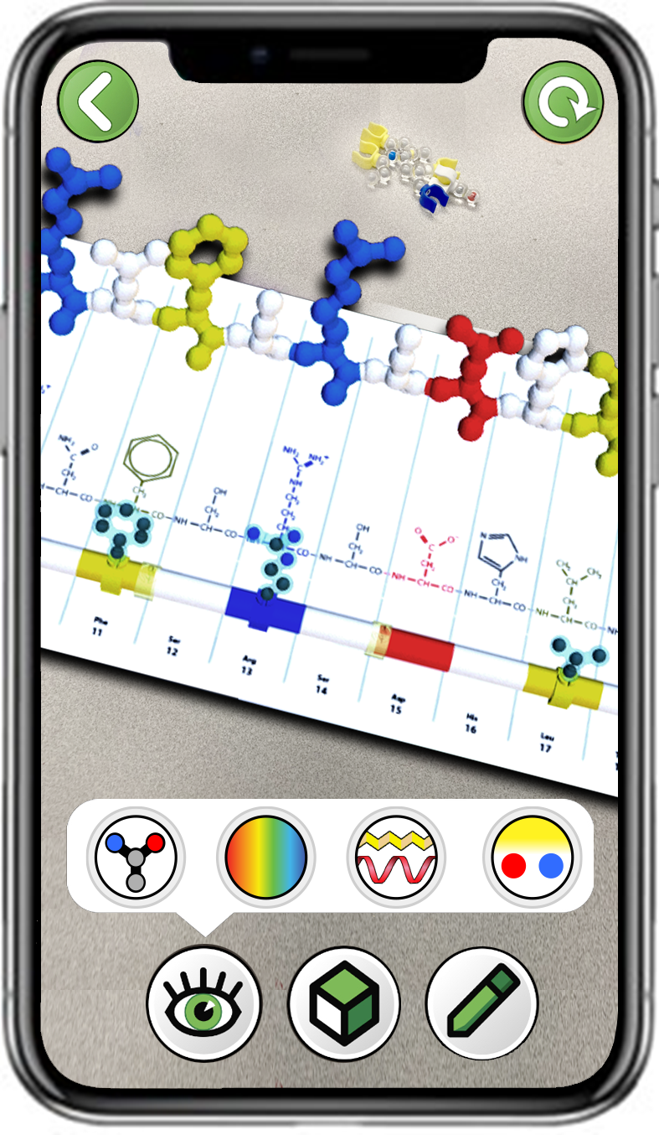
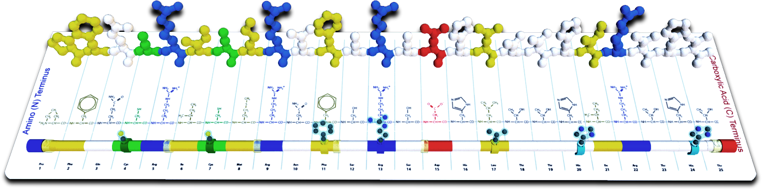
What Are Amino Acid Sidechains?
Explore the fourth button
What do you notice?
What is being shown in this AR overlay?
Notes:
Teacher: Have students open the app and select the appropriate activity and scene. Move around the room and assist students with their technology.
Student: Open the app and select the appropriate activity and scene.

Slide 18
The Zinc Finger Protein's Sidechains
Hydrophobic sidechains are yellow.
Hydrophilic sidechains are white.
Basic sidechains are blue.
Acidic sidechains are red.
Cysteine sidechains are green.
Add seven important
amino acid sidechains to
your mini-toober:
Cys 4 Cys 7 Phe11 Arg13
Leu17 His20 His24
Notes:
Teacher: Monitor and assist students in construction of the primary structure on the mini-toober. The amino acid spacing is approximate and does not need to be exact.
Student: Follow the instructions on the screen and think about the properties of the amino acids you are adding to the mini-toober.

Slide 19
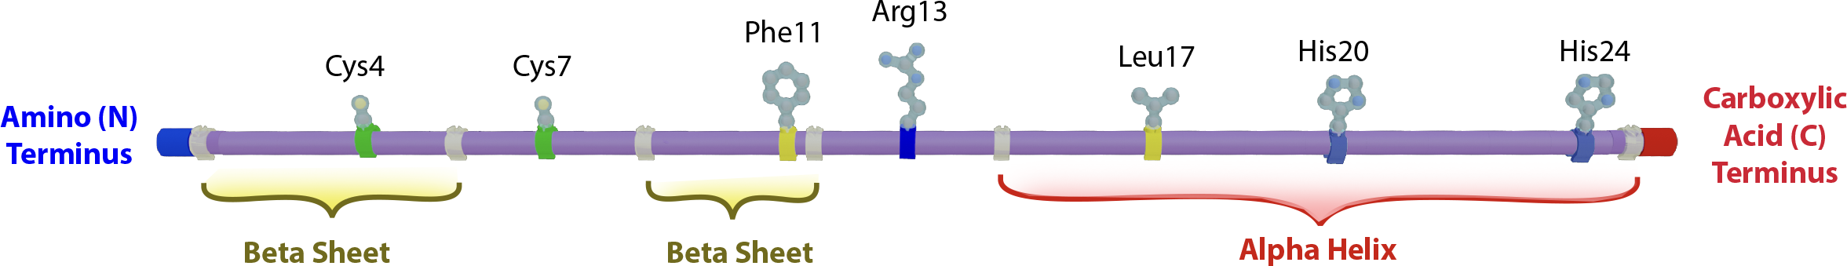
Review Your Annotated Mini-Toober
Review your annotated mini-toober to confirm that it is ready to fold into a zinc finger protein.
Directionality of the protein (blue and red endcaps)
Location of secondary structures (clear clips at start and end of one alpha helix and two beta sheets)
Seven key sidechains (cys4, cys7, phe11, arg13, leu17, his20, his24)
Notes:
Teacher: Check that your students have everything in the correct place on the mini-toober.
Student: Double-check your work to this point.

Slide 20
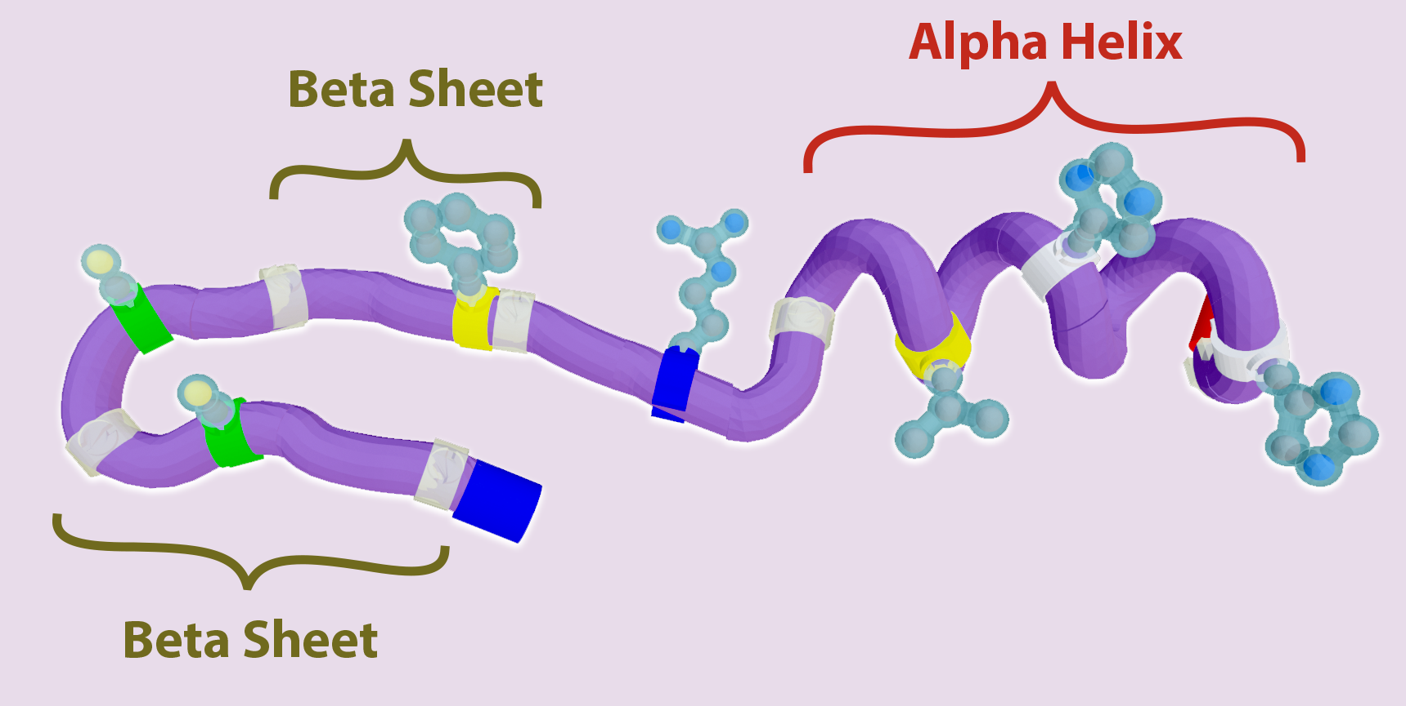

Teacher Guide – Scene 2
Scene 2: Secondary Structure
Students will use the AR overlay as a guide to fold the secondary structures of the zinc finger protein.
They will learn the importance of both alpha helices and beta sheets in providing stability to the protein. Both secondary structures occur because of interactions of the amino and carboxyl groups on the backbone of the amino acid sequence and not the side chains.
The slider bar allows for regions of the 25 amino acid long zinc finger protein to be shown or hidden.
The color button changes the color scheme shown on the mini-toober model.

Slide 21
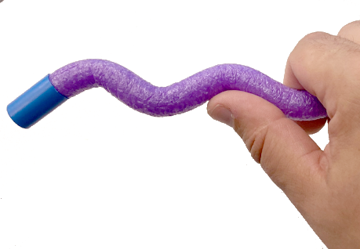
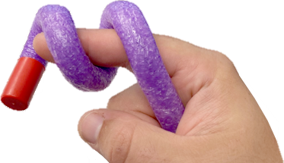
Alpha Helices and Beta Sheets
We start by folding the secondary structures of the zinc finger protein.
Alpha helices and beta sheets can be modeled with your mini-toober.
Alpha Helices
Beta Sheets.
Notes:
Teacher: Help students add secondary structures to the mini-toober. Coil the mini-toober around your right index finger to give it a right handed helix.
Student: Follow the instructions on the slide. Add secondary structures to your mini-toober – 2 sheets and one helix. PLAY!

Slide 22
Explore Secondary Structure with the 3DMD AR EDU App
Select Secondary
Structure
Scan the Amino Acid Side Chain Chart©
The AR overlay will act as a folding guide, showing the shape of the zinc finger protein's one alpha helix and two beta sheets.
Notes:
Teacher: Help students navigate to the correct overlay. Assist students in navigation and technology.
Student: Follow the instructions on the slide. PLAY! In their notebook, describe the scene that they see.

Slide 23
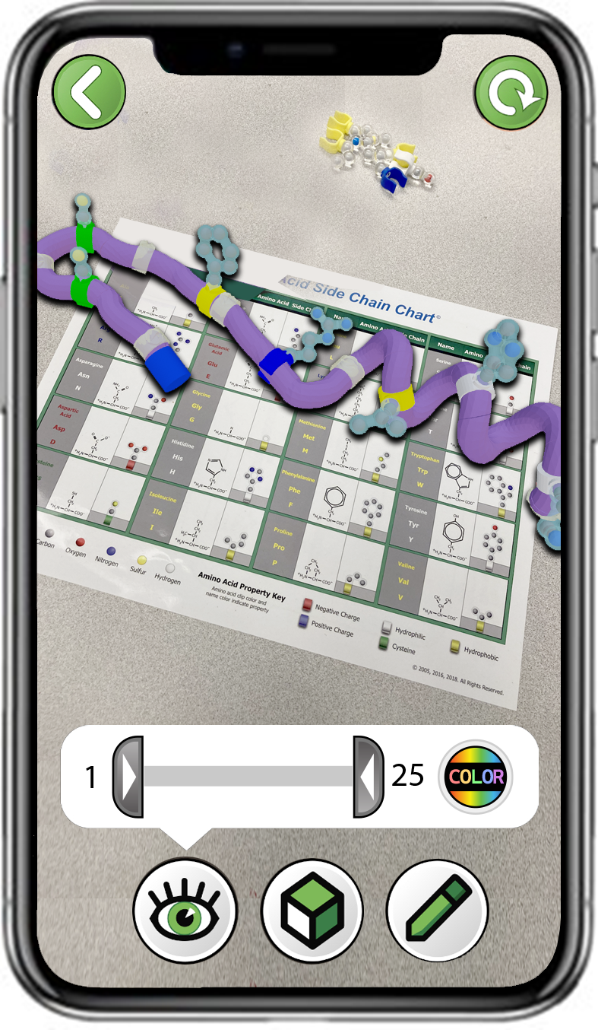
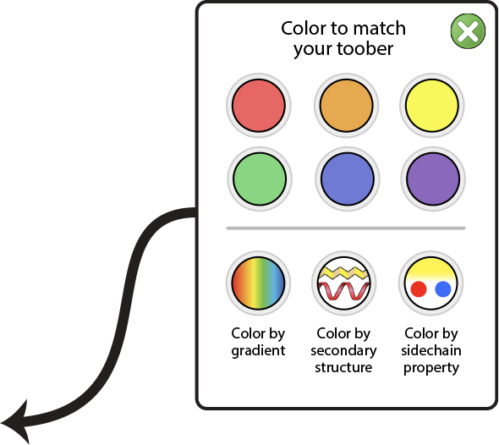
Changing Color Schemes
The slider bar will show or hide sections of the protein.
The color button will let you change the color of the mini-toober shown in the AR overlay.
Color by secondary structure will highlight alpha helices and beta sheets.
Notes:
Teacher: Help students navigate to the correct overlay. Assist students in navigation and technology.
Student: Follow the instructions on the slide. Select the correct color for your physical mini-toober. Play with the slider bar to truncate or expand the protein. Use the button to color secondary structures in the AR environment.

Slide 24
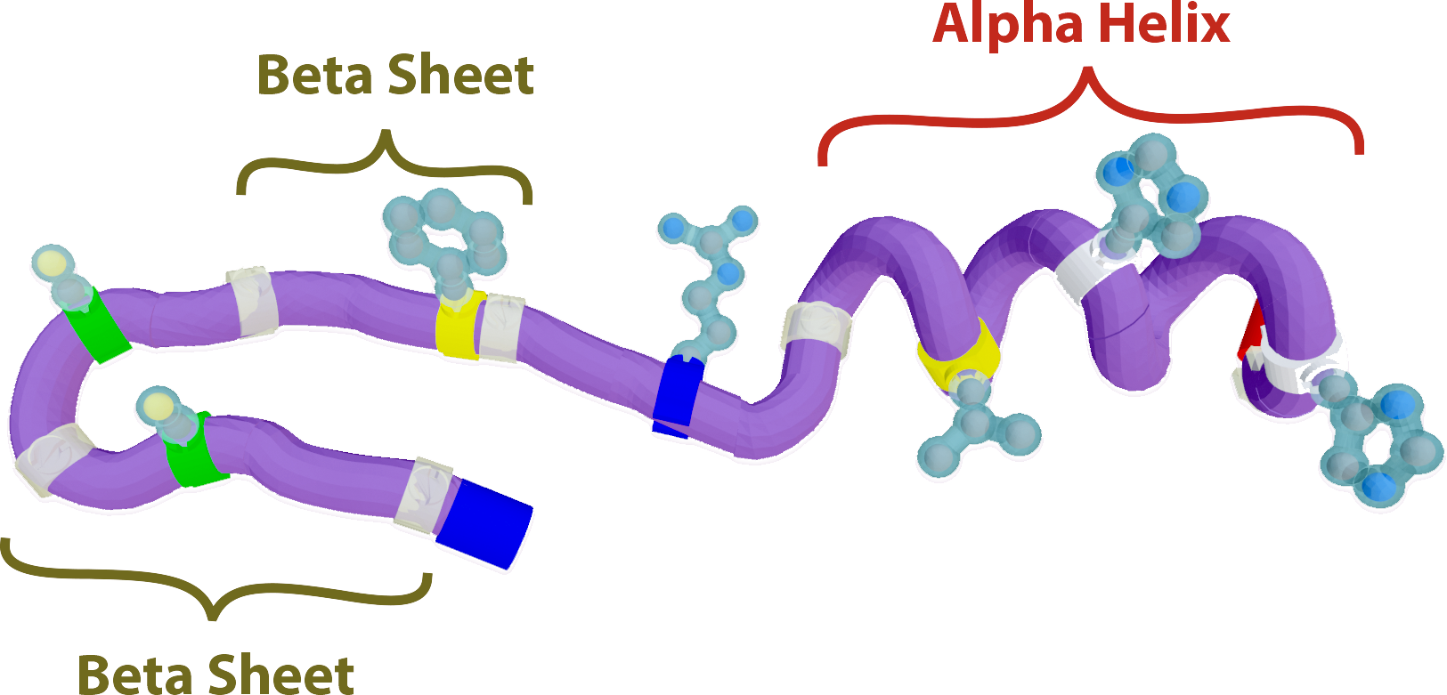
What Do Secondary Structures Do?
Make sure to model the hairpin turn between the two sections of beta sheet.
Do the two sections of beta sheet interact?
How might secondary structures like alpha helices and beta sheets stabilize a protein?
Notes:
Teacher: Help students identify where the hairpin needs to be made between the two beta sheets. This is an example of an anti-parallel beta sheet. Give them time to respond to the questions in their notebook or discuss them with a partner.
Student: Add a hairpin turn between the beta sheets to match the onscreen model.

Slide 25
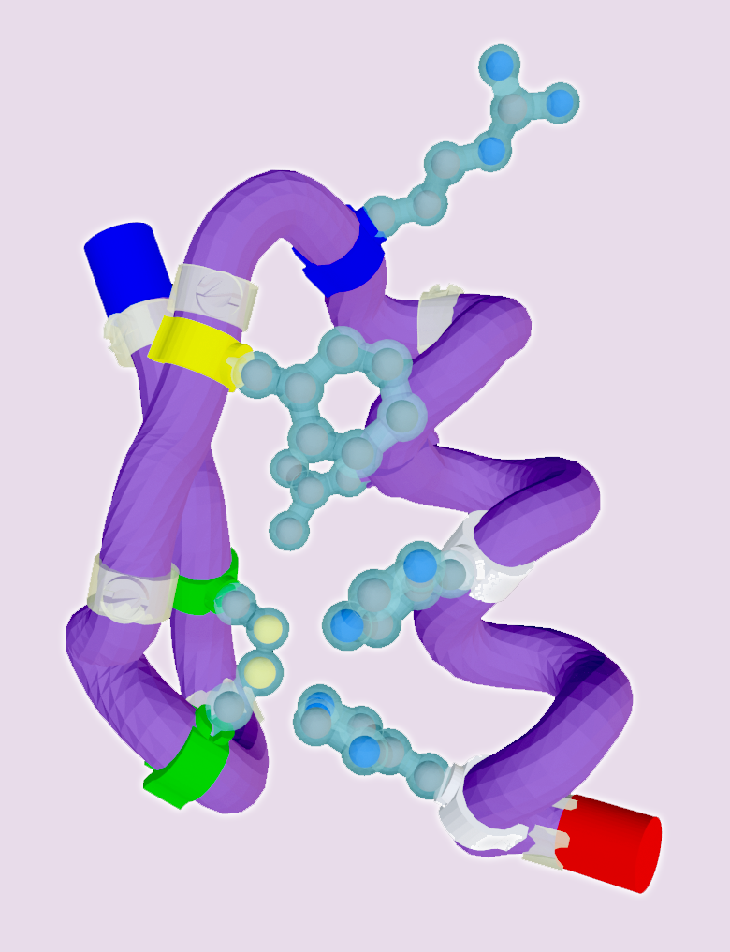
Teacher Guide – Scene 3
Scene 3: Tertiary Structure
Students will make the final folds to their zinc finger mini-toober model. They will explore how certain amino acids interact with a zinc ion to stabilize the tertiary structure. They will brainstorm with their partner about the role of zinc fingers in nature.
The slider bar allows for regions of the 25 amino acid long zinc finger protein to be shown or hidden.
The color button changes the color scheme shown on the mini-toober model.

Slide 26
Explore Tertiary Structure with the 3DMD AR EDU App
Select Tertiary
Structure
Scan the Amino Acid Side Chain Chart©
Tertiary structure is the final folded shape of a protein.
The AR overlay will act as a folding guide, showing the final overall shape of the zinc finger protein.
Notes:
Teacher: Have students open the app and select the appropriate activity and scene. Move around the room and assist students with their technology.
Student: Open the app and select the appropriate activity and scene.

Slide 27
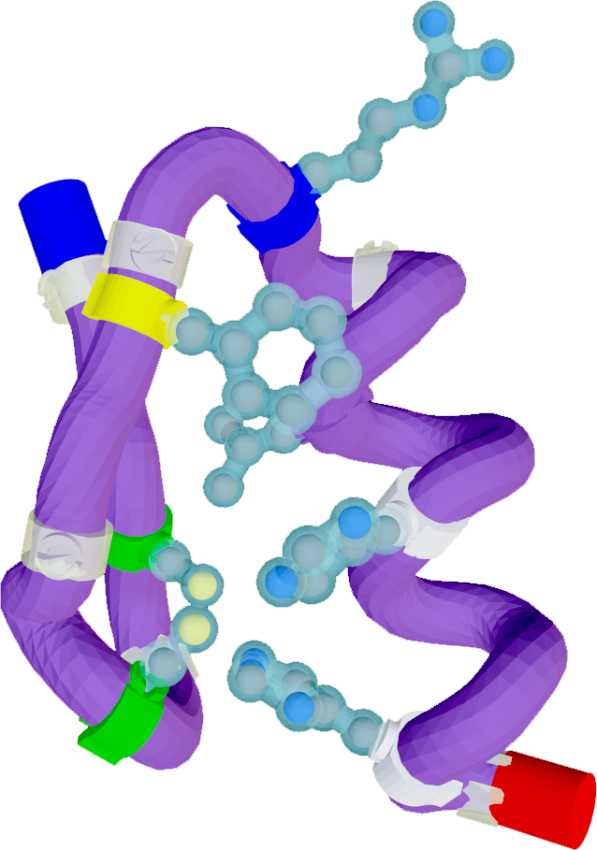
Making the Final Fold
Usually, a cysteine amino acid bonds with another cysteine to make a disulfide bond.
In this protein, the interesting amino acids are
cys – cys – his – his
These amino acids interact with a zinc ion to stabilize the tertiary structure.
This shape is called a zinc finger motif. It is one of the most common protein motifs in nature.
Zinc
Notes:
Teacher: Assist students with the final fold.
Remind students of the 4 rules of protein folding (Sidechain App)
Hydrophobic amino acids will cluster towards the center of your protein
Hydrophilic amino acids will reach out to interact with the surrounding water
Acids and bases will be attracted to one another and form a salt bridge
Cysteines usually interact with each other and form a disulfide bond (Covalent)
Student: Follow the instructions on the screen to fold the mini-toober ™ into the final configuration.

Slide 28
Making the Final Fold
Why do you think zinc finger motifs would be so common in nature?
What do you think they might do?
What might a zinc finger motif interact with? (Hint: it is something in all living things)
Zinc
Notes:
Teacher: Give students time to speculate about the role a zinc finger might have in nature. A motif is a region of a protein that is similar in its 3 dimensional shape without a direct evolutionary relationship. They are usually short in length and may have a shorthand such as sheet-turn-sheet-turn-helix.
Student: Discuss the on-screen questions with a partner and answer them in your notebook.

Slide 29
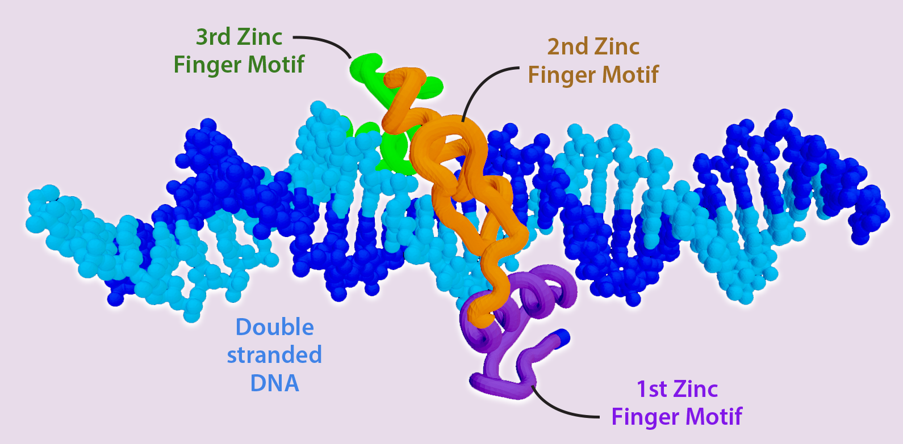
Teacher Guide – Scene 4
Scene 4: DNA Binding
Students will view a 3-dimensional representation of three zinc finger motifs bound to DNA. Zinc finger proteins bind to DNA to regulate replication, transcription, and storage of DNA. Zinc fingers are common in all living things throughout the natural world because they all have DNA to regulate, store, transcribe, and replicate.

Slide 30
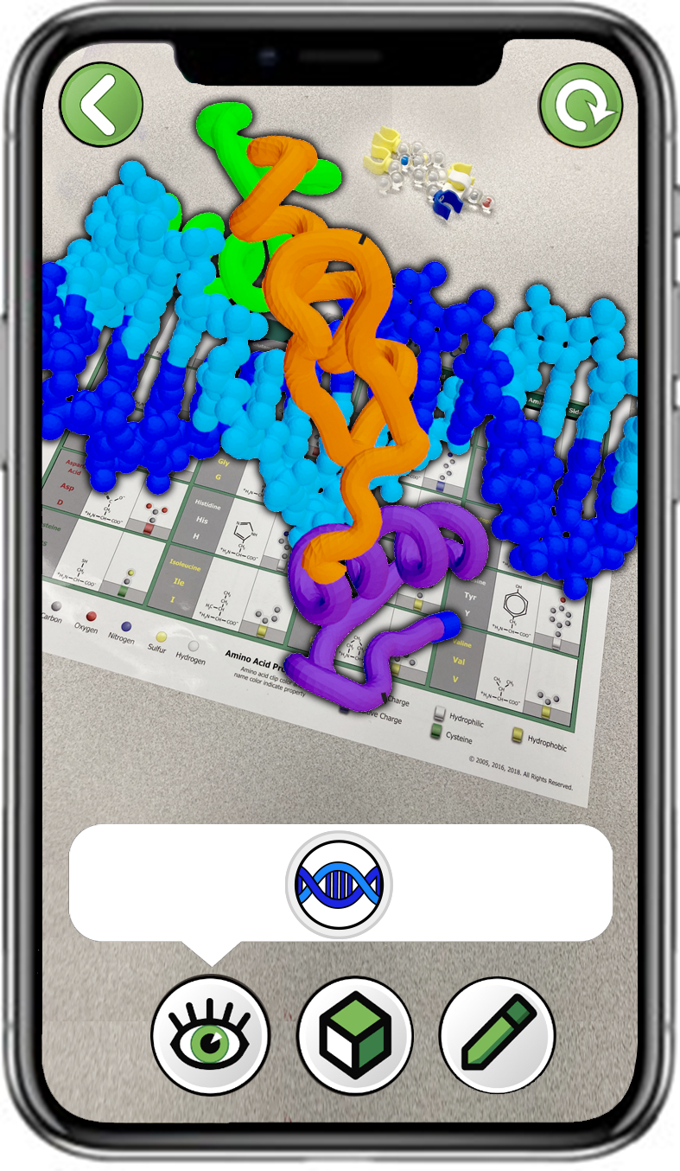
Explore DNA Binding with the 3DMD AR EDU App
Select
DNA Binding
Scan the Amino Acid Side Chain Chart©
Explore the
AR overlay
Note, you may need to stand up and back away from your sidechain chart to see the full overlay!
Notes:
Teacher: Have students open the app and select the appropriate activity and scene. Move around the room and assist students with their technology.
Student: Open the app and select the appropriate activity and scene.

Slide 31
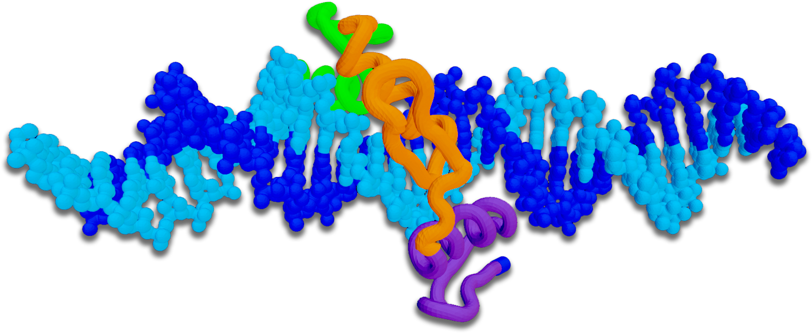
Why Would Proteins Interact with DNA?
How many zinc finger motifs do you see in this structure?
To what are the zinc fingers binding?
Why would a protein need to interact with DNA?
Notes:
Teacher: Represented here are three zinc finger binding DNA. These structures help proteins interact with DNA. These motifs are attached to much larger proteins that regulate replication, transcription, and storage of DNA. Facilitate a discussion with students so that they can appreciate the role zinc fingers play in nature.
Student: Turn and talk with your partner(s). Be prepared to share your ideas with class.

Slide 32
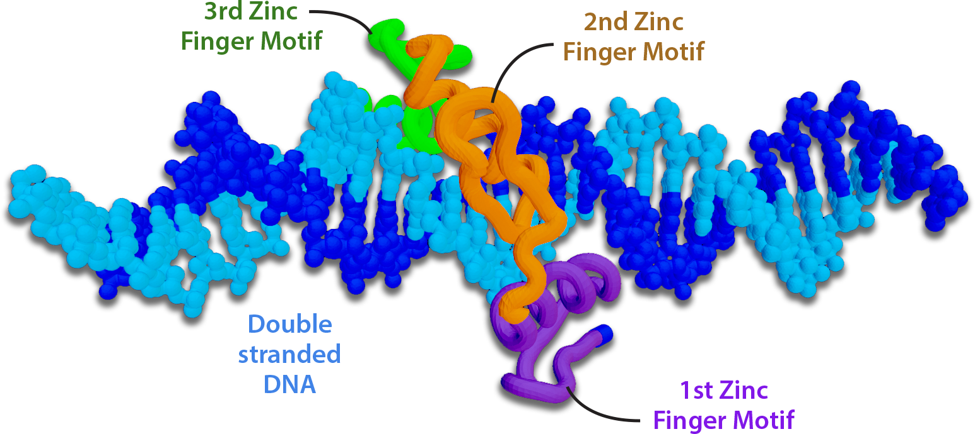
Zinc Fingers Bind to and Regulate DNA
Three zinc finger motifs bind to double-stranded DNA to regulate gene expression.
The 3D folded structure of the zinc finger allows it to perform its specific function.
Notes:
Teacher: Ask students to identify all three zinc fingers in the AR environment. Ask your students why Arg13 may play an important role in zinc fingers interacting with DNA.
Student: Investigate the AR environment and locate all three motifs. Speculate how zinc fingers and DNA could interact.

Slide 33
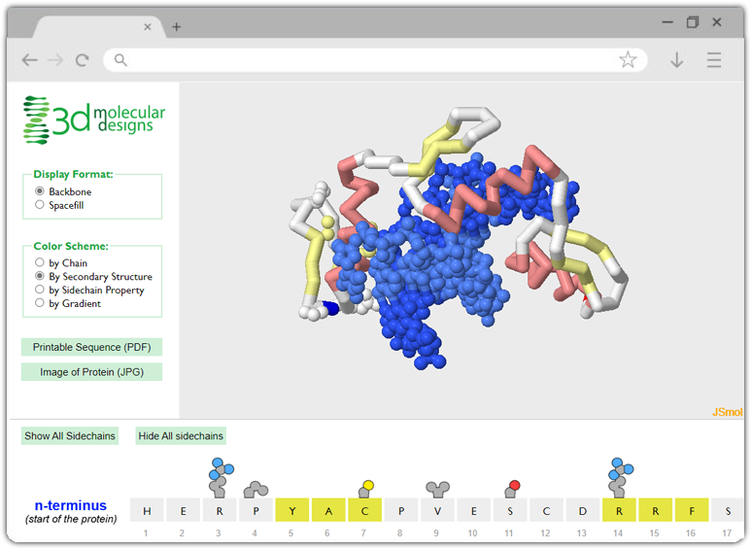
Further Exploration of the Zinc Finger Protein
The structure of three zinc finger motifs bound to DNA can be further explored at:
https://www.centerforbiomolecularmodeling.org/markMyweb/1zaa/
Notes:
Teacher: Going deeper – invite students to follow the link to the Protein Exploratorium. They should have a good idea of the color schemes presented.
Student: PLAY! What else do you notice?

Slide 34
The Variety of Protein Shapes in Nature
Zinc finger motifs are just one example of a protein structure.
Each type of protein has a unique primary structure (sequence of amino acids) and folds into a unique 3D shape.
This wide variety of structures allows proteins to perform a wide variety of functions in the body.
Antibody
Protein
RNA Polymerase
Protein
Green
Fluorescent
Protein
Insulin
Protein
Hemoglobin
Protein
Notes:
Teacher: Facilitate a discussion with students so that they can appreciate the variety of protein structures. This is what keeps a living system going! More folding activities coming soon!
Student: Notice similarities and differences between these structures.

Slide 35
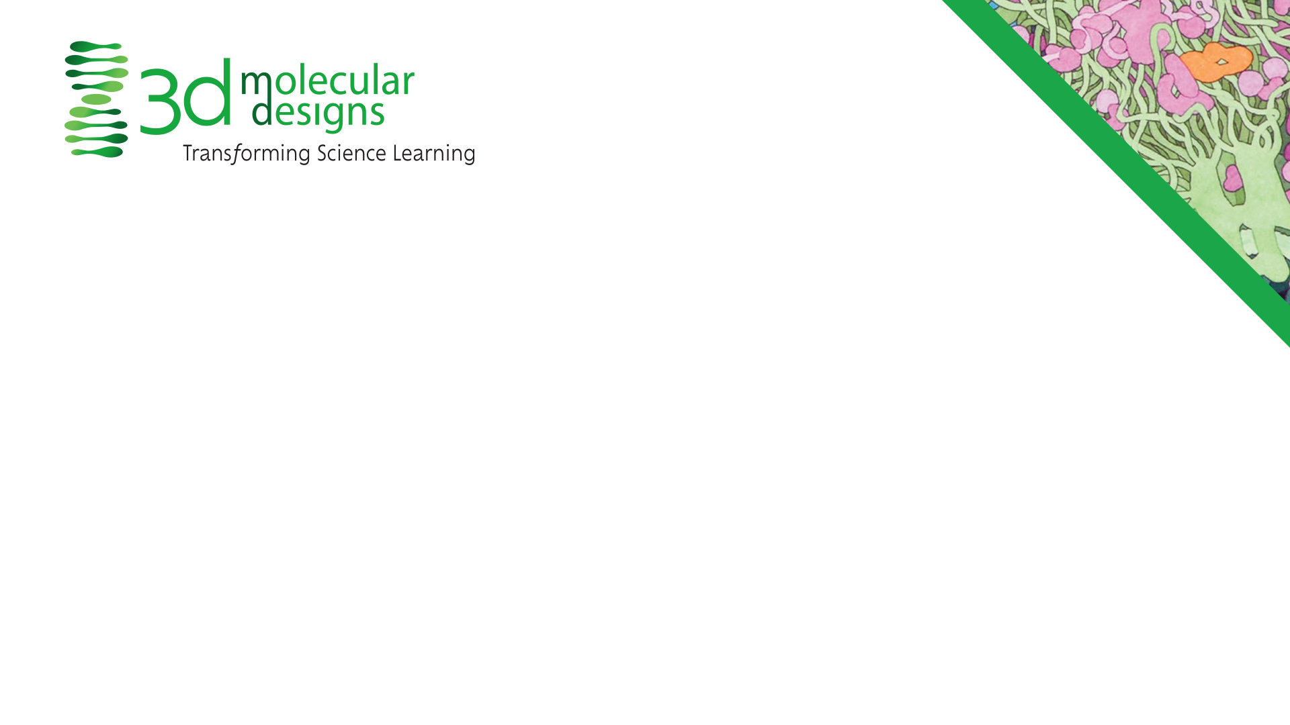
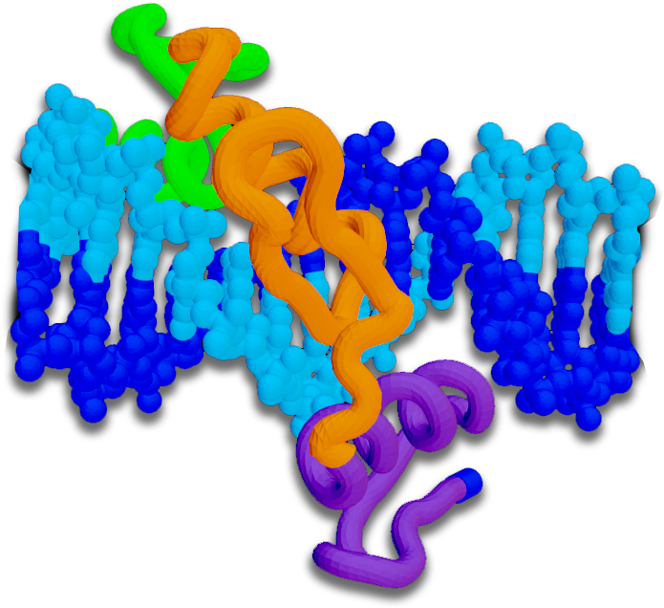
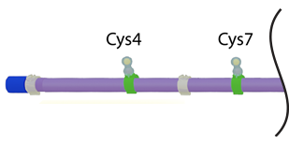
Conclusions
Primary Structure is the sequence of amino acids in a protein.
Secondary Structure is the order and length of alpha helices and beta sheets.
Tertiary Structure is the final overall folded structure of a protein.
The unique folded structure of a protein allows it to perform a unique function.
Notes:
Teacher: Summary slide with learning objectives of this lesson.
Student: Jot your thoughts and ideas in your notebook.

