Slide 1
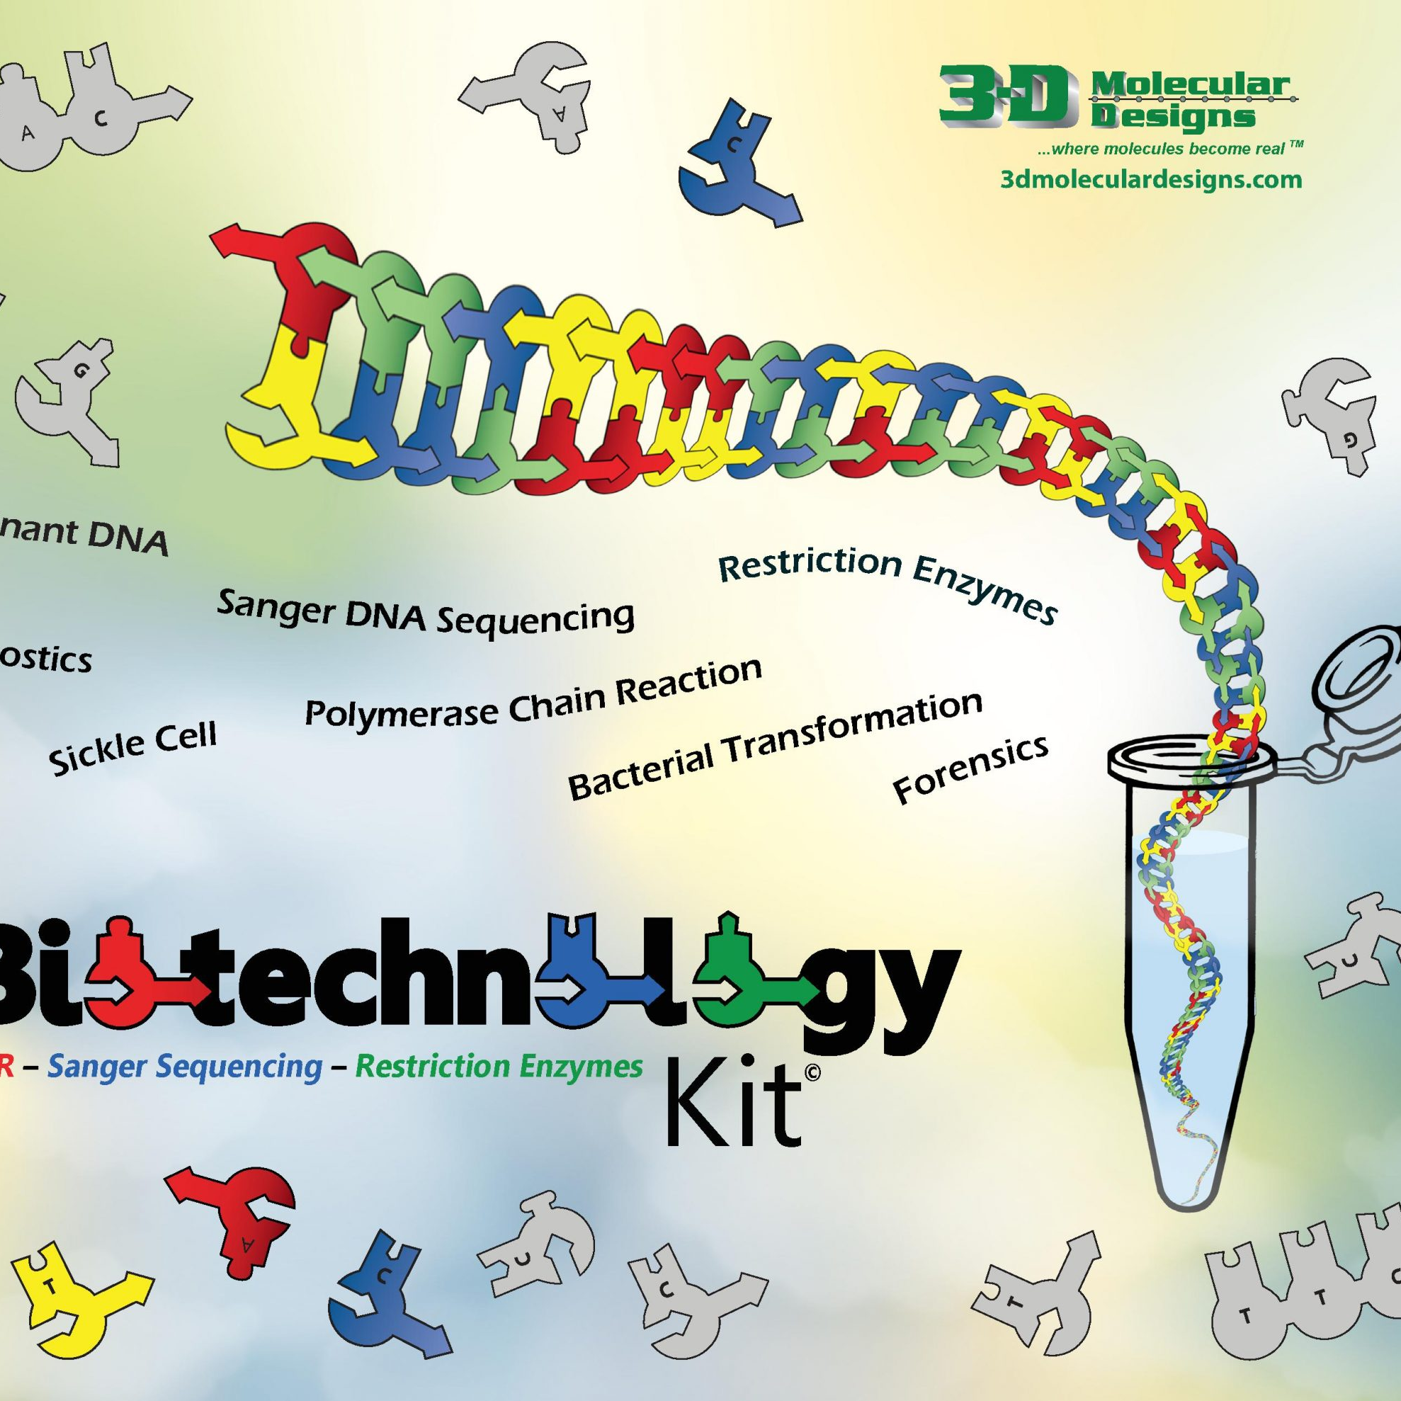

Biotech Breakthrough! Biotechnology Accessibility through 3D Models and Design Challenges
Mark “Arnie” Arnholt
3D Molecular Designs

Slide 2
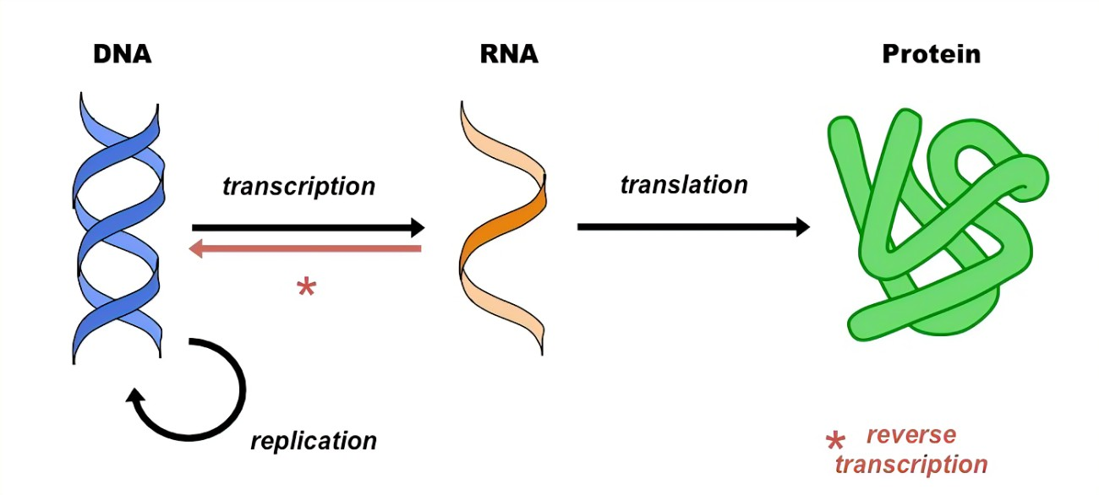
The Central Dogma of Biology

Slide 3
Restriction enzymes – Molecular scissors
Endonucleases that cleave DNA into fragments at specific recognition sites.
Defense mechanism for Bacteria and Archaea to defend themselves against viruses
Make incisions through the sugar-phosphate backbone of DNA

Slide 4
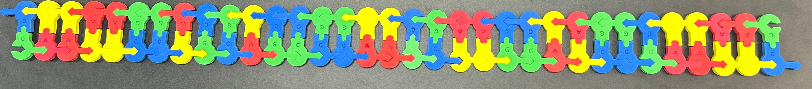
Let’s look at our target gene…
Our target gene has been truncated as the actual gene would be hundreds of BP’s long.
It also has lots of restriction sites in it-
Notes:
3'-CTTAAGGACGTCCGGTTCGAACCTAGGCTTAAG-5'
5'-GAATTCCTGCAGGCCAAGCTTGGATCCGAATTC-3'
Above is the sequence that is used for this activity.

Slide 5
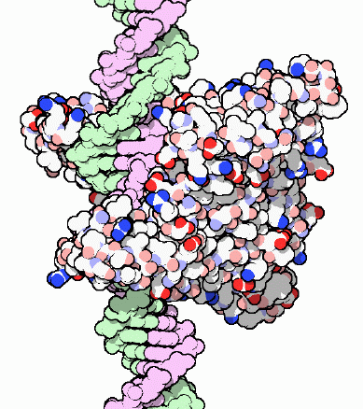
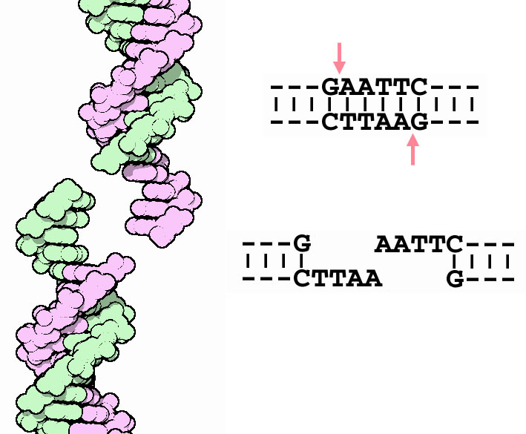
EcoRI
Notes:
PDB-101: Molecule of the Month: Restriction Enzymes (rcsb.org)

Slide 6

We will need to digest our target DNA
Restriction enzymes at hand include:
Eco RI
Bam HI
PstI
HIND III
Hae III
Scan me!

Slide 7


Why Palindromes?

Slide 8
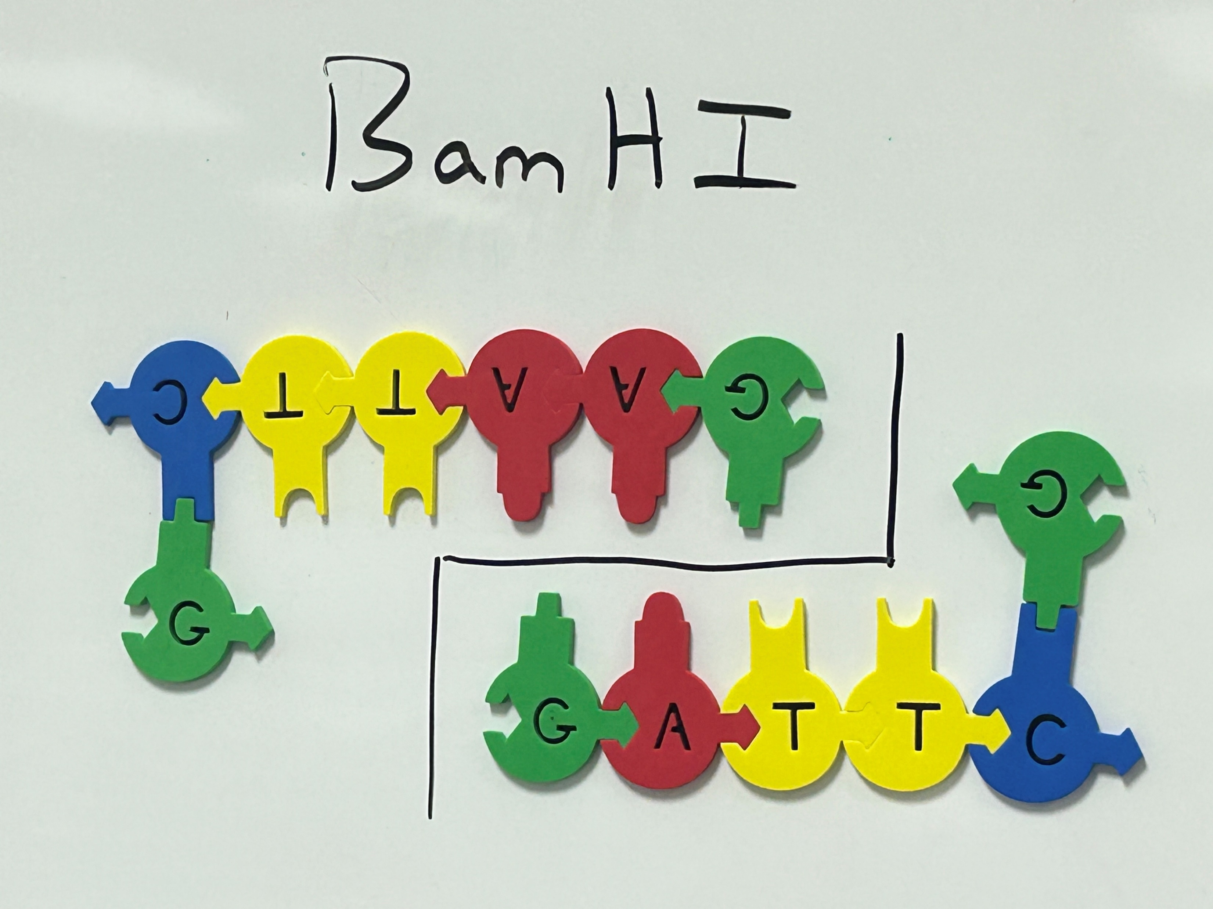
BamHI
Notes:
‘3 – CTTAAGG-5’
5’ – GGATTC-3’
Directionality is important because all of these sequences need to be read in the 5' to 3' direction.

Slide 9
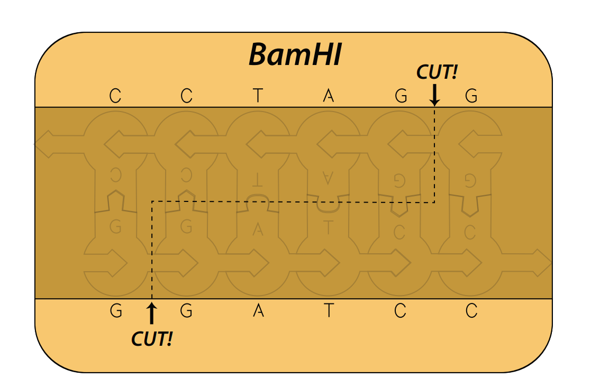
BamHI
Notes:
This is the image target for your web-based AR. Notice the dimerization of the enzymes.

Slide 10
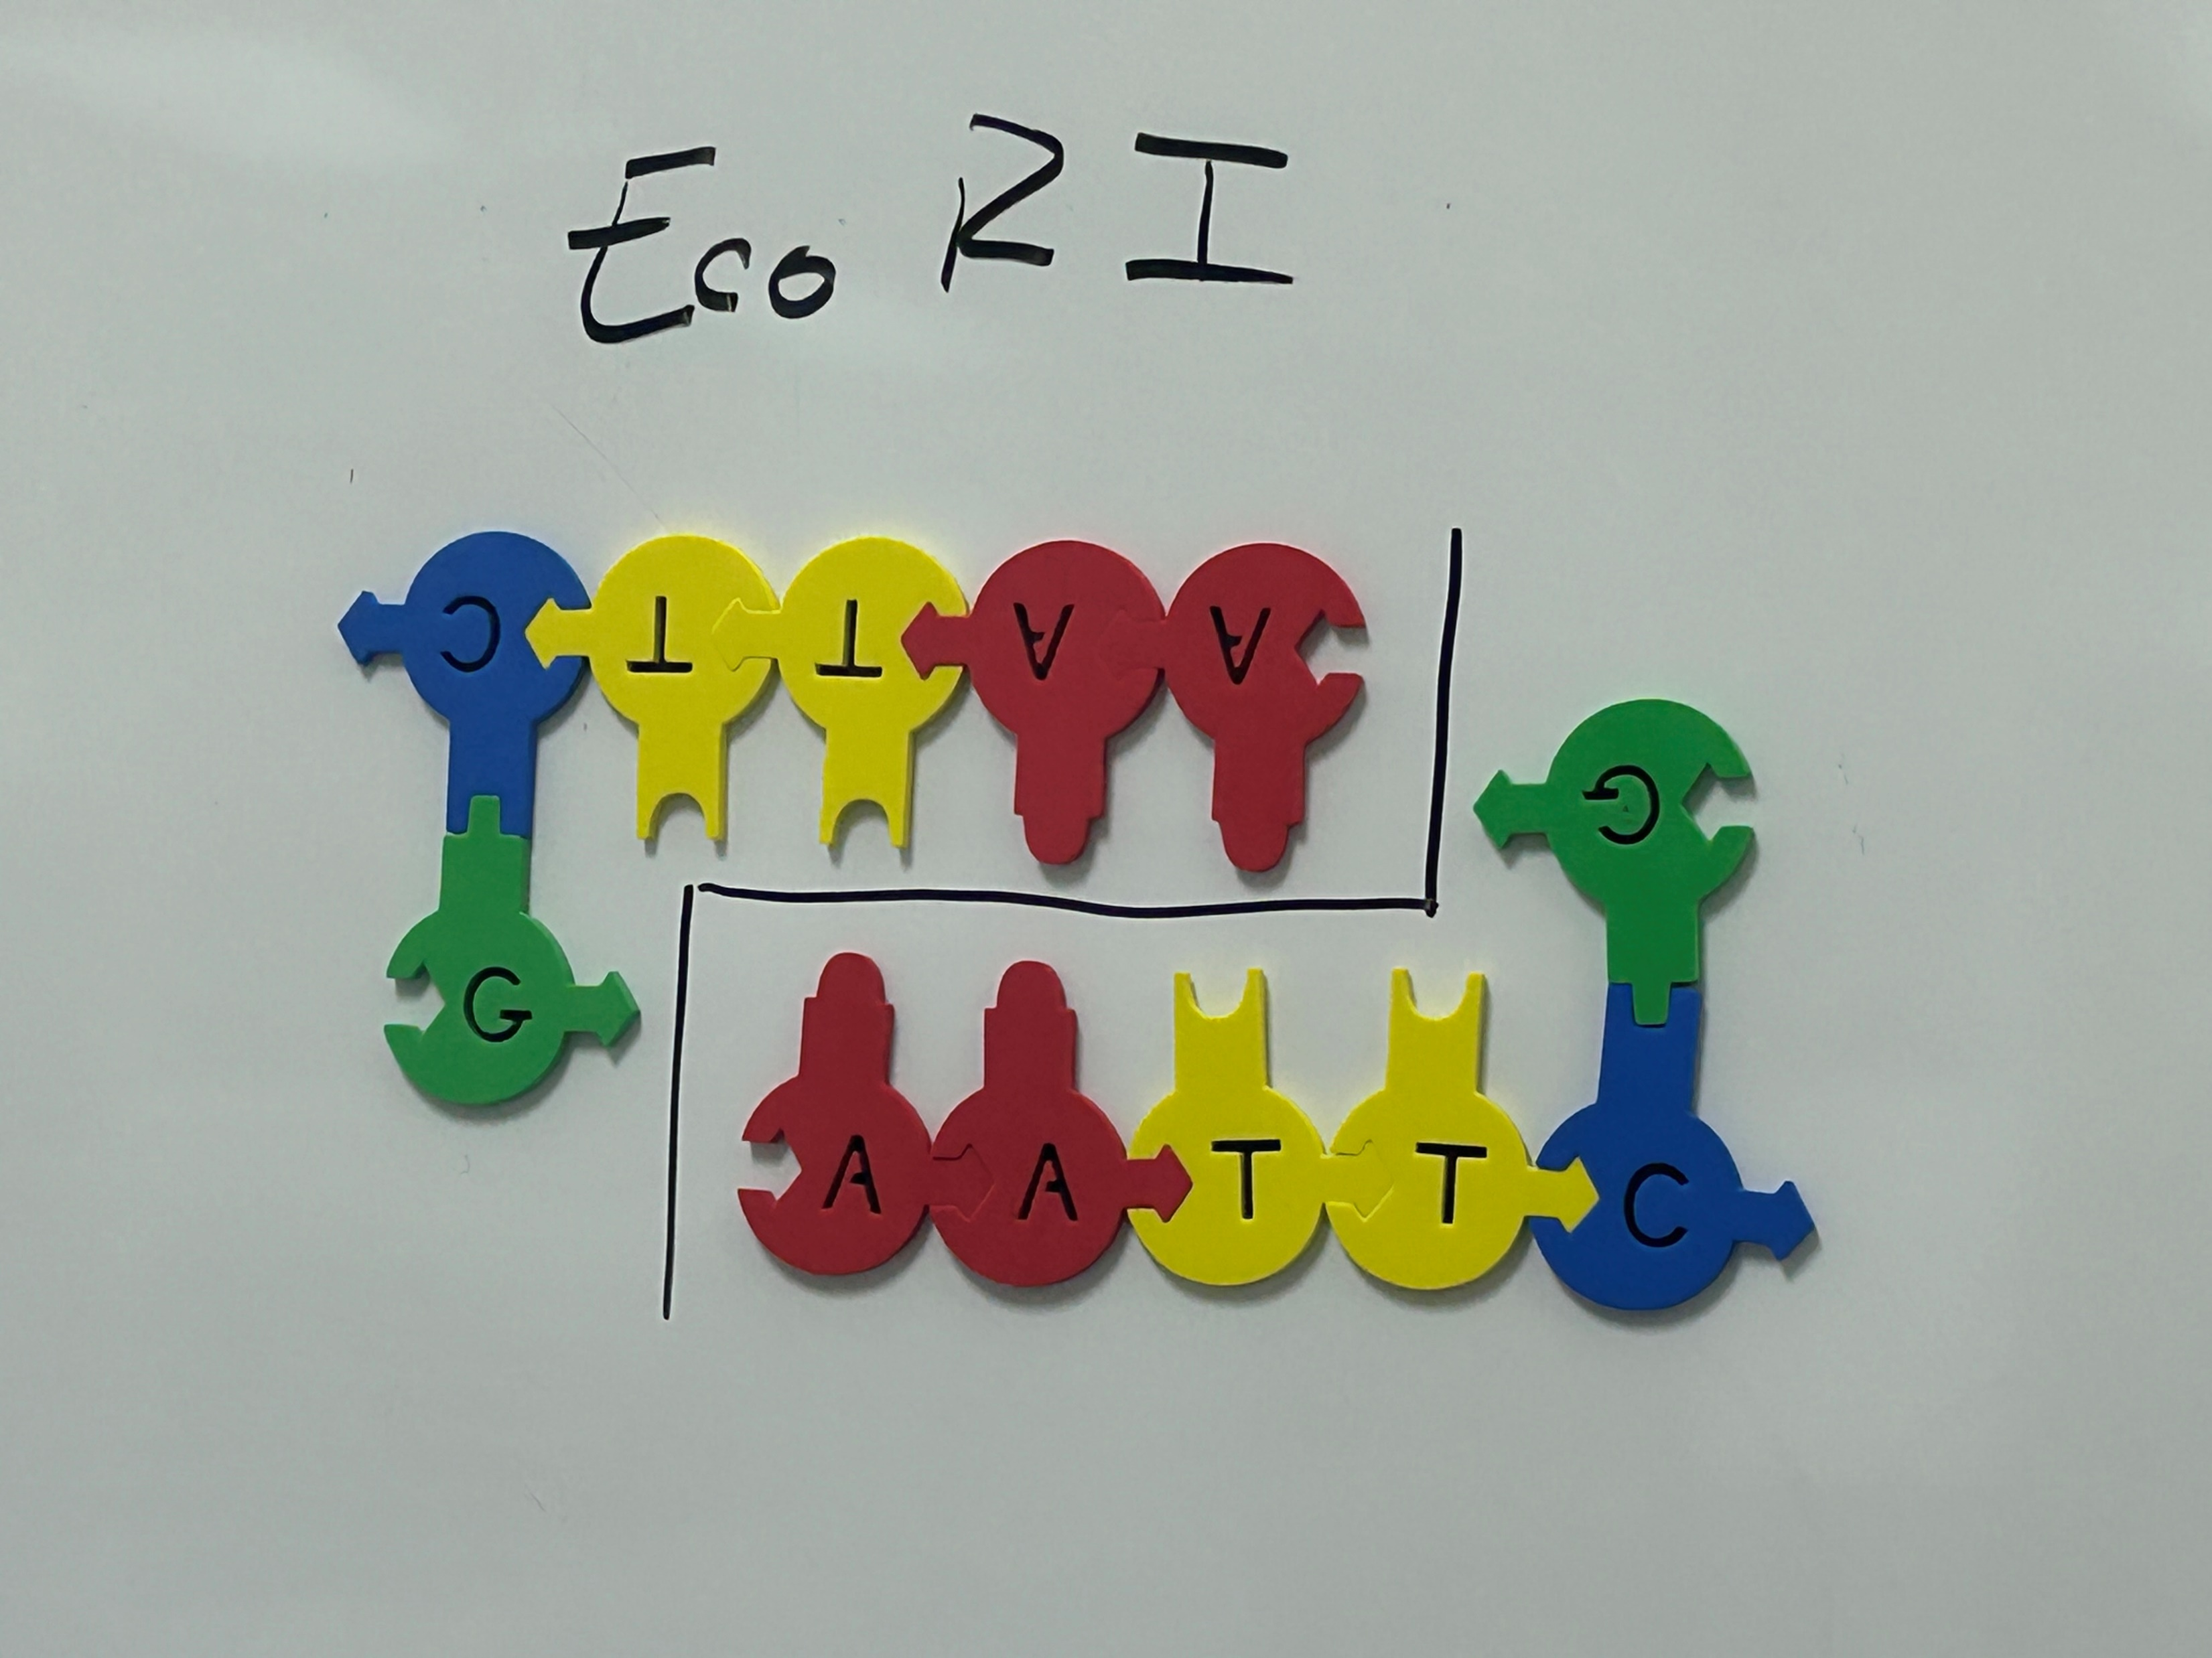
EcoRI
Notes:
3’ – CTTAAG-5’
5’-GAATTC-3’

Slide 11
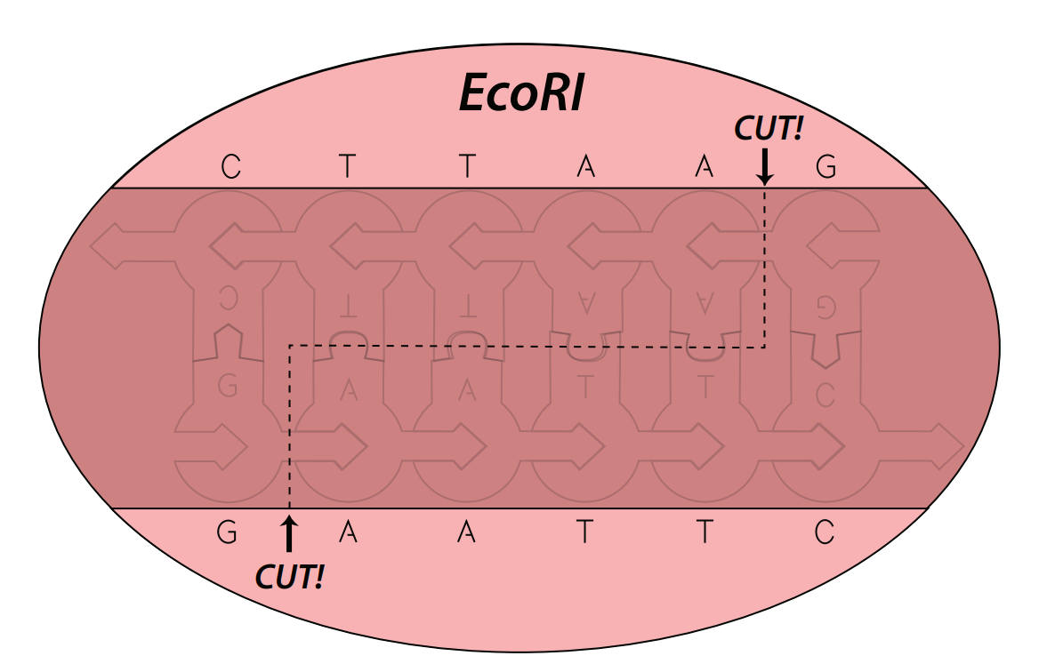
EcoRI
Notes:
This is the image target for your web-based AR. Notice the dimerization of the enzymes.

Slide 12
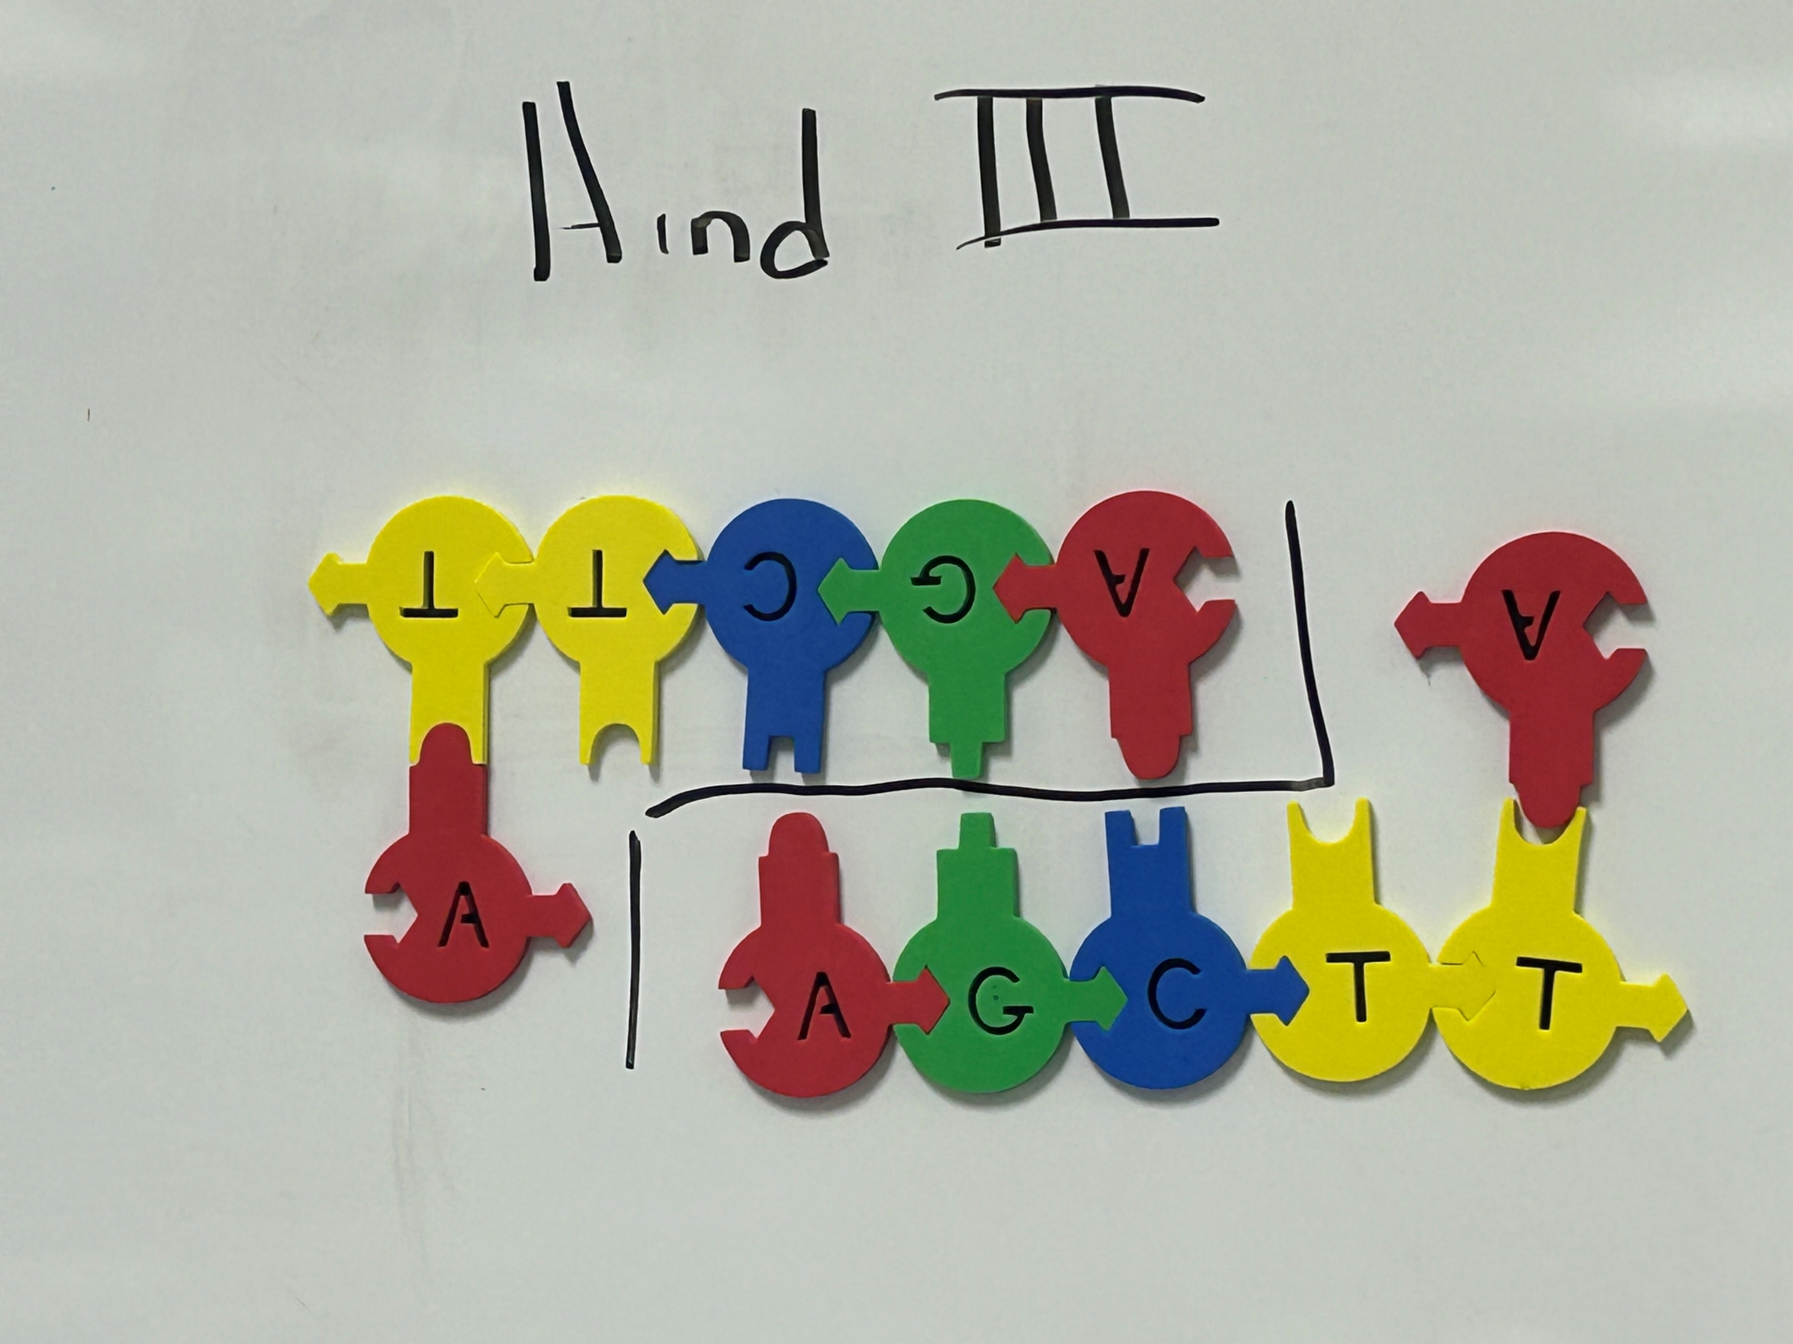
Hind III
Notes:
3’-TTCGAA-5’
5’-AAGCTT-3’

Slide 13
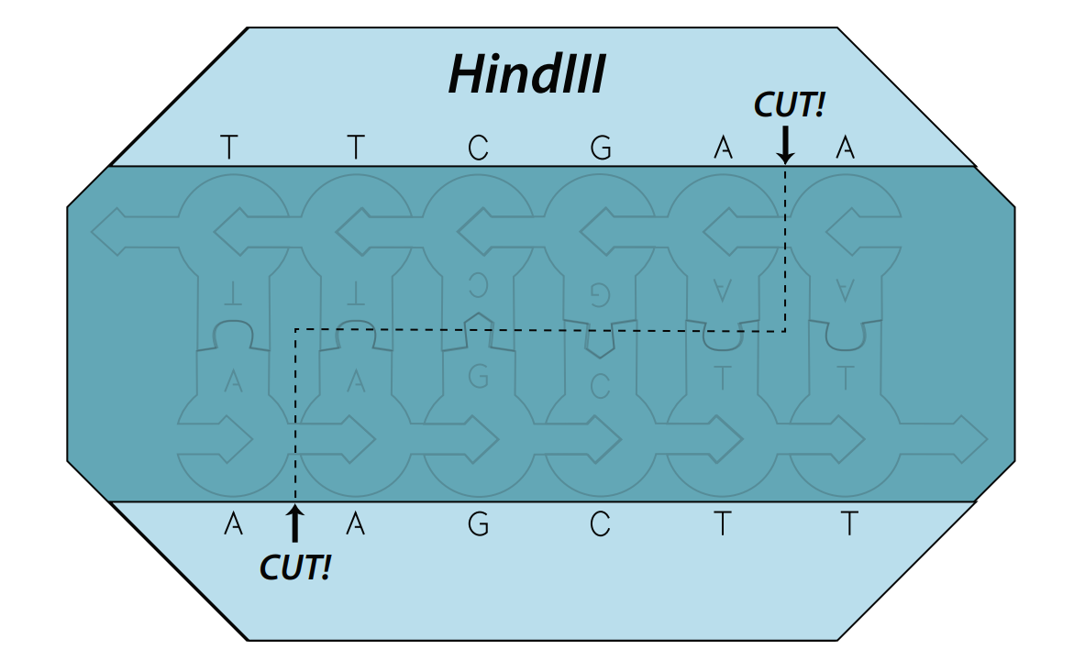
Hind III
Notes:
This is the image target for your web-based AR.

Slide 14
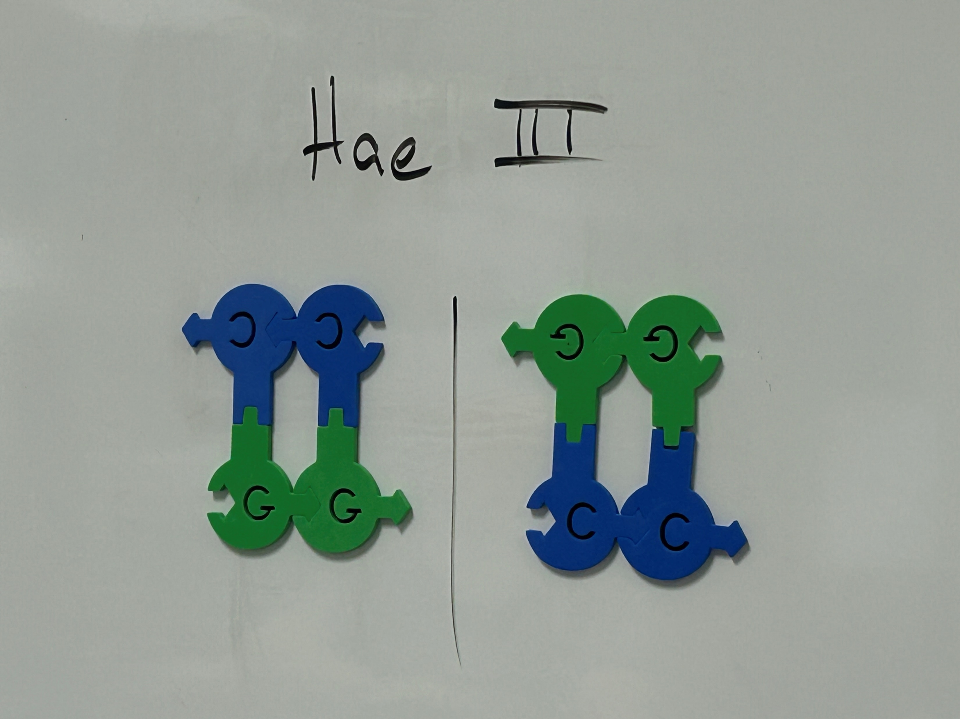
Hae III
Notes:
‘3-CCGG-5’
5’-GGCC-3’

Slide 15
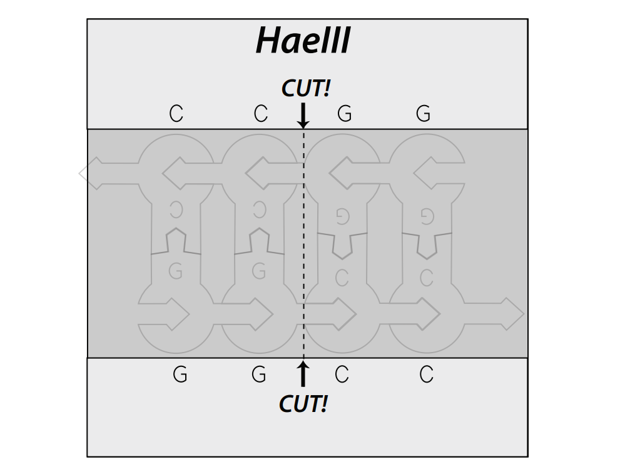
Hae III

Slide 16
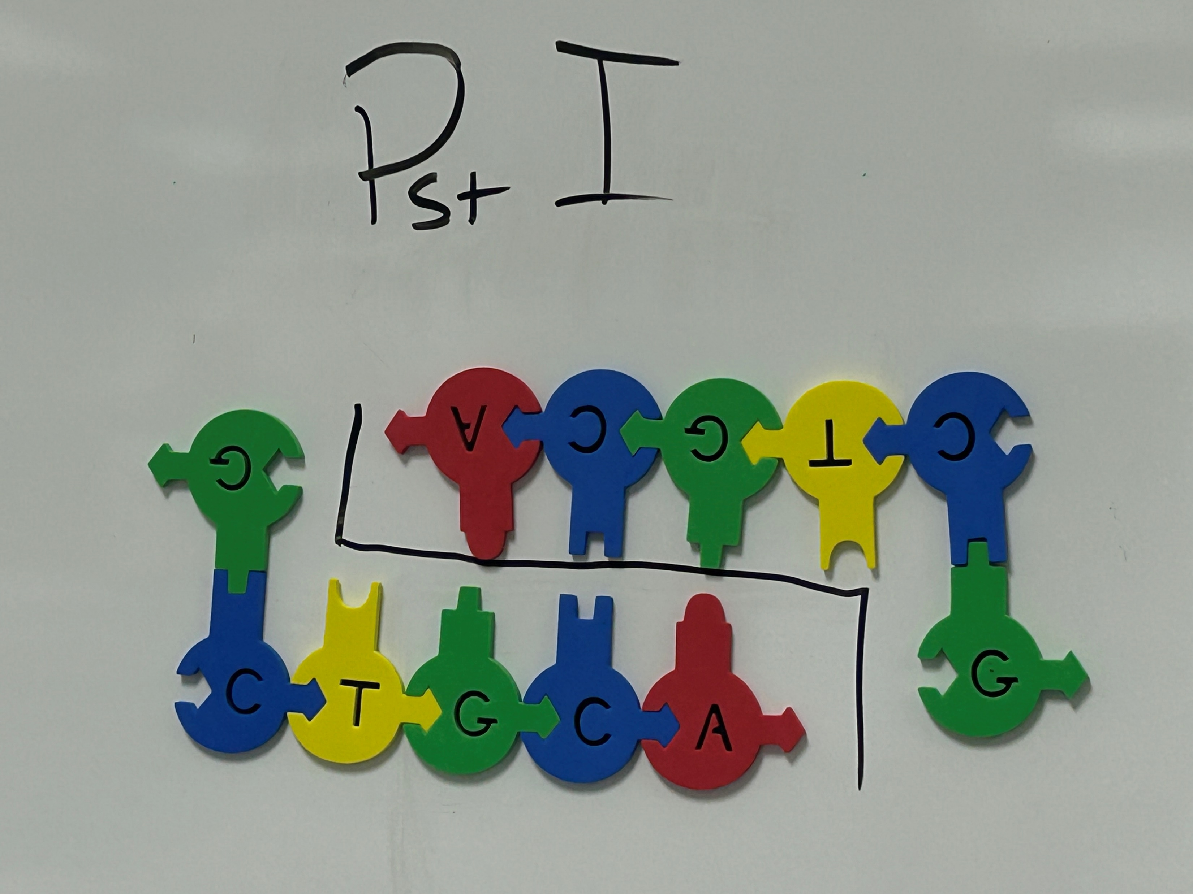
PstI
Notes:
3’GACGTC-5’
5’-CTGCAG-3’

Slide 17
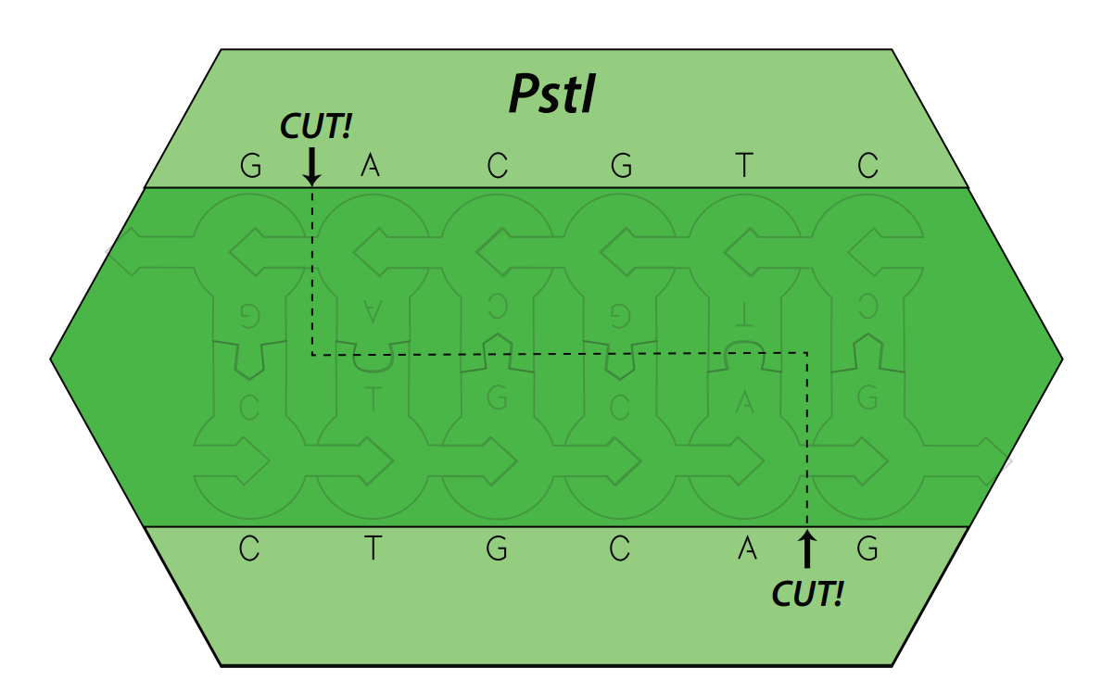
PstI

Slide 18
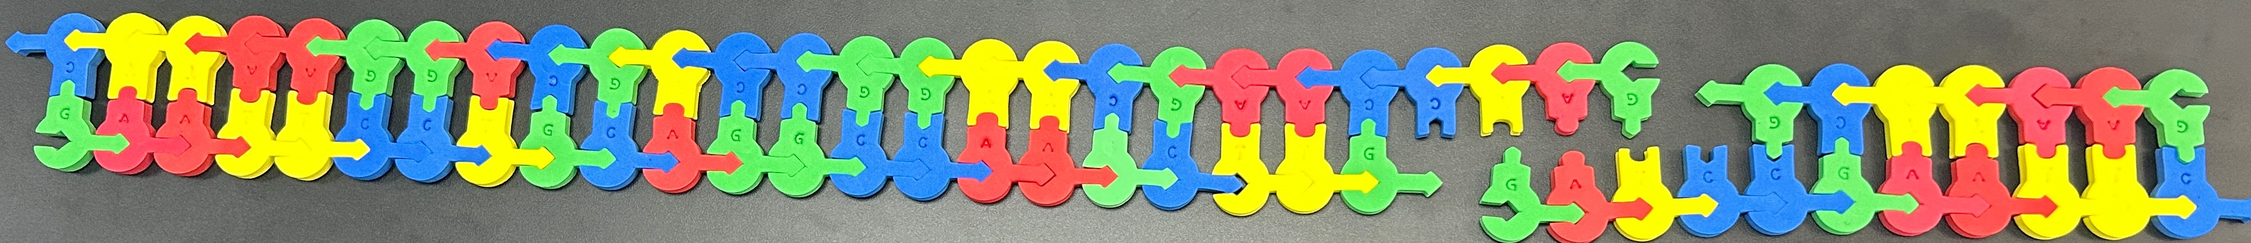
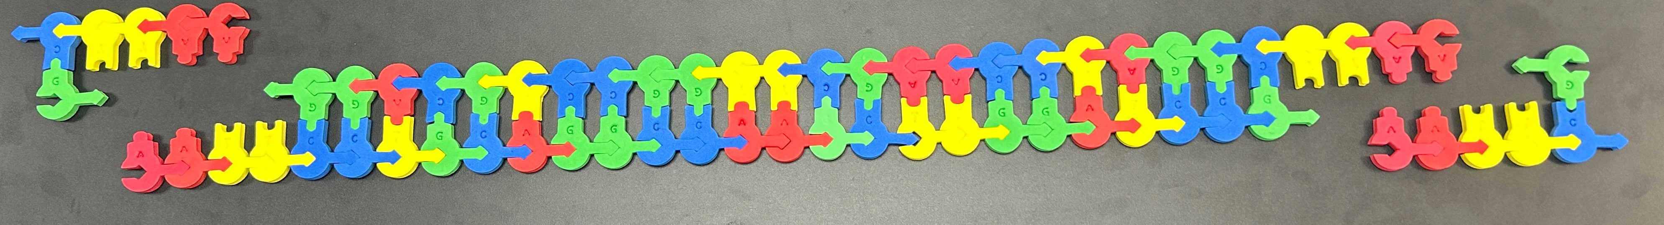
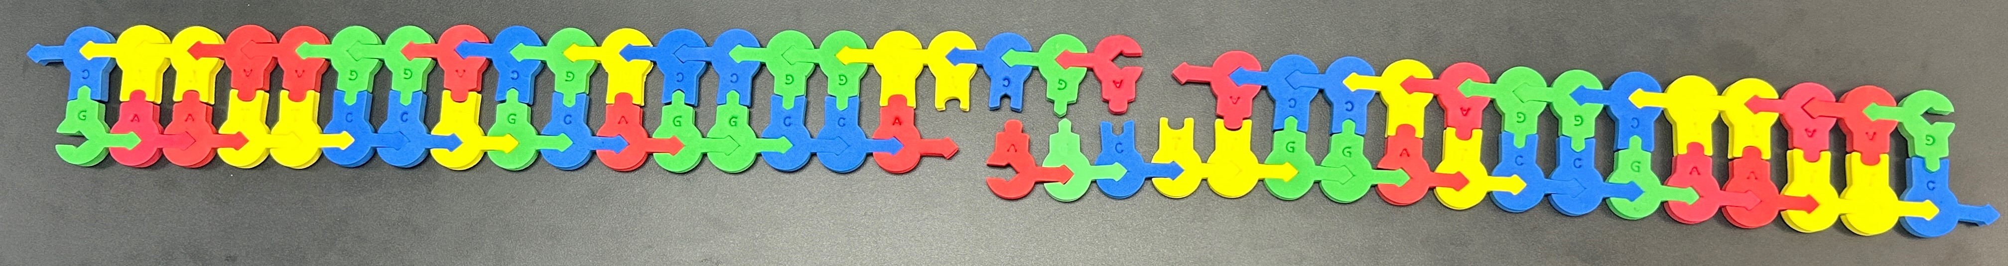
Our digests…
BamHI digestion product
EcoRI Digestion Product
HindIII digestion product
Notes:
Teacher tip- This would not be in a single tube. Set each group/table up with a single sequence and multiple enzymes. Have learners move around the room to see the products in different tubes.

Slide 19
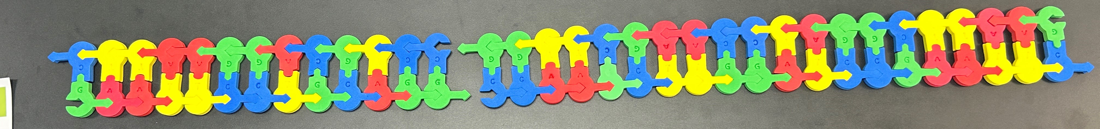
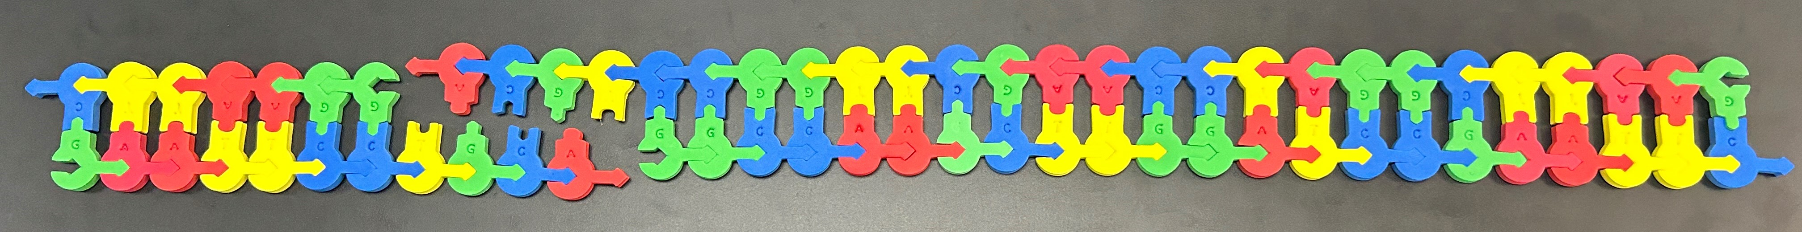
Our digests…
HaeIII digestion product
PstI digestion product

Slide 20
Product differences
Some of these digests leave sticky ends, great for inserting a new gene with the addition of a ligase and the correct sticky ends
Some of these leave blunt ends, great for inactivating a gene
Both will activate DNA repair systems in the cell-

Slide 21
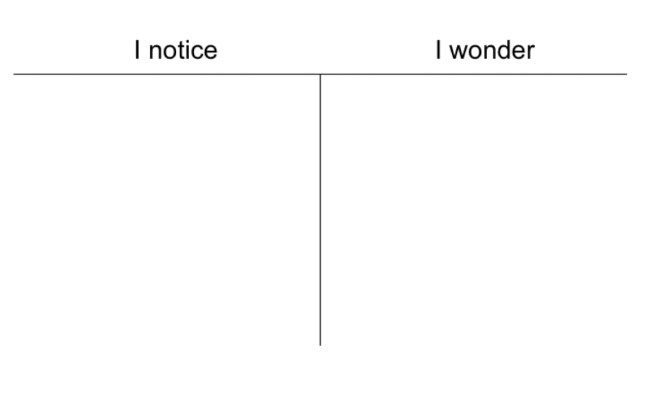
The problem with education …

Slide 22

Fun with Math!
Each of these restriction enzymes has a 4-7 bp recognition sequence.
How specific is this?
4bp … ¼ x ¼ x ¼ x ¼ = 1/256
5bp … 1/1,024
6bp …1/4,096
7bp … 1/16,384

Slide 23
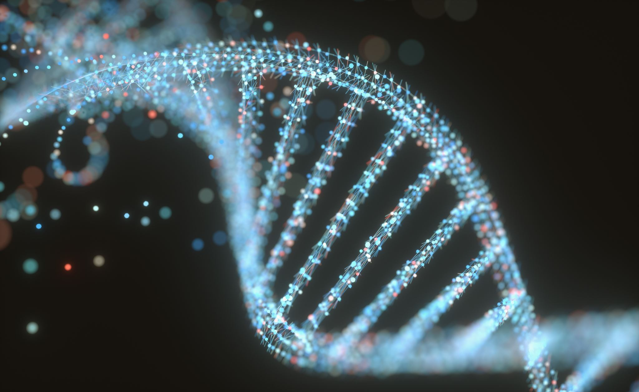
The human genome is 3.2 billion bp!
If our most specific RE cuts once every 16,384 bp, how many restriction sites would it identify at random?
195,312….
That’s a lot of fragments!
Let’s try to knock this gene out!
Can we make something more specific?
Notes:
This is bad… your cell would not survive this cataclysmic event…

Slide 24
How do we increase specificity?
We look to nature!
Zinc fingers are the most common nucleotide recognition motif –
Can we use its specificity to engineer a restriction enzyme?
Well… yes, if it’s the right kind!

Slide 25
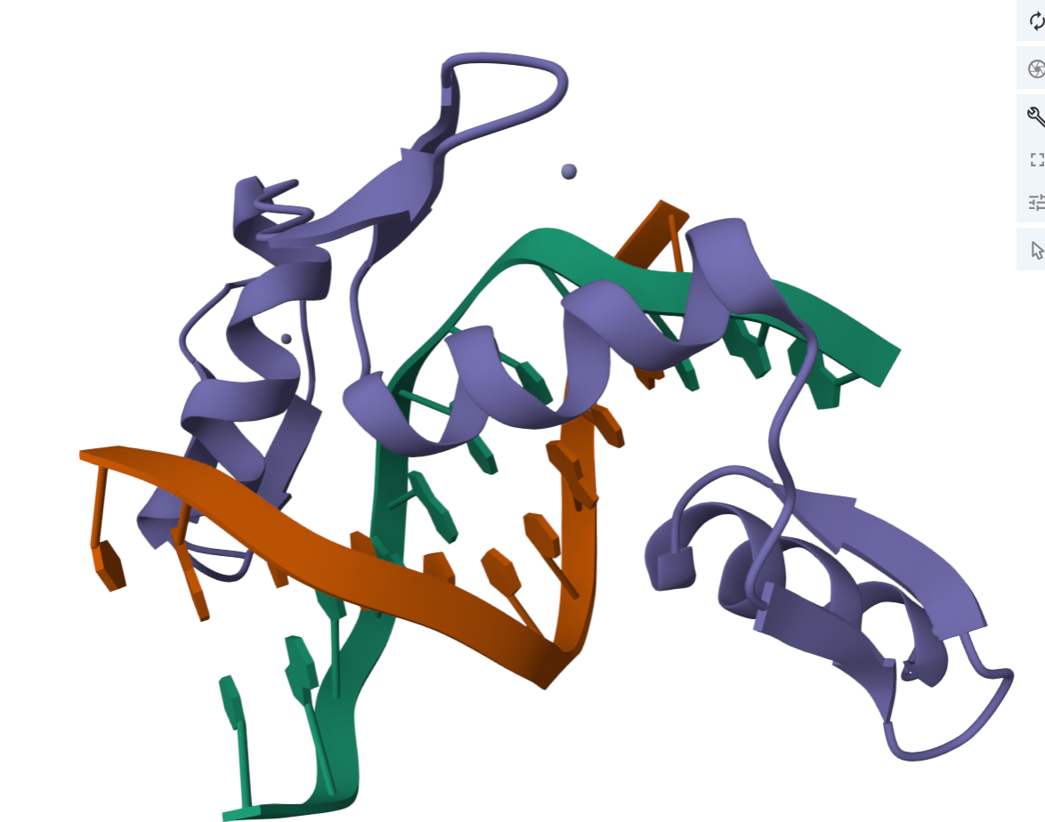
The Zinc Finger-
Zinc Fingers can be edited to recognize a specific nucleotide sequence
Cys-Cys-His-His coordinate a Zinc ion to hold shape

Slide 26
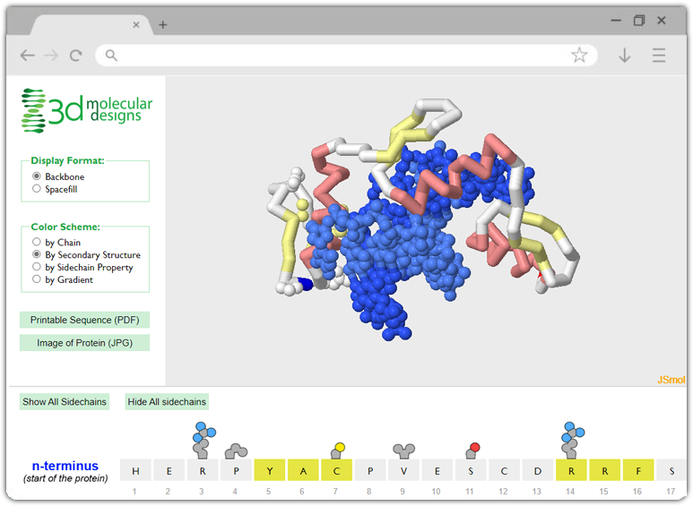
The Exploritorium
The structure of three zinc finger motifs bound to DNA can be further explored at:
https://www.centerforbiomolecularmodeling.org/markMyweb/1zaa/

Slide 27
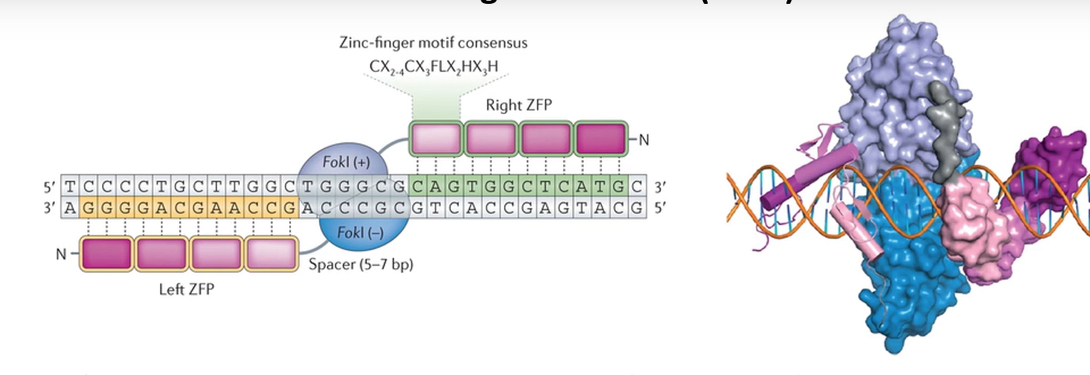
New problem
While many restriction enzymes need to form dimers to activate their endonuclease activity, many of them do not have separate recognition and endonuclease domains.
Notes:
FokI is our restriction enzyme domain. When we link 3-4 zinc finger proteins (ZFP), they will identify a specific sequence and allow the FokI domains to form the dimer and make the cut in the targeted gene.

Slide 28
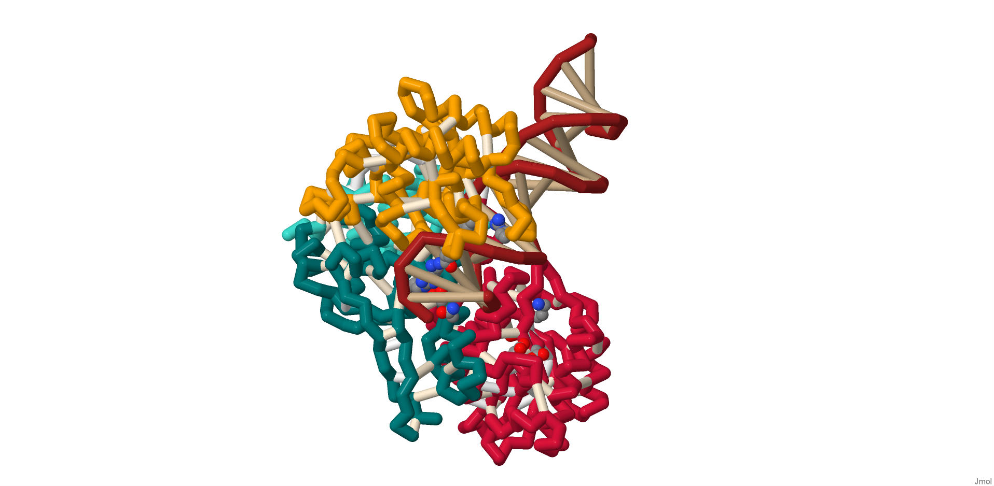

Slide 29
Triplet position
Nucleotide | 5’ | Middle | 3’
G | Arg 6 Asp2 | Lys 3 | Arg -1
A | Gln 6 | Ser3 | Gln -1
C | Ser 2 | Val 3 | Asp -1
T | Lys 6 Asp 2 | Ala3 | Leu -1
Notes:
* Modified and simplified for student use – >From Wolfe et al (1999)

Slide 30
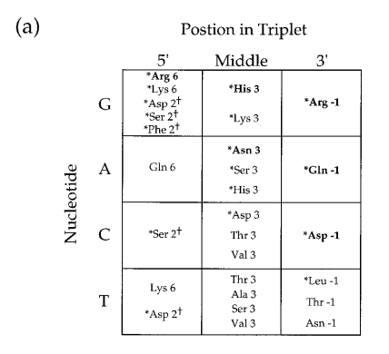
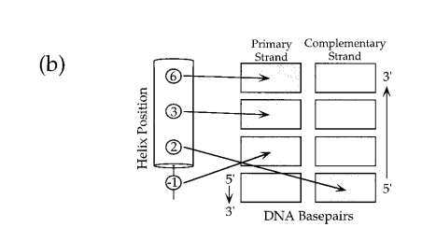
Actual data based upon specific sequence
Notes:
* Modified and simplified for student use – >From Wolfe et al (1999)

Slide 31
Which Amino Acid do we need in the alpha helix?
Finger 3
-1 2 3 6
Finger 2
-1 2 3 6
Finger 1
-1 2 3 6
Fok I Left

Slide 32
What about the other side?
Fok I Right
Finger 1
6 3 2 -1
Finger 2
6 3 2 -1
Finger 3
6 3 2 -1

Slide 33
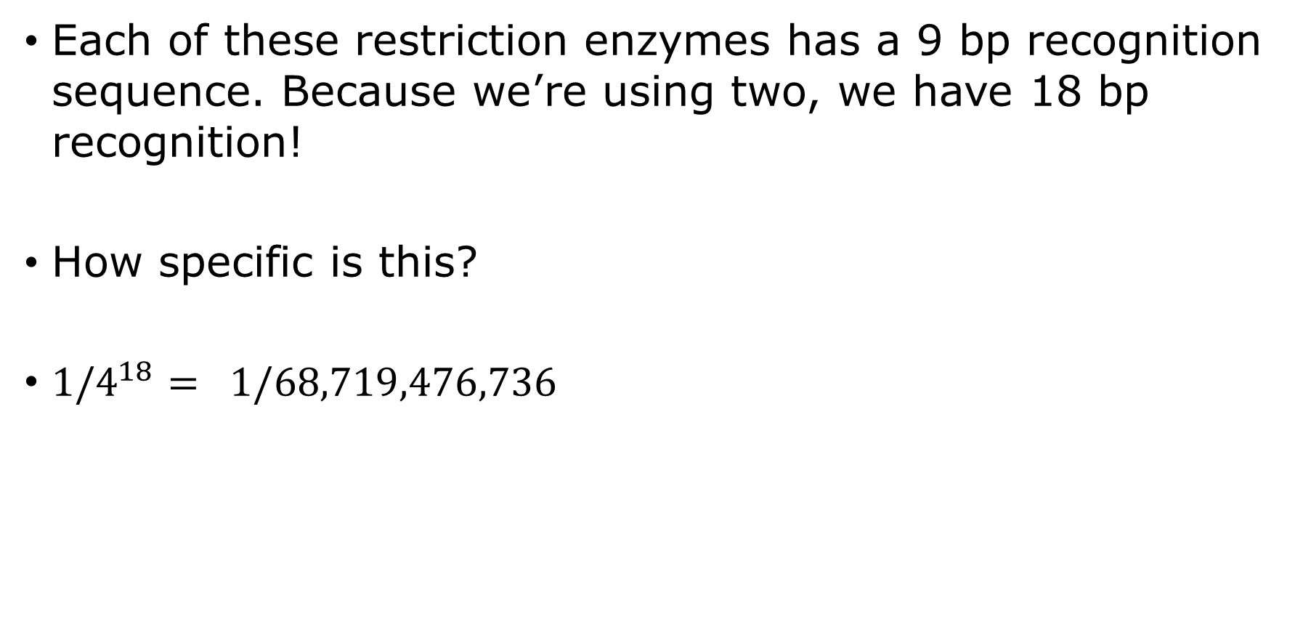
More fun with math!
Each of these restriction enzymes has a 9 bp recognition sequence. Because we’re using two, we have 18 bp recognition!
How specific is this?
${1/4}^{18}= 1/68,719,476,736$

Slide 34


Slide 35
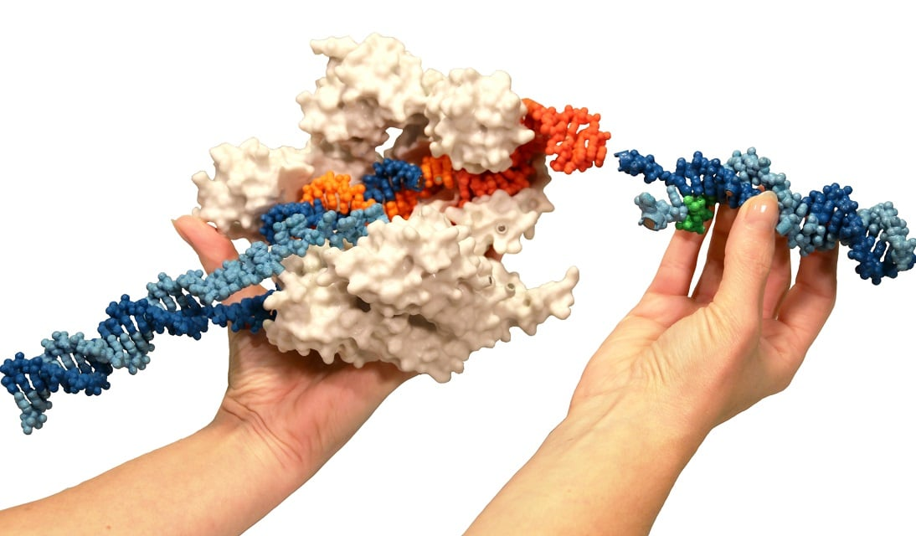
From 1985-2009… this was the future of genome editing!
Zinc finger nucleases were our solution for the future, but…
For reasons unknown, they didn’t always dimerize and make the cut!
Next were TALENS, and years were spent determining the fusion and directing specificity until … CRISPR took over- Stay for Tim's workshop next and learn more…

Slide 36
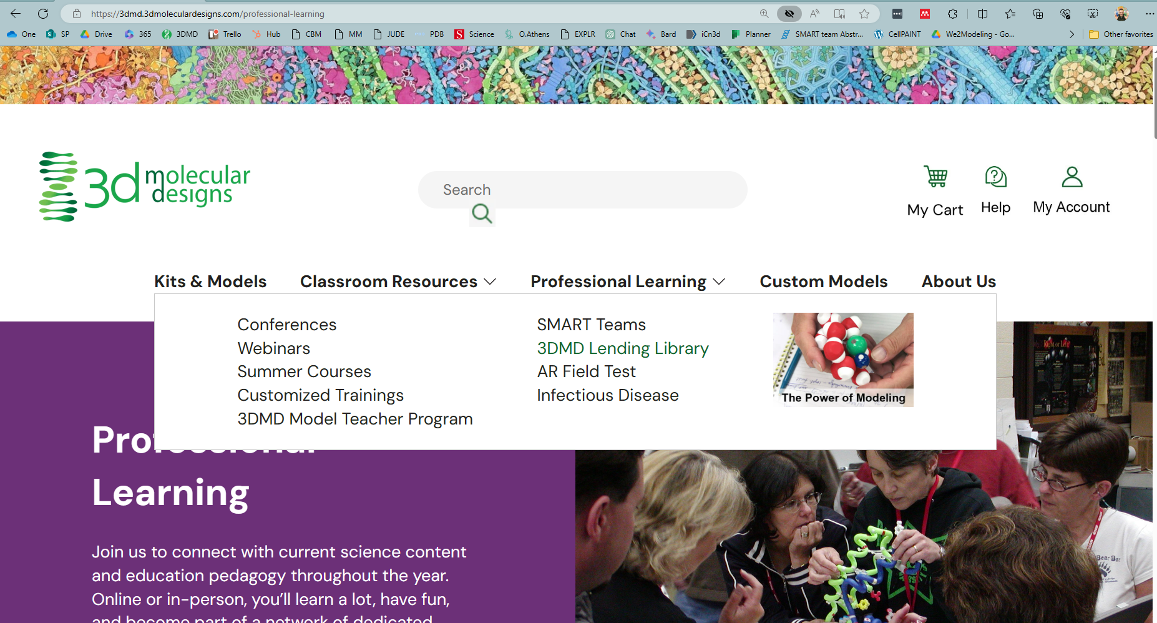
Lending Library!

Slide 37
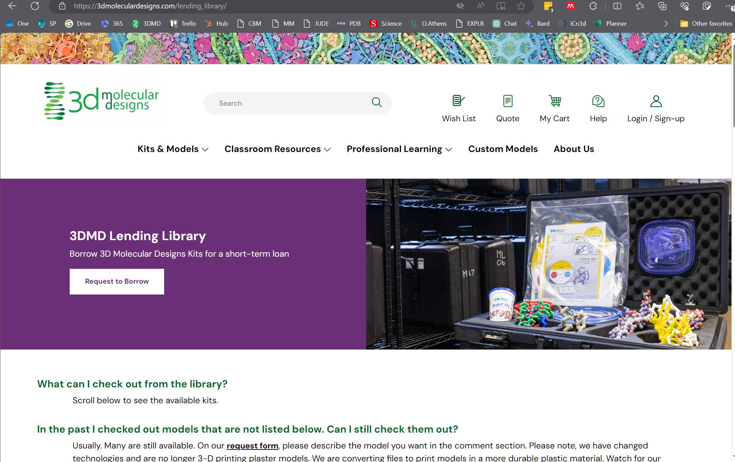
Try before you buy!

Slide 38

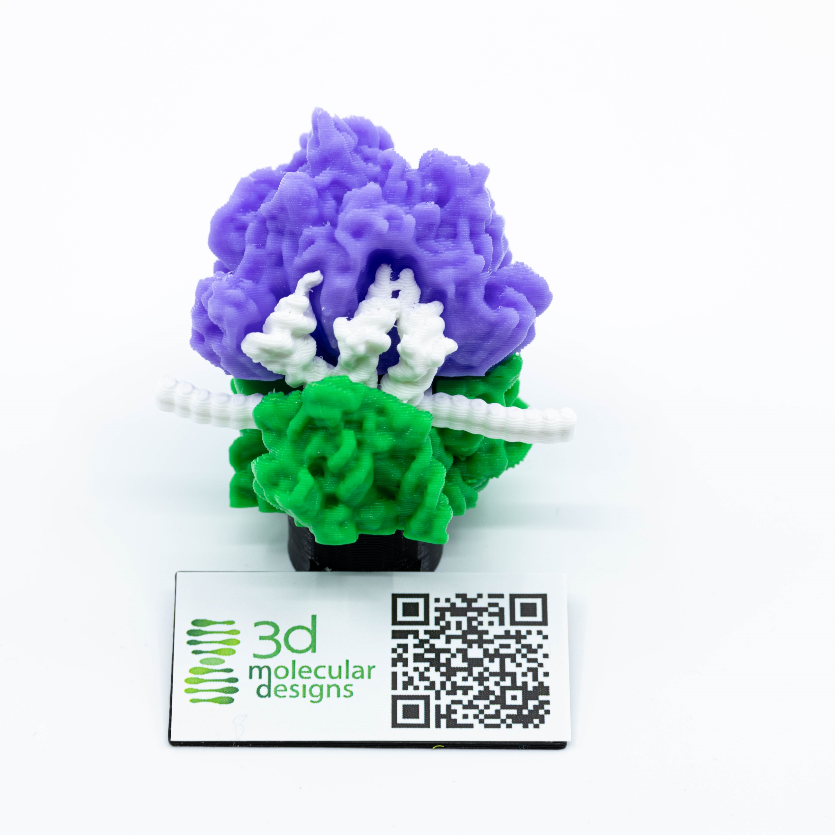
Scan this QR code and fill out our survey!
Show me your Ribosome image and I’ll give you a model with AR enhancement as a thank-you gift!

Slide 39
Workshop NGSS Connections
SEPs | CCCs | DCIs
Asking Questions and Defining Problems (HS-LS3-1) | Cause and Effect (HS-LS3-2) | Structure and Function (HS-LS1-1)
Developing and Using Models (HS-LS1-4) | Scale Proportion, and Quantity (HS-LS3-3)
Analyzing and Interpreting Data (HS-LS3-3) | Systems and System Models (HS-LS3-3)
 | Science is a Human Endeavor (HS-LS3-3)

