Slide 1
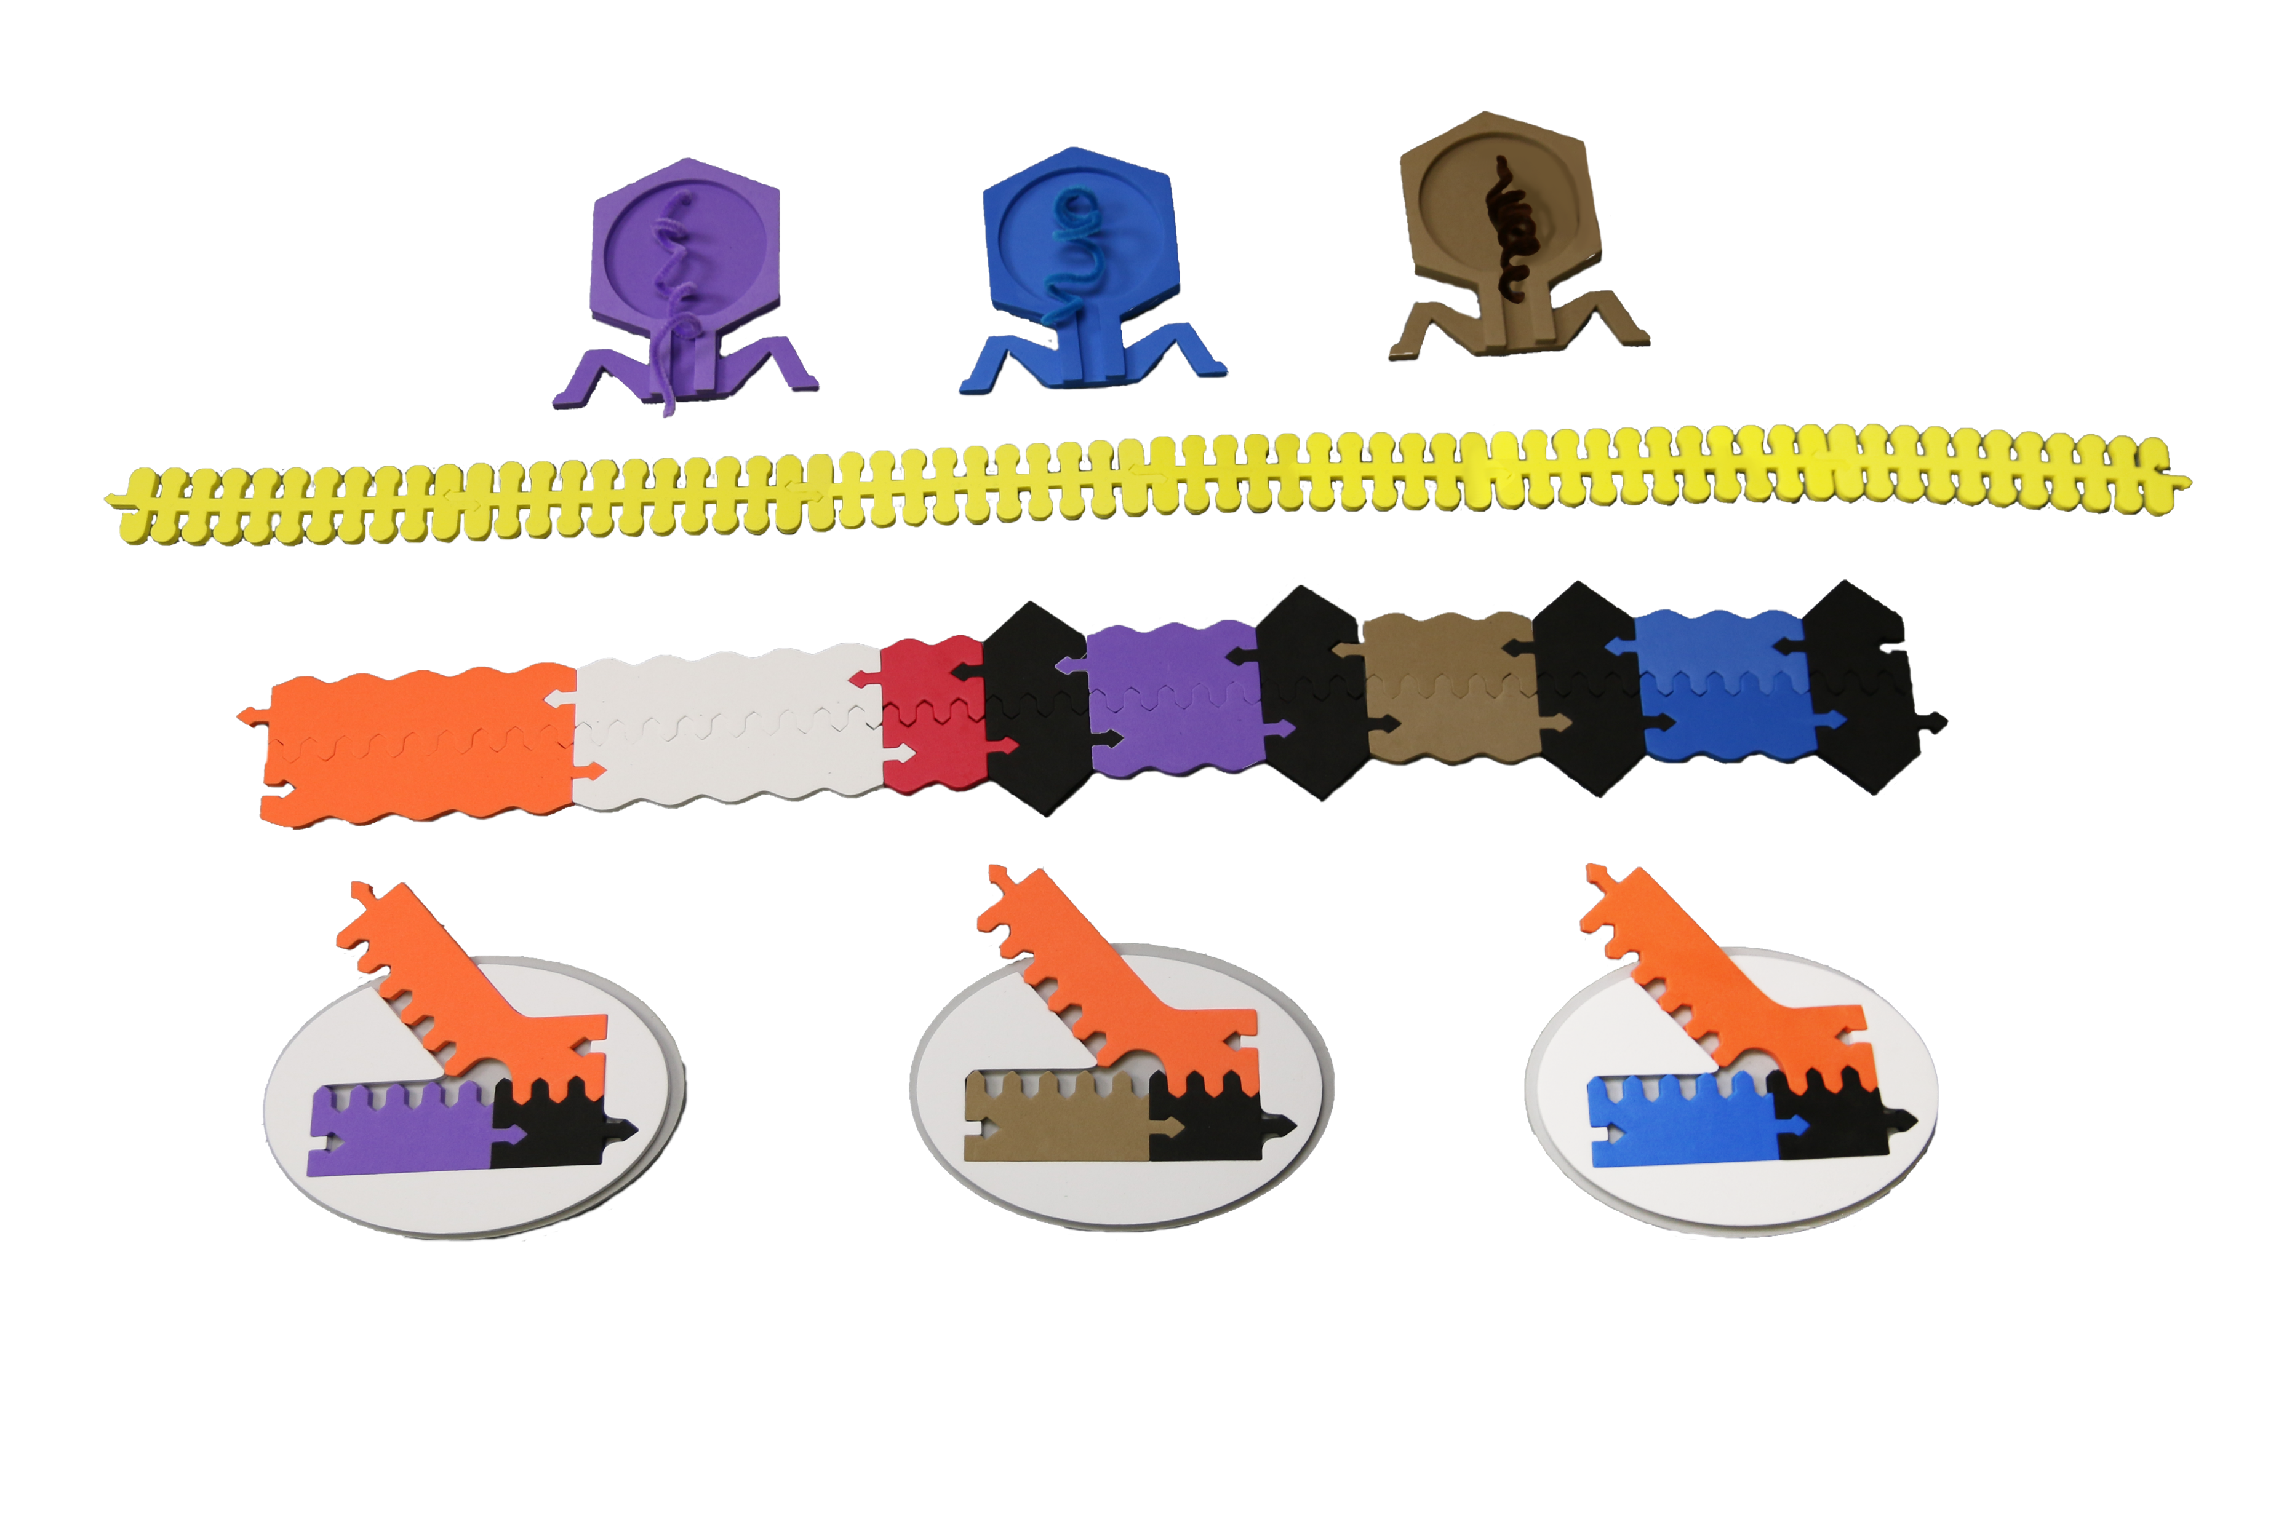
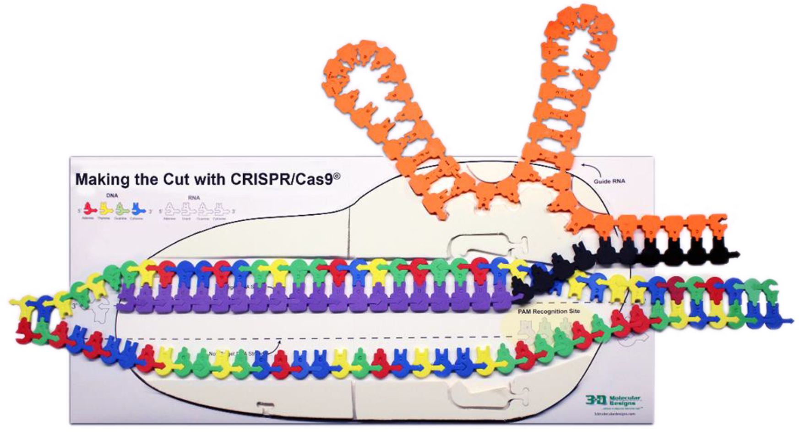
CRISPR: Isn’t it Time We Fixed Your Genome?
Tim Herman, PhD.
Founding Partner & Science Officer

Slide 2
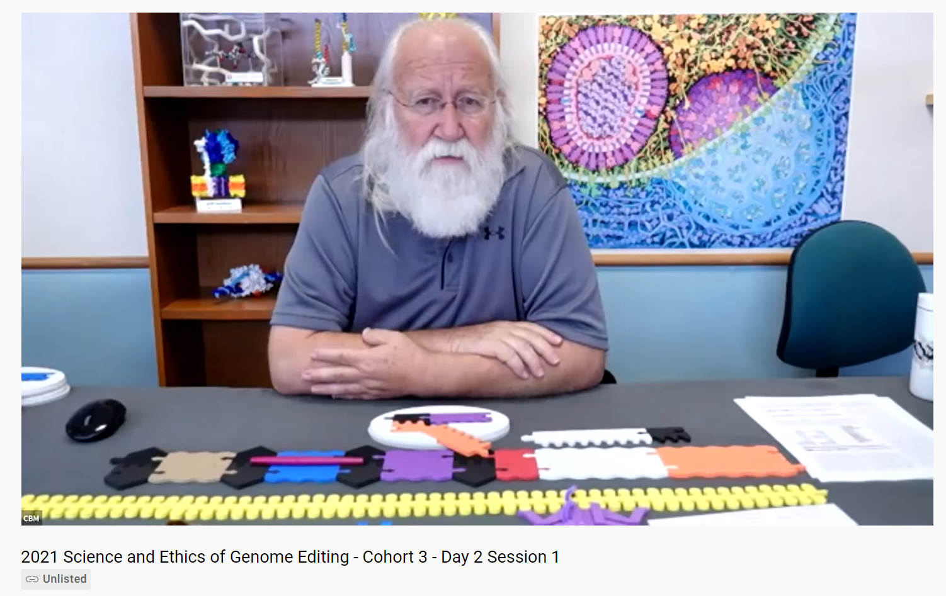
CRISPR …….. as a story of the process of science
https://www.youtube.com/watch?v=KNyFIXkszkM

Slide 3

Should we introduce high school students to CRISPR?
YES …because….
CRISPR has revolutionized how
molecular science is done.
CRISPR technology will be used
to edit eukaryotic genomes.
Important ethical issues related to the use of CRISPR technology exist.
CRISPR is an incredible story of the process of science.

Slide 4
So,… how should we introduce students to CRISPR?
                How can we capture students’ interest in CRISPR?
  How can we connect CRISPR to what we are already teaching?

Slide 5
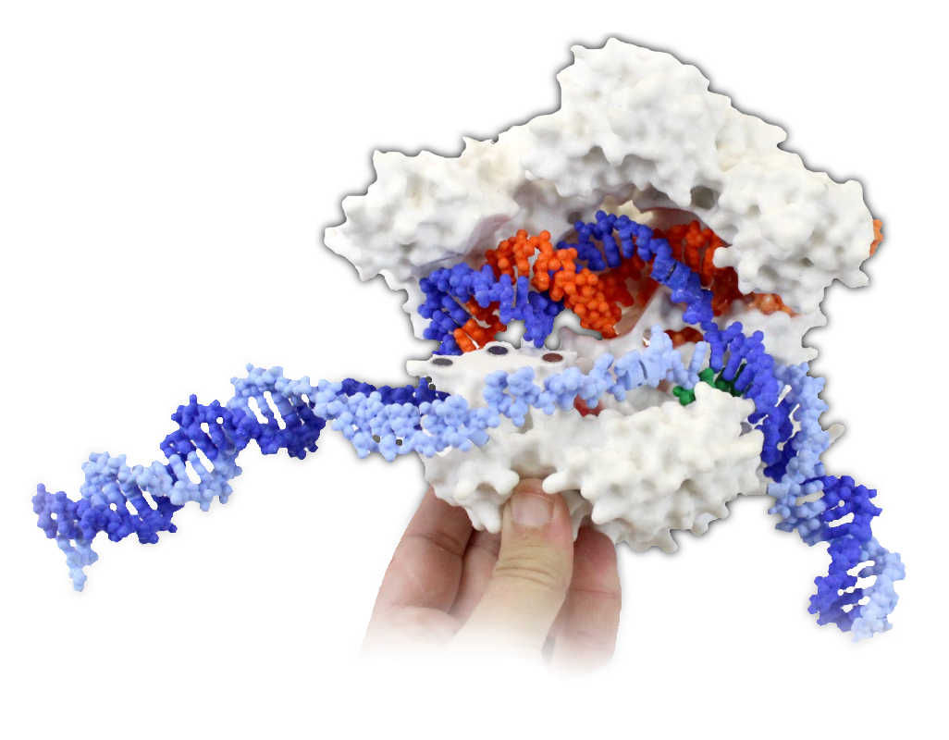
But first,…CRISPR…. as an adaptive immunity system in bacteria.
CRISPR Cas9

Slide 6
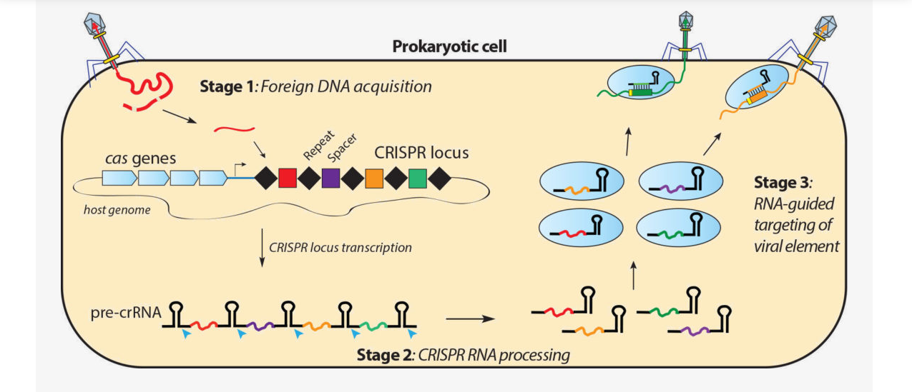
CRISPR – Clustered Regularly Interspaced Short Palindromic Repeats

Slide 7
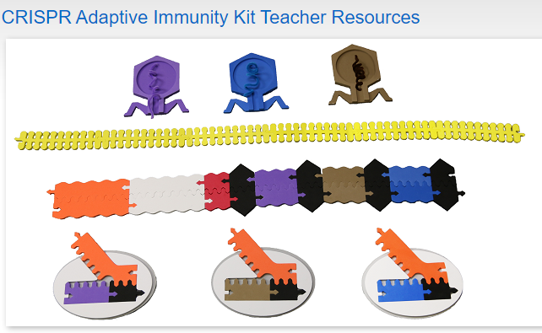
Teacher Resources (3dmoleculardesigns.com)

Slide 8
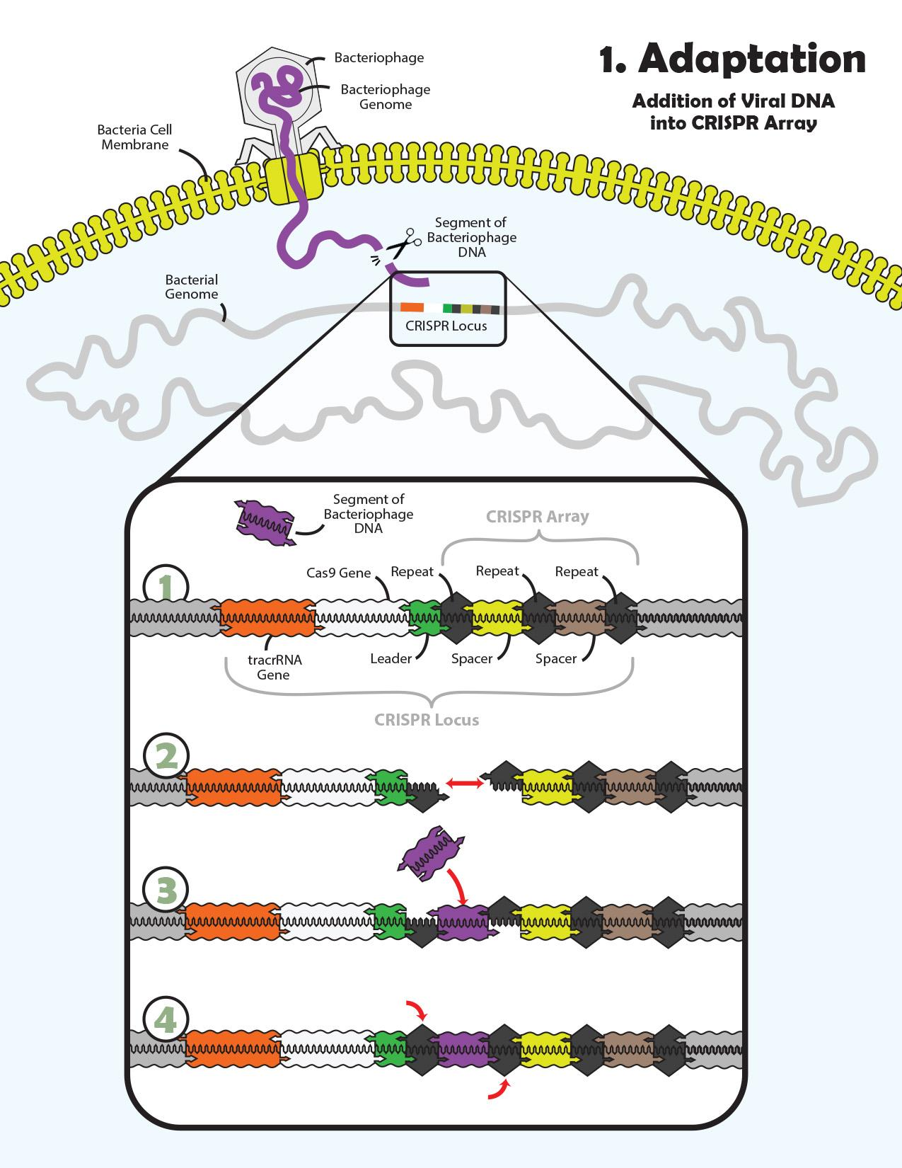
Guiding Graphics

Slide 9
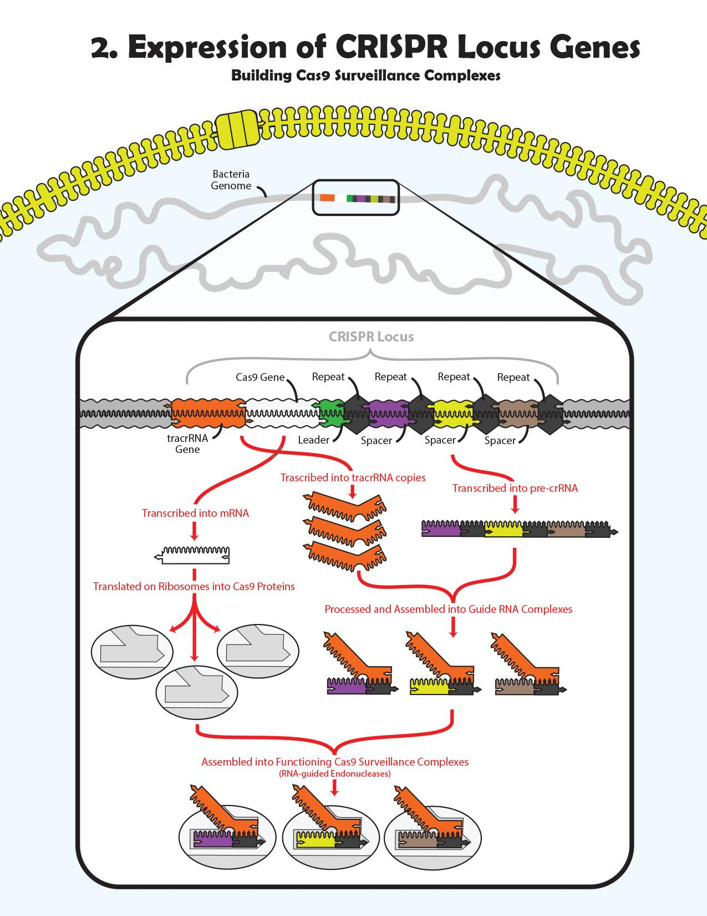
Guiding Graphics

Slide 10
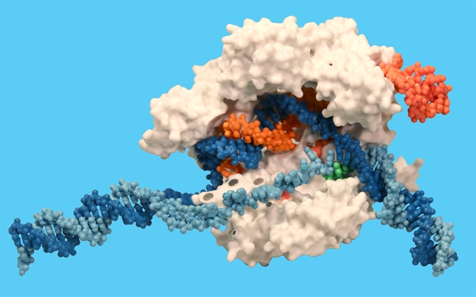
Cas9
trac RNA
Cas9
Cas9
Guide RNA
Target DNA strand
Non-Target DNA strand
PAM site

Slide 11
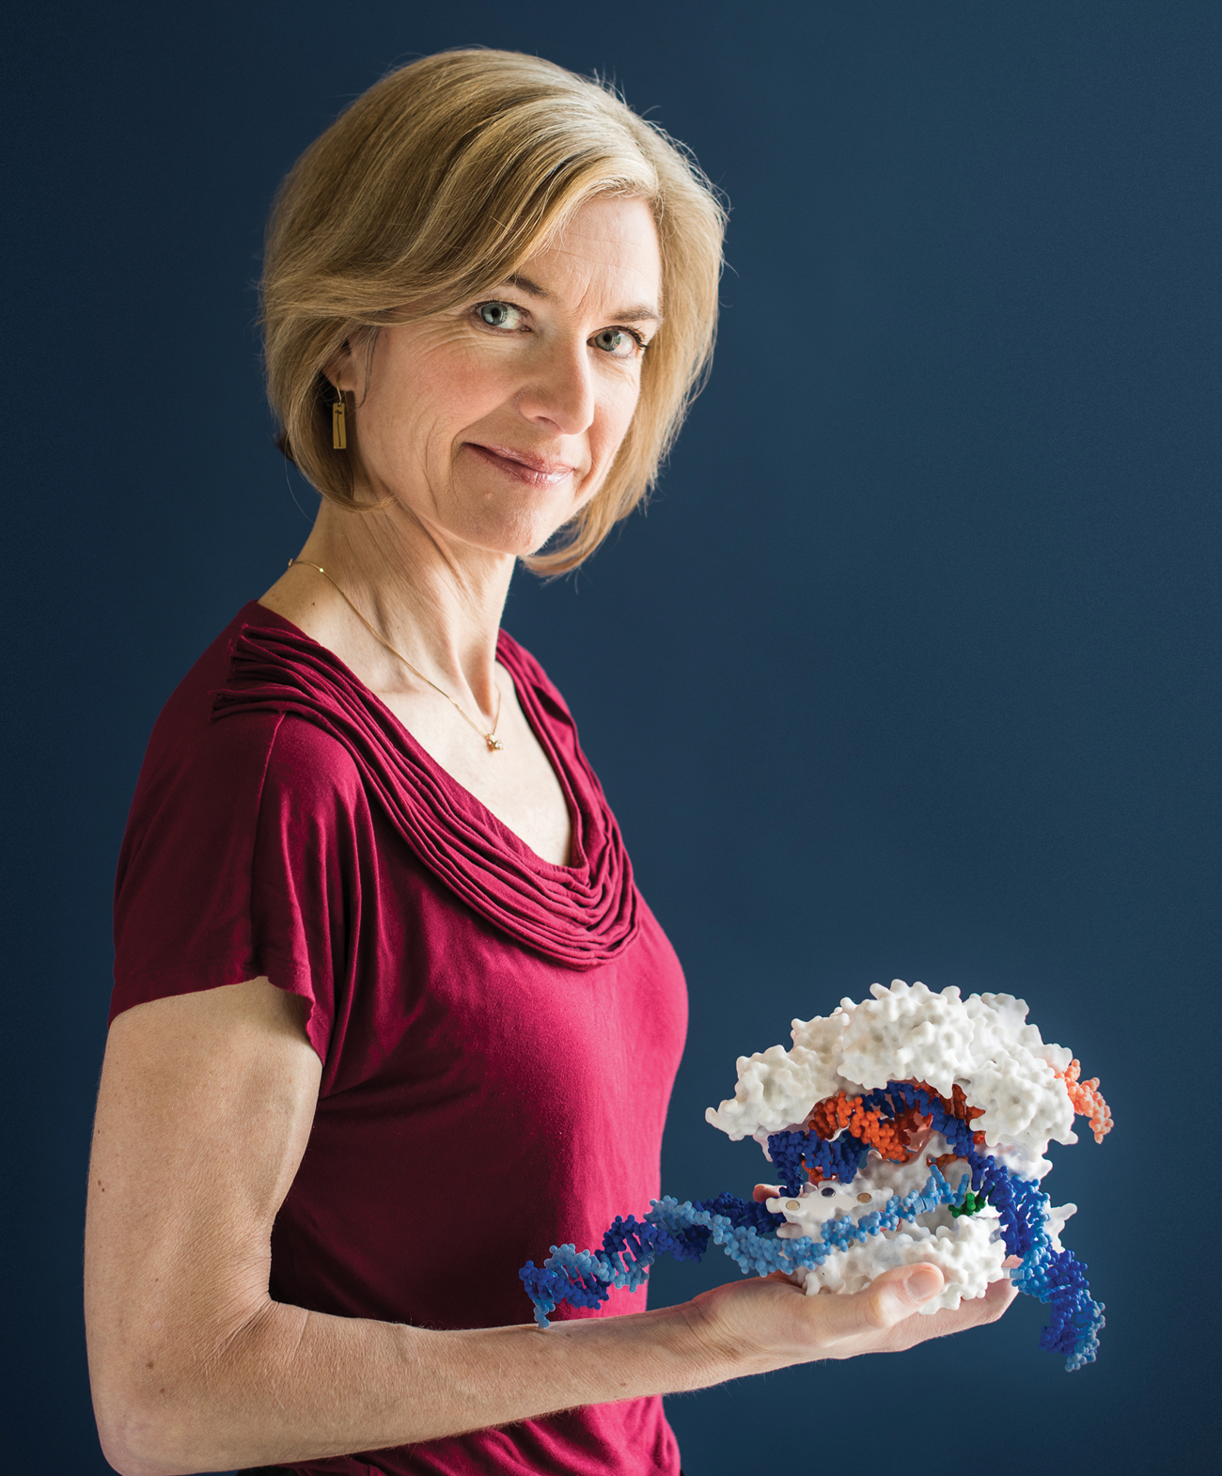
Jennifer Doudna
Image: Drew Kelly

Slide 12
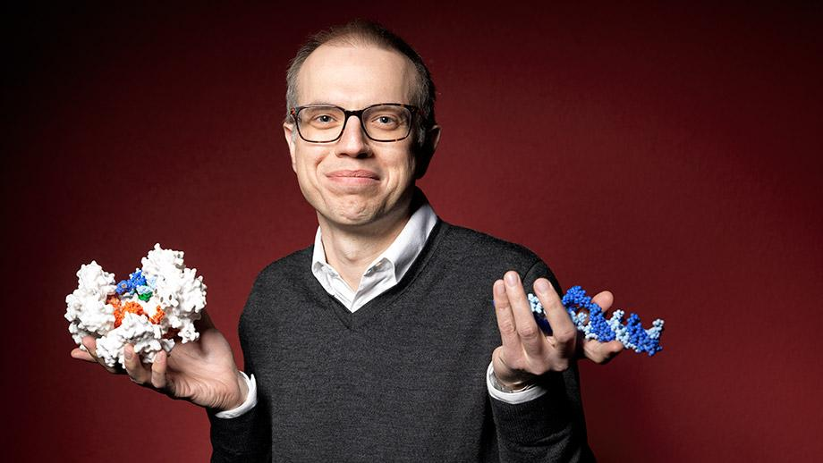
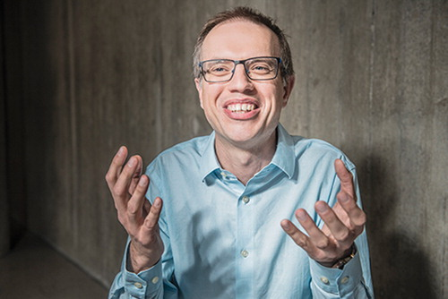
Martin Jinek
Credit: Michael Tomes
Image: Philipp Rohner

Slide 13
The magic of models….
Models make words meaningful!
Interactive physical models provide students with a way to understand a description (written or verbal) of a complex molecular process – such as how CRISPR functions as an adaptive immunity system in bacteria.

Slide 14
A Framework for thinking about CRISPR
CRISPR Biology … how does CRISPR function in bacteria as an adaptive immune system?
CRISPR Biotechnology … how are we using CRISPR tools to edit eukaryotic genomes?

Slide 15
What makes Cas9 special?
Cas9 can target a statistically unique site in the 3.2 billion base-pair human genome,
…and make a double-stranded cut.

Slide 16
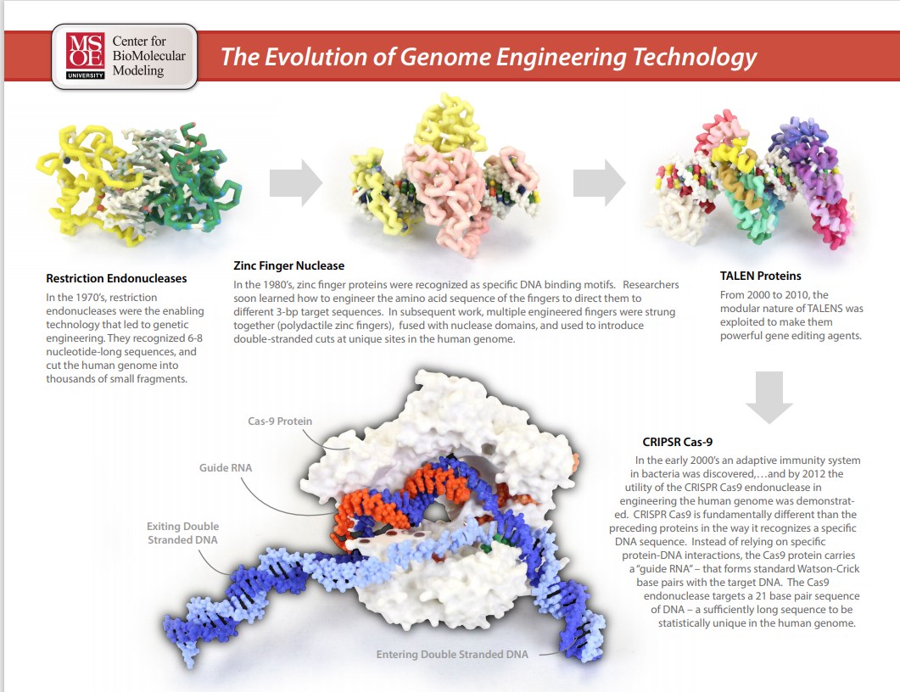

Slide 17
EcoRI… a restriction enzyme that cuts DNA
at a 6 base-pair palindromic site:
3’-CTTAAG- 5’
5’-GAATTC- 3’
In a random sequence of nucleotides, you would expect to find an EcoRI restriction site every 4096 nucleotides.

Slide 18
The human genome is made up of 3,200,000,000 bp of DNA.
Since EcoRI cuts every 4096 bp… EcoRI would cut the human genome into:
3,200,000,000
=
781,250 fragments
4,096
in other words… a mess

Slide 19
CRISPR Cas9 cuts the human genome only once
… at a statistically unique site.
How many nucleotides must Cas9 be able to recognize…for it to be a statistically unique sequence in the human genome?
The answer is…
12 16 24 38 42 ?

Slide 20
A statistically unique site in the human genome…
GAATTCGTCGCTAATG
16 nucleotides
4 X 4 X 4 X 4 X 4 X 4 X 4 X 4 X 4 X 4 X 4 X 4 X 4 X 4 X 4 X 4 = 4.3 X 10⁹
…or…
4¹⁶ = 4.3 X 10⁹

Slide 21
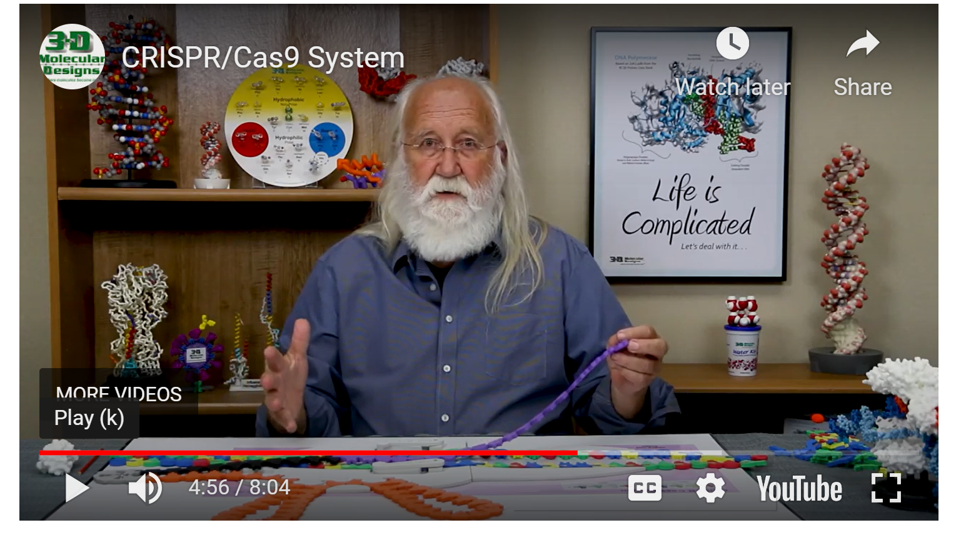
CRISPR: Connecting New Science to What You Already Teach
https://www.3dmoleculardesigns.com/Teacher-Resources/Making-the-Cut-with-CRISPR-Cas9-Animations-and-Videos.htm

Slide 22
Guiding Graphics

Slide 23
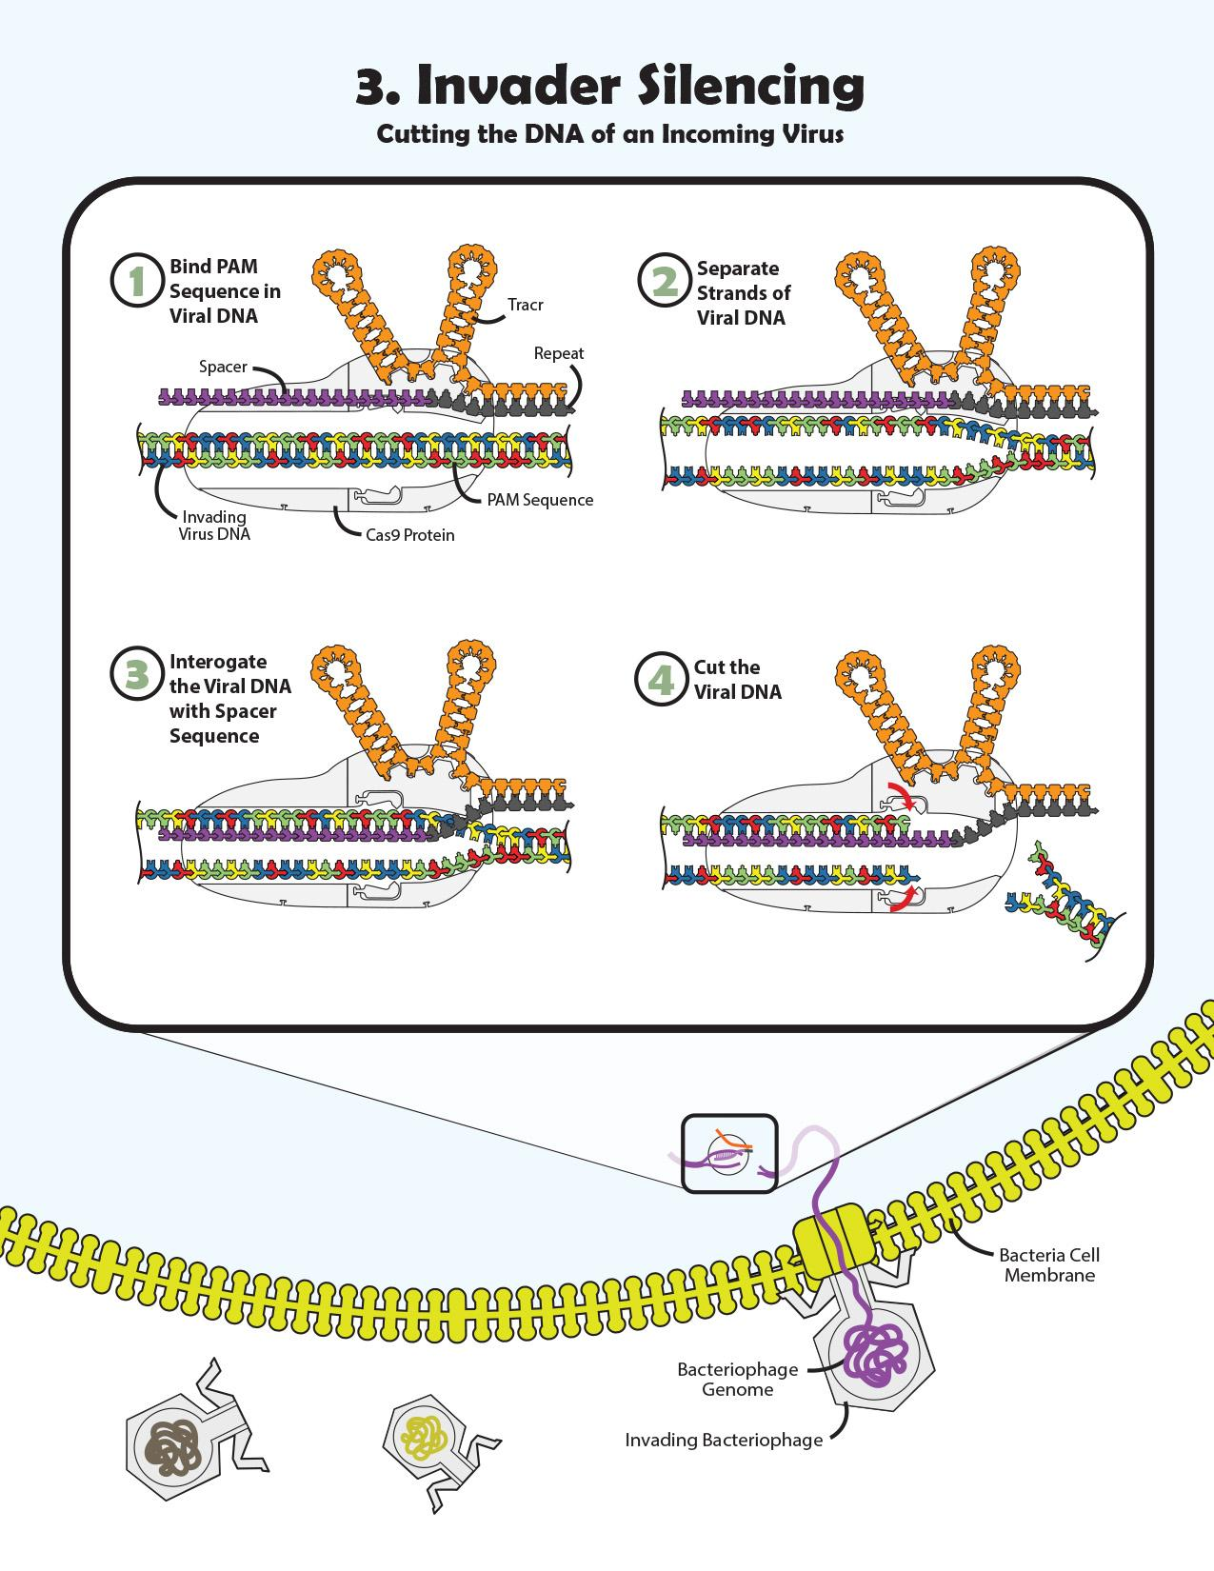
Guiding Graphics

Slide 24
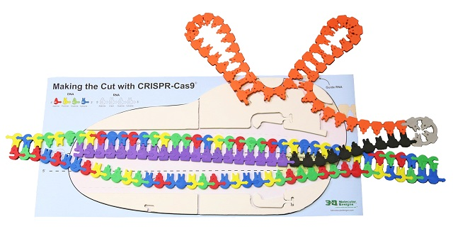
The Making the Cut with the CRISPR-Cas9 Kit

Slide 25
5 Steps in the Making the Cut
Step 1… Assembling the tracrRNA…on the Cas9 protein
Step 2… Adding the crRNA to the tracr RNA
Step 3… Binding the PAM site of double-stranded DNA to Cas9
Step 4… Interrogating the Target DNA strand with the guide RNA
Step 5… Cutting the Target and Non-Target DNA strands

Slide 26
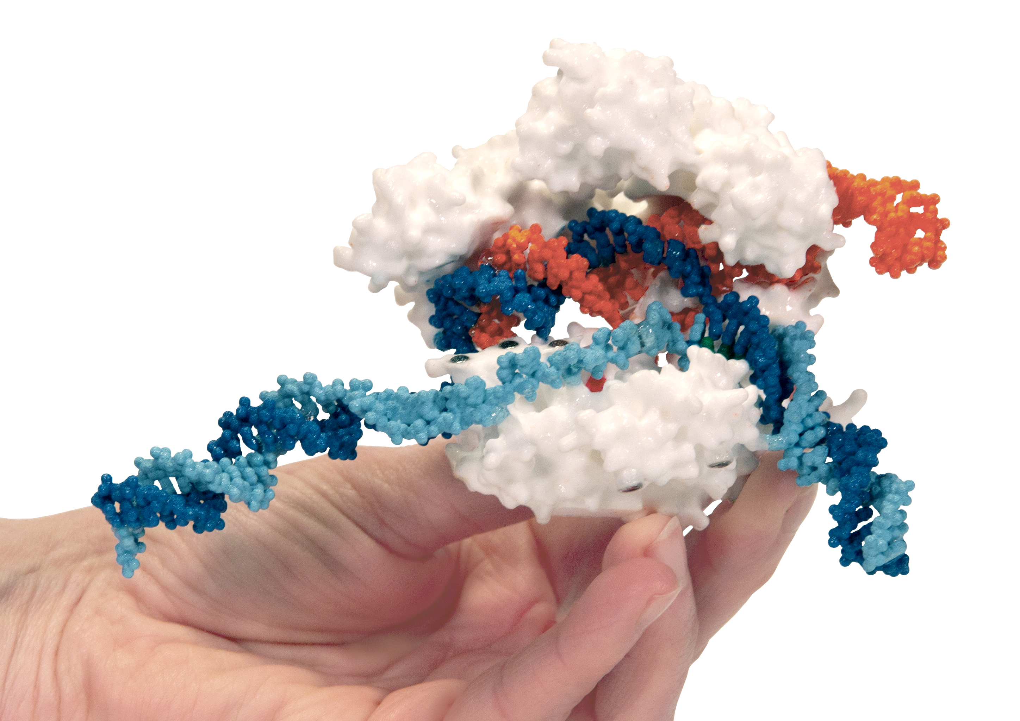
CRISPR Cas9… for real

Slide 27

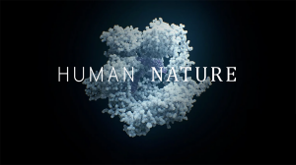
Two must see / read accounts of the CRISPR story.

Slide 28
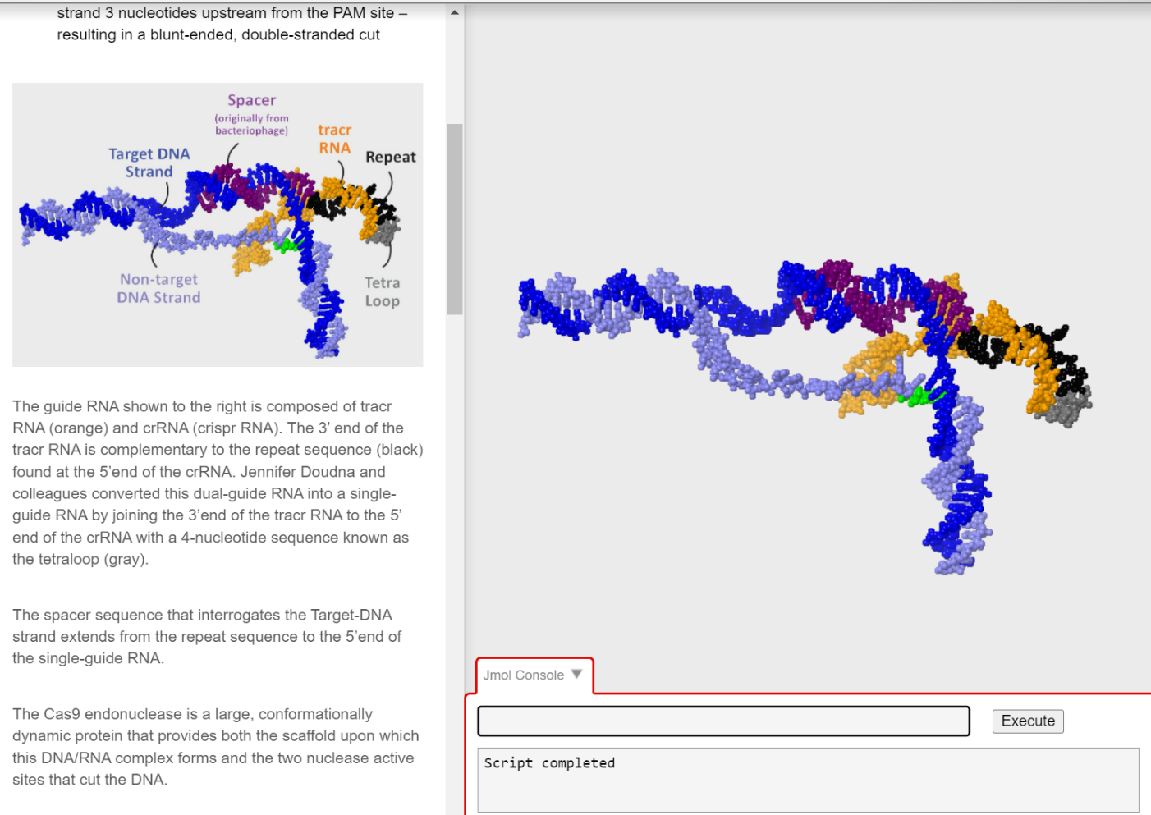
Two Cas9 Jmol Explorations…
computer-based explorations of the structure of Cas9
Making the Cut with CRISPR Cas9 https:/www.centerforbiomolecularmodeling.org/markMyweb/basicPrinciplesOfChemistry/cas9.html
The Conformationally Dynamic Domains of Cas9 https://www.centerforbiomolecularmodeling.org/markMyweb/basicPrinciplesOfChemistry/timsCas9.html

Slide 29
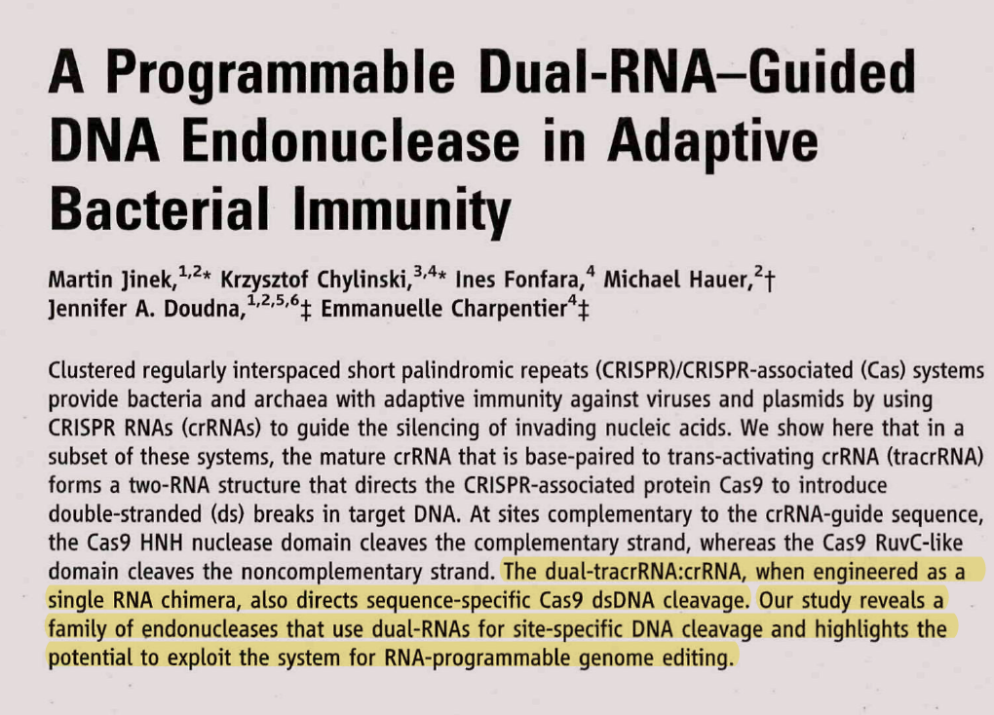
17 AUGUST 2012 VOL 337 SCIENCE

Slide 30
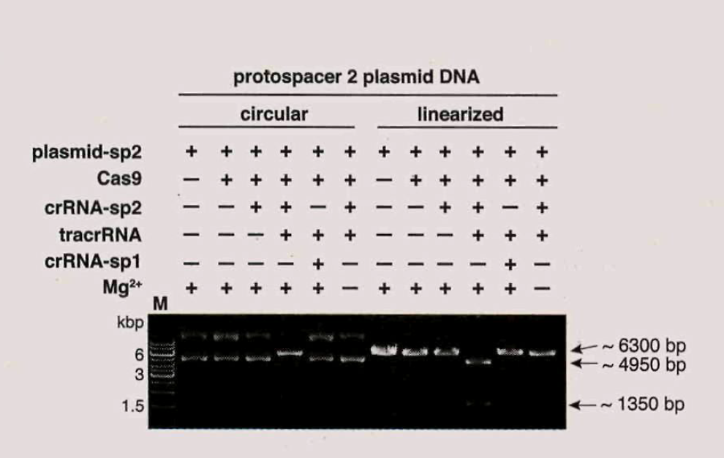
The “evidence” for much of what we know in the molecular biosciences
is based on shifts in bands on gels!
Both tracrRNA and crRNA are necessary for Cas9 cleavage of DNA

Slide 31
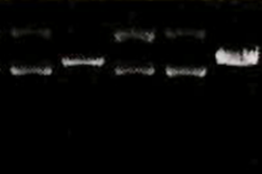
Experimental Evidence….that tracRNA was required for Cas9 endonuclease activity
Plasmid + + + +
Cas9 + + + -
crRNA + + - +
tracRNA - + + +

Slide 32

Its all about
Shifting bands…
… on gels !

Slide 33
Concluding statement, 2012 Jinek paper
“We propose an alternative methodology based on RNA-programmed Cas9 that could offer considerable potential for gene targeting and genome editing applications.”

Slide 34
What happens after the cut?
Minding our metaphors….
Stay tuned…

