Slide 1
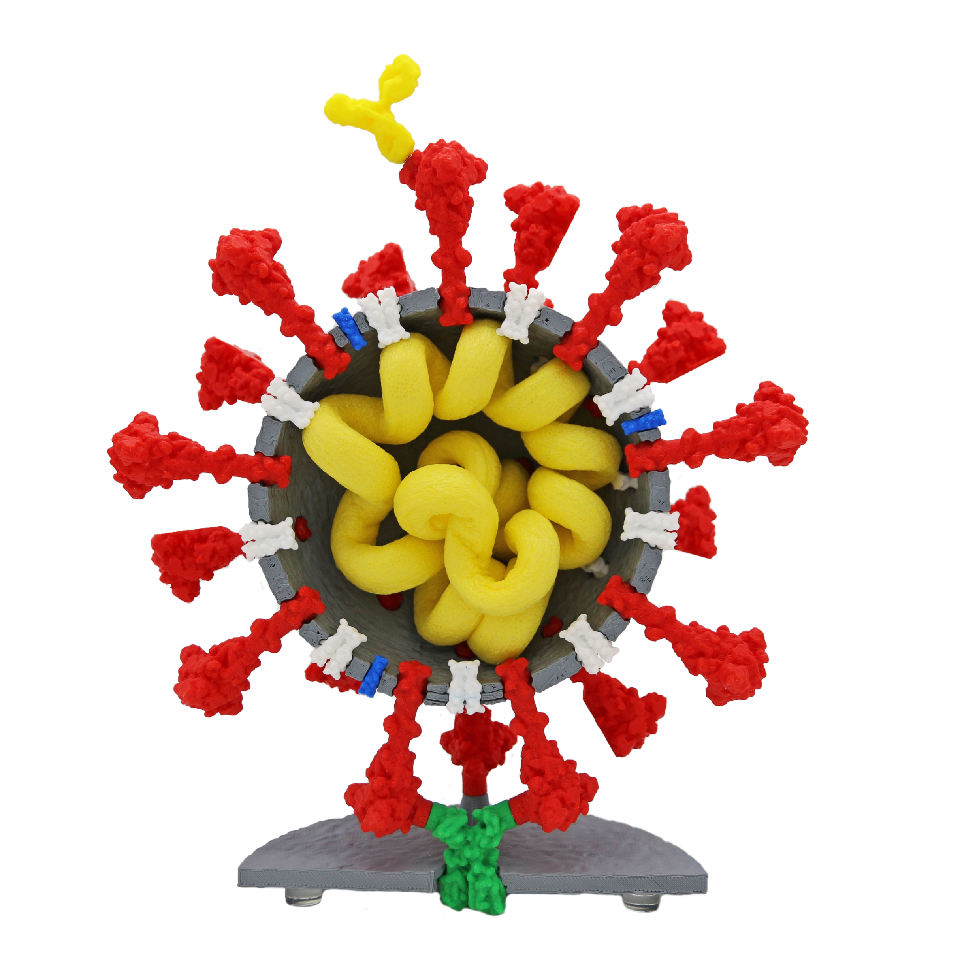
Coronavirus…
…from genome sequence…
…to an mRNA vaccine…
…in less than a year.
Science to the rescue!
Tim Herman, Founding Partner & Science Officer

Slide 2
The Coronavirus Pandemic….
….from tragedy….. to opportunity!
Influenza
CoV-2
Viruses
Mutations
Immune System
RNA genomes
Vaccines
Bacteriophages
Attenuated Virus
Antibodies
Protein Structure/Function
DNA → RNA → Protein

Slide 3
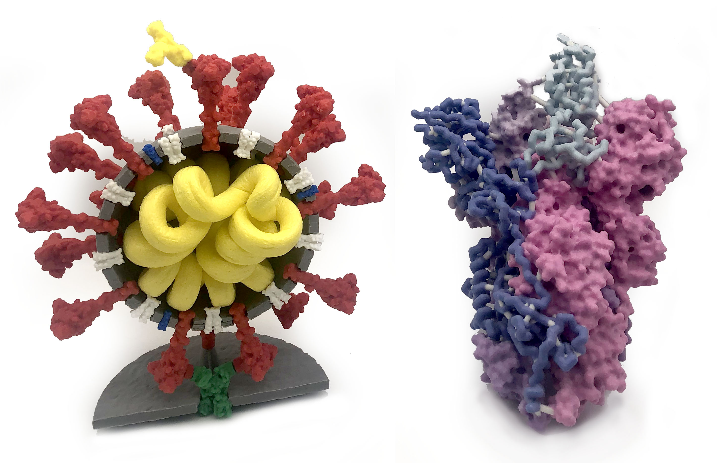
Coronavirus …and the Spike protein
The magic of models…

Slide 4
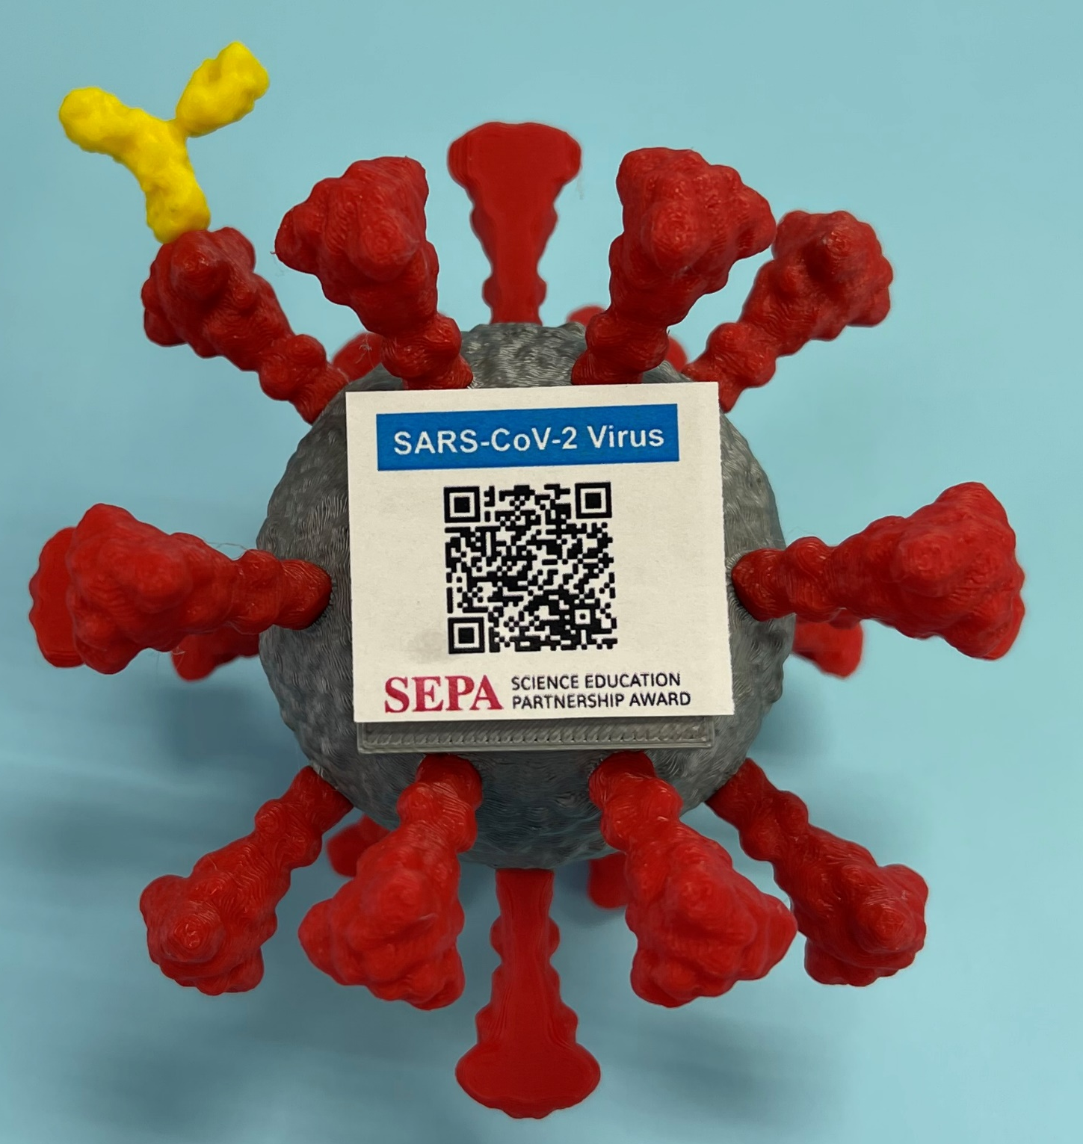
Models make words meaningful!
Interactive physical models provide students with a way to understand a description (written or verbal) of a complex molecular process – such as how a vaccine protects us from coronavirus infection.
And now, physical models can be enhanced with Augmented Reality technology.

Slide 5
2022 is a great time to be a biology teacher!!
Great science happening all around us
    …many stories to tell.
Google is our friend…
All we are missing is …TIME

Slide 6
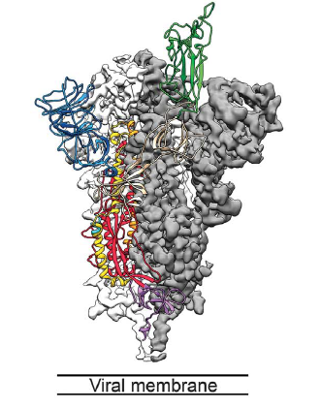
Here’s the story….SCIENCE to the rescue……
December 2019, new coronavirus (CoV-2) reported in China
January 10, 2020, nucleotide sequence of CoV-2 reported…and shared with the world.
January 13, 2020, optimized version of the spike gene sent to Moderna.
March 20, 2020, Jason McLellan publishes 3D structure of
CoV-2 spike protein.
Clinical Trials................................
December 18, 2020, Moderna mRNA vaccine EUA.

Slide 7
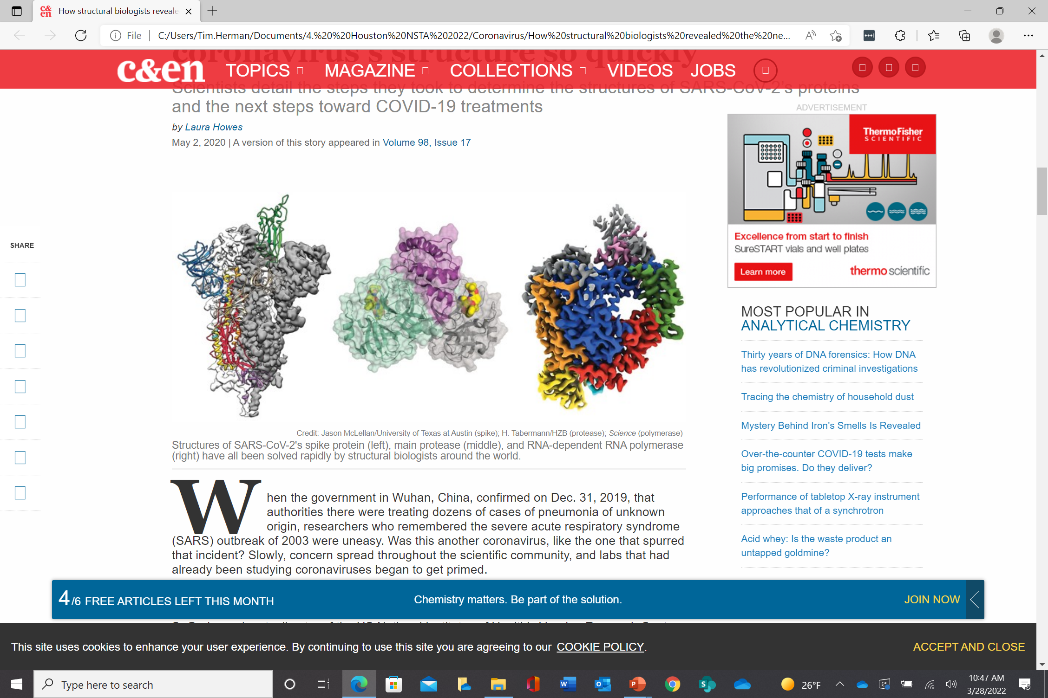
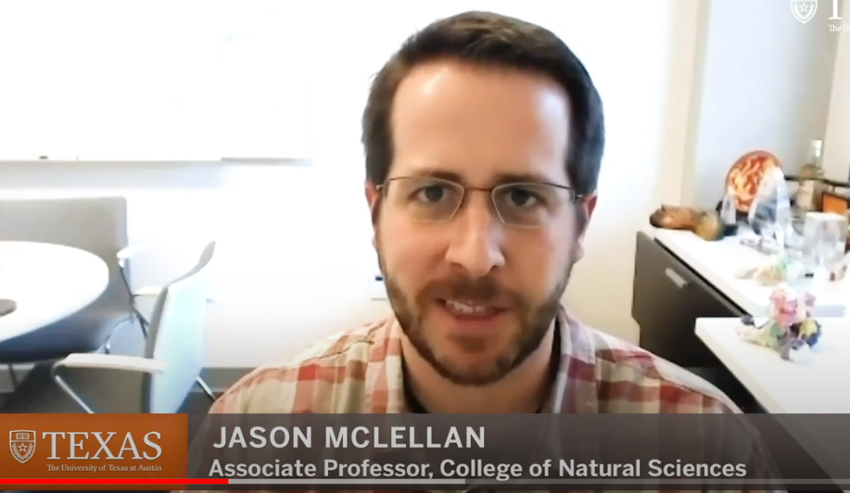
…within 3 months of the CoV-2 genome being sequenced
Key Innovations from UT Austin’s McLellan Lab Powers COVID-19 Vaccines
UT-Austin researcher explains lab’s key role in coronavirus vaccine development

Slide 8
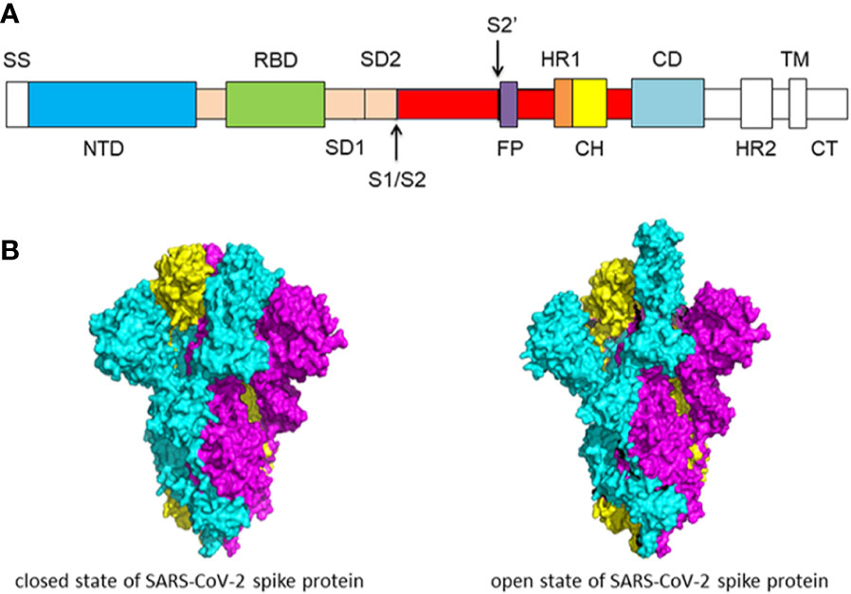

Slide 9
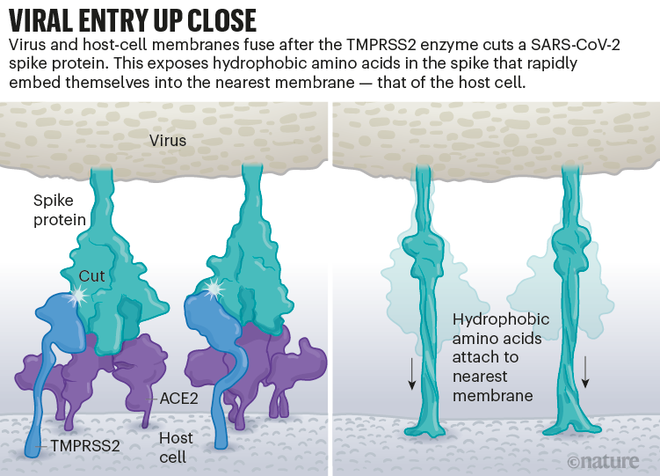

Slide 10
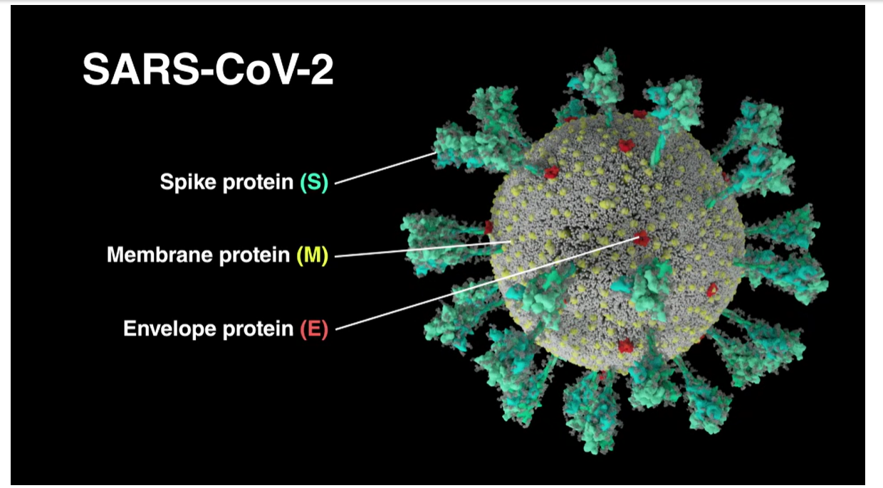
An animation of the SAARS CoV-2 infection process
……from THE ANIMATION LAB at the University of Utah

Slide 11
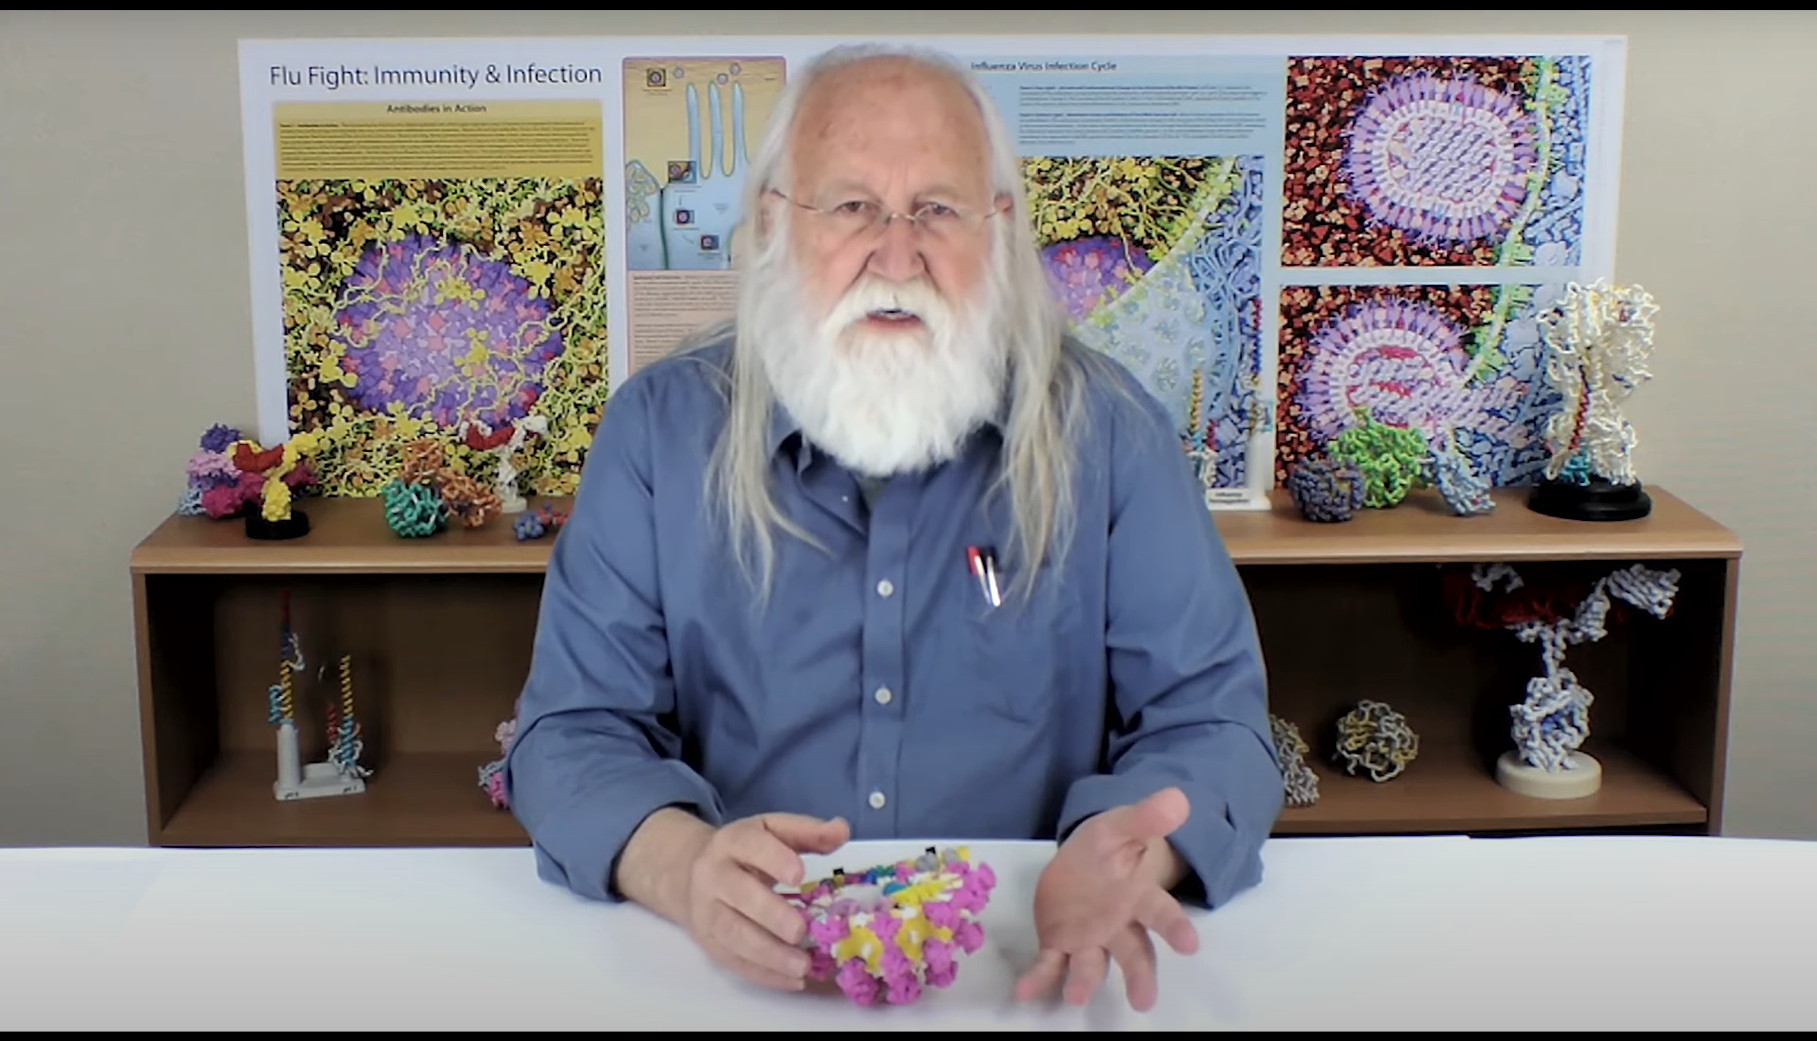
The Science of Coronavirus… a video series
https://www.3dmoleculardesigns.com/The-Science-of-Coronaviruses.htm

Slide 12
Two strategies to STOP CoV-2
1. Vaccines, from new vaccine platforms
mRNA vaccines
ultra-potent, multi-valent vaccines
Antivirals
Remdesovir
Paxlovid

Slide 13
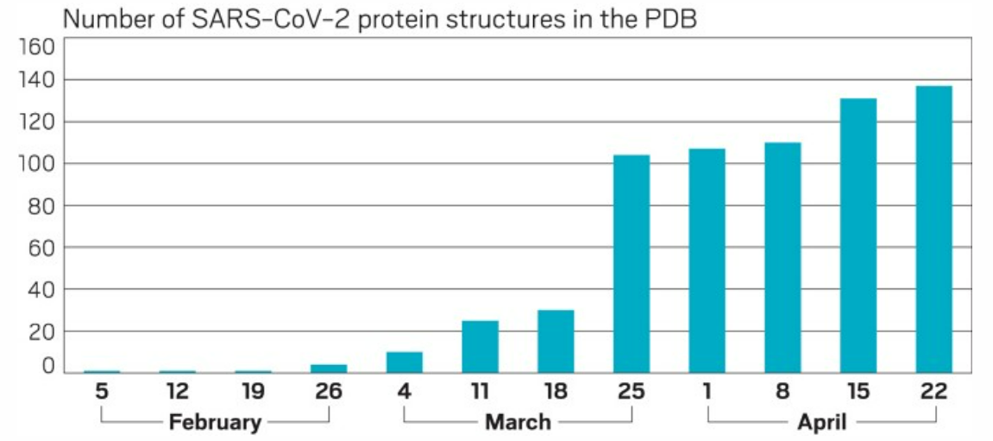
Drug Targets
Main Protease
Spike
RNA Polymerase

Slide 14
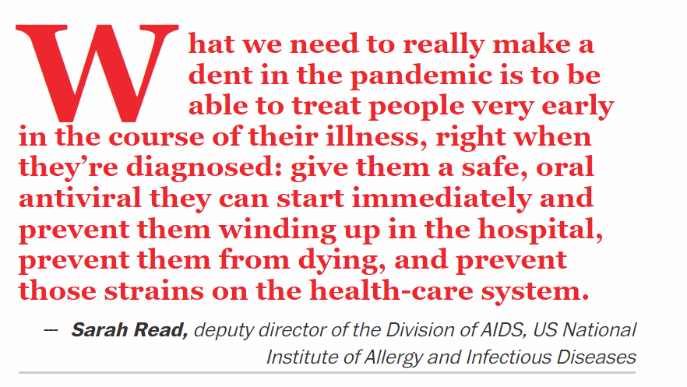
Oral Antivirals….
https://cen.acs.org/pharmaceuticals/drug-discovery/covid-19-oral-antiviral-pill-candidates/99/i19?ref=search_results

Slide 15
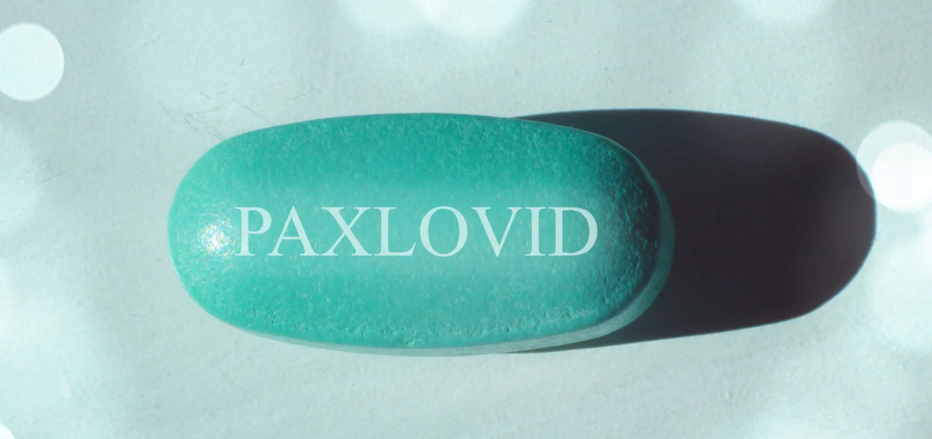
Paxlovid… an oral antiviral pill
Paxlovid is an antiviral therapy consisting of two antiviral medications nirmatrelvir, and ritonavir.

Slide 16
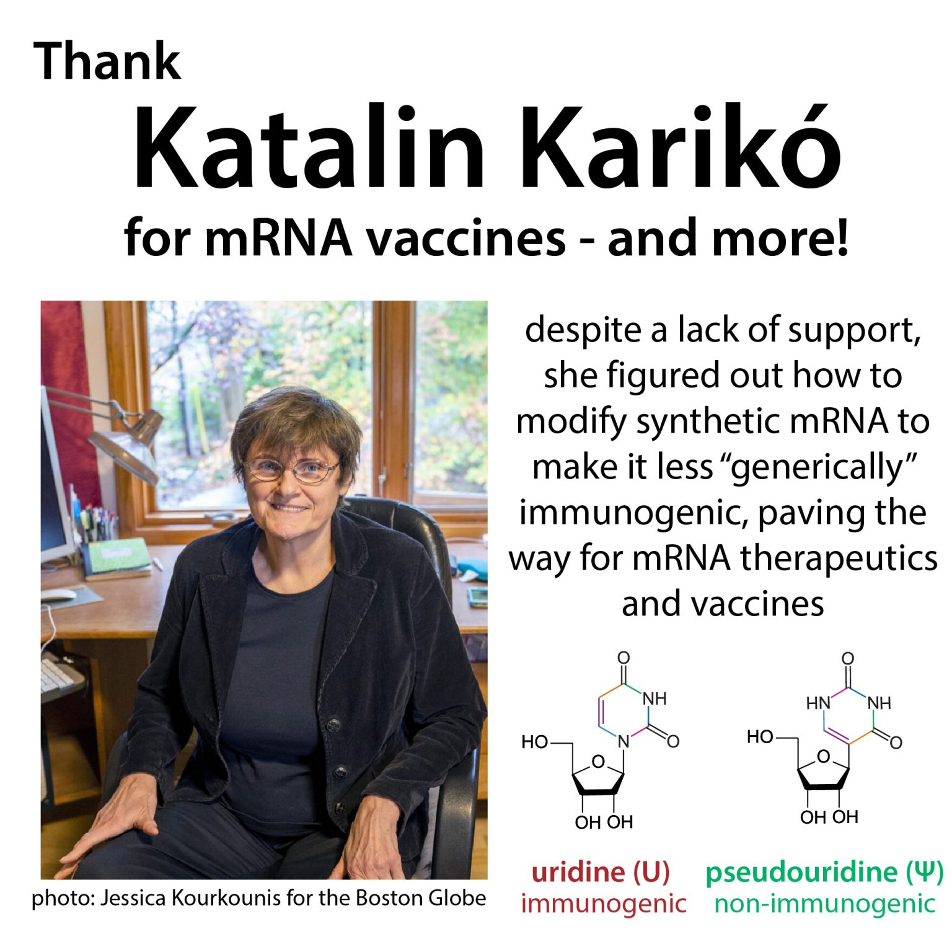
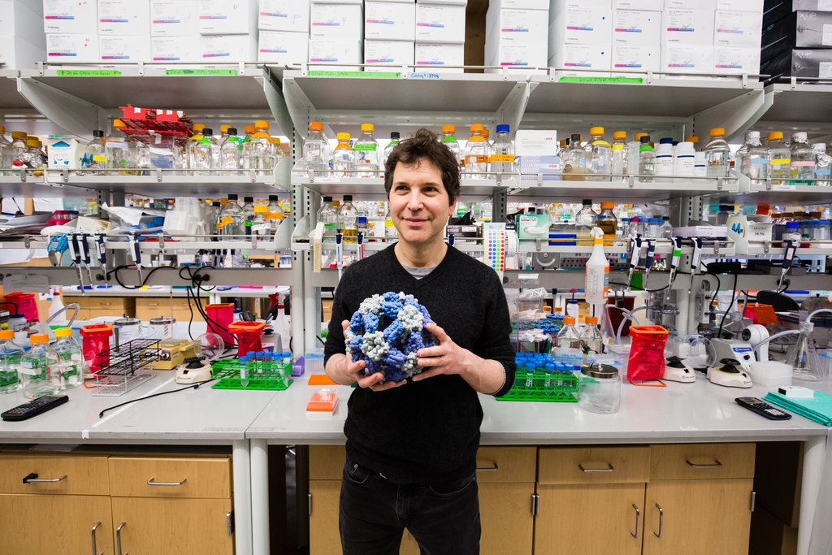
New Approaches to Vaccine Developments: a preview….
David Baker
and ultra-potent, multivalent nanoparticle flu vaccines
photo: Evan McGlinn for The New York Times

Slide 17
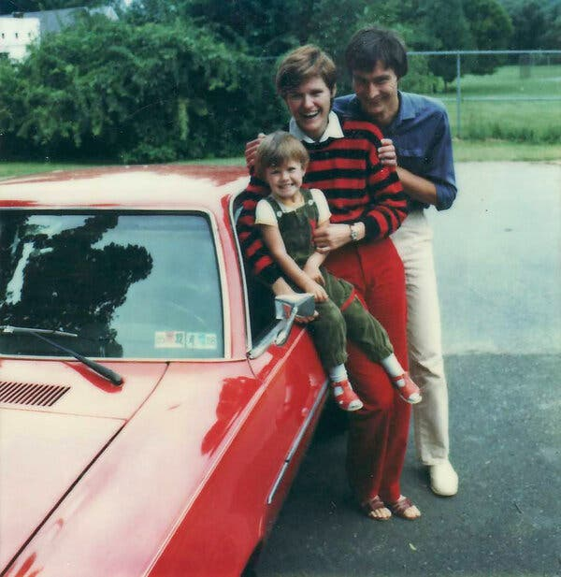
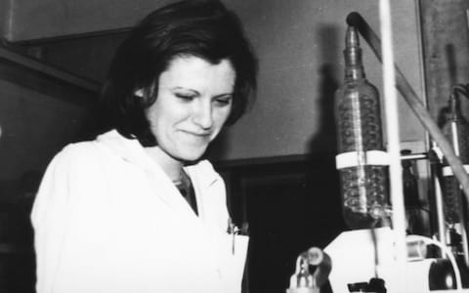
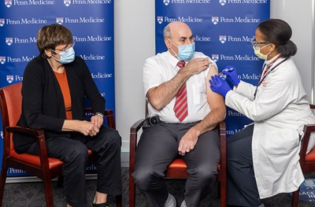
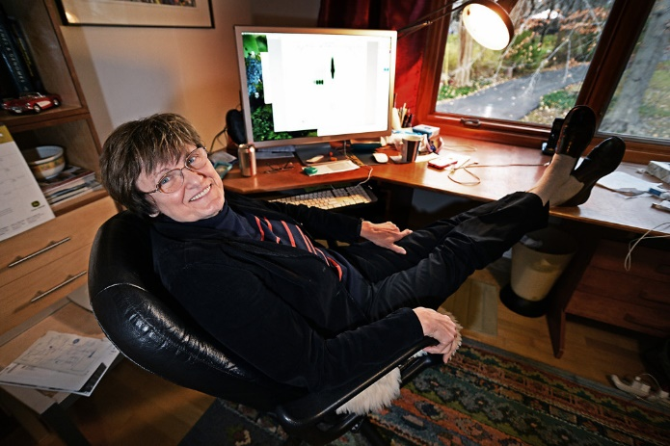
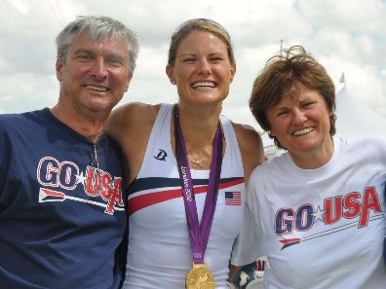
Kati Karikó... and the perseverance of women research associates…..
https://www.nytimes.com/2021/04/08/health/coronavirus-mrna-kariko.html
https://www.cnn.com/2020/12/16/us/katalin-kariko-covid-19-vaccine-scientist-trnd/index.html

Slide 18
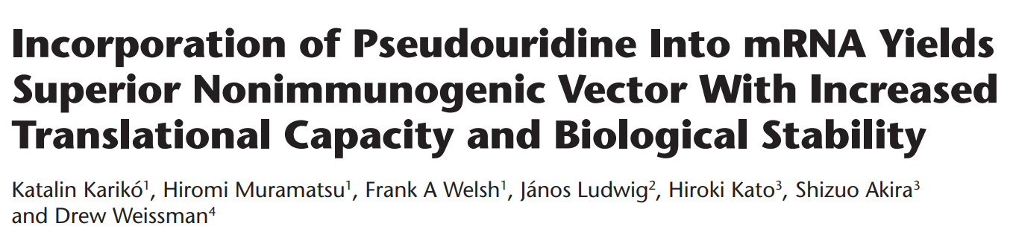
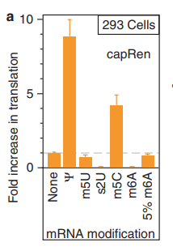
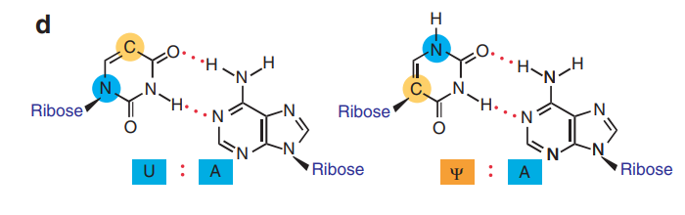
Molecular Therapy vol. 16 no. 11, 1833–1840 Nov. 2008
pseudouridine

Slide 19
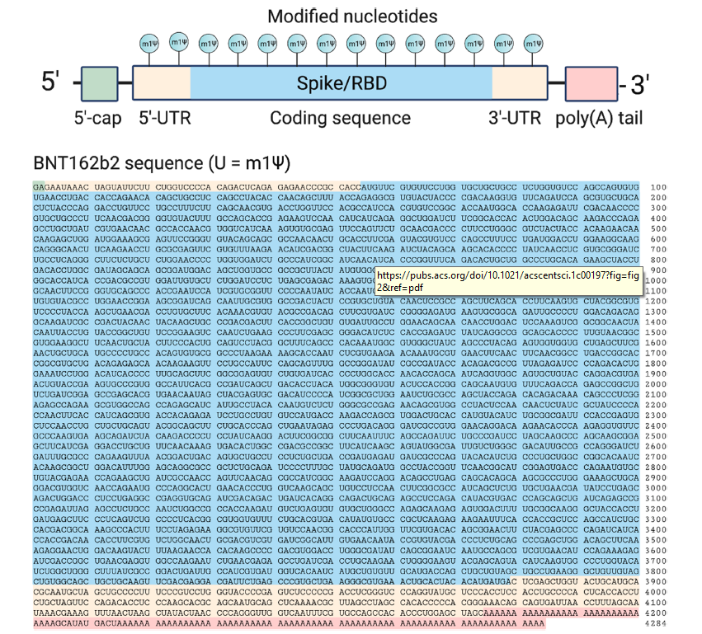
Coming soon……
An mRNA Vaccine Design Activity

Slide 20
STEM….
Engineering…delivered to us a design for an effective mRNA vaccine for CoV-2
Science…delivered to us the nucleotide sequence encoding the spike protein of CoV-2

Slide 21
The modRNA sequence of the vaccine is 4,284 nucleotides long and encodes the full-length spike protein of SARS CoV-2.
In addition to a 5’-cap and a 3’-poly-A sequence, the coding sequence was engineered to contain:
A signal sequence…to insure trafficking of the spike protein to the outside surface of an immune cell.
Codons were “optimized” for better expression in human cells
All uridine bases were replaced with pseudouridine bases
Two proline mutations were added to stabilize an immunogenic form of spike

Slide 22
The modRNA sequence of the vaccine is 4,284 nucleotides long. It encodes the full-length spike protein of Sars CoV-2. It consists of a five-prime cap; a five prime untranslated region derived from the sequence of human alpha globin; a signal peptide (bases 55–102) and two proline substitutions (K986P and V987P, designated "2P") that cause the spike to adopt a prefusion-stabilized conformation ….a codon-optimized gene of the full-length spike protein of SARS-CoV-2 (bases 103–3879); followed by a 3’untranslated region (bases 3880–4174) for increased protein expression and mRNA stability and a poly(A) tail. The sequence contains no uridine residues; they are replaced by 1-methyl-3'-pseudouridylyl.

Slide 23
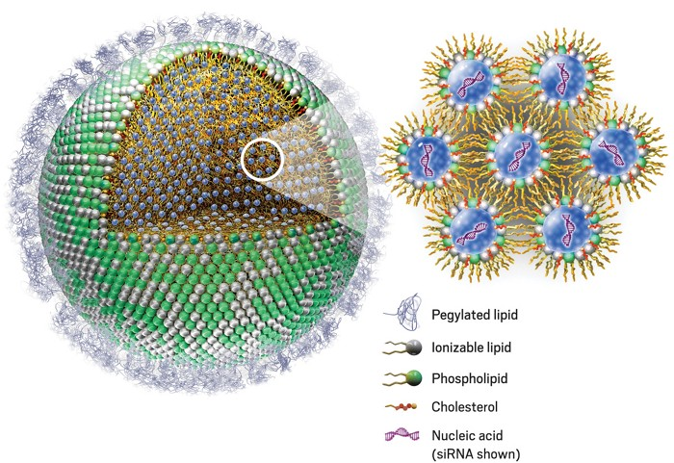
LNPs: Lipid Nano Particles
https://cen.acs.org/pharmaceuticals/drug-delivery/Without-lipid-shells-mRNA-vaccines/99/i8?ref=search_results

Slide 24
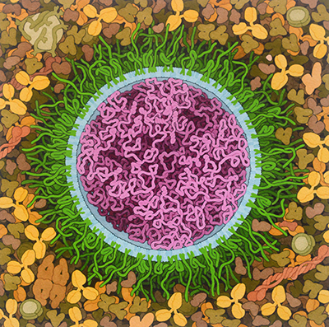
Molecular Landscapes by David S. Goodsell
SARS-CoV-2 mRNA Vaccine, 2020

Slide 25
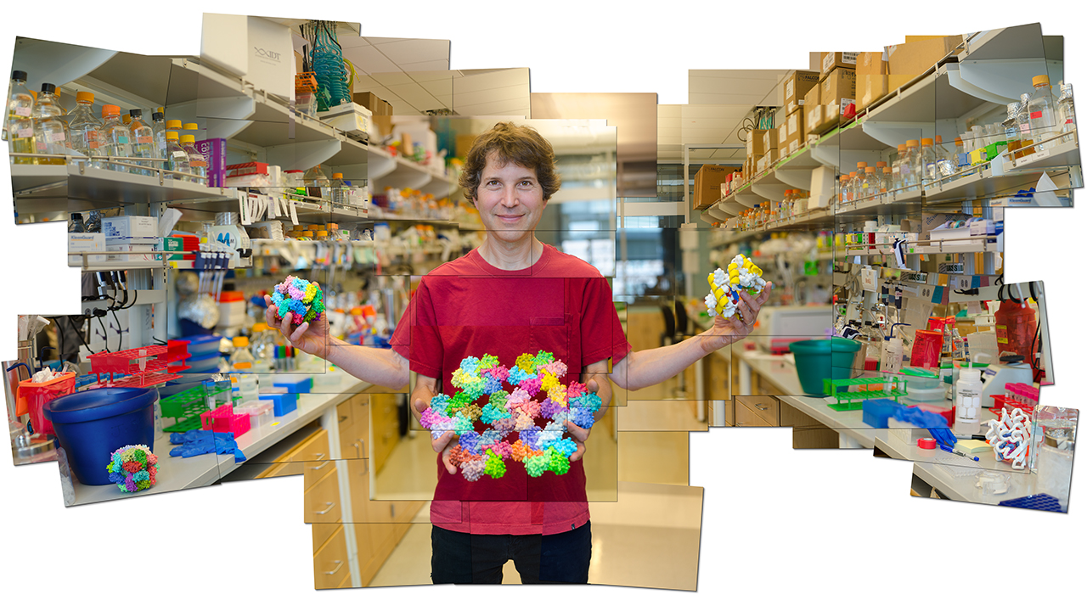
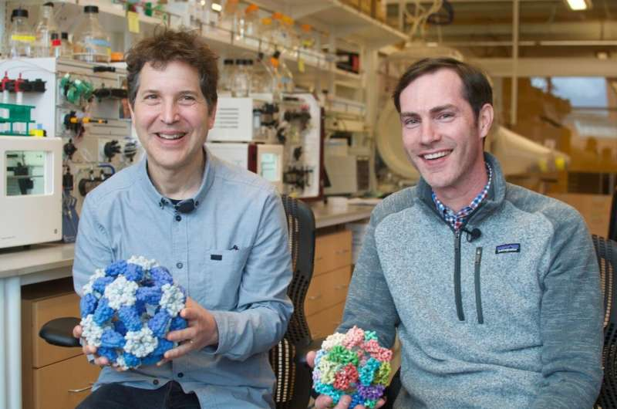
David Baker, founder of the Institute for Protein Design
David Baker shows off models of some of the unnatural proteins his team has designed and made. © RICH FRISHMAN
David Baker,PhD, Director of the Institute for Protein Design with Dr. Neil King. Credit: Ian C Haydon/UW Institute for Protein Design
Self-Assembling Nanomaterials and Vaccines
David’s TedTalk…. Audacious Project – Institute for Protein Design (uw.edu)

Slide 26
Elicitation of Potent Neutralizing Antibody Responses by Designed Protein Nanoparticle Vaccines for SARS-CoV-2
Quadrivalent influenza nanoparticle vaccines induce broad protection
https://www.nature.com/articles/s41586-021-03365-x

Slide 27
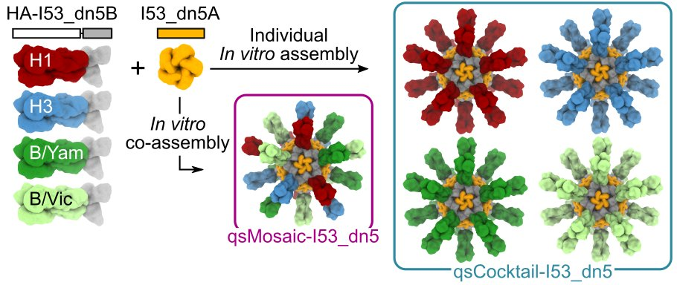
Design and characterization of HA nanoparticle immunogens.

Slide 28
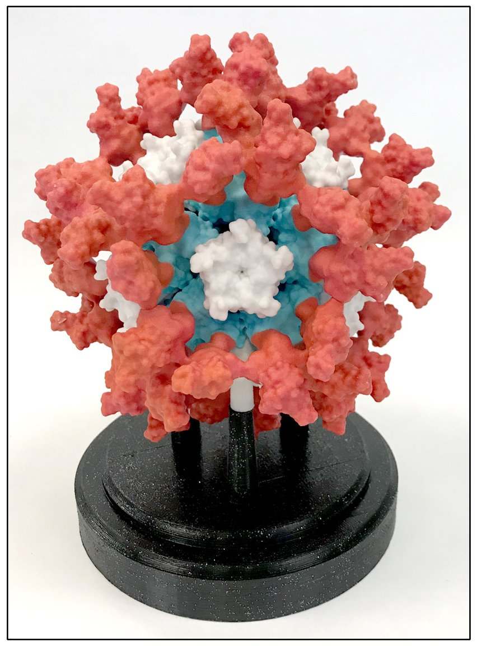

Slide 29
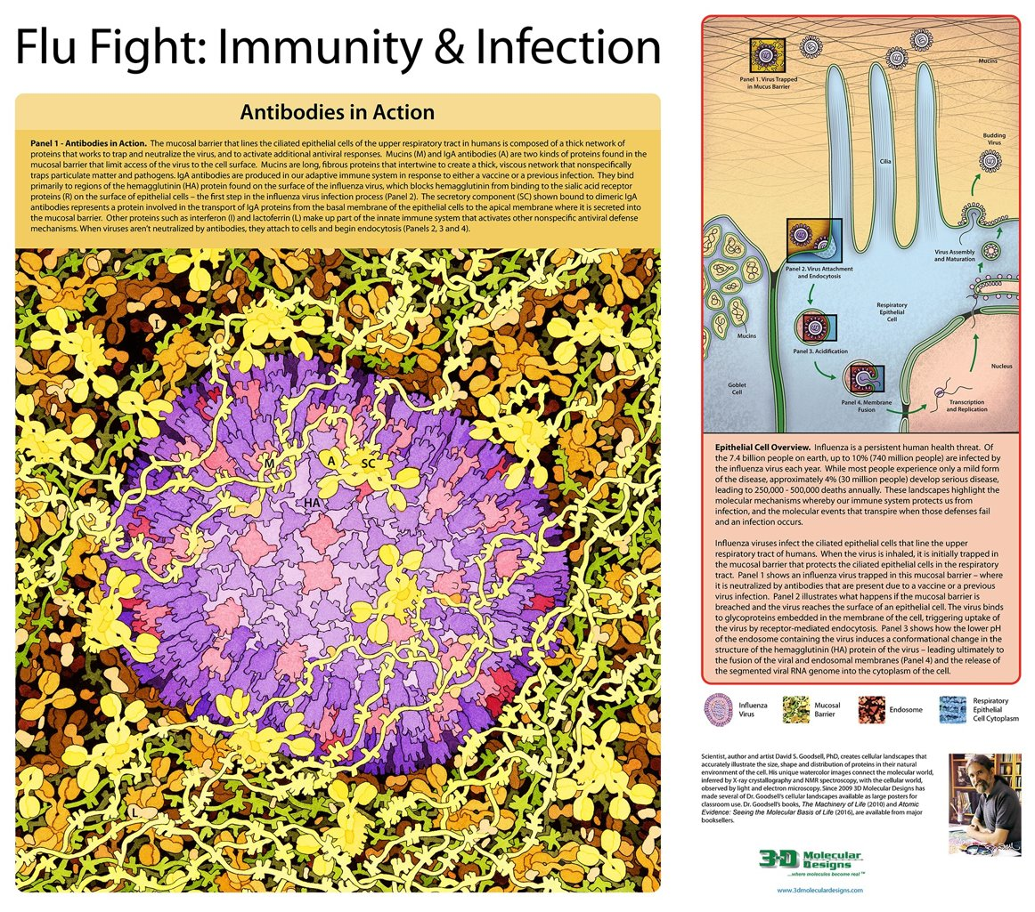

Slide 30
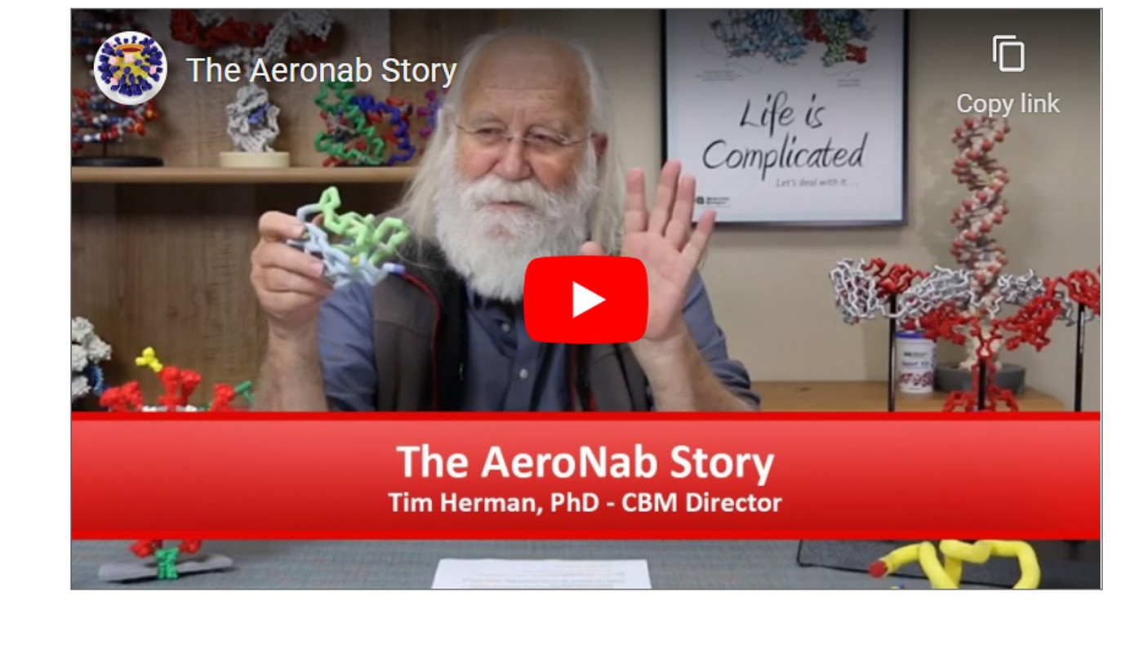
The AeroNab Story
Modeling A Protein Story, MAPS/SMART Teams
https://www.centerforbiomolecularmodeling.org/mapsTeams/antibodies.php

Slide 31
Coming soon,… to a workshop near you.
Tomorrow’s Science Today: preparing for the next pandemic.
An NIH SEPA project.
New Instructional Materials
  Models, models and more models….
    A Virus Collection,.. including CoV-2
    Antibodies/vaccines /and your immune system
    mRNA vaccines and multi-valent, ultra-potent vaccines…from synthetic biology.
    Stories, stories and more stories….
A Professional Learning Experience…beginning in the summer of 2024
But first,…enroll now in Modeling the Molecular World, 2023
Session 1 -- June 26-30, or
Session 2 -- July 17 - 21

