Slide 1
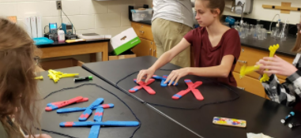
3D Models for 3D Instruction: Using Models with Storylines
Kim Parfitt
3DMD
Professional Learning Manager

Slide 2
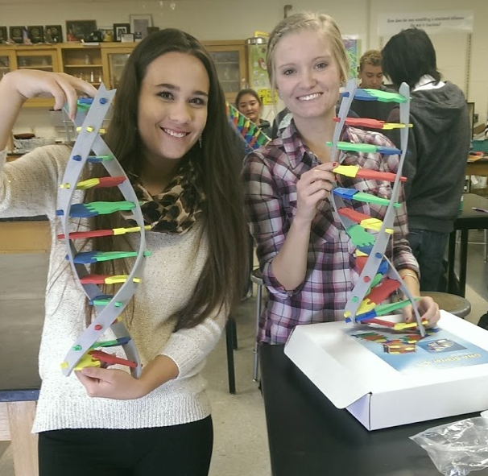

Kim Parfitt
Taught for 18 years at Cheyenne Central High School
And after 11 years of using 3D models and attending CBM summer courses, I am now working full-time for this amazing company.

Slide 3
Now, about you…

Slide 4
Workshop Learning Goals
You will be able to:
Explore the connection between existing, and potential storylines, and 3D models.
Explain how 3D models can support your students making sense of phenomena.

Slide 5
“The storylines approach includes design principles for engaging students with phenomena and problems to elicit their own questions that teachers, with support of curriculum materials, use to guide the trajectory of their sensemaking.”
“…storylines organize cycles of engaging with phenomena, questions, and sensemaking to incrementally build, test, and revise explanatory models...”
    Brian J. Reiser
    Northwestern University

Slide 6
coherence

Slide 7
Coherence
from the student perspective

Slide 8
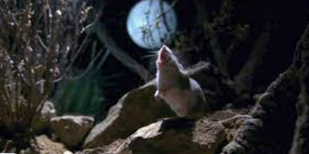
A Mouse That Howls

Slide 9
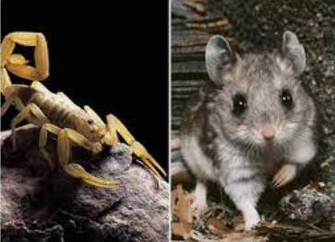
And it is a warrior!

Slide 10
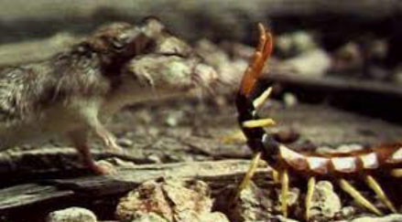

Slide 11
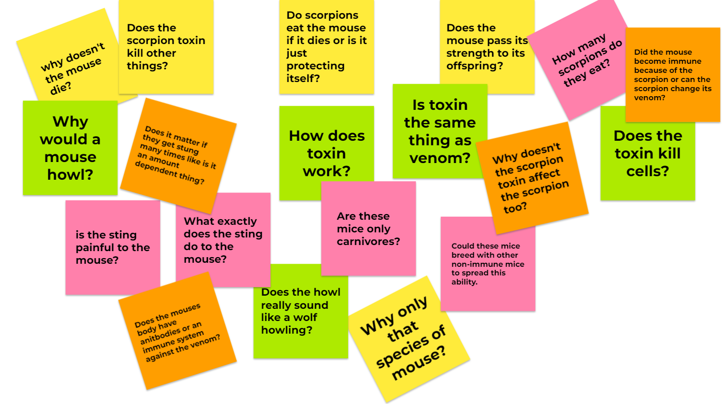
Driving Question Board

Slide 12
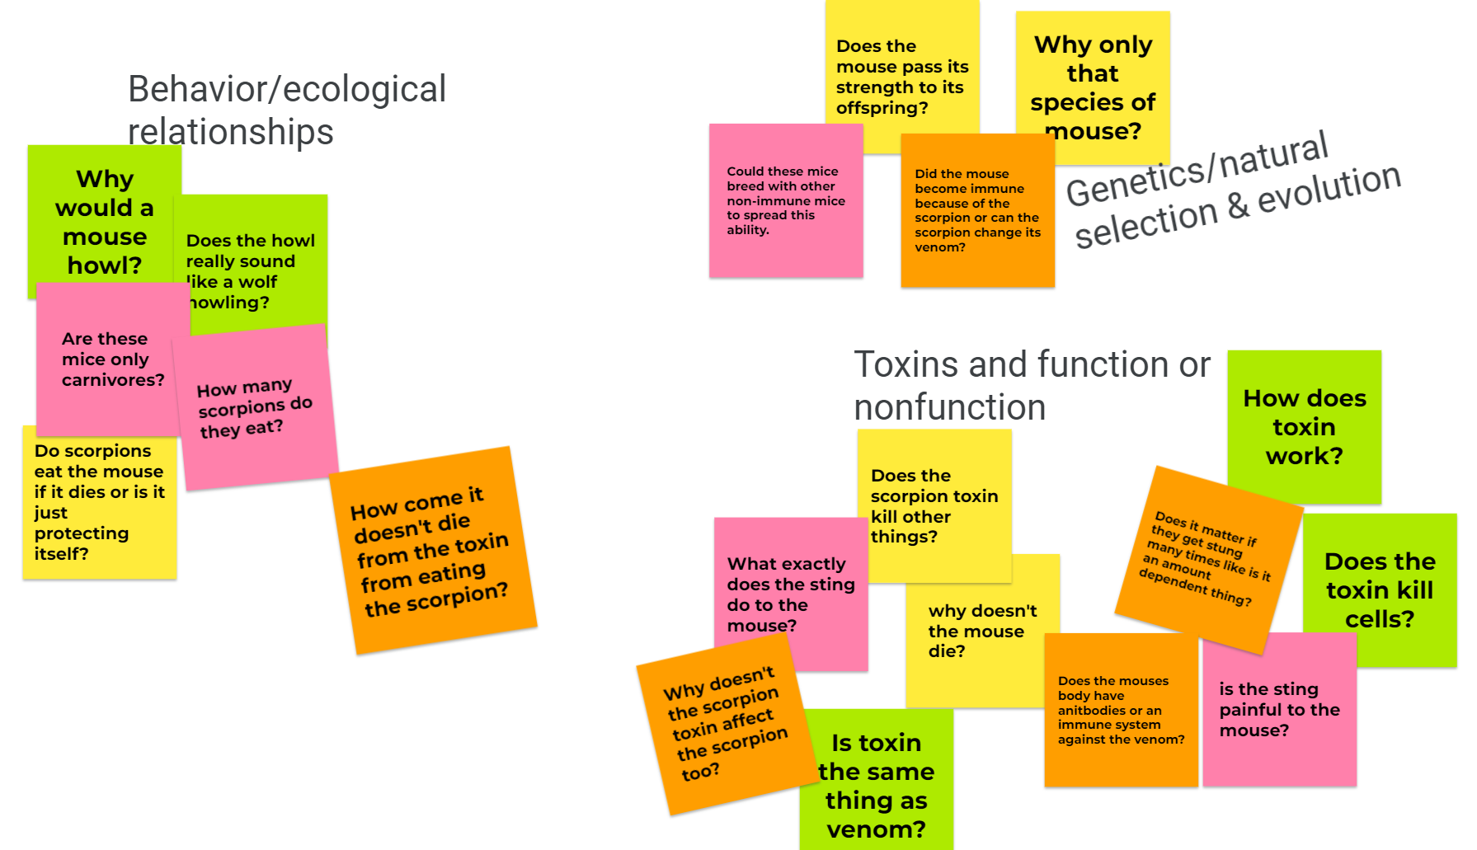

Slide 13
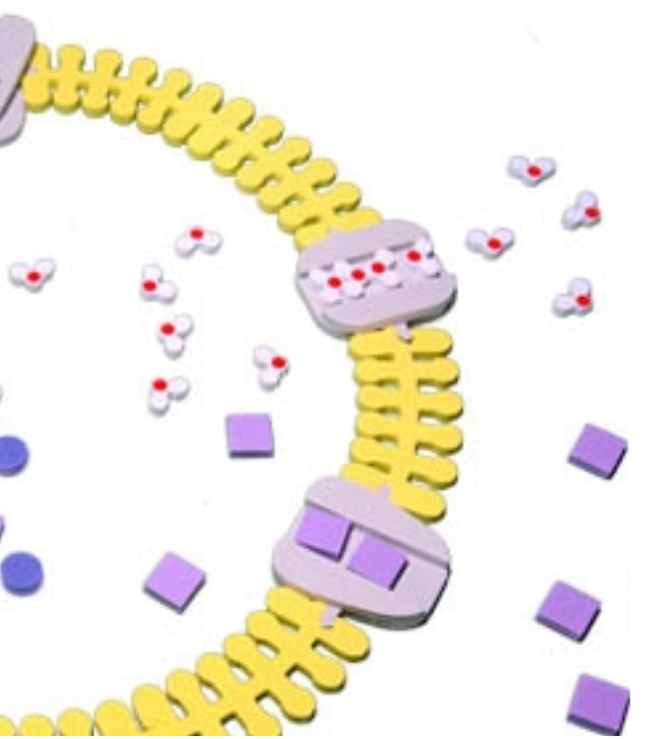
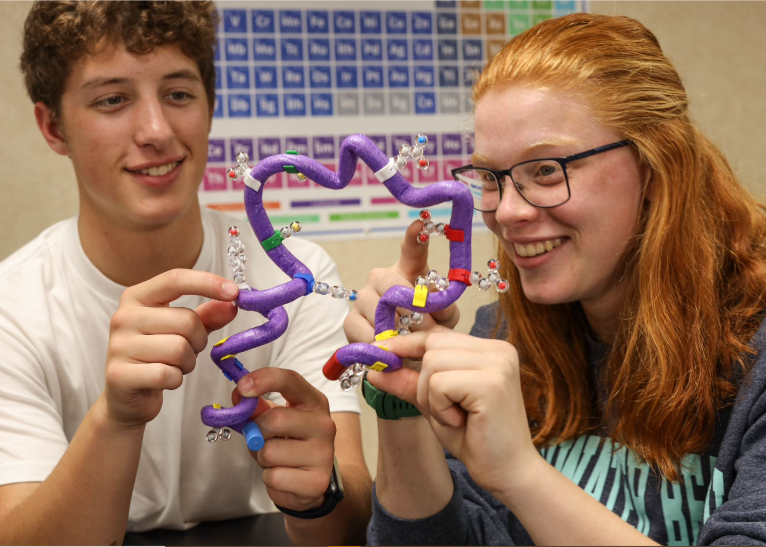
How can grasshopper mice take on scorpions, but other mice species can’t, and does it matter?
Why does the venom work on some species and not others?
Phospholipid & Membrane Transport Kit
Amino Acid Starter Kit

Slide 14
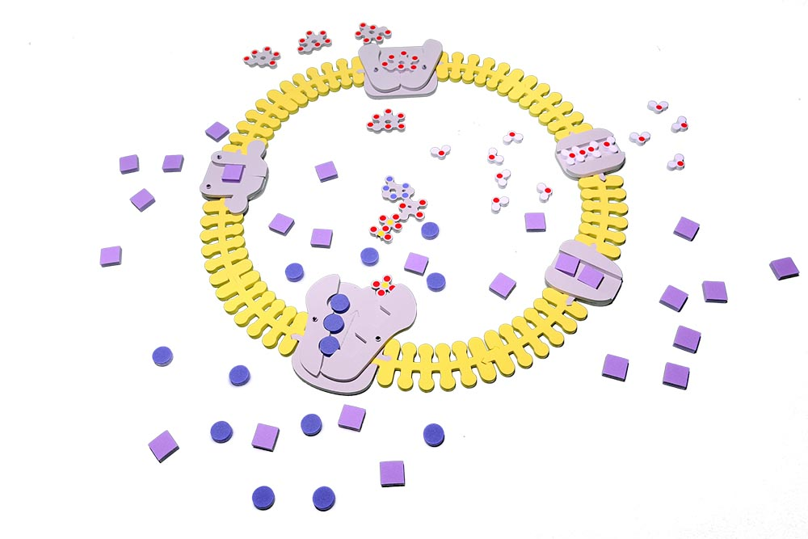
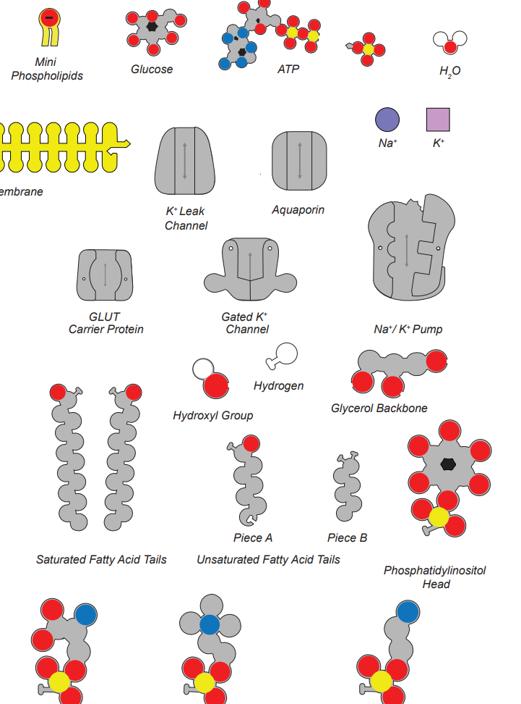
The aquaporin shows us passive transport but active transport can also be shown.

Slide 15
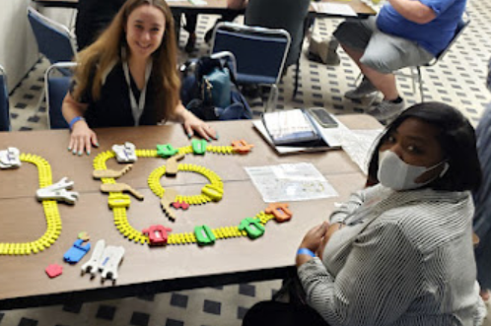

Slide 16
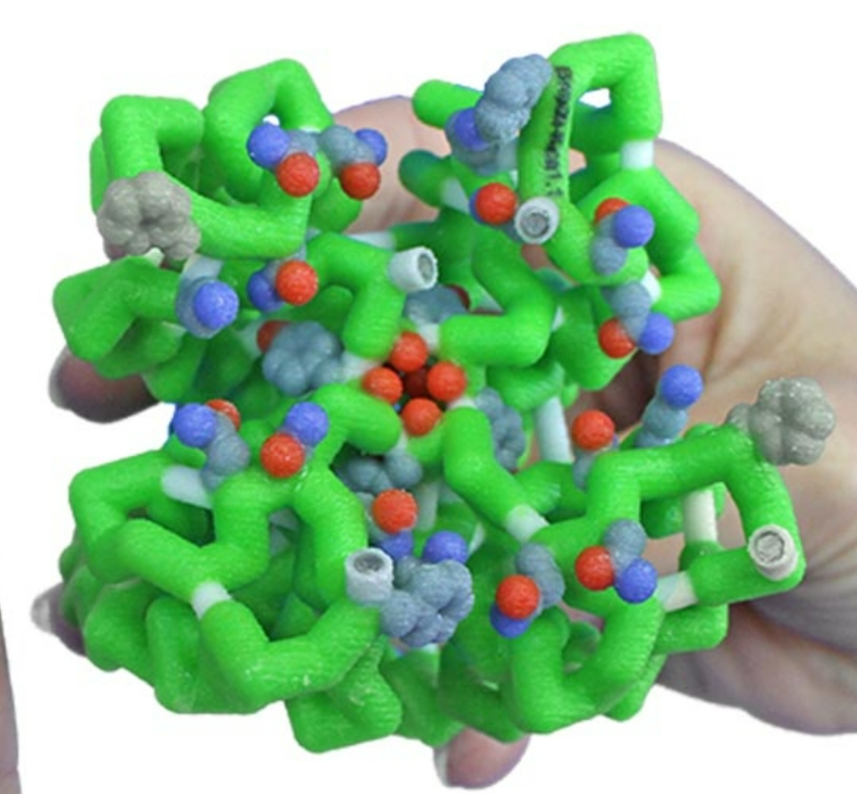

Slide 17
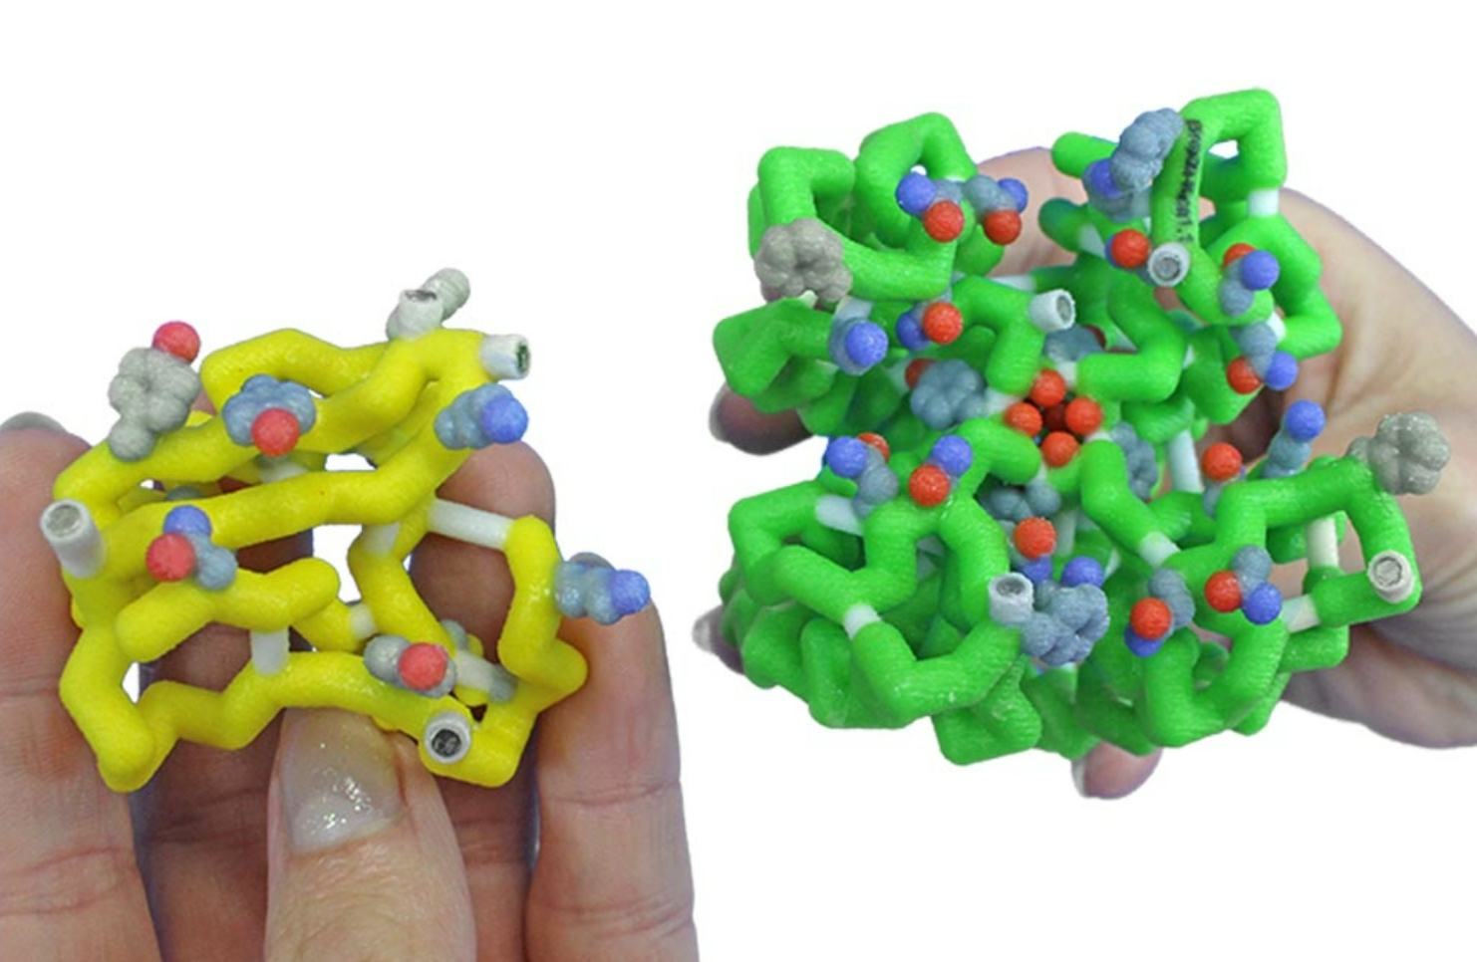

Slide 18
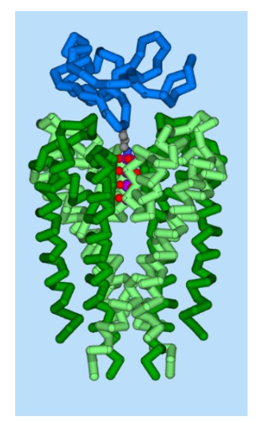

Slide 19
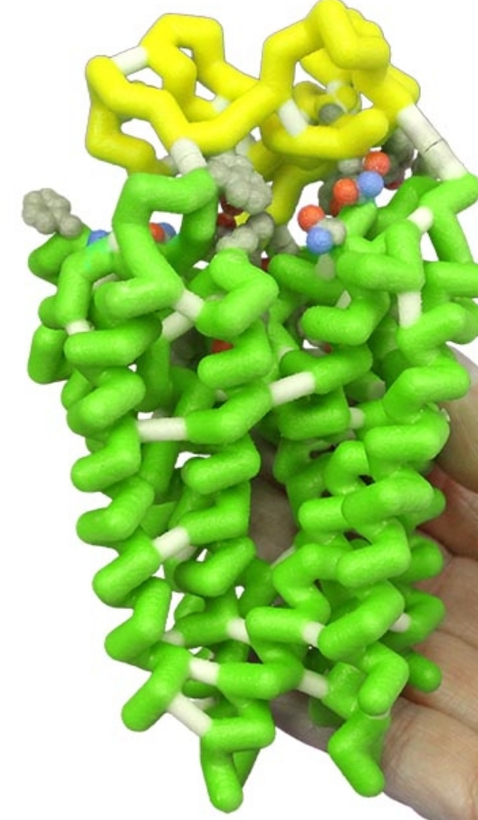

Slide 22
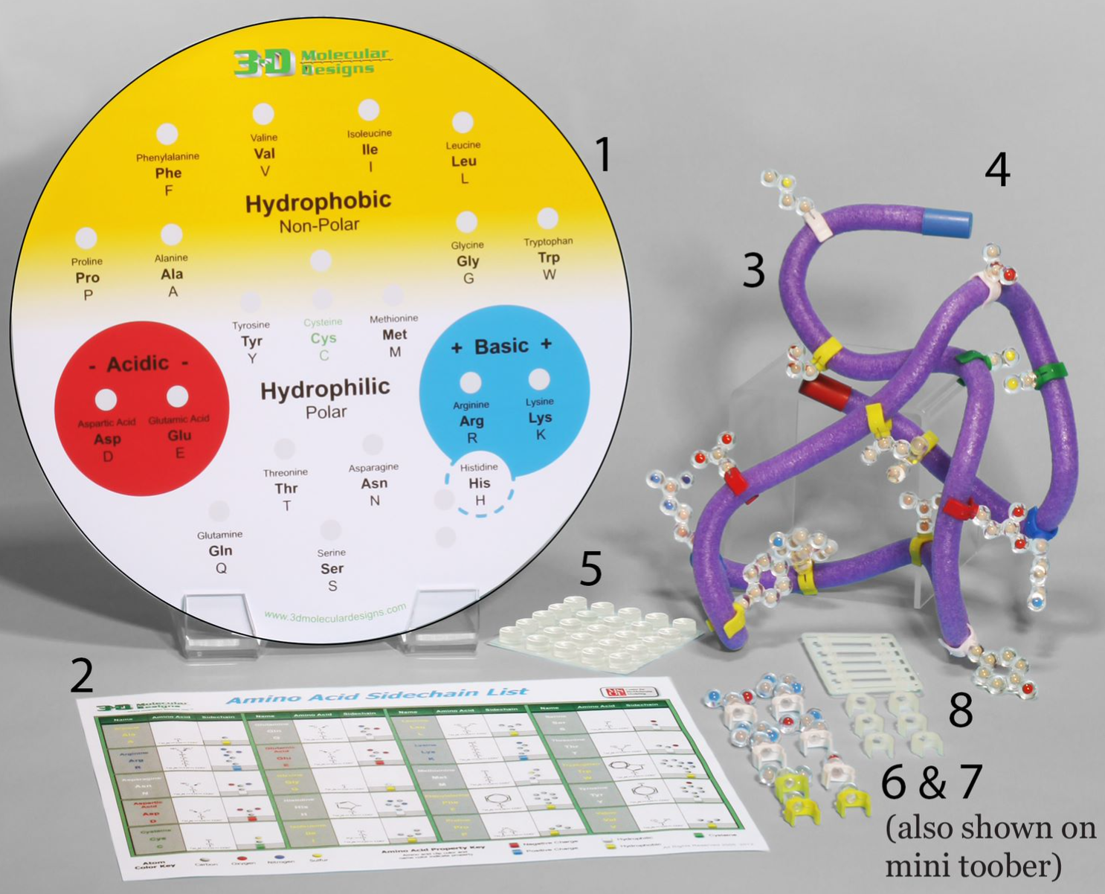

Slide 23
The scorpion toxin and the potassium channel - PMC (nih.gov)
Toxins | Free Full-Text | Scorpion Toxins Specific for Potassium (K+) Channels: A Historical Overview of Peptide Bioengineering | HTML (mdpi.com)
Voltage-Gated Sodium Channel in Grasshopper Mice Defends Against Bark Scorpion Toxin | Science

Slide 24
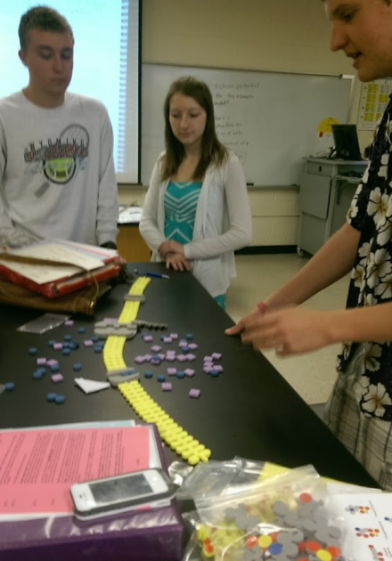
What stories could your students investigate with these models?

Slide 25
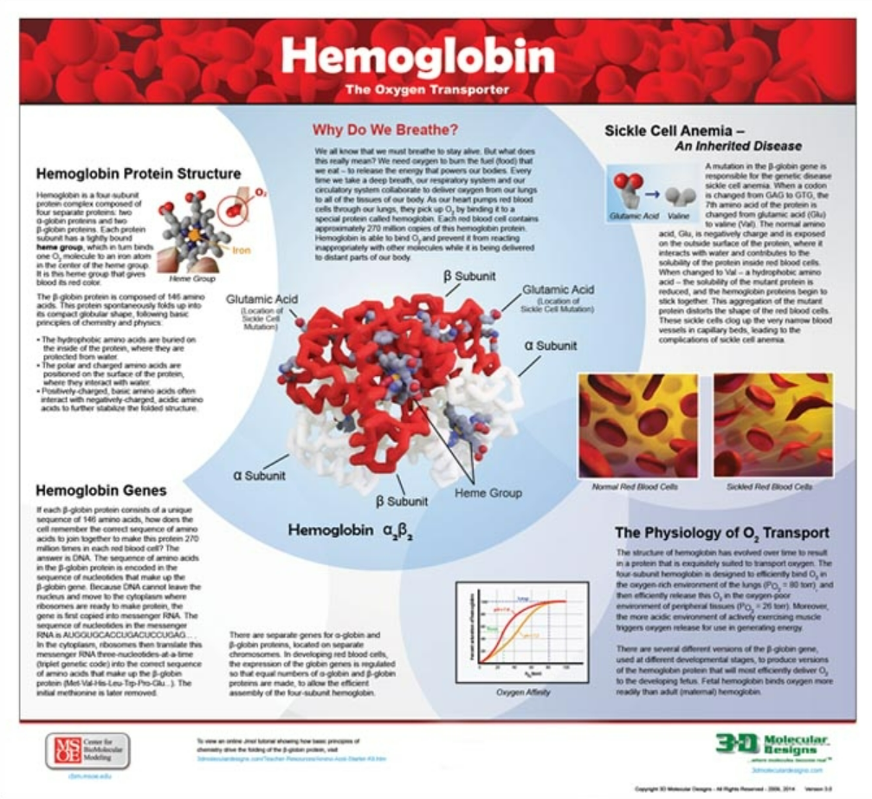
Sickle Cell Anemia

Slide 26
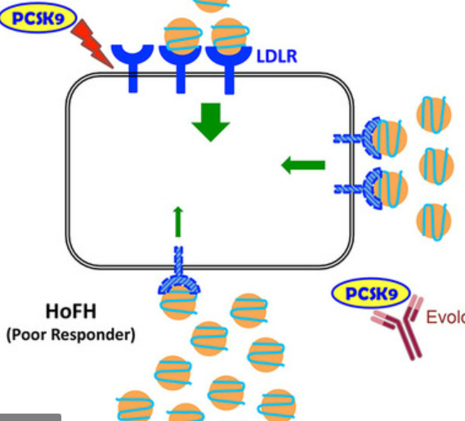
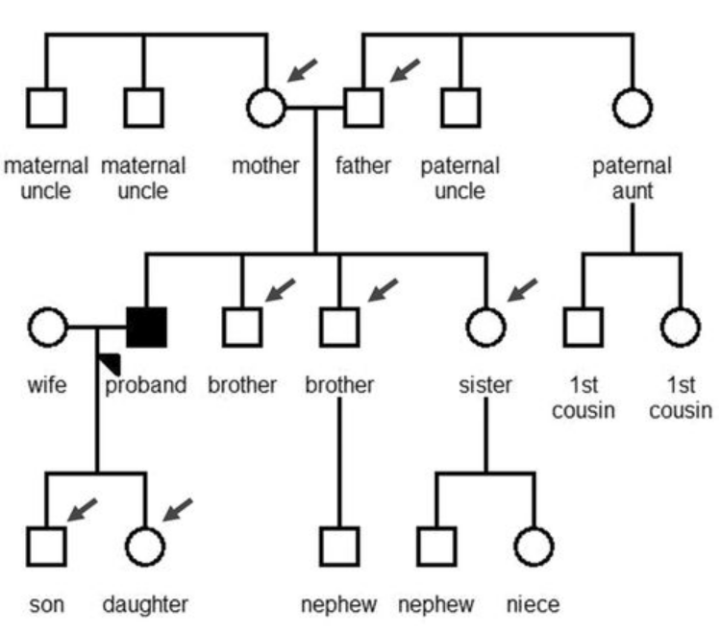
Heart Disease

Slide 27
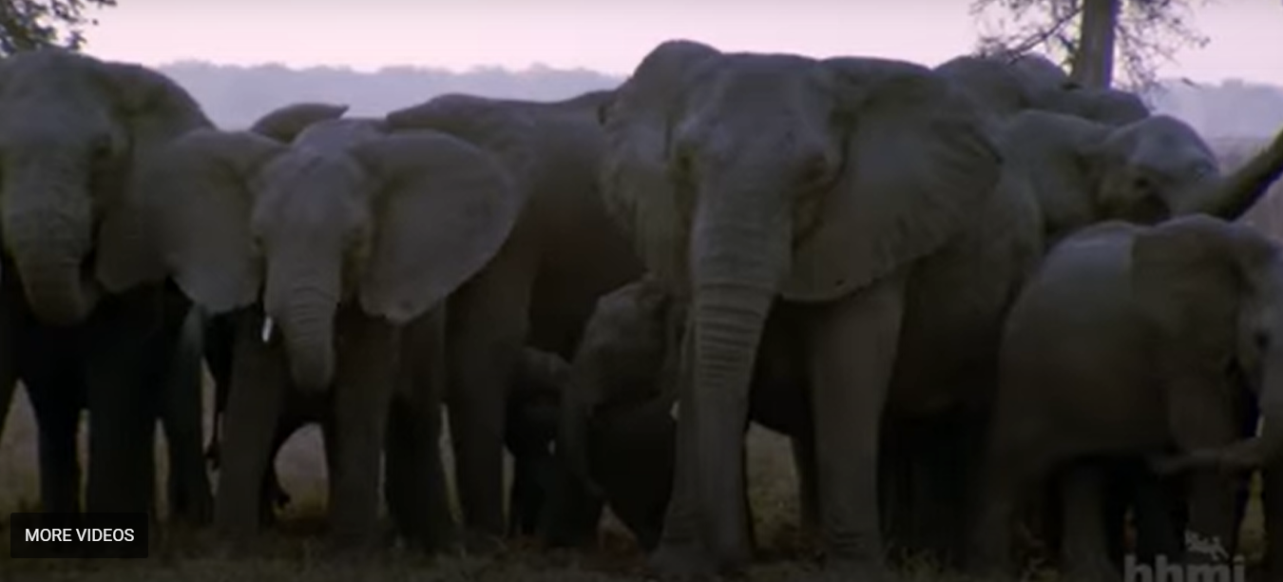

Slide 28
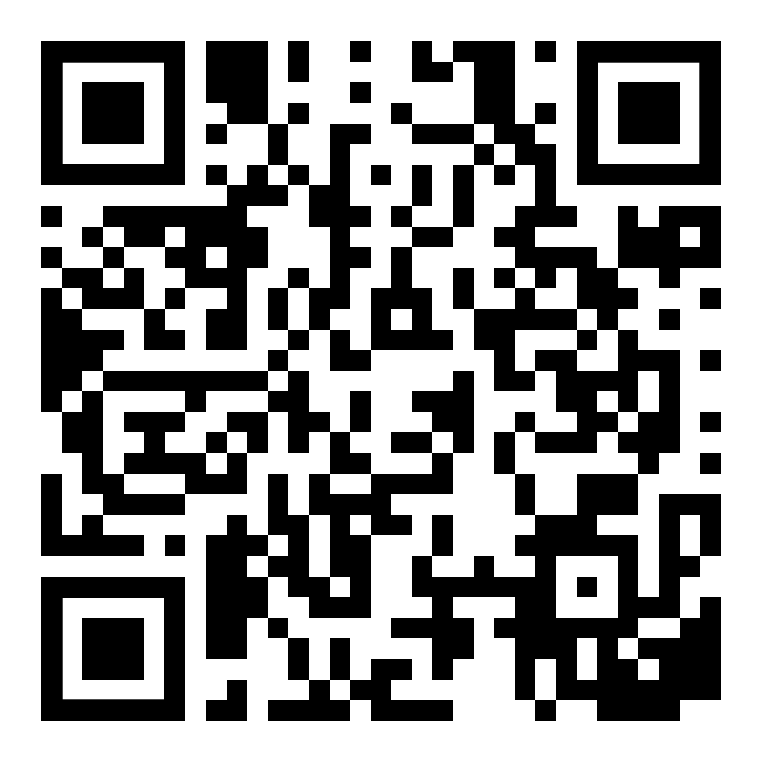
We put teachers first!
Your opinions are important to us.
Receive your 20% discount by completing this short survey.
This will also allow us to email you the resources associated with this session.
Notes:
updated

Slide 29
Students make sense by investigating phenomena that reveals student understanding of all three dimensions of the NGSS.
Students explicitly use the practices (SEPs) and cross cutting concepts (CCCs) to figure out the disciplinary core ideas (DCIs) to make their own sense of the phenomenon.
Teachers use tasks that invite students to explain the phenomenon and reveal the students understanding or proficiency in all three dimensions.
    (adapted from BSCS & NGSS Framework)

