Slide 1
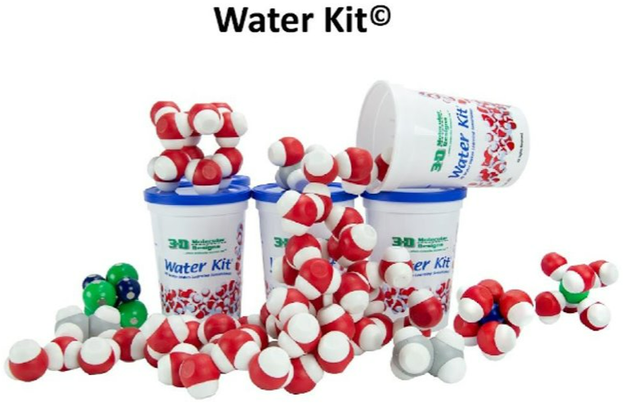
Get to Know H₂O
with Hands-on Models

Slide 2
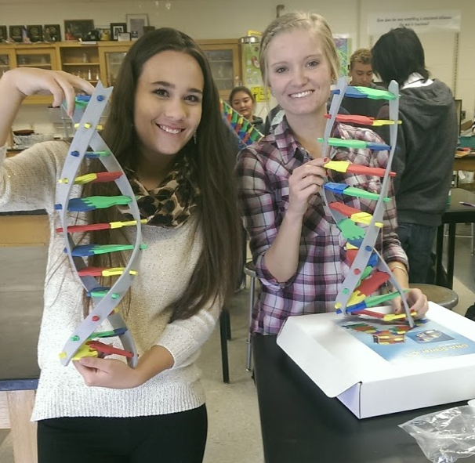







Kim Parfitt
Taught for 18 years at Cheyenne Central High School
And after 11 years of using 3D models and attending CBM summer courses, I am now working full-time for this amazing company.
Kim.Parfitt@3dmoleculardesigns.com
Leadership Academy

Slide 3
Now, about you…

Slide 4
Workshop Learning Goals
You will be able to:
Wonder how a simple water molecule can help students build science literacy.
Explore how the polar nature of water allows interactions with other molecules to make life possible (and interesting).
Explain how modeling with the Water Kit can reveal and support student thinking in biology.

Slide 5
Investigate the materials at your table.
What do you notice?
What do you wonder?

Slide 6
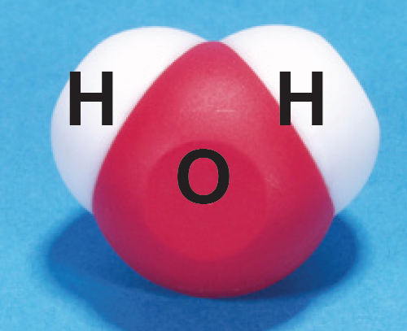
Atom
Molecule
Compound
Bond

Slide 7
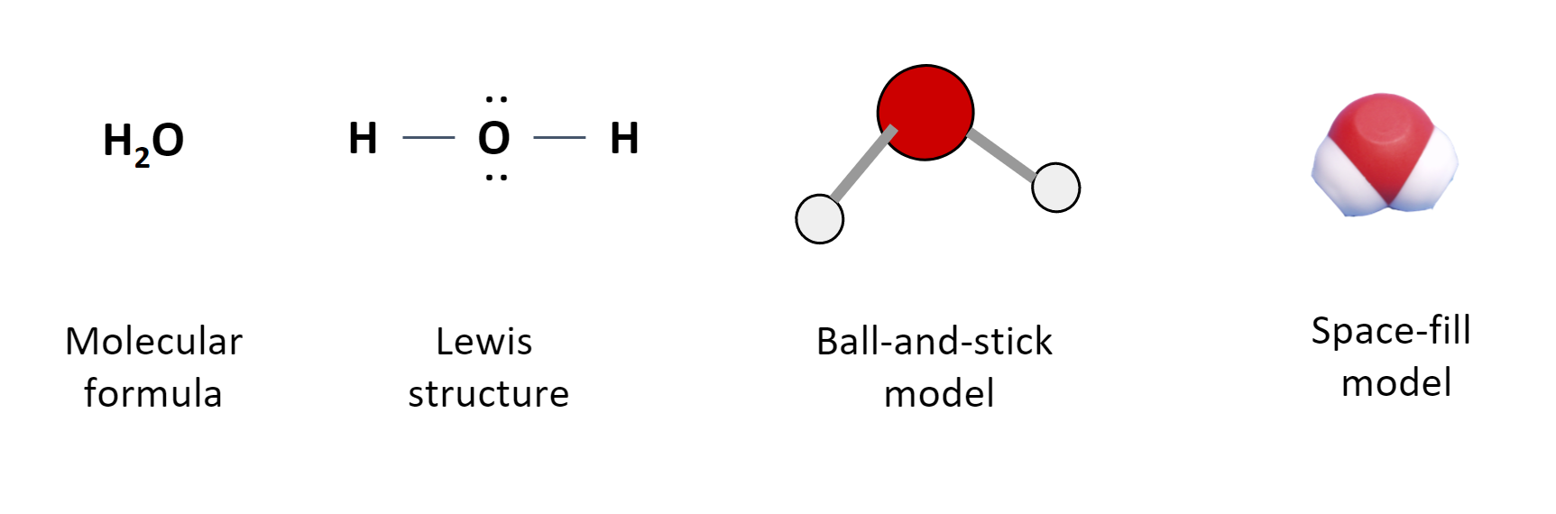

Slide 8
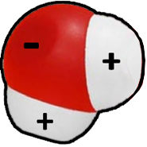
Polar Molecule
The shared electrons in a water molecule spend more time near the oxygen atom and less near the two hydrogen atoms, resulting in slightly positive and slightly negative regions.

Slide 9
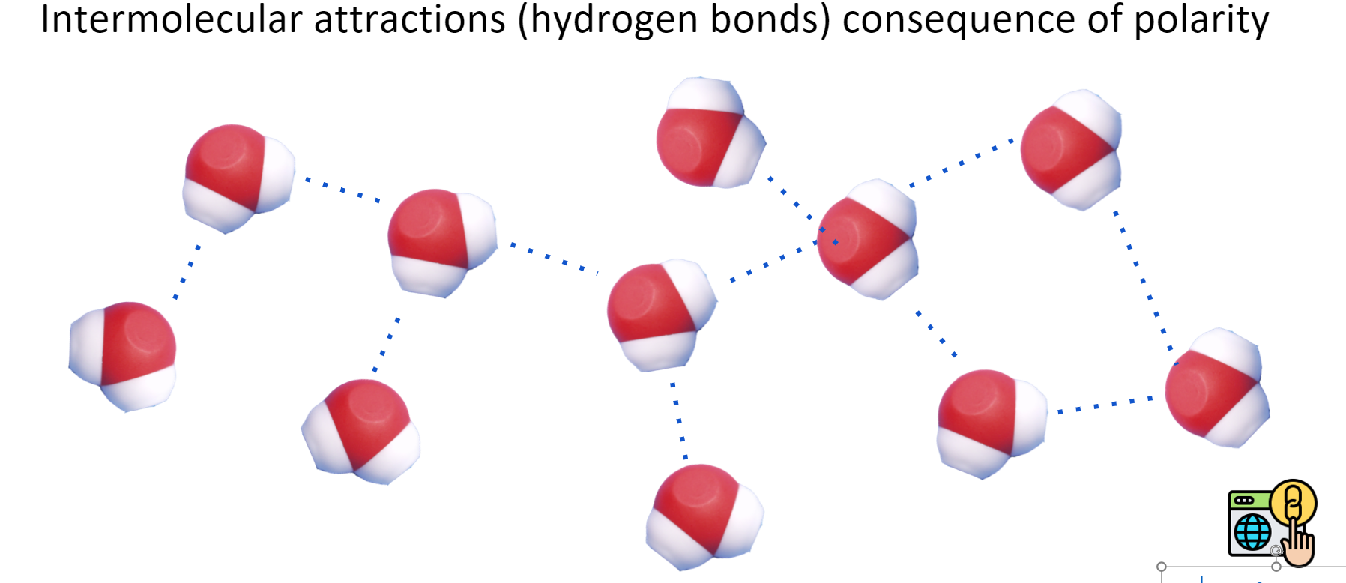
See how many water molecules one can a water molecule bond with.

Slide 10
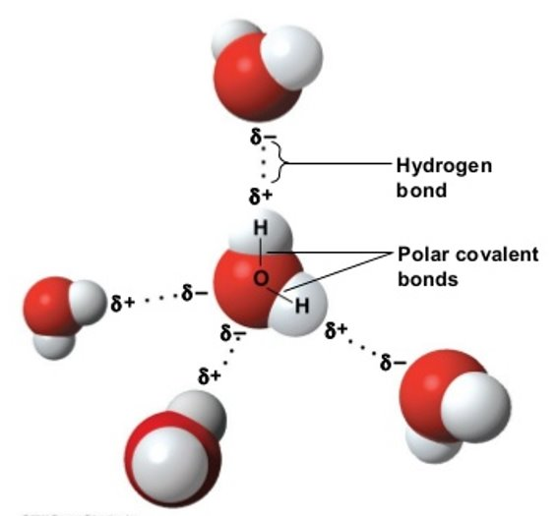

Slide 11
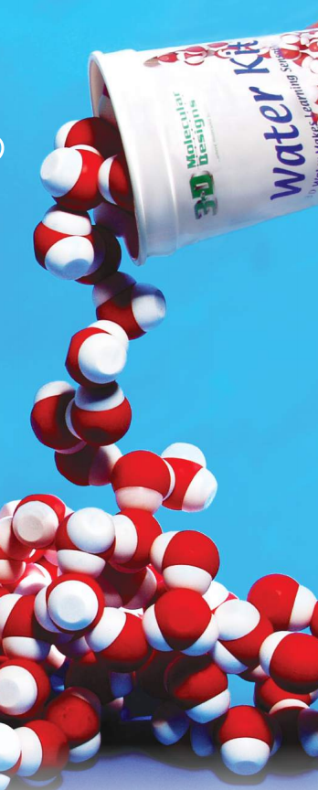
Concepts I count on:
Polar molecule
Covalent bonds are atoms sharing an electron
Hydrogen bonds are weaker attractions between molecules
Adhesion and cohesion made possible
Color scheme in modeling
First transfer of 3D model into science notebook
How to manage materials in our classroom

Slide 12
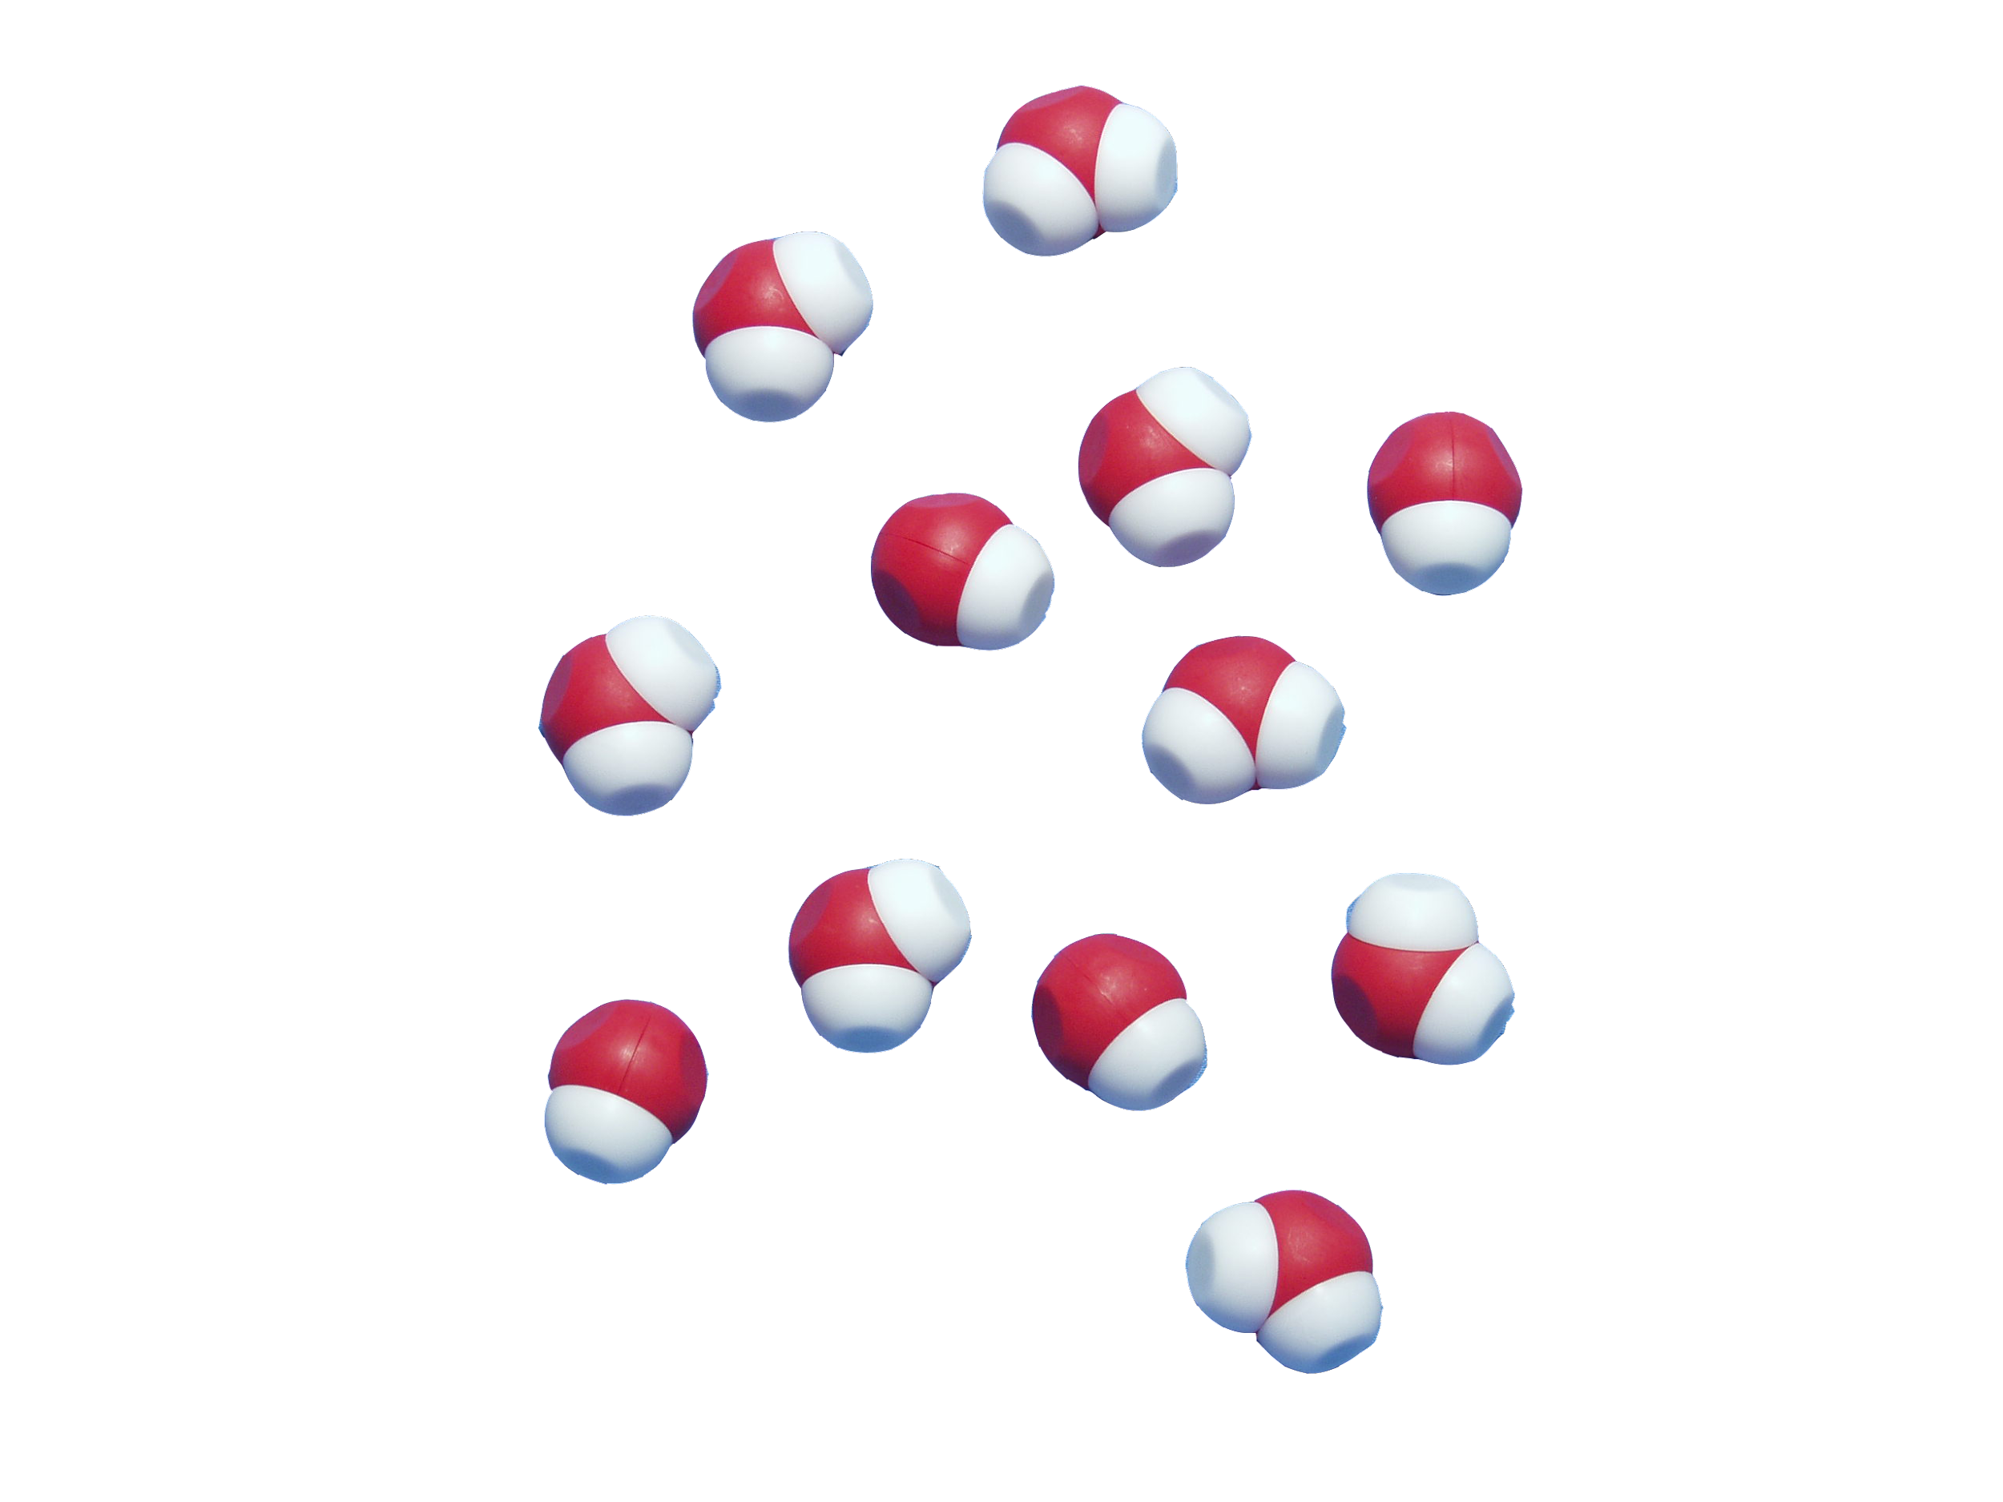
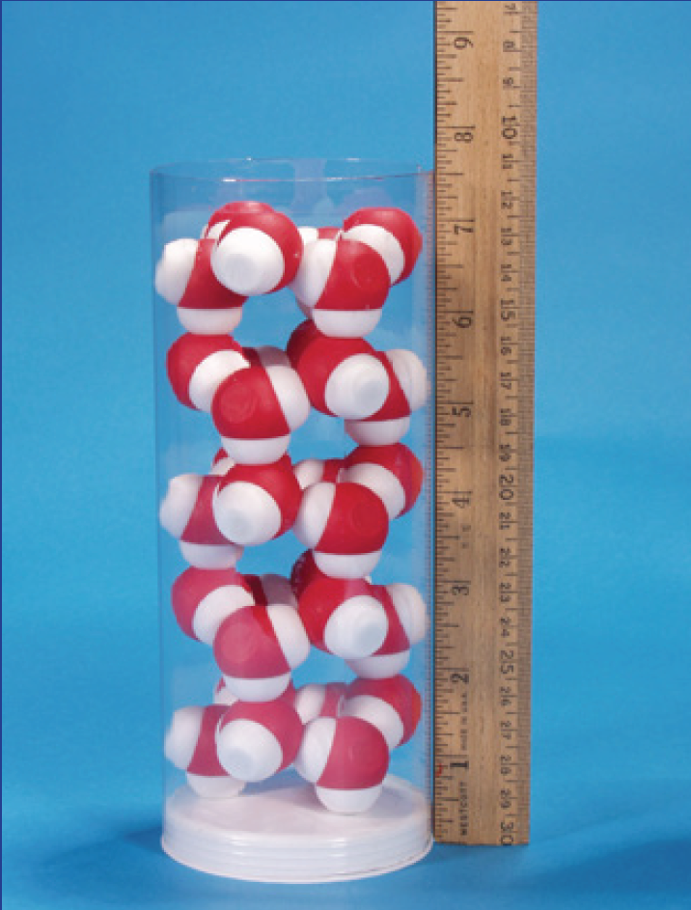
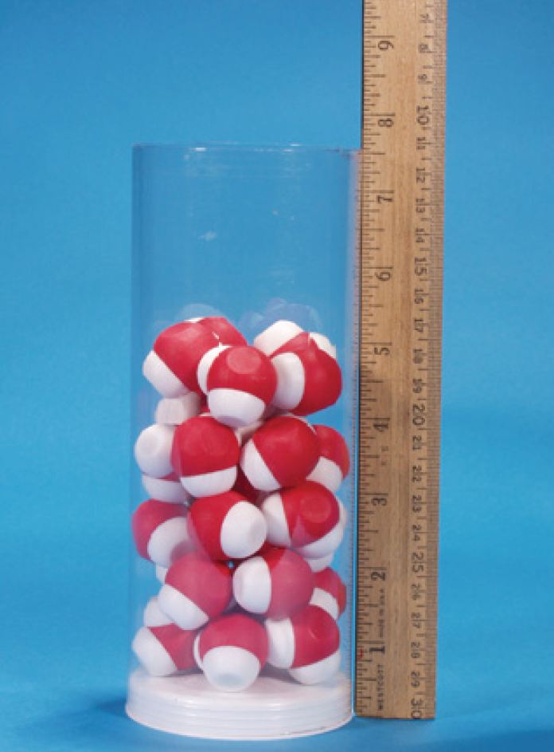
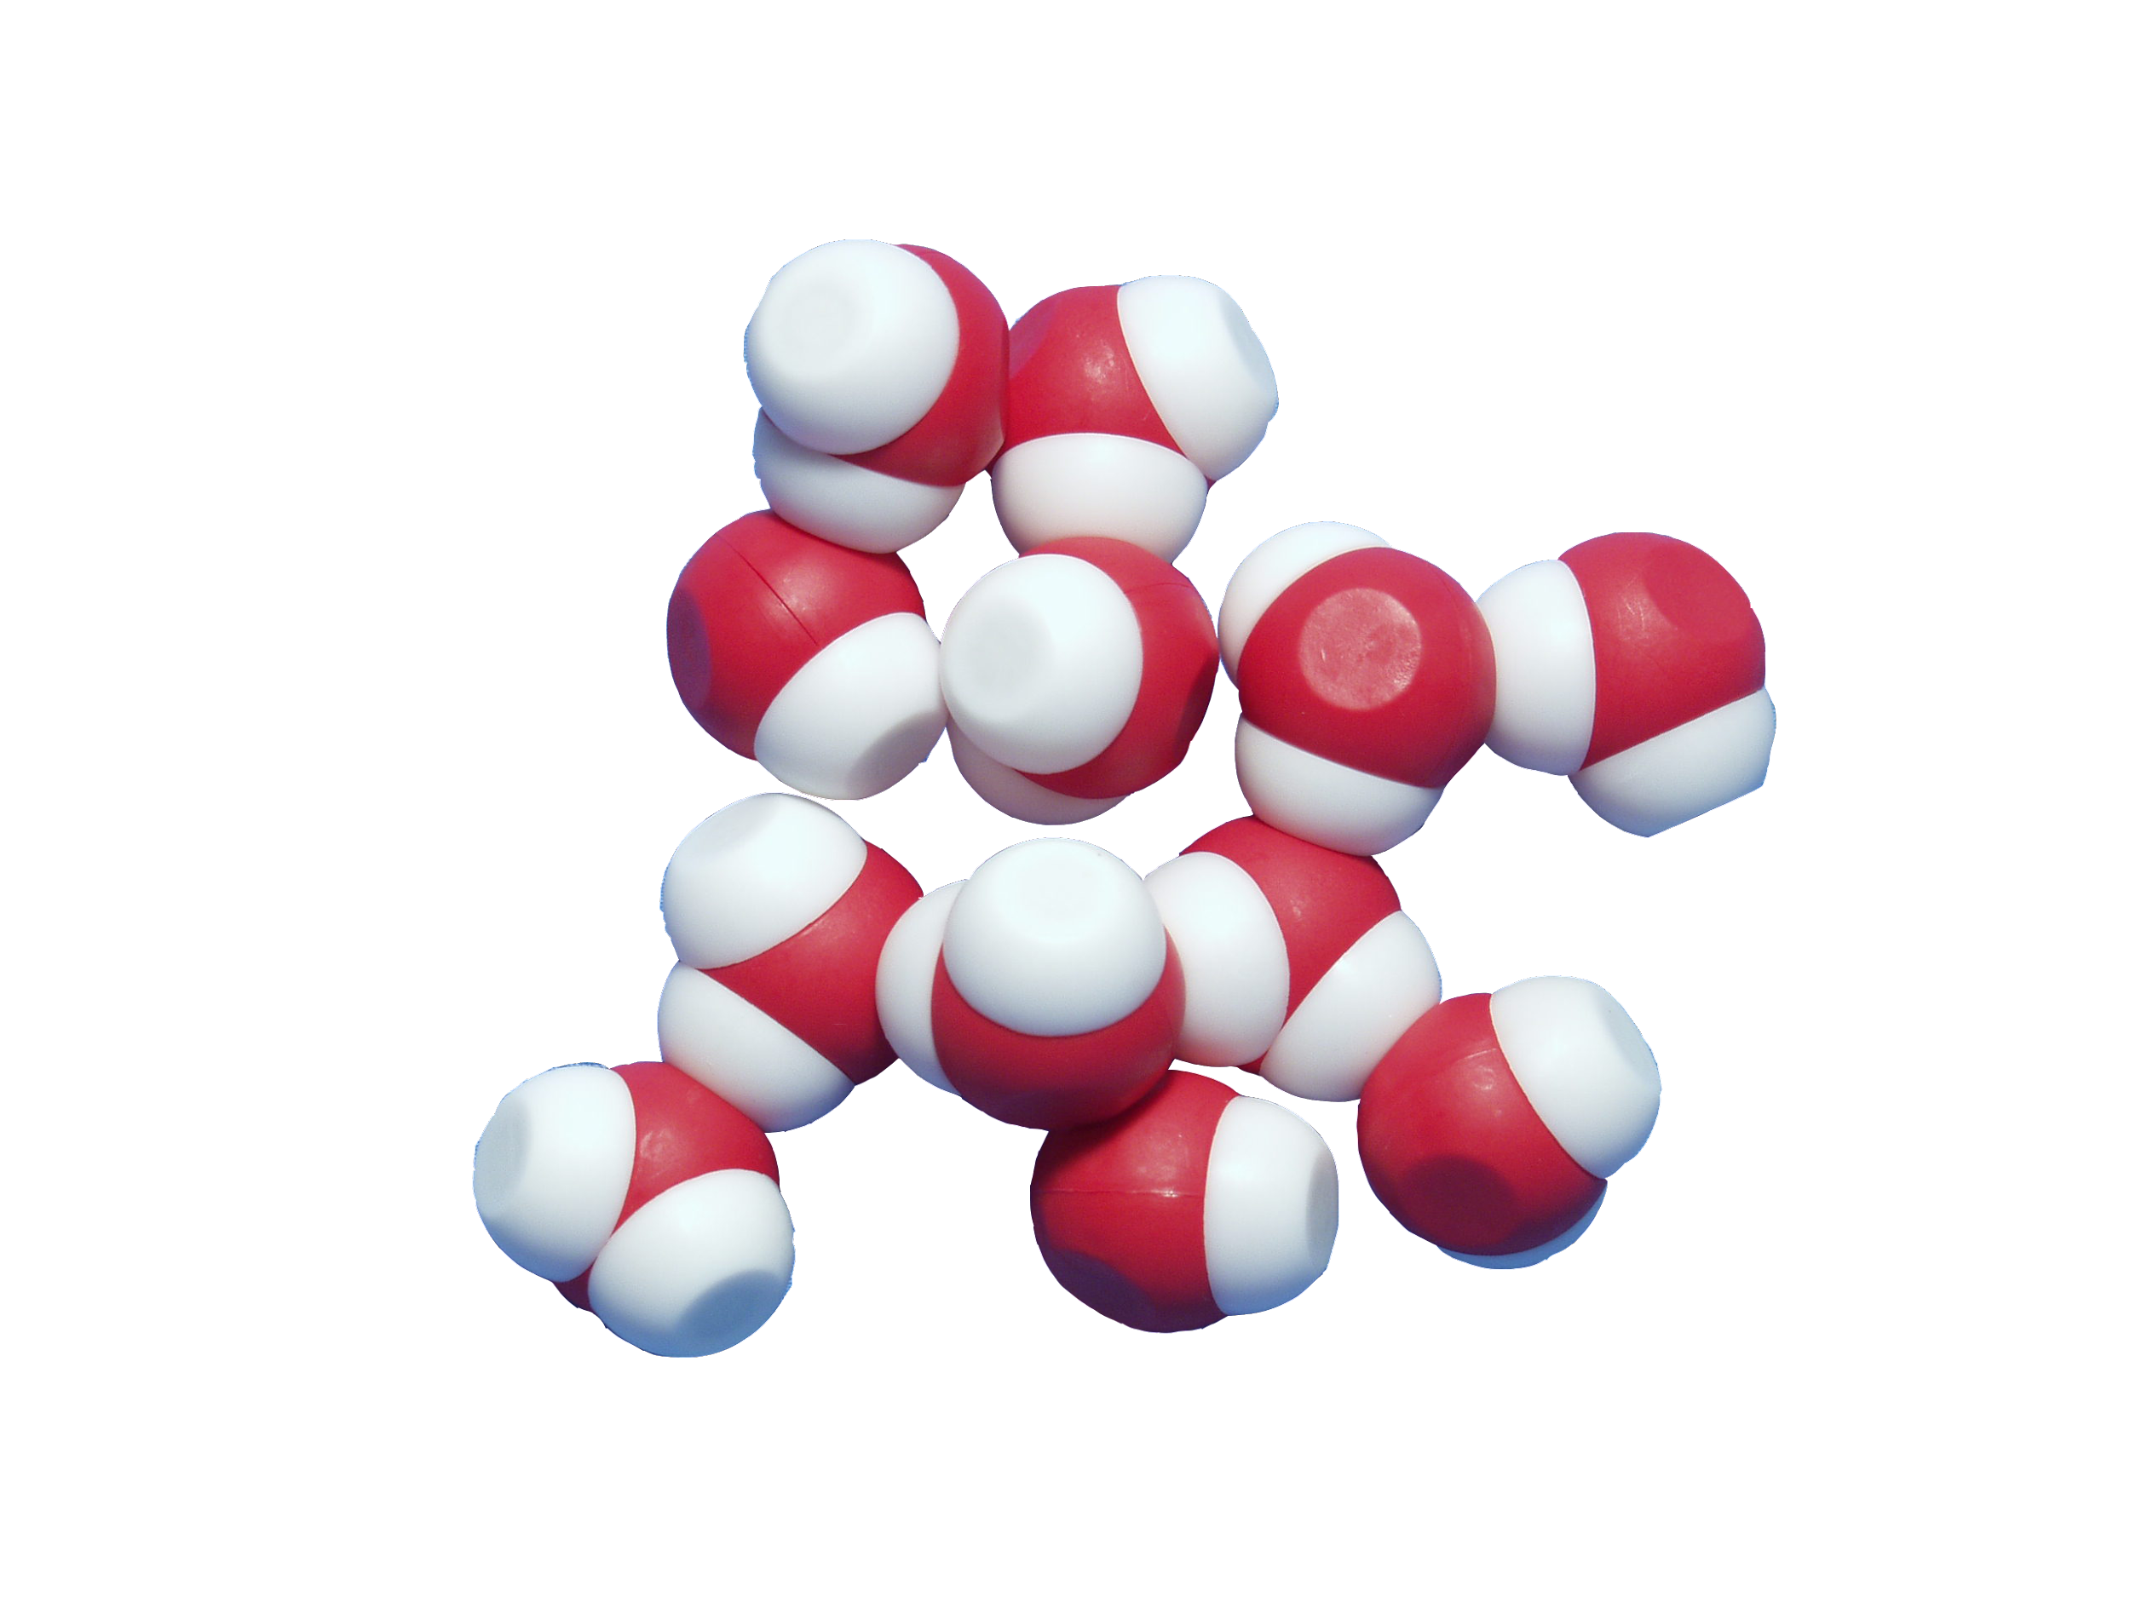
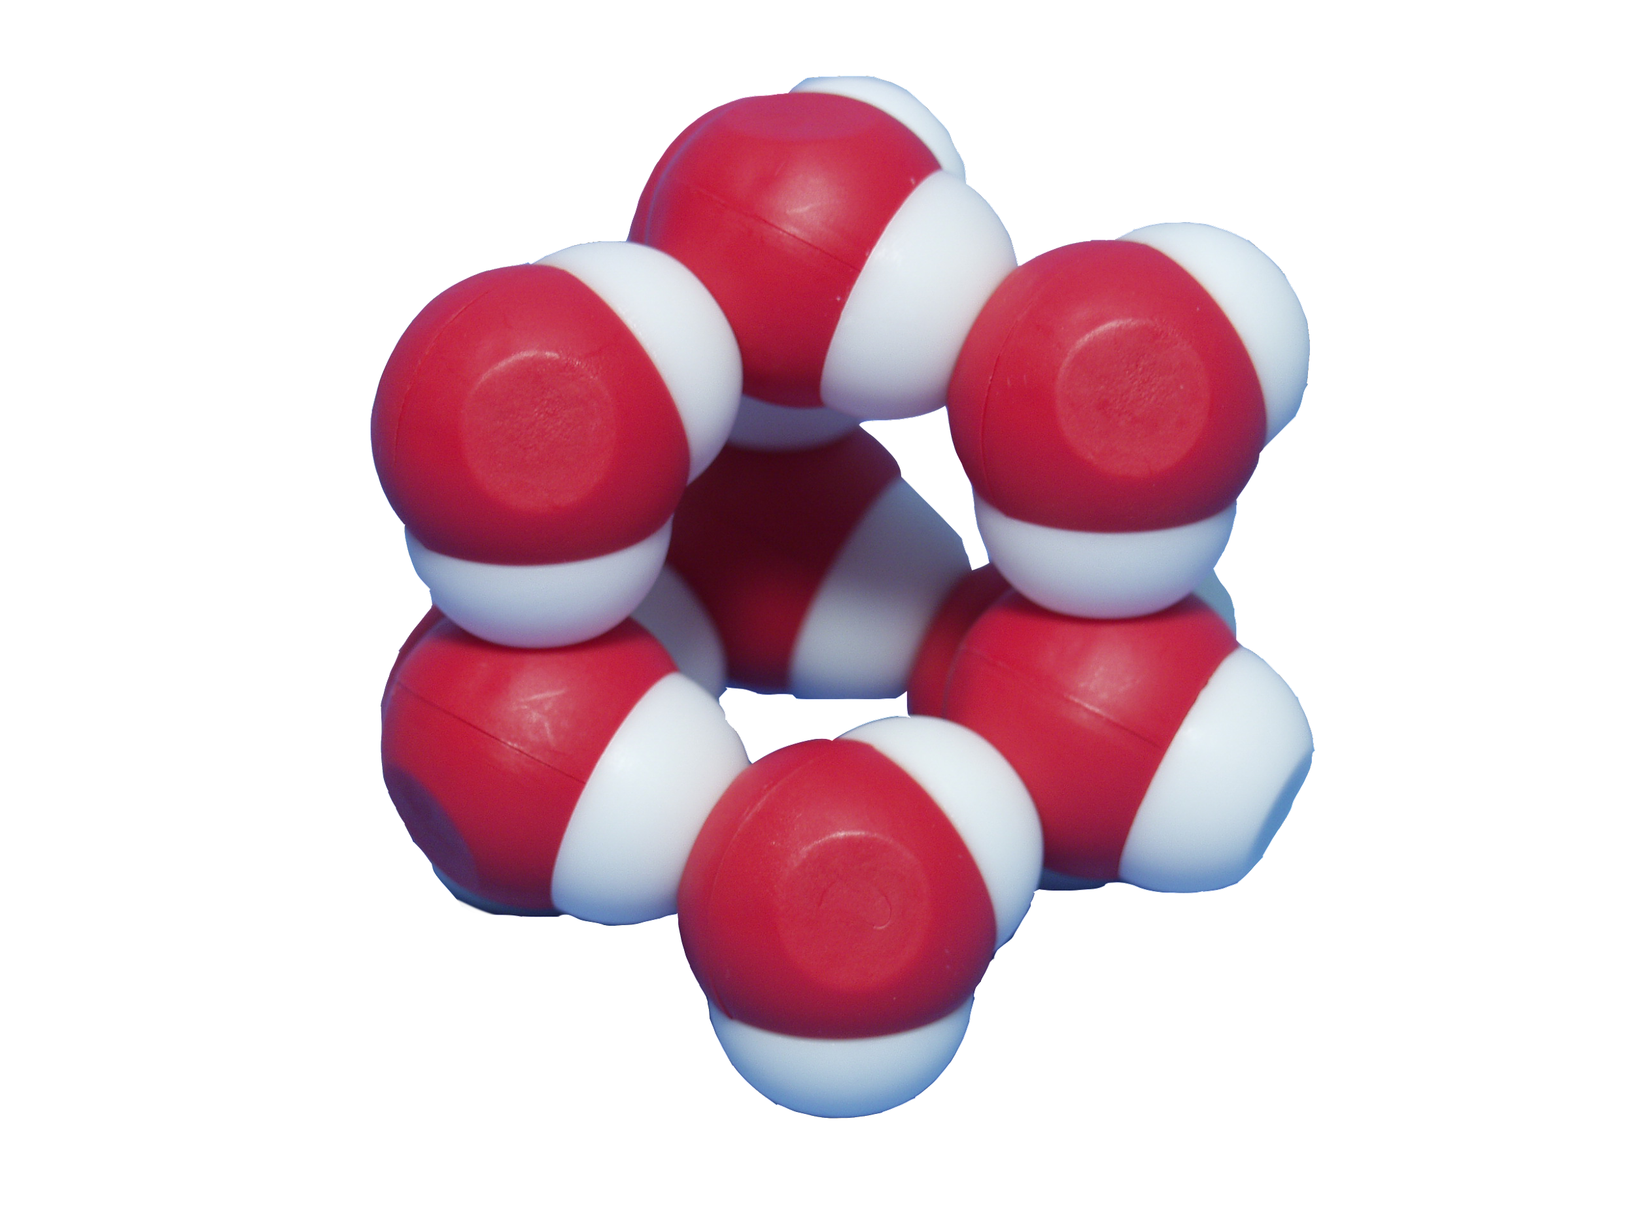
Quick and Easy : States of Matter

Slide 14
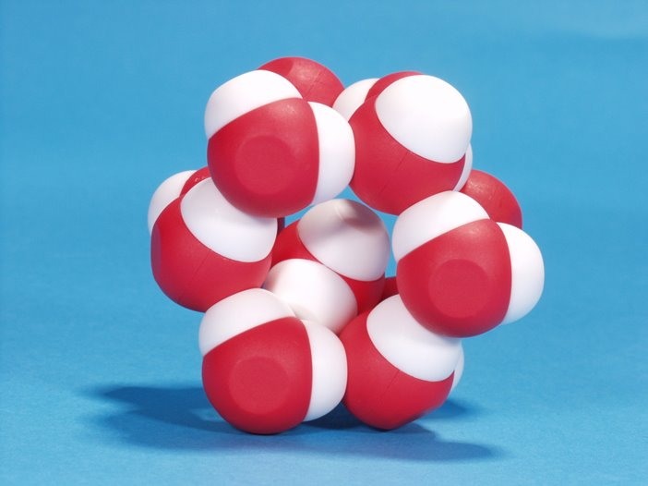

Slide 15
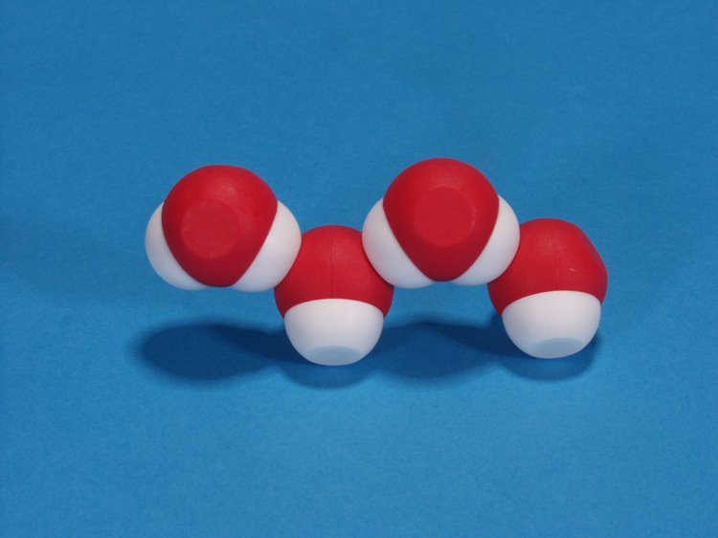

Slide 16
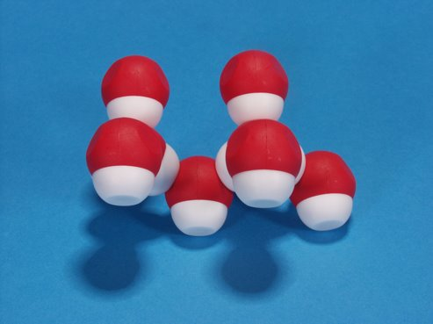
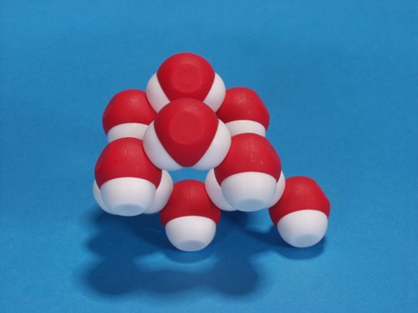

Slide 17
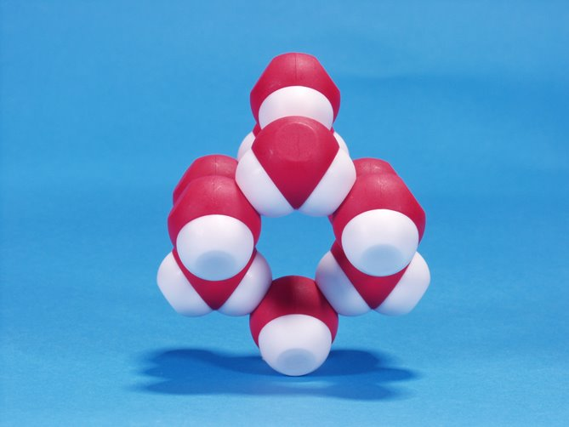

Slide 18
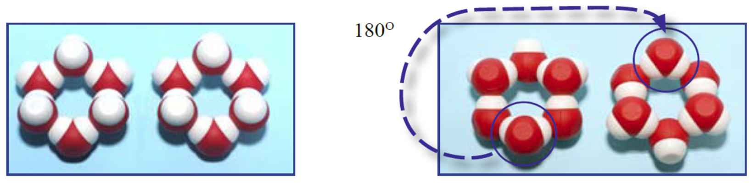

Slide 19
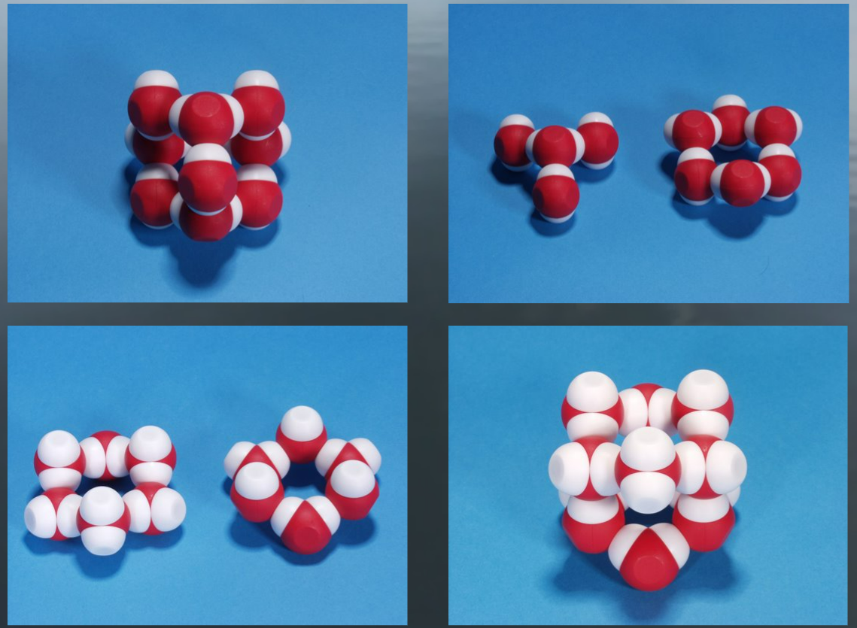

Slide 20
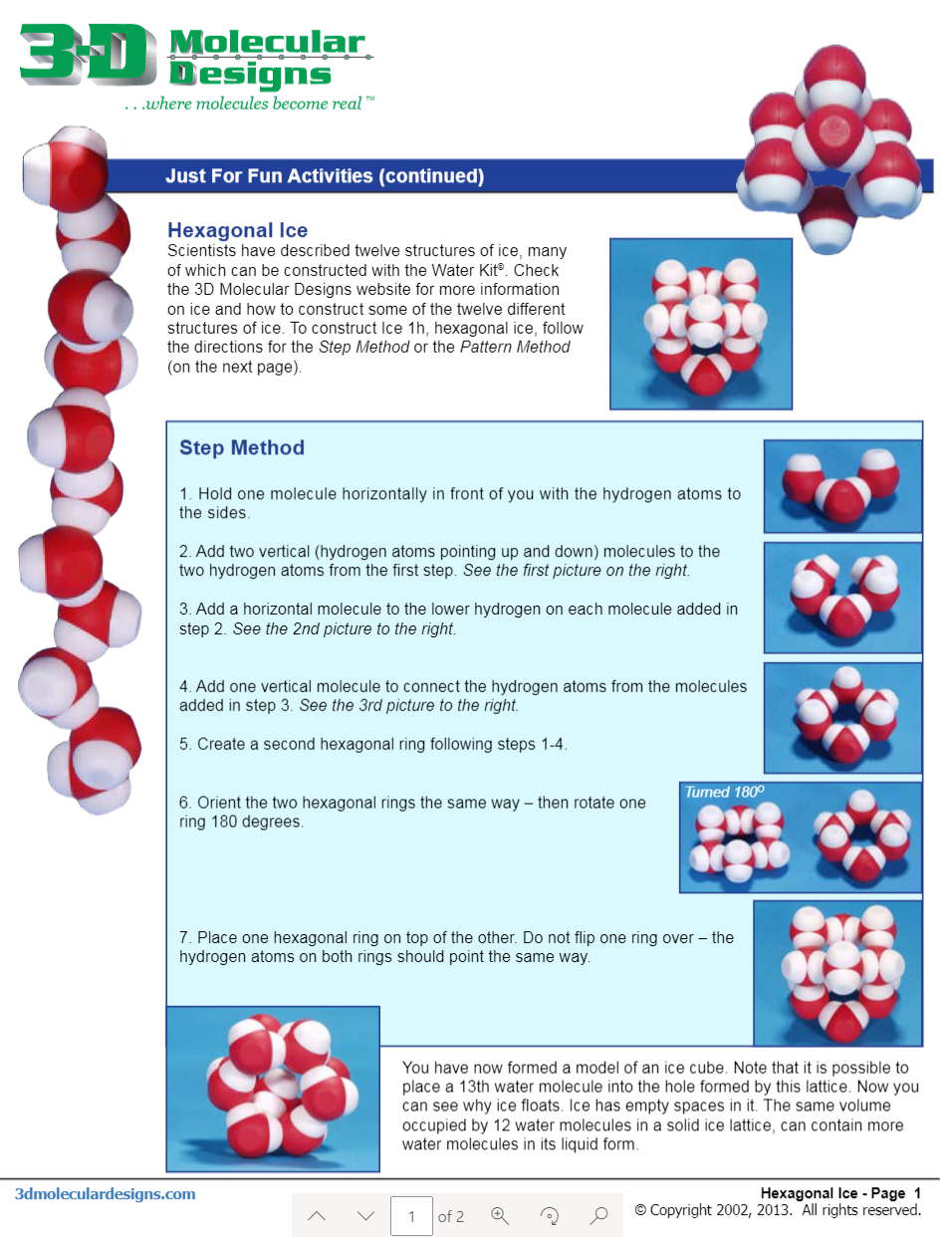
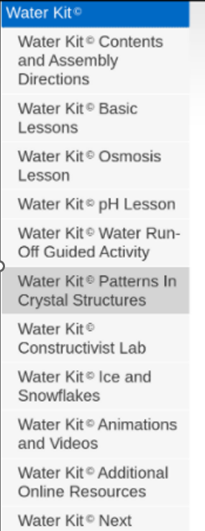

Slide 21
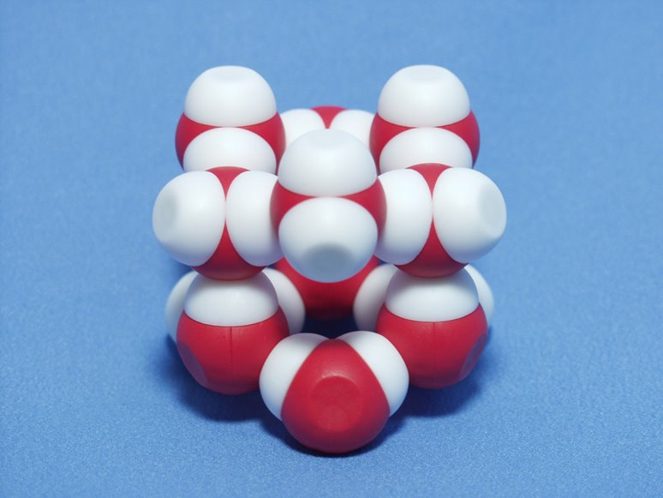
Density

Slide 22
Volume
The crystalline structure of ice has a lot of space.​
As water freezes it expands.​
Notes:
What about adhesion and cohesion? What can we do with this?

Slide 23
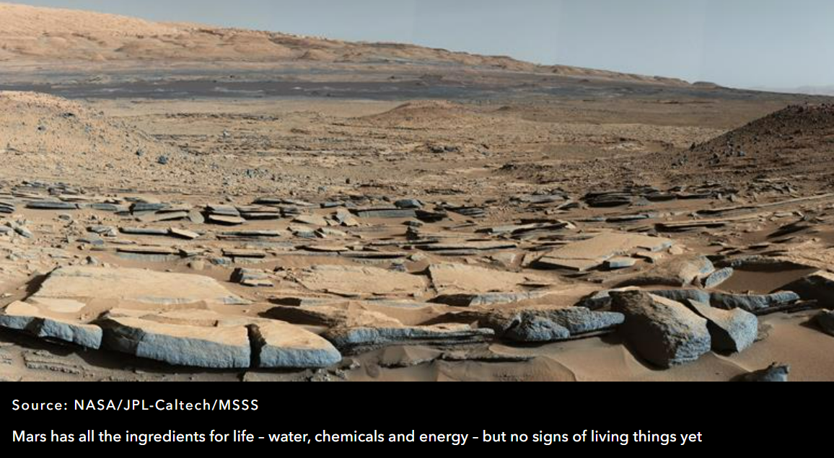

Slide 24


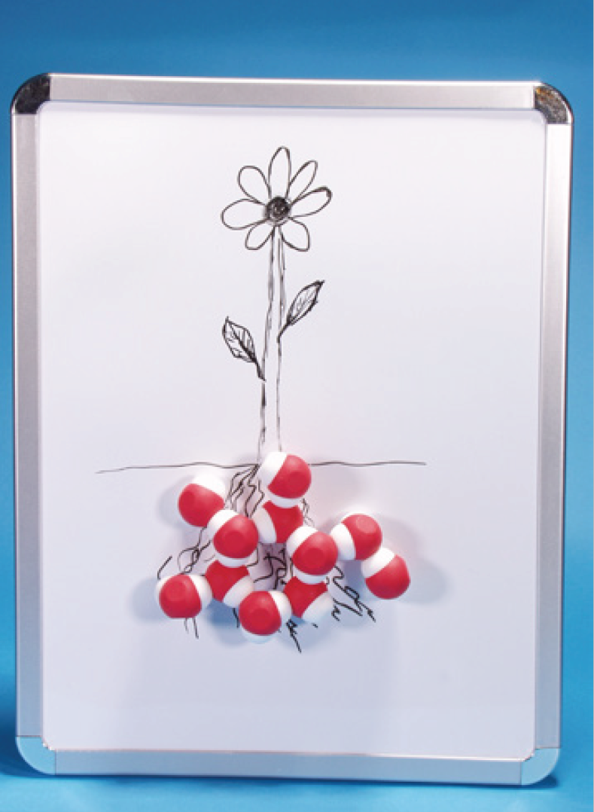
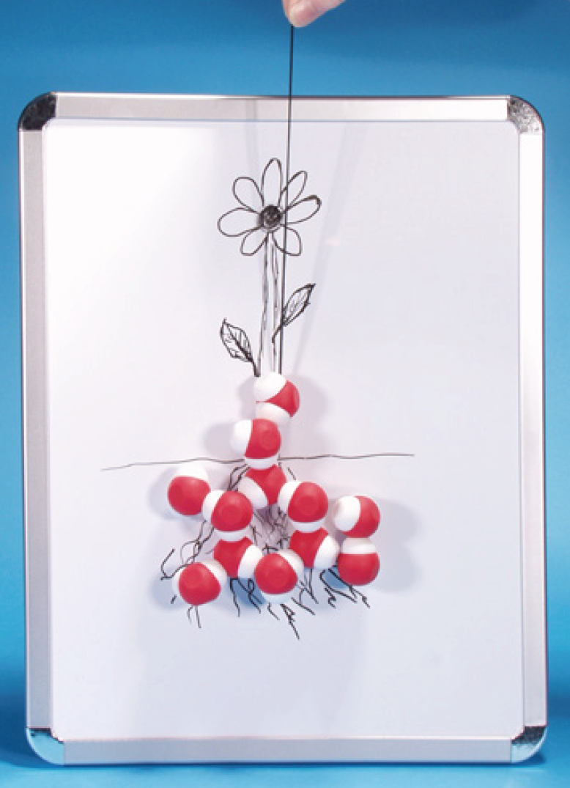
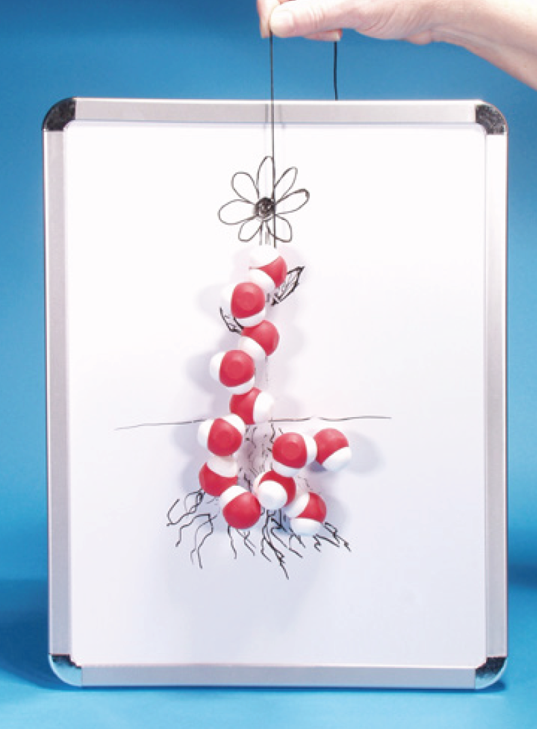
TRANSPIRATION

Slide 25
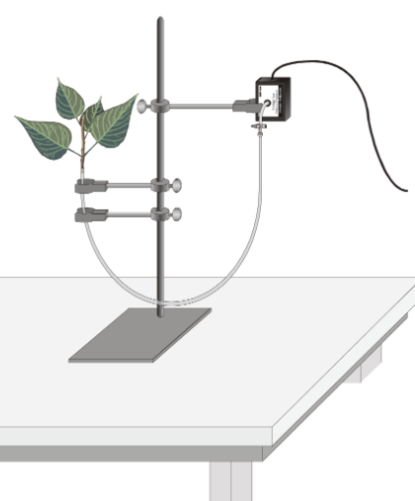
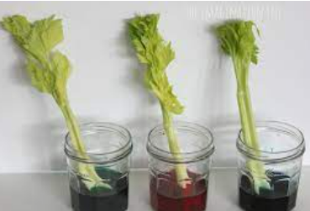

Slide 26
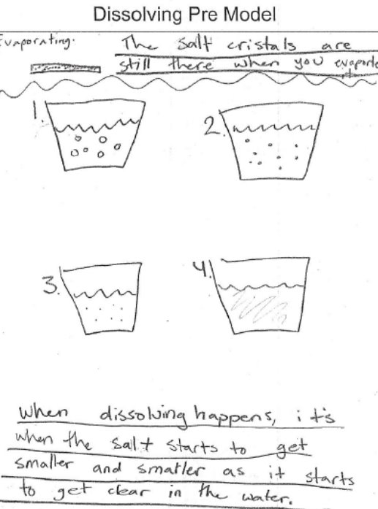
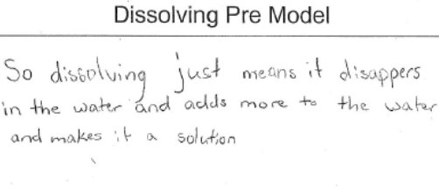
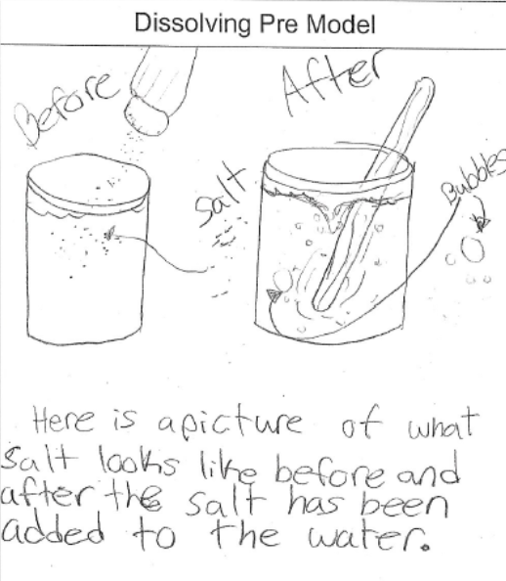

Slide 27
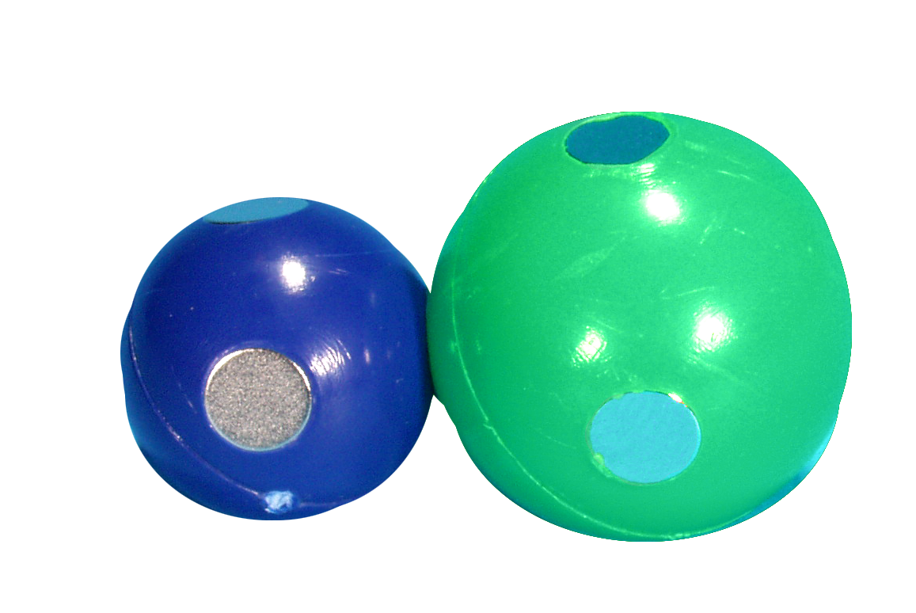
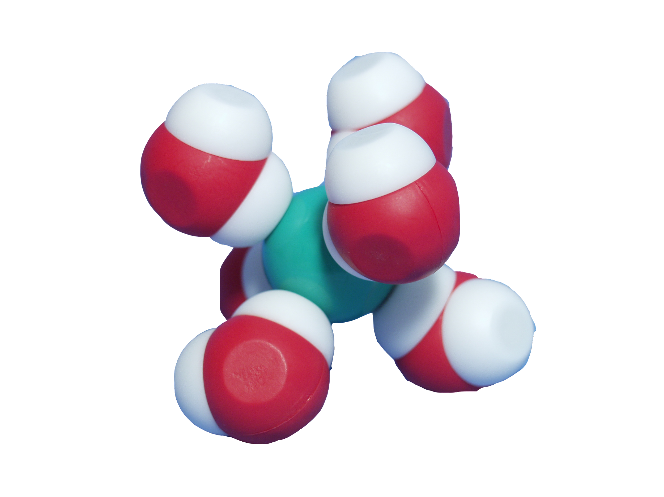
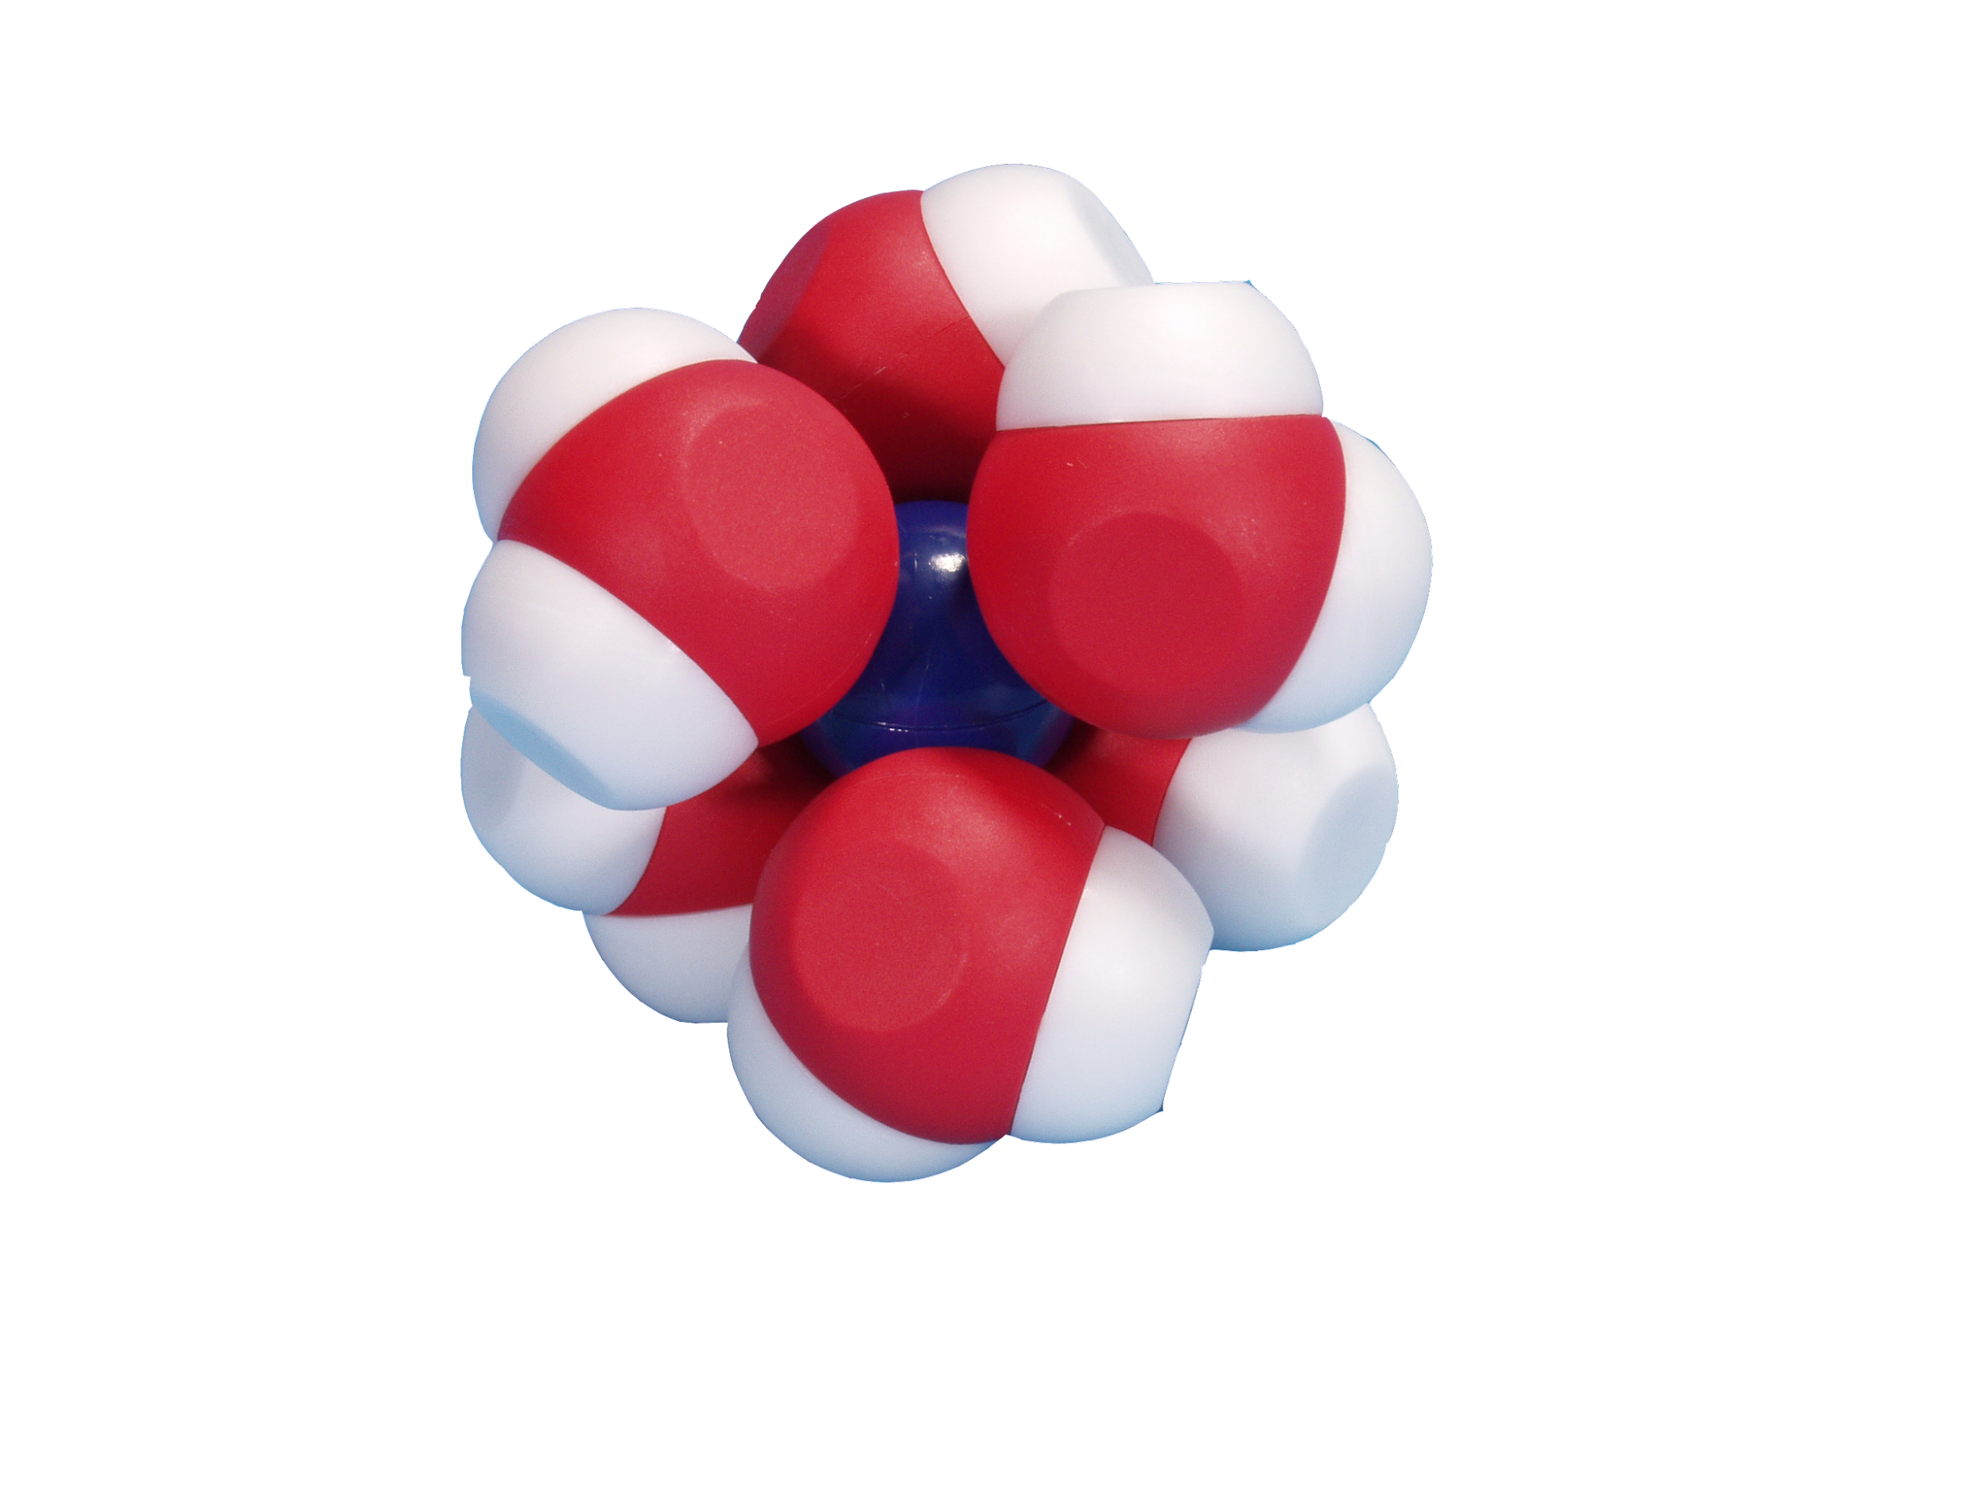
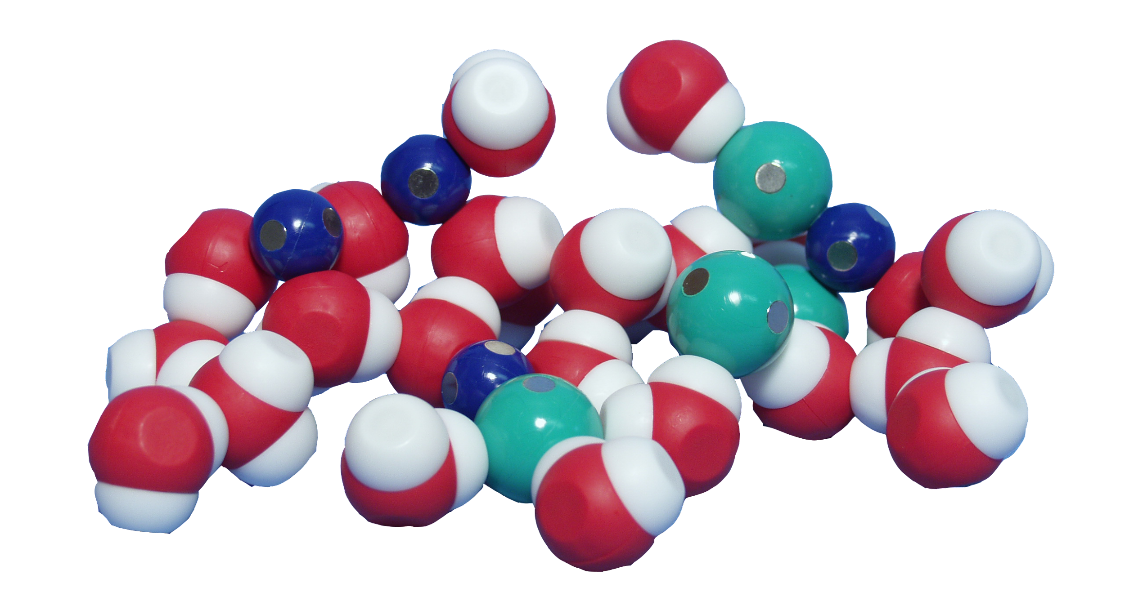
Why is water so good at dissolving things?
Cl—
Na⁺
Notes:
Solvation is the process of reorganizing solvent and solute molecules into solvation complexes. Solvation involves bond formation, hydrogen bonding, and London dispersion forces/van der Waals forces. Solvation of a solute by water is called hydration. (Wikipedia)
Common student question: Which particle is which again? Have them figure out the answer question by exploring interaction with water model
Why does water dissolve ethanol (C₂H₅OH)?
Why does water interact weakly with ethane (C₂H₆)?
When 1 mole of sodium chloride crystals are dissolved in an excess of water, the enthalpy change of solution is found to be +3.9 kJ mol⁻¹. The change is slightly endothermic, and so the temperature of the solution will be slightly lower than that of the original water.
Energy released when attractions formed can be heard as a “click” (sound energy) with models, but is released as heat energy in particles
AP Chem connection (Topic 4.4): Physical and chemical changes.
Sometimes physical processes involve the breaking of chemical bonds. For example, plausible arguments could be made for the dissolution of a salt in water, as either a physical or chemical process, involves breaking of ionic bonds, and the formation of ion-dipole interactions between ions and solvent.
AP Chem connection (Topic 7.14): Thermodynamics of dissolution.
The free energy change (ΔG°) for dissolution of a substance reflects a number of factors: the breaking of the intermolecular interactions that hold the solid together, the reorganization of the solvent around the dissolved species, and the interaction of the dissolved species with the solvent. It is possible to estimate the sign and relative magnitude of the enthalpic and entropic contributions to each of these factors. However, making predictions for the total change in free energy of dissolution can be challenging due to the cancellations among the free energies associated with the three factors cited.
Connection: Immiscibility of oil and water (connection: when oil tankers leak, petroleum forms oil slick that floats on water and eventually carried onto beaches)

Slide 28
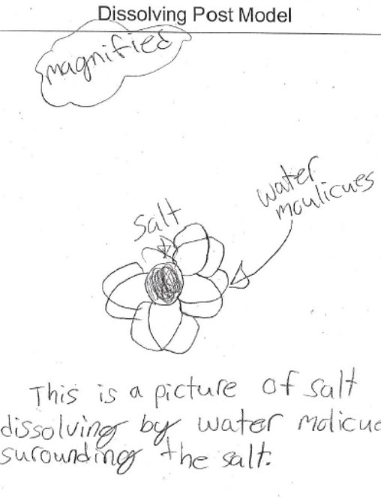
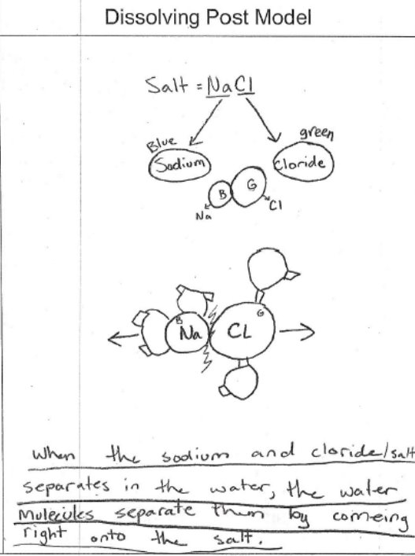
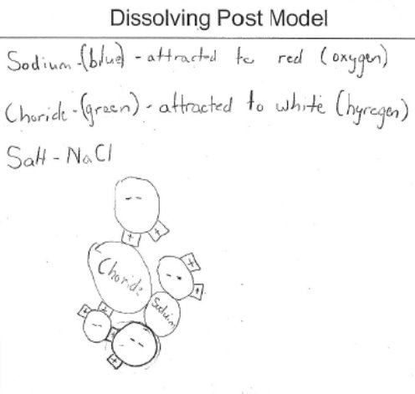

Slide 29
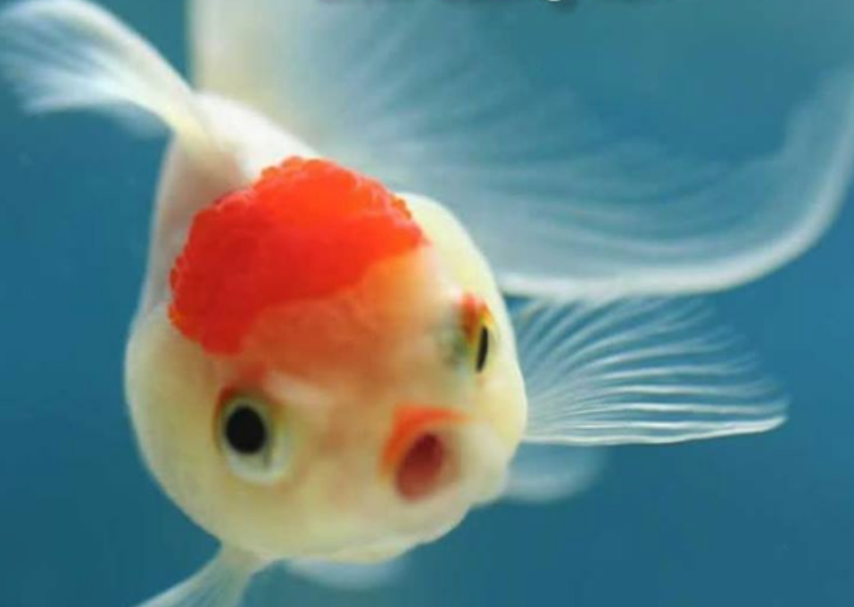
Do fish drink water?

Slide 30
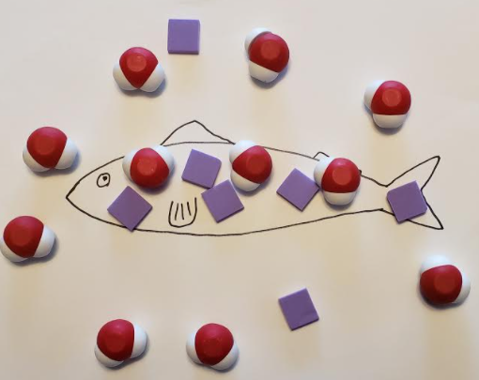
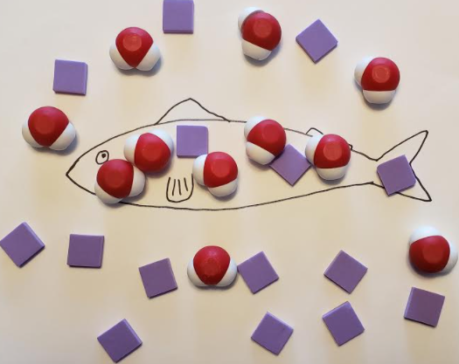
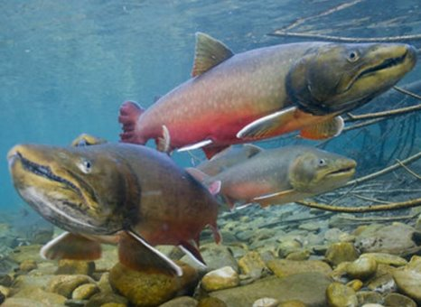
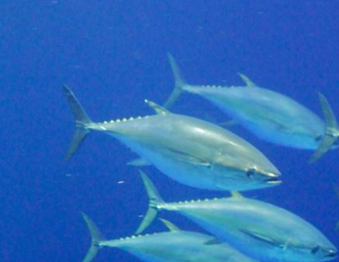
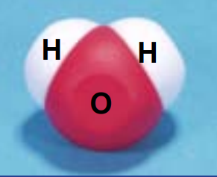
"Great white shark and blue fin tuna" by niallkennedy is licensed under CC BY-NC 2.0​
"Bull Trout Underwater" by USFWS Mountain Prairie is licensed under CC BY 2.0​

Slide 31
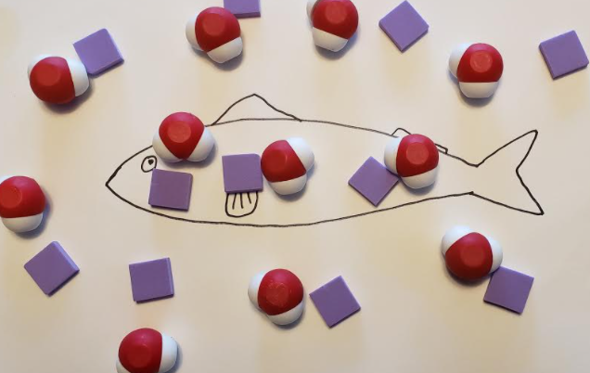
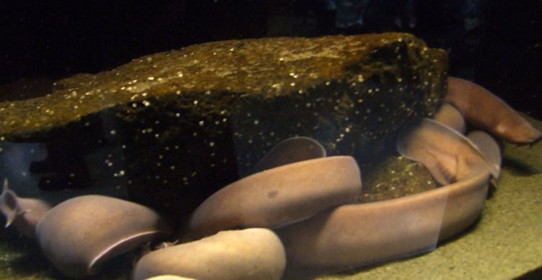
"Pacific Hagfish" by Travis S. is licensed under CC BY-NC 2.0​

Slide 32
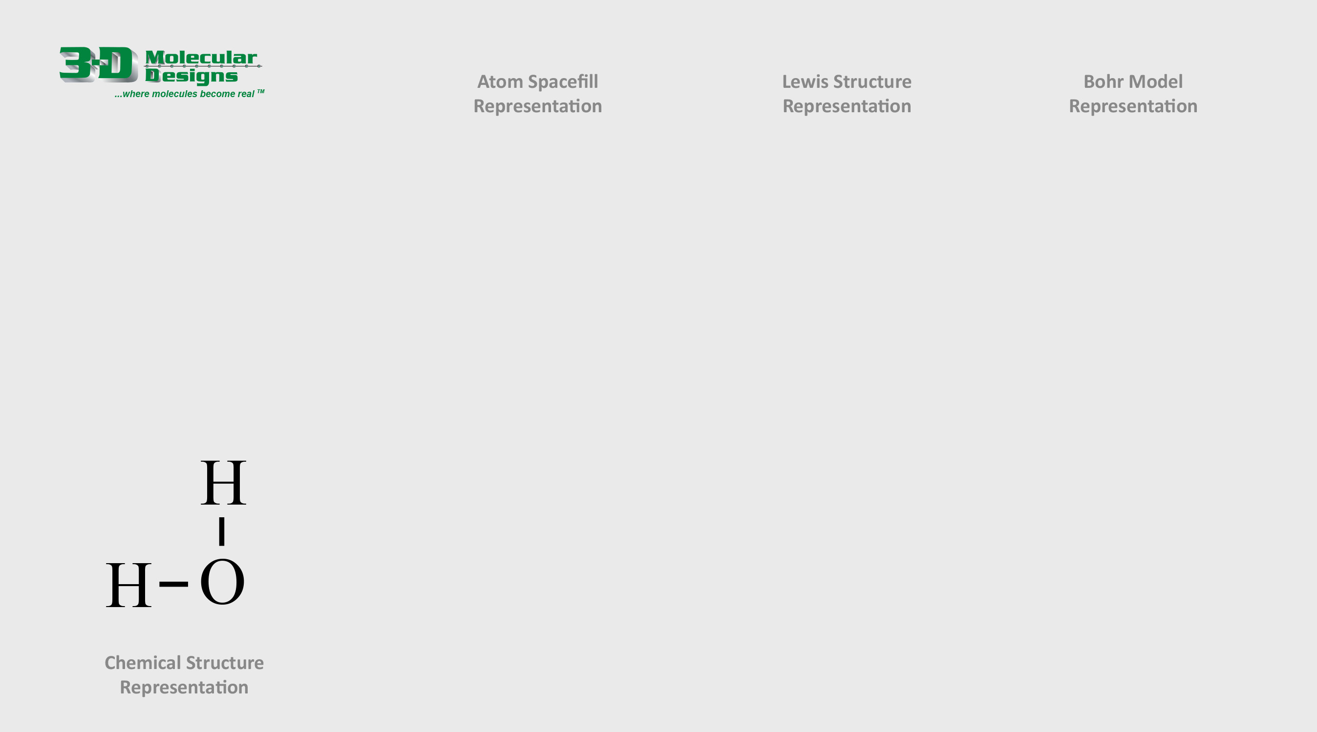
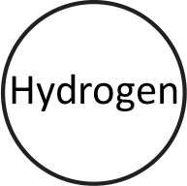



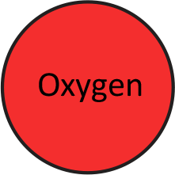



Building a Water Molecule
A single water molecule contains one oxygen atom and two hydrogen atoms that are covalently bonded together, meaning that they share electrons.
1. Study the chemical structure shown below.
2. Drag and connect the pieces on the right to build your own single water molecules in three common molecule representations.
3. Answer the question below and move to the next slide.
What is the bond called that joins a hydrogen to an oxygen in a water molecule?

Slide 33

The Polar Nature of Water
The shared electrons in a water molecule spend more time near the oxygen atom and less near the two hydrogen atoms, resulting in slightly positive and slightly negative regions.
This impacts how they interact with other molecules, forming hydrogen bonds when they get close to an opposite charge.
1. Study how two water molecules interact using the image shown below.
2. Drag the water molecule shown to the right to demonstrate how water molecules might interact with the other common molecules.

Slide 34

The Three States of Matter
Matter can exist in three states, solid, liquid and gas.
As a gas (above 100°C), water molecules barely form hydrogen bonds with each other, and are very spread out.
As a liquid (between 0°C and 100°C), water molecules are very close to each other and form and break hydrogen bonds quickly.
As a solid (below 0°C), water molecules form permanent hydrogen bonds that crystalize into a hexagonal lattice structure.
1. Study the various chemical drawings shown above and to the right.
2. Drag and rotate the water molecule shown to the right to create three illustrations of the three states of matter.
3. Answer the question to the right and move to the next slide.
Why is solid water (ice) less dense than liquid water?

Slide 35


CH₃OH

Slide 36

Ethanol is an alcohol made from grains. ​
Ethanol is polar.​

Slide 37

Ethane is an odorless, colorless gas that can be used as a fuel, a freezing agent, and in making other chemicals.​
Ethane is non-polar. It does not have partial positive or negative charges.​

Slide 38

We put teachers first!
Your opinions are important to us.
Enter to win a $500 gift card by
completing this short survey.
This will also allow us to email you the resources associated with this session.
Notes:
updated

Slide 39
THANK YOU FOR ATTENDING!
Kits and models used in this session:
Purchase kits at 3dmoleculardesigns.com.
Use discount code FC22 to receive 20% off most items in our catalog. Student Modeling Packs are not eligible for discount.

Slide 40

www.3dmoleculardesigns.com/Teacher-Resource/Water-Kit.htm
Na Cl

