Slide 1
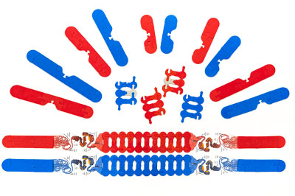
Chromosomes in Action: New Ways to Model Mitosis and Meiosis
Notes:
For this presentation, we will use the Chromosomes Connections Kit.

Slide 2
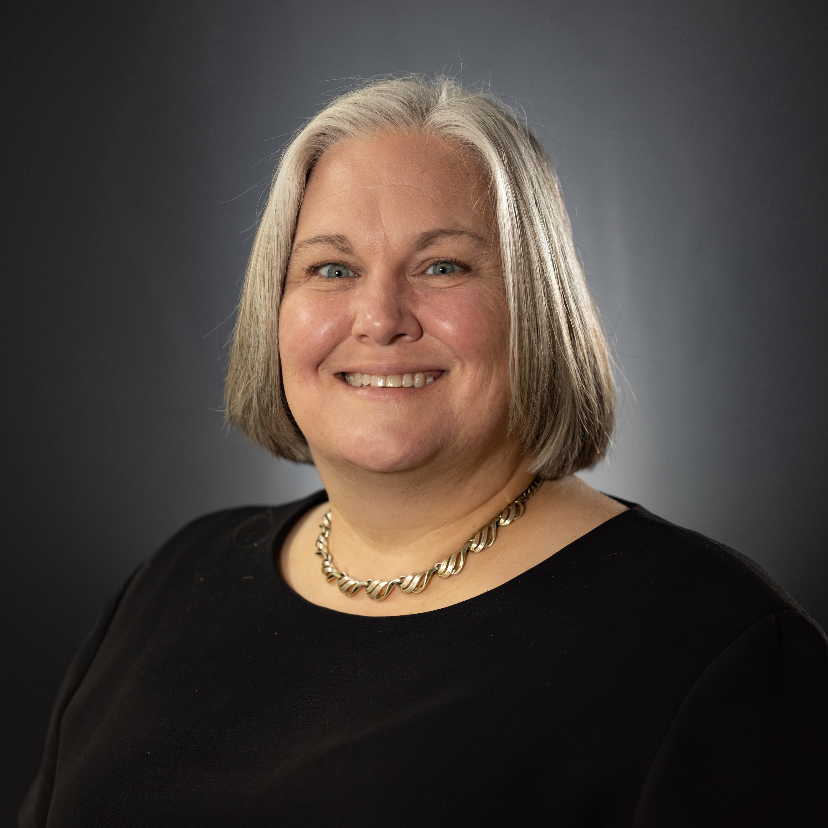
Ruth Hutson, MSSE
Notes:
I’m Ruth Hutson, a 3D Molecular Designs Science Educator. I’ve been teaching for 25 years . Before coming to 3DMD, I was the science department at a small rural high school in Northeast Kansas and taught Concurrent College Biology, biology, chemistry, physics, and Earth Science. In addition to being the HS Science Department, I was also play director, Scholars Bowl coach, and junior class sponsor. I discovered the 3DMD products in 2015 and loved using them with all my classes. Today I'd like to share with you how I use these kits with my high school biology class and Concurrent College Biology course.

Slide 3
Who’s Here
Middle School, High School, Post-secondary
Rural, Suburban, Urban
Biology, AP Biology, Anatomy and Physiology, Other
Where are you in your course?

Slide 4
Workshop Learning Goals
Demonstrate how cell division using mitosis results in identical daughter cells.
Explain how mitosis alternates with interphase in the cell cycle
Compare and contrast mitosis with meiosis.
Demonstrate what processes in meiosis increase gamete diversity when compared to the parent cell.
Have fun!
Notes:
Ruth says We are going to be modeling with the Chromosome Connections Kit. I use this kit throughout the year. At the end of this session, you should be able to… read goals from slide).
Let’s get started with some modeling [Advance slide]

Slide 5
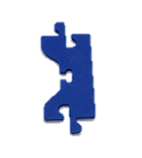
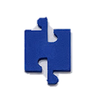

Construct a chromosome
Start with one centromere
Add 3 to 4 chromosome connectors to each side of the centromere.
Add a cap piece to each end of the chromatid.
Notes:
Start with a centromere piece
Add 3-4 chromosome connectors on each side of the centromere piece.
Add a cap piece to each end of the chromatid.

Slide 6
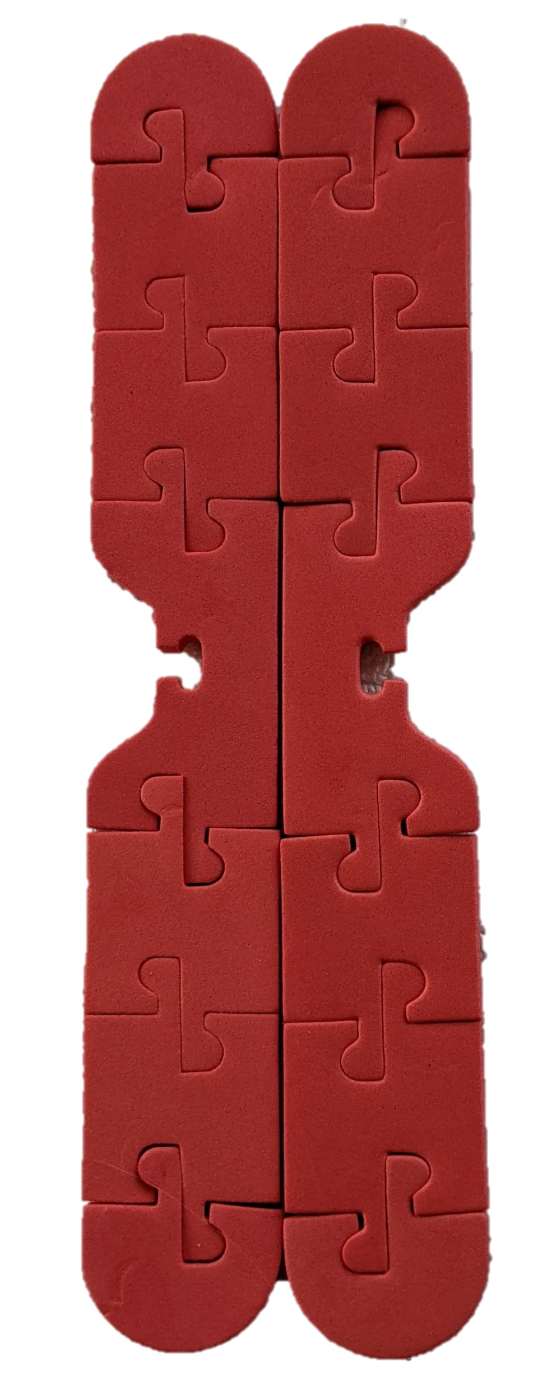
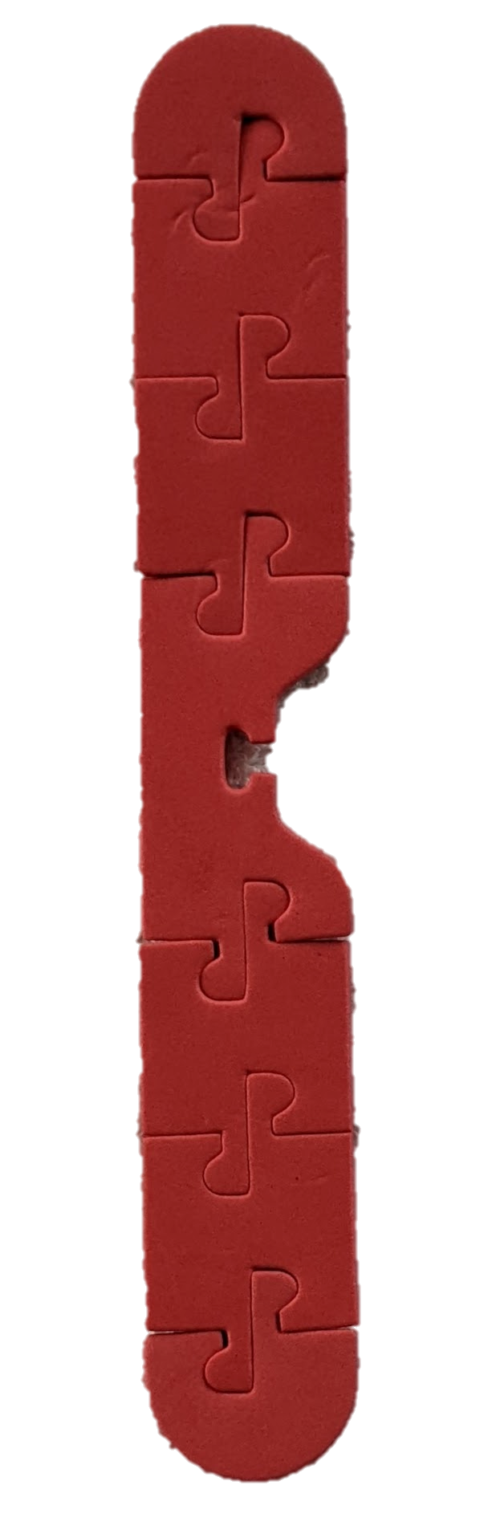
Create a duplicate copy of the chromosome to make a sister chromatid
Notes:
Next create a duplicate copy of the chromosome to make a sister chromatid by using the other components found in the Chromosome Connections Kit (Note: your chromosome does not need to look exactly like the one pictured, but it does not to have all the components.)

Slide 7
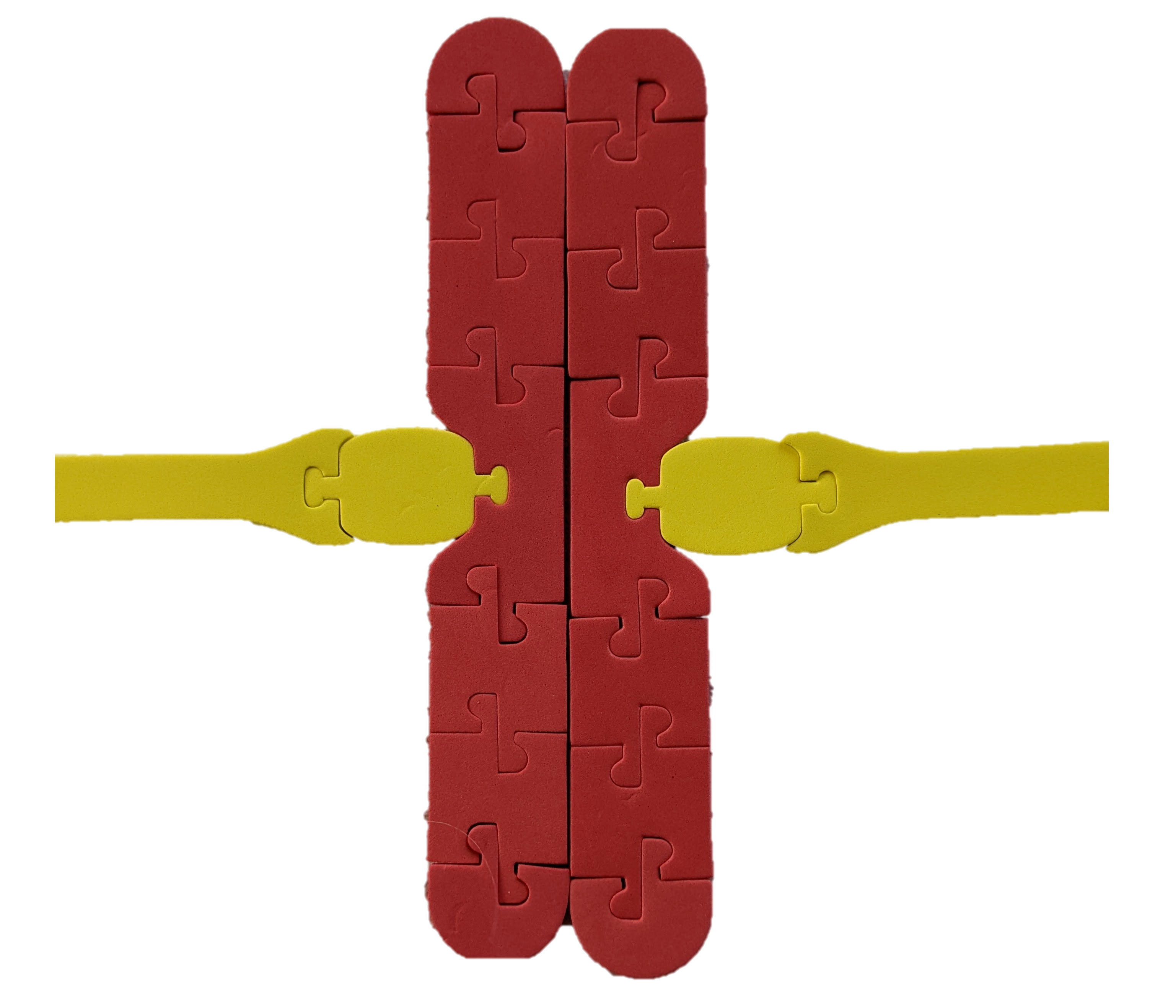
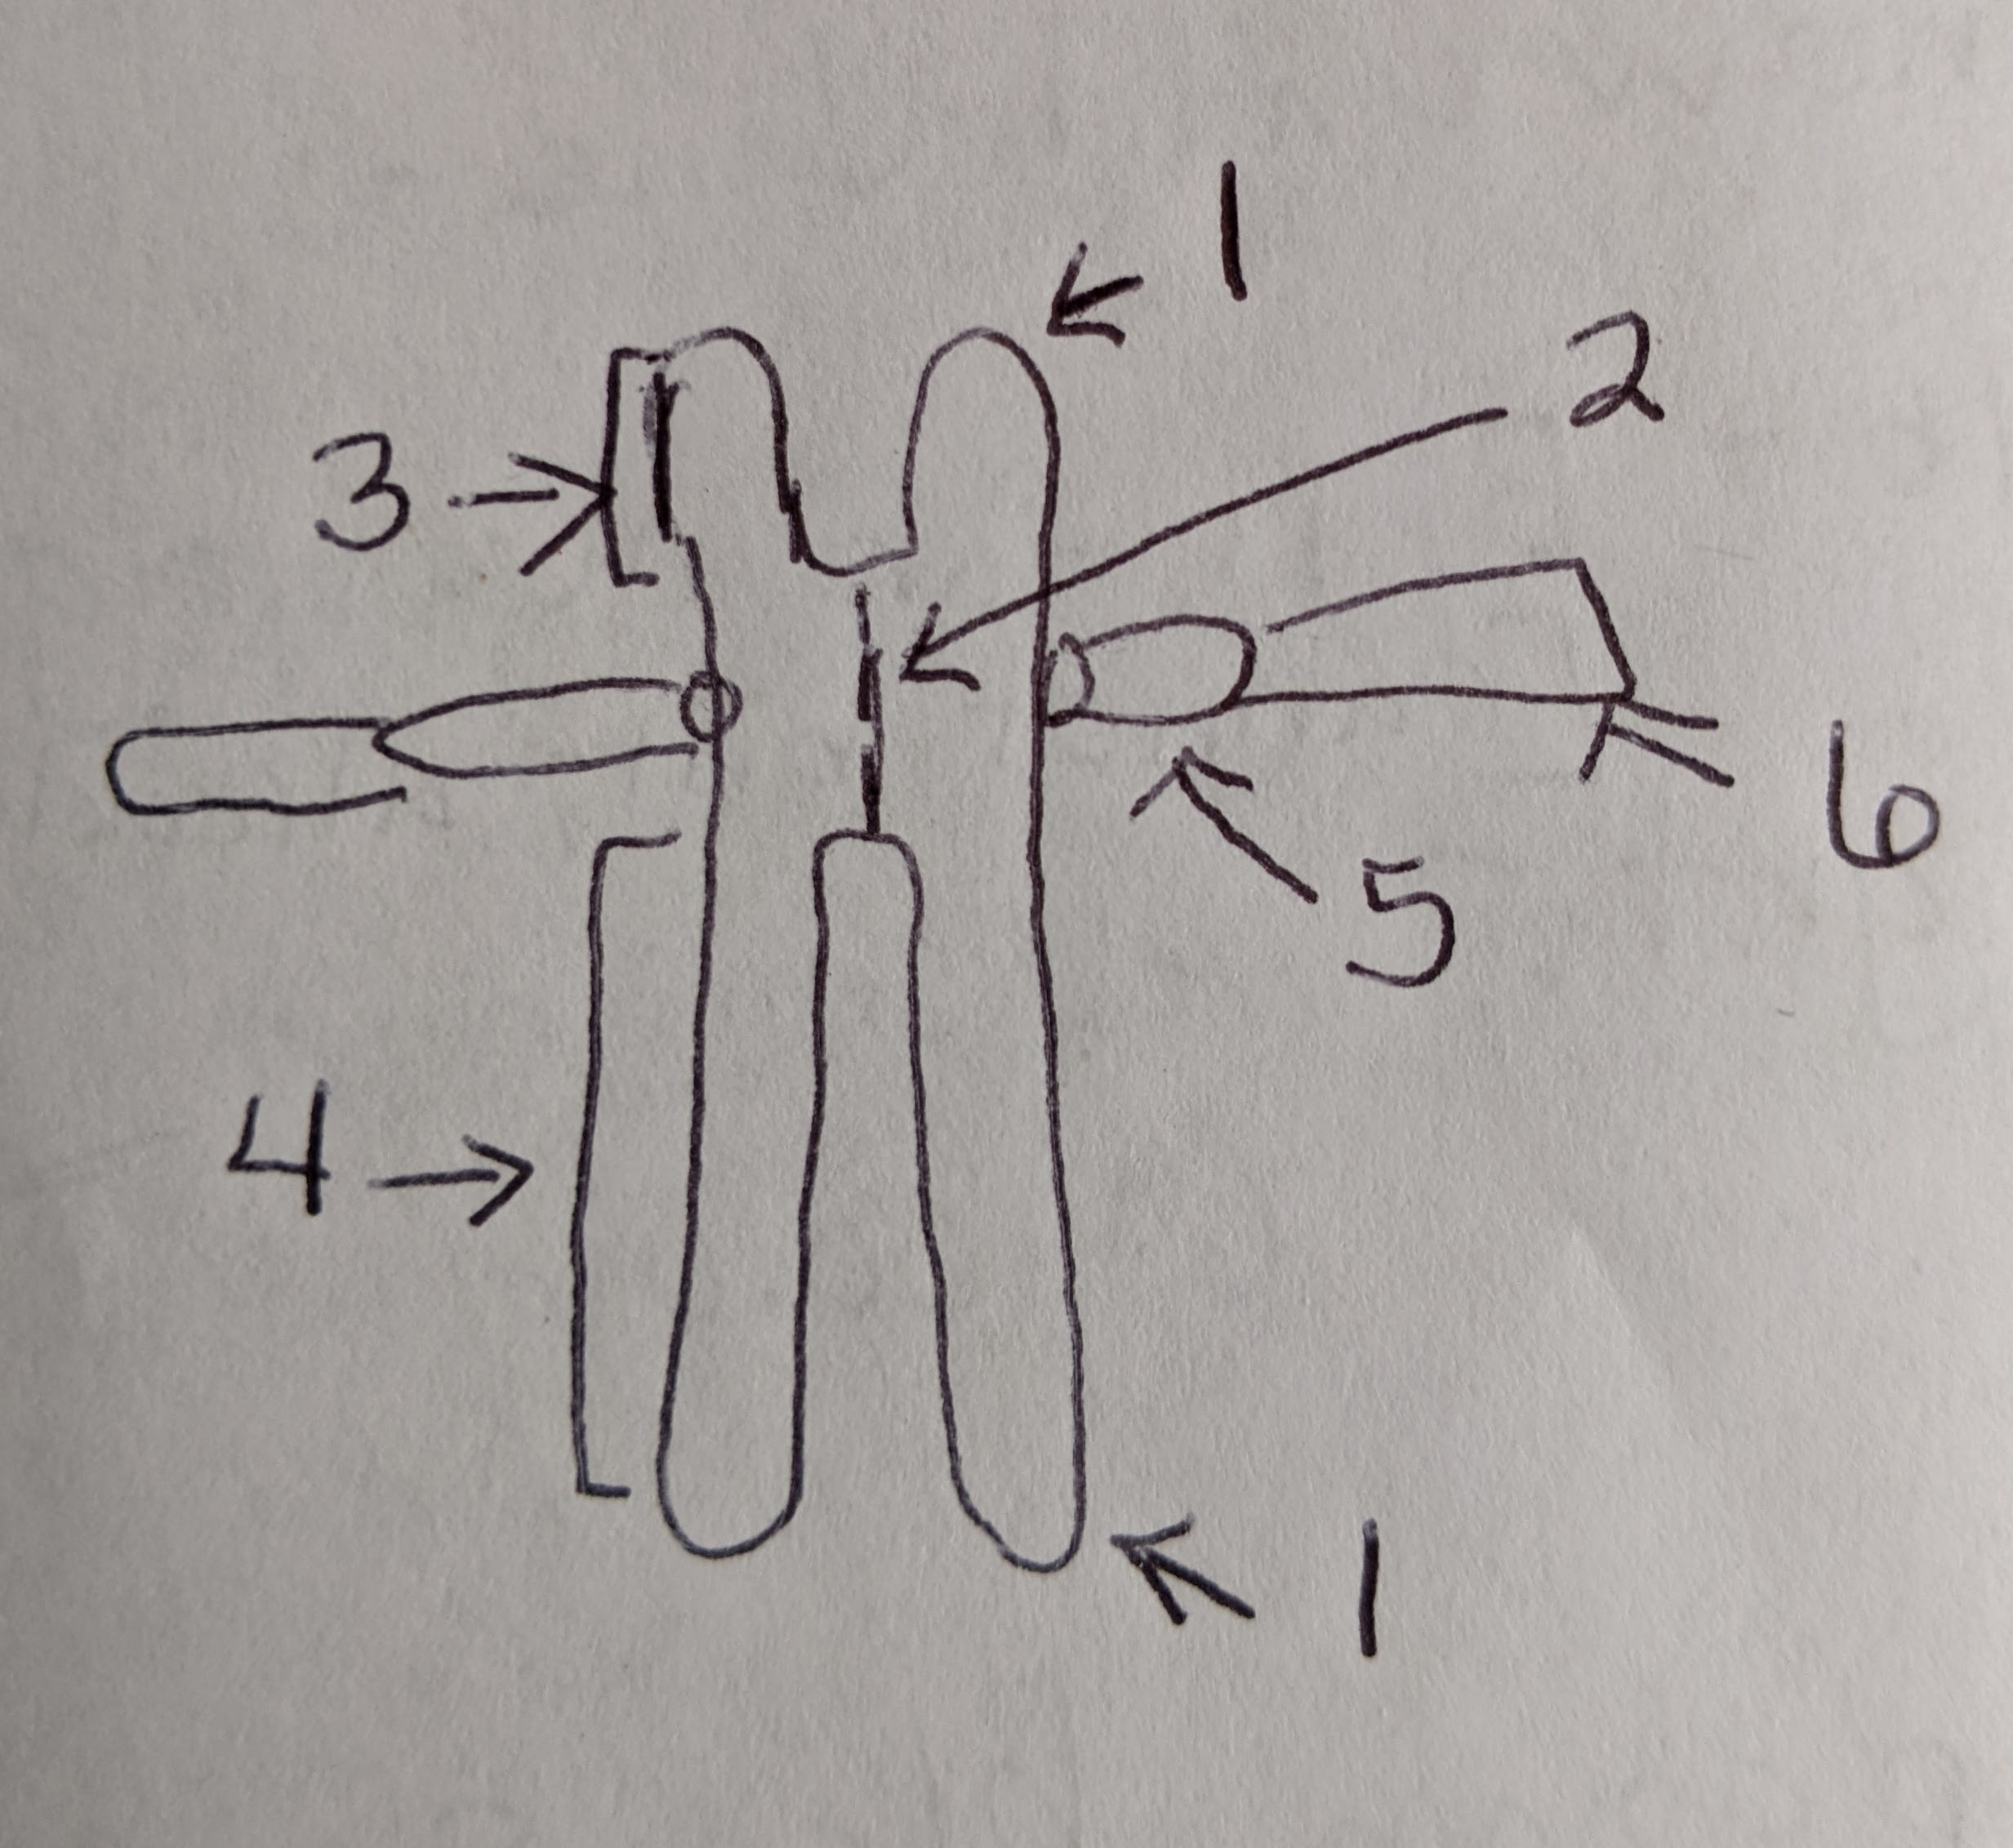
Label the parts
Notes:
Label the telomere, centromere, p and q arms, kinetochore, and spindle fibers. Identify their color on the model. Compare and contrast your sister chromatids with that of another student or group. In the space provided on the student answer sheet, describe how they are the same and how they are different. Refer to the NIH’s Chromosome Fact Sheet (https://www.genome.gov/about-genomics/fact-sheets/Chromosomes-Fact-Sheet) if you need assistance in determining the parts of the chromosome.

Slide 8
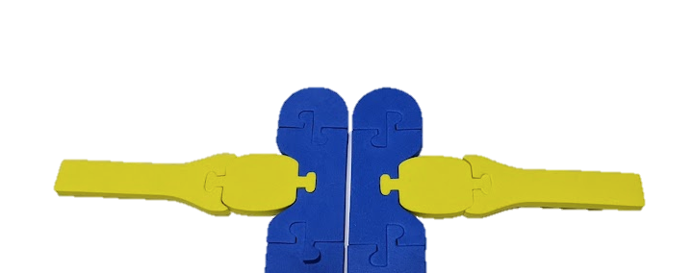
A closer look at the spindle apparatus
Notes:
A closer look at the spindle apparatus
Direct your attention to the center of your sister chromatids where the spindle apparatus attaches to the centromere. Using the following resource, Role of a Kinetochore during Cell Division (https://www.thoughtco.com/kinetochore-definition-373543) and the model you created, speculate the purpose of each part of the spindle apparatus.
A closer look at the centromere
Now direct your attention to the center of your sister chromatids where the centromeres come together. Refer to the NIH’s Centromere glossary page (https://www.genome.gov/genetics-glossary/Centromere). Consider the purpose of the centromere and its purpose in the cell cycle.

Slide 9
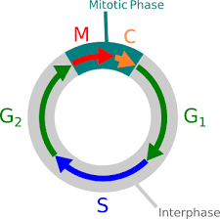
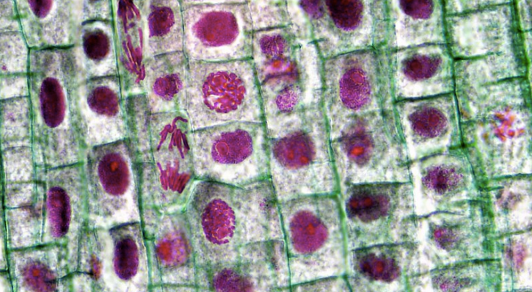
Onion Root Tip Lab
Berkshire Community College Bioscience Image Library (2014)
Wikipedia Creative Commons
Notes:
or simplicity's sake, you will only use six chromosomes in this model, but remember that onions have sixteen. Start this activity by building six chromosomes and their sister chromatid of any sizes using both the blue and the red foam pieces. Using your images from the lab and the sister chromosomes that you built, demonstrate what is occurring in the snapshots from the onion cell. Properly identify and chronologically order each phase shown below. Then make a model that determines how the chromosomes can condense, organize, and finally end up into two identical daughter cells

Slide 10
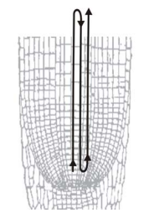
Use an inverted S pattern to count cells
Wikipedia Creative Commons
Notes:
Ruth says For simplicity's sake, you will only use six chromosomes in this model, but remember that onions have sixteen. Start this activity by building six chromosomes and their sister chromatid of any sizes using both the blue and the red foam pieces. Using the images from the pre-lab and the sister chromosomes that you built, demonstrate what is occurring in the snapshots from the onion cell. Properly identify and chronologically order each phase shown below. Then make a model that determines how the chromosomes can condense, organize, and finally end up into two identical daughter cells

Slide 11
 | Interphase | Prophase/ Prometaphase | Metaphase | Anaphase | Telophase | Total
Number of cells |  |  |  |  |  | 100
Proportion in each phase |  |  |  |  |  | 1
Approximate Timing |  |  |  |  |  | 24 hours
Data table for cell counts for student or professionally prepared slide
Notes:
Ruth says For simplicity's sake, you will only use six chromosomes in this model, but remember that onions have sixteen. Start this activity by building six chromosomes and their sister chromatid of any sizes using both the blue and the red foam pieces. Using the images from the pre-lab and the sister chromosomes that you built, demonstrate what is occurring in the snapshots from the onion cell. Properly identify and chronologically order each phase shown below. Then make a model that determines how the chromosomes can condense, organize, and finally end up into two identical daughter cells

Slide 12
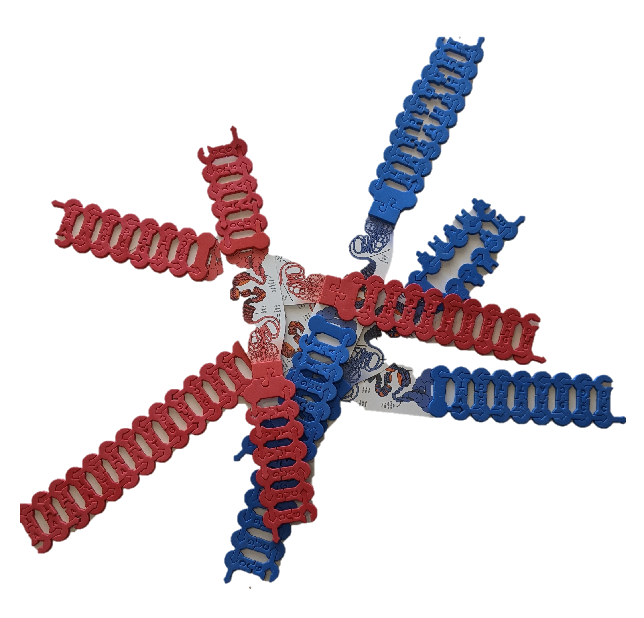
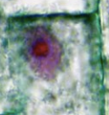
Modeling Allium lab images

Slide 13
A closer look at the Cell Cycle: Modeling Interphase
What are the key highlights in this phase that students need to understand?
What structures to students need to understand so they can understand cell processes in the future?

Slide 14
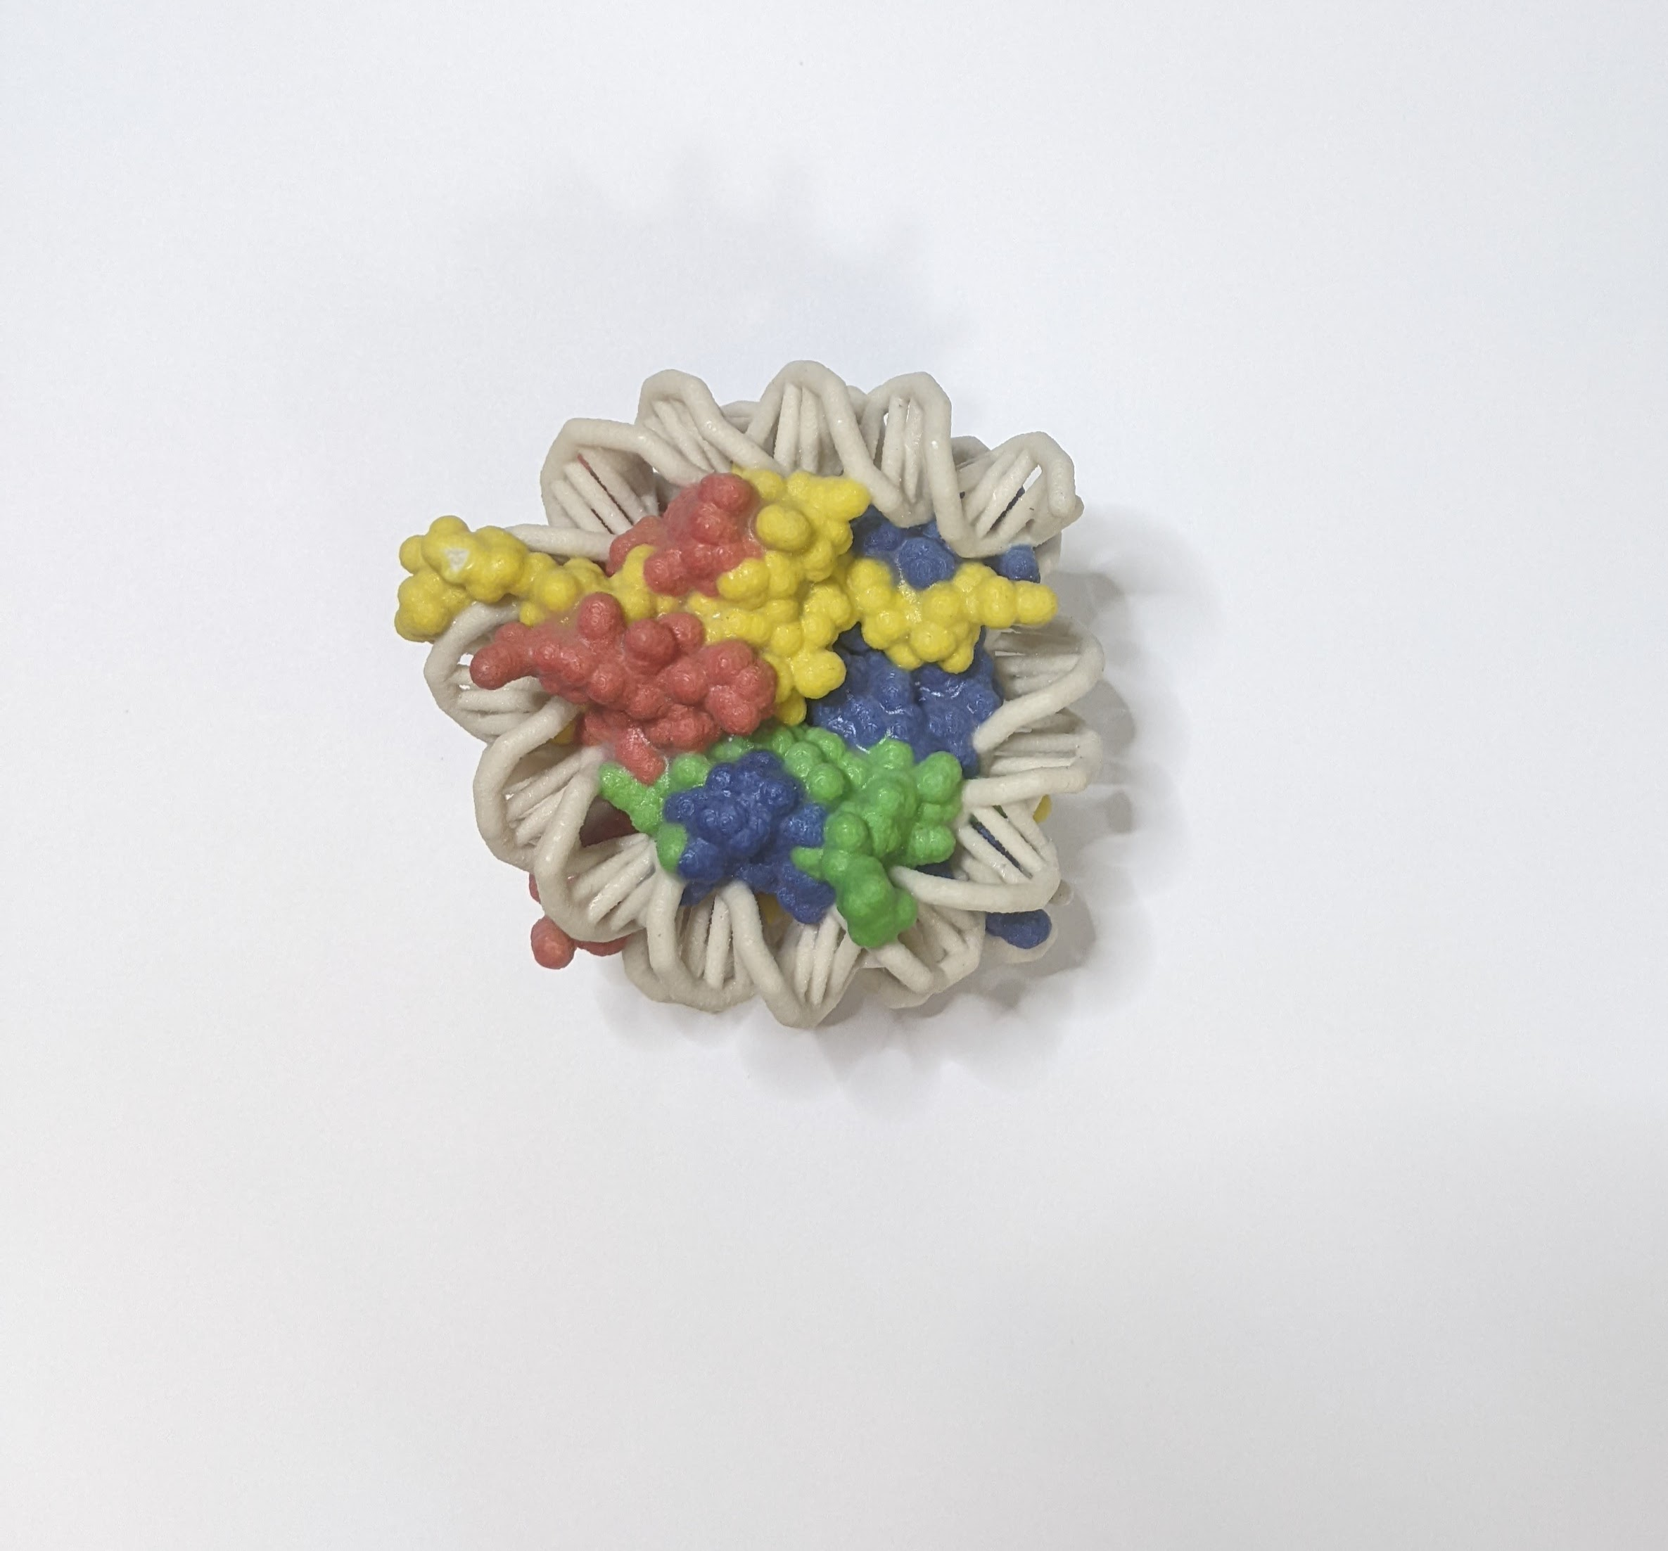
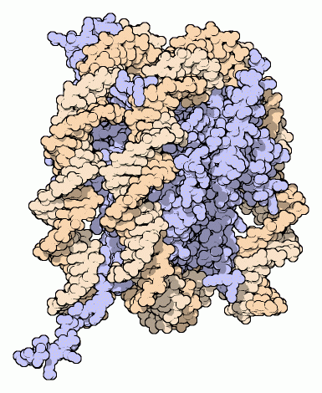
A closer look at the nucleosome
Notes:
The model shows the eight histone proteins as tubes that follow the protein chain. The DNA is modeled as thinner white helix that follow the two strands as they circle around the protein octamer. The tails of the eight protein chains, seen extending outward from the center, are longer in reality. Because they are so long and flexible, they are disordered in the crystal and cannot be seen. The one long chain shown in yellow gives a hint at what they might look like if we cold see the entire nucleosome in the cell This structure only includes a short piece of DNA. In reality, millions of nucleosomes are arrayed along long strands of DNA.

Slide 15
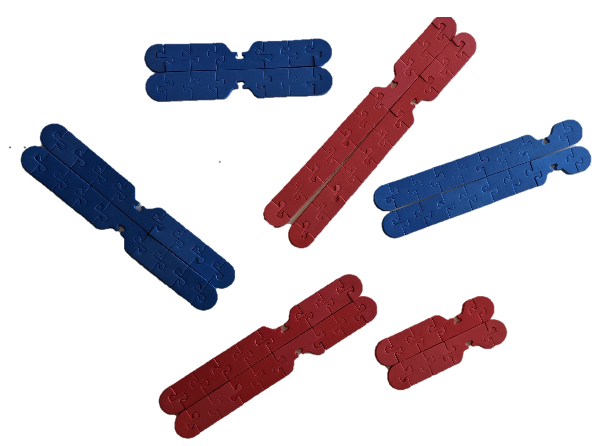

Modeling Allium lab images

Slide 16
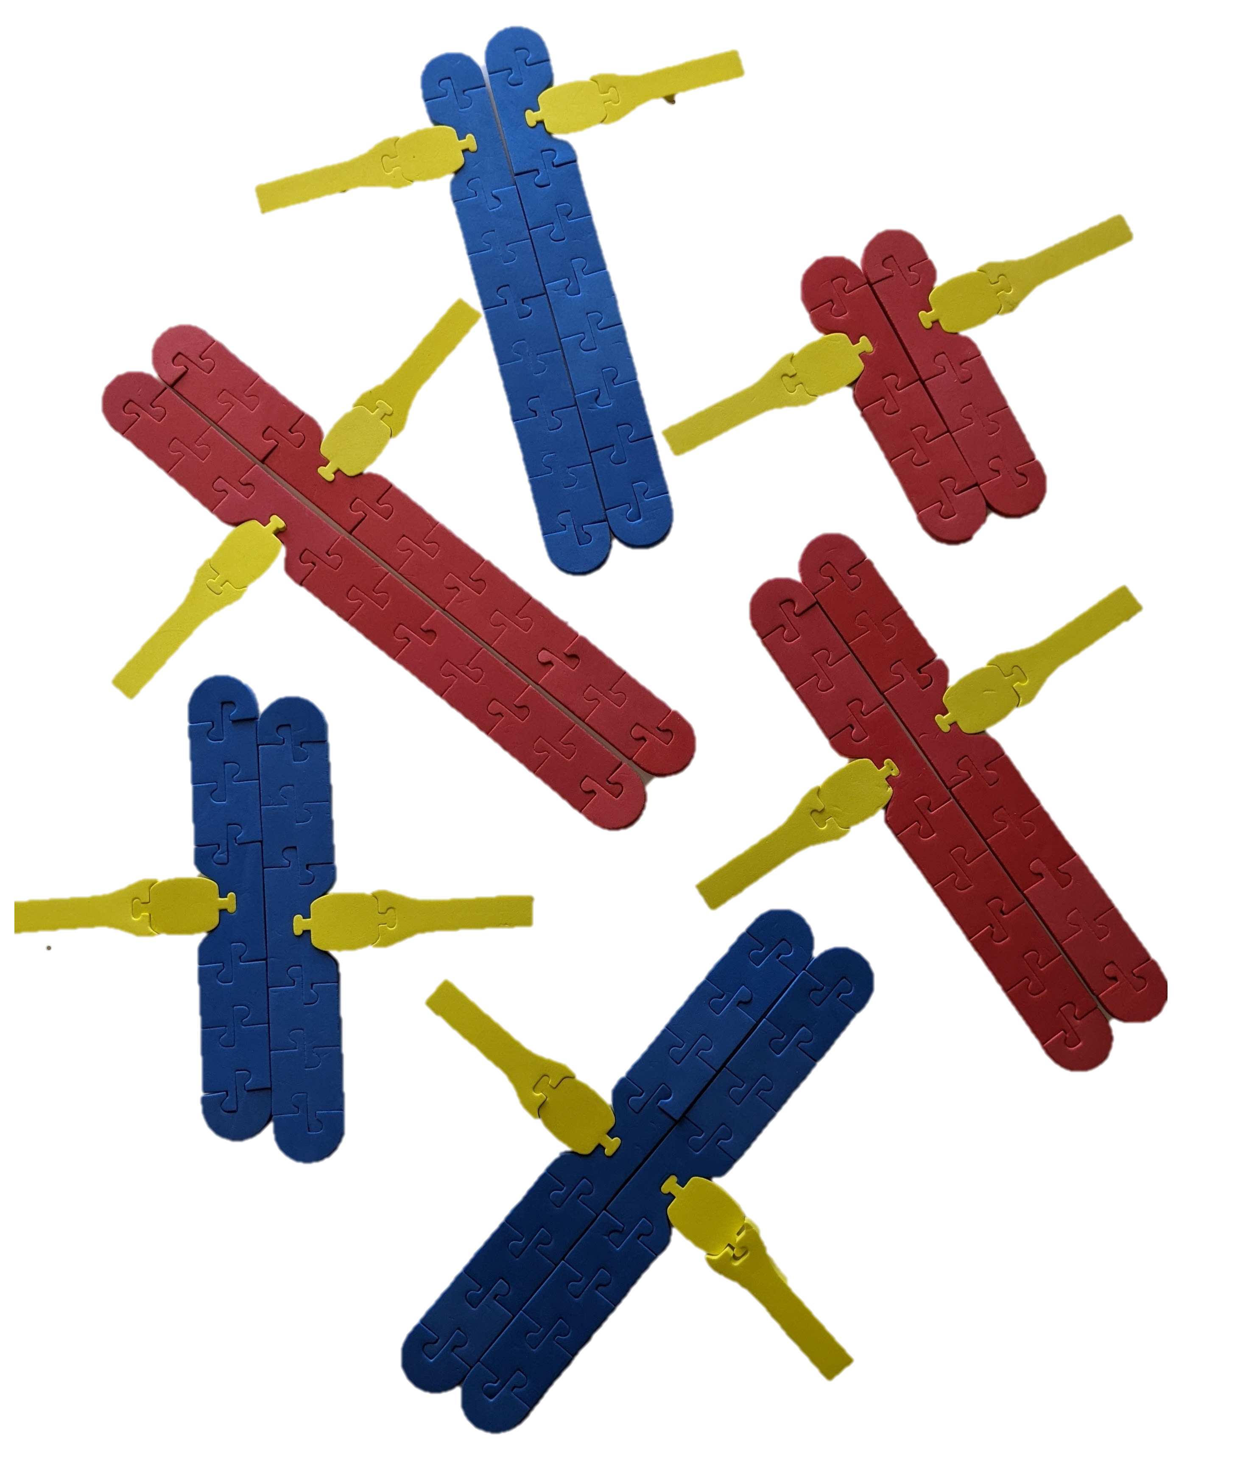
Cell Cycle: Modeling Prometaphase
What are the key highlights in this
phase that students need to understand?
What structures to students need to understand so they can
understand cell processes
in the future?

Slide 17
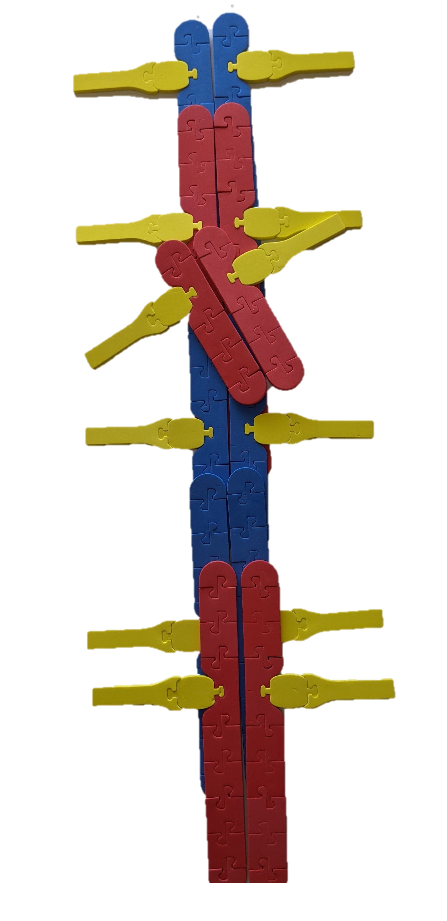
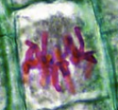
Modeling Allium lab images

Slide 18
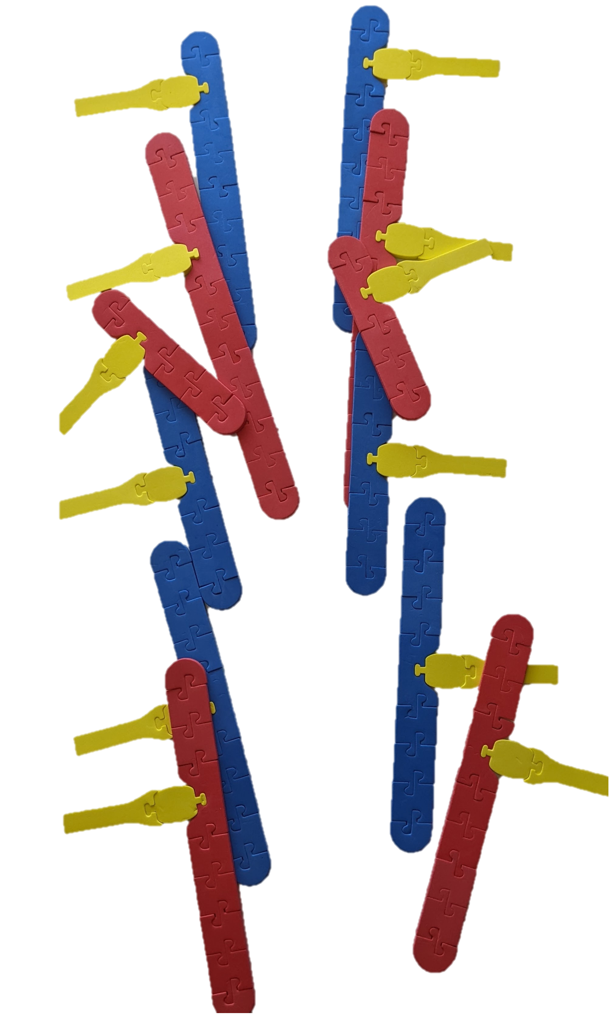

Modeling Allium lab images

Slide 19
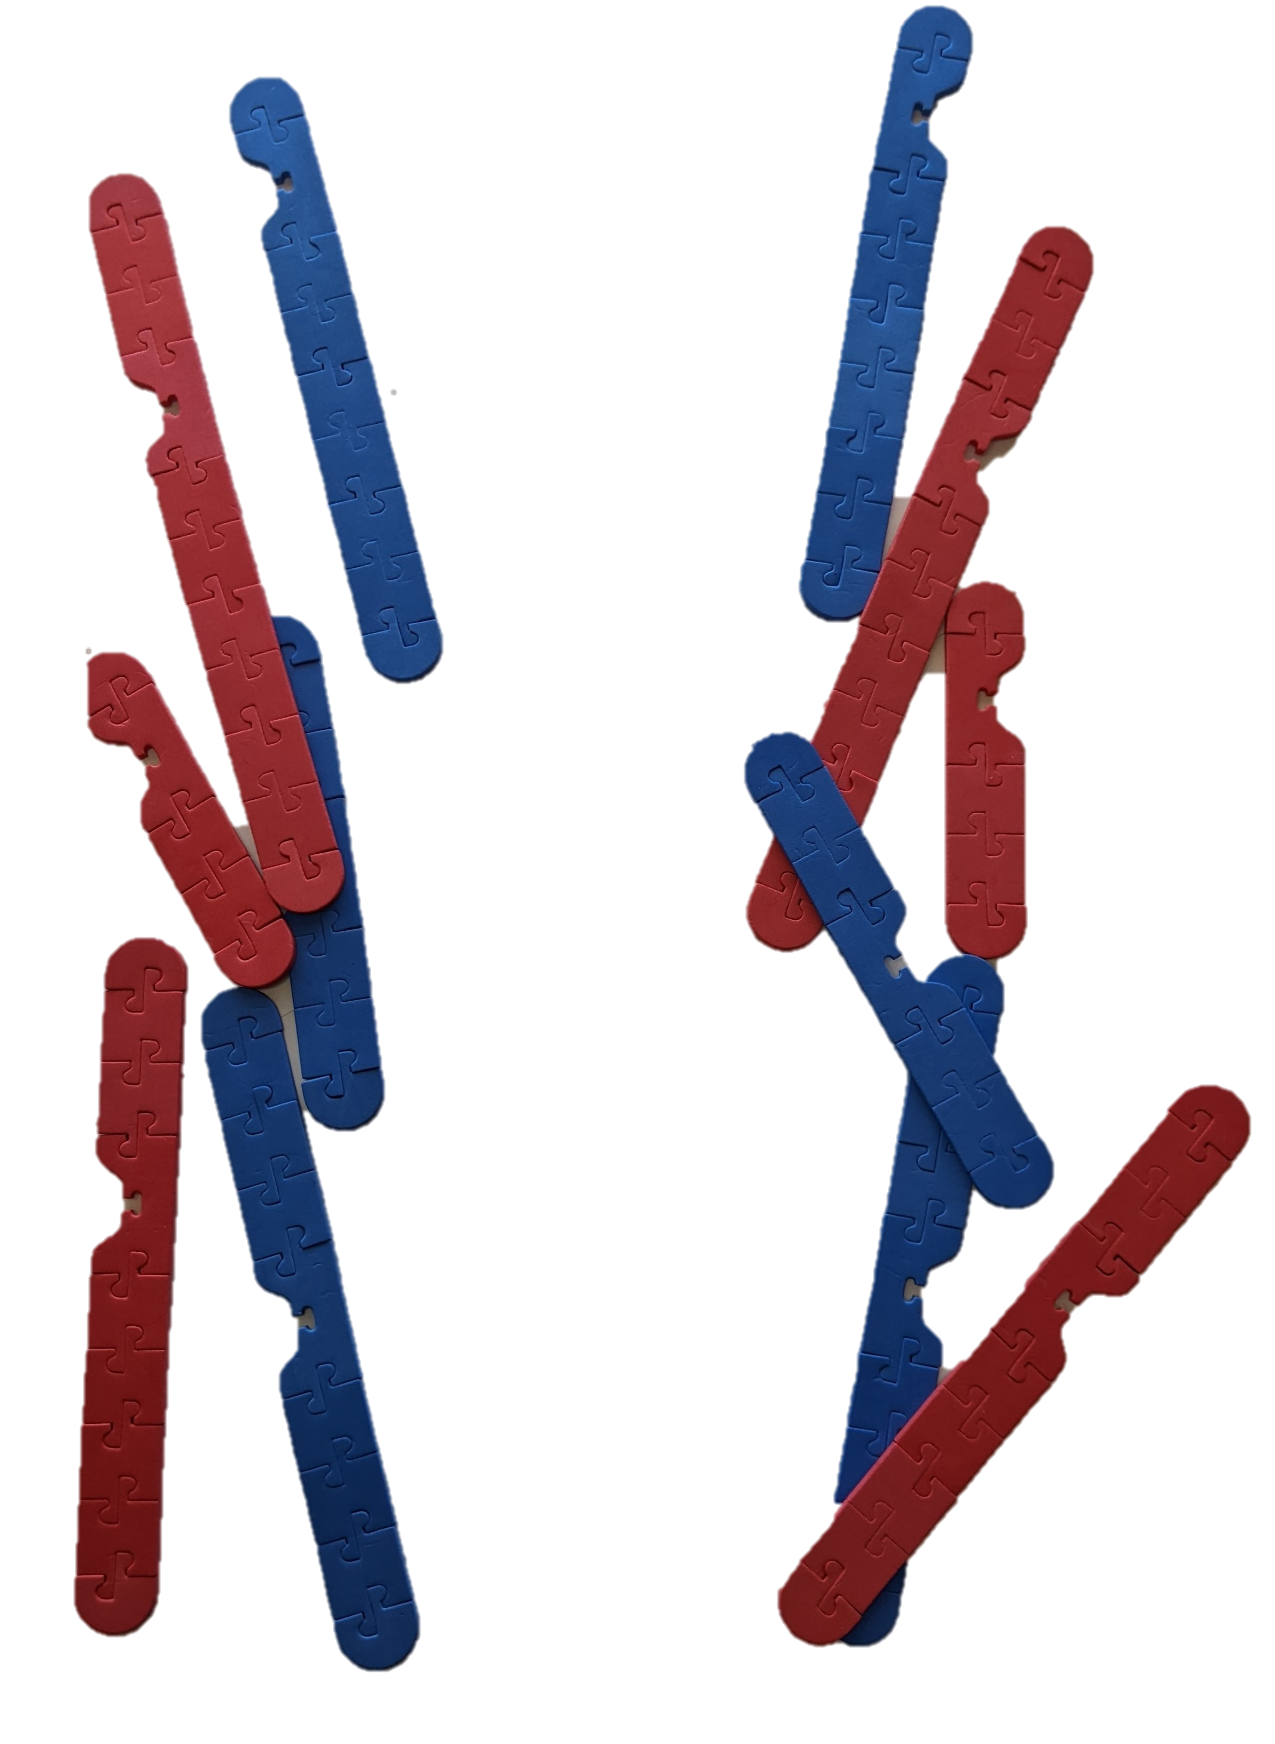
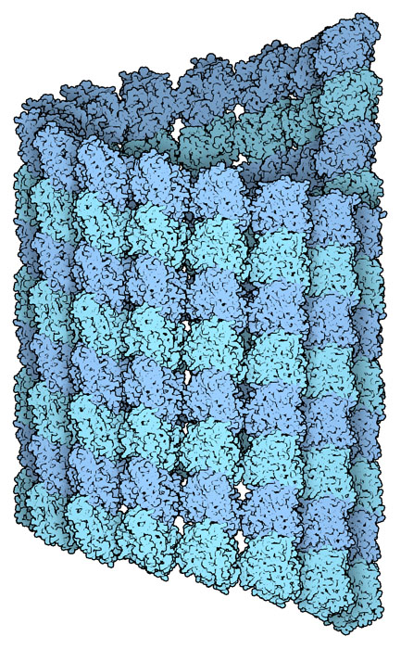
Cell Cycle: Modeling Early Telephase
Notes:
PDB-101: Molecule of the Month: Microtubules (rcsb.org)
“Microtubules are composed of a cylindrical shell of the protein tubulin. This tubulin comes in two similar forms, called alpha and beta tubulin, which form a tight dimeric complex. They then stack side-by-side to form the cylindrical tubule. Microtubules are in a constant state of growth and shrinkage, in a process called dynamic instability. This is controlled by a molecule of GTP that is bound to the beta subunit of tubulin. Free tubulin dimers have GTP bound, and this forms a stable complex when it adds to a growing filament. But later, the GTP is cleaved to GDP, and the GDP-bound tubulin is less stable in the filament. If the GDP-bound tubulin is at the end of the filament, it can start a process of disassembly. If, however, a new GTP-bound tubulin binds to the shrinking end, it stops the process and the microtubule starts growing again.”

Slide 20
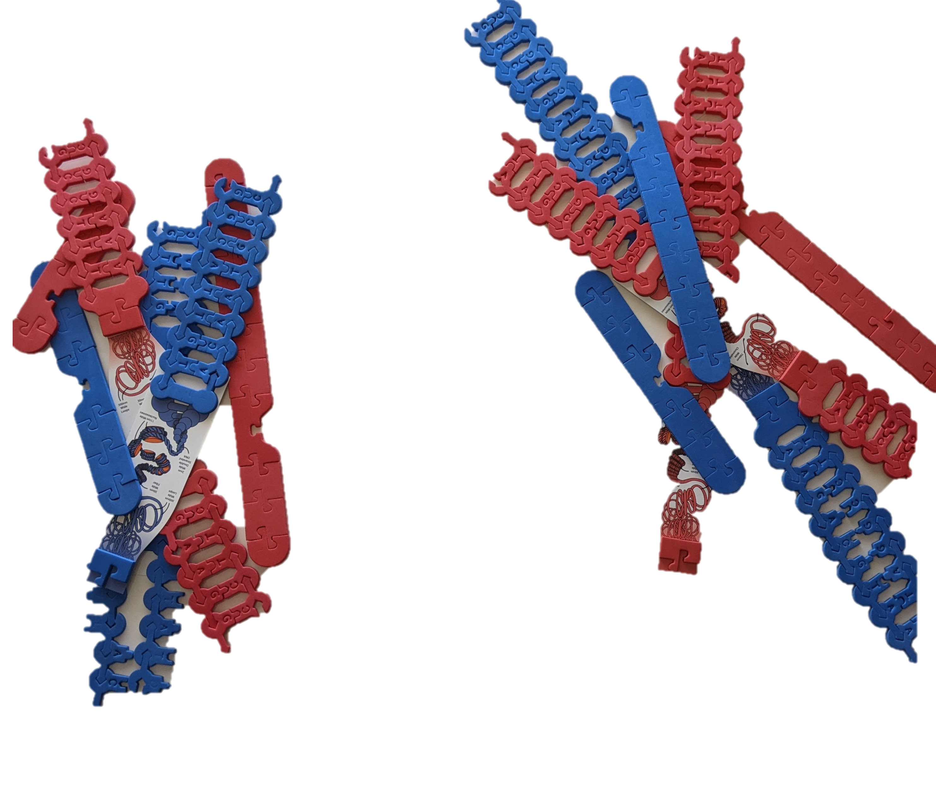
Cell Cycle: Modeling Late Telephase
What extensions or phenomenon
might help student be interested
in this cell process?

Slide 21
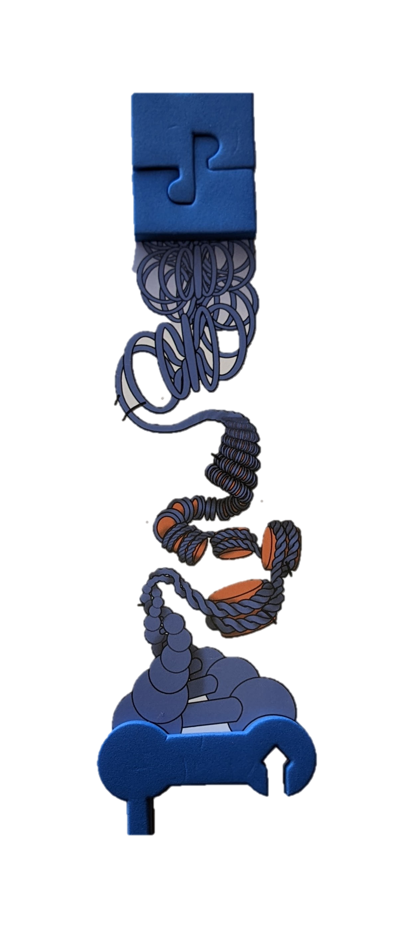
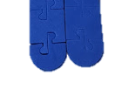
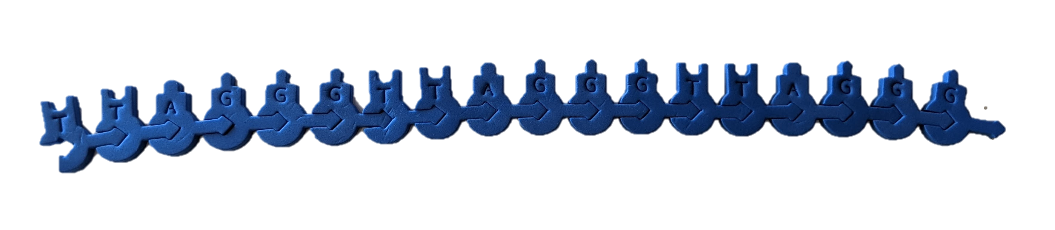
A closer look at the telomere
Notes:
Now focus on the ends of the sister chromatids that you created. These are the telomeres which are receptive, non-coded sequences of DNA that keeps the coded DNA from becoming damaged. In humans, the telomere sequence is TTAGGG. This sequence is usually repeated about 3,000 times and can reach up to 15,000 base pairs in length.
To model the telomere, remove the end cap, unspool the end of the sister chromatids by adding two Scaling Graphics (one to each chromatid) shown to the right, and add in three repeating units of TTAGGG and their complementary base pairs to the bottom of the chromosome to represent the molecular form of the chromosome. Remember that this sequence is found at all ends of the chromosome. Using the resource Are Telomeres the Key to Aging and Cancer found at Learn.Genetics from the Genetic Science Learning Center (https://learn.genetics.utah.edu/content/basics/telomeres) as a reference, create a model that demonstrates what happens to the telomere through subsequent cell divisions. Use your model and the information you found to answer questions 8 - 11 on your student answer sheet.

Slide 22
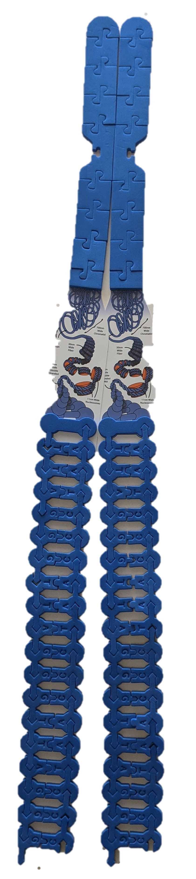
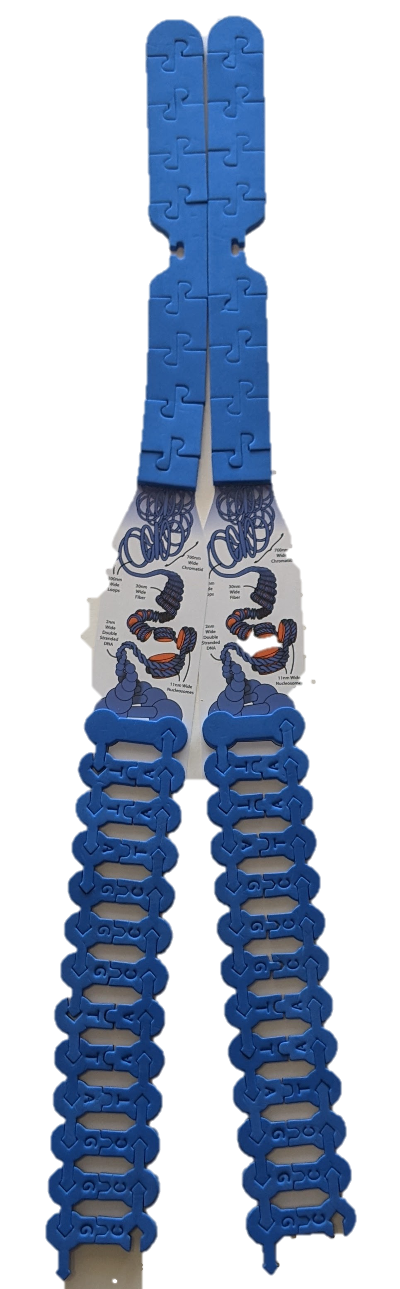
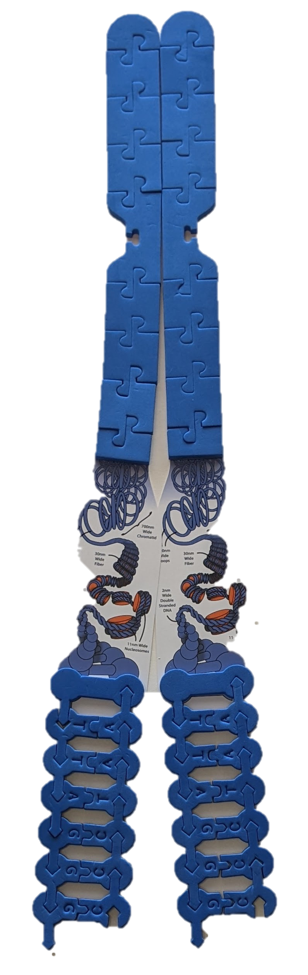
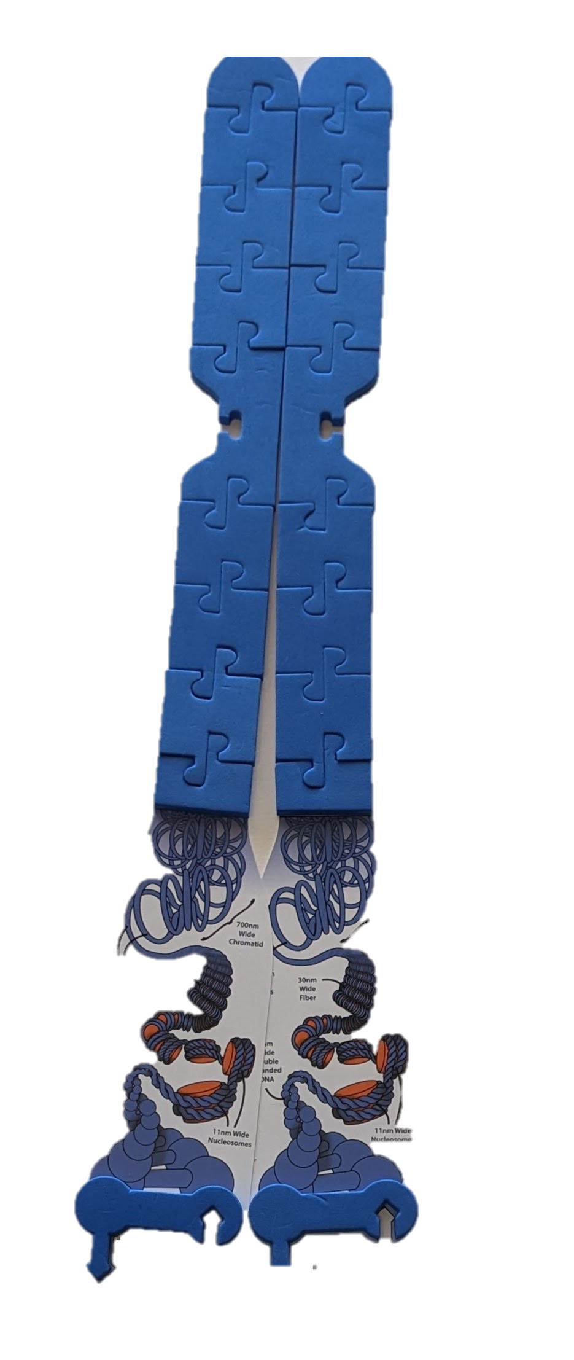
A closer look at the telomere
Notes:
Teacher Notes: Now focus on the ends of the sister chromatids that you created. These are the telomeres which are receptive, non-coded sequences of DNA that keeps the coded DNA from becoming damaged. In humans, the telomere sequence is TTAGGG. This sequence is usually repeated about 3,000 times and can reach up to 15,000 base pairs in length.
To model the telomere, remove the end cap, unspool the end of the sister chromatids by adding two Scaling Graphics (one to each chromatid) shown to the right, and add in three repeating units of TTAGGG and their complementary base pairs to the bottom of the chromosome to represent the molecular form of the chromosome. Remember that this sequence is found at all ends of the chromosome. Using the resource Are Telomeres the Key to Aging and Cancer found at Learn.Genetics from the Genetic Science Learning Center (https://learn.genetics.utah.edu/content/basics/telomeres) as a reference, create a model that demonstrates what happens to the telomere through subsequent cell divisions.

Slide 23
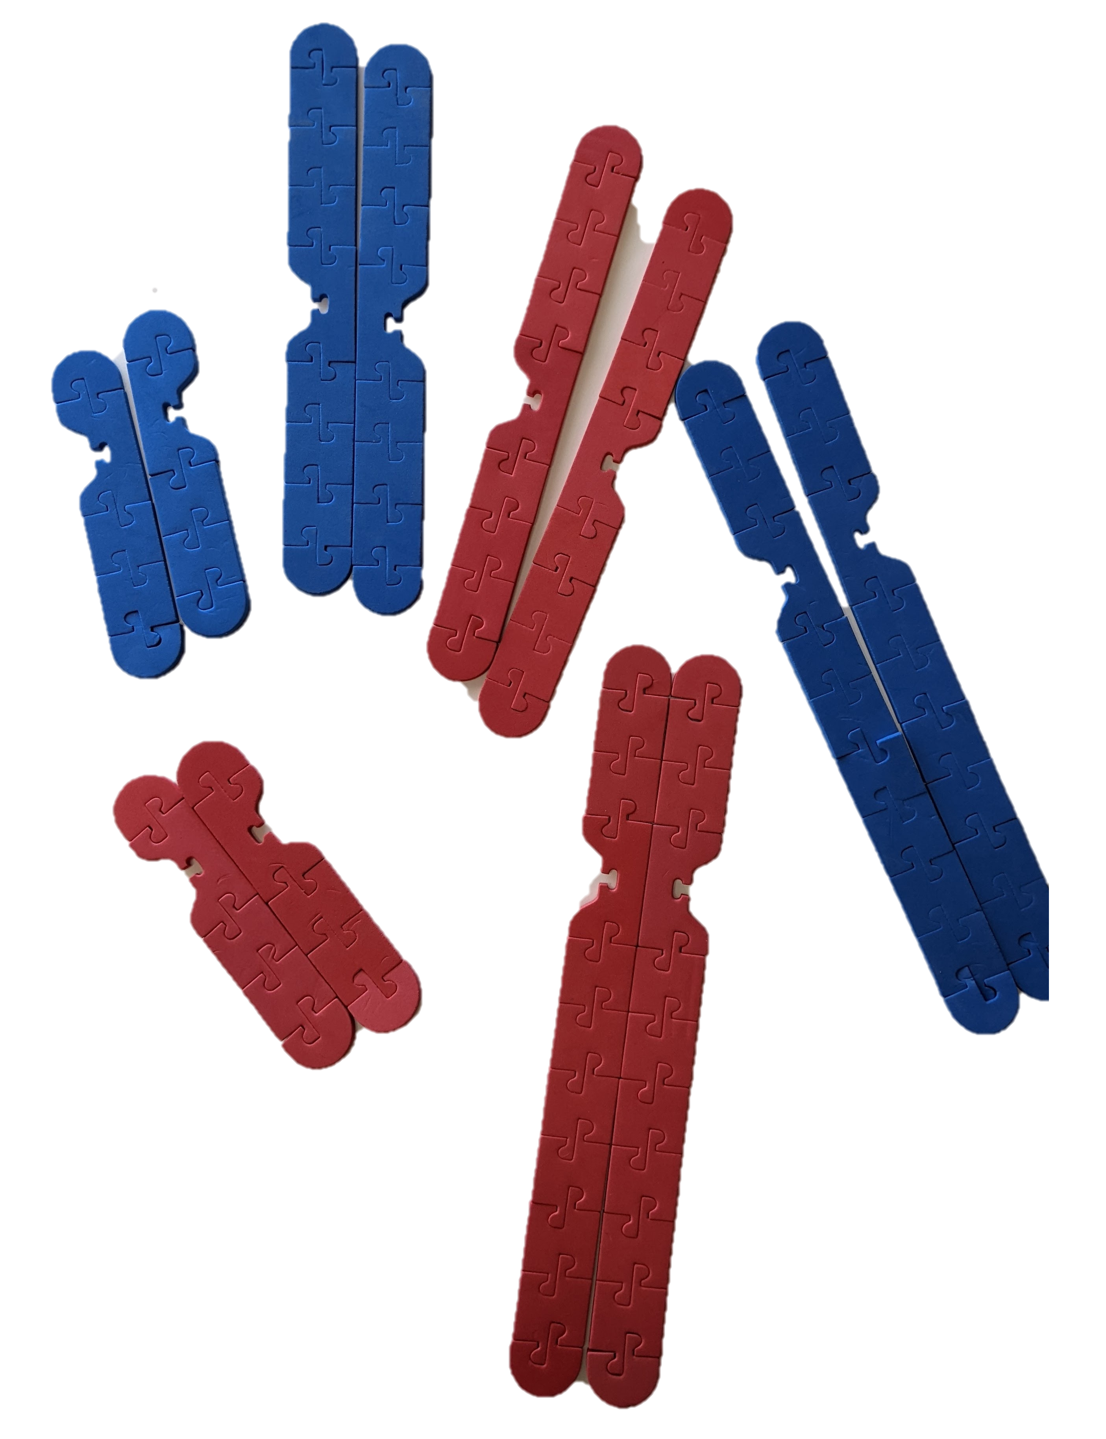
Cell Cycle: Modeling Meiosis

Slide 24
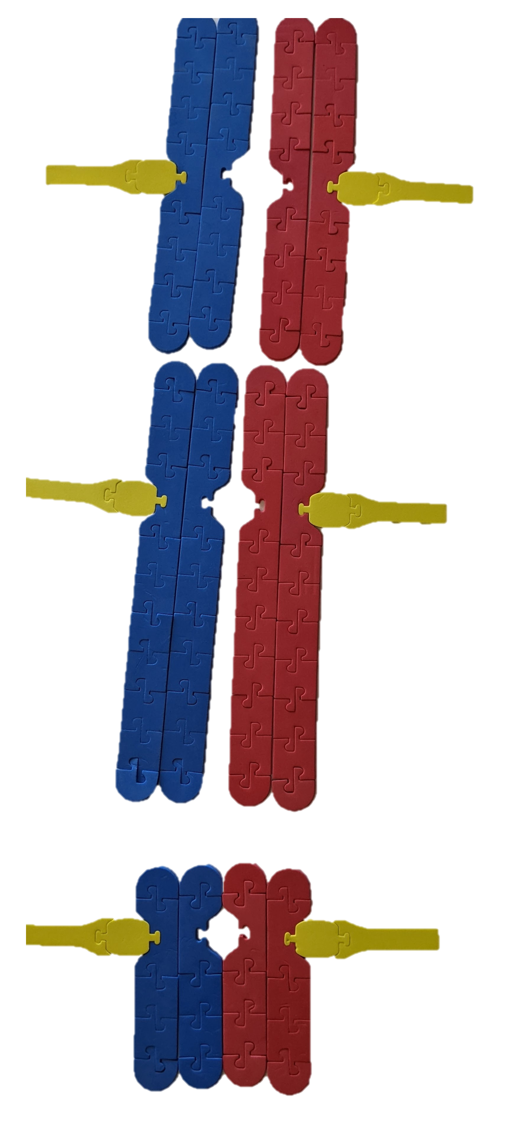
Cell Cycle: Modeling Meiosis

Slide 25
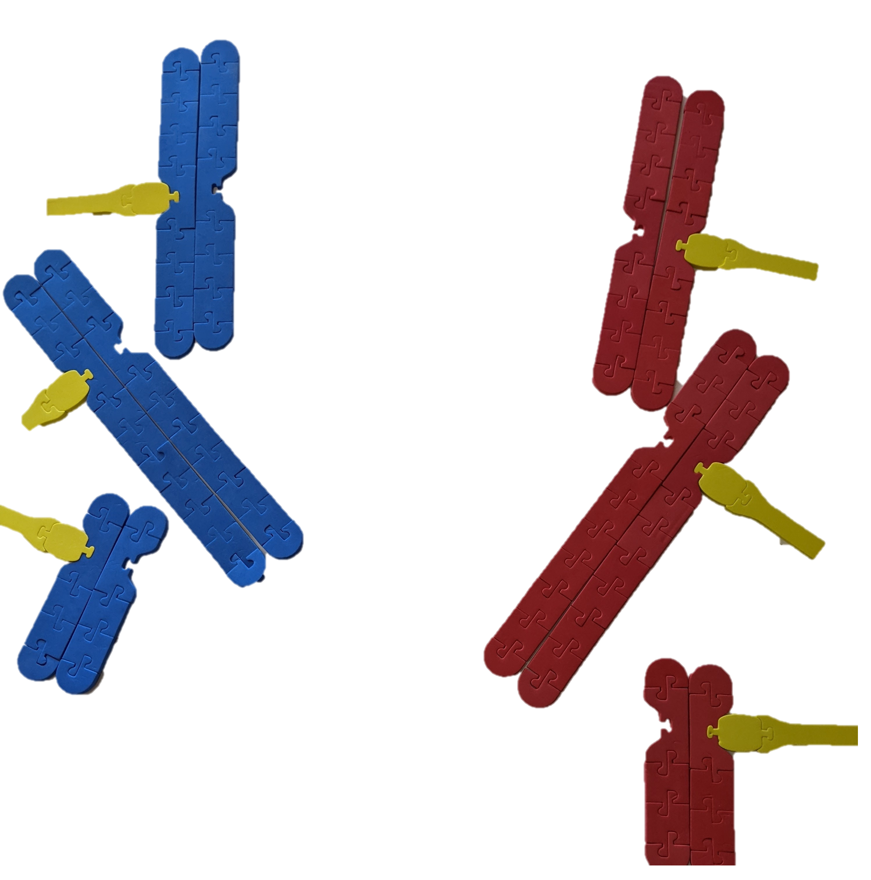
Cell Cycle: Modeling Meiosis

Slide 26
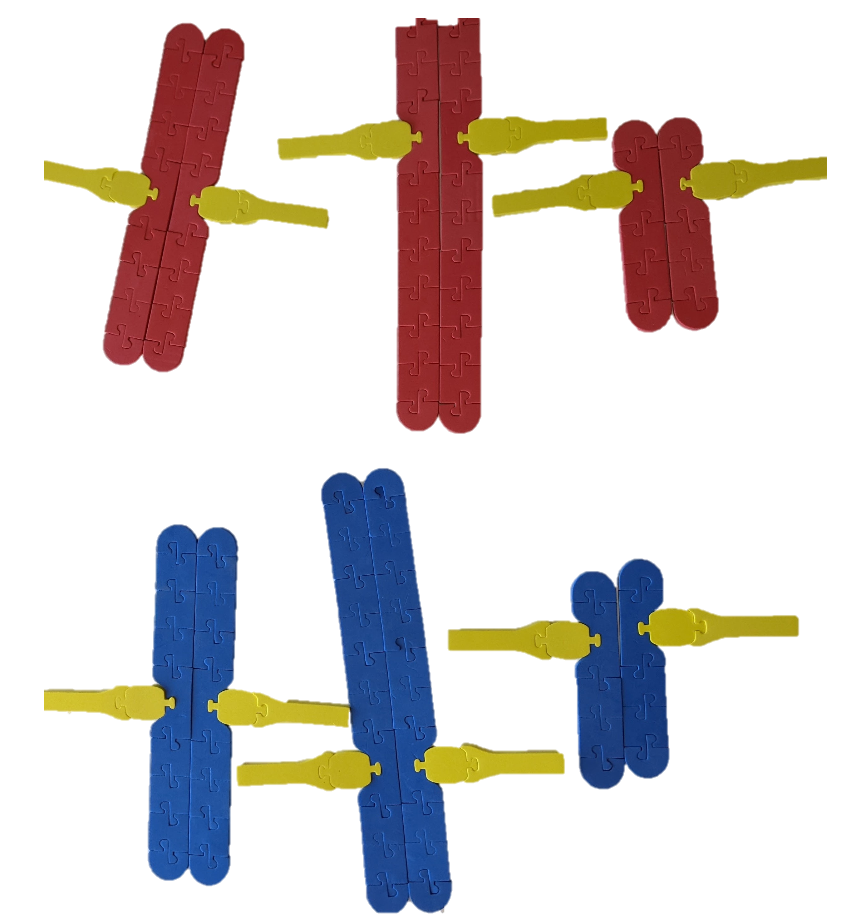
Cell Cycle: Modeling Meiosis

Slide 27
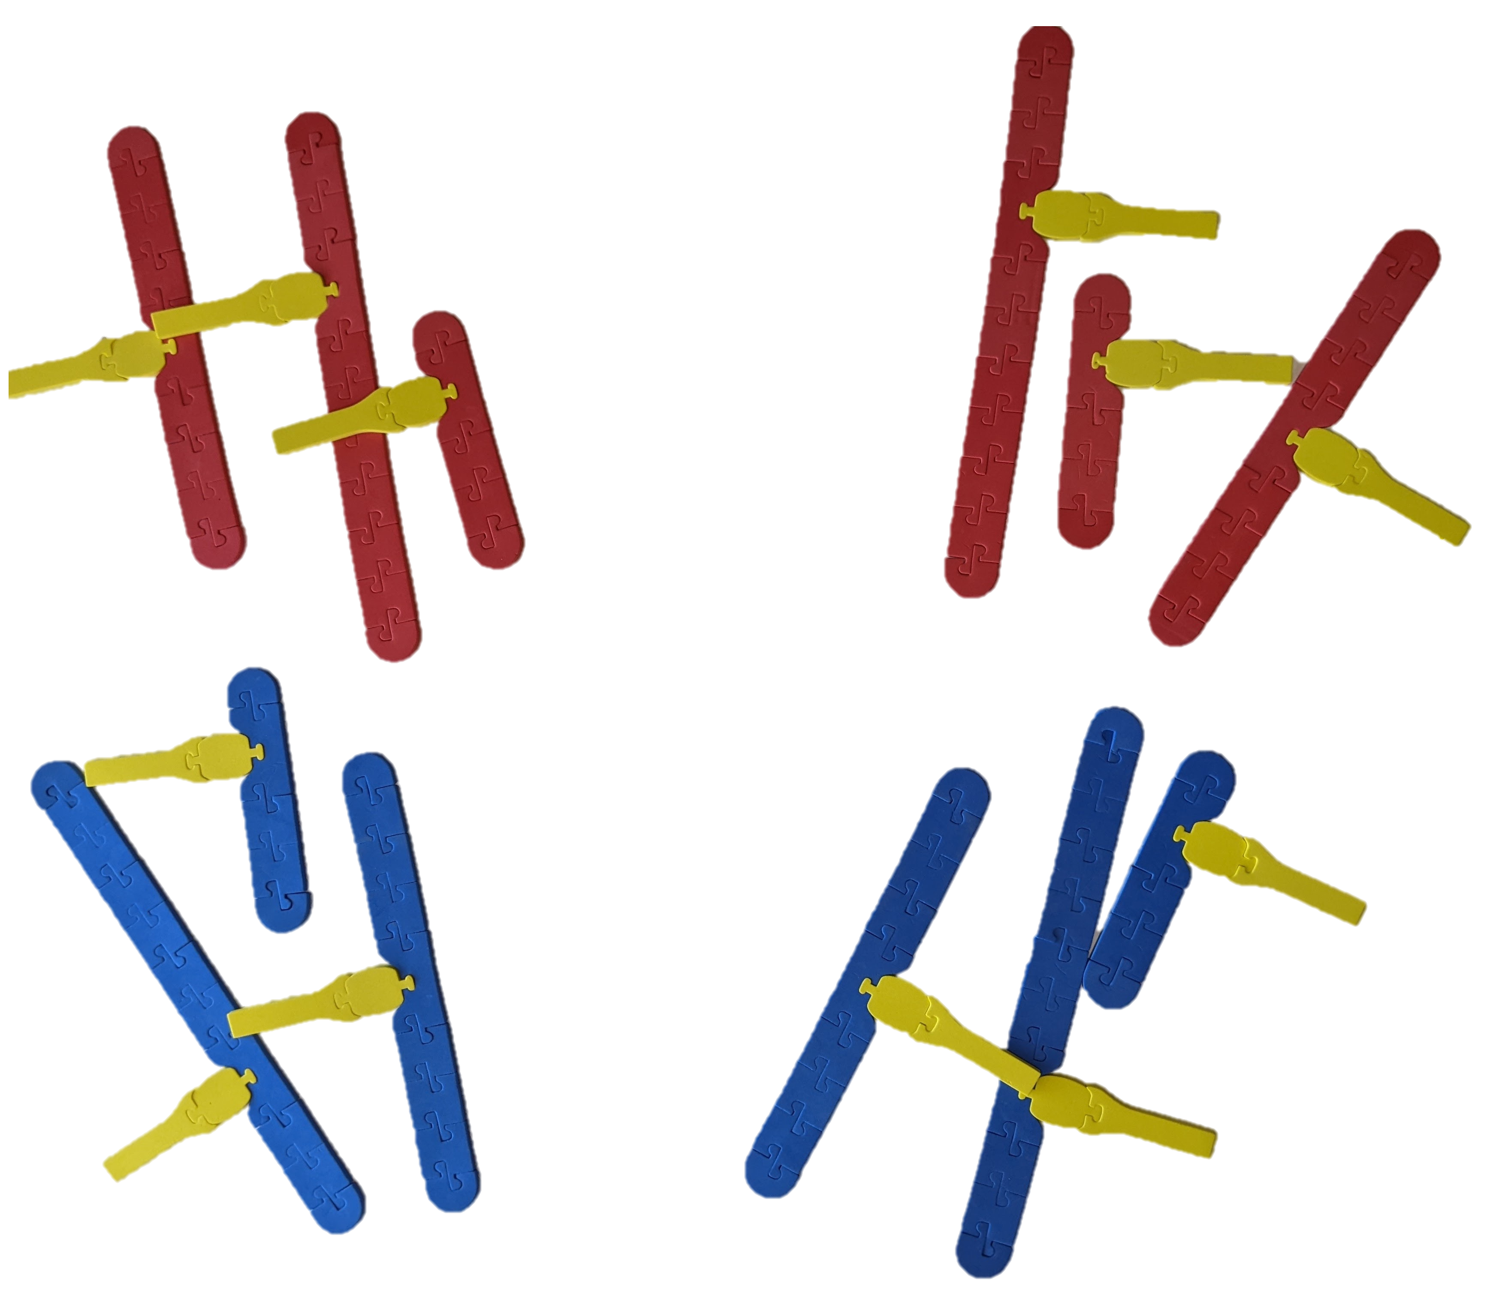
Cell Cycle: Modeling Meiosis

Slide 28
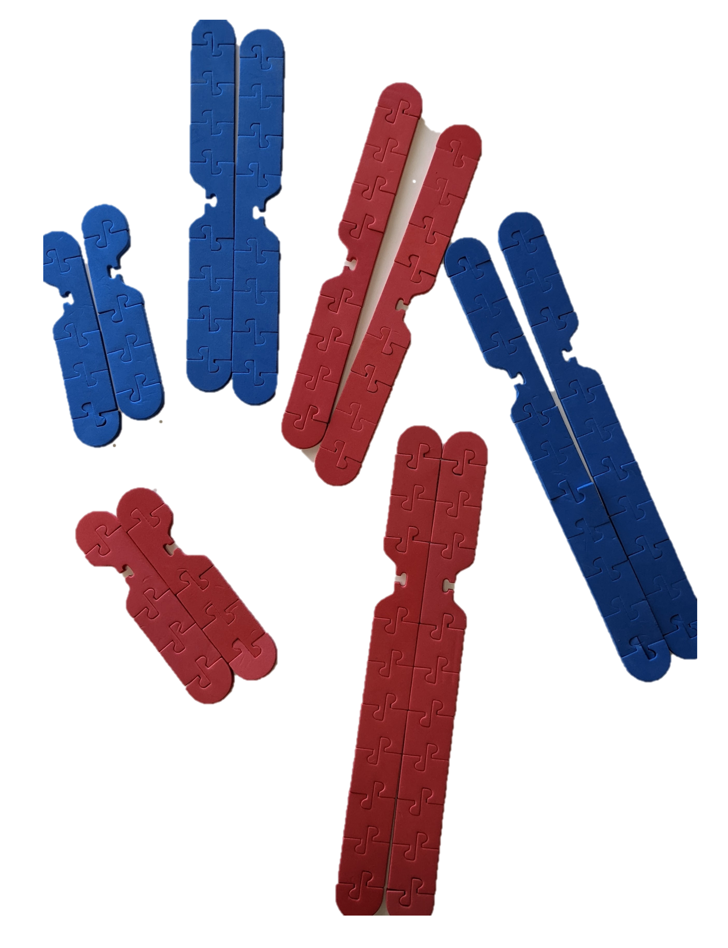
Cell Cycle: Modeling Crossing Over
How would you model crossing-over of homologous chromosomes?

Slide 29
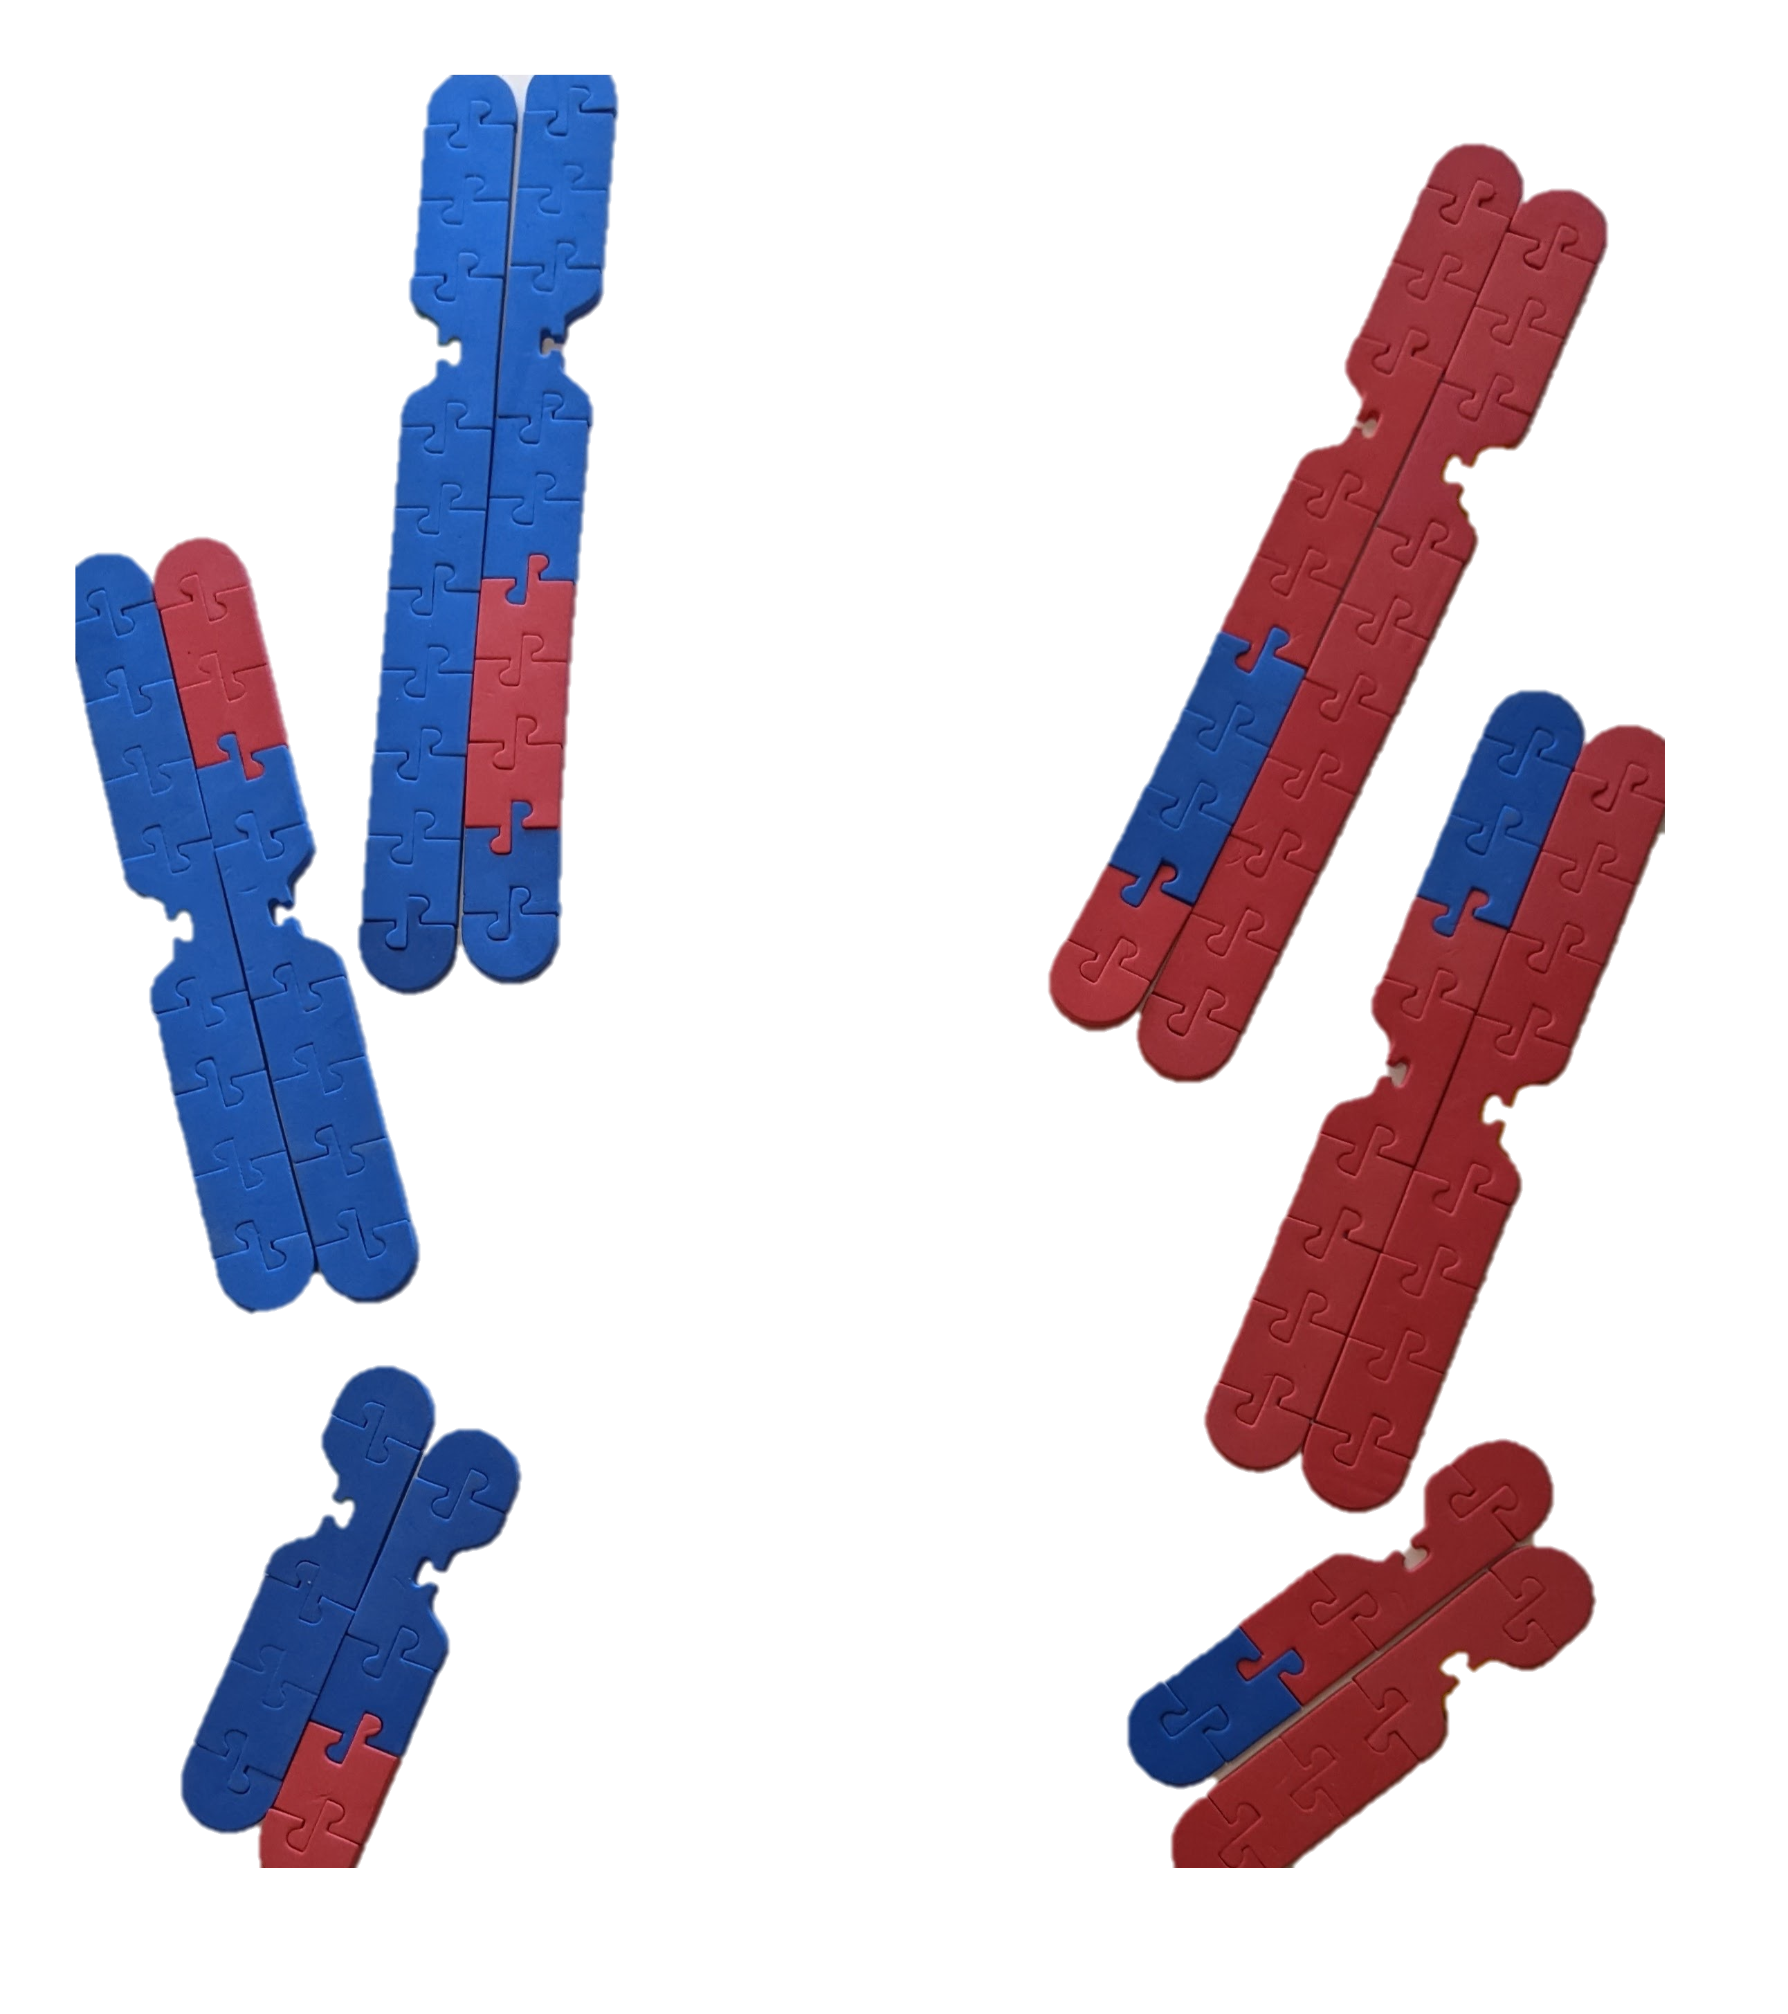
Cell Cycle: Modeling Crossing Over

Slide 30
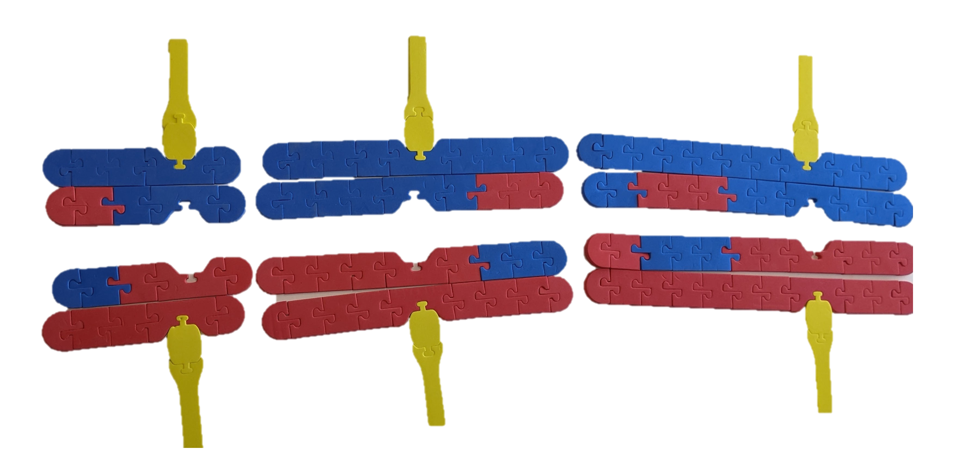
Cell Cycle: Modeling Crossing Over
How would you model anaphase and telophase from this point?

Slide 31
 | Mitosis | Meiosis
Location in body | body cells | reproductive cells
Number of chromosomal divisions | one | two
Resulting daughter cells | identical to parent cell | different from parent cell
Comparison to parent cell (number of chromosomes) | same amount | half the amount
Cell components needed | spindle fibers and kinetochore, centromere, chromosomes parts | spindle fibers and kinetochore, centromere, chromosomes parts
Amount of genetic diversity | identical to parent cell | more genetic diversity to parent cell
Presence of tetrad formation | None | Present

Slide 32
Workshop NGSS Connections
(and/or other applicable standards)
SEPs | CCCs | DCIs | TEKS
Asking Questions and Defining Problems | Systems and System Models | HS-LS1-4 | Student Expectation-B2.E
Developing and Using Models | Cause and Effect | HS-LS3-2 | Student Expectation B.5A
 | Scale, Proportion, and Quantity |  | Student Expectation B.6G
Notes:
Ruth says: Here are the NGSS and TEKS Connections for this workshop.

Slide 33

We value your opinion!
Let us know what you think.
Scan the QR Code and complete this short survey.

Slide 34
Notes:
The above image is a detailed of a cross section of a cell by Dr. David Goodsell. David Goodsell uses watercolor to aid in our understanding of the molecular world through cellular landscapes. This view of the cell is in cross section and is magnified 1,000,000X. Many compare Goodsell’s artistic expression with the post-impressionist style of Henri Rousseau. Goodsell draws molecules with flat colors and emphasizes their relative size with outlines. Similar colors are used to identify cellular structures. DNA and nuclear proteins are drawn in yellow and orange. Ribosomes are shown in magenta, while cytoplasmic proteins are shown in blue. Membranes are colored in green. Overall size and shape of macromolecules are based on atomic coordinates. The relative amounts of molecules is determined using biochemical data, while the locations of the molecules is determined using electron micrographs. You can find more information about Goodsell’s cellular landscapes by visiting the Protein Data Bank website at RCSB PDB: Homepage.
Additional Resource: David Goodsell: The master of mol art (asbmb.org)

