Slide 1
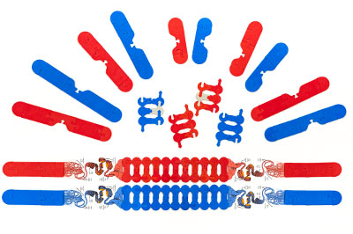
Chromosomes in Action: Revisualizing Meiosis
Notes:
For this presentation, we will use the Chromosomes Connections Kit.

Slide 2

Ruth Hutson, MSSE
Notes:
I’m Ruth Hutson, a 3D Molecular Designs Science Educator. I’ve been teaching for 25 years . Before coming to 3DMD, I was the science department at a small rural high school in Northeast Kansas and taught Concurrent College Biology, biology, chemistry, physics, and Earth Science. In addition to being the HS Science Department, I was also play director, Scholars Bowl coach, and junior class sponsor. I discovered the 3DMD products in 2015 and loved using them with all my classes. Today I'd like to share with you how I use these kits with my high school biology class and Concurrent College Biology course.

Slide 3
Who’s Here
Middle School, High School, Post-secondary
Rural, Suburban, Urban
Biology, AP Biology, Anatomy and Physiology, Other
Where are you in your course?

Slide 4
Workshop Learning Goals
Demonstrate what cell processes increase gamete diversity when compared to the parent cell.
Explain which mechanisms contribute to genetic variation
Have fun!
Notes:
Ruth says We are going to be modeling with the Chromosome Connections Kit. I use this kit throughout the year. At the end of this session, you should be able to… read goals from slide).
Let’s get started with some modeling [Advance slide]

Slide 5
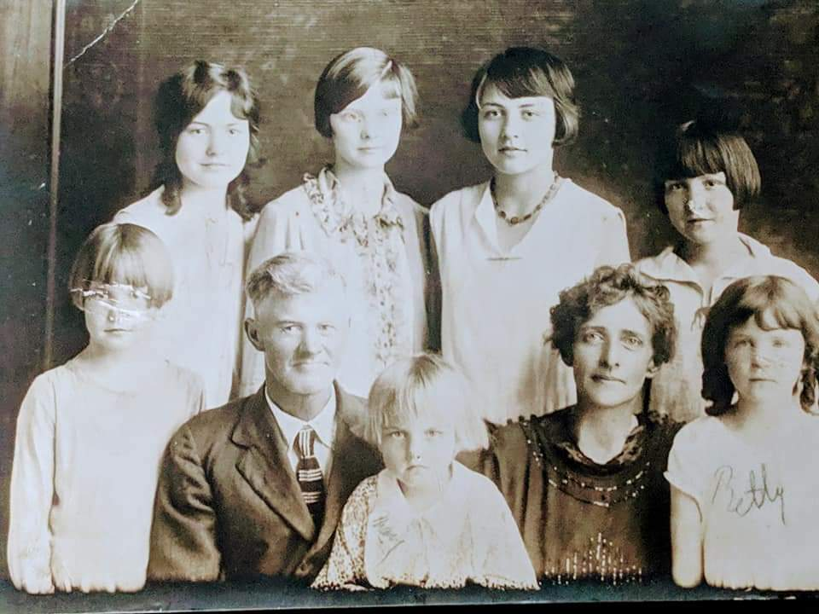
Why do I look different than my siblings?
Notes:
Storytime [Advance slide]
Indian muntjac (Muntiacus muntjak) 6/7: 2n = 6 for females and 7 for males.

Slide 6
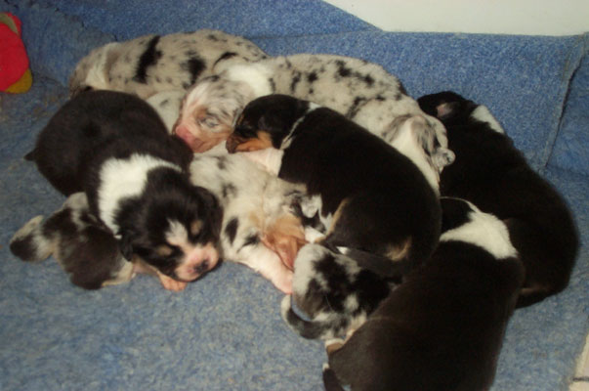
Why do siblings in a litter look differently?
This Photo by Unknown Author is licensed under CC BY-SA
Notes:
Storytime [Advance slide]
Indian muntjac (Muntiacus muntjak) 6/7: 2n = 6 for females and 7 for males.

Slide 7
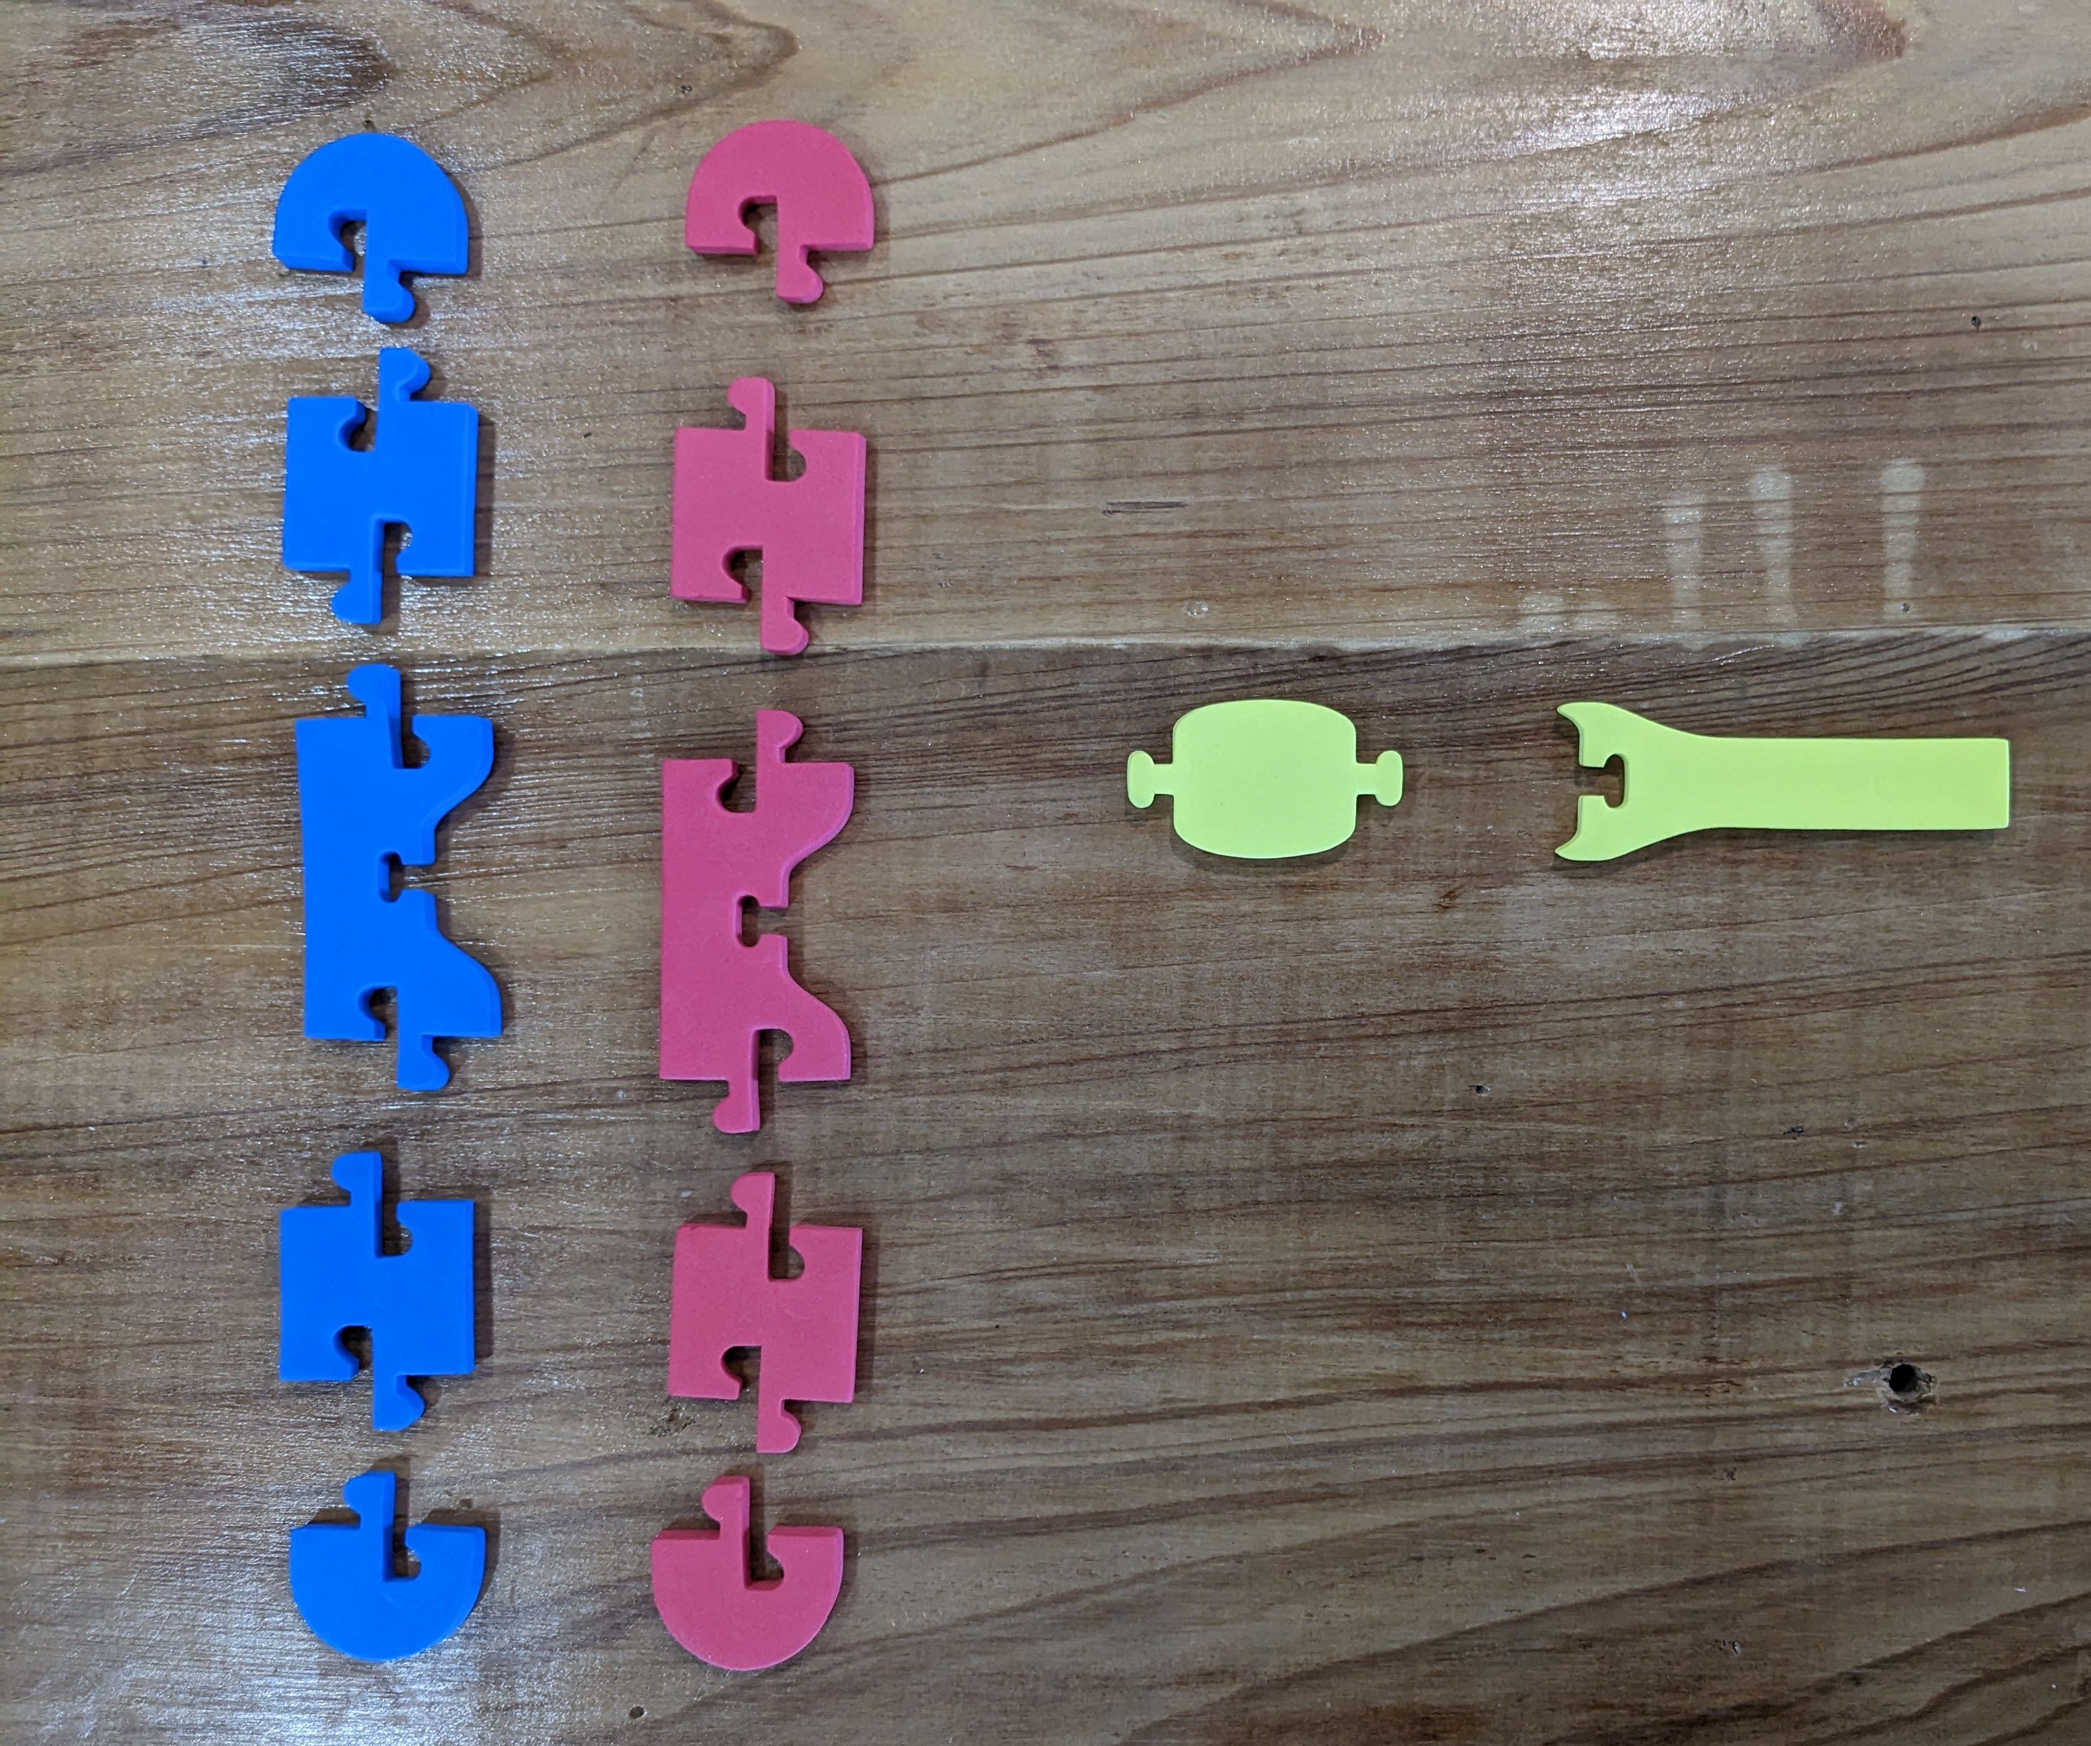
Suggested Chromosome Assembly
Chromosome Size | Part | Egg donating parent chromosome (Red Foam) | Sperm donating parent chromosome (Blue Foam)
Short chromosome (Acrocentric) | p arm linkers | 0 | 0
 | q arm linkers | 1 | 1
Medium Chromosome (metacentric) | p arm linkers | 1 | 1
 | q arm linkers | 1 | 1
Long Chromosome (submetacentric) | p arm linkers | 1 | 1
 | q arm linkers | 2 | 2
Notes:
Start with a centromere piece
Add 3-4 chromosome connectors on each side of the centromere piece.
Add a cap piece to each end of the chromatid.

Slide 8
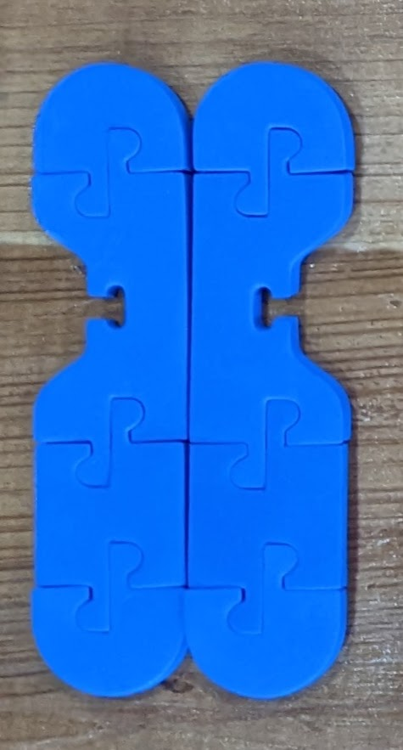
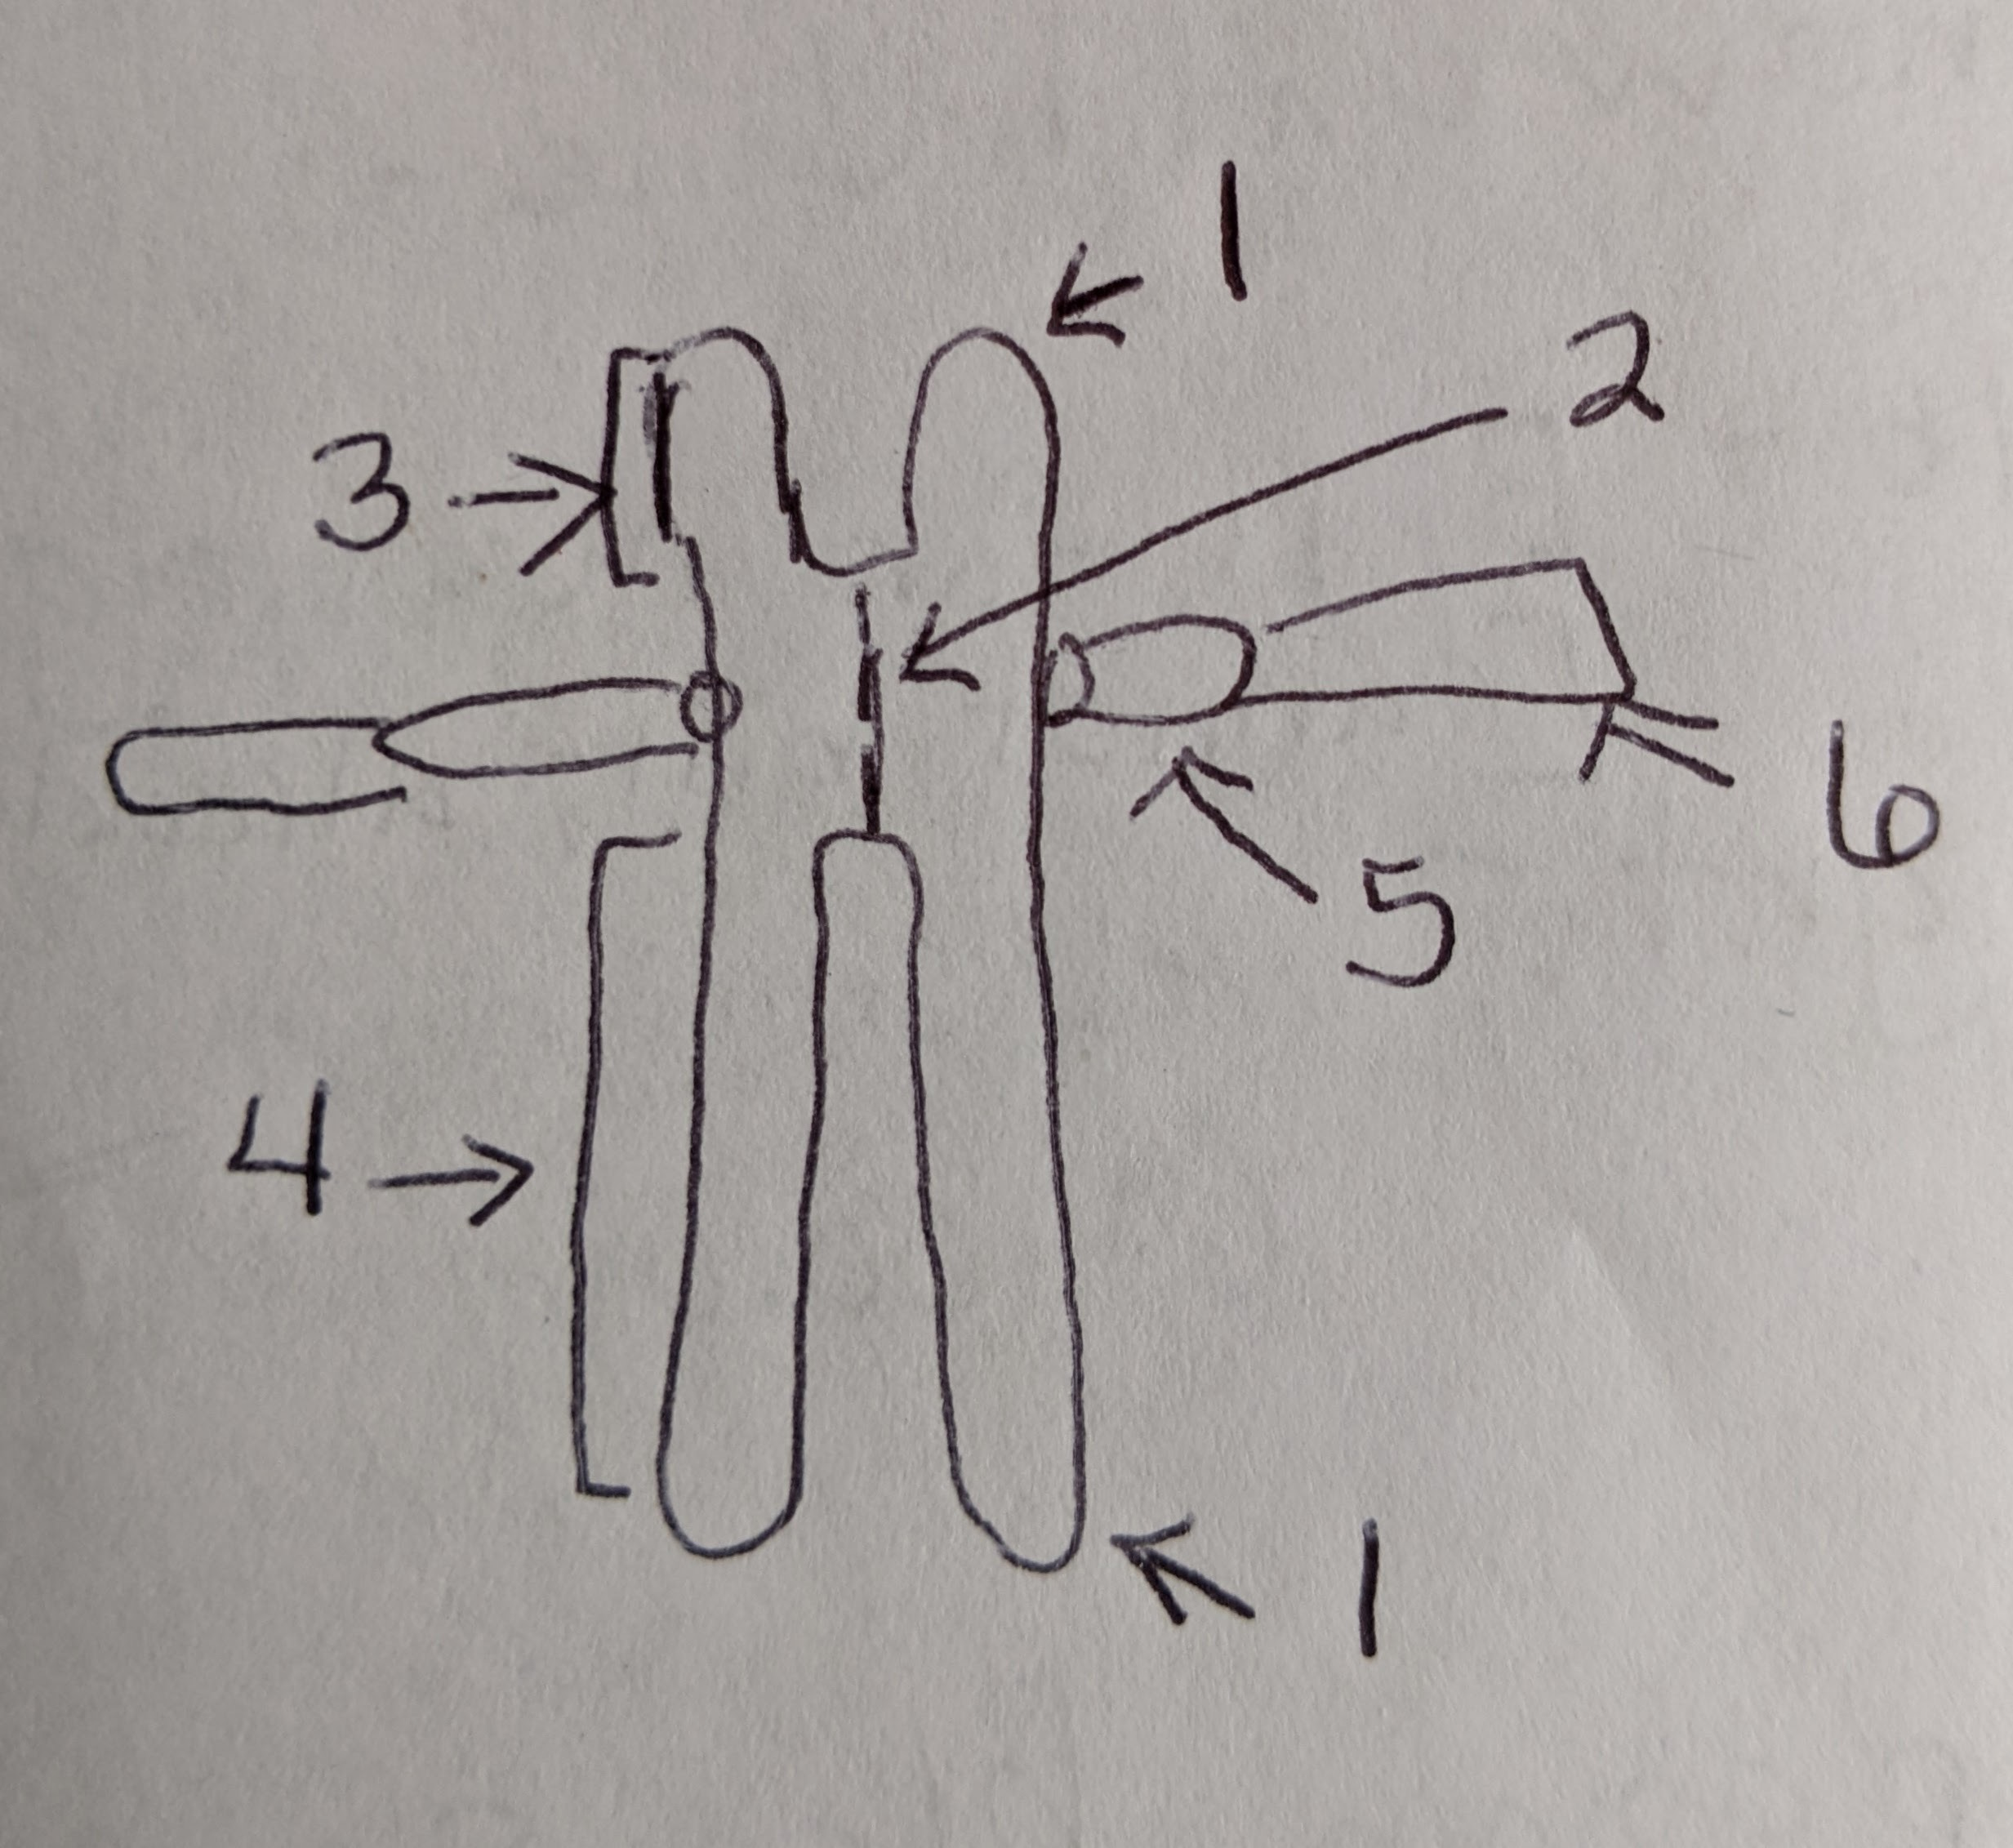
Label the parts to create a shared vocabulary
Notes:
Label the telomere, centromere, p and q arms, kinetochore, and spindle fibers. Identify their color on the model. Compare and contrast your sister chromatids with that of another student or group. In the space provided on the student answer sheet, describe how they are the same and how they are different. Refer to the NIH’s Chromosome Fact Sheet (https://www.genome.gov/about-genomics/fact-sheets/Chromosomes-Fact-Sheet) if you need assistance in determining the parts of the chromosome.

Slide 9
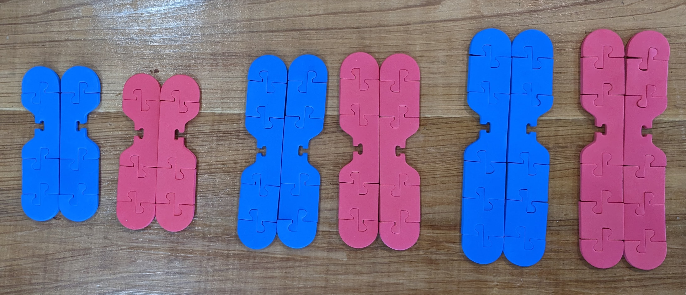
Create a duplicate copy to make a sister chromatid
Notes:
Next create a duplicate copy of the chromosome to make a sister chromatid by using the other components found in the Chromosome Connections Kit (Note: your chromosome does not need to look exactly like the one pictured, but it does not to have all the components.)

Slide 10
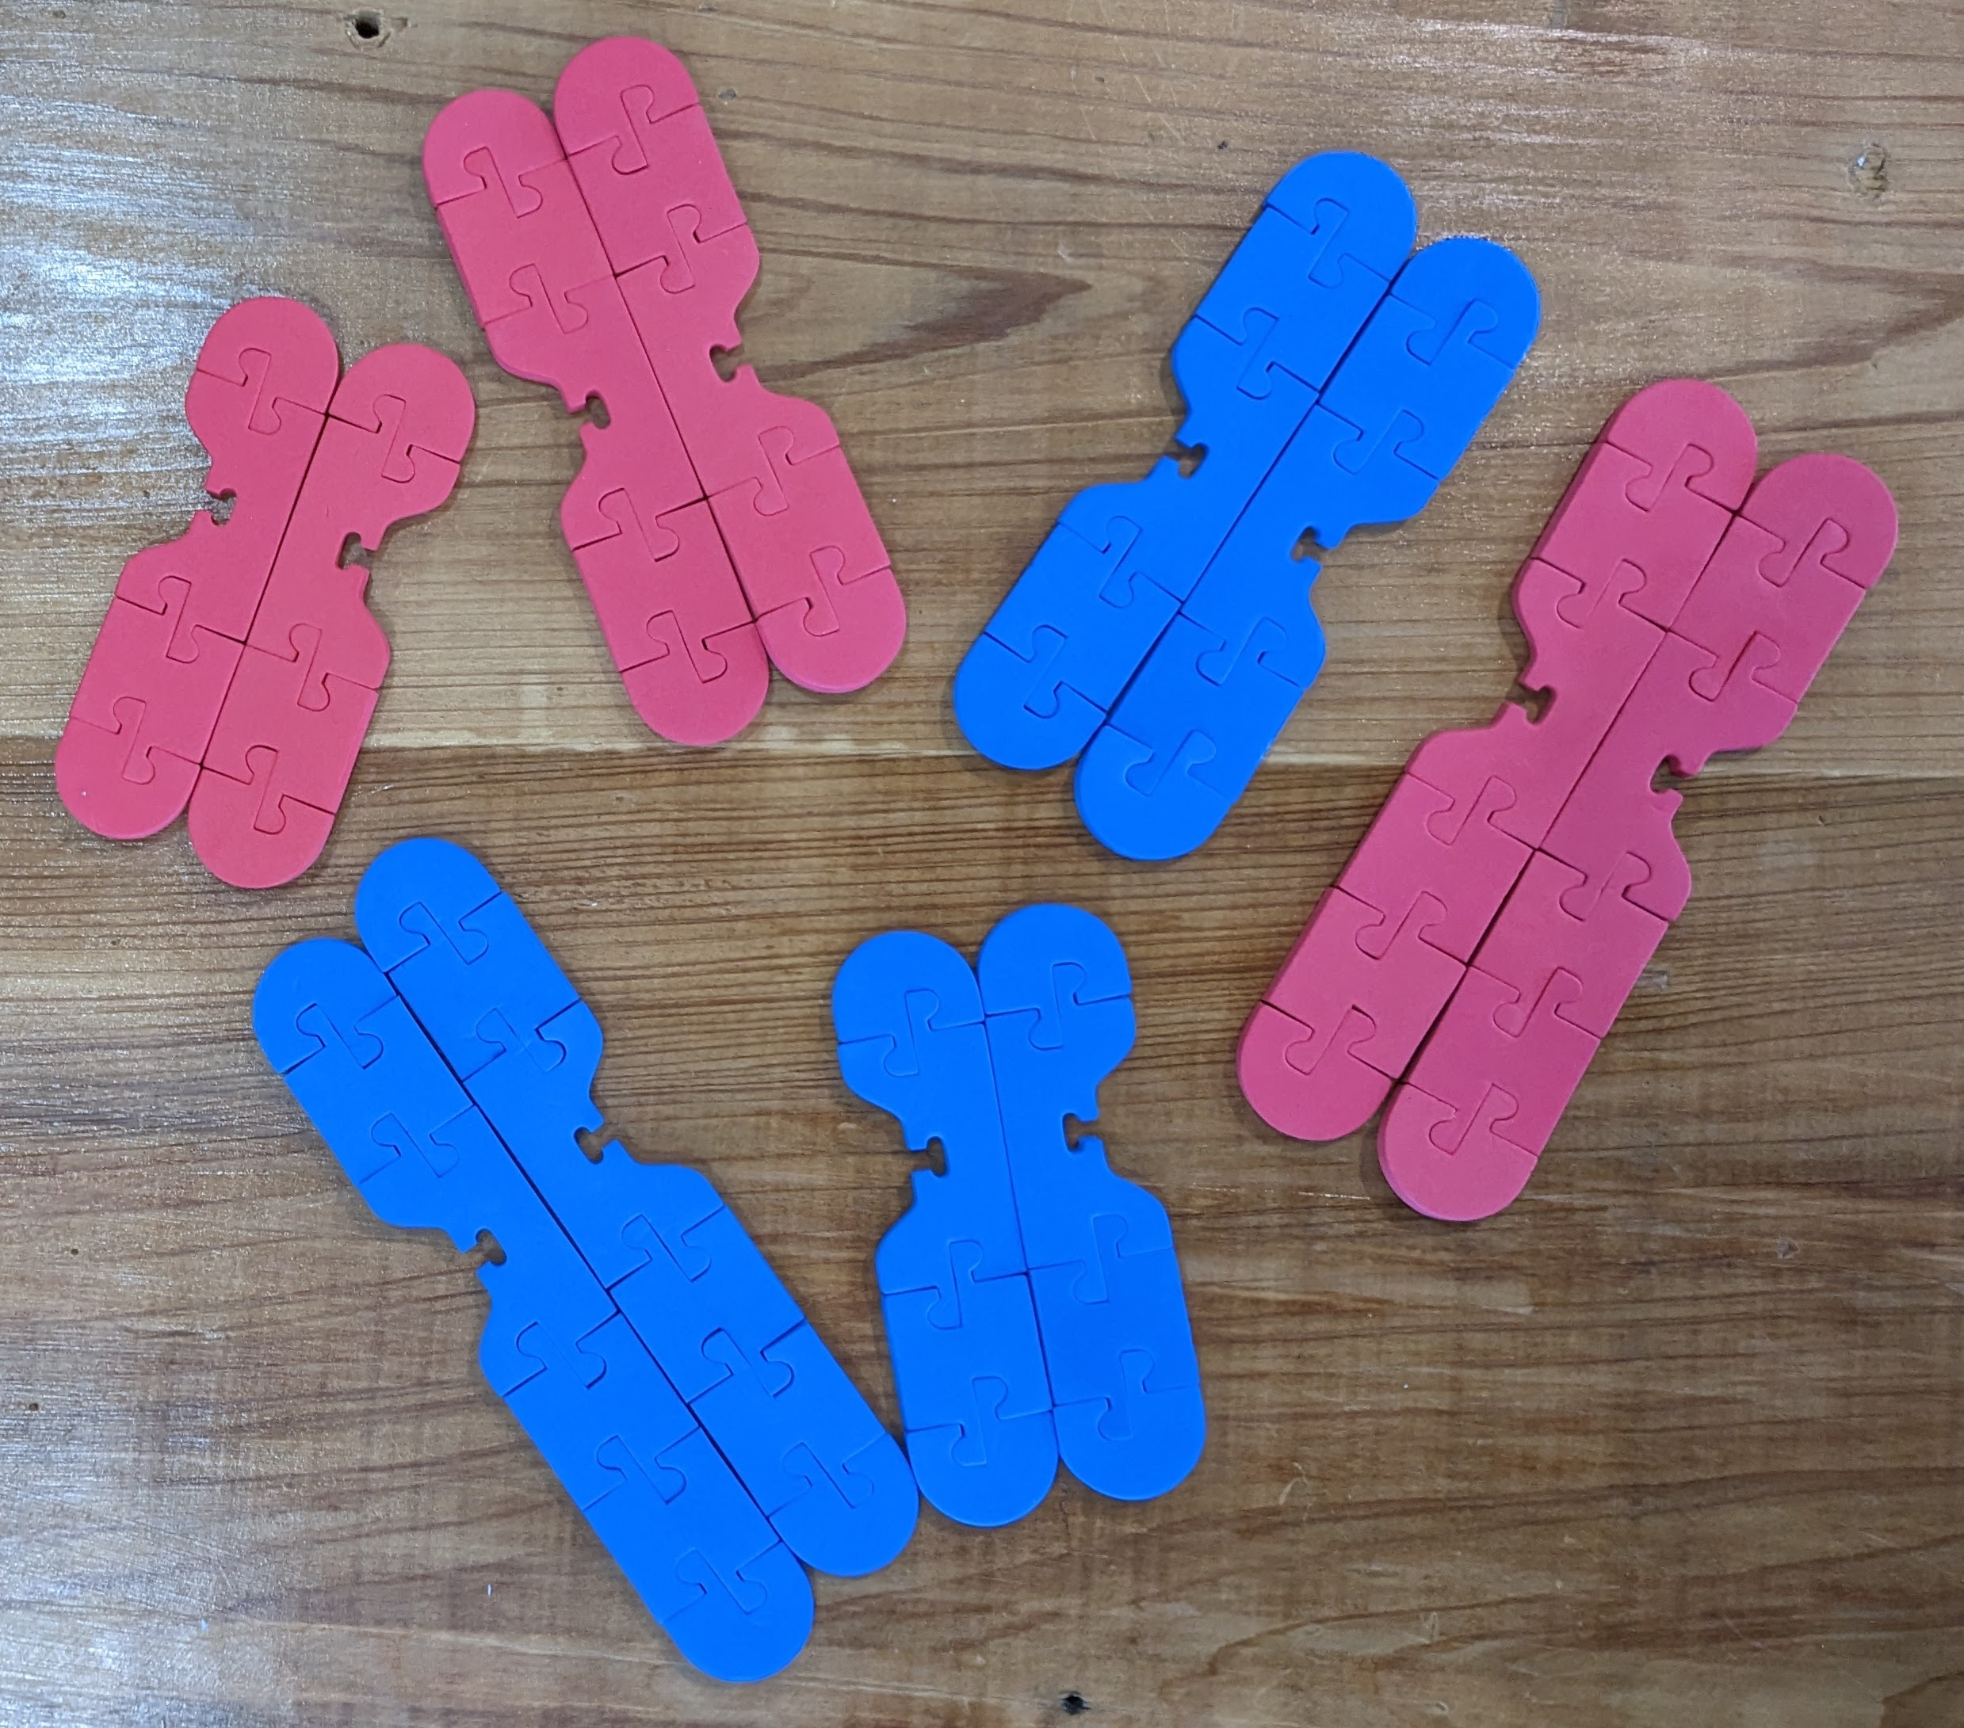
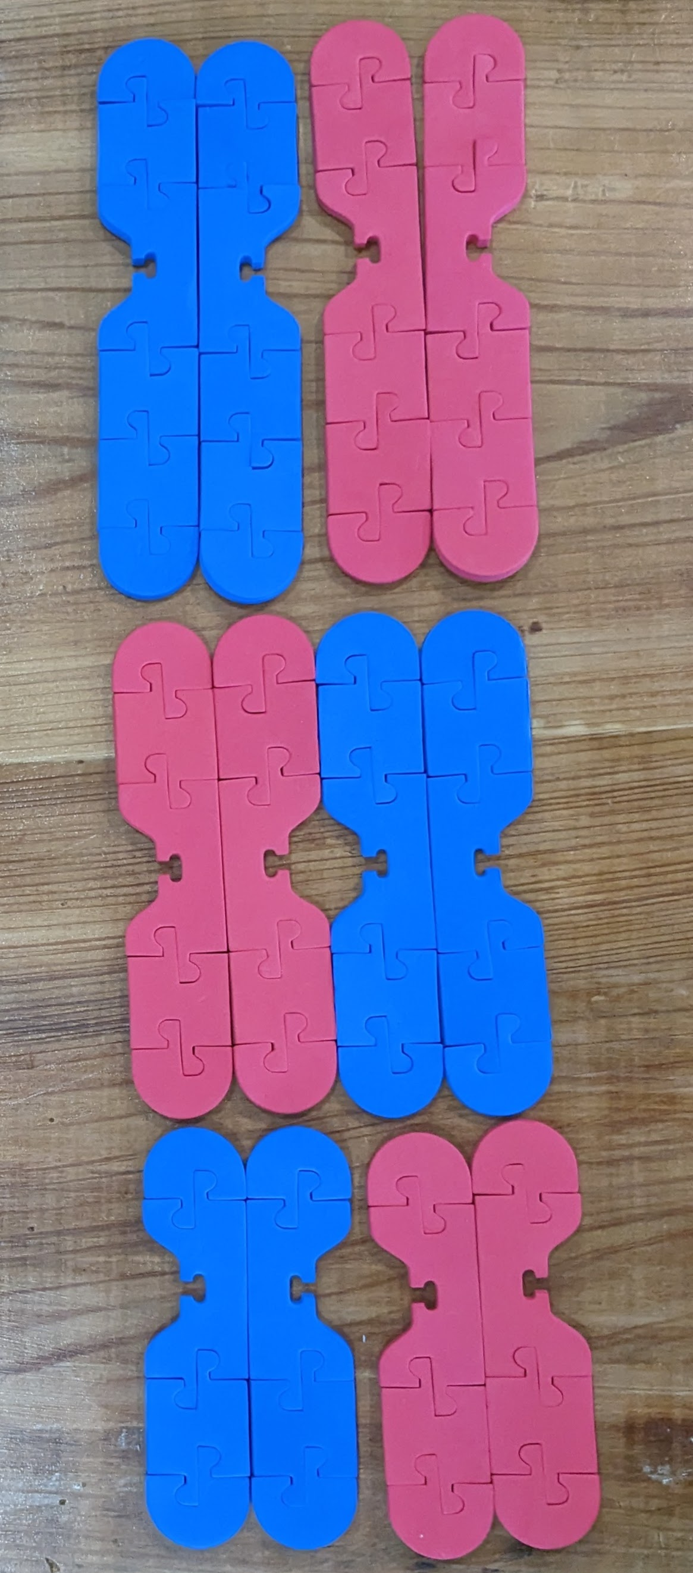
What happens during meiosis?
What occurs next so the end result are four haploid cells?
How can your students model what happens when eggs are made?
Notes:
Two alleles of a single trait will separate randomly. There is a 50% chance that either allele will end up in either gamete.

Slide 11
Mechanisms that Contribute to Genetic Variation
Diploid number of chromosomes:
Haploid number of chromosomes:
How many possibilities of chromosome combinations during meiosis?
Notes:
Genes are inherited independently of each other. Inheritance of one gene is not reliant on inheritance of another gene. Alleles received from one gene never influence the one received from the other gene. Takes place during meiosis. Mendel picked genes that were on different chromosomes. This law applies to genes located on different chromosomes. For genes located on the same chromosome, it depend how close they are to each other on the chromosomes. Closely located genes can be said to be linked.

Slide 12
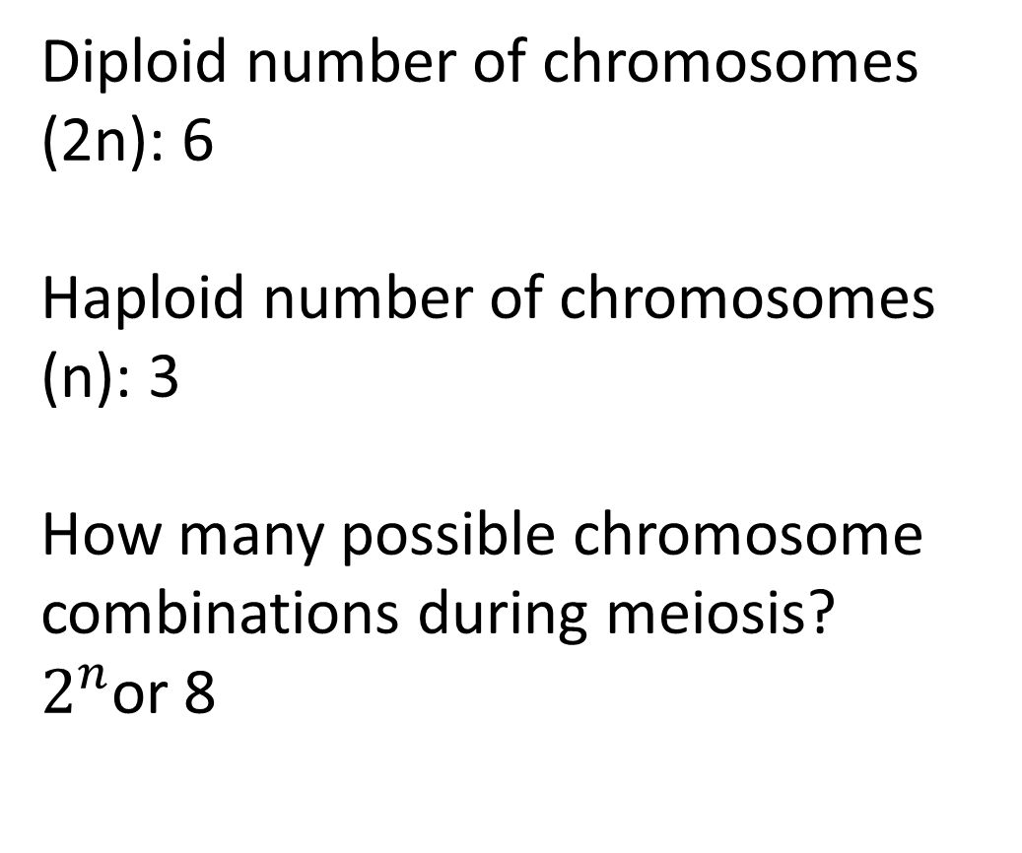
Mechanisms that Contribute to Genetic Variation
Diploid number of chromosomes (2n): 6
Haploid number of chromosomes (n): 3
How many possible chromosome combinations during meiosis?
$2^{n}$or 8
How many possible combinations in humans?
Notes:
Genes are inherited independently of each other. Inheritance of one gene is not reliant on inheritance of another gene. Alleles received from one gene never influence the one received from the other gene. Takes place during meiosis. Mendel picked genes that were on different chromosomes. This law applies to genes located on different chromosomes. For genes located on the same chromosome, it depend how close they are to each other on the chromosomes. Closely located genes can be said to be linked.

Slide 13
What happens during meiosis?
How do homologous chromosomes find each other?
Notes:
Two alleles of a single trait will separate randomly. There is a 50% chance that either allele will end up in either gamete.

Slide 14
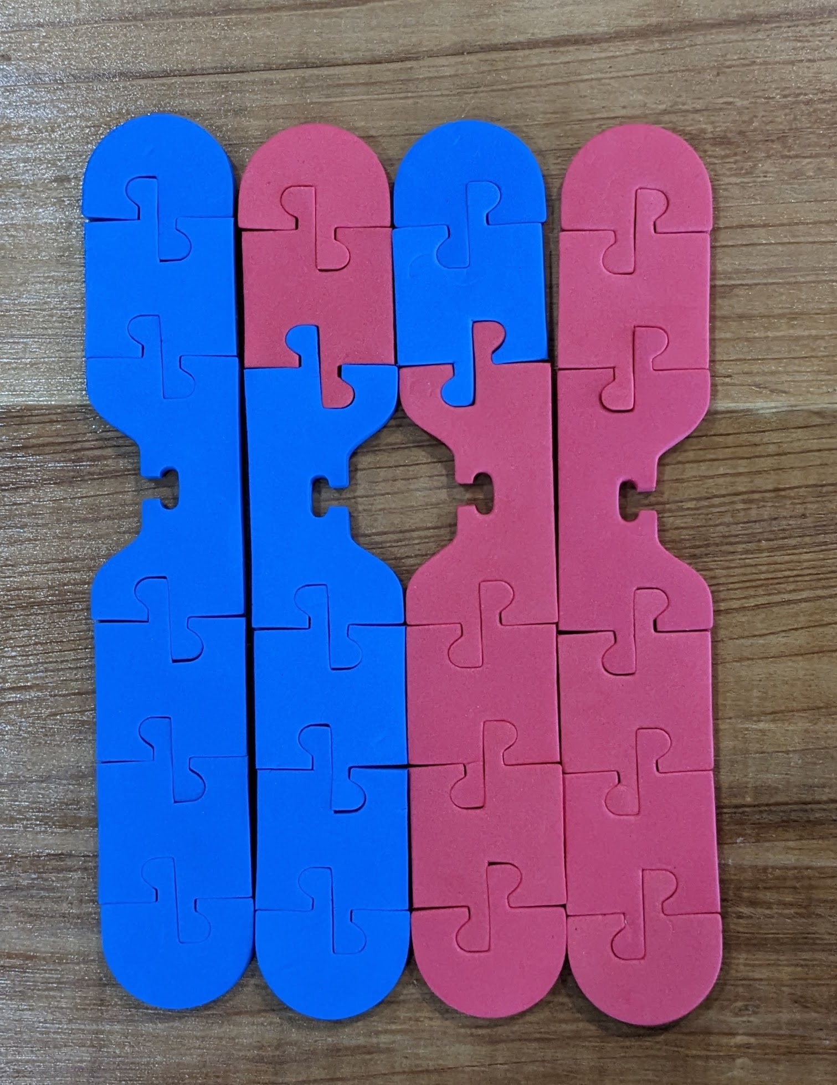
Crossing Over at the Microscopic Scale

Slide 15

Crossing Over at the Microscopic Scale
.

Slide 16
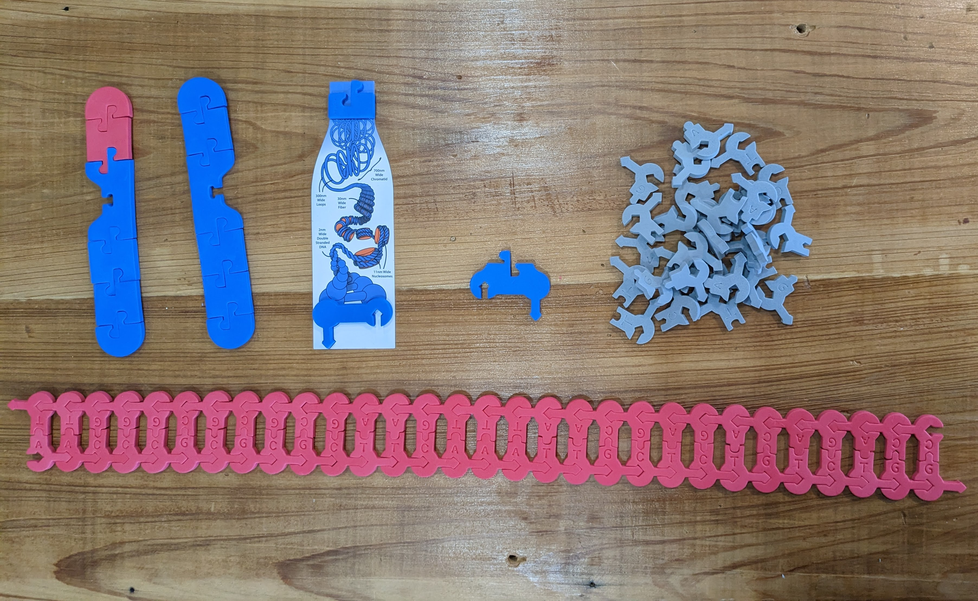
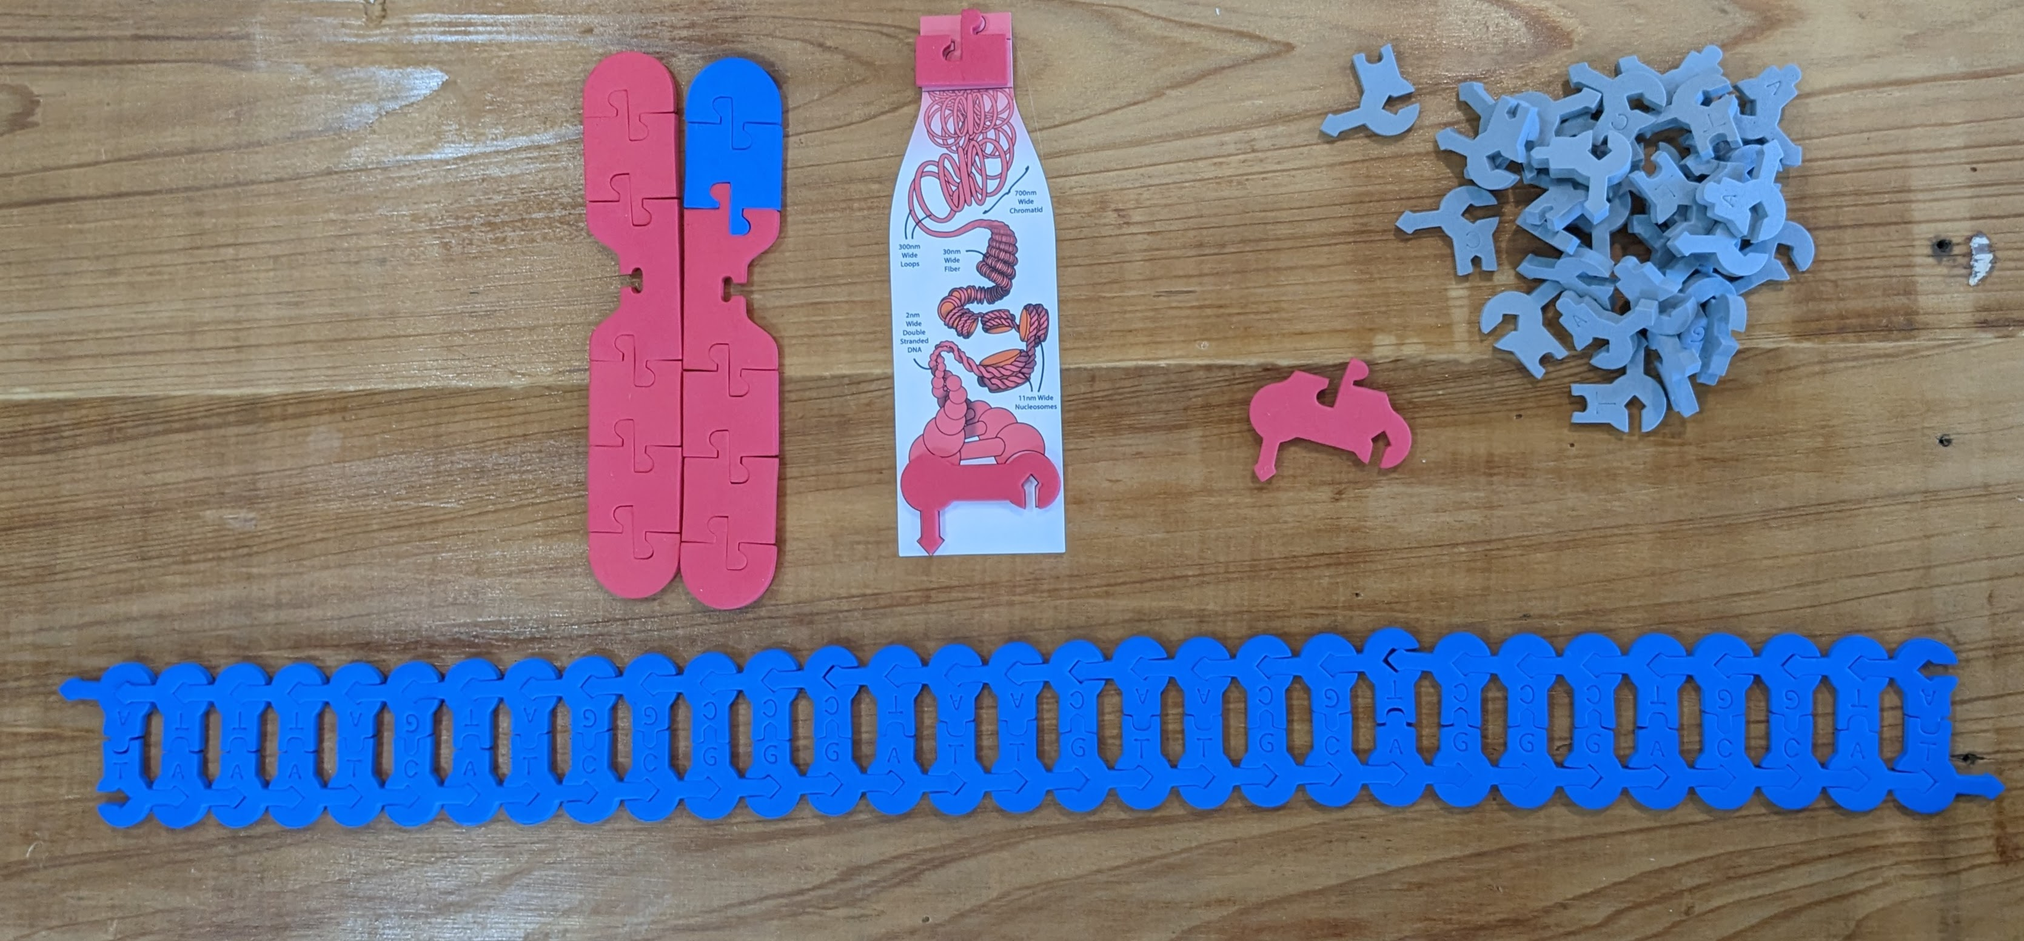
Crossing Over at the Molecular Scale
Add a 4X scaling graphic to help students under the relationship between DNA and the chromosome.
Helps students better understand scale and proportion.
Can explore the Holliday junction

Slide 17
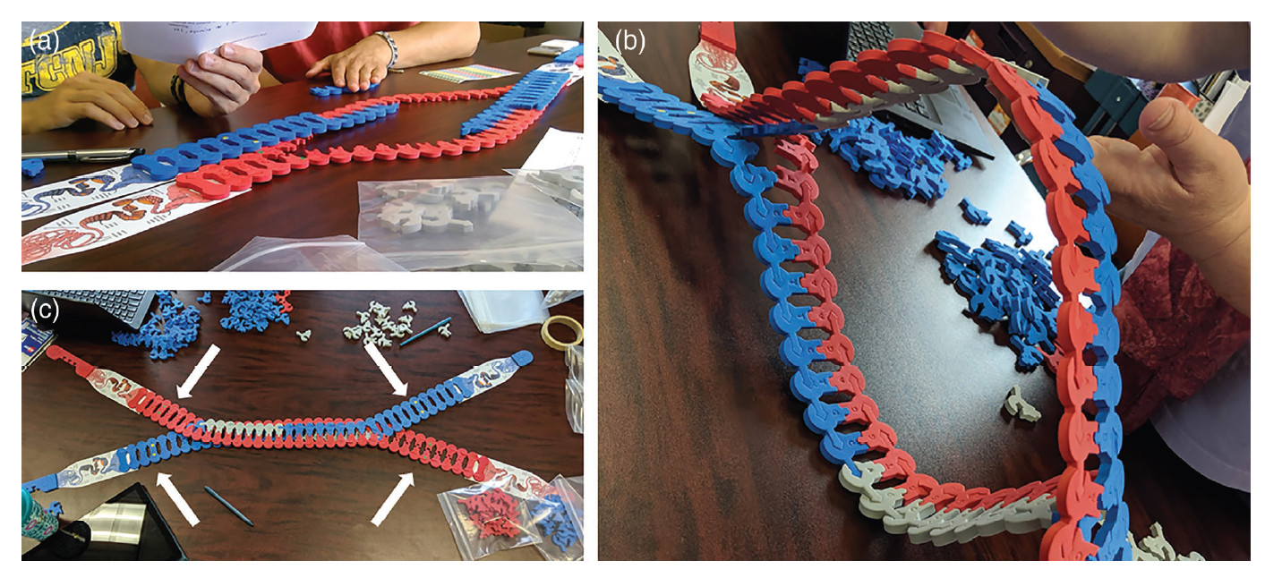
Crossing Over at the Molecular Scale
Wright, et al. 2022. Biochem Mol Biol Educ. 2022;50:44–54. https://doi.org/10.1002/bmb.21583

Slide 18
Crossing Over at the Molecular Scale

Slide 19
Workshop NGSS Connections
SEPs | CCCs | DCIs
Asking Questions and Defining Problems | Systems and System Models | HS-LS1-4
Developing and Using Models | Cause and Effect | HS-LS3-2
 | Scale, Proportion, and Quantity
Notes:
Ruth says: Here are the NGSS and TEKS Connections for this workshop.

Slide 20

We value your opinion!
Let us know what you think.
Scan the QR Code and complete this short survey.

Slide 21
Notes:
The above image is a detailed of a cross section of a cell by Dr. David Goodsell. David Goodsell uses watercolor to aid in our understanding of the molecular world through cellular landscapes. This view of the cell is in cross section and is magnified 1,000,000X. Many compare Goodsell’s artistic expression with the post-impressionist style of Henri Rousseau. Goodsell draws molecules with flat colors and emphasizes their relative size with outlines. Similar colors are used to identify cellular structures. DNA and nuclear proteins are drawn in yellow and orange. Ribosomes are shown in magenta, while cytoplasmic proteins are shown in blue. Membranes are colored in green. Overall size and shape of macromolecules are based on atomic coordinates. The relative amounts of molecules is determined using biochemical data, while the locations of the molecules is determined using electron micrographs. You can find more information about Goodsell’s cellular landscapes by visiting the Protein Data Bank website at RCSB PDB: Homepage.
Additional Resource: David Goodsell: The master of mol art (asbmb.org)

