Slide 1
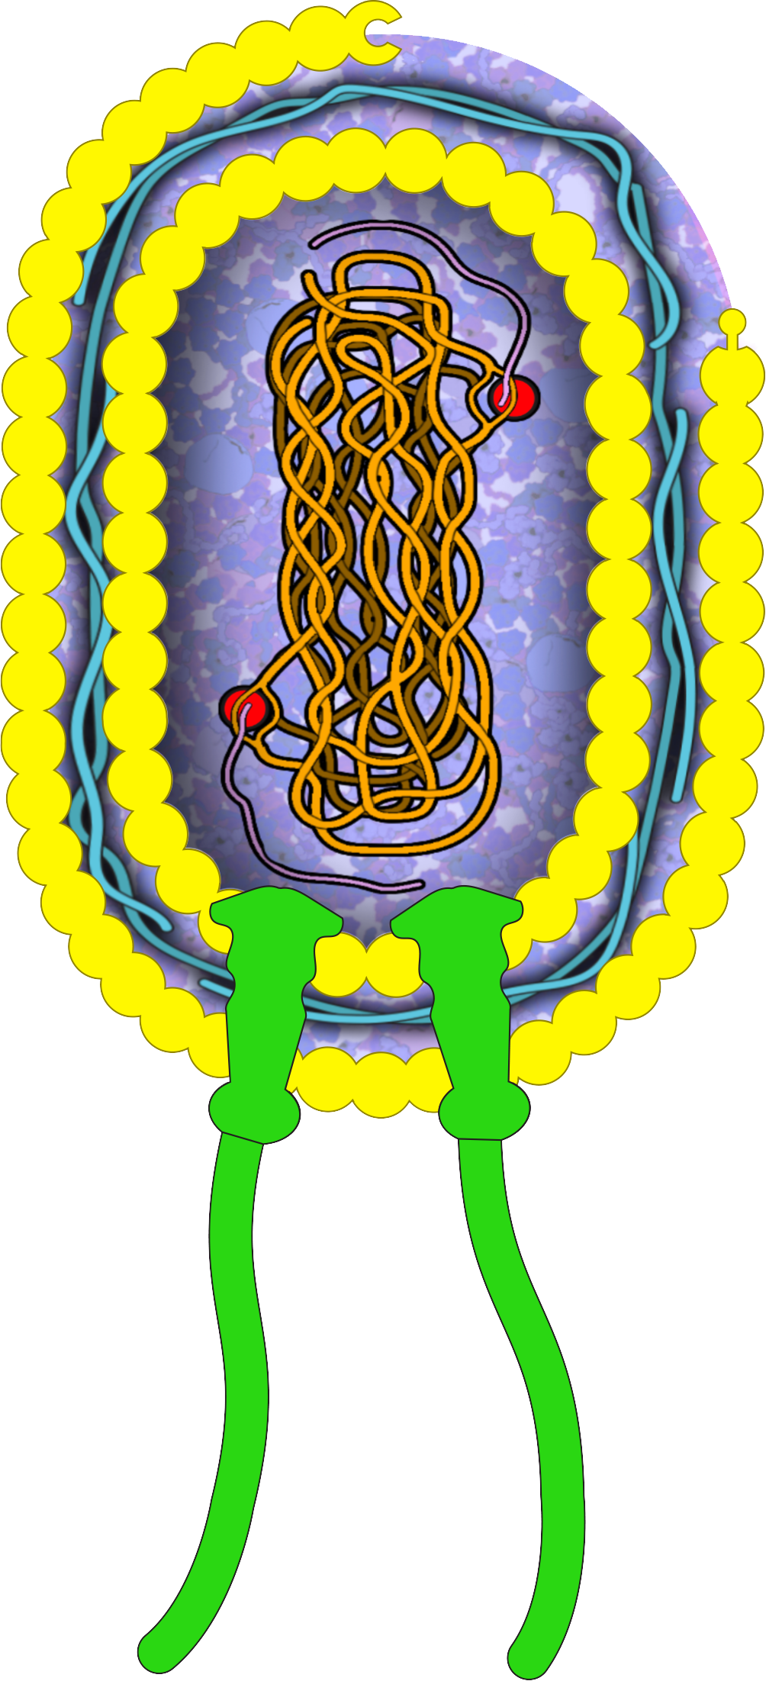
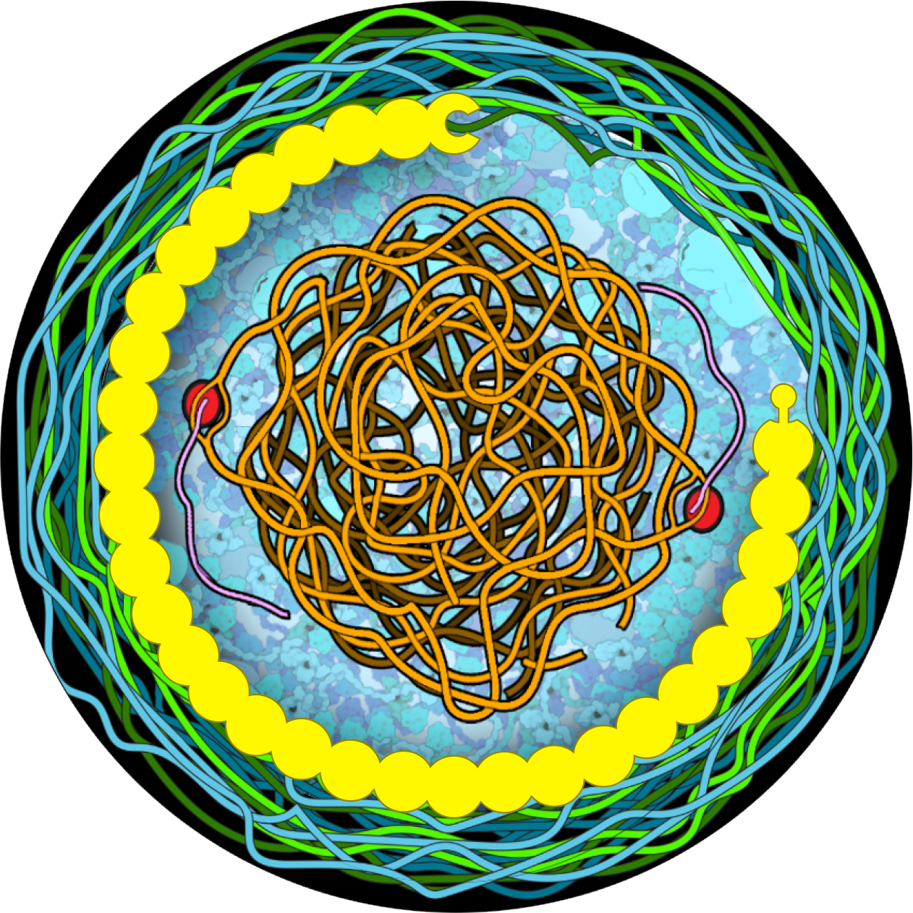
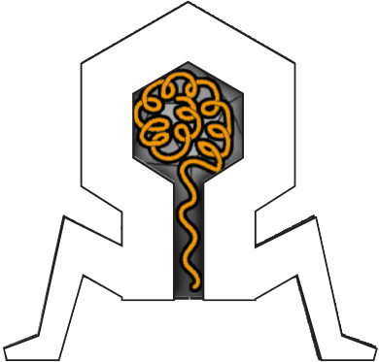
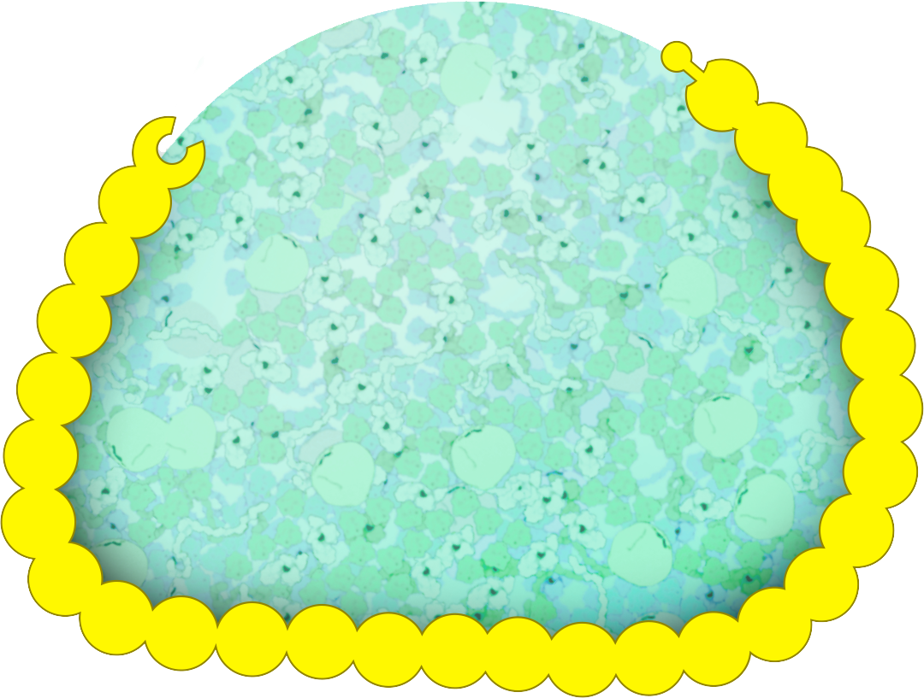
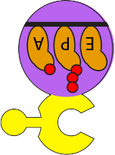
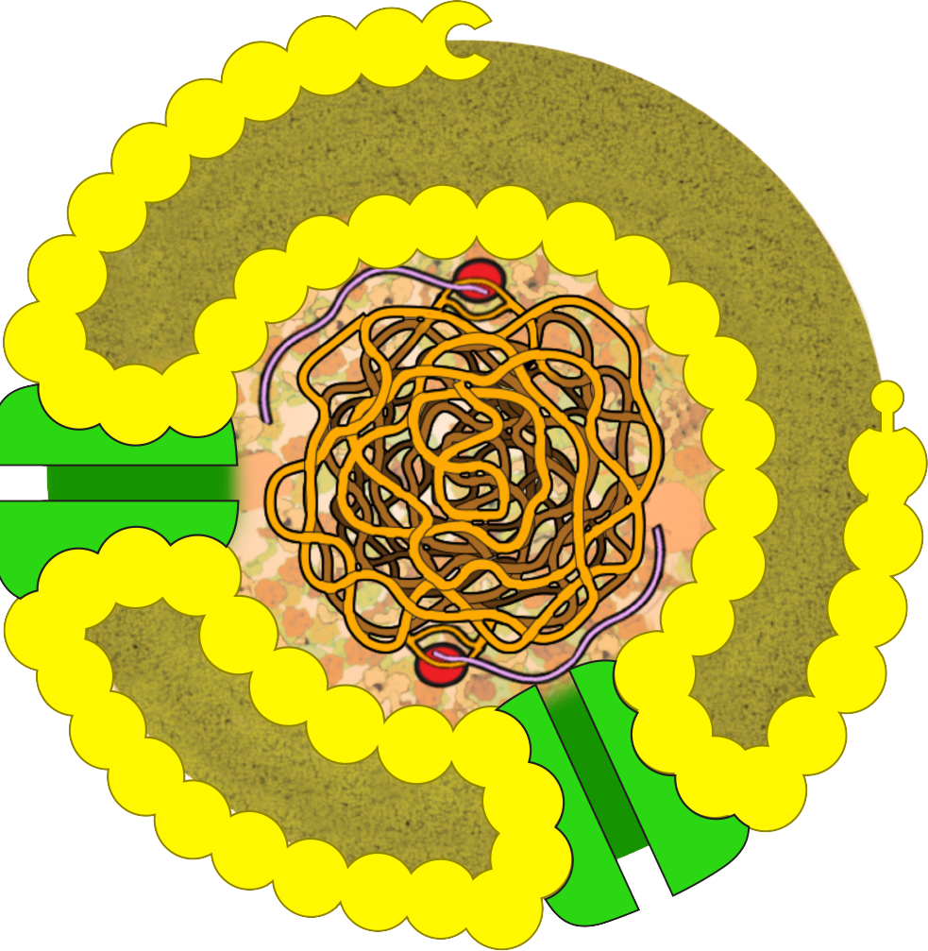

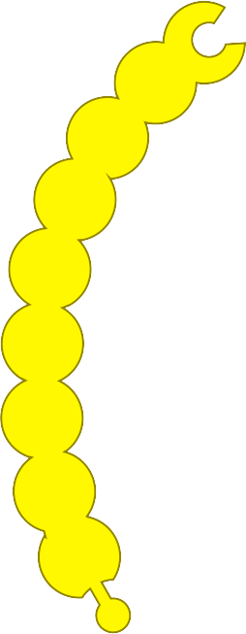

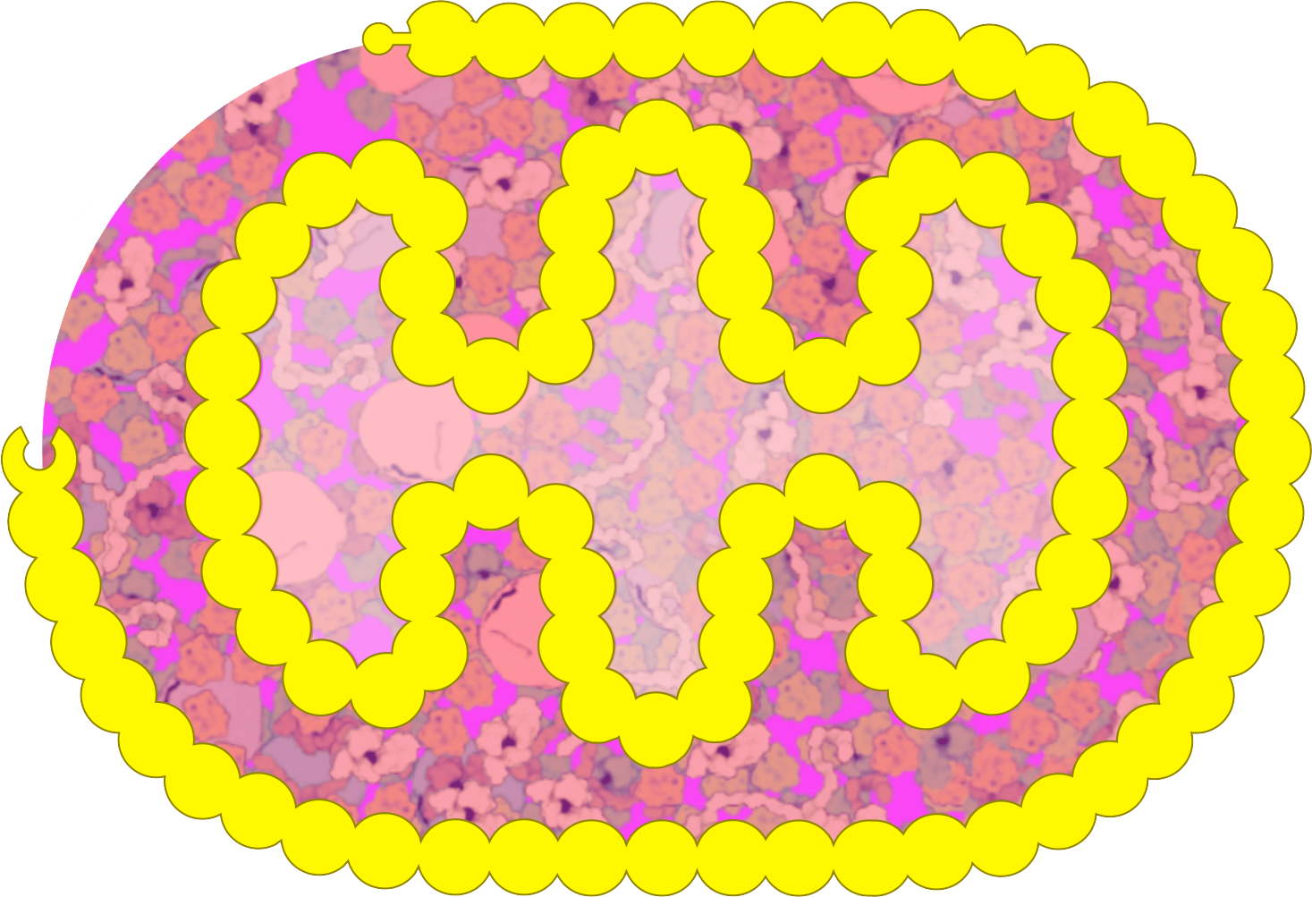
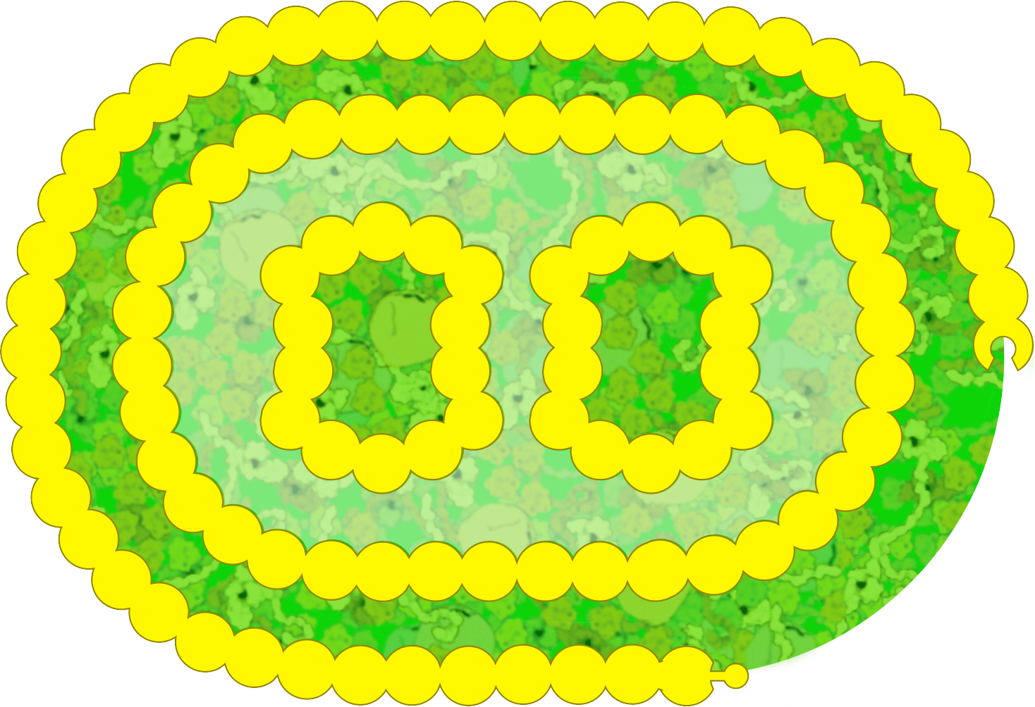

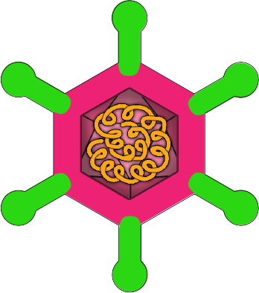

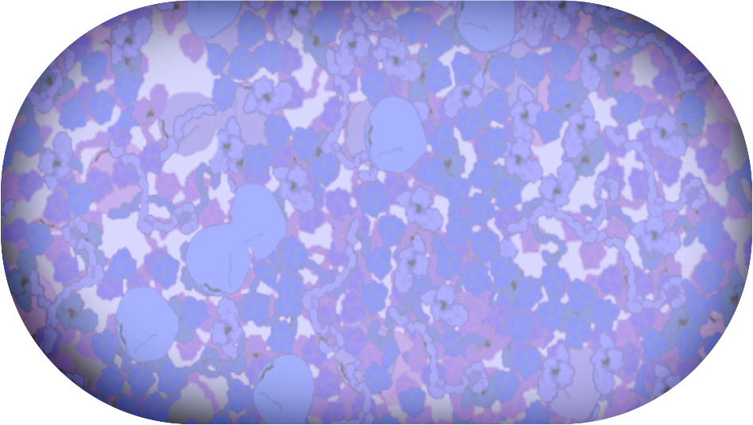

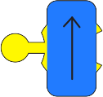
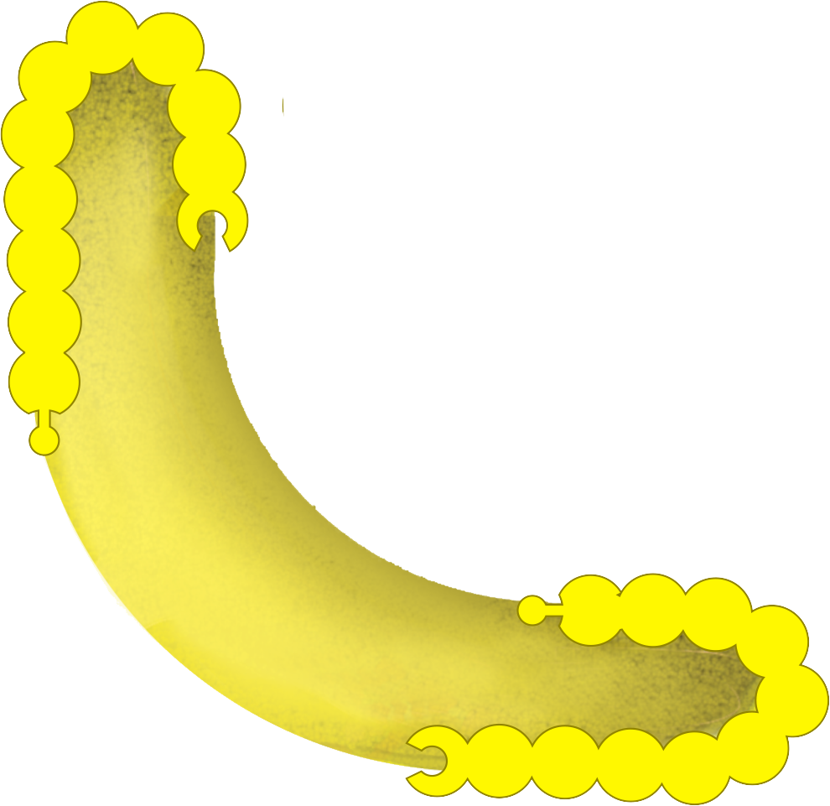
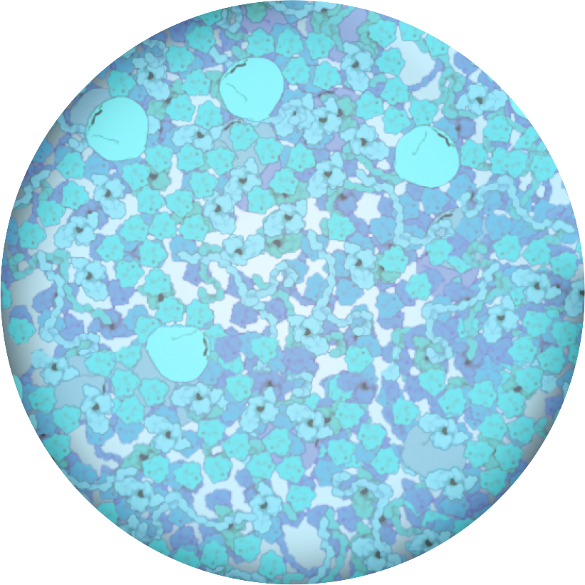
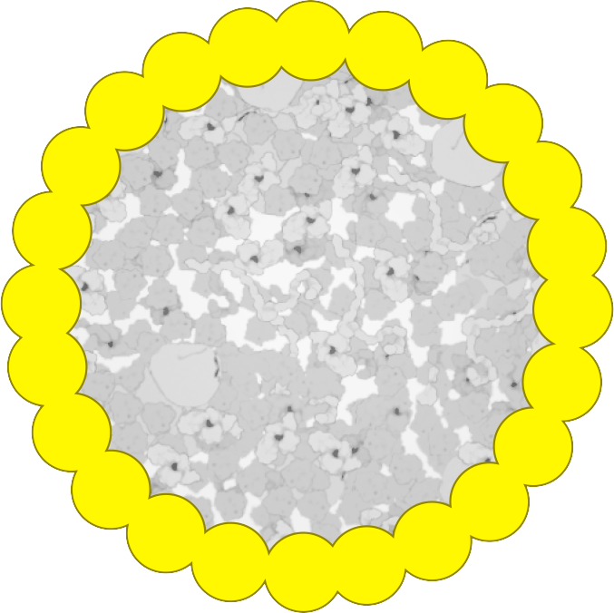
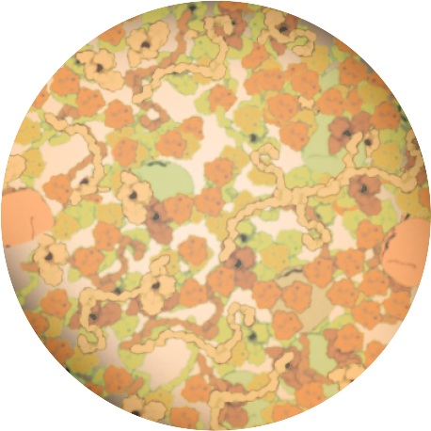

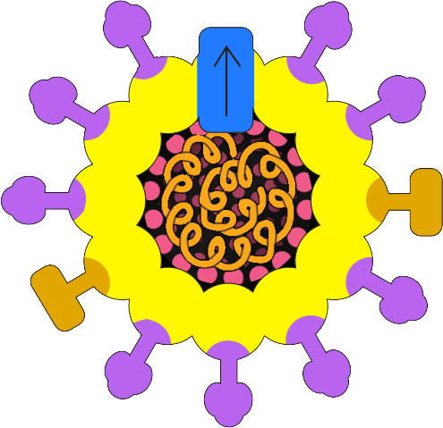


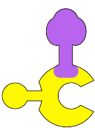

Slide 2
Gram-Negative Bacterial Cell Gram-Positive Bacterial cell
Gram-negative cellular landscape
Gram-positive cellular landscape

Slide 3
Mitochondria
Vacuole
Lysosome
Chloroplast

Slide 4
Cytoplasmic Ribosome
Nucleus cellular landscape
Ribosome docked to membrane
Endomembrane system (Endoplasmic Reticulum and Golgi)
Nucleus

Slide 5
Build your own dynamic membrane
(Endocytosis, exocytosis)
Static membrane pieces

Slide 6
Bacteriophage HIV Adeno-Associated Virus Coronavirus
Sialic Acid Influenza Influenza Proton
Receptor Neuraminidase Hemagglutinin Pump
Influenza

