Slide 2
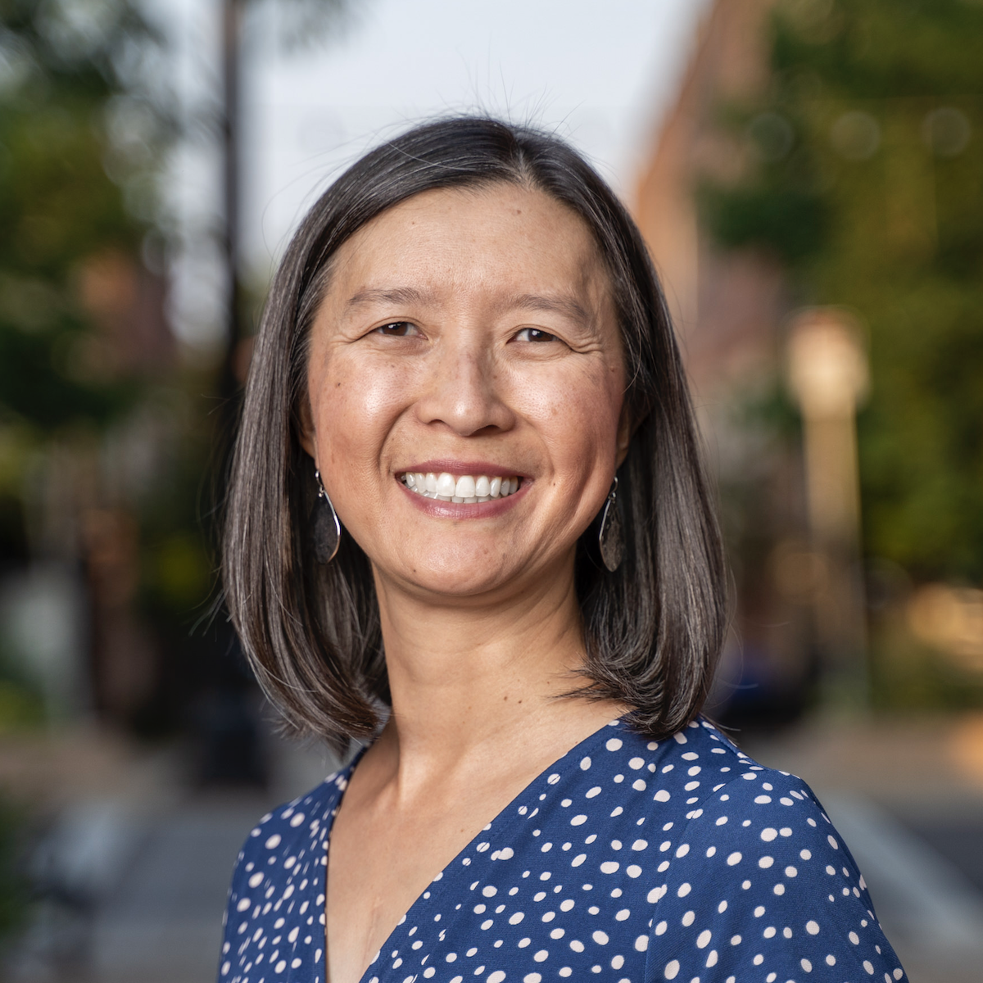
Unraveling Multiple Representations of Chromosomes to Reveal Student Thinking
Presenter: Chris Chou
Longmont High School (Longmont, CO)
Mrs.Chou@gmail.com

Slide 3
Workshop Learning Goals
Model chromosome structure and anatomy
Compare and contrast mitosis and meiosis
Model mechanisms that contribute to genetic variation
Construct Punnett squares to connect inheritance of traits to chromosomes at the molecular level

Slide 4

Which grades/subjects do you teach?

Slide 5
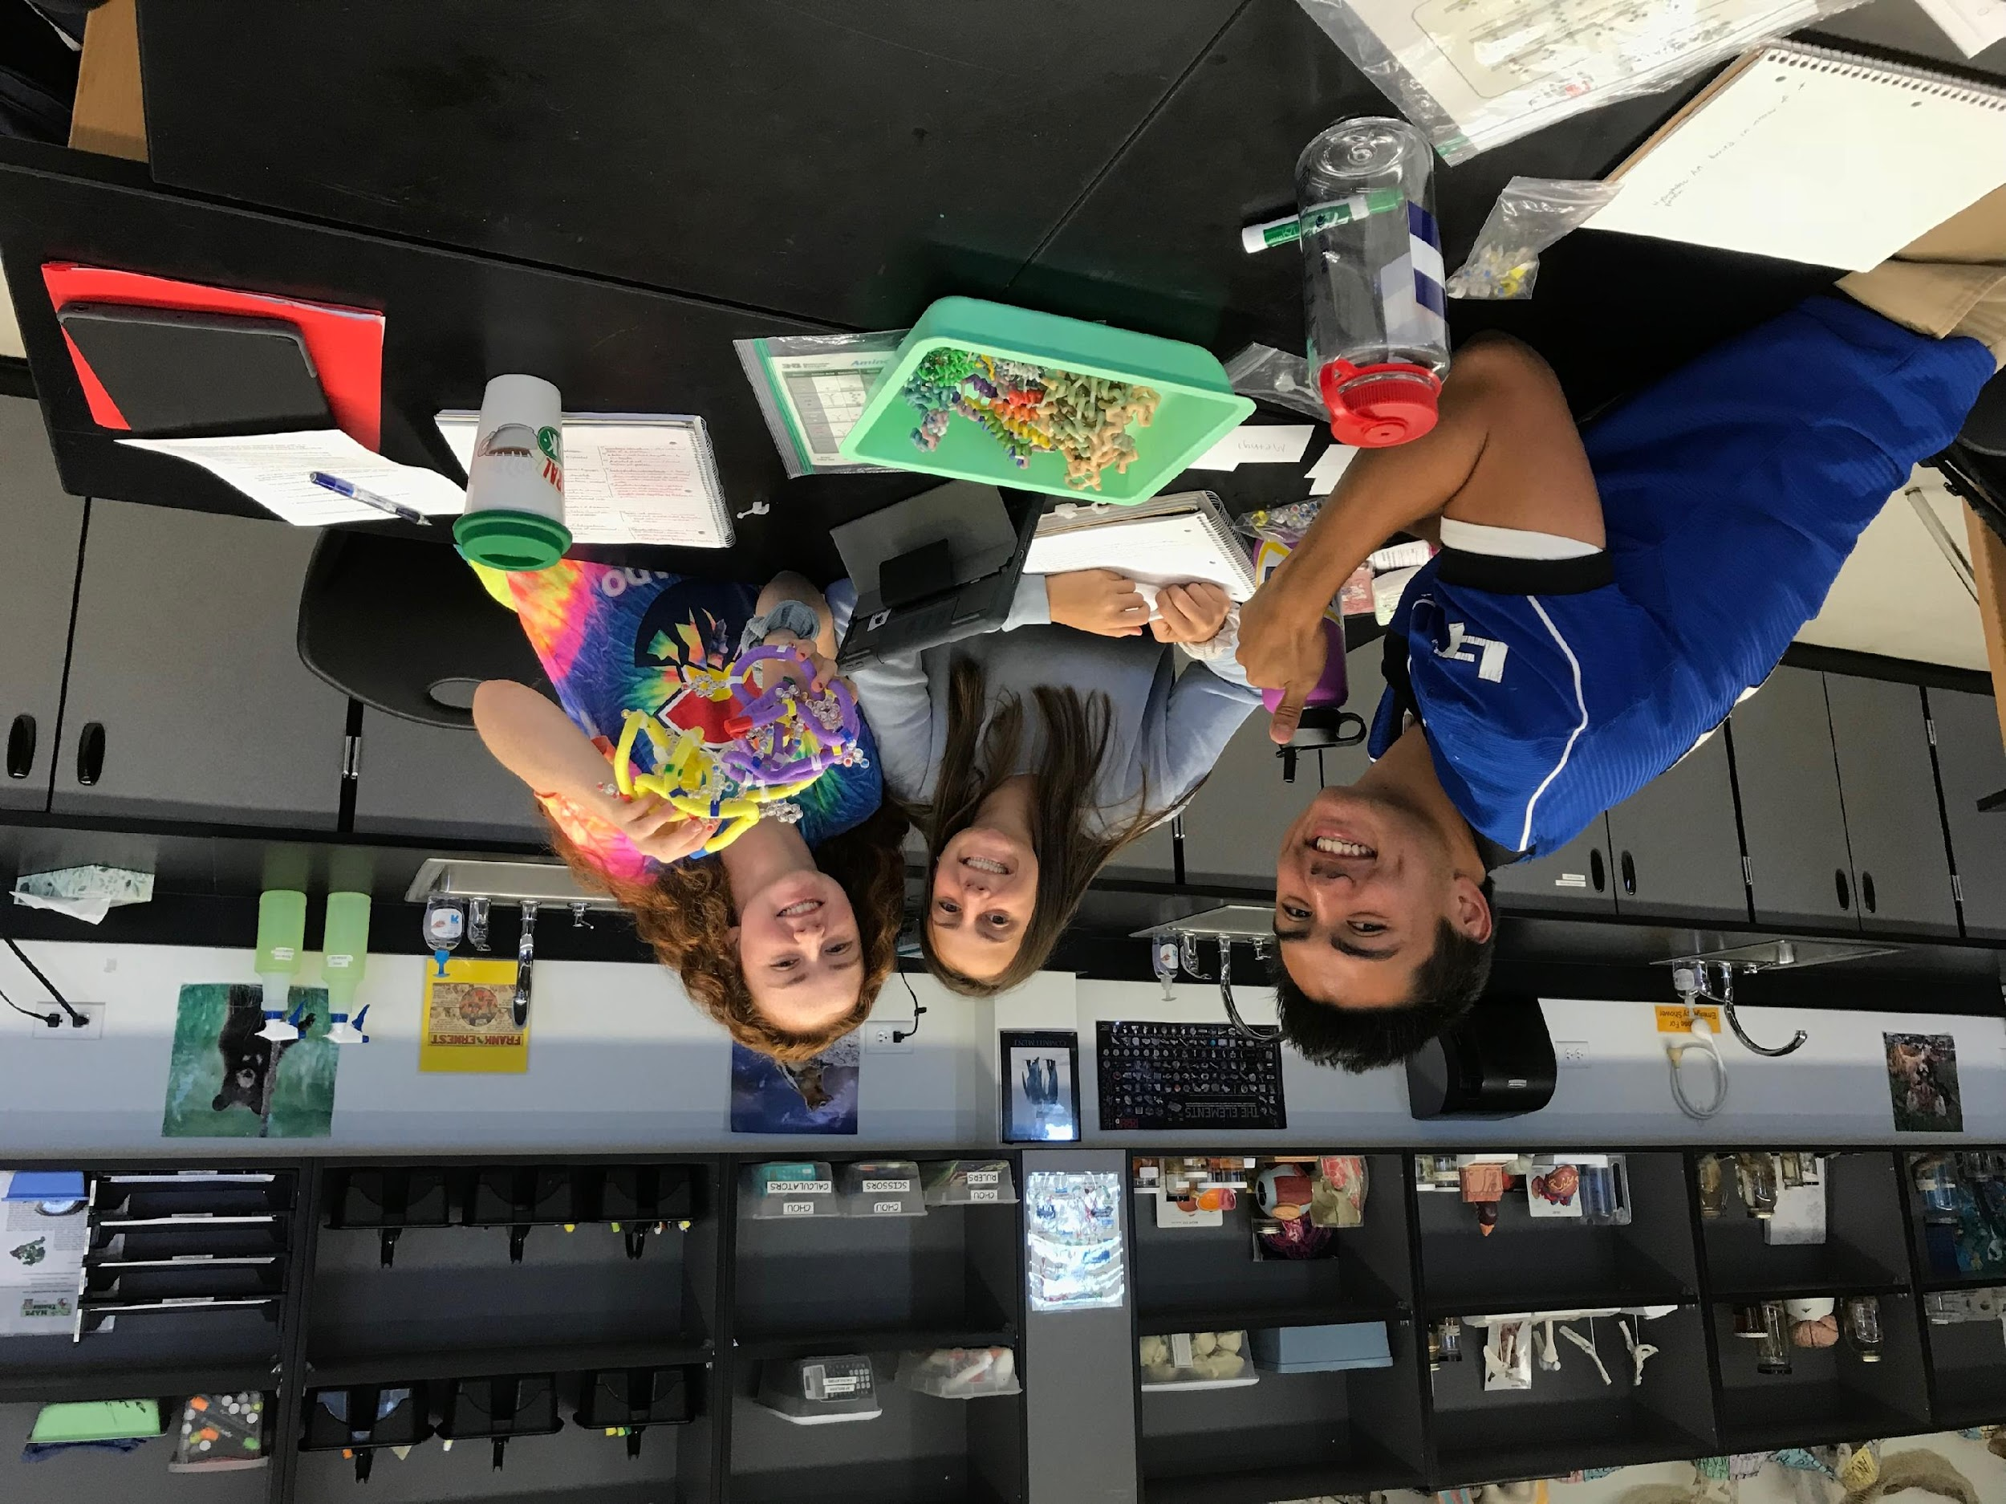
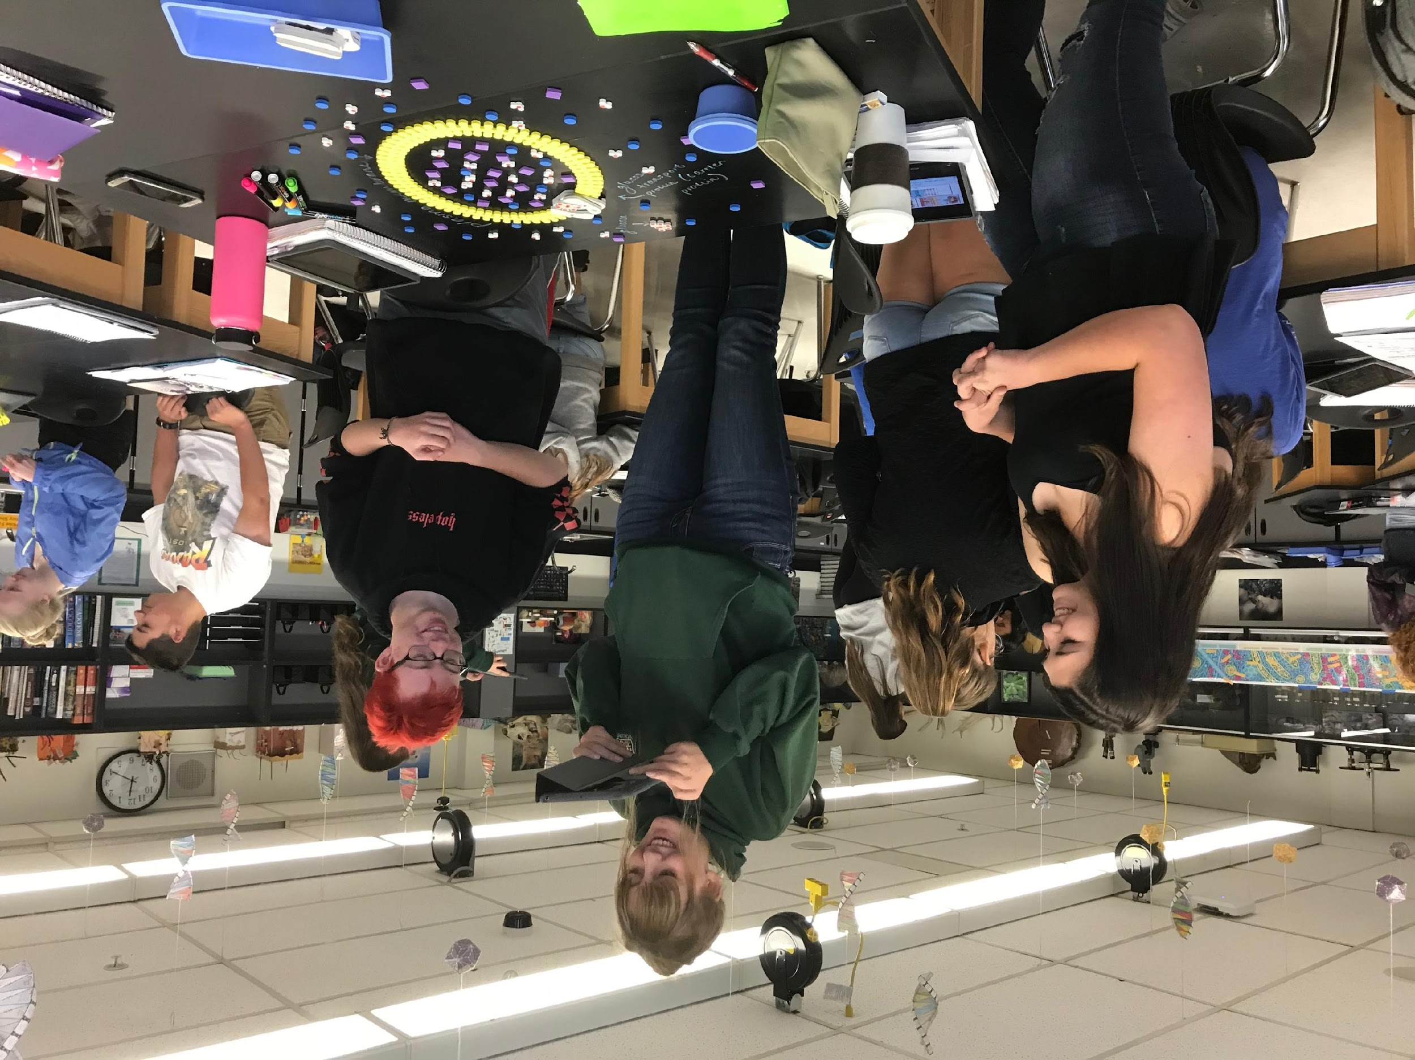
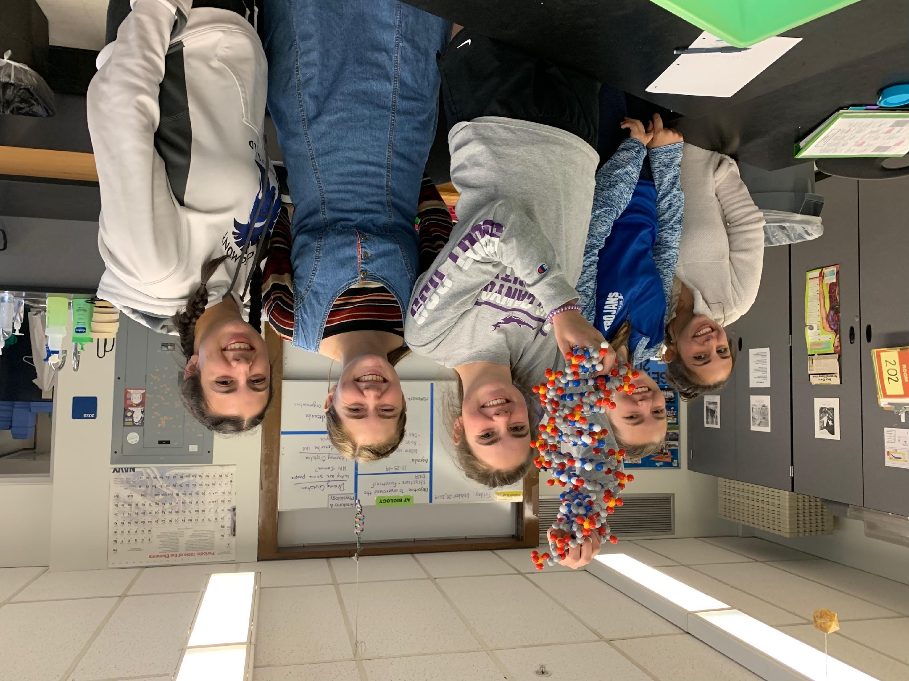
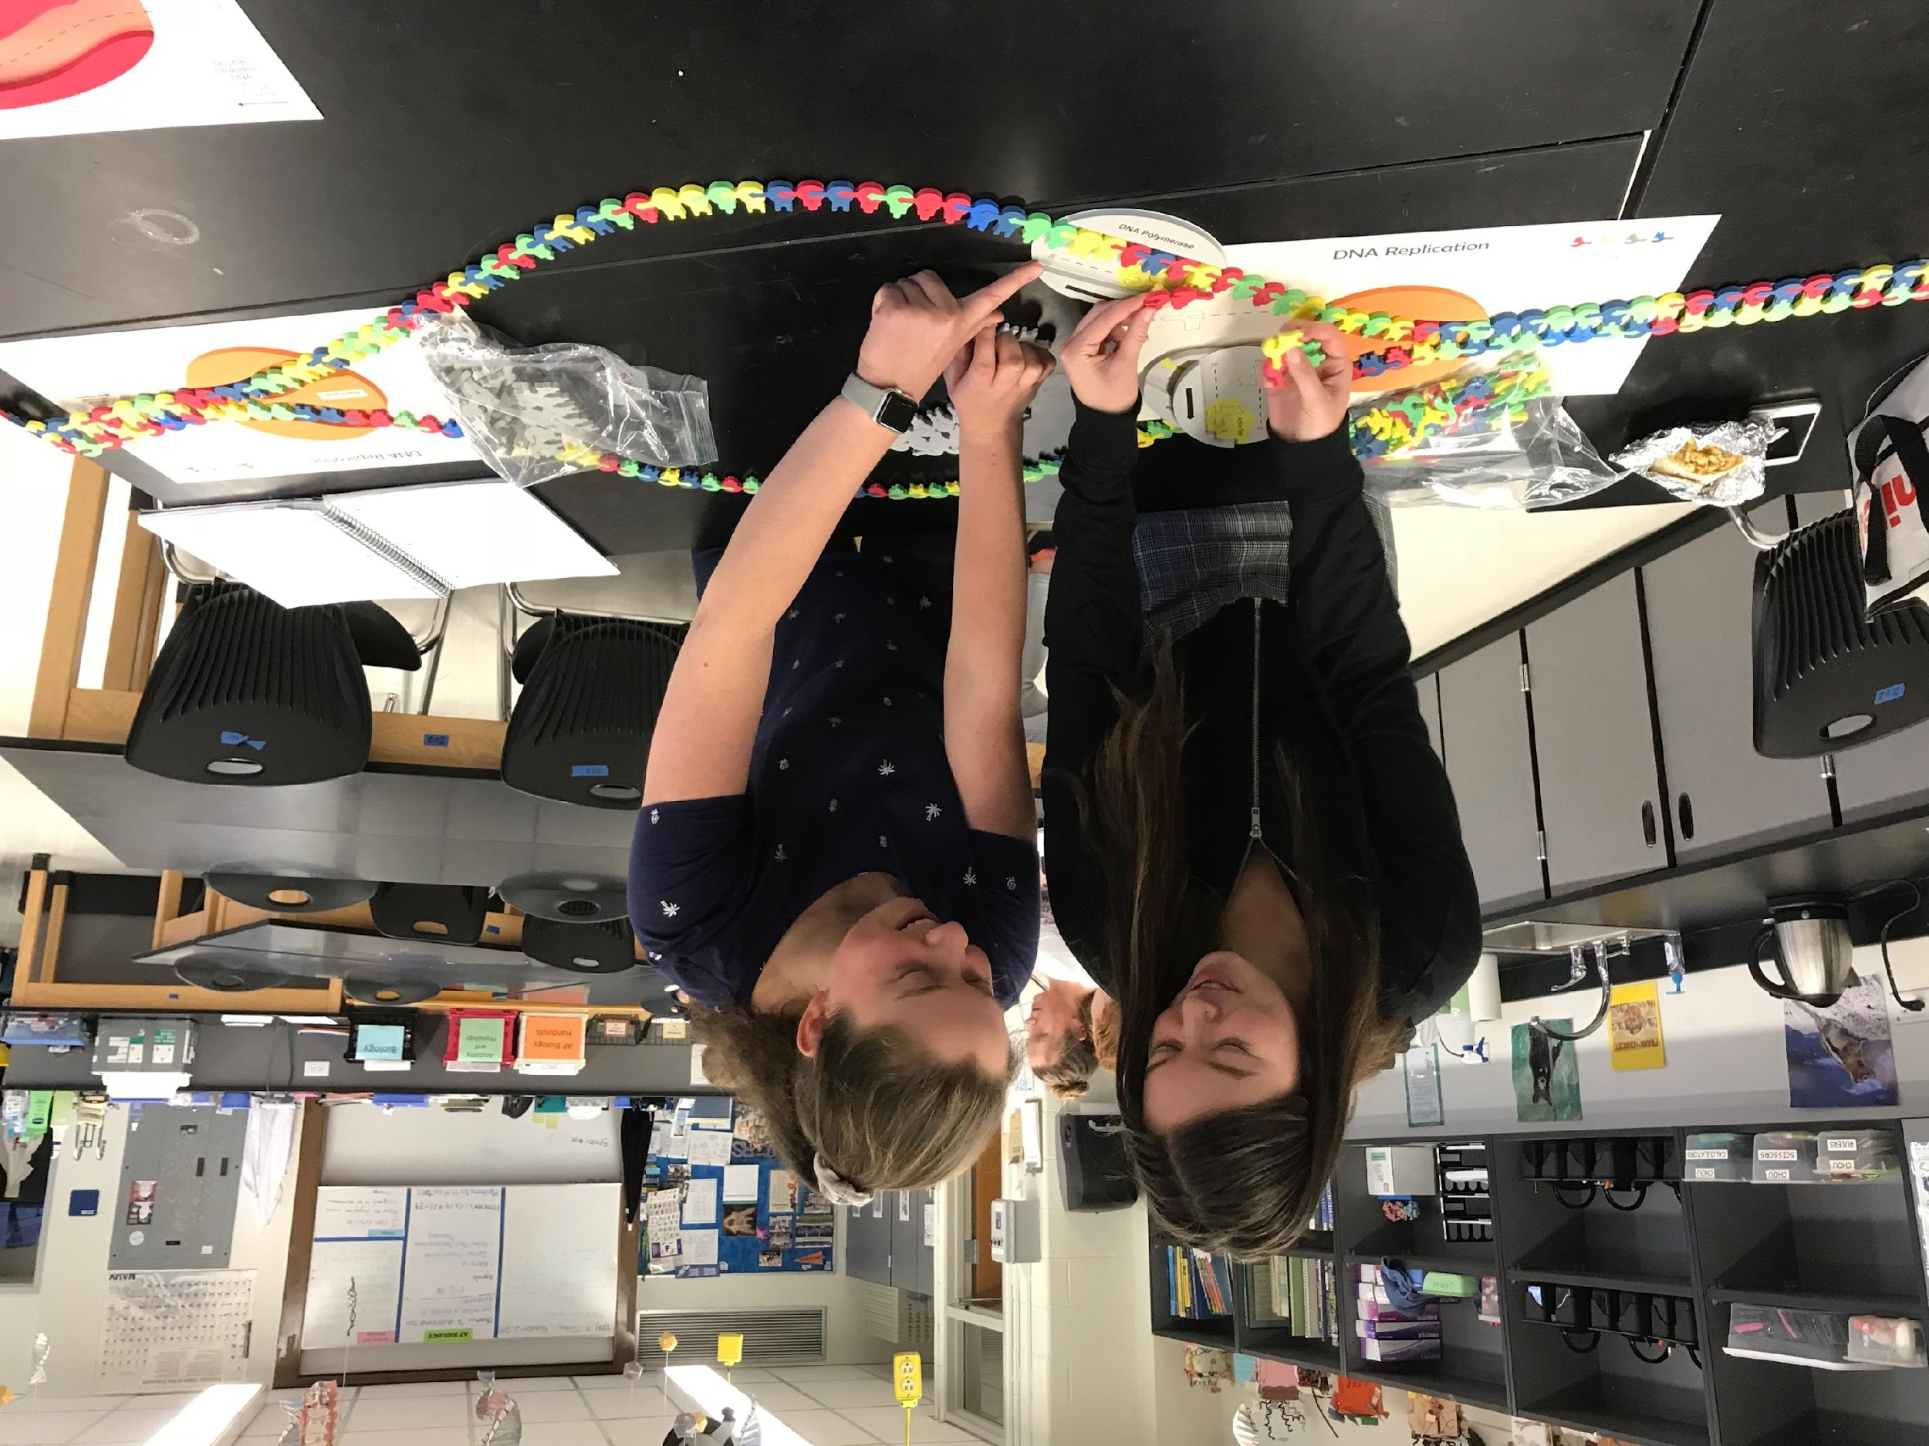
Why Models?
Notes:
Why Models? One important practice of science is to be able to develop and use models. You can help student develop their critical thinking skills when you ask them to evaluate models – What about this model is useful? What things about this model is wrong? Plus, it allows students to engage on hands-on, minds-on learning. They love it! We do a lot of modeling in my classroom. I use many 3D Molecular Design kits, but also playdoh, pipecleaners, and table markers to model biological processes.

Slide 6
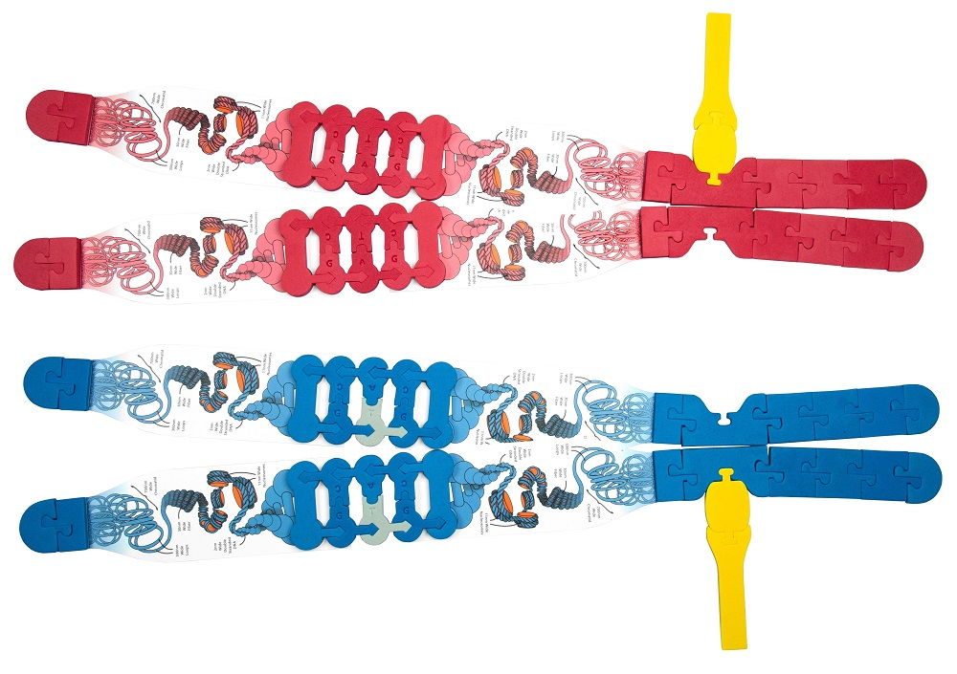

Slide 7
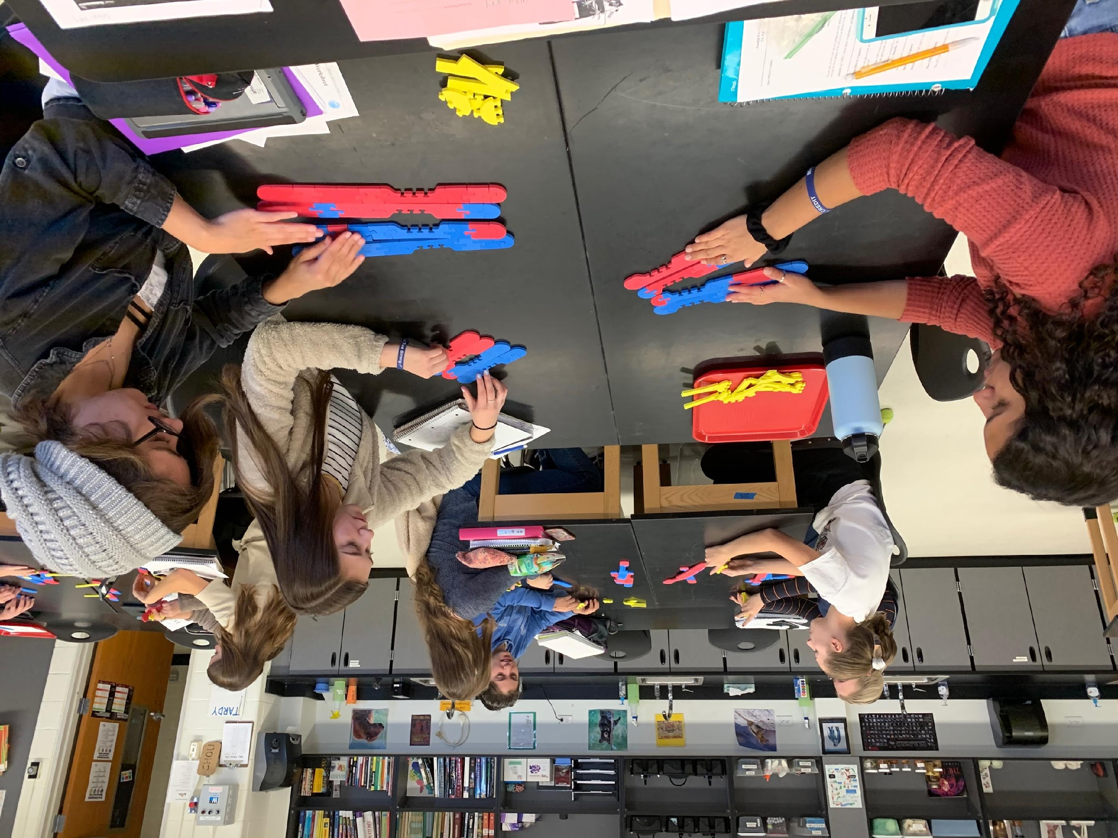
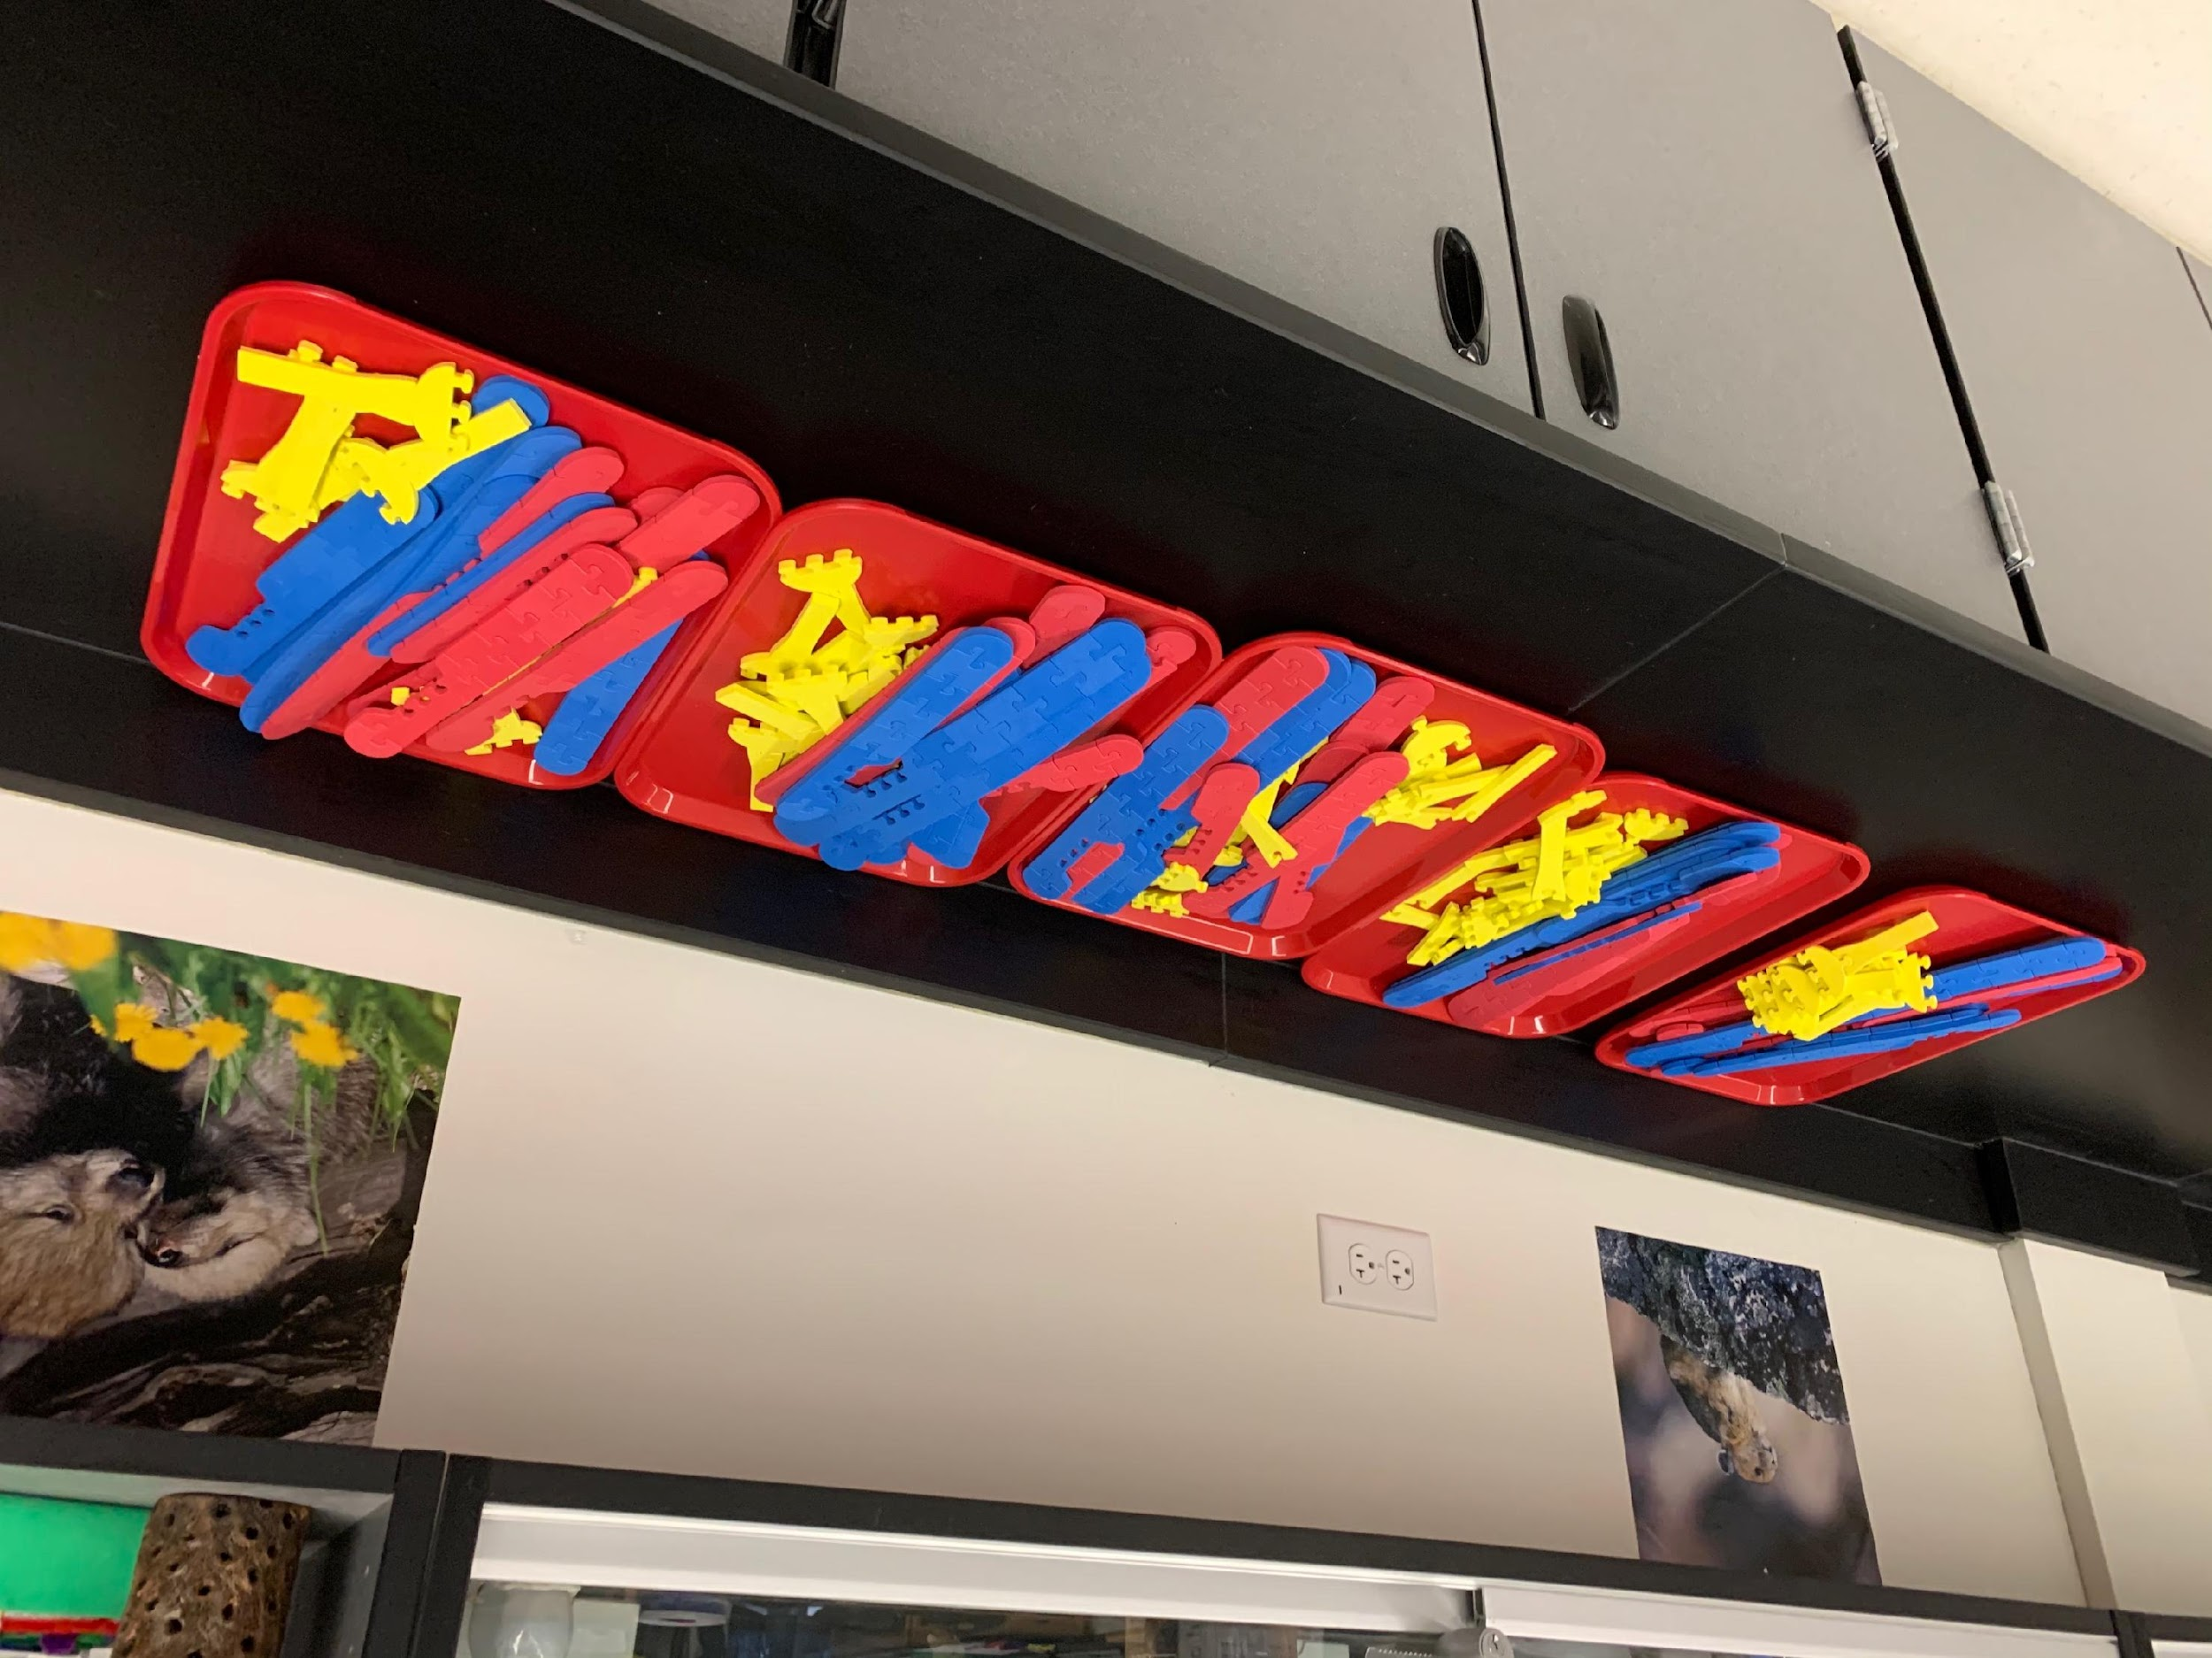

Slide 8
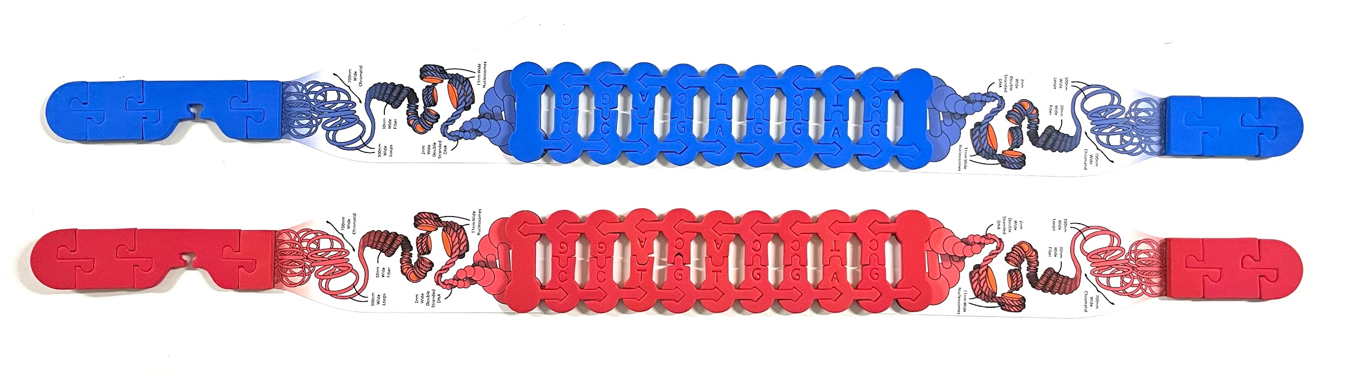
Let’s construct a model of a chromosome.
What do you notice? What do you wonder?

Slide 9
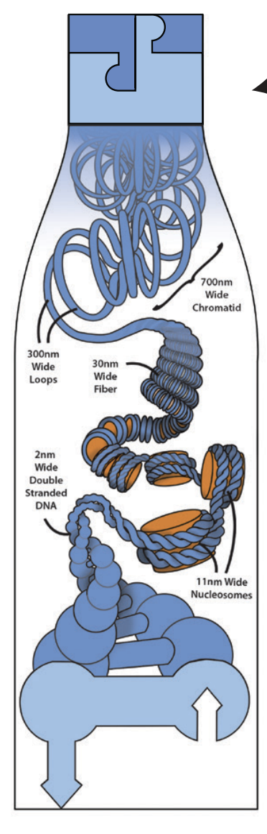
Let’s focus on this particular part of the model.
What do you notice?
What do you wonder?

Slide 10
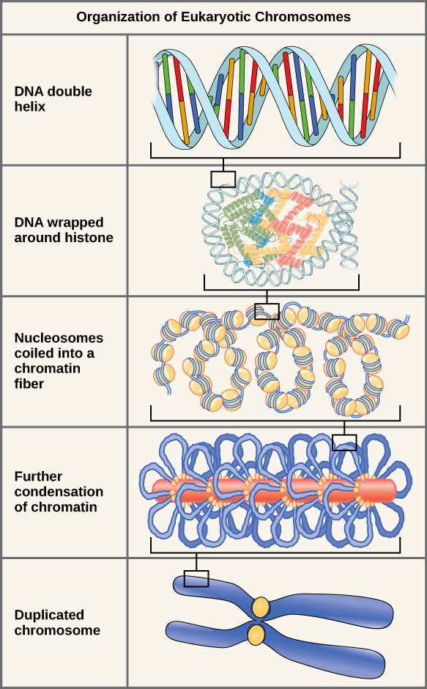

Slide 11
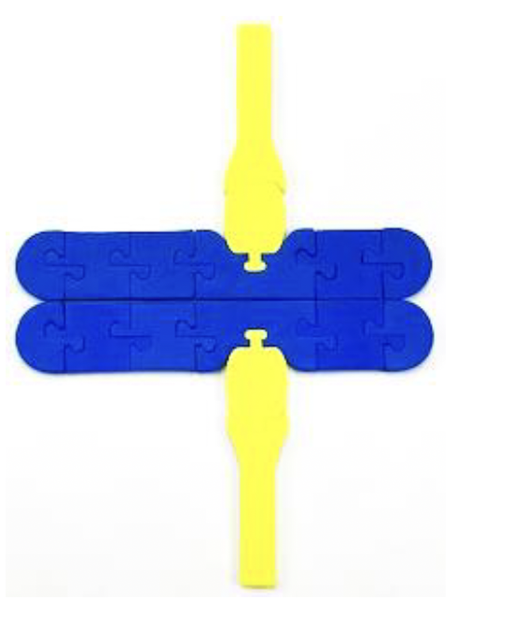
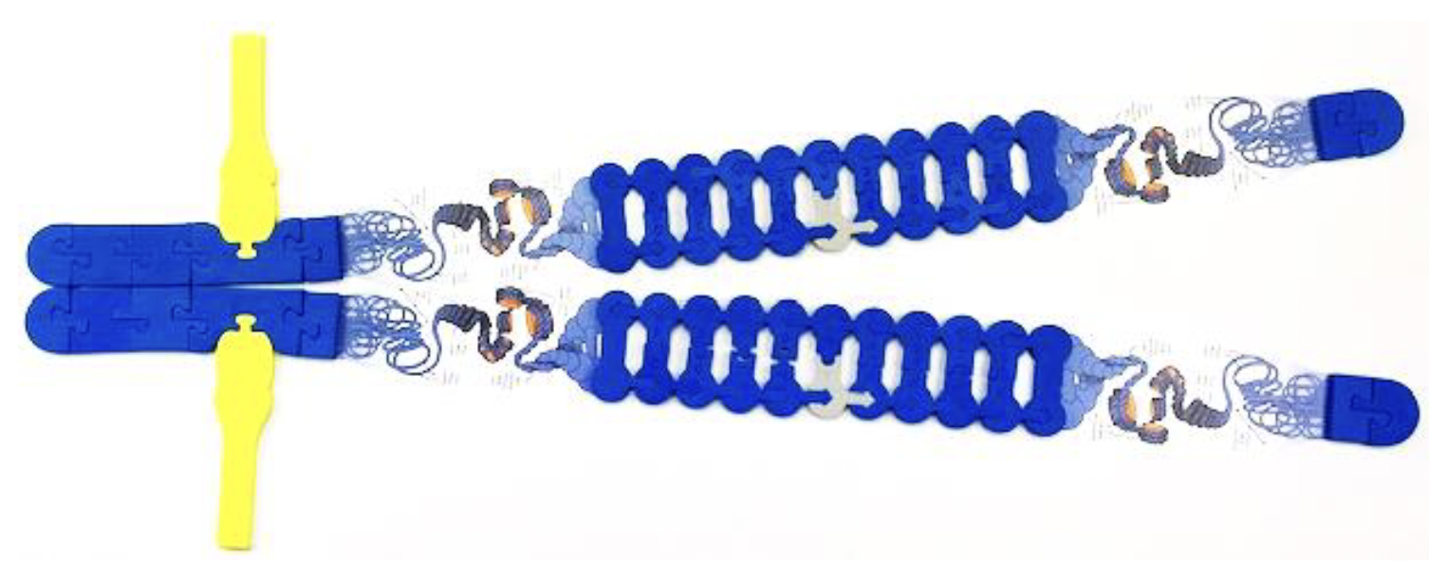
Comparing Chromosomes:
Microscopic Scale vs. Molecular Scale
Microscopic Scale
Molecular Scale

Slide 12






Construct 6 chromosomes:

Slide 13
Homologous chromosomes
Maternal chromosomes
Telomere
Centromere
Paternal chromosomes
Telomere
Notes:
Maternal chromosomes = inherited from the mom (egg); Paternal chromosomes = inherited from dad (sperm cell); Homologous chromosomes = chromosome pairs of approximately the same length, centromere position, and staining pattern, for genes with the same corresponding loci; centromere = constricted region of a chromosome that separates it into a short arm (p) and a long arm (q) AND the region of a chromosome to which the microtubules of the spindle attach, via the kinetochore, during cell division; telomere = the end of a chromosome. Telomeres are made of repetitive sequences of non-coding DNA that protect the chromosome from damage; each time a cell divides, the telomeres become shorter; eventually, the telomeres become so short that the cell can no longer divide.

Slide 14
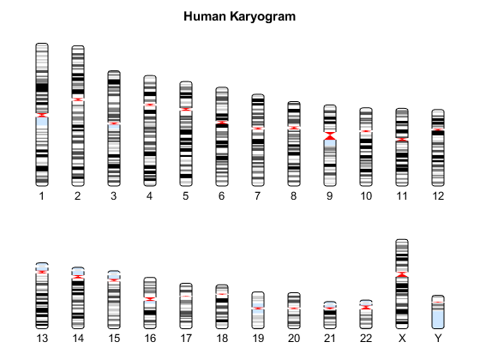
Karyogram
Notes:
A Karyogram is a way used to depict chromosomes, the way chromosomes are organized in the image makes them easy to visualize. They are arranged into homologous pairs each of which is arranged into size order- from largest to smallest.

Slide 15
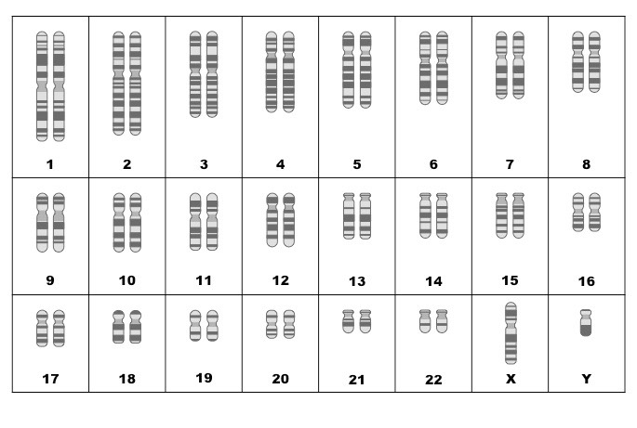
Notes:
This diagram shows 2 of each kind of chromosome. Human have 46 chromosomes in (almost) every cell in our body. One copy of each chromosome comes from your mom (maternal chromosome), and 1 from your dad (paternal chromosome). Each pair of chromosomes is called a “homologous pair”.

Slide 16
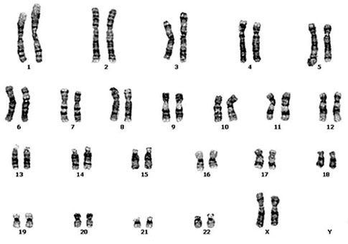
Human Karyotype
Notes:
(Normal Human Female Karyotype) Karyotype - chromosomal characteristics of an individual cell, shown as the array of metaphase chromosomes from a photomicrograph of a single cell nucleus. The chromosomes are arranged in pairs in descending order of size and according to the position of the centromere. Note: METAPHASE chromosomes means that each chromosome was replicated.

Slide 17
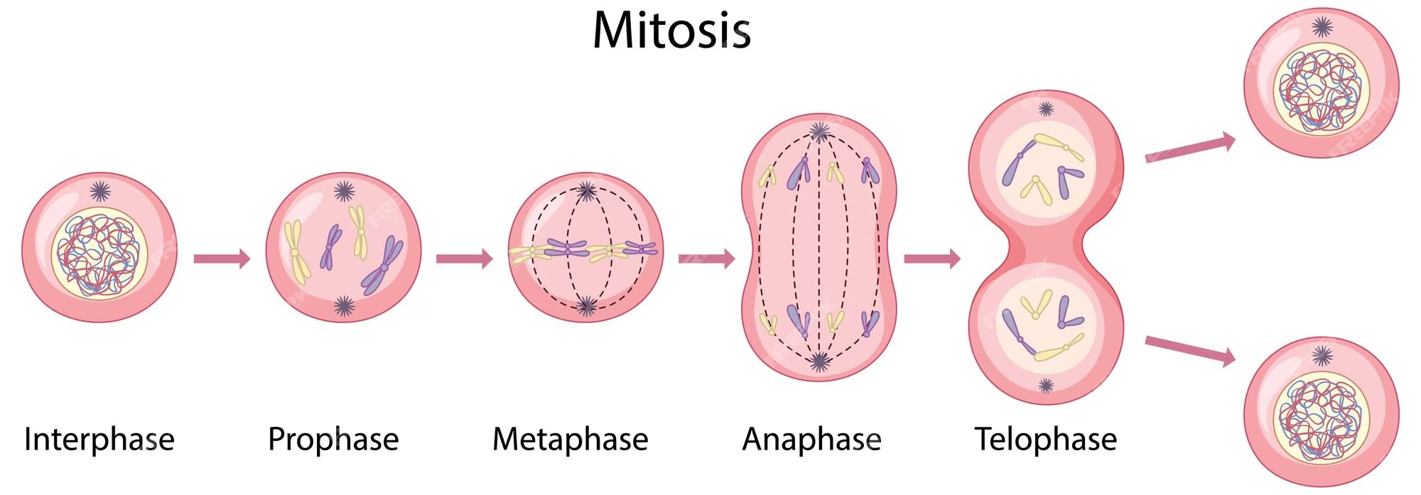
What happens to chromosomes during cell division?

Slide 18
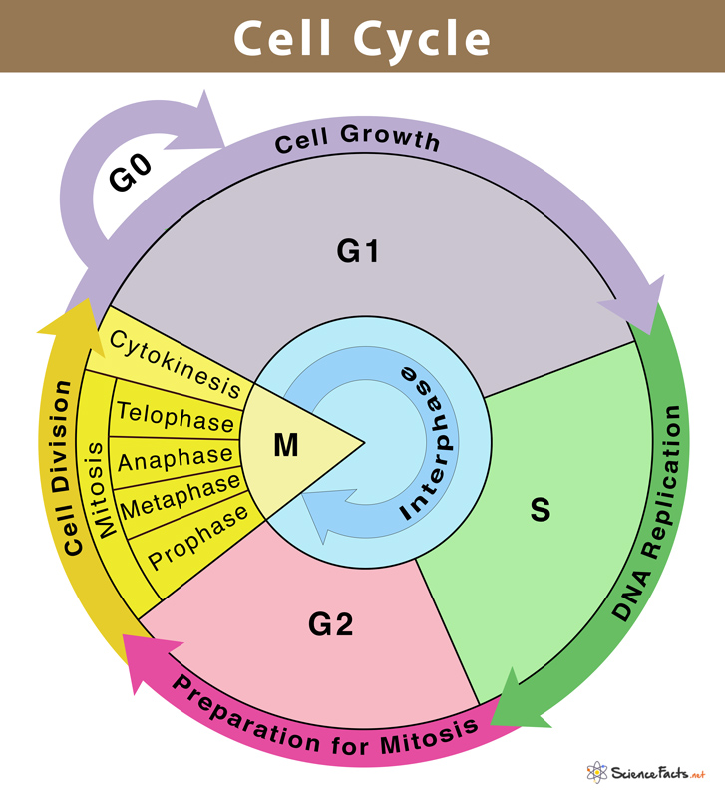
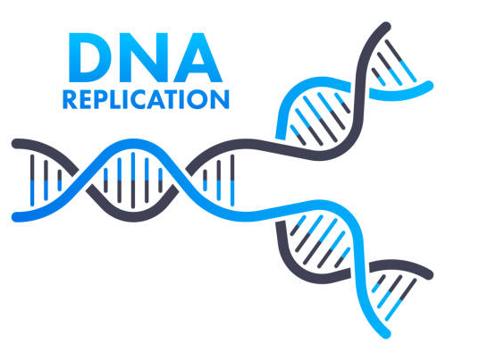

Notes:
Cell Cycle shows the life cycle of a cell. Briefly explain G1, S, G2 and M phases. Note the “S Phase” where DNA is replicated! Also, “Metaphase” is the part of cell division where is it halted to take a photograph of the “chromosome replicated”. The purposes of cell division are for growth, tissue repair, and reproduction.

Slide 19
What happens to chromosomes before a cell divides?

Slide 20
Each chromosome = 2 identical sister chromatids
chromosome
(replicated)
chromosome
(replicated)
Homologous chromosomes

Slide 21
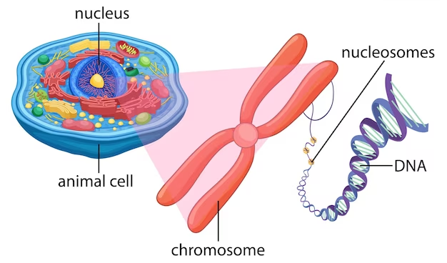
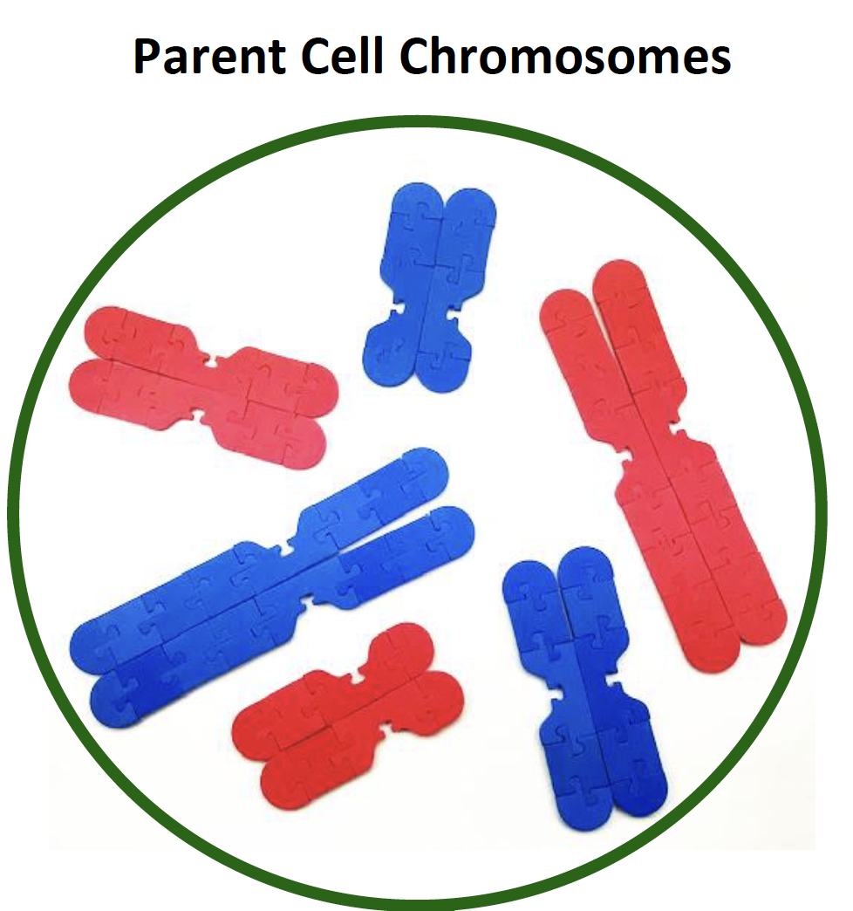
Diploid Cell
2n = 6
(nucleus)

Slide 22
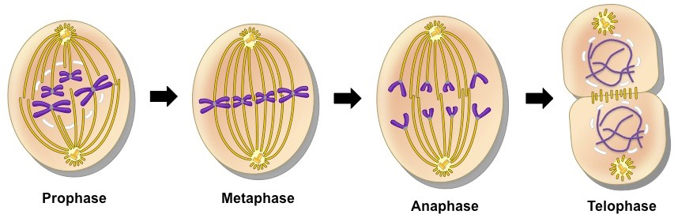
Modeling Mitosis
Notes:
The purpose of mitosis is for growth and tissue repair. Now that the chromosomes have been replicated, it’s time to distribute them into 2 identical daughter cells. Each new daughter cell should have a complete set of DNA and should be identical to the parent cell. Note that ”mitosis” refers to the division of the nucleus, and “cytokinesis” refers to the division of the cytoplasm where the 2 daughter cells completely separate from each other. The diagram only shows mitosis, but not cytokinesis.

Slide 23
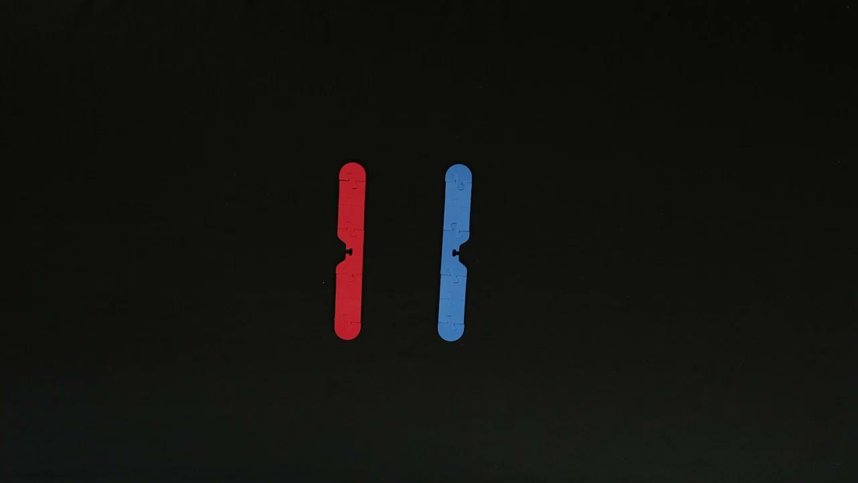

Slide 24
Move your chromosomes to model the process of Mitosis
Notes:
Ideas for doing this in class: (I do, we do, you do) students pair up and model the process together then take turns modeling and explaining to partner; timelapse video; Stop Motion video (use app)

Slide 25

As a learner, what are some “Aha Moments” that arose for you during this activity?
What are some things you wondered about as you modeled mitosis?
What are some driving questions that you could pose to your class where this activity would be useful as you investigate a specific problem?

Slide 26
Questions to ask your students:
How do the daughter cells compare to the original parent cell?
How many chromosomes were in each parent cell?
How many chromatids were in the cell during prophase?
How many chromosomes are in each daughter cell?

Slide 27
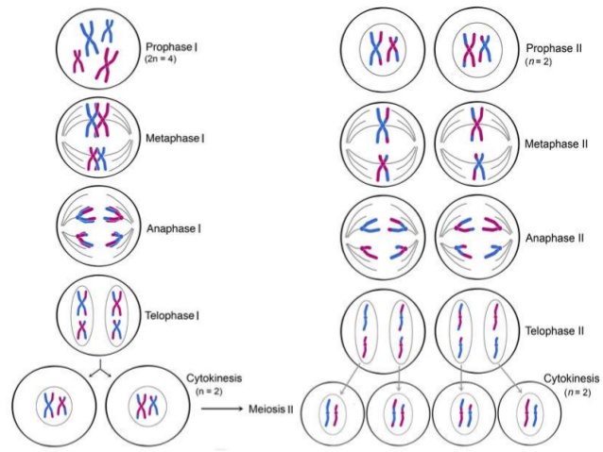
Modeling Meiosis
Notes:
The purpose of mitosis is for growth and tissue repair. Now that the chromosomes have been replicated, it’s time to distribute them into 2 identical daughter cells. Each new daughter cell should have a complete set of DNA and should be identical to the parent cell. Note that ”mitosis” refers to the division of the nucleus, and “cytokinesis” refers to the division of the cytoplasm where the 2 daughter cells completely separate from each other. The diagram only shows mitosis, but not cytokinesis.

Slide 28
Interphase
Prophase I
DNA Replication
Synapsis
replicated chromosomes
(chromatin condenses to form chromosomes)
pairing of homologous chromosomes

Slide 29
Prophase I - Crossing Over
tetrad = 4 chromatids
crossing over between non-sister chromatids

Slide 30
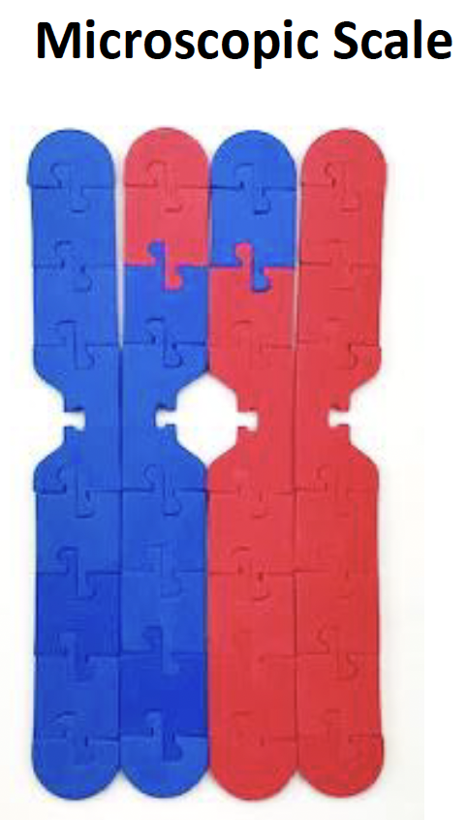
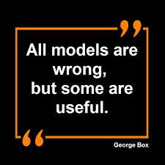
Crossing Over
What are some limitations of this model?

Slide 31
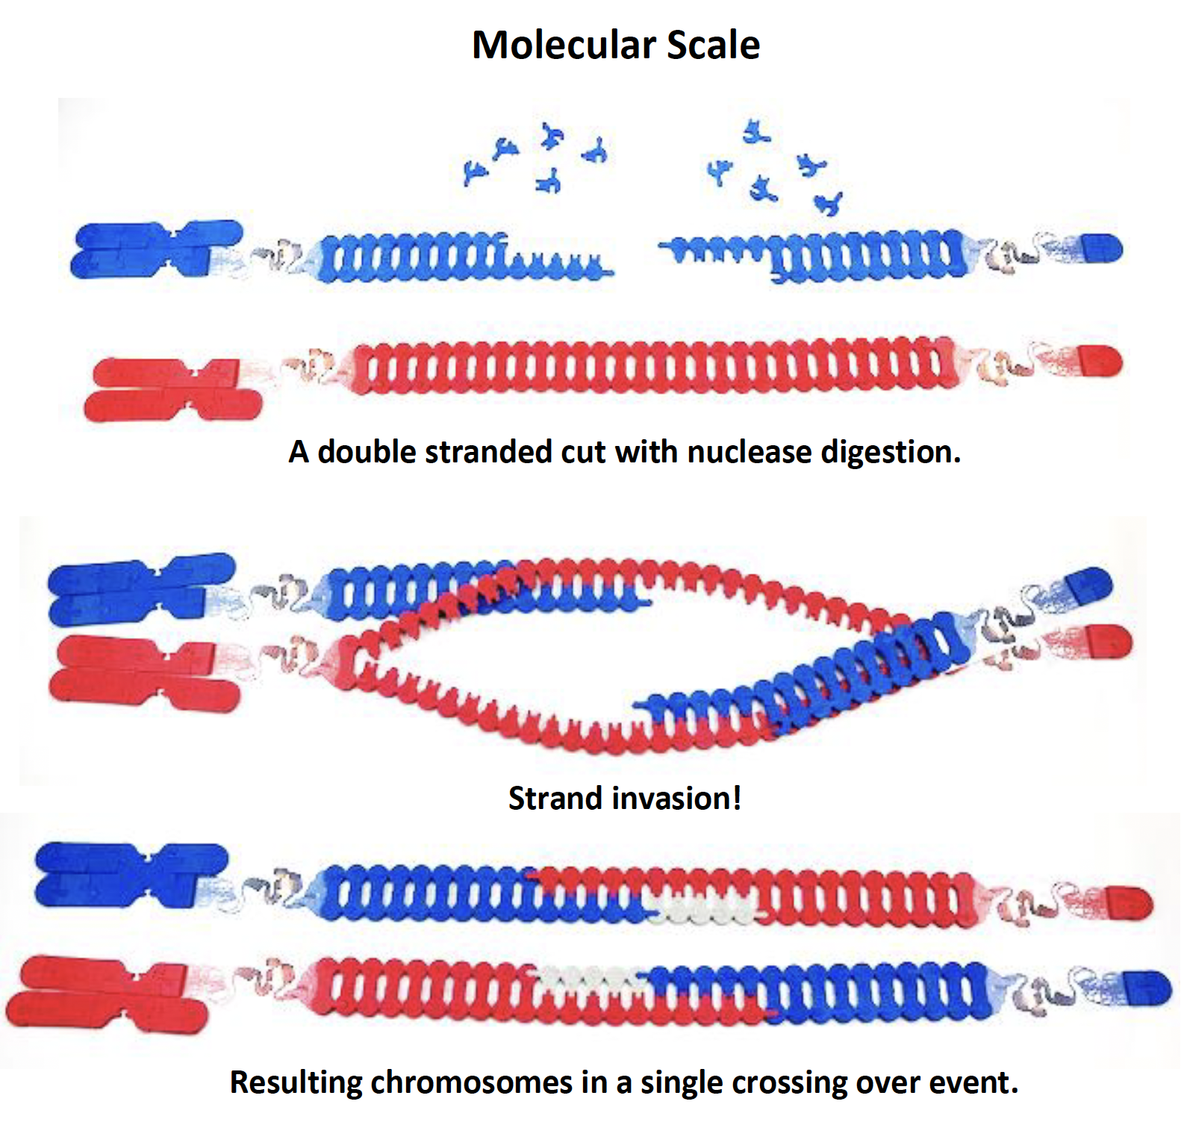
Crossing Over
Molecular Scale
Microscopic Scale

Slide 32
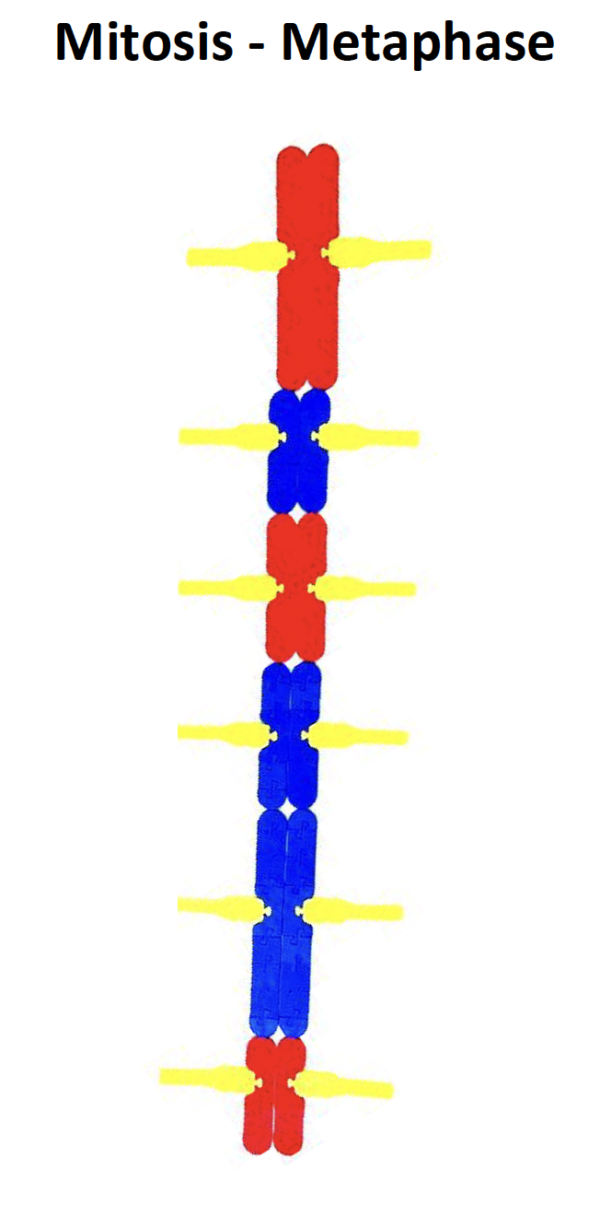
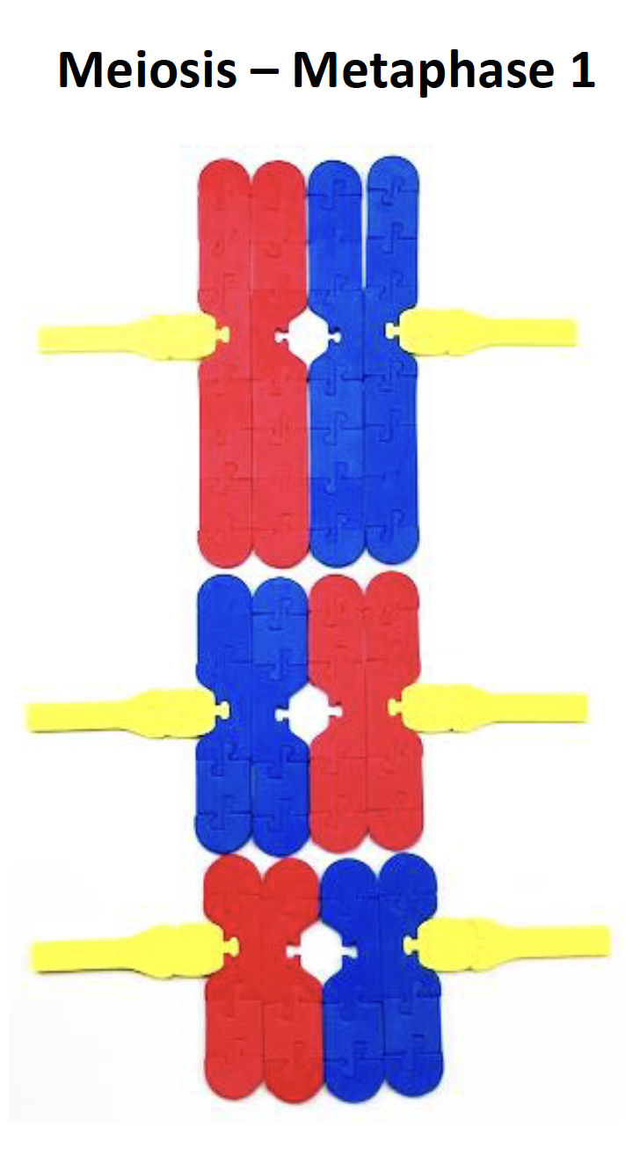

How does Metaphase (in Mitosis) differ from Metaphase I (in Meiosis)?
Mitosis - Metaphase
Meiosis - Metaphase I

Slide 33
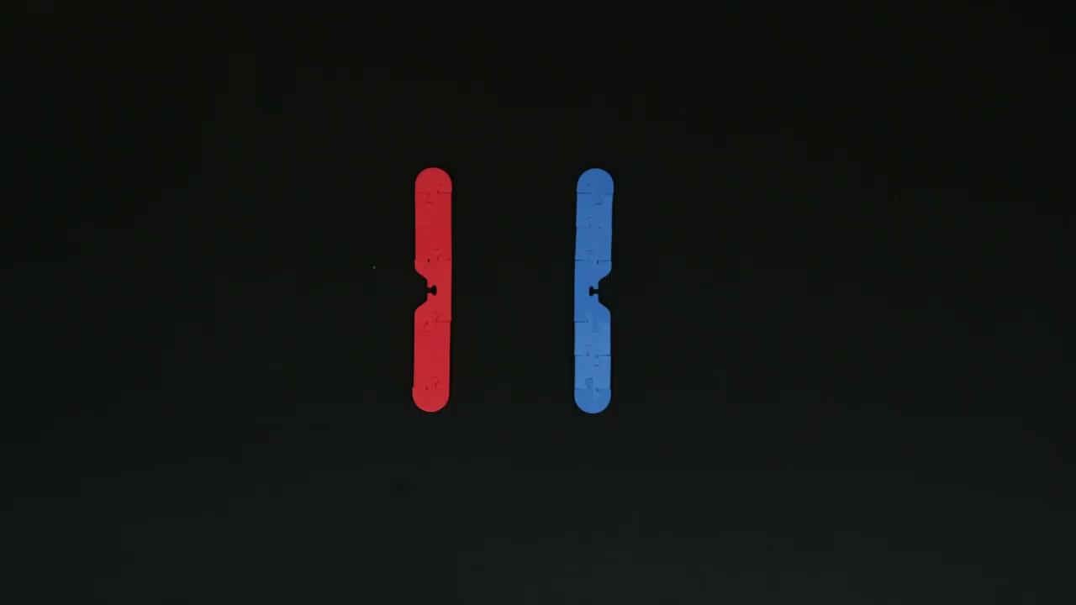

Slide 34
Move your chromosomes to model 2 divisions: Meiosis I and Meiosis II

Slide 35
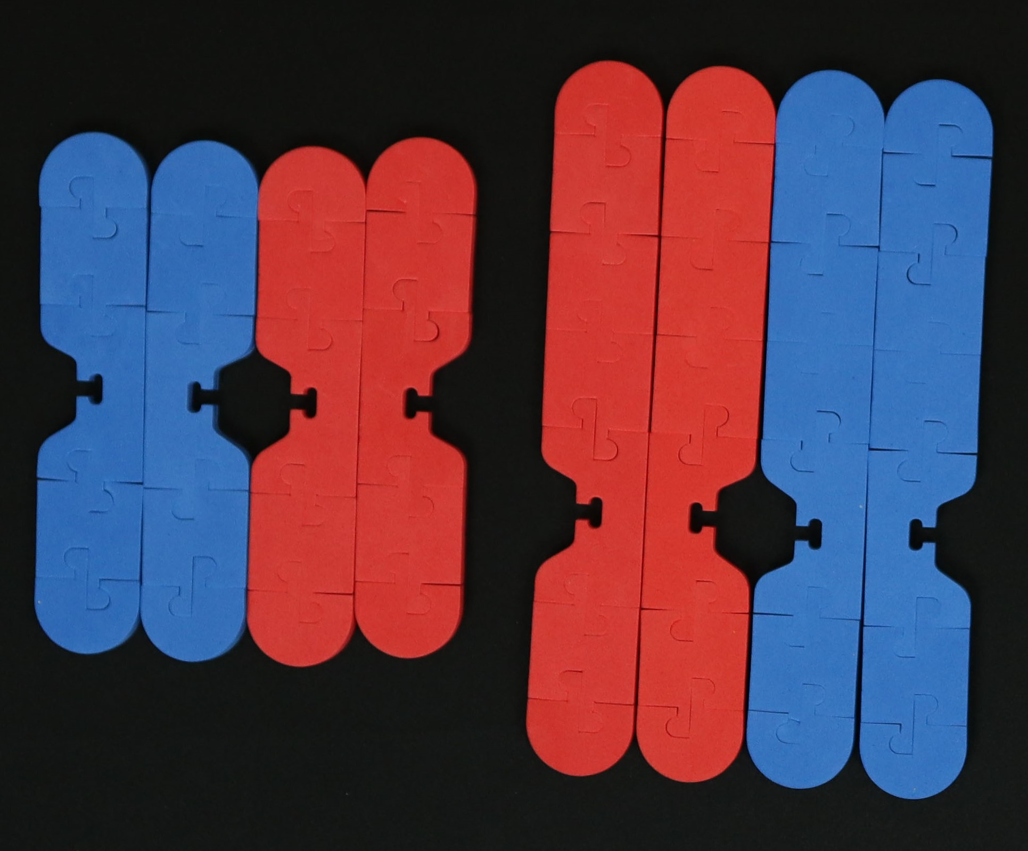
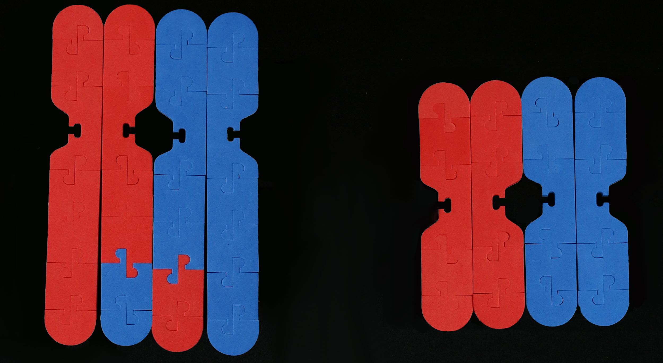
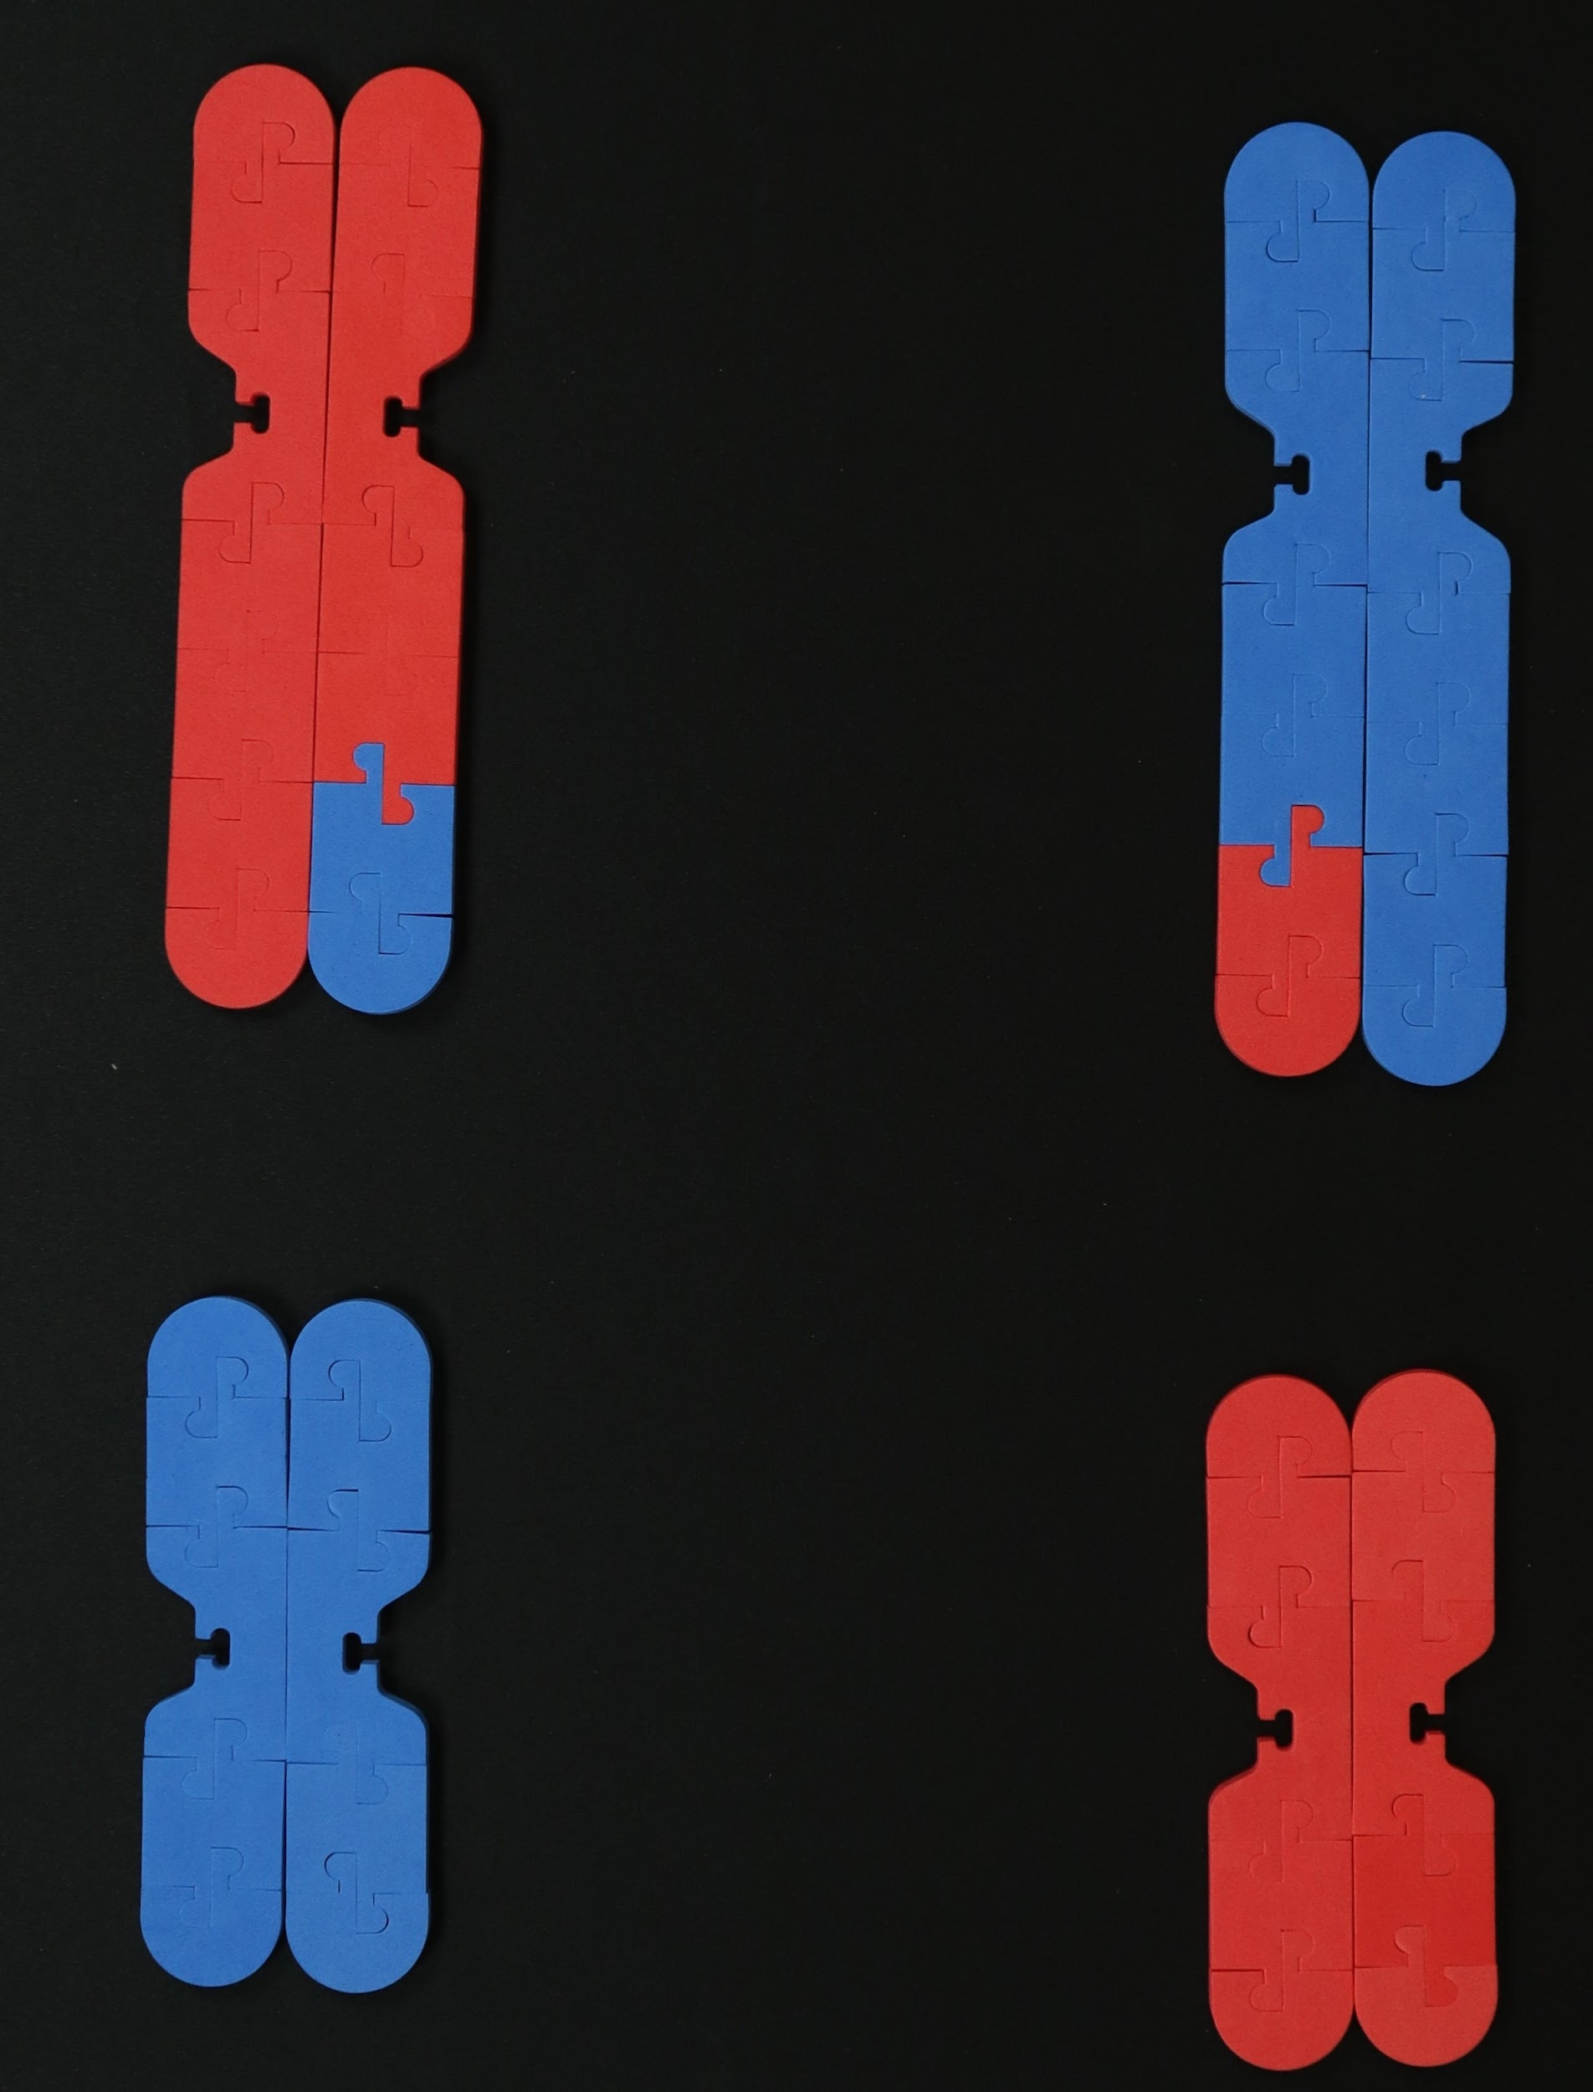
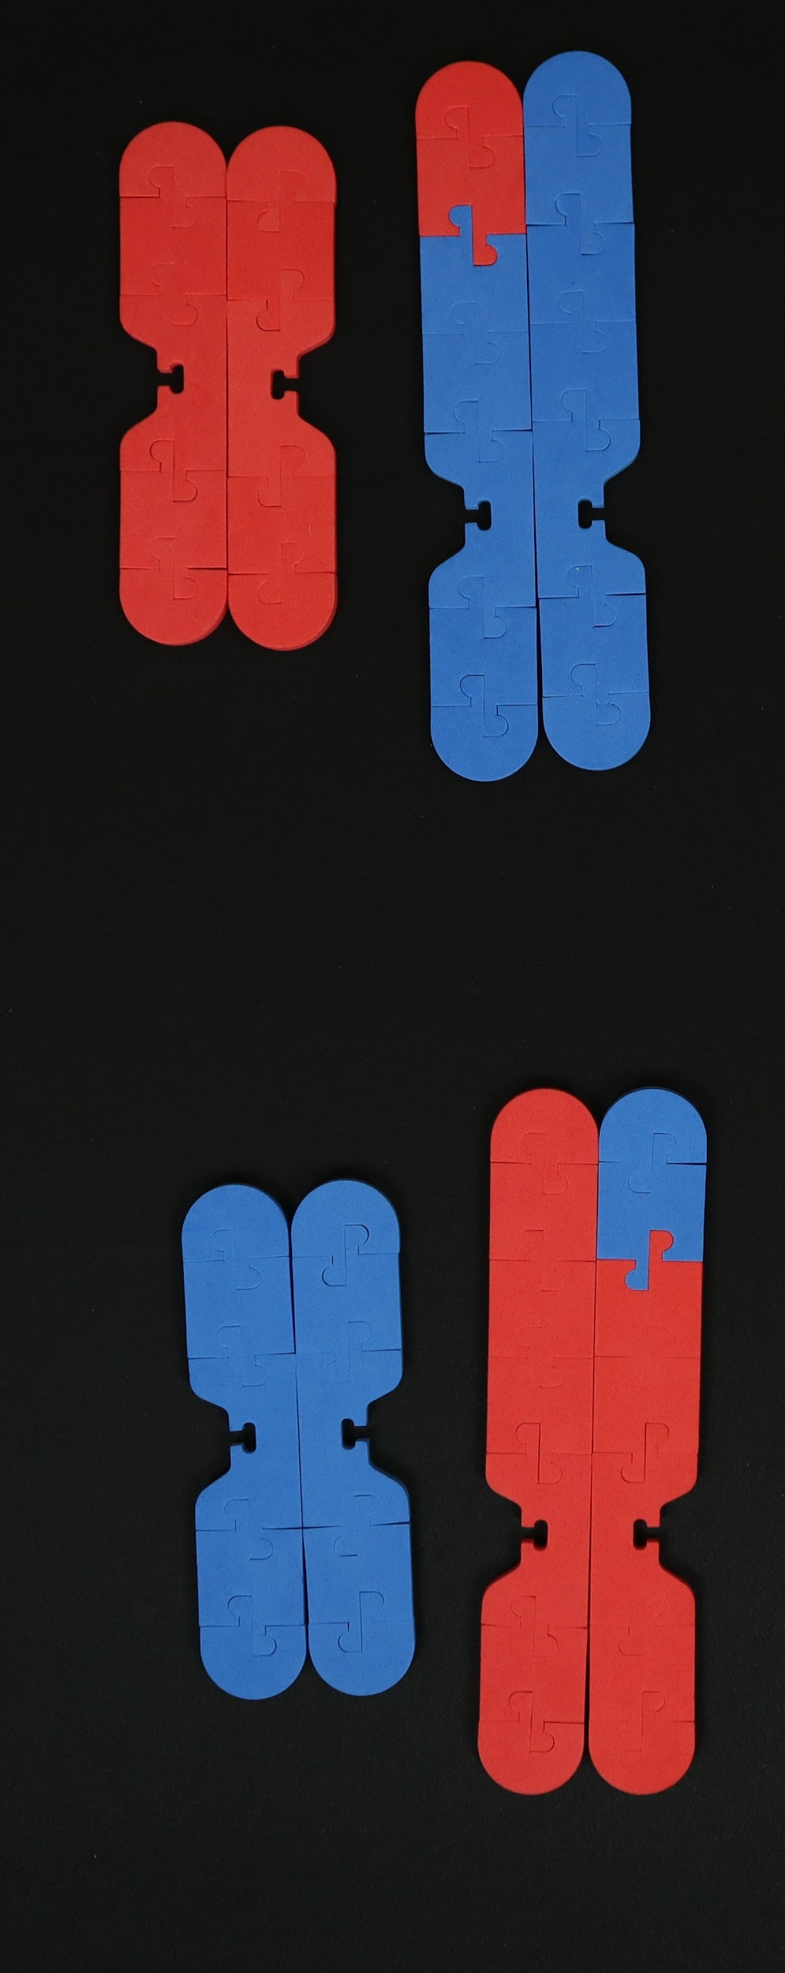
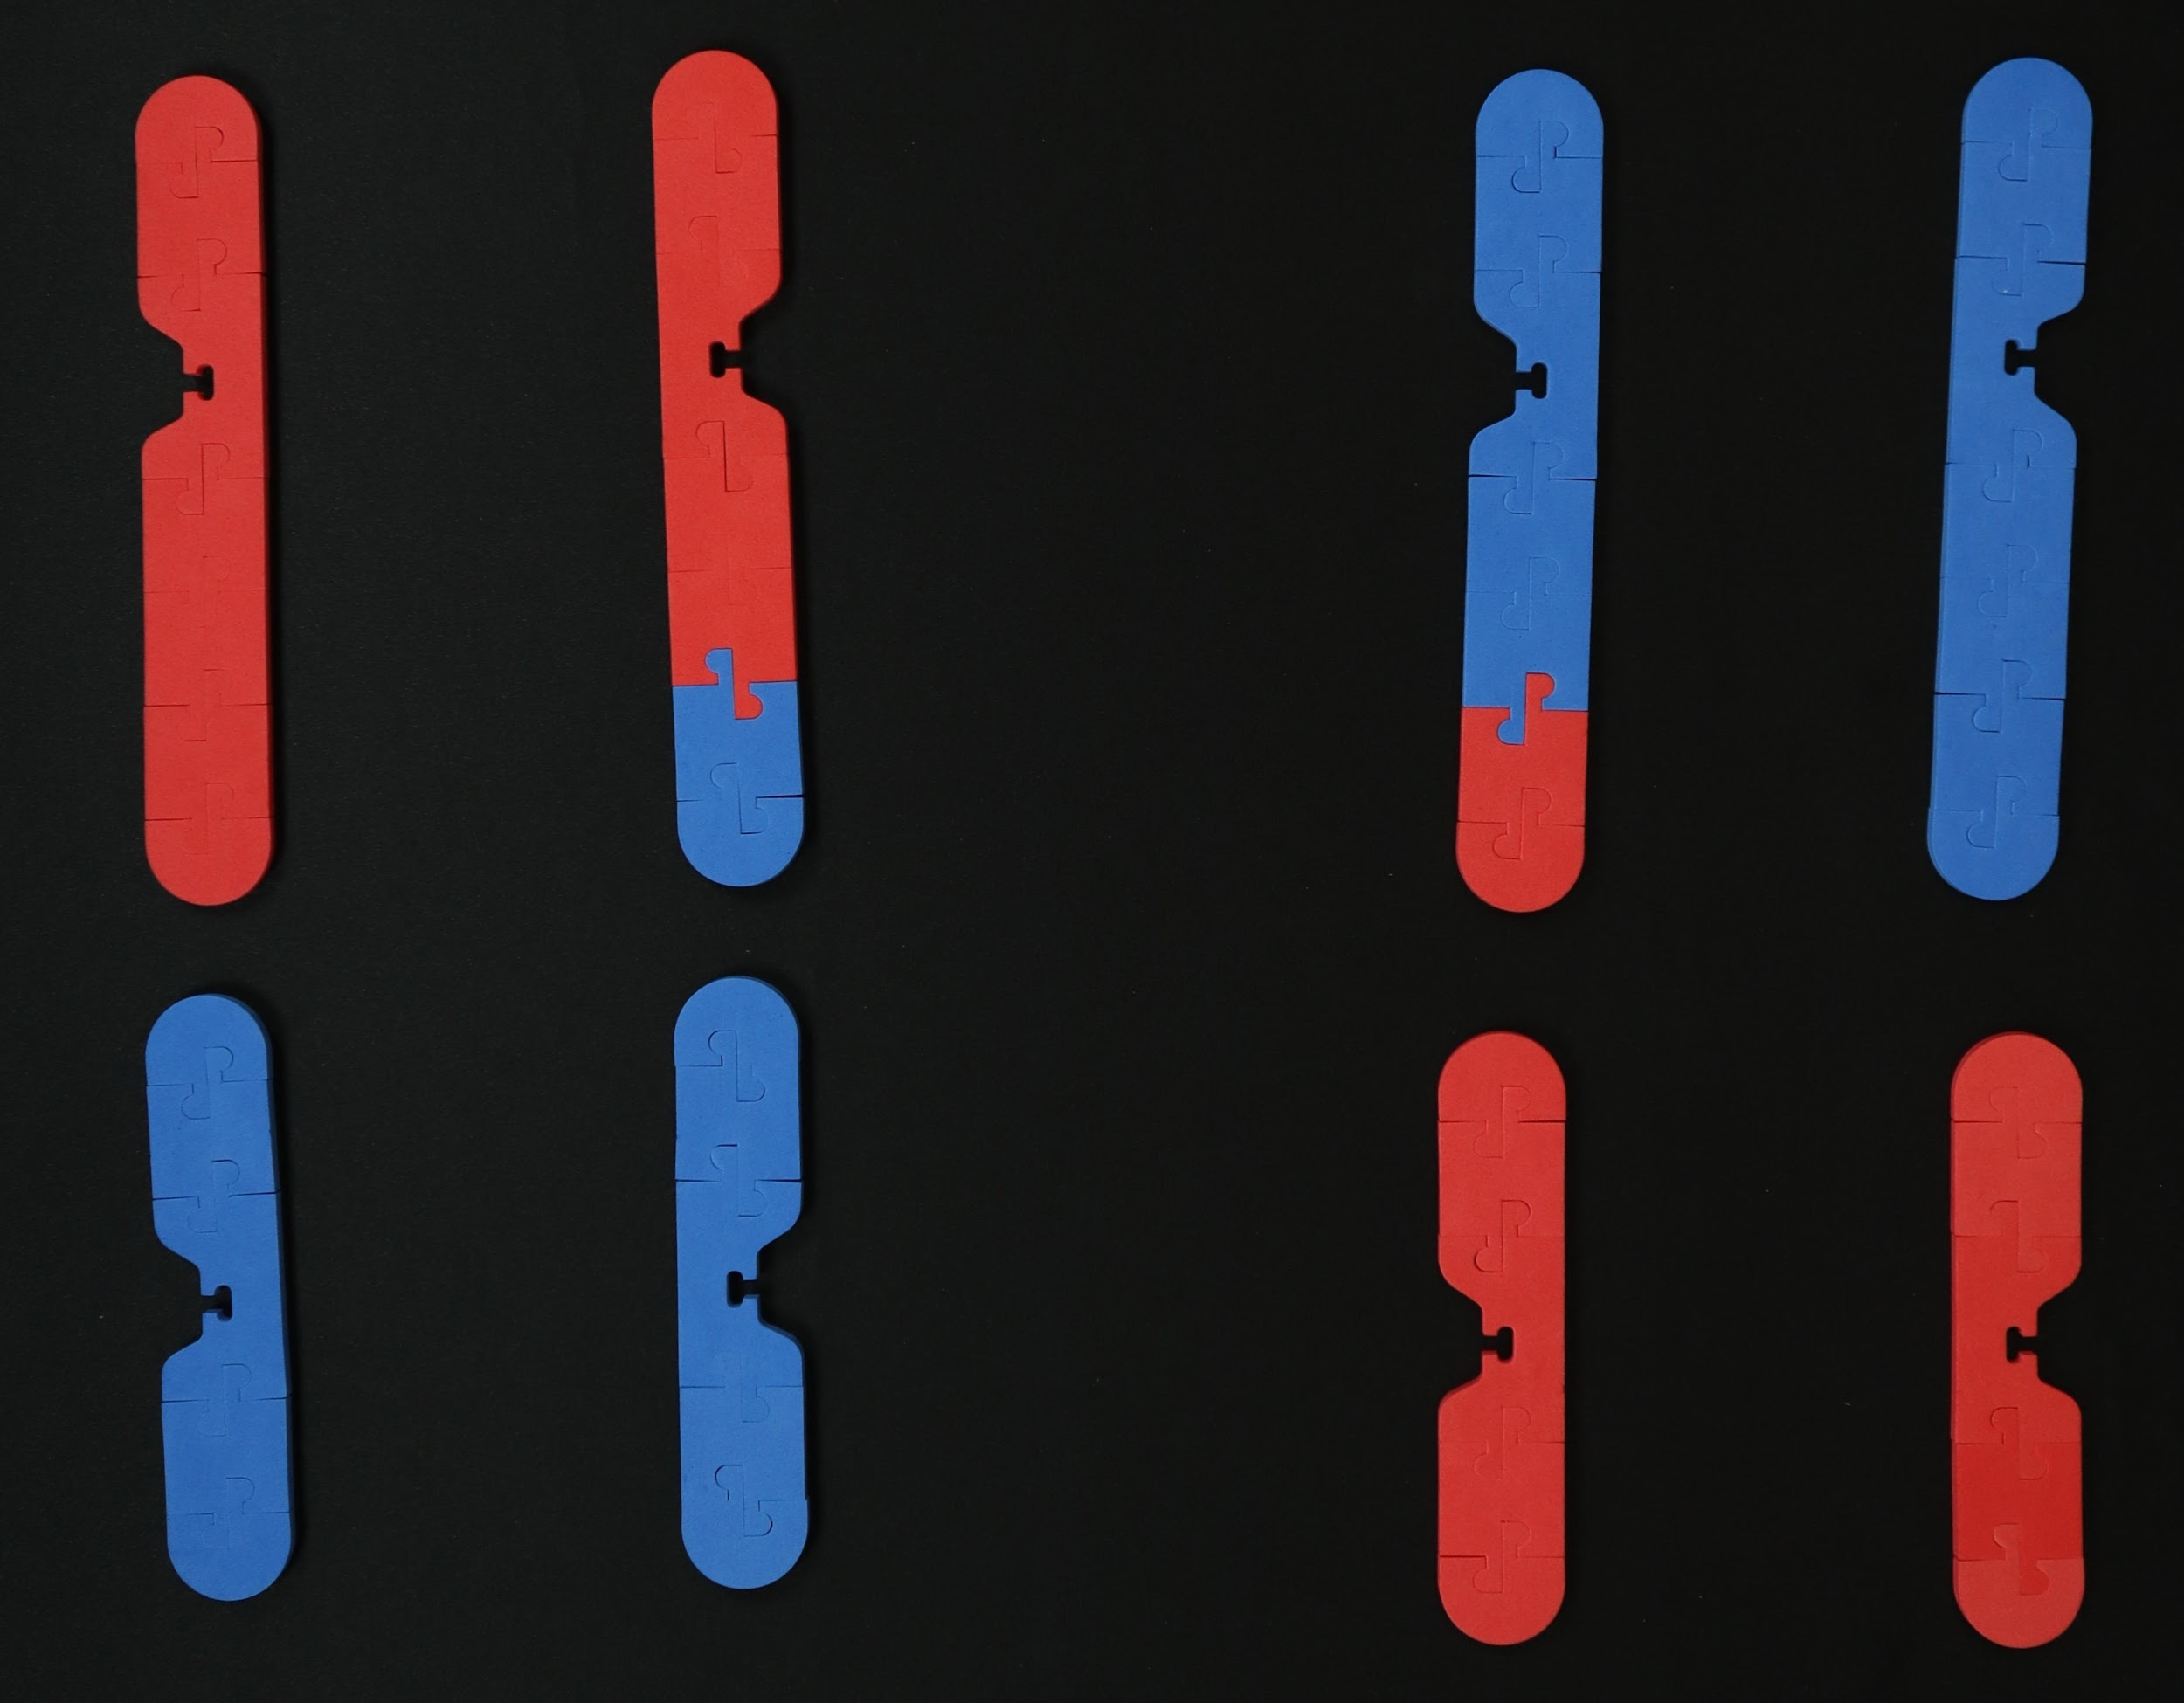
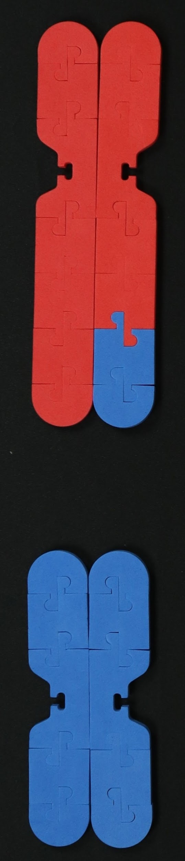
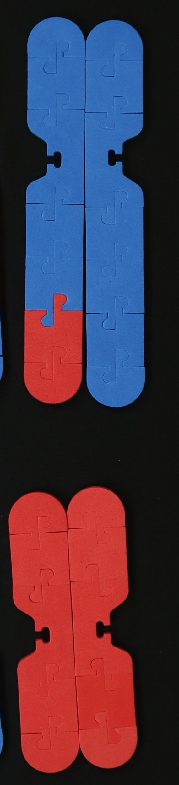
Meiosis I
synapsis
crossing over
Prophase I
Metaphase I
Anaphase I
Telophase I
Meiosis II
Prophase II
Metaphase II
Anaphase II
Telophase II
Notes:
Note: Student kit does NOT contain kinetochores and microtubules; can use string to model the spindle fibers in student kit; Ideas for doing this in class: (I do, we do, you do) students pair up and model the process together then take turns modeling and explaining to partner; time-lapse video; Stop Motion video (use app); This part of modeling reveals a LOT of student misconceptions!!

Slide 36
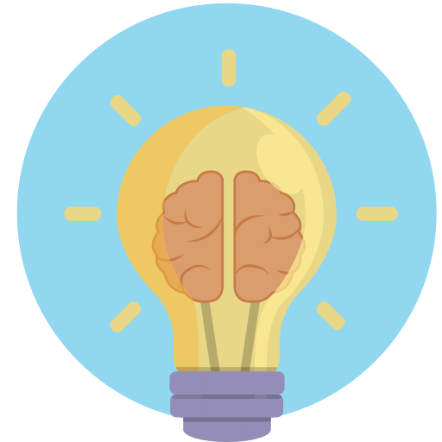
What are some “Aha Moments” you experienced as a learner during this activity?

Slide 37
What are some probing questions that you might ask your students as they model the process of meiosis?
What are some specific tasks you could you ask your students to do to demonstrate their understanding of meiosis?

Slide 38
Questions to ask your students:
In meiosis, how do the daughter cells compare to the original parent cell?
How many chromosomes were in the parent cell?
How many chromosomes are in each daughter cell?
List all the ways in which mitosis and meiosis are similar.
List all the ways in which mitosis and meiosis are different.

Slide 39
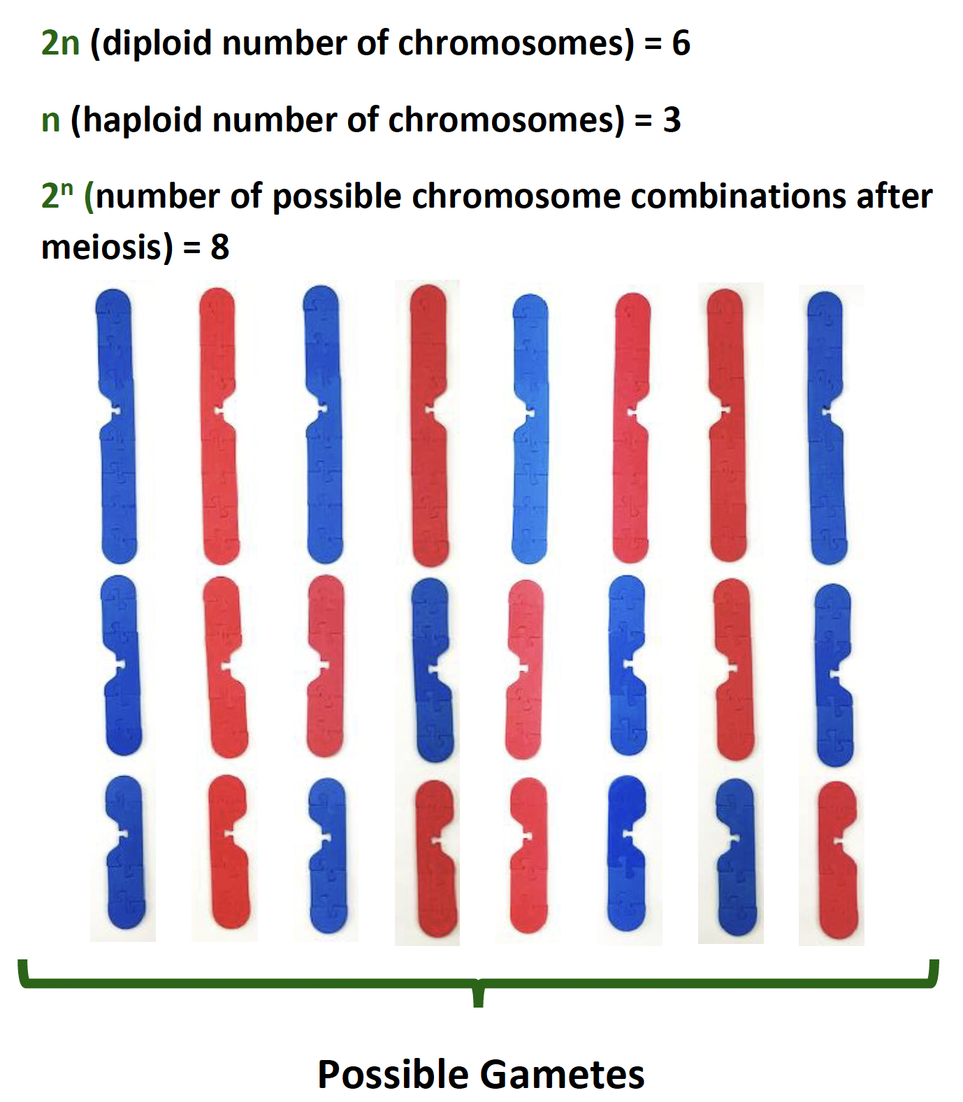
Genetic Variation: Law of Independent Assortment

Slide 40
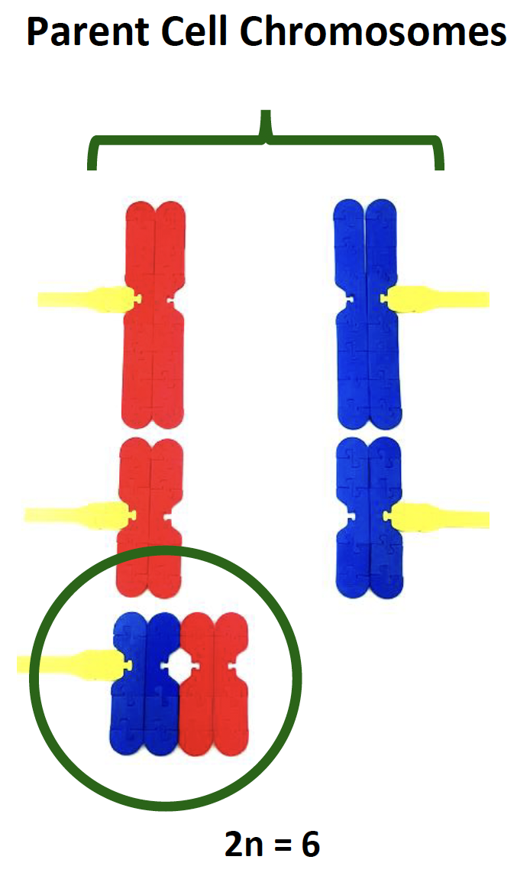
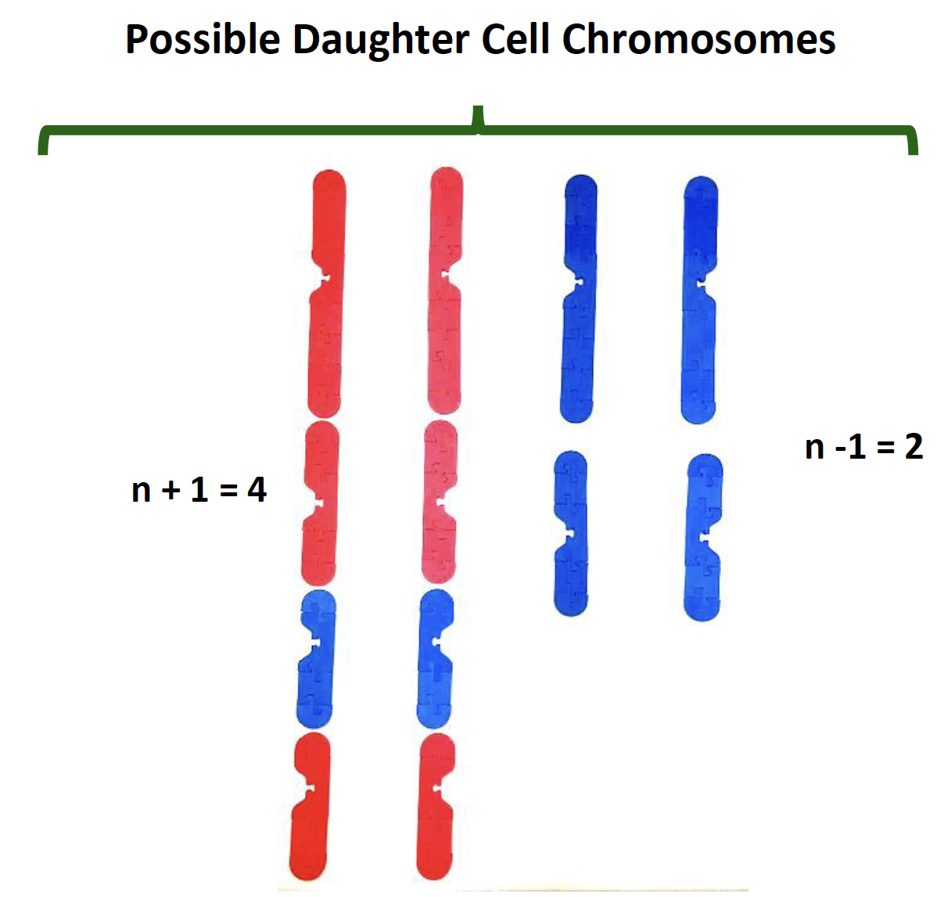
Nondisjunction in Meiosis I

Slide 41
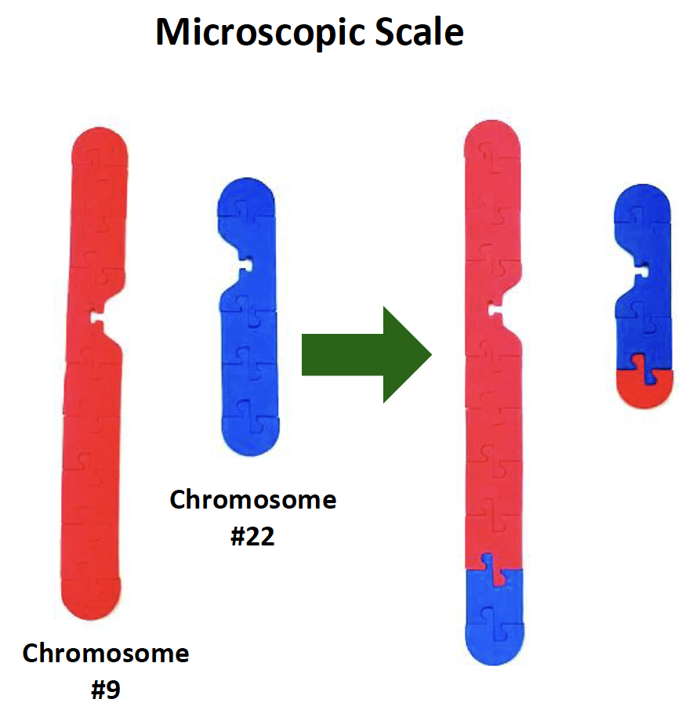
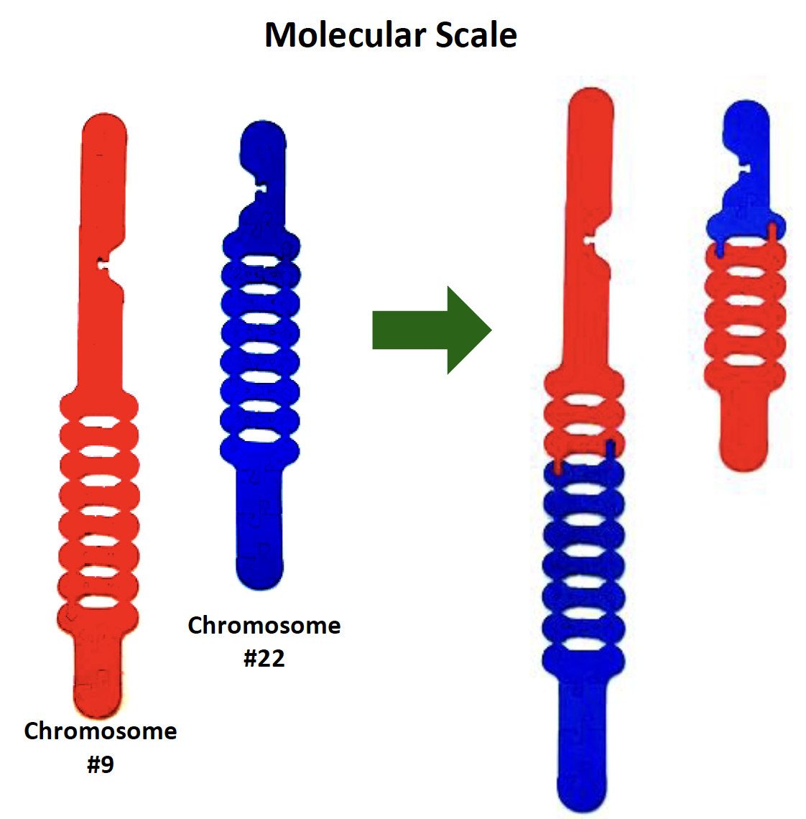

Nondisjunction: Philadelphia Chromosome
Formation of a new gene (BCR-ABL) → Chronic myelogenous leukemia
Microscopic Scale
Molecular Scale
Philadelphia Chromosome

Slide 42


Slide 43
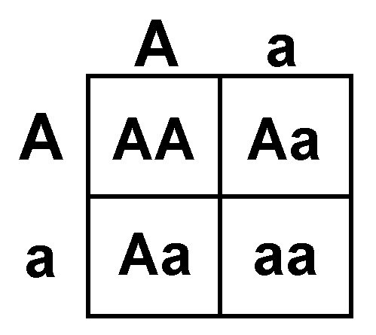
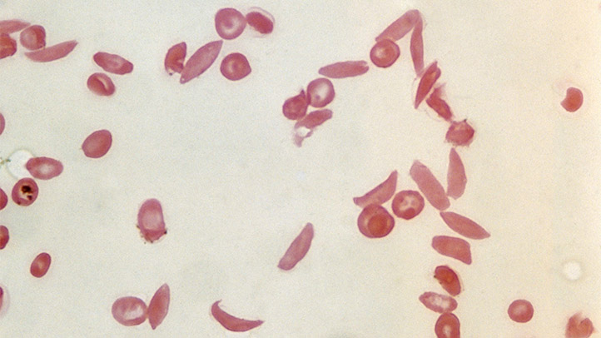
Case Study: Sickle Cell Anemia
Constructing Punnett Squares

Slide 44
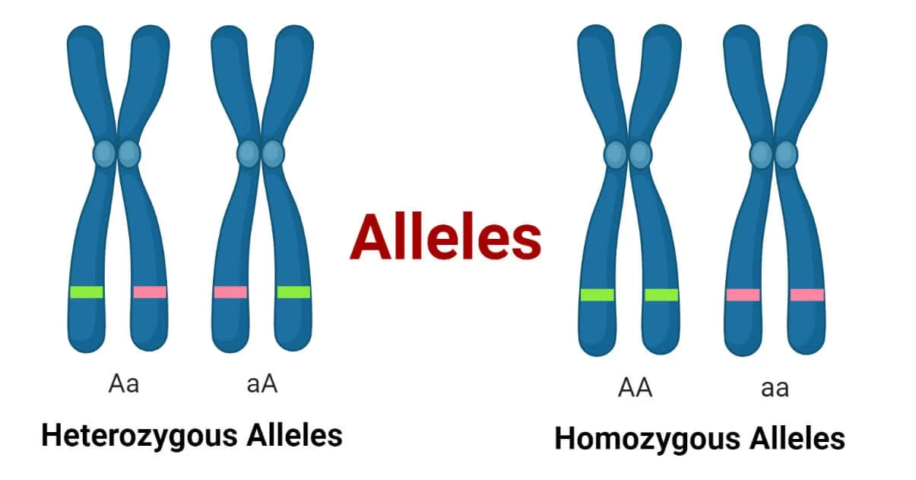
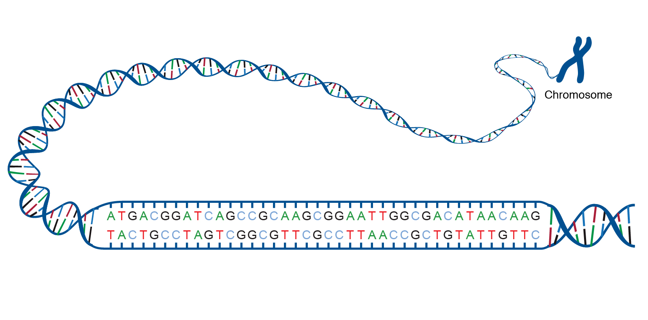
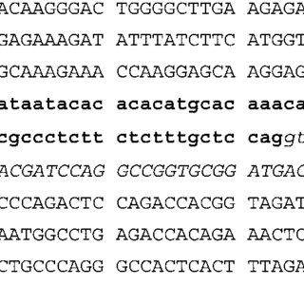
Allele ⟺ Chromosome ⟺ DNA Sequence

Slide 45
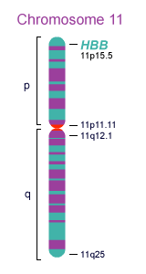
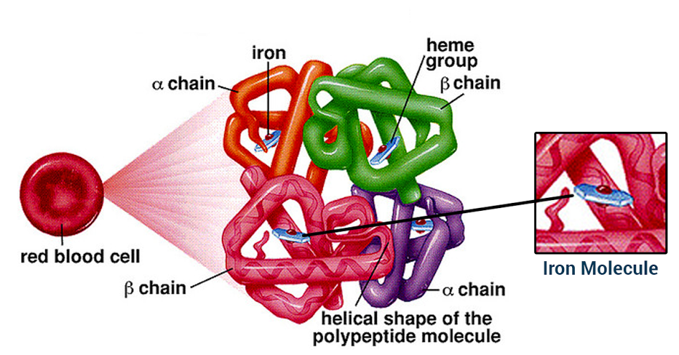
HBB Gene → Beta-globin protein
Notes:
HBB Gene encodes for the beta-globin protein, 2 of the subunits that make up hemoglobin, a protein found in red blood cells. The Hemoglobin protein is made up of 2 alpha and 2 beta-globin subunits. Each globin subunit has a heme-group, which can bind to oxygen. The main job of red blood cells is to carry oxygen throughout the body, so hemoglobin proteins are essential for this task. The HBB gene is located on human chromosome 11. HBB protein is produced by the gene HBB which is located in the multigene locus of β-globin locus on chromosome 11, specifically on the short arm position 15.5.

Slide 46
Let’s return to our original model of a chromosome.
The DNA sequence shown is a portion of the HBB gene.
What would happen if there was a mutation?

Slide 47
Let’s examine a point mutation in Codon 6 of the HBB gene
3’ G G A C T C C T C 5’
3’ G G A C A C C T C 5’
5’ C C T G A G G A G 3’
5’ C C T G T G G A G 3’
Codon 6
GAG → GTG

Slide 48

The model of the DNA sequence can be used to show a point mutation
Paternal Chromosome
Maternal Chromosome

Slide 49
Let’s focus on Codon 6.
Paternal Chromosome
Maternal Chromosome

Slide 50

Let’s focus on Codon 6.
Paternal Chromosome
Maternal Chromosome

Slide 51

Mutation = Change in DNA sequence
Notes:
Single base pair substitution of T to A (in bottom strand) Position 5248232 SNP ID rs334. T/A. Glu7Val. Missense. Most common mutation of HBB gene. Glutamic Acid (hydrophilic side chain) to Valine (hydrophobic side chain).

Slide 52


Abnormal Hemoglobin
Normal Hemoglobin
glutamic acid
valine
Notes:
Ask: What differences do you spot between the structure of normal hemoglobin and the abnormal hemoglobin? Answer: The structures are VERY SIMILAR. The only difference is the Glu to Val substitution that creates a hydrophobic pocket (changing the quaternary structure) and the bonding between subunits. This makes the HbS more “sticky” so that subunits clump together in a linear fashion (as shown in the right diagram)

Slide 53



Slide 54
Normal Hemoglobin
Abnormal Hemoglobin

Slide 55




Point mutations (on autosomes) can be found on paternal or maternal chromosomes
Paternal Chromosome
Maternal Chromosome

Slide 56
Allele Designations
A
a
A
a
Paternal Chromosome
Maternal Chromosome

Slide 57
Possible Allele Combinations
AA
Normal (not affected by sickle cell disease)
Aa
or
Carrier (sickle cell trait)
aa
Affected with sickle cell disease

Slide 58
Model a cross between an unaffected “carrier” parent (heterozygous) with an affected parent (homozygous for sickle cell disease) using the mini DNA sequences
Aa x aa

Slide 59

Aa x aa
What are the possible combinations of alleles (DNA sequences) that their children could inherit?
(Aa)
(Aa)
(aa)
(aa)

Slide 60
What are other ways in which these models could be used to help students make connections to the molecular world?

Slide 61
NGSS Connections
SEPs | CCCs | DCIs
Asking Questions and Defining Problems | Patterns | LS1.A: Structure and Function
Developing and Using Models | Cause and Effect: Mechanism and Explanation | LS1.B: Growth and Development of Organisms
Constructing Explanation and Designing Solutions | Scale, Proportion, and Quantity | LS3.A: Inheritance of Traits
Engaging in Argument from Evidence | Structure and Function | LS3.B: Variation in Traits
Analyzing and Interpreting Data | Stability and Change

Slide 62



Free account!
3dmoleculardesigns.com

Slide 63


Bring an empty suitcase!
You'll take home all these classroom resources!
2024
Join us at 3D Molecular Designs in Milwaukee, WI
Session 1: July 29 - August 2
Session 2: August 5-9
Early Bird Pricing: $900 $750

Slide 64

2024
Join us at 3D Molecular Designs in Milwaukee, WI
Scan to Register for Summer 2024 Courses!

Slide 65

Thank you for attending this session!
Please come back and join us for our last session!
Presenter: Chris Chou
Mrs.Chou@gmail.com
Take this survey for a chance to win a $50 gift card!

Slide 66



