Slide 1

Unraveling Chromosomes through Modeling
Keri Shingleton, Ph.D.
Notes:
Saturday 10:30 AM

Slide 2
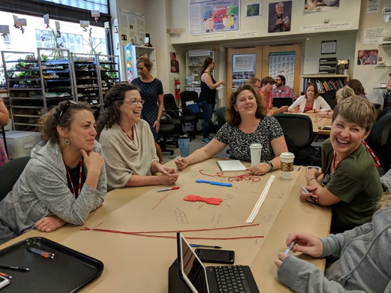



Who am I?
Who am I?

Slide 3
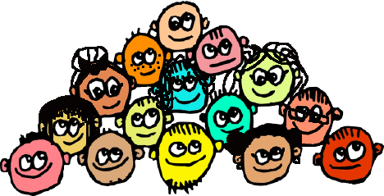
Who are you?

Slide 4

Teaching with models…

Slide 5
We all teach chromosomes with models of one sort or another…
What kinds of chromosome models do you use?

Slide 6
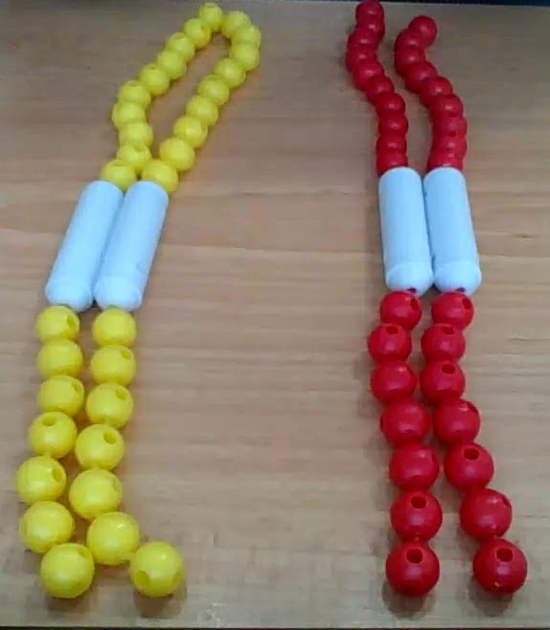
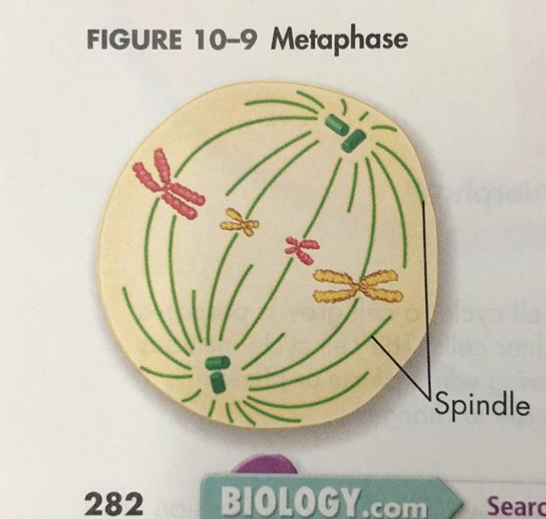
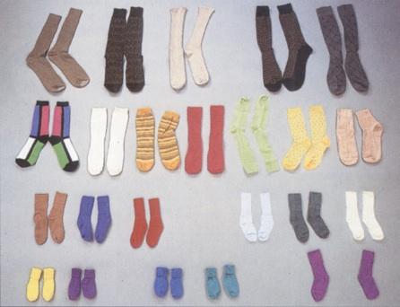
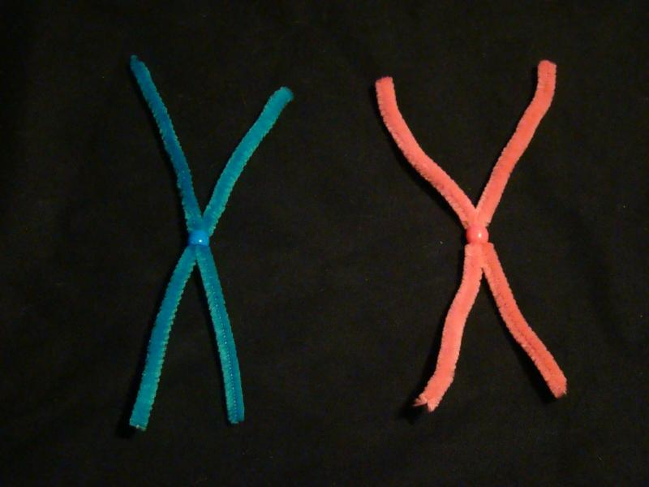
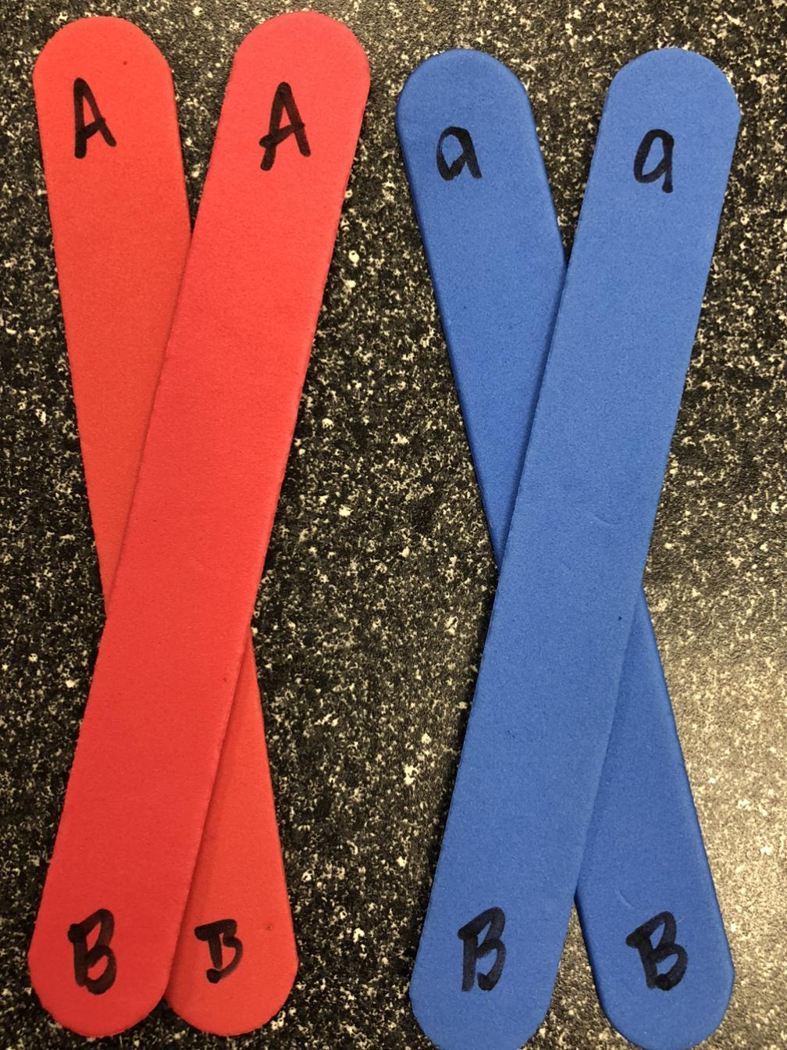
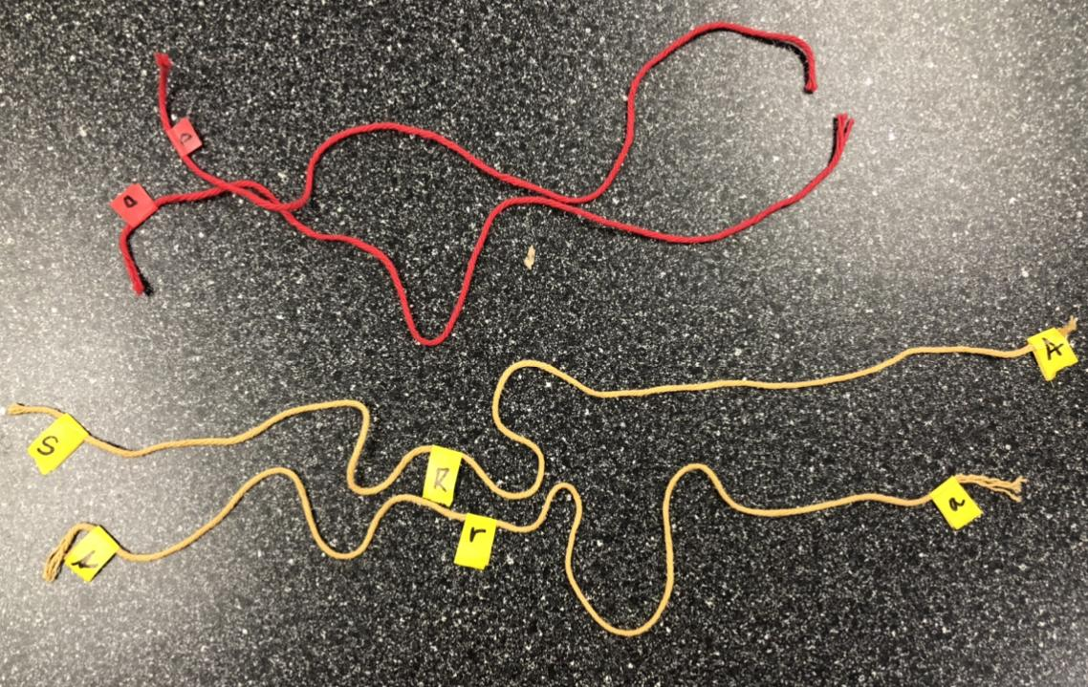
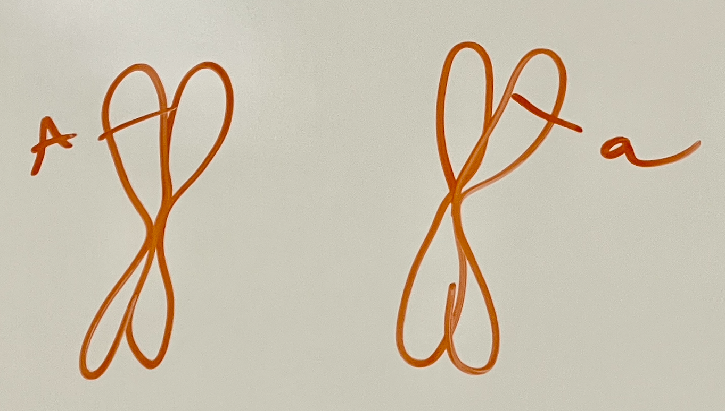
What chromosome models do you use?

Slide 7
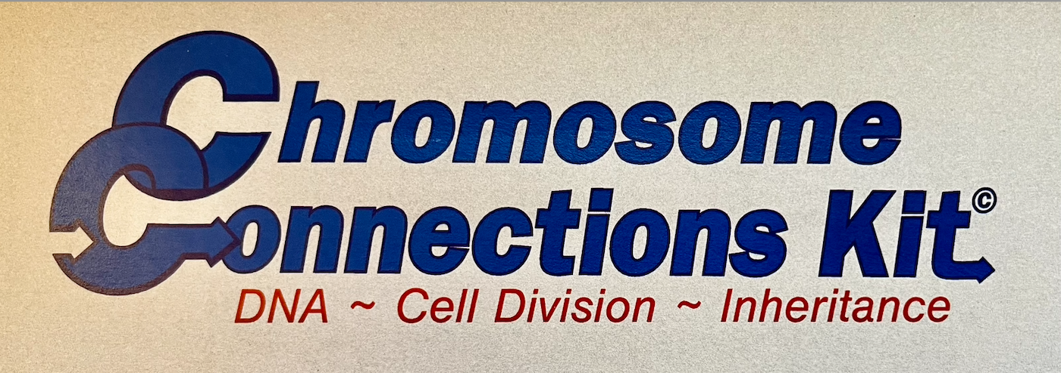
But what IS a chromosome? Build one!
Notes:
Hand teachers the chromosome kit and invite them to build a chromosome.

Slide 8
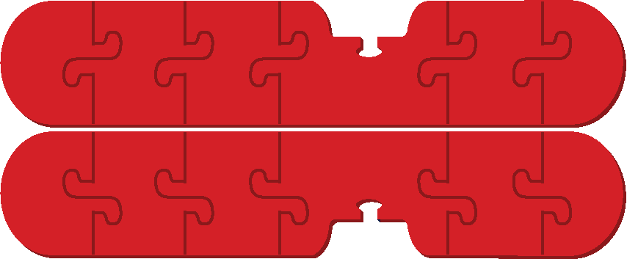

Is this a chromosome? Or this?

Slide 9
Is this a chromosome? Or this?
Or both?

Slide 10
Now build a homologous pair!

Slide 11




Now build a homologous pair!

Slide 12
Could these be homologous pairs?
OR

Slide 13
Could these be homologous pairs?
What more would you need to know?
OR

Slide 14
Could these be homologous pairs?
A
A
A
A
A
a
a
A
OR

Slide 15
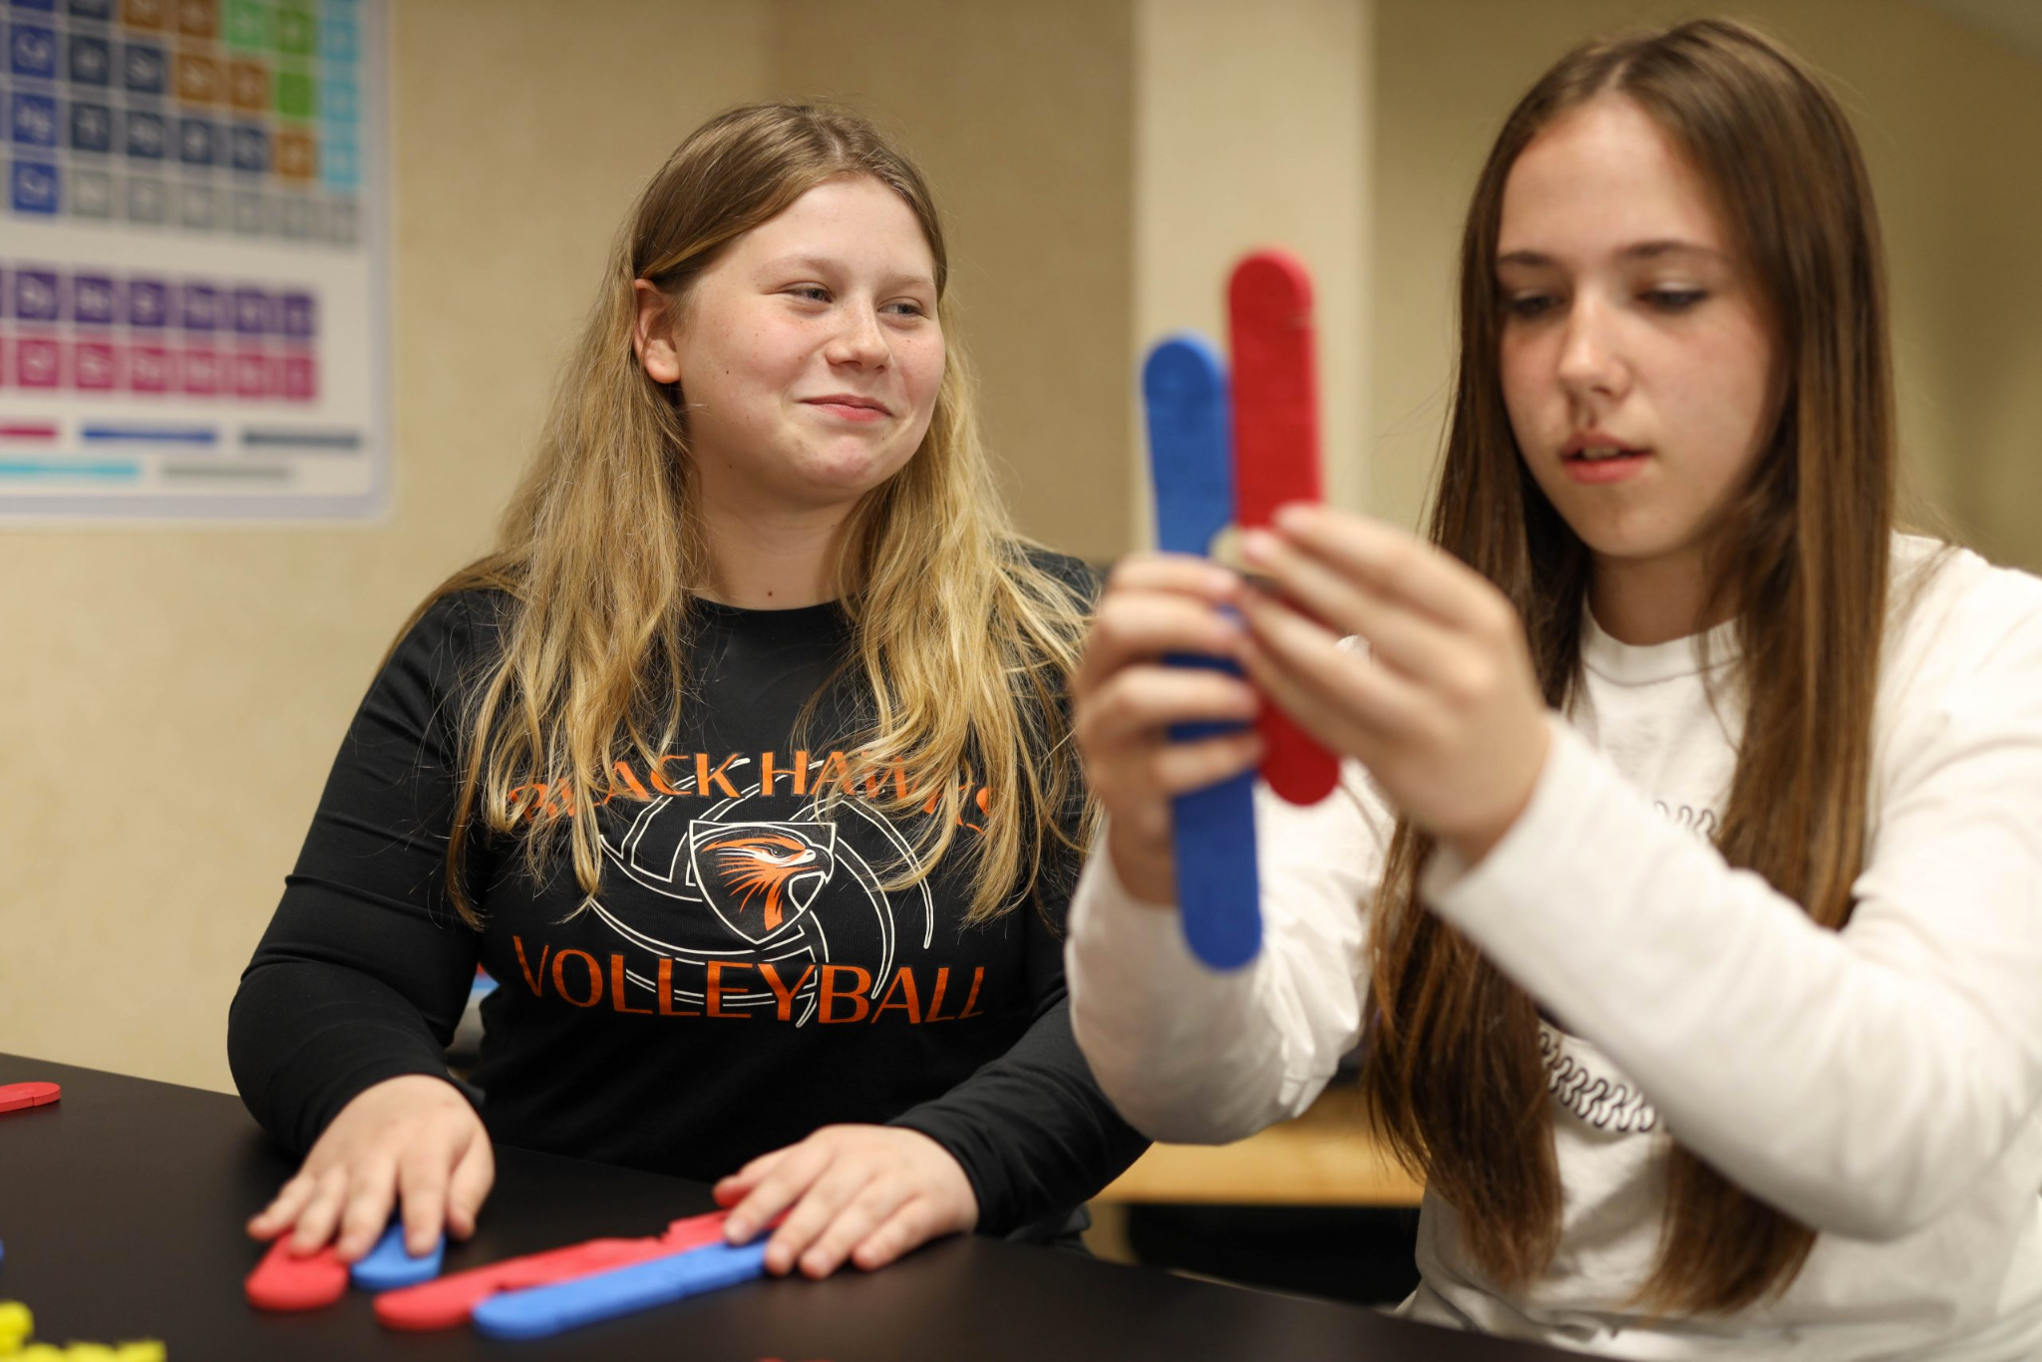
What do our students key into when we model this way?

Slide 16
Could these be homologous pairs?
A
A
A
A
A
a
a
A
OR
What does “A’ or “a” really mean? And how does this notation AND use of color confuse or sstudents?

Slide 17

How does this model inform the definition of a chromosome?
Chromosome: The compact structure into which a cell’s DNA is organized, held together by proteins. The genomes of different organisms are arranged into varying numbers of chromosomes, and human cells have 23 pairs.
https://innovativegenomics.org/glossary/
Notes:
But do chromosomes only exist in a cell when the dna is compact like this? Well…

Slide 18
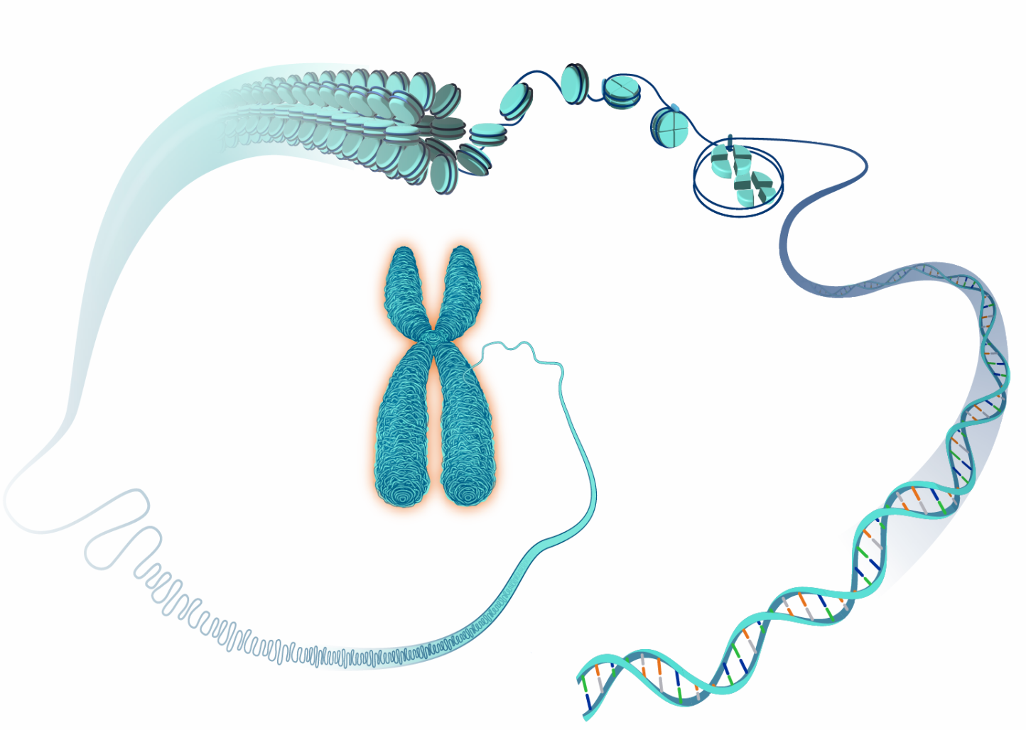
Chromosomes are threadlike structures made of protein and a single molecule of DNA that serve to carry the genomic information from cell to cell. In plants and animals (including humans), chromosomes reside in the nucleus of cells.
https://www.genome.gov/genetics-glossary

Slide 19
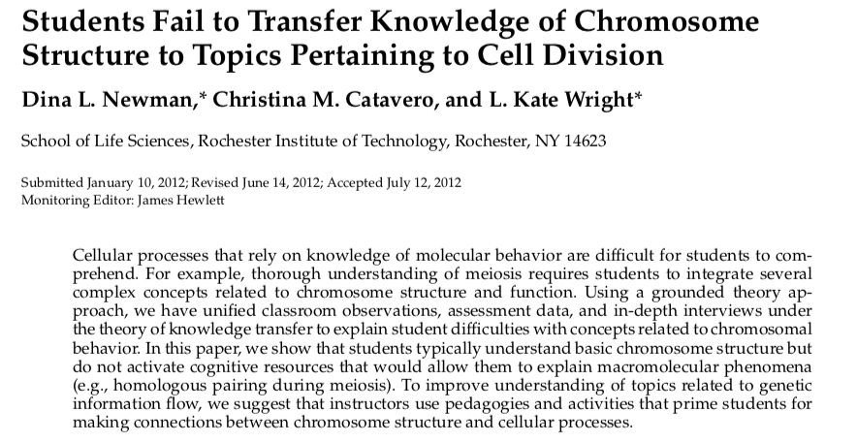
Chromosomes: one word, several meanings, much confusion!

Slide 20
“To improve understanding of topics related to genetic information flow, we suggest that instructors use pedagogies and activities that prime students for making connections between chromosome structure and cellular processes.”

Slide 21
How can we improve this model so students make these connections?

Slide 22
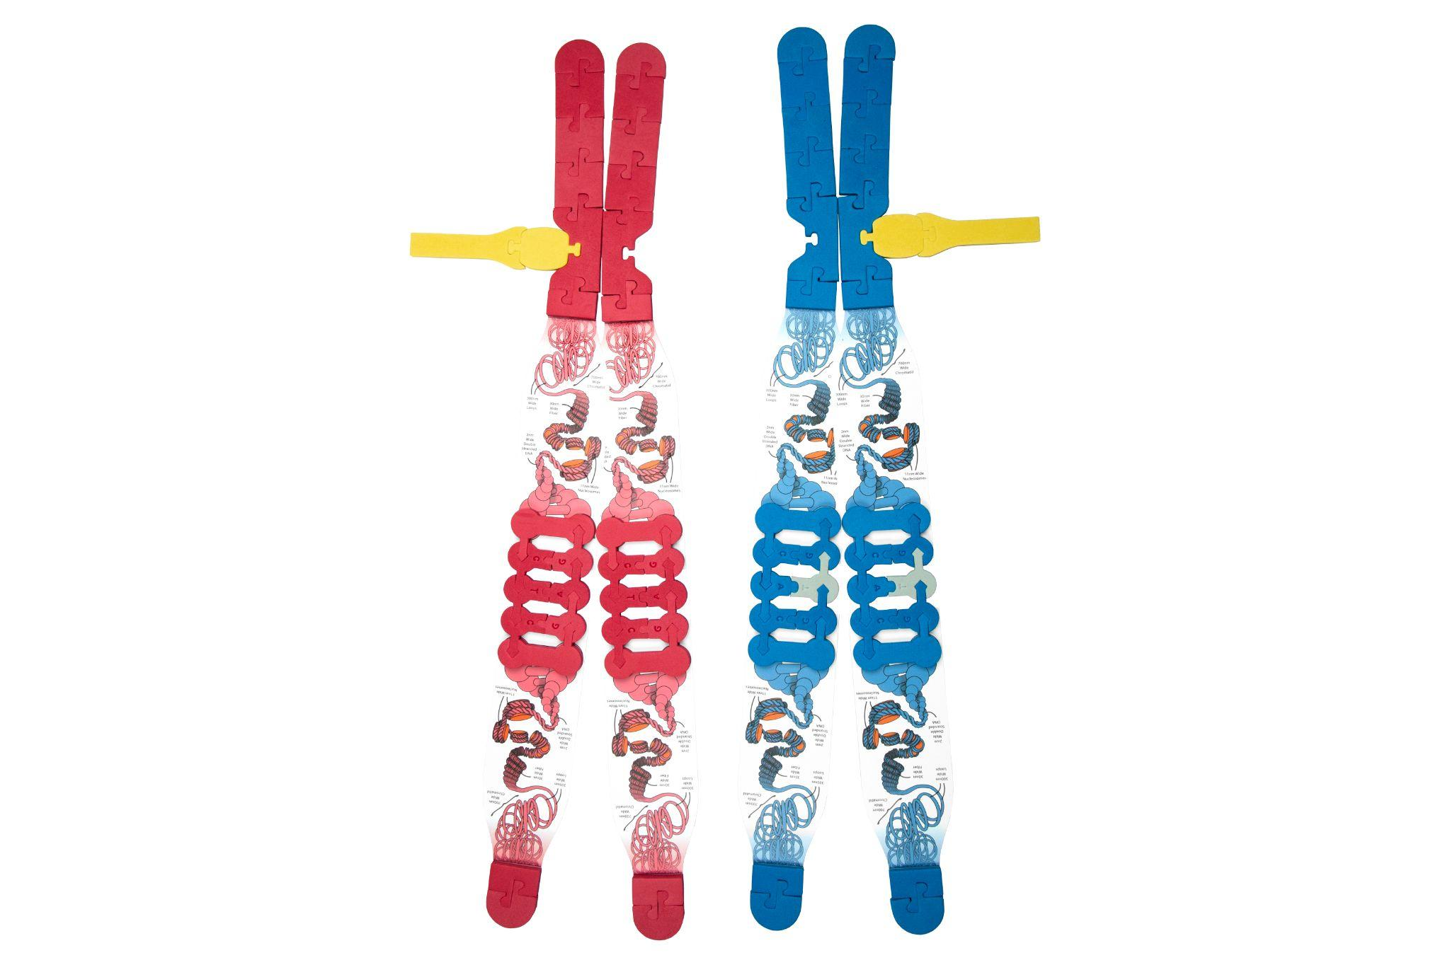
What can we do with a model like this that we could not do before?
A=
=a

Slide 23
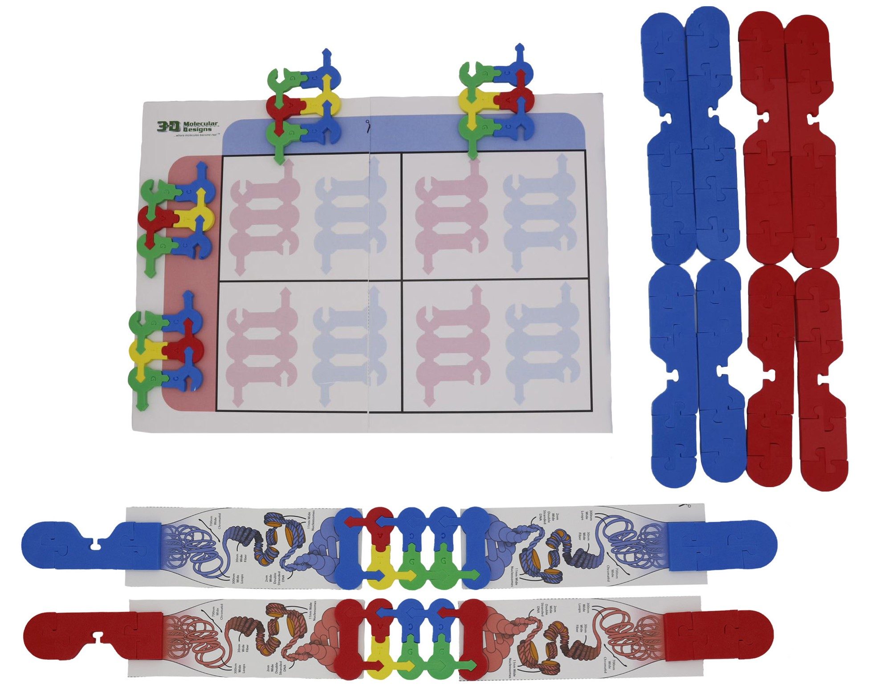
Punnett Squares!
A
a
A
a

Slide 24
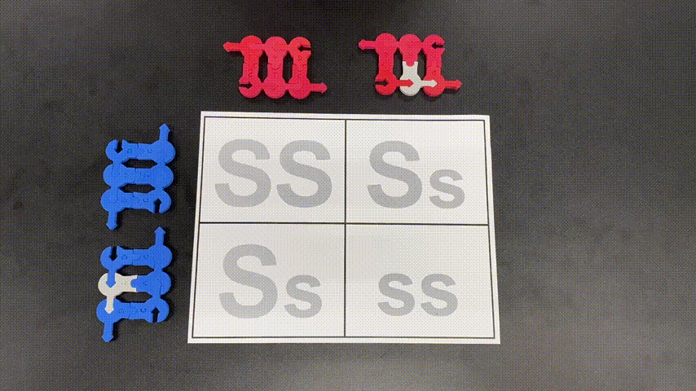
GIF of Punnett Square

Slide 25
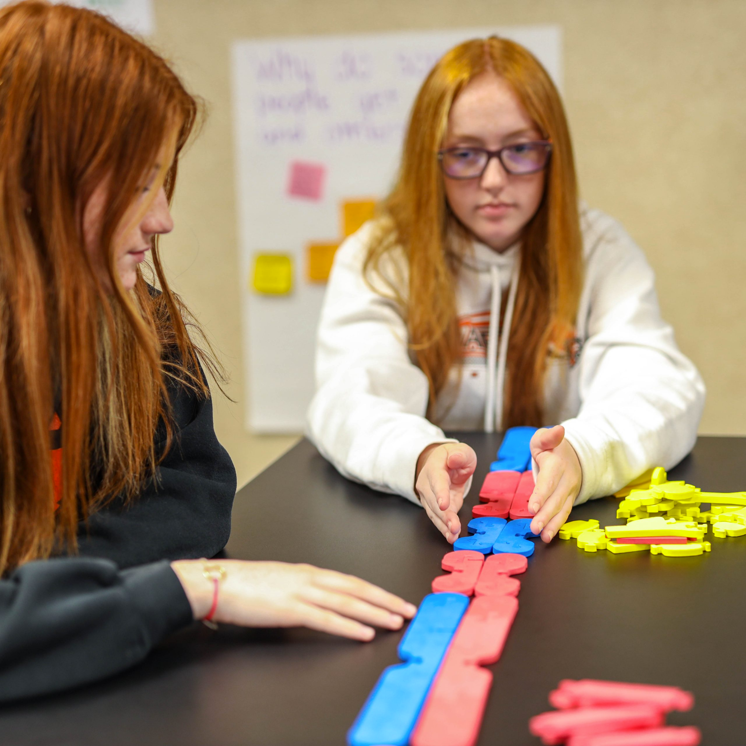
And of course you can still do mitosis and meiosis… But what is different in this picture?

Slide 26
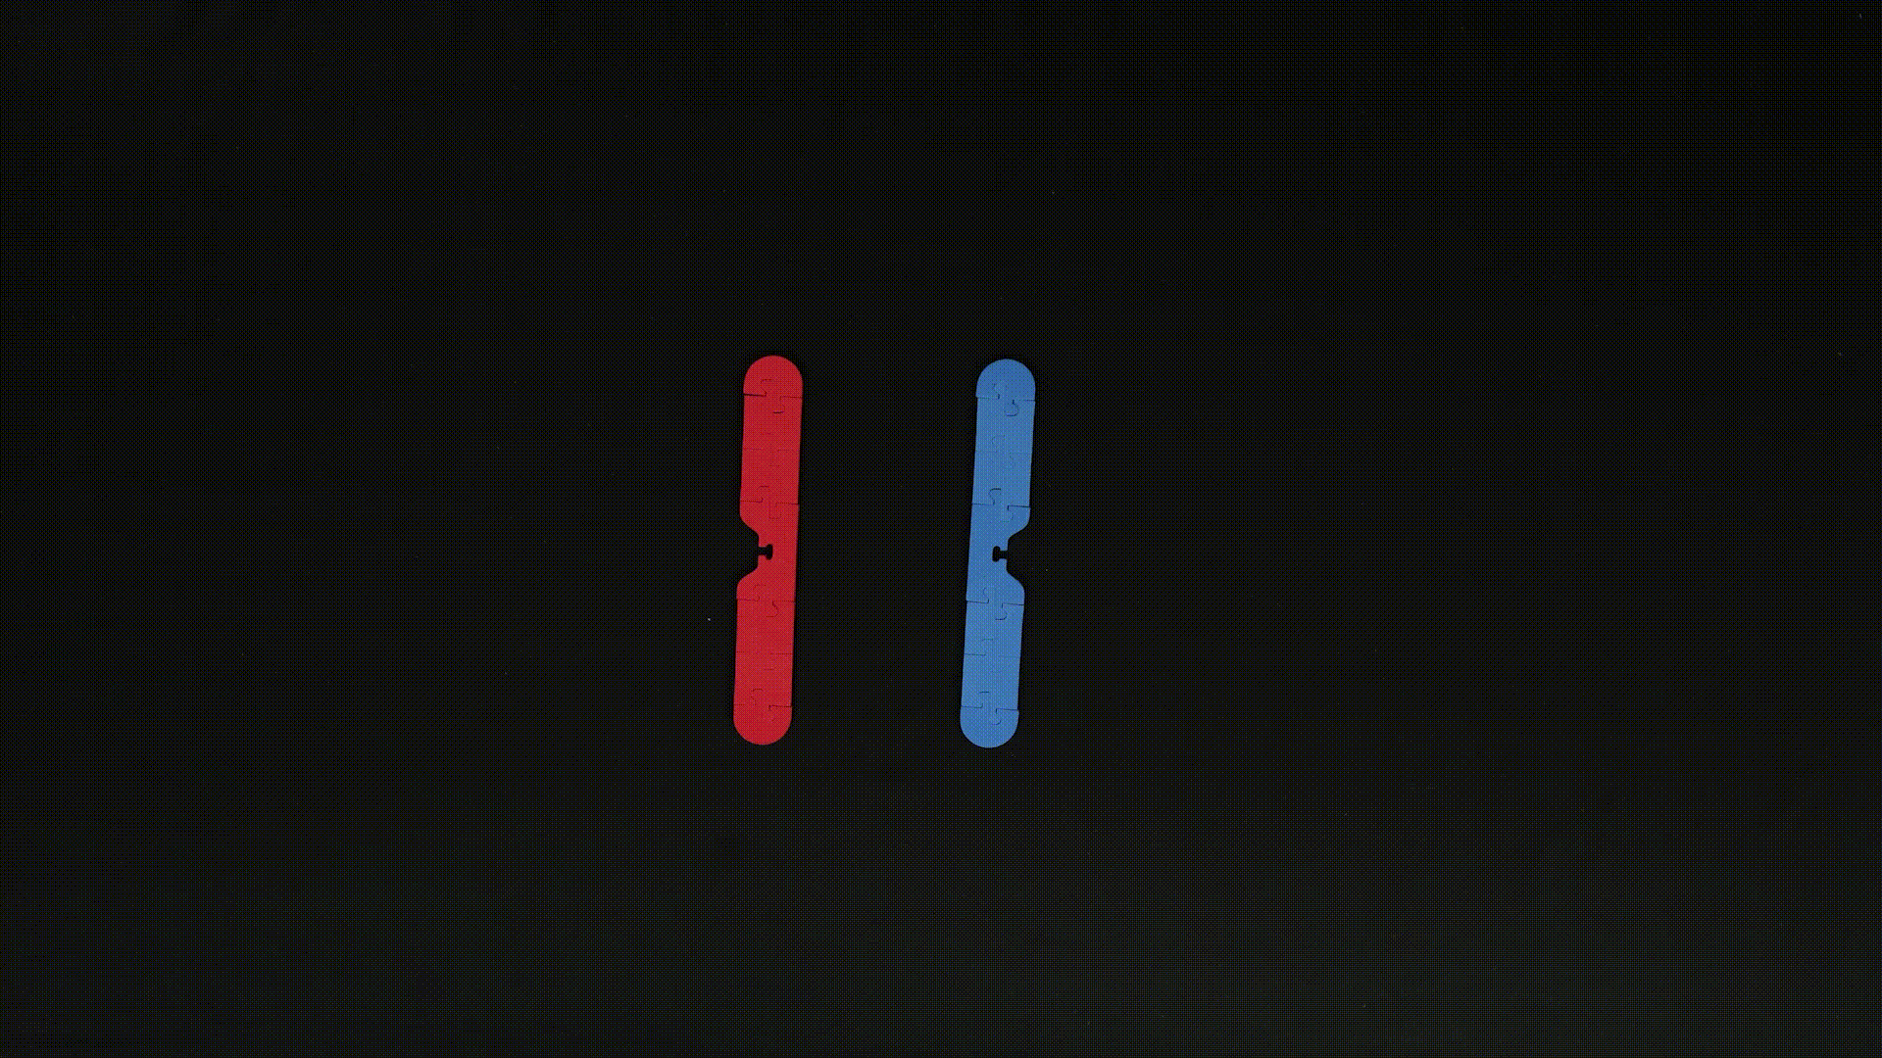
Gif of Mitosis

Slide 28
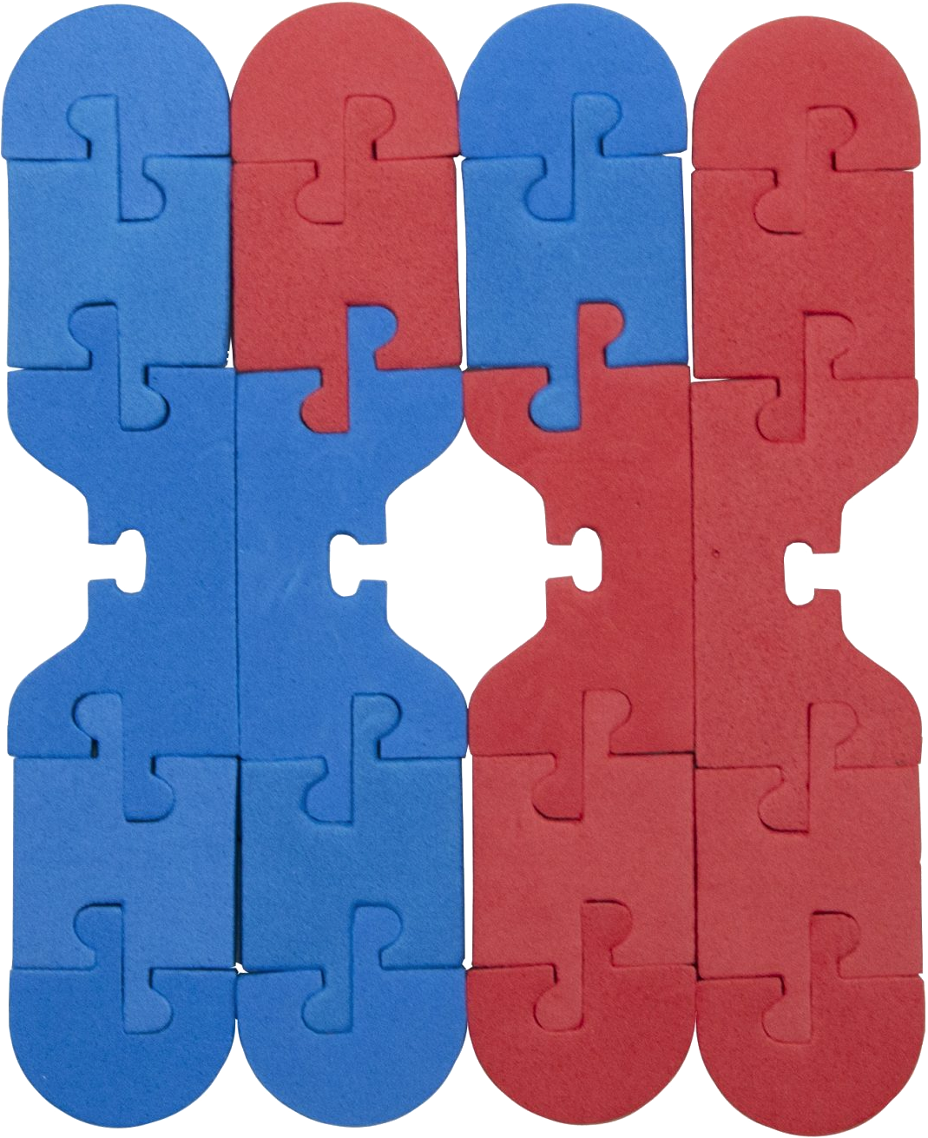
Crossing over… THIS?

Slide 29
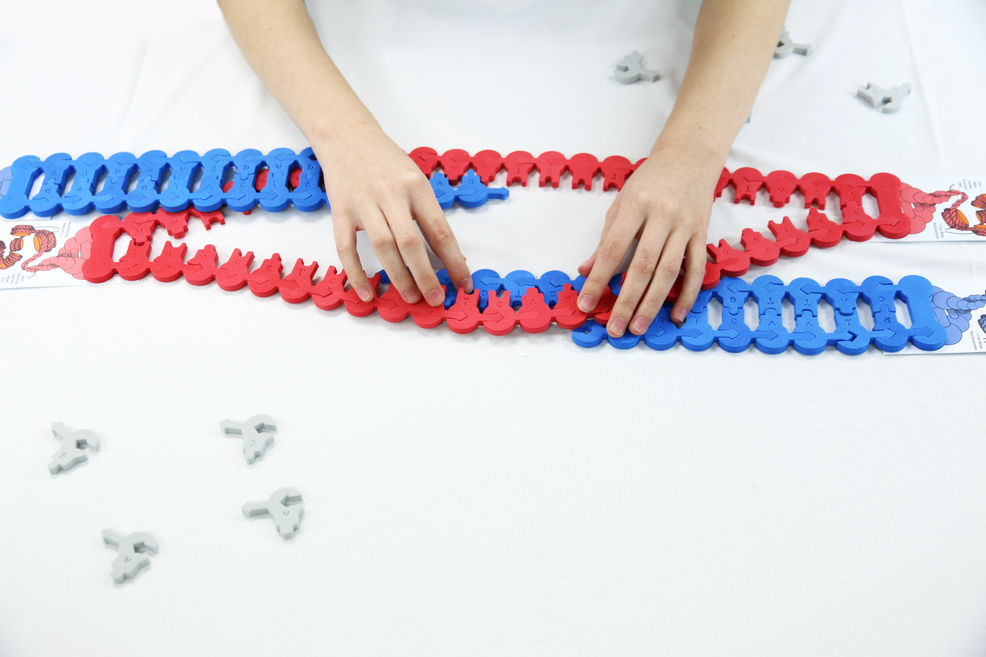
Crossing over… or THIS?

Slide 30

Summer Courses!

Slide 31

THANK YOU!!
Stop by our booth:
Remember the conference discount code: FC22
Keri Shingleton
kerishingleton@gmail.com

Slide 32


