Slide 1
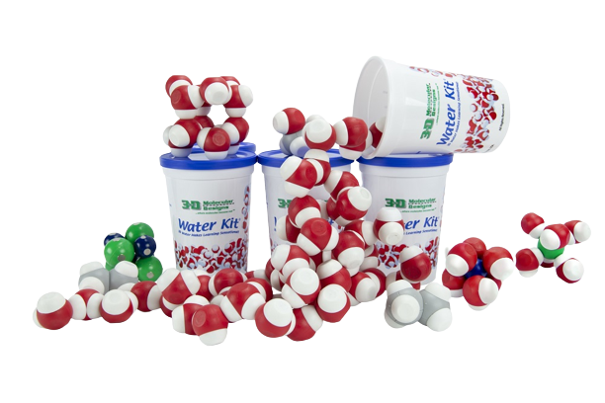

Hydrophobic Marvels
Using Water Models to Unravel the Self-Cleaning Secrets of Lotus Leaves
Andrew Taylor
NABT Baltimore 2023

Slide 2
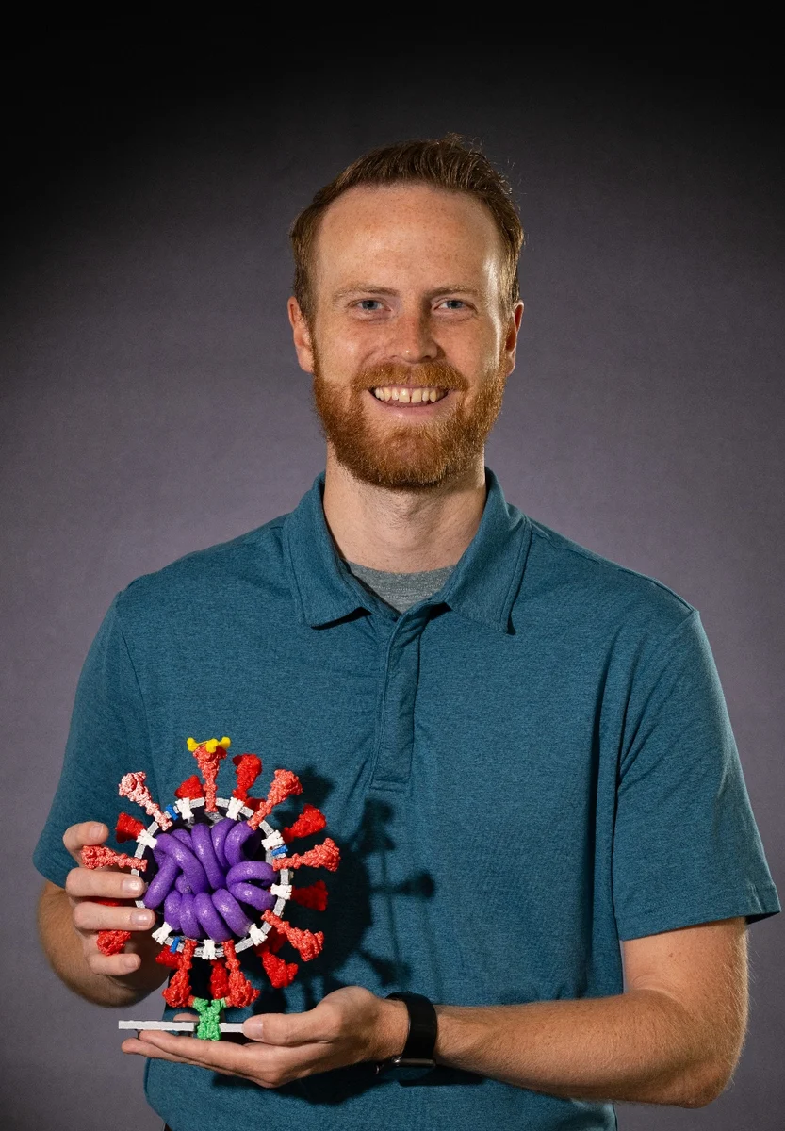
Andrew Taylor
MS Bio, BS Bio
Olathe Northwest High School
Olathe, KS (near Kansas City)
3DMD Model Teacher
NABT Region IV Coordinator
Current President of KABT
Email: and.taylor07@gmail.com

Slide 3
Workshop Goals
Use water models to explain phenomena.
Make predictions about new scenarios using water models as evidence.

Slide 4
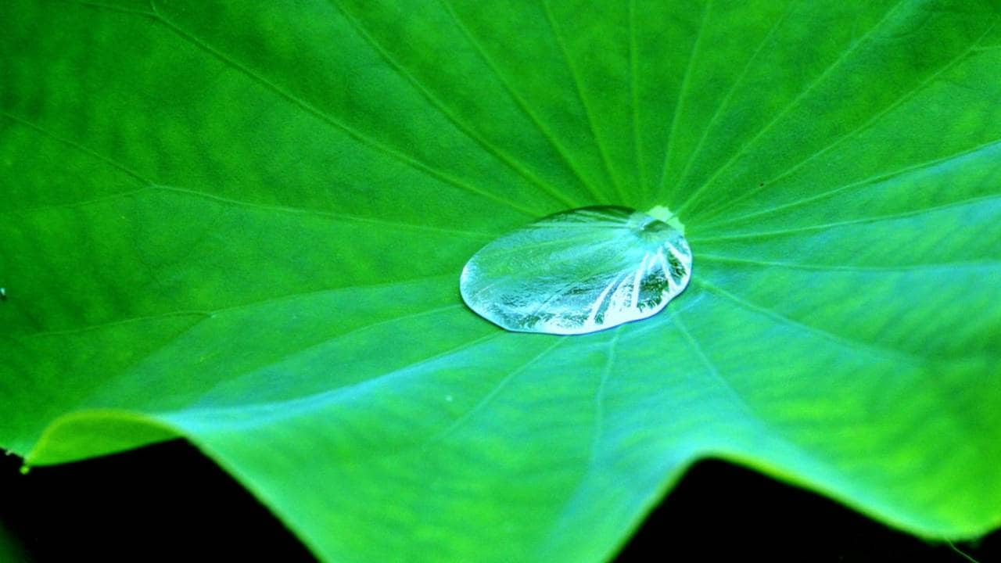
Lotus Leaf Tests
Add a single drop of water to the lotus leaf. Write down qualitative observations of how the drop of water appears and behaves on the lotus leaf.

Slide 5
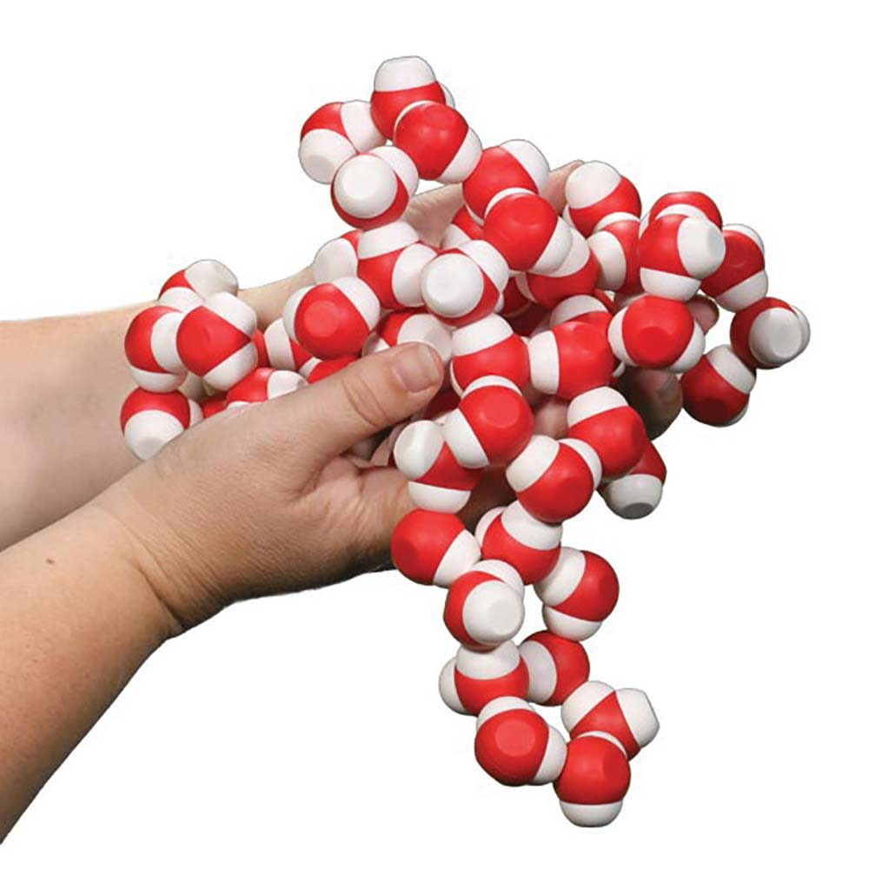
Models!
Ensure each person has just one water molecule from the kit.
What do you notice and wonder? How do the individual water molecules interact with each other?

Slide 6
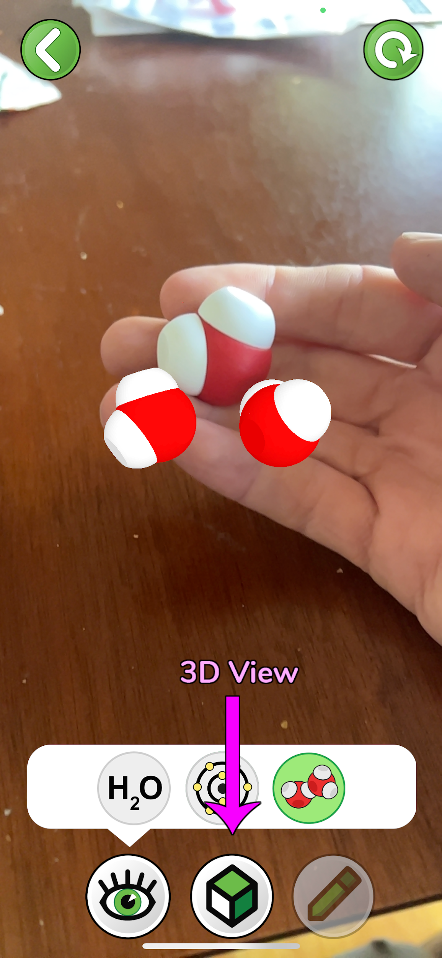
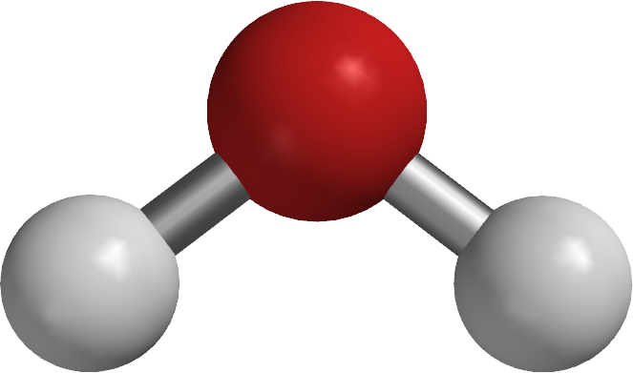
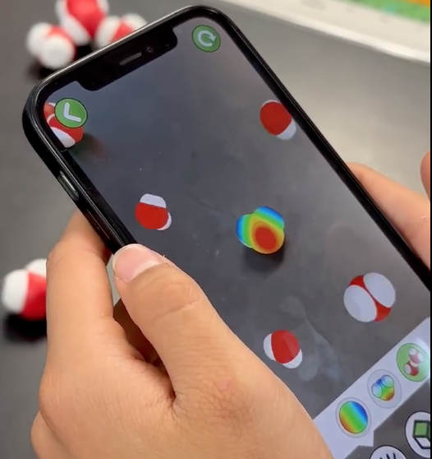
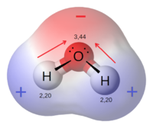
H
O
H

Slide 7
Models!
Use a full set (12 water molecules) at your table to try and recreate the phenomena of the water droplet on the lotus leaf.
Notes:
What are the properties of the water that allow it behave that way?

Slide 8
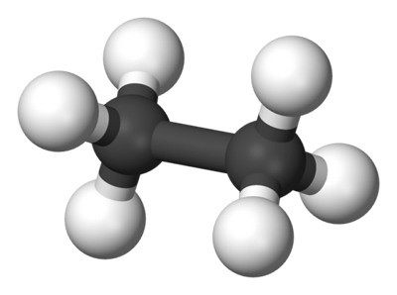
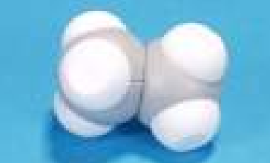
Models!
Take out the ethane molecule and play with it. See how it interacts with the water molecules.
What do you notice? What do you wonder?
Notes:
Transition point. Now that we think we know how the properties of water allow it to behave as we observed, let's consider the properties of the leaf.

Slide 9

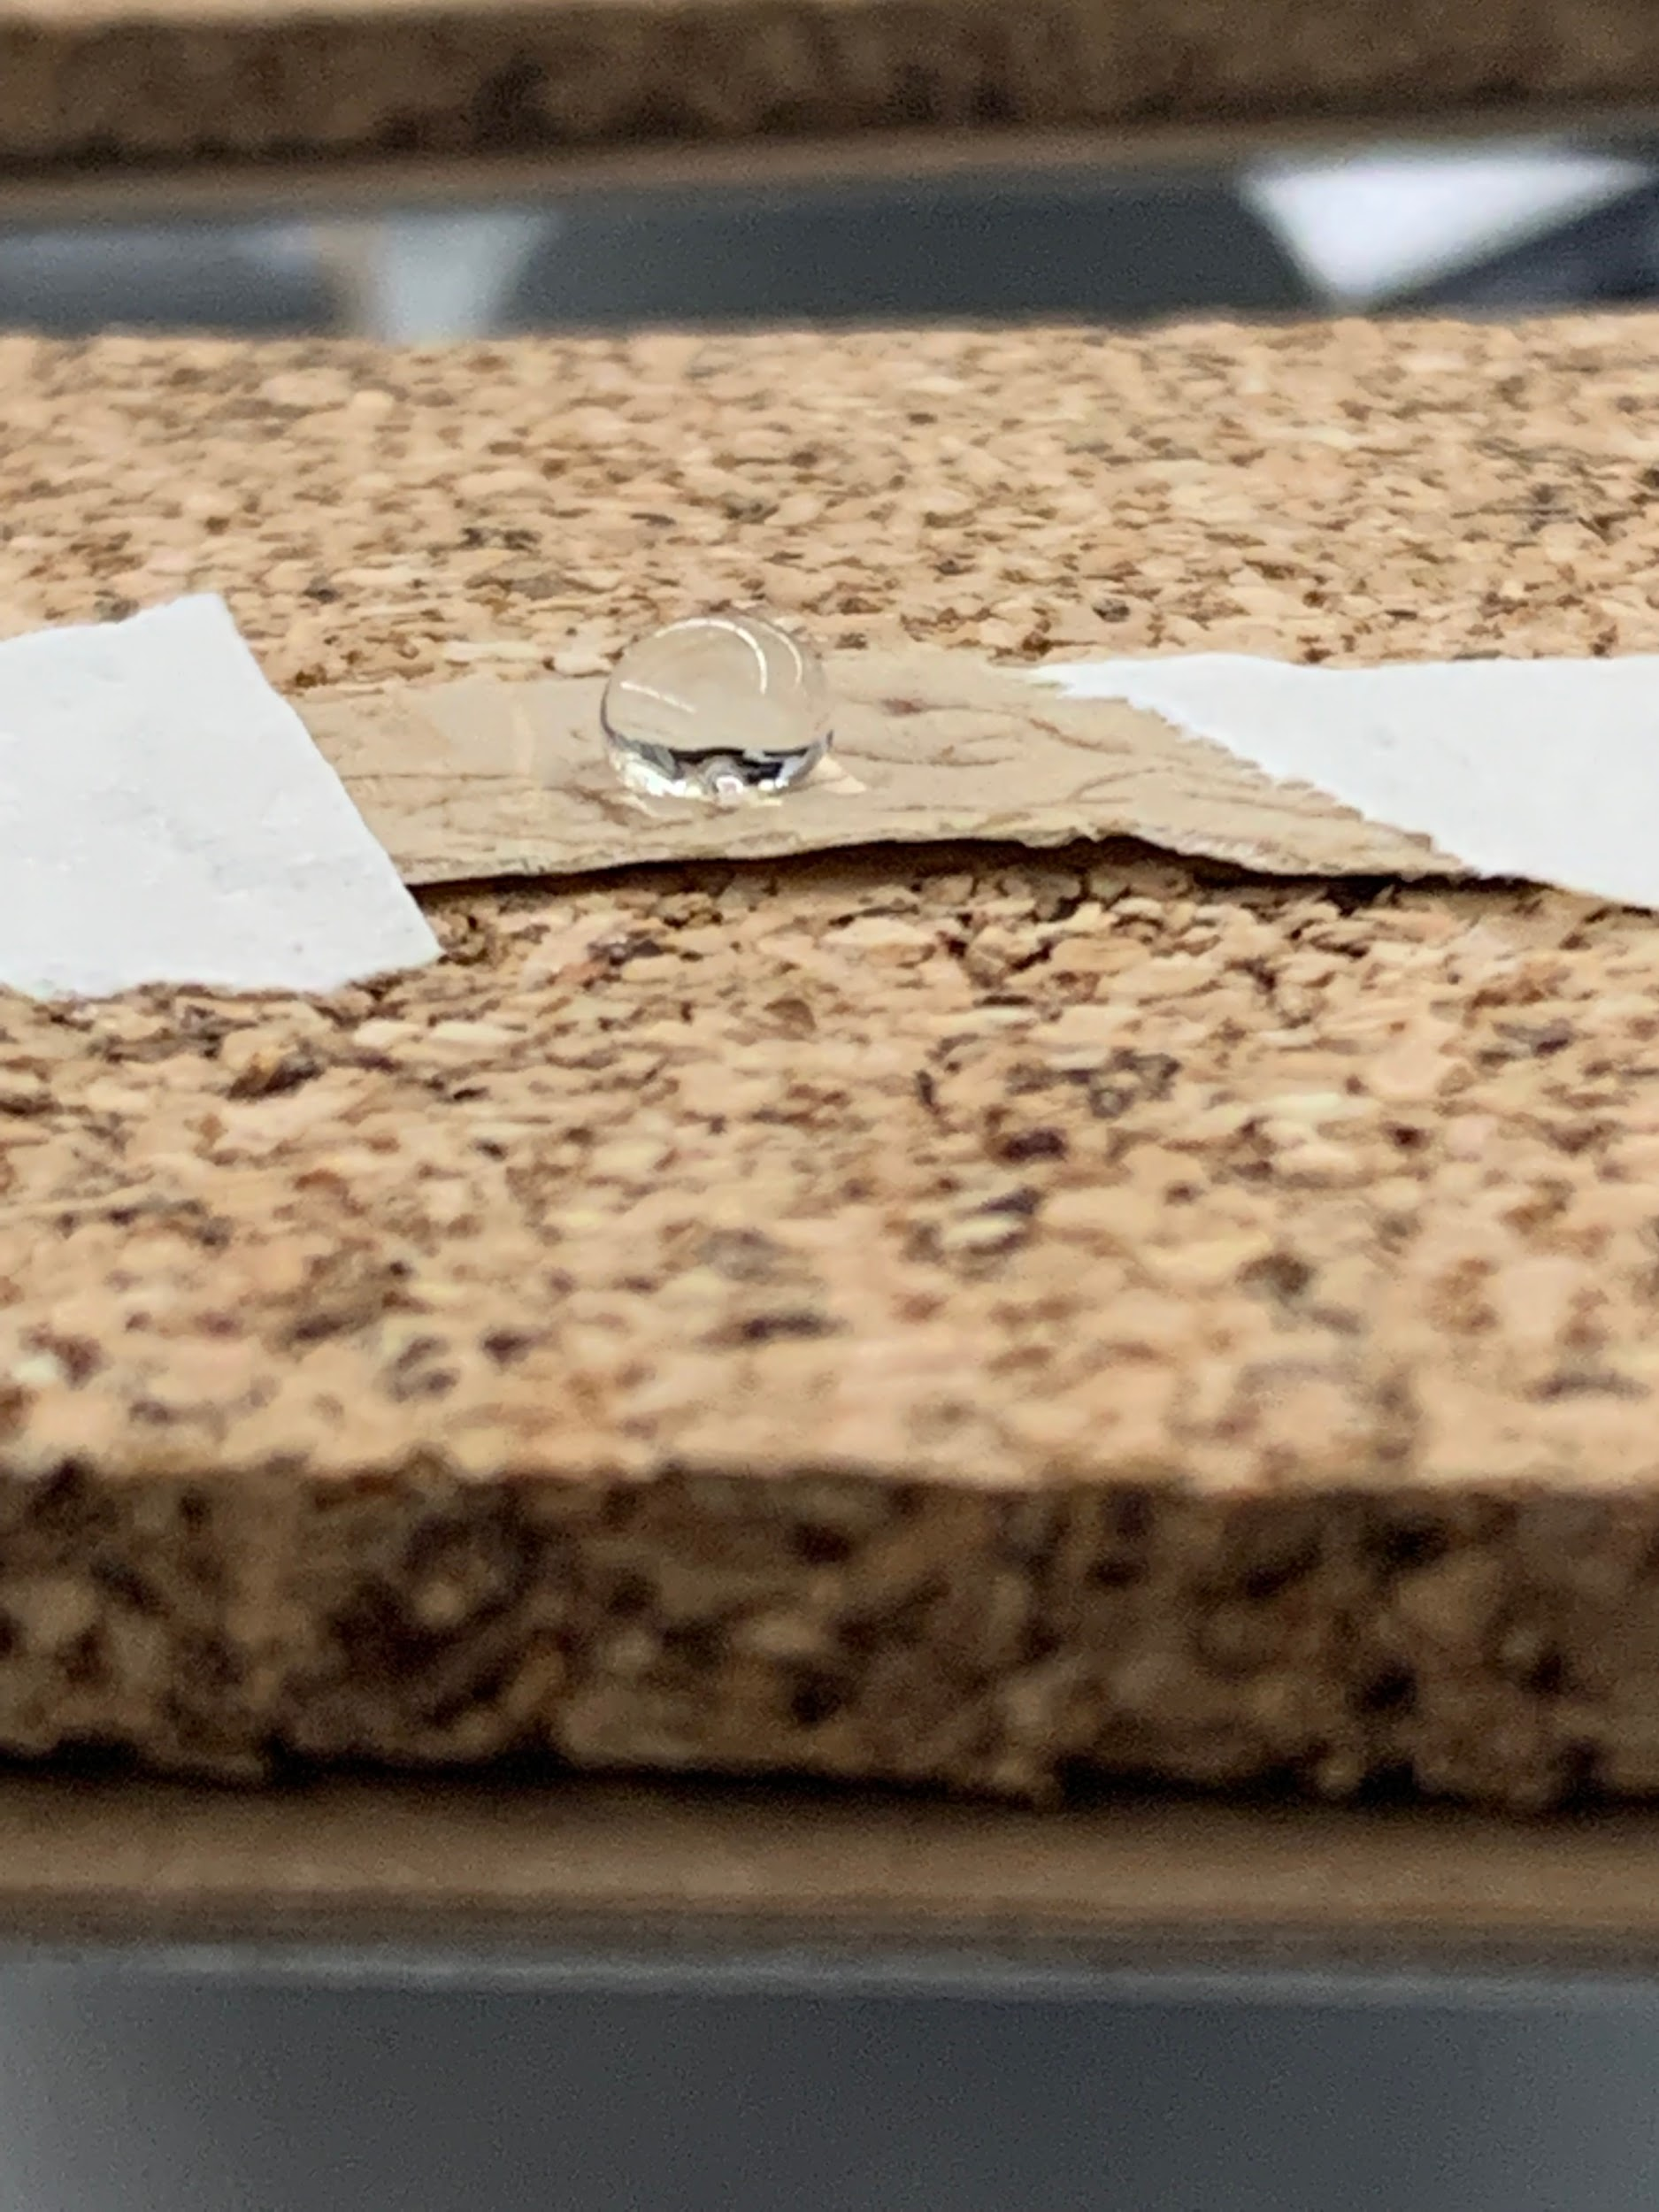
Models!
Reflect on the models to create a sketch of how the interactions between the water molecules allow the water to form a rounded ball on the leaf.

Slide 10
Turn and Talk
What would we expect to observe if the leaf surface were charged (polar)?
What would we expect to observe if the leaf surface were neutrally charged (non-polar)?

Slide 11
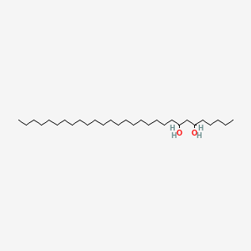
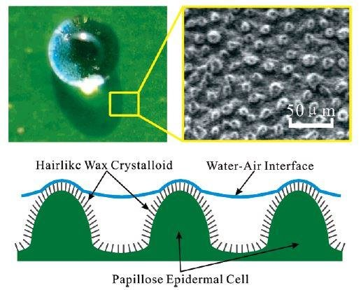

Slide 12
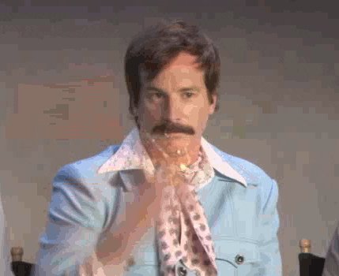
Self-Cleaning?
Add a sprinkle of glitter to the lotus leaf.
Add a drop of water to the area of the lotus leaf with the glitter.
What do you notice? What do you wonder?

Slide 13
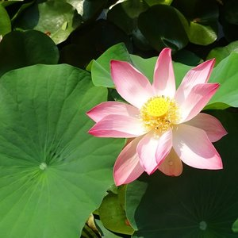
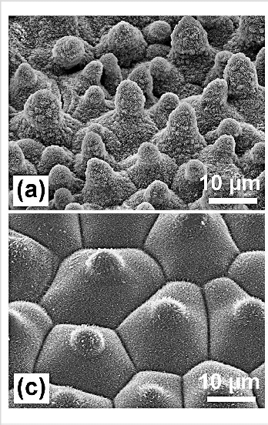
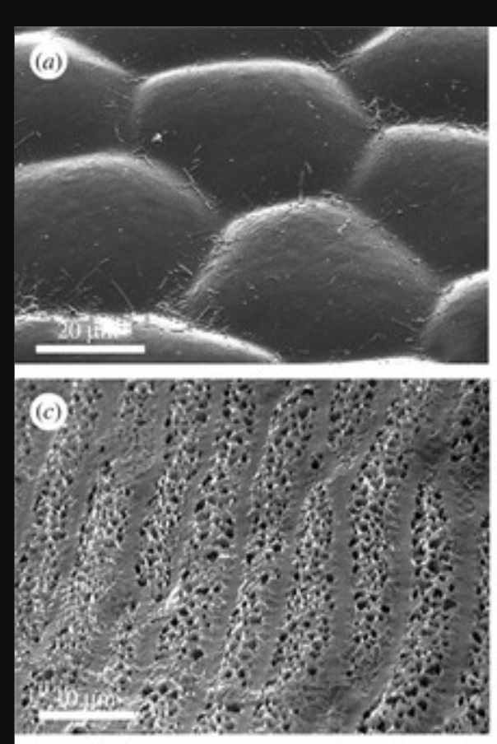
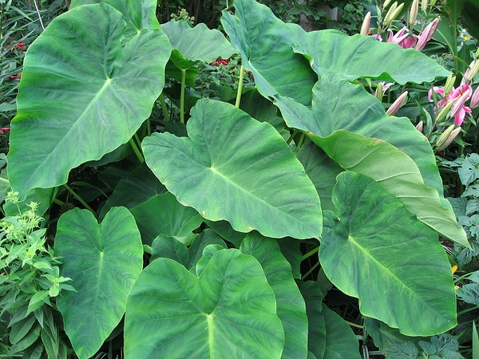
Scanning Electron Microscope Images of Various Plant Leaves
What do you notice? What do you wonder?
Lotus
Hydrophilic Plant Leaves
Taro
Notes:
https://www.researchgate.net/figure/SEM-images-of-the-papillose-leaf-surfaces-of-Nelumbo-nucifera-Lotus-a-Euphorbia_fig3_51697476

Slide 14
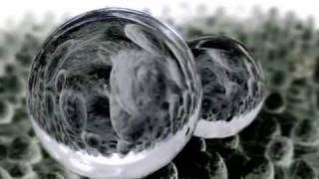
The Lotus Effect

Slide 15
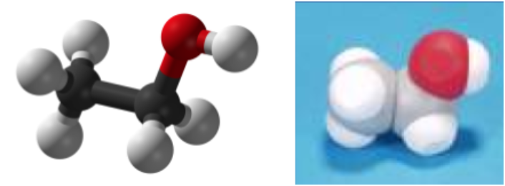
More Models!
Remove a hydrogen from the ethane model. Remove a hydrogen from a water molecule. Place the remaining OH group onto the ethane as seen in the images below.
Play with the ethanol molecule, and see how it interacts with the other modeling molecules.
What do you notice? What do you wonder?

Slide 16
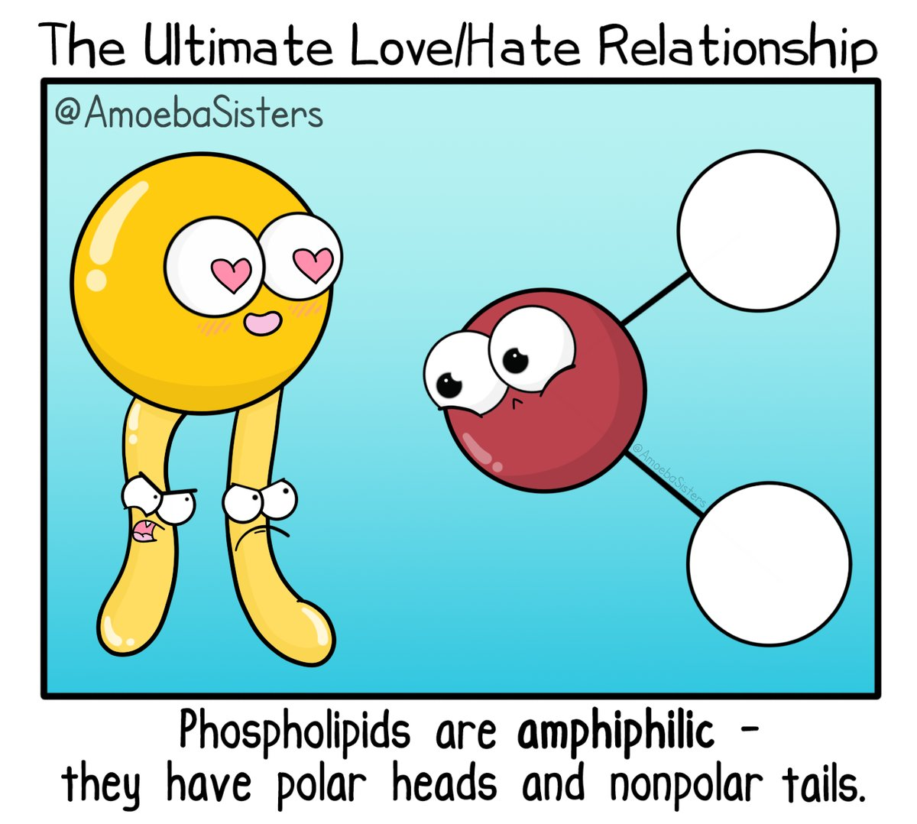
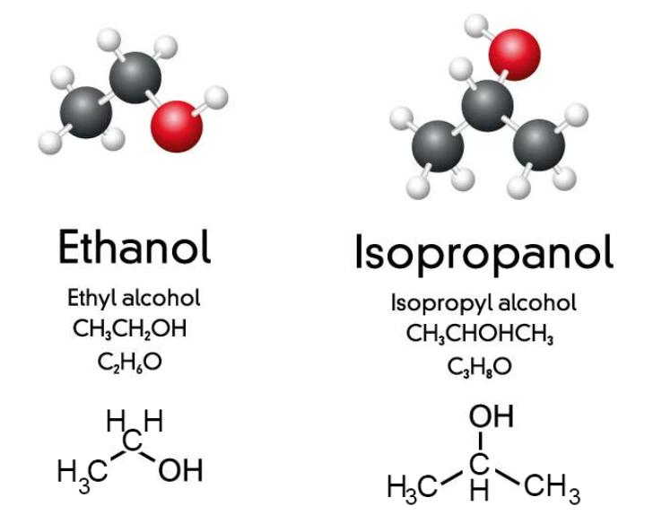

Slide 17
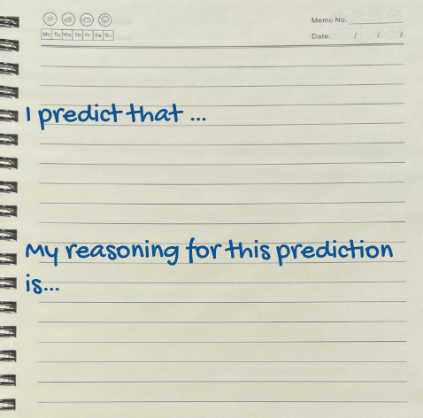
Predict!
What will happen to isopropyl alcohol when added to the lotus leaf? How will it compare to the water droplet?

Slide 18
Test!
Add a drop of isopropyl alcohol to the lotus leaf.
Did your data match up with your prediction?

Slide 19
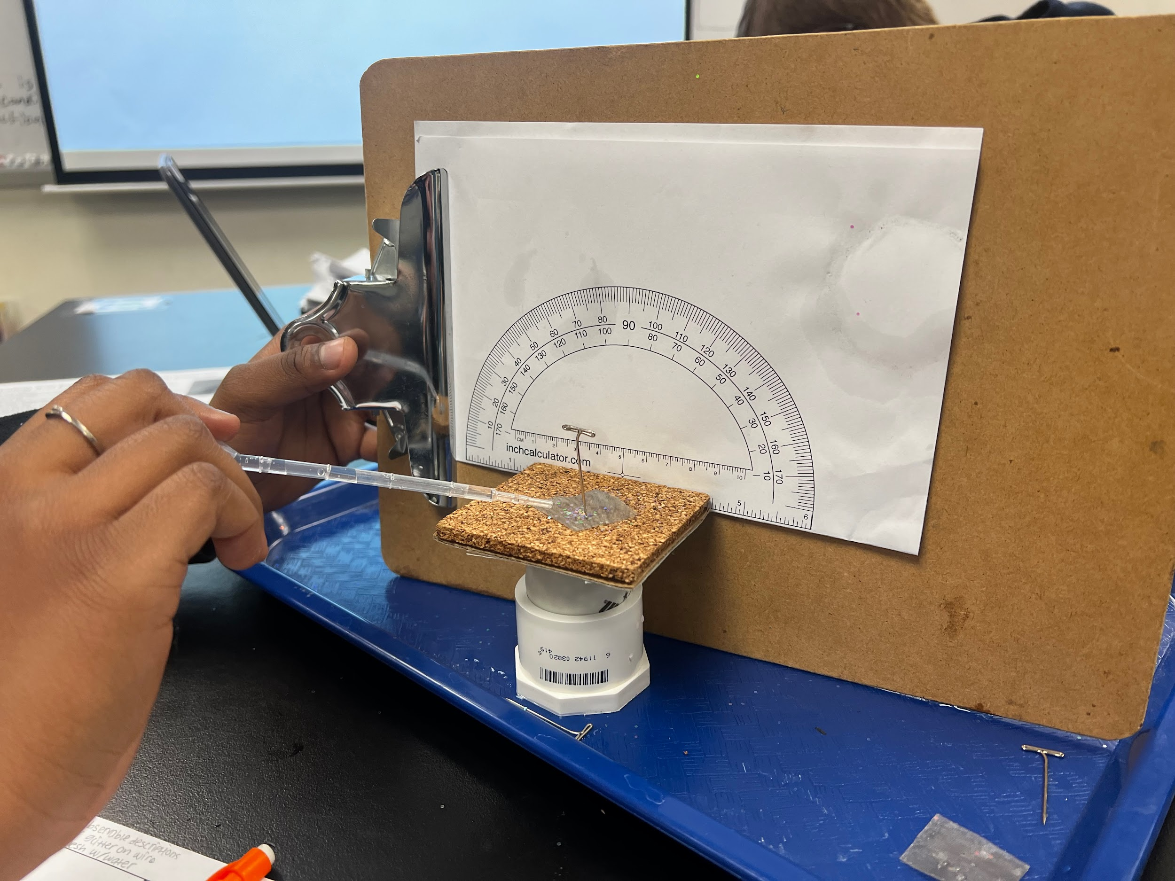
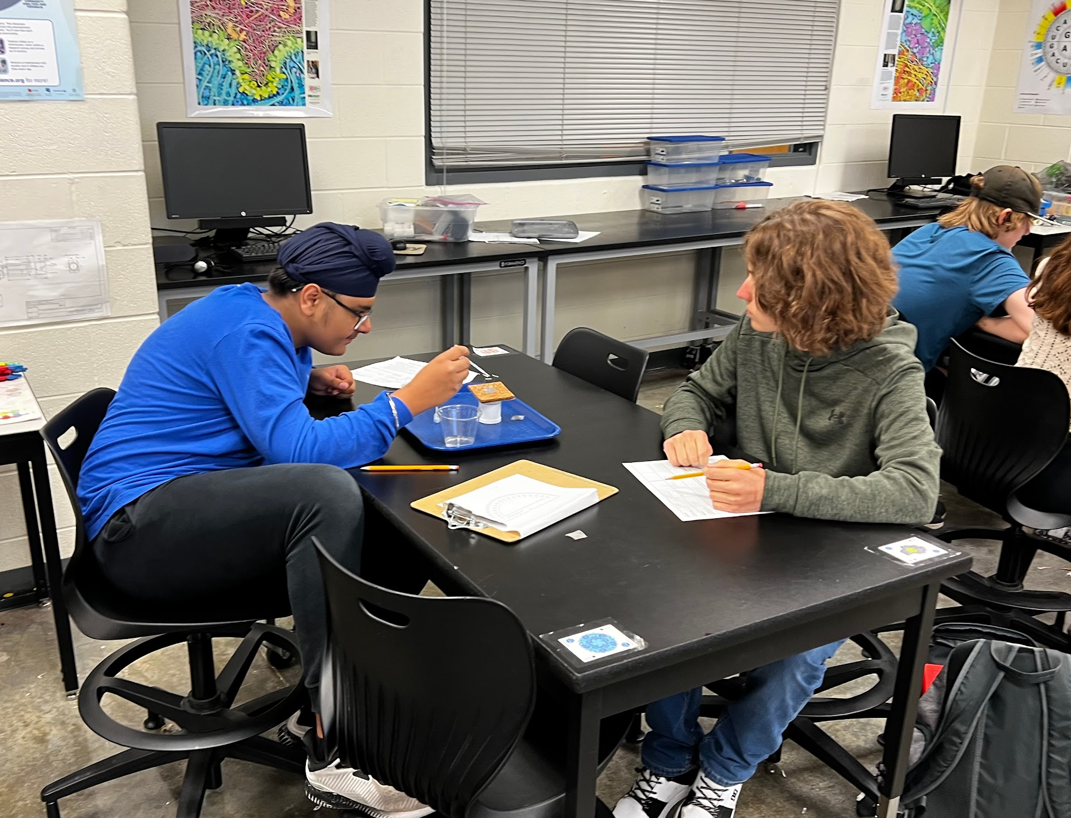
Biomimicry Engineering Extensions

Slide 20

Kits and models used in this session:
Water Kit
Scan this QR code to fill out a survey for a 20% coupon code off most kits and a chance to win a $50 gift card!
Purchase and Borrow Kits from
3DMolecularDesigns.com

