Slide 1

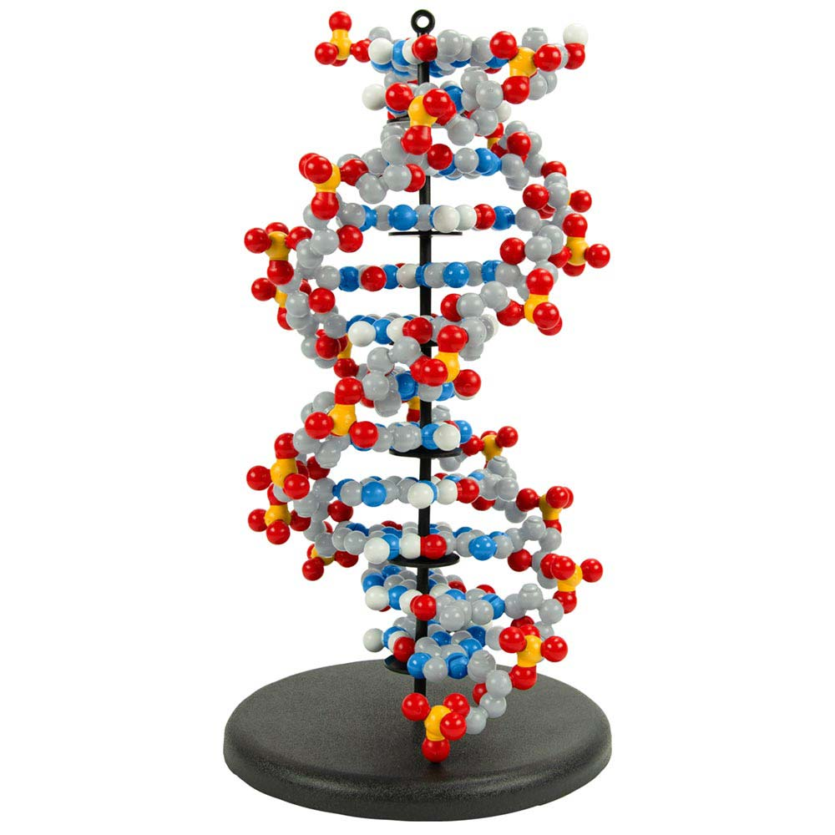
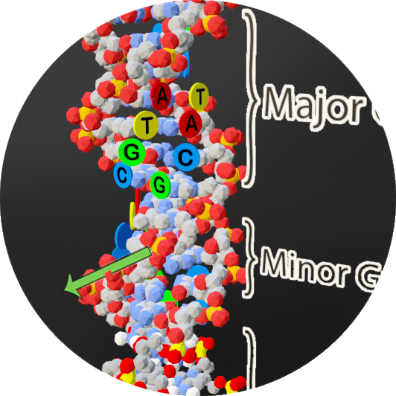

Extending the
DNA Double Helix
"You are neither small nor insignificant. You are just very well folded."
- Karyn Buxman
Activity ID: DDNA-AR2
Required Models: 1 DDNA©/ Group
Required Media: 3DMD AR EDU App

Slide 2

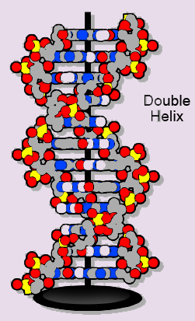
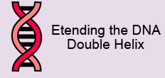
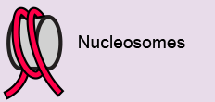
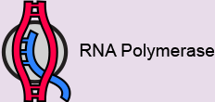
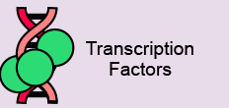
Teacher Guide – Summary
Activity Summary
This AR activity explores the structure of DNA and how other molecules interact with DNA. DNA is comprised of individual nucleotide monomers (A, T, G, and C) that link together into two strands running in opposite (anti-parallel) directions. Hydrogen bonding between base pairs hold the two strands of DNA together. DNA interacts with a variety of other molecules, including the nucleosome protein (DNA storage), the RNA polymerase protein (transcription), and zinc finger proteins (gene regulation).
This activity requires the 3DMD AR EDU application, available for download from the Google Play and Apple App stores. The activity is split into four AR scenes designed to be explored in order. Each AR scene is represented by a consistent icon in this slide deck and the 3DMD AR EDU app (see icon images below.)
Scene 1:
A review of DNA structure and an exploration of genome length.
Scene 2:
How do proteins help store and organize DNA?
Scene 3:
How do proteins make transcripts of DNA genes?
Scene 4:
How do proteins help regulate access to DNA?

Slide 3
Teacher Guide - Overview
Activity Objectives
  Students will compare DNA size with the physical model.
  Students will explore why DNA interacts with different proteins.
  Estimated Class Time:
45 minutes
Required Models:
Dynamic DNA Kit©
Required Media:
3DMD AR EDU App + subscription
Other Materials Needed:
Notebook and writing tools
A meter stick (1 foot ruler would also work)
Grade, Class
9-12 Biology
Topics
DNA Structure (directionality, base pairing)
DNA Storage
DNA Transcription
Gene Regulation
Prerequisite Knowledge
Polarity
Covalent bonding
Hydrogen bonding
Introduction to DNA Structure (nucleotides, directionality, base pairing)

Slide 4






Teacher Guide - Using This Slide Deck
Student and Teacher Slide Deck Pages
  Slides that are meant for student viewing will feature a green top
  banner. Slides that are meant only for teacher viewing will feature a
  purple top banner and will appear hidden when in "slide show" mode.
Prompting Icons
  Each student slide will include a prompting icon in the top right corner of the slide. These icons on each slide cue your students to the type of activity they will be doing.
Turn and talk discussion
Write in your notebook
Quiet thinking time
Digital modeling
Physical modeling
Teacher Moves and Student Moves
Class slides provide notes (teacher notes below the slide) with specific information to assist you in facilitating the activity using effective modeling and education practices.

Slide 5
Teacher Guide - Standards
Next Generation Science Standards
Science and Engineering Practices | Cross Cutting Concepts | Disciplinary Core Ideas
Asking Questions and Defining Problems | Patterns | HS-LS1-1
Developing and Using Models | Structure and Function
Constructing Explanations and Designing

Slide 6
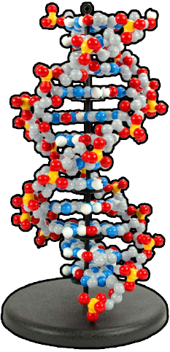


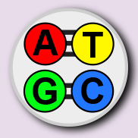
Teacher Guide – Scene 1
Scene 1: Extending the DNA Double Helix
Scan a twelve base pair long section of double-stranded DNA from the Dynamic DNA Kit© to display three different digital overlays. The overlays will extend the length of the DNA model and highlight some basic features of DNA structure. For easier scanning, the twelve base pair long section of DNA should be placed on the black display stand (image to the right) and initially viewed from above until the app can lock onto the image target from the model.
Overlay 1:
Twenty nucleotides will be added to one strand of the plastic DNA model.
Overlay 2:
Twenty nucleotides will be added to the second strand of DNA, forming base pairs.
Overlay 3:
A-T and G-C base pairs, strand directionality, and major/minor groove are highlighted.

Slide 7



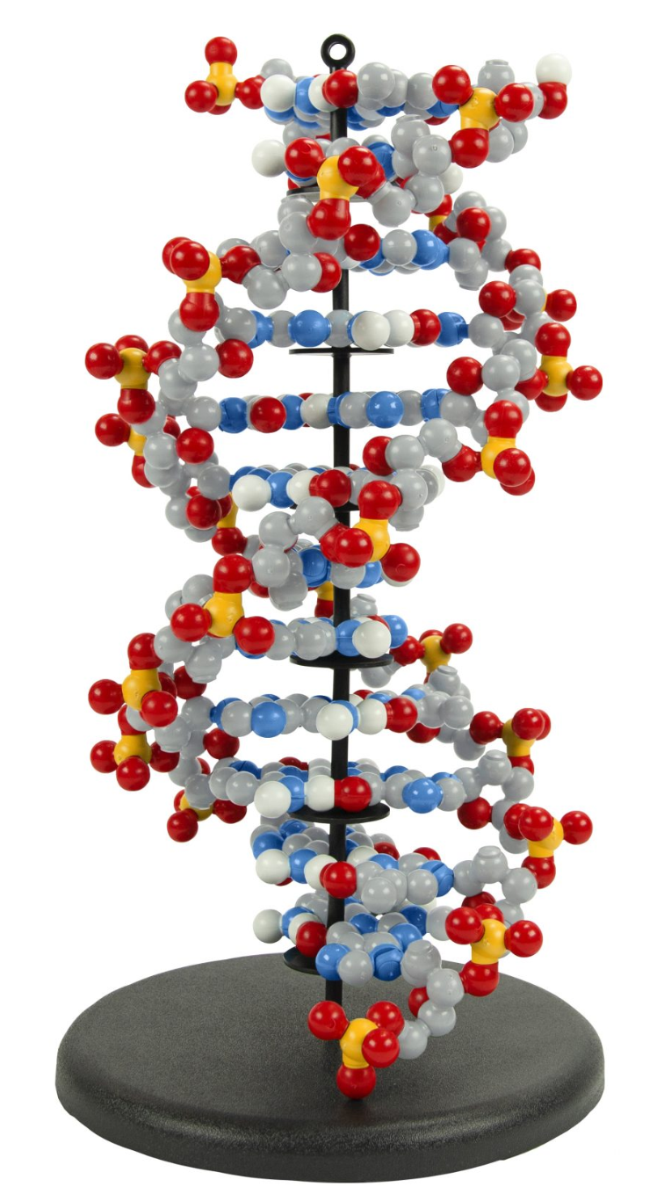
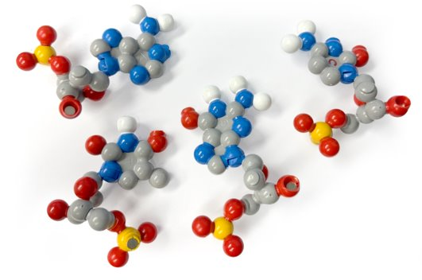
What does DNA look like?
The Dynamic DNA Kit© is one way to represent the structure of double-stranded DNA.
What features of DNA does this model represent well?
Are there any features of DNA that this model does not represent well?
Discuss with your partner and record your answers in your notebook.
Notes:
Teacher: Ask students to discuss the prompts with their partner(s) and share their ideas with the class.
Student: After discussion, students should write their responses in their notebooks.

Slide 8
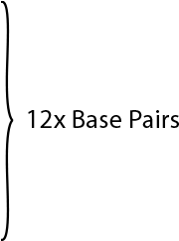
How Long is our DNA Genome?
One feature of DNA that this model does not represent accurately is the length of our DNA genome.
The physical model only shows 12 base pairs. But our real DNA genome is much longer. . .
. . . so let's extend this model!
Notes:
Teacher: Ask students to make a prediction of the length of DNA in one cell.
Student: Write their prediction in their notebook.

Slide 9

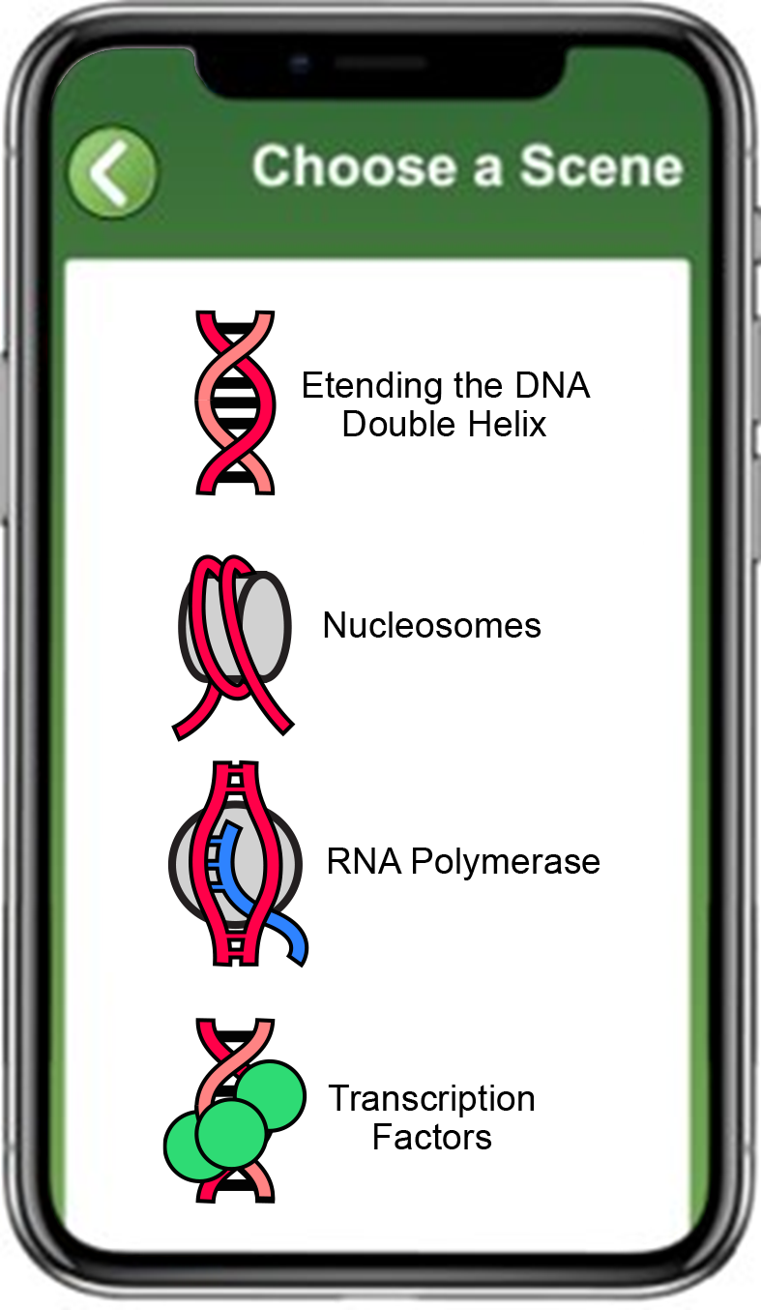
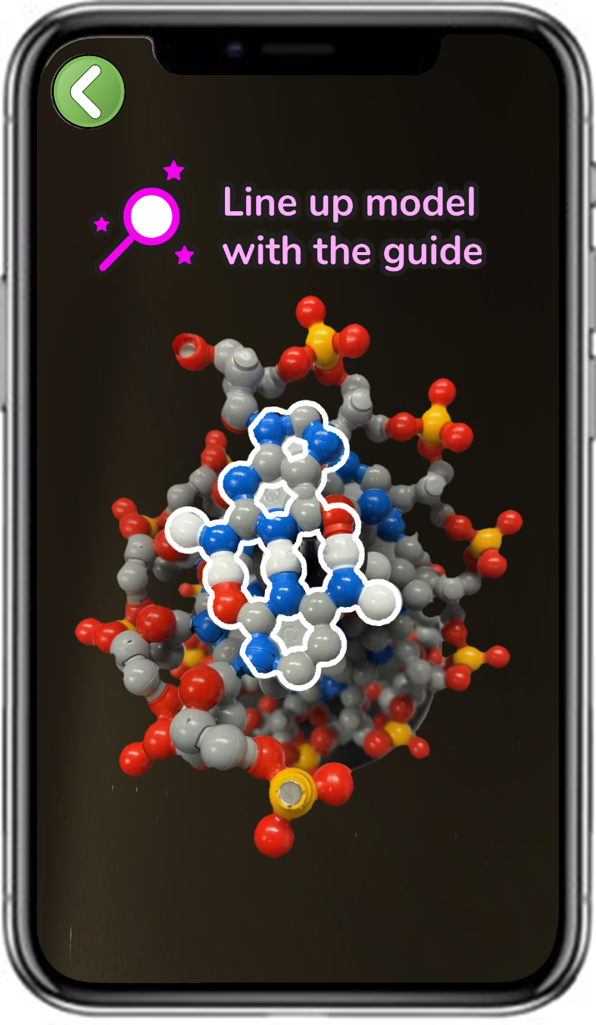
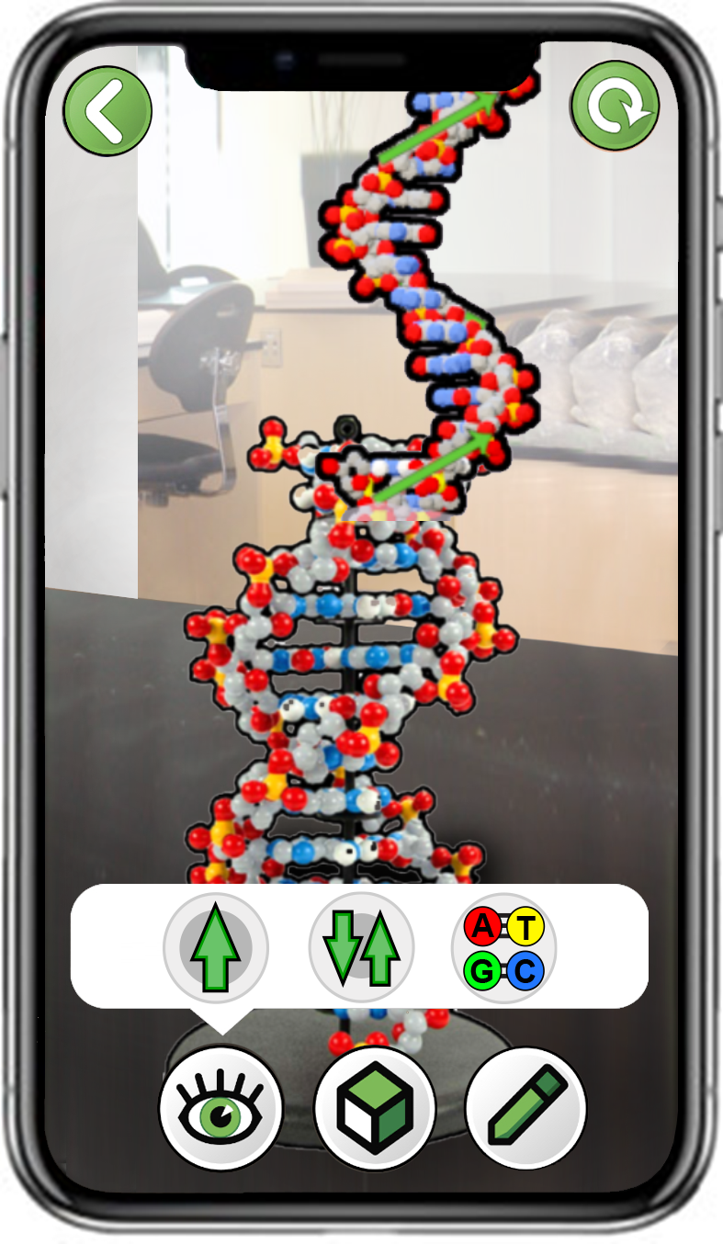
Exploring an Extended Representation of DNA
Scan a 12x Base Pair Model of DNA
Make sure the top base pair is G-C.
Start by scanning from above to lock on.
Choose Extending the DNA Double Helix
Explore all three buttons
Notes:
Teacher: Have students open the app and select the appropriate activity and scene. Move around the room and assist students with their technology. The top base pair HAS TO BE a 5’C = G 3’.
Or… Phosphate-Sugar-Cytosine-Guanine-Sugar-Phosphate. The 3’G needs to be at the bottom of your screen.
Student: Open the app and select the appropriate activity and scene.

Slide 10
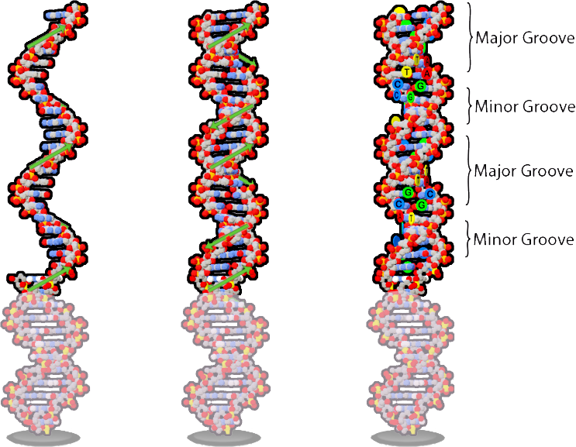
Exploring an Extended Representation of DNA
Were both strands of the DNA double helix extend? Did they extend in the same direction?
What holds the two strands together?
What might the labels "major groove" and "minor groove" mean?
Notes:
Teacher: Ask students to answer the prompts on the screen.
Student: Record their answers to the prompts in their notebook once they have viewed the AR.

Slide 11
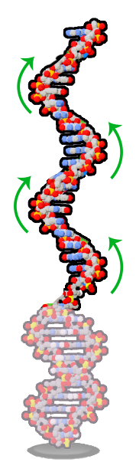
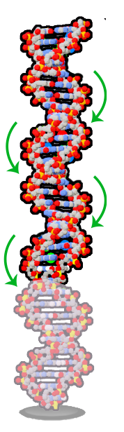

DNA Strands Extend in Anti-Parallel Directions
Both strands of DNA were extended.
The first strand extends from the bottom to the top.
The second strand extends from the top to the bottom.
Does this make the two DNA strands "parallel" or "anti-parallel" to each other?
Notes:
Teacher: Explain to students that the DNA has direction. Strands can only grow in one direction. Those directions are opposite for each strand.
Student: Answer the prompt in their notebook.

Slide 12
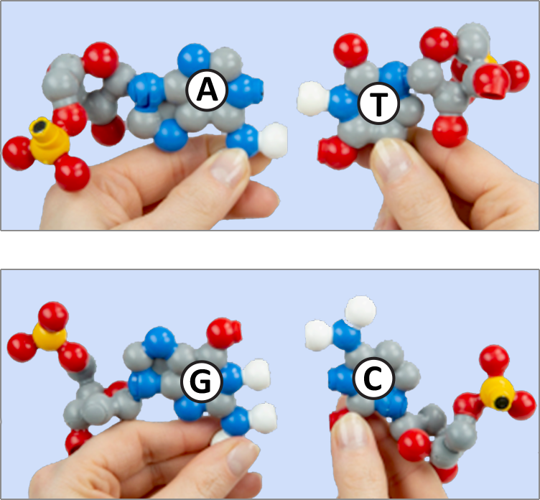
DNA Strands Form Complementary Base Pairs
The two strands of DNA are held together with base pairing. These contact points represent hydrogen bonds.
Adenine (A) nucleotides pair with Thymine (T) nucleotides.
Guanine (G) nucleotides pair with Cytosine (C) nucleotides.
How many points of contact are there between A and T?
How many points of contact are between a G and C?
Notes:
Teacher: Help student groups determine how many hydrogen bonds occur between adenine and thymine and guanine and cytosine.
Student: Share your answers with the class. Adenine and thymine form 2 hydrogen, while guanine and cytosine form 3 hydrogen bonds.

Slide 13
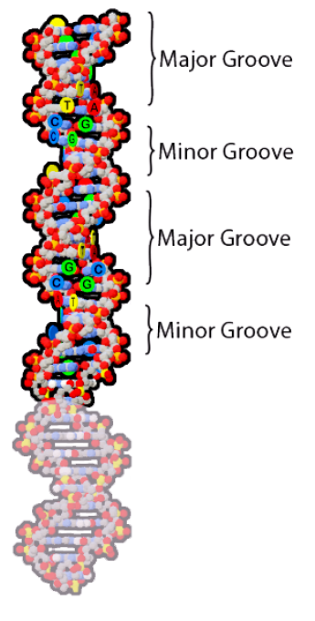
The DNA Double Helix has Major and Minor Grooves
Double-stranded DNA has indents or "grooves", like the space between threads on a screw.
These grooves are nearly symmetrical. But one groove is slightly larger than the other.
How might this impact the way other molecules interact with DNA?
Notes:
Teacher: Ask students to discuss the prompt with their partner. Help them explore the model using the third button (A-T G-C) on the app.
Student: Once groups have come to a consensus, have them record their ideas in their notebook. Explore the model using the third button on the app. Verify your findings or revise them, as necessary.

Slide 14
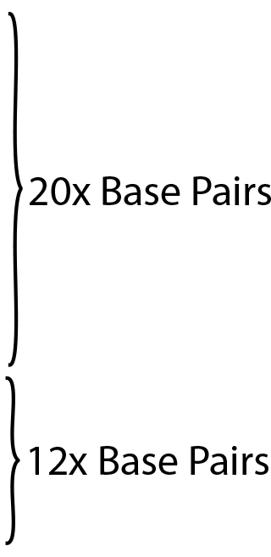
How Long is the Human Genome?
The AR added twenty more base pairs to the twelve base pairs in the physical model. However, the real human genome is not 32 base pairs long.
It is 3.2 billion base pairs long!
How long would our whole genome be at the same scale as this physical DNA model?
Notes:
Teacher: Ask your students to recall their prediction of large DNA is in a cell.
Student: Share your prediction that you made earlier with the class.

Slide 15

What is the Length of the Physical Model?
Start by taking measurements of the physical model. Create a table like the one to the right.
Record the number of base pairs in the physical model.
Using a meter stick, record the vertical length of the physical model in cm
Representation Type | Vertical Length | Number of Base Pairs | Length Per Base Pair
Physical Plastic DNA Model
Real DNA Genome
Notes:
Teacher: Ask students to follow the onscreen prompts.
Student: Record their answers in their notebook.

Slide 16
What is the Length of the Physical Model?
Start by taking measurements of the physical model. Create a table like the one to the right.
Record the number of base pairs in the physical model.
Using a meter stick, record the vertical length of the physical model in cm
Representation Type | Vertical Length | Number of Base Pairs | Length Per Base Pair
Physical Plastic DNA Model | 42cm | 12 base pairs
Real DNA Genome
Notes:
Teacher: Ask students to follow the onscreen prompts.
Student: Record their answers in their notebook.

Slide 17
What is the Length of the Physical Model?
We can use math to calculate the length of each single base pair in the physical model.
Divide the total vertical length by the number of base pairs to determine the length per base pair.
Representation Type | Vertical Length | Number of Base Pairs | Length Per Base Pair
Physical Plastic DNA Model | 42cm | 12 base pairs
Real DNA Genome
÷
Notes:
Teacher: Ask students to follow the onscreen prompts.
Student: Record their answers in their notebook.

Slide 18
What is the Length of the Physical Model?
We can use math to calculate the length of each single base pair in the physical model.
Divide the total vertical length by the number of base pairs to determine the length per base pair.
Representation Type | Vertical Length | Number of Base Pairs | Length Per Base Pair
Physical Plastic DNA Model | 42cm | 12 base pairs | 3.5cm per base pair
Real DNA Genome
÷
Notes:
Teacher: Ask students to follow the onscreen prompts.
Student: Record their answers in their notebook.

Slide 19
What is the Length of a Full Genome?
Now multiple the number of base pairs in the real human genome by the length per base pair to get the length of our full genome at the scale of this DNA Model.
Representation Type | Vertical Length | Number of Base Pairs | Length Per Base Pair
Physical Plastic DNA Model | 42cm | 12 base pairs | 3.5cm per base pair
Real DNA Genome |  | 3,200,000,000 base pairs
Notes:
Teacher: Ask students to follow the onscreen prompts.
Student: Record their answers in their notebook.

Slide 20
What is the Length of a Full Genome?
Now multiple the number of base pairs in the real human genome by the length per base pair to get the length of our full genome at the scale of this DNA Model.
Representation Type | Vertical Length | Number of Base Pairs | Length Per Base Pair
Physical Plastic DNA Model | 42cm | 12 base pairs | 3.5cm per base pair
Real DNA Genome | 11,200,000,000 cm | 3,200,000,000 base pairs
Notes:
Teacher: Ask students to follow the onscreen prompts.
Student: Record their answers in their notebook.

Slide 21
What is the Length of a Full Genome?
At the scale of this DNA model, a single copy of our human genome would wrap around the Earth almost 30x times!
How does all that DNA fit in each cell?
Representation Type | Vertical Length | Number of Base Pairs | Length Per Base Pair
Physical Plastic DNA Model | 42cm | 12 base pairs | 3.5cm per base pair
Real DNA Genome | 11,200,000,000 cm | 3,200,000,000 base pairs
Notes:
Teacher: Ask students to follow the onscreen prompts. Ask your students to convert this number into something more meaningful like kilometers and miles.
These numbers are meaningless due to their size. Some quick conversions… 112,000,000 m… 112,000 km … or 69,593.5 miles.
Student: Record their answers in their notebook.

Slide 22
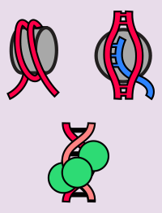
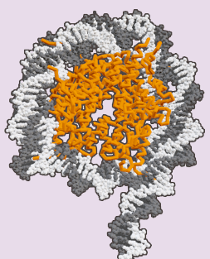
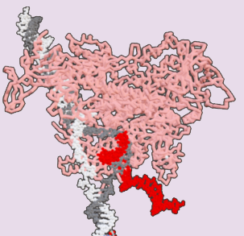
Teacher Guide – Scenes 2-4
Scene 2-4: Proteins the Interact with DNA
Scanning a twelve base pair long section of double-stranded DNA from the Dynamic DNA Kit© will display three proteins that interact with DNA: nucleosomes, RNA polymerase, and zinc fingers. Students will share ideas of what each protein does, before being shown what role each plays in the human genome.
For easier scanning, the twelve base pair long section of DNA should be placed on the black display stand (image to the right) and initially viewed from above until the app can lock onto the image target in the model. Note the top base pair MUST BE 5’C-G3’.
Scene 2: Nucleosomes
Stores and organizes DNA in the nucleus. Each nucleosome protein holds ~150 base pairs of DNA.
Scene 3: RNA Polymerase
Opens double-stranded DNA and allows a single-stranded mRNA transcript to be created.
Scene 4: Zinc Fingers
A transcription factor that regulates access to DNA and gene expression.

Slide 23
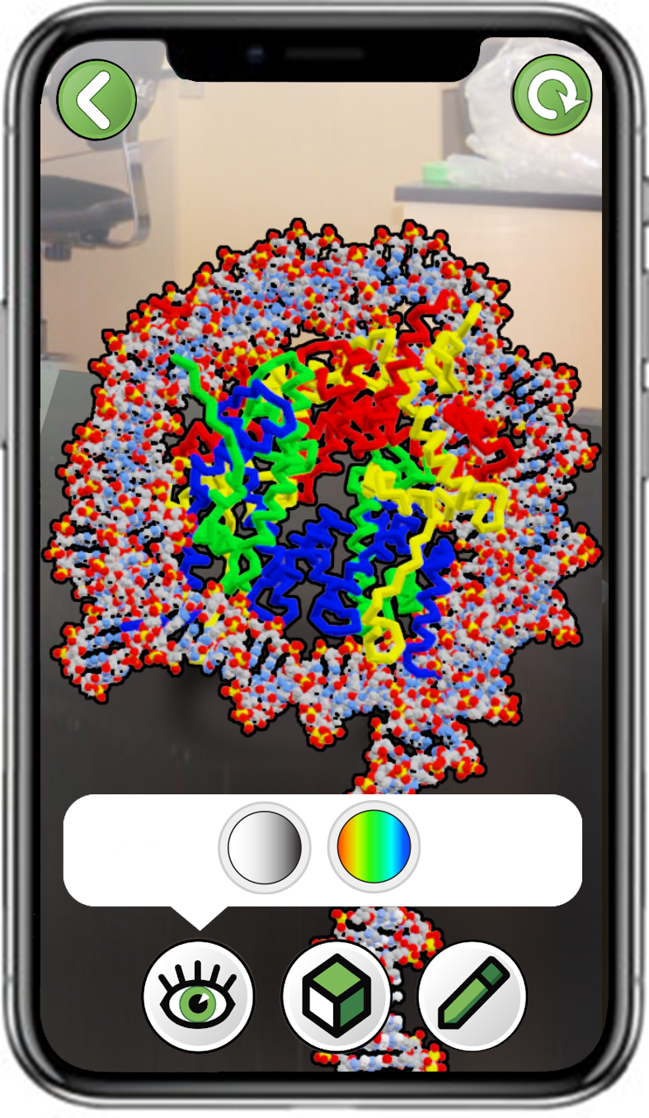
Exploring Nucleosomes
Scan a 12 Base Pair Model of DNA
Make sure the top base pair is G-C.
Start by scanning from above to lock on.
Choose
Nucleosomes
Explore both color schemes
Notes:
Teacher: Have students open the app and select the appropriate activity and scene. Move around the room and assist students with their technology. The top base pair HAS TO BE a 5’C = G 3’.
Or… Phosphate-Sugar-Cytosine-Guanine-Sugar-Phosphate. The 3’G needs to be at the bottom of your screen.
Student: Open the app and select the appropriate activity and scene.

Slide 24
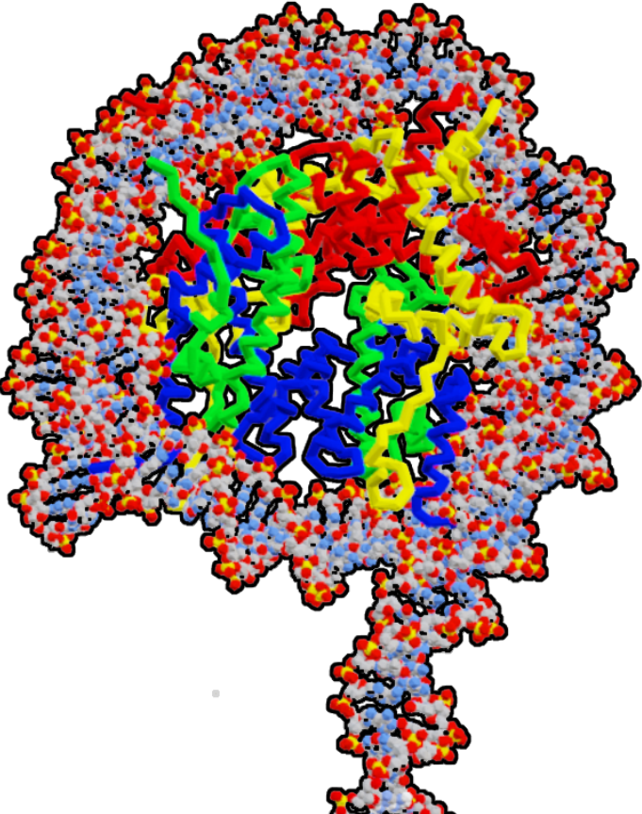
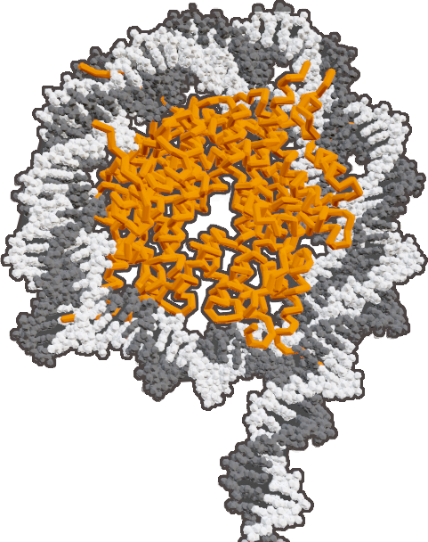
Exploring Nucleosomes
What shapes and colors do you see?
Is the DNA interacting with anything?
Notes:
Teacher: Ask students to follow the prompts on the screen.
Student: Discuss what you discovered with your partners and record your findings in your notebook.

Slide 25

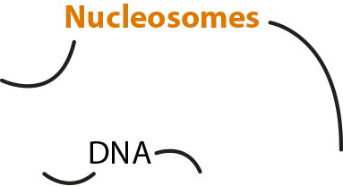
Nucleosomes Keep DNA Safe and Organized
Our entire genome is wrapped around nucleosome proteins.
Each nucleosome holds approximately 150 base pairs of DNA.
Nucleosomes help keep our DNA safe and organized.
Notes:
Teacher: Explain to students the role of nucleosomes.
Student: Jot down important ideas in their notebook.

Slide 26
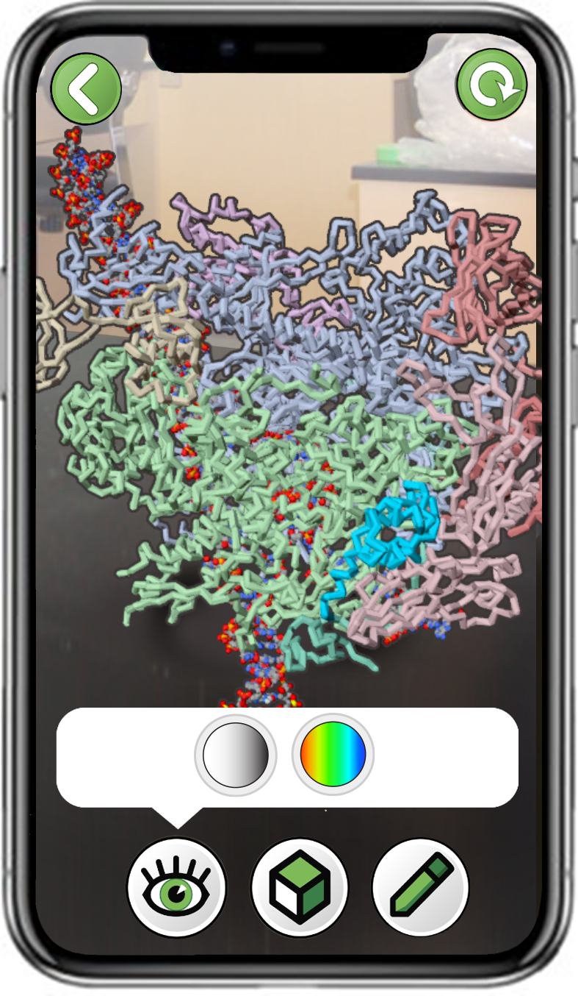
Exploring RNA Polymerase
Scan a 12 Base Pair Model of DNA
Make sure the top base pair is G-C.
Start by scanning from above to lock on.
Choose
RNA Polymerase
Explore both color schemes
Notes:
Teacher: Have students open the app and select the appropriate activity and scene. Move around the room and assist students with their technology. The top base pair HAS TO BE a 5’C = G 3’.
Or… Phosphate-Sugar-Cytosine-Guanine-Sugar-Phosphate. The 3’G needs to be at the bottom of your screen.
Student: Open the app and select the appropriate activity and scene.

Slide 27
Exploring RNA Polymerase
What shapes and colors do you see?
Is the DNA interacting with anything?
Notes:
Teacher: Ask students to follow the prompts on the screen.
Student: Discuss what you discovered with your partners and record your findings in your notebook.

Slide 28
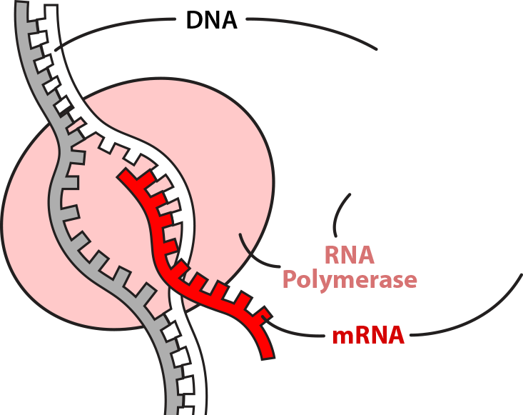
RNA Polymerase Creates mRNA
DNA contains the instructions needed to create proteins.
RNA Polymerase creates a single-stranded copy of these instructions, called mRNA.
The mRNA is then used by ribosomes to create proteins.
Notes:
Teacher: Explain to students the role of RNA polymerase.
Student: Jot down important ideas in their notebook.

Slide 29
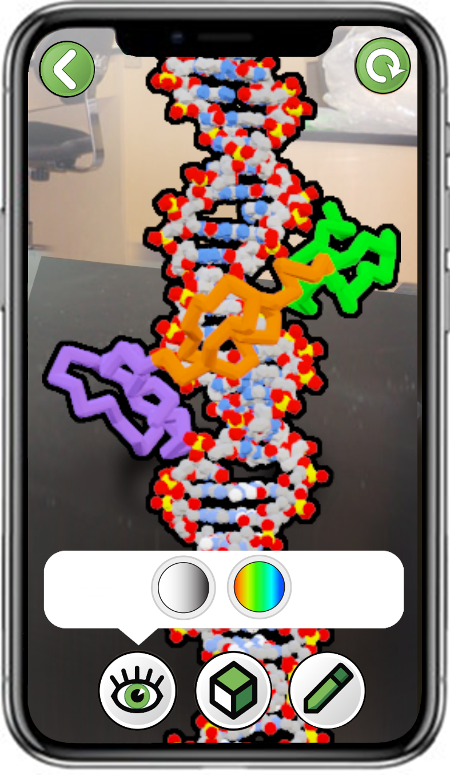
Exploring Zinc Fingers
Scan a 12x Base Pair Model of DNA
Make sure the top base pair is G-C.
Start by scanning from above to lock on.
Choose
Transcription Factors
Explore both color schemes
Notes:
Teacher: Have students open the app and select the appropriate activity and scene. Move around the room and assist students with their technology. The top base pair HAS TO BE a 5’C = G 3’.
Or… Phosphate-Sugar-Cytosine-Guanine-Sugar-Phosphate. The 3’G needs to be at the bottom of your screen.
Student: Open the app and select the appropriate activity and scene.

Slide 30
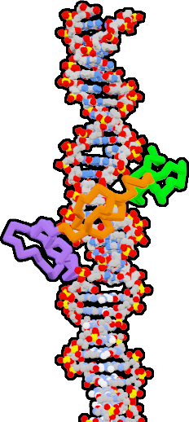
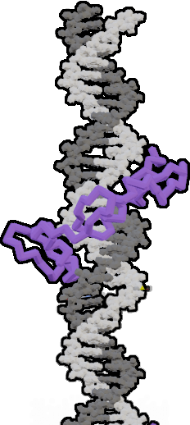
Exploring Zinc Fingers
What shapes and colors do you see?
Is the DNA interacting with anything?
Notes:
Teacher: Ask students to follow the prompts on the screen.
Student: Discuss what you discovered with your partners and record your findings in your notebook.

Slide 31
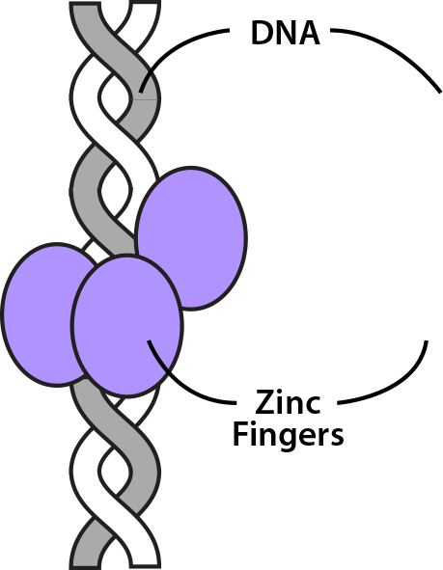
Zinc Fingers Regulate Access to DNA
DNA contains the instructions needed to create proteins.
Zinc Finger Proteins regulate access to those instructions, controlling when an mRNA transcript is created.
Notes:
Teacher: Explain to students the role of RNA polymerase.
Student: Jot down important ideas in their notebook.

Slide 32

Conclusions
Our DNA genome is incredibly long, approximately 3.2 billion base pairs in length!
Proteins called Nucleosomes help safely store DNA in our genome.
Proteins called RNA Polymerases open our DNA to access the instructions needed to create more proteins.
Proteins called Zinc Fingers help regulate access to our DNA genome.
Notes:
Teacher: Summary slide with learning objectives of this lesson.
Student: Jot your thoughts and ideas in your notebook.

