Slide 1

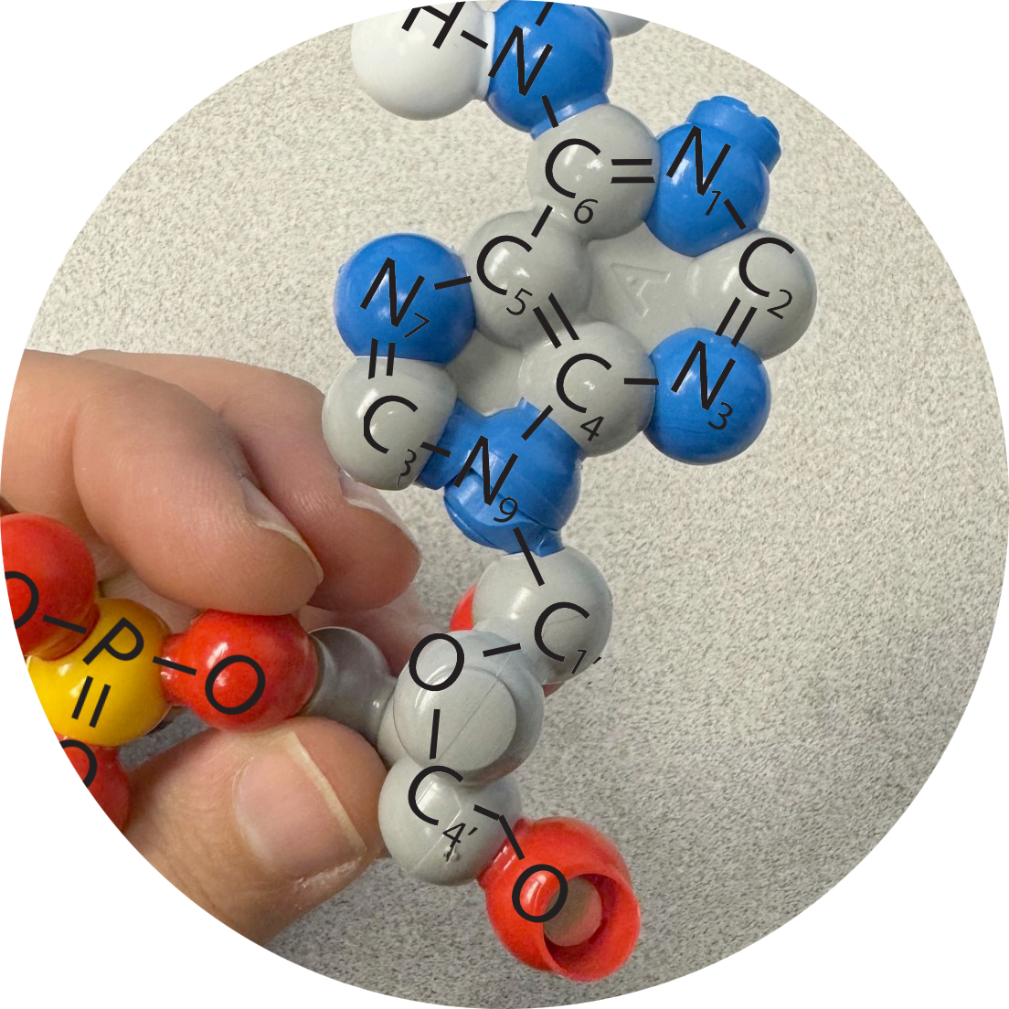
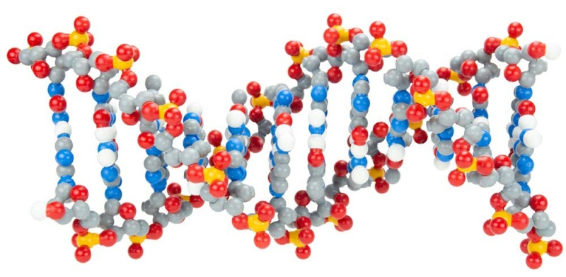

Transferring Models
with the Dynamic DNA Kit
"DNA neither cares nor knows. DNA just is. And we dance to its music."
- Richard Dawkins
Activity ID: DDNA-AR1
Required Models: 1 DDNA©/ Group
Required Media: 3DMD AR EDU App

Slide 2

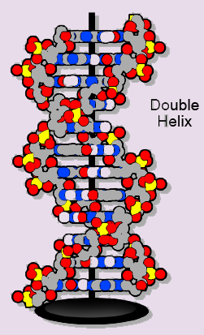
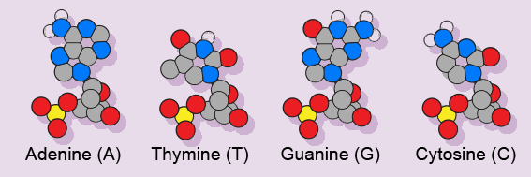
Teacher Guide – Summary
Activity Summary
This AR activity explores the components of DNA structure using several commonly used DNA models. DNA is made of nucleotides. Each nucleotide contains a phosphate, deoxyribose sugar, and one of four nitrogenous bases. Nitrogenous bases typically use base pairing in which adenine hydrogen bonds with thymine and cytosine hydrogen bonds with guanine. The DNA strand has directionality from the 5’ to the 3’ direction based on the carbon in the sugar on the backbone.
This activity requires the 3DMD AR EDU application, available for download from the Google Play and Apple App stores. The activity is split into two AR scenes designed to be explored in order. Each AR scene is represented by a consistent icon in this slide deck and the 3DMD AR EDU app (see icon images below.)
Scene 2: Scan a specific nucleotide sequence created with the nucleotides from the Dynamic DNA ©, students will investigate DNA in its helical configuration.
Scene 1: Scanning the plastic nucleotides from the Dynamic DNA Kit© will display the several overlays of a single nucleotide. Students will compare the Dynamic DNA© nucleotide to a cartoon, a chemical structure, and a simple schematic representation.

Slide 3
Teacher Guide - Overview
Activity Objectives
  Evaluate multiple models of the structure of the nucleotide.
  Construct a DNA sequence and discover the directionality of DNA.
  Estimated Class Time:
45 minutes
Required Models:
Dynamic DNA Kit©
Required Media:
3DMD AR EDU App + subscription
Other Materials Needed:
Notebook and writing tools
*Optional – Flow of Genetic Information Kit ©
Grade, Class
9-12 Biology
Topics
DNA Structure
Nucleotide Structure
Base Pairing
Directionality
Prerequisite Knowledge
Polarity
Covalent bonding
Hydrogen bonding

Slide 4





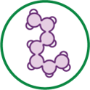
Teacher Guide - Using This Slide Deck
Student and Teacher Slide Deck Pages
  Slides that are meant for student viewing will feature a green top
  banner. Slides that are meant only for teacher viewing will feature a
  purple top banner and will appear hidden when in "slide show" mode.
Prompting Icons
  Each student slide will include a prompting icon in the top right corner of the slide. These icons on each slide cue your students to the type of activity they will be doing.
Turn and talk discussion
Write in your notebook
Quiet thinking time
Digital modeling
Physical modeling
Teacher Moves and Student Moves
Class slides provide notes (teacher notes below the slide) with specific information to assist you in facilitating the activity using effective modeling and education practices.

Slide 5
Teacher Guide - Standards
Next Generation Science Standards
Science and Engineering Practices | Cross Cutting Concepts | Disciplinary Core Ideas
Asking Questions and Defining Problems | Patterns | HS-LS1-1
Developing and Using Models | Structure and Function
Constructing Explanations and Designing

Slide 6
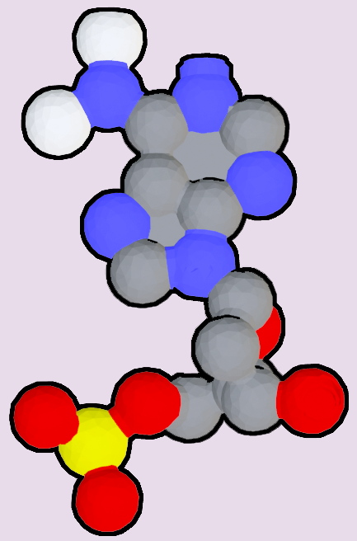
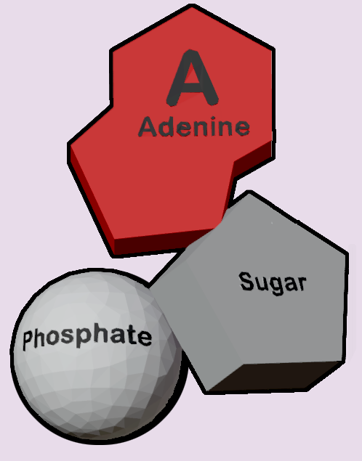
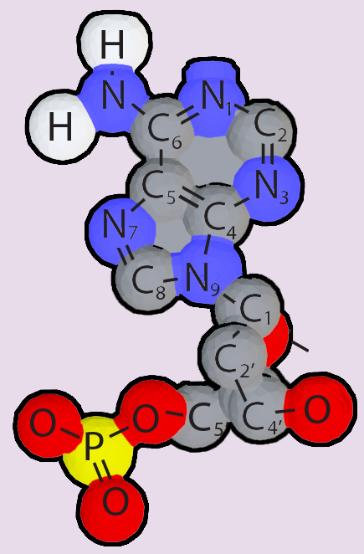

Teacher Guide – Scene 1
Scene 1: Nucleotide Structure
Scanning individual plastic nucleotides from the Dynamic DNA Kit© will display three different digital representations of each nucleotide: a cartoon representation, a chemical structure representation, and a schematic representation. Students compare the different representations.
Physical Model
Nucleotide atoms shown with balls and bonds as sticks.
Cartoon
Nucleotide components shown as different schematic shapes.
Chemical Structures
Nucleotides atoms shown with periodic table abbreviations.
Schematic
Nucleotides shown as simple schematic shapes.

Slide 7
Teacher Guide – Scene 1 (continued)
Physical Model
Individual atoms are shown as spheres.
Color of the atoms adhere to CPK coloring.
Oxygen = Red
Nitrogen = Blue
Carbon = Gray
Hydrogen = White
Phosphate = Yellow
Cartoon
Phosphates are white spheres.
Ribose sugars are gray pentagons.
Nitrogenous bases are colored rings.
Adenine = Red double ring
Guanine = Green double ring
Thymine = Yellow single ring
Cytosine = Blue single ring
Chemical Structure
Atom letters represent periodic table abbreviation.
Chemical bonds are shown as lines.
O = Oxygen
N = Nitrogen
C = Carbon
H= Hydrogen
P = Phosphorus
Schematic
Arrows to represent nucleotide backbone directionality.
Color/shape represent nucleotide type.
Adenine = Red
Guanine = Green
Thymine = Yellow
Cytosine = Blue

Slide 8



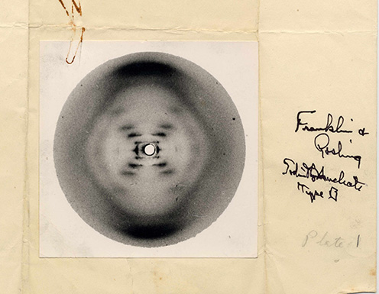
What does DNA look like?
This is the famous "Photo 51". Rosalind Franklin used this image to determine the structure of DNA, but what does DNA really look like?
How do we represent DNA structure?
Notes:
Teacher: Ask students to describe what DNA looks like. What do you already know about DNA?
Student: Students should write down what they already now about DNA in their notebook.

Slide 9
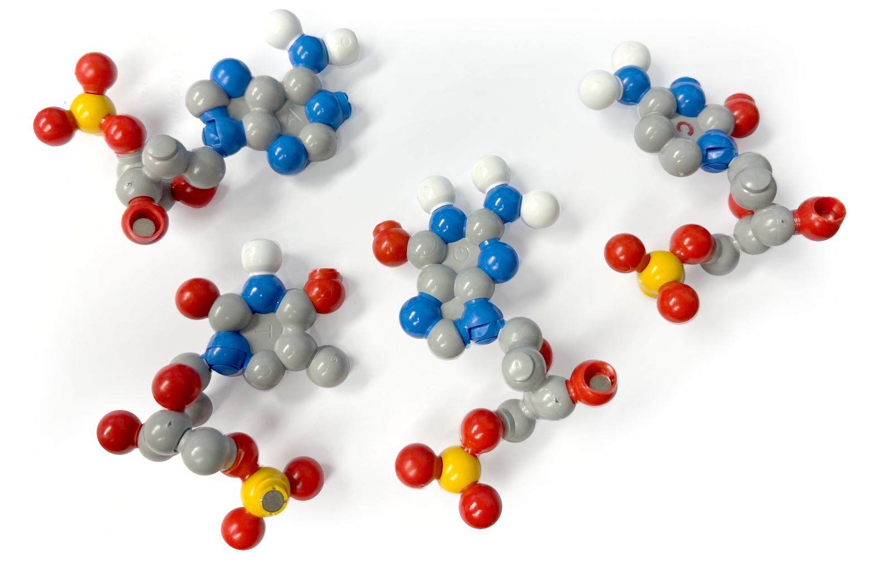
Exploring Plastic Models of Nucleotides
DNA is a polymer made of individual monomers called nucleotides. Take out one plastic nucleotide model of each letter: A, T, G, and C.
How are they similar?
How are they different?
Record your observations in your notebook.
Notes:
Teacher: Give student groups an adenine, thymine, guanine, and cytosine nucleotide. Give them time to compare and contrast the nucleotide with each other. Ask groups what they observed.
Student: Observe the nucleotides closely with your group. Identify any patterns among the nucleotides. Be prepared to share your findings with the class.

Slide 10
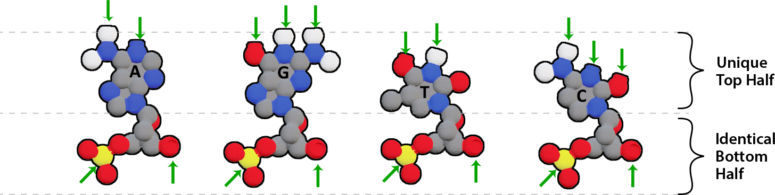
Key Features of Plastic Nucleotide Models
All four nucleotides have an identical shape on the bottom half, but a unique shape on the top half.
There are magnets in the top and bottom halves.
There are red, yellow, gray, blue and white atoms.
Why do they have these features?
To find out, let's explore some additional ways to represent DNA nucleotides.
Notes:
Teacher: Give students time to think and respond to the writing prompt.
Student: Students should write down why they think these features are highlighted in their notebook.

Slide 11

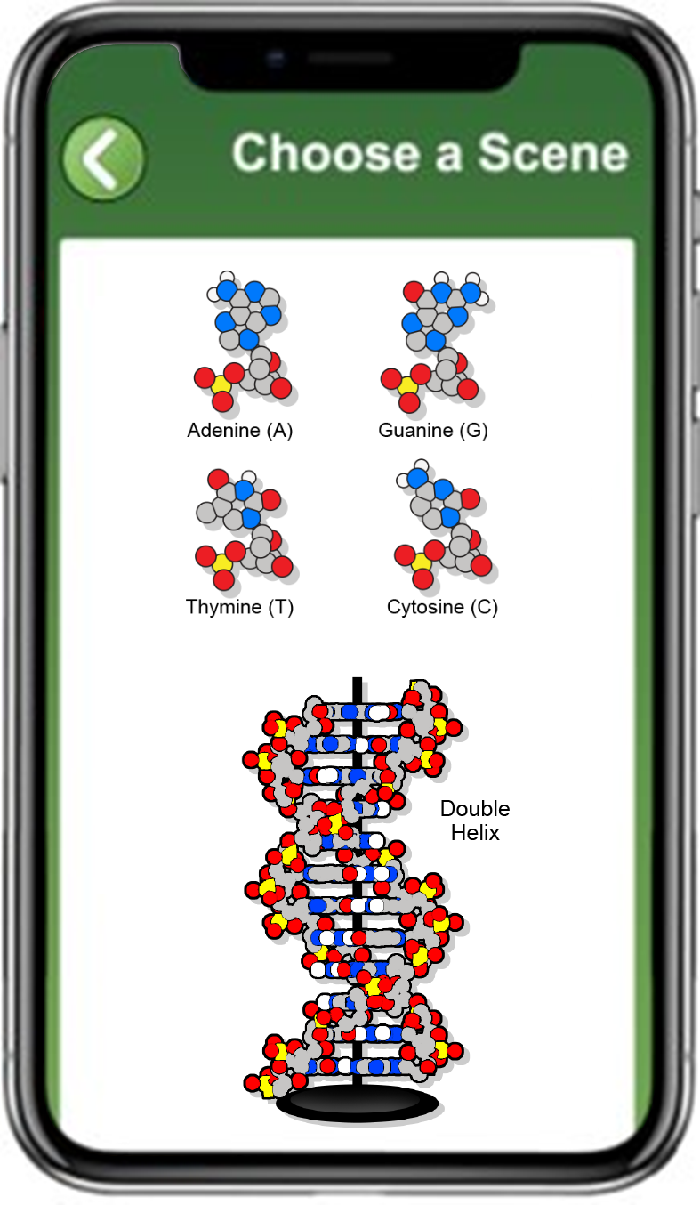
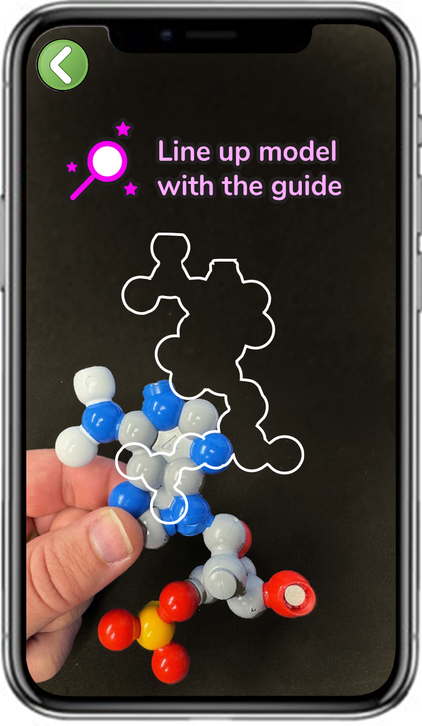
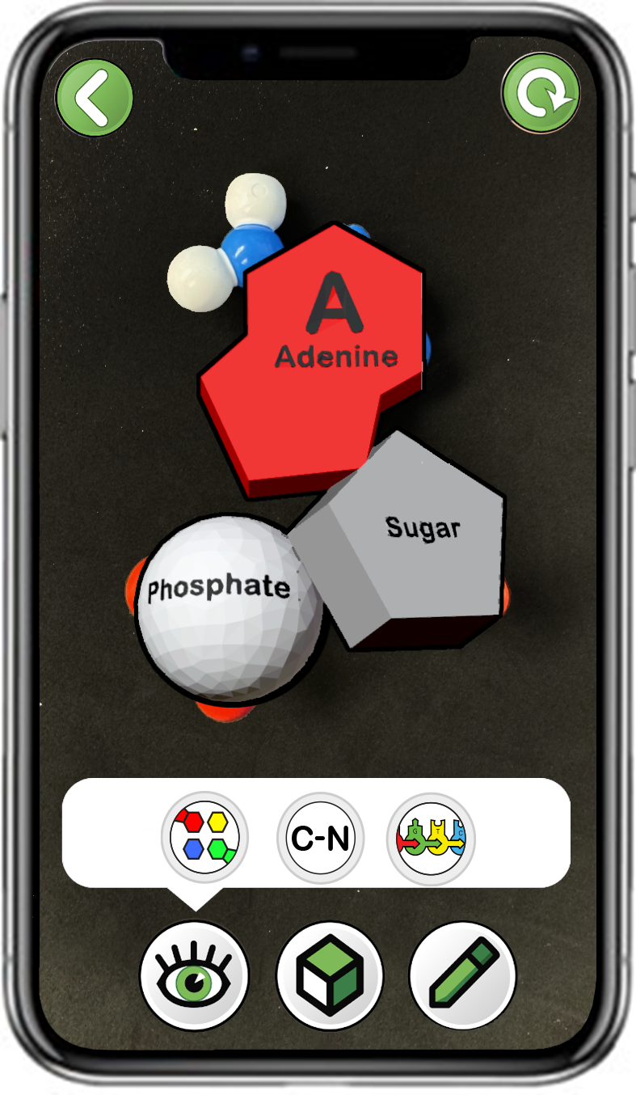
Exploring Cartoon Representations of Nucleotides
Choose
Adenosine (A)
Scan a single plastic adenosine (A)
Only click the left button
Notes:
Teacher: Have students open the app and select the appropriate activity and scene. Move around the room and assist students with their technology.
Student: Open the app and select the appropriate activity and scene.

Slide 12
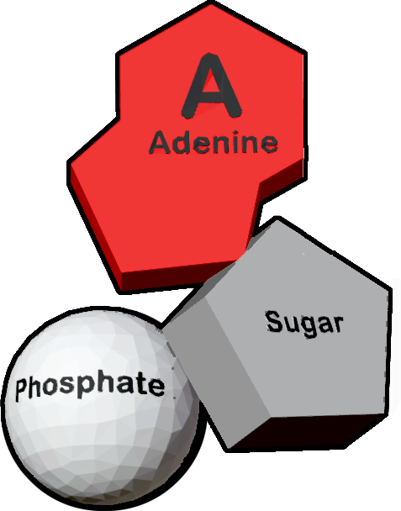
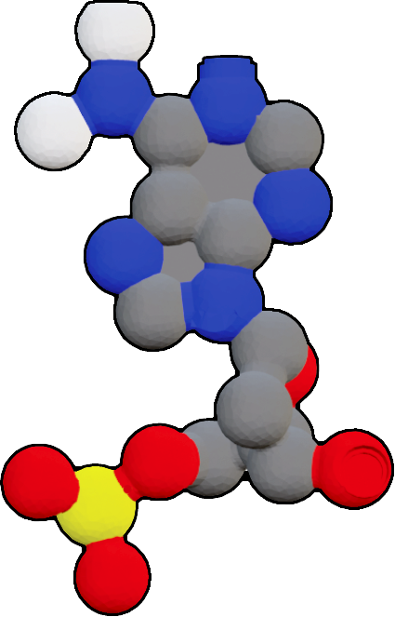
The Adenosine (A) Nucleotide
What are the three main parts of an adenosine (A) nucleotide?
On the plastic model, what color atoms are present in each of the three parts?
Notes:
Teacher: Give student groups time to compare the two models. Ask them to respond to the writing prompt in their notebook. Facilitate a discussion and allow student groups to share their findings. Students will be able to confirm their answers on the next slide.
Student: Write responses to the prompts in your notebook. Be prepared to share your findings with the class.

Slide 13
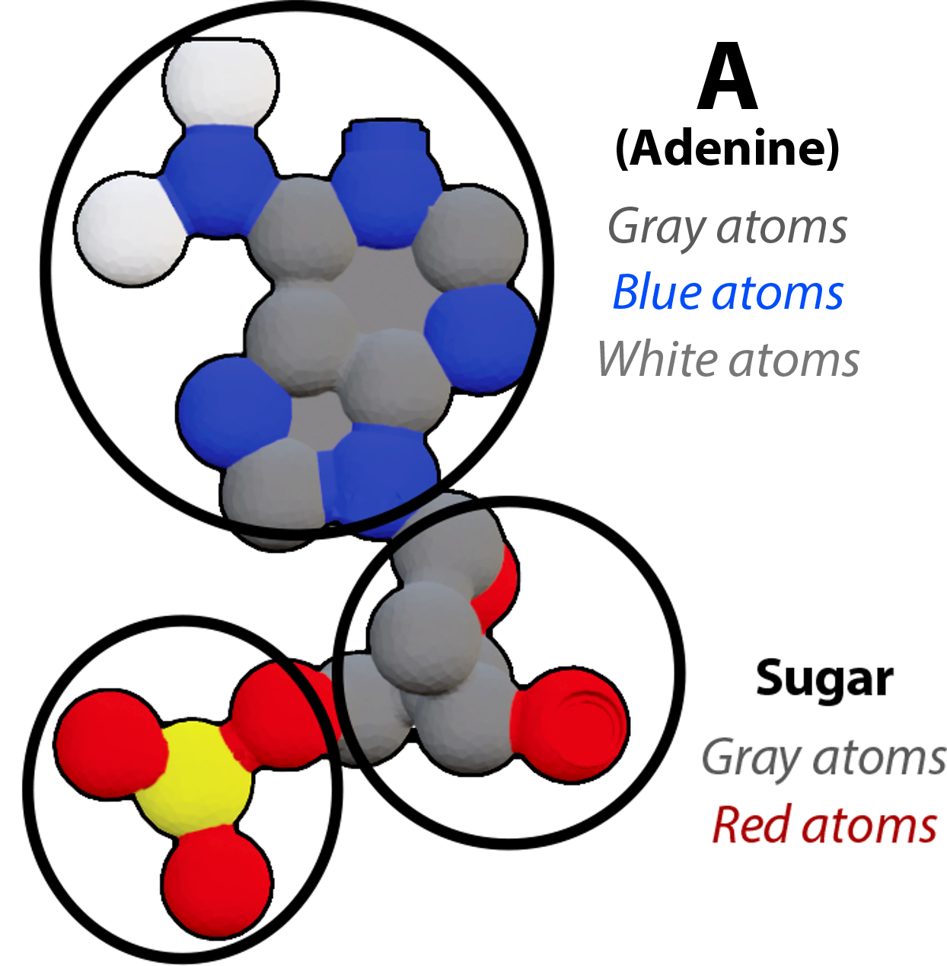
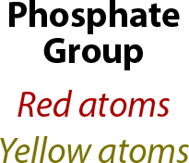
The Adenosine (A) Nucleotide
What are the three main parts of an adenosine (A) nucleotide?
On the plastic model, what color atoms are present in each of the three parts?
Notes:
Teacher: Confirm student findings that each representation has a nitrogenous base, a deoxyribose sugar, and a phosphate group.
Student: Confirm or modify your responses.

Slide 14
Explore the Three Remaining Nucleotides
Repeat this step for each of the three remaining nucleotides.
What shapes, colors and labels do you see?
How are the four similar?
How are they different?
Record your observations in your notebook.
Notes:
Teacher: Have students open the app and select the appropriate activity and scene. Move around the room and assist students with their technology. Give your students time to explore the other three nucleotides, then ask them to share their findings.
Student: Open the app and select the appropriate activity and scene. What new patterns can they identify? Share what they see with their group and the class.

Slide 15
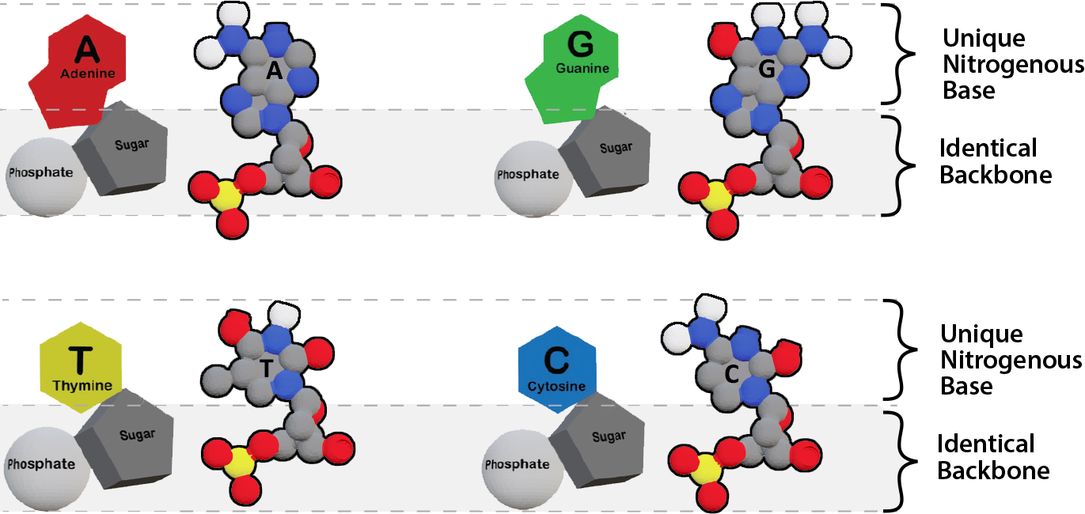
Key Features of Cartoon Representations
Each cartoon representation has:
  A unique nitrogenous base on the top.
  An identical backbone on the bottom, comprised of a sugar and a phosphate.
This is why the plastic models have identical bottom halves but a unique top half.
Notes:
Teacher: Confirm student findings that each representation has a nitrogenous base, a deoxyribose sugar, and a phosphate group.
Student: Confirm or modify your responses.

Slide 16
Exploring Chemical Structure Representations of Nucleotides
Let's explore another way to visualize DNA nucleotides, called a chemical structure representation.
In a chemical structure, each atom is represented by its periodic table abbreviation.
Predict which color is used to identify each element.
Notes:
Teacher: Explain to students that the following elements make up DNA.
Student: Predict which colors correspond with the elements shown. Record their predictions in their notebook.

Slide 17
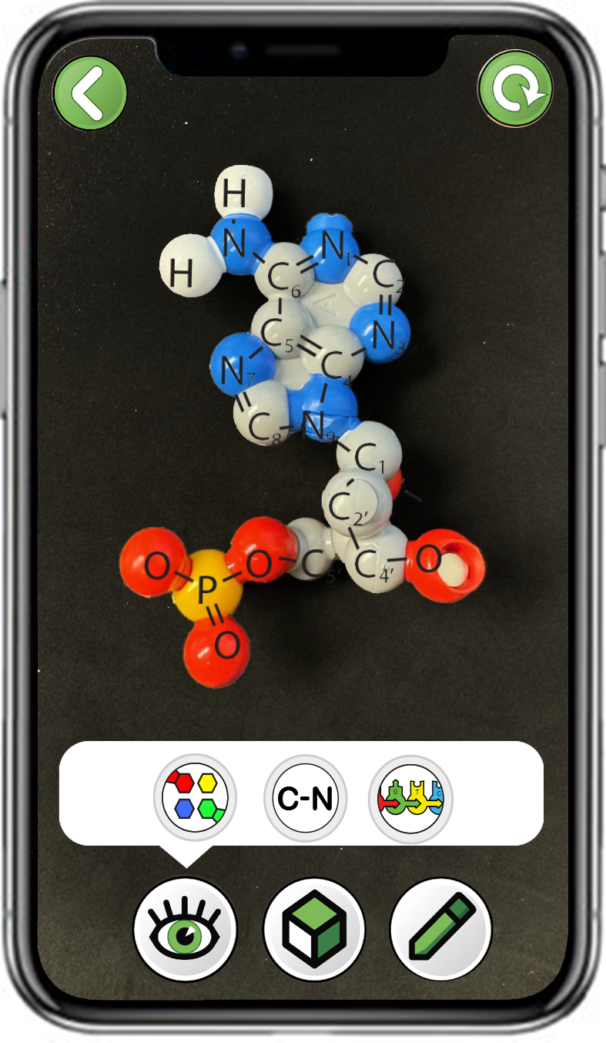
Exploring Chemical Structure Representations of Nucleotides
Choose
Adenosine (A)
Scan a single plastic adenosine (A)
Only click the middle button
Notes:
Teacher: Have students open the app and select the appropriate activity and scene. Move around the room and assist students with their technology.
Student: Open the app and select the appropriate activity and scene.

Slide 18

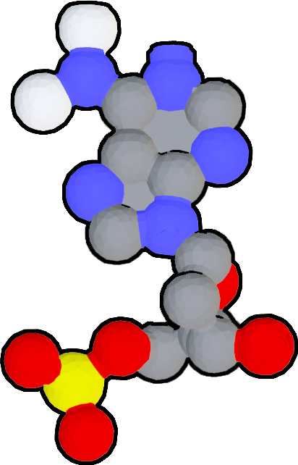
Chemical Structures and the CPK Color Scheme
The plastic model uses color to represent the types of atoms in a nucleotide.
What type of atom is represented by each color?
Red: _________________
Gray: _________________
Blue: _________________
Yellow: _________________
White: _________________
Notes:
Teacher: Ask students to notice the colors used for each of the atoms in DNA. Nitrogen is blue. Hydrogen is white. Carbon is gray. Oxygen is red. Phosphorus is yellow-orange (tangerine). Note: This color scheme is CPK coloring. You may want to print this slide off for students to use as a template.
Student: Students should confirm or modify their predictions for the representative colors for the elements in DNA.

Slide 19
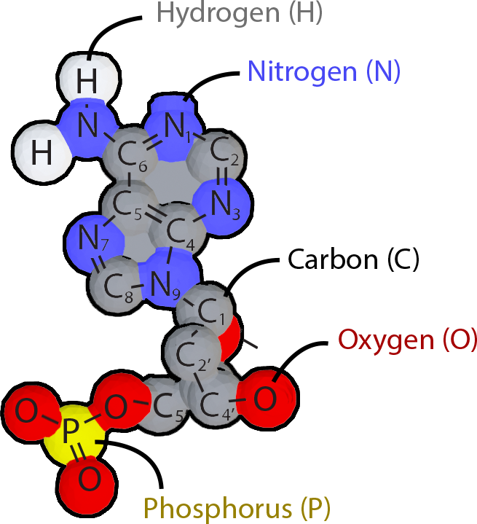
Chemical Structures and the CPK Color Scheme
The plastic model uses color to represent the types of atoms in a nucleotide.
What type of atom is represented by each color?
Red: Oxygen (O) _
Gray: Carbon (C) _
Blue: Nitrogen (N) _
Yellow: Phosphorus (P) _
White: Hydrogen (H) _
Notes:
Teacher: Confirm student findings.
Student: Confirm or modify your responses.

Slide 20
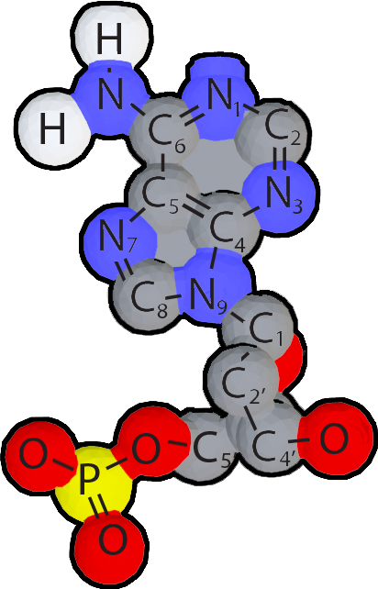
The Phosphate, Sugar and Nitrogenous Base of a Nucleotide
Identify the phosphate, sugar, and nitrogenous base in the chemical structure representation.
Draw a nucleotide in your notebook or take a screenshot in the app using the pencil in the bottom right corner.
Label the nitrogenous base, sugar and phosphate.
Notes:
Teacher: Ask students to complete the writing prompt.
Student: Complete the writing prompt on the slide.

Slide 21
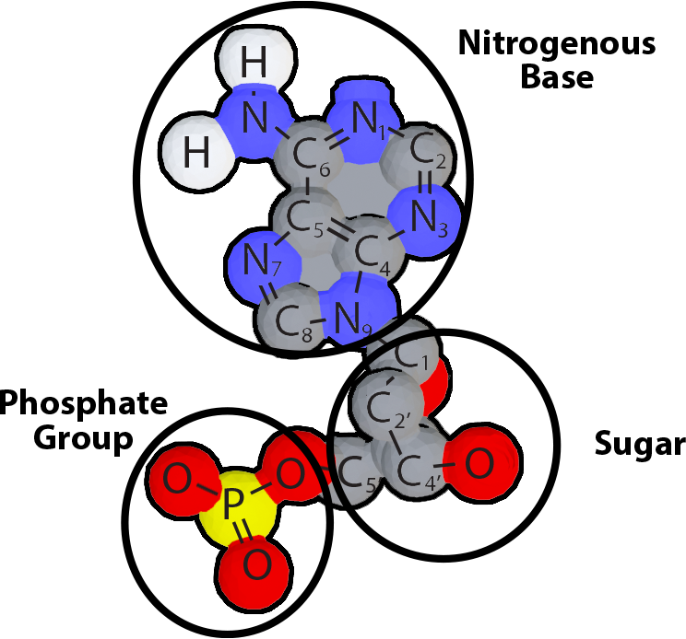
The Phosphate, Sugar and Nitrogenous Base of a Nucleotide
Identify the phosphate, sugar and nitrogenous base in the chemical structure representation.
Draw a nucleotide in your notebook or take a screenshot in the app using the pencil in the bottom right corner.
Label the nitrogenous base, sugar and phosphate.
Notes:
Teacher: Confirm student findings that each representation has a nitrogenous base, a deoxyribose sugar, and a phosphate group.
Student: Confirm or modify your responses.

Slide 22
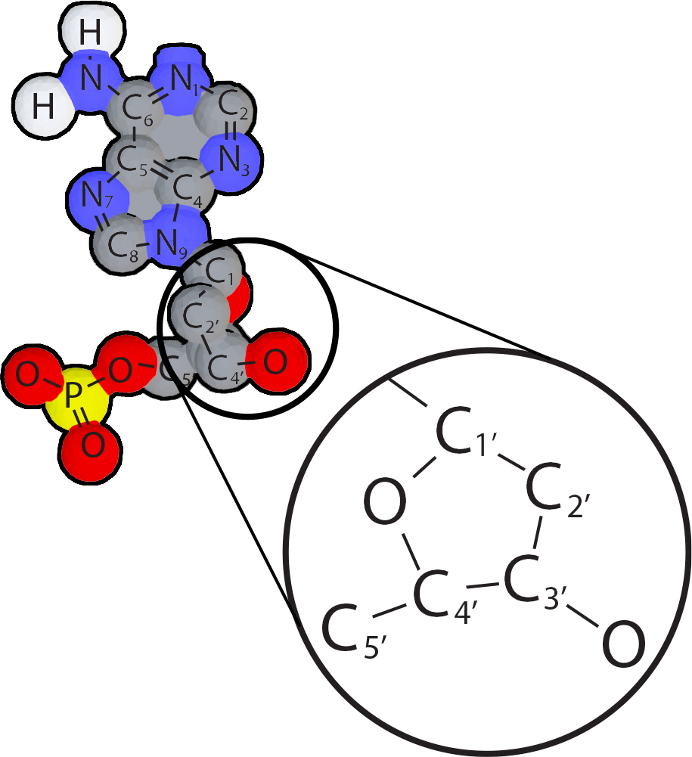
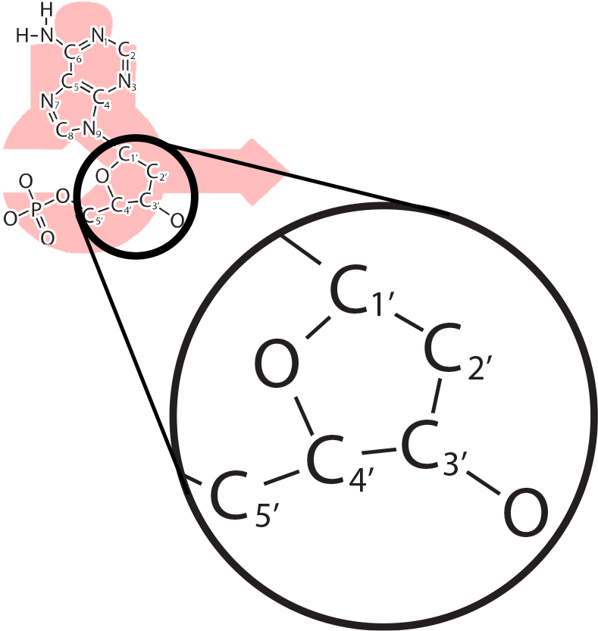
The 5' to 3' Directionality of Nucleotides
Where are the numbers in this chemical structure?
Find the 5' and 3' carbon atoms in the sugar.
In your drawing or screenshot, draw an arrow from the C_{5'} to the C_{3'} carbon in the sugar.
This 5' to 3' arrow represents the direction multiple nucleotides join together to form a DNA strand.
Notes:
Teacher: Ask students to use the 3-D viewing mode and focus on the Sugar. Notice the 5’ and 3’ ends of Deoxyribose. Students will need to rotate their physical or digital models to see the 5' and 3' carbons.
Student: Modify your prediction to reflect the new information.

Slide 23
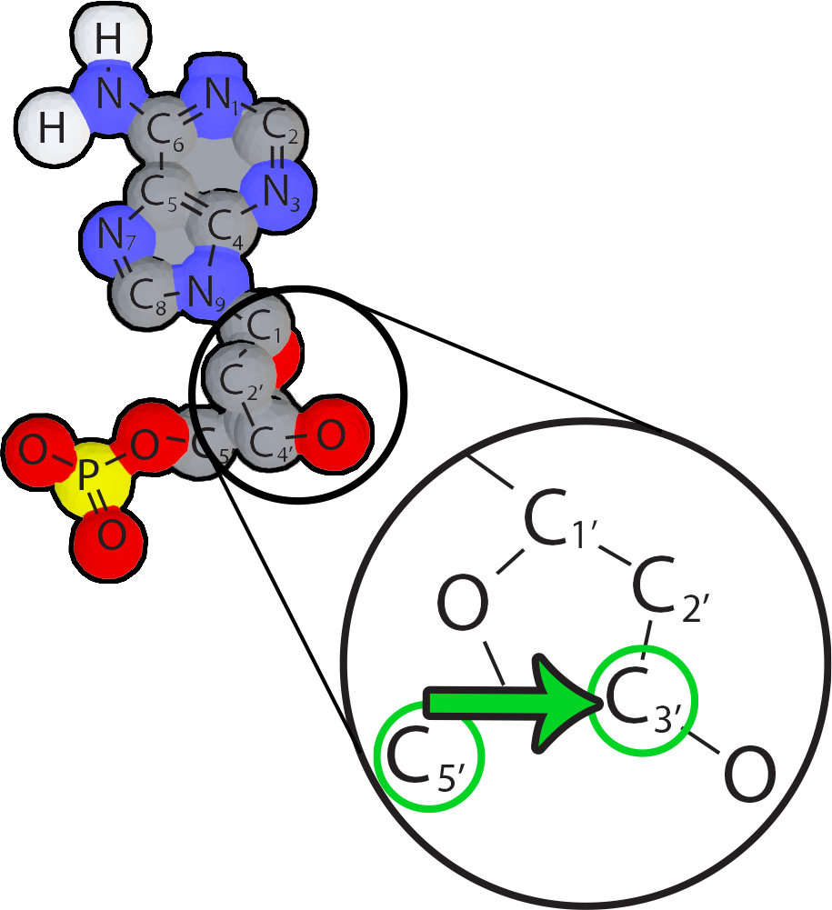
The 5' to 3' Directionality of Nucleotides
Where are the numbers in this chemical structure?
Find the 5' and 3' carbon atoms in the sugar.
In your drawing or screenshot, draw an arrow from the C_{5'} to the C_{3'} carbon in the sugar.
This 5' to 3' arrow represents the direction multiple nucleotides join together to form a DNA strand.
Notes:
Teacher: Confirm student findings and identify the 5' and 3' carbons.
Student: Confirm or modify your responses.

Slide 24
Explore the Three Remaining Nucleotides
Repeat this step for each of the three remaining nucleotides.
Identify the sugar, phosphate and nitrogenous base in each.
Identify the 5' and 3' carbon atoms.
Notes:
Teacher: Have students open the app and select the appropriate activity and scene. Move around the room and assist students with their technology.
Student: Open the app and select the appropriate activity and scene.

Slide 25
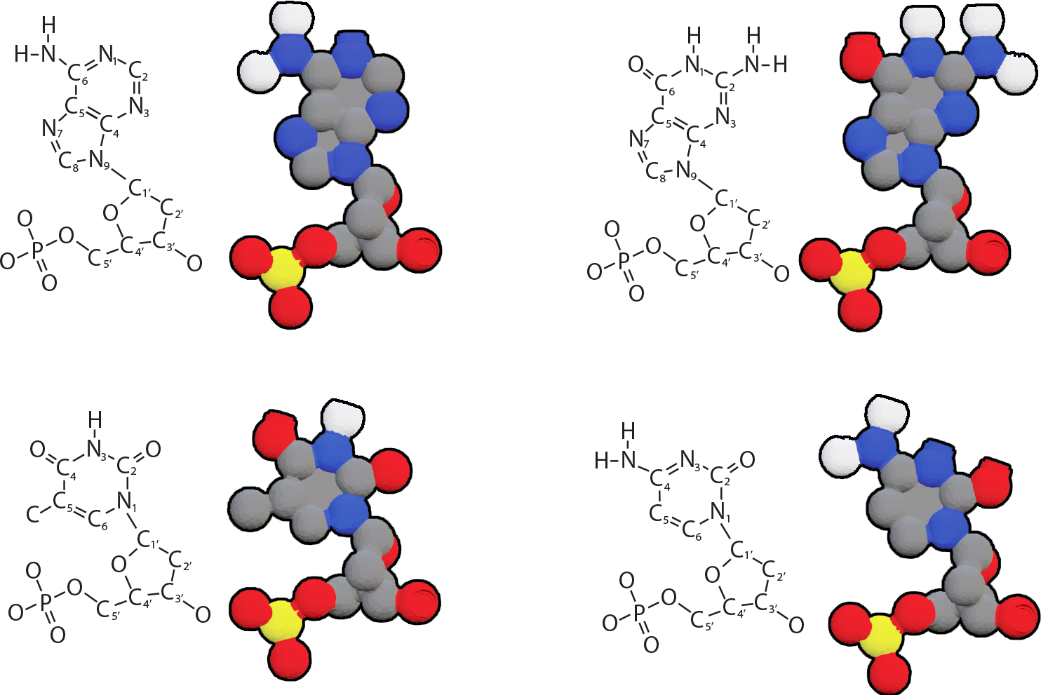
Key Features of Chemical Structure Representations
Each chemical structure representation has:
  A unique nitrogenous base on the top and identical backbone on the bottom
  A sugar with 5' and 3' carbons, representing the directionality of the nucleotide.
Notes:
Teacher: Confirm student findings and identify the 5' and 3' carbons.
Student: Confirm or modify your responses.

Slide 26
Explore the Three Remaining Nucleotides
Repeat this step for each of the three remaining nucleotides.
What features do you see in the schematic representation?
What features are missing from the schematic representation?
Notes:
Teacher: Discuss with students the process of transferring knowledge acquired by looking at a model and applying it to a new model. This is known as model transference.
Student: Compare the foam nucleotide with overlays 1 and 2. What are the benefits of using the foam nucleotide model?

Slide 27
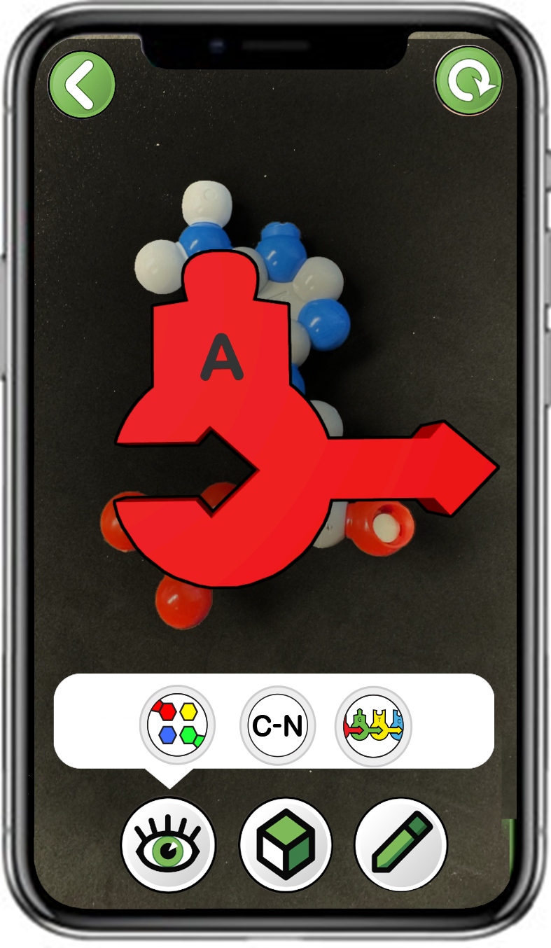
Exploring Schematic Representations of Nucleotides
Choose
Adenosine (A)
Scan a single plastic adenosine (A)
Only click the right button
Notes:
Teacher: Have students open the app and select the appropriate activity and scene. Move around the room and assist students with their technology.
Student: Open the app and select the appropriate activity and scene.

Slide 28
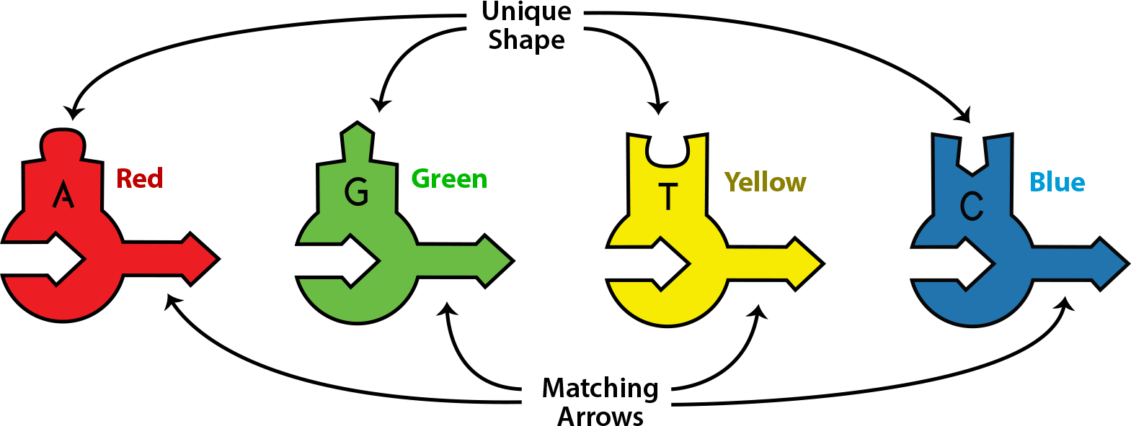
Exploring Schematic Representations of Nucleotides
The schematic representation lacks atomic details such as numbering and element.
It does show directionality (arrow), an identical backbone shape and a unique nitrogenous base shape and color.
Notes:
Teacher: Discuss with students the process of transferring knowledge acquired by looking at a model and applying it to a new model. This is known as model transference.
Student: Compare the foam nucleotide with overlays 1 and 2. What are the benefits of using the foam nucleotide model?

Slide 29
Compare and contrast
Each of the molecular representation highlight different aspects of nucleotide structure. Fill out the chart below to compare and contrast the representations.
Representation Type | Benefits | Limitations
Physical Plastic Model
Cartoon Representation
Chemical Structure Representation
Schematic Representation
Notes:
Teacher: Ask students to compare and contrast the structures of all four models.
Student: What are the benefits of using each model? Consider all four models and determine the benefits of each.

Slide 30
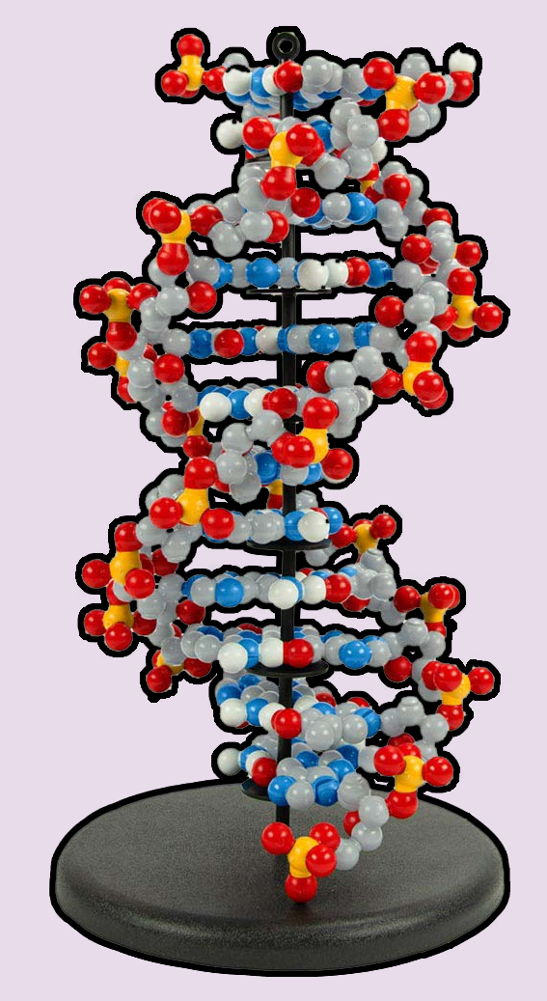
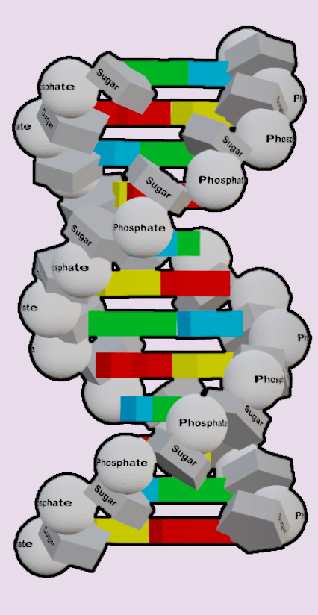
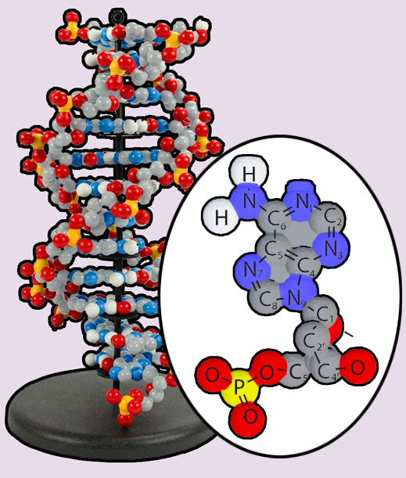
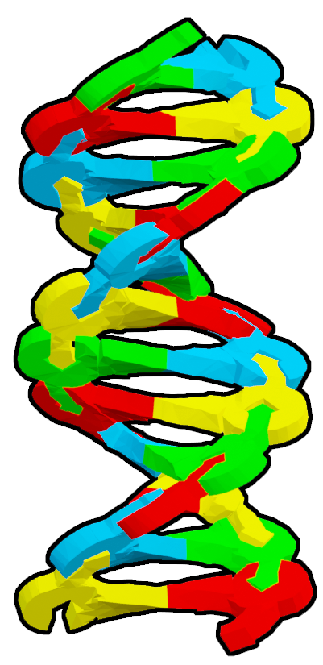
Teacher Guide – Scene 2
Scene 2: Double-stranded DNA Structure
Scanning a short 12x base pair long section of double-stranded DNA made from 24x individual plastic nucleotides from the Dynamic DNA Kit© (image to the right) will display three different digital representations: A cartoon representation, a chemical structure representation and a ball & stick representation. Students compare the different representations.
For easier scanning, the 12x base pair long section of DNA should be placed on the black display stand.
Cartoon
Nucleotide components shown as different schematic shapes.
Chemical Structures
Atoms shown with periodic table letter abbreviations.
Schematic
Nucleotides shown as simple schematic shapes.

Slide 31

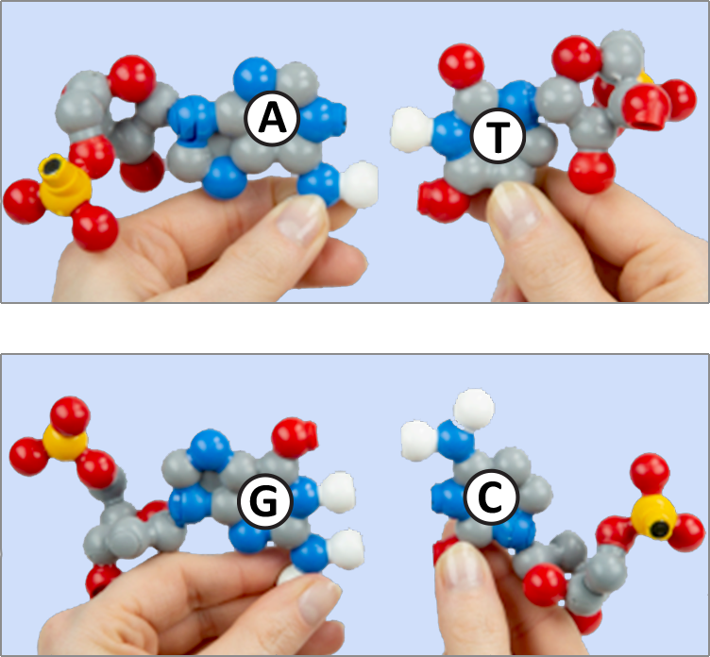
Building Base Pairs from DNA Nucleotides
Nucleotides link together to form base pairs.
Adenine pairs with Thymine.
Guanine pairs with Cytosine.
Using 24x nucleotides (6x of each type), create 12x base pairs.
How many hydrogen bonds are formed in this base pairing?
How many hydrogen bonds are formed in this base pairing?
Notes:
Teacher: Ask students to find the corresponding partner to form a physical model of base pair using Dynamic DNA nucleotides. An Adenine-Thymine base pair will form 2 hydrogen bonds, while a Cytosine-Guanine base pair will form 3 hydrogen bonds.
Student: Students should find a partner that has their complementary DNA nucleotide to make a base pair.

Slide 32
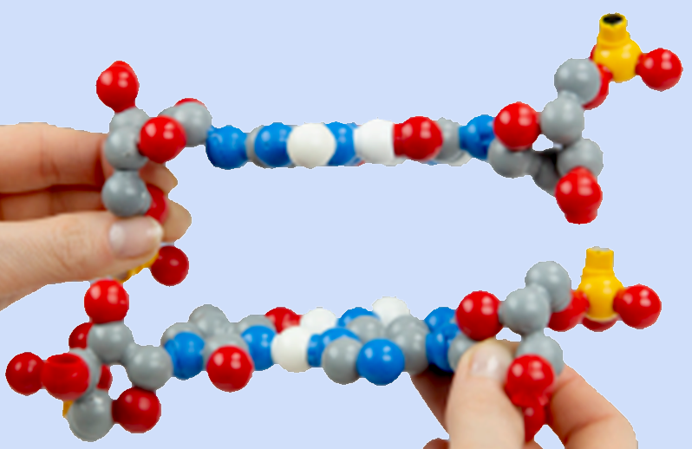
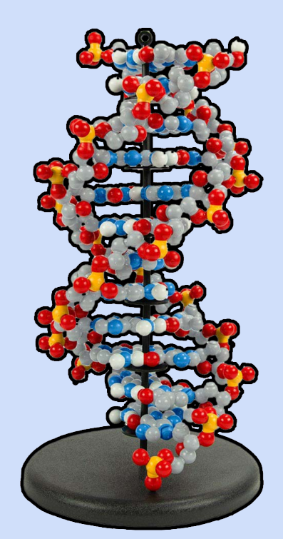

Building Double-stranded DNA From Base Pairs
Use the magnets in the phosphate and sugar to stack a G-C base pair on top of an A-T base pair.
Using the black display stand, continue stacking until you have used all 12x base pairs!
Notes:
Teacher: Assist students in building a double helix.
Student: Student pairs should find another group. Using the magnets they should start forming a double helix. Students should continue doing this until they have a helix of twelve nucleotide base pairs.

Slide 33
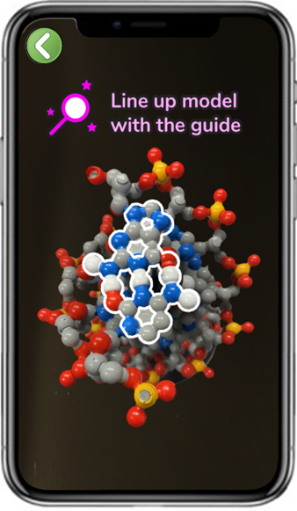
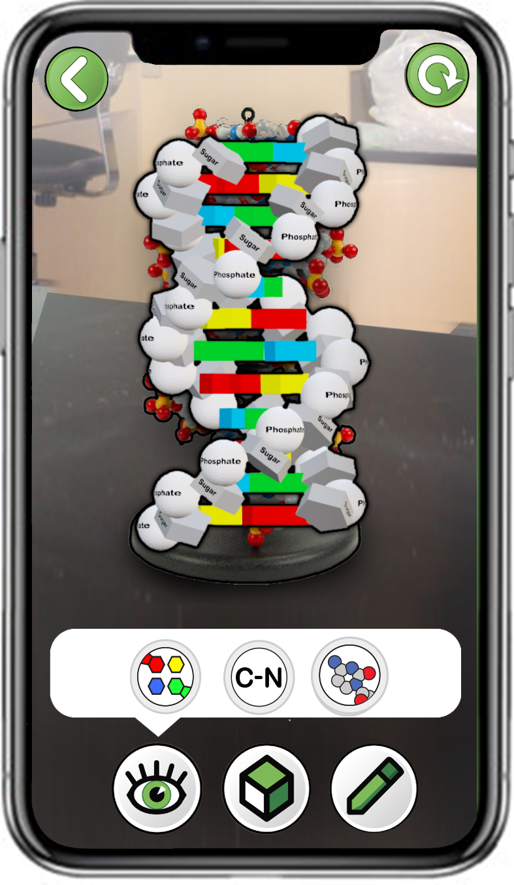
Exploring Three Representations of Double-stranded DNA
Scan a 12 Base Pair Model of DNA
Make sure the top base pair is G-C.
Start by scanning from above to lock on.
Choose
Double Helix
Explore all three buttons
Notes:
Teacher: Have students open the app and select the appropriate activity and scene. Move around the room and assist students with their technology.
Student: Open the app and select the appropriate activity and scene.

Slide 34
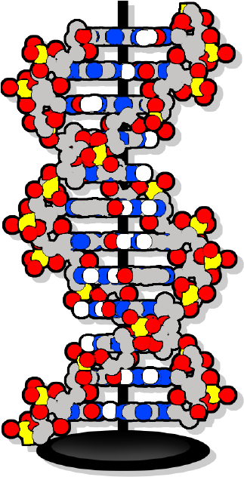
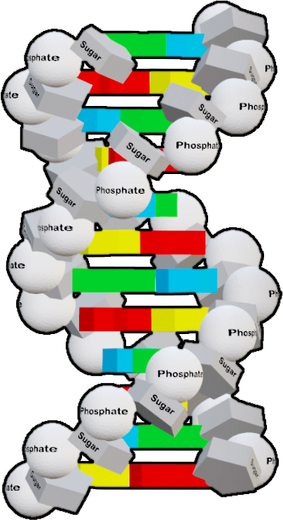
Finding Directionality in Double-stranded DNA
Identify the 5' and 3' end of each of the two DNA strands?
Draw the DNA in your notebook or take a screenshot in the app using the pencil in the bottom right corner.
Circle the 5' and 3' ends. Draw an arrow on each strand showing directionality.
Notes:
Teacher: Have students select the next overlay. Ask students to zoom in on the ends of the DNA strand and switch to 3-D mode for better viewing. Assist students in finding the 5' and 3' carbons on their models.
Students: Follow the instructions on the screen. Their group may need to step back to view the entire image. Switching to 3-D mode will allow for better viewing of the number on the carbon and give more groups access to the model target.
Check their predictions and correct their labeling, if necessary.

Slide 35
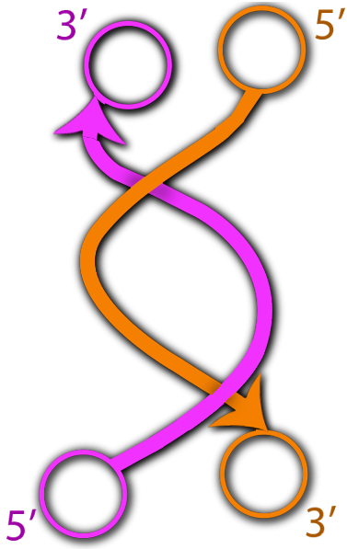
Finding Directionality in Double-stranded DNA
Do the two strands in a DNA double-helix move in the same (parallel) direction, or an opposite (anti-parallel) direction.
Which representations were most useful in determining directionality?
Notes:
Teacher: Have students select the next overlay. Ask students to zoom in on the ends of the DNA strand and switch to 3-d mode for better viewing.
Students: Follow the instructions on the screen. Their group may need to step back to view the entire image. Switching to 3-d mode will allow for better viewing of the number on the carbon and give more groups access to the model target.

Slide 36
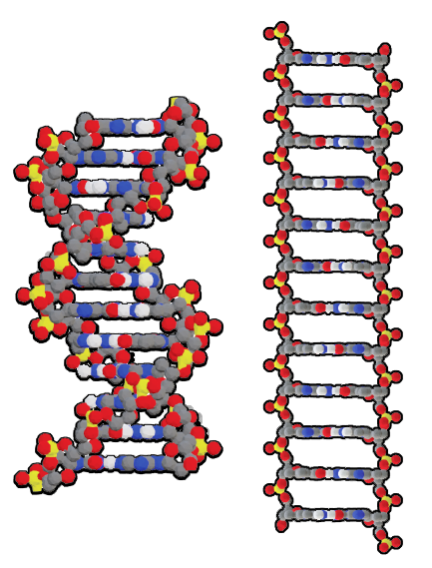
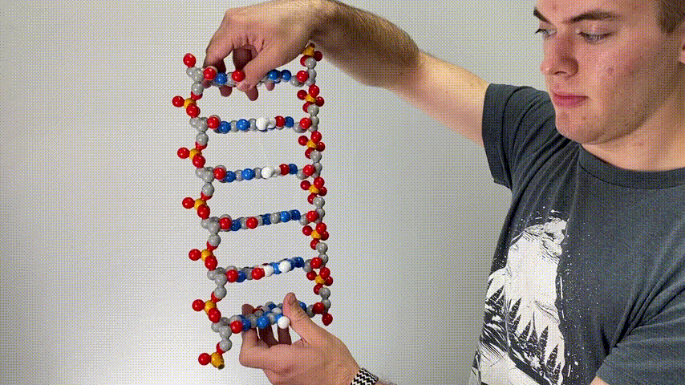
DNA Represented as a Double Helix and a Linear Ladder
DNA is often represented as either a double helix or a linear ladder.
Why is it useful to switch between linear and helical representations of DNA?
Notes:
Teacher: Give students time to process and respond to the prompt.
Students: Pause, rewind, ponder, play. Share your ideas with the class.

Slide 37
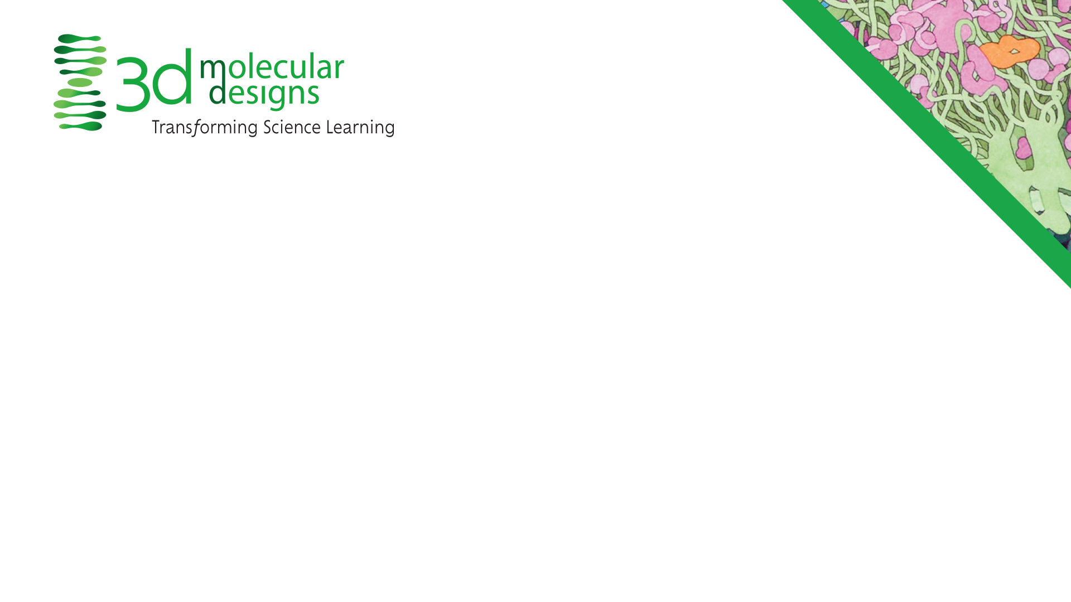
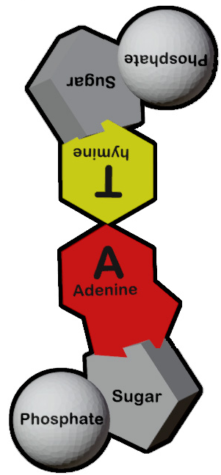
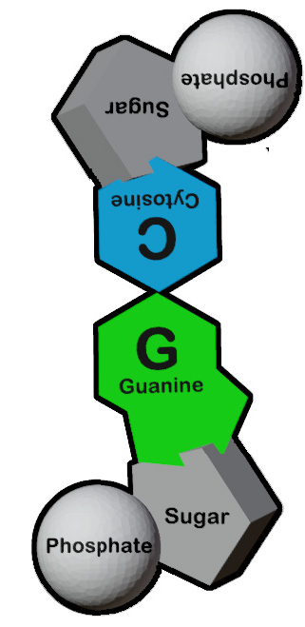
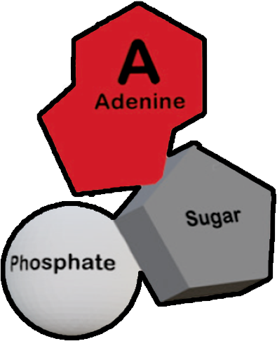
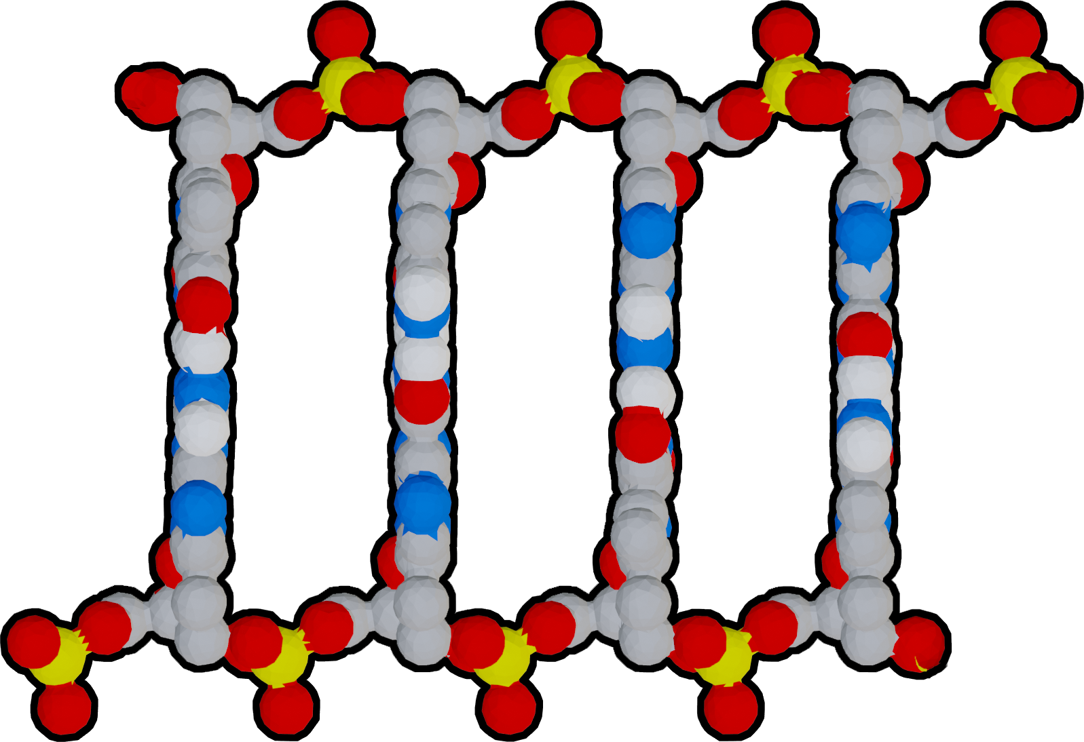
Conclusions
Nucleotides are comprised of a backbone (phosphate and sugar) and nitrogenous base.
Nucleotides have directionality, based on the 5' and 3' carbon atoms in the backbone sugar.
Multiple nucleotides form base pairs. A pairs with T and G pairs with C.
DNA has two strands that have antiparallel 5' to 3' directionality.
Notes:
Teacher: Summary slide with learning objectives of this lesson.
Student: Jot your thoughts and ideas in your notebook.

