Slide 1
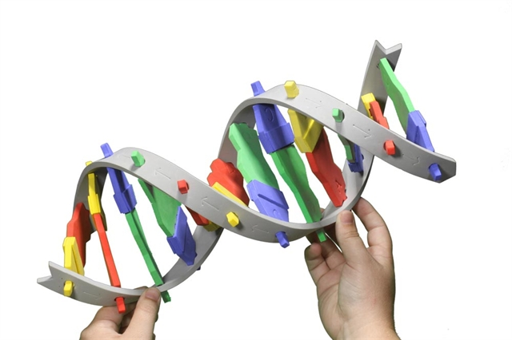
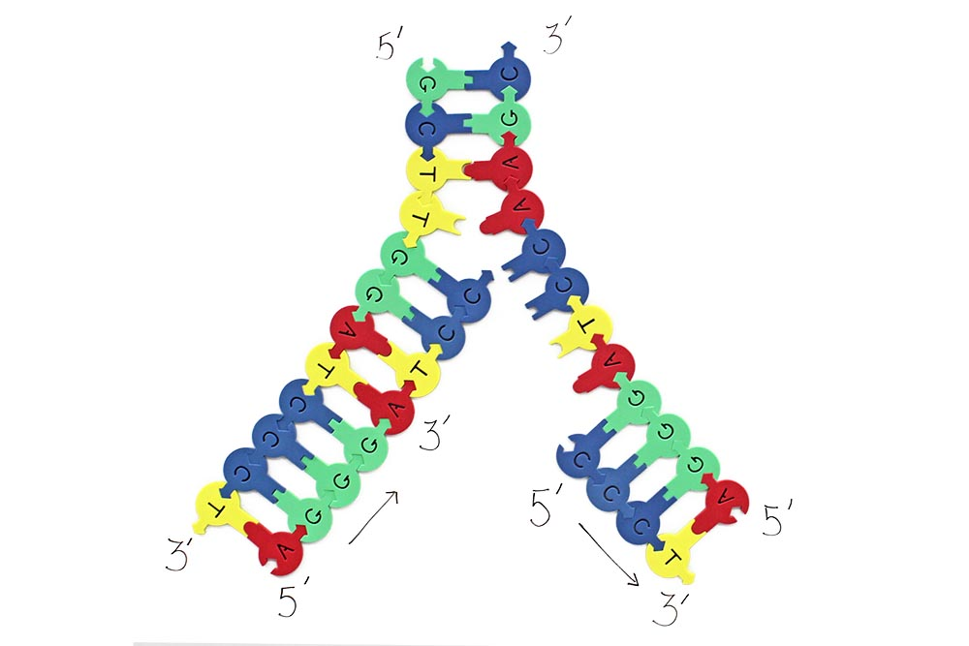
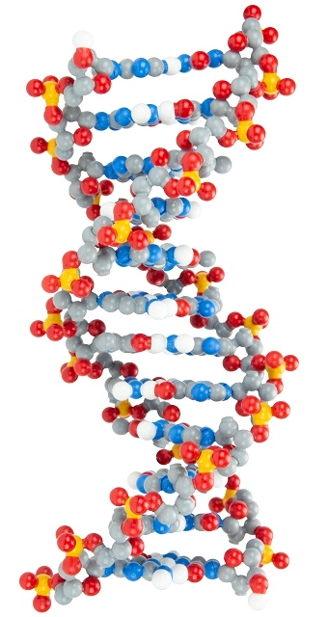

DNA Unplugged
Using Multiple Physical Models of DNA to Teach Structure and Function

Slide 2
Workshop Learning Goals
1) Facilitate DNA exploration and question generation
2) Use multiple models to develop a deeper understanding of DNA structure
3) Discover other uses of the DNA Starter Kit, Dynamic DNA, and DNA Nucleotides
4) Have fun!

Slide 3
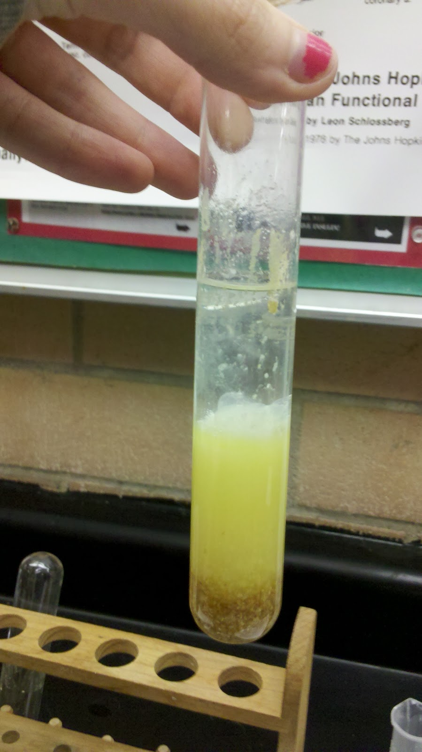
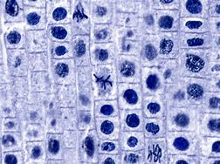
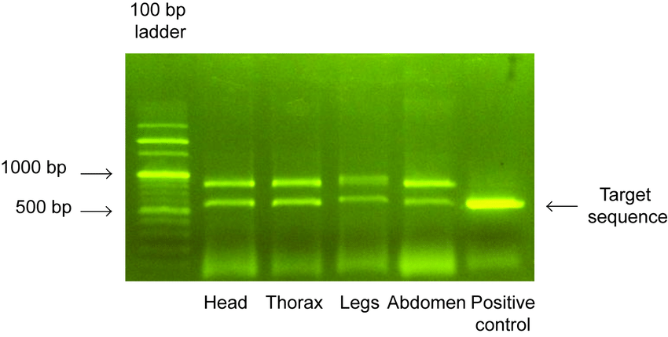
What does DNA look like?
Under a microscope
In the lab
Chapin's Bio Blog: DNA Extraction from Wheat Germ
In a gel
Gel electrophoresis of 16S gene amplified in four genomic DNA samples... | Download Scientific Diagram (researchgate.net)
Onion Root Tip Photograph by Joseph F. Gennaro Jr. | Fine Art America

Slide 4
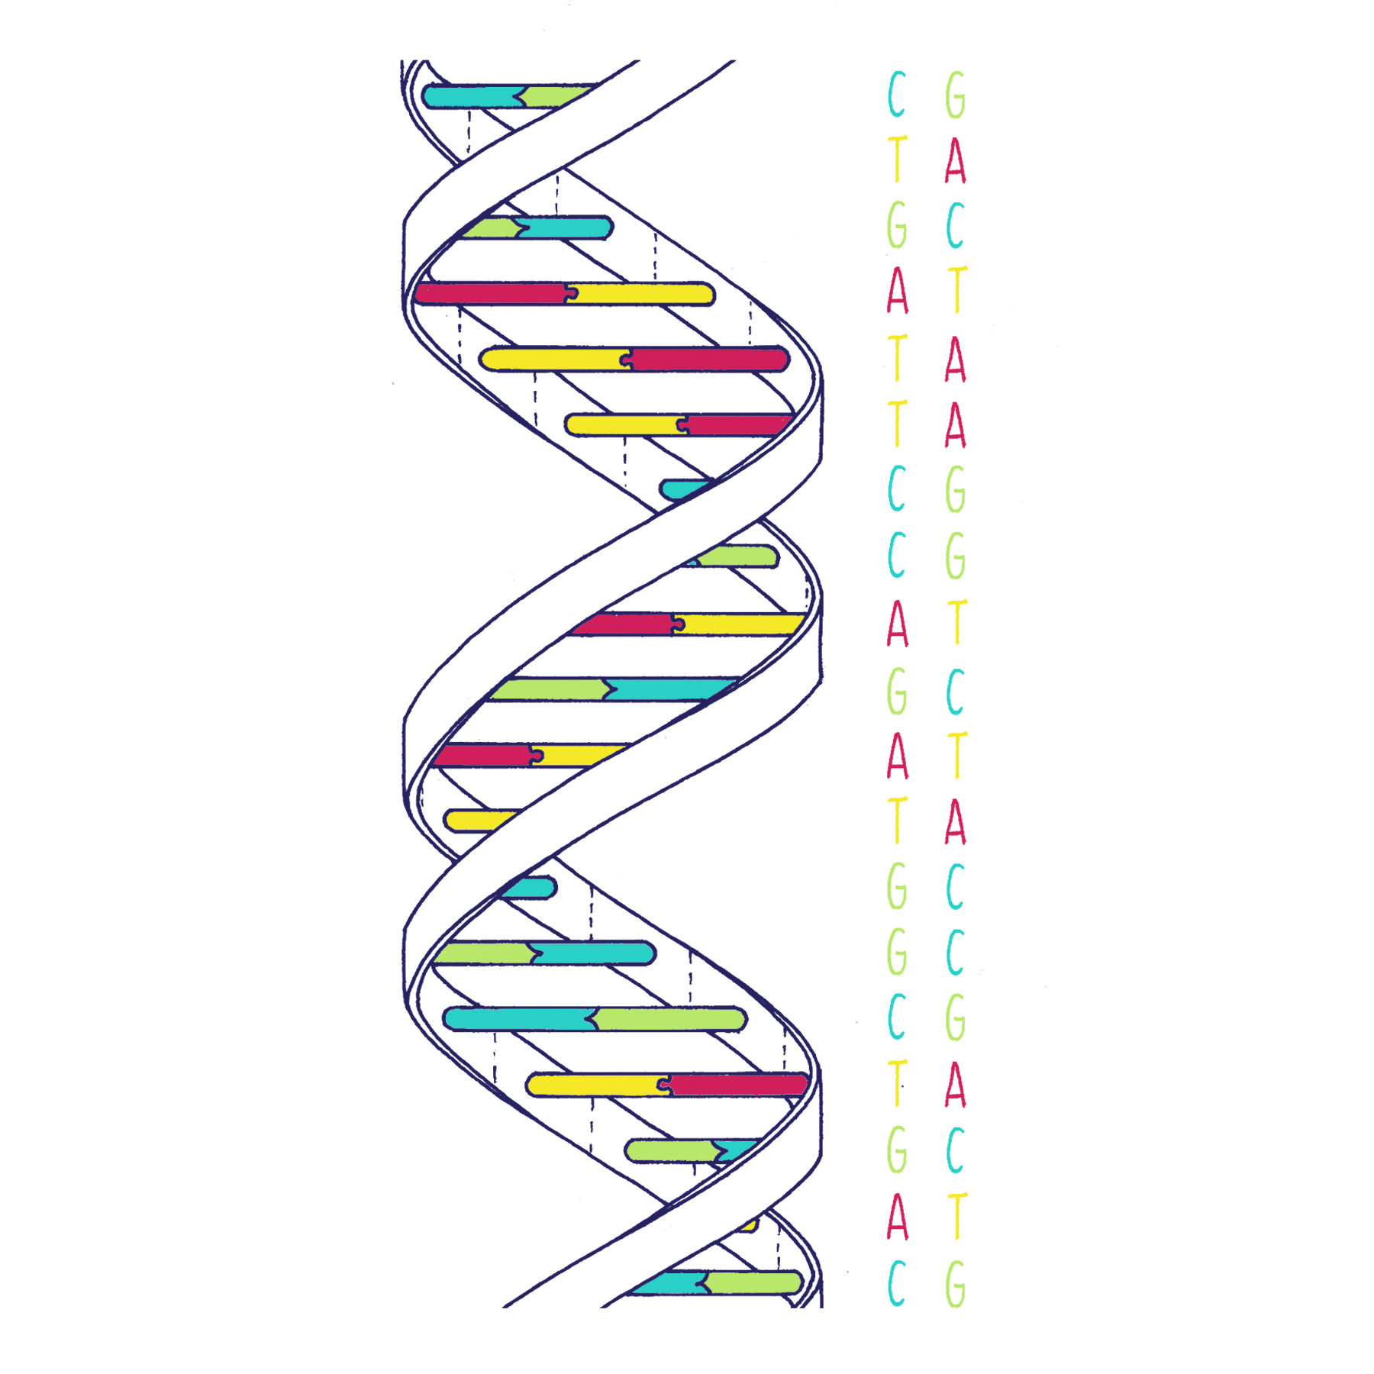
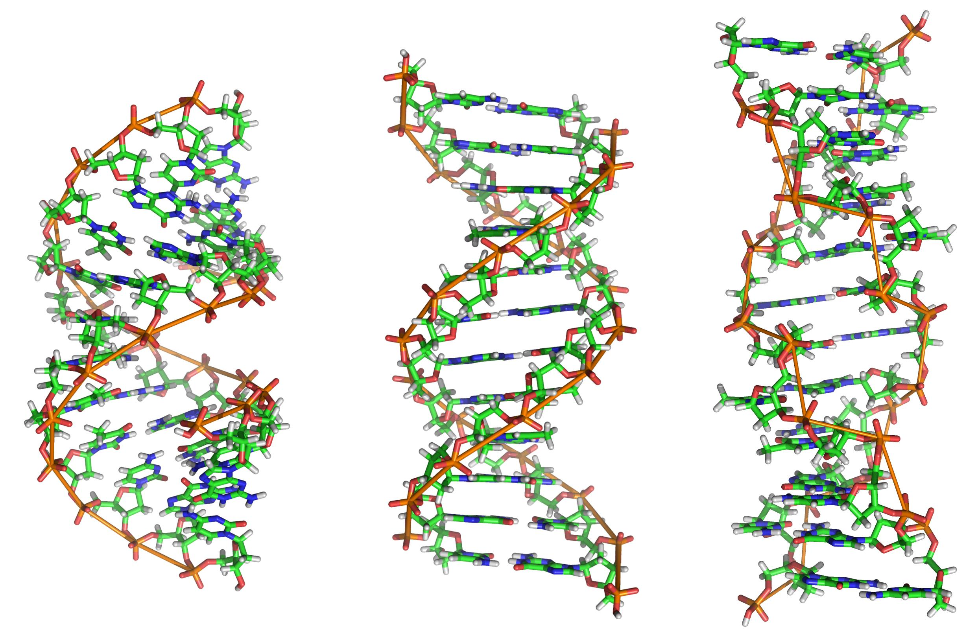
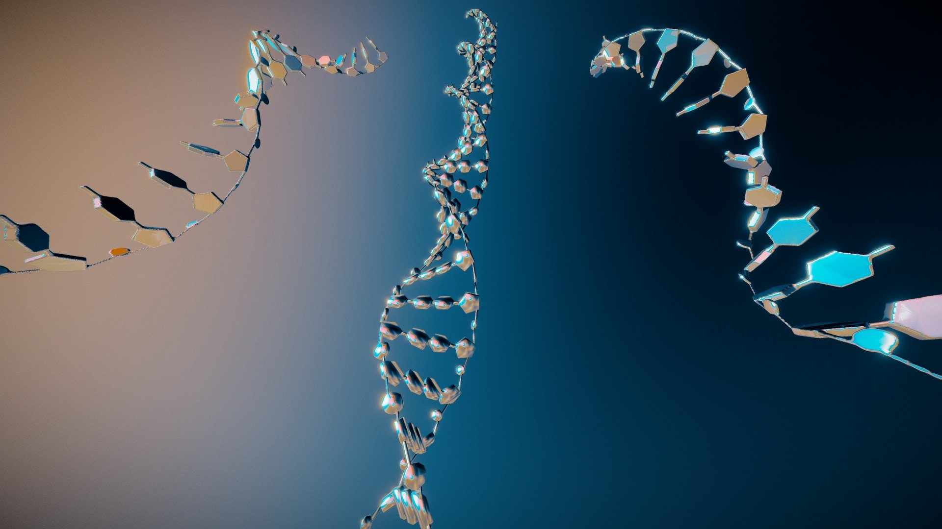

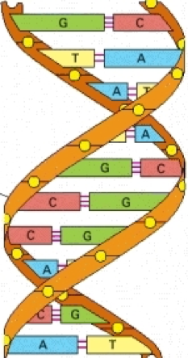
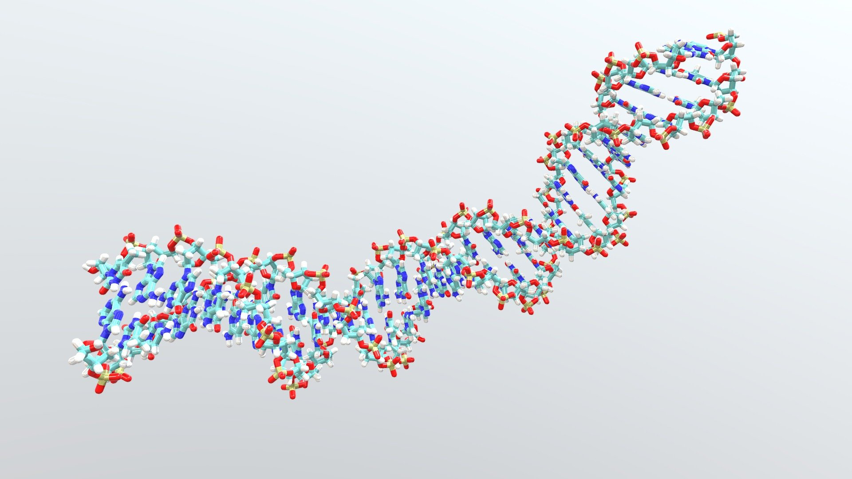
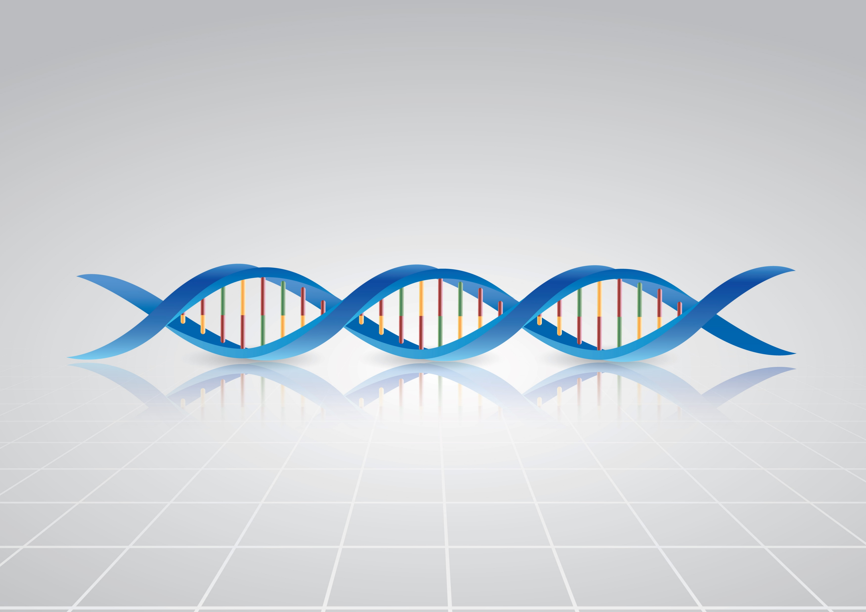
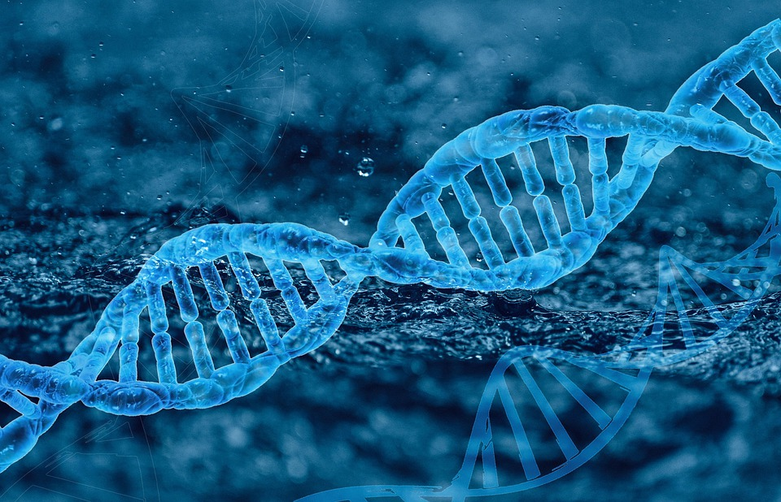
What model(s) of DNA do you use with your students?

Slide 5
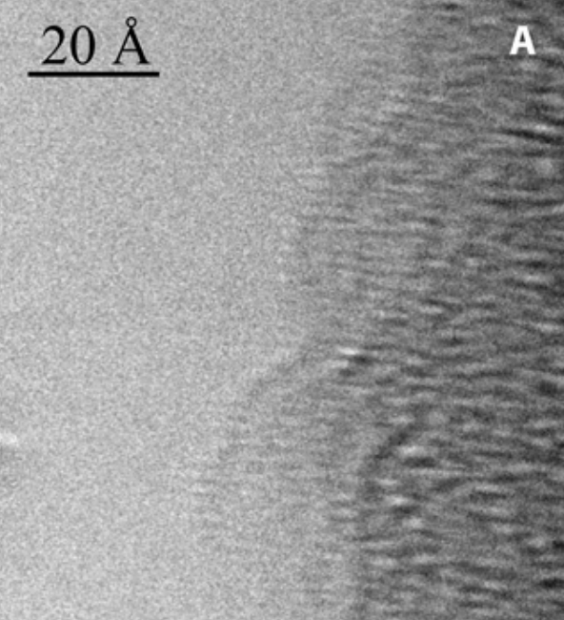
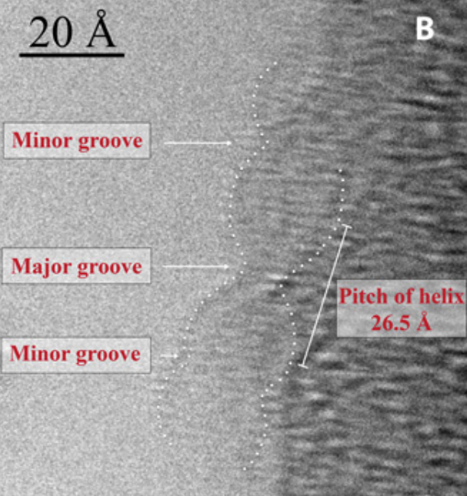
A “Photo” of DNA?
The structure of DNA by direct imaging | Science Advances

Slide 6
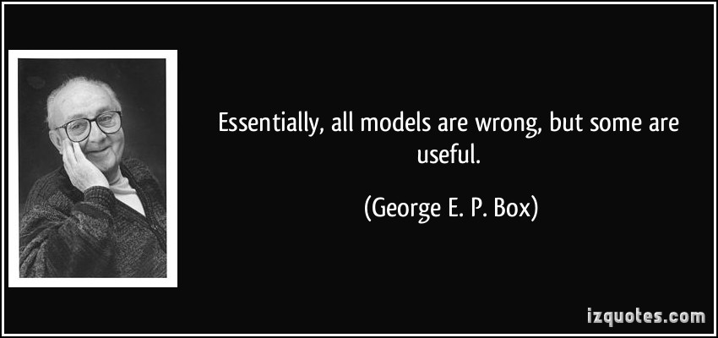

Slide 7
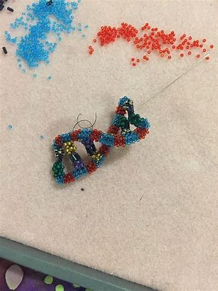
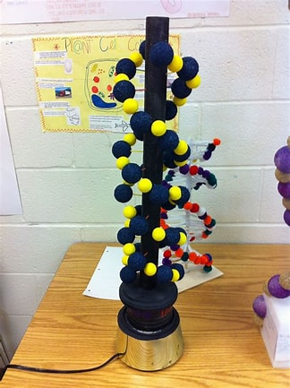
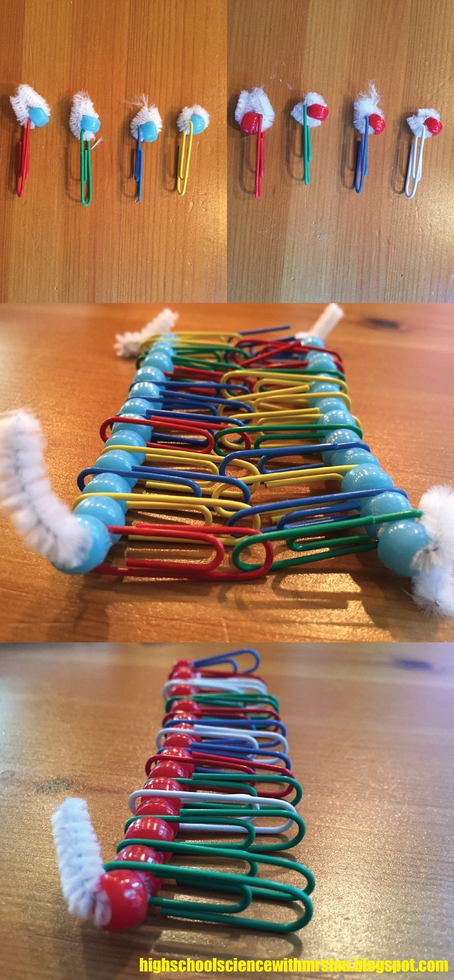
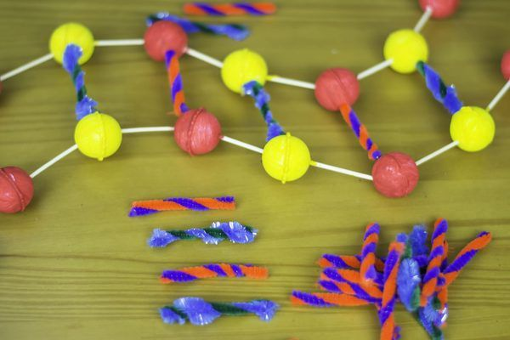
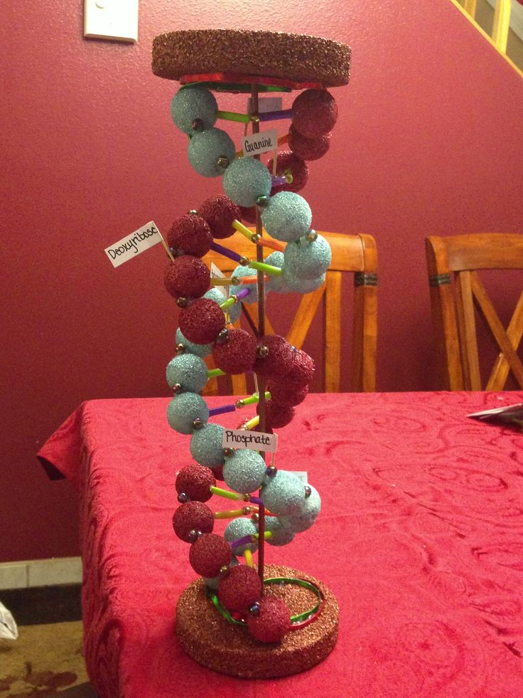
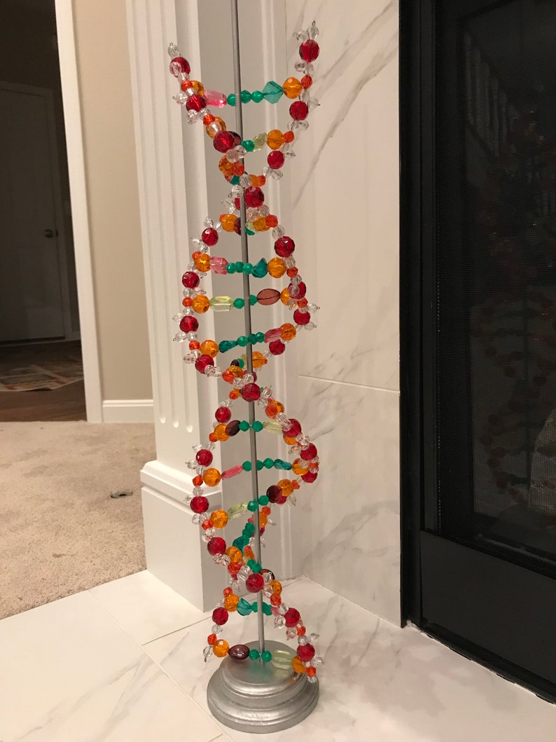
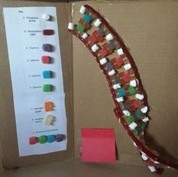
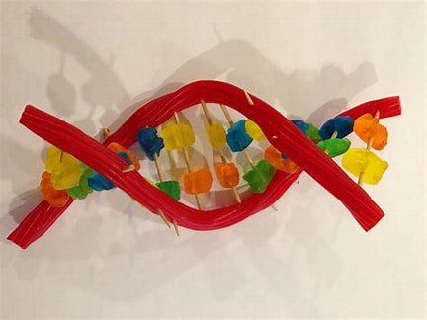
So… we have students build models…

Slide 8
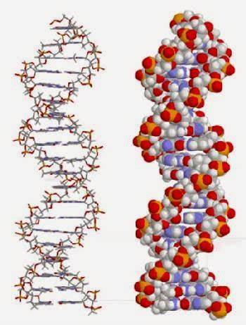
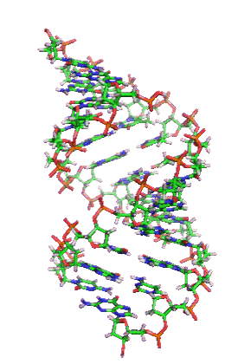
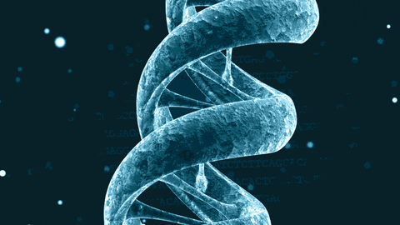
Caution!
What do you want them to know?
Different models show different things

Slide 9
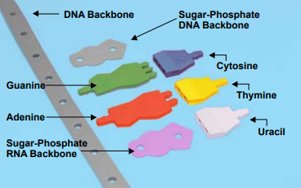
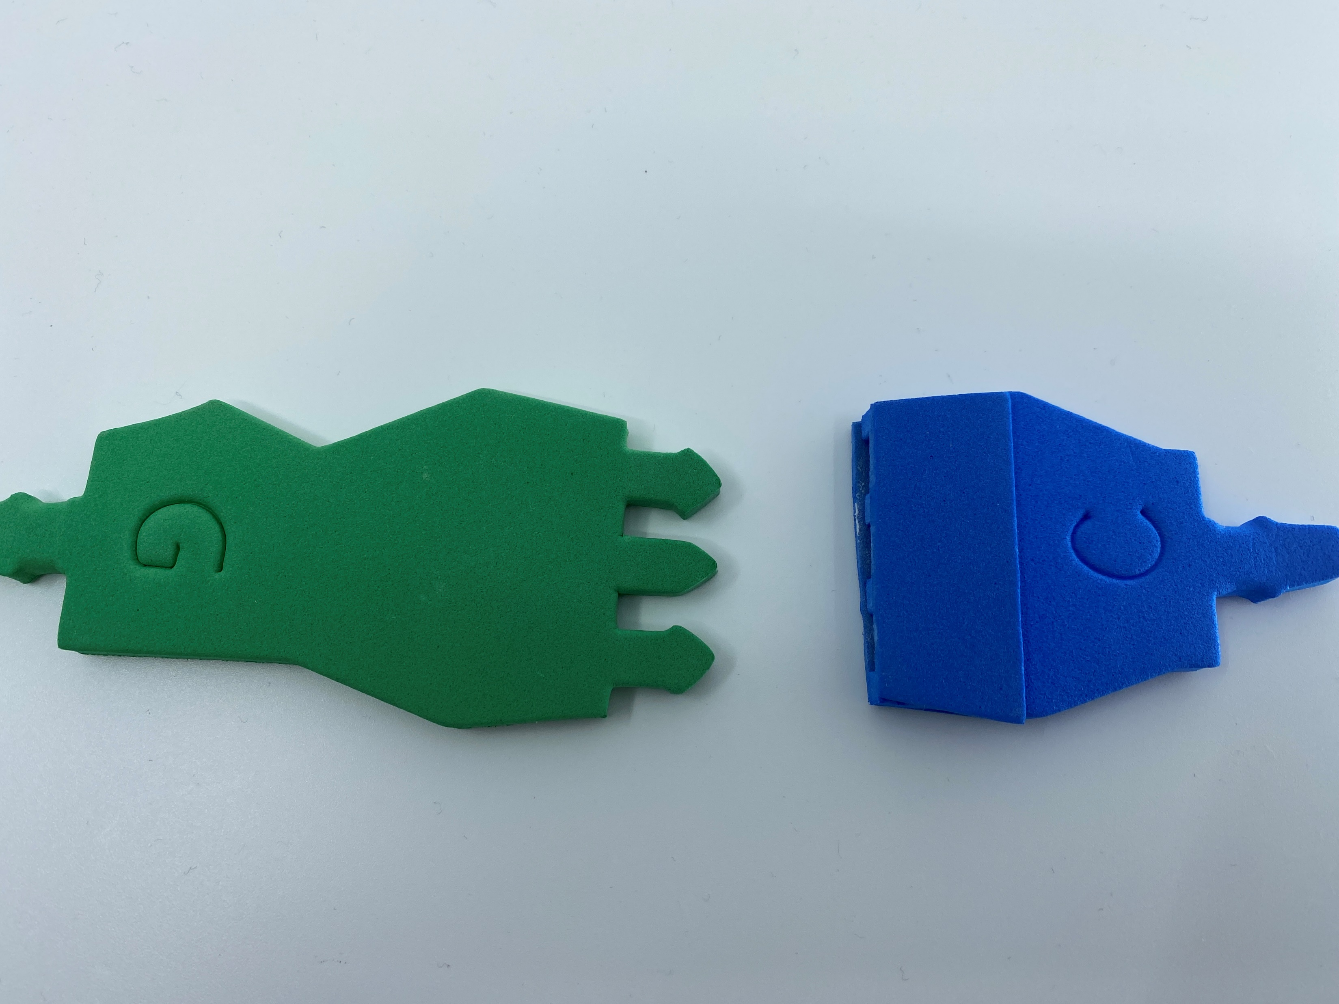
What do you notice about these 2 pieces?
What questions do you think your students may have?
Purines – Pure As Gold
Pyrimidines – Pyramids CUT
Purine + Pyrimidine = 3 rings
Why is that important?

Slide 10
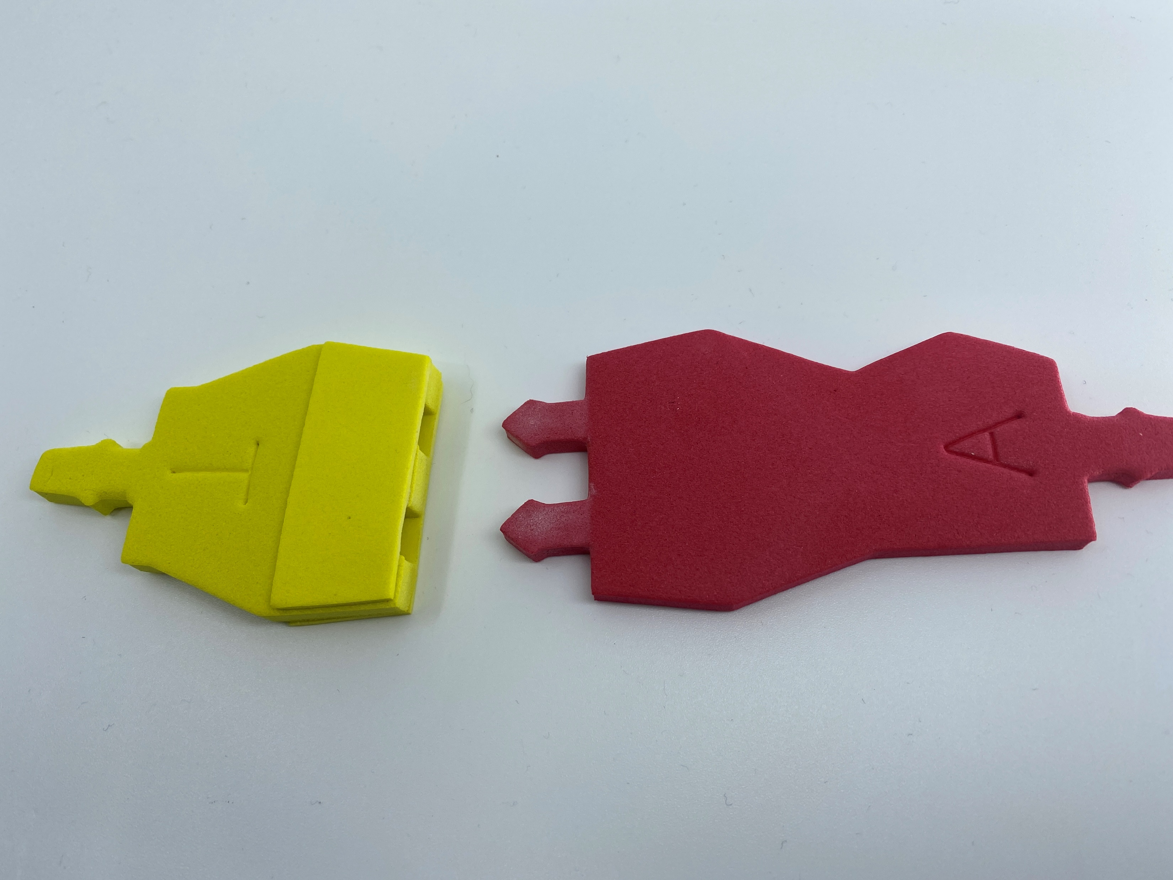
What do you notice about these 2 pieces?
What questions do you think your students may have?
Purines – Pure As Gold
Pyrimidines – Pyramids CUT
Purine + Pyrimidine = 3 rings
Why is that important?

Slide 11
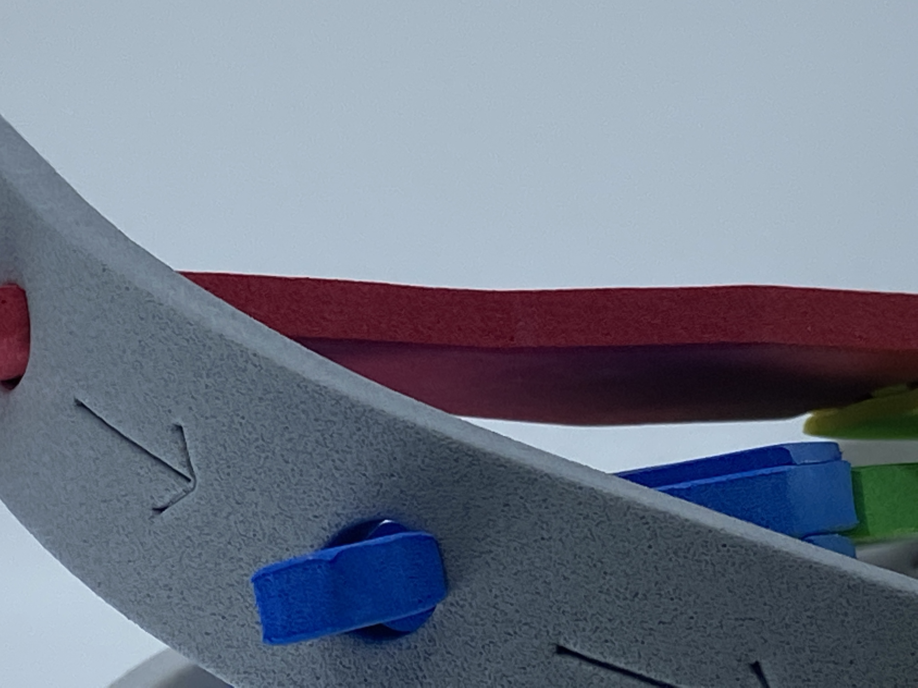
Look at the Backbone
What do the arrows represent?
5’ to 3’ -> Directionality
Antiparallel

Slide 12
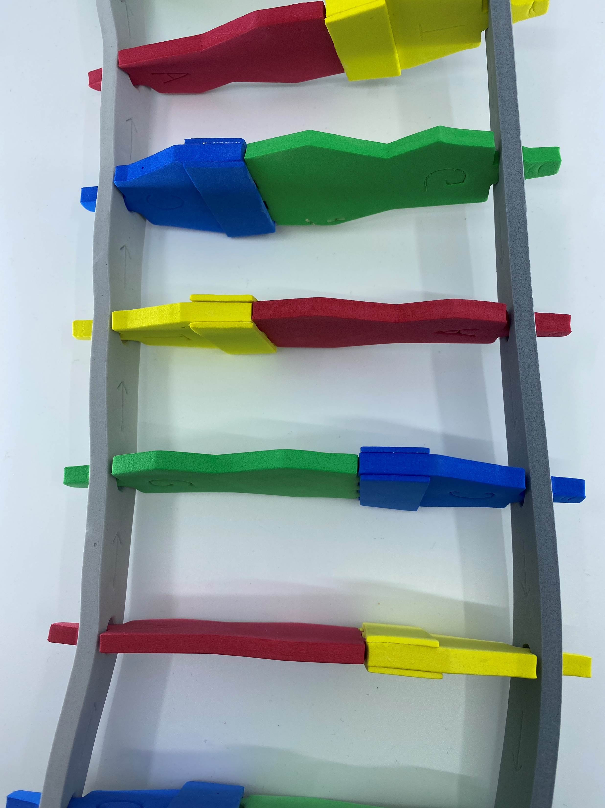
Look at the Backbone
What do the arrows represent?
5’ to 3’ -> Directionality
Antiparallel

Slide 13
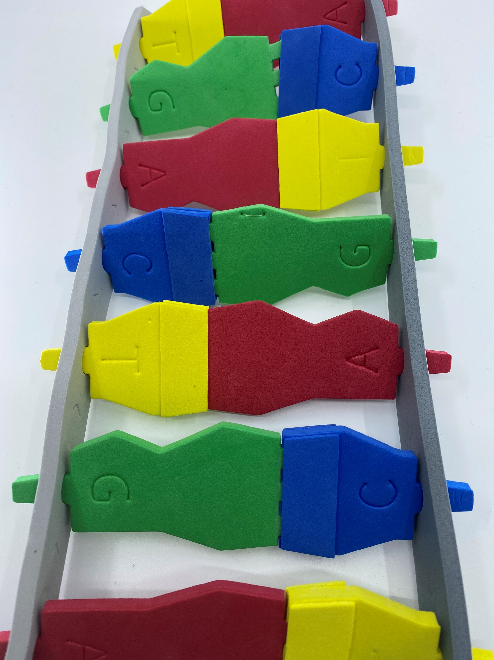
Look at the Backbone
What do the arrows represent?
5’ to 3’ -> Directionality
Antiparallel

Slide 14
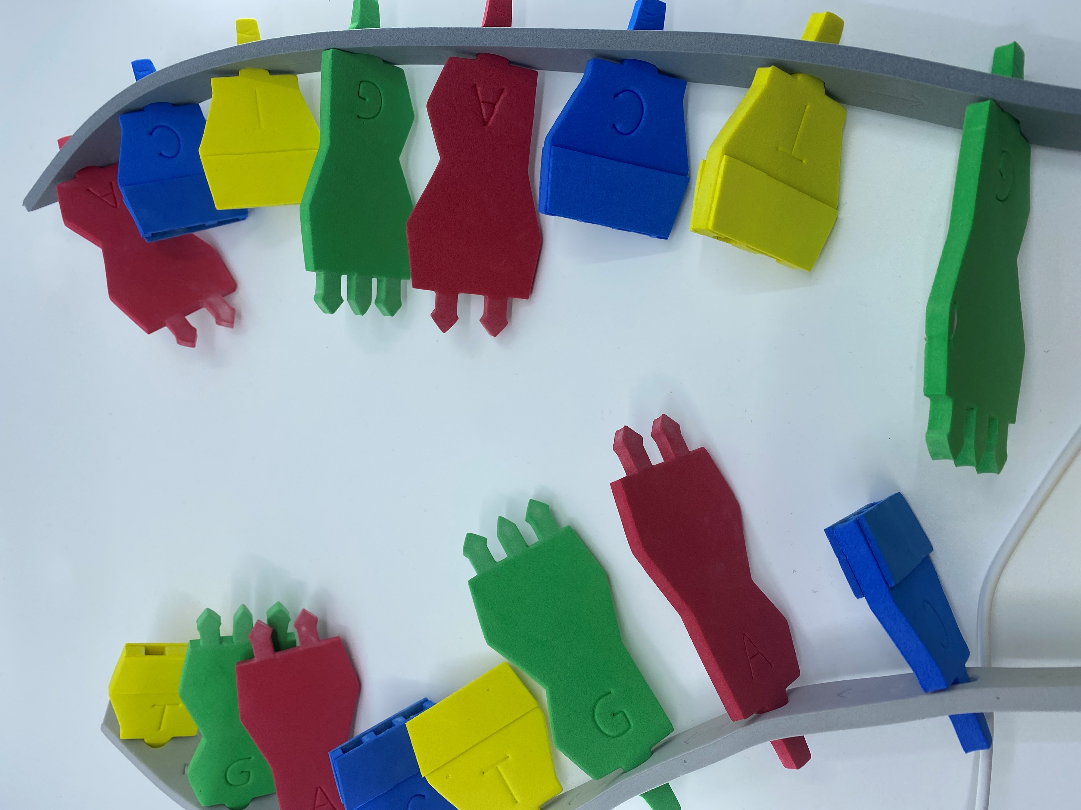

Slide 15
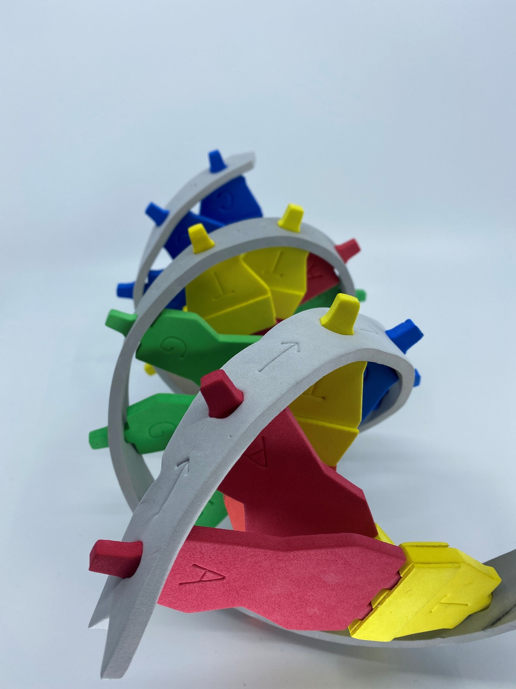
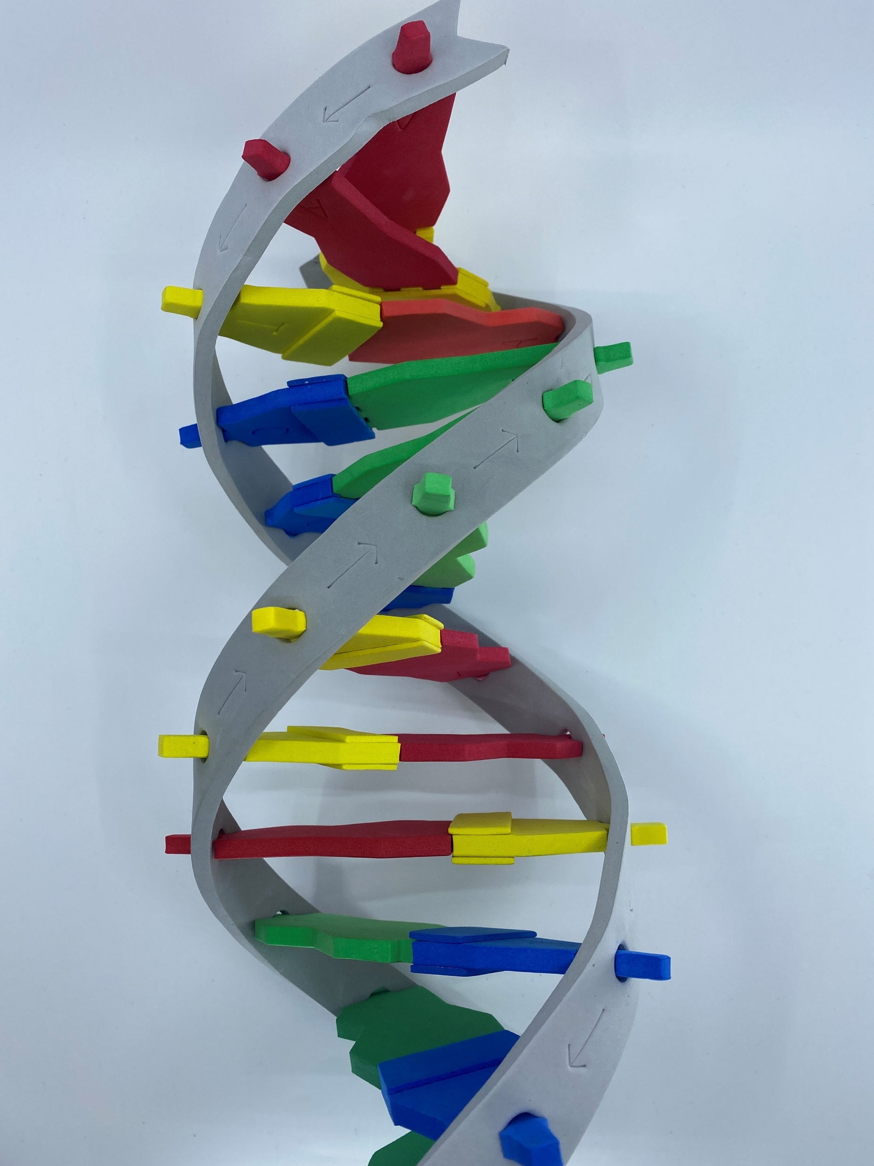
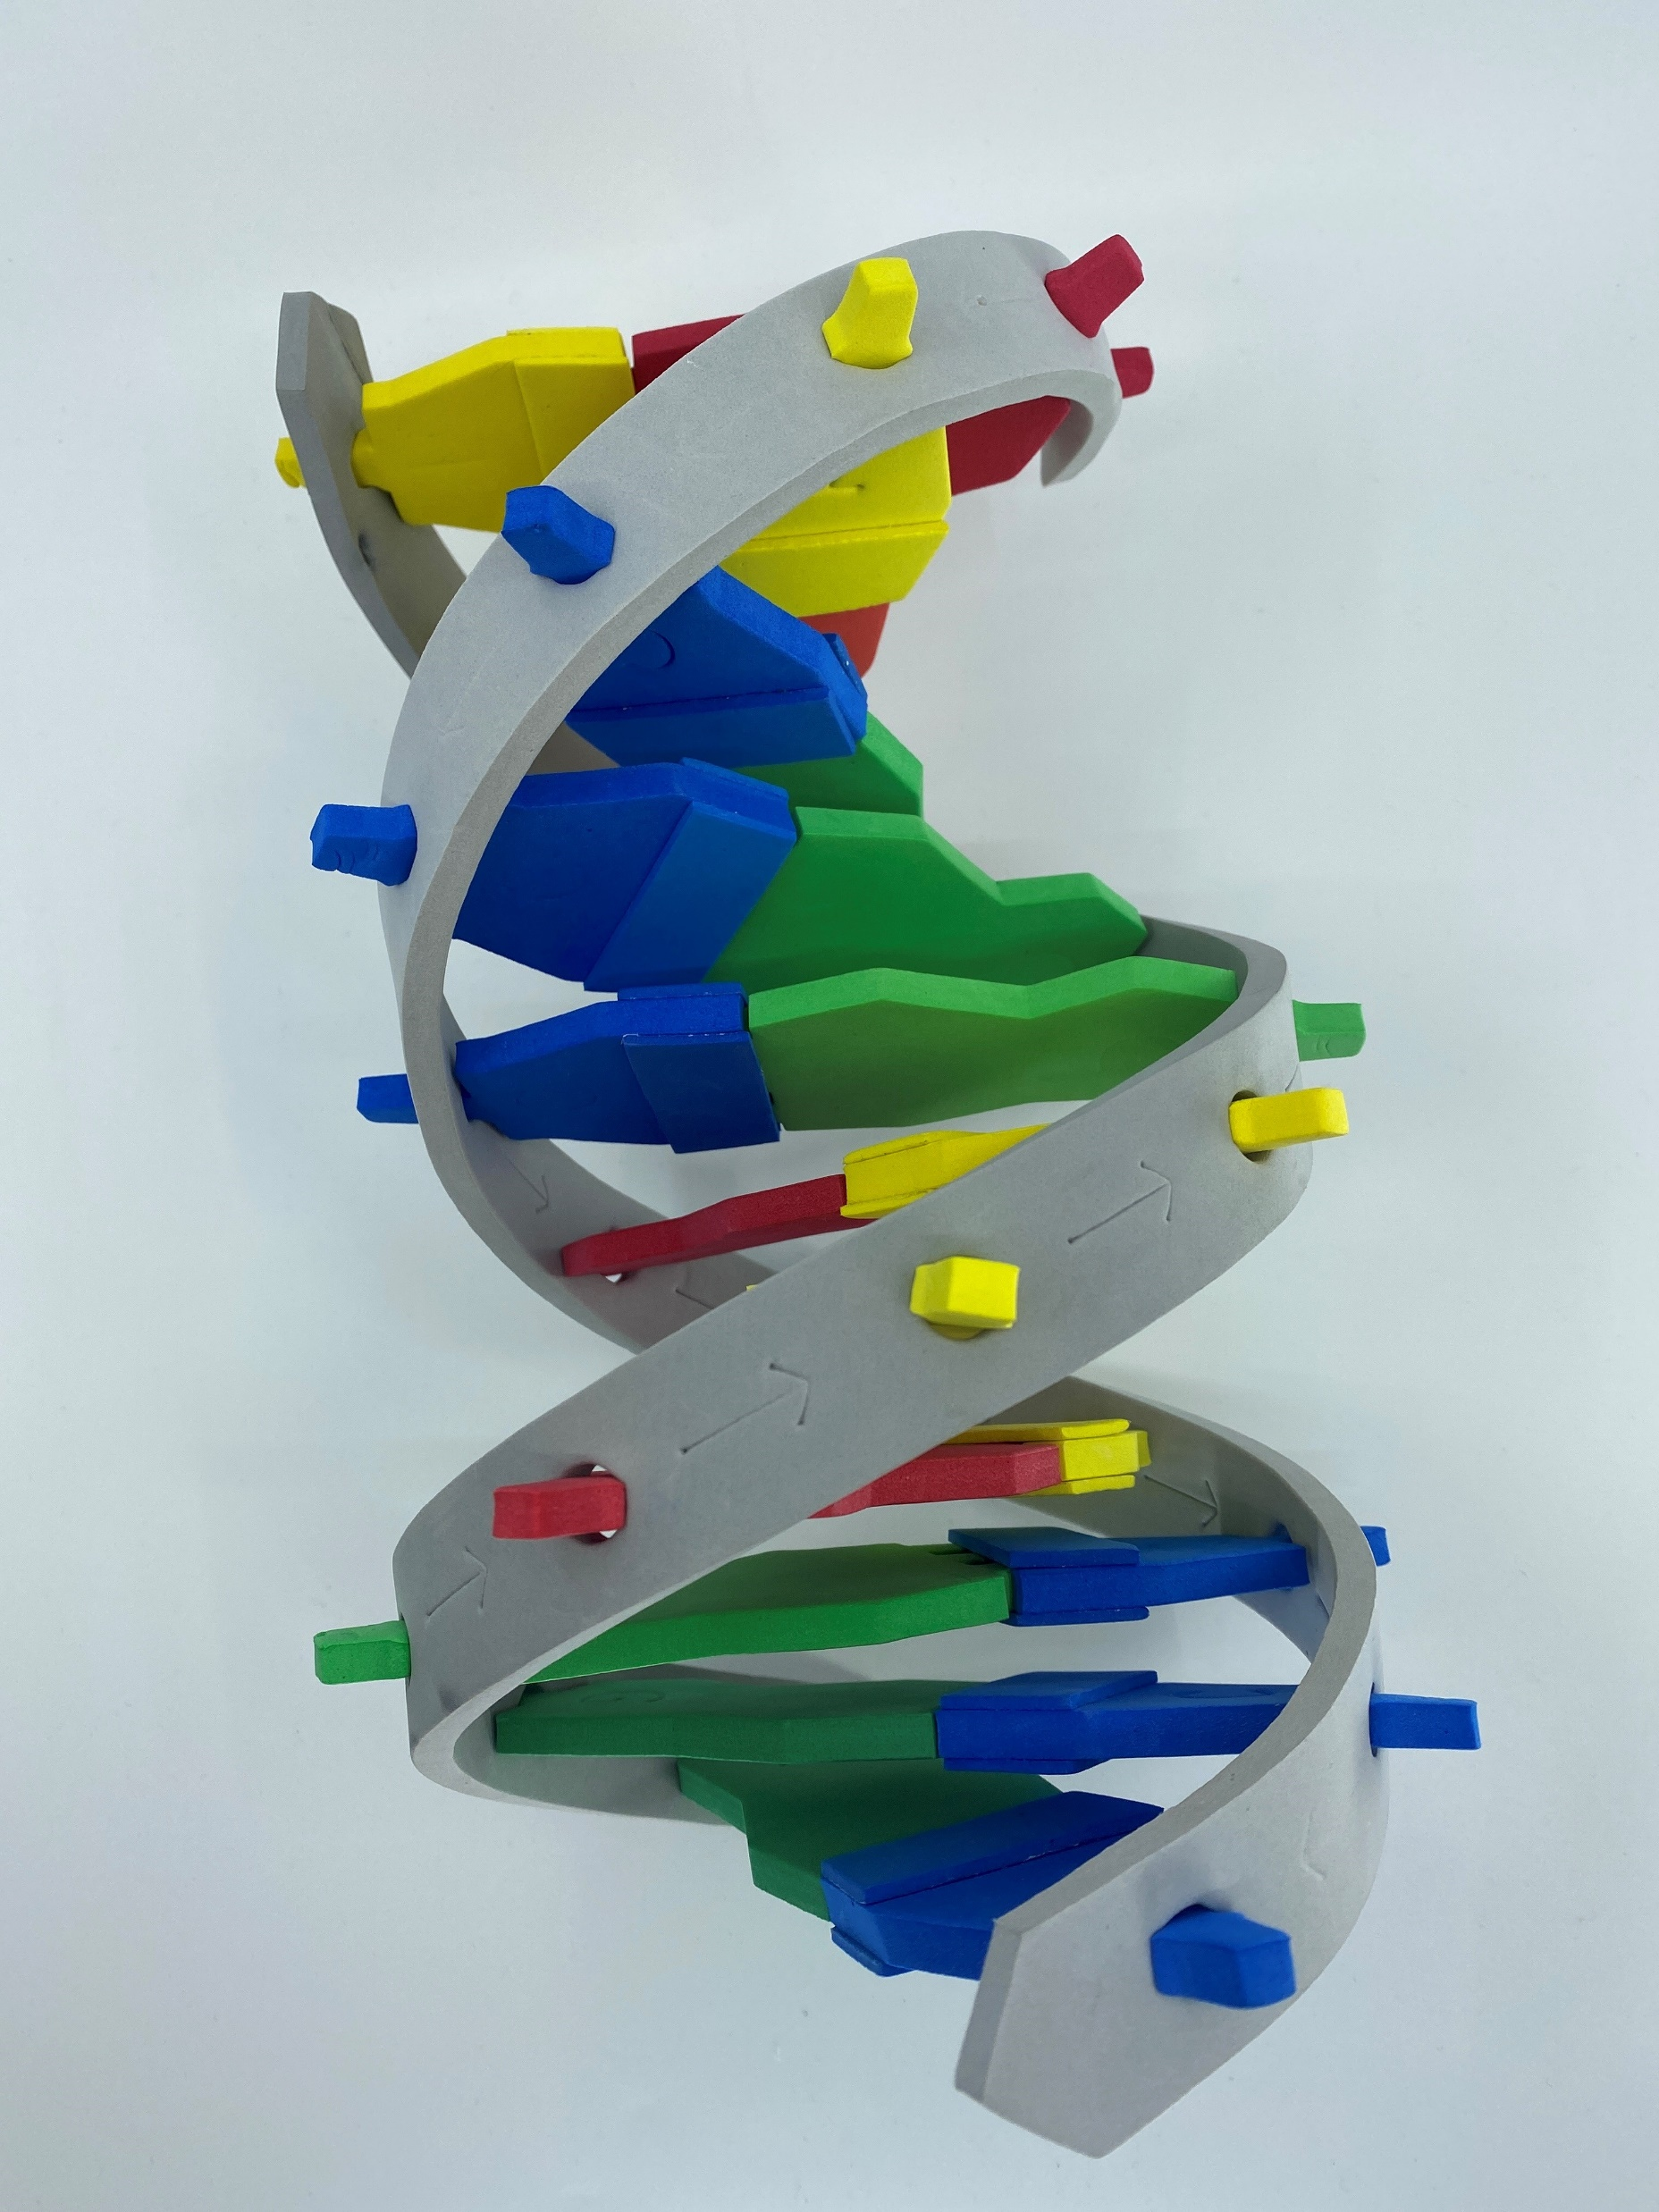

Slide 16
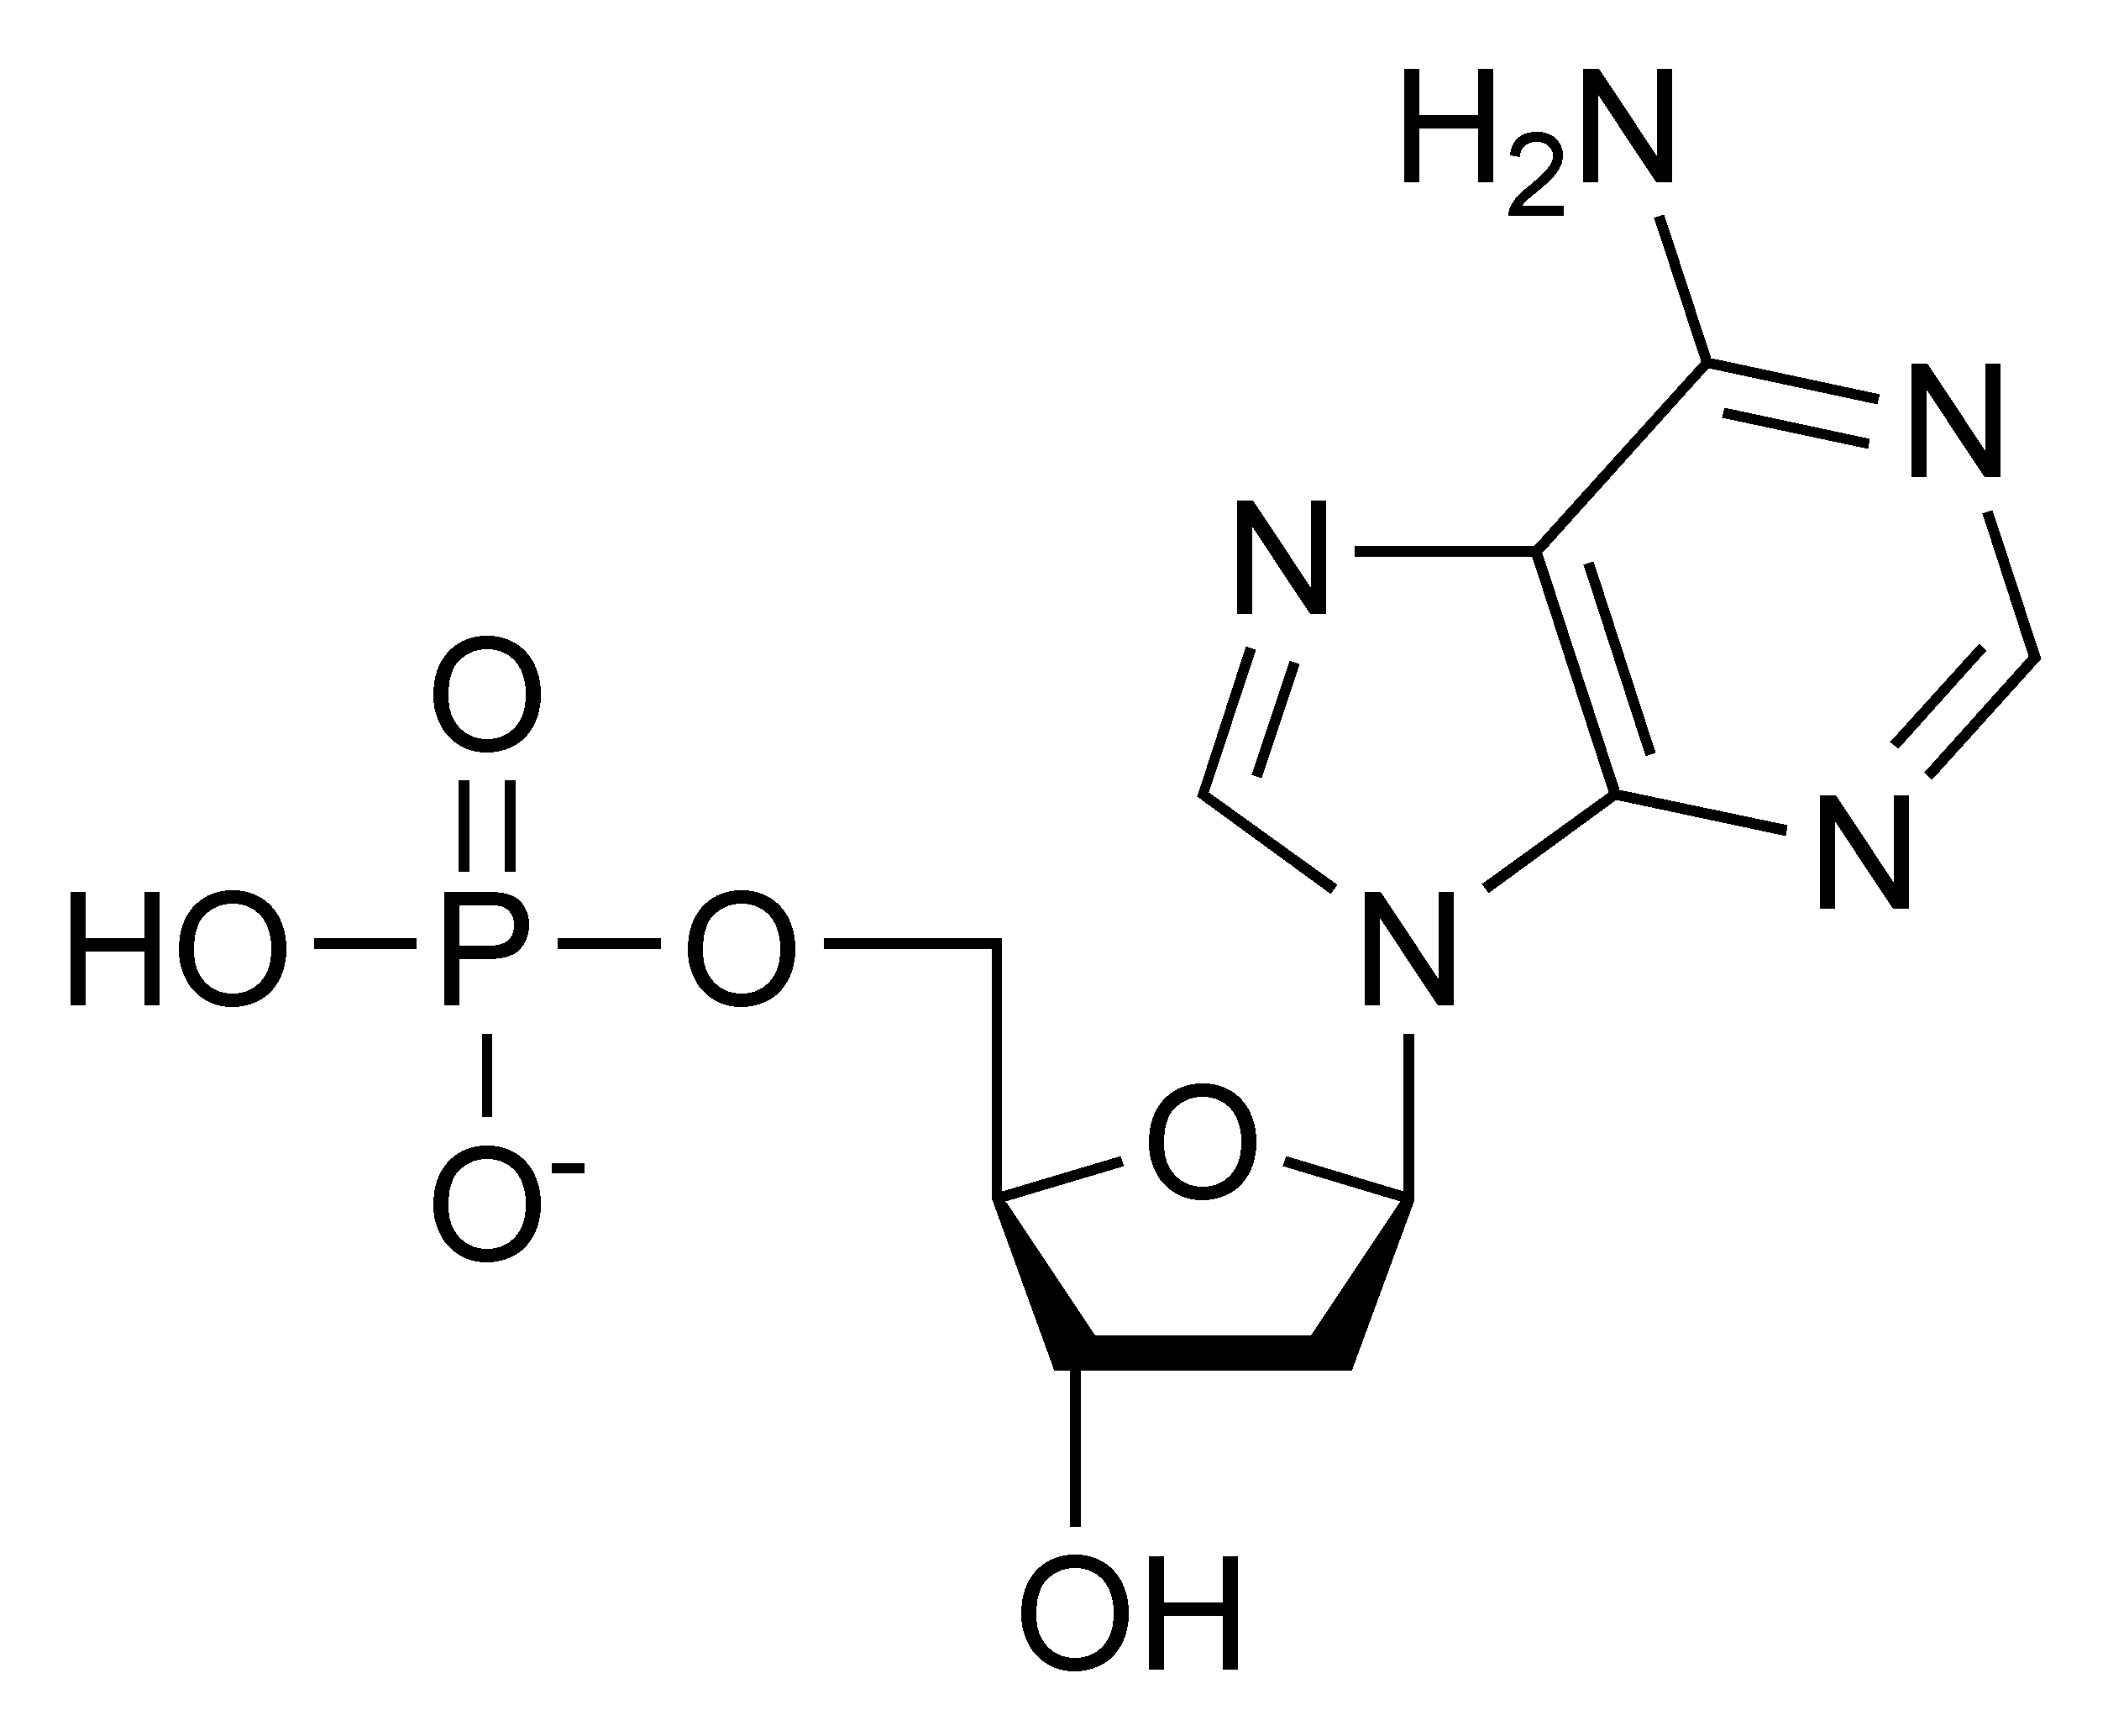
Let’s look at a single nucleotide.
What are some observations you can make?

Slide 17
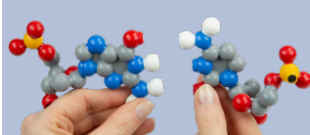
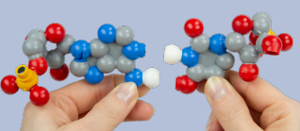
We need another model!

Slide 18
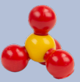
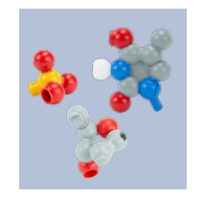
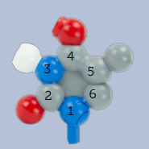
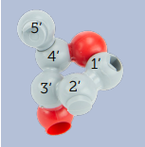
Let’s deconstruct a single
nucleotide
Phosphate group
Nitrogenous Base (Thymine)
Sugar - Deoxyribose

Slide 19
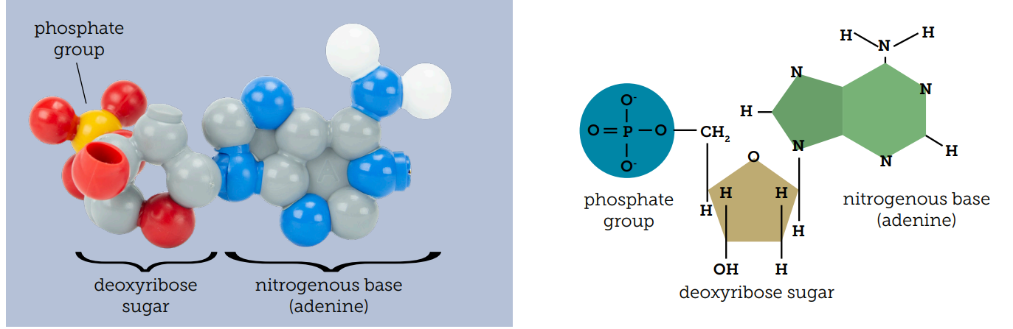

Slide 20

This model uses the CPK color scheme.
This was determined by Corey, Pauling, and Koltun
and can be used to determine if you are talking to a chemist or biochemist
“What color is a Carbon atom?”

Slide 21
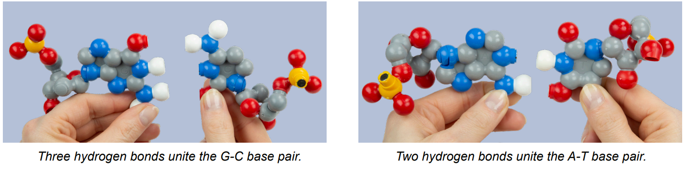
Base pair with a complimentary nucleotide. A-T and C-G.
Notice the difference in the number of hydrogen bonds created.

Slide 22
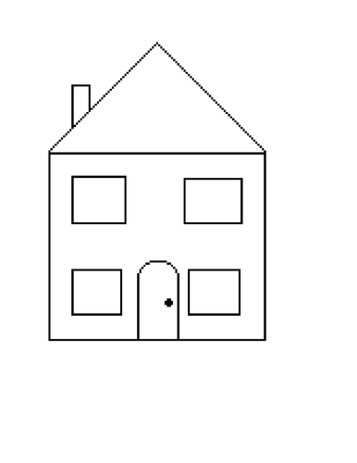
How is Deoxyribose like a house?

Slide 23
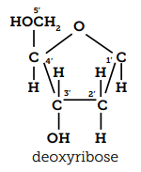
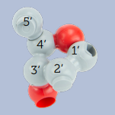
These are 2 different models of deoxyribose.
How are they similar?
What makes them different?
Which one is “better”?

Slide 24
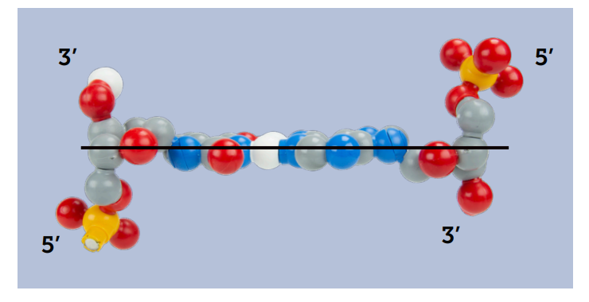
DNA is anti-parallel

Slide 25


Slide 26


Double helix-
Right-handed
Major / minor groove
Linear format- Replication / Transcription
Directionality
What else could you teach with this model?

Slide 27


The nucleotide model
What does this model help your students focus on?

Slide 28

Replication with Direction!

Slide 29


Let’s Build a Sequence!

Slide 30


Restriction Enzymes!
2 Restriction sites are in your sequence. Use this to show Blunt vs Sticky ends. Ligations are also easily accomplished, along with the consequences!

Slide 31

We will need to digest our target DNA
Restriction enzymes
Eco RI
Why Palidromes?
Scan me!

Slide 32

EcoRI
Notes:
This is the image target for your web-based AR. Notice the dimerization of the enzymes.

Slide 33

EcoRI
Notes:
3’ – CTTAAG-5’
5’-GAATTC-3’

Slide 34

BamHI
Notes:
‘3 – CTTAAGG-5’
5’ – GGATTC-3’
Directionality is important because all of these sequences need to be read in the 5' to 3' direction.

Slide 35

BamHI
Notes:
This is the image target for your web-based AR. Notice the dimerization of the enzymes.

Slide 36


THANK YOU FOR ATTENDING!
Purchase kits at 3dmoleculardesigns.com
Demo DNA Nucleotides © Dynamic DNA© DNA Starter Kit ©
Kits and models used in this session:

Slide 37

Lending Library!

Slide 38

Try before you buy!

Slide 39


Scan this QR code and fill out our survey!
Show me your Ribosome image and I’ll give you a model with AR enhancement as a thank-you gift!

Slide 40
Workshop NGSS Connections
SEPs | CCCs | DCIs
Asking Questions and Defining Problems (HS-LS3-1) | Cause and Effect (HS-LS3-2) | Structure and Function (HS-LS1-1)
Developing and Using Models (HS-LS1-4) | Scale Proportion, and Quantity (HS-LS3-3)
Analyzing and Interpreting Data (HS-LS3-3) | Systems and System Models (HS-LS3-3)
 | Science is a Human Endeavor (HS-LS3-3)

