Slide 1
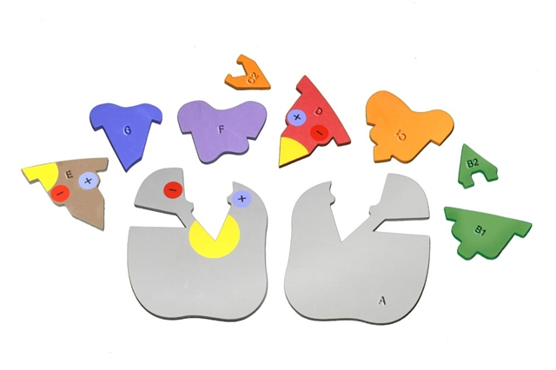
Playtime with Enzymes: Making Student Thinking Visible
Notes:
For this presentation, we will use the Enzymes in Action Kit.

Slide 2

Ruth Hutson, MSSE
Notes:
I’m Ruth Hutson, a 3D Molecular Designs Science Educator. I’ve been teaching for 25 years . Before coming to 3DMD, I was the science department at a small rural high school in Northeast Kansas and taught Concurrent College Biology, biology, chemistry, physics, and Earth Science. In addition to being the HS Science Department, I was also play director, Scholars Bowl coach, and junior class sponsor. I discovered the 3DMD products in 2015 and loved using them with all my classes. Today I'd like to share with you how I use these kits with my high school biology class and Concurrent College Biology course.

Slide 3
Who’s Here
Middle School, High School, Post-secondary
Rural, Suburban, Urban
Biology, AP Biology, Anatomy and Physiology, Other
Where are you in your course?

Slide 4
Workshop Learning Goals
Identify and investigate the role of enzymes.
Compare and contrast catabolism with anabolism.
Explore several case studies and use physical models to explain what is happening at the molecular level.
Have fun!
Notes:
Ruth says We are going to be modeling with the Enzymes in Action Kit. We use this kits throughout the year. At the end of this session, you should be able to… read goals from slide).
Let’s get started with some modeling [Advance slide]

Slide 5
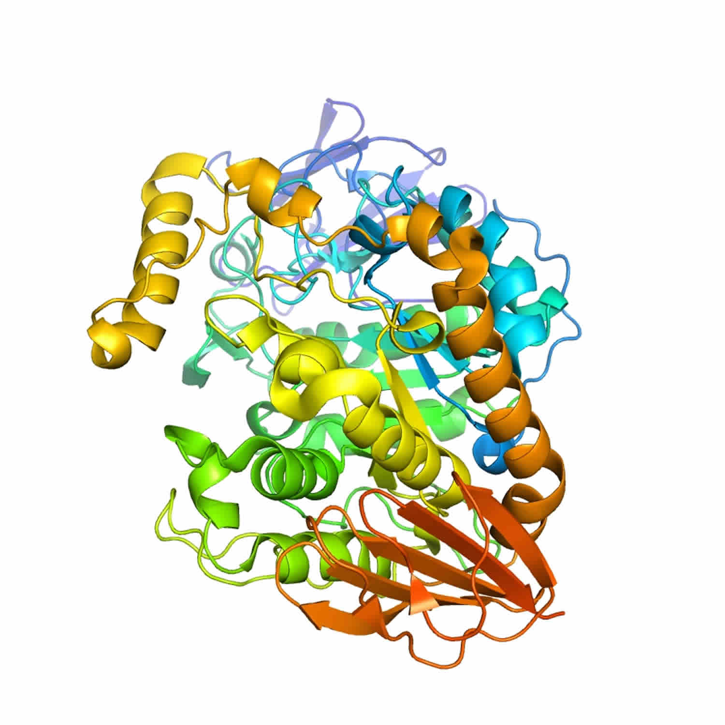
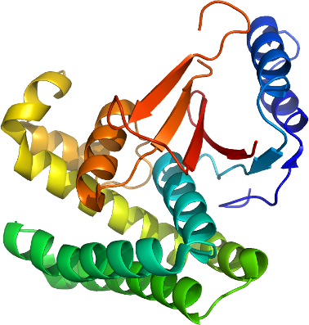
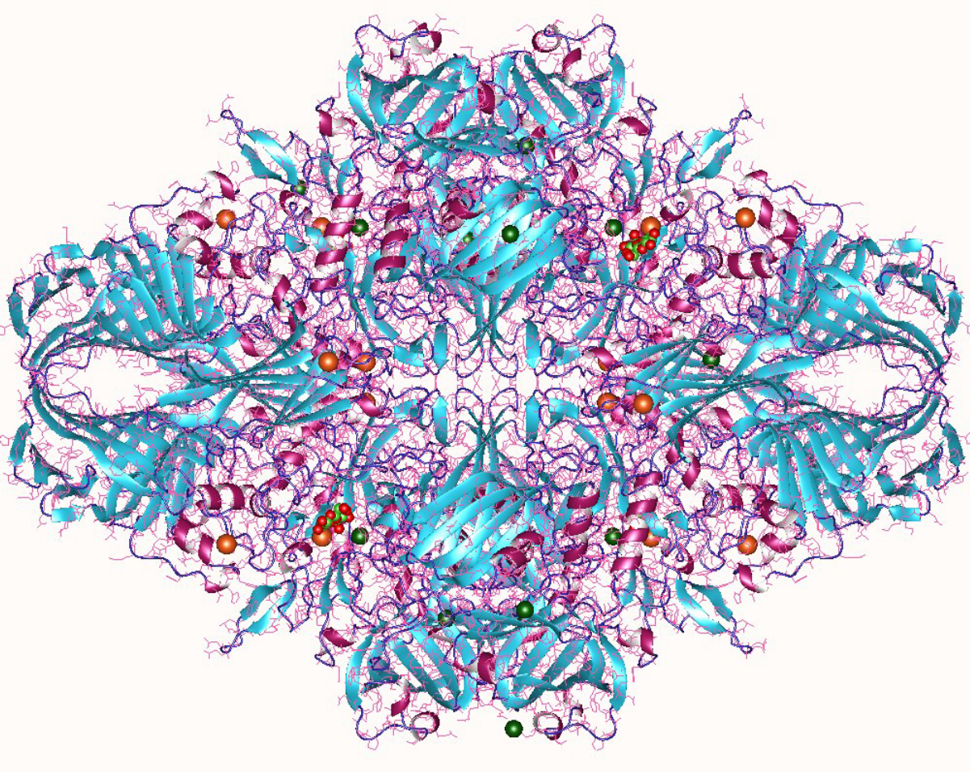
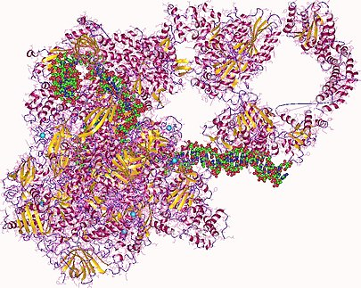
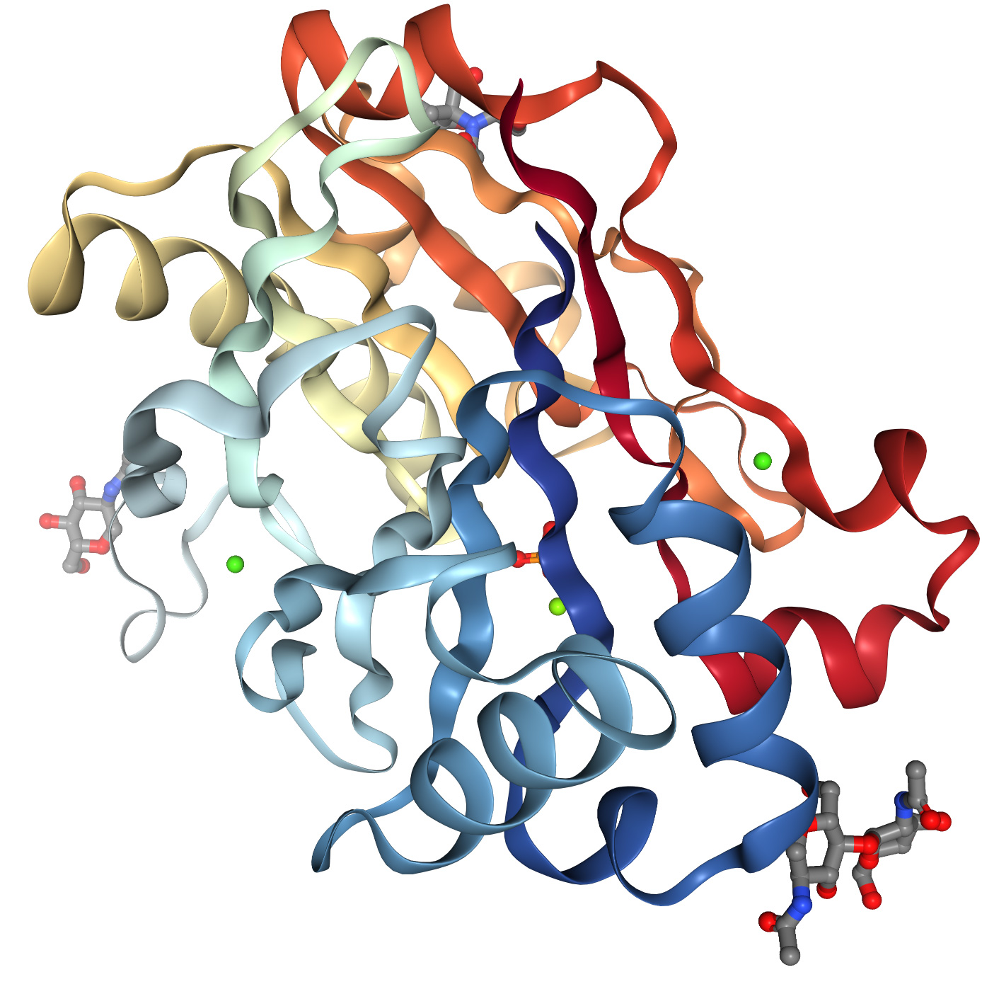
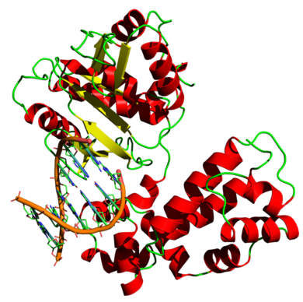
What Enzymes do You Use as Examples?
Notes:
Examples of anabolic enzymes:
Aminoacyl-tRNA-synthetase, DNA ligase, DNA polymerase, ATP synthase, Rubisco, Glycogen synthase, Glucokinase, Hexokinases, RNA polymerase, Asparagine synthetase, Glutamine synthetase, Methionine synthase, Citrate synthase, Pseudouridine synthase, Cellulose synthase, Succinyl CoA synthetase,
Examples of catabolic enzymes:
Amylase (Diastase), ATPase, Catalase, Cellulase, DNA helicase, Lactase, Lipase, Maltase, Pepsin, Protease (Bromelain, Chymotrypsin, Pepsin, and Trypsin), Sucrase

Slide 6
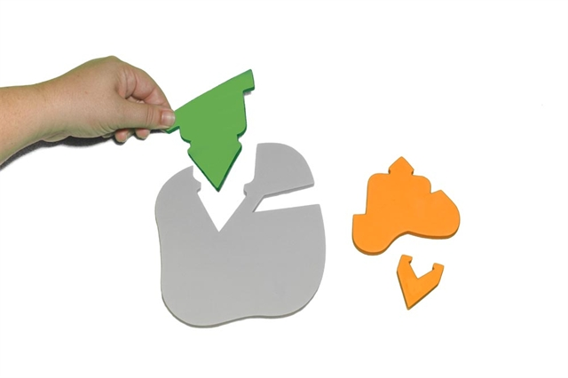
Identify the enzyme, active site, and substrate.
Notes:
Set the scene: The gray foam piece is a model of the enzyme. The green foam pieces (B1 and B2) are used to model catabolism, while the orange foam pieces (C1 and C2) are used to model anabolism.
Helpful hints: Have student draw the modeling process in their lab notebook to refer to later. Encourage them to label the changes in the model as when they add the substrates. Be sure to help students understand that there are many kinds of enzymes, and each performs a specific reaction. Review with students the two major classes of enzymes: catabolic and anabolic. In catabolic reactions, the enzymes act on a substrate to break chemical bonds. In anabolic reactions, the enzymes act on a substrate to make chemical bonds.
What the model shows: Conformational change of the enzyme's active site
What the model doesn’t show: The three-dimensional complexity of the reaction

Slide 7
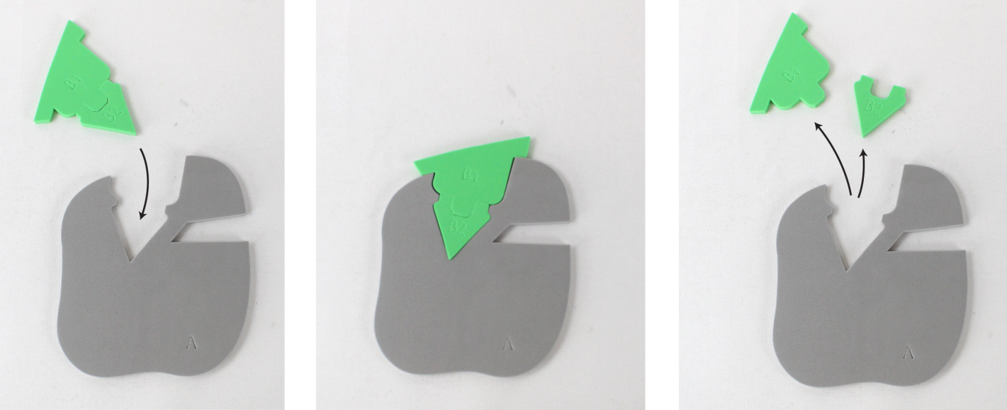
Modeling Enzyme Action: Catabolism
Notes:
Set the scene: Using sucrase as the example, sucrose binds to the active site. A bond is broken leaving glucose and fructose as products.
Helpful hints: Help student identify the active site and the two reactants needed for the reaction as well as the final product.
Key question for students: Why do you think it is an advantage for the enzyme to remain unchanged while catalyzing a chemical reaction?
What the model shows: A stylized form of the reaction, changes in substrate, and a conformational change in the active site of the enzyme.
What the model doesn’t show: The specific atoms involved in the reaction.

Slide 8
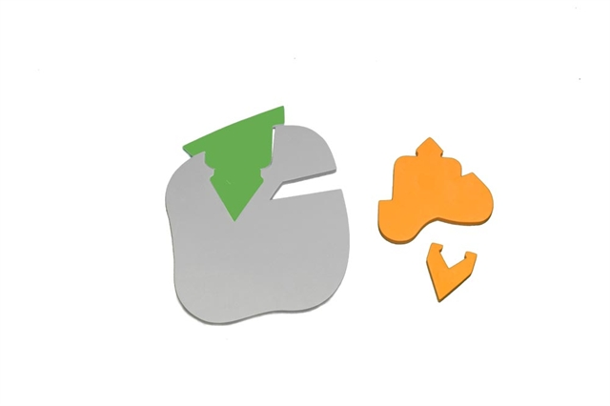
Induced Fit Model of Enzyme Action
Notes:
Set the scene: Dr. Daniel Koshland, Jr. proposed the induced fit model to describe enzyme-substrate interaction (1958). Enzymes are flexible structures. When binding with a substrate, there will be small changes in the shape of the enzymes active site so that there is maximum interaction between the enzyme and the substate.
Helpful hints: Encourage students to describe how the foam catabolism model (green) demonstrates the induced fit model of enzyme-substrate interaction.
What the model shows: A stylized form of the reaction, changes in substrate, and a conformational change in the active site of the enzyme.
What the model doesn’t show: The specific atoms involved in the reaction.

Slide 9
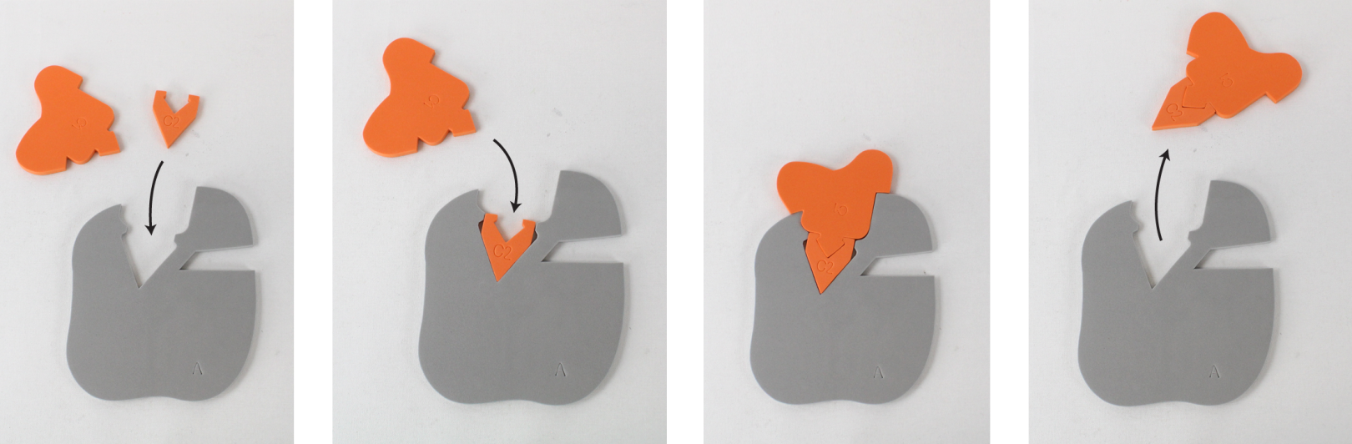
Modeling Enzyme Action: Anabolism
Notes:
Set the scene: Using cellulose synthase as the example, a glucose is added to cellulose to create a longer chain of glucose molecules.
Helpful hints: Help student identify the active site and the two reactants needed for the reaction as well as the final product. Do not assemble the orange pieces prior to the anabolism action.
What the model shows: A stylized form of the reaction. The interlocking pieces stimulate a chemical bond being formed. Can be used to demonstrate the lock-and-key model of enzyme-substrate interaction (Emil Fischer, 1894).
What the model doesn’t show: The specific atoms involved in the reaction.

Slide 10
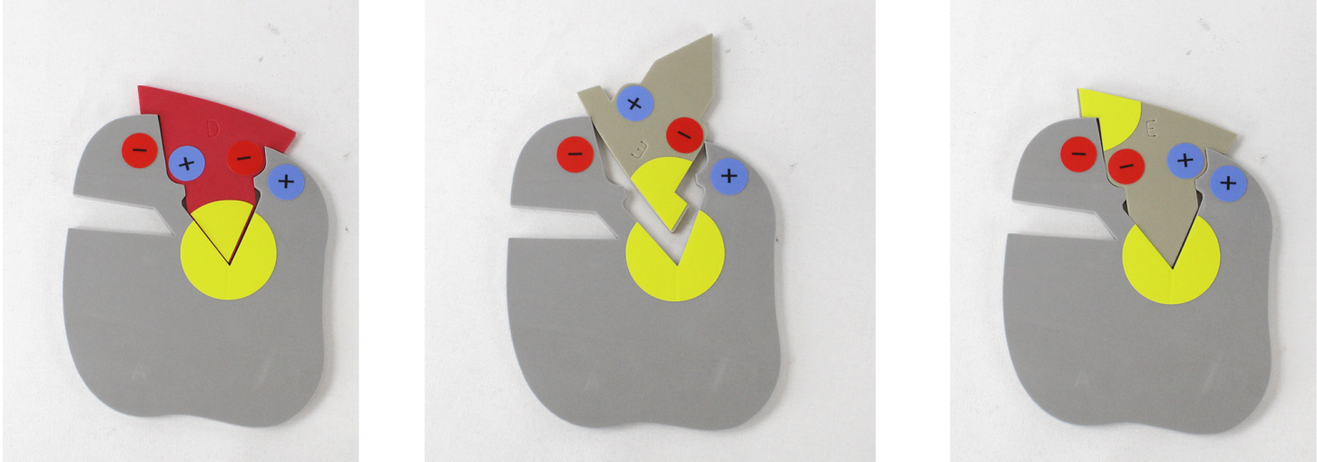
Modeling Enzyme Action: Specificity
Notes:
Set the scene: To model this concept, use the grey enzyme that has the stickers on it as well as the red and tan substrate pieces.
Helpful hints: Explain to the students that the active site of the enzyme is made of specific amino acids that in this case as hydrophobic. These amino acids interact with specific parts of the substrate (specific active site configurations.) Other substances will not make the same interaction. Point out the charges as well to help students better understand the interaction between the enzyme and the substrate. Can also discuss the Lock and Key Model of Enzyme Action (Emil Fisher, 1894).
What the model shows: Conformation changes of the active site as well as regions of the active site that interact with the substate.
What the model doesn’t show: The 3D nature of this interaction

Slide 11
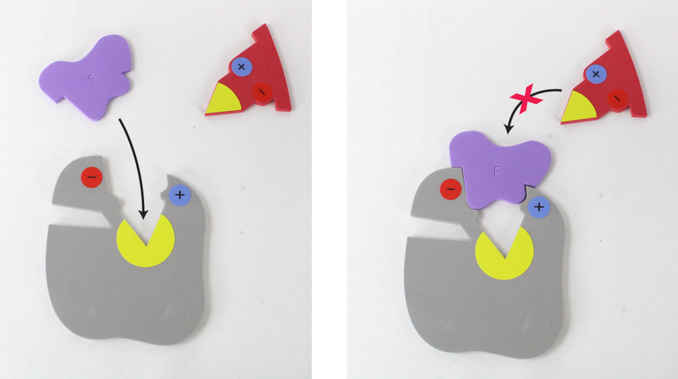
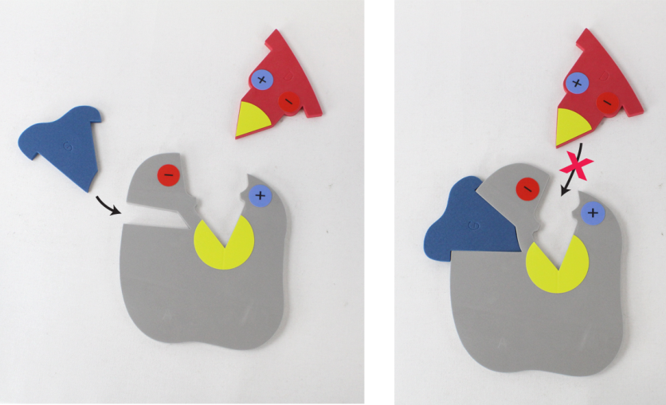
Modeling Inhibition
Competitive Inhibition
Noncompetitive Inhibition
Notes:
Set the scene: To model this process, use the purple, blue, and red foam pieces as well as the grey enzyme with stickers.
Examples of competitive inhibitors:
Relenza (influenza medication) which inhibits the enzyme neuraminidase from cleaving hemagglutinin
Malonic acid binds to the active site of succinate dehydrogenase and inhibits its ability to oxidize succinate to fumaric acid (Krebs cycle)
Alpha-glucosidase inhibitors (anti-diabetic medicine like Acarbose-Precose-Glucobay and Miglitol-Glyset ) inhibits alpha-glucosidase which is found in the villi of the small intestine and prevents the absorption and digestion of glucose.
Example of non-competitive inhibitors:
Cyanide which inhibits ATP production by changing the active site of cytochrome oxidase.
Helpful hints: Help student identify the active site and the allosteric site. Students should notice what happens to the active site when something binds with the allosteric site. Ask students to predict what might happen in a cell if the concentration of the competitive inhibitor is greater than the concentration of the substrate. Encourage student to notice how the shape of the active site changes when something is bound to the allosteric site.
What the model shows: A stylized form of the reaction. The competitive inhibitor blocks the active site making it inaccessible to the substrate. The noncompetitive inhibitor binds at the allosteric site making the active site conformationally change.
What the model doesn’t show: The specific atoms involved in the reaction or the 3D nature of this interaction

Slide 12
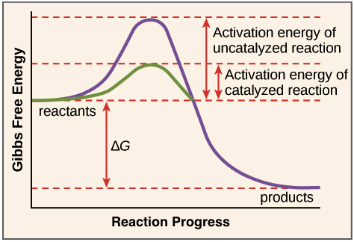
Modeling Enzyme Action: Activation Energy
https://www.khanacademy.org/science/biology/energy-and-enzymes/introduction-to-enzymes/a/activation-energy
Notes:
Set the scene: Present the graph to students, then ask them to retrieve the gray foam piece and the two green substrate pieces.
Helpful hints: Begin by connecting the green foam pieces. To illustrate the activation energy without the enzyme interaction, pull the apart the two green pieces with your hands. Reconnect the green pieces. This time lock them into the active site on the gray A enzyme (without stickers) foam piece. With the help of the enzyme, it takes less energy to pull the pieces apart. The activation energy has been lowered.

Slide 13
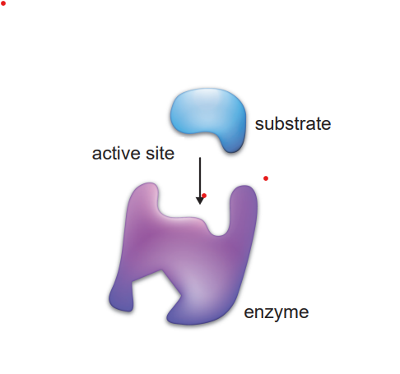
Assessment: After examining the model of the enzyme, design a competitive or non-competitive inhibitor for the enzyme. Explain how its action would inhibit the substrate binding to the enzyme.
Notes:
Set the scene: Deep drive into drug design. Encourage students to research how drugs or poisons can act as inhibitors to enzymes’ active sites or allosteric sites.
Helpful hints: Have students share what they have learned for a real-world connection.

Slide 14
Workshop NGSS Connections
(and/or other applicable standards)
SEPs | CCCs | DCIs | TEKS
Planning and Carrying Out Investigations | Systems and System Models | HS-LS1-2 | Student Expectation-B2.E
Developing and Using Models | Stability and Change | HS-LS3-2 | Student Expectation B.9C
Asking Questions (for science) and Defining Problems (for engineering) | Cause and Effect: Mechanism and Explanation
Notes:
Ruth says: Here are the NGSS and TEKS Connections for this workshop.

Slide 15

We value your opinion!
Let us know what you think.
Scan the QR Code and complete this short survey.

Slide 16
Notes:
The above image is a detailed of a cross section of a cell by Dr. David Goodsell. David Goodsell uses watercolor to aid in our understanding of the molecular world through cellular landscapes. This view of the cell is in cross section and is magnified 1,000,000X. Many compare Goodsell’s artistic expression with the post-impressionist style of Henri Rousseau. Goodsell draws molecules with flat colors and emphasizes their relative size with outlines. Similar colors are used to identify cellular structures. DNA and nuclear proteins are drawn in yellow and orange. Ribosomes are shown in magenta, while cytoplasmic proteins are shown in blue. Membranes are colored in green. Overall size and shape of macromolecules are based on atomic coordinates. The relative amounts of molecules is determined using biochemical data, while the locations of the molecules is determined using electron micrographs. You can find more information about Goodsell’s cellular landscapes by visiting the Protein Data Bank website at RCSB PDB: Homepage.
Additional Resource: David Goodsell: The master of mol art (asbmb.org)

