Slide 1
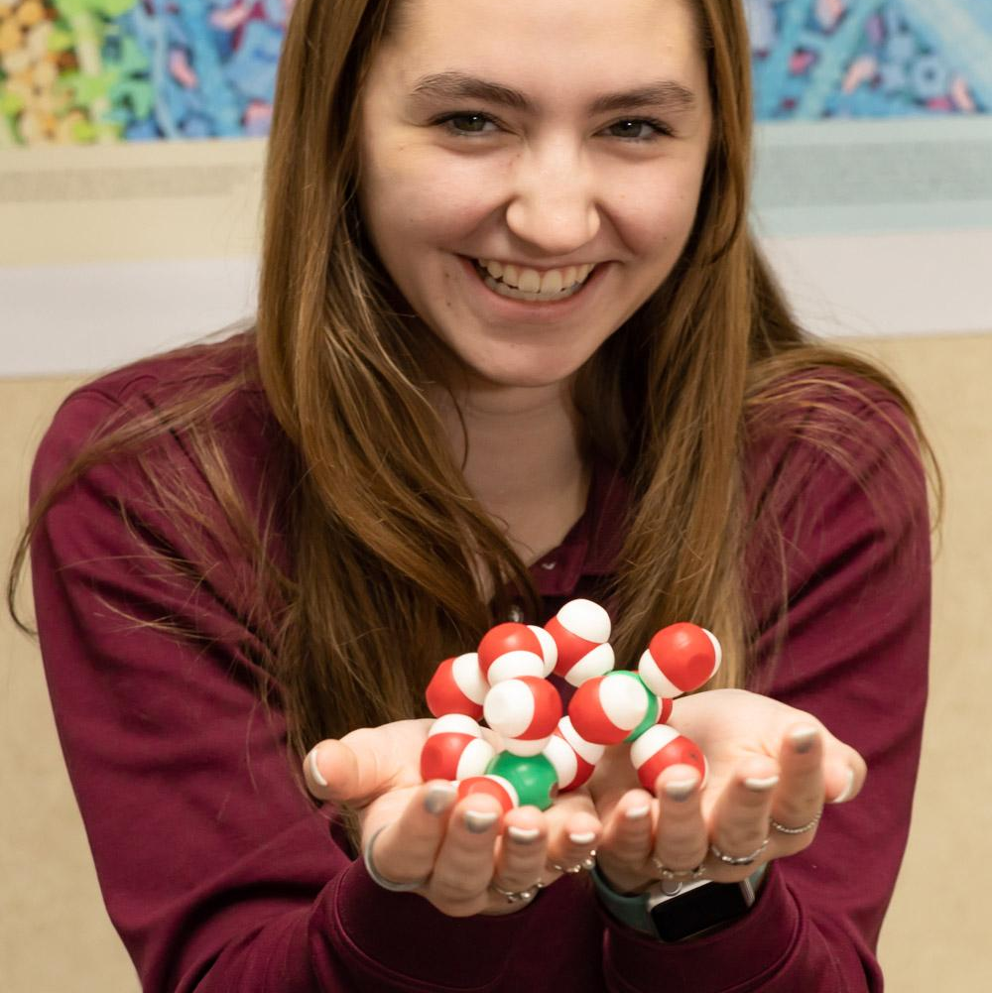
Getting to Know H₂O with Hands on Models
Keri Shingleton, Ph.D.
Holland Hall School
Tulsa, Oklahoma

Slide 2
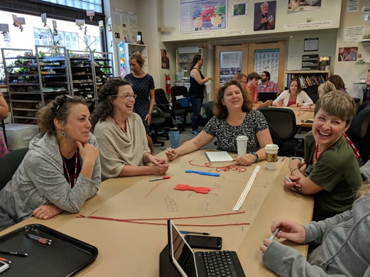



Who am I?
Who am I?

Slide 3

Who are you?

Slide 4
In this workshop, you can expect to…
Play!
Discover!
Think!
Apply what you have learned to develop your own models!

Slide 5

What do our students NEED to know about water and why?

Slide 6
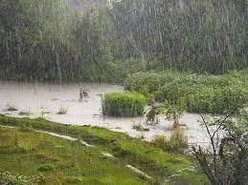
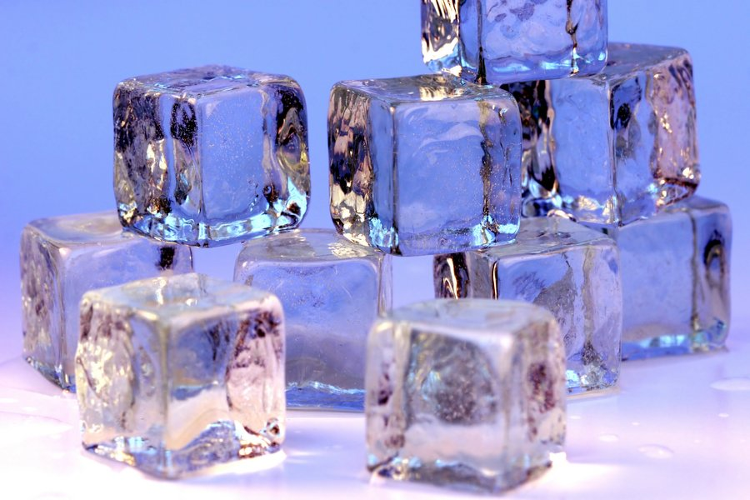

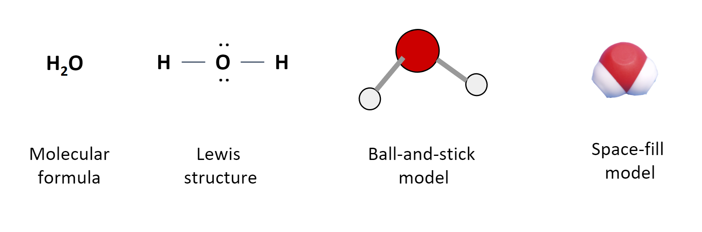
Let’s Get Started...
1,600 × 1,200
https://commons.wikimedia.org/wiki/File:Ice_cubes_openphoto.jpg
https://tinyurl.com/2zw24twj
https://commons.wikimedia.org/wiki/File:Rain_on_the_field.jpg
Notes:
While not specifically mentioned in NGSS, the properties of water are themselves essential for student understanding of so many concepts in Biology. Included in these concepts are the properties of membranes… I don’t know about your curricula, but where I teach, students have not taken chemistry before biology… and I used to spend too much time teaching them basic chemistry in order for them to understand water. Now that I am teaching through phenomena, it just doesn’t make sense! Why spend three weeks teaching about atoms and bonding in order for them to understand water and membranes! They will lose track of their questions if we do that.
Enter these magical models…
Put on your student hat for a moment and pretend you know nothing about water… what can a simple kit tell you?

Slide 7
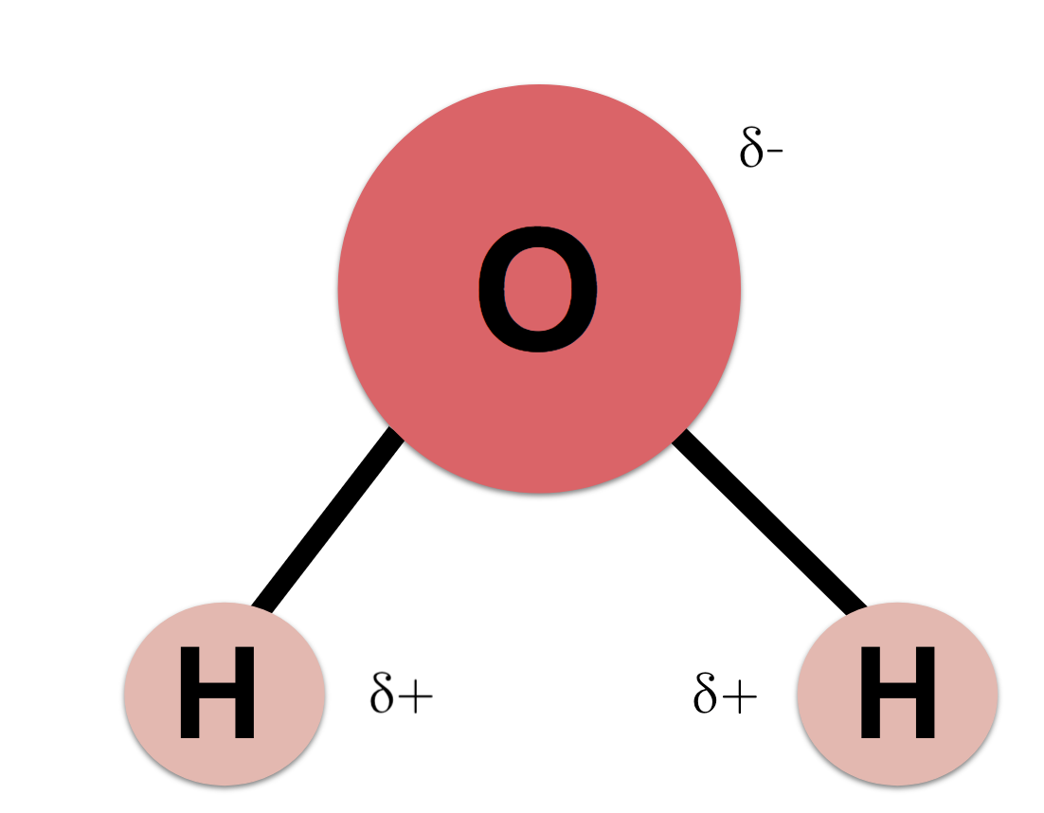
Let’s Get Started...
Properties of water….
https://www.khanacademy.org/science
Notes:
While not specifically mentioned in NGSS, the properties of water are themselves essential for student understanding of so many concepts in Biology. Included in these concepts are the properties of membranes… I don’t know about your curricula, but where I teach, students have not taken chemistry before biology… and I used to spend too much time teaching them basic chemistry in order for them to understand water. Now that I am teaching through phenomena, it just doesn’t make sense! Why spend three weeks teaching about atoms and bonding in order for them to understand water and membranes! They will lose track of their questions if we do that.
Enter these magical models…
Put on your student hat for a moment and pretend you know nothing about water… what can a simple kit tell you?

Slide 8

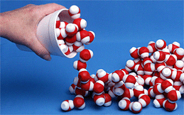
Let’s Get Started...
Properties of water….
It is time to PLAY…
RECORD your observations
Allow yourself to be a learner! Suspend what you think you know… take the opportunity to wonder and question…
Notes:
Put on your student hat for a moment and pretend you know nothing about water… what can a simple kit tell you?

Slide 9

What did you notice?

Slide 10
What do you wonder?

Slide 11

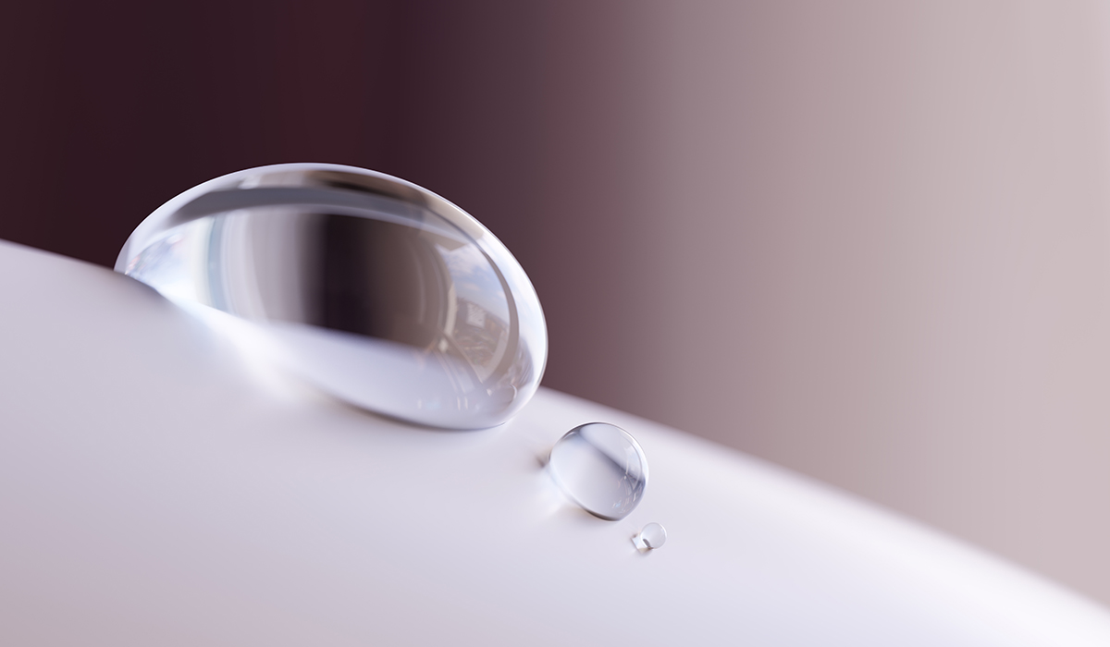
What topics would this simple activity help you teach?
https://www.brighton-science.com/blog/what-is-the-difference-between-surface-tension-and-surface-energy-1

Slide 12
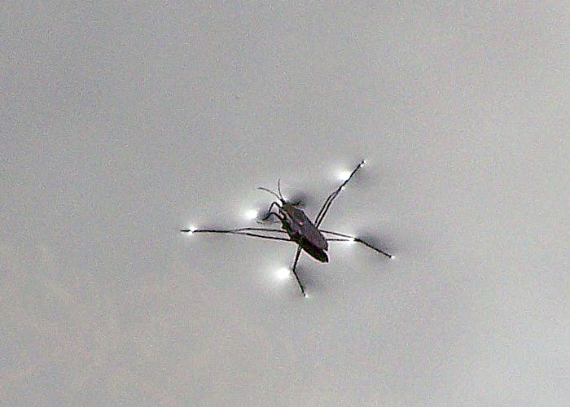
Develop a model that explains this. Go ahead… sketch it!
https://uwm.edu/field-station/water-strider/

Slide 13
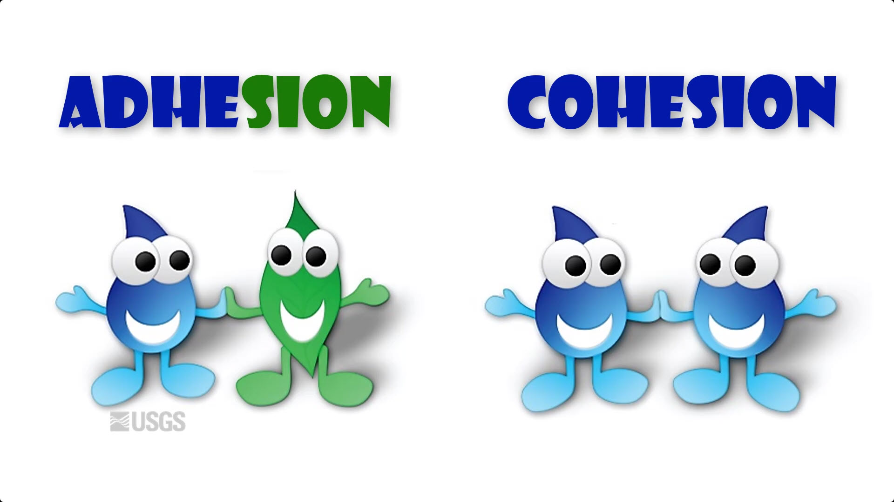
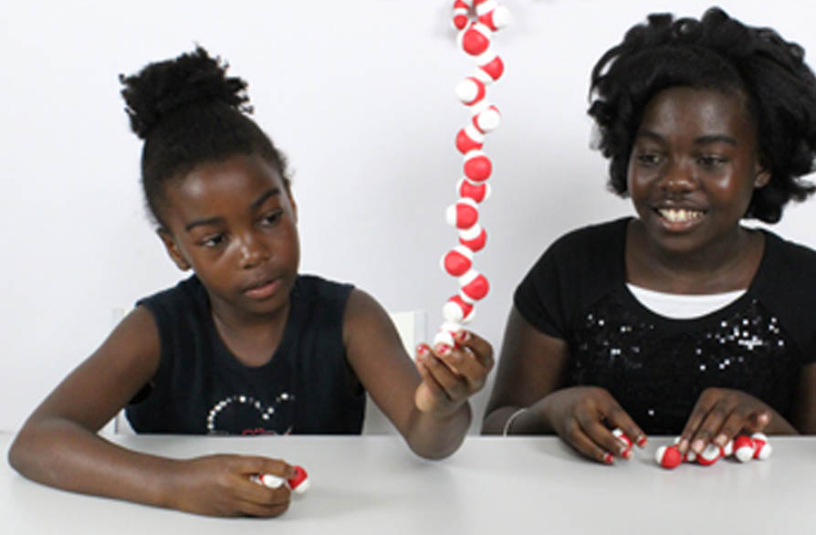
Cohesion
https://www.usgs.gov/media/videos/adhesion-and-cohesion-water

Slide 14
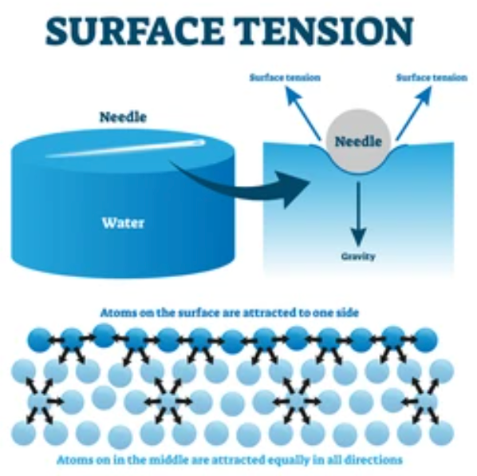
Cohesion
https://www.usgs.gov/media/videos/adhesion-and-cohesion-water
https://www.shutterstock.com/search/surface-tension

Slide 15
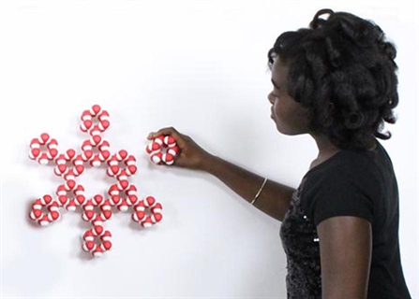
What about Adhesion?
https://www.usgs.gov/media/videos/adhesion-and-cohesion-water

Slide 16

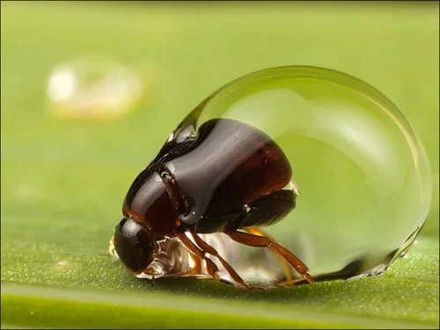
https://www.usgs.gov/media/videos/adhesion-and-cohesion-water
Shouldn’t the water strider’s legs stick to the water due to adhesion?
https://i.imgur.com/jQCvEF2.jpg

Slide 17
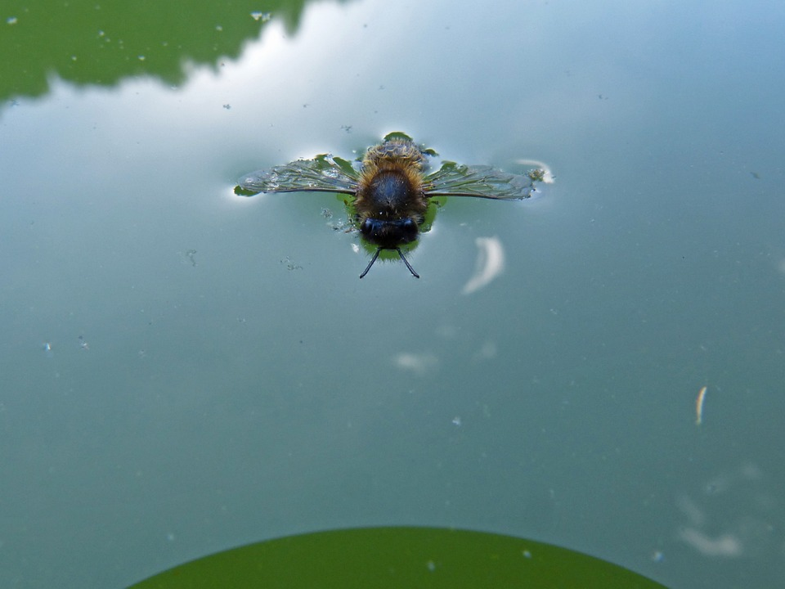
https://pixabay.com/photos/bee-drowned-drown-float-up-insect-1139677/

Slide 18
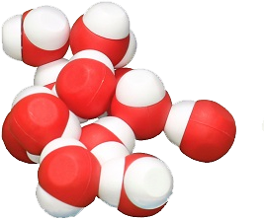
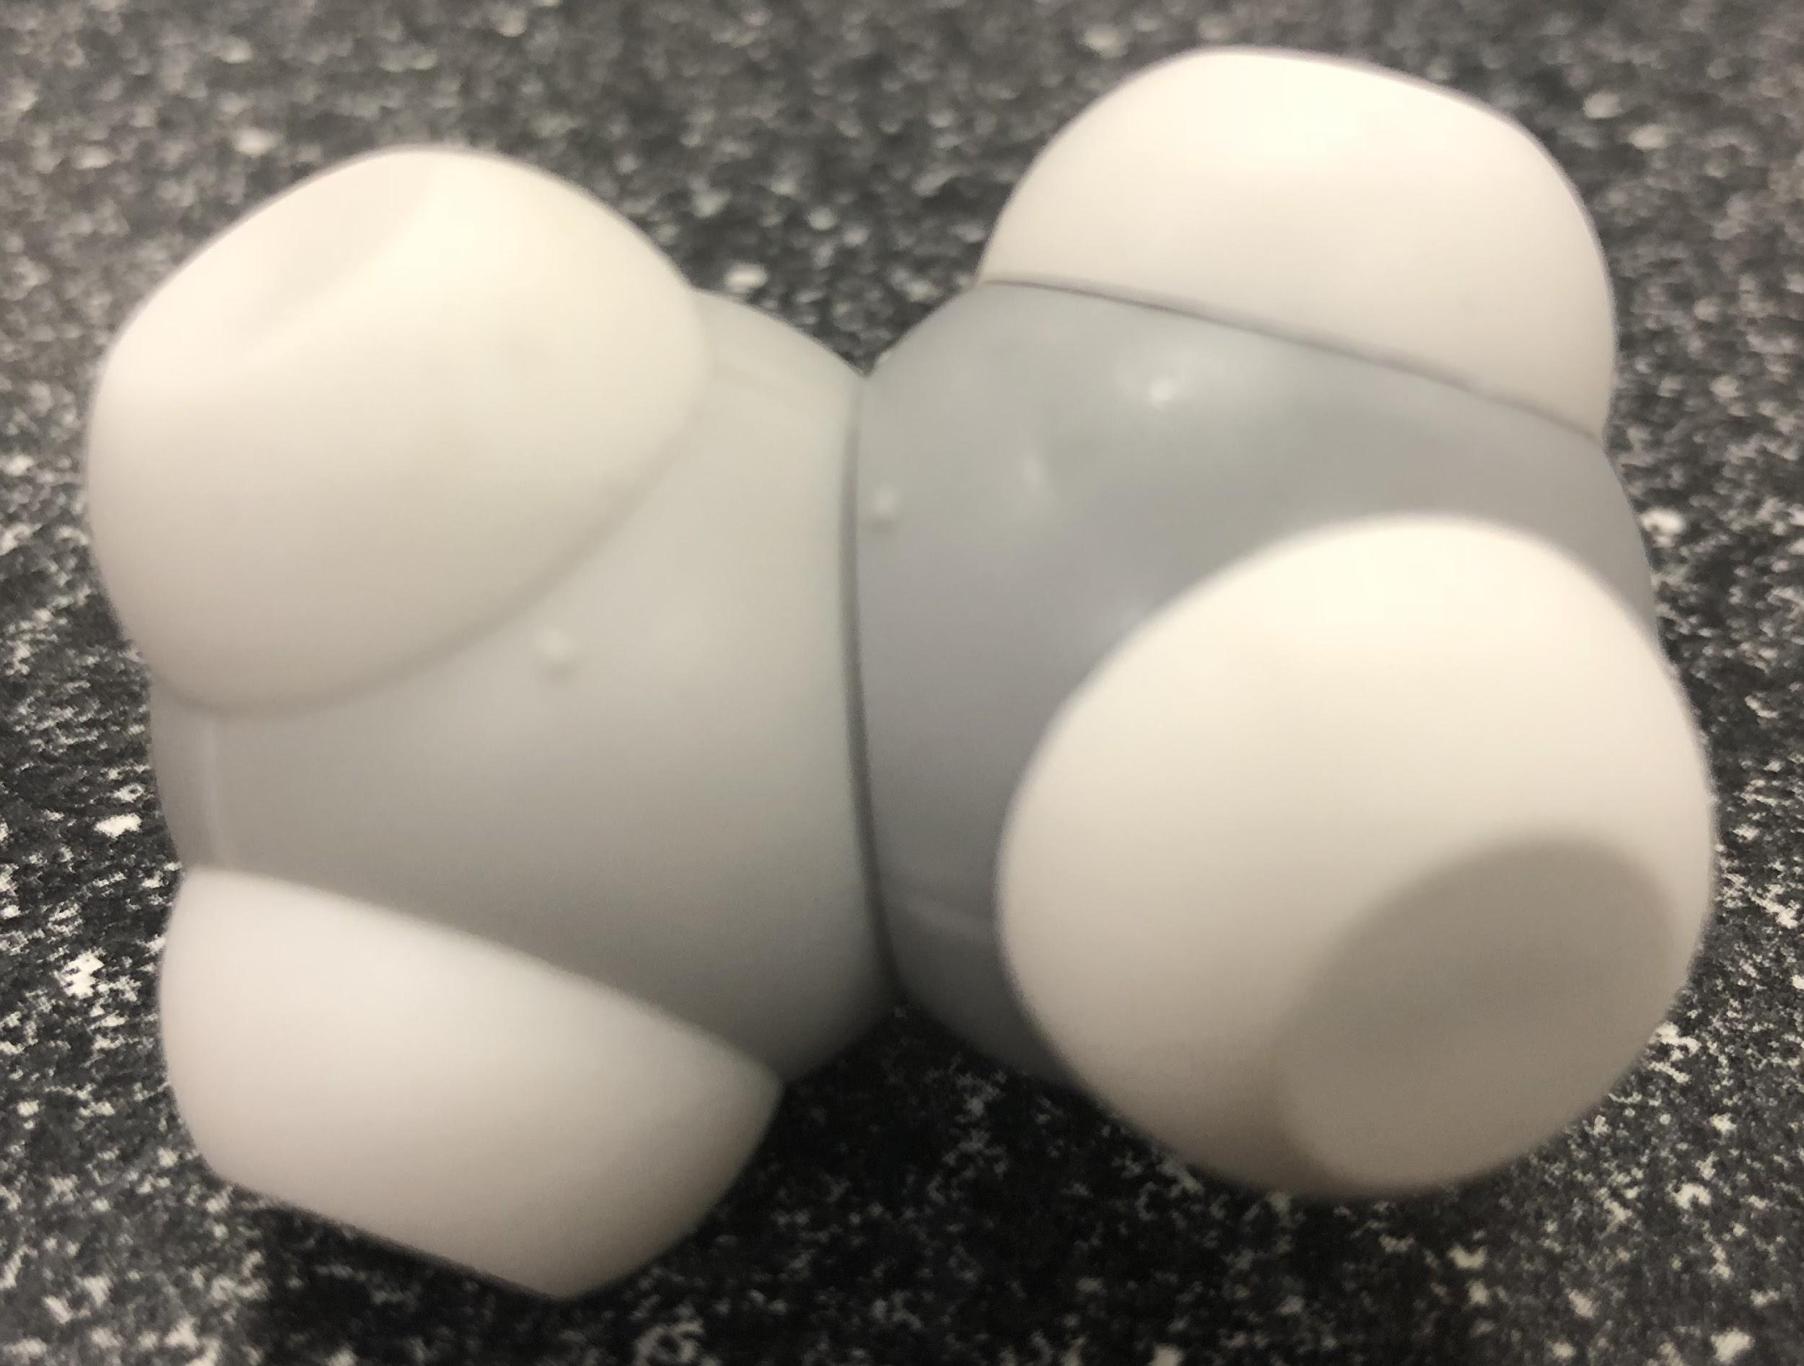
Let’s explore some more!
+

Slide 19
What did you notice?

Slide 20
What do you wonder?

Slide 21
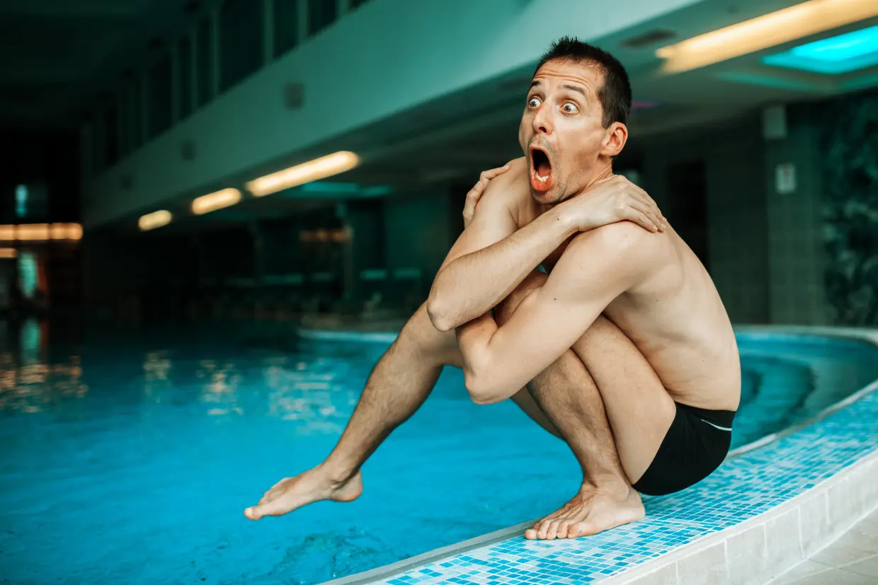
What does it mean to be… hydrophobic?
https://www.thesun.co.uk/fabulous/5325697/what-is-aquaphobia-causes-treatment/

Slide 22

What does it mean to be… hydrophobic?
https://www.thesun.co.uk/fabulous/5325697/what-is-aquaphobia-causes-treatment/

Slide 23
Can you revise your model?
https://uwm.edu/field-station/water-strider/

Slide 24
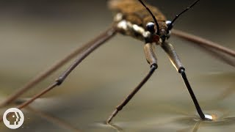
What is the “answer”?

Slide 25
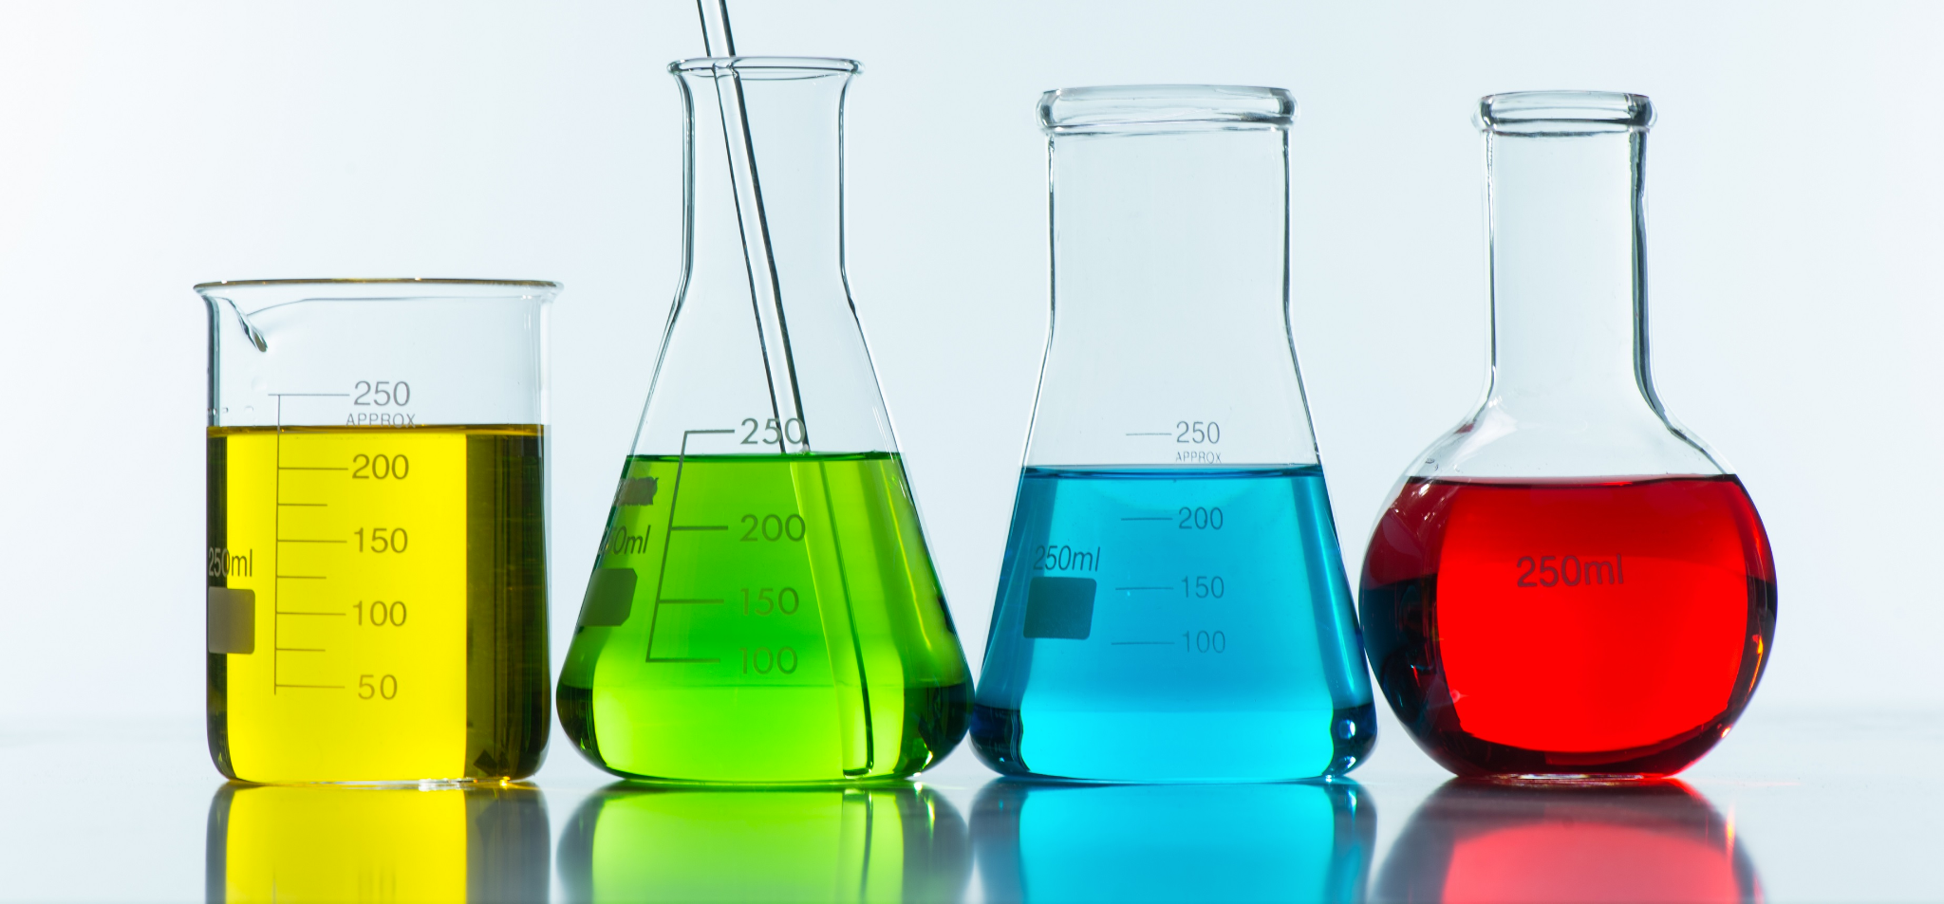
What is solubility?
https://jooinn.com/chemical-solution-3.html

Slide 26
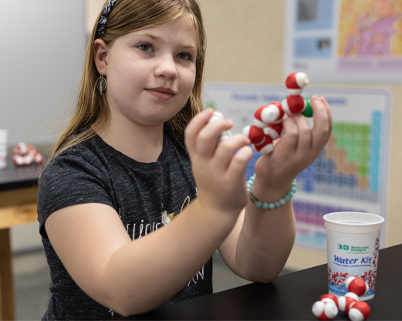
Give it a try! Dissolve some salt!

Slide 27
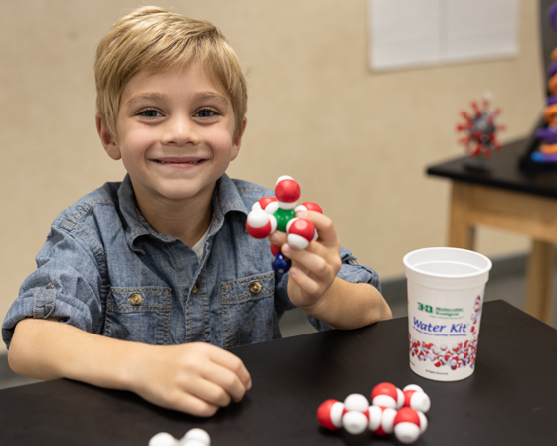
Give it a try! Dissolve some salt!

Slide 28
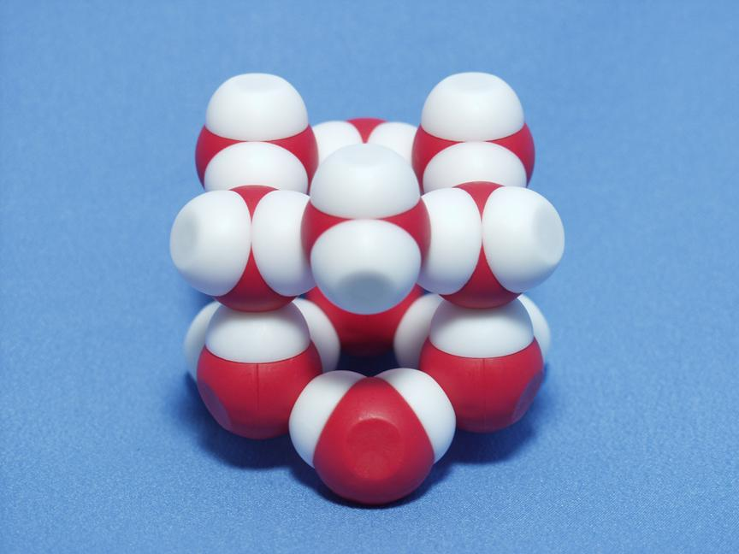
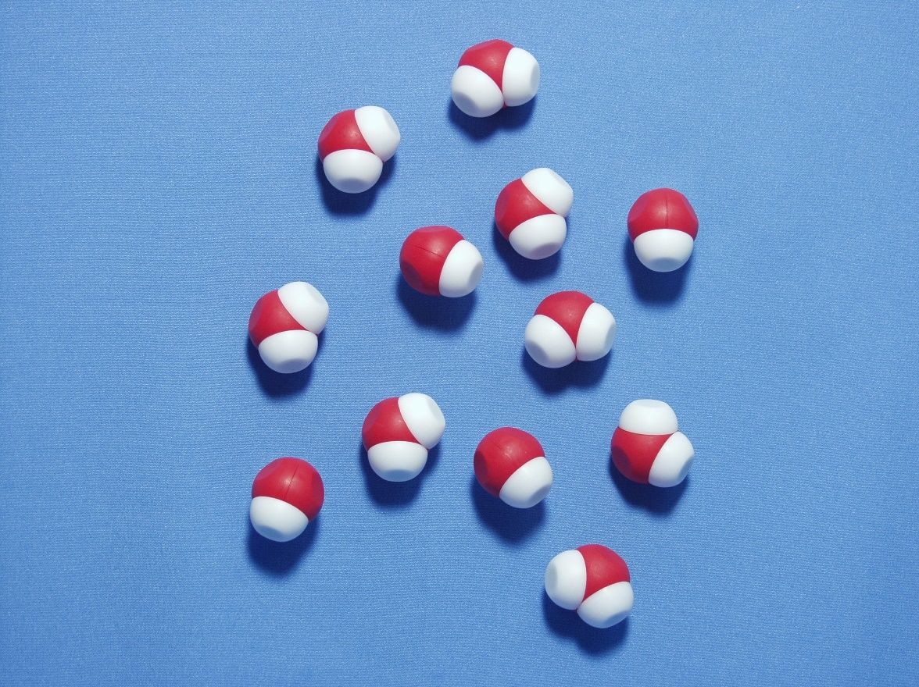
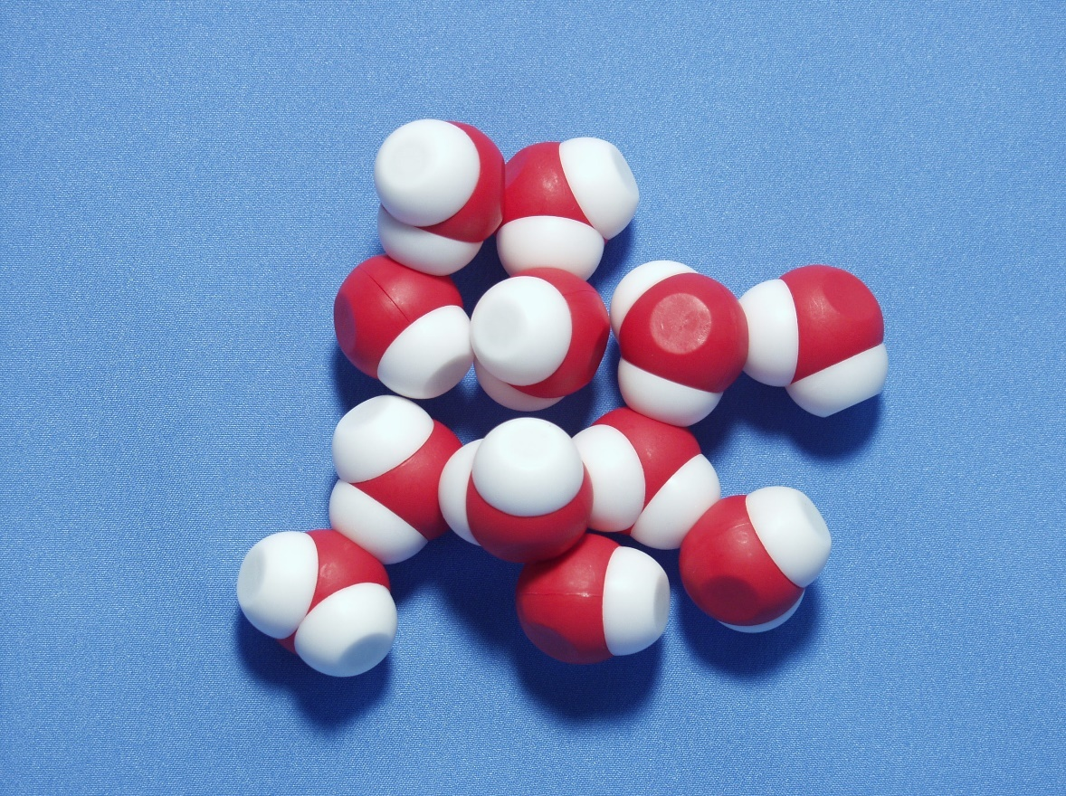
Phases

Slide 29
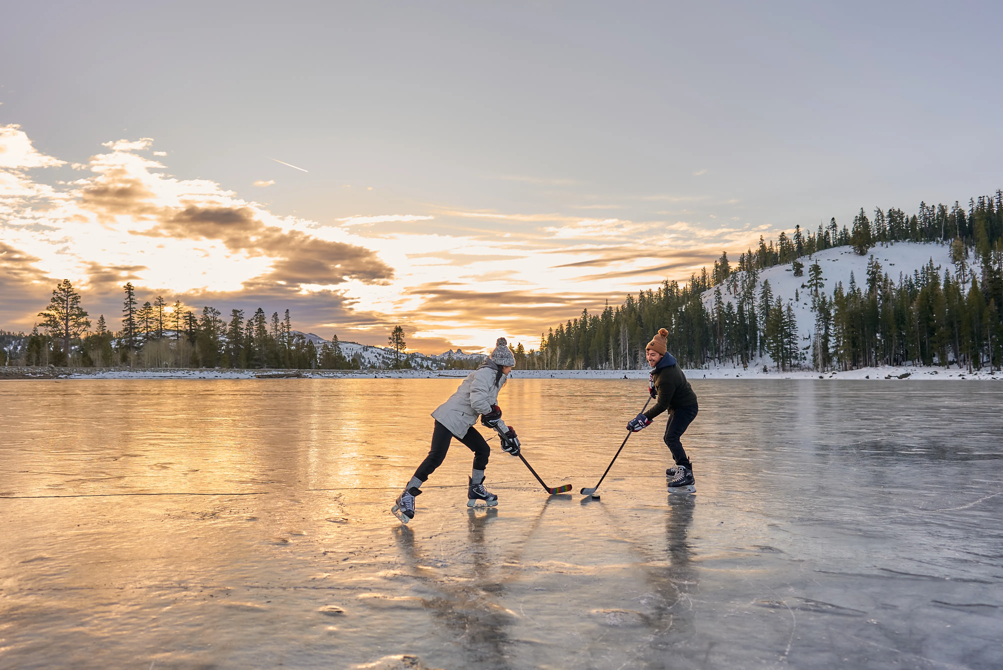

Slide 30
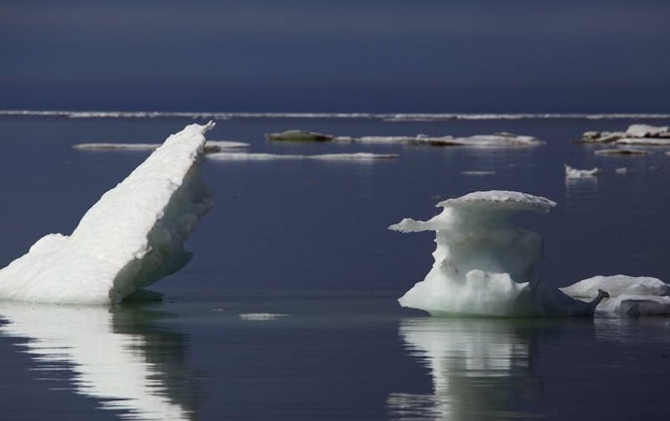
Speaking of ice!!!
https://earthsky.org/earth/why-arctic-winter-sea-ice-stalled-2020/

Slide 31
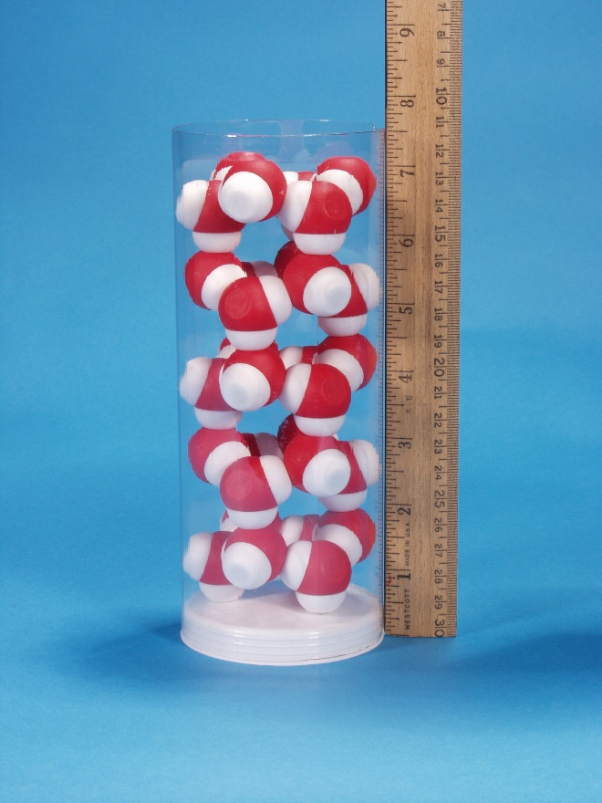
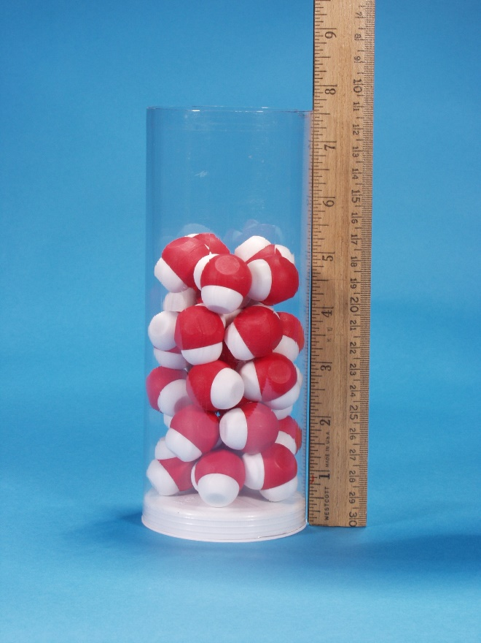
Density

Slide 32
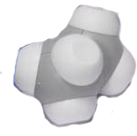
What do you think would happen?
+

Slide 33
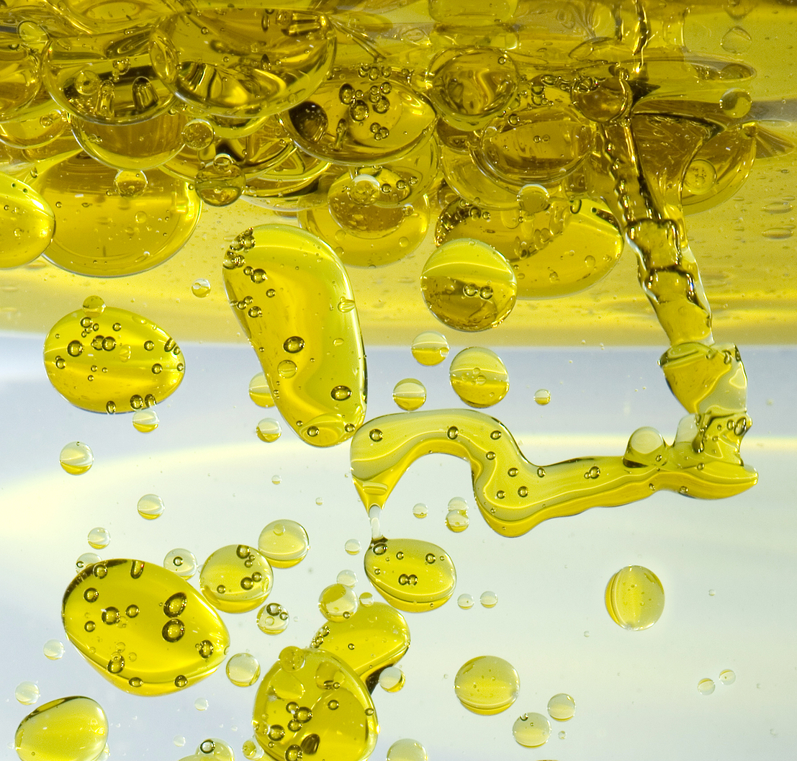
Hydrophilic?
Hydrophobic?
Density?
http://www.todayifoundout.com/wp-content/uploads/2015/08/olive-oil-in-water.png

Slide 34
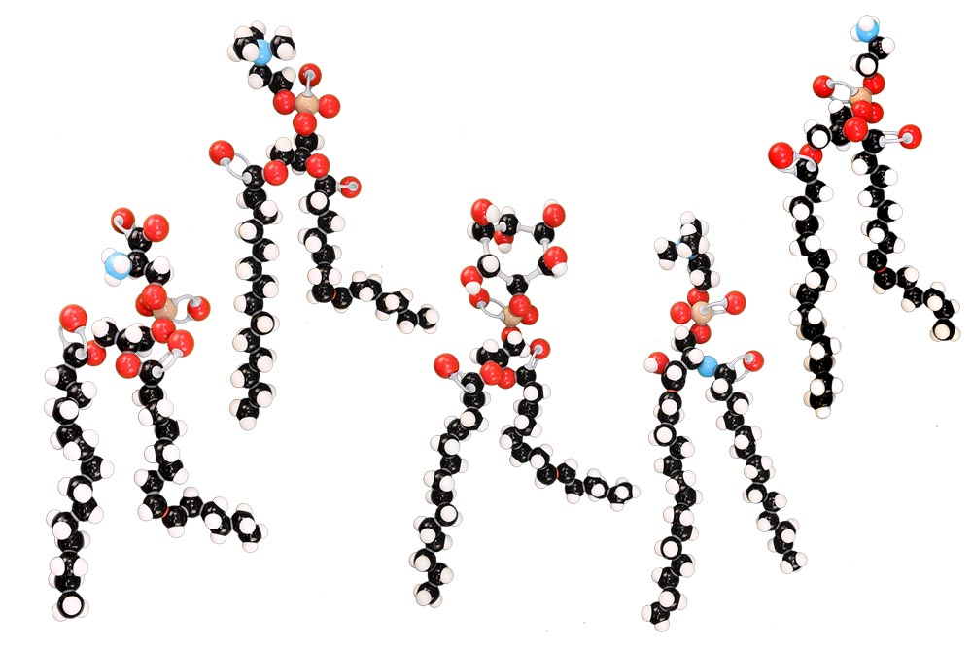
What about….

Slide 35
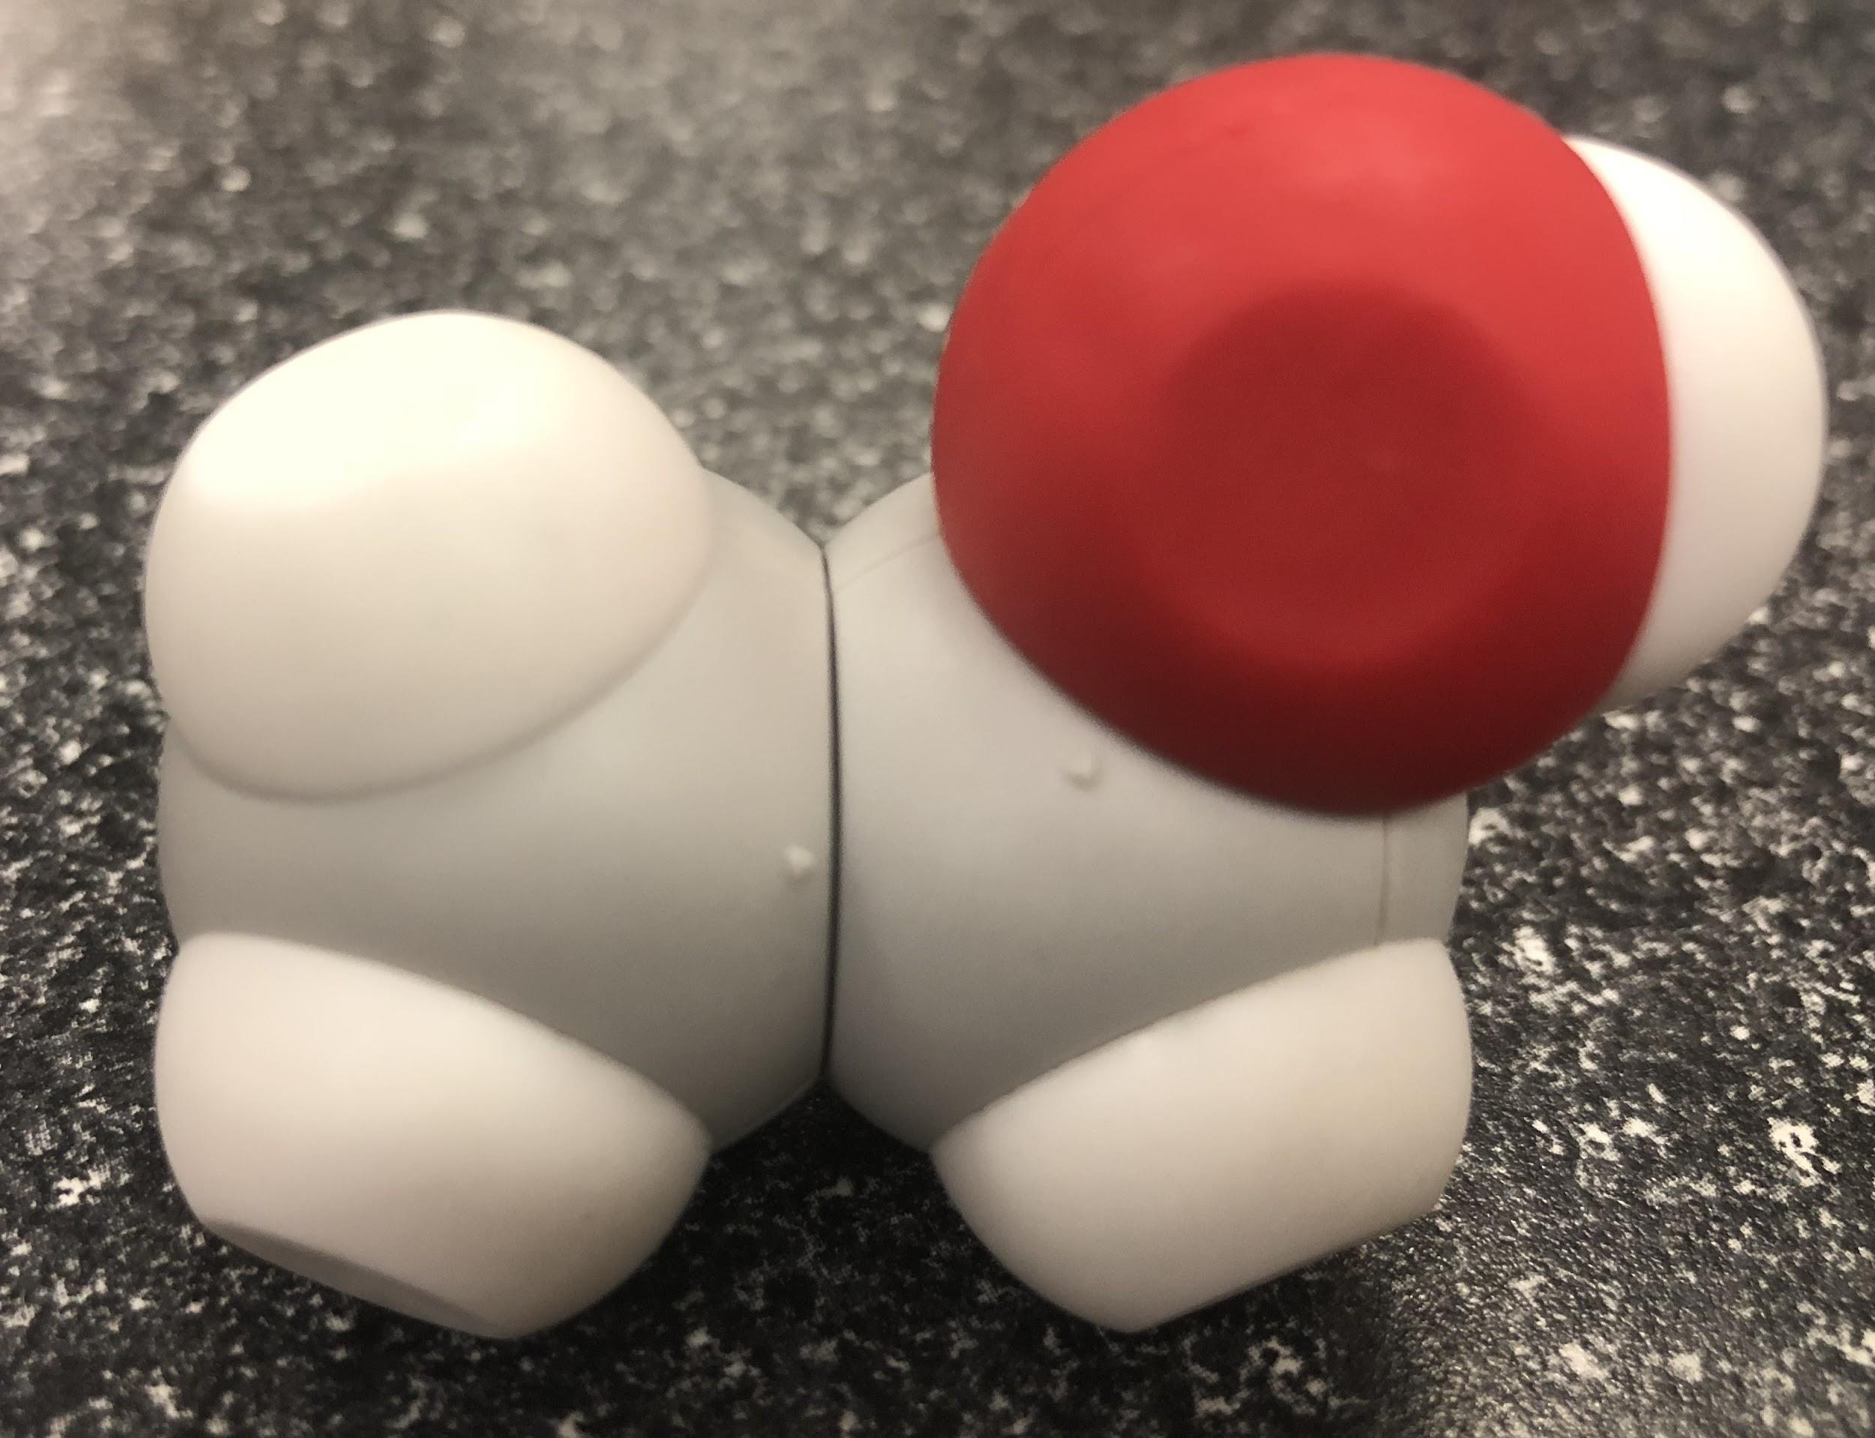
Now Let’s think about membranes...
what about alcohols?

Slide 36
What if….

Slide 37
Now Let’s think about membranes...
How does this inform students about membranes?

Slide 38
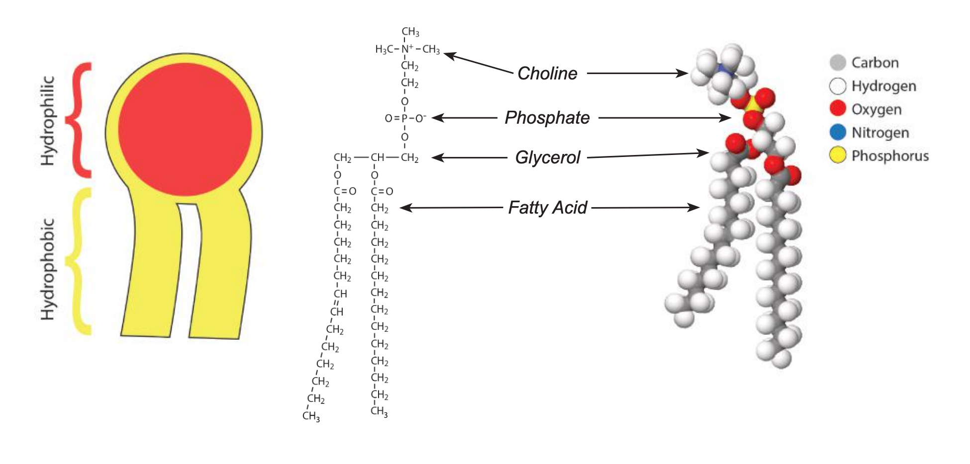
Now Let’s think about membranes...

Slide 39
Questions I can help with?
Keri Shingleton
kerishingleton@gmail.com

Slide 40

Summer Courses!

Slide 41

THANK YOU!!
Remember the conference discount code: SC23
Keri Shingleton
kerishingleton@gmail.com

Slide 42

Scan this code for a chance to win a $250 gift certificate to 3D Molecular Designs!

