Slide 1

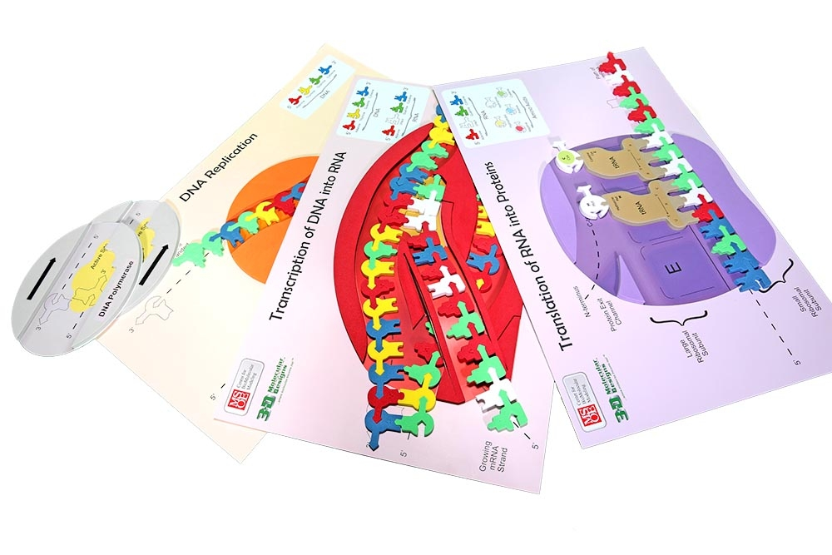
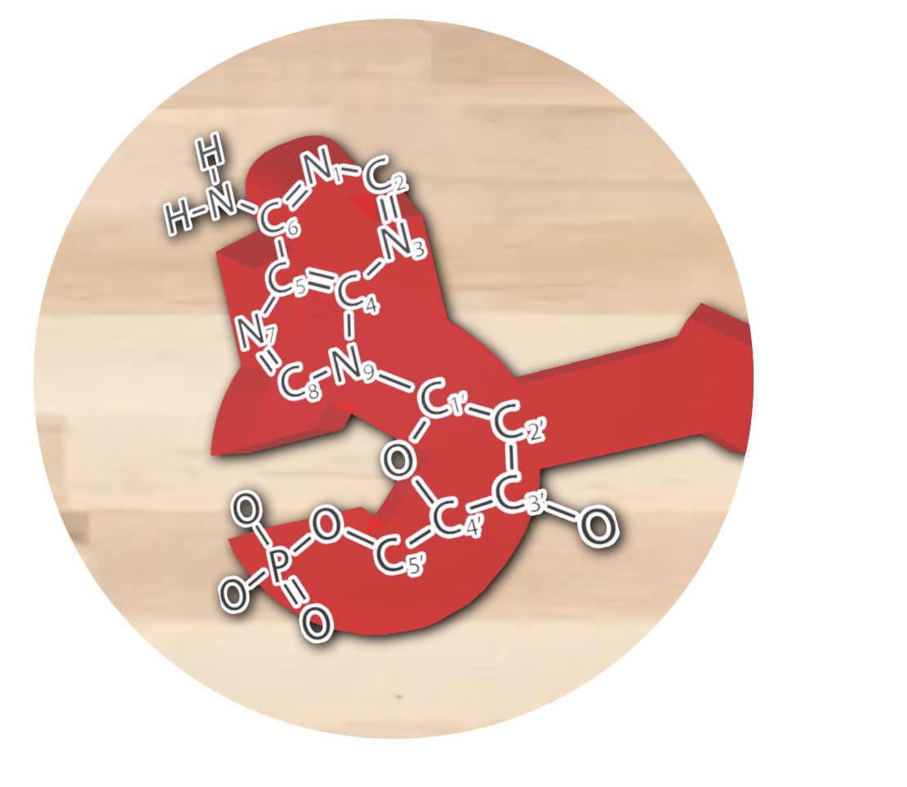

Transferring Models
with the Flow of Genetic Information Kit
“The language of DNA is written in A, T, G, and C – the alphabet of life."
- Craig Venter
Activity ID: FGIK-AR1
Required Models: 1 FGIK©/ Group
Required Media: 3DMD AR EDU App

Slide 2

Teacher Guide – Summary
Activity Summary
This AR activity explores the components of DNA structure using several commonly used models of DNA. DNA is made of nucleotides. Each nucleotides contains a phosphate, deoxyribose sugar, and one of four nitrogenous bases. Nitrogenous bases typically use base pairing in which adenine hydrogen bonds with thymine and cytosine hydrogen bonds with guanine. The DNA strand has directionality from the 5’ to the 3’ direction based on the carbon in the sugar on the backbone.
This activity requires the 3DMD AR EDU application, available for download from the Google Play and Apple App stores. The activity is split into two AR scenes designed to be explored in order. Each AR scene is represented by a consistent icon in this slide deck and the 3DMD AR EDU app (see icon images below.)
Scene 1: Scanning the foam nucleotides from the Flow of Genetic Information Kit© will display the several overlays of a single nucleotide. Students will compare the foam nucleotide to its structural formula, a cartoon version, and a spacefill model.
Scene 2: Scan a specific nucleotide sequence created with the foam nucleotides from the Flow of Genetic Information Kit ©, students will investigate DNA in its linear configuration.

Slide 3
Teacher Guide - Overview
Activity Objectives
  Evaluate multiple models of the structure of the nucleotide.
  Construct a DNA sequence and discover the directionality of DNA.
  Estimated Class Time:
45 minutes
Required Models:
Flow of Genetic Information Kit©
Required Media:
3DMD AR EDU App + subscription
Other Materials Needed:
Notebook and writing tools
Optional – Dynamic DNA kit ©
Grade, Class
9-12 Biology
Topics
DNA Structure
Nucleotide Structure
Base Pairing
Directionality
Prerequisite Knowledge
Polarity
Covalent bonding
Hydrogen bonding

Slide 4
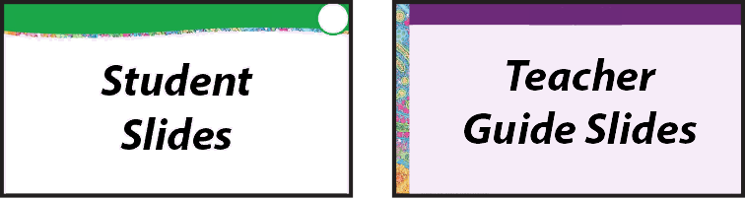




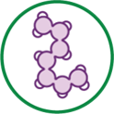
Teacher Guide - Using This Slide Deck
Student and Teacher Slide Deck Pages
  Slides that are meant for student viewing will feature a green top
  banner. Slides that are meant only for teacher viewing will feature a
  purple top banner and will appear hidden when in "slide show" mode.
Prompting Icons
  Each student slide will include a prompting icon in the top right corner of the slide. These icons on each slide cue your students to the type of activity they will be doing.
Turn and talk discussion
Write in your notebook
Quiet thinking time
Digital modeling
Physical modeling
Teacher Moves and Student Moves
Class slides provide notes (teacher notes below the slide) with specific information to assist you in facilitating the activity using effective modeling and education practices.

Slide 5
Teacher Guide - Standards
Next Generation Science Standards
Science and Engineering Practices | Cross Cutting Concepts | Disciplinary Core Ideas
Asking Questions and Defining Problems | Patterns | HS-LS1-1
Developing and Using Models | Structure and Function
Constructing Explanations and Designing

Slide 6
Teacher Guide – Scene 1
Scene 1: Nucleotide Structure
Scanning individual foam nucleotides from the Flow of Genetic Information Kit© will display three different digital representations of each nucleotide: A cartoon representation, a chemical structure representation and a ball & stick representation. Students compare the different representations.
Physical Model
Nucleotides shown as simple schematic shapes.
Cartoon
Nucleotide components shown as different geometric shapes.
Chemical Structures
Nucleotides atoms shown with periodic table abbreviations.
Ball & Stick
Nucleotide atoms shown with balls and bonds as sticks.

Slide 7
Teacher Guide – Scene 1 (continued)
Scene 1: Nucleotide Structure (continued)
Physical Model
Arrows to represent nucleotide backbone directionality.
Color/shape represent nucleotide type.
Adenine = Red
Guanine = Green
Thymine = Yellow
Cytosine = Blue
Cartoon
Phosphates are white spheres.
Ribose sugars are gray pentagons.
Nitrogenous bases are colored rings.
Adenine = Red double ring
Guanine = Green double ring
Thymine = Yellow single ring
Cytosine = Blue single ring
Chemical Structure
Atom letters represent periodic table abbreviation.
Chemical bonds are shown as lines.
O = Oxygen
N = Nitrogen
C = Carbon
H= Hydrogen
P = Phosphorus
Ball & Stick
Individual atoms are shown as spheres.
Color of the atoms adhere to CPK coloring.
Oxygen = Red
Nitrogen = Blue
Carbon = Gray
Hydrogen = White
Phosphorus = Yellow

Slide 8



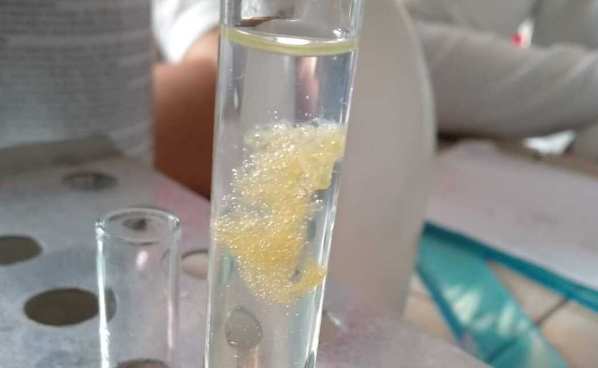
What does DNA look like?
In a test tube, it usually looks like this, but what does DNA really look like?
How do we represent what DNA structure is like?
Notes:
Teacher: Ask students to describe what DNA looks like. What do you already know about DNA?
Student: Students should write down what they already now about DNA in their notebook.

Slide 9
Exploring Foam Models of Nucleotides
DNA is a polymer made of individual monomers called nucleotides. Take out one foam nucleotide model of each color.
How are they similar?
How are they different?
Record your observations in your notebook.
Notes:
Teacher: Give student groups an adenine, thymine, guanine, and cytosine nucleotide. Give them time to compare and contrast the nucleotide with each other. Ask groups what they observed.
Student: Observe the nucleotides closely with your group. Identify any patterns among the nucleotides. Be prepared to share your findings with the class.

Slide 10
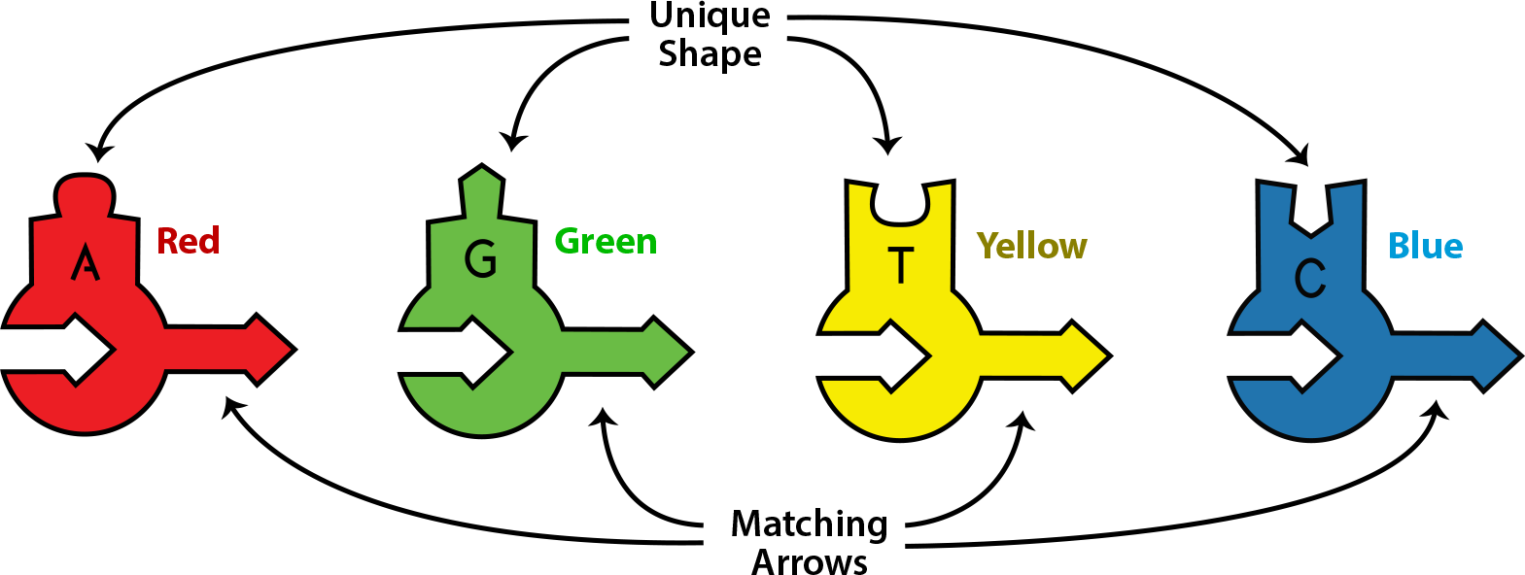
Key Features of Foam Nucleotide Models
Each foam nucleotide has a unique color (A, G , T, and C).
Each has a unique shape on the top.
Each has an identical arrow shape on the bottom.
Why do they have these features?
To find out, let's explore some additional ways to represent DNA nucleotides.
Notes:
Teacher: Give students time to think and respond to the writing prompt.
Student: Students should write down why they think these features are highlighted in their notebook.

Slide 11

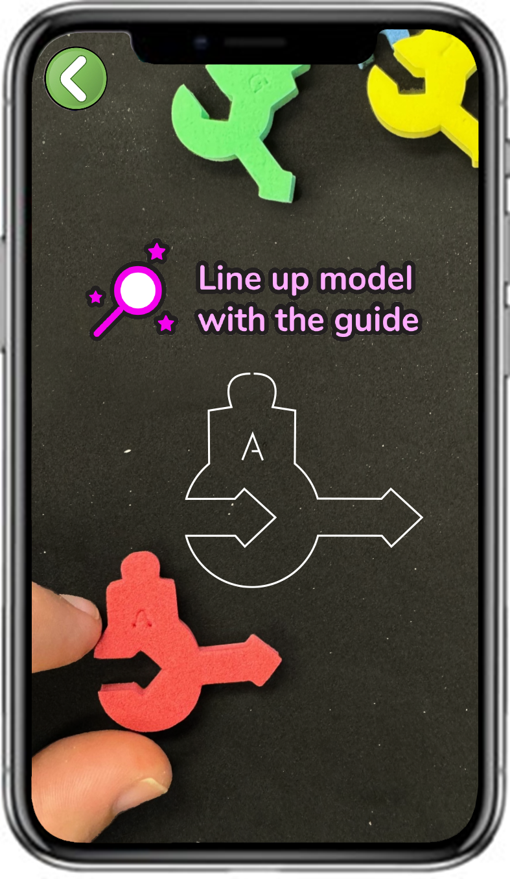
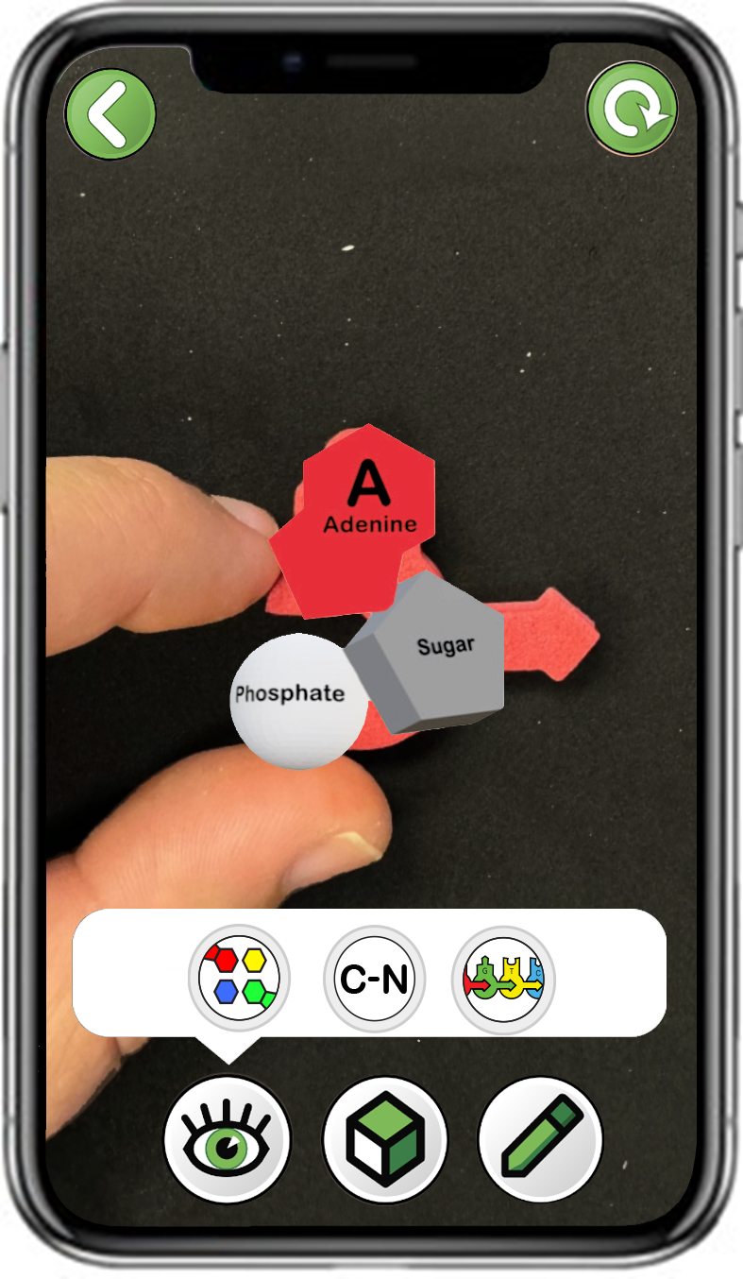
Exploring Cartoon Representations of Nucleotides
Choose
Adenosine (A)
Scan a single red foam adenosine (A)
Only click the left button
Notes:
Teacher: Have students open the app and select the appropriate activity and scene. Move around the room and assist students with their technology.
Student: Open the app and select the appropriate activity and scene.

Slide 12
Explore the Three Remaining Nucleotides
Repeat this step for each of the three remaining nucleotides.
What shapes, colors and labels do you see?
How are the four similar?
How are they different?
Record your observations in your notebook.
Notes:
Teacher: Have students open the app and select the appropriate activity and scene. Move around the room and assist students with their technology. Give your students time to explore the other three nucleotides, then ask them to share their findings.
Student: Open the app and select the appropriate activity and scene. What new patterns can they identify? Share what they see with their group and the class.

Slide 13
Key Features of Cartoon Representations
Each cartoon representation has:
  A unique nitrogenous base on the top.
  An identical backbone on the bottom, comprised of a sugar and a phosphate.
This is why the schematic foam models have identical bottom shapes but a unique color and shape on top!
Notes:
Teacher: Confirm student findings that each representation has a nitrogenous base, a deoxyribose sugar, and a phosphate group.
Student: Confirm or modify your responses.

Slide 14
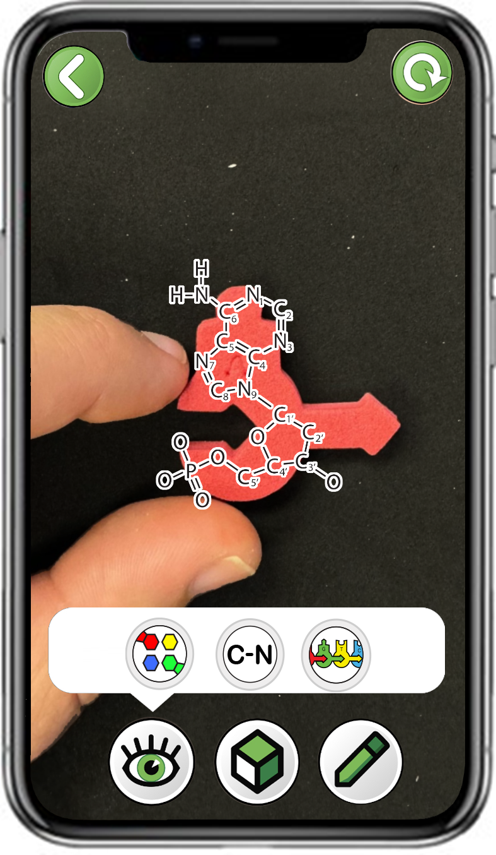
Exploring Chemical Structure Representations of Nucleotides
Choose
Adenosine (A)
Scan a single red foam adenosine (A)
Only click the middle button
Notes:
Teacher: Have students open the app and select the appropriate activity and scene. Move around the room and assist students with their technology.
Student: Open the app and select the appropriate activity and scene.

Slide 15
Exploring Chemical Structure Representations of Nucleotides
Let's explore another way to visualize DNA nucleotides, called a chemical structure representation.
In a chemical structure, each atom is represented by its periodic table abbreviation.
Notes:
Teacher: Explain to students that the following elements make up DNA.
Student: Predict which colors correspond with the elements shown. Record their predictions in their notebook.

Slide 16

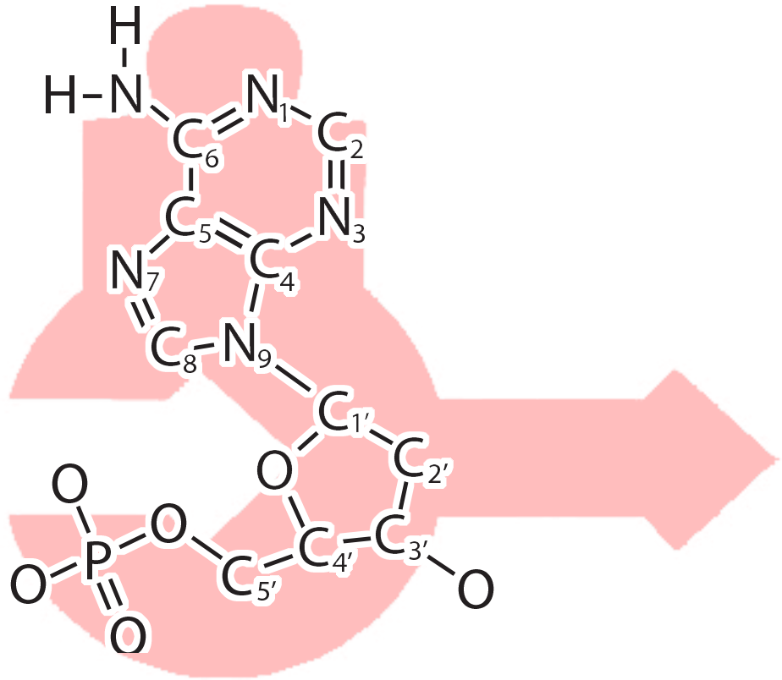
The Phosphate, Sugar and Nitrogenous Base of a Nucleotide
Identify the phosphate, sugar and nitrogenous base in the chemical structure representation?
Draw a nucleotide in your notebook or take a screenshot in the app using the pencil in the bottom right corner.
Label the nitrogenous base, sugar and phosphate.
Notes:
Teacher: Ask students to complete the writing prompt.
Student: Complete the writing prompt on the slide.

Slide 17
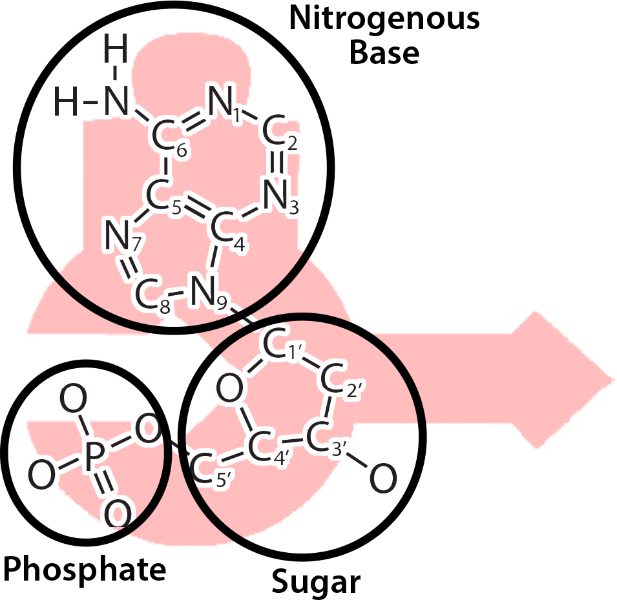
The Phosphate, Sugar and Nitrogenous Base of a Nucleotide
Identify the phosphate, sugar and nitrogenous base in the chemical structure representation.
Draw a nucleotide in your notebook or take a screenshot in the app using the pencil in the bottom right corner.
Label the nitrogenous base, sugar and phosphate.
Notes:
Teacher: Confirm student findings that each representation has a nitrogenous base, a deoxyribose sugar, and a phosphate group.
Student: Confirm or modify your responses.

Slide 18
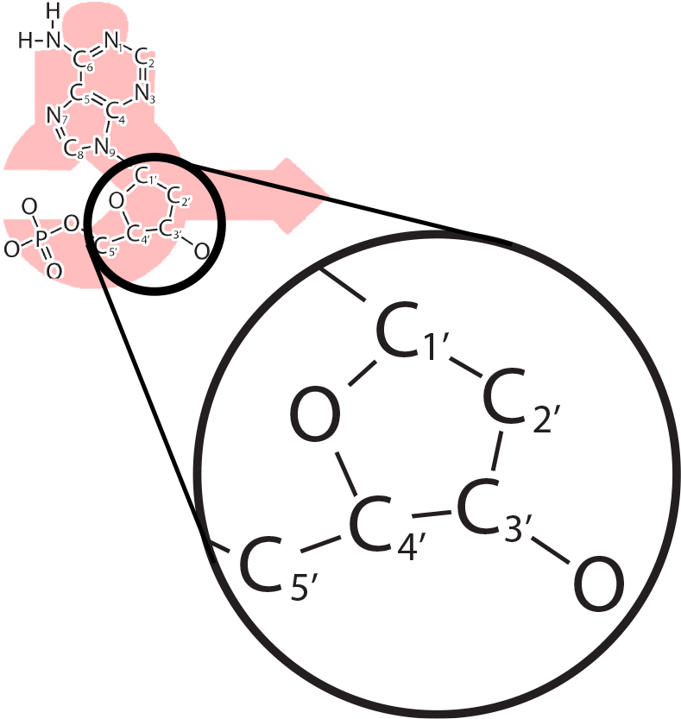
The 5' to 3' Directionality of Nucleotides
Where are the numbers in this chemical structure?
Find the 5' and 3' carbon atoms in the sugar.
In your drawing or screenshot, draw an arrow from the C_{5'} to the C_{3'} carbon in the sugar.
This 5' to 3' arrow represents the direction multiple nucleotides join together to form a DNA strand.
Notes:
Teacher: Ask students to use the 3-D viewing mode and focus on the Sugar. Notice the 5’ and 3’ ends of Deoxyribose. Students will need to rotate their physical or digital models to see the 5' and 3' carbons.
Student: Modify your prediction to reflect the new information.

Slide 19

The 5' to 3' Directionality of Nucleotides
Where are the numbers in this chemical structure?
Find the 5' and 3' carbon atoms in the sugar.
In your drawing or screenshot, draw an arrow from the C_{5'} to the C_{3'} carbon in the sugar.
This 5' to 3' arrow represents the direction multiple nucleotides join together to form a DNA strand.
Notes:
Teacher: Confirm student findings and identify the 5' and 3' carbons.
Student: Confirm or modify your responses.

Slide 20
Explore the Three Remaining Nucleotides
Repeat this step for each of the three remaining nucleotides.
How are the chemical structures for the four DNA nucleotides similar?
How are they different?
Notes:
Teacher: Have students open the app and select the appropriate activity and scene. Move around the room and assist students with their technology.
Student: Open the app and select the appropriate activity and scene.

Slide 21
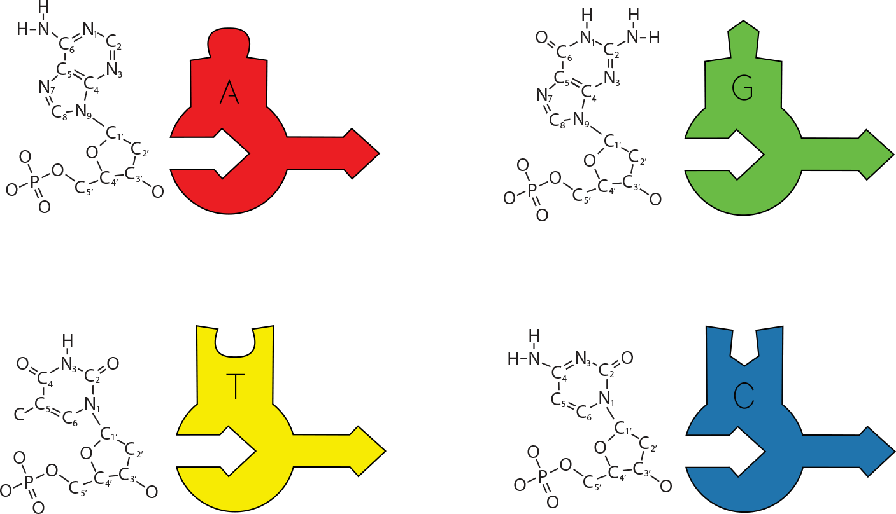
Key Features of Chemical Structure Representations
Each chemical structure representation has:
  A unique nitrogenous base on the top and identical backbone on the bottom
  A sugar with 5' and 3' carbons, representing the directionality of the nucleotide.
This is why the schematic foam models have an arrow pointing in the 5' to 3' direction!
Notes:
Teacher: Confirm student findings and identify the 5' and 3' carbons.
Student: Confirm or modify your responses.

Slide 22
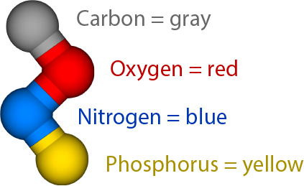
Exploring Ball & Stick Representations of Nucleotides
Let's explore one more way to visualize DNA nucleotides, called a ball & stick representation.
In a ball & stick representation, each atom is shown as a colored sphere, with bonds represented by sticks connecting the atoms.
Notes:
Teacher: In this ball and stick format, we use CPK coloring.
Student: Students should write down the color – key in their notebooks.

Slide 23
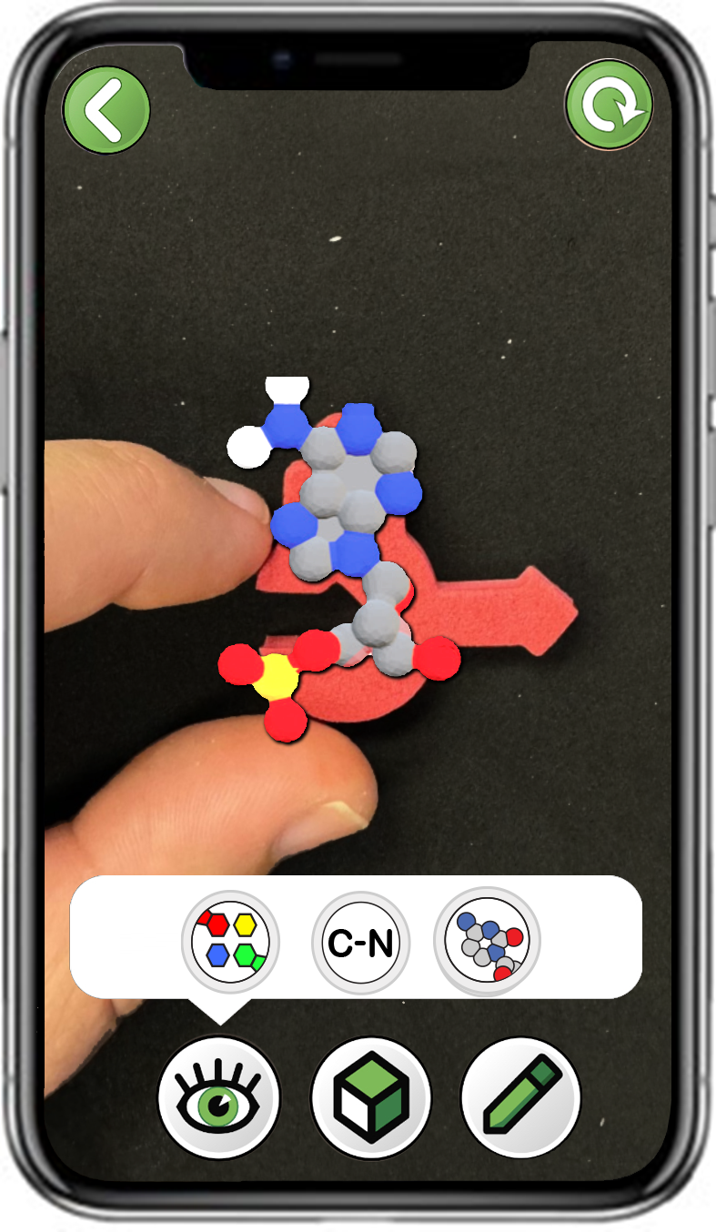
Exploring Ball & Stick Representations of Nucleotides
Choose
Adenosine (A)
Scan a single red foam adenosine (A)
Only click the right button
Notes:
Teacher: Have students open the app and select the appropriate activity and scene. Move around the room and assist students with their technology.
Student: Open the app and select the appropriate activity and scene.

Slide 24
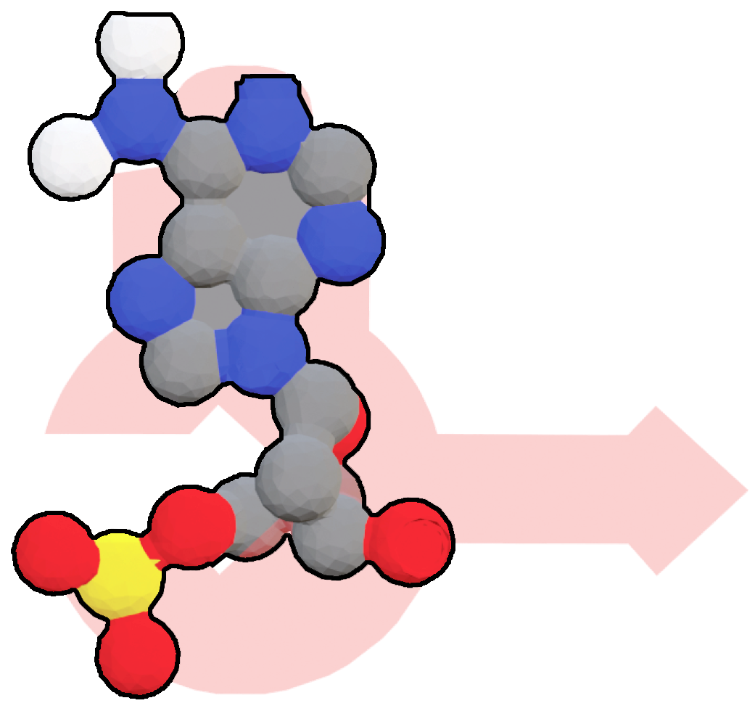
Exploring Ball & Stick Representations of Nucleotides
Identify the phosphate, sugar and nitrogenous base in the ball & stick representation.
Why might the top part be referred to as a "nitrogenous base"?
Notes:
Teacher: Give students processing time and time to respond to the writing prompt.
Student: Students should respond to the prompt.

Slide 25
Explore the Three Remaining Nucleotides
Repeat this step for each of the three remaining nucleotides.
How are the nitrogenous bases for each of the four nucleotides similar?
How are they different?
Notes:
Teacher: Ask students to describe what DNA looks like. Facilitate a discussion.
Student: Compare and contrast among the nucleotides. Share your group's findings with the class.

Slide 26
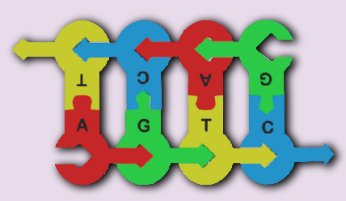
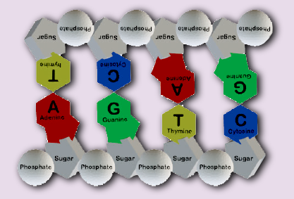
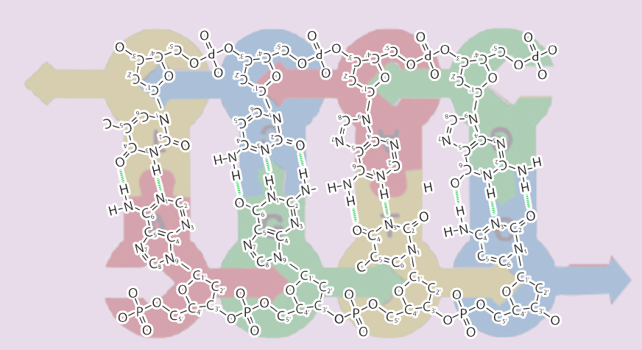
Teacher Guide – Scene 2
Scene 2: Double-stranded DNA Structure
Scanning a short section of double-stranded DNA made from eight individual foam nucleotides from the Flow of Genetic Information Kit© (image to the right) will display three different digital representations: A cartoon representation, a chemical structure representation and a ball & stick representation. Students compare the different representations.
Cartoon
Nucleotide components are shown as different geometric shapes.
Chemical Structures
Individual atoms are shown with periodic table abbreviations.
Ball & Stick
Individual atoms shown with balls and bonds as sticks.

Slide 27
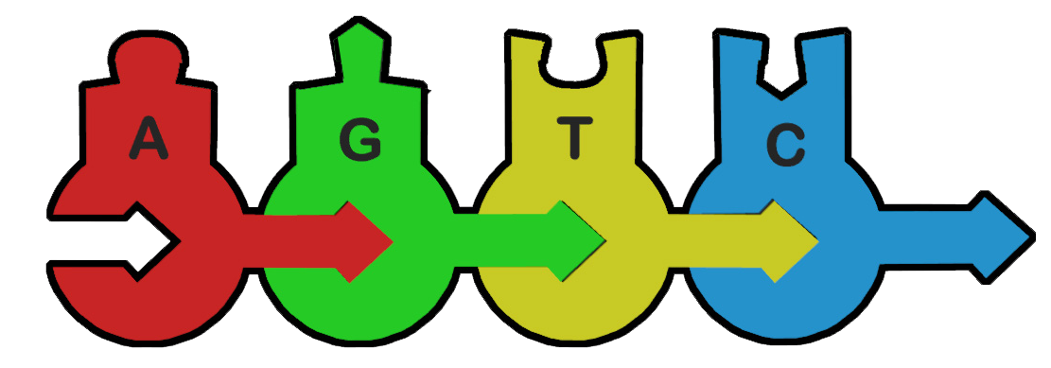
Building a Short Piece of Single-Stranded DNA
Using additional nucleotides, build the short piece of single-stranded DNA shown to the right.
Notes:
Teacher: Assist students in building the sequence.
Student: Create the sequence shows on the screen with foam nucleotides.

Slide 28
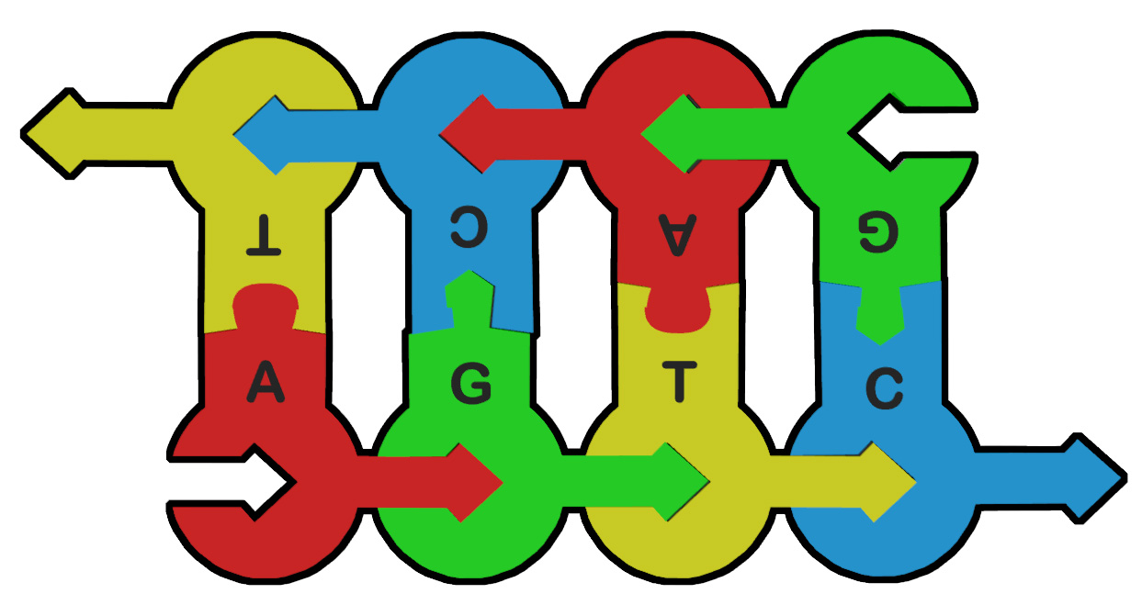
Building a Short Piece of Double-Stranded DNA
Next, build a second strand of DNA that is complementary to the first strand.
What are some features you notice of this section of double-stranded DNA?
Record your observations in your notebook.
Notes:
Teacher: Assist students in building the sequence.
Student: Create the sequence shown on the screen with foam nucleotides and respond to the prompt in your notebook.

Slide 29
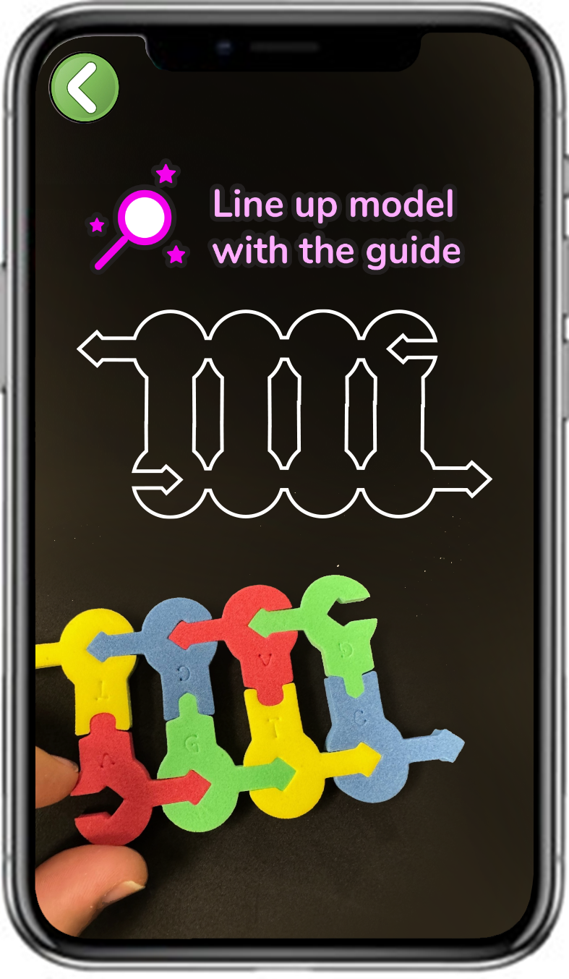
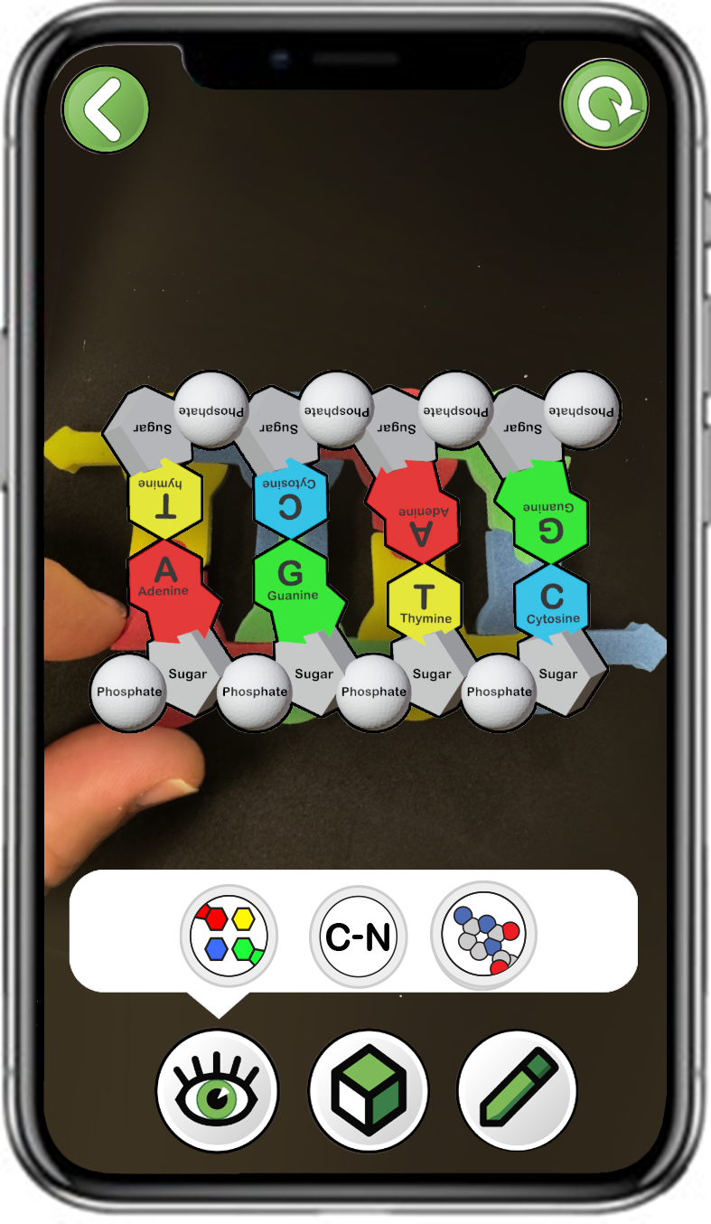
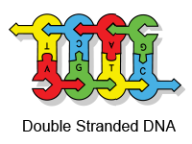
Exploring Three Representations of Double Stranded DNA
Choose
Double-Stranded DNA
Scan the correct segment of
double-stranded DNA
Explore all three buttons
Notes:
Teacher: Have students open the app and select the appropriate activity and scene. Move around the room and assist students with their technology.
Student: Open the app and select the appropriate activity and scene.

Slide 30
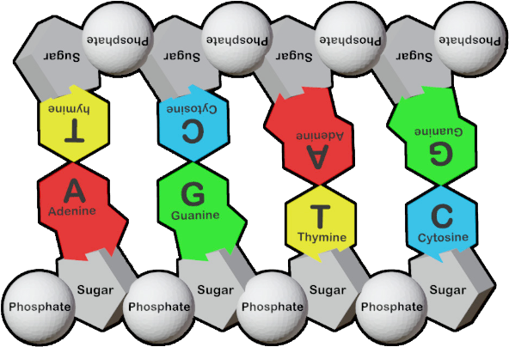
Cartoon Representations of Double-stranded DNA
What do you notice?
How are the nitrogenous bases of the eight nucleotides interacting?
How are the backbones of the eight nucleotides interacting?
Notes:
Teacher: Allow for processing time and time to respond to the prompts.
Student: Examine the image and respond to the prompts in your notebook.

Slide 31
Cartoon Representations of Double-stranded DNA
What do you notice?
How are the nitrogenous bases of the eight nucleotides interacting?
Nucleotide bases form predictable pairs. A pairs with T and G pairs with C.
How are the backbones of the eight nucleotides interacting?
Nucleotide backbones form bonds between sugar and phosphate groups, resulting in two strands.
Notes:
Teacher: Confirm student findings.
Student: Confirm or modify your responses.

Slide 32
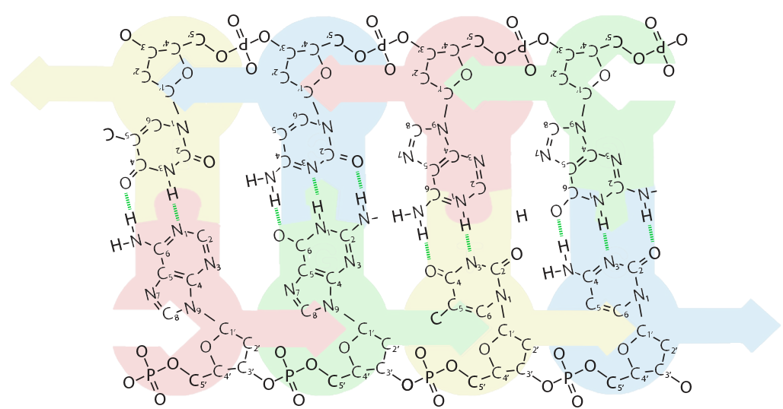
Chemical Structure Representations of Double-stranded DNA
What do you notice?
How many bonds are formed between the nitrogenous bases in an A-T base pair?
How many bonds in a G-C base pair?
Notes:
Teacher: Have students select the next overlay. Ask students to locate a A-T base pair. Zoom in and determine the number of hydrogen bonds. Repeat this for a G-C base pair.
Students: Select the next overlay. Find an A-T base pair and a G-C base pair.

Slide 33
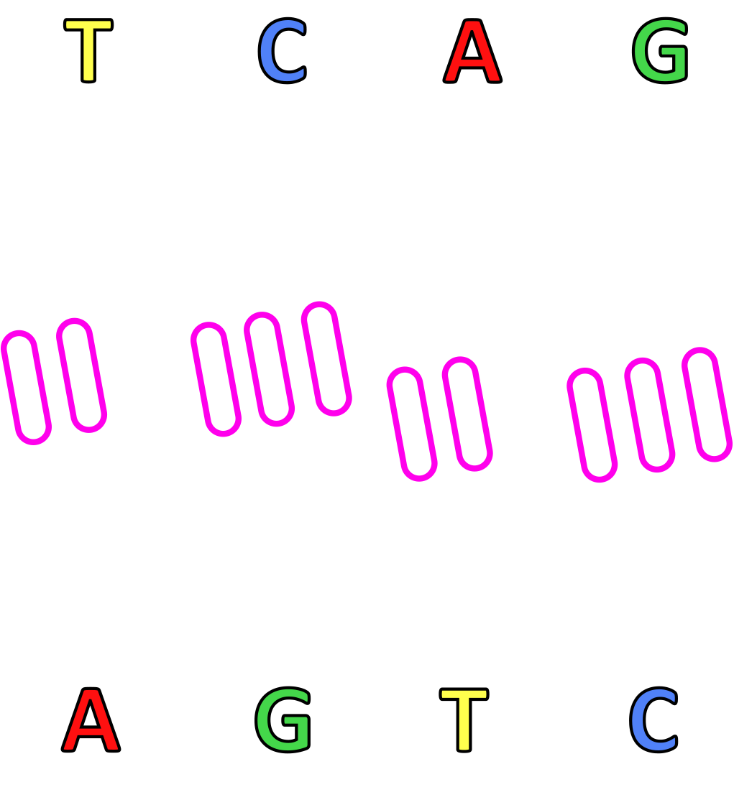
Chemical Structure Representations of Double-stranded DNA
What do you notice?
How many bonds are formed between the nitrogenous bases in an A-T base pair?
There are two bonds between the bases of an A-T base pair. These are hydrogen bonds.
How many in a G-C base pair?
There are three bonds between the bases of a G-C base pair. These are also hydrogen bonds.
Notes:
Teacher: Confirm student findings.
Student: Confirm or modify your responses.

Slide 34
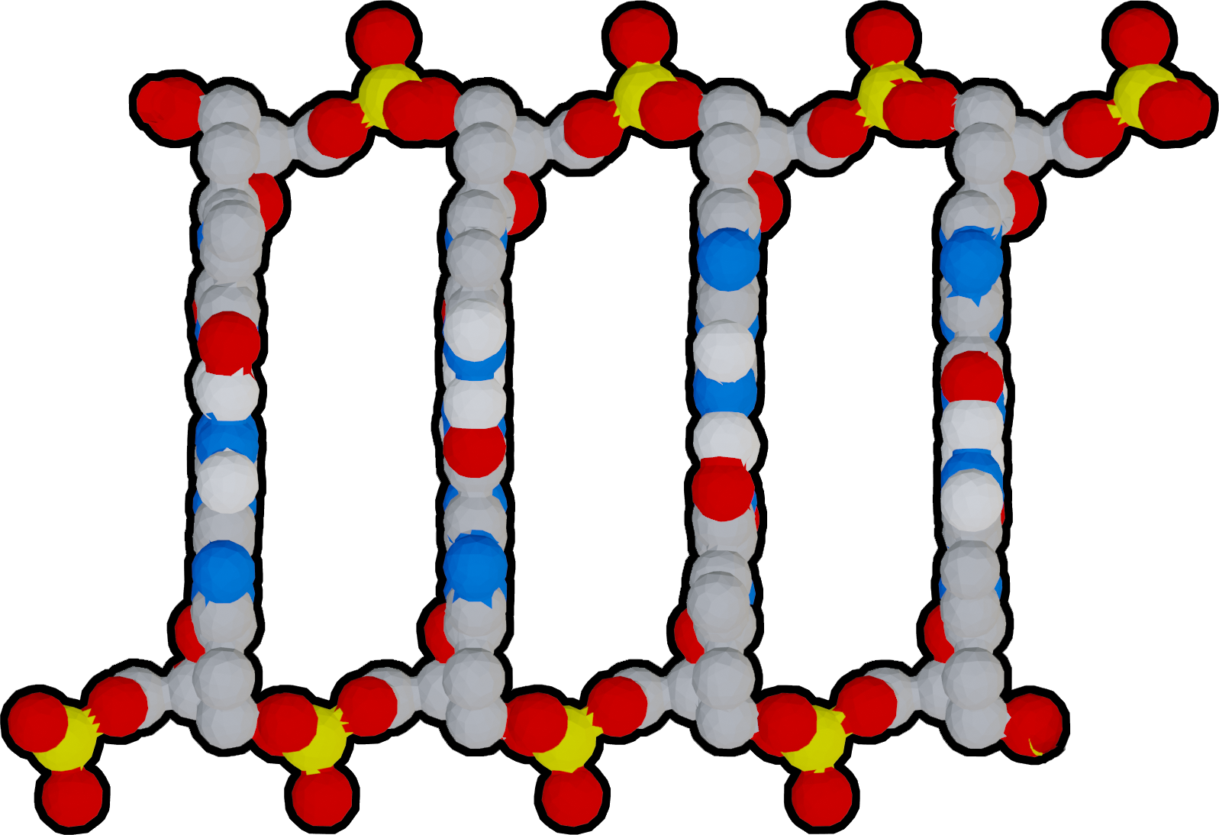
Ball & Stick Representations of Double-stranded DNA
What do you notice?
Identify the 5' and 3' carbon atoms in the backbone sugars.
What is the resulting directionality for each strand in the double-stranded DNA?
Notes:
Teacher: Have students select the next overlay. Remind students that the 5’ end will begin with a phosphate group and the 3’ end will be a sugar. Ask students to sketch or use the screen capture tool and annotate.
Students: Annotate this with the screen capture feature in the app or, alternatively, sketch this in your notebook.

Slide 35
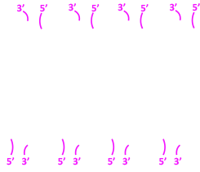
Ball & Stick Representations of Double-stranded DNA
What do you notice?
Identify the 5' and 3' carbon atoms in the backbone sugars.
Each nucleotide has a sugar in its backbone with a 3' and 5' carbon atom (labeled in magenta).
What is the resulting directionality for each strand in the double-stranded DNA?
The top strand points left and the bottom strand points right. They are antiparallel.
Notes:
Teacher: Confirm student findings and identify the 5' and 3' ends of the DNA strands.
Student: Confirm or modify your responses.

Slide 36
Compare and contrast
Each of the molecular representation highlight different aspects of nucleotide structure. Fill out the chart below to compare and contrast the representations.
Representation Type | Benefits | Limitations
Physical Foam Model
Cartoon Representation
Chemical Structure Representation
Ball & Stick Representation
Notes:
Teacher: Ask students to compare and contrast the structures of all four models.
Student: What are the benefits of using each model? Consider all four models and determine the benefits of each.

Slide 37
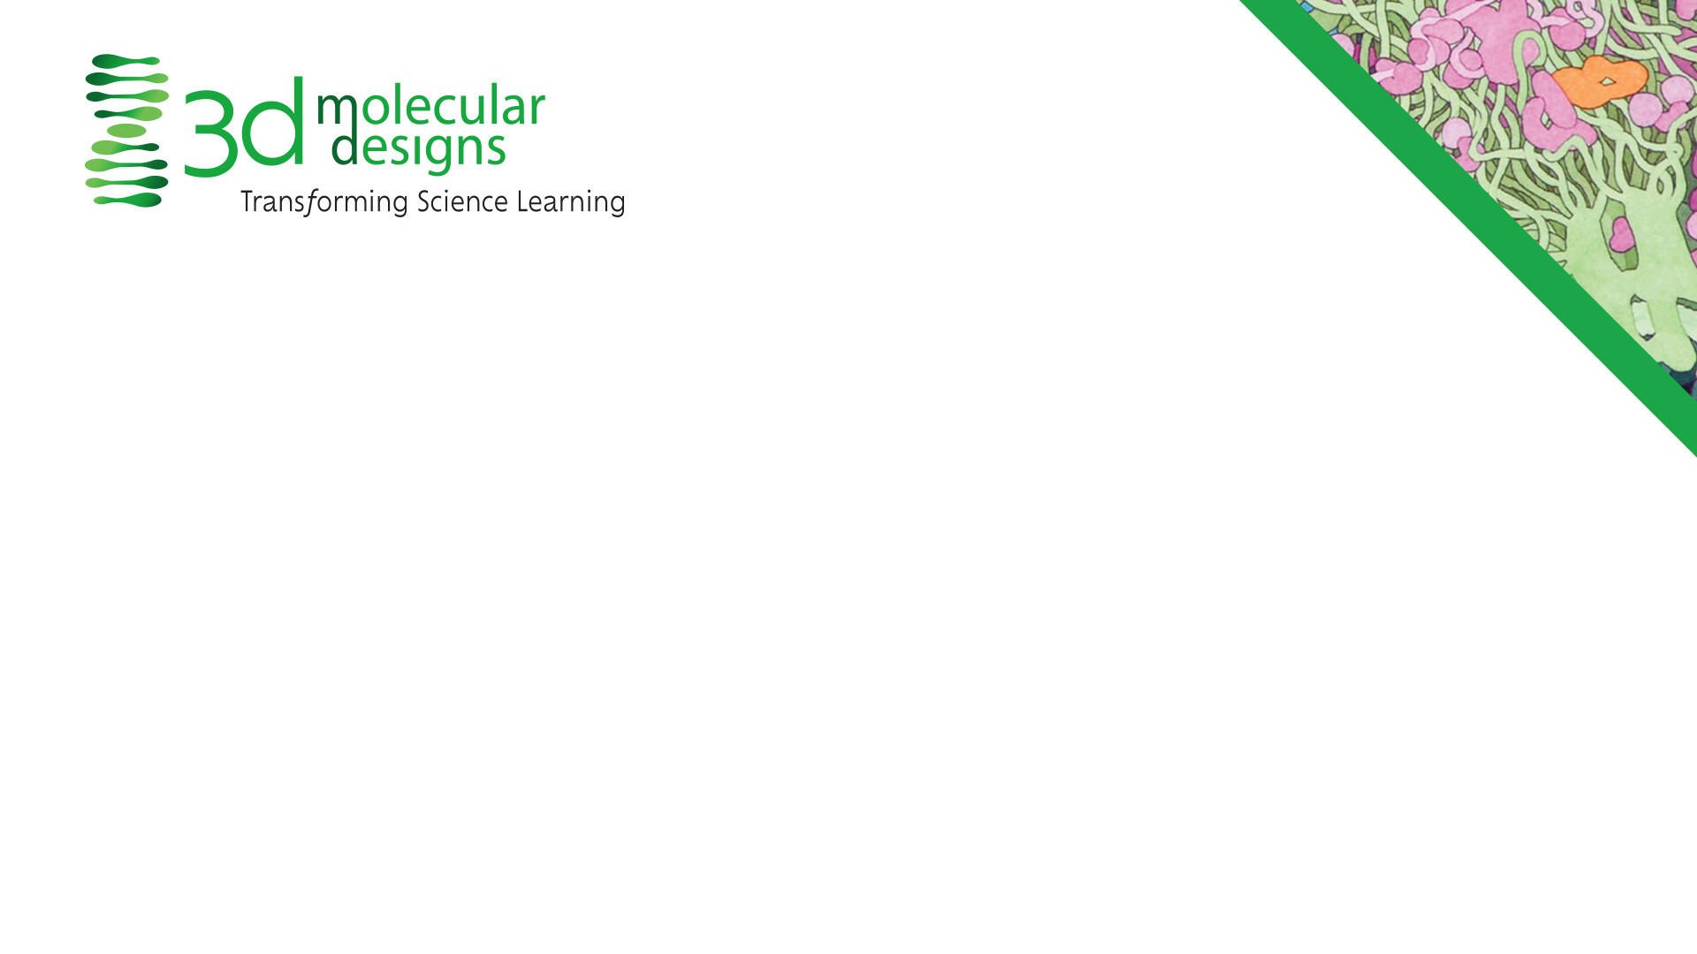
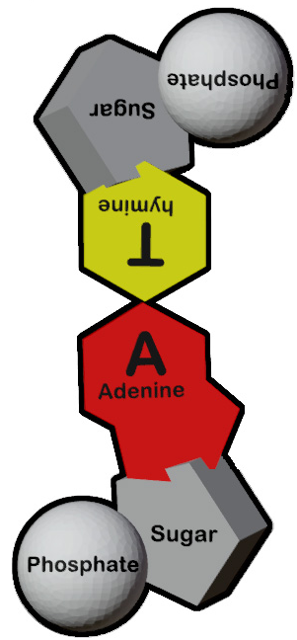
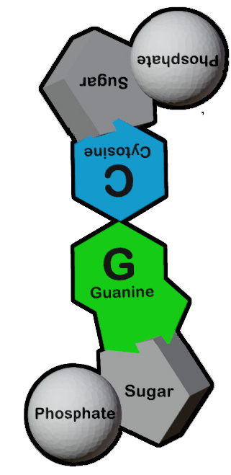
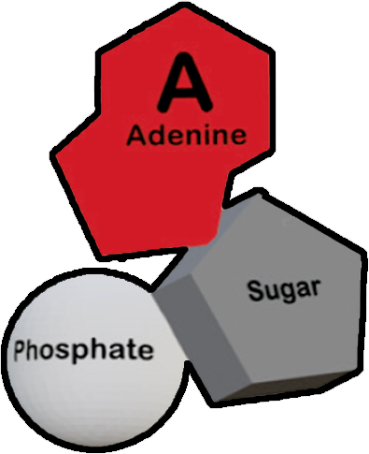
Conclusions
Nucleotides are comprised of a backbone (phosphate and sugar) and nitrogenous base.
Nucleotides have directionality, based on the 5' and 3' carbon atoms in the backbone sugar.
Multiple nucleotides form base pairs. A pairs with T and G pairs with C.
DNA has two strands that have antiparallel 5' to 3' directionality.
Notes:
Teacher: Summary slide with learning objectives of this lesson.
Student: Jot your additional thoughts and ideas in your notebook.

