Slide 2
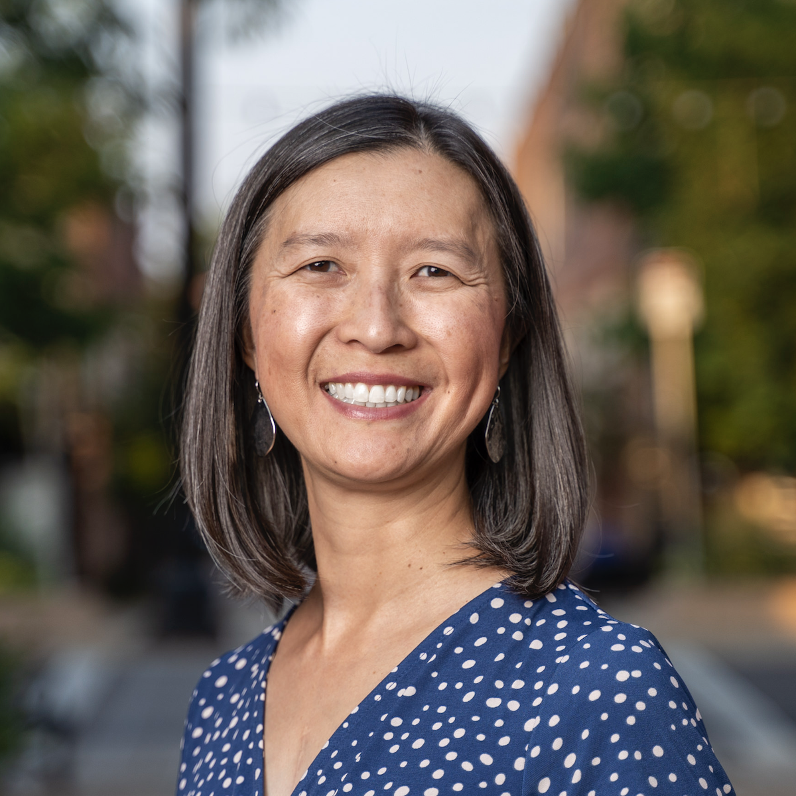
Making Sense of Genetic Information Through Modeling: Replication, Transcription, Translation
Presenter: Chris Chou
Longmont High School (Longmont, CO)
Mrs.Chou@gmail.com

Slide 3
Workshop Learning Goals
Model the processes of replication, transcription, and translation
Compare the function of DNA and RNA
Explain how polypeptides (proteins) are formed

Slide 4

Which grades/subjects do you teach?

Slide 5
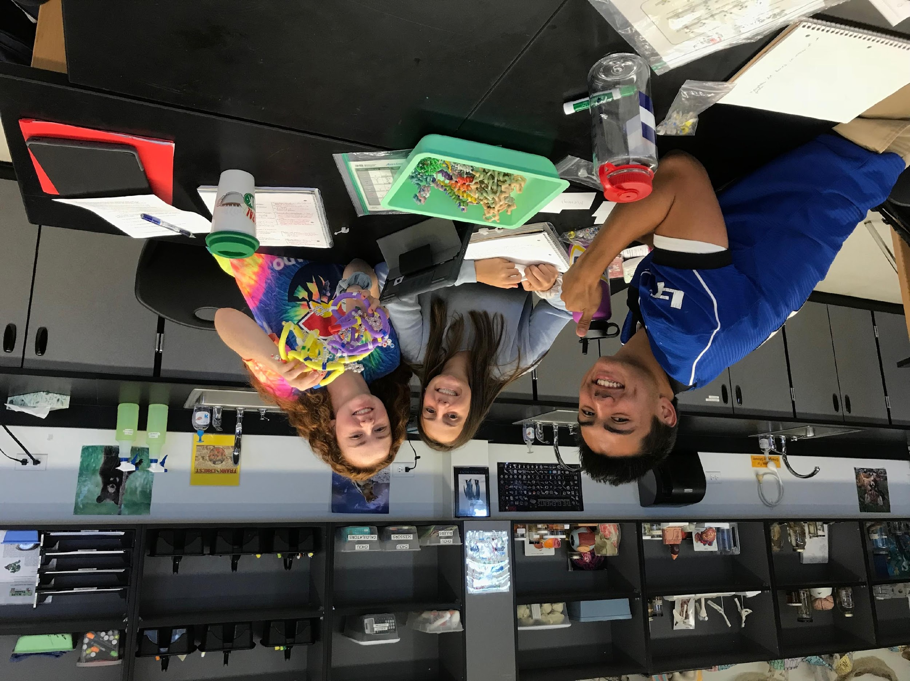
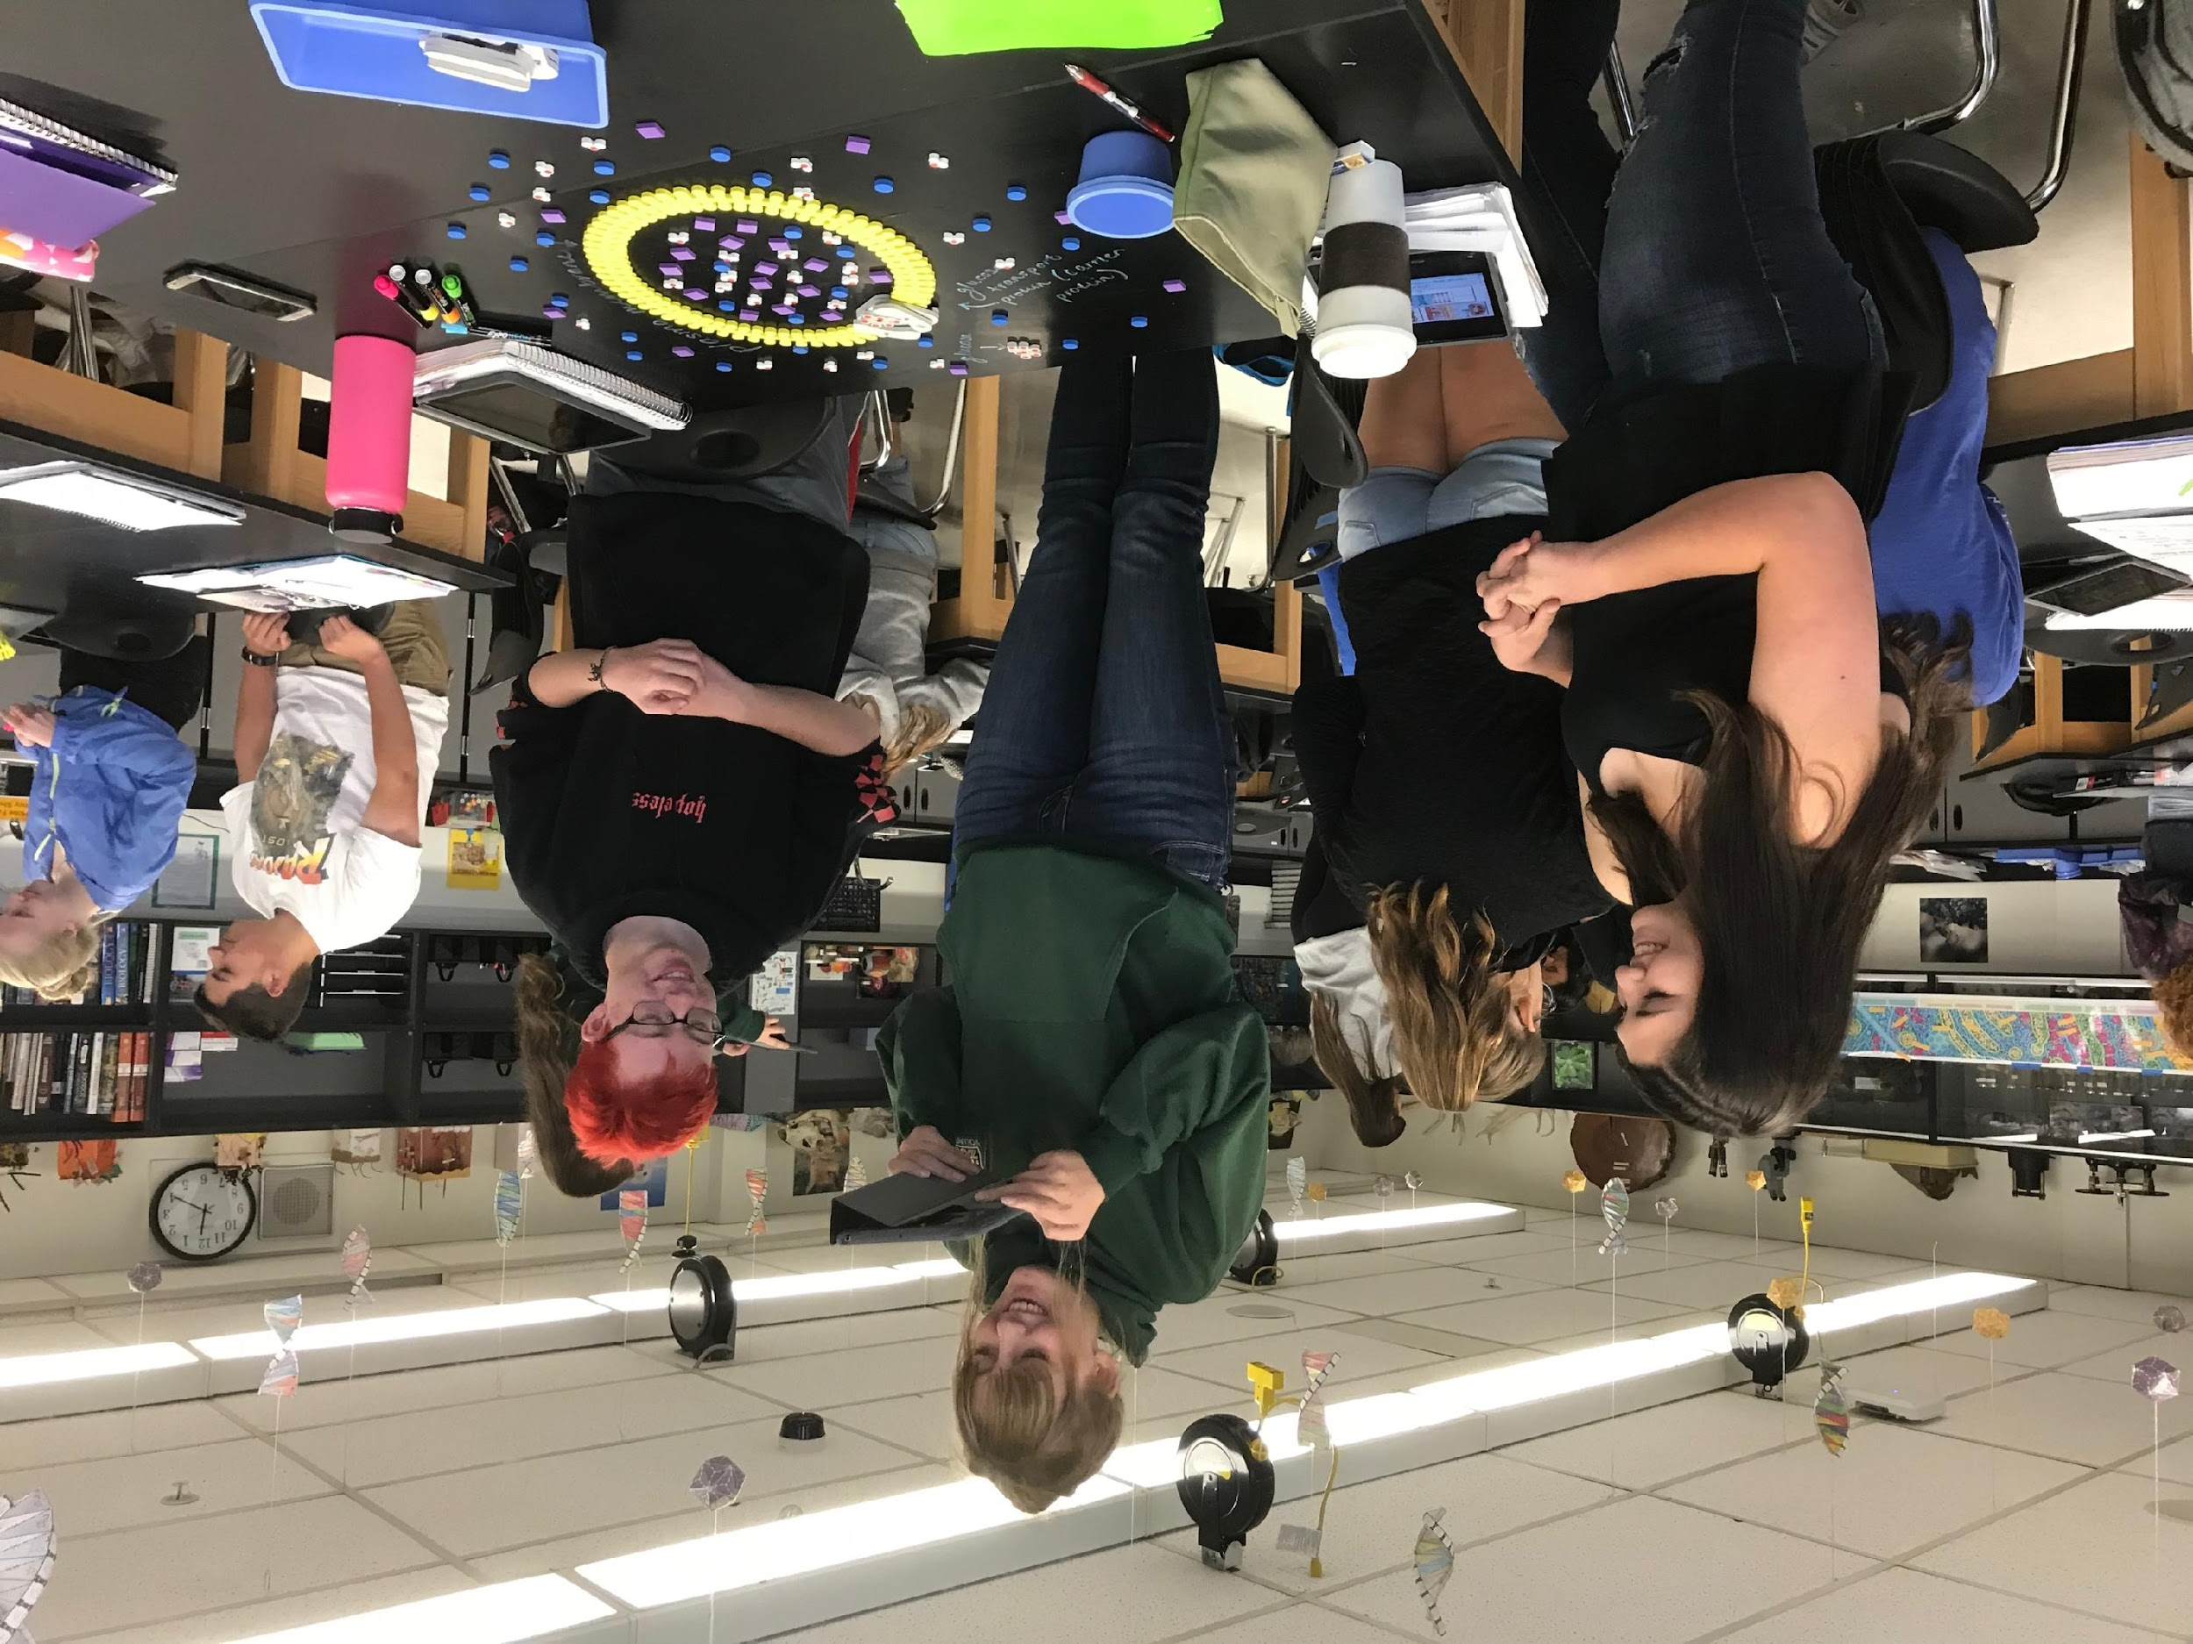
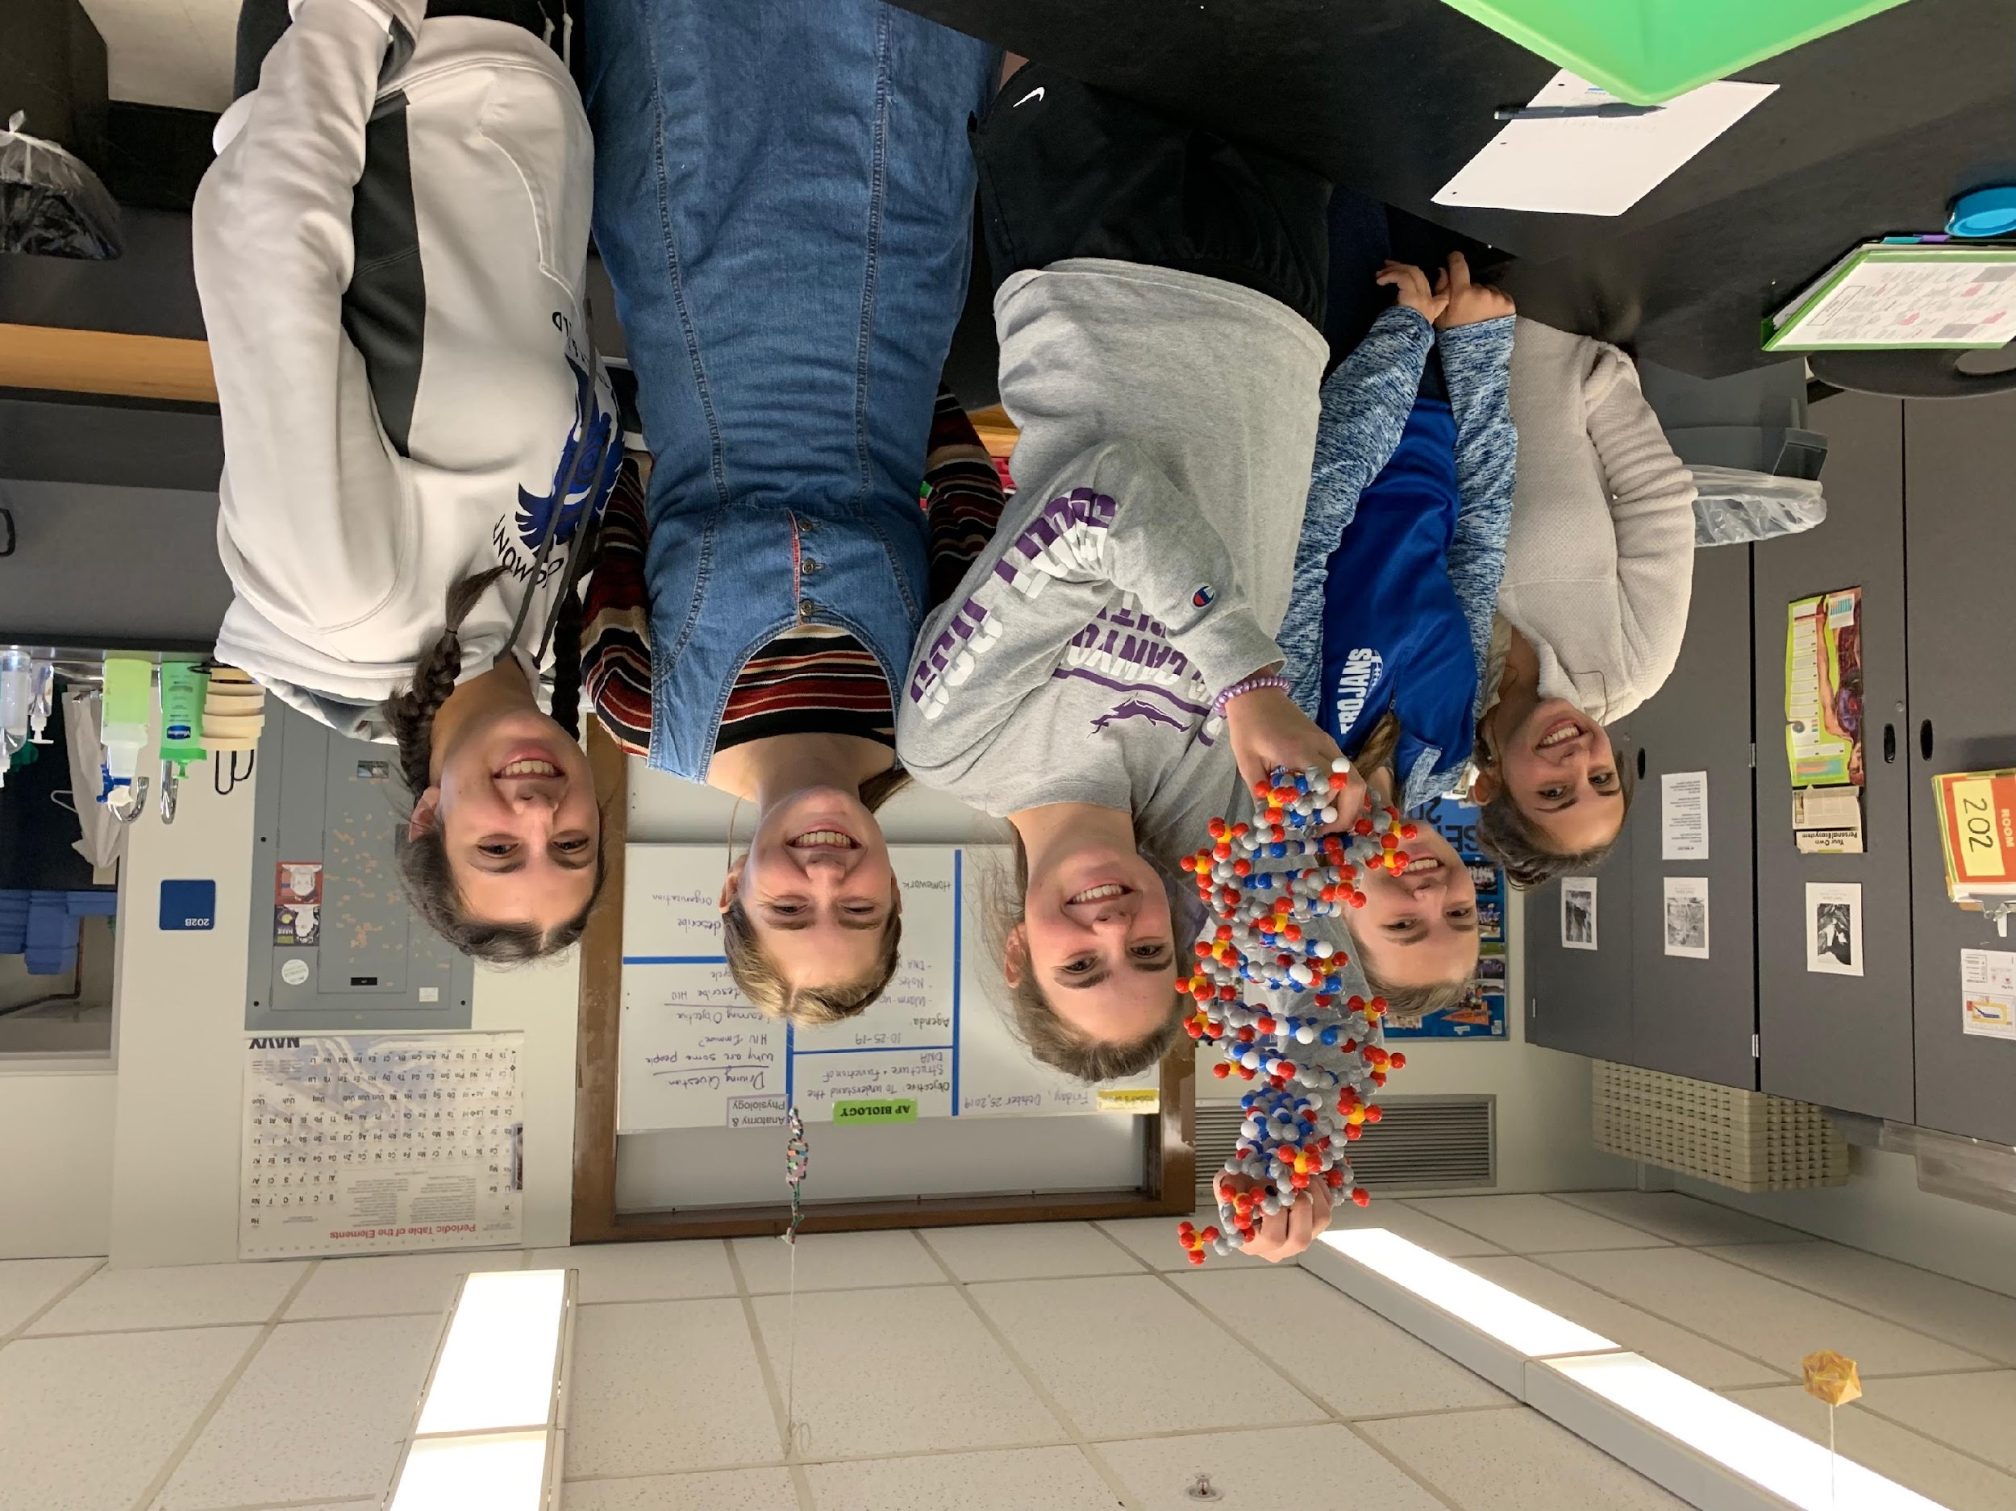
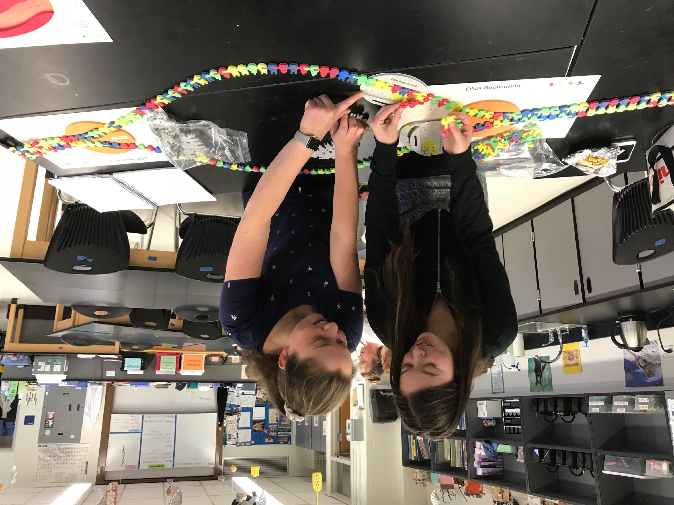
Why Models?
Notes:
Why Models? One important practice of science is to be able to develop and use models. You can help student develop their critical thinking skills when you ask them to evaluate models – What about this model is useful? What things about this model is wrong? Plus, it allows students to engage on hands-on, minds-on learning. They love it! We do a lot of modeling in my classroom. I use many 3D Molecular Design kits, but also playdoh, pipecleaners, and table markers to model biological processes.

Slide 6
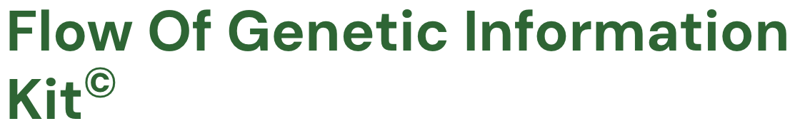
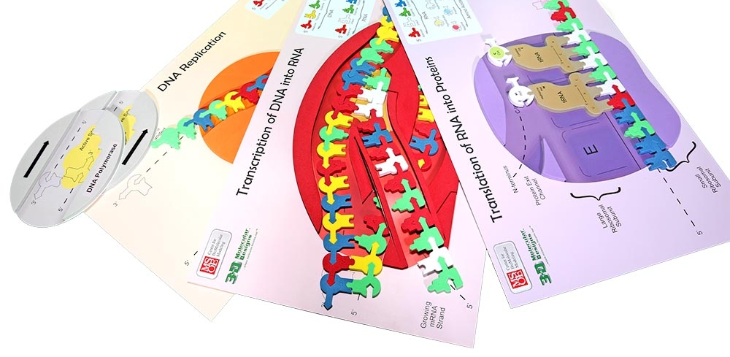

Slide 7
Prerequisite Knowledge and Skills
(For this activity)
Hydrogen bonding and covalent bonding
Cell structure
Prokaryotic and eukaryotic cells
Basic DNA structure
Cell cycle basics

Slide 8
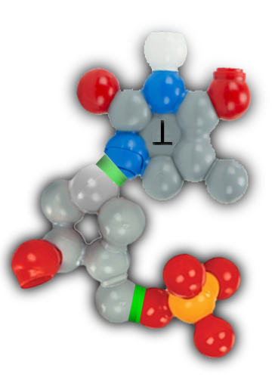
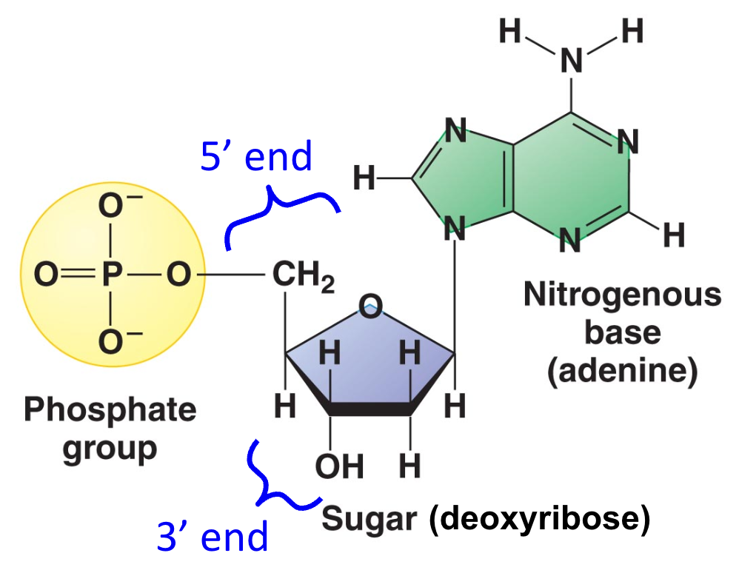
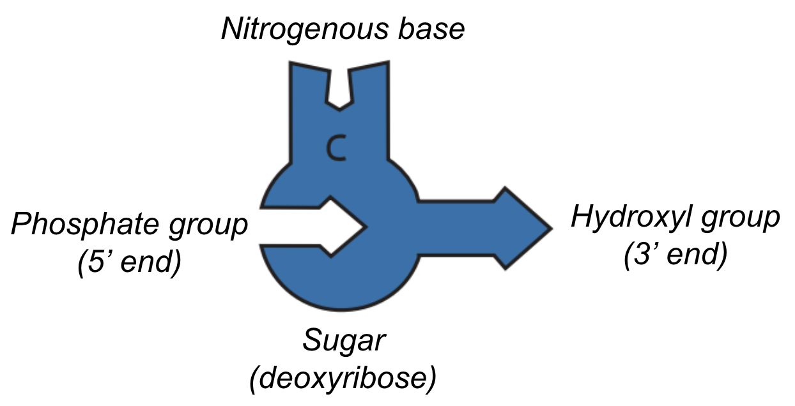
These are different representations of DNA nucleotides.
What do you notice? What do you wonder?

Slide 9
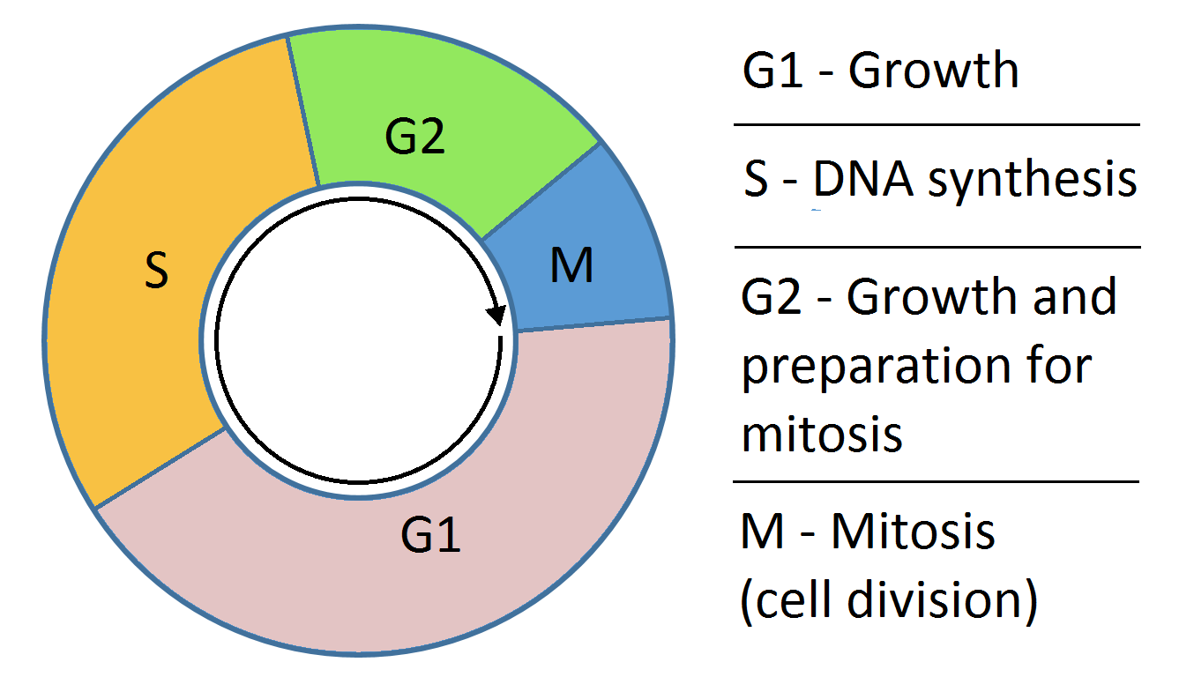
The Cell Cycle
DNA Replication
REPLICATION
Transcription
Translation

Slide 10
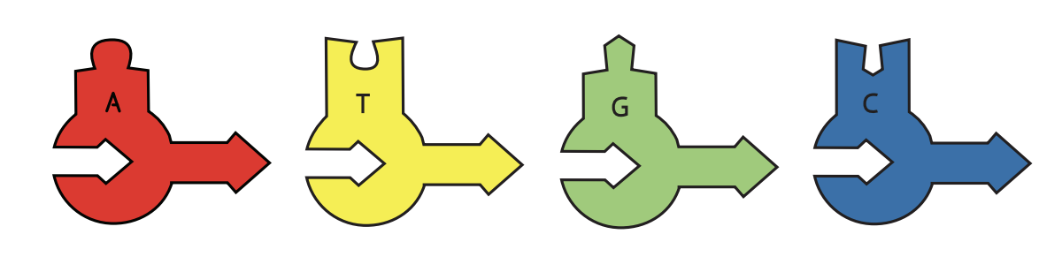
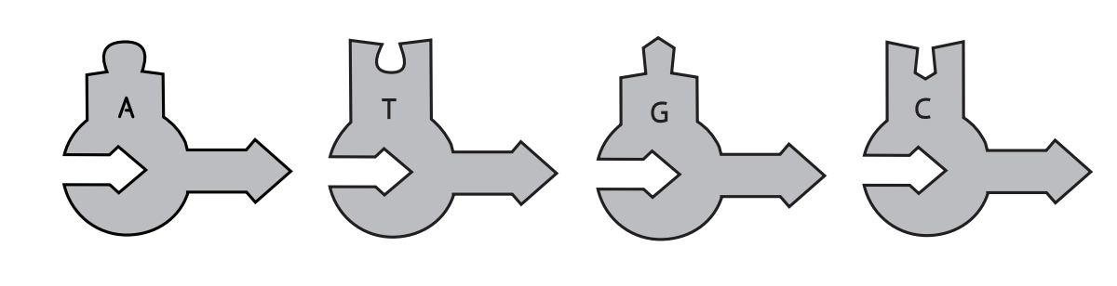
Replication
Materials Needed:
DNA Replication Placemat (Helicase)
2 DNA polymerases
Foam DNA nucleotides (colored and grey)

Slide 11
Replication Tips:
Colored = parent DNA strands
Grey = daughter DNA strands
Note: New nucleotides are added to the 3’ end of a growing DNA strand by DNA polymerase
3’ end
5’ end

Slide 12
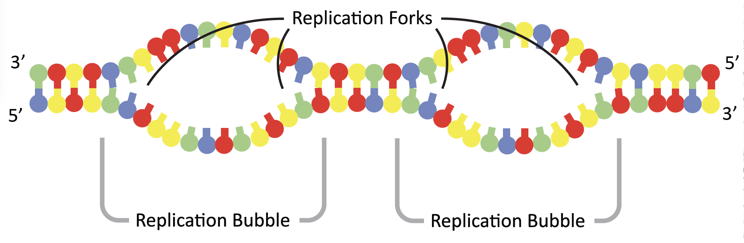
Origins of Replication

Slide 13
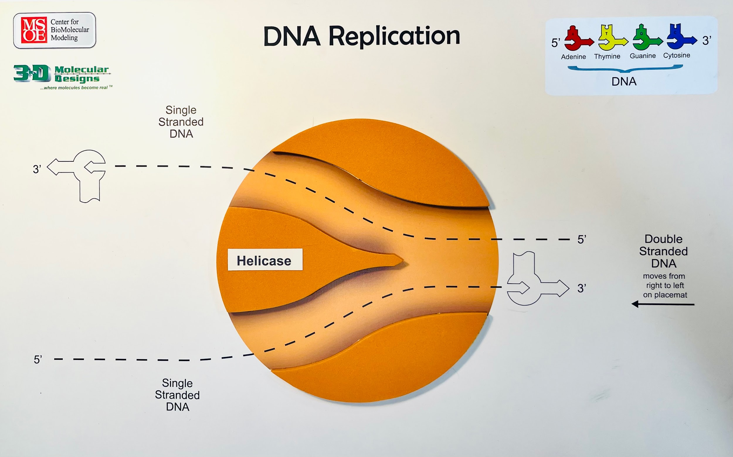
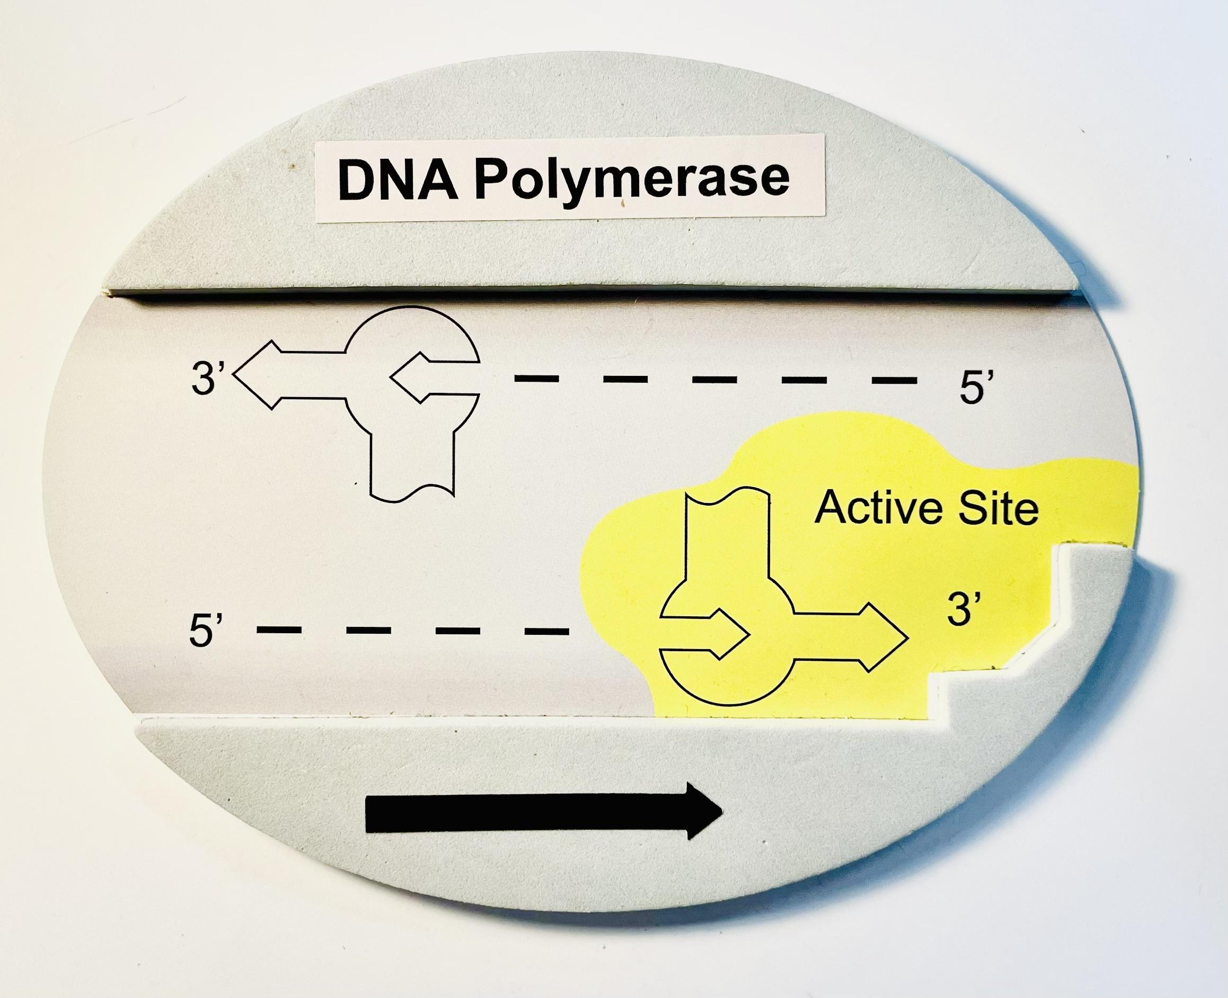
What do you notice? What do you wonder?
Replication Enzymes
HELICASE
DNA POLYMERASE

Slide 14
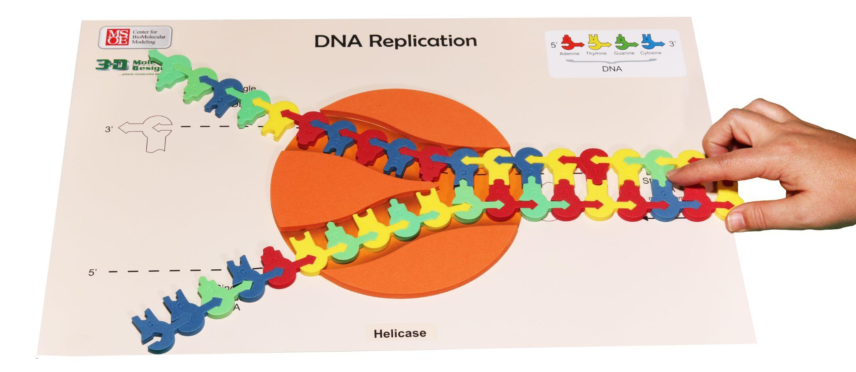
Model the Process of Replication
HELICASE unwinds and “unzips” DNA at a replication fork

Slide 15
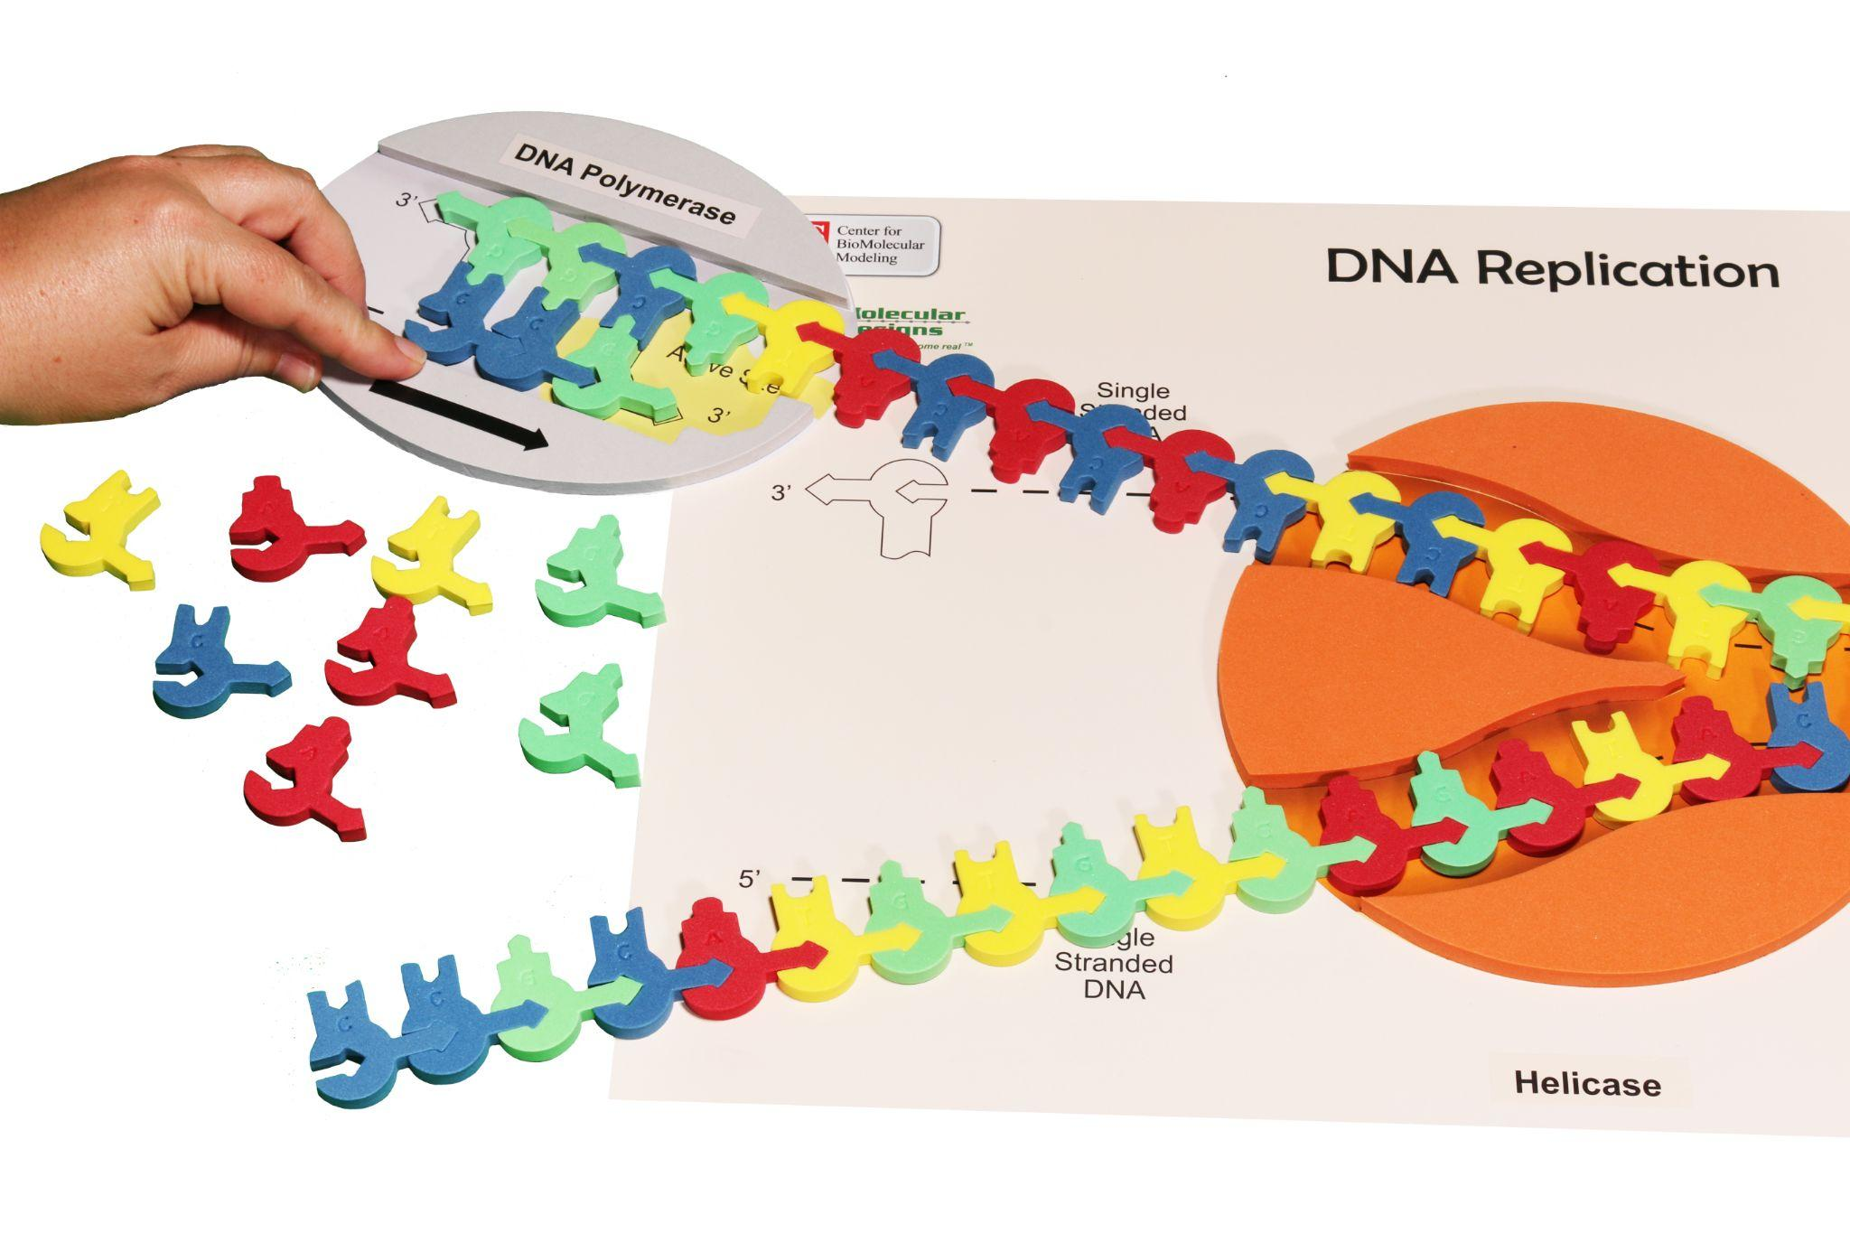
Model the Process of Replication
DNA POLYMERASE synthesizes a complementary strand of DNA, which is elongated in the 5’→3’ direction
3’
5’
3’
5’

Slide 16
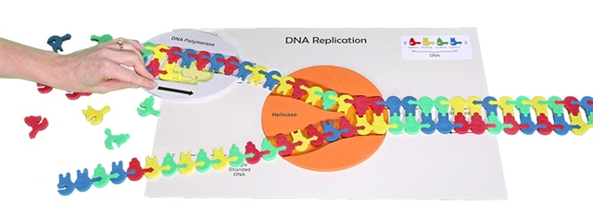
How will DNA be synthesized on the opposite strand of DNA?
3’
5’
3’
5’
?
Based on the enzymatic property of DNA polymerase, model and explain what you think will happen.

Slide 17
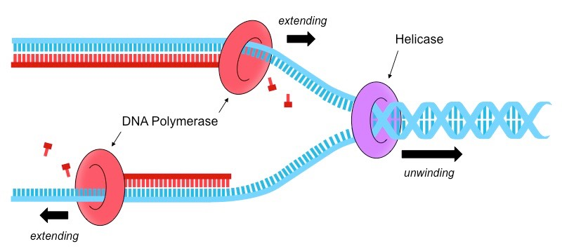
Leading vs. Lagging Strands
Leading strand (3’→5’)
3’
5’→3’ continuous →
5’
3’
5’
← discontinuous
Lagging strand (5’→3’)

Slide 18
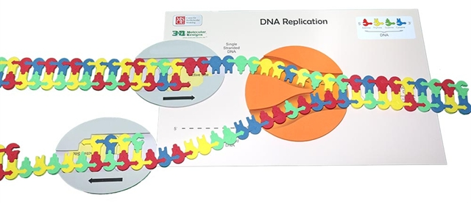
On the lagging strand, DNA is synthesized discontinuously in short sequences called Okazaki fragments
Leading strand (3’→5’)
3’
5’
5’
3’
3’
5’
Region B
5’
3’
Region A
Lagging strand (5’→3’)

Slide 19
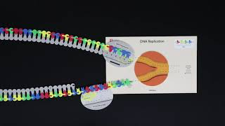

Slide 20

What are some “Aha Moments” you experienced as a learner during this activity?
What are important takeaways that your students will gain from modeling this process?

Slide 21
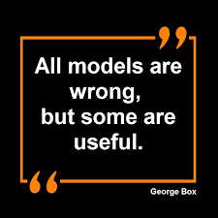
What are some limitations of this model?

Slide 22
Transcription
Materials Needed:
Transcription Placemat (RNA polymerase)
Double-stranded DNA sequence
RNA nucleotides

Slide 23
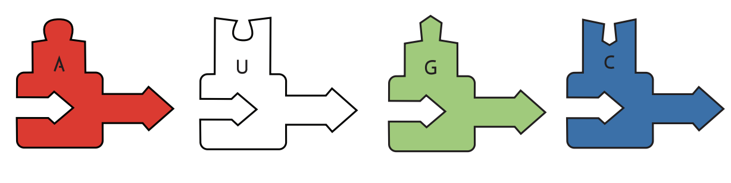
DNA vs. RNA
DNA
RNA
How do these differ?

Slide 24
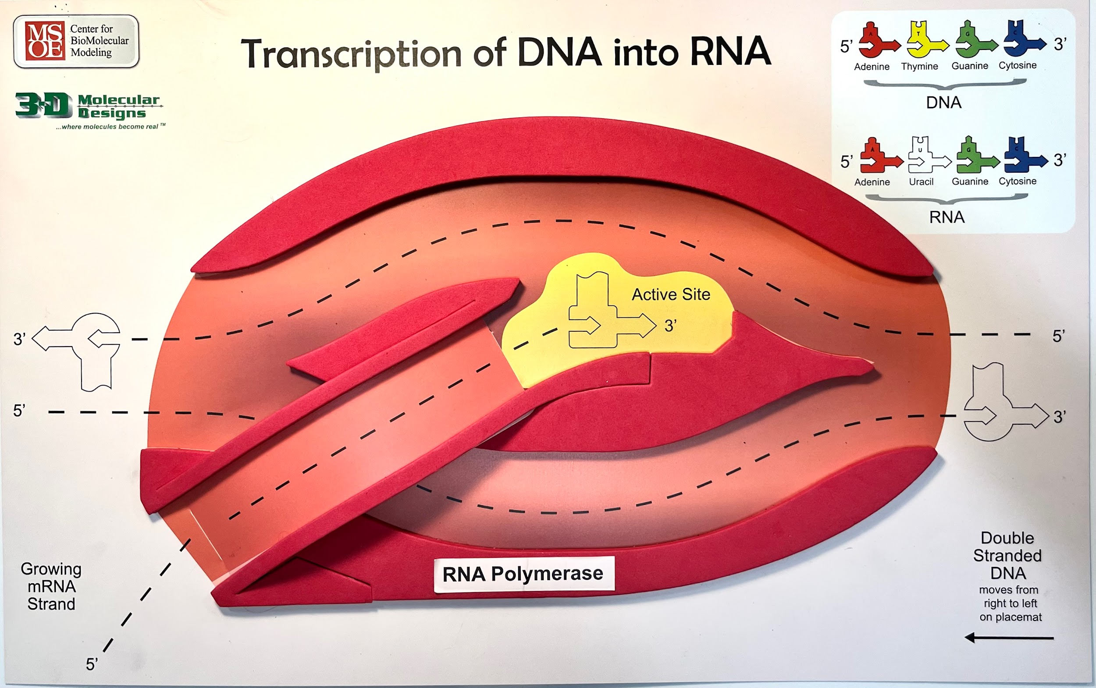
What do you notice? What do you wonder?
Transcription Enzyme: RNA Polymerase

Slide 25
Transcription Tips:
Double-stranded DNA template
RNA: uracil (vs. thymine in DNA) pairs with adenine
Note: RNA polymerase adds the RNA nucleotides to the 3’ end of the growing RNA strand

Slide 26
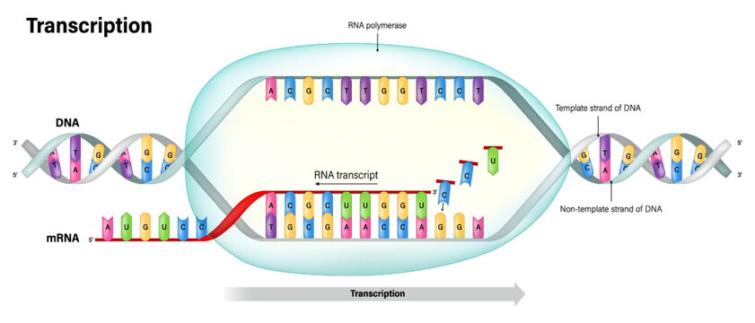

Slide 27
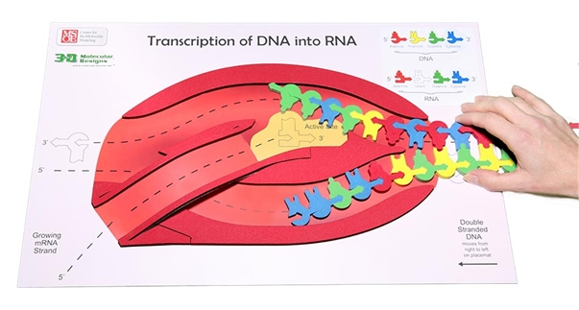
Model the Process of Transcription
RNA POLYMERASE unwinds DNA, synthesizes a single strand of RNA (complementary to DNA), which is elongated in the 5’→3’ direction, and rewinds DNA
RNA polymerase moves

Slide 28
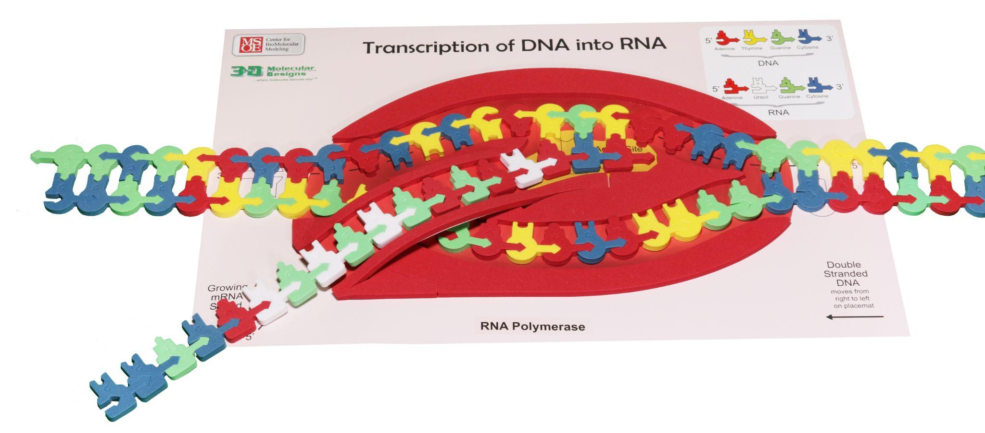
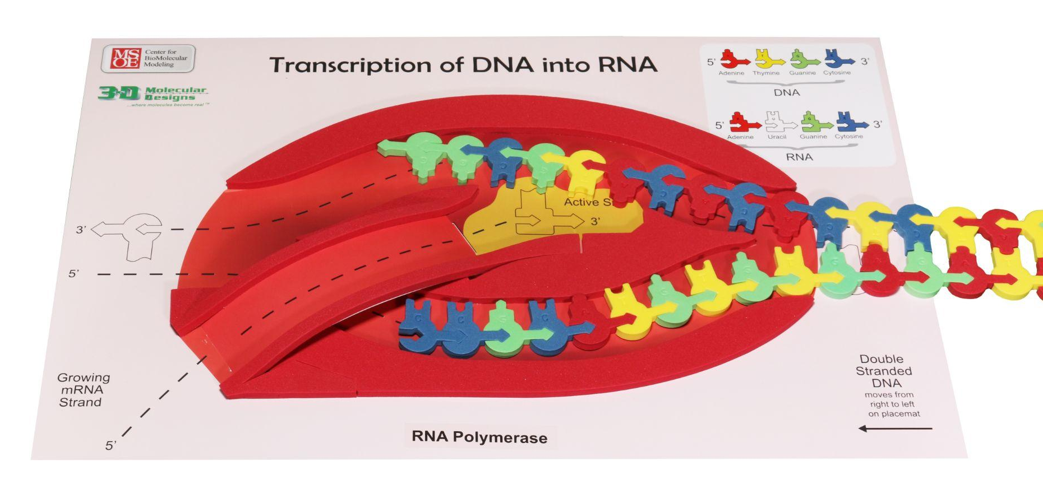

Slide 29
What are some “Aha Moments” you experienced as a learner during this activity?
What are important takeaways that your students will gain from modeling this process?

Slide 30
What are some limitations of this model?

Slide 31
Translation
Materials Needed:
Translation placemat (ribosome)
mRNA strand (from transcription)
Foam tRNAs, amino acids, stop codon
Genetic codon chart/circle

Slide 32
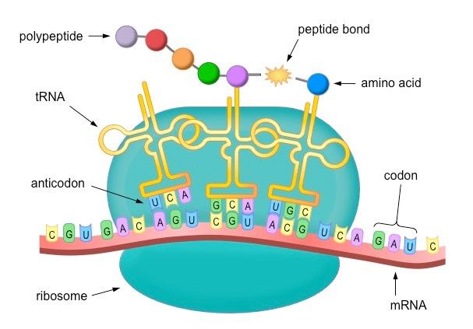
Translation

Slide 33
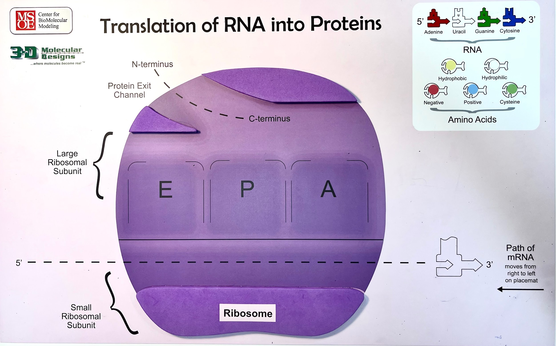
What do you notice? What do you wonder?
Ribosome: Site of Protein Synthesis

Slide 34
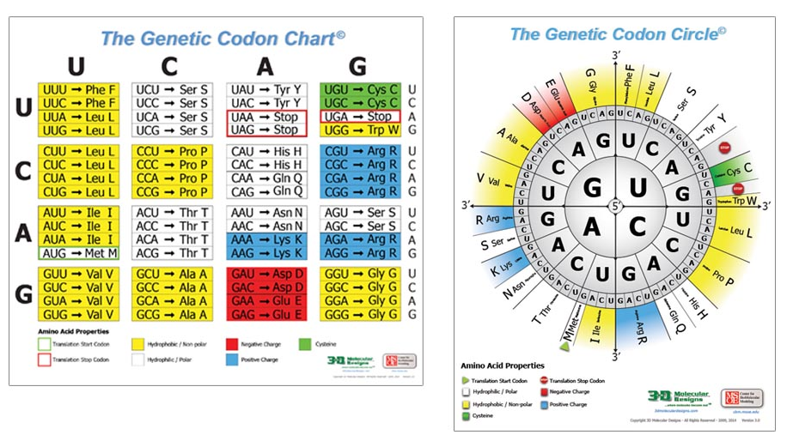
What will you need to pre-teach your students about the mRNA Codon Chart (or Circle) before modeling the process of translation?

Slide 35
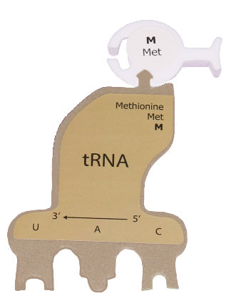
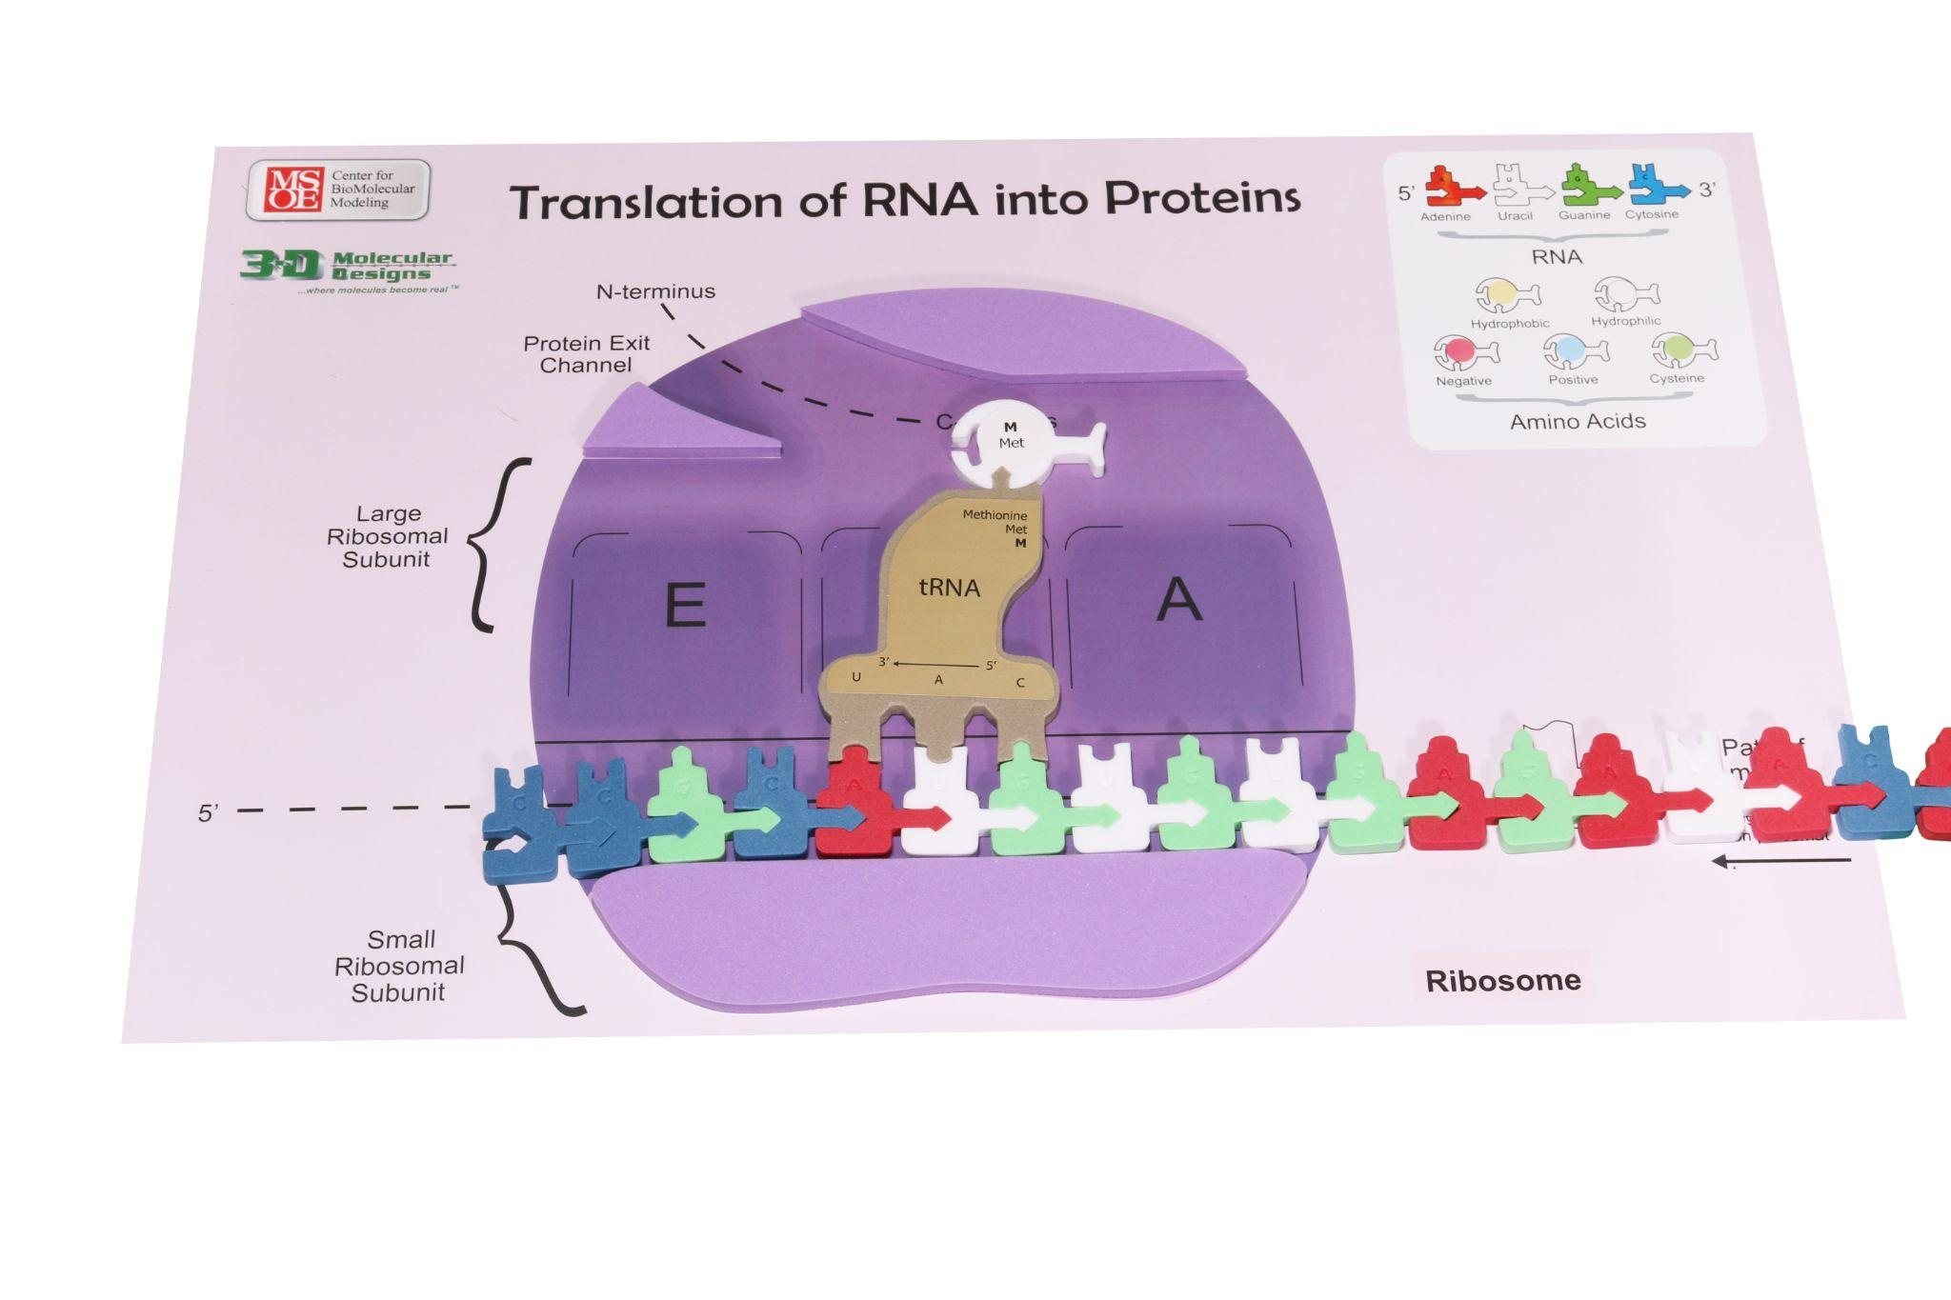
Part 1:
Attach amino acids to tRNAs
Part 2:
Polypeptide synthesis
Kit provides 2 histidines and 2 cysteines
  Histidines: shows redundancy in the mRNA codons
  tRNA for cysteine is reused

Slide 36
Translation Tips:
mRNA template needed (from transcription)
Translation begins at AUG (start codon)
Translation ends with UAG (stop codon)

Slide 37
Model the Process of Transcription

Slide 38
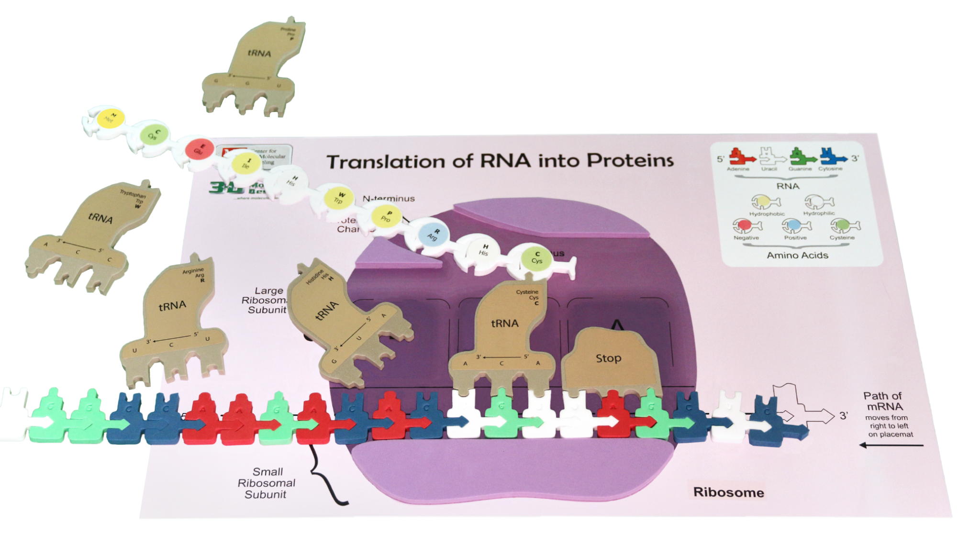

Slide 39
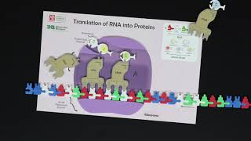

Slide 40
What are some challenges you experienced as a learner during this activity?
What are some tips you have for facilitating this activity successfully with your students?

Slide 41
What are some limitations of this model?

Slide 42



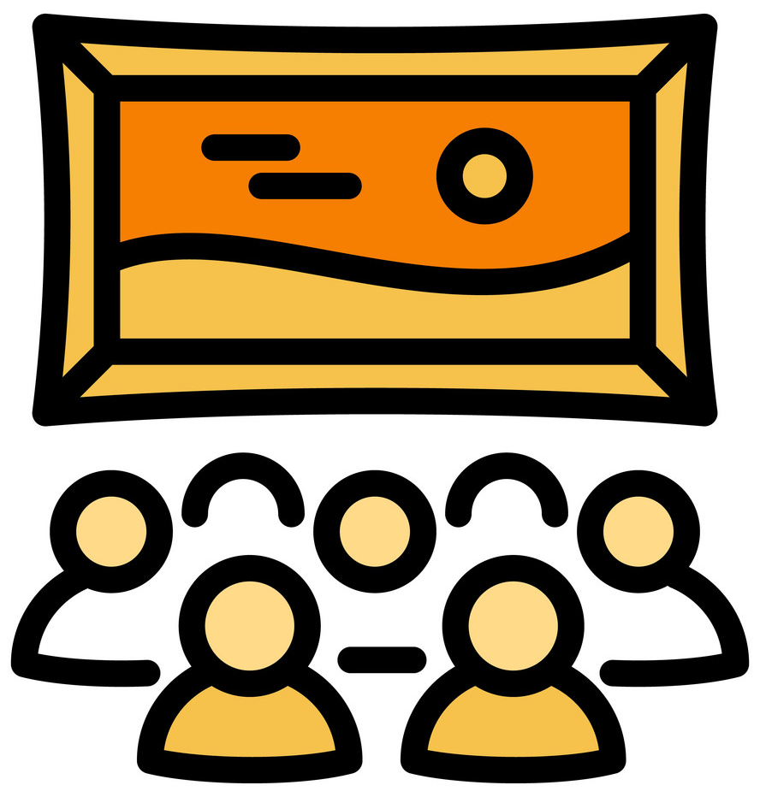

Ideas for capturing student learning
Stop motion animation
Comic strip panels
Video demonstrations
Infographic (with photos and captions)
Gallery walk / Interactive Exhibit

Slide 43
NGSS Connections
SEPs | CCCs | DCIs
Asking Questions and Defining Problems | Patterns | LS1.A: Structures and Processes
Developing and Using Models | Cause and Effect: Mechanism and Explanation | LS1.B: Growth and Development of Organisms
Using Mathematics and Computational Thinking | Scale, Proportion, and Quantity | LS3.A: Inheritance of Traits
Analyzing and Interpreting Data | Structure and Function | LS3.B: Variation in Traits
Constructing Explanations and Designing Solutions | Stability and Change | ETS1.B: Using simulations to model solutions

Slide 44
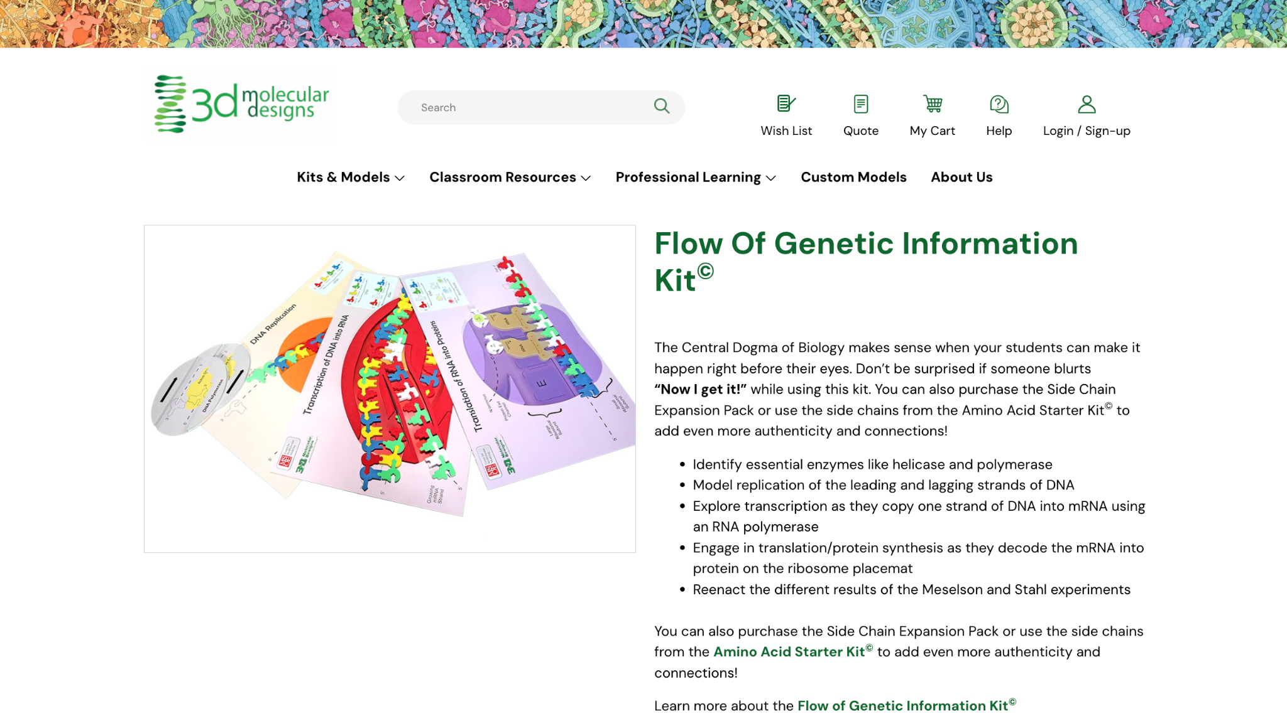
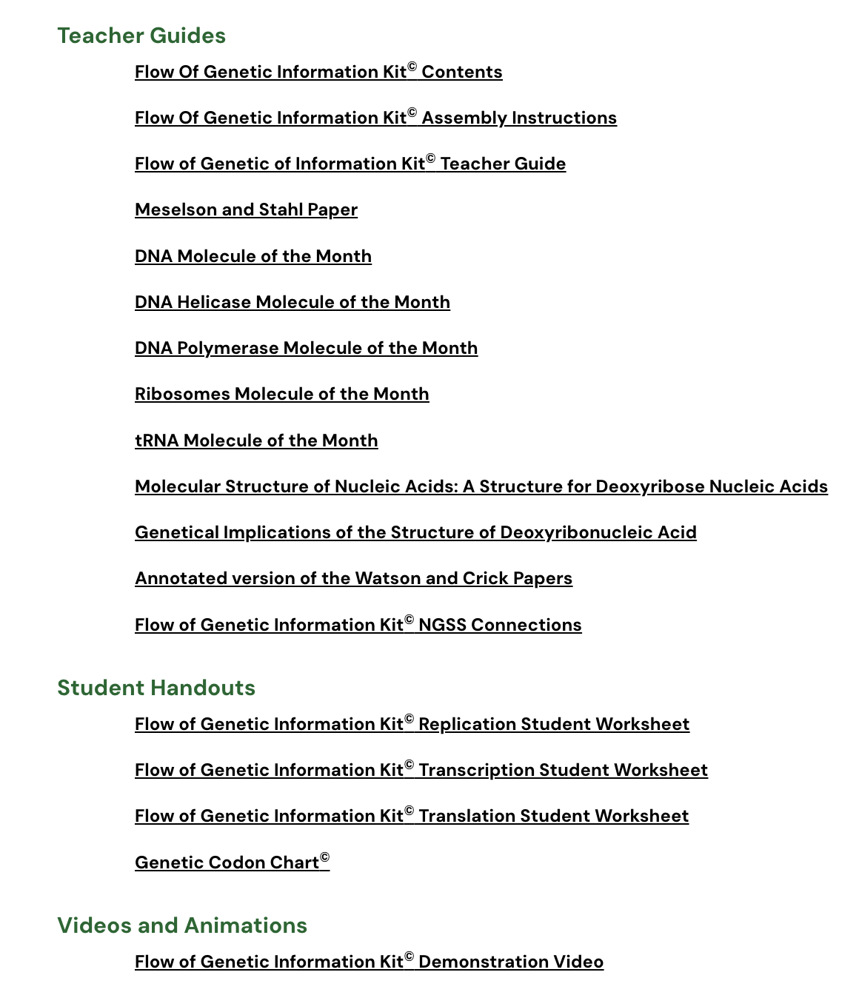
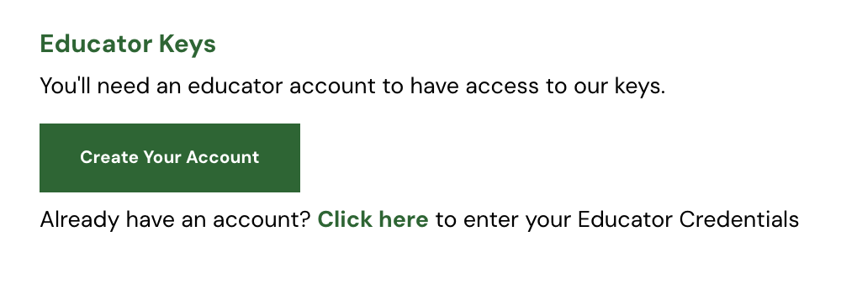
Free account!
3dmoleculardesigns.com

Slide 45


Bring an empty suitcase!
You'll take home all these classroom resources!
2024
Join us at 3D Molecular Designs in Milwaukee, WI
Session 1: July 29 - August 2
Session 2: August 5-9
Early Bird Pricing: $900 $750

Slide 46
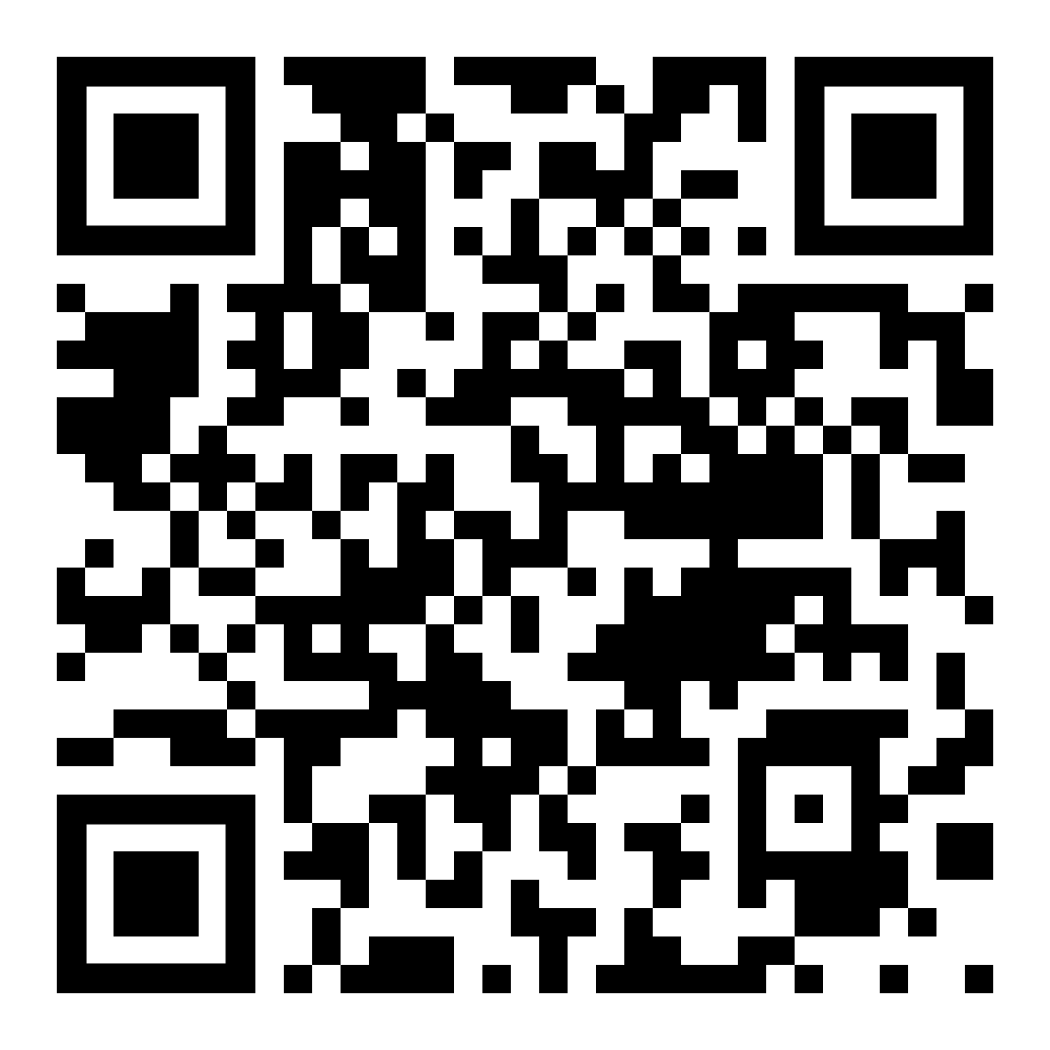
2024
Join us at 3D Molecular Designs in Milwaukee, WI
Scan to Register for Summer 2024 Courses!

Slide 47
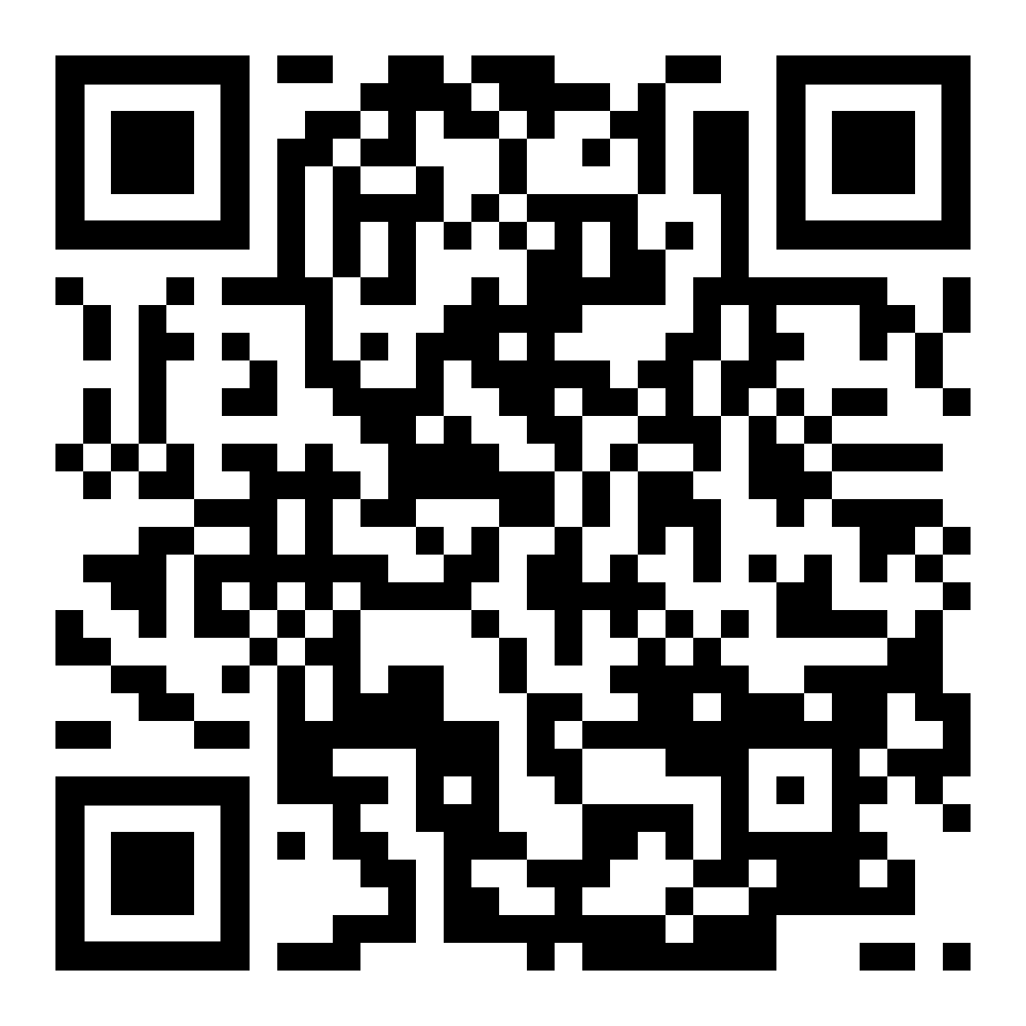
Thank you for attending this session!
Please come back and join us for our other sessions tomorrow!
Presenter: Chris Chou
Mrs.Chou@gmail.com
Take this survey for a chance to win a $50 gift card!

Slide 48

