Slide 1
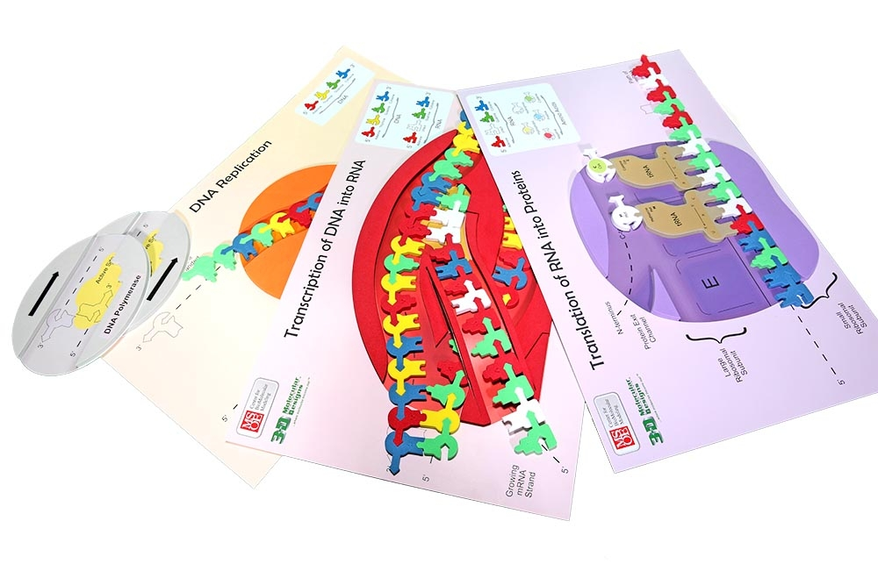
Unwinding the Complexities of the Central Dogma
Notes:
For this presentation, we will use the Flow of Genetic Information kits and several 3D printed models (large Ribosomal subunit, small Ribosomal subunit, and a tRNA model.)

Slide 2
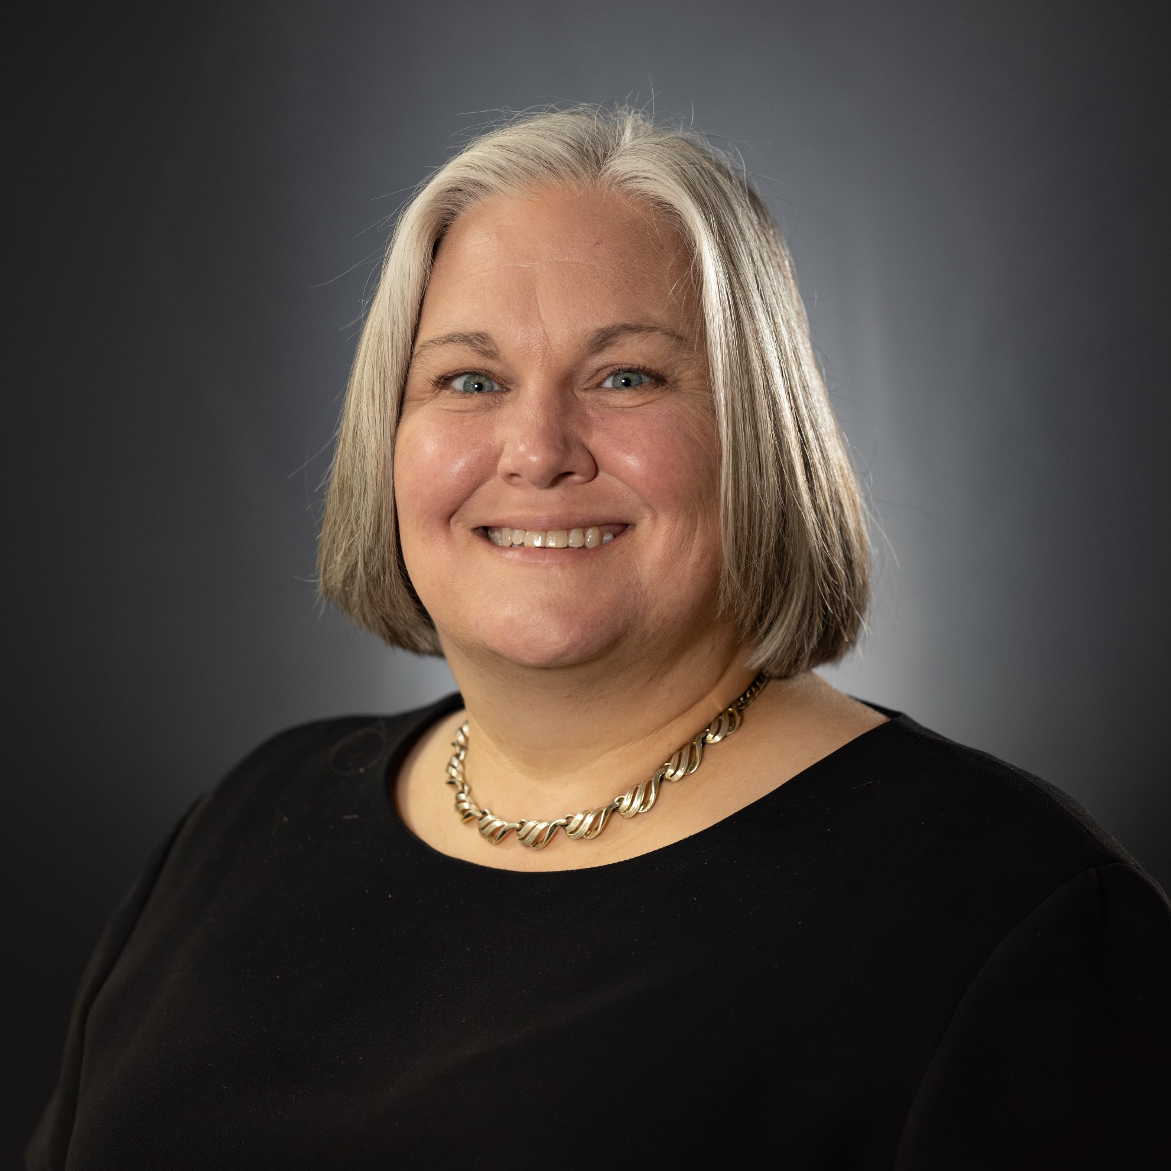
Ruth Hutson, MSSE
Notes:
I’m Ruth Hutson, a 3D Molecular Designs Science Educator. I’ve been teaching for 25 years . Before coming to 3DMD, I was the science department at a small rural high school in Northeast Kansas and taught Concurrent College Biology, biology, chemistry, physics, and Earth Science. In addition to being the HS Science Department, I was also play director, Scholars Bowl coach, and junior class sponsor. I discovered the 3DMD products in 2015 and loved using them with all my classes. Today I'd like to share with you how I use these kits with my high school biology class and Concurrent College Biology course.

Slide 3
Workshop Learning Goals
Explain the purpose and process of transcription and translation using models of DNA and RNA.
Explore how physical models foster an understanding of how the structure of DNA and RNA determine the structure of proteins, which carry out the essential functions of life.
Have fun!
Notes:
Ruth says We are going to be modeling with the Flow of Genetic Information Kit. We use this kits throughout the year. At the end of this session, you should be able to… read goals from slide).
Let’s get started with some modeling [Advance slide]

Slide 4
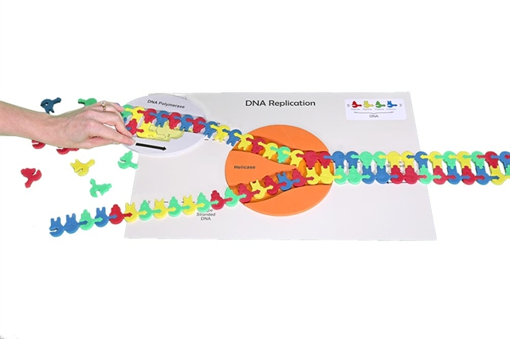
Replication
4
Notes:
Set the scene: The nucleus of the eukaryotic cell at an origin of replication on the double-stranded DNA. Enter DNA helicase. In the wings: DNA polymerase.
Helpful hints: For large classes, pre-make the DNA sequence. The kit has some labeled Sequence I and Sequence II. We are going to be working with Sequence I.
You can also use double-stick tape to hold those sequences together so that students don’t take them apart. Arrows on the models guide students in showing the direction of replication.
What the model shows: The directionality (5’ to 3’) of the DNA molecule. Only one replication bubble (origin of replication) is shown. This is what the mat represents. Replication of both lagging and leading strands are shown. Hydrogen bonding between the base pairs and the base pairing rules are highlighted in this model.
What the model doesn’t show: 3-D structure of DNA and the sugar-phosphate backbone are not shown. The role of initiator proteins that form the replication bubbles is not shown. We arrive on the scene with all of that in place. This kit also doesn’t focus on the role of gyrase and ligase. That complexity can be brought in later, if you wish with other modeling.

Slide 5
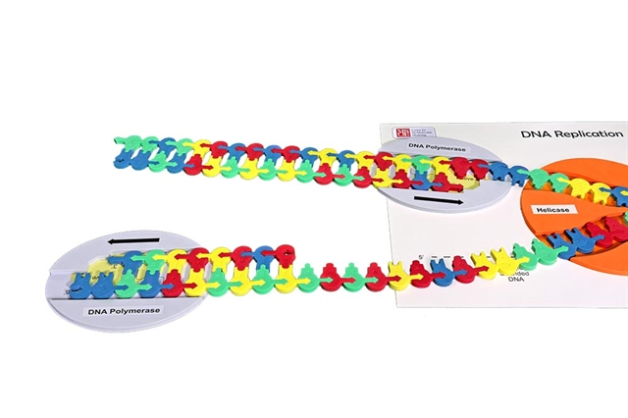
Replication
5
Notes:
Although there are multiple enzymes involved in DNA replication, the kit only focuses on DNA Polymerase and DNA helicase. You can look at the student handout for this activity at FGIKReplicationStudentHandout6-19-15.compressed.pdf (3dmoleculardesigns.com).
If you want to explore DNA’s structure, then consider attending Mark Arnholt’s presentation DNA With a Twist: Use of Multiple Models in the Classroom. It is today at 11:00 am in this room.

Slide 6
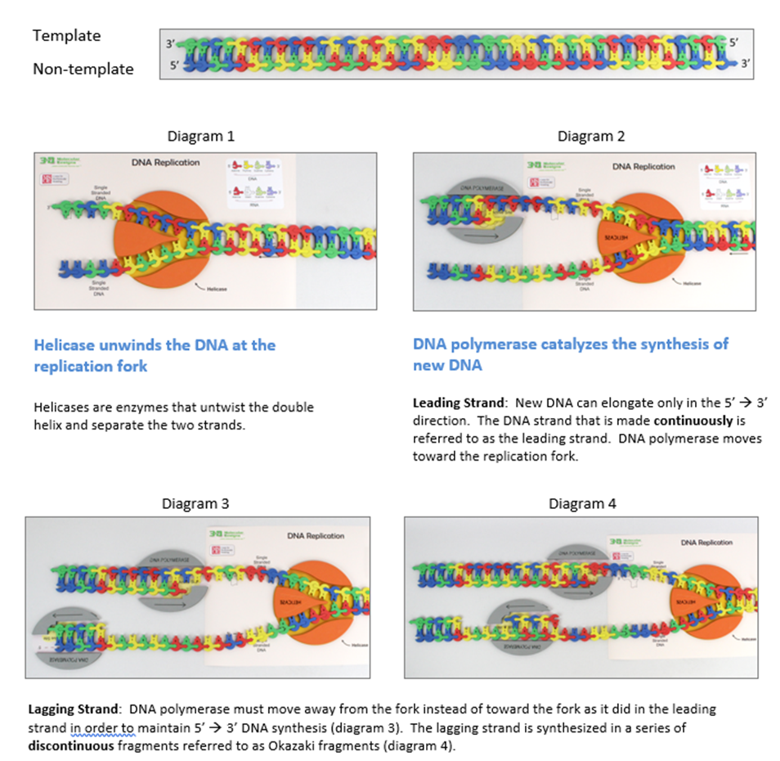
Notes:
Note: This slide is not shown in the main presentation. It is a reference for teachers for later use.

Slide 7
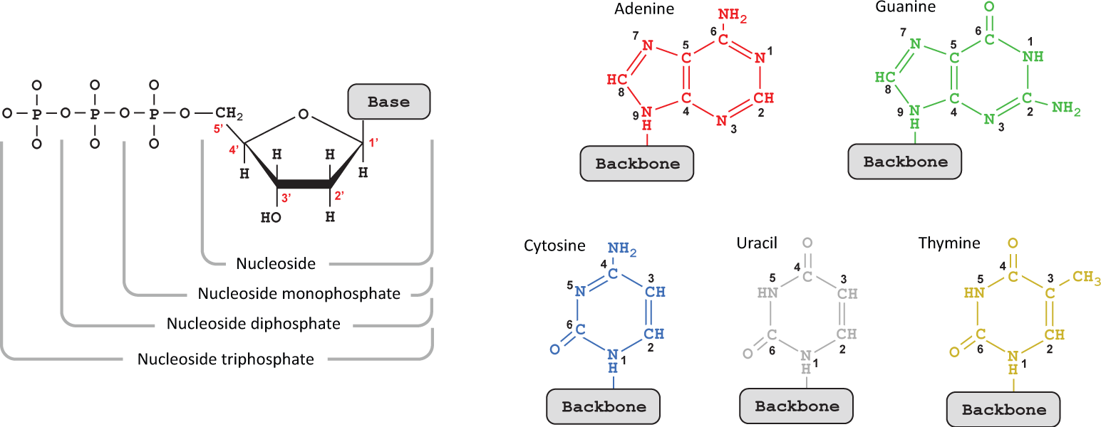
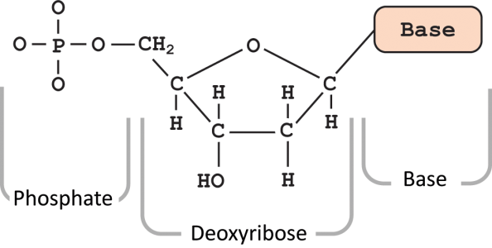
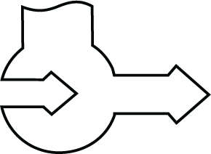
Transcription
Helpful Hints:
Take care in loading the DNA in the RNA polymerase.
Remember RNA is synthesized from the 5’ to the 3’ end.
5’
3’
5’
3’

Slide 8
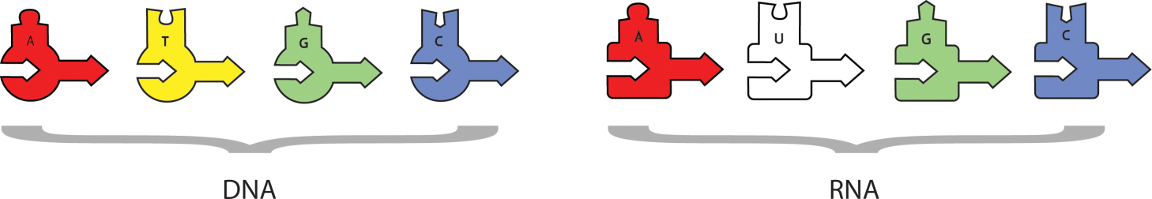
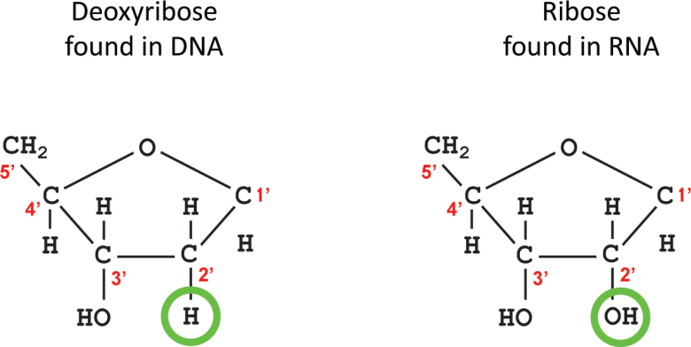
Transcription
Helpful Hint:
The DNA pieces are different than the RNA pieces!

Slide 9
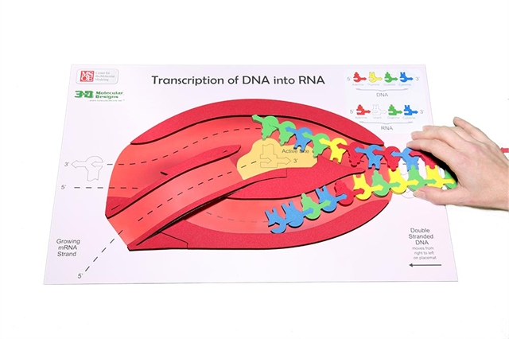
Transcription: Initiation
9
Notes:
Our primary focus today is transcription and translation because at least in my case, these are two of the cell processes with which my students struggled. [Poll the room to see if other educators also saw this trend.] Why was that?
For our first activity, you need the transcription mat, the pre-made DNA sequence, and the RNA nucleotides.
Set the scene: The nucleus of the eukaryotic cell. There are two major stages in making a protein: transcription in which DNA is used as a template to make a single-stranded mRNA and translation where RNA is used to create a sequence of linked amino acids that make a polypeptide which is later folded into a 3-D protein. At rise, we see RNA polymerase ready to start gene expression through transcription. The first phase of transcription is initiation.
Helpful hints: Point out to student the differences between RNA structure and DNA structure. Use Dynamic DNA to show differences between deoxyribose and ribose and the thymine and uracil. How are those differences denoted on the foam nucleotides? Notice the pointed edges on the foam enzymes
What is not shown in the model
A collection of proteins known as transcription factors facilitate the binding of the RNA polymerase to the DNA
What is shown in the model
The DNA strands are separated. RNA polymerase joins the RNA nucleotides as they pair along one of the strands of the DNA template. In this model, the template strand is the top strand, and the non-template strand is the bottom strand. Notice the directionality of the template and non-template strands. RNA polymerases can only assemble mRNA in the 5’to3’direction. On the model the template strand of DNA should be oriented in the top slot with the 3’ end (arrow end) entering first.

Slide 10
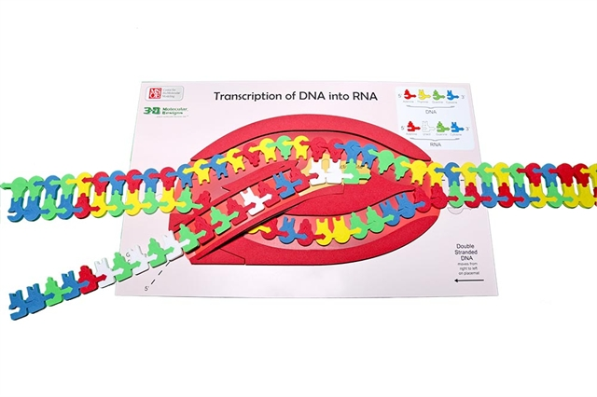
Transcription: Elongation
10
Notes:
The second phase is elongation.
Helpful hints: Put students into groups of three of four to complete this process because you need many hands to complete this in a timely fashion. After sprinkling the area with RNA nucleotides, feed the double stranded DNA into the RNA polymerase. Notice the pointed edges that help split apart the hydrogen bonds between both DNA and RNA nucleotides. Also, notice the RNA of the exit ramp in the RNA polymerase.
What is in the model: The model shows the base pairing between nucleotides using hydrogen bonds. The model shows directionality. There are keys on the mat that guide students in reinforcing the base pairing rules.
What is not in the model: We don’t make a mRNA of 900 nucleotides that would represent the smallest mRNA. It is important to point out that complexity to the students without having them modeling it for time's sake.

Slide 11
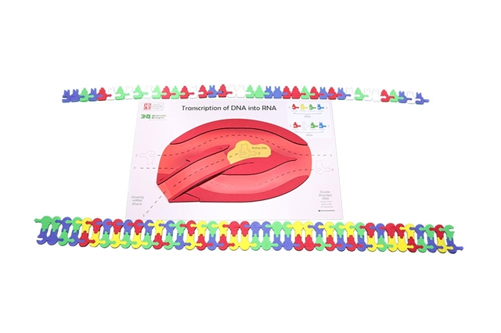
Transcription: Termination
11
Notes:
The third phase is termination.
Helpful hints: At the end of this activity, save the RNA sequence you made for later and use it as a tool to assess your students’ understanding.
A student handout detailing this activity can be found at the link below:
FGIKTranscriptionStudentHandout6-19-15.compressed.pdf (3dmoleculardesigns.com)

Slide 12
A brief tour through the cell
This image is an excerpt from Tour of a Human Cell by David Goodsell, as shown in 3D Molecular
Designs’ Tour of a Human Cell© poster and David Goodsell’s book, The Machinery of Life.
Notes:
This is one of the many molecular landscapes by Dr. David Goodsell who is affiliated with the Protein Data Bank. You can more of these at PDB-101: Goodsell Gallery (rcsb.org). I love using them in conjunction with the kit because they demonstrate to students that we are only touching on a fraction of the cell’s complexity.

Slide 13
Nucleus
Nuclear Membrane
Cytoplasm
This image is an excerpt from Tour of a Human Cell by David Goodsell, as shown in 3D Molecular
Designs’ Tour of a Human Cell© poster and David Goodsell’s book, The Machinery of Life.
Notes:
Let’s note where we been and where we are going.

Slide 14
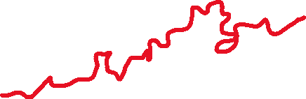

DNA
mRNA
mRNA
Nuclear Pore
RNA Polymerase
This image is an excerpt from Tour of a Human Cell by David Goodsell, as shown in 3D Molecular
Designs’ Tour of a Human Cell© poster and David Goodsell’s book, The Machinery of Life.
Notes:
Let’s also identify some structures. You can print these landscapes as a pdf in black and white or greyscale and have them color them in. I would have my students insert them in their lab notebooks so they could reference them later.

Slide 15
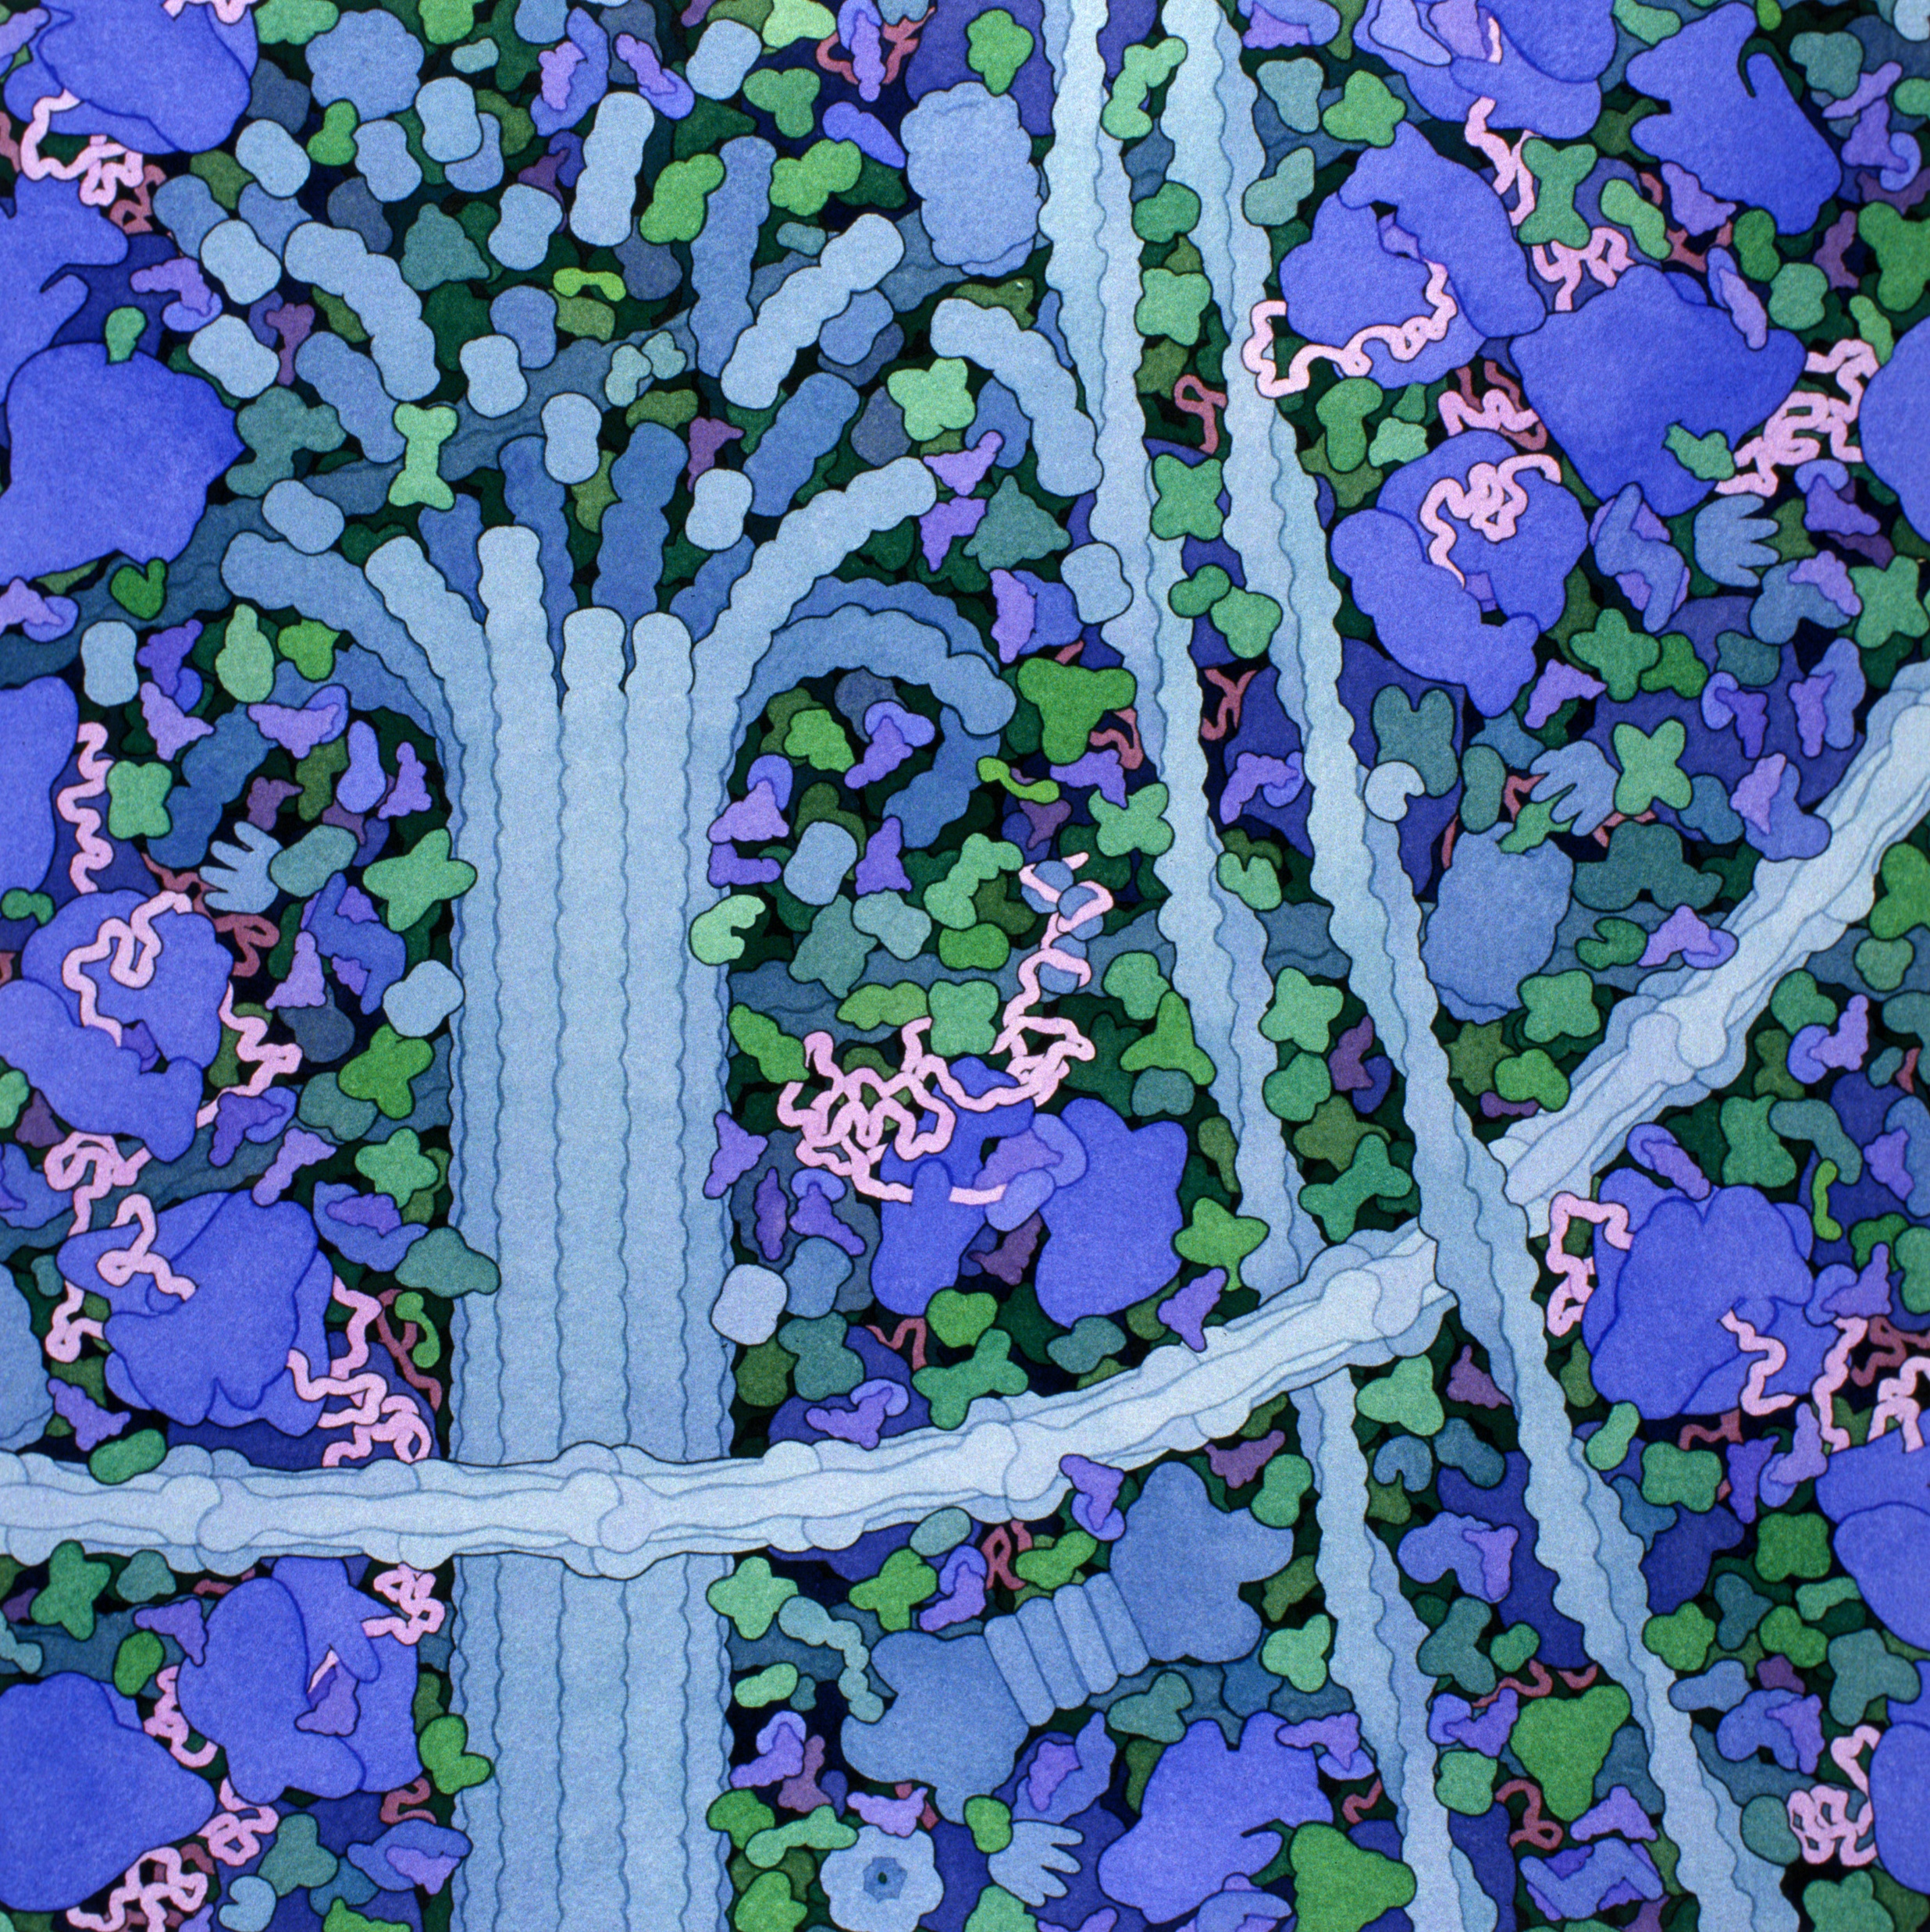
Translation
Acknowledgement: Illustration by David S. Goodsell. doi: 10.2210/rcsb_pdb/goodsell-gallery-006
15
Notes:
Set the scene: In the cytoplasm of the cell, in the ribosome.
Helpful hints: Start by explaining the role of each of the tools needed for translation: tRNA, ribosome, and mRNA. I first start with the structure of transfer RNA. Students in my class would have learned about the structure of proteins earlier in the year so now we are just adding complexity to the process.

Slide 16
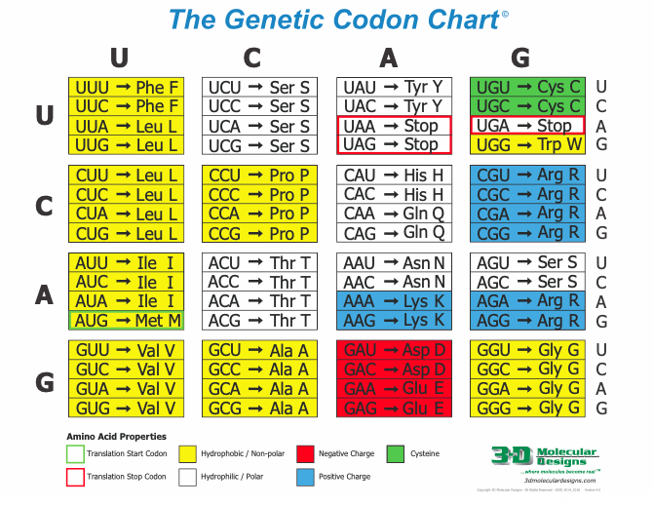
Notes:
I first show students how to read the genetic codon chart and add amino acids to the tRNAs provided in the kit.

Slide 17
Pair the tRNA with the amino acids
Notes:
Helpful hints: Walk students through reading the charts and them time to pair the amino acids with their tRNA. Then revisit the chart and talk about all the possibilities for anticodons.

Slide 18
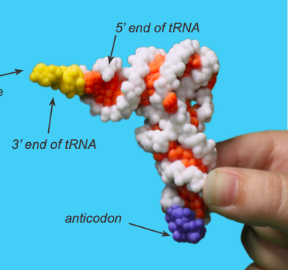
A closer look at tRNAs
Notes:
LibCal - Walter Schroeder Library
You visit the link above to check out collections of the 3D models that we have used during this session.
The anticodon forms complementary base pairs with the codon of the mRNA. This will vary between amino acid. The other functional part of the tRNA (the CCA sequence) where the amino acid binds is the same for every amino acid. It is located at the 3’ prime end of the structure.

Slide 19
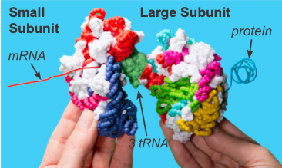
A closer look at ribosomes
Notes:
PDB-101: Molecule of the Month: Ribosome (rcsb.org)
The link above will give you some detailed information about the structure of the ribosome.
The ribosome is made of two subunits. These must join for protein translation to occur. Once the small and large subunits fully attach, the growing polypeptide chain passes through a channel in the large subunit The mRNA passes out through a channel in the small subunit.

Slide 20
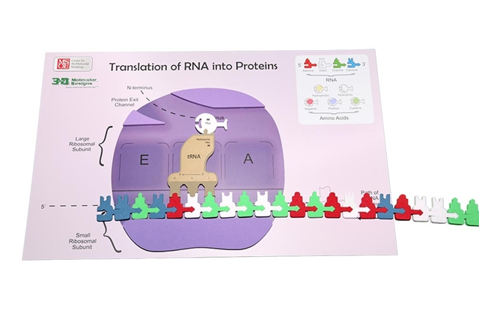
Translation: Initiation
20
Notes:
Set the scene: The first phase is initiation.
Helpful hints: Starting from the 5”end of the mRNA at the start codon (AUG), every three bases determines a particular amino.
What is in the model:
mRNA enters the ribosome (shown in purple). The top is the large subunit, while the small unit is shown under the EPA sites.
tRNA bring the amino acid to the ribosome

Slide 21
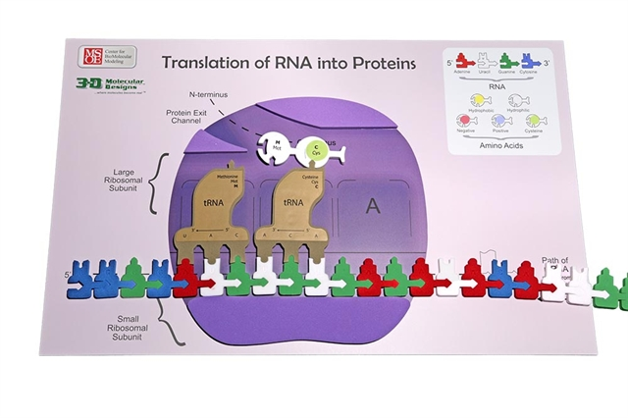
Translation: Elongation
21
Notes:
The second phase is elongation. The anticodon of another tRNA base pairs with the mRNA in the A site. The new protein is made in the N-terminal to C-terminal direction. A rRNA found in the large ribosomal subunit catalyzes the formation of a peptide bond between the amino group in the A site and the carboxyl end of the amino acid in the P site.
Helpful hints: Have multiple students work together for smooth transition of the process. There are a lot of parts to move so groups of 3 to 4 are best.
What is in the model
The important parts of the small and large ribosomal subunits are labeled.
The E (Exit), P (peptidyl), and A (aminoacyl) sites are shown.
What is not in the model
This is a two dimensional model.

Slide 22
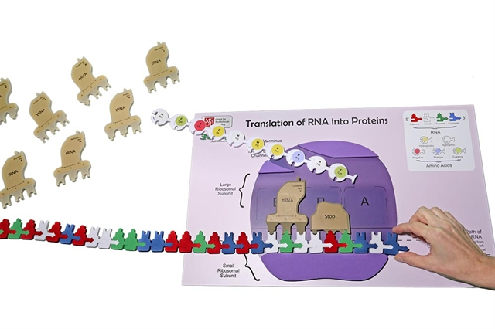
Translation: Termination
22
Notes:
The third phase is termination. The developing polypeptide will exit the ribosome through the opening in the large ribosomal subunit.
What is in the model
The ribosome reaches a stop codon on the mRNA. The A site of the ribosomes accepts a release factor.

Slide 23
Notes:
What happens next? The polypeptide will fold into a protein following specific rules.
Assess your student understanding by having them look at the mRNA that transcribe in the transcription. What amino acids are shown there.
Have a look at the classification of amino acids and see what they are. This will help them understand how that protein is going to “fold.” If you have the amino acid starter kit, you can look at the side chains of those amino acids.

Slide 24
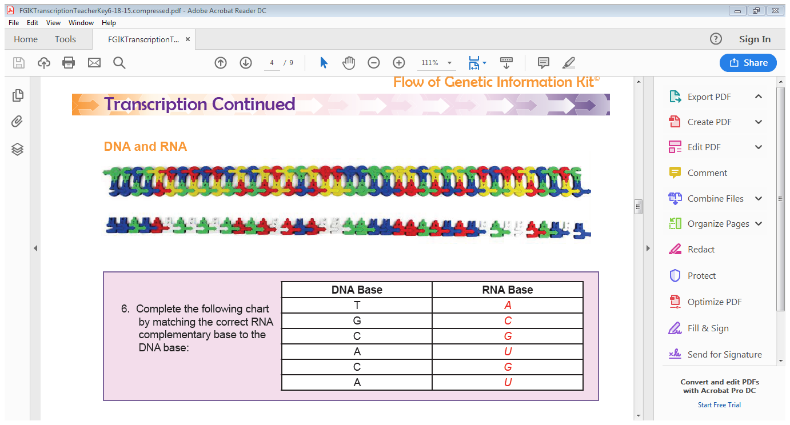
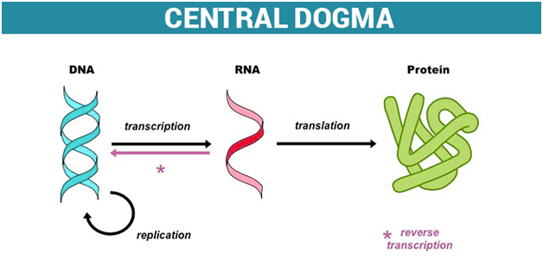
Let’s review
Notes:
Helpful Hints: This is a big kit. I have students put a couple of reminders in their lab notebooks
DNA-RNA Base pair rules
The goal of each step in the central dogma
The differences between DNA and RNA

Slide 25
Workshop NGSS Connections
(and/or other applicable standards)
SEPs | CCCs | DCIs | TEKS
Using Mathematics and Computational Thinking | Scale, Proportion, and Quantity | 5-PS1-2 | Student Expectation- B.6C
Developing and Using Models | Patterns | MS-PS1-1
Planning and Carrying Out Investigations |  | HS-PS1-3
Notes:
Ruth says: Here are the NGSS Connections for this workshop.

Slide 26

We value your opinion!
Let us know what you think.
Scan the QR Code and complete this short survey.

