Slide 1

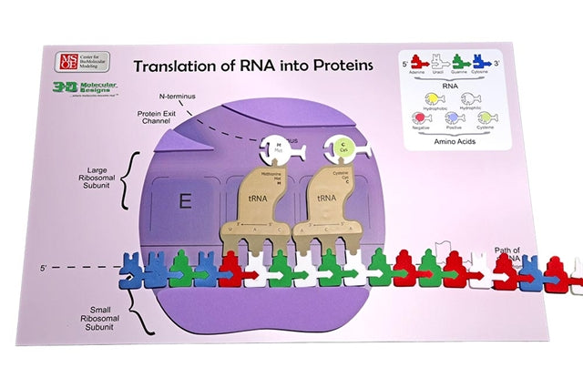
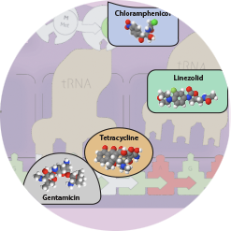

Protein
Translation
"Life is a protein's way of making more protein."
- Albert Szent-Györgyi
Activity ID: FGIK-AR1
Required Models: 1 FGIK©/ Group
Required Media: 3DMD AR EDU App

Slide 2

Teacher Guide – Summary
Activity Summary
This AR activity explores the process of protein synthesis and how certain antibiotics block that process. Protein synthesis consists of three phases: initiation, elongation, and termination. To initiate protein synthesis, the AUG start codon of the mRNA is bound to the P site of the small ribosomal subunit. Another tRNA moves into the A site of the small ribosomal subunit. The mRNA advances, the amino acid from the P site detaches and forms a peptide bond with the adjoining amino acid from the A site. During elongation, more amino acids are added to extend the polypeptide. Protein synthesis terminates when a stop codon is reached on the mRNA, and the polypeptide chain is released out of the protein exit channel.
This activity requires the 3DMD AR EDU application, available for download from the Google Play and Apple App stores. The activity is split into four AR scenes designed to be explored in order. Each AR scene is represented by a consistent icon in this slide deck and the 3DMD AR EDU app (see icon images below.)
Scene 1:
A review of translation.
Scene 2:
How does chloramphenicol prevent translation?
Scene 3:
How does erythromycin prevent translation?
Scene 4:
How does tetracycline prevent translation?
Scene 5:
How does linezolid prevent translation?

Slide 3
Teacher Guide - Overview
Activity Objectives
  Students will review protein translation.
  Students will explore how different antibiotics interfere with protein translation
  Estimated Class Time:
45 minutes
Required Models:
Flow of Genetic Information Kit©
Required Media:
3DMD AR EDU App + subscription
Other Materials Needed:
Notebook and writing tools
Grade, Class
9-12 Biology
Topics
Translation
Central Dogma
Ribosome
Proteins
Prerequisite Knowledge
Transcription

Slide 4
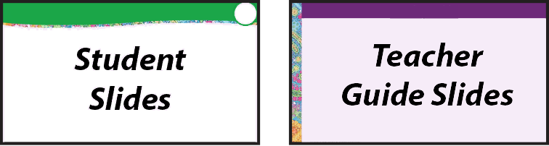





Teacher Guide - Using This Slide Deck
Student and Teacher Slide Deck Pages
  Slides that are meant for student viewing will feature a green top
  banner. Slides that are meant only for teacher viewing will feature a
  purple top banner and will appear hidden when in "slide show" mode.
Prompting Icons
  Each student slide will include a prompting icon in the top right corner of the slide. These icons on each slide cue your students to the type of activity they will be doing.
Turn and talk discussion
Write in your notebook
Quiet thinking time
Digital modeling
Physical modeling
Teacher Moves and Student Moves
Class slides provide notes (teacher notes below the slide) with specific information to assist you in facilitating the activity using effective modeling and education practices.

Slide 5
Teacher Guide - Standards
Next Generation Science Standards
Science and Engineering Practices | Cross Cutting Concepts | Disciplinary Core Ideas
Asking Questions and Defining Problems | Patterns | HS-LS1-1
Developing and Using Models | Structure and Function
Constructing Explanations and Designing

Slide 6
Teacher Guide – Scene 1
Scene 1: A Review of Protein Translation
Scan the protein synthesis placemat from the Flow of Genetic Information Kit© to display four different digital overlays. The overlays will walk students through initiation, elongation, and termination. For easier scanning, scan the placemat in portrait mode and point your camera slightly to the right toward the A site until the app can lock onto the image target from the model.
Overlay 1: AUG codon identified.
mRNA promotes protein initiation based upon the sequence.
Overlay 2: First peptide bond formation.
The second codon is read and a peptide bond is made between the two amino acids.
Overlay 3: Protein elongation.
Peptide bonds are continuously formed.
Overlay 4: Stop Codon
Protein translation is terminated.

Slide 7



What Do You Remember About Translation?
The Translation mat of the Flow Of Genetic Information Kit© is one way to represent the process of protein translation.
What parts of the process does this model represent well?
Are there any features of this model that it does not represent well?
Discuss with your partner and record your answers in your notebook.
Notes:
Teacher: Ask students to discuss the prompts with their partner(s) and share their ideas with the class.
Student: After discussion, students should write their responses in their notebooks.

Slide 8

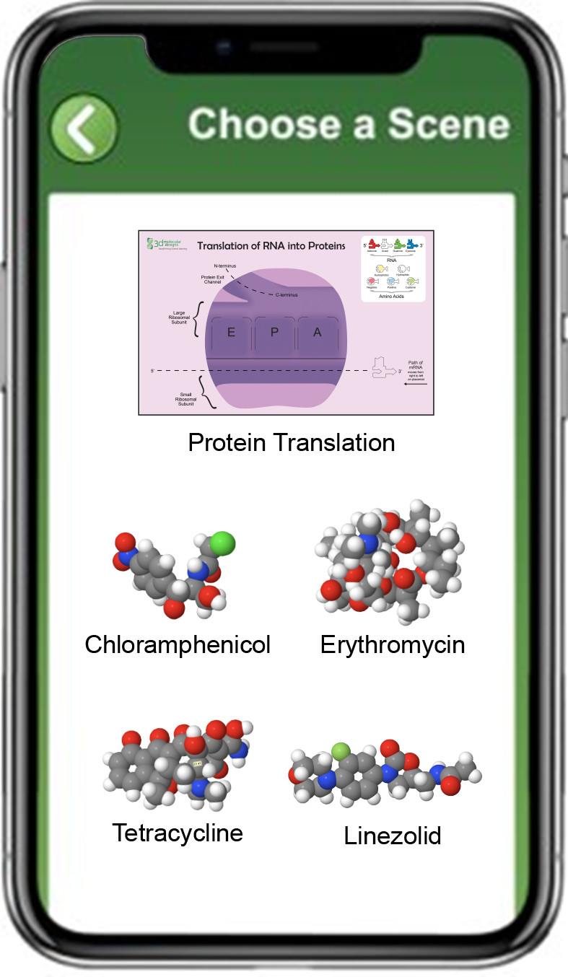
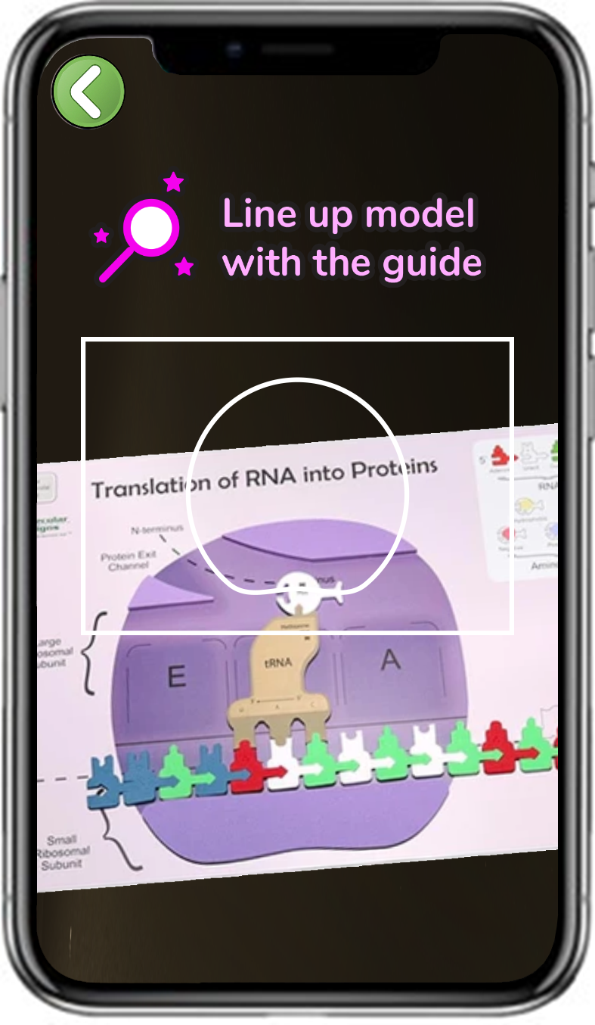
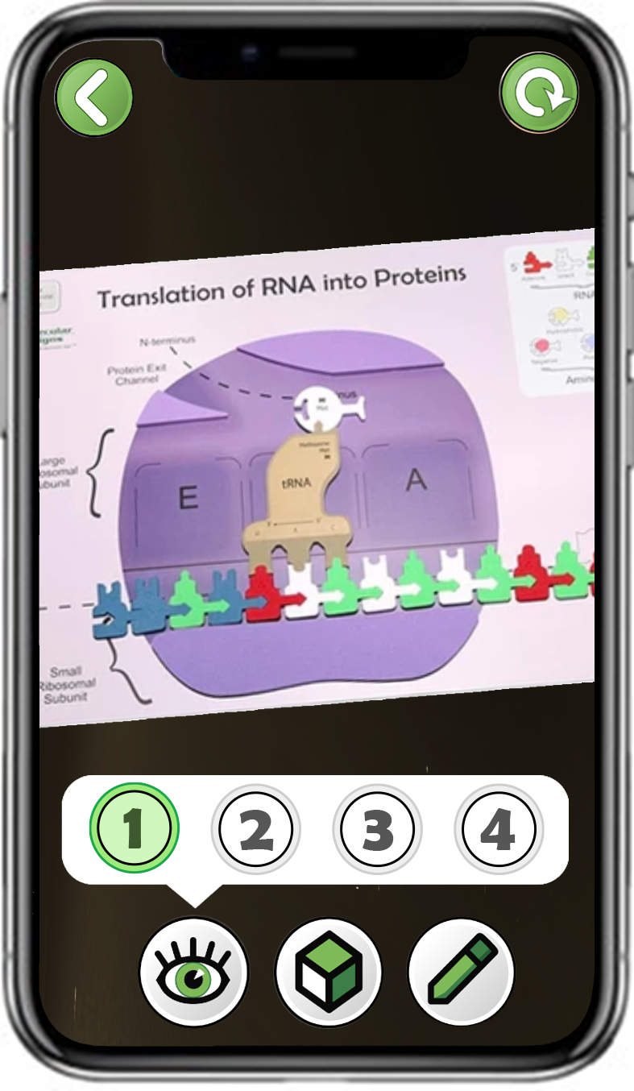
Exploring Protein Translation
Choose Protein translation
Scan a purple
translation mat
Explore all four buttons
Notes:
Teacher: Have students open the app and select the appropriate activity and scene. Move around the room and assist students with their technology. Students should point their cameras toward the A site of the ribosome.
Student: Open the app and select the appropriate activity and scene.

Slide 9
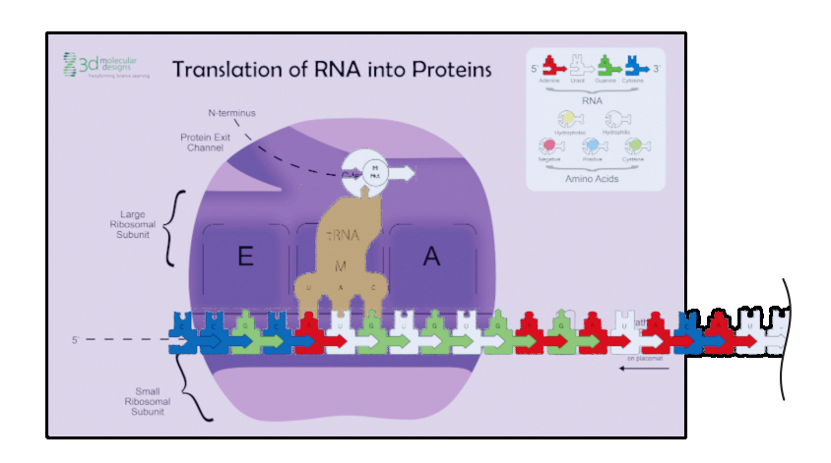
Review of Protein Translation - Part 1
Select button one and play the animation as many times as necessary.
Write your group’s observations in your notebook.
Notes:
Teacher: Allow students to make observations using the button 1 animation.
Student: Follow the prompts on the slide. Talk with their group about what is happening.

Slide 10
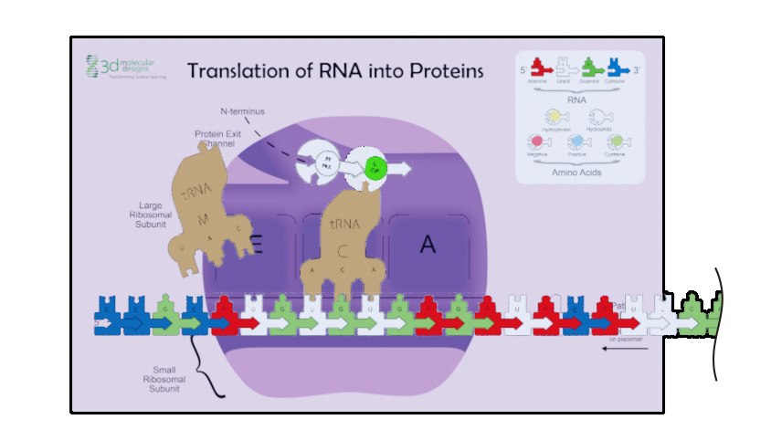
Review of Protein Translation - Part 2
Select button two and play the animation as many times as necessary.
Write your group’s observations in your notebook.
Notes:
Teacher: Allow students to make observations using the button 2 animation.
Student: Follow the prompts on the slide. Talk with their group about what is happening.

Slide 11
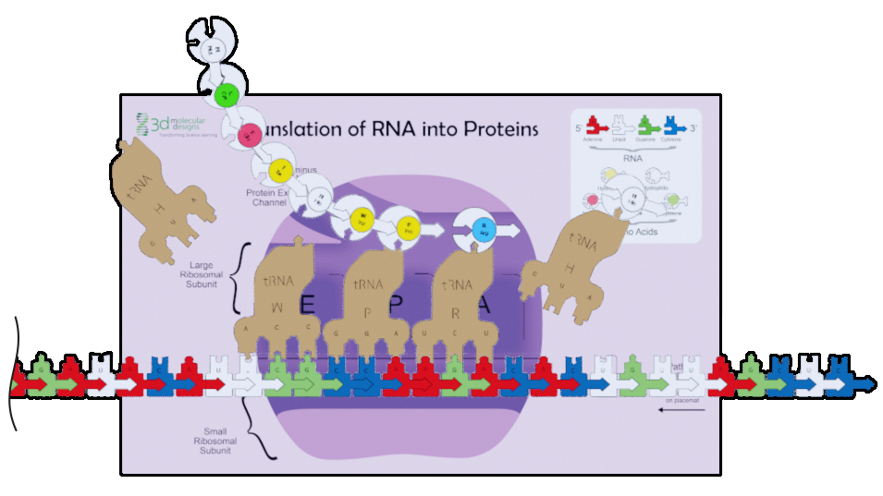
Review of Protein Translation - Part 3
Select button three and play the animation as many times as necessary.
Write your group’s observations in your notebook.
Notes:
Teacher: Allow students to make observations using the button 3 animation.
Student: Follow the prompts on the slide. Talk with their group about what is happening.

Slide 12
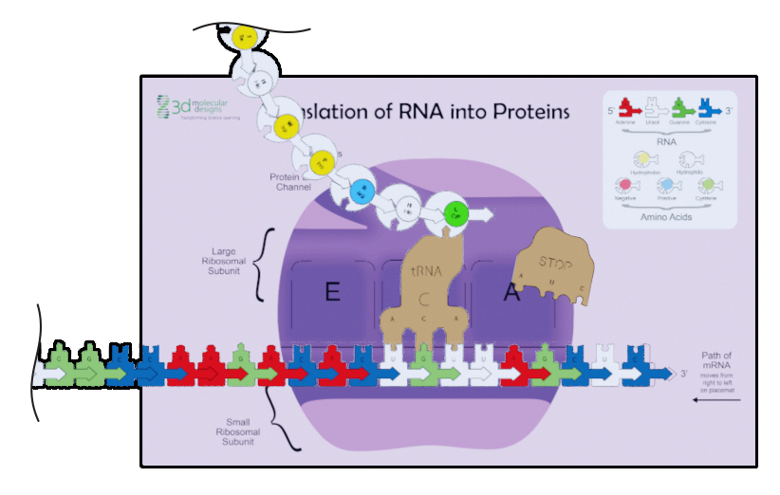
Review of Protein Translation - Part 4
Select button four and play the animation as many times as necessary.
Write your group’s observations in your notebook.
Notes:
Teacher: Allow students to make observations using the button 4 animation.
Student: Follow the prompts on the slide. Talk with their group about what is happening.

Slide 13
Consensus Modeling
Share what your group noticed during each of the stages of protein translation with the class.
Write a one-sentence description of what is happening in each scene in your notebook.
Notes:
Teacher: Facilitate a discussion with all students to come to a consensus model.
Student: Be prepared to share your thoughts and ideas with the whole class to contribute to the consensus model.

Slide 14
Teacher Guide – Scenes 2-5
Scene 2-5: Antibiotics Block Protein Translation
Scanning the protein synthesis placemat from the Flow of Genetic Information Kit© will display four antibiotics that interact with different parts of the ribosome before being shown what role each plays in the human genome.
Scan the protein synthesis placemat from the Flow of Genetic Information Kit© to display four different digital overlays. The overlays will show students how antibiotics interfere with protein synthesis. For easier scanning, scan the placemat in portrait mode and point your camera slightly to the right toward the A site until the app can lock onto the image target from the model.
Scene 2: Chloramphenicol
This antibiotic blocks the area between the P site and A site preventing peptide bonds formation.
Scene 3: Erythromycin
This antibiotic blocks the protein exit channel preventing the polypeptide from exiting the ribosome.
Scene 4: Tetracycline
This antibiotic blocks the P site preventing tRNA from entering the ribosome.
Scene 5: Linezolid
Blocks the A Site and prevents tRNA from entering the ribosome

Slide 15
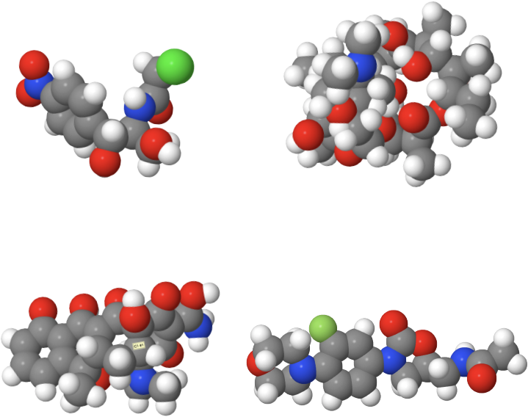
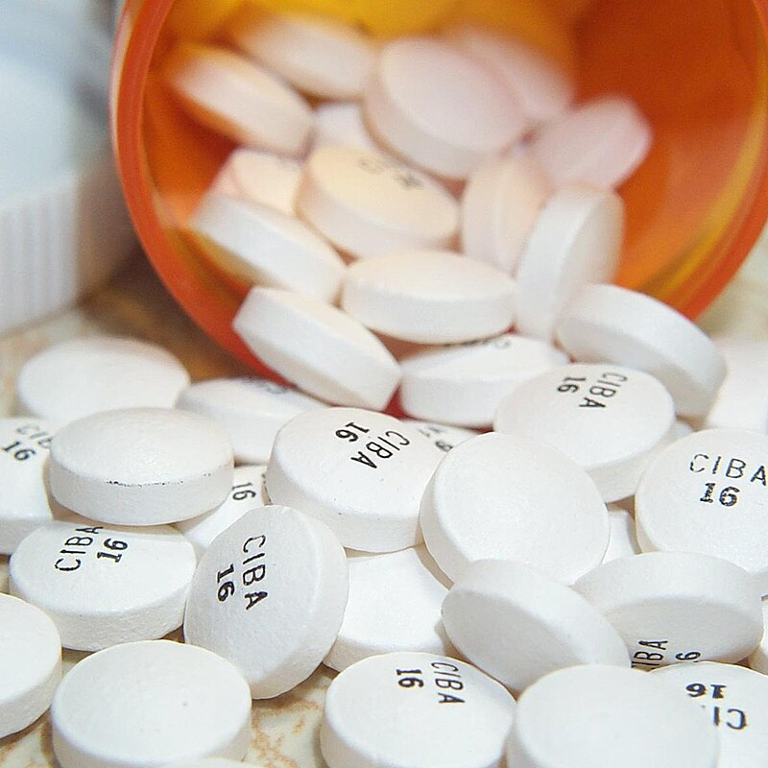
What Happens if Protein Translation Stops?
What happens if protein translation stops?
This is the goal of many different antibiotics.
Make a prediction with your partner about how antibiotics may cause this.
Notes:
Teacher: Facilitate a class discussion.
Student: Discuss with their partner and write a prediction in their notebook.

Slide 16
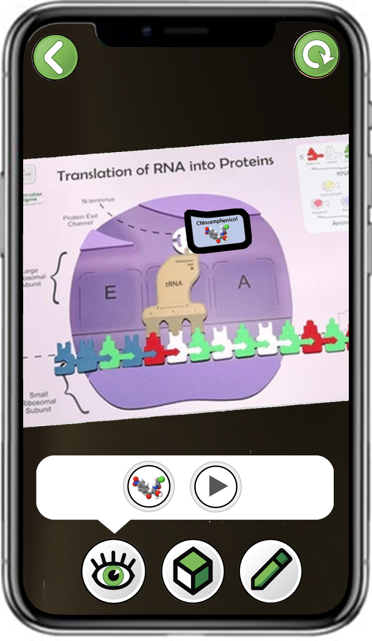
Exploring Chloramphenicol
Choose
Chloramphenicol
Scan a purple
translation mat
Explore only the first button
Notes:
Teacher: Have students open the app and select the appropriate activity and scene. Move around the room and assist students with their technology. Students should point their cameras toward the A site of the ribosome.
Student: Open the app and select the appropriate activity and scene.

Slide 17

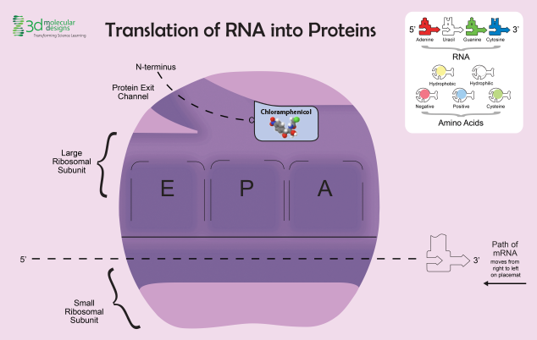
Chloramphenicol Antibiotic
Look at where Chloramphenicol binds within the ribosome.
What will be the consequences to the polypeptide during protein translation?
Model your prediction using the foam kit pieces.
Notes:
Teacher: Explain that Chloramphenicol is an antibiotic. Ask students to make a prediction about what will happen during protein translation.
Student: Discuss with their group where the drug is binding in the bacterial ribosome. Write a prediction in their notebook.

Slide 18
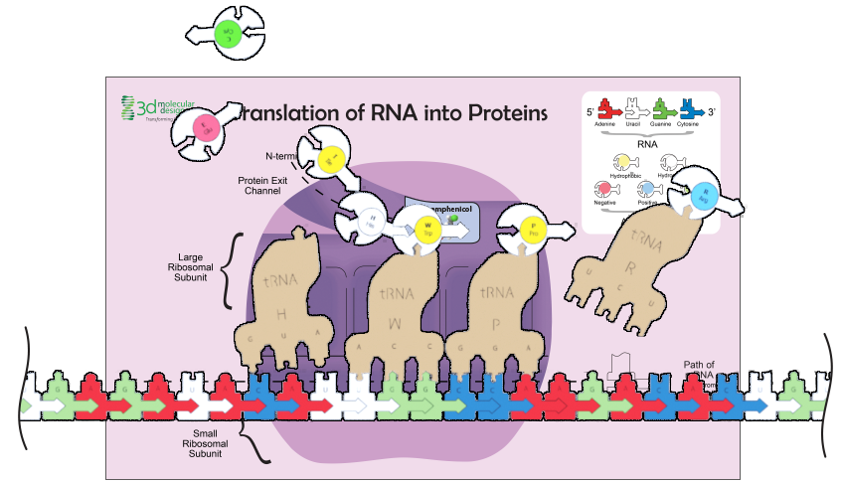

Chloramphenicol Interference
Now explore the second button.
Did the antibiotic change the translation of the protein the way you thought it would?
Notes:
Teacher: Ask students to discuss the prompt with their partner.
Student: Once groups have come to a consensus, have them record their ideas in their notebook. Explore the model using the play icon on the app. Verify their findings or revise them, as necessary.

Slide 19
Exploring Erythromycin
Choose
Erthyromycin
Scan a purple
translation mat
Explore only the first button
Notes:
Teacher: Have students open the app and select the appropriate activity and scene. Move around the room and assist students with their technology. Students should point their cameras towards the A site of the ribosome.
Student: Open the app and select the appropriate activity and scene.

Slide 20
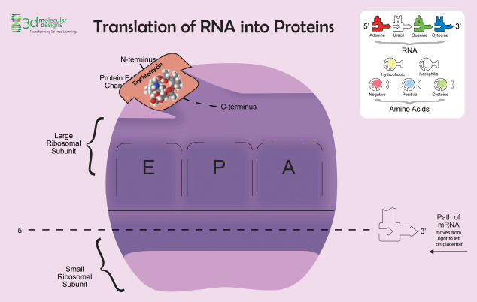
Erythromycin Antibiotic
Look at where Erythromycin binds within the ribosome.
What will be the consequences to the polypeptide during protein translation?
Model your prediction using the foam kit pieces.
Notes:
Teacher: Explain that Erythromycin is an antibiotic. Ask students to make a prediction about what will happen during protein translation.
Student: Discuss with their group where the drug is binding in the bacterial ribosome. Write a prediction in their notebook.

Slide 21
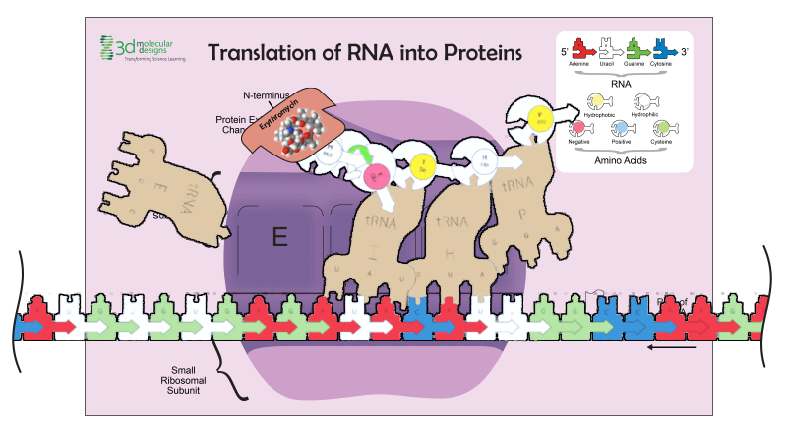
Erythromycin Interference
Now explore the second button.
Did the antibiotic change the translation of the protein the way you thought it would?
Notes:
Teacher: Ask students to discuss the prompt with their partner.
Student: Once groups have come to a consensus, have them record their ideas in their notebook. Explore the model using the play icon on the app. Verify their findings or revise them, as necessary.

Slide 22
Exploring Tetracycline
Choose
Tetracycline
Scan a purple
translation mat
Explore only the first button
Notes:
Teacher: Have students open the app and select the appropriate activity and scene. Move around the room and assist students with their technology. Students should point their cameras toward the A site of the ribosome.
Student: Open the app and select the appropriate activity and scene.

Slide 23
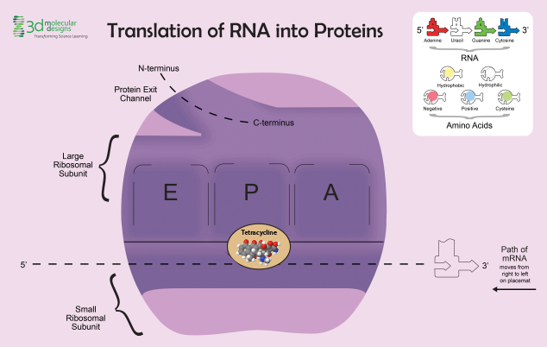
Tetracycline Antibiotic
Look at where Tetracycline binds within the ribosome.
What will be the consequences to the polypeptide during protein translation?
Model your prediction using the foam kit pieces.
Notes:
Teacher: Explain that Tetracycline is an antibiotic. Ask students to make a prediction about what will happen during protein translation.
Student: Discuss with their group where the drug is binding in the bacterial ribosome. Write a prediction in their notebook.

Slide 24
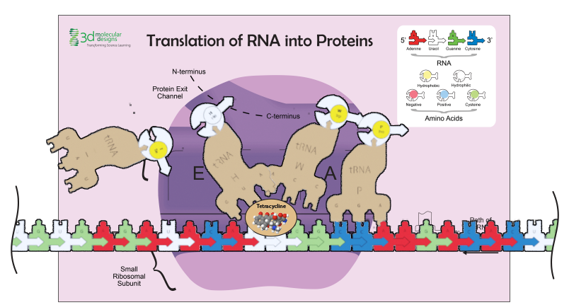
Tetracycline Interference
Now explore the second button.
Did the antibiotic change the translation of the protein the way you thought it would?
Notes:
Teacher: Ask students to discuss the prompt with their partner.
Student: Once groups have come to a consensus, have them record their ideas in their notebook. Explore the model using the play icon on the app. Verify their findings or revise them, as necessary.

Slide 25
Exploring Linezolid
Choose
Linezolid
Scan a purple
translation mat
Explore only the first button
Notes:
Teacher: Have students open the app and select the appropriate activity and scene. Move around the room and assist students with their technology. Students should point their cameras toward the A site of the ribosome.
Student: Open the app and select the appropriate activity and scene.

Slide 26
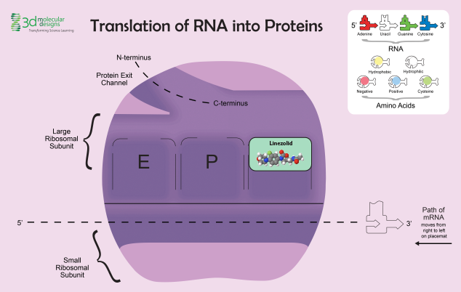
Linezolid Antibiotic
Look at where Linezolid binds within the ribosome.
What will the consequences to the polypeptide during protein translation?
Model your prediction using the foam kit pieces.
Notes:
Teacher: Explain that Linezolid is an antibiotic. Ask students to make a prediction about what will happen during protein translation.
Student: Discuss with their group where the drug is binding in the bacterial ribosome. Write a prediction in their notebook.

Slide 27
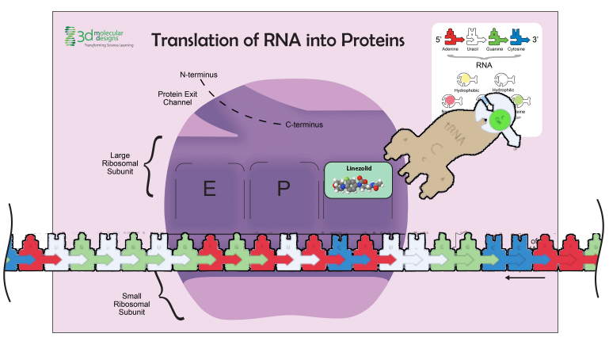
Linezolid Interference
Now explore the second button.
Did the antibiotic change the translation of the protein the way you thought it would?
Notes:
Teacher: Ask students to discuss the prompt with their partner.
Student: Once groups have come to a consensus, have them record their ideas in their notebook. Explore the model using the play icon on the app. Verify their findings or revise them, as necessary.

Slide 28
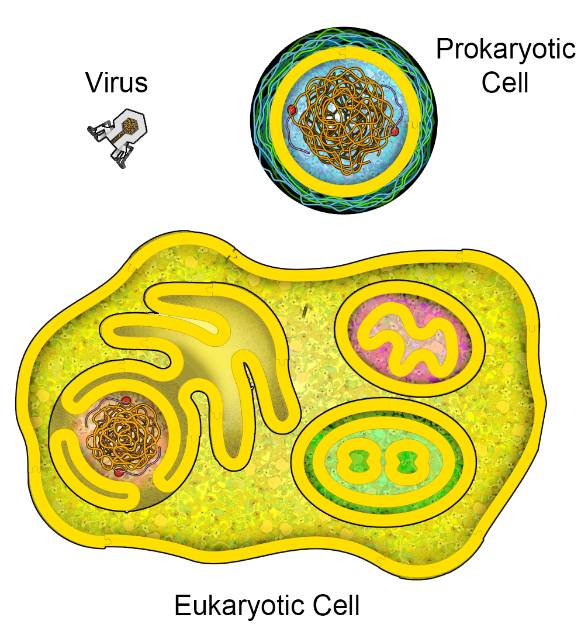
Thinking Deeper About Antibiotics
Why do antibiotics stop translation in bacteria but not in humans?
What would you target in a prokaryotic ribosome to shut down protein synthesis?
Would antibiotics work on a virus? Why or why not?
Notes:
Teacher: Have student group choice one of the prompts to research. Facilitate a discussion after students have researched.
Student: Research the differences between prokaryotic and eukaryotic ribosome. Share what they found with the class.

Slide 29

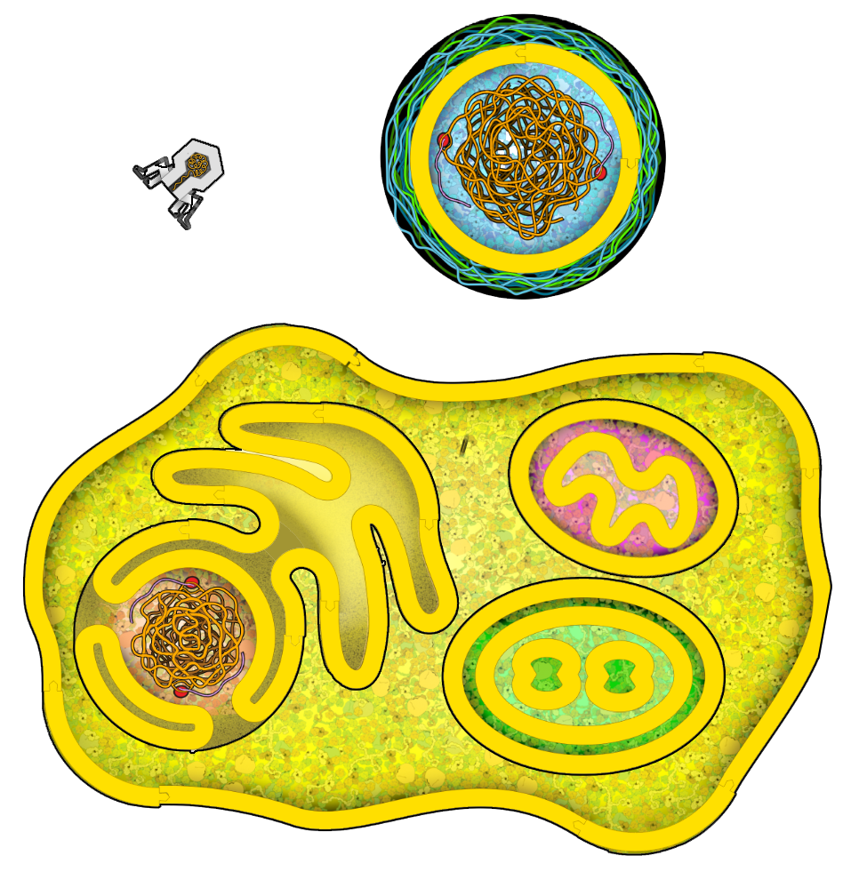
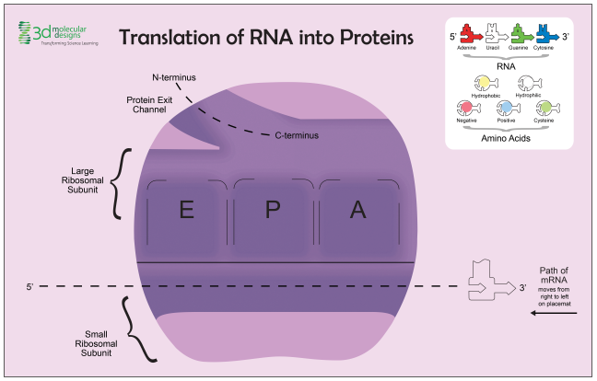
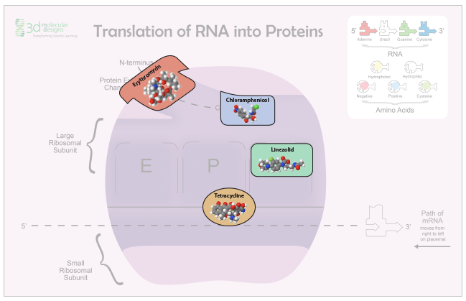
Conclusions
Ribosomes have APE Sites that allows for the binding of tRNA.
Some antibiotics target sites on the ribosome
There are distinct differences in prokaryotic and eukaryotic ribosomes.
Notes:
Teacher: Summary slide with learning objectives of this lesson.
Student: Jot their thoughts and ideas in their notebook.

