Slide 1
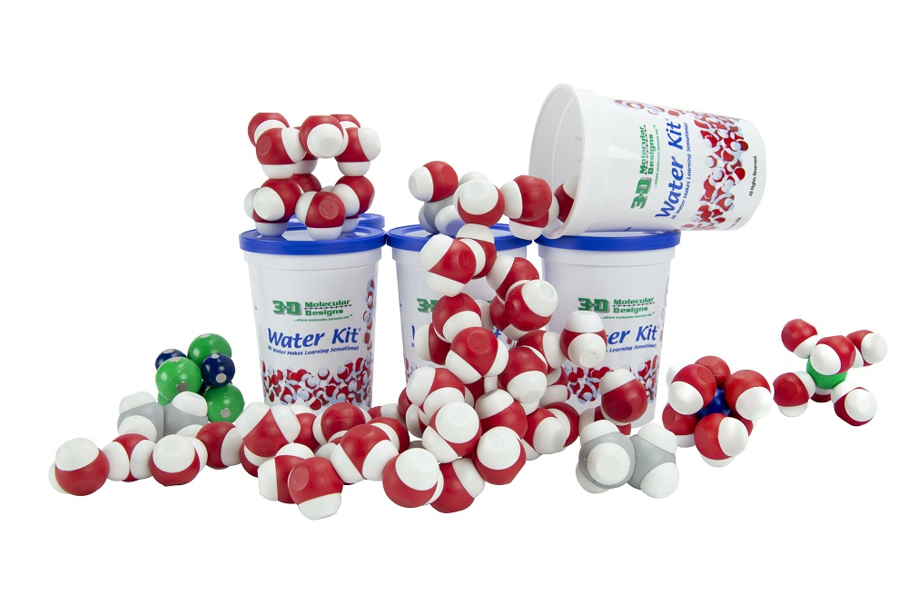


From Atoms to Oceans: Modeling the Properties of Water
Mark “Arnie” Arnholt
3D Molecular Designs

Slide 2
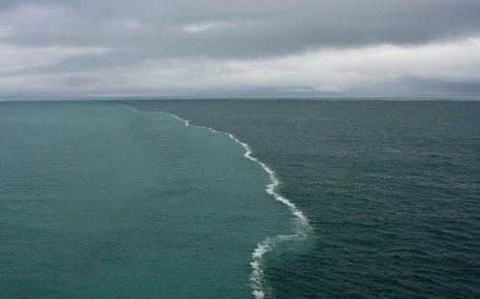
Meeting of the North Sea and Baltic Sea
What is happening here?
How can we model this?

Slide 3
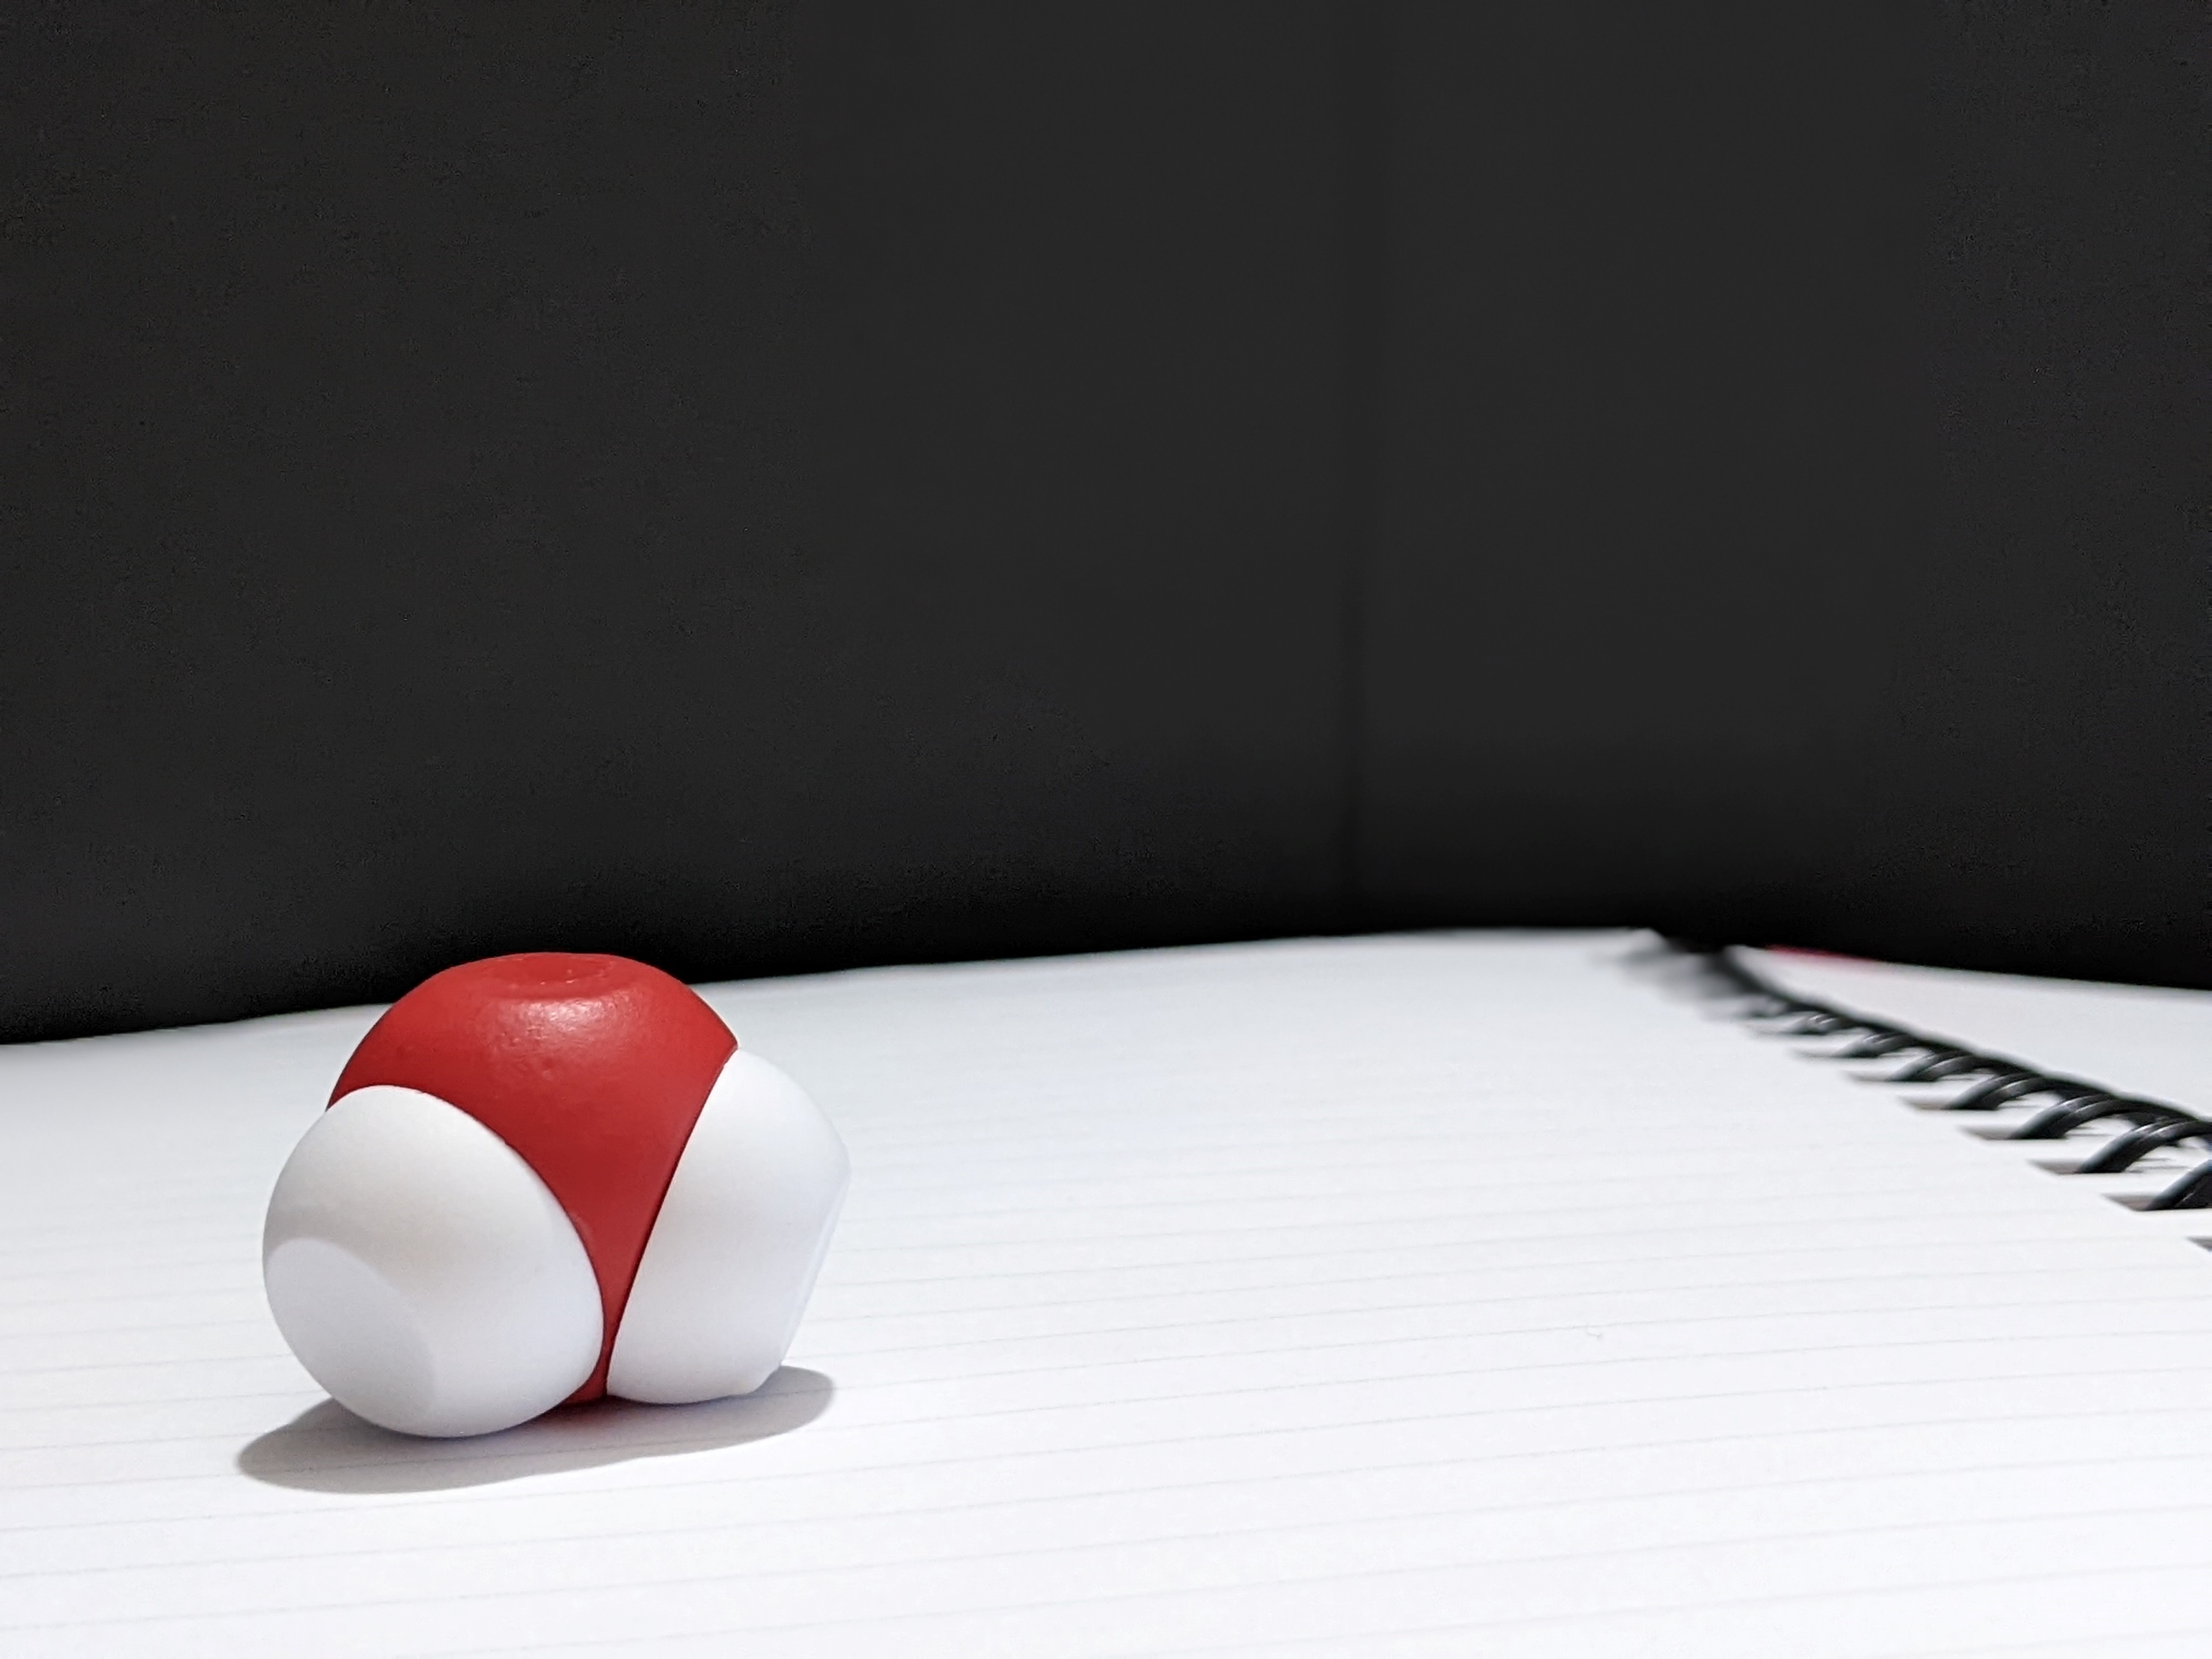
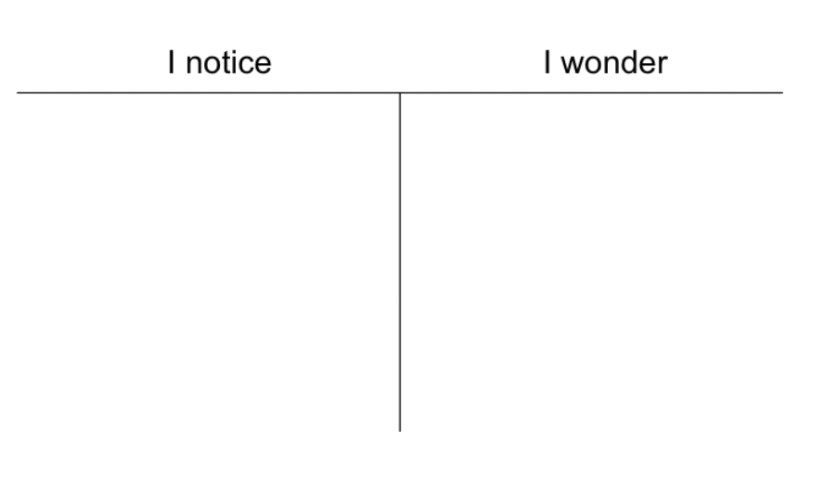

Slide 4
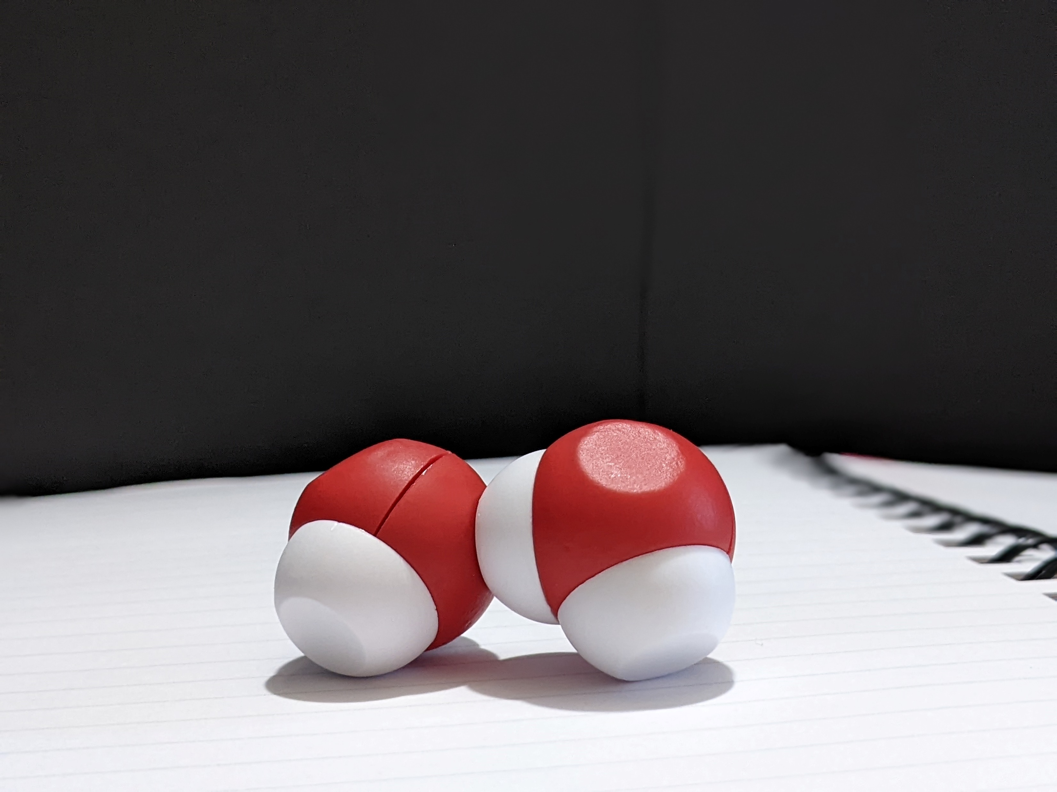
Remove four molecules of water from your Water Kit and observe how they interact with each other. ​
​
Record your observations in your lab notebook. ​
​
What occurs as you add more molecules of water until you have added all twelve molecules?

Slide 5
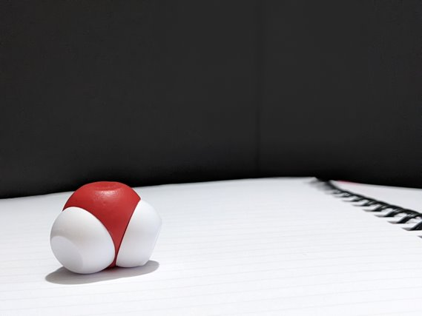
Let's take a closer look at the water molecule. Very carefully separate a hydrogen from an oxygen. ​
What do you see? ​
Do both hydrogens connect to the oxygen in a similar fashion?​
Compare the difficulty in separating a hydrogen from an oxygen within a water molecule to separating two water molecules from each other.

Slide 6
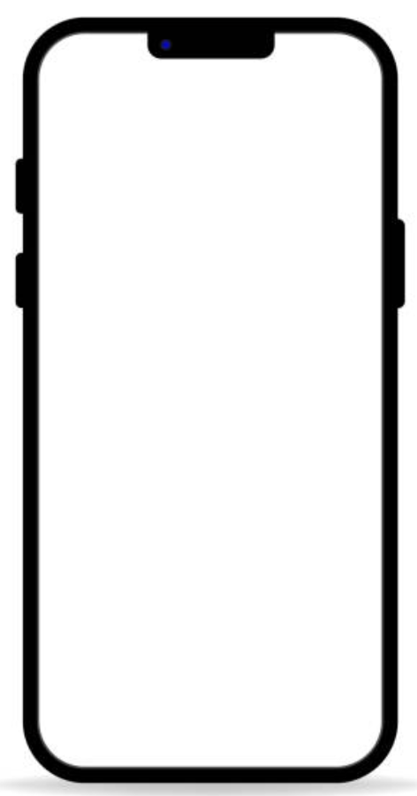

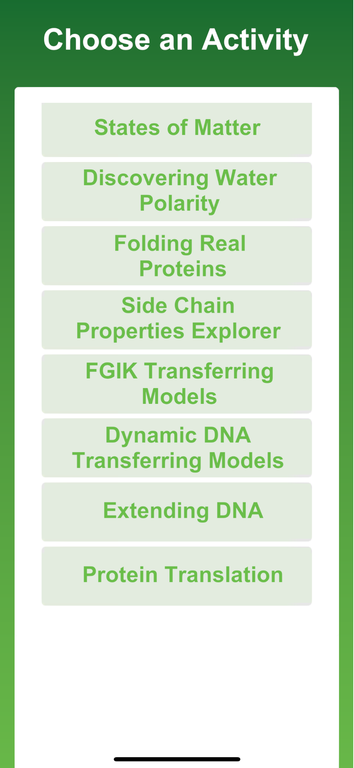
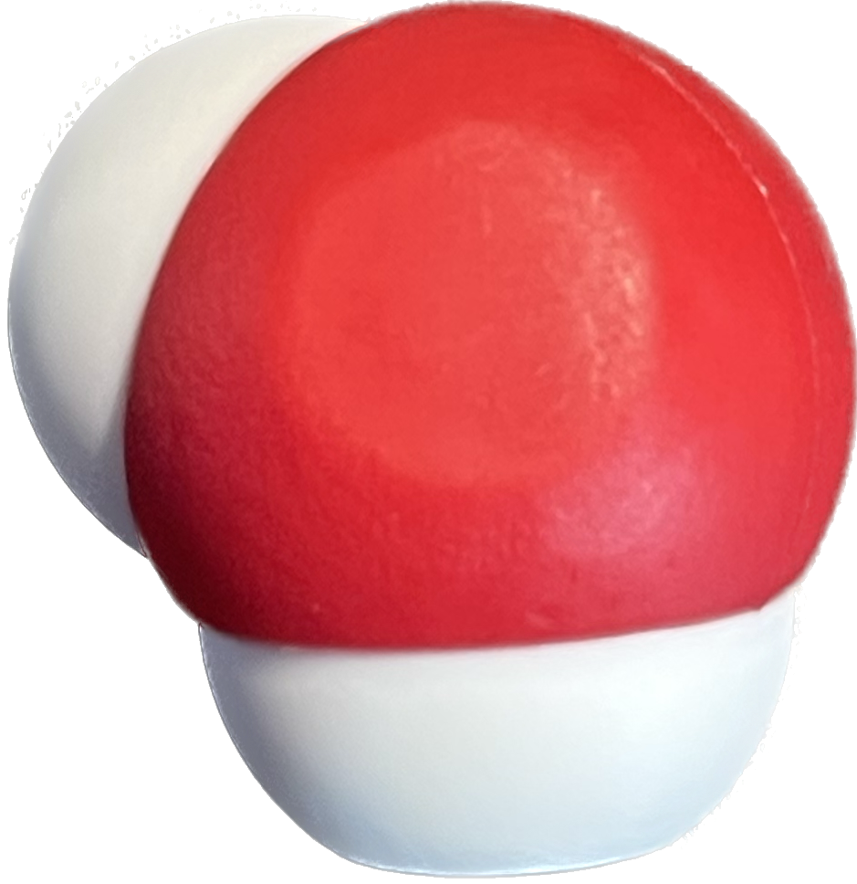
But why do the molecules interact this way?

Slide 7

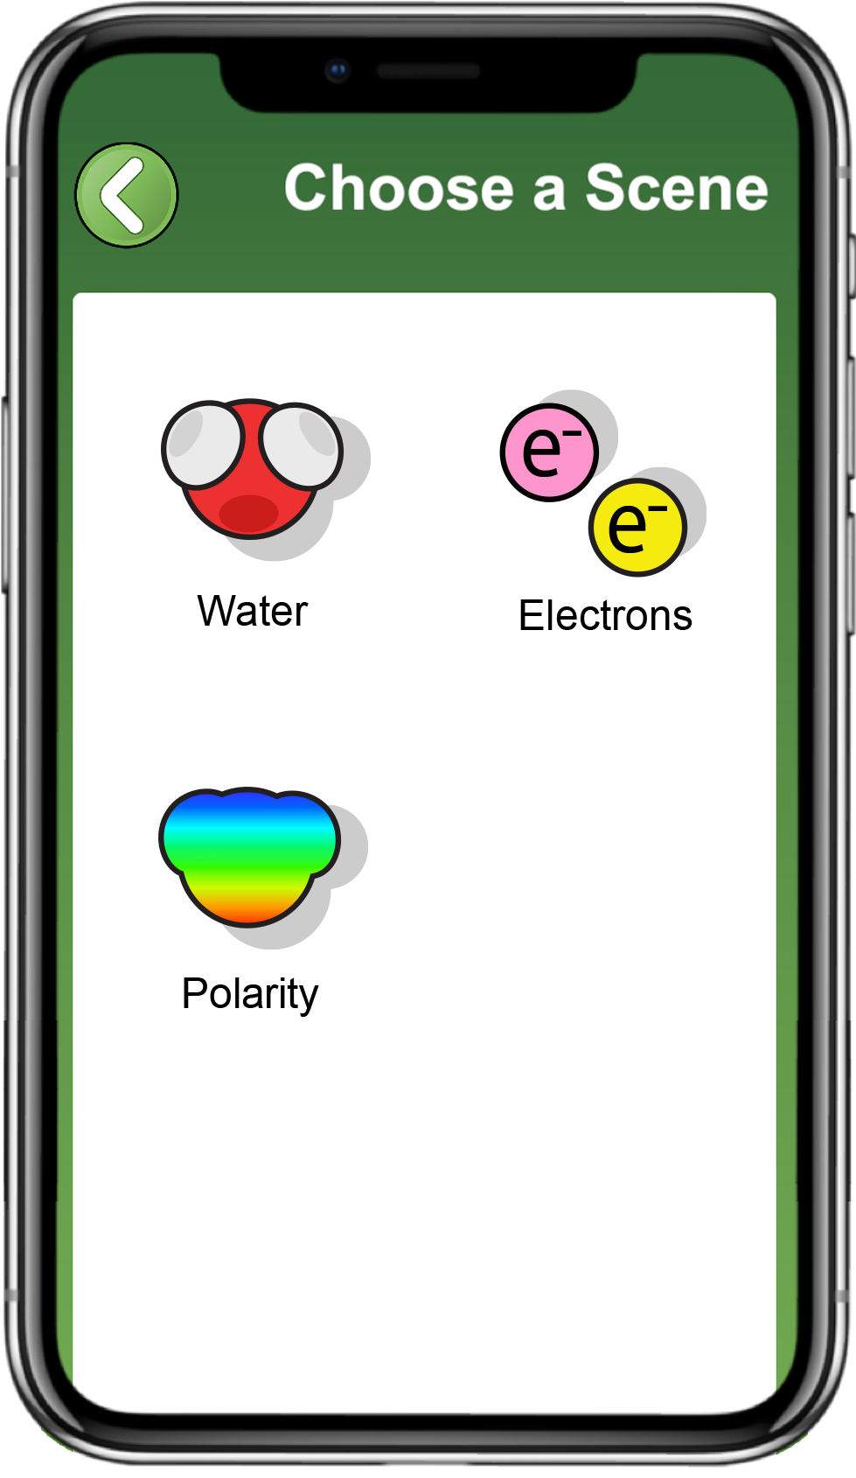
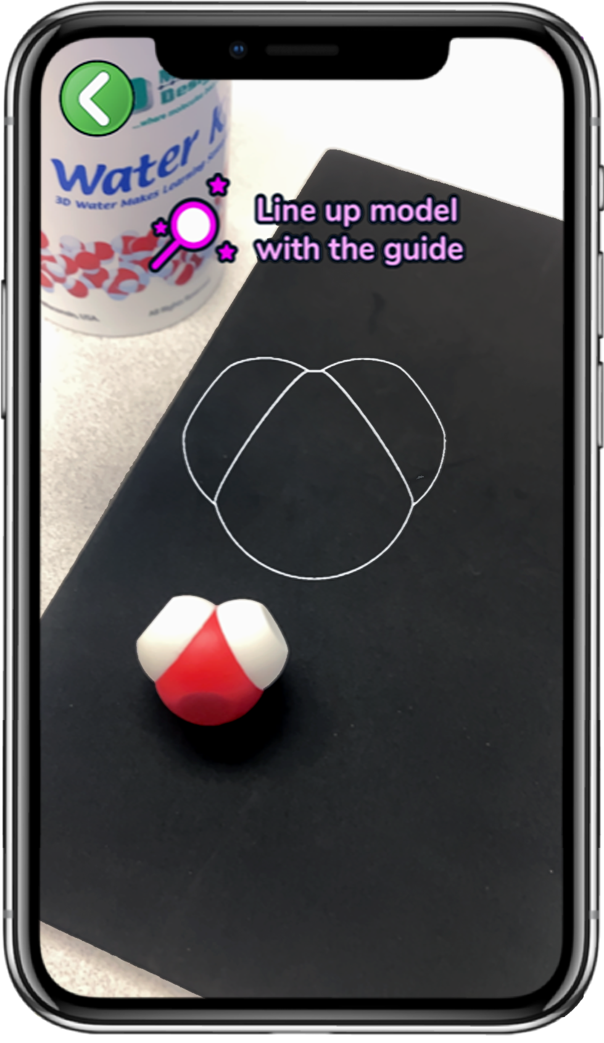
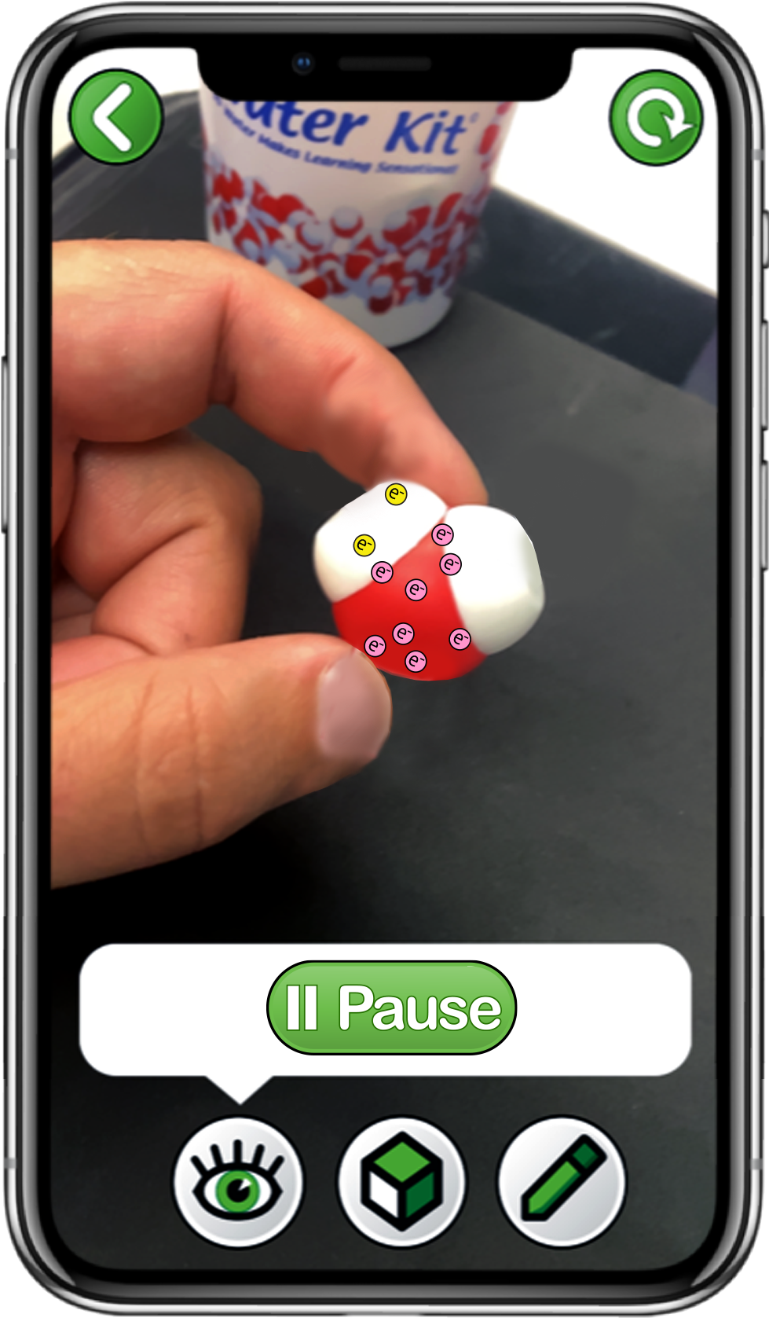

Explore Electrons with the
3DMD AR EDU App
Choose
Electrons
Scan a single water molecule
Explore the
Play and Sample buttons

Slide 8
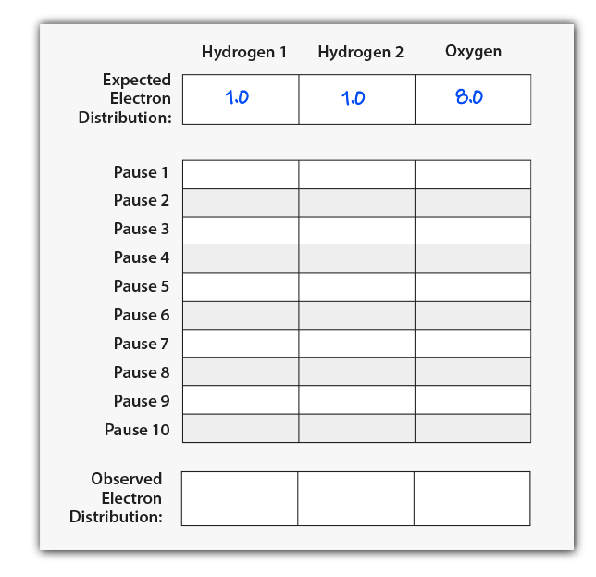

Explore Electron Distribution
Electrons move very, very fast!!
Use the Sample button to stop the movement of electrons.
Count and record the number of electrons for each sample on your data table.
Start and Sample electron locations ten times to complete your data table.

Slide 9

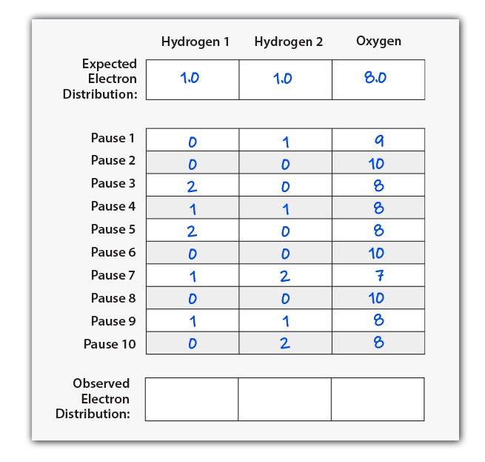
Average Observed Electron Distribution
Once your data table is filled with at least ten samples, calculate the average electrons observed near each atom.
Average of x = (x₁ + x₂ + x₃ +. . . x_{n}) / n
Record these averages in the bottom row of your table.

Slide 10

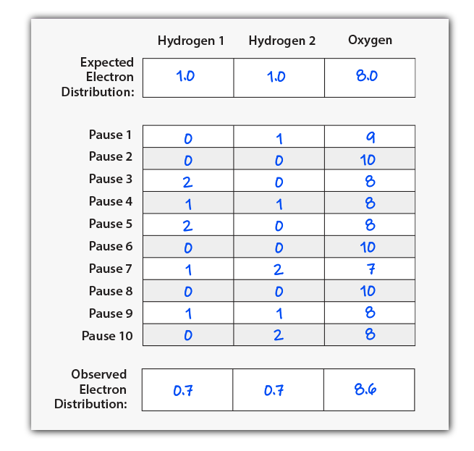
Does every group have the same data?
How does your Expected Electron Distribution compare to your average of Observed Electron Distributions?
Do electrons spend more time near the hydrogen atoms or the oxygen atom?
Why might that be?
What impact might this have on a water molecule?

Slide 11
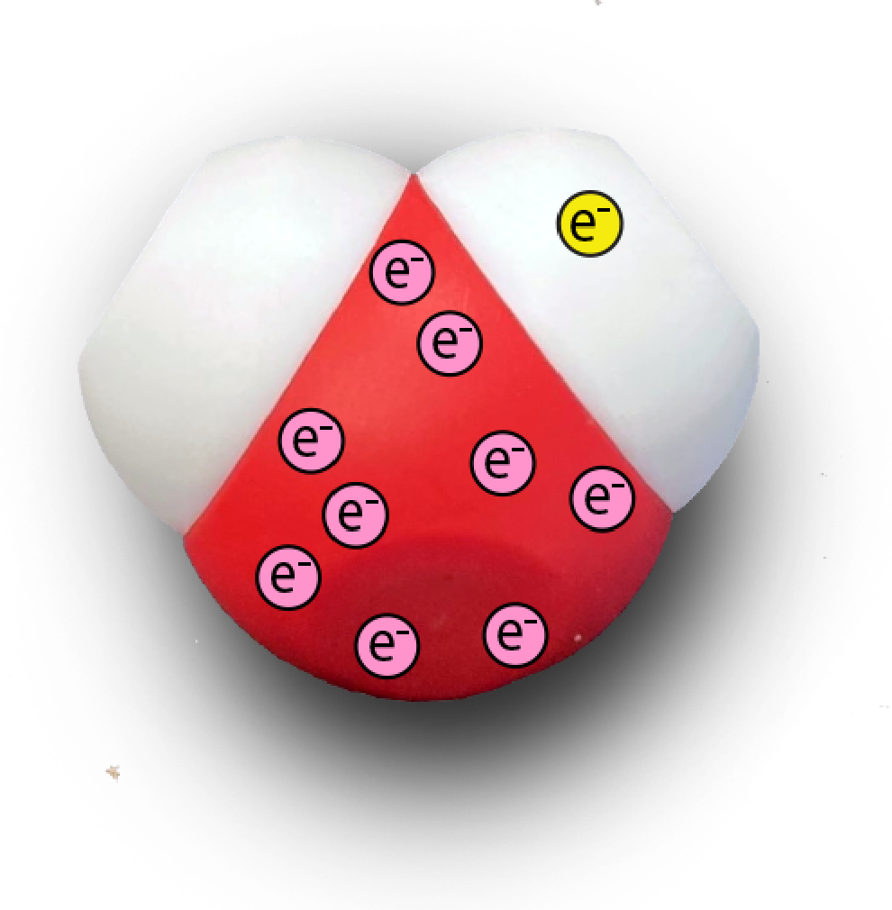
Electrons Are Not Shared Equally
The electrons in a water molecule are not shared equally!
On average, electrons spend slightly more time near the oxygen atom than would be expected.
We call this property of water POLARITY!

Slide 12
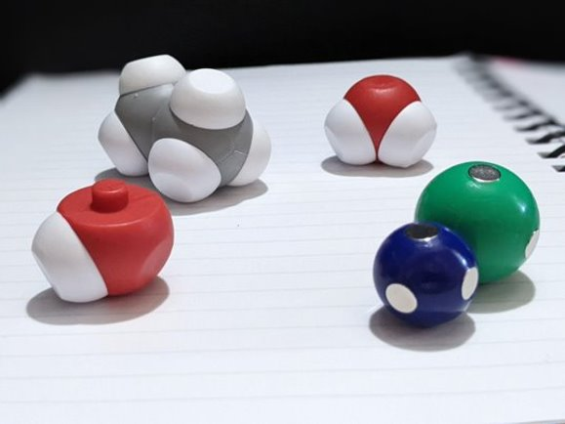
Look at the other contents of the Water Kit.
What other substances contain posts that would represent covalent bonding? ​
​
How many separate covalent bonds can you find?

Slide 13
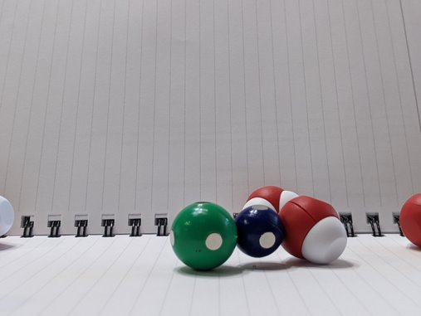
How does sodium chloride interact with water? ​
How do the sodium ion and the chloride ion interact with each other? ​
​
Compare the three types of chemical bonds about which you have learned. Rank them in order of strength of the bond.​

Slide 14
Comparing Types of Forces | COVALENT BONDING | IONIC BONDING | HYDROGEN BONDING
What is it? | Formed when two atoms share a bond within one molecule, can be partially charged or without charge. | Complete transfer of electrons between two atoms resulting in one that is positively charged, and one negatively charged. | A weak attraction of a hydrogen atom that is covalently bound to a more electronegative “donor” atom or group.
How is it represented by the model? | The plastic post connecting the oxygen and the hydrogen in water | The magnet in the sodium atom connecting to the magnet of chlorine atom | The hydrogen of one water molecule attracted to the oxygen of another water molecule
Type of force | Intramolecular Force | Intramolecular Force | Intermolecular Force
Notes:
This ends the first day of using this kit. Use this graphic to summarize what students should know about the model.
Does anyone have a better way that they use when they summarize using this kit?

Slide 15
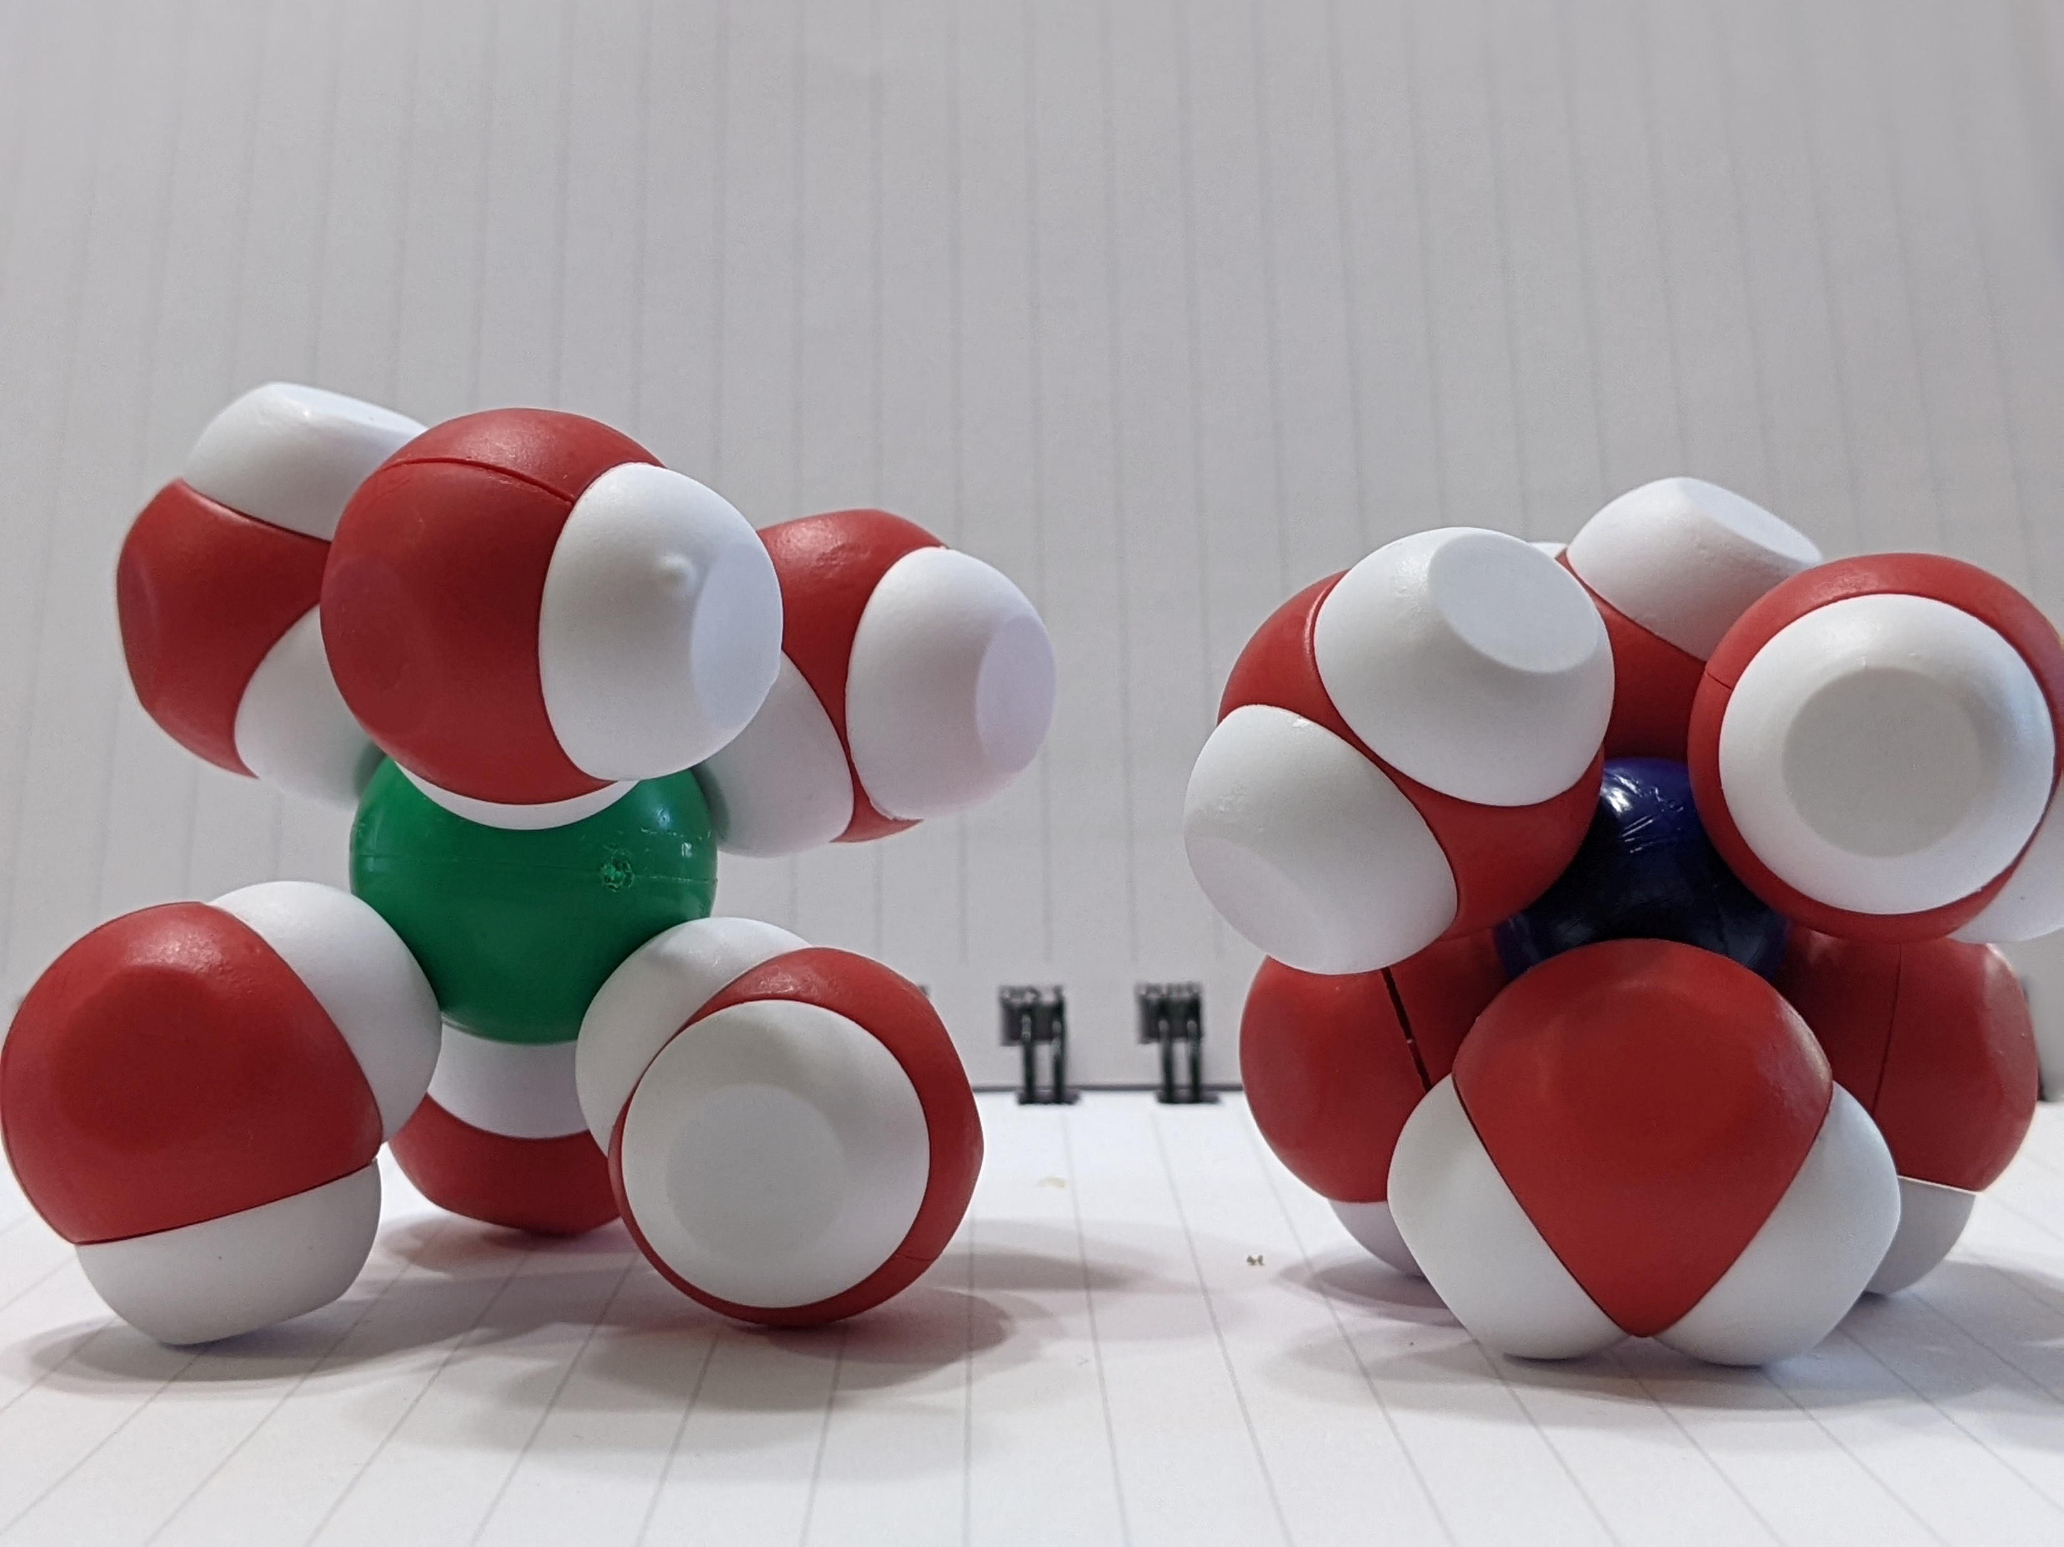
Let’s start by modeling sodium chloride’s interaction with water​
Describe what occurs when water interacts with sodium chloride. ​
Which ion interacts with oxygen? Why?​
Which ion interacts with hydrogen?
Why?
Notes:
Explain to students what a solvation shell is. In the case of water, it is known as a hydration shell.

Slide 16
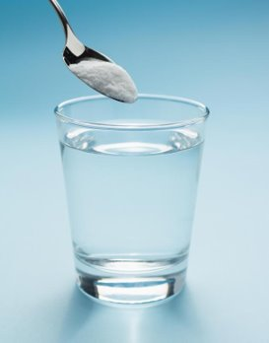
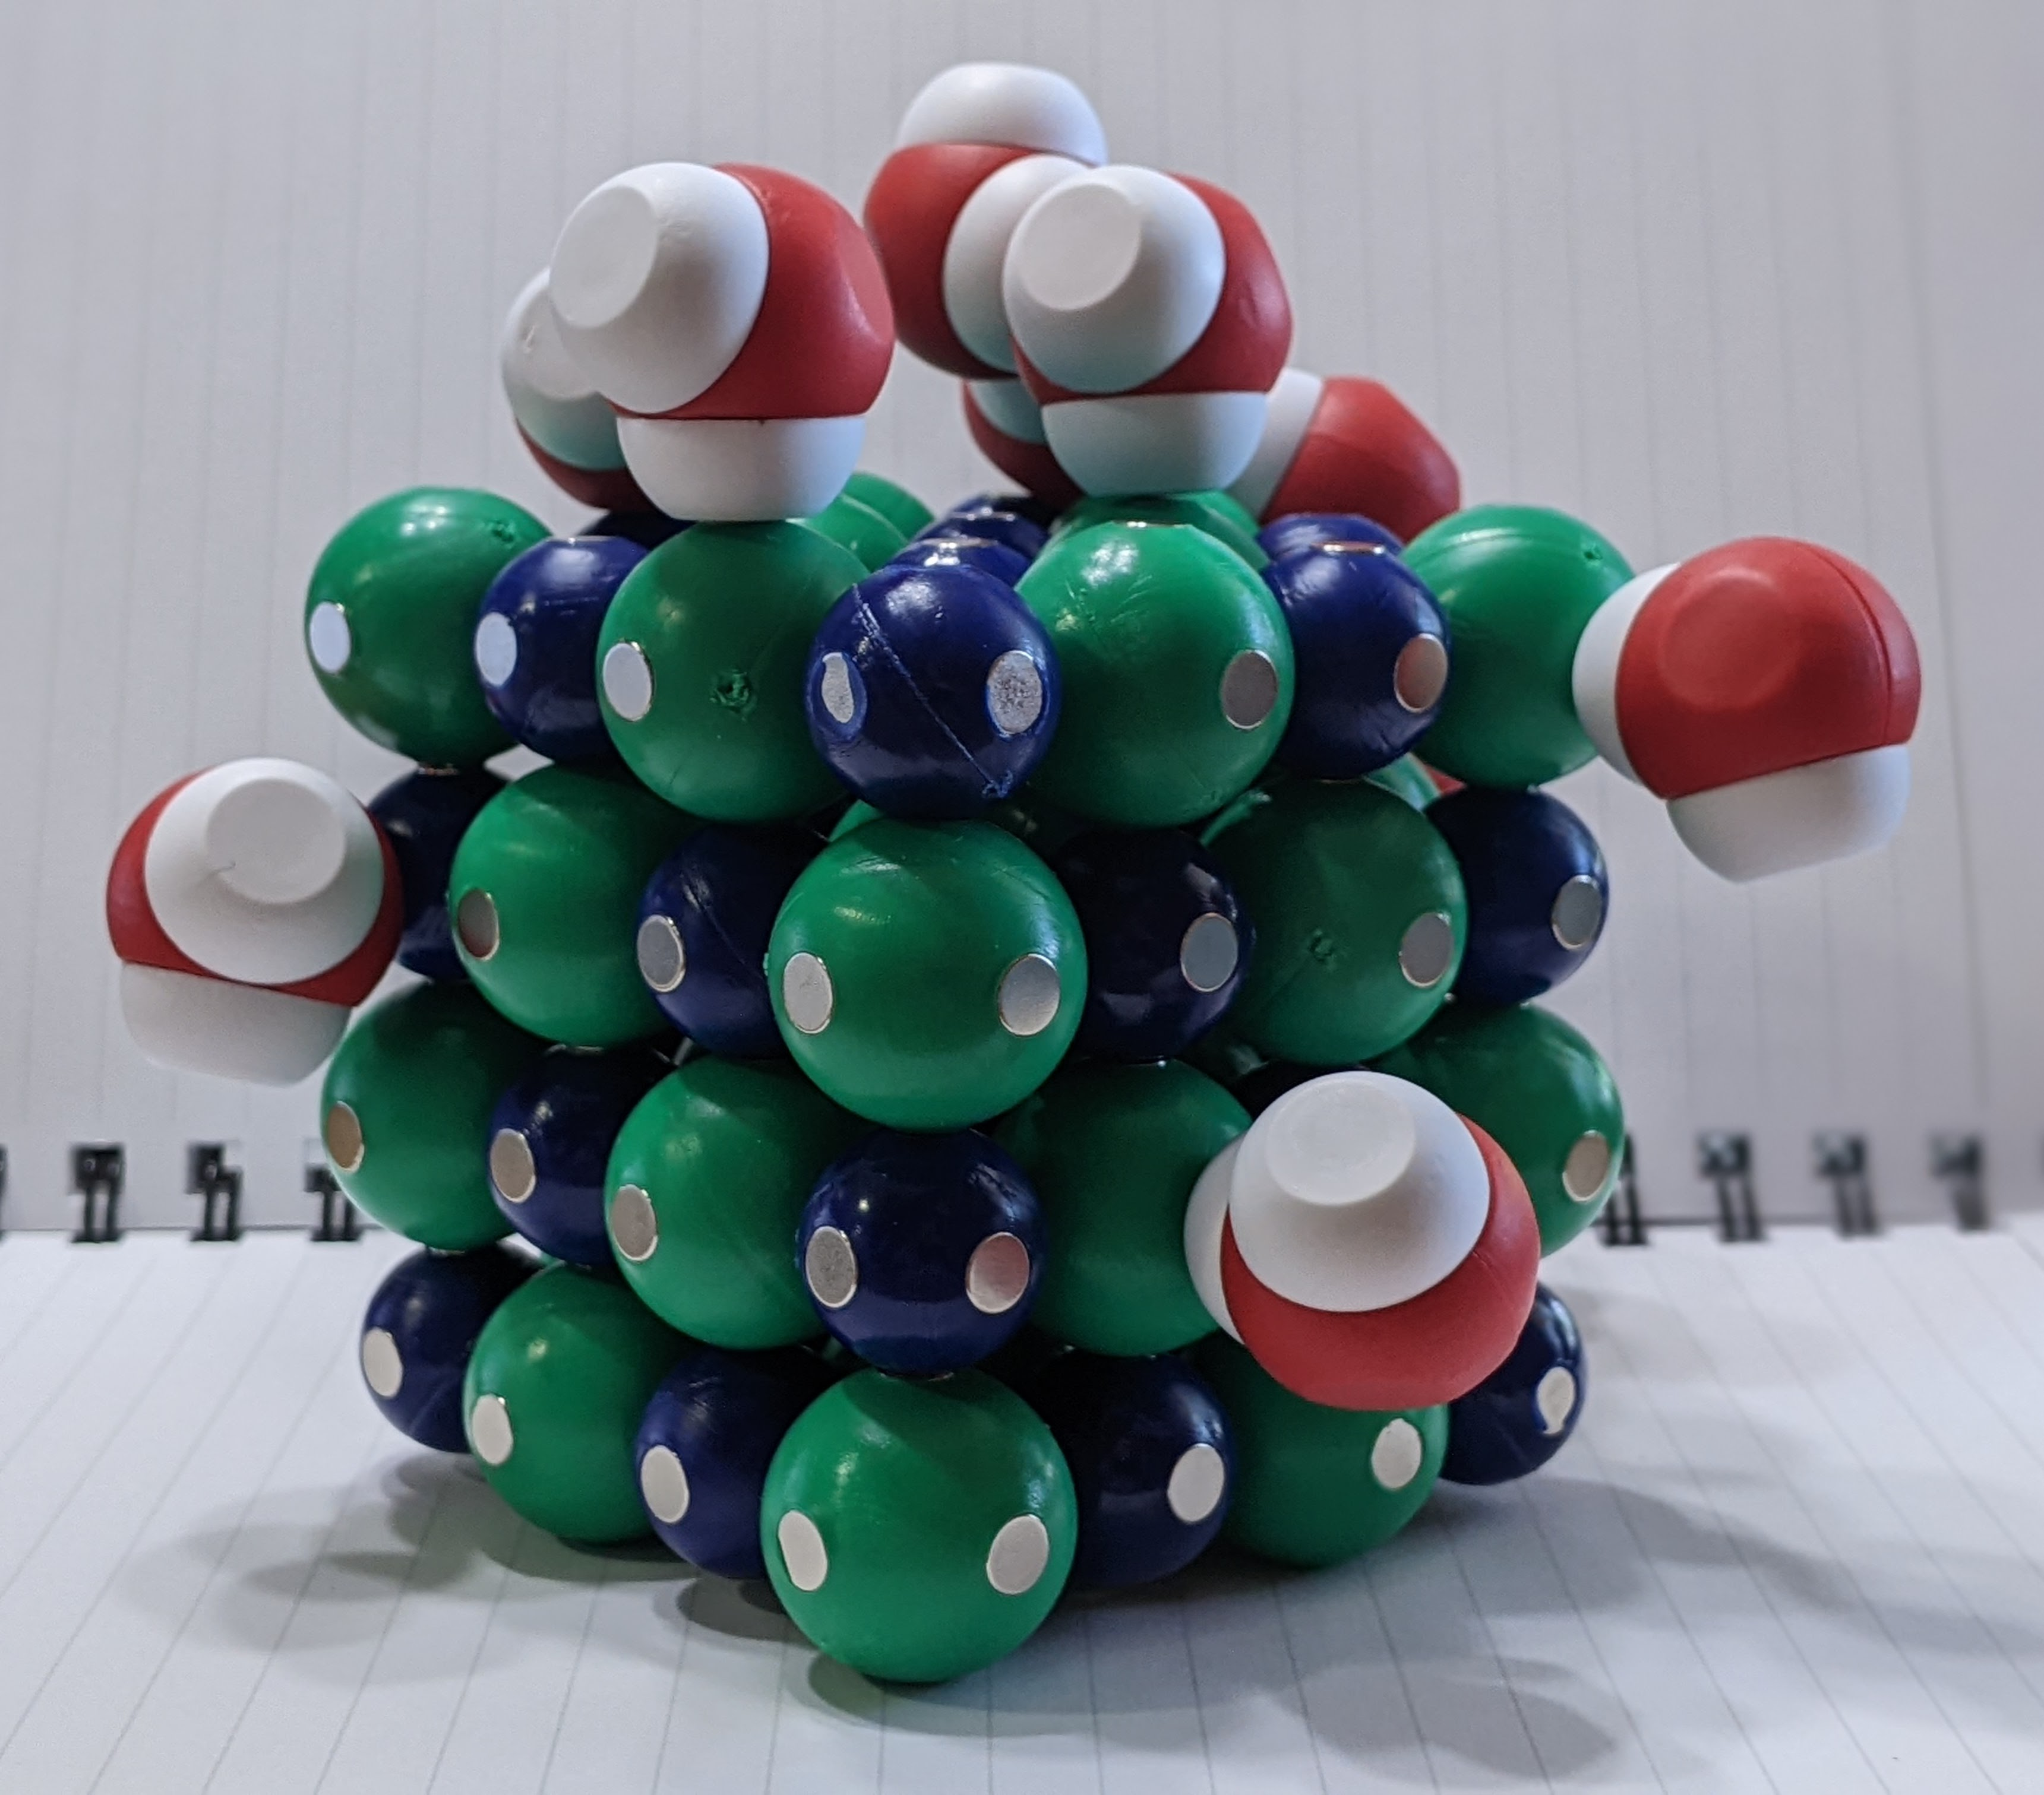
Let’s model a sodium chloride lattice dissolving in water
Notes:
Assess students’ understanding by asking them to model another scenario. Make a saturated solution together. After discussing the characteristics of an unsaturated solution and supersaturated solution, allow students create those models.

Slide 17
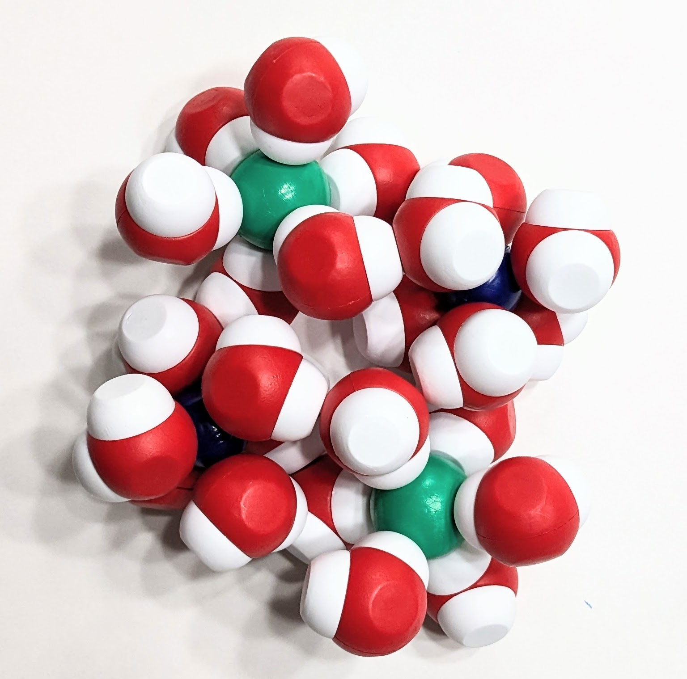
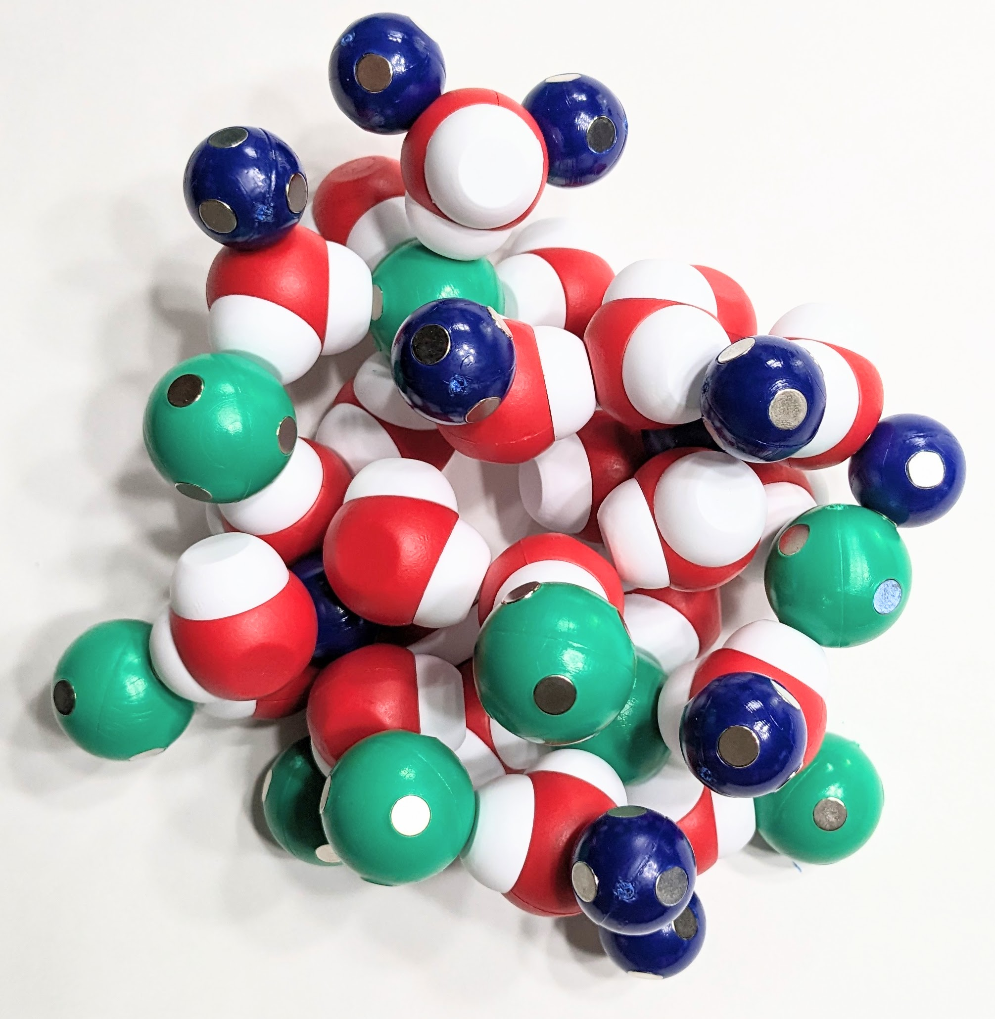
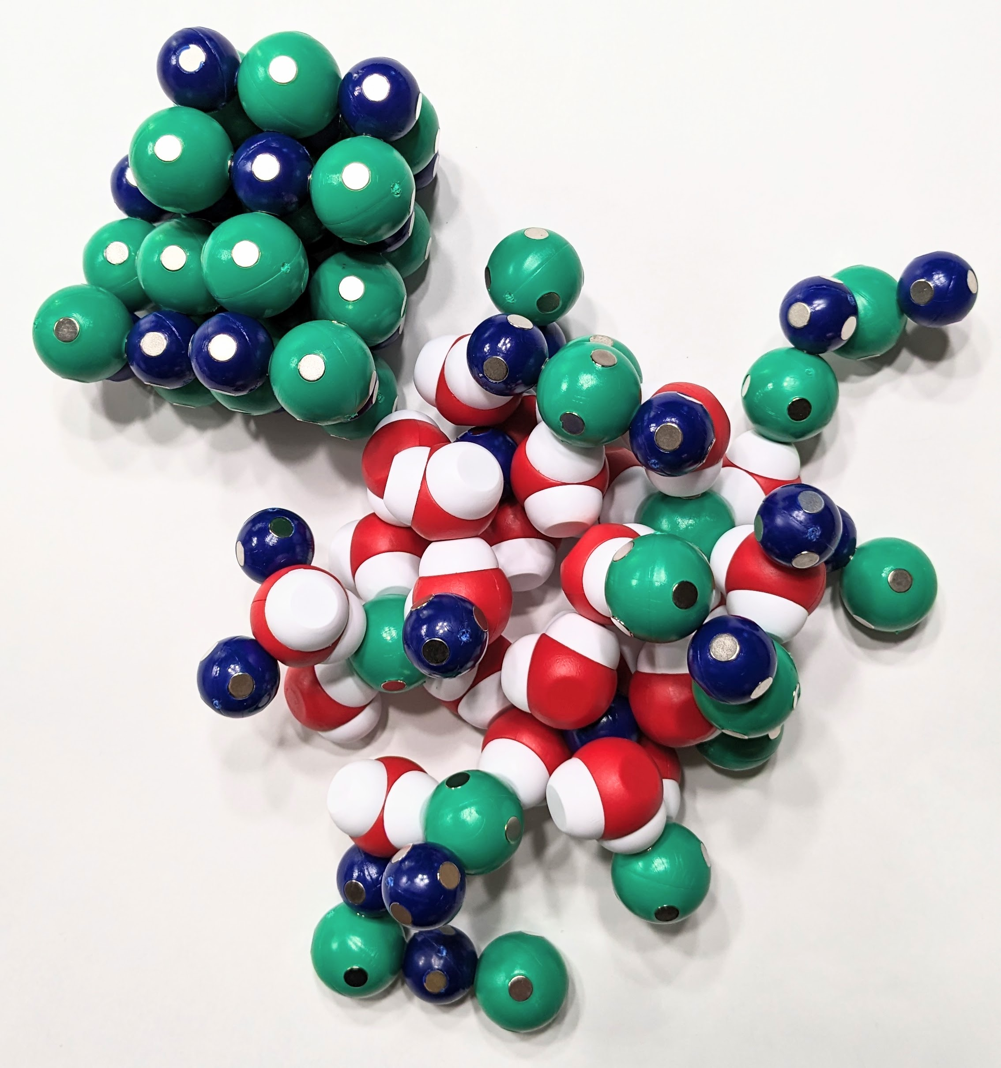
Modeling Solutions
Unsaturated | Saturated | Supersaturated
A solution that contains less than the maximum amount of solute that is capable of being dissolved. | A solution that contains the maximum amount of solute that is capable of dissolving. | A solution that contains more than the maximum amount of solute that is capable of being dissolved at a given temperature. By adding a seed crystal, the solution recrystallizes.

Slide 18
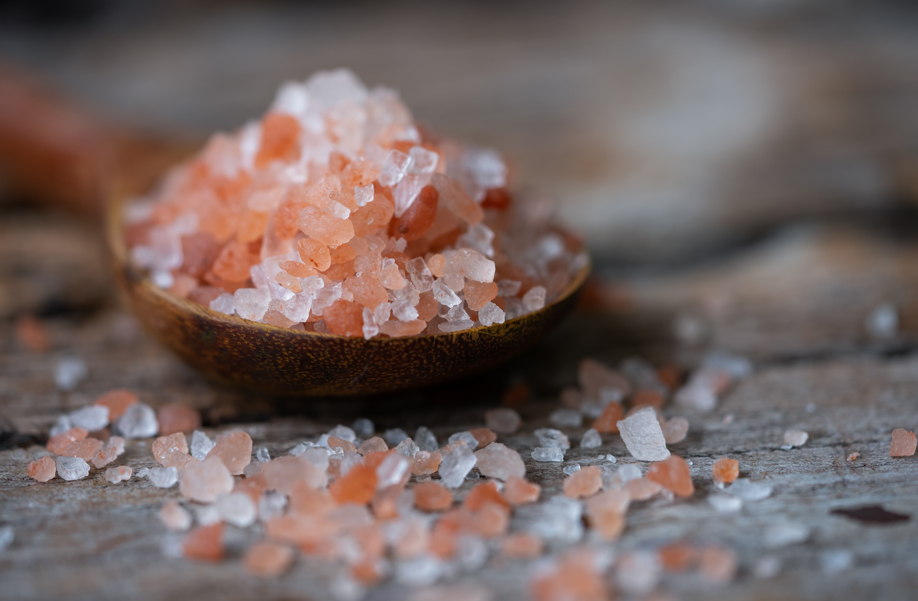
A closer look by other factors affecting solubility
Notes:
Solubility in water is affected by:
Temperature (Solubility increases with temperature for most solids dissolved in liquid water. Higher temperatures increase the vibration or kinetic energy of the solute molecules.)
Pressure (gaseous substances are much more influenced by pressure than solids and liquids)
Polarity (like dissolves like)
Molecular size (Smaller molecules are generally more soluble in water than larger molecules.)

Slide 19
Propose an explanation

Slide 20
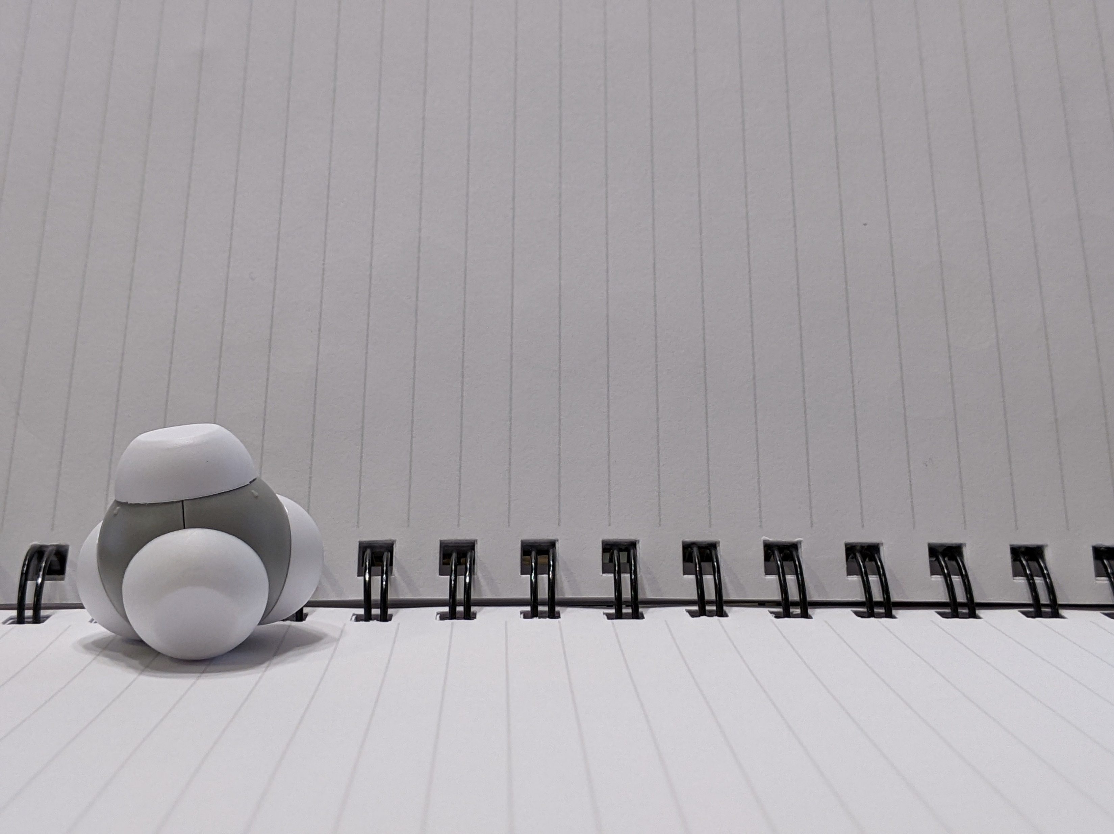
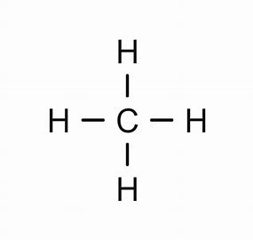
Notes:
Ruth says: Then we talk about the structural formula. For this activity, I am going to have you move about the room as we make ethane, propane, butane, etc. We will end by making octane. With your seat partner, please make ethane. You should already be familiar with the ethane molecule since we just worked with it. What is its structural formula?
[Advance slide]

Slide 21
How can this be made into an extended structure?
Notes:
Ruth says: Then we talk about the structural formula. For this activity, I am going to have you move about the room as we make ethane, propane, butane, etc. We will end by making octane. With your seat partner, please make ethane. You should already be familiar with the ethane molecule since we just worked with it. What is its structural formula?
[Advance slide]

Slide 22
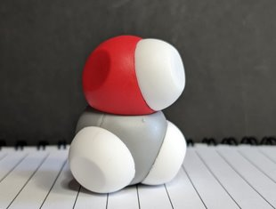
What is going on in this beaker at the molecular scale?
Unknown Solution | Observations in Lab | Modeling
Methanol
Ethanol
Butanol
Octanol
Notes:
Test methanol's solubility in water by placing the methanol molecule in an empty cup with three or four water molecules. Place the lid on tightly and shake to mix. [Shake cup with flourish and pour the contents on the table.] Now pour the contents on the table.

Slide 23
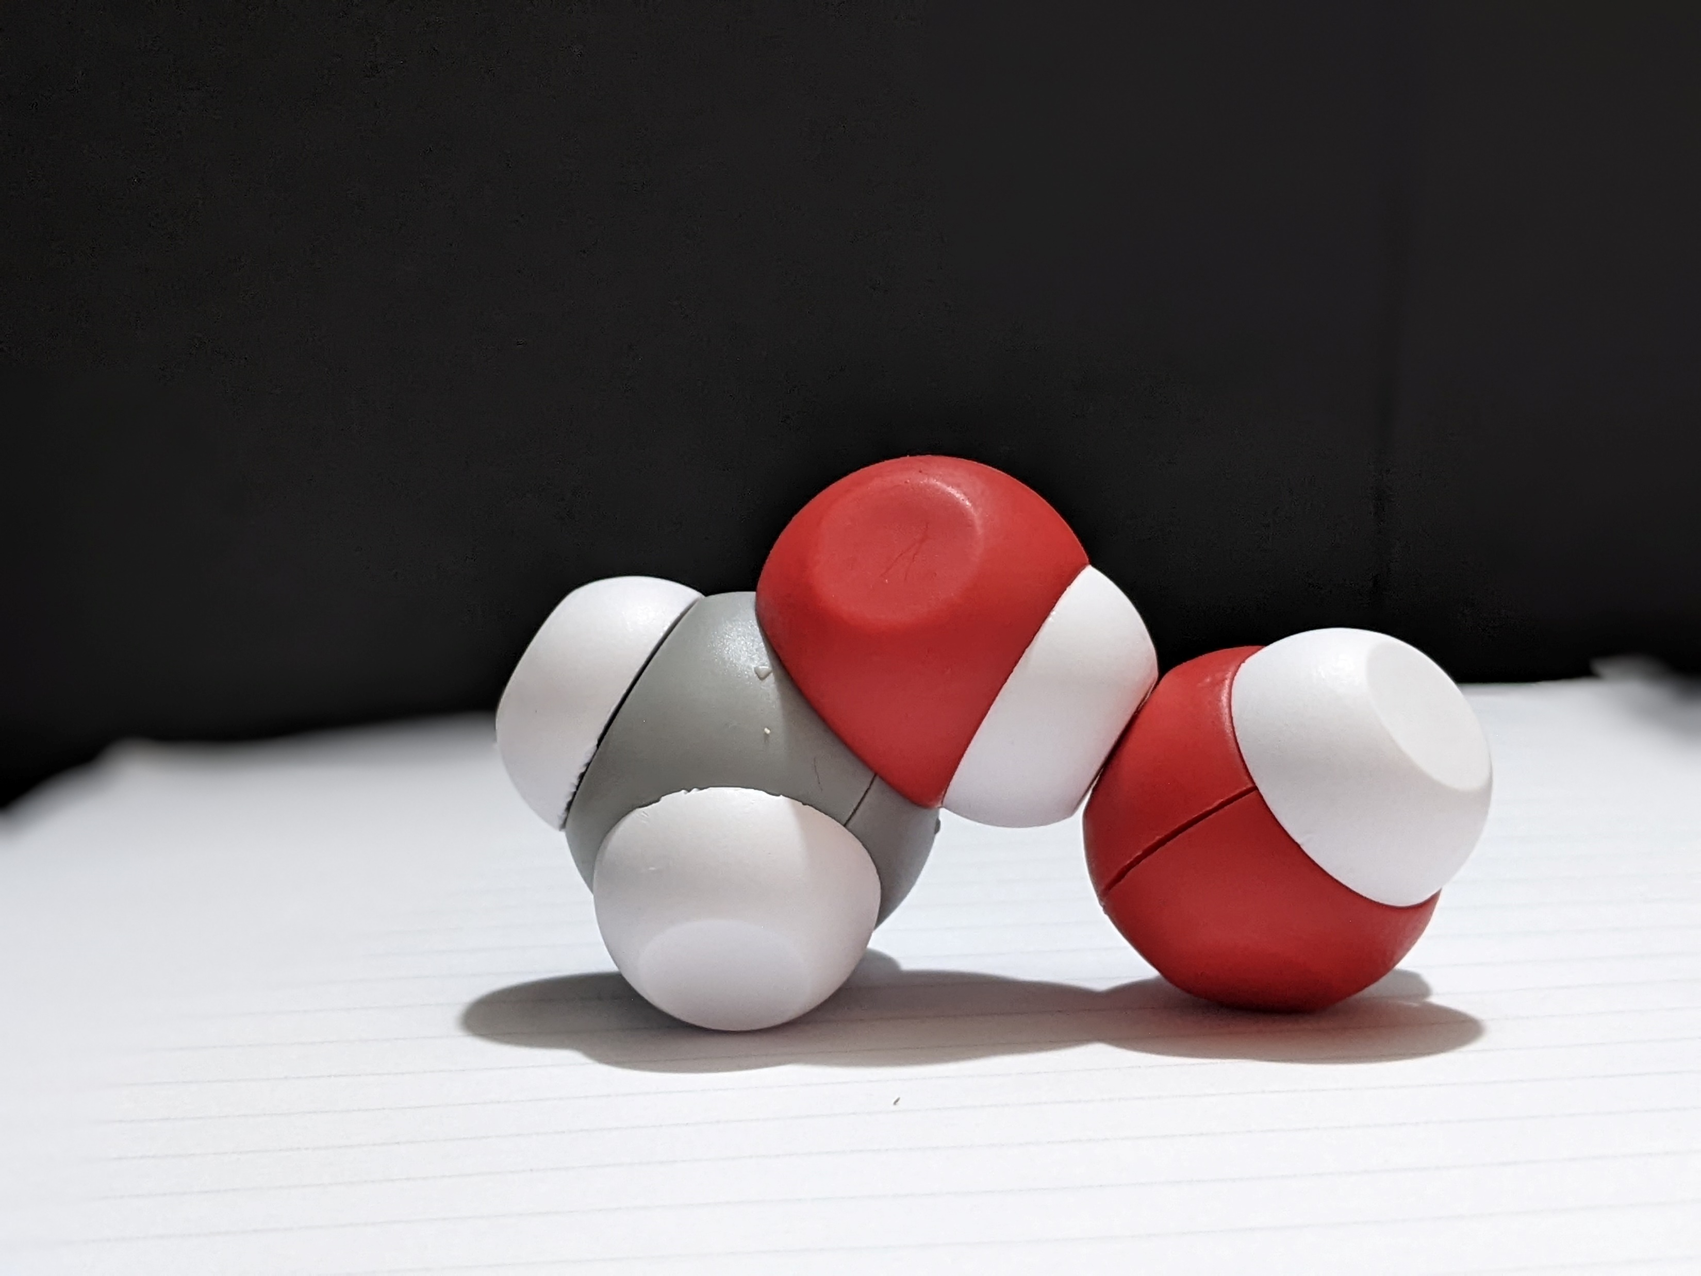
What is going on in this beaker at the molecular scale?
Unknown Solution | Observations in Lab | Modeling
Methanol
Ethanol
Butanol
Octanol
Notes:
Discuss findings.

Slide 24
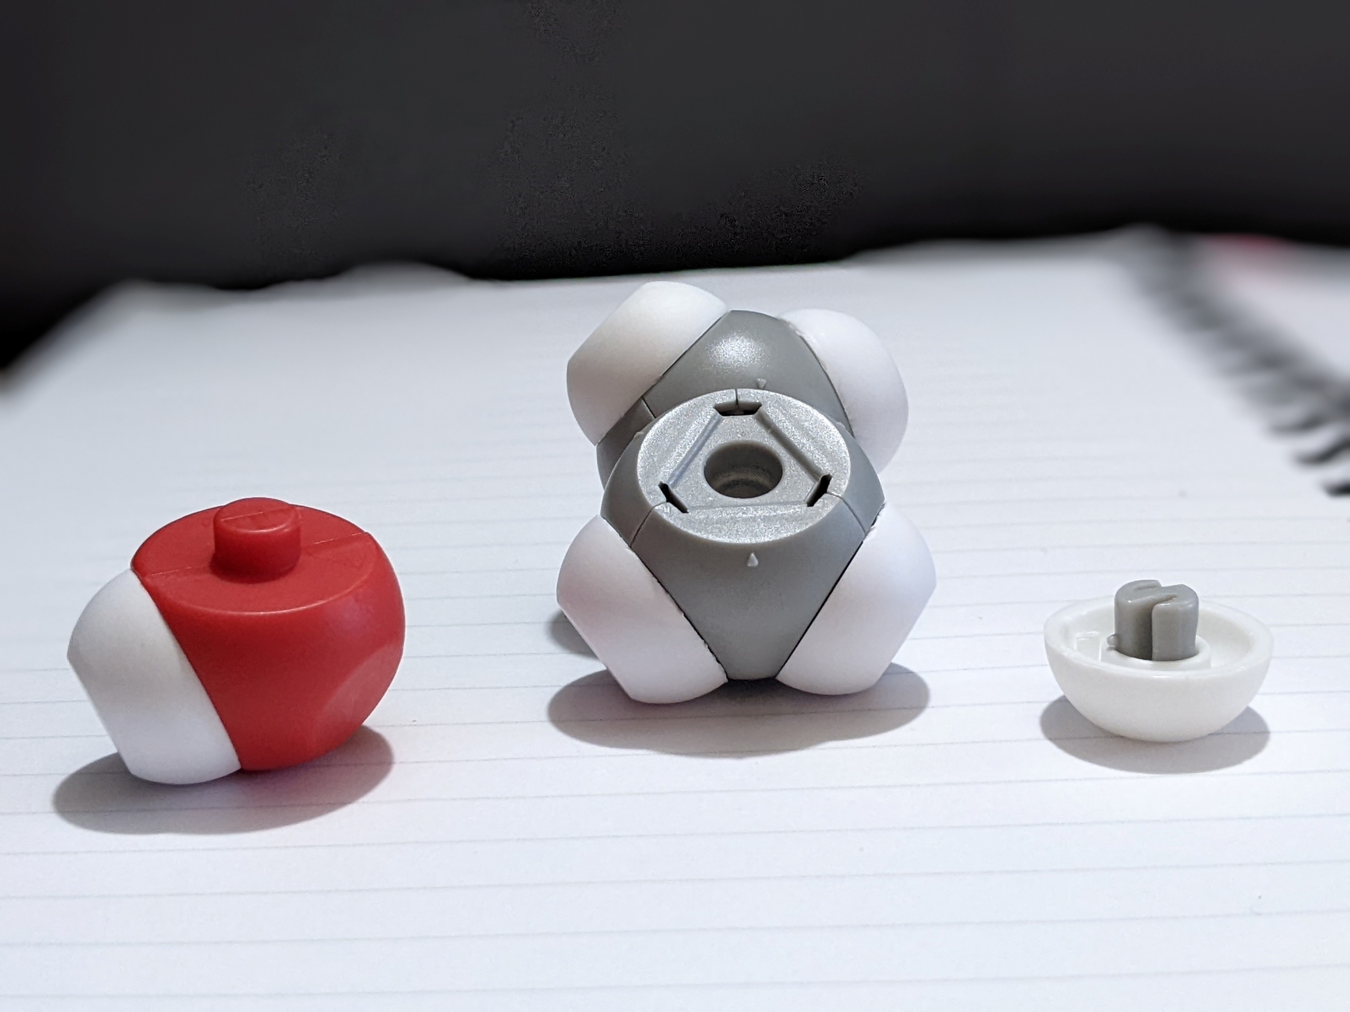
What is going on in this beaker at the molecular scale?
Unknown Solution | Observations in Lab | Modeling
Methanol
Ethanol
Butanol
Octanol
Notes:
To do modeling this at the molecular scale, first must build a model of alcohol. Use the 'broken' water part from the kit and the ethane molecule.
Review the parts of the molecules. Students will make all four molecules or assign groups and have them share their findings. Remove the hydrogen atom that has the S-bond. I've shown it on the screen. It is the hydrogen that has a star beside it. Once that hydrogen and the post is removed, the hydroxyl group can be covalently bonded to the remaining structure.

Slide 25

Modify the ethane molecule to make an ethanol molecule.
What is the chemical formula of ethanol? ​
​
How does ethanol interact with water?​
How does that compare to how ethane interacts with water?

Slide 26
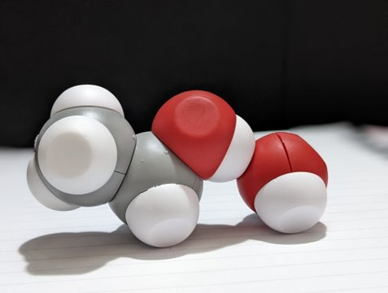
Identify the location of the covalent bonds in the ethanol molecule. ​
Where do you find hydrogen bonding?

Slide 27
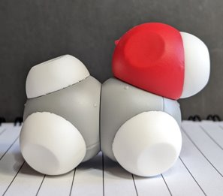
What is going on in this beaker at the molecular scale?
Unknown Solution | Observations in Lab | Modeling
Methanol
Ethanol
Butanol
Octanol
Notes:
Do the same thing for ethanol.

Slide 28
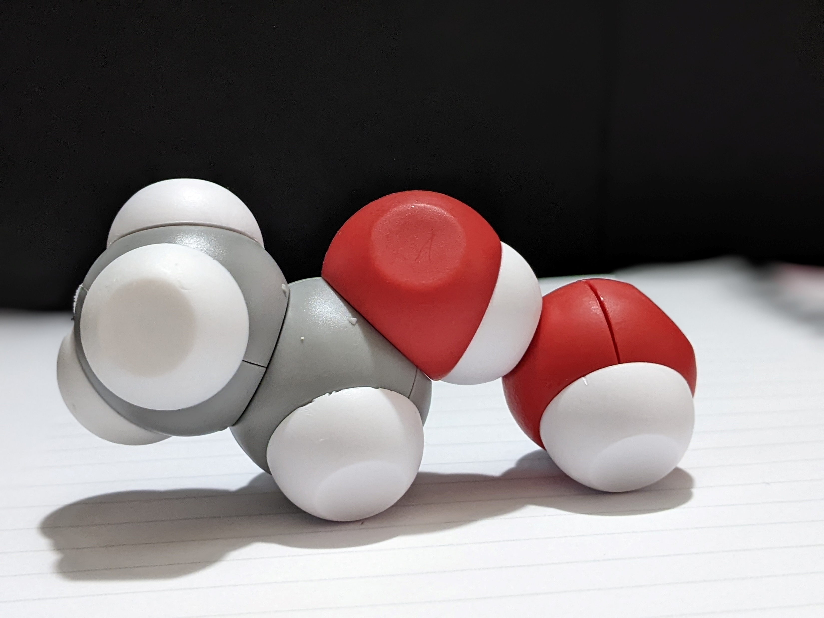
What is going on in this beaker at the molecular scale?
Unknown Solution | Observations in Lab | Modeling
Methanol
Ethanol
Butanol
Octanol
Notes:
Discuss findings.

Slide 29
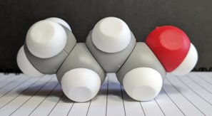
What is going on in this beaker at the molecular scale?
Unknown Solution | Observations in Lab | Modeling
Methanol
Ethanol
Butanol
Octanol
Notes:
To build butanol with a partner. Test butanol’s solubility and discuss findings.
How can we explain what is happening as the carbon and hydrogen chain gets longer?

Slide 30
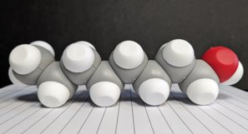
What is going on in this beaker at the molecular scale?
Unknown Solution | Observations in Lab | Modeling
Methanol
Ethanol
Butanol
Octanol
Notes:
Take apart their butanol molecule and return to your seats with the parts you used to make it. Assemble the ethane molecules and return it to the cup.
Ask for a volunteer and test a pre-made octanol molecule. Make a prediction based on what you already know about methanol, ethanol, and butanol? Test octanol’s solubility.

Slide 31
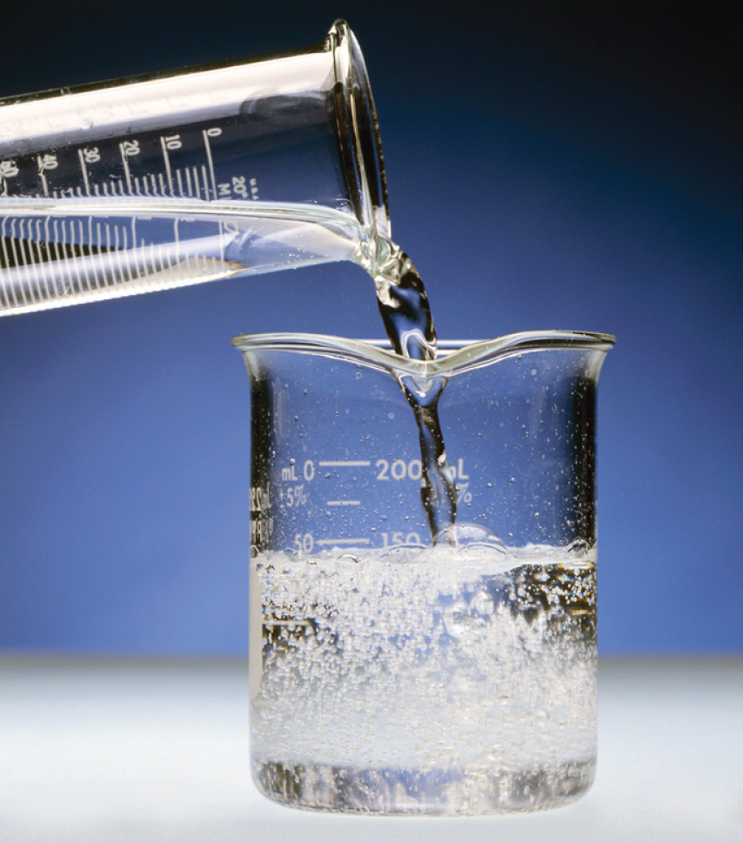
Based on what you have learned about polarity use the Water Kit to help explain why alcohols become less soluble in water as their carbon chain increases in length.
Notes:
Summarize what was discovered in the lab. As the carbon chain on the alcohol increases, the alcohol becomes less soluble in water.

Slide 32
Assessment Time
Salt dissolves readily in water, but not as well in alcohol. Create a model that explains why using either ethanol or methanol. Contrast that model with the model we made of salt dissolving in water. Make a sketch in the space provided and write a short narrative for the sketch. Be sure to label all parts and interactions in your drawing.
Notes:
I assess my students understanding by asking them to model another scenario. [Talk about the time frame, modifications for those on IEPs, and materials at their disposal. Also, give rationale.

Slide 33
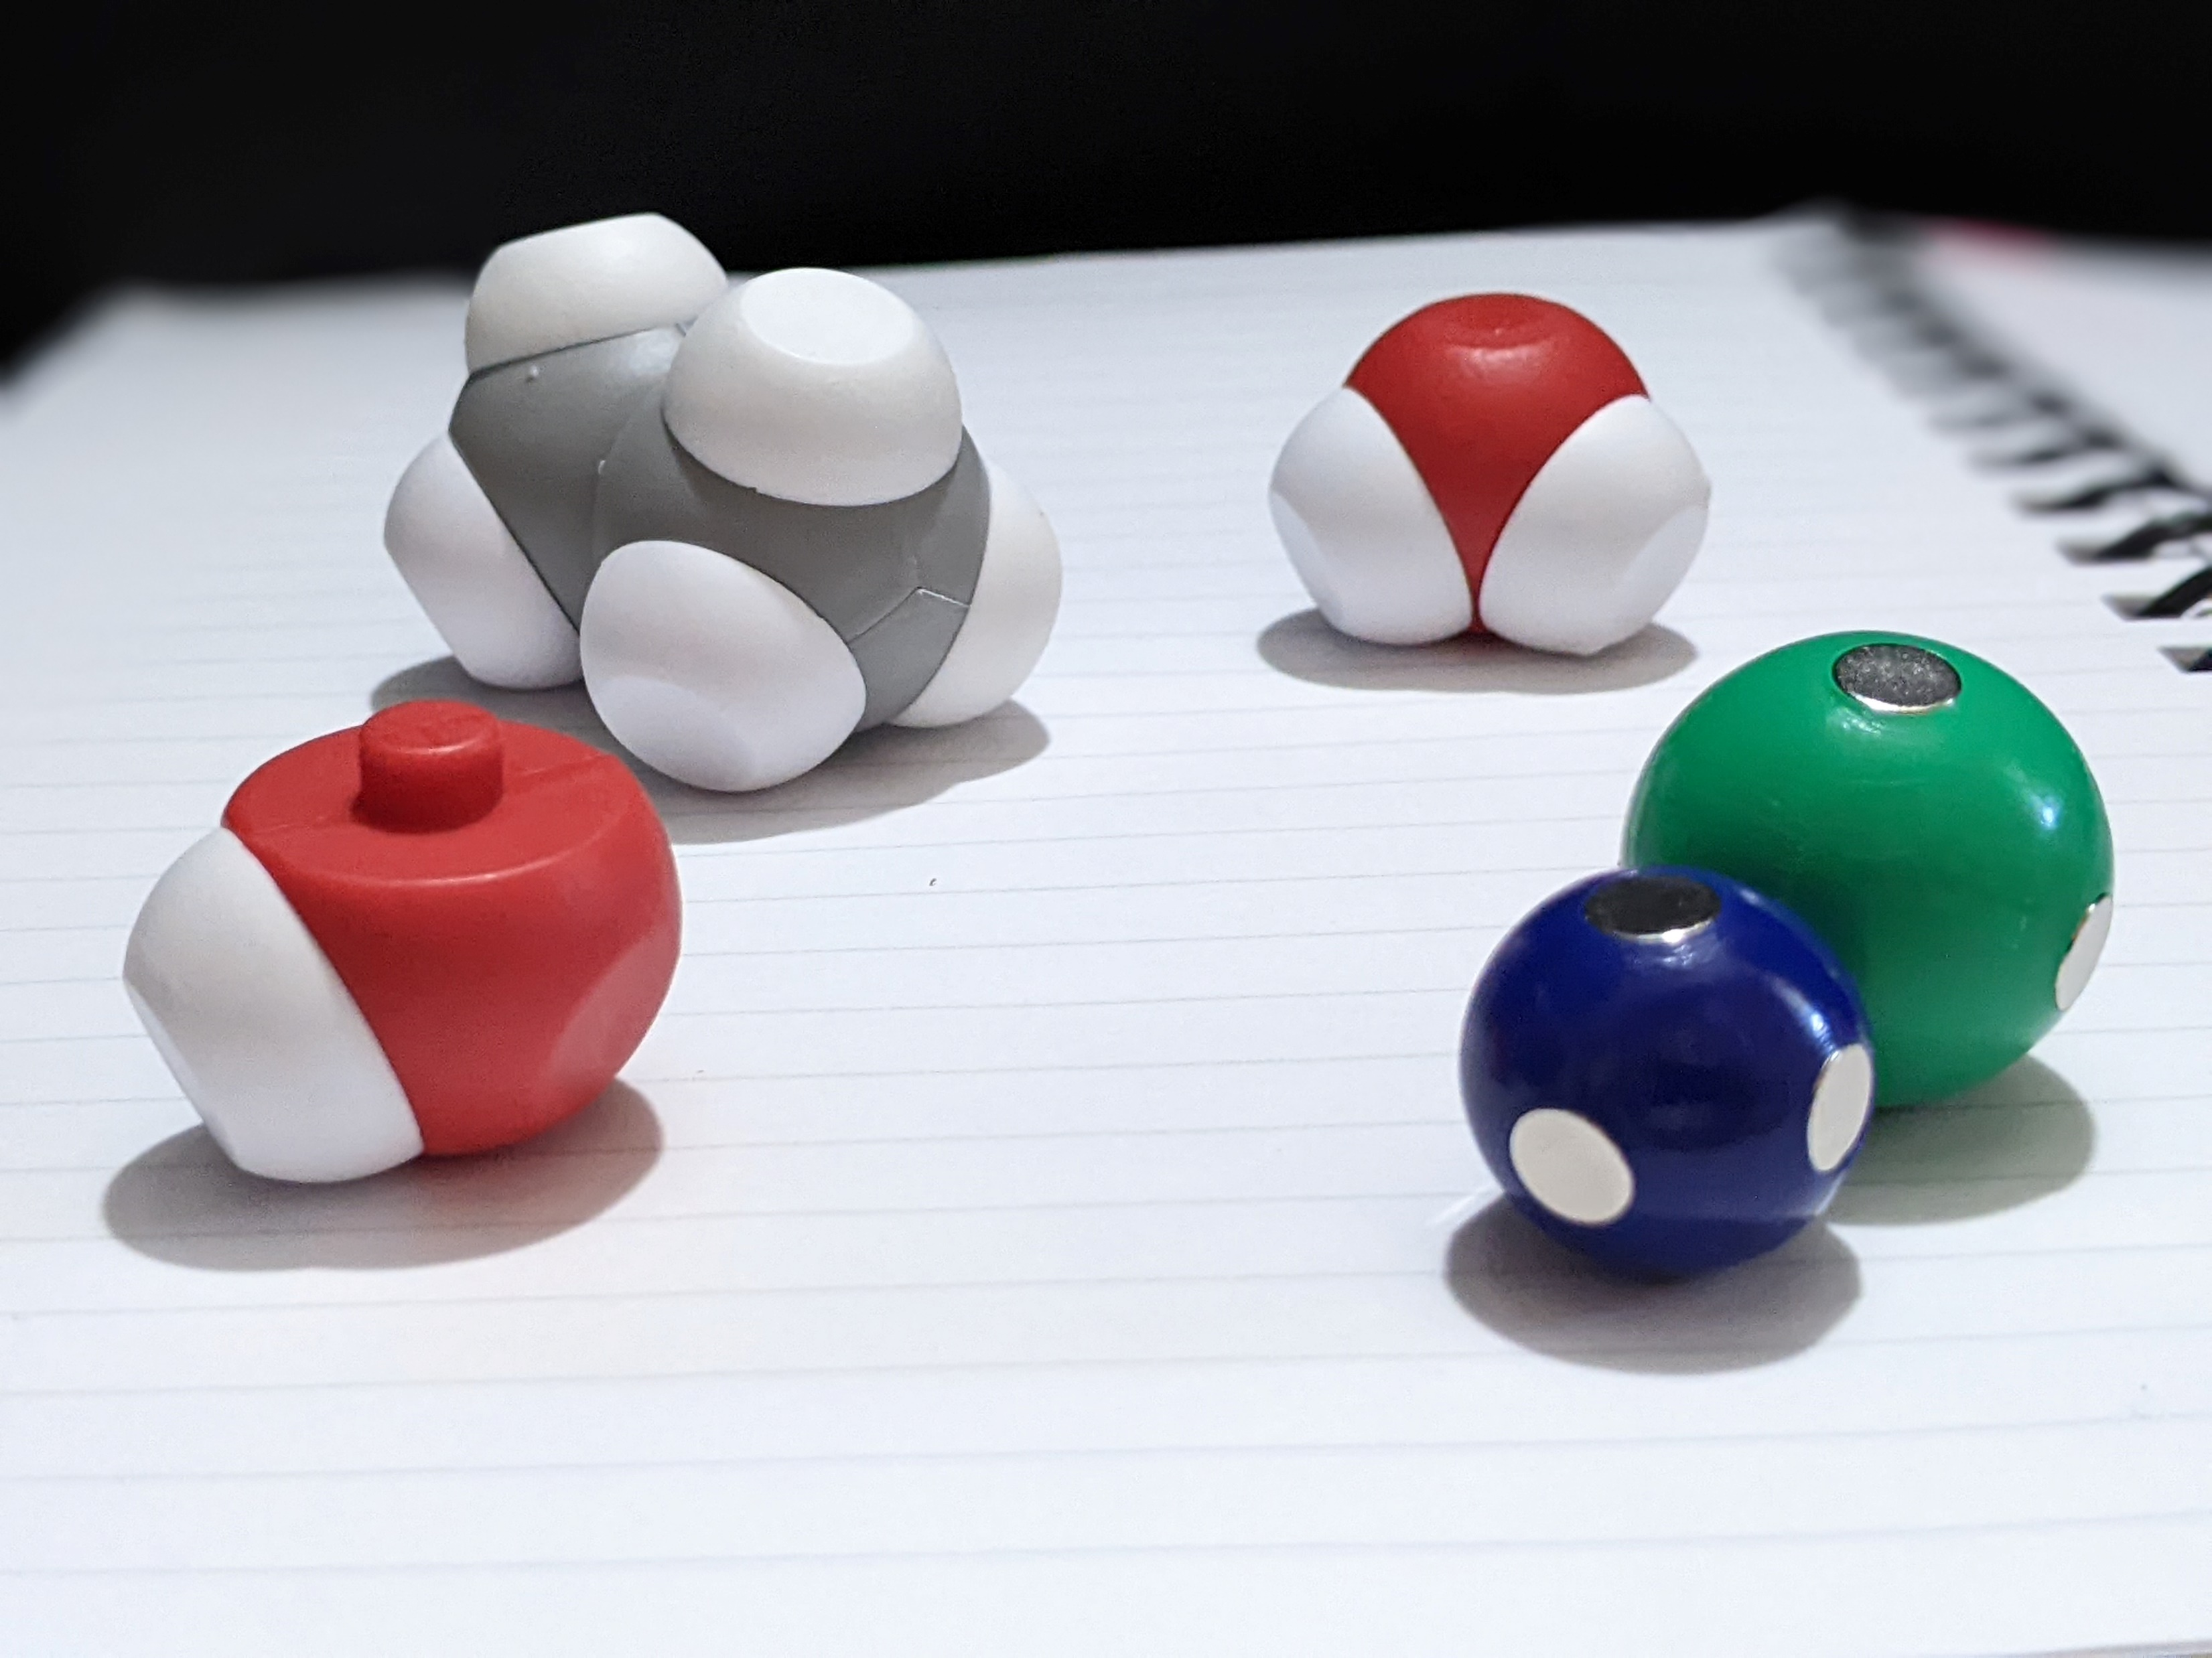
Additional Assessment Ideas
Create an experiment to compare:
Melting points
Boiling points
Vapor pressures
Surface Tension
Evaporation Rates
Then model what is occurring at the molecular level.
Notes:
Discuss some additional assessment ideas.

Slide 34
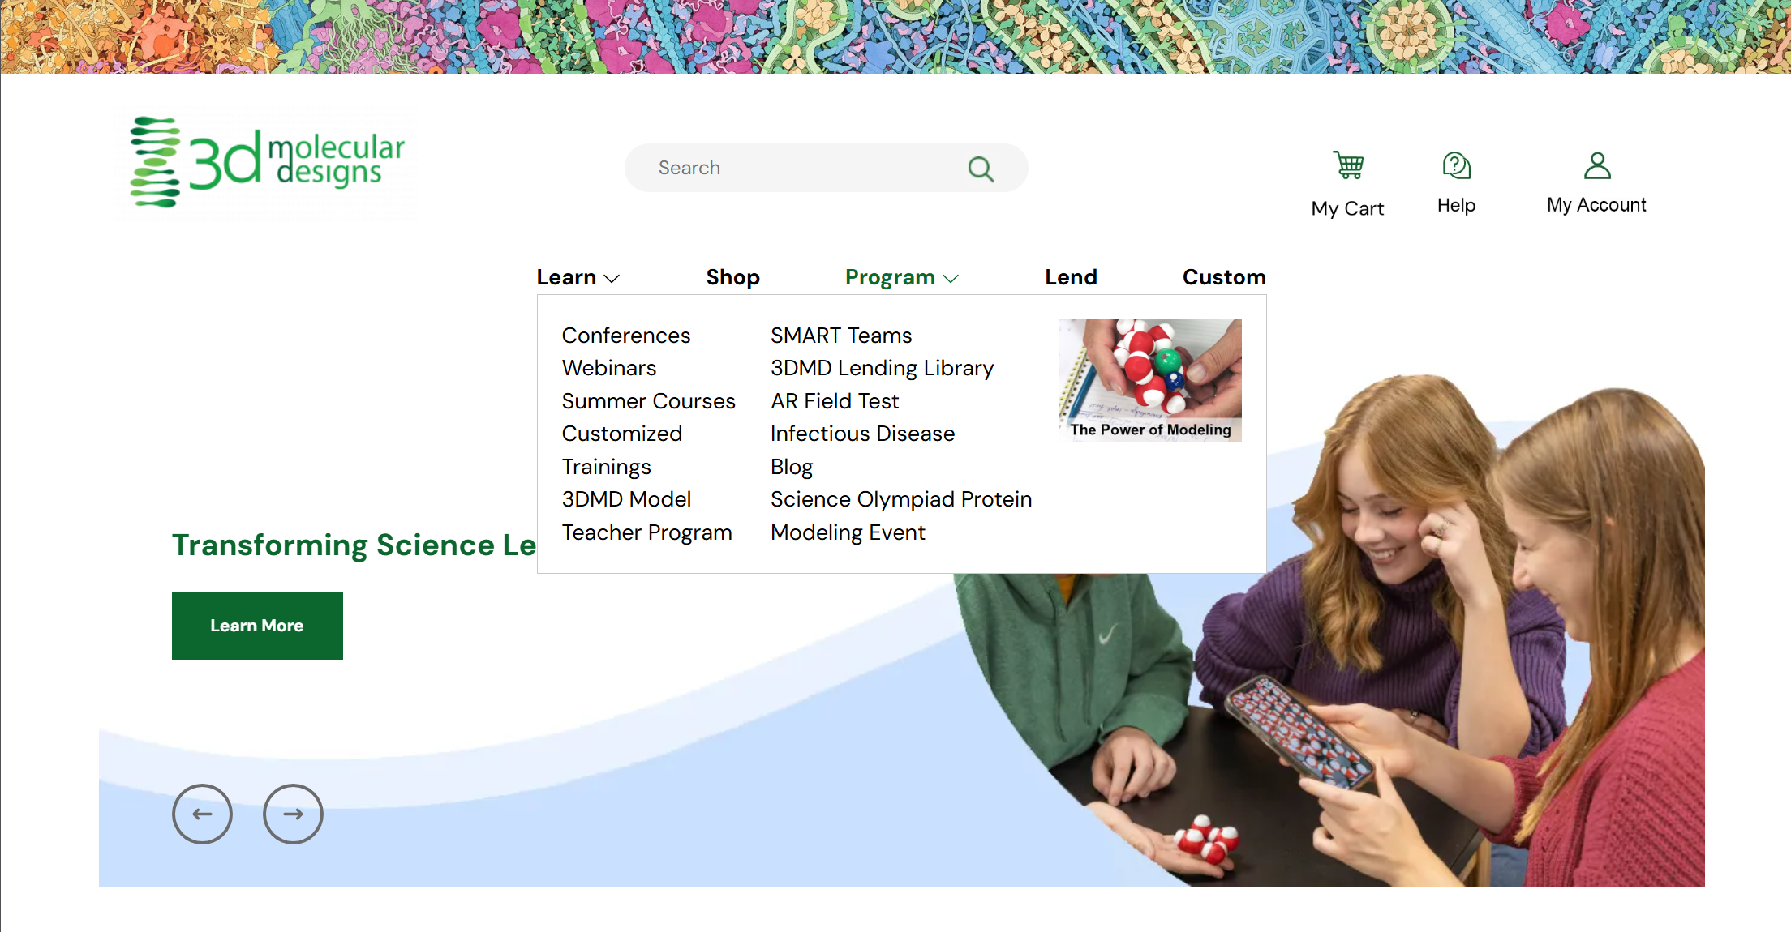
Lending Library!

Slide 35
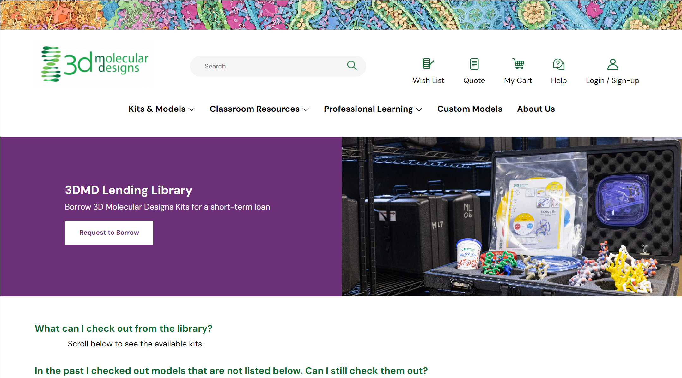
Try before you buy!

Slide 36
Workshop NGSS Connections
SEPs | CCCs | DCIs
Asking Questions and Defining Problems | Scale, Proportion, and Quantity | MS-PS1-1
Developing and Using Models | Patterns | MS-PS1-5
Planning and Carrying Out Investigations | Cause and Effect | HS-PS1-3
Constructing Explanations and Designing Solutions |  | HS-PS1-7
Notes:
Here are the NGSS Connections for this workshop.

Slide 37
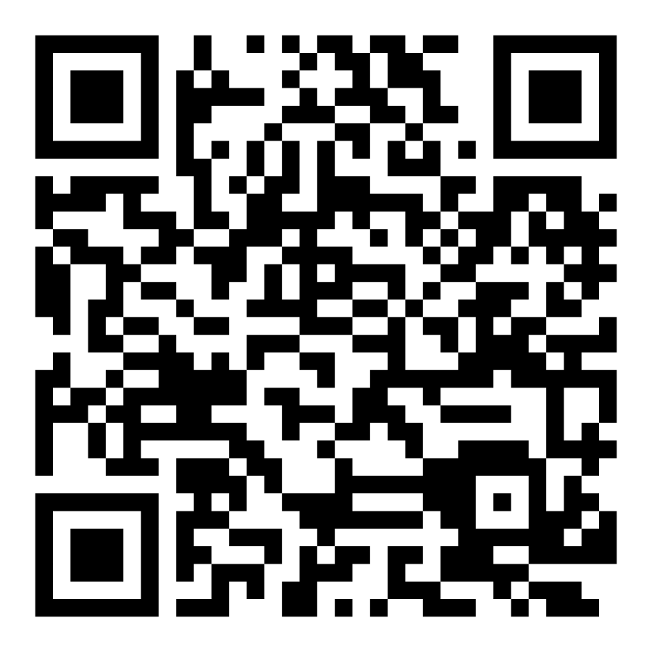
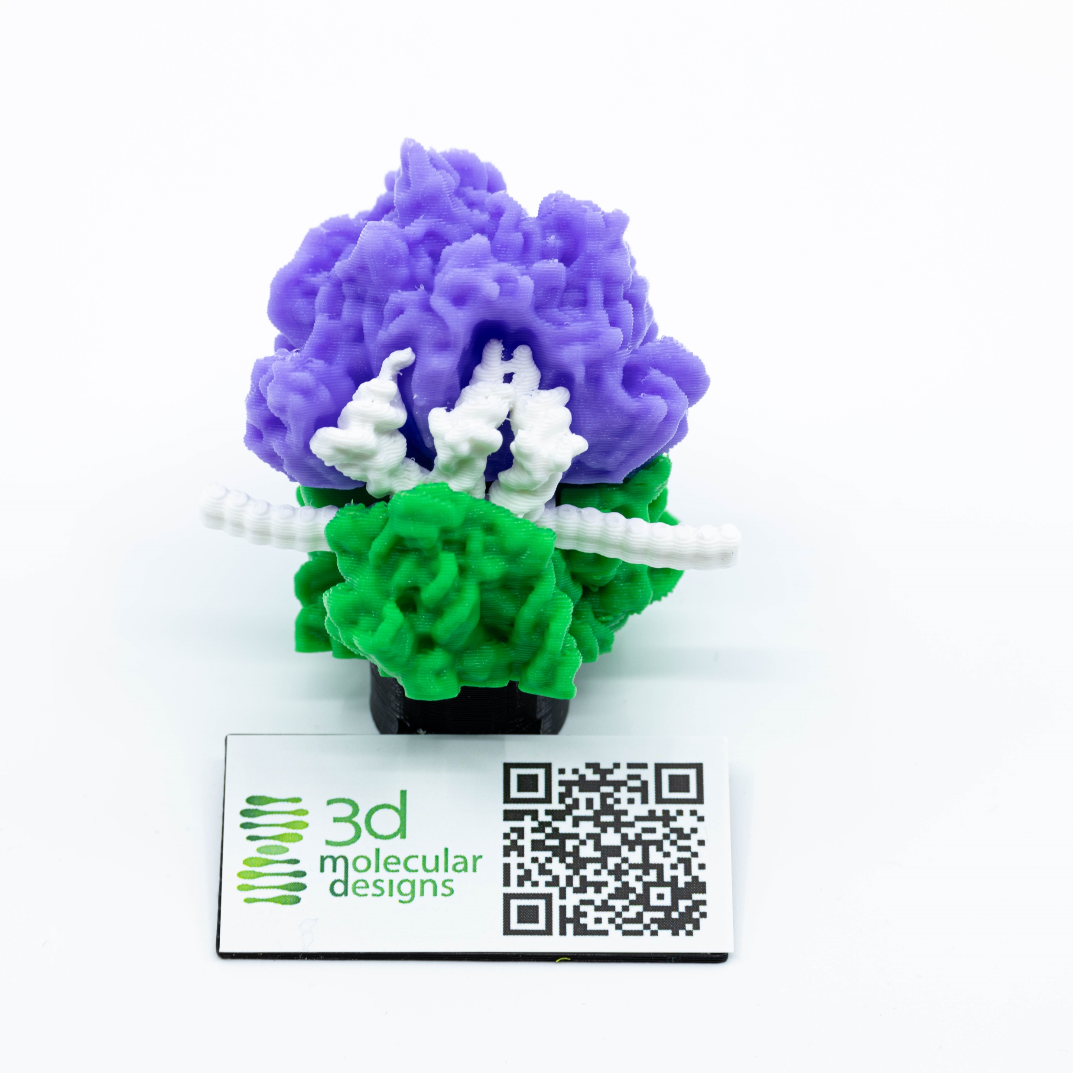
Scan this QR code and fill out our survey!
Show me your Ribosome image and I’ll give you a model with AR enhancement as a thank-you gift!

