Slide 1

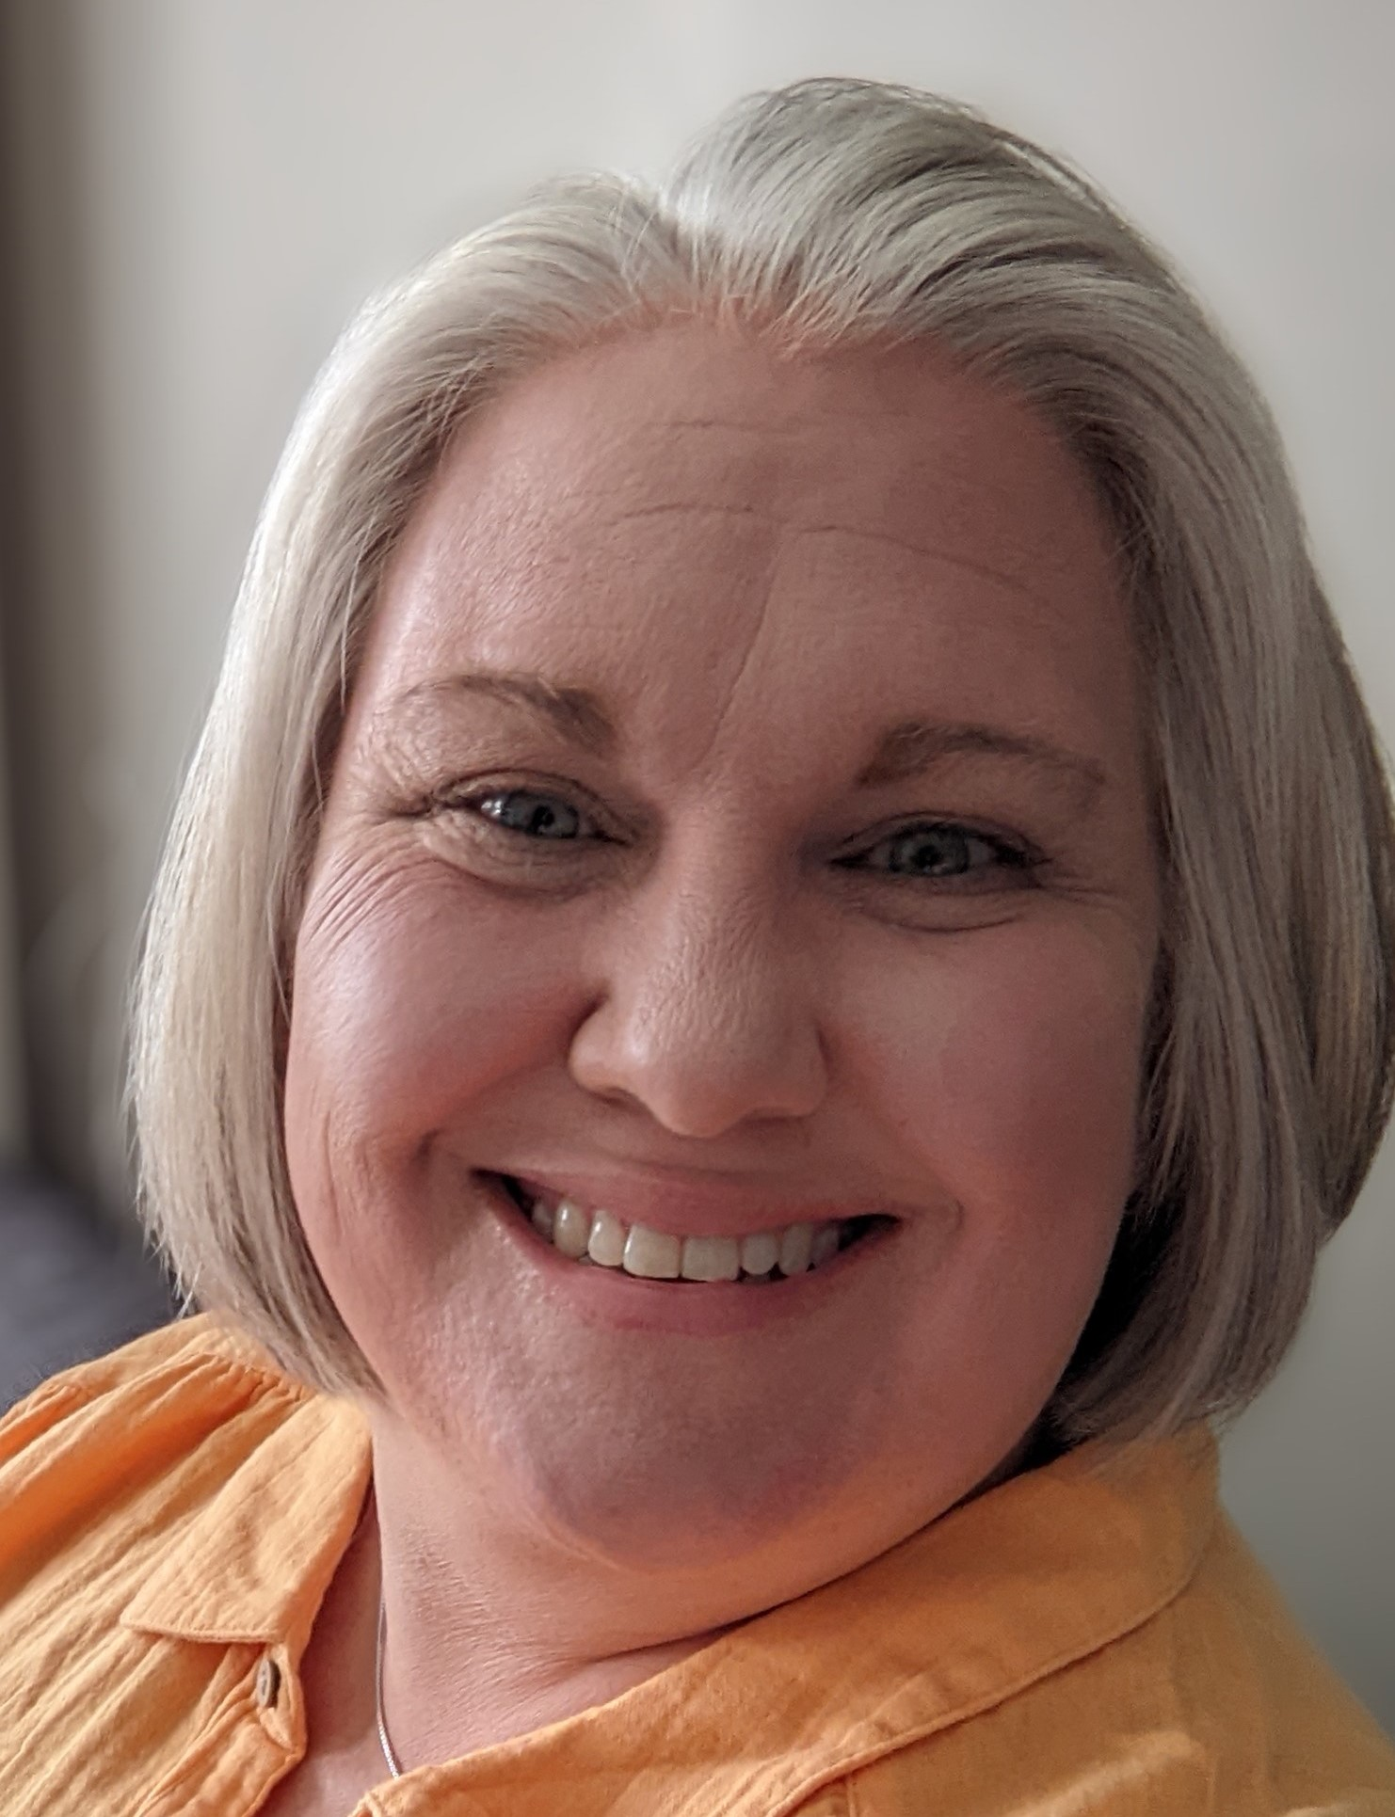
Genes Unraveled: Modeling Inheritance Mysteries
Ruth Hutson, MSSE

Slide 2
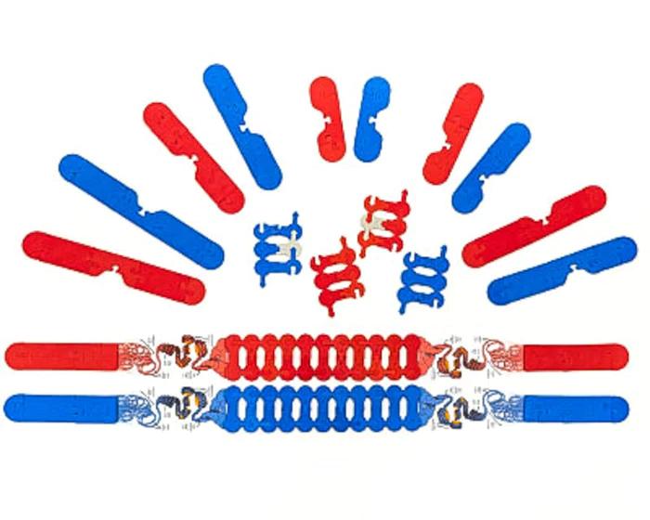
Notes:
During this 50 minute session, we will use the Chromosome Connections Kit.

Slide 3
Workshop Outcomes
Construct Punnett squares with gene sequences as alleles to connect inheritance of traits to chromosomes at the molecular level.
Model several types of inheritance using the Chromosome Connection Kit©.
Make and defend a claim based on evidence that genetic variations result from a variety of factors.

Slide 4
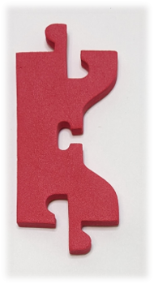
Construct a chromosome
Start with one centromere​
Add 3 to 4 chromosome connectors to each side of the centromere​
Add a cap piece to each end of the chromatid.
Notes:
Walk students through the construction of a chromosome by starting with one centromere.

Slide 5
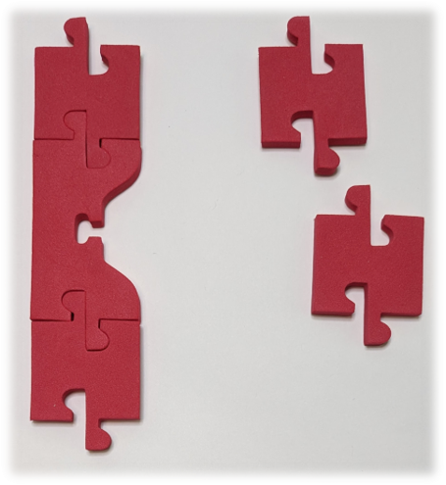
Construct a chromosome
Start with one centromere​
Add 3 to 4 chromosome connectors to each side of the centromere​
Add a cap piece to each end of the chromatid.
Notes:
Have students add three to four chromosome connectors to either side of the centromere. ​
Student chromosomes can have variations in how many connectors are on either side. ​
Allowing for this diversity opens an opportunity to talk about chromosome classification later in the lesson.

Slide 6
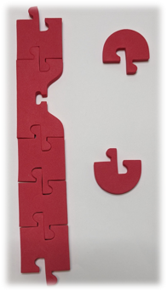
Construct a chromosome
Start with one centromere​
Add 3 to 4 chromosome connectors to each side of the centromere​
Add a cap piece to each end of the chromatid.
Notes:
Start with a centromere piece​
Add 3-4 chromosome connectors on each side of the centromere piece.​
Add a cap piece to each end of the chromatid. ​
Give students freedom to make a chromosome of their own so you can explore chromosome classification later in the lesson.

Slide 7

Create a sister chromatid
Create a duplicate copy of the chromosome to make a sister chromatid.
Notes:
Next create a duplicate copy of the chromosome to make a sister chromatid by using the other components found in the Chromosome Connections Kit (Note: your chromosome does not need to look exactly like the one pictured, but it does not to have all the components.)

Slide 8
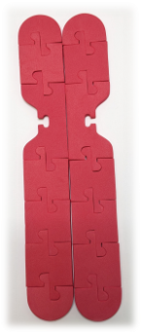
Create a sister chromatid
Create a duplicate copy of the chromosome to make a sister chromatid.
Notes:
Next create a duplicate copy of the chromosome to make a sister chromatid by using the other components found in the Chromosome Connections Kit (Note: your chromosome does not need to look exactly like the one pictured, but it does not to have all the components.)

Slide 9
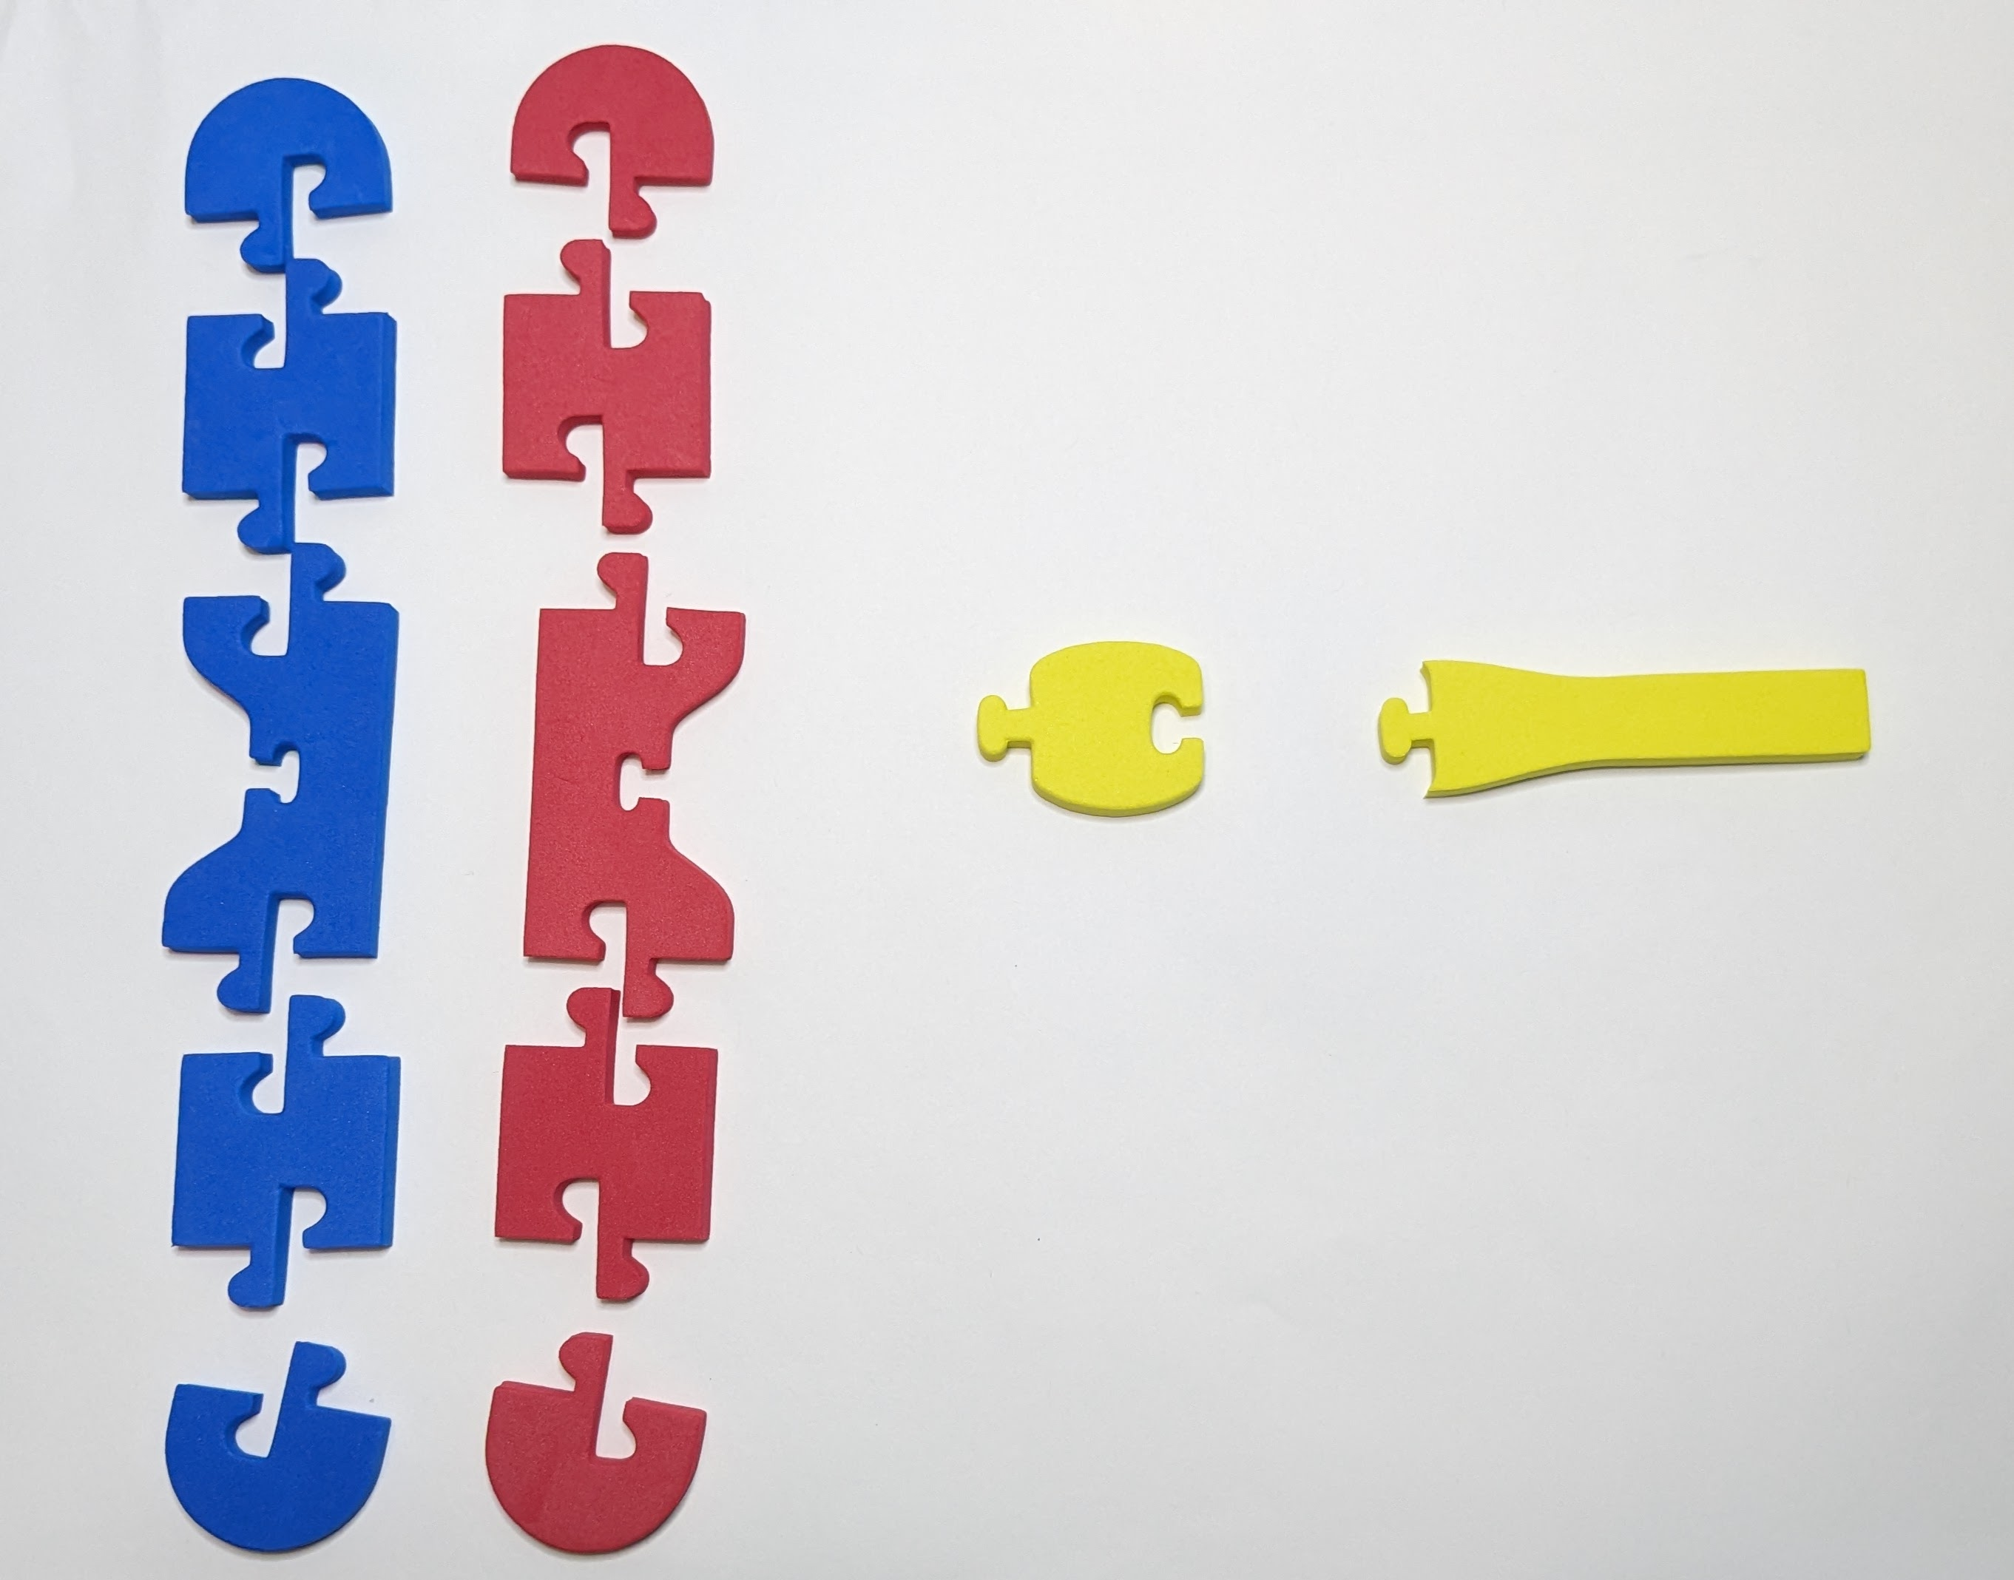
Suggested Chromosome Assembly
Chromosome Size | Part | Egg donating parent chromosome (Red Foam) | Sperm donating parent chromosome (Blue Foam)
Short chromosome (Acrocentric) | p arm linkers | 0 | 0
 | q arm linkers | 1 | 1
Medium Chromosome (Metacentric) | p arm linkers | 1 | 1
 | q arm linkers | 1 | 1
Long Chromosome (Submetacentric) | p arm linkers | 1 | 1
 | q arm linkers | 2 | 2
Notes:
Start with a centromere piece
Add 3-4 chromosome connectors on each side of the centromere piece.
Add a cap piece to each end of the chromatid.

Slide 10
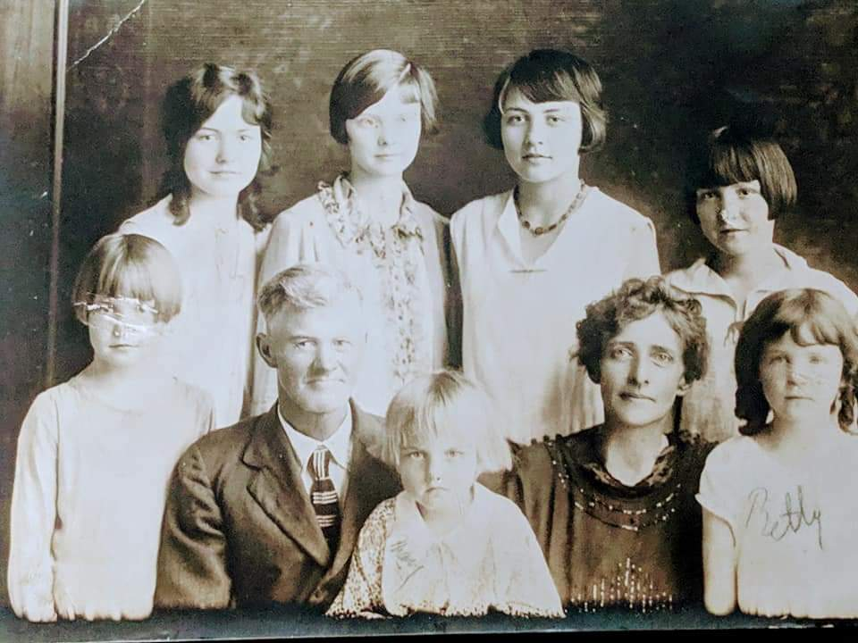
Why do I look different than my siblings?
Notes:
This is the guiding question that my students explore throughout our inheritance unit. We look at inheritance in terms of complete dominance, codominance, and incomplete dominance. We also only look at genes that code for proteins and how the mutation affects the protein. Finally, we make the connection between the gene’s location on the chromosome and help students understand what a genome is.

Slide 11
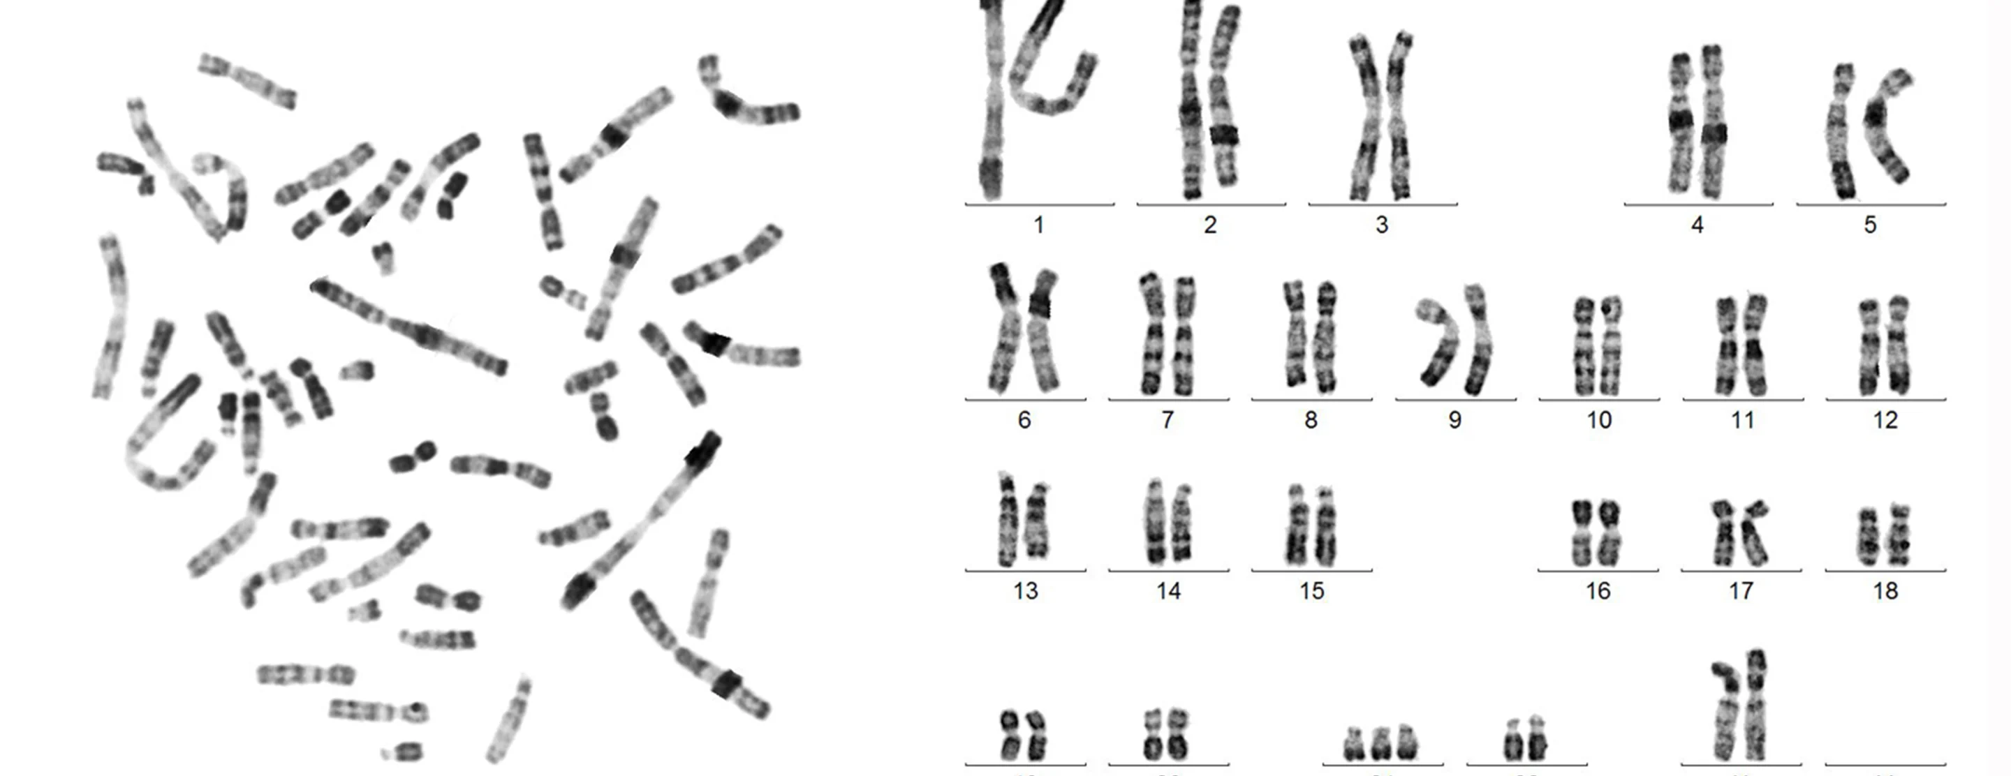
Let’s look at chromosome 11
Notes:
Students need to understand the differences between autosomes and sex chromosomes. Later in the year, we talk about the effects of multiple chromosomes, so it is important for my students to know the relationships between chromosomes and genes. Our first case is an example of an autosomal codominance disorder when the shape of the red blood cells are considered.

Slide 12
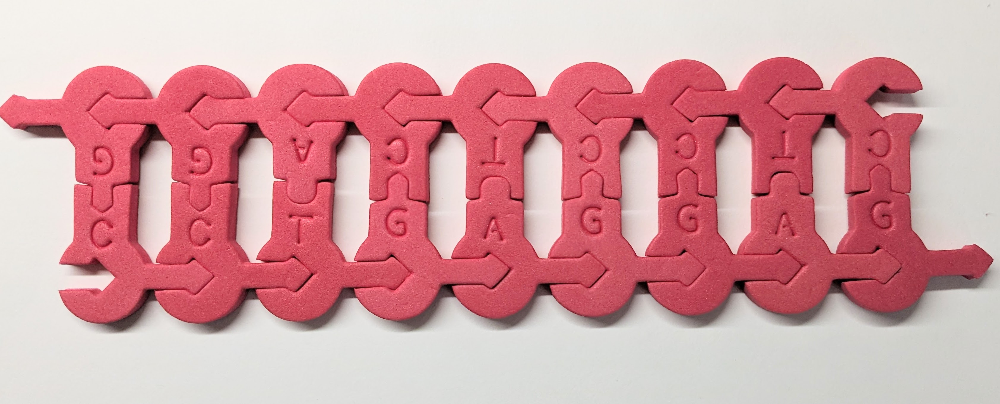
Create a normal beta-globin DNA gene sequence
3’ G G A C T C C T C 5’
5’ C C T G A G G A G 3’
Notes:
The HBB gene provides instructions for making a protein called beta-globin. Beta-globin is a component (subunit) of a larger protein called hemoglobin, which is located inside red blood cells. In adults, hemoglobin consists of four protein subunits: usually two subunits of beta-globin and two subunits of a protein called alpha-globin, which is produced from another gene called HBA. Each of these protein subunits is attached (bound) to an iron-containing molecule called heme; the iron in the center of each heme can bind to one oxygen molecule. Hemoglobin within red blood cells binds to oxygen molecules in the lungs. These cells then travel through the bloodstream and deliver oxygen to tissues throughout the body.
Our first example is one of codominance. Sickle cell disease is an inherited condition due to a single point mutation in the gene for beta-globin protein found on chromosome 11. The mutation results in a beta-globin protein change from the amino acid glutamic acid to valine. People with the condition have atypical hemoglobin molecules which can distort red blood cells into a sickle shape. Painful episodes can occur when the sickled red blood cells get stuck in the capillaries depriving tissues and organs of oxygen-rich blood.

Slide 13
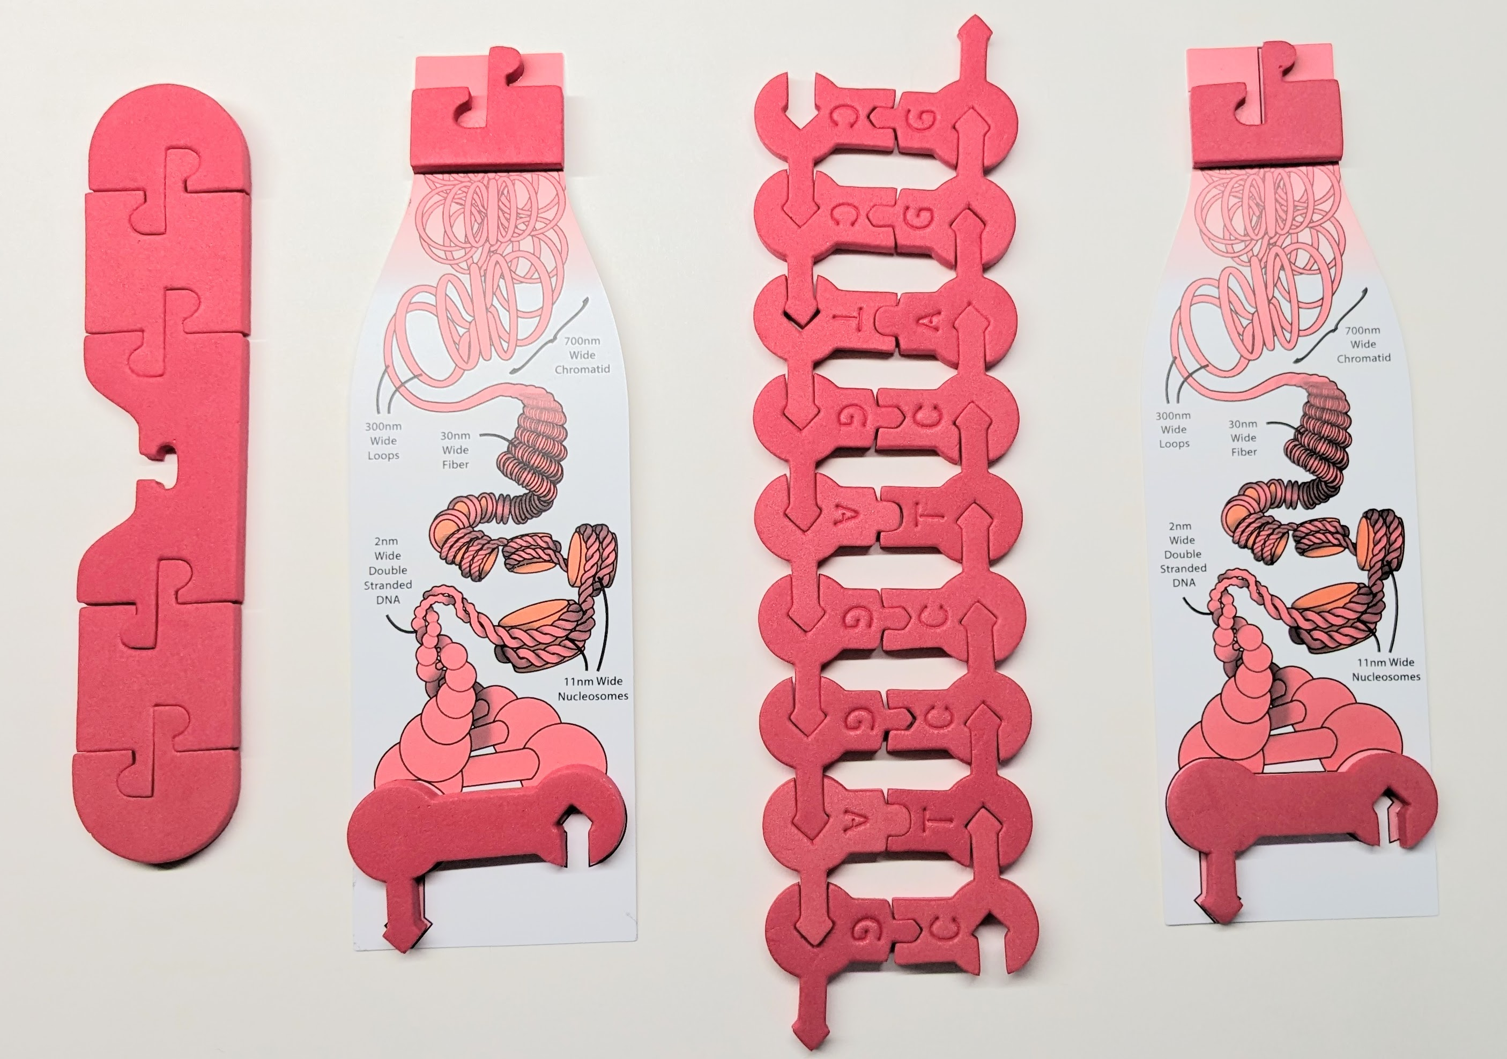
Use insert pieces to assemble the maternal chromosome
Notes:
This will help students make the connection between chromosomes and genes. It also allows you to discuss the size of genes and that we are looking at a single-point mutation in the gene. The normal allelic variant for the B-globin gene locus is 1600 base pairs. It would be difficult to look at the entire locus so we have pick a very short portion of the gene where the point mutation occurs.

Slide 14
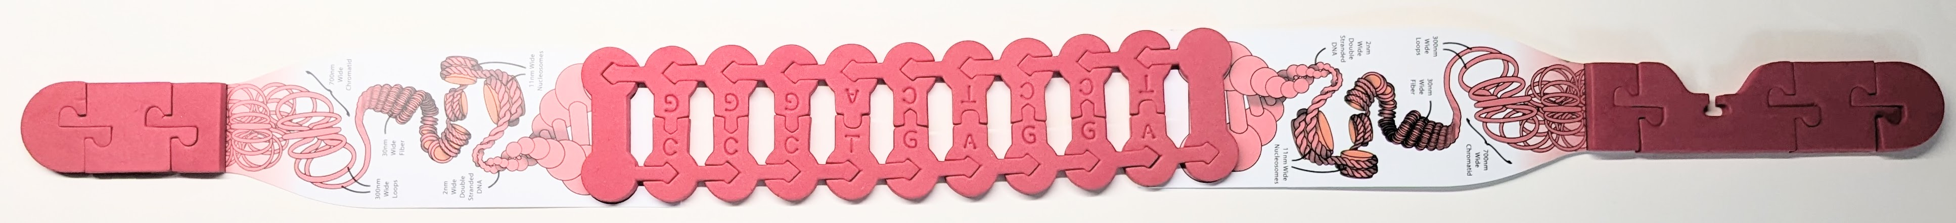
Use insert pieces to assemble the maternal chromosome
Human B-globin is located on the p-arm of chromosome 11.
The human B-globin locus is a 60-kb segment on the short arm and contains five functional genes and two pseudogenes. We will look at a small part of this locus.
It is responsible for the creation of the beta parts of the oxygen transport protein, hemoglobin.
Notes:
Chromosome 11 is classified as a submetacentric chromosome. Its centromere is slightly above the center of the entire chromosome. The p arm is shorter than the q arm.
Pseudogenes are nonfunctional segments of DNA that resemble functional genes. They are derived from functional genes that have lost their protein-coding ability due to mutations over time. Pseudogenes can be formed by gene duplication or by reverse transcription of mRNA. The DNA sequence of a pseudogene is very similar to its functional counterpart but contains variant mutations that render the gene inactive.

Slide 15
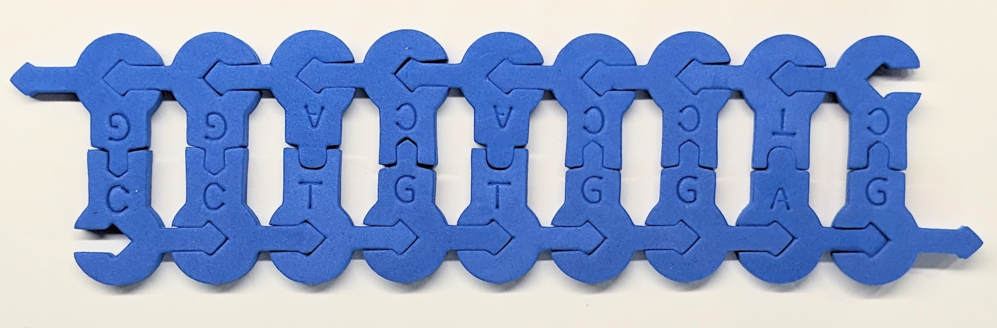
Create a sickle cell beta-globin DNA gene sequence
3’ G G A C A C C T C 5’
5’ C C T G T G G A G 3’
Notes:
Sickle cell anemia is caused due to point mutation. The glutamic acid of the 6th codon in beta globin chain is replaced by valine. This type of mutant hemoglobin causes a change in red blood cell shape from biconcave to sickle shape, thereby leading to reduced oxygen-carrying capacity.

Slide 16
Create a sickle cell beta-globin DNA gene sequence
3’ G G A C A C C T C 5’
5’ C C T G T G G A G 3’
Notes:
Sickle cell anemia is caused due to point mutation. The glutamic acid of the 6th codon in beta globin chain is replaced by valine. This type of mutant hemoglobin causes a change in red blood cell shape from biconcave to sickle shape, thereby leading to reduced oxygen-carrying capacity.

Slide 17
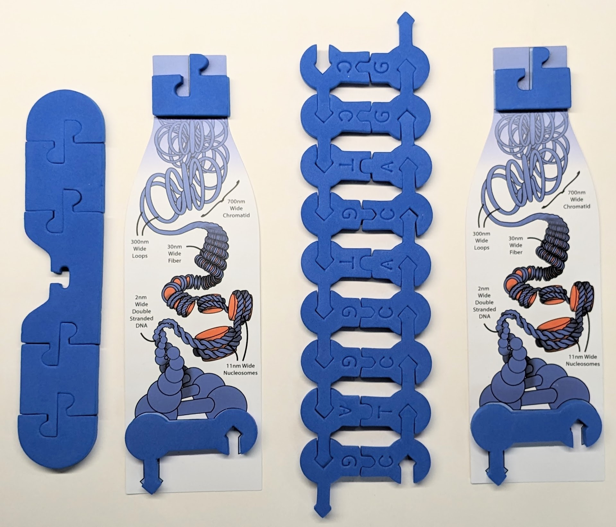
Use insert pieces to assemble the paternal chromosome
Notes:
Again, we want students to understand that genes have a specific location on the chromosome. The hemoglobin subunit beta gene (HBB gene) is located on chromosome 11 on the short arm position 15.4. Students don’t need to know all that information, but it is nice if they have an appreciation that we can know where a gene is with respect to other genes.

Slide 18
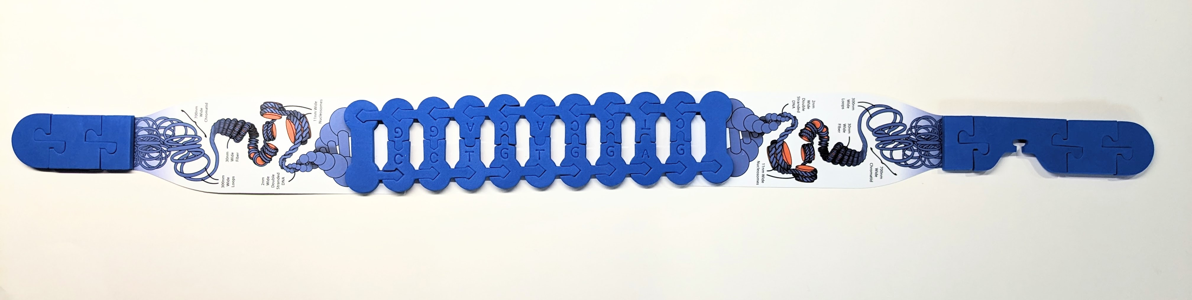
Use insert pieces to assemble the paternal chromosome
What is the difference between the two sequences?
Notes:
The normal hemoglobin tetramer consists of two alpha chains and two beta chains. Mutant beta globin causes sickle cell anemia. Absence of beta chains causes beta-zero-thalassemia. Reduced amounts of detectable beta globin causes beta-plus-thalassemia. The order of the genes in the beta-globin cluster is 5'-epsilon -- gamma-G -- gamma-A -- delta -- beta--3'.

Slide 19
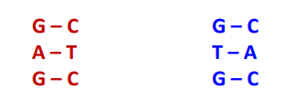
Use insert pieces to assemble the paternal chromosome
What is the difference between the two sequences?

Slide 20
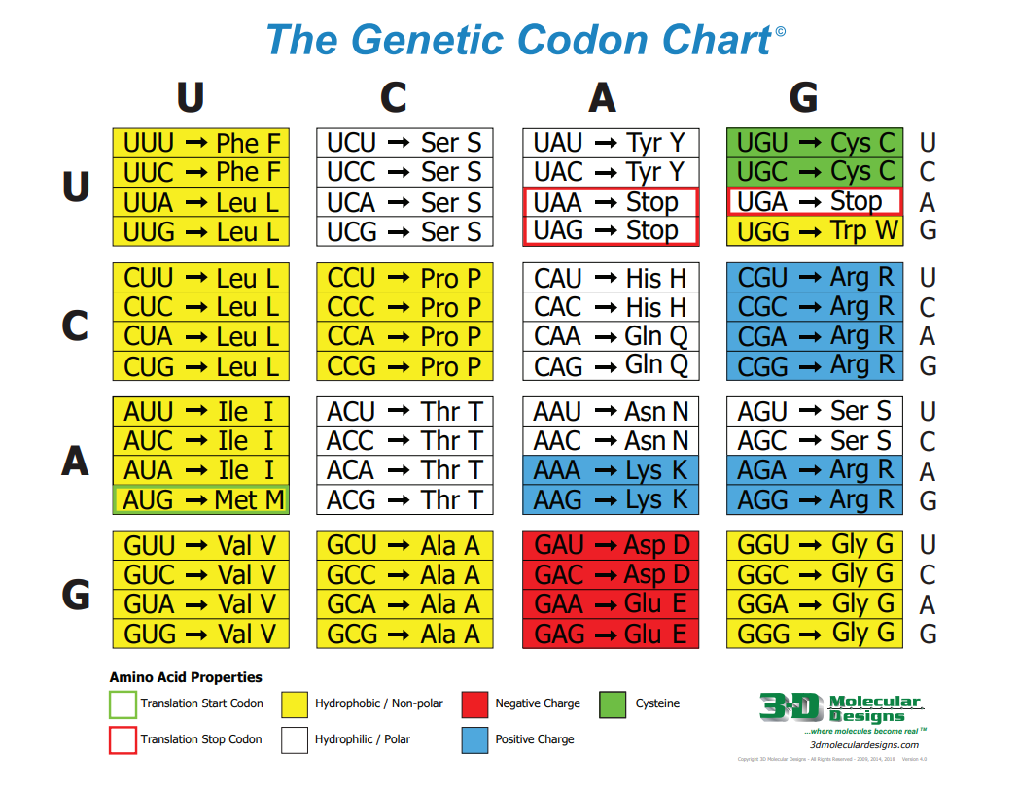
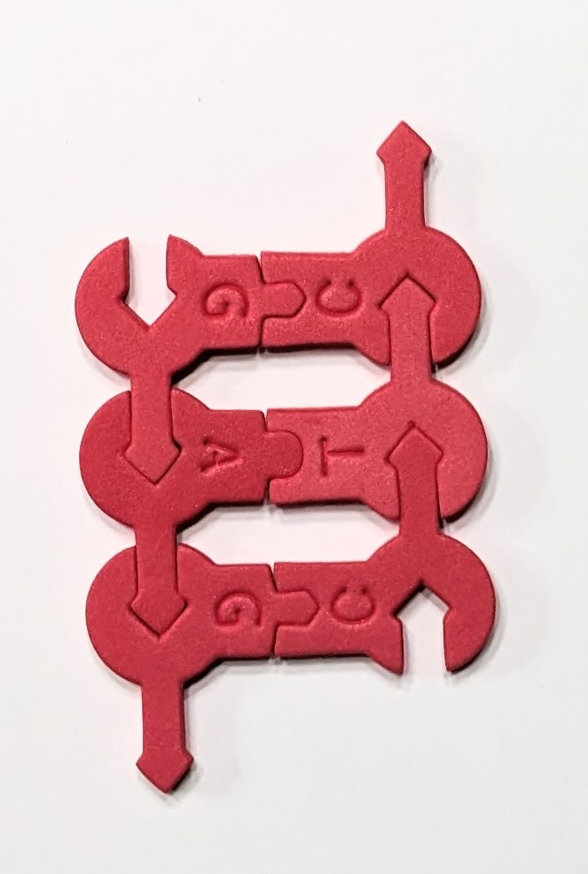
What is the difference between the two sequences?
How might that affect the resulting protein?

Slide 21
What is the difference between the two sequences?
How might that affect the resulting protein?

Slide 22
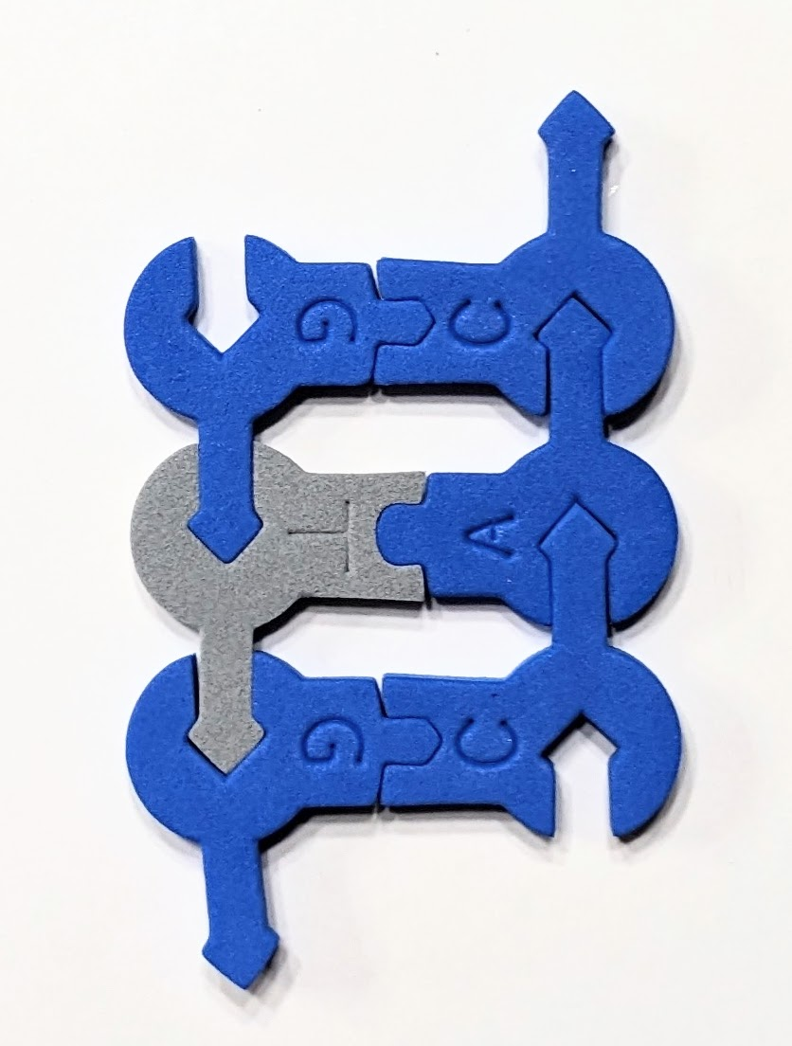
What is the difference between the two sequences?
How might that affect the resulting protein?

Slide 23
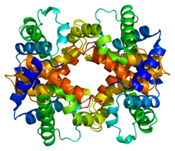
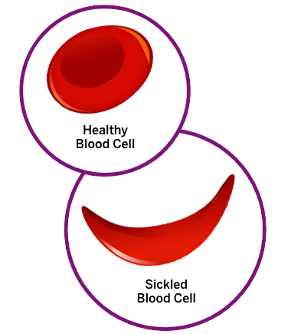
What is the difference between the two sequences?
How might that affect the resulting protein?
Beta-globin
Notes:
More than a thousand naturally occurring HBB variants have been discovered. The most common variant is HbS, which causes sickle cell disease. The single-point mutation changes the folded protein to make a hydrophobic region of the beta-globin. HbS will form rigid fibers under the right conditions which will cause the sickling of entire blood cells.

Slide 24
Understanding Codominance
Sickle Cell Anemia Possible Genotypes and Phenotypes | DNA sequence
SS Homozygous Typical beta-globin
Ss Heterozygous Carrier Typical beta-globin and Atypical beta-globin
ss Homozygous Atypical beta-globin
Notes:
Each person has two copies of every gene in their genome. Sometimes the alleles are the same on each chromosome. Sometimes the gene sequences differ resulting in different alleles on each of the homologous chromosomes. Punnett squares are used to predict the probability of inheriting certain alleles from one’s parents. Typically, a shorthand notation is used to aid in prediction, but students don’t always understand what that notation means in terms of genes. Using the part of the DNA that codes for the amino acid in question help reinforce the DNA-protein connection.
Traditionally, when first teaching Punnett squares, a capital letter is used to represent a dominant allele while a small letter represents the recessive trait. When discussing other types of inheritance that notation can become confusing for students. By using a portion of the genetic code, students can have a better understanding without having to remember the shorthand.

Slide 25

A visit to the genetic counselor
Two individuals with sickle
cell trait want to know their chances of having a child with sick cell anemia. Complete the Punnett square using DNA sequences to fill in each of the squares.
How would you advise them?
Notes:
Individuals with sickle cell trait have one typical beta-globin and one atypical beta-globin. It is generally a benign condition. A child that inherits two atypical beta-globin genes will have sickle cell disease which is a treatable condition.
In this Punnett square, we focus on the DNA sequence that contains the point mutation.

Slide 26
A visit to the genetic counselor
What are the implications?
Notes:
The possibility of having a child with sickle cell anemia is 25%. There is a 50% possibility of having a child with sickle cell trait. There is a 25% possibility of having a child with two typical beta-globin genes.
Both types of hemoglobin are expressed so this example doesn’t follow true Mendelian principles. The carriers with sickle cell trait will have both typical hemoglobin and hemoglobin S. Later in the year we refer to this trait as an advantage to keeping the malarial parasite at bay.

Slide 27
Moving to chromosome 4
Notes:
Our second case study is an example of autosomal dominant inheritance. Not all dominant inherited conditions are due to repeat sequences. Huntington disease is caused by a trinucleotide repeat of CAG which codes for the amino acid glutamine. The gene is located on the p arm at location 16.3.
Huntington disease is a progressive brain disorder that causes uncontrolled movements, emotional problems, and loss of cognition. The most common form of this disorder usually appears in a person’s thirties or forties. Mutations in the HTT gene on chromosome 4, cause Huntington disease. The HTT gene provides instructions for synthesizing a protein called huntingtin whose role appears to affect nerve cell function. The mutation involves a DNA segment known as a CAG trinucleotide repeat. Typically, the CAG segment is repeated 10 to 35 times within the gene. In people affected with Huntington disease, the CAG segment is repeated 36 to more than 120 times. In the example we will use today, one segment CAG in the model would represent a repeat of 25 times. Two segments of CAG would represent a trinucleotide repeat of 50 times.

Slide 28
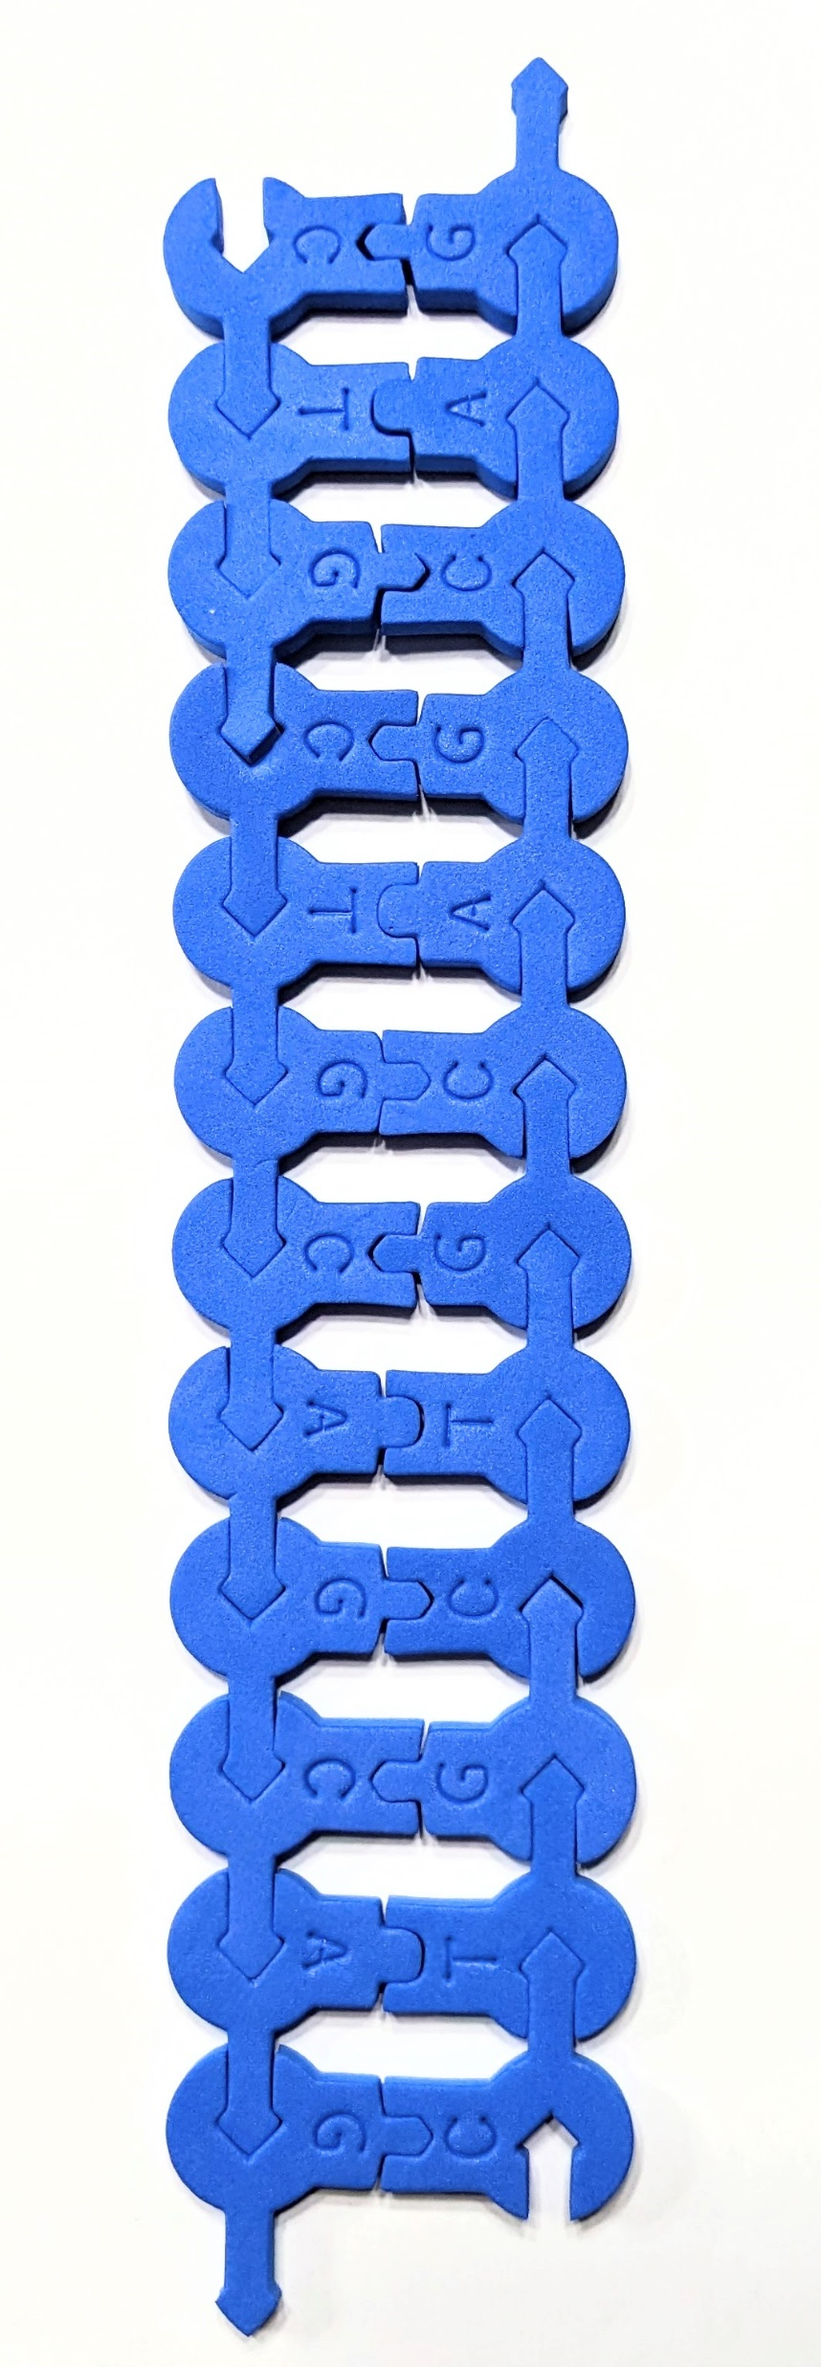
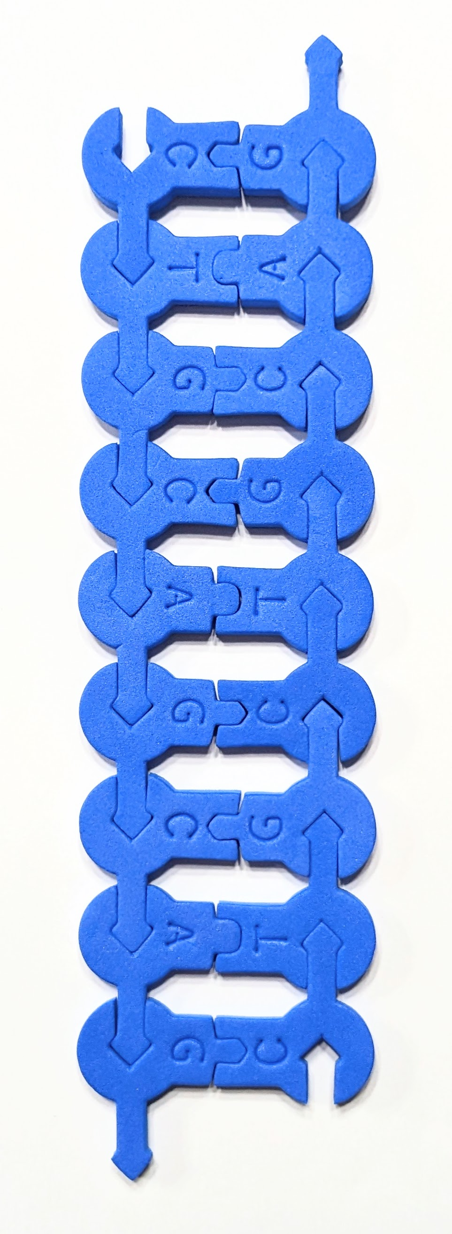
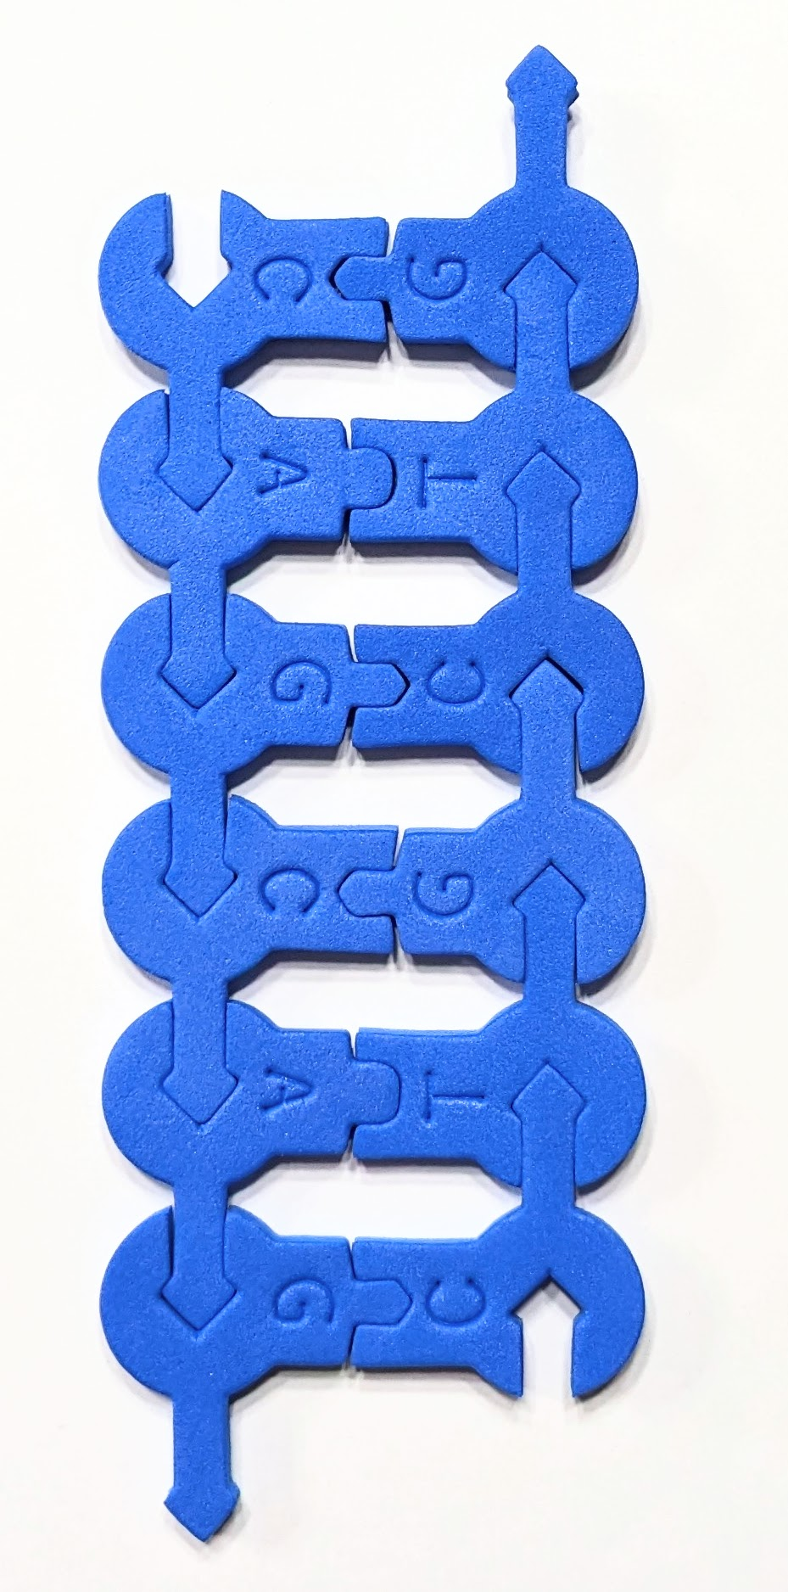
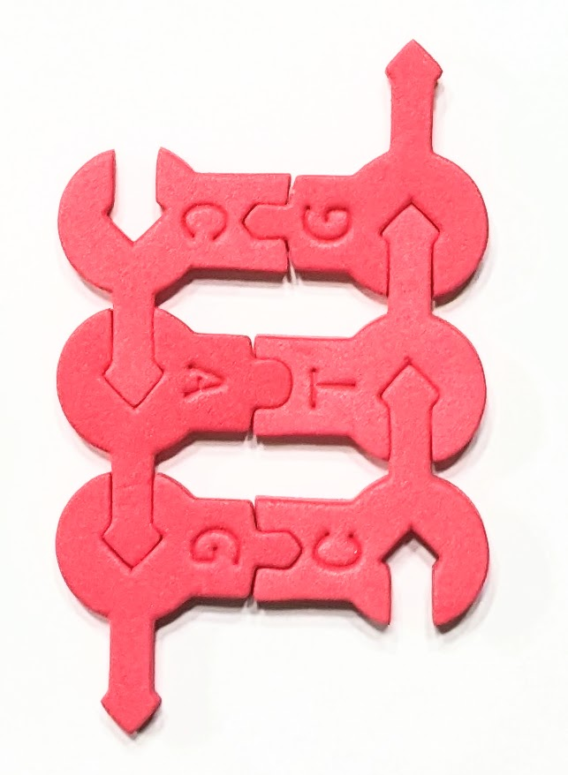
Huntington disease is caused by multiple repeats of CAG at the 5’ end of the HTT gene
How might that affect the resulting protein?
Notes:
Huntingtin is a protein that is important for the development of the nervous system. The mutation in the HTT gene causes the triple nucleotide CAG to be repeated at the 5’ end which adds a long chain of glutamine at the end of the protein.
To find out more about this condition, look at this Nature video Huntington Disease – YouTube.

Slide 29
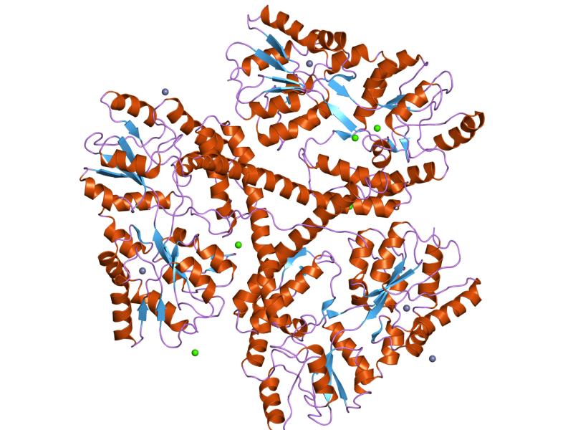
Huntington disease is caused by multiple repeats of CAG at the 5’ end of the HTT gene
How might that affect the resulting protein?
Huntingtin
Notes:
Huntingtin is a protein that is important for the development of the nervous system. It also has some role in cell transport because it interacts with both tubulin and dynein. The mutation in the HTT gene causes the triple nucleotide CAG to be repeated at the 5’ end which adds a long chain of glutamine at the end of the protein.
Huntington's Disease: The Science of a genetic disorder - YouTube

Slide 30
Understanding Complete Dominance
Huntington disease Possible Genotypes and Phenotypes | DNA sequences
HH Atypical huntingtin protein Huntington disease
Hh Atypical huntingtin protein Huntington disease
hh Normal huntingtin protein
Notes:
Over 40 repeats of CAG means that disease will occur because mutated huntingtin proteins are broken into smaller pieces. The extra glutamine is removed by proteases and those fragments can bind to other proteins. HHT exon 1 can form aggregates like amyloid fibrils.
We have simplified this model. In more advanced classes, one might want to explore the inheritance model further. In real life, the more CAG repeats that an individual has affect both the onset of the disease and the speed of symptom progression. If a person has less than a 27-repeat count, then they will not get the disease. A count of 27-35 repeat presents as an intermediate form of the disease. The person will not be affected, but there could be a risk to their offspring. A person with a 36-39 repeat count shows reduced penetrance where the person may or may not be affected, but their offspring has a 50% chance of getting the disease. A person with a repeat count of higher than 40 shows full penetrance and will be affected by the disease and their offspring will also be at risk. Rarely is Huntington's disease caused by a new mutation, where neither parent has over 36 CAG repeats.

Slide 31
A visit to the genetic counselor
One individual with severe Huntington disease and a healthy individual want to know their chances of having a child with Huntington disease. Complete the Punnett square using DNA sequences to fill in each of the squares.

Slide 32
A visit to the genetic counselor
One individual with severe Huntington disease and a healthy individual want to know their chances of having a child with Huntington disease. Complete the Punnett square using DNA sequences to fill in each of the squares.
What are the implications?
Notes:
Any child that this couple has will inherit Huntington disease. However, the severity depends on the number of CAG repeats. Currently, only symptoms can be treated. However, there may be medical advances by the time those children are adults. Note: in this lesson, each sequence represents 25 CAG repeats.
At this point in the unit, we discuss the ethics behind genetic screening and when an individual is considered mature enough to choose to test. What to do when treatment can only alleviate symptoms and there is no cure. Full-time care is required in later stages. I don’t give students any answers and just let them explore what they might do.

Slide 33
Let’s look at the sex chromosomes
Notes:
Hemophilia is a sex-linked recessive blood clotting disorder where affected individuals experience protracted bleeding following an injury or surgery. In the most severe cases, incessant bleeding occurs after only minor trauma or even spontaneously without any damage at all! Complications can result from bleeding into the brain, muscles, joints, or other internal organs. The major types of hemophilia are hemophilia A and hemophilia B caused by mutations in the F8 and F9 genes, respectively, located on the X chromosome. The F8 gene provides instructions for making a protein called coagulation factor VIII. Coagulation factor IX is a related protein produced from the F9 gene. Changes in these genes result in altered or missing proteins that cannot function effectively in the blood clotting process.

Slide 34
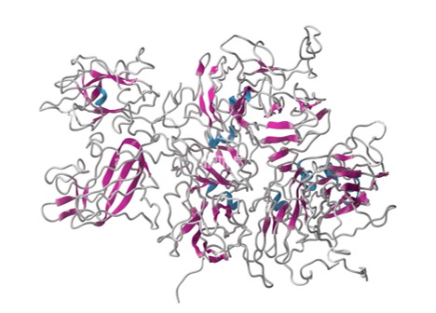
Hemophilia A is caused by a mutation in the F8 gene on the X sex chromosome.
Clotting Factor VIII
Notes:
Hemophilia is caused by a deficiency in several clotting factors. In this case, we will look at coagulation factor VIII which is coded for by the F8 gene. The F8 gene is found on the X chromosome. The X chromosome is the largest submetacentric (centromere slightly off-center) chromosome in the human genome. The Y chromosome is one of the smallest acrocentric human chromosomes. Biologically speaking, a typical human female has two X chromosomes while a typical human male has one X and one Y chromosome. The Y chromosome does not carry the clotting factor genes!

Slide 35
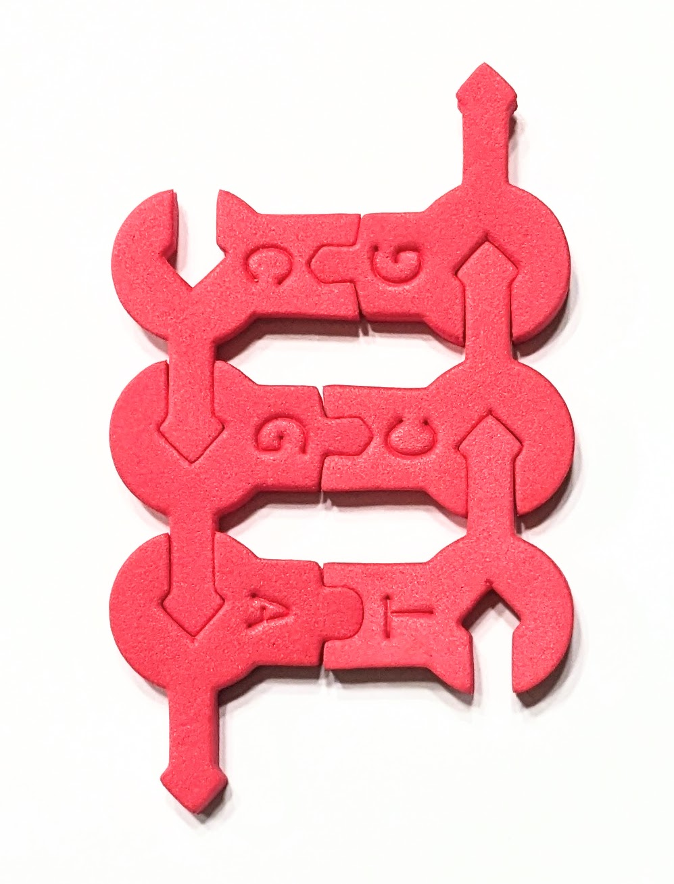
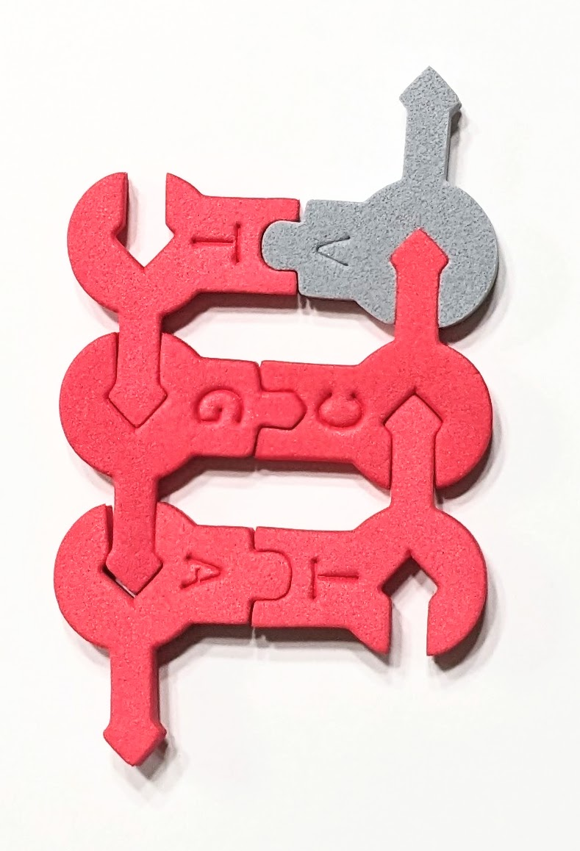
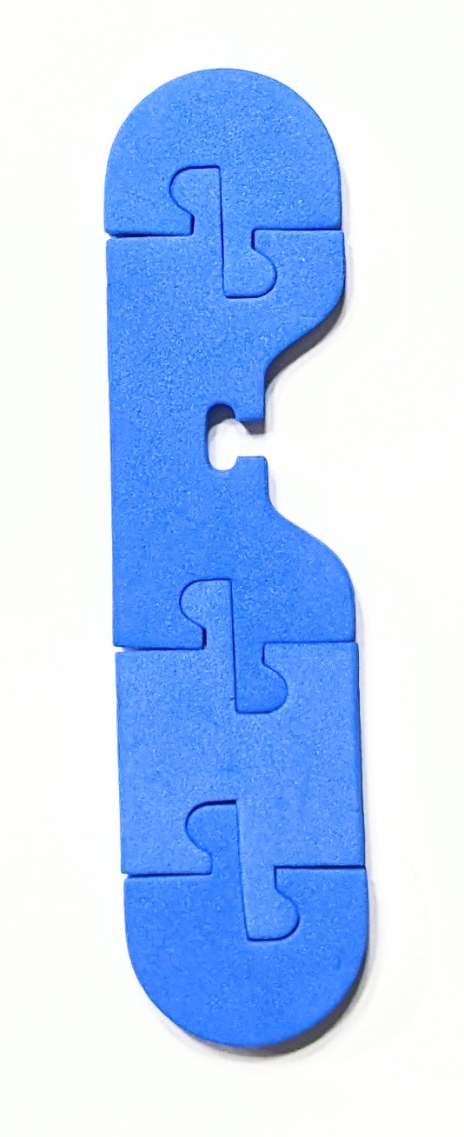
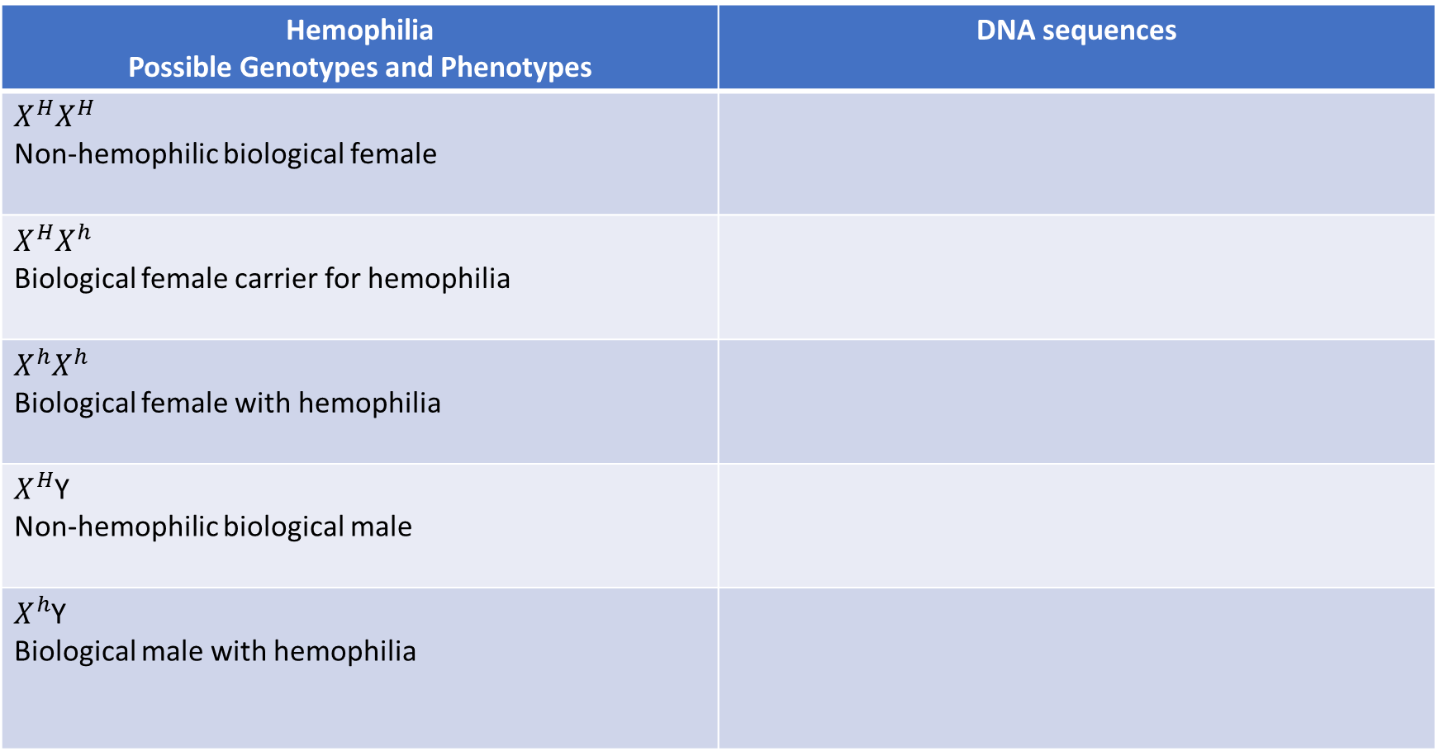
Understanding Sex-linked Inheritance
Hemophilia Possible Genotypes and Phenotypes | DNA sequences
$$X^{H}X^{H}$$ Non-hemophilic biological female
$$X^{H}X^{h}$$ Biological female carrier for hemophilia
$$X^{h}X^{h}$$ Biological female with hemophilia
$X^{H}$Y Non-hemophilic biological male
$X^{h}$Y Biological male with hemophilia

Slide 36
A visit to the genetic counselor
A carrier female and non-hemophiliac male want to know if they have a chance of having a child with hemophilia. Complete the Punnett square using DNA sequences to fill in each of the squares.

Slide 37
A visit to the genetic counselor
A carrier female and non-hemophiliac male want to know if they have a chance of having a child with hemophilia. Complete the Punnett square using DNA sequences to fill in each of the squares.

Slide 38
Our last stop is chromosome 2.

Slide 39

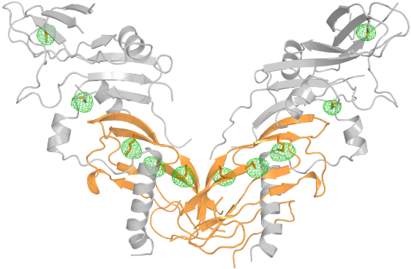
The gene for myostatin has a variant that causes significantly increased muscle mass and strength.
Myostatin
Notes:
The myostatin gene acts as a negative muscle regulator. If one has too little myostatin, then an increase in skeletal muscle mass is seen. Overexpression of the myostatin gene leads to a wasting syndrome that is identified by extensive muscle loss.

Slide 40
A guanine was replaced by an adenine. What are the implications of this mutation?
Myostatin
Notes:
The myostatin gene acts as a negative muscle regulator. If one has too little myostatin, then an increase in skeletal muscle mass is seen. Overexpression of the myostatin gene leads to a wasting syndrome that is identified by extensive muscle loss.

Slide 41
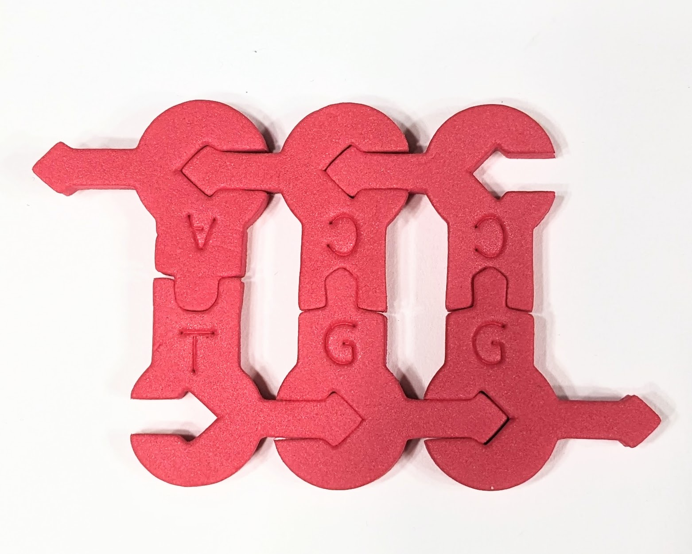
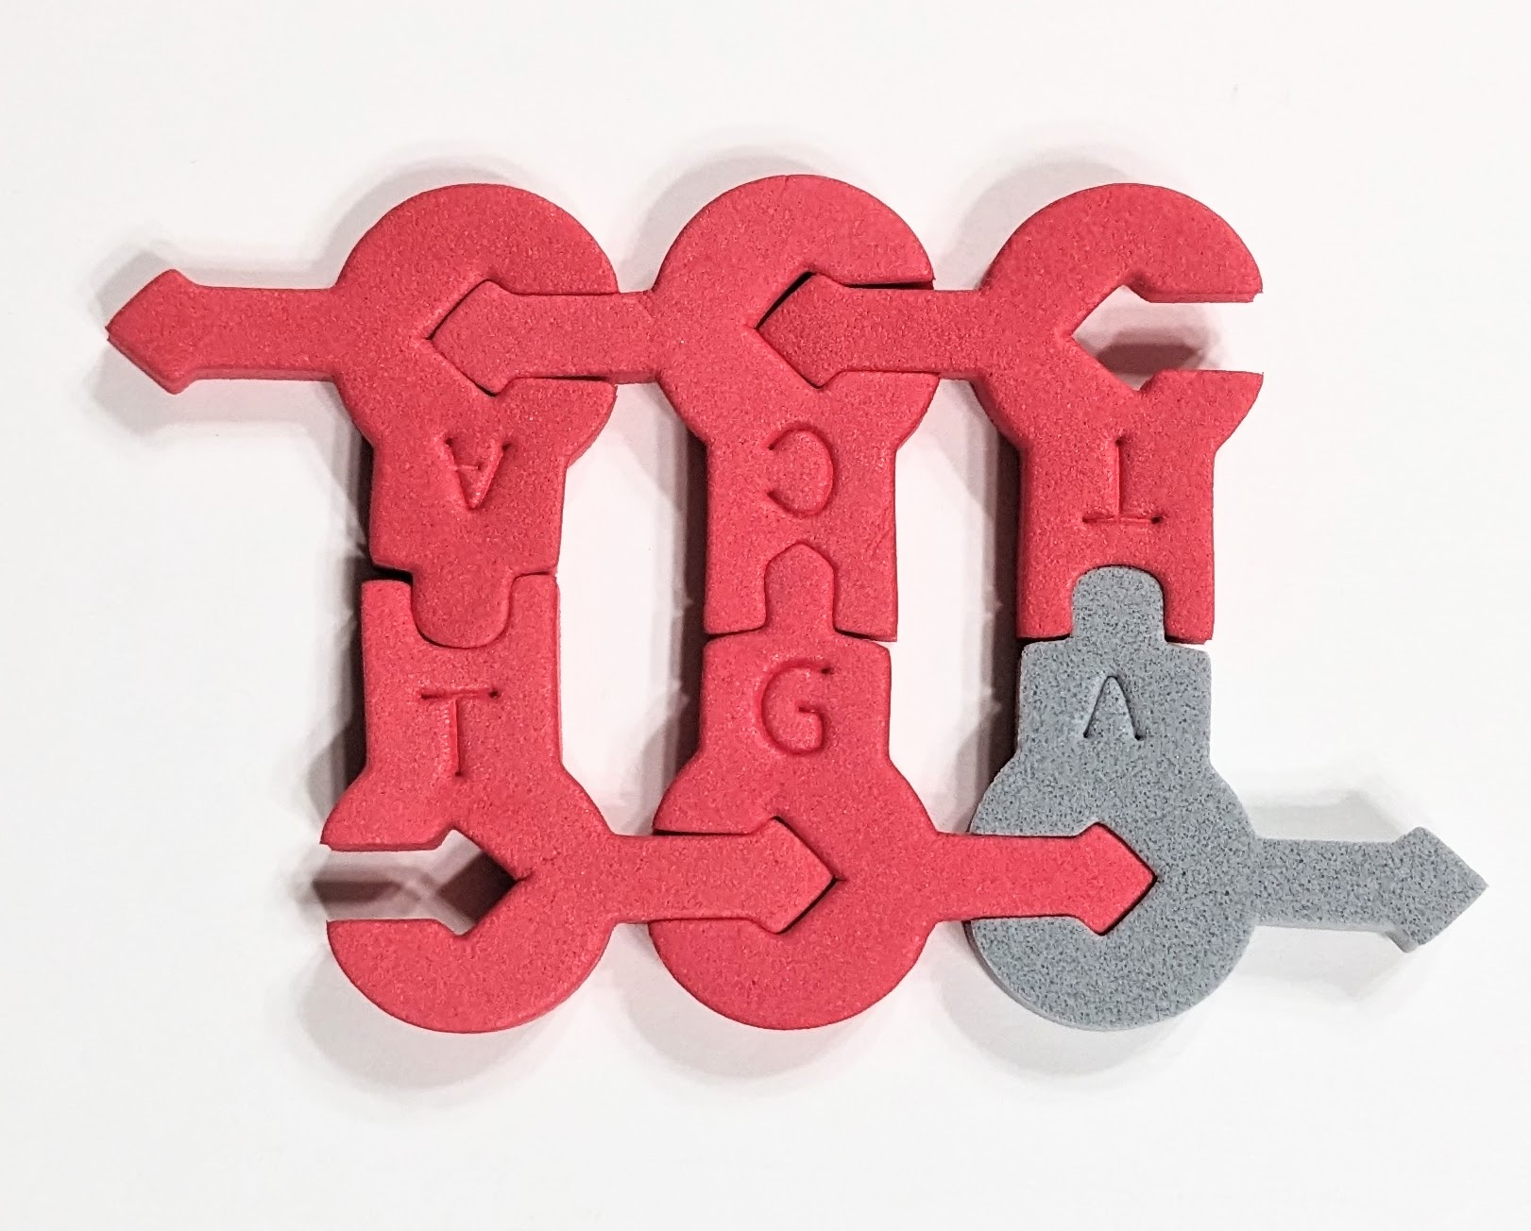
Understanding Incomplete Dominance
Myostatin-related muscle hypertrophy Possible Genotypes and Phenotypes | DNA Sequence
Homozygous dominant MM
Heterozygous Mm
Homozygous recessive mm
Notes:
Muscle hypertrophy syndrome is
Variants (also known as mutations) in the MSTN gene cause myostatin-related muscle hypertrophy. The MSTN gene provides instructions for making a protein called myostatin, which is active in muscles used for movement (skeletal muscles) both before and after birth. This protein normally limits muscle growth, ensuring that muscles do not grow too large. Variants that reduce the production of functional myostatin lead to an overgrowth of muscle tissue
Myostatin-related muscle hypertrophy has a pattern of inheritance known as incomplete autosomal dominance. People with a variant in both copies of the MSTN gene in each cell (homozygotes) have significantly increased muscle mass and strength. People with a variant in one copy of the MSTN gene in each cell (heterozygotes) also have increased muscle bulk, but to a lesser degree.
Schuelke et al. report a case of muscle hypertrophy associated with a mutation in the myostatin gene. The patient was homozygous for a guanine-to-adenine transition at nucleotide g.IVS1+5 — a mutation that may lead to missplicing.

Slide 42
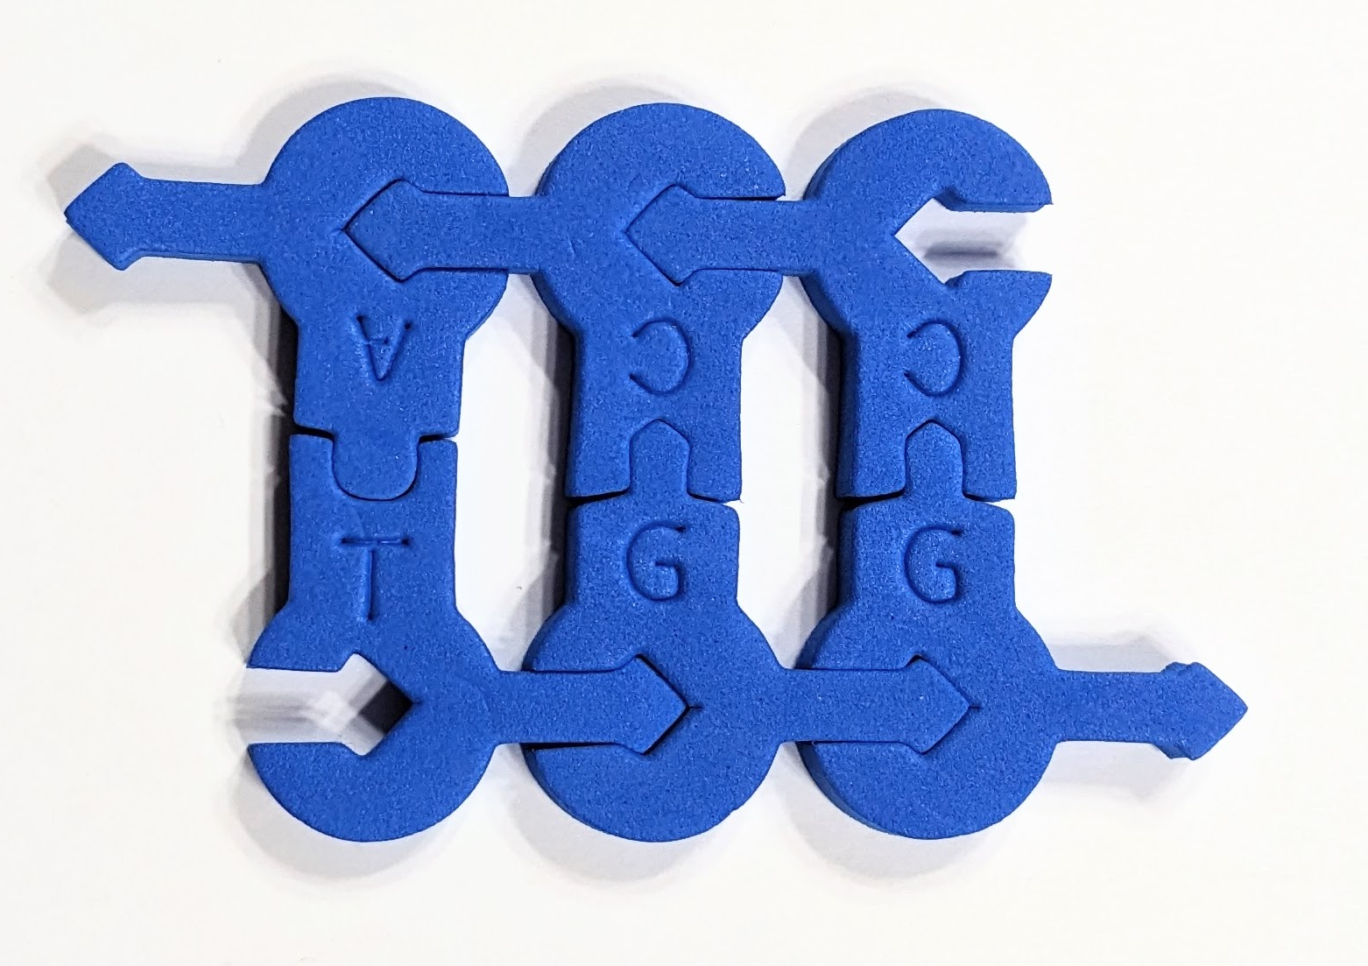
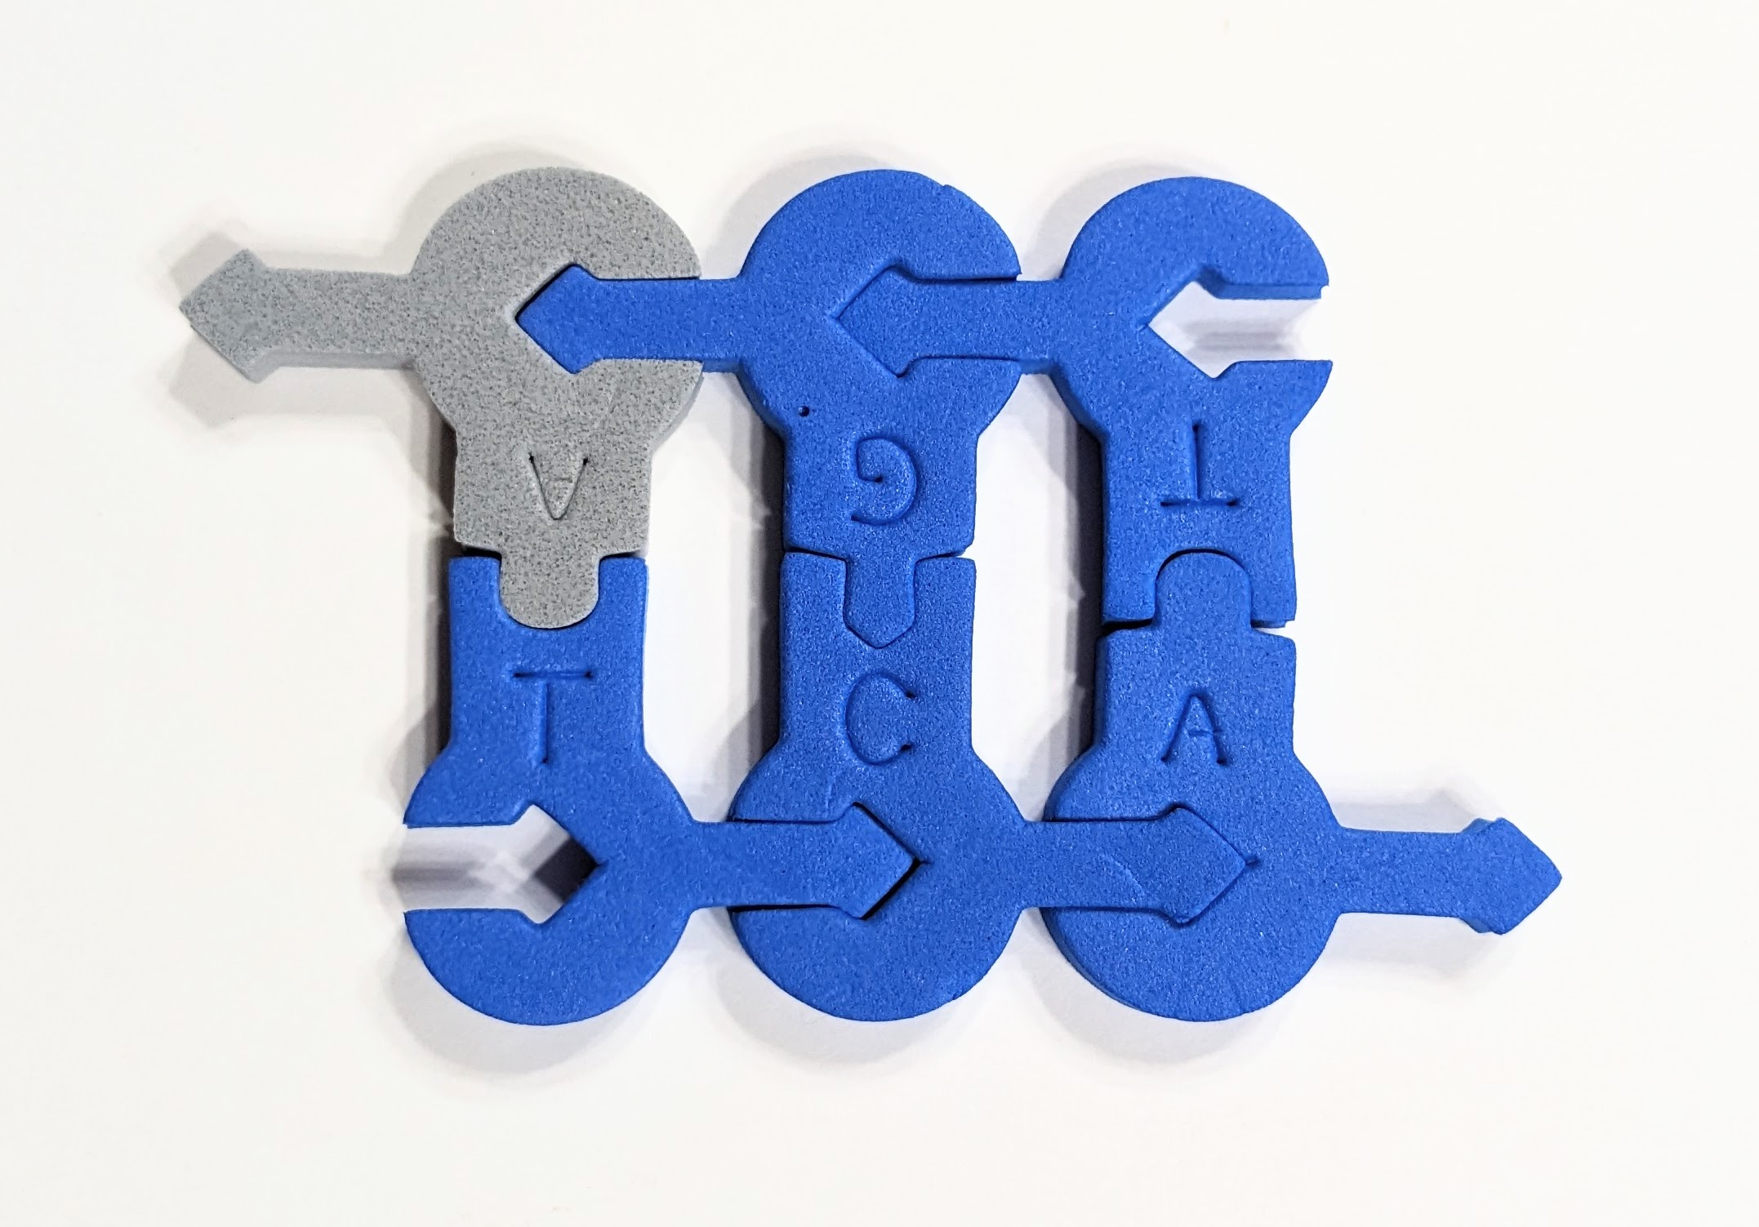
A visit to the genetic counselor
Two heterozygous individuals with muscle hypertrophy syndrome want to know if they might have affected children. Complete the Punnett square using DNA sequences to fill in each of the squares.
What are the implications?

Slide 43
A visit to the genetic counselor
Two heterozygous individuals with muscle hypertrophy syndrome want to know if they might have affected children. Complete the Punnett square using DNA sequences to fill in each of the squares.
What are the implications?

Slide 44
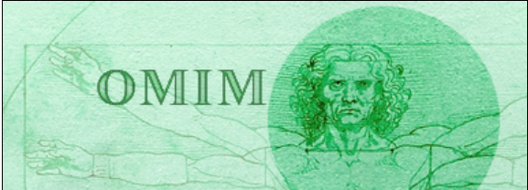

Genetic databanks to help you develop other cases
Home - OMIM - NCBI (nih.gov)
MedlinePlus: Genetics

Slide 45
Additional Resources
Understanding Sickle Cell - Sickle Cell Speaks
Sickle hemoglobin (HbS) allele and sickle cell disease: a HuGE review - PubMed (nih.gov)
What is HD? - Huntington's Disease Society of America (hdsa.org)
Home - Hemophilia Federation of America
Myostatin-related muscle hypertrophy: MedlinePlus Genetics
Entry - *601788 - MYOSTATIN; MSTN – OMIM
Myostatin Mutation Associated with Gross Muscle Hypertrophy in a Child | NEJM

Slide 46
Additional Resources
The status of the human gene catalogue | Nature
Human Genome Is Much More Than Just Genes | Science | AAAS
An integrated encyclopedia of DNA elements in the human genome | Nature

Slide 47
Workshop NGSS Connections
SEPs | CCCs | DCIs
Asking Questions and Defining Problems | Systems and System Models | HS-LS1-4
Developing and Using Models | Cause and Effect | HS-LS3-2
 | Scale, Proportion, and Quantity | Georgia Standards: SB3, SB6
Notes:
Ruth says: Here are the NGSS Connections for this workshop.

Slide 48


Summer Course 2024 – Modeling the Molecular World
Join us in Milwaukee for hands-on discovery and professional development
July 29 – Aug 2 OR Aug 5 – 9
Scan to register!
Bring an empty suitcase!
You'll take home all these classroom resources!
Notes:
Scholarships are available. If you have questions, you can contact Ruth Hutson at ruth.hutson@3dmoleculardesigns.com.

Slide 49
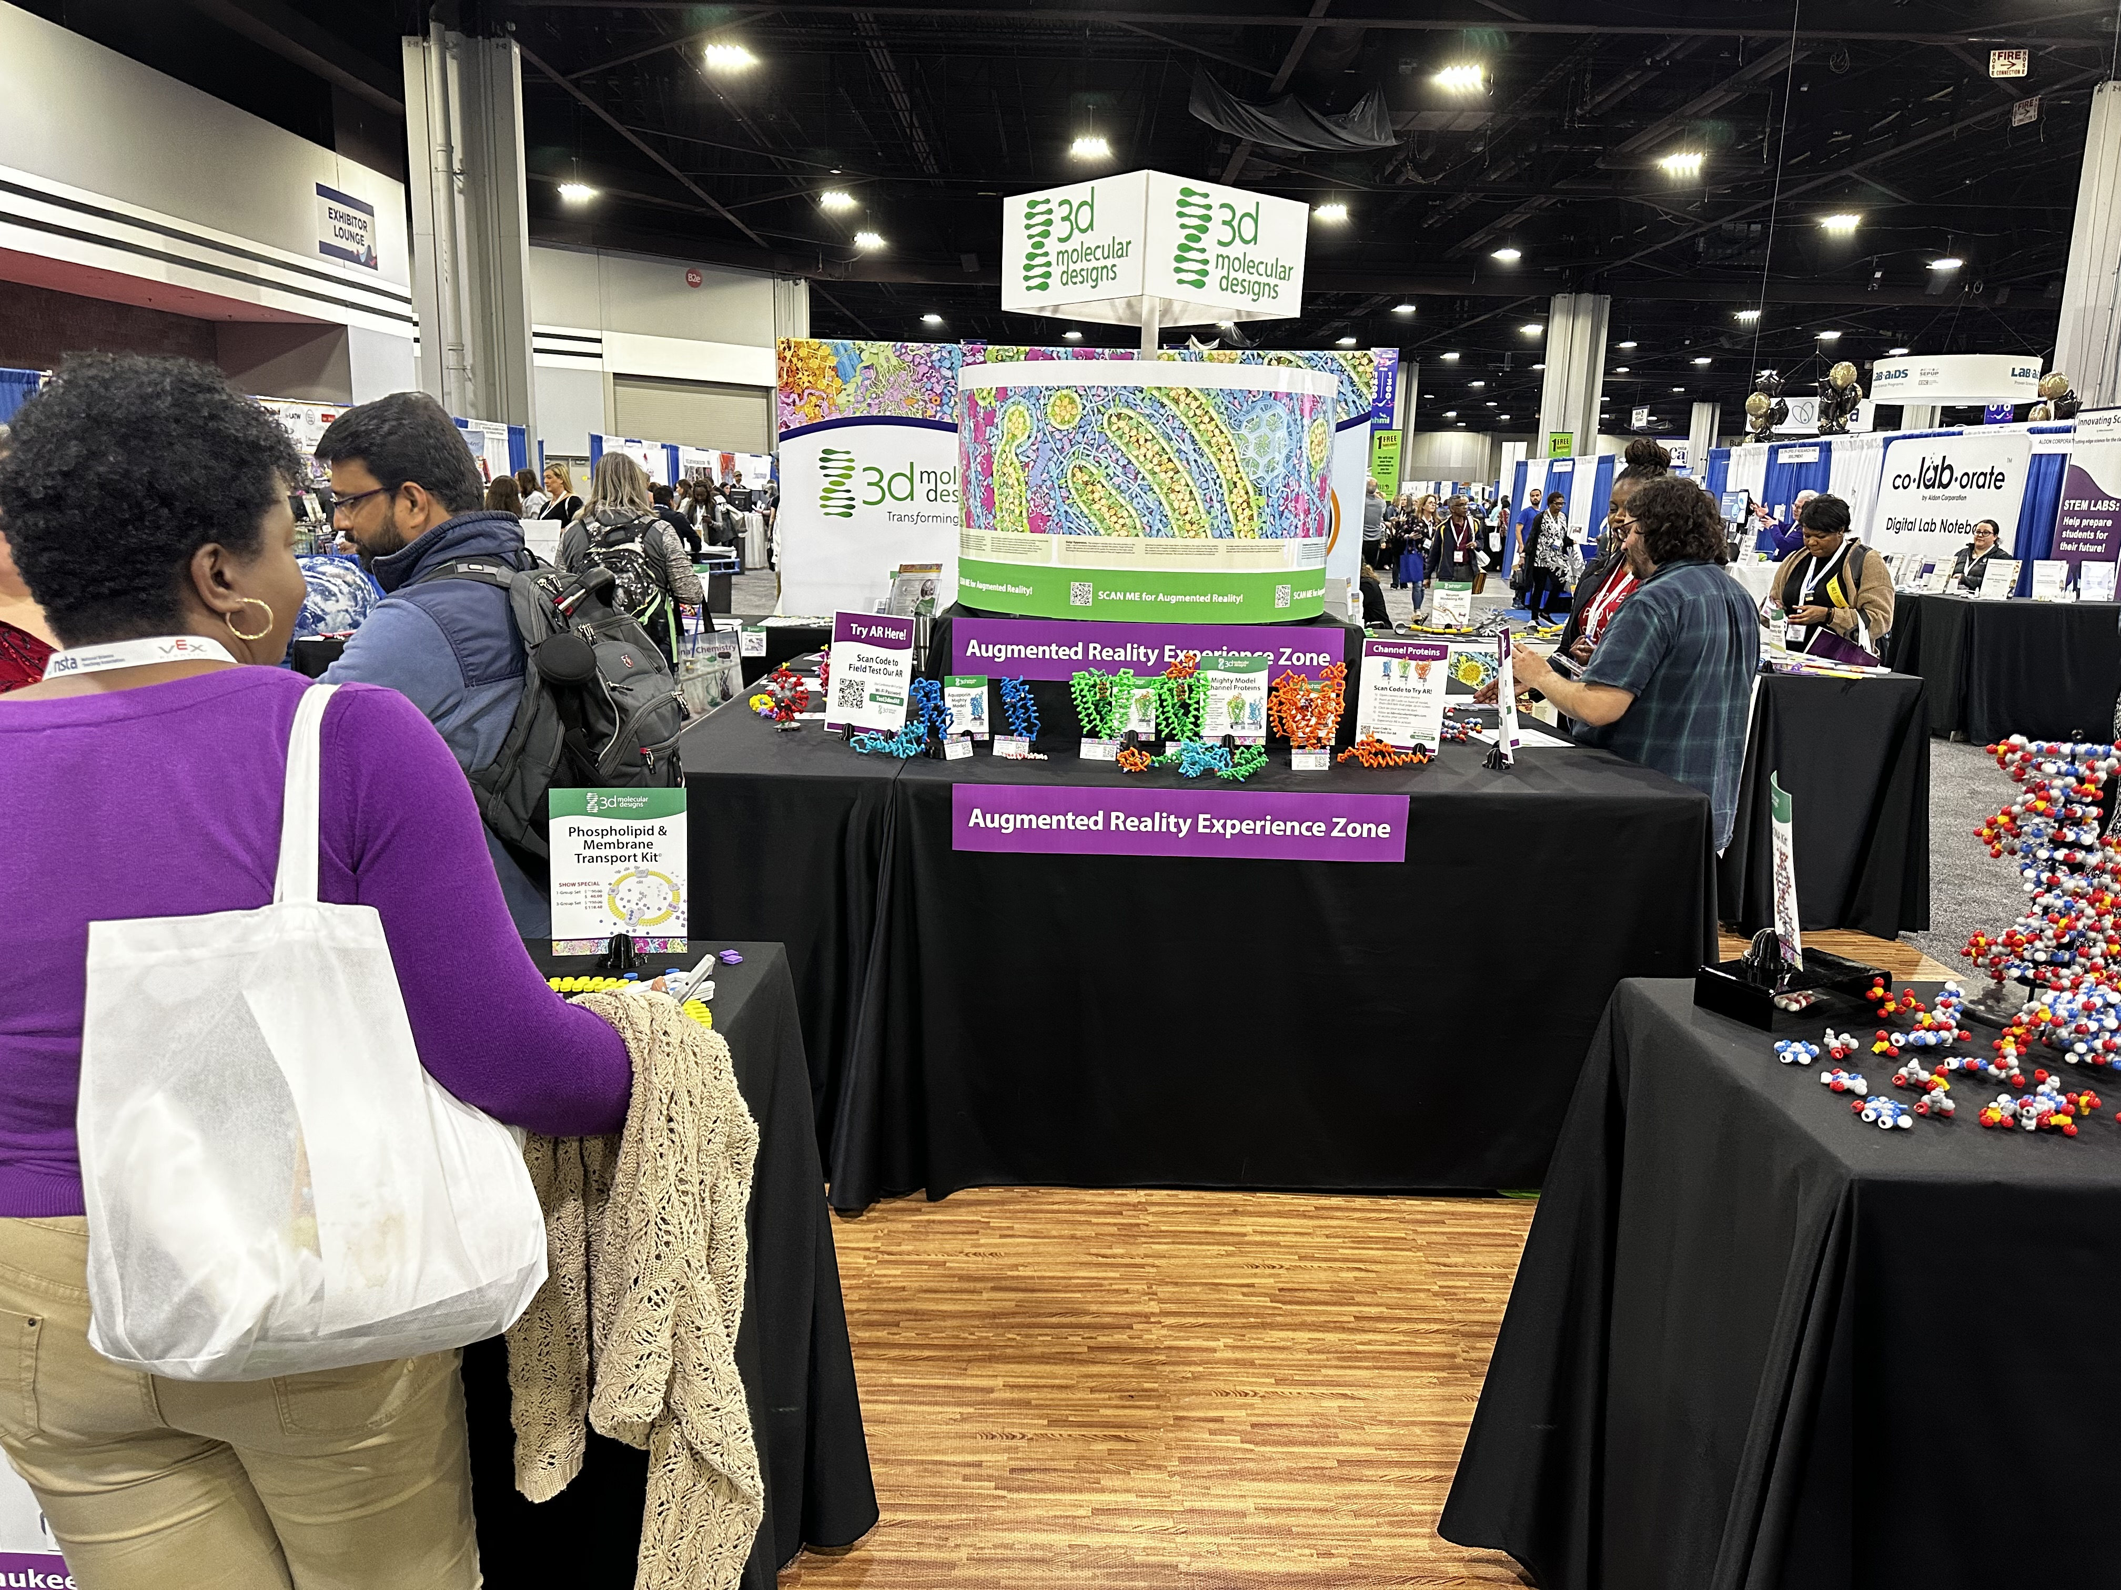
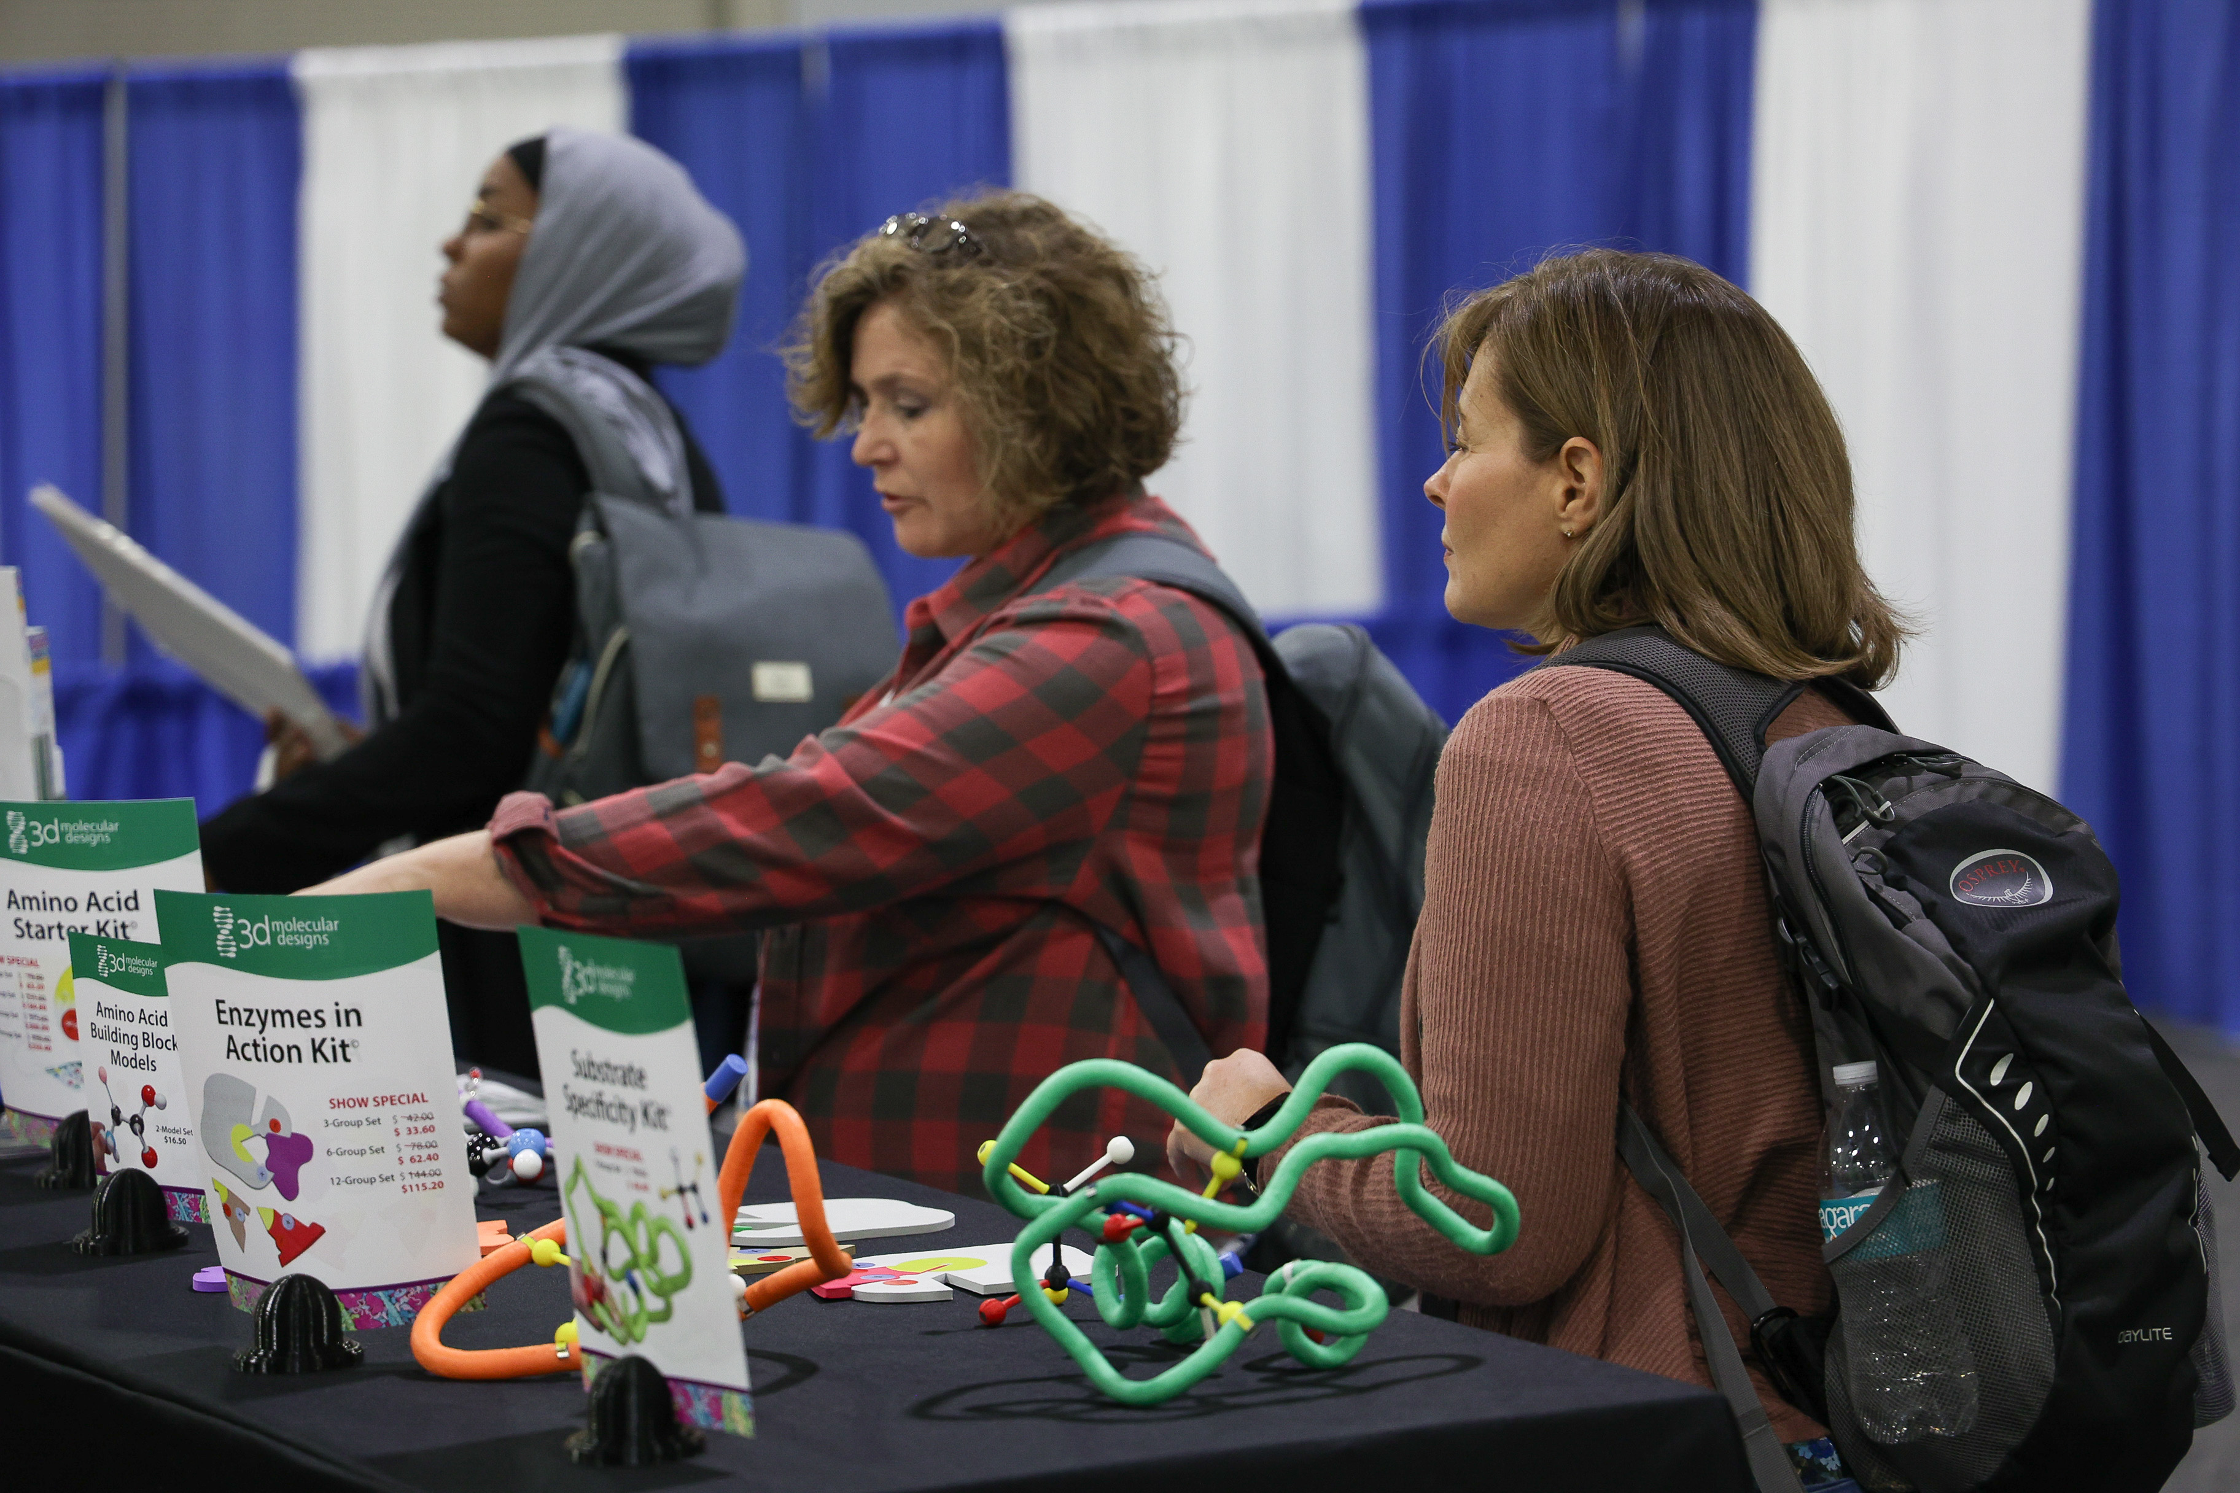
Visit Our Booth!
Continue your exploration of our dynamic kits and models at Booth 3 !

Slide 50
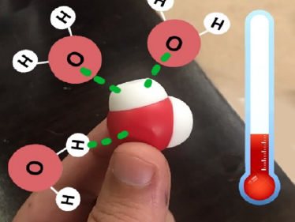
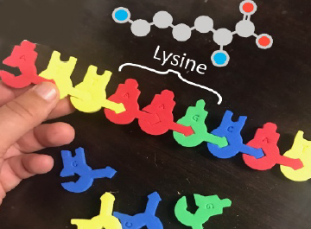
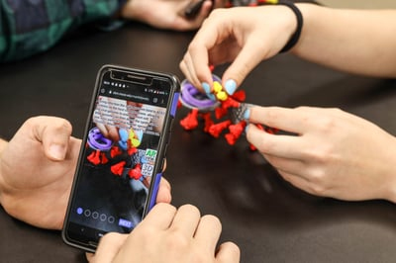
AR Enhancements
We're enhancing our kits and models to inspire more hands-on learning with new augmented reality features!
Stop by Booth 3 to
check out our new
Augmented Reality Enhancements!

Slide 51

We value your opinion!
Let us know what you think.
Scan the QR Code and complete this short survey.

Slide 53
A visit to the genetic counselor
Notes:
Use this graphic organizer with your students. Print it on 11X17 paper to fit your genetic sequences, then laminate for continued use. In addition, you can use DRAFTPunnettSquareStudentAnswerSheet3-12-20c7419-1.pdf (3dmoleculardesigns.com) and DraftPunnettSquareStudentActivityGuide3-12-20-1.pdf (3dmoleculardesigns.com).

