Slide 1


Enzyme Explorations: Real-world Connections with Wet Labs
Ruth Hutson, MSSE

Slide 2
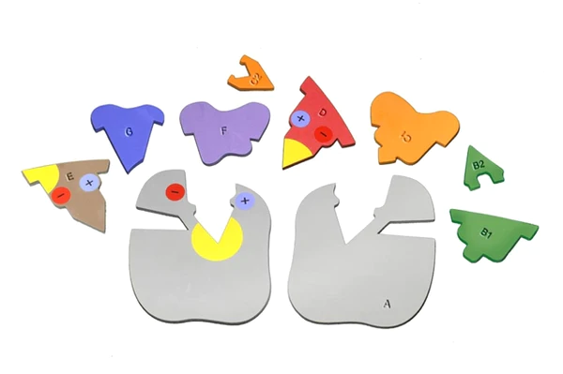
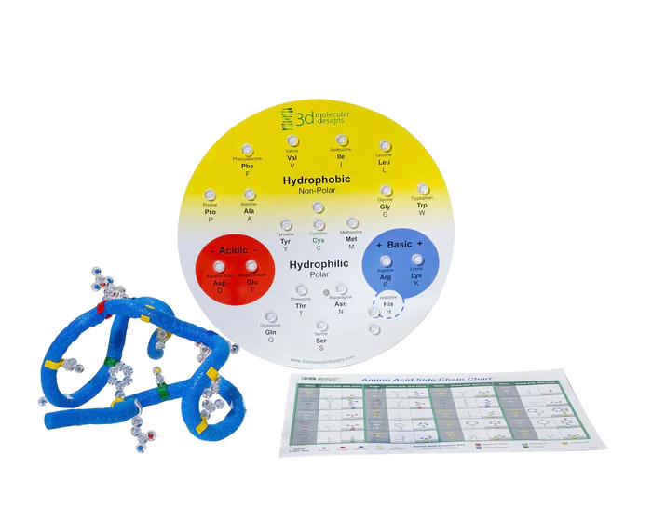
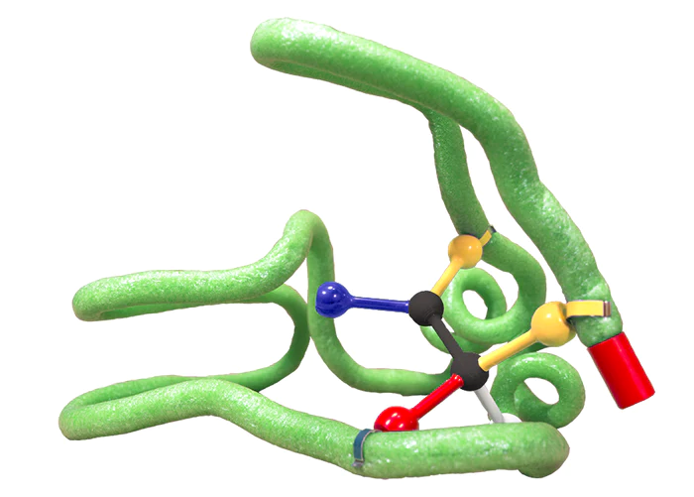
Notes:
For today’s 50-minute session we are going to explore how to use the Enzyme in Action Kit, Amino Acid Starter Kit, and Substrate Specificity Kit to help students interpret results from the catalase “Bubbly” lab.

Slide 3
Workshop Outcomes
Construct an enzyme active site.
Explore what happens to protein structure when environmental conditions are perturbed.
Make predictions and compare them to wet labs results.

Slide 4
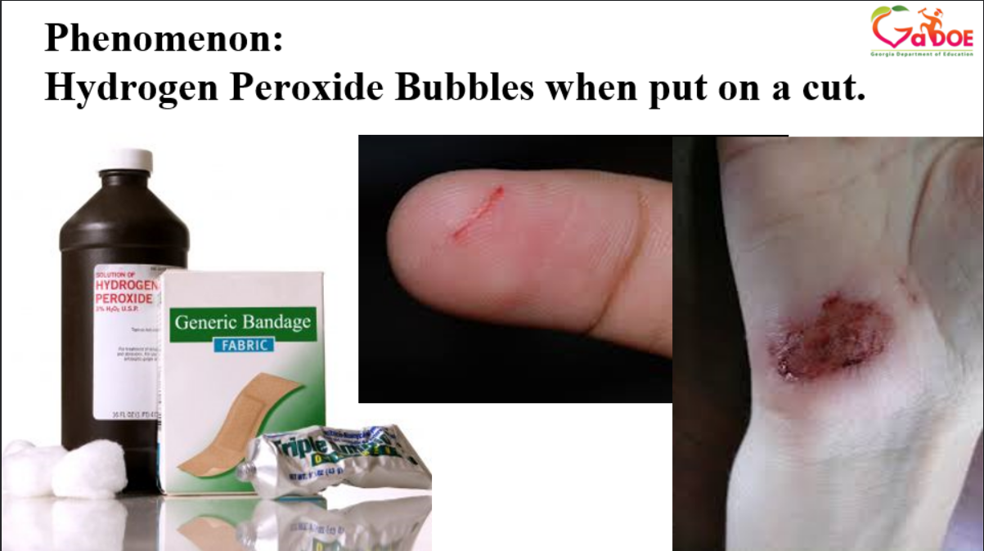
Notes:
What the teacher is doing: Monitor student groups and answer questions, as necessary
What the student is doing: Consider the following questions:
What are some observations you made? What patterns did you notice? What did things have in common? What do you think these things happened?

Slide 5
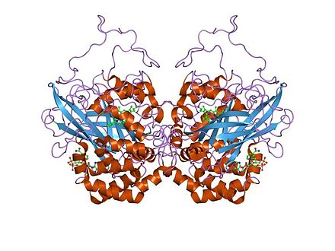
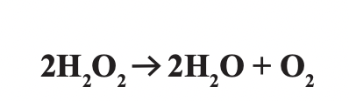
Catalase Lab
Case study and a multi-day wet lab that allows students to explore and manipulate enzyme actions
Notes:
Catalase is a nice introductory enzyme for students to use as a case study because it is found in many different organisms. I typically use bovine catalase because we can get it from beef liver. If that is unacceptable for you, you can order purified bovine catalase solution from a biological supply house like Carolina Biological or you can make a slurry of potato catalase. I discovered that some of my students were very confused when it came to interpreting what they saw macroscopic level with what was happening nanoscopic level. They could not envision it. It was too abstract for them.
What the teacher is doing: Monitor students while they complete the lab.
What the student is doing: Complete the Bubbly Lab.

Slide 6
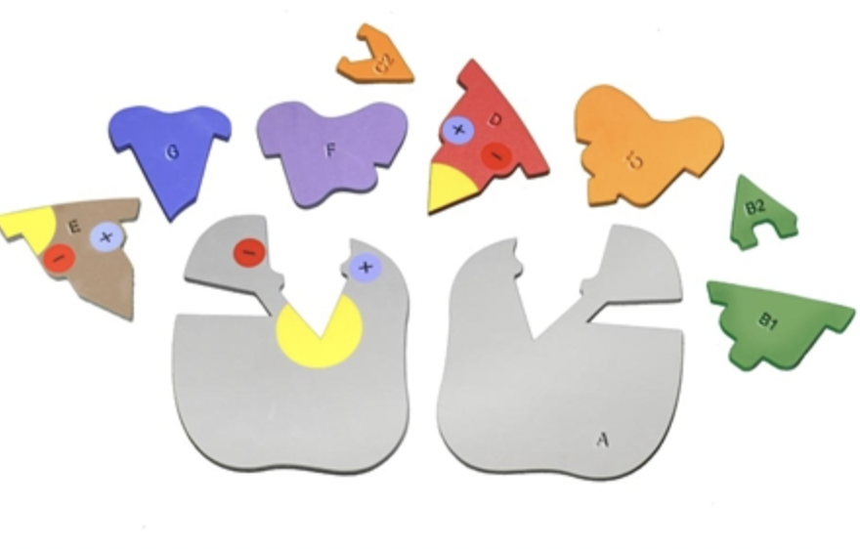
Catabolism
Anabolism
Enzyme
Specificity
Lock and Key Model
Induced Fit Model
Notes:
Before we complete the lab, I use a worksheet from 3DMD to introduce students to the different components of the model and how those can be used to explain the general functions of enzymes. We look at the relationship between catabolism and anabolism. We also compare the lock and key model and induced fit model.
That worksheet can be found on our website with the Enzymes in Action Kit© Resources (3dmoleculardesigns.com). Let’s look at some specific parts of the lab and how students used the kit to explain what was happening at the nanoscopic level. Please use parts of the Enzyme in Action to explore enzyme specificity.
What the teacher is doing: Introduce the scenarios for each.
What the student is doing: Model using the Enzymes in Action Kit.

Slide 7
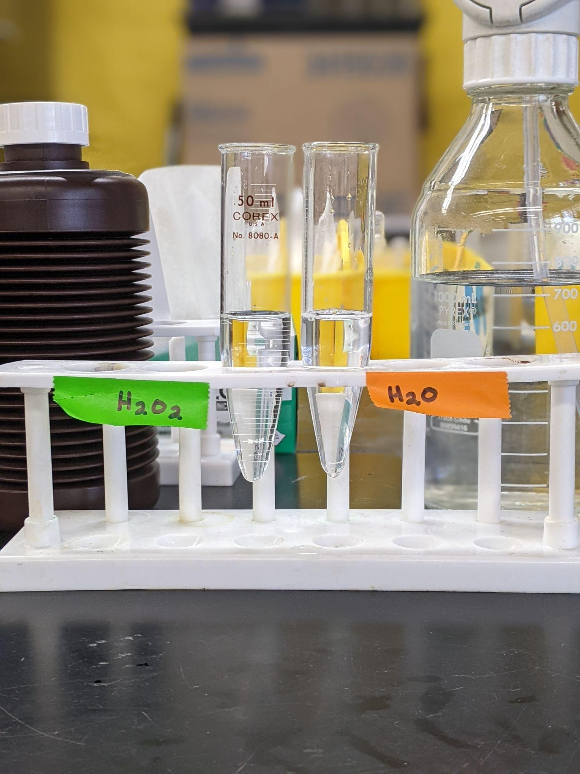
HYDROGEN PEROXIDE
WATER
Notes:
We first look at enzyme specificity by reacting water and hydrogen peroxide with a liver slurry (that contain catalase). Throughout this part of the presentation I will show the before image first, followed by the after image, then I will ask you to do some modeling with your enzymes in action pieces. For these modeling exercises, please retrieve the following parts from your student modeling kit: A, B1, B2, D, F, and G. All of the images that shown are either from my students’ lab results or the Enzymes in Action kit. Let’s do some modeling.

Slide 8
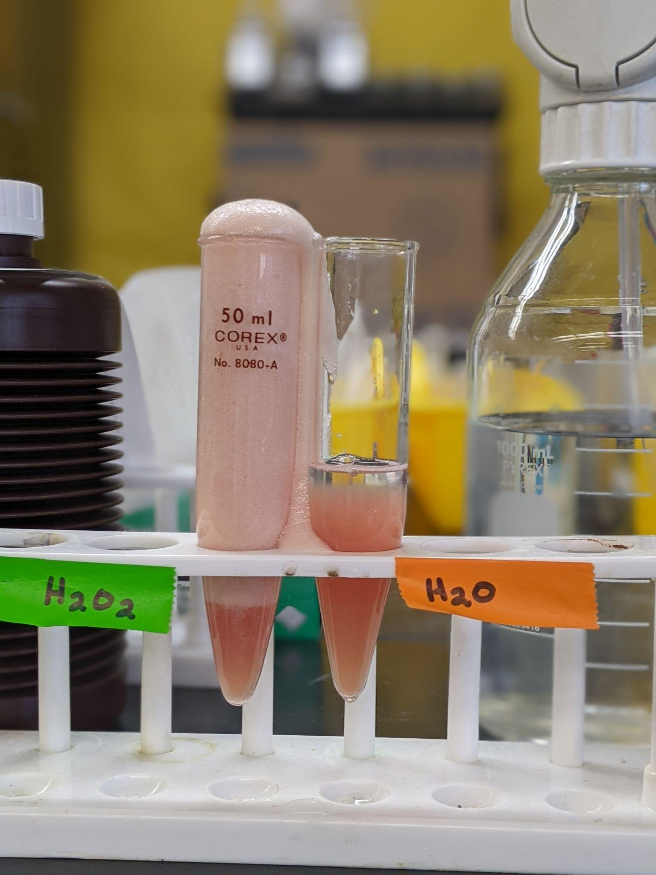
HYDROGEN PEROXIDE
WATER
Notes:
What the teacher is doing: Explain that when catalase encounters hydrogen peroxide, it causes the activation energy to be lower and hydrogen peroxide decomposes into oxygen and water.
Notice that water does not decompose in the presence of catalase.
What the student is doing: Construct a preliminary model based on your results. How can the Enzyme in Action kit be used to model what is happening at the molecular level?

Slide 9
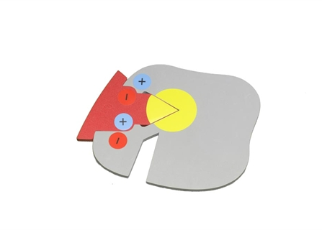
HYDROGEN PEROXIDE
WATER
Notes:
What the teacher is doing: Ask groups to share their models and explain how, then ask how would one model water.
What the student is doing: Explain their preliminary model based on your results. How can the Enzyme in Action kit be used to model what is happening at the molecular level?

Slide 10
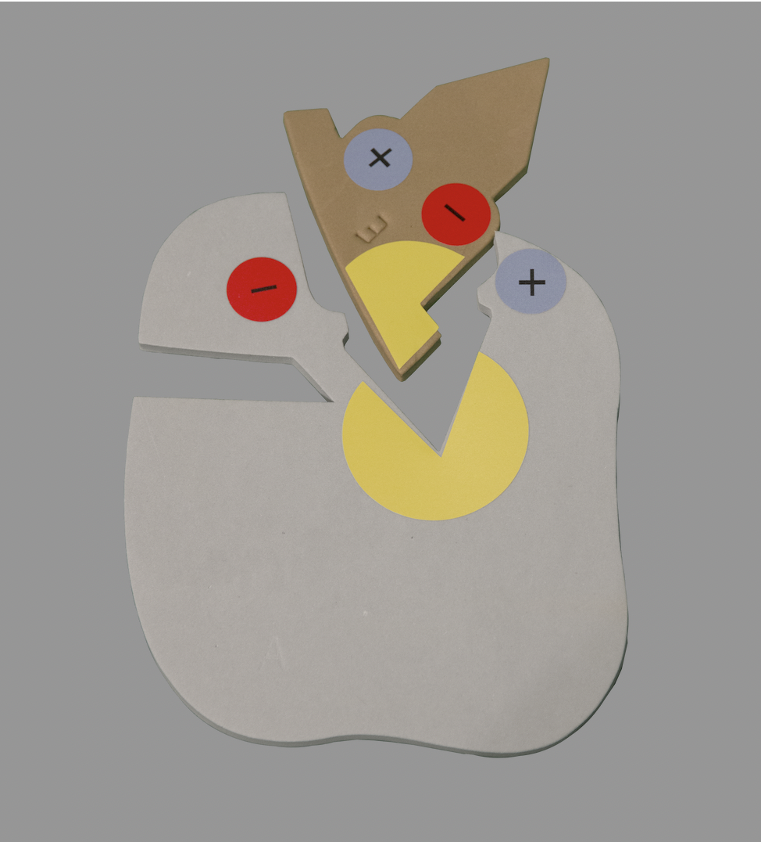
HYDROGEN PEROXIDE
WATER
Notes:
What the teacher is doing: Ask groups to share their models and explain how.
What the student is doing: Explain their preliminary model based on your results. How can the Enzyme in Action kit be used to model what is happening at the molecular level?

Slide 11
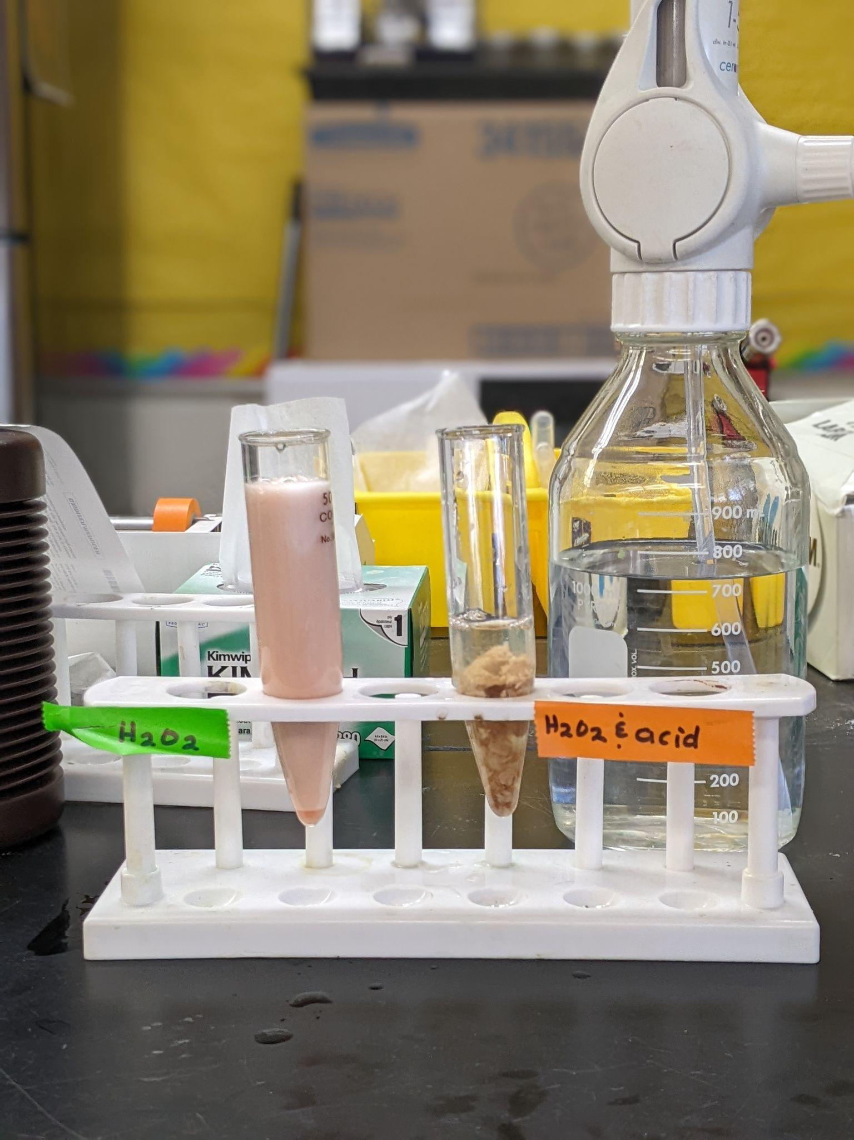
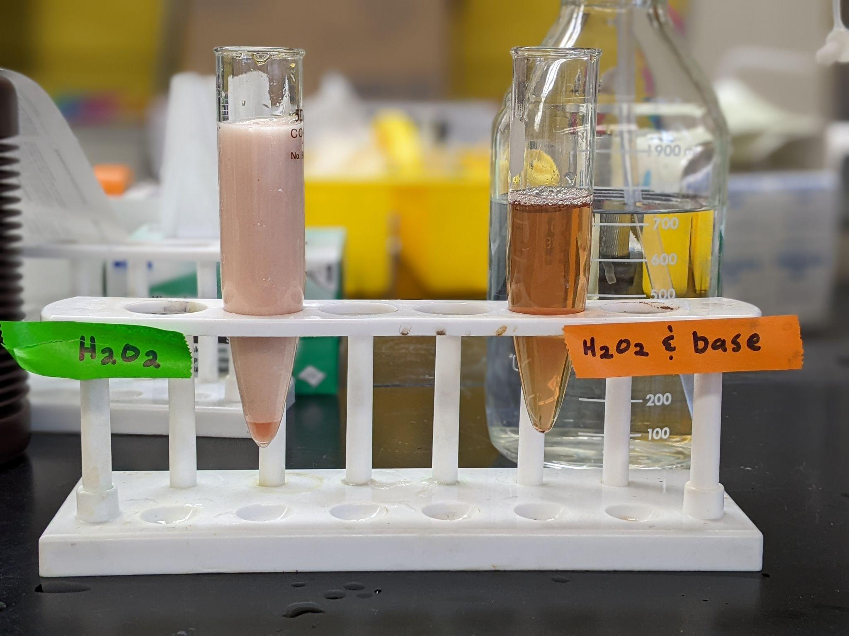
COMPARING ACIDS AND BASES
Notes:
What the teacher is doing: Discuss the after images of the wet lab results with groups.
What the student is doing: Model what is happening on the molecular level.

Slide 12
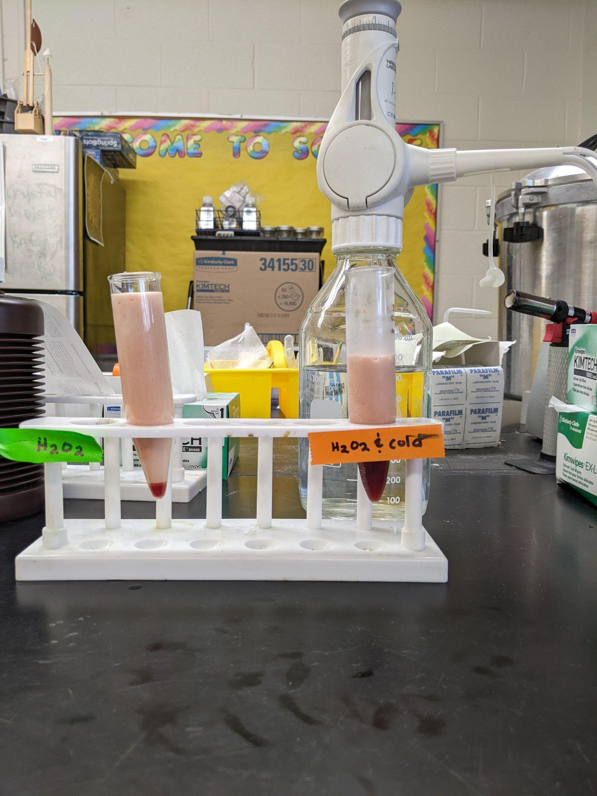
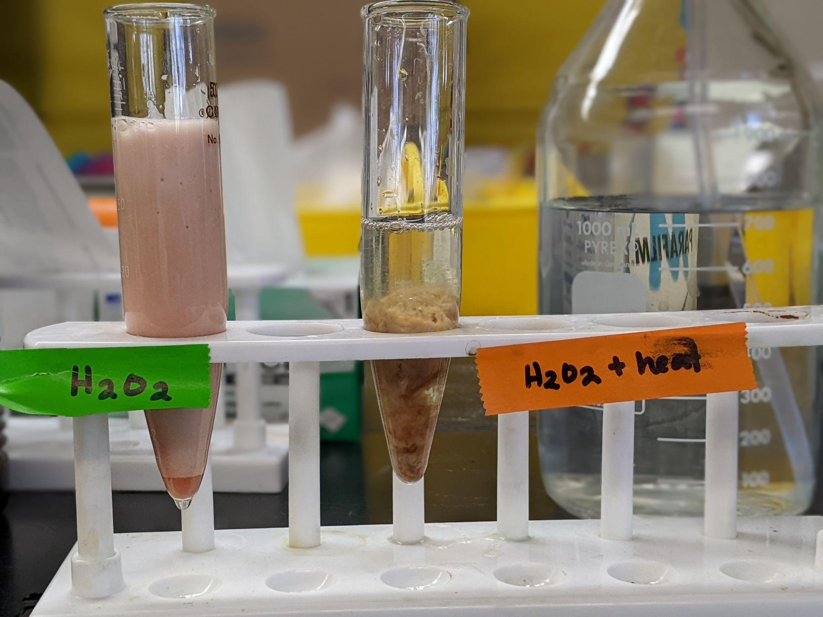
COMPARING COLD AND HEAT
Notes:
What the teacher is doing: Discuss the after images of the wet lab results with groups.
What the student is doing: Model what is happening on the molecular level.

Slide 13
Modeling Catalase‘s Active Site
Notes:
What the teacher is doing: Discuss what is happening to the enzyme in more detail. Ask students to write about what they know about protein structure.
What the student is doing: Brainstorm what they already know about protein structure and enzyme’s active site.

Slide 14
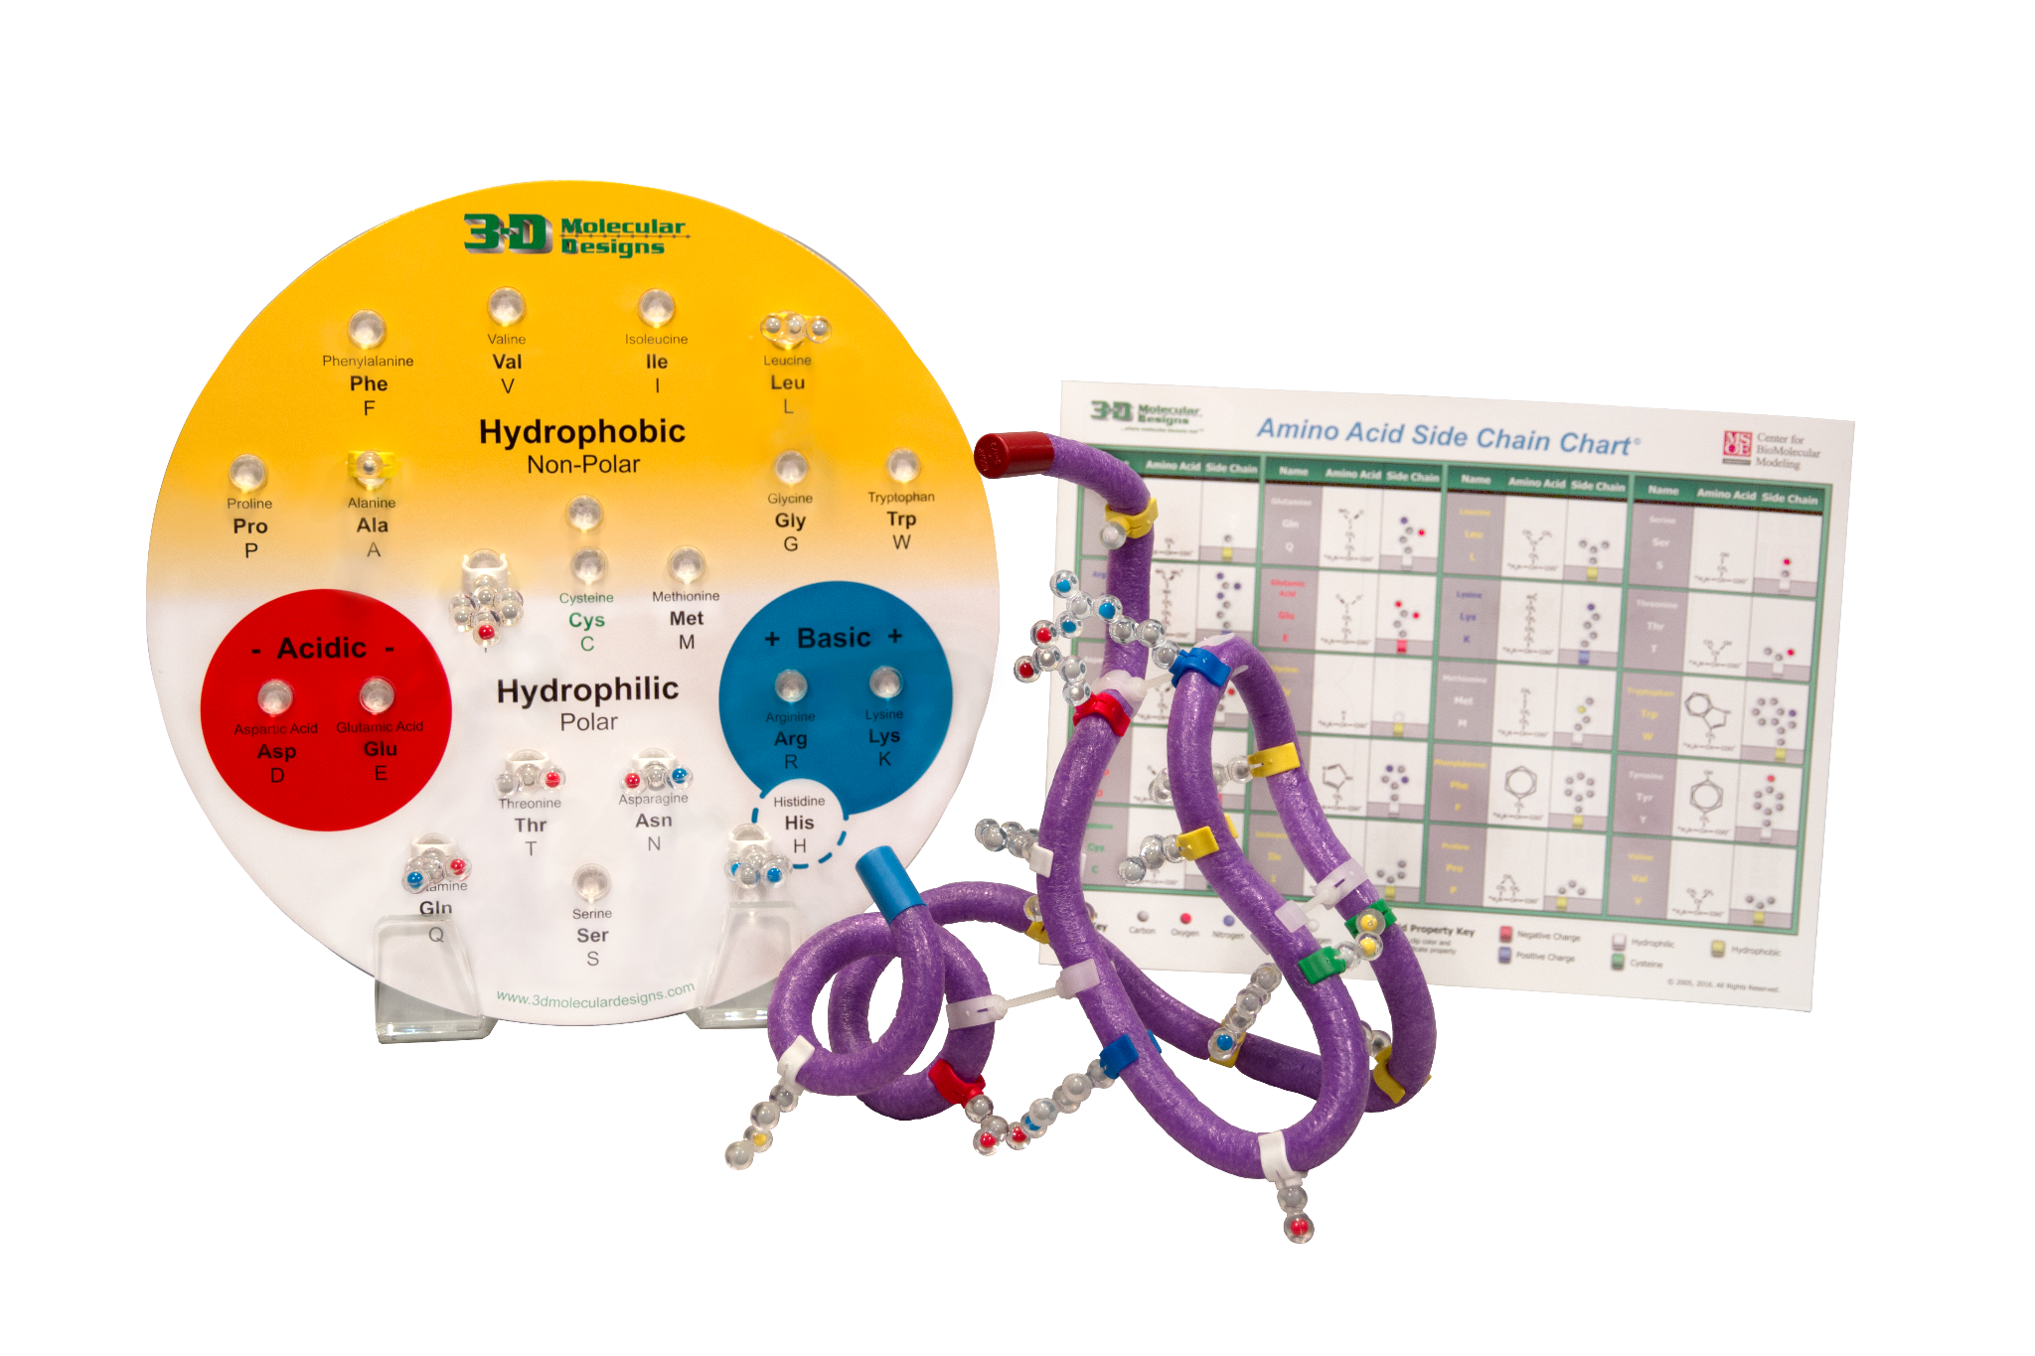
Notes:
We use the amino acid starter kit to further understand what happens to the enzyme active site when it is exposed to fluctuations in temperature or exposed to chemicals like acids and bases. Please get out your mini-toober to model along with me.

Slide 15
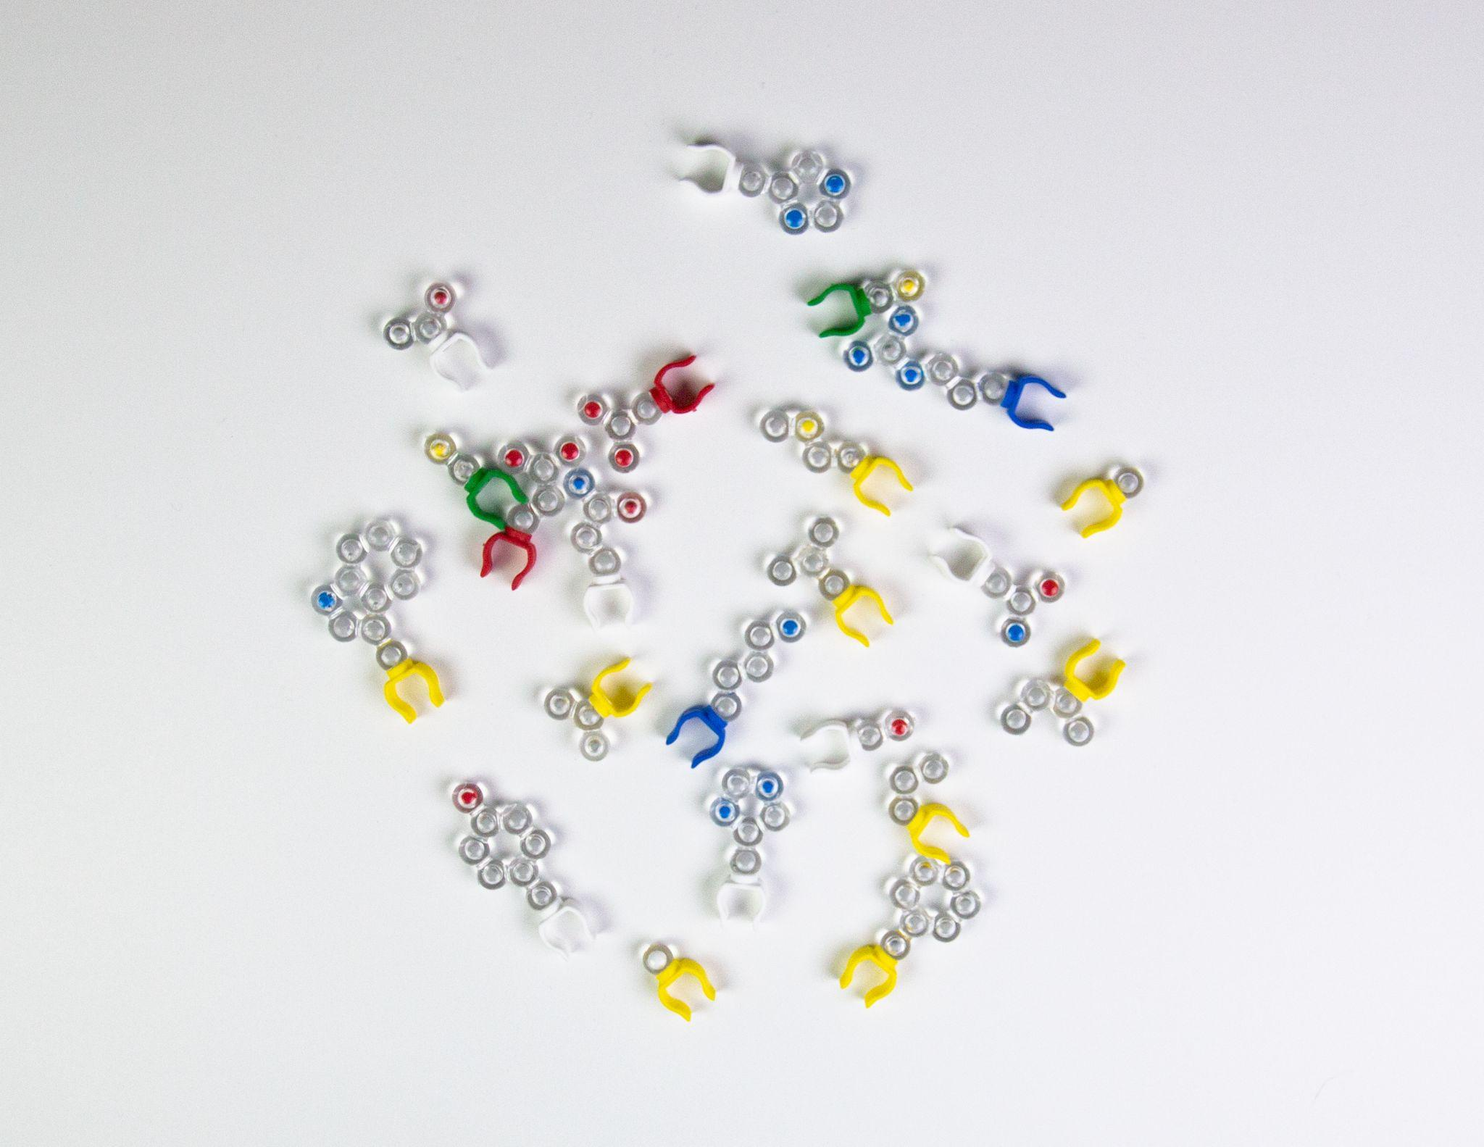
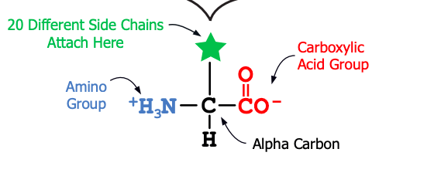
Notes:
What the teacher is doing: Review the structure of amino acids using the Molymod kits. Give students time to sort through the side chains.
What the student is doing: Get out the bag of 20 amino acid side chains the kit. Sort these side chains into a meaningful pattern.

Slide 16
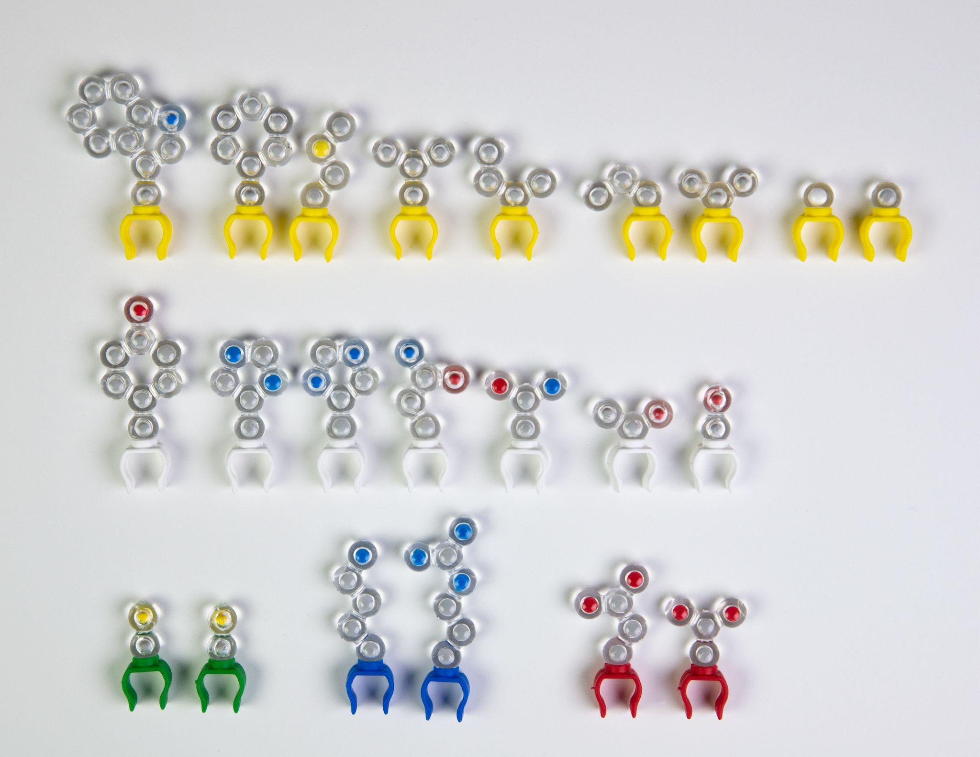
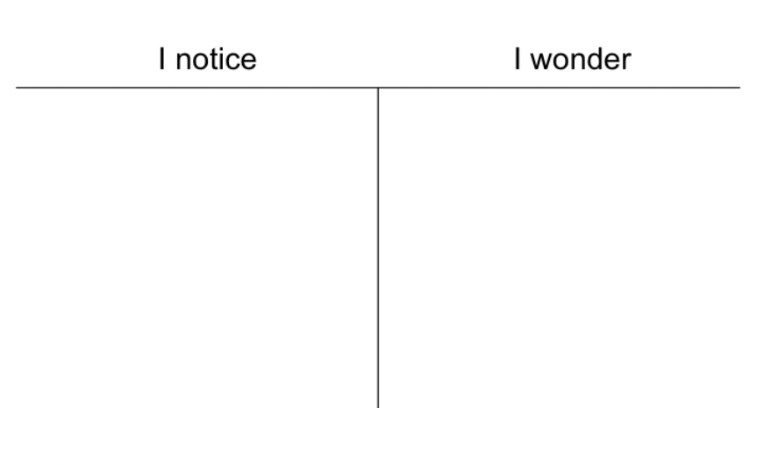
WHAT PATTERNS DO YOU SEE AMONG THE SIDE CHAINS?
WHAT QUESTIONS DO YOU HAVE?
Notes:
Look closely at the side chains and consider the two questions on the screen.

Slide 17
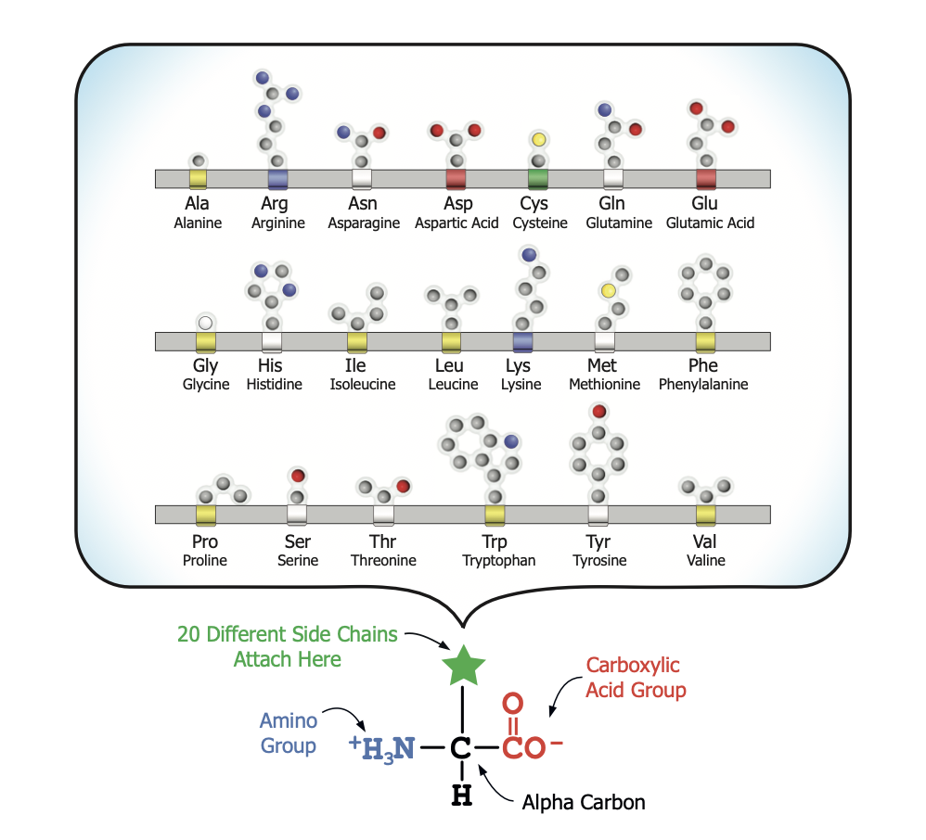
Notes:
What the teacher is doing: Ask students to share how they grouped their amino acids.
What the student is doing: Use the amino acid side chain chart, identify and place the side chains in their proper location on the amino acid organizer.

Slide 18
WHAT CAUSES PROTEINS TO FOLD INTO THEIR 3-D SHAPES? MAKE A PREDICTION
Notes:
What the teacher is doing: Give students time to respond to the question.
What the student is doing: Consider this prompt and it within your group. Hint: it has something to do with its affinity to water.

Slide 19
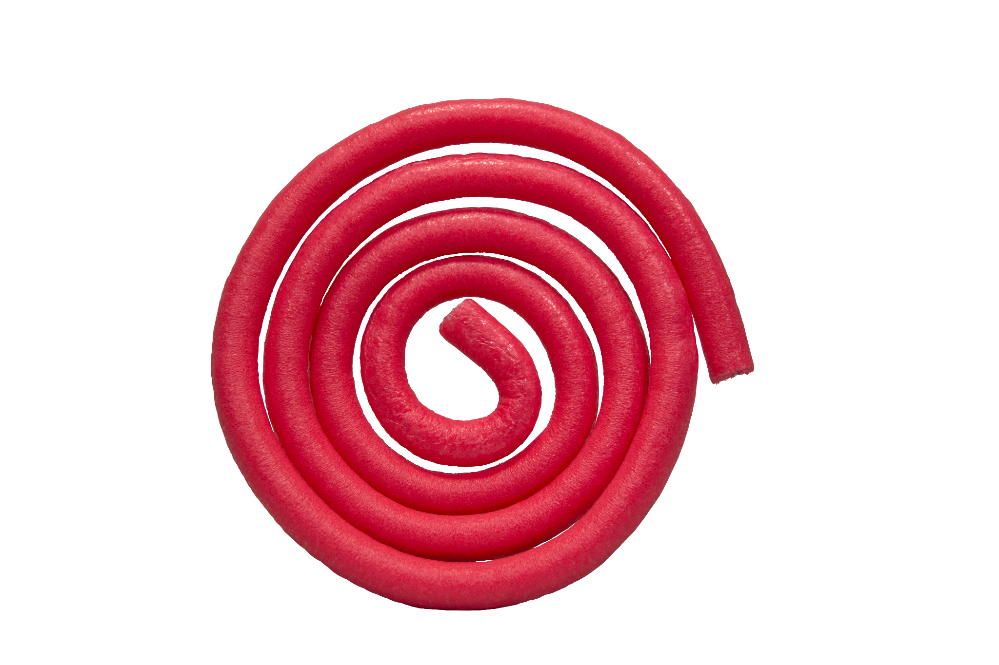
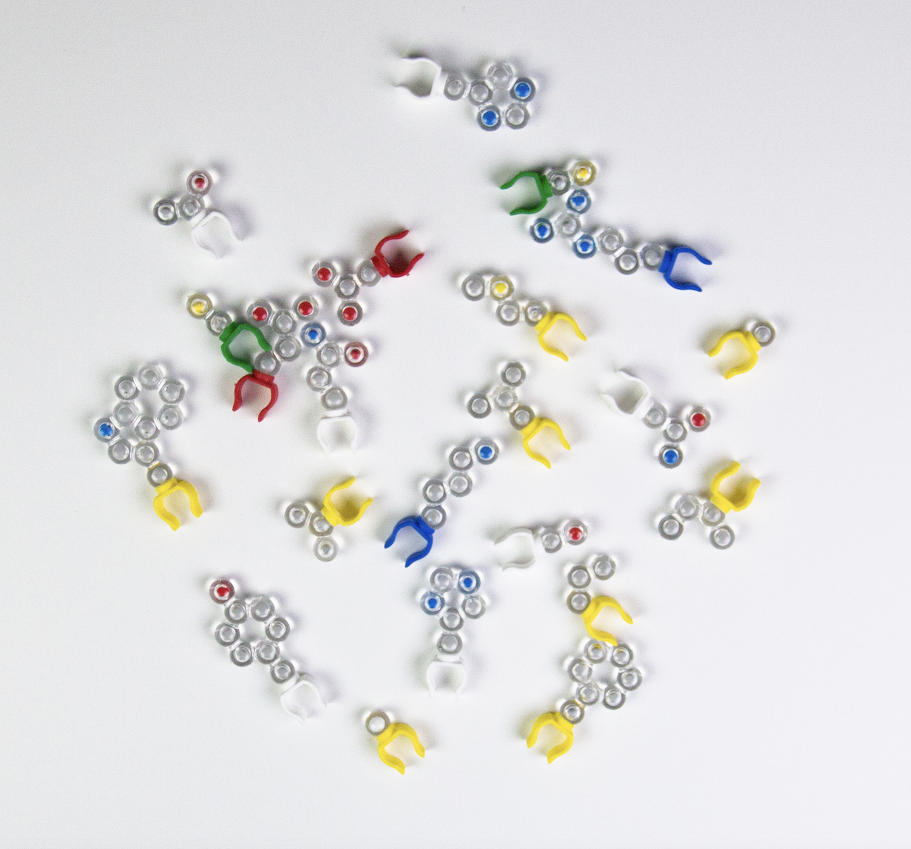
Notes:
What the teacher is doing: Ask groups to retrieve the mini-toober and 15 amino acid side chains.
What the student is doing: Get out the supplies on the slide.

Slide 20
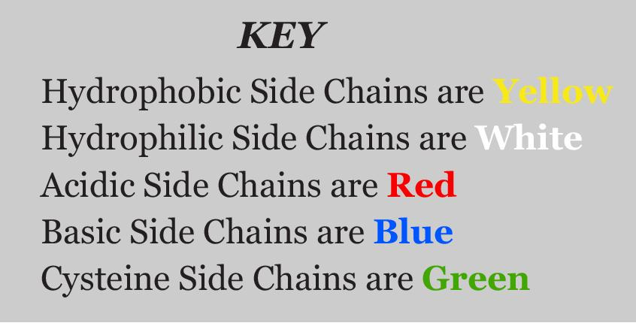
Notes:
What the teacher is doing: Ask groups to retrieve the mini-toober and 15 amino acid side chains. Also, we are only focusing on short segment of the protein. The average size protein has 300 amino acids.
What the student is doing: Get out the supplies on the slide.

Slide 21
SIX HYDROPHOBIC
THREE HYDROPHILIC
TWO ACIDIC
TWO BASIC
TWO CYSTEINE
A TOTAL OF FIFTEEN SIDE CHAINS
Notes:
What the teacher is doing: Ask groups to retrieve the mini-toober and 15 amino acid side chains. Also, we are only focusing on short segment of the protein. The average size protein has 300 amino acids.
What the student is doing: Get out the supplies on the slide.

Slide 22
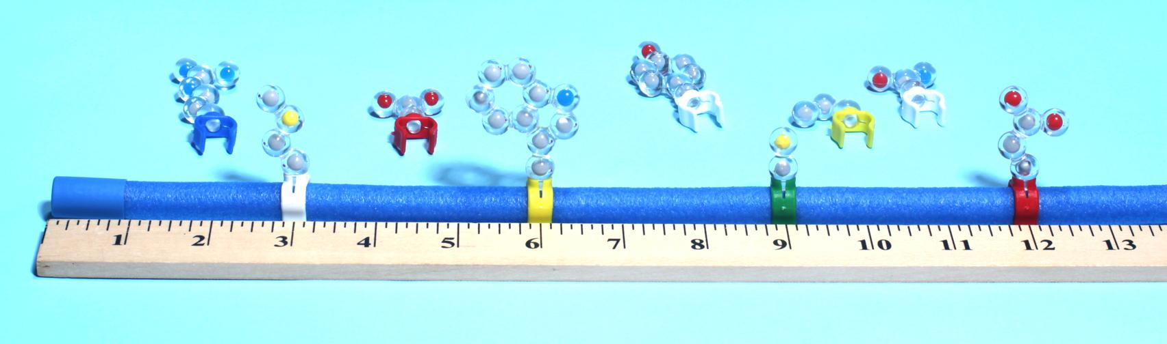
IN ANY ORDER ARRANGE YOUR AMINO ACIDS EQUIDISTANT FROM EACH OTHER.
YOU HAVE MADE A POLYPEPTIDE.
Notes:
What the teacher is doing: Give groups time to construct the polypeptide.
What the student is doing: Place 15 amino acids in any order. Just make sure they are equidistant from each other. They have now made a polypeptide, which is the primary structure of a protein.

Slide 23
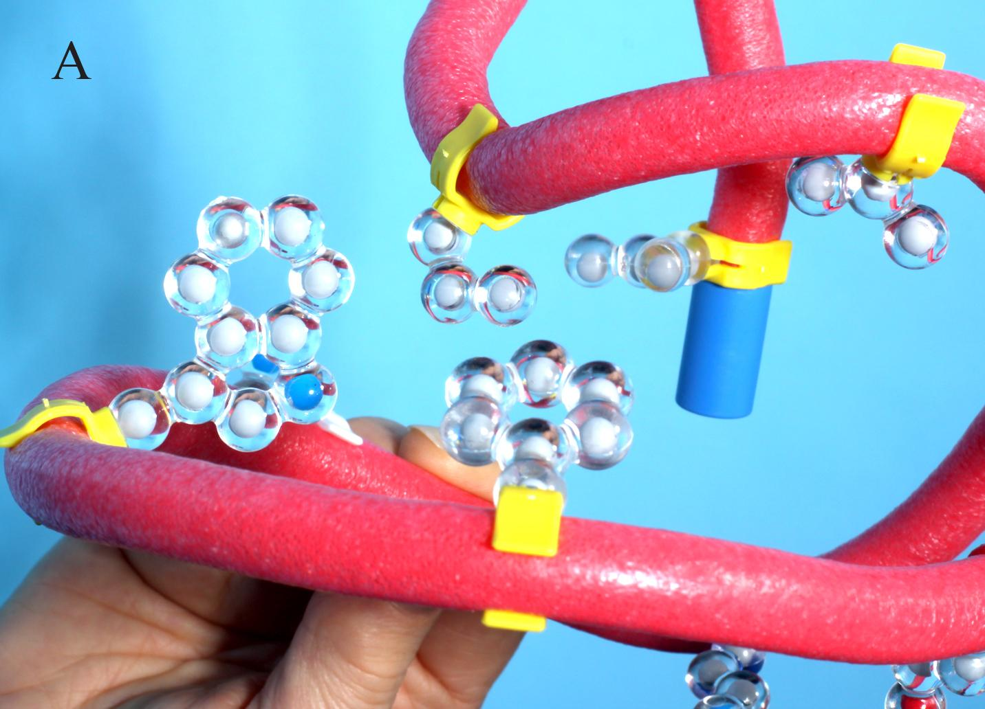
LET’S “FOLD” IT INTO A PROTEIN
ROTATE THE HYDROPHOBIC AMINO ACIDS TO THE INSIDE
Notes:
What the teacher is doing: Explain how to fold the polypeptide.
What the student is doing: They are not really “folding” the protein, the amino acid is actually rotating about their axes. Consider why the hydrophobic amino acids rotate to the inside. (They are trying to get away from the water. They are non-polar and water is a slightly polar molecule.)

Slide 24
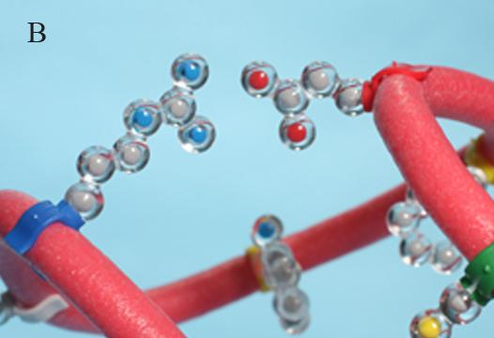
CONTINUE “FOLDING”
BRING THE ACIDIC AND BASIC SIDE CHAINS TOGETHER UNTIL THEY ARE TWO CM FROM EACH OTHER
Notes:
What the teacher is doing: Continue to walk through the steps of protein folding.
What the student is doing: They are not really “folding” the protein, the amino acid is actually rotating about their axes. Continue to fold by bringing the acidic and basic side chains together until they are about two centimeters apart. Acidic and basic side chains form salt bridges.

Slide 25
MAKE SURE THAT YOU ALSO ROTATE ANY HYDROPHOBIC SIDE CHAINS THAT MOVE OUT OF PLACE.
THROUGHOUT THIS WHOLE EXERCISE FIND A SHAPE IN WHICH ALL THE PROPERTIES APPLY.
Notes:
What the teacher is doing: Continue to walk through the steps of protein folding.
What the student is doing: Fold the acidic and basic side chains. Rotate any hydrophobic side chains that may have moved out of place. Find a shape in which all the properties being highlighted occur simultaneously. This makes sure that the protein is in the lowest energy state.

Slide 26
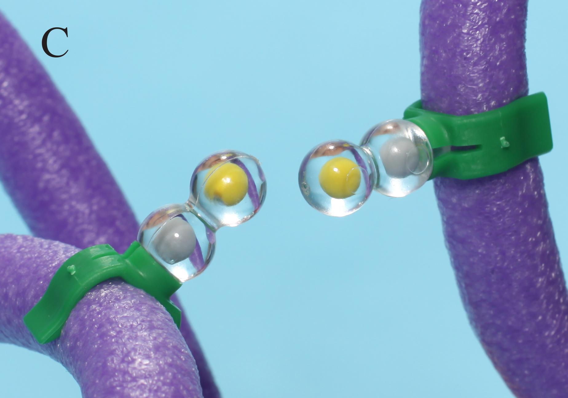
CONTINUE “FOLDING”
POSITION THE CYSTEINES SO THEY ARE OPPOSITE EACH OTHER.
Notes:
What the teacher is doing: Continue to walk through the steps of protein folding.
What the student is doing: Focus on the cysteine side chains which bond together to form a disulfide bond. Position them so they are opposite each other.

Slide 27
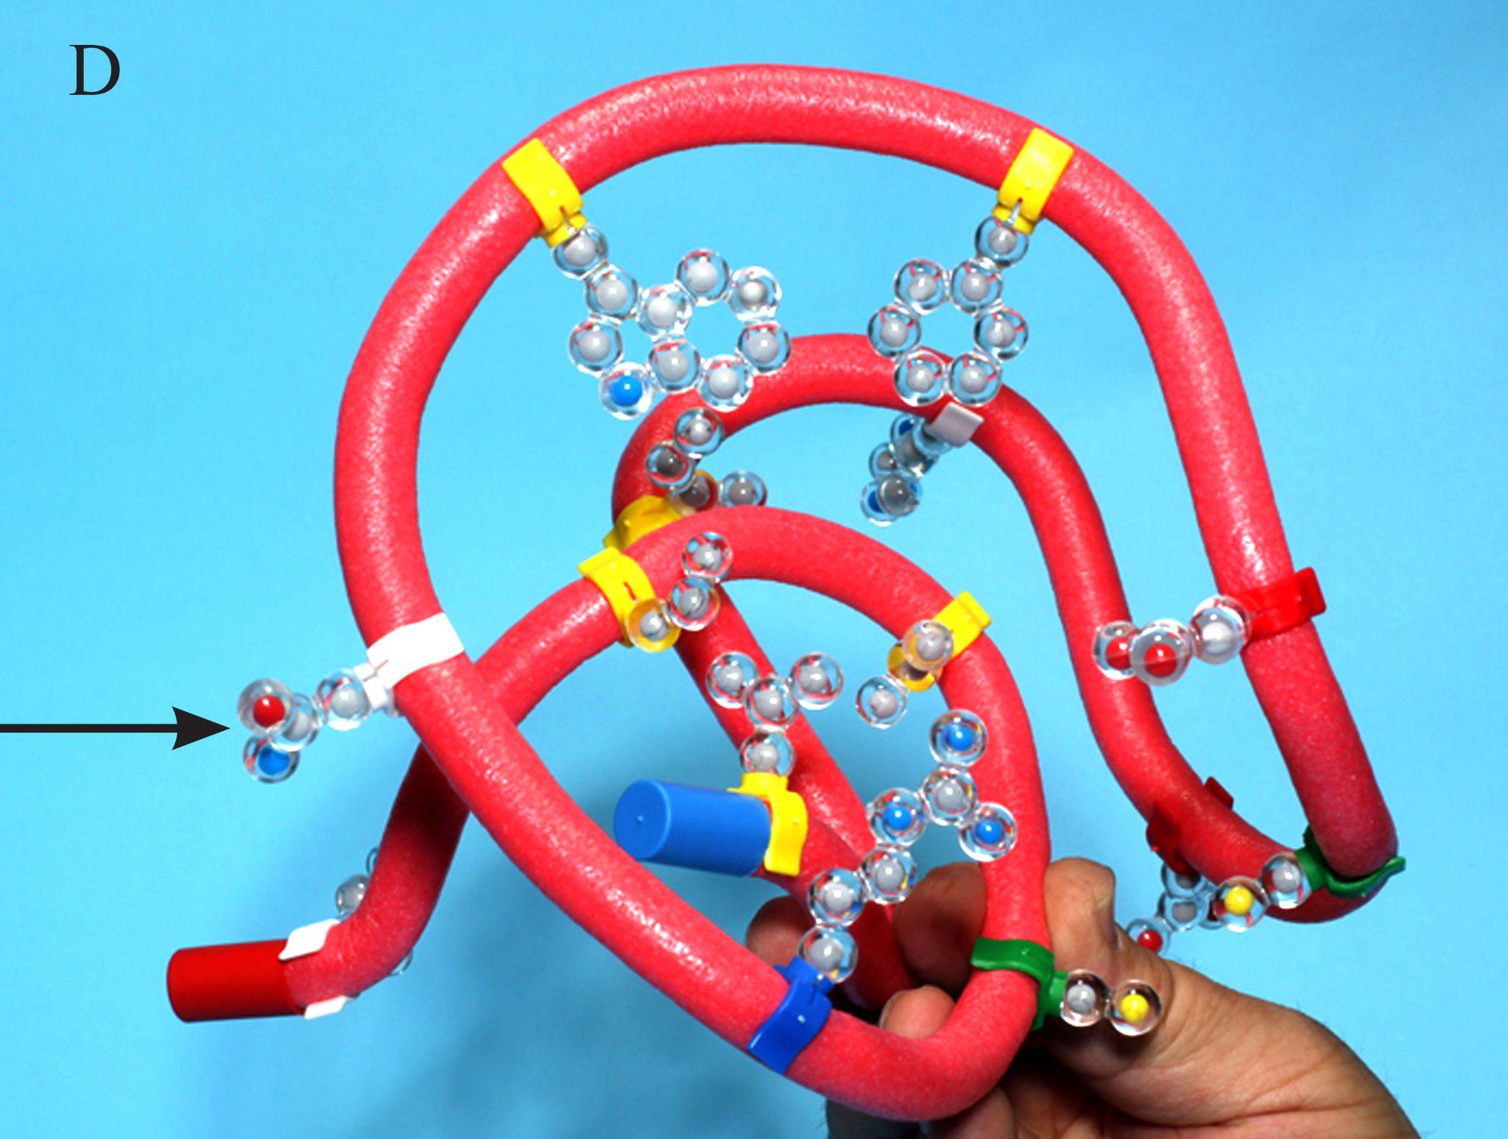
CONTINUE “FOLDING”
FINALLY ROTATE THE HYDROPHILIC SIDE CHAINS SO THEY ARE ON THE OUTER SURFACE
Notes:
What the teacher is doing: Continue to walk through the steps of protein folding.
What the student is doing: Rotate the hydrophilic side chain about the toober so they are on the outer surface. Take a moment to notice the shape of the protein.

Slide 28
THE FINAL SHAPE OF THE PROTEIN IS CALLED THE
TERTIARY STRUCTURE
Notes:
What the teacher is doing: Explain primary, secondary, and tertiary structures and discuss the stability of the globular protein. Do not show students the secondary structure that they master the folding guidelines. Otherwise, they do not gain as deep an understanding of why proteins naturally arrange themselves in the shapes they do.
What the student is doing: Share their final proteins by holding them in the air.

Slide 29
WHY DIDN’T YOUR PROTEINS ALL LOOK THE SAME?
Notes:
What the teacher is doing: Ask students to complete the question as an exit ticket.
What the student is doing: After sharing their protein structure, consider the question with our groups.

Slide 30
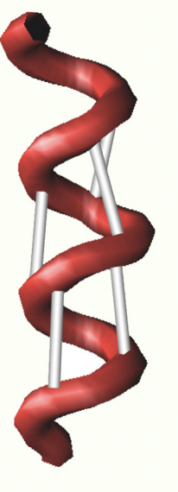
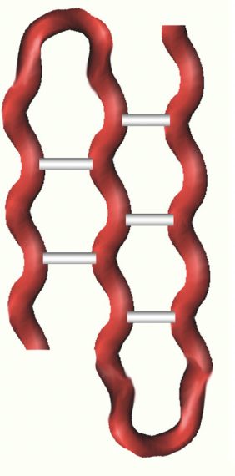
THE IMPORTANCE OF SECONDARY STRUCTURE
ALPHA HELIX
BETA SHEET
HOW DO SECONDARY STRUCTURES STABILIZE A PROTEIN?
Notes:
What the teacher is doing: Discuss alpha helices and beta sheet. Refer to the toobers as well as the amino acid building blocks.
What the student is doing: Model these structures with the protein they just constructed.

Slide 31
WHAT ABOUT QUATERNARY STRUCTURE?
Notes:
What the teacher is doing: Show the catalase monomer and describe its structure.
What the student is doing: Brainstorm the types of proteins that have a quaternary structure.

Slide 32
COMPARING ACIDS AND BASES
Notes:
What the teacher is doing: Discuss the results of the wet lab again.
What the student is doing: Discuss after images of wet lab and the damaged active site. Model what is going on at the molecular level at the enzyme’s active site with the toober.

Slide 33
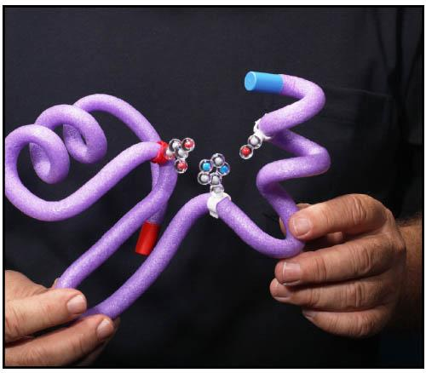
COMPARING ACIDS AND BASES
Notes:
What the teacher is doing: Help students build a simple active site. Remind them that it is highly simplified.
What the student is doing: Discuss after images of the wet lab and the damaged active site. Model what is happening at the molecular level at the enzyme’s active site with the toober.

Slide 34
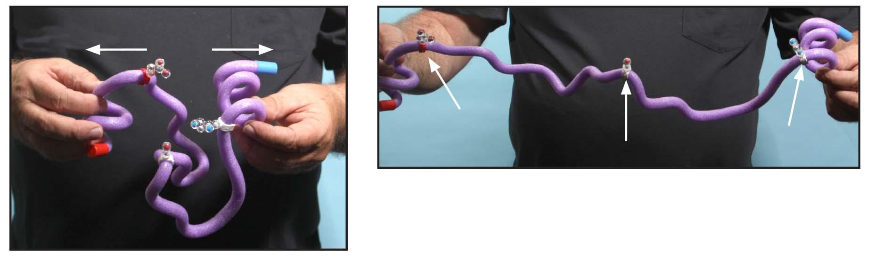
COMPARING ACIDS AND BASES
Notes:
What the teacher is doing: Help students build a simple active site. Remind them that it is highly simplified. Both the acid and the base cause the protein to denature.
What the student is doing: Discuss after images of the wet lab and the damaged active site. Model what is happening at the molecular level at the enzyme’s active site with the toober.

Slide 35
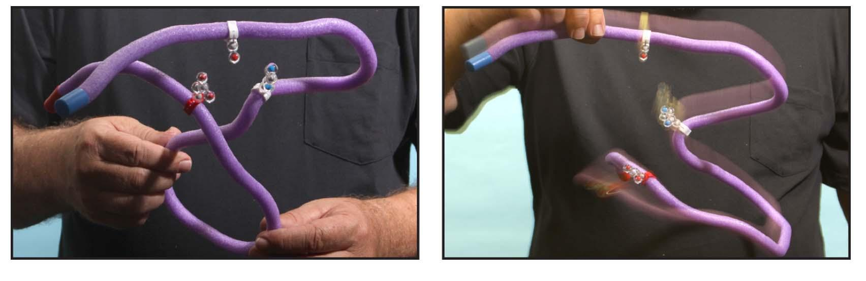
COMPARING ACIDS AND BASES
Notes:
What the teacher is doing: Help students build a simple active site. Remind them that it is highly simplified. Both the acid and the base cause the protein to denature.
What the student is doing: Discuss after images of the wet lab and the damaged active site. Model what is happening at the molecular level at the enzyme’s active site with the toober. Will the active site go back to its original shape? Why not?

Slide 36
COMPARING COLD AND HEAT
Notes:
What the teacher is doing: Discuss the results of the wet lab again.
What the student is doing: Discuss after images of wet lab and the damaged active site. Model what is going on at the molecular level at the enzyme’s active site using the Substrate Specificity Kit.

Slide 37
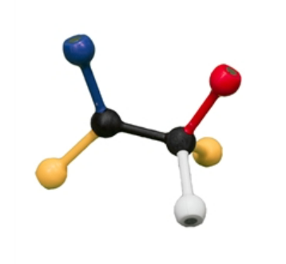
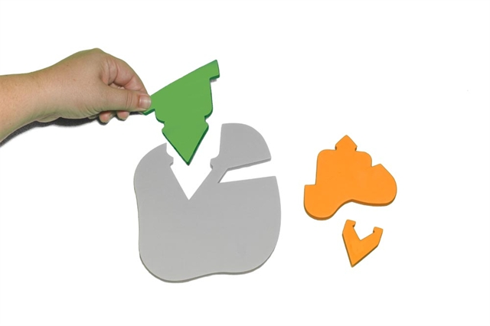
Let’s Examine the Kit
Notes:
What the teacher is doing: Explain briefly that enzymes are three-dimensional protein. We are going to make a model of the active site determine how the substrate and active site interact.
What the student is doing: Consider the similarities and differences between the two models. The green substrate from the Enzymes in Action kit will now be represented by the colored spheres.

Slide 38
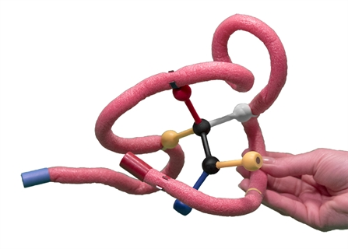
Let’s Examine the Kit
Notes:
What the teacher is doing: Explain briefly that enzymes are three-dimensional protein. We are going to make a model of the active site determine how the substrate and active site interact.
What the student is doing: Consider the similarities and differences between the two models. The three-foot or six-foot mini-toobers will represent the grey enzyme.

Slide 39
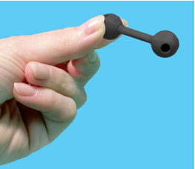
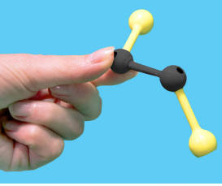
Assembling the Substrate
Select the piece with the black 4-hole sphere and 2-hole sphere.
Connect one yellow functional group to the four-hole sphere.
Connect the other yellow functional group to the two-hole sphere.
Connect the remaining functional groups randomly.
Notes:
What the teacher is doing: Monitor student groups and answer questions as necessary
What the student is doing: Construct a substrate using the directions on the slide.

Slide 40
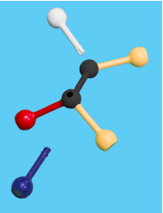
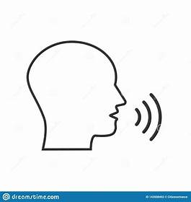
Examining the Substrate Model
Functional group color | Chemical property | Type of bond/interaction
Red
Blue
White
Yellow
Green
Notes:
What the teacher is doing: Ask student groups to review and remember what we have used in the past. Encourage them to use the amino acid property chart to help them.
What the student is doing: Work as an individual first and then share your ideas with your shoulder partner. Be prepared to share your idea with the class.

Slide 41
Examining the Substrate Model
Amino acid R-group color | Chemical property | Type of bond/interaction
Red | Acidic Negative Charge | Salt Bridge
Blue | Basic Positive Charge | Salt Bridge
White | Hydrophilic | Polar
Yellow | Hydrophobic | Nonpolar
Green | Cysteine | Disulfide Bonds
Notes:
What the teacher is doing: Facilitate a discussion and build a class consensus model.
What the student is doing: Share your group’s finding and aid in creatin the class consensus model.

Slide 42
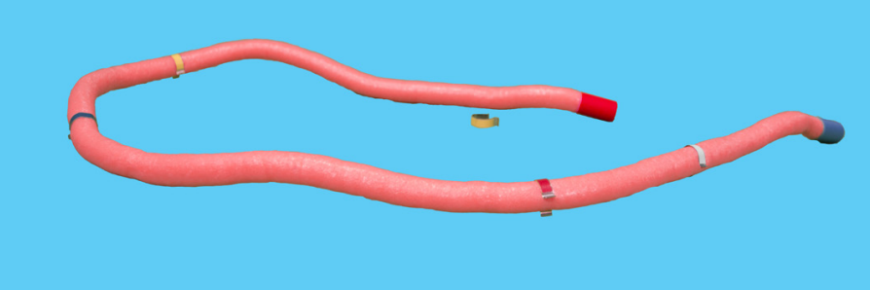
Assembling the enzyme
Place the metal clips along the entire length and in random order on the 3-foot mini toober.
Notes:
What the teacher is doing: Monitor student groups and answer questions as necessary.
What the student is doing: Follow the directions on the screen to create the enzyme.

Slide 43

Constructing the Enzyme-Substrate Complex
Fold the mini-toober around the substrate
Follow the basic principles of chemistry as design the complex
Remember that your complex should be three-dimensional
Notes:
What the teacher is doing: Monitor student groups and answer questions as necessary
What the student is doing: Construct an enzyme-substrate using the directions on the slide.

Slide 44
What we learned
Interaction between the substrate and enzyme is highly specific.
A slight change in the shape of substrate or enzyme will alter the ability to catalyze the reaction.
  Selective ability of enzyme
  Efficiency of the enzyme

Slide 45
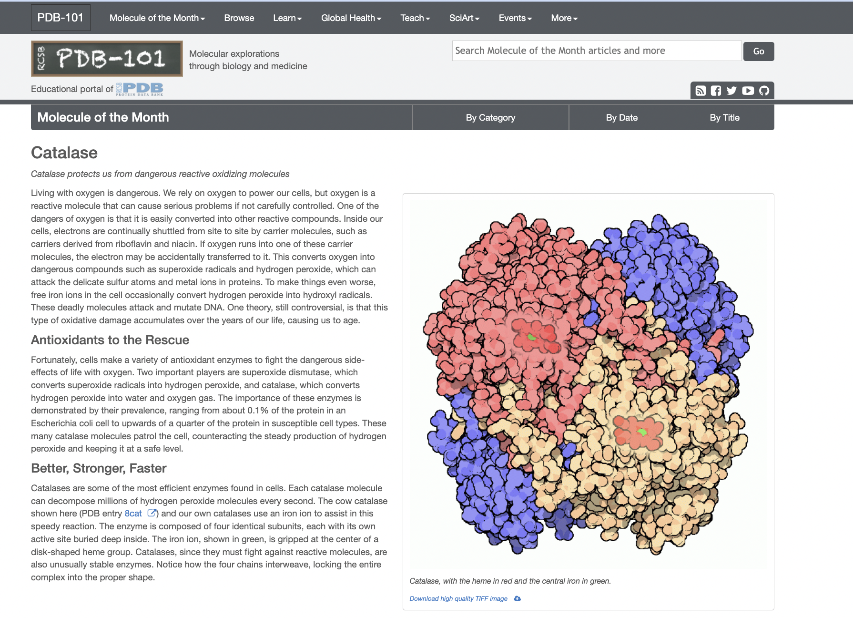
Notes:
Many of my students are really intrigued by this model and want to know more. They have questions or want further information so I post additional resources on my online Planbook. This is a great way to steer students to realize that there is more to understand and that our models don’t provide the entire answer.
The link to the resource is https://pdb101.rcsb.org/motm/57.
[Advance slide]

Slide 46
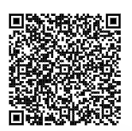
Jmol Exploration of Catalase
This is a placeholder for the image of the Catalase Jmol exploration.
CBM - Catalase (msoe.edu)
Notes:
Participants will analyze protein structures more deeply using Jmol (a free and open-source viewer of molecular structures). Try this at home at later when you have better internet. It works best on a computer.
CBM - Catalase (msoe.edu)

Slide 47
Workshop NGSS Connections
SEPs | CCCs | DCIs
Asking Questions | Patterns | HS-LS1-1
Developing and Using Models | Cause and Effect | HS-LS1-2
Constructing Explanations | Structure and Function | Georgia Standard: SB1
 | Stability and Change | Georgia Standard: SB2
 | Scale, Proportion, and Quantity
Notes:
These kits are aligned with many of the Next Generation Science Standards including the following Science and Engineering Practices, Cross Cutting Concepts, and Disciplinary Core Ideas.

Slide 48


Summer Course 2024 – Modeling the Molecular World
Join us in Milwaukee for hands-on discovery and professional development
July 29 – Aug 2 OR Aug 5 – 9
Scan to register!
Bring an empty suitcase!
You'll take home all these classroom resources!
Notes:
Scholarships are available. If you have questions, you can contact Ruth Hutson at ruth.hutson@3dmoleculardesigns.com.

Slide 49
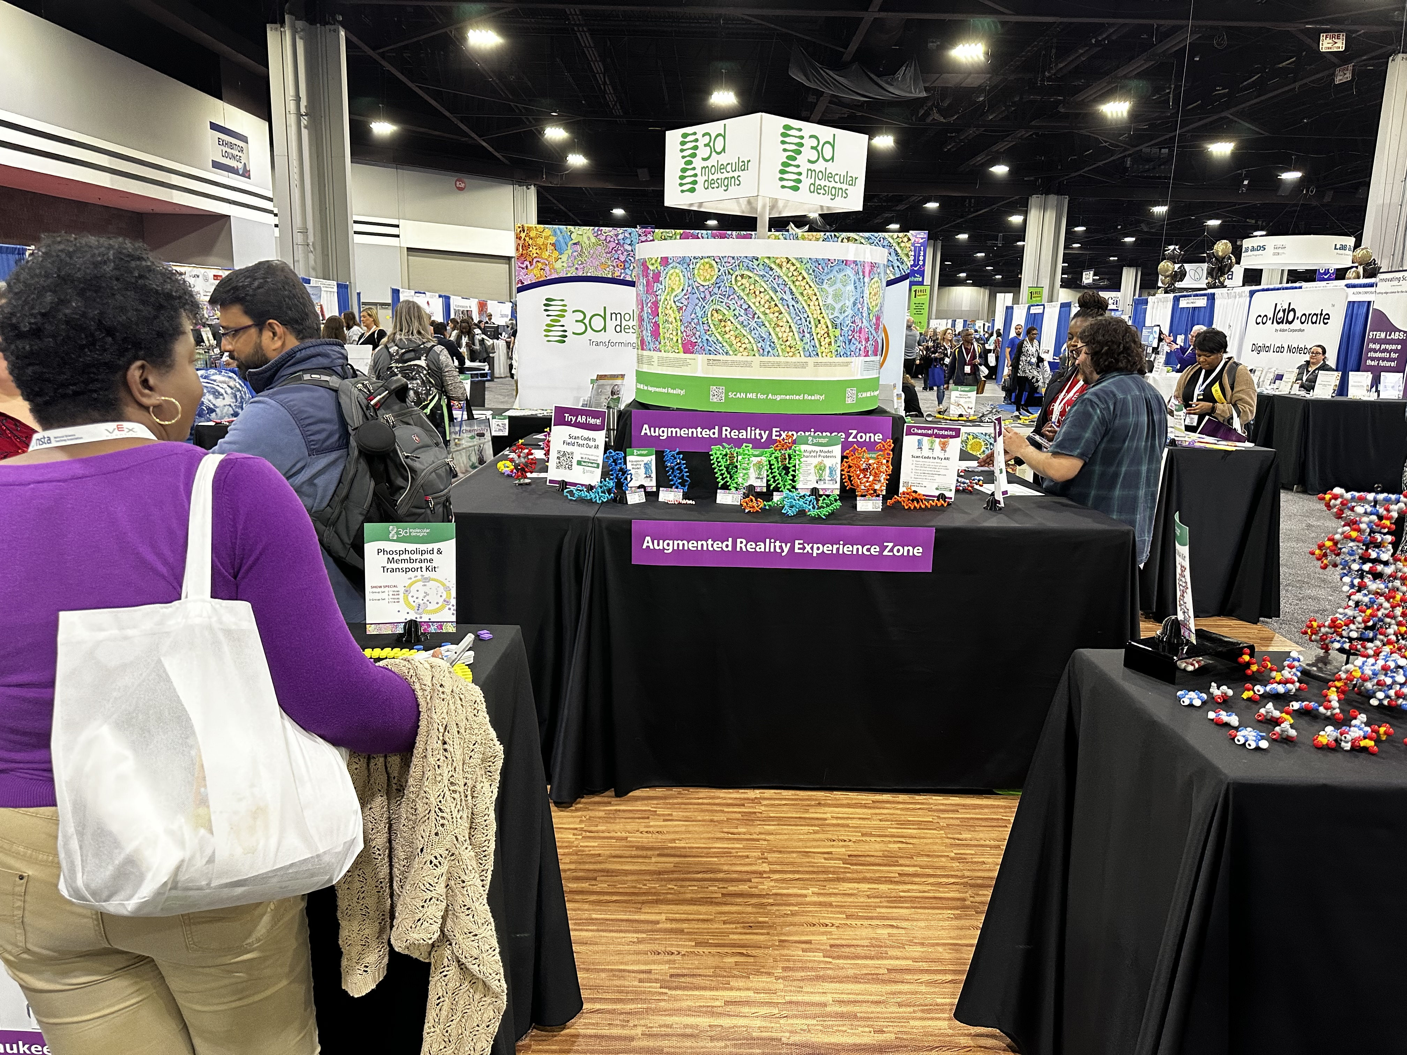
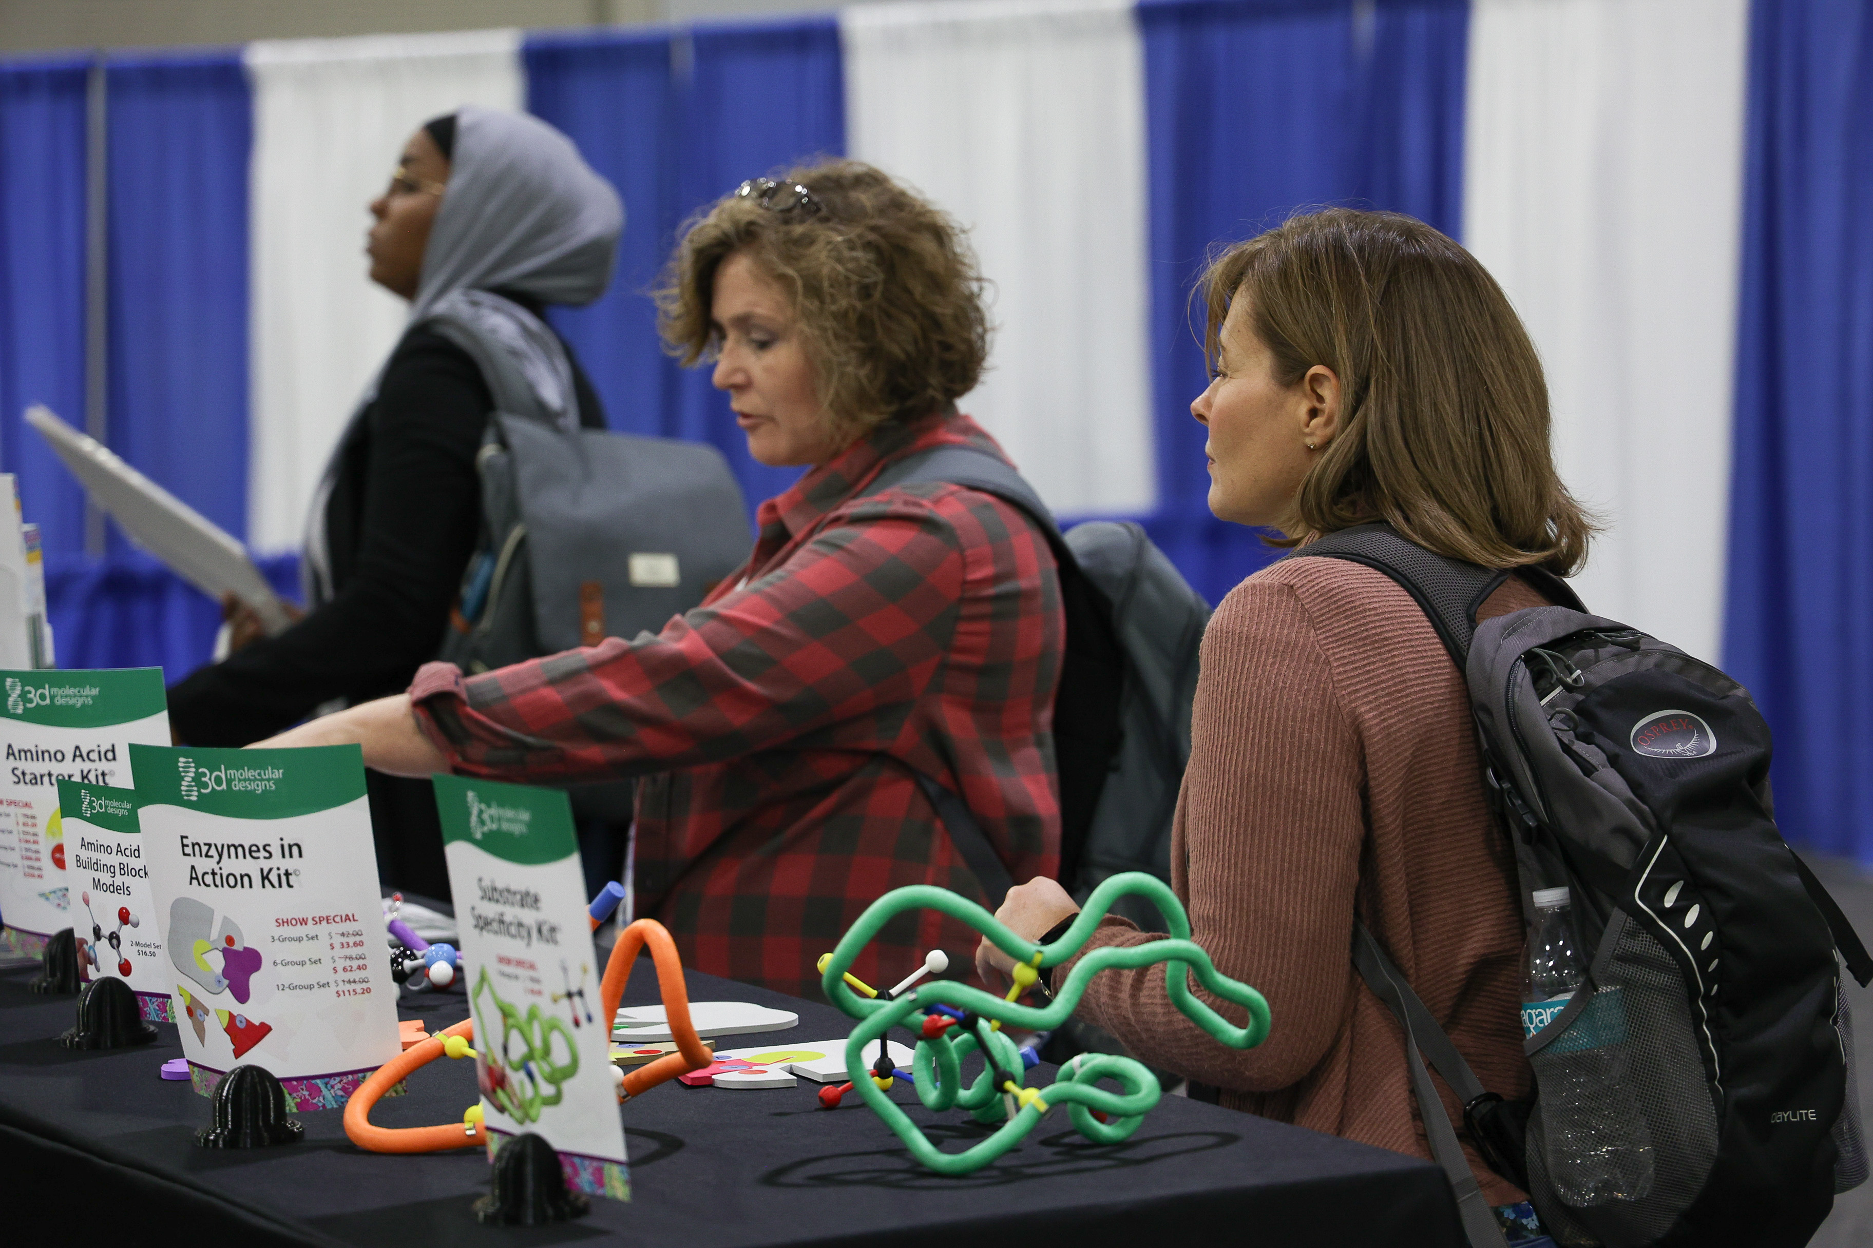
Visit Our Booth!
Continue your exploration of our dynamic kits and models at Booth 3 !

Slide 50
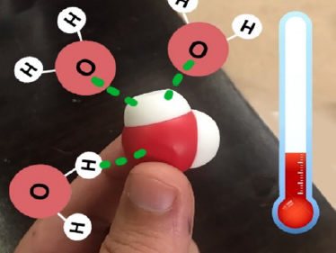
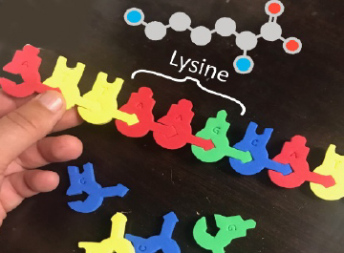
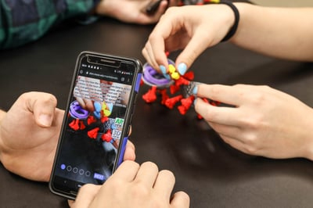
AR Enhancements
We're enhancing our kits and models to inspire more hands-on learning with new augmented reality features!
Stop by Booth 3 to
check out our new
Augmented Reality Enhancements!

Slide 51

We value your opinion!
Let us know what you think.
Scan the QR Code and complete this short survey.

