Slide 1

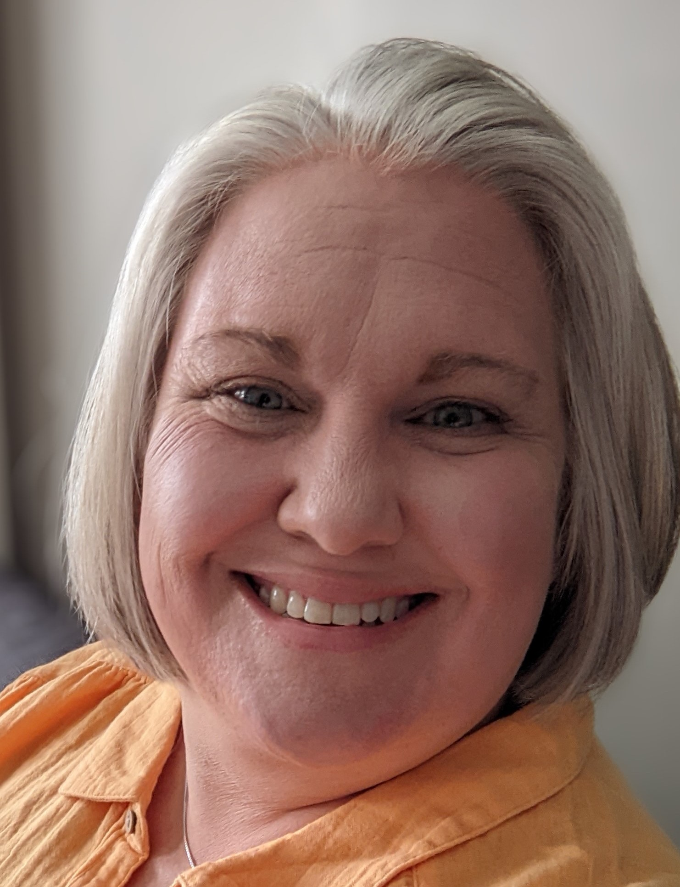
From Code to Creation: The Central Dogma Essentials
Ruth Hutson, MSSE

Slide 2
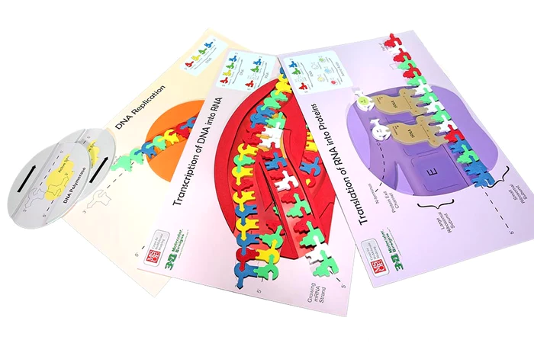
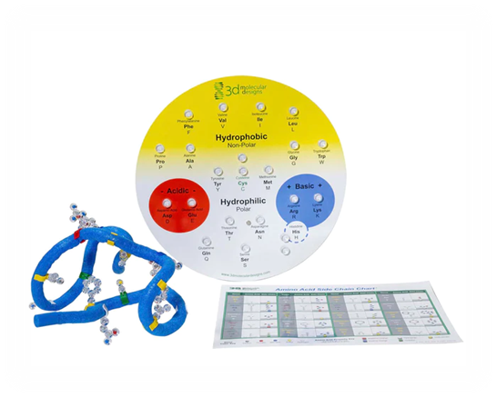
Notes:
In this 110-minute session, we will use the Flow of Genetic Information Kit and the Amino Acid Starter Kit.

Slide 3
Workshop Outcomes
Construct an explanation based on evidence for how the structure of DNA determines the structure of proteins, which carry out the essential function of life through systems of specialized cells by explaining the purpose and purpose of replication, transcription, and translation using models of DNA and RNA.
Examine patterns within and between side chains of amino acids.
Model protein secondary and tertiary structure based on the primary structure of amino acid sequence.

Slide 4
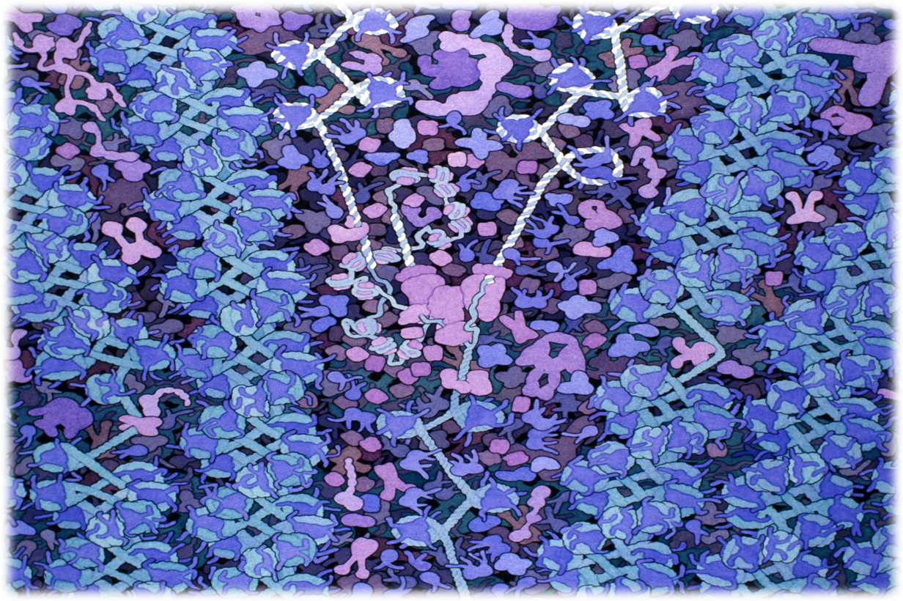
Replication​ in the Eukaryotic Nucleus
Notes:
​
Acknowledgment: Illustration by David S. Goodsell. doi: 10.2210/rcsb_pdb/goodsell-gallery-004​
​
This painting shows DNA being replicated in the nucleus. DNA polymerase is shown at the center in purple, with a DNA strand entering from the bottom and exiting as two strands towards the top. The new strands are shown in white. Chromatin fibers are shown at either site of the replication fork, with DNA wrapped into nucleosomes. This painting was created for the biotech company Biosites.​
​
Things to notice on this landscape: DNA-Histone Complex

Slide 5
Replication​ in the Eukaryotic Nucleus
Notes:
​
Acknowledgment: Illustration by David S. Goodsell. doi: 10.2210/rcsb_pdb/goodsell-gallery-004​
​
This painting shows DNA being replicated in the nucleus. DNA polymerase is shown at the center in purple, with a DNA strand entering from the bottom and exiting as two strands towards the top. The new strands are shown in white. Chromatin fibers are shown at either site of the replication fork, with DNA wrapped into nucleosomes. This painting was created for the biotech company Biosites.​
​Things to notice on this landscape: DNA polymerase complex

Slide 6
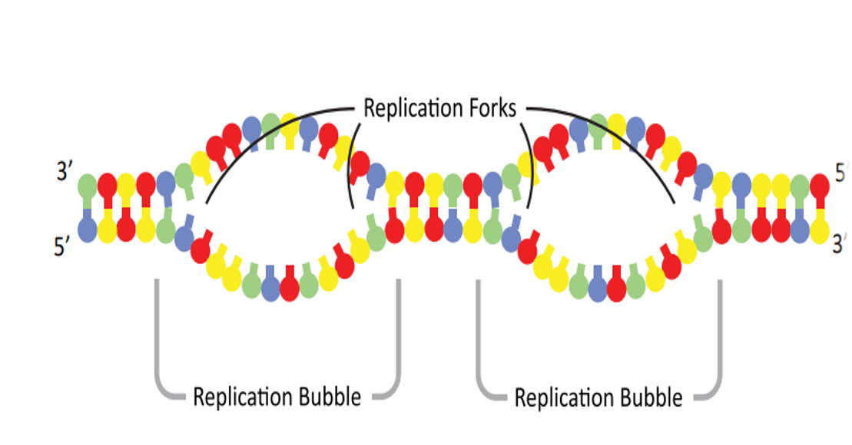
Replication​ Forks
Notes:
Set the scene: The nucleus of the eukaryotic cell has multiple replication bubbles. For simplification, we will only model one of them. ​
​
Thought experiment about to consider why we need many replication bubbles. ​
Nucleotides are added at an approximate rate of 50 nucleotides per second in eukaryotic cells. The human genome contains 6.4 billion nucleotides (3.2 billion base pairs), which must be copied. Calculate the length of time in days that it would take to copy the human genome. Show all calculations including units.

Slide 7
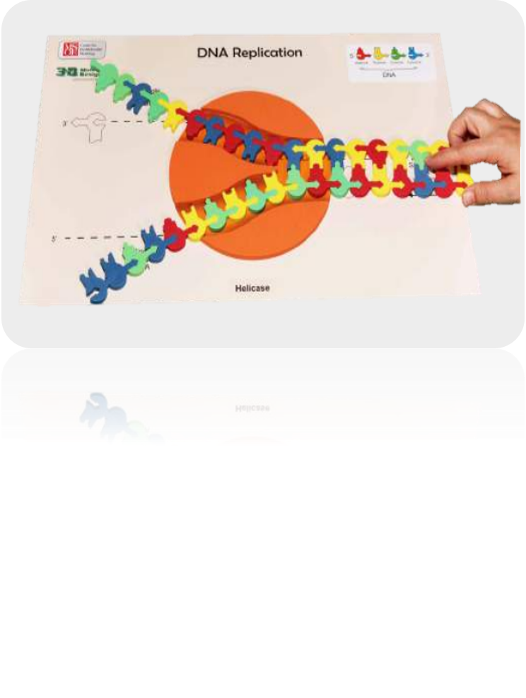
Replication​
Notes:
Set the scene: The nucleus of the eukaryotic cell at an origin of replication on the double-stranded DNA. Enter DNA helicase. In the wings: DNA polymerase​
​
Questions to consider: What does the helicase appear to be doing? What type of bond is being broken? Why the helicase able to break these bonds? ​
​
Helpful hints: For large classes, pre-make the DNA sequence. The kit has some labeled Sequence I and Sequence II. We are going to be working with Sequence I. ​
You can also use double-stick tape to hold those sequences together so that students don’t take them apart. Arrows on the models guide students in showing the direction of replication. ​
​
What the model shows: The directionality (5’ to 3’) of the DNA molecule. Only one replication bubble (origin of replication) is shown. This is what the mat represents. Replication of both lagging and leading strands are shown. Hydrogen bonding between the base pairs and the base pairing rules are highlighted in this model. ​
​
What the model doesn’t show: 3-D structure of DNA and the sugar-phosphate backbone are not shown. The role of initiator proteins that form the replication bubbles is not shown. We arrive on the scene with all of that in place. This kit also doesn’t focus on the role of gyrase and ligase. That complexity can be brought in later, if you wish with other modeling. ​
​

Slide 8
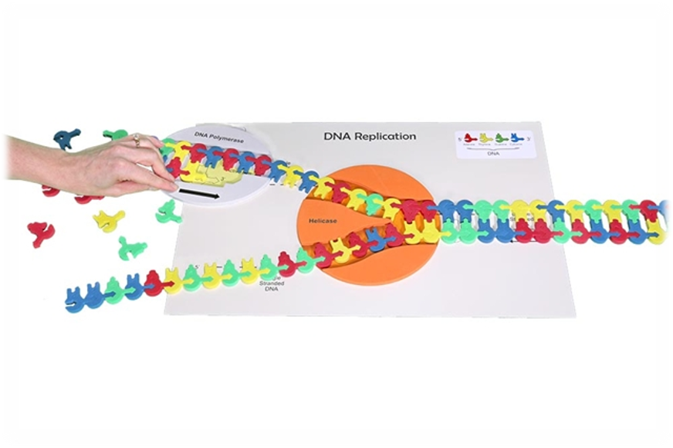
Continuous Replication​
Notes:
Set the scene: Enter DNA polymerase. The DNA polymerase enzyme catalyzes the synthesis of new DNA by adding nucleotides to a preexisting chain. New DNA can elongate only in the 5’ 3’ direction. The DNA strand that is made continuously is referred to as the leading strand. ​
​
Questions to consider: As the new nucleotide is added to the growing DNA strand, which part of the new nucleotide forms a bond with the 3’OH group? Why won’t you be able to synthesize the other strand of DNA in a continuous manner when using the model? ​
​
Helpful hints: Arrows on the models guide students in showing the direction of replication. The top strand is the strand that continuously replicates. ​
​
What the model shows: The directionality (5’ to 3’) of the DNA molecule. Only one replication bubble (origin of replication) is shown. This is what the mat represents. Replication of both lagging and leading strands are shown. Hydrogen bonding between the base pairs and the base pairing rules are highlighted in this model. ​
​
What the model doesn’t show: 3-D structure of DNA and the sugar-phosphate backbone are not shown. The role of initiator proteins that form the replication bubbles is not shown. We arrive on the scene with all of that in place. This kit also doesn’t focus on the role of gyrase and ligase. That complexity can be brought in later, if you wish with other modeling.

Slide 9
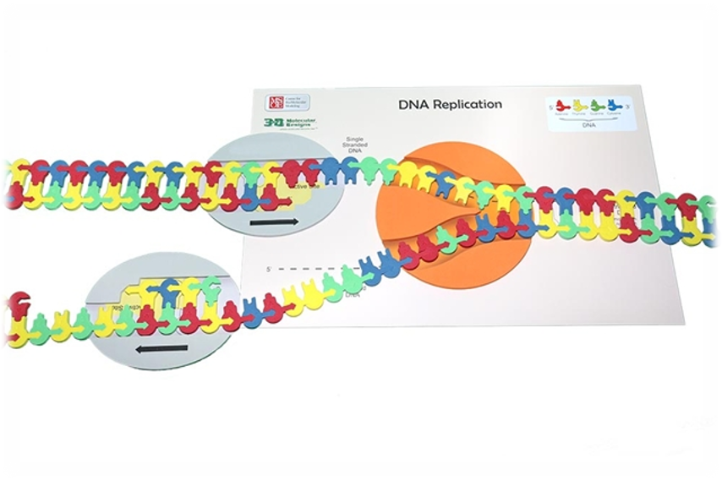
Discontinuous Replication​
Notes:
Set the scene: Enter DNA polymerase on the lagging strand. The DNA polymerase enzyme catalyzes the synthesis of new DNA by adding nucleotides to a preexisting chain. New DNA can elongate only in the 5’ 3’ direction. The DNA strand that is made discontinuously is referred to as the lagging strand. Notice that the DNA polymerase must move away from the fork instead of toward the fork, as it did in the leading strand. In order to accommodate the 5’ 3’ synthesis of DNA, short fragments are made on the second strand. ​
​
Questions to consider: As the new nucleotide is added to the growing DNA strand, which part of the new nucleotide forms a bond with the 3’OH group? Why won’t you be able to synthesize the other strand of DNA in a continuous manner when using the model? ​
​
Helpful hints: Arrows on the models guide students in showing the direction of replication. The top strand is the strand that continuously replicates. ​
​
What the model shows: The directionality (5’ to 3’) of the DNA molecule. Only one replication bubble (origin of replication) is shown. This is what the mat represents. Replication of both lagging and leading strands are shown. Hydrogen bonding between the base pairs and the base pairing rules are highlighted in this model. ​
​
What the model doesn’t show: 3-D structure of DNA and the sugar-phosphate backbone are not shown. The role of initiator proteins that form the replication bubbles is not shown. We arrive on the scene with all of that in place. This kit also doesn’t focus on the role of gyrase and ligase. That complexity can be brought in later, if you wish with other modeling. ​

Slide 10
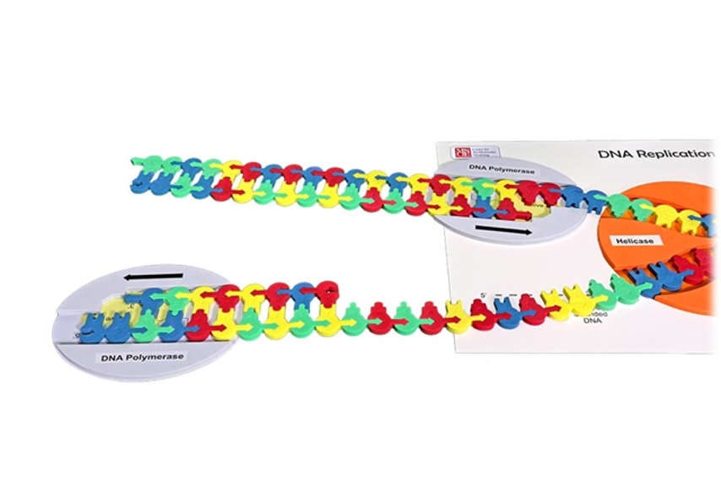
Comparing Leading and Lagging Strands​
Notes:
The lagging strand requires you to move the DNA polymerase! Place the DNA polymerase back at the fork junction to create the next fragment. Move the DNA polymerase so that the bases may be added from the 5’ 3’ direction. You have now created a second fragment of DNA on the lagging strand. These fragments are referred to as Okazaki fragments and are usually 100-200 nucleotides long in eukaryotic cells.​
​
Although there are multiple enzymes involved in DNA replication, the kit only focuses on DNA Polymerase and DNA helicase. You can look at the student handout for this activity at FGIKReplicationStudentHandout6-19-15.compressed.pdf (3dmoleculardesigns.com).

Slide 11
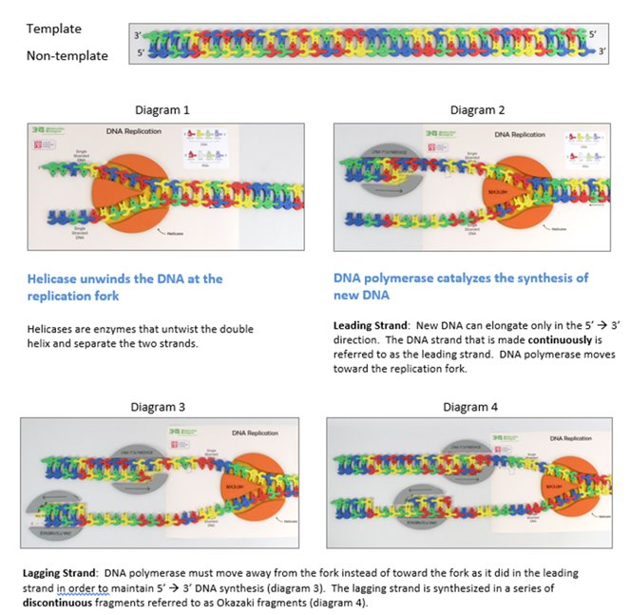
Notes:
A quick review of what we discovered.

Slide 12

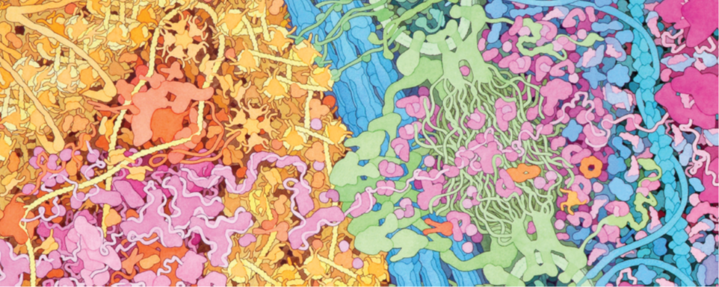
A Brief Tour Through the Cell​
This image is an excerpt from Tour of a Human Cell by David Goodsell, as shown in 3D Molecular​
Designs’ Tour of a Human Cell© poster and David Goodsell’s book, The Machinery of Life
Notes:
This is one of the many molecular landscapes by Dr. David Goodsell who is affiliated with the Protein Data Bank. You can more of these at PDB-101: Goodsell Gallery (rcsb.org). I love using them in conjunction with the kit because they demonstrate to students that we are only touching on a fraction of the cell’s complexity.

Slide 13
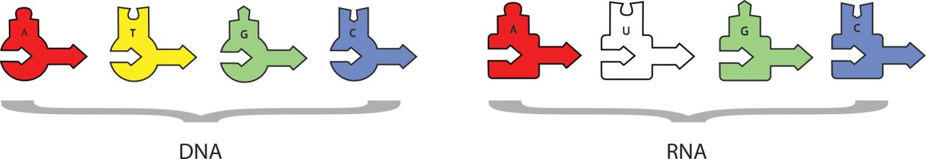
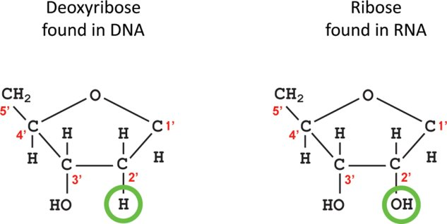
Transcription ​
Notice:
The DNA pieces are different than the RNA pieces.

Slide 14
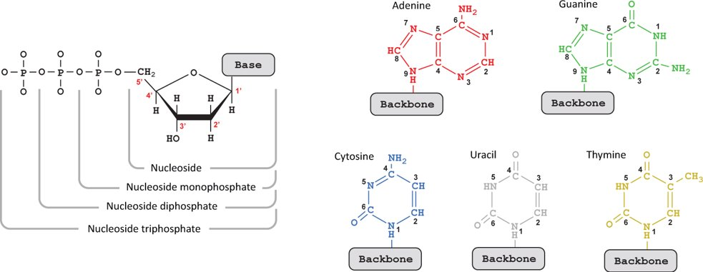
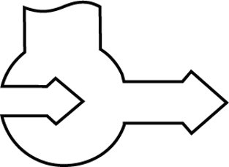
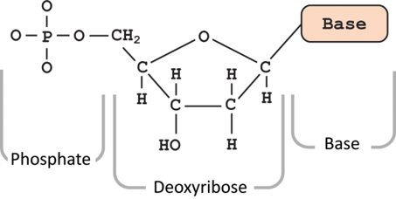
Transcription ​
Helpful Hints:
Take care when loading the DNA in the RNA polymerase.
Remember RNA is synthesized from the 5’ to the 3’ end.
5’
3’

Slide 15
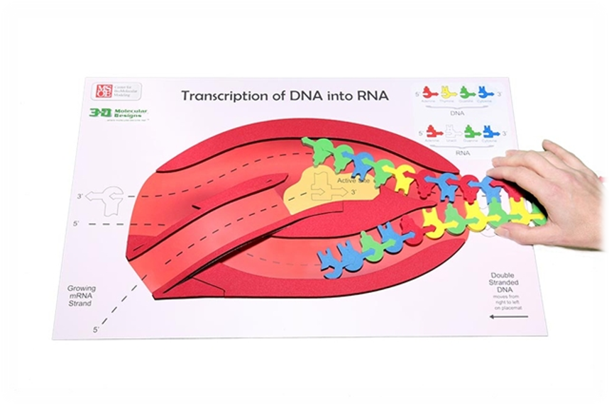
Transcription: Initiation ​
Notes:
For our next activity, you need the transcription mat, the pre-made DNA sequence, and the RNA nucleotides. ​
​
Set the scene: The nucleus of the eukaryotic cell. There are two major stages in making a protein: transcription in which DNA is used as a template to make a single-stranded mRNA and translation where RNA is used to create a sequence of linked amino acids that make a polypeptide which is later folded into a 3-D protein. At rise, we see RNA polymerase ready to start gene expression through transcription. The first phase of transcription is initiation. ​
​
Helpful hints: Point out to students the differences between RNA structure and DNA structure. Use Dynamic DNA to show differences between deoxyribose and ribose and the thymine and uracil. How are those differences denoted on the foam nucleotides? Notice the pointed edges on the foam enzymes ​
​
What is not shown in the model ​
A collection of proteins known as transcription factors facilitate the binding of the RNA polymerase to the DNA ​
​
What is shown in the model​
The DNA strands are separated. RNA polymerase joins the RNA nucleotides as they pair along one of the strands of the DNA template. In this model, the template strand is the top strand, and the non-template strand is the bottom strand. Notice the directionality of the template and non-template strands. RNA polymerases can only assemble mRNA in the 5’to3’direction. On the model the template strand of DNA should be oriented in the top slot with the 3’ end (arrow end) entering first. ​
​

Slide 16
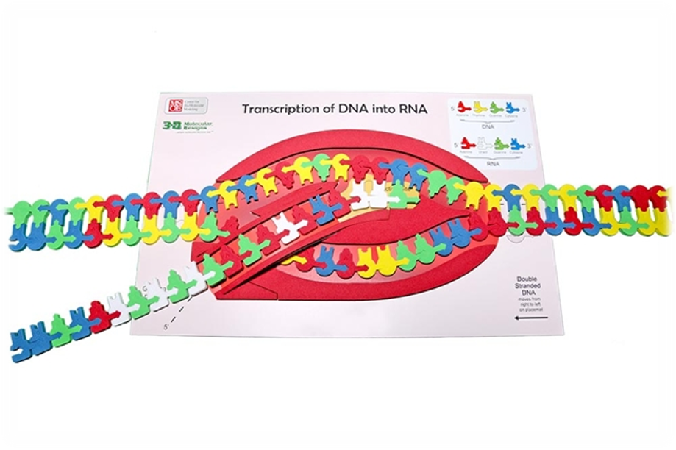
Transcription: Elongation ​
Notes:
The second phase is elongation. ​
​
Helpful hints: Put students into groups of three of four to complete this process because you need many hands to complete this in a timely fashion. After sprinkling the area with RNA nucleotides, feed the double stranded DNA into the RNA polymerase. Notice the pointed edges that help split apart the hydrogen bonds between both DNA and RNA nucleotides. Also, notice the RNA of the exit ramp in the RNA polymerase. ​
​
What is in the model: The model shows the base pairing between nucleotides using hydrogen bonds. The model shows directionality. There are keys on the mat that guide students in reinforcing the base pairing rules. ​
​
What is not in the model: We don’t make a mRNA of 900 nucleotides that would represent the smallest mRNA. It is important to point out that complexity to the students without having them modeling it for time's sake.

Slide 17
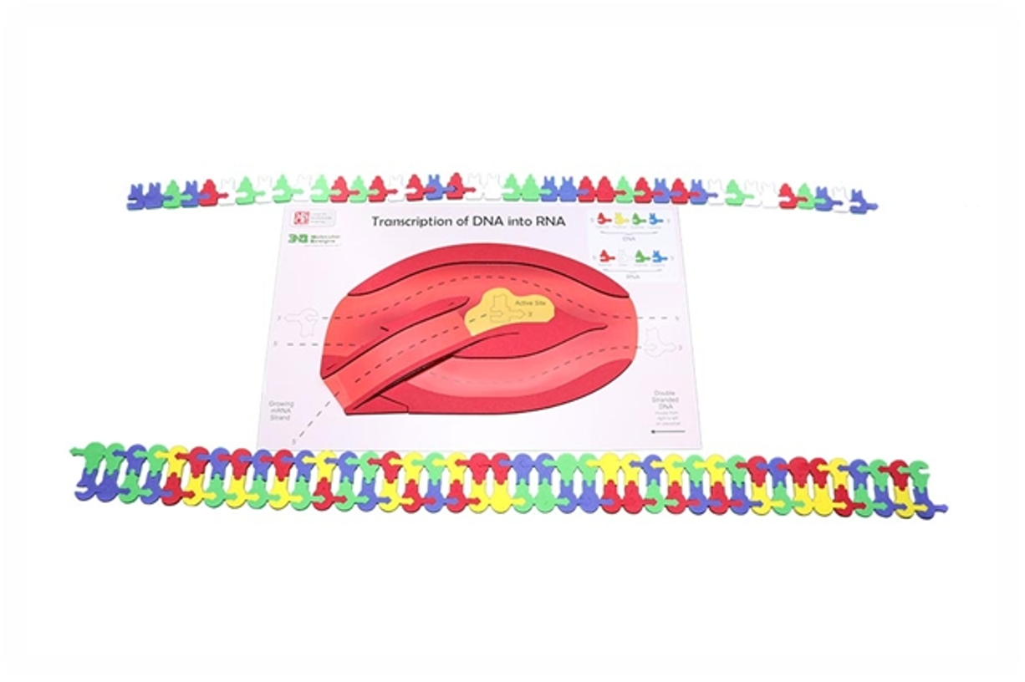
Transcription: Termination ​
Notes:
The third phase is termination.​
​
Helpful hints: At the end of this activity, save the RNA sequence you made for later and use it as a tool to assess your students’ understanding. ​
​
A student handout detailing this activity can be found at the link below: ​
​
FGIKTranscriptionStudentHandout6-19-15.compressed.pdf (3dmoleculardesigns.com)​
​
Take time to compare the mRNA with the DNA. Look for template vs. non-template strand, coding vs. non-coding, and sense vs. antisense strands of DNA. ​
The sense strand is also called the coding strand, plus strand,, or non-template strand. The coding strand is same as the mRNA except that thymine in DNA is replaced by uracil in RNA. ​
The coding strand contains the codons.

Slide 18
Nucleus
Nuclear Membrane
Cytoplasm
This image is an excerpt from Tour of a Human Cell by David Goodsell, as shown in 3D Molecular
Designs’ Tour of a Human Cell© poster and David Goodsell’s book, The Machinery of Life.
Notes:
Let’s note where we have been and where we are going.

Slide 19
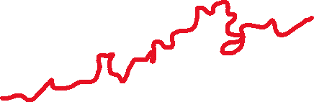
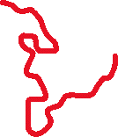
DNA
mRNA
mRNA
Nuclear Pore
RNA Polymerase
This image is an excerpt from Tour of a Human Cell by David Goodsell, as shown in 3D Molecular
Designs’ Tour of a Human Cell© poster and David Goodsell’s book, The Machinery of Life.
Notes:
Let’s also identify some structures. You can print these landscapes as a pdf in black and white or greyscale and have them color them in. I would have my students insert them in their lab notebooks so they could reference them later.
Look down in the lower left to see the capping enzyme which is adding methylguanosine to the 5”end of the mRNA. It is by the RNA polymerase.
Let’s also identify some structures. You can print these landscapes as a pdf in black and white or greyscale and have them color them in. I would have my students insert them in their lab notebooks so they could reference them later.
The mRNA that is still in the nucleus nearest the nuclear pore is having the introns removed by a spliceosome. Only exons will be left in the mature
messenger RNA.

Slide 20
Pair the tRNA with the amino acids
Notes:
Helpful hints: Walk students through reading the charts and them time to pair the amino acids with their tRNA. Then revisit the chart and talk about all the possibilities for anticodons.

Slide 21
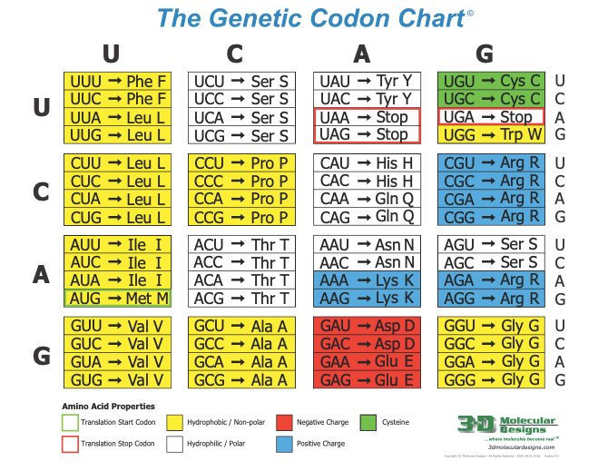

Slide 22
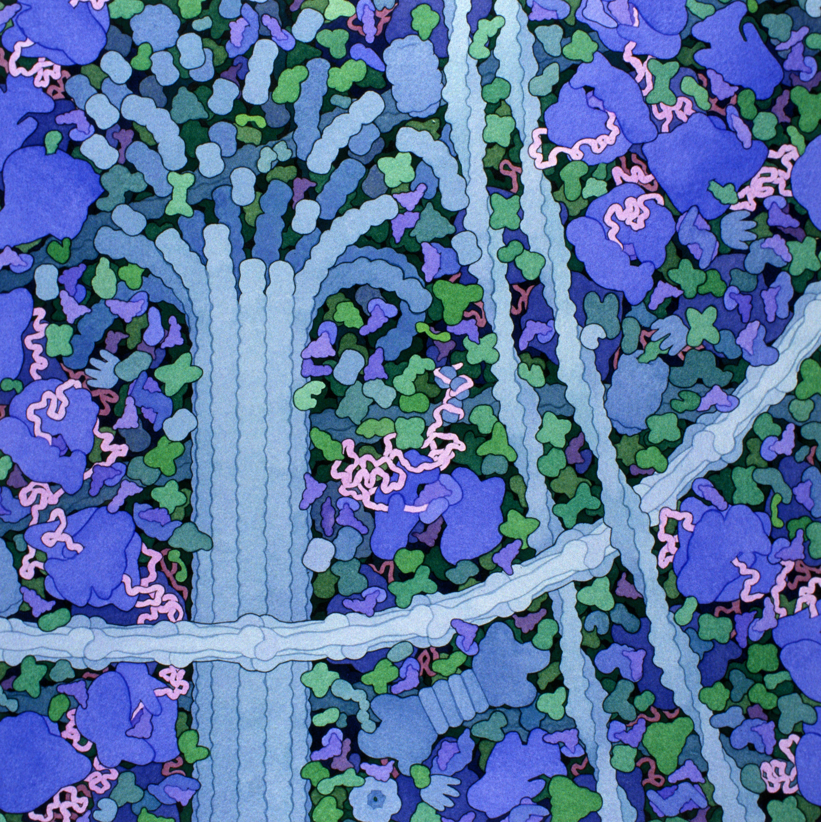
Translation
Acknowledgement: Illustration by David S. Goodsell. doi: 10.2210/rcsb_pdb/goodsell-gallery-006
22
Notes:
Set the scene: In the cytoplasm of the cell, in the ribosome.
Helpful hints: Start by explaining the role of each of the tools needed for translation: tRNA, ribosome, and mRNA. I first start with the structure of transfer RNA. Students in my class would have learned about the structure of proteins earlier in the year so now we are just adding complexity to the process.

Slide 23
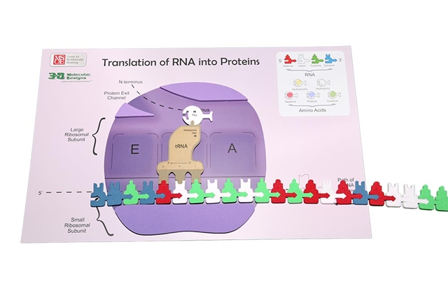
Translation: Initiation
23
Notes:
Set the scene: The first phase is initiation.
Helpful hints: Starting from the 5”end of the mRNA at the start codon (AUG), every three bases determines a particular amino.
What is in the model:
mRNA enters the ribosome (shown in purple). The top is the large subunit, while the small unit is shown under the EPA sites.
tRNA bring the amino acid to the ribosome

Slide 24
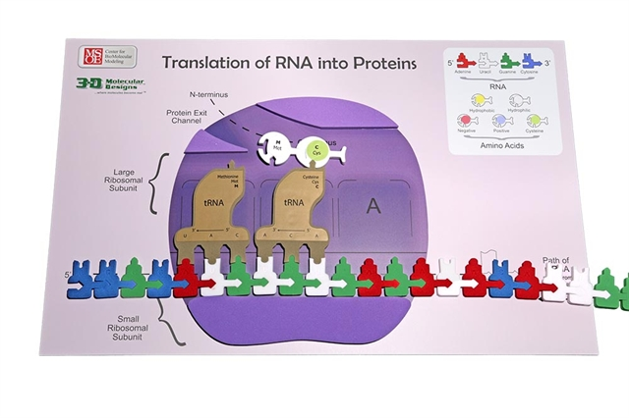
Translation: Elongation
24
Notes:
The second phase is elongation. The anticodon of another tRNA base pairs with the mRNA in the A site. The new protein is made in the N-terminal to C-terminal direction. A rRNA found in the large ribosomal subunit catalyzes the formation of a peptide bond between the amino group in the A site and the carboxyl end of the amino acid in the P site.
Helpful hints: Have multiple students work together for smooth transition of the process. There are a lot of parts to move so groups of 3 to 4 are best.
What is in the model
The important parts of the small and large ribosomal subunits are labeled.
The E (Exit), P (peptidyl), and A (aminoacyl) sites are shown.
What is not in the model
This is a two-dimensional model.

Slide 25
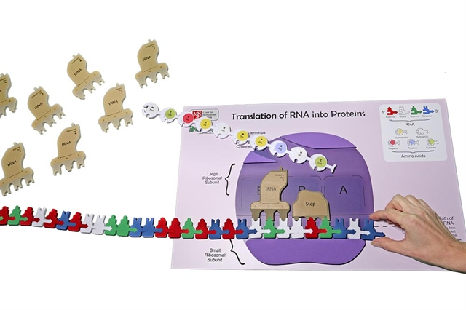
Translation: Termination
25
Notes:
The third phase is termination. The developing polypeptide will exit the ribosome through the opening in the large ribosomal subunit.
What is in the model
The ribosome reaches a stop codon on the mRNA. The A site of the ribosomes accepts a release factor.

Slide 26
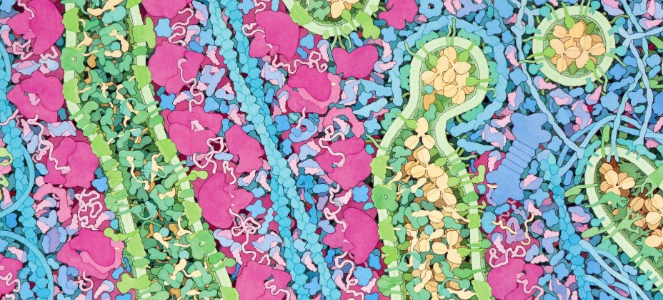
Revisit the panorama
26
Notes:
What is the difference structurally between the rough ER and the Golgi? Where is the mRNA? Where is the polypeptide? What is happening to the polypeptide in the rough ER? ​
What is the role of the green transporter proteins? ​
​
Sorting and Transporting: How does a vesicle bud off the rough ER? ​
What proteins help the polypeptide fold correctly?​
What is the fate of a misfolded protein? ​
​
How does the vesicle get to the Golgi?

Slide 27
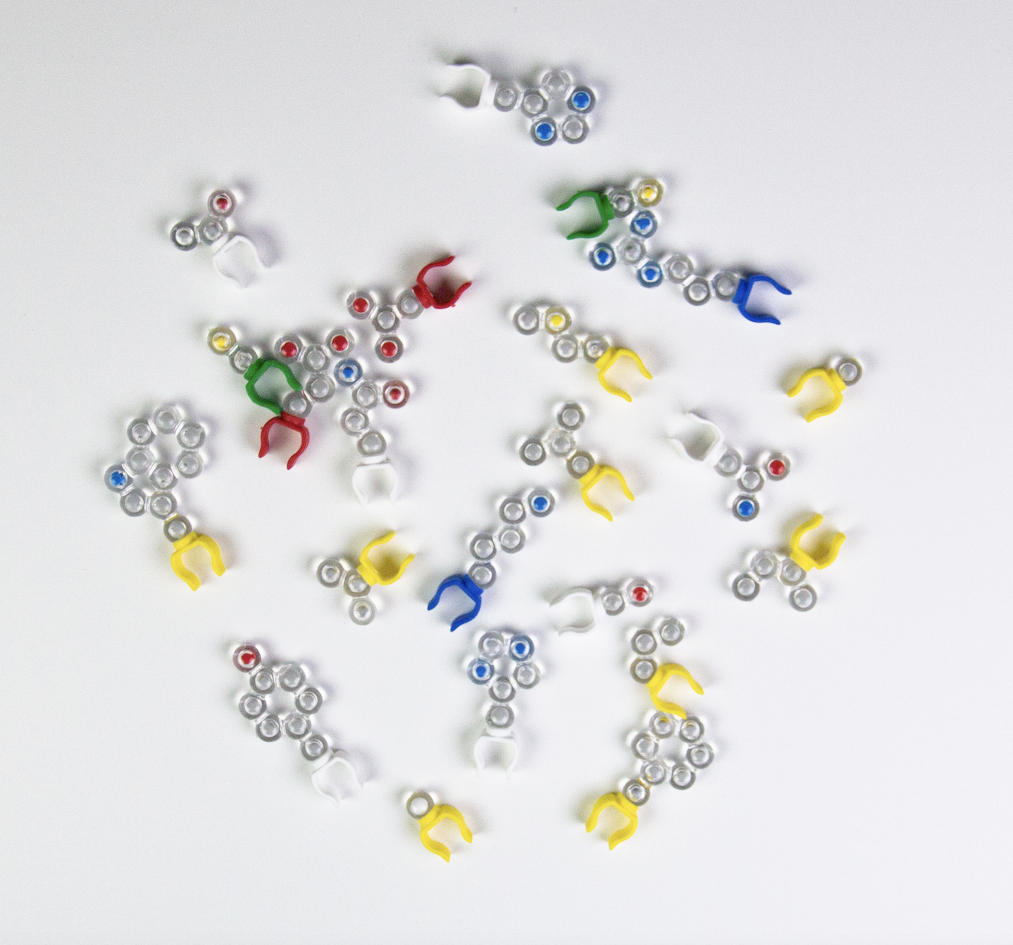
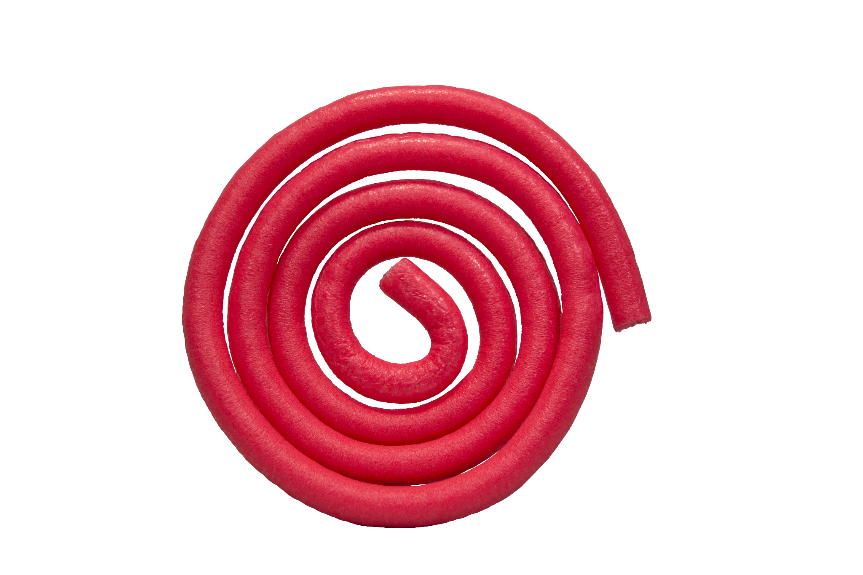
Protein Folding in Cytoplasm or Rough ER
27
Notes:
Set the scene: Inside the rough endoplasmic reticulum.
Helpful hints: Teach protein structure with students before transitioning into this activity.
What is in the model:
The toober represents the amino group and carboxyl group. The clip represents the central carbon. The side chains are injection molded parts that attach to the clips. The N-terminus is shown as a blue cap, and the C-terminus is shown as a red cap. If you would like to explore this further, check out Amino Acid Starter Kit© Resources (3dmoleculardesigns.com)

Slide 28
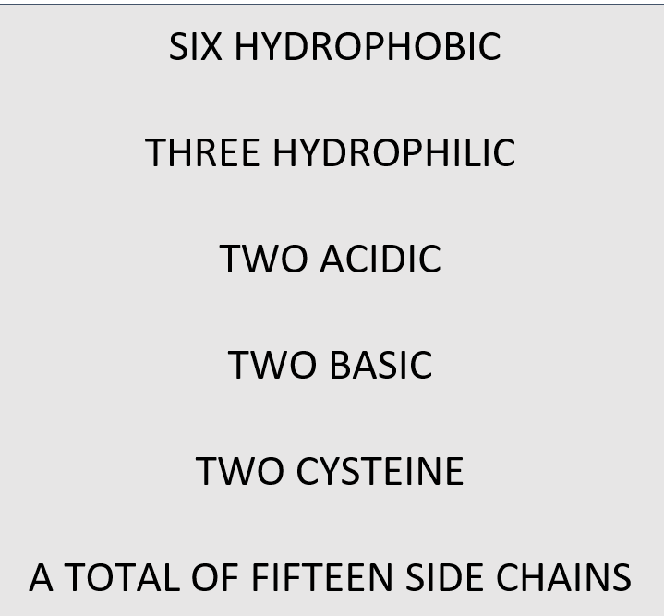
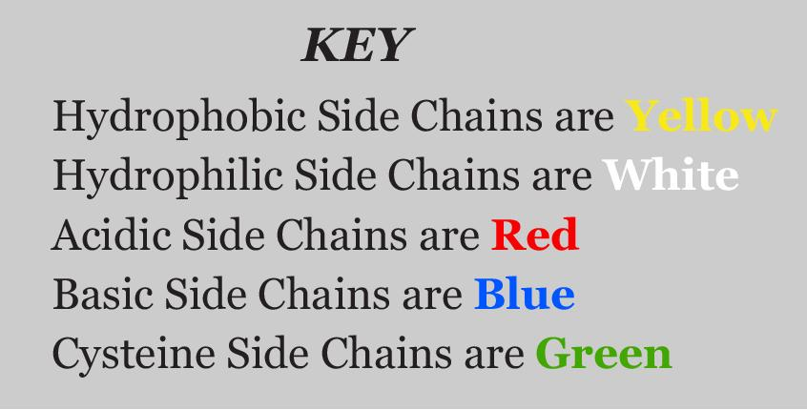
Protein Folding in Cytoplasm or Rough ER
28
Notes:
Once you have taught protein structure and the central dogma, you can review this protein folding activity to explain what occurs after protein translation ends.

Slide 29
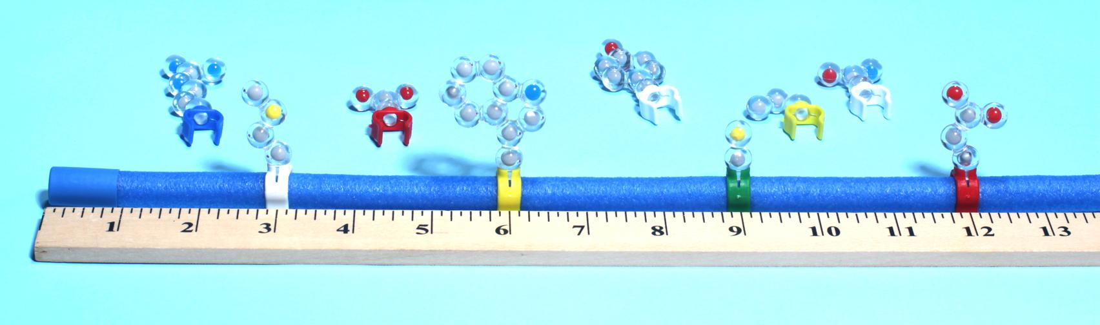
In any order arrange your amino acids so they are equidistant from each other.
You have made a polypeptide.
Notes:
Once you have taught protein structure and the central dogma, you can review this protein folding activity to explain what occurs after protein translation ends.

Slide 30
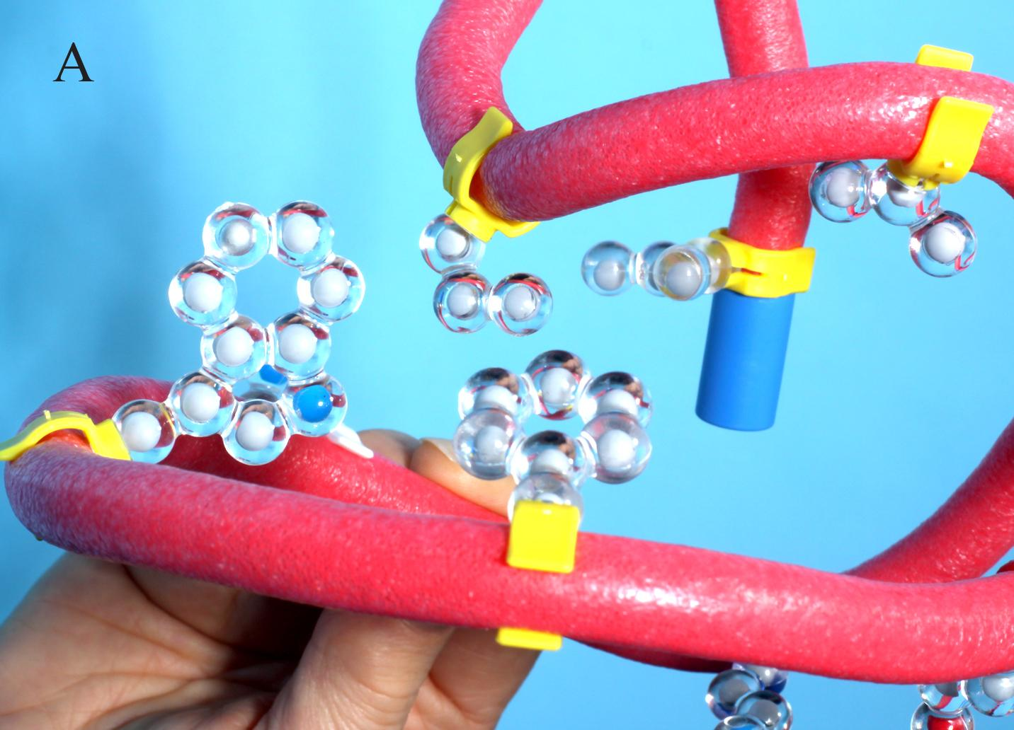
“Fold” the polypeptide into a protein.
Rotate hydrophobic amino acids to the inside.
Notes:
Once you have taught protein structure and the central dogma, you can review this protein folding activity to explain what occurs after protein translation ends.

Slide 31
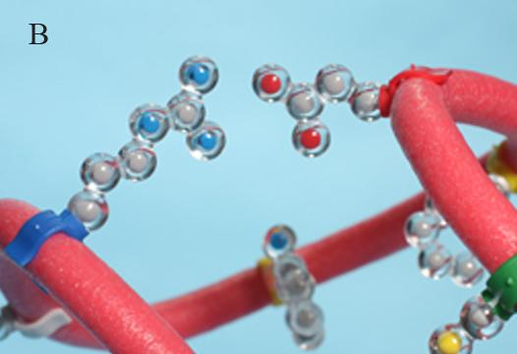
Continue “folding” by bringing the acidic and basic side chains until they are 2 cm apart.

Slide 32
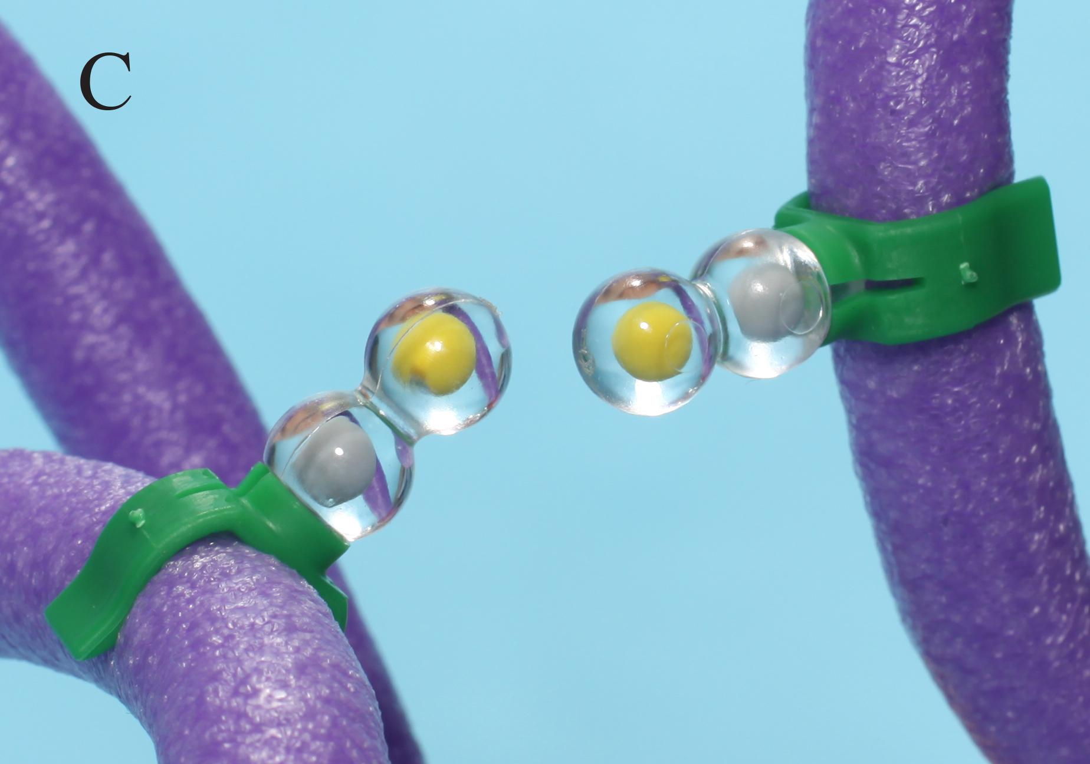
Continue “folding” by positioning cysteines so they are opposite each other.

Slide 33
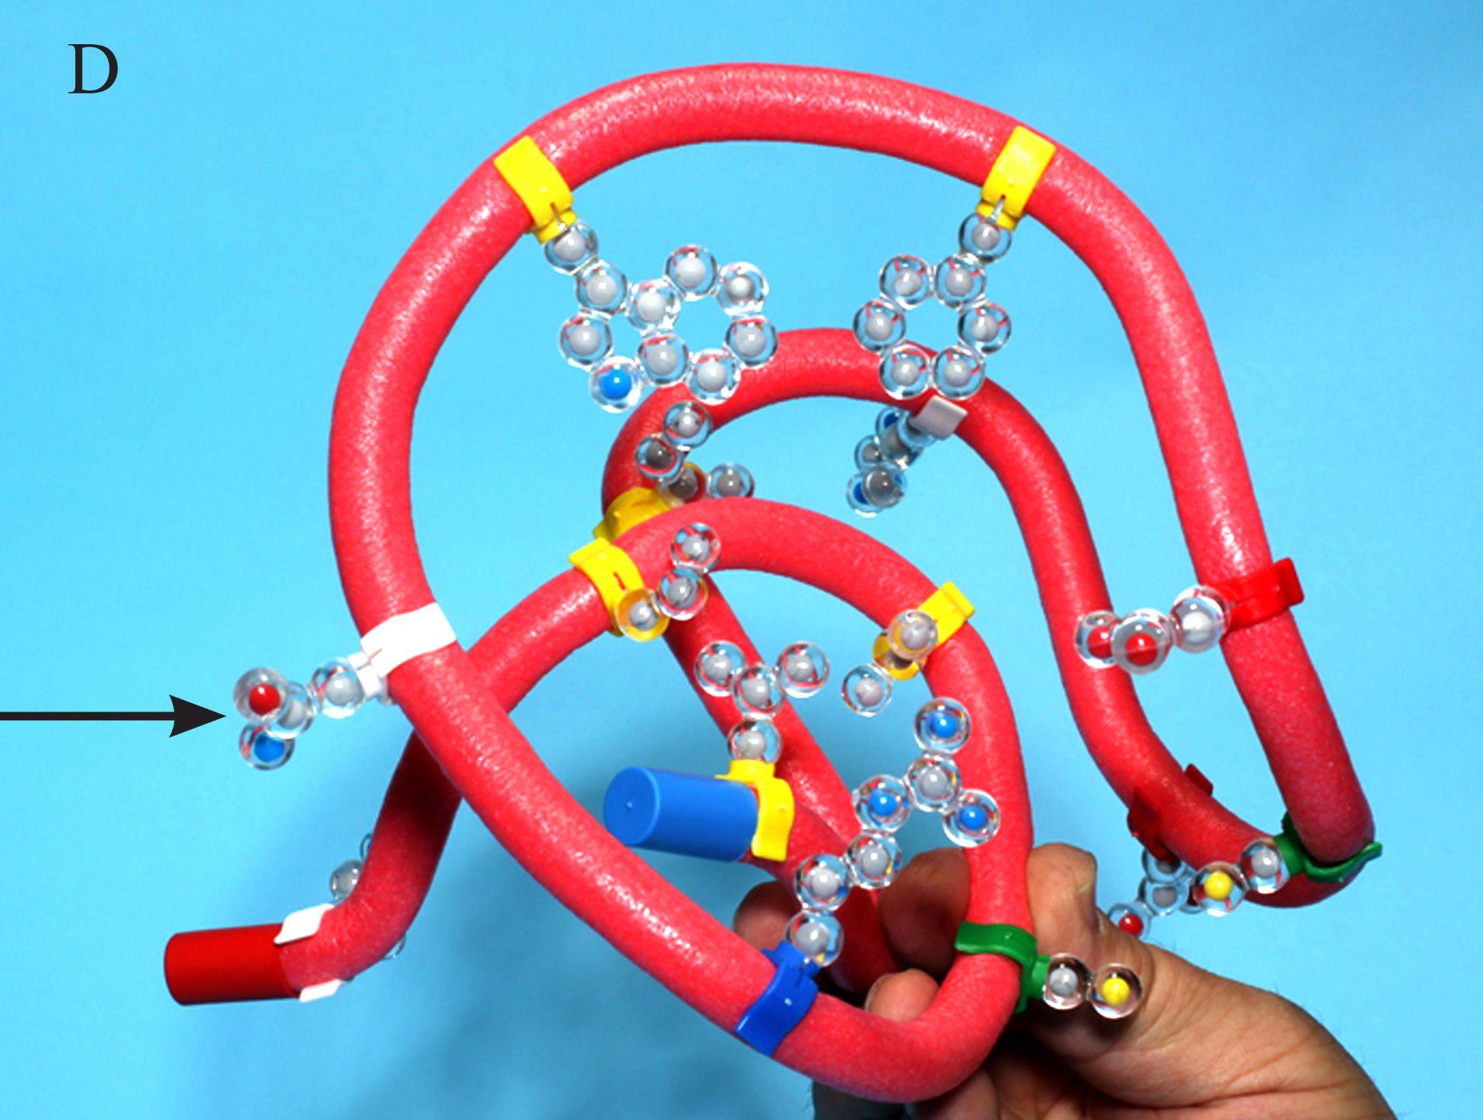
Continue “folding” by rotating the hydrophilic side chains so they are on the outer surface of the protein.

Slide 34
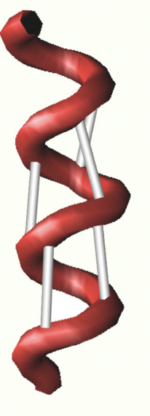
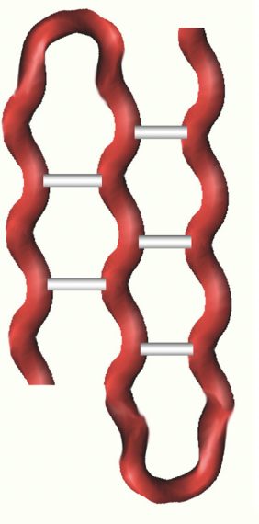
Review of secondary structure
Alpha Helix
Beta Sheet
Notes:
With older classes, you can also remind them of the importance of secondary structure.

Slide 35
Revisit the panorama
35
Notes:
What is the difference structurally between the rough ER and the Golgi? Where is the mRNA? Where is the polypeptide? What is happening to the polypeptide in the rough ER? ​
What is the role of the green transporter proteins? ​
​
Sorting and Transporting: How does a vesicle bud off the rough ER? ​
What proteins help the polypeptide fold correctly?​
What is the fate of a misfolded protein? ​
​
How does the vesicle get to the Golgi?

Slide 36
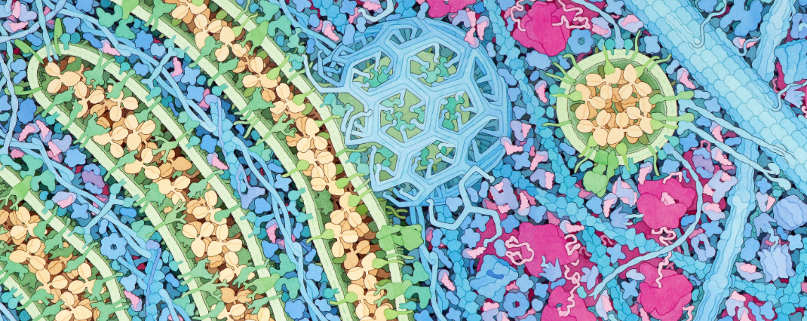
Revisit the panorama
36
Notes:
Why would it be important to continue to modify the structure of the antibody? What do sugars or other substances do for the antibody’s 3-D structure?
Look closely at the antibody in the Golgi. The Golgi is the processing and sorting area in the cell. Sugars and lipids attach to the proteins that need them like this antibody.
Look at vesicle fusion at the Golgi and compare it to the cell membrane. The protein that aid in binding with the membrane are SNAP receptors on the vesicle and SNARE receptors on the Golgi.
How do vesicles bud off the Golgi. Look more closely at clathrin. Identify several clathrin monomers within the geodesic dome. Notice how clathrin interconnects. It takes as many as 36 clathrin triskelions to make one Clathrin dome.
How do cells determine which direction vesicles move?

Slide 37
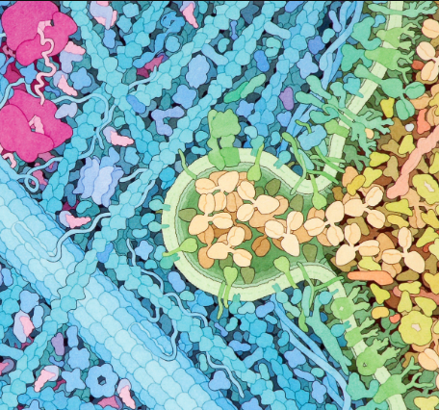
Revisit the panorama
37
Notes:
The vesicle fuses and the newly folded and glycosylated protein moves out of the cell.

Slide 38
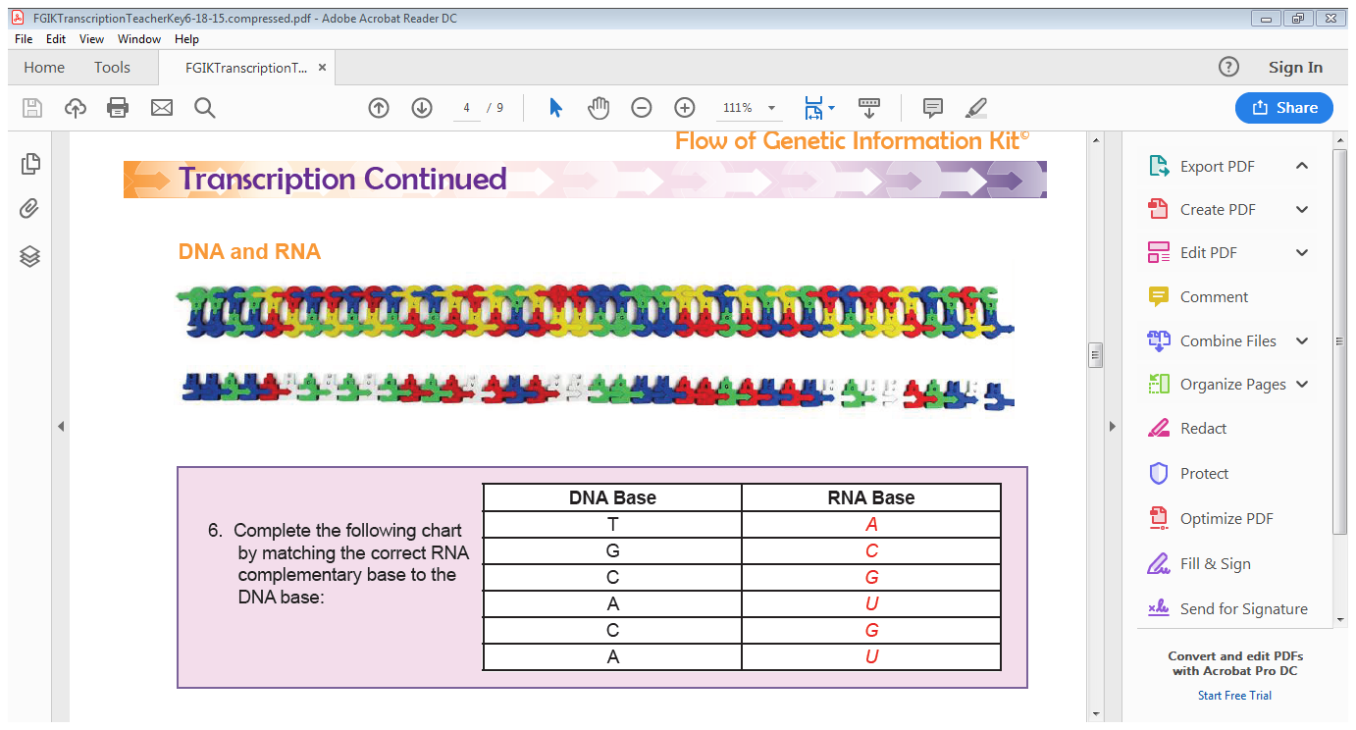
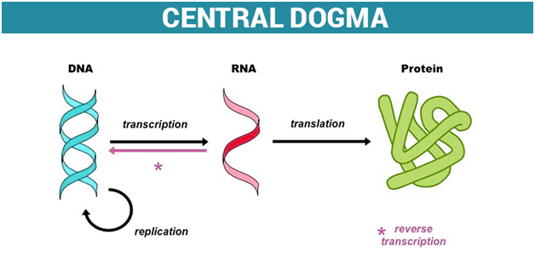
Let’s review
Notes:
Helpful Hints: This is a big kit. I have students put a couple of reminders in their lab notebooks
DNA-RNA Base pair rules
The goal of each step in the central dogma
The differences between DNA and RNA

Slide 39
Helpful Resources
Tracking the Resolution of Student Misconceptions about the Central Dogma of Molecular Biology - PubMed (nih.gov)​
DNA → RNA: What Do Students Think the Arrow Means? - PMC (nih.gov)​
What's in a cell? — young people's understanding of the genetic relationship between cells, within an individual: Journal of Biological Education: Vol 34, No 3 (tandfonline.com)​
Teaching More by Lecturing Less | CBE—Life Sciences Education (lifescied.org)
Eukaryotic cell panorama - Goodsell - 2011 - Biochemistry and Molecular Biology Education - Wiley Online Library

Slide 40
Workshop NGSS Connections
SEPs | CCCs | DCIs
Asking Questions | Scale, Proportion, and Quantity | HS-LS1-1
Developing and Using Models | Patterns | MS-LS1-2
Constructing Explanations and Designing Solutions | Structure and Function | Georgia Standards: SB1 and SB2
Notes:
Here are the NGSS Connections for this workshop.

Slide 41


Summer Course 2024 – Modeling the Molecular World
Join us in Milwaukee for hands-on discovery and professional development
July 29 – Aug 2 OR Aug 5 – 9
Scan to register!
Bring an empty suitcase!
You'll take home all these classroom resources!
Notes:
Scholarships are available. If you have questions, you can contact Ruth Hutson at ruth.hutson@3dmoleculardesigns.com.

Slide 42
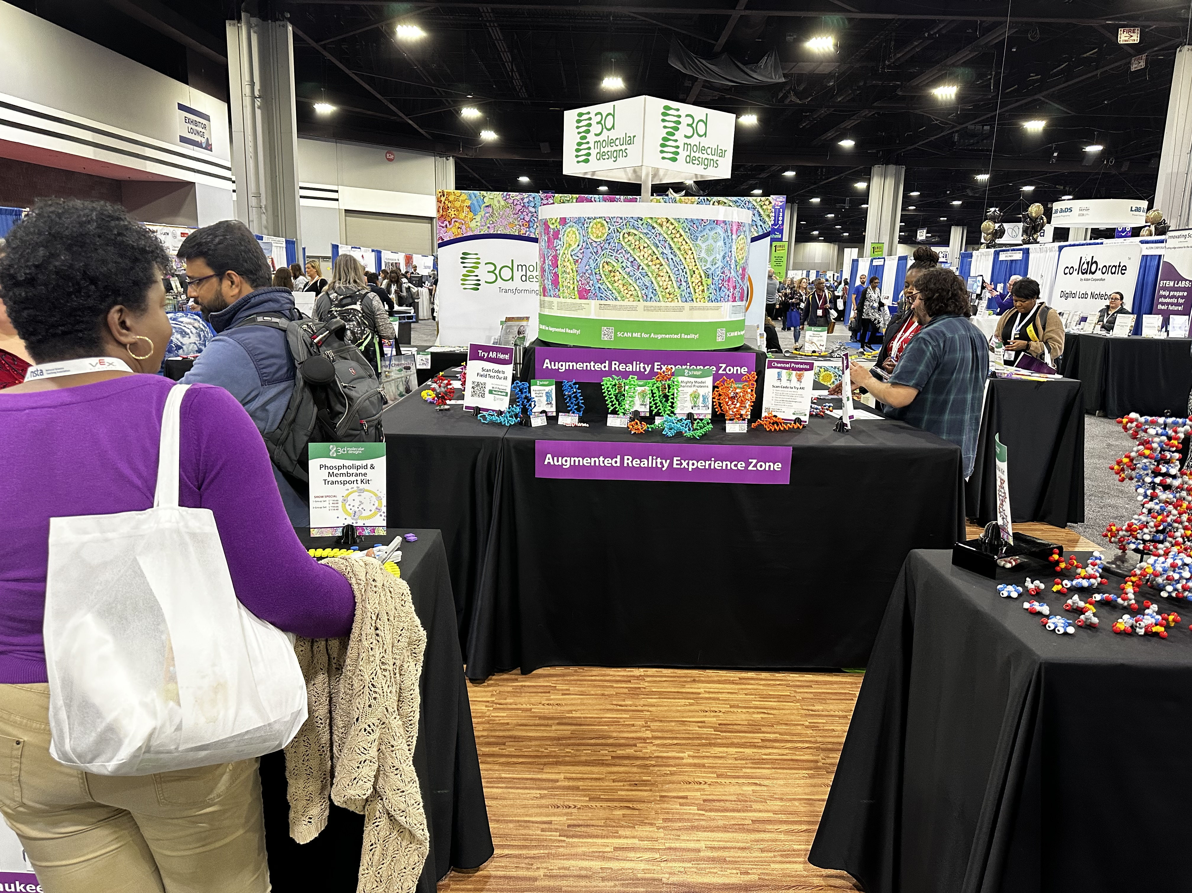
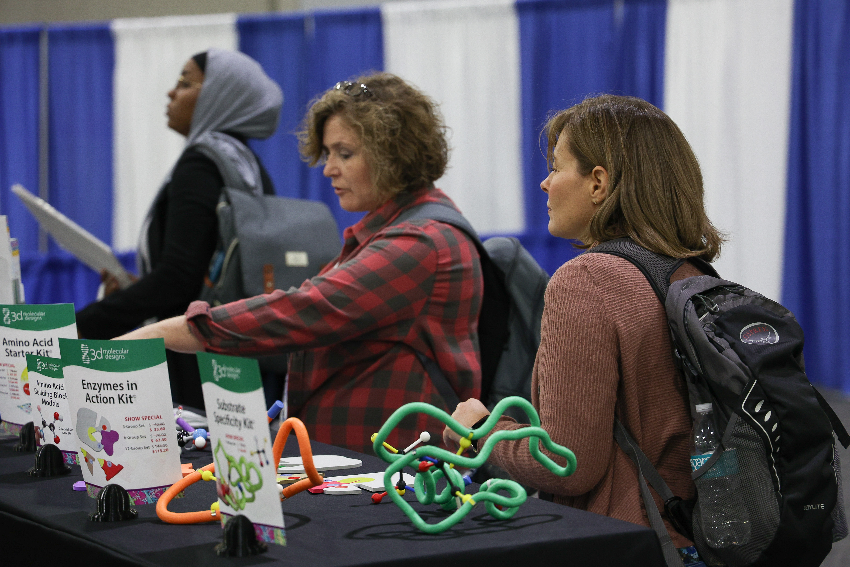
Visit Our Booth!
Continue your exploration of our dynamic kits and models at Booth 3 !

Slide 43
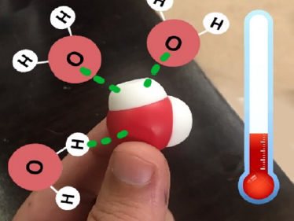
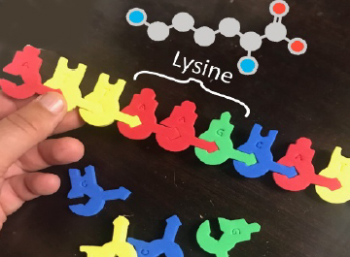
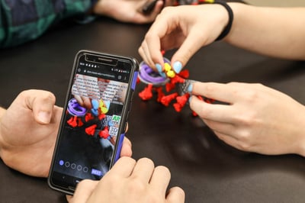
AR Enhancements
We're enhancing our kits and models to inspire more hands-on learning with new augmented reality features!
Stop by Booth 3 to
check out our new
Augmented Reality Enhancements!

Slide 44

We value your opinion!
Let us know what you think.
Scan the QR Code and complete this short survey.

