Slide 1

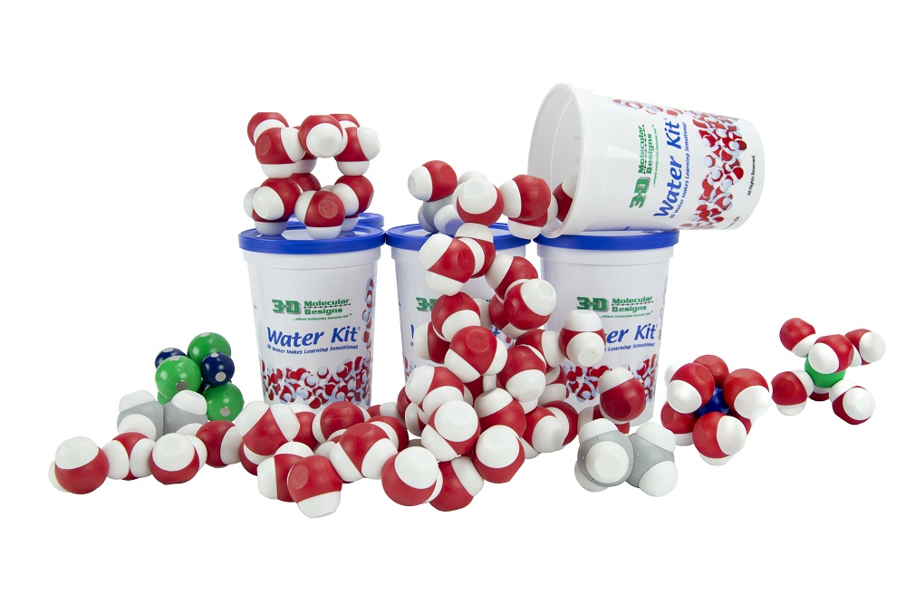
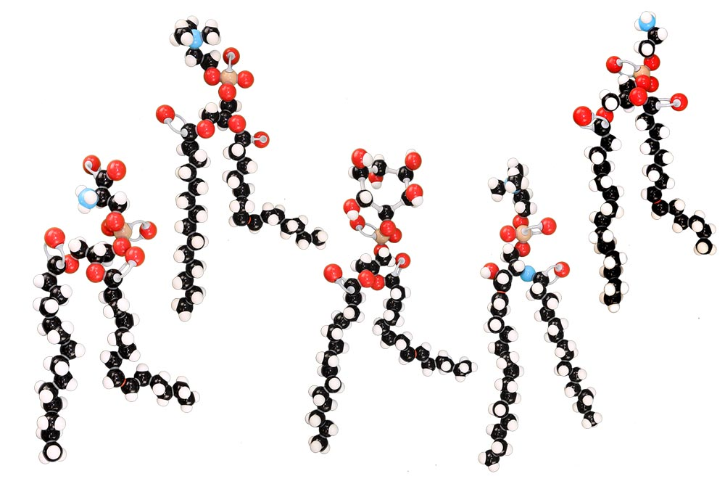
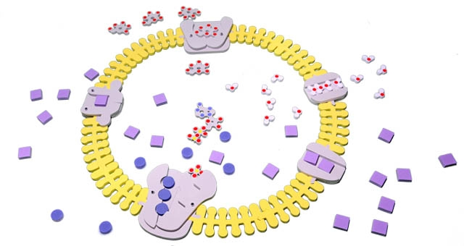
Get a Move On: Modeling Molecular Transport Across Cell Membranes
Notes:
For this presentation, we will use the Water Kit, Phospholipids Molymod Models, the Phospholipids and Membrane Kit, and several 3D printed models (aquaporin, potassium voltage-gated channel, and sodium voltage-gated channel).

Slide 2
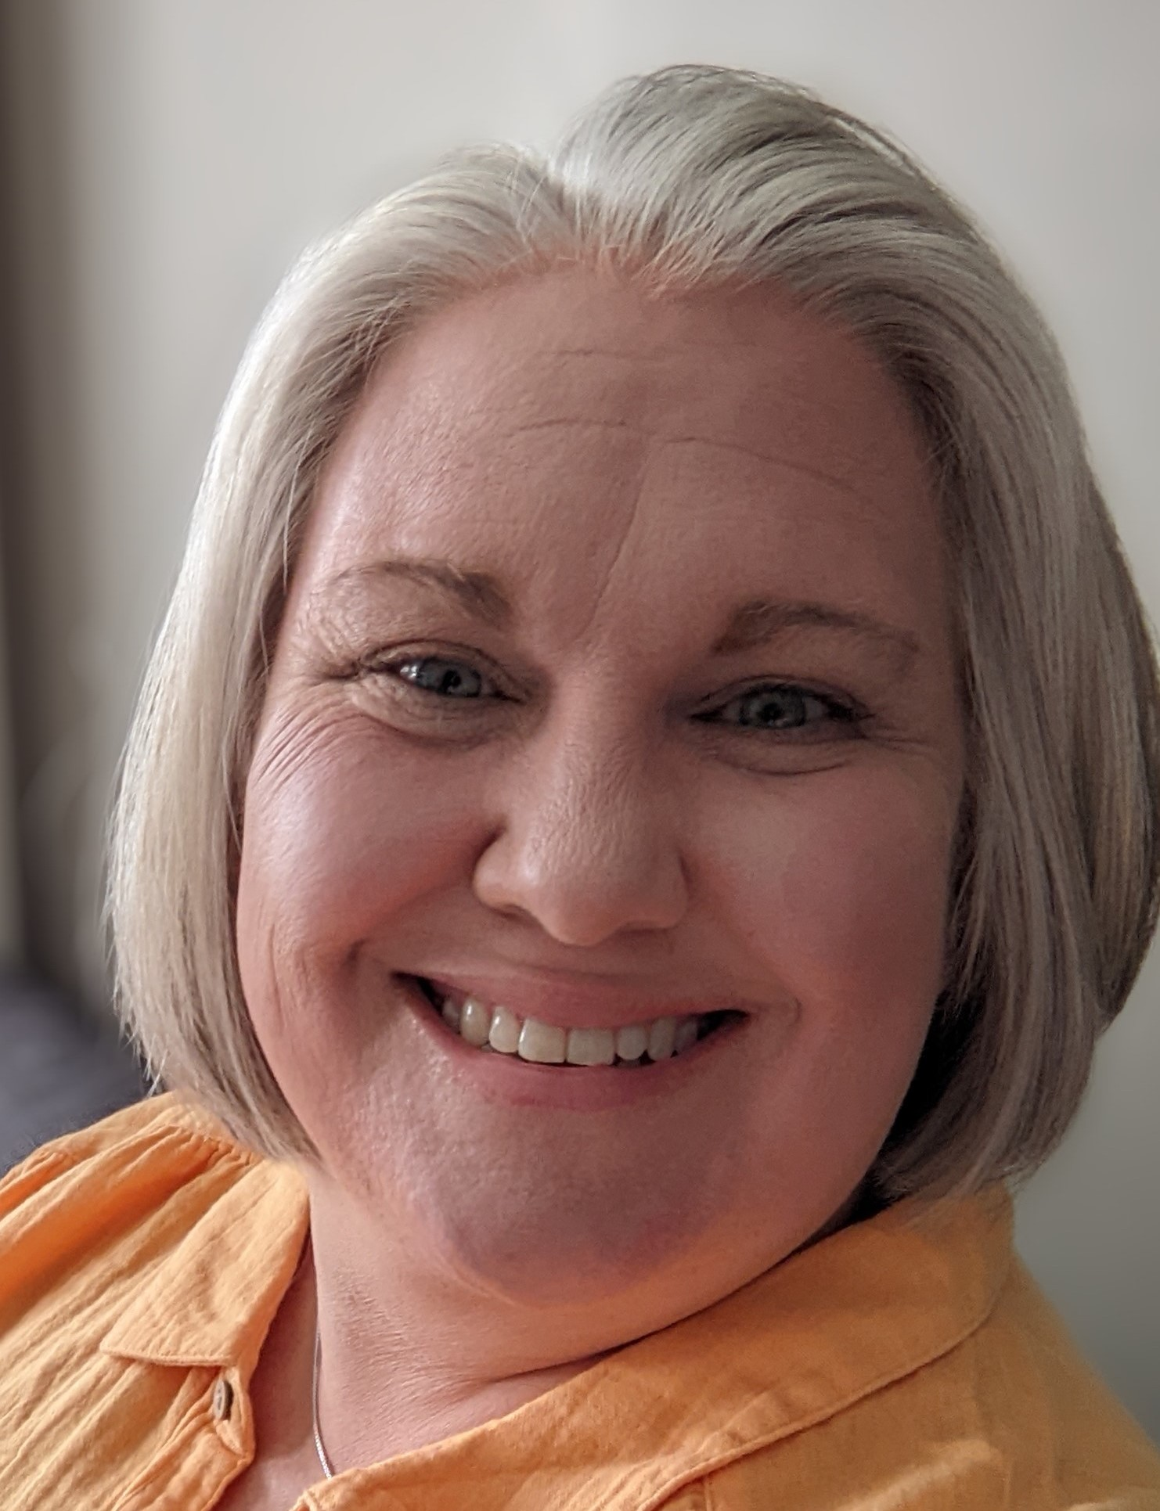
Presenter:
RUTH HUTSON,MSSE
3D Molecular Designs Science Educator
Notes:
I’m Ruth Hutson, a 3D Molecular Designs Science Educator. I’ve been teaching for 25 years . Before coming to 3DMD, I was the science department at a small rural high school in Northeast Kansas where I taught Concurrent College Biology, biology, chemistry, physics, and Earth Science. I discovered the 3DMD products in 2015 and loved using them with all my classes. Today I'd like to share with you how I use these kits with my biology and concurrent College Biology classes.

Slide 3
Workshop Learning Goals
Model the polar nature of water
Determine how similarities and differences in phospholipid structure affect membrane permeability .
Construct and cross cell membrane
Compare and contrast multiple models to better understand cellular processes and apply that knowledge to a case study.
Have fun!
Notes:
Ruth says: At the end of this session, you should be able to… read goals from slide).
So let’s get started with some modeling [Advance slide]

Slide 4
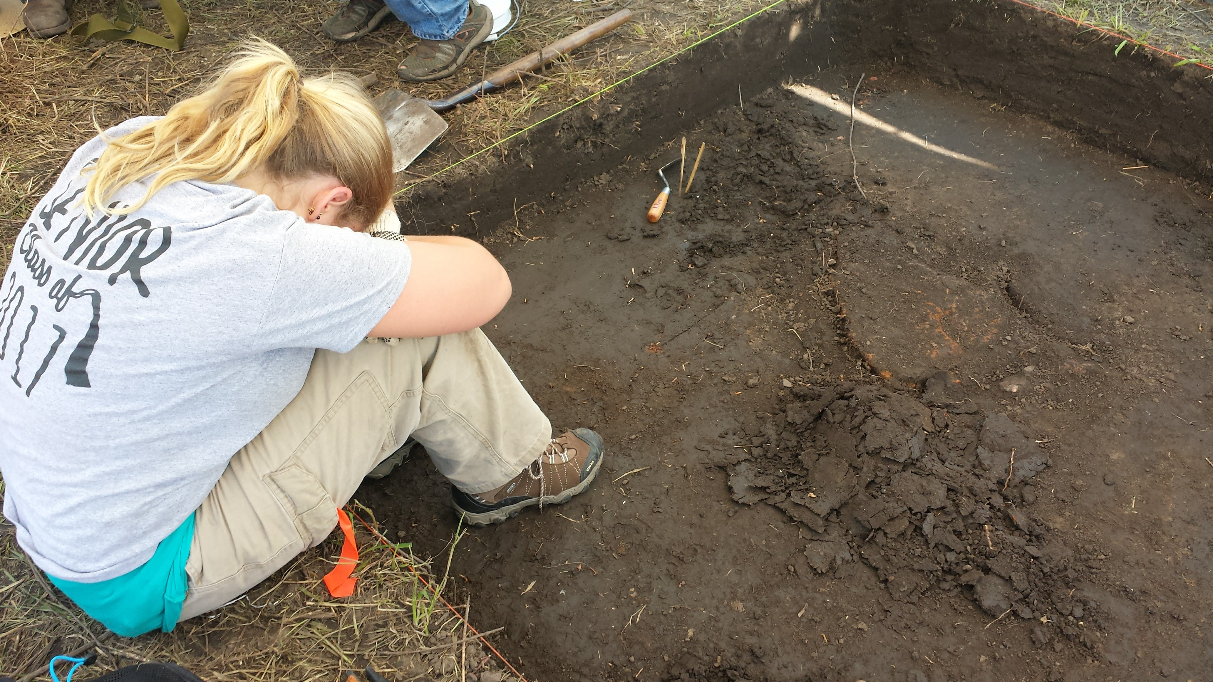
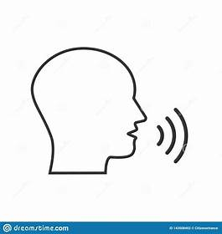
Seventeen-year old female was at a public archeology dig doing field work in June when she suddenly became ill. She complained of nausea and vomited once. She had a headache and her legs were cramping. She left the field site early and went home where she rested, drank water, and stayed inside where it was air conditioned.
What is your initial diagnosis?
What would you encourage the young lady to do?
Notes:
I introduce the unit with a case study so that students can relate a real-world scenario with what is going on in their bodies at the molecular level.

Slide 5
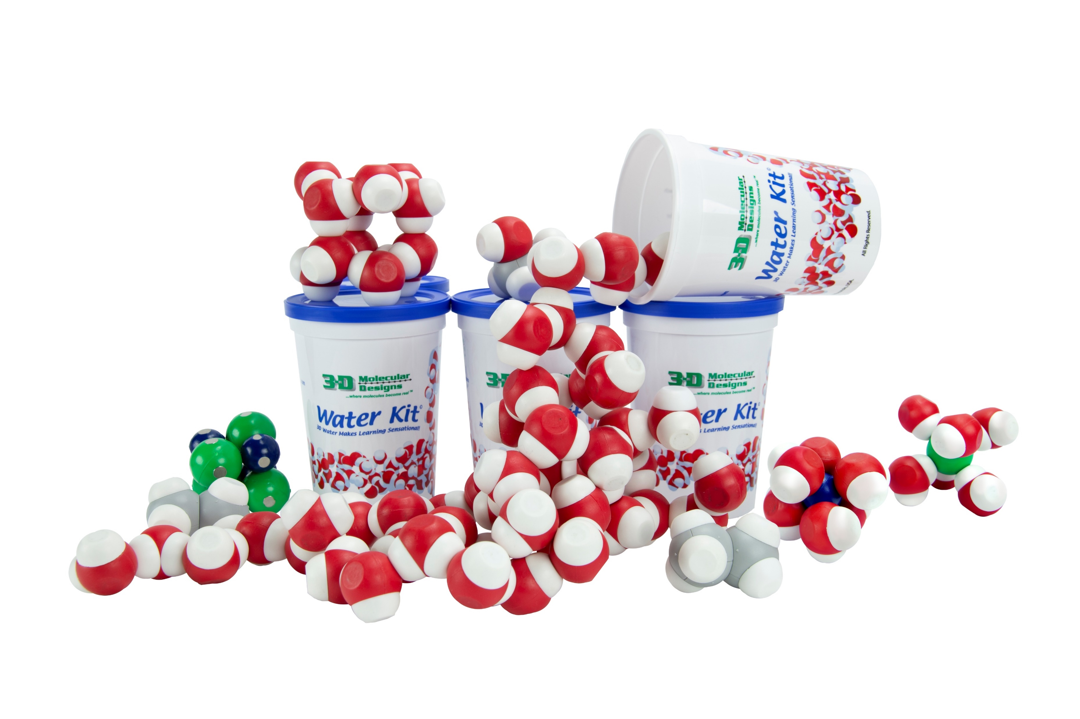
Find a physical representation of water.
How do you know which model represents a water molecule?
What color represents the oxygen?
Which atoms interact with each other?
Why do water molecules stick to each other?
Notes:
Ruth says: To first understand what might be happening in our case, my classes first explore the nature of water. Spill your cup of water on the table look carefully at the contents. [Advance slide]

Slide 6
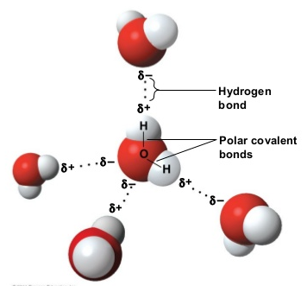
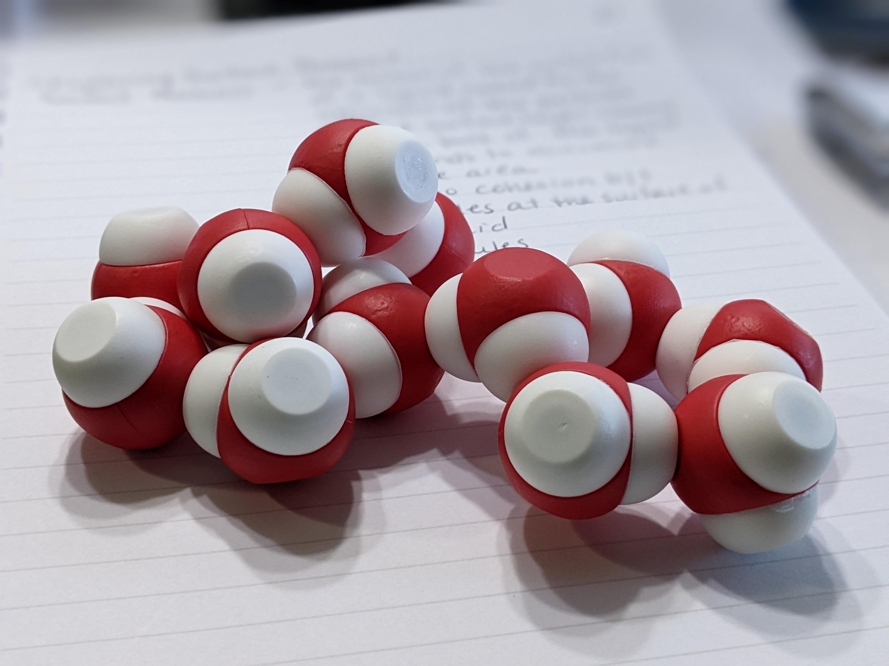
Notes:
Ruth says: Materials management is a must for my classes. Since these are older classes and they would have had previous experience with the water cup, I do not parse out the contents of the cup. If this is your students first experience with the water cup you might only want to give them two molecules of water.
You should notice that oxygens are attracted to hydrogens on other water molecules. This is because of hydrogen bonding which leads to many of the important properties of water and how it interacts with other substances. [Advance slide.]

Slide 7
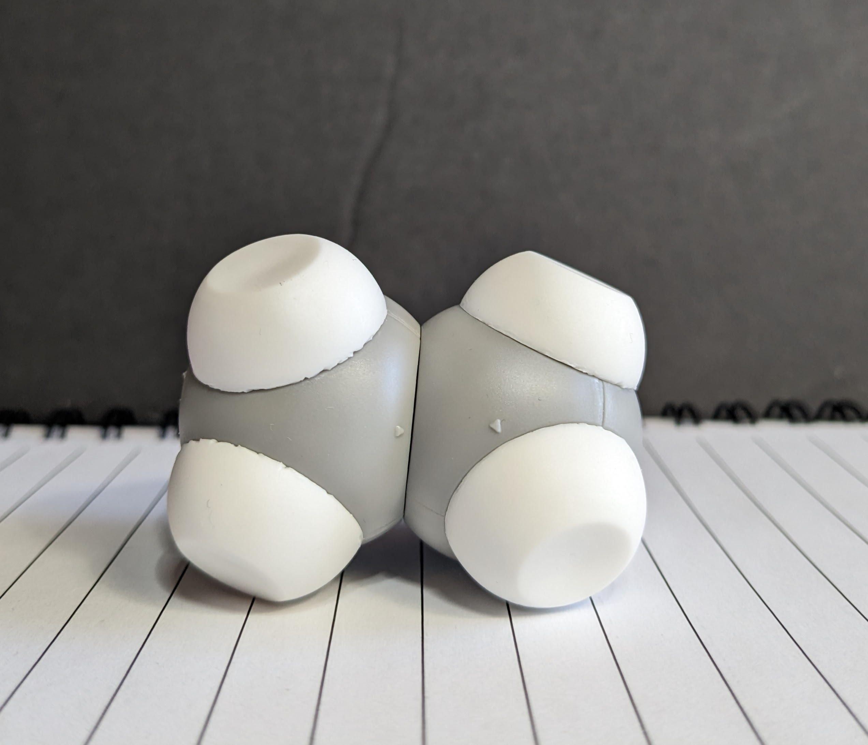
What patterns do you see?
What questions do you have?
Notes:
Now I have them retrieve the grey and white molecule from the cup and interact it with several water molecules. How it this interact with water? Talk about the difference between the thought bubble and text on the screen. [Wait for responses.]
[Advance slide.]

Slide 8
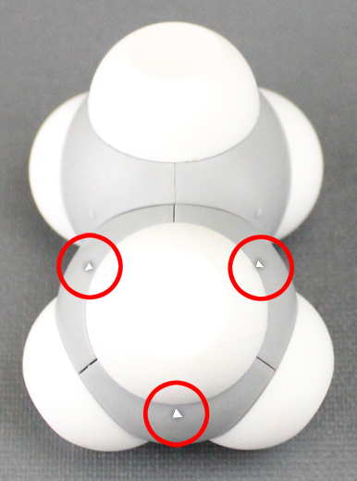
How does this molecule interact with water molecules ?
What patterns do you see?
What questions do you have?
A closer look at solubility
Notes:
Ethane is a non-polar molecule because it has an even charge across the entire molecule. Ethane does not form hydrogen bonds. Since water is polar and has an unequal charge across the molecule, it will not interact with ethane.
[Advance slide.]

Slide 9
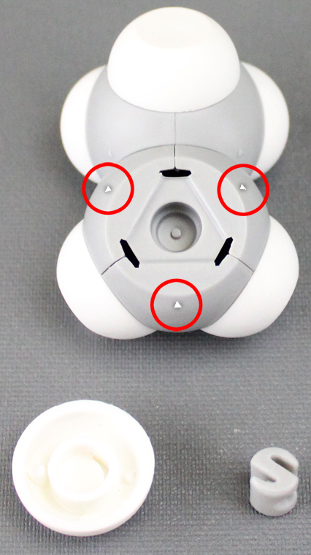
Molecular Manipulation
A closer look at solubility
Remove a hydrogen
Add a hydroxide

Slide 10
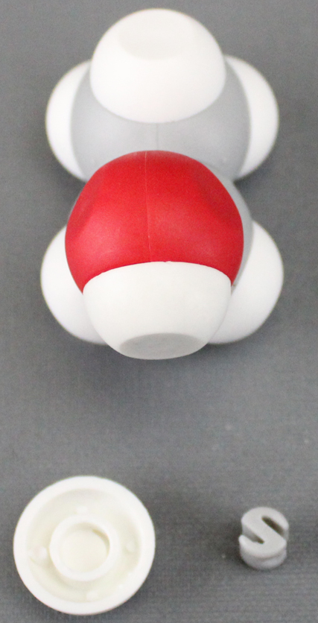
How does this molecule interact with water molecules ?
What patterns do you see?
What questions do you have?
A closer look at solubility

Slide 11
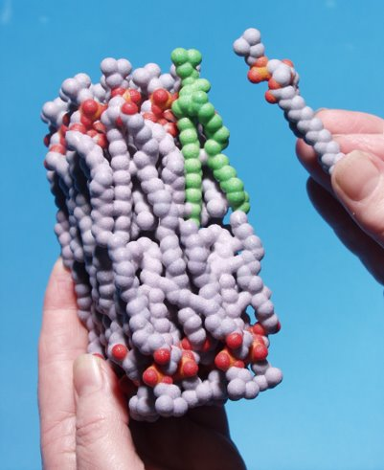

Getting through the cell membrane
How does a polar molecule like water diffuse through a largely hydrophobic bilayer?

Slide 12
Notes:
Ruth says: There are five phospholipid models: phosphatidylcholine, phosphatidylserine, phosphatidylinositol, phosphatidylethanolamine, and sphingomyelin
Each table has a different phospholipid.
[Advance slide]

Slide 13
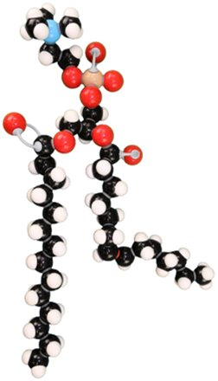
Getting Through the Cell Membrane
Examine the phospholipid molymod at your table.
Describe the overall structure of your model
What atoms are present? What colors represent these atoms?
What are two questions you have about your model?

Slide 14
Getting Through the Cell Membrane
Compare and contrast your group’s phospholipid to another group’s phospholipid.
Speculate why a cell membrane would have different phospholipids.
Notes:
Discuss some additional assessment ideas.

Slide 15
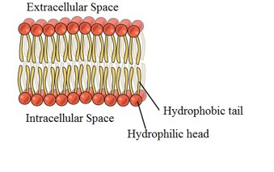
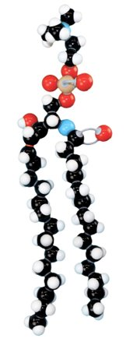
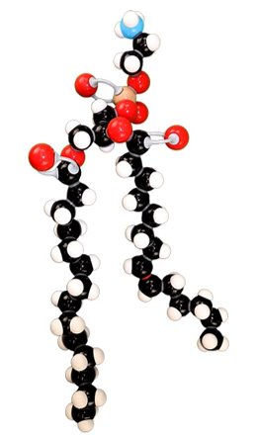
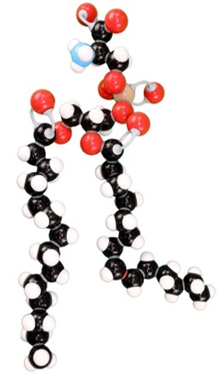
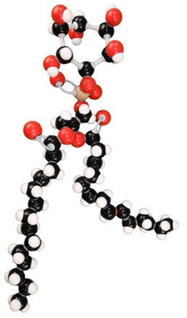
Focus on Phospholipid Heads
.
Phosphatidylserine
Phosphatidylinositol
Sphingomyelin
Phosphatidylethanolamine
Phosphatidylcholine

Slide 16
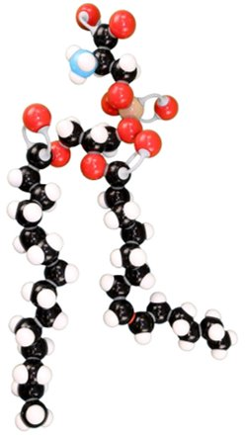
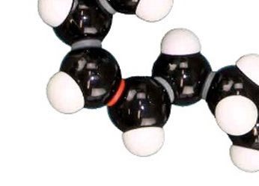
Focus on Phospholipid Tails
Hydrogen in the cis configuration
Produces a larger “kink” in the atail

Slide 17
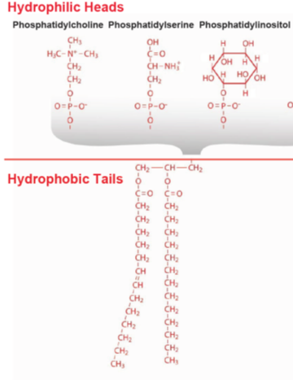
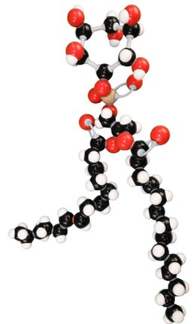
Modeling the Membrane: Phospholipids
Using multiple models help explain nuance in the phenomena we are typing to explain.

Slide 18
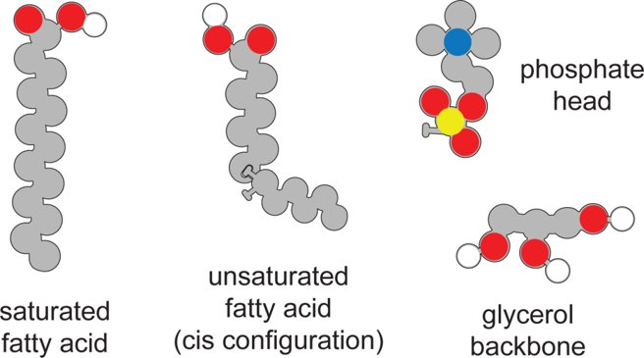
Constructing A Phospholipid

Slide 19
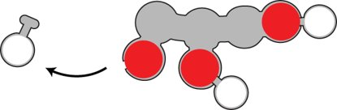
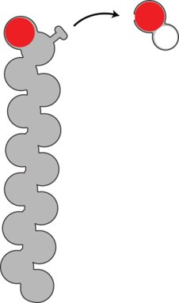
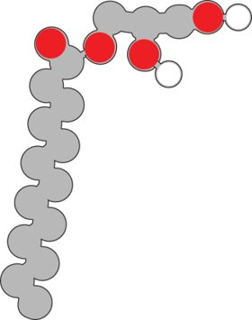
Constructing A Phospholipid
Remove a hydroxyl
From the saturated
fatty acid.
Join the glycerol and
saturated fatty acid
Together.
Remove a hydrogen from the glycerol backbone.

Slide 20

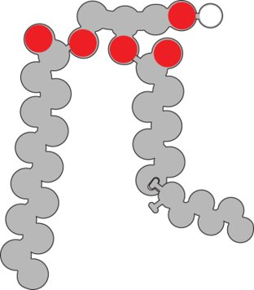
Constructing A Phospholipid
Join the hydrogen and the hydroxyl group to make water.
Remove a
hydrogen from
the glycerol
backbone
Attach the unsaturated
fatty acid to the glycerol
backbone
Notes:
Ruth says: Phospholipid models
[Advance slide]

Slide 21
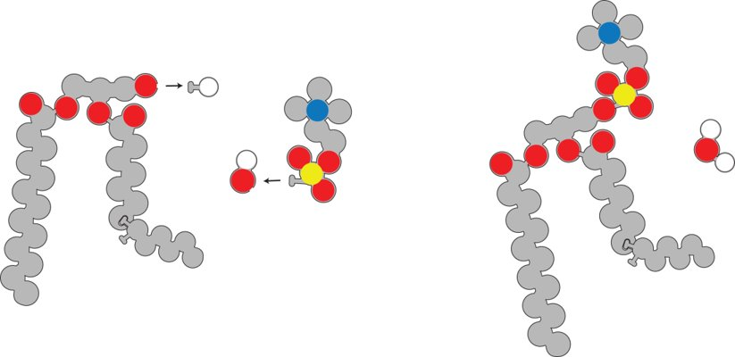
Constructing A Phospholipid
Remove a hydrogen from the glycerol backbone and attach
the phosphate head.
Join the hydrogen with a hydroxyl group to make water.

Slide 22
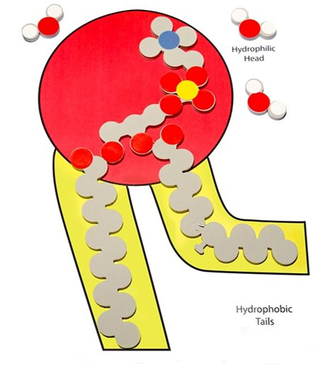
Constructing A Phospholipid
What do all three models have in common?
How are the models different?
Why is it important to use multiple models
to represent the same structure?
Notes:
Ruth says: Phospholipid models
[Advance slide]

Slide 23
Building a Cell Membrane
How would ten phospholipids arrange to form a film on water?
How would ten phospholipids arrange to be submerged in a beaker of water?
How would phospholipids be arranged to be both submerged and contain water.
Notes:
In the first thought experiment, the phospholipids heads would be pointing down and the phospholipids tails would be pointing away from the water. A monofilm would be formed.
In the second thought experiment, the phospholipid heads would be pointing outwards and the phospholipid tails would be pointing inside. A micelle would be formed.
In the final thought experiment, there would be two layers of phospholipids, the heads would be nearest the water on the inside and outside. The tails would be touching forming a liposome.

Slide 24
The next day the young lady awoke with swollen ankles, a more severe headache, extreme fatigue, and throughout the day she continued to vomit.
Later in the afternoon, she visited her General Practitioner who ordered a urine sample and blood test. She also had a negative strep test.
How your initial diagnosis changed based on the new information?
What other information do you need to know?
Notes:
Now that student have identified how water behaves. We give them a little more information about the case. This would be day two of the lesson and the case data would be the first routine of the day.

Slide 25
Getting through the cell membrane
How does a polar molecule like water diffuse through a largely hydrophobic bilayer?
Notes:
The middle of the lipid bilayer is highly hydrophobic. Water molecules are small enough to pass but are slowed down because of the hydrophobic nature of the middle zone of the bilayer. The movement of water through the cell membrane was too quick to be explained by diffusion alone. Something else had to assist in the movement of water into the cell.

Slide 26
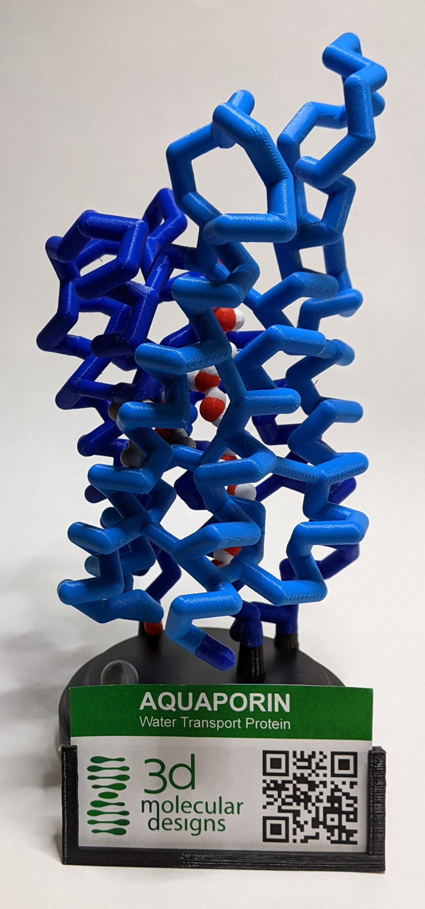
Enter AQUAPORIN!
Transport protein that spans the membrane
Notes:
Ruth says: Aquaporin is a transport channel that facilitates the diffusion of water across the cell membrane. In 1992, Peter Agre discovered this protein while working with Rh factors in red blood cells. It was later known as aquaporin 1 which is abbreviated as AQP 1. Currently, there are 13 aquaporin variants in humans. For today, we are just going to focus on AQP 1.
Structure of AQP 1 PDB-101: Molecule of the Month: Aquaporin (rcsb.org)
Aquaporin has four identical chains. Each chain has its own channel at the center of the subunit. One such subunit is pictured. The channel is filled with a single file line of water passing through the protein channel. Two charged amino acids are at the entry to make sure that only water, and not hydronium or hydroxyl, (the products when water dissociates) passes through the channel. Water enters the channel oxygen side down until it reaches two specific amino acids (both asparagine) that causes water to reorient and continue hydrogen side down.
[Advance slide]

Slide 27
Results of Lab work
Basic Metabolic Panel, Simplified
Na: 120
Cl: 95
BUN: 9
Glucose: 60
K: 3.0
CO2: 25
Cr: 0.8
Notes:
Here are the results of the patient’s blood work.

Slide 28
Results of Lab work
Basic Metabolic Panel, Simplified
Na: 120
Cl: 95
BUN: 9
Glucose: 60
K: 3.0
CO2: 25
Cr: 0.8
Na: 135-145
Cl:95-105
BUN: 7-24
Using the Phospholipid and Membrane Transport Kit, how would you model this phenomenon?
Glucose: 60-120
K: 3.5-5.1
CO2:22-28
Cr: 0.7-1.4
Notes:
Let’s compare them with the normal ranges of the Basic Metabolic Panel. Are these results within the normal range?
The sodium and potassium levels are low, but the rest of the levels are within the normal range. However, they are on the low end of the spectrum.
When looking at the other symptoms that the patient was experiencing it appears she is not dehydrated. Instead she is experiencing an imbalance with the total body water with the total body sodium (electrolytes).
Let’s model what might be going on in a cell using the components of the Phospholipid and Membrane Transport Kit? Focus on sodium, sugar, and potassium and don’t worry about the other levels. How might your students model this phenomenon?

Slide 29
Results of Lab work
Urinanalysis
Appearance: Clear
pH: 7.0
Specific Gravity: 1.00
Protein: 0
Glucose: 75 mg/d
Ketones: 0
Notes:
Now let’s look at the urinanalysis results to see if they back up your model.

Slide 30
Results of Lab work
Urinanalysis
Appearance: Clear (Clear to Yellow)
pH: 7.0 (4.5-7.2; optimum: 6.0)
Specific Gravity: 1.00 (1.005-1.025)
Protein: 0
Glucose: 75 mg/d
Ketones: 0
Using the Phospholipid and Membrane Transport Kit, how would you model this phenomenon?
Notes:
Now let’s compare these with the range of normal levels and discuss the clinical implications. We are just going to focus on the first three items on the report.
Clinical implications and interpretation of abnormal results:
Normal urine is clear or light yellow in color with no odor. The appearance changes when it contains bacteria, WBCs, fat, RBCs, or chyle (milky bodily fluid containing fat droplets or lymph.)
Presence of these substances could mean that there is a urinary tract infection, kidney infection, or exposure to drugs. A fruity odor could indicate diabetes, dehydration, or starvation.
Normal pH is between 4.5 to 7.2 with the optimum pH being 6.0. pH of urine changes throughout the day. Infections make the urine more alkaline.
Specific Gravity is a comparison of the density of urine to the density of water which is 1.00. Specific gravity goes up when urine is highly concentrated and coms down when the water level in urine is high.

Slide 31
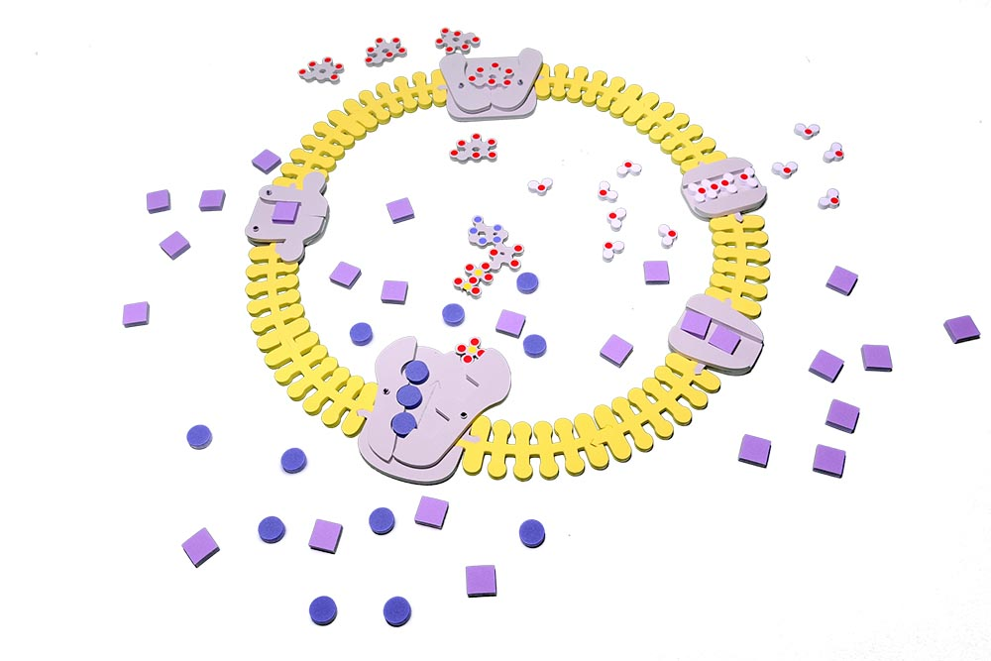
Let’s investigate some membrane channels

Slide 32
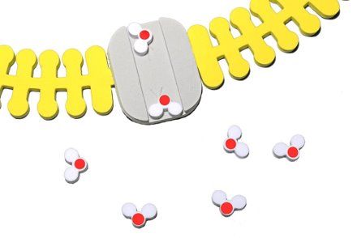
Passive Transport:
Aquaporin
K+ Leak Channel
Gated K+ Channel

Slide 33
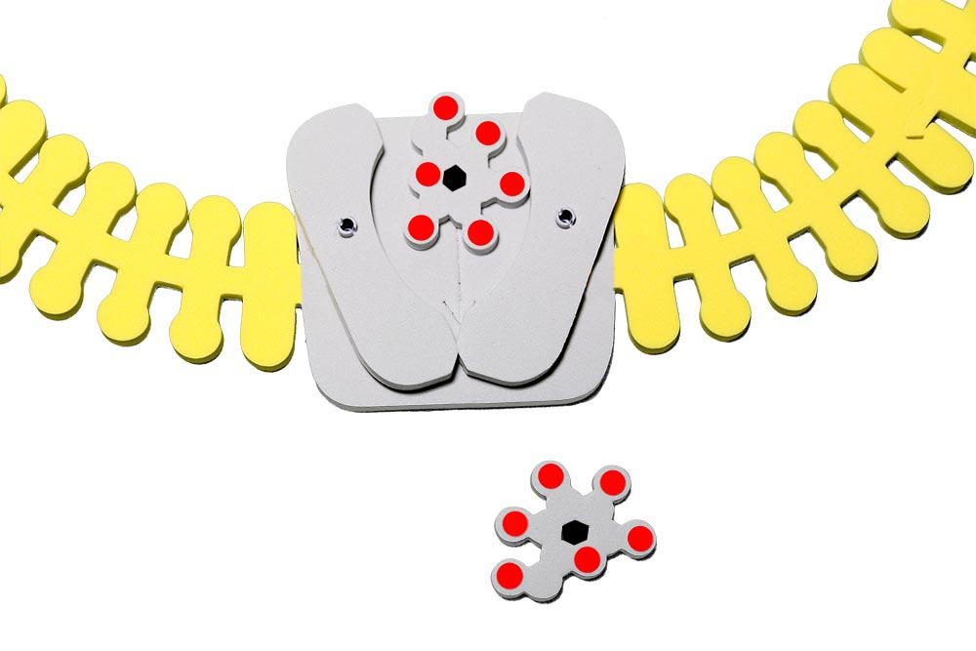
Passive Transport with Carrier Protein:
Glucose Transporter 1
(Glut 1)

Slide 34
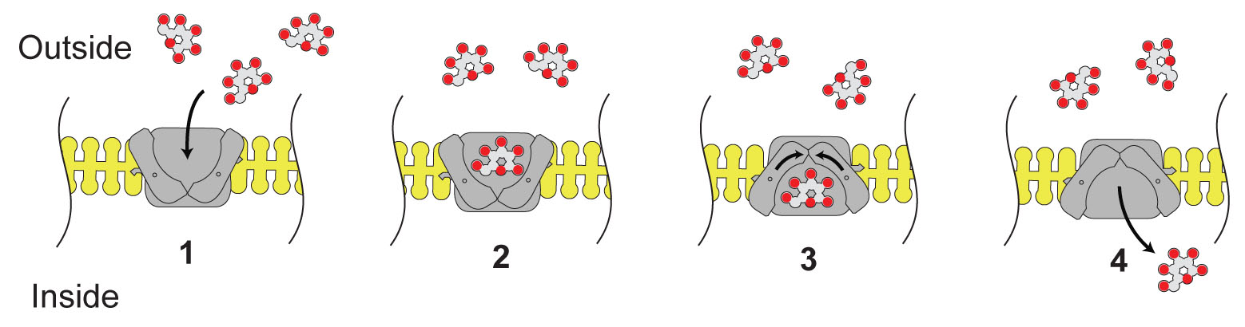
Modeling passive transport with a carrier protein

Slide 35
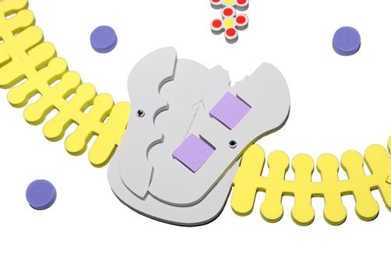
Active Transport
Sodium-Potassium Pump

Slide 36
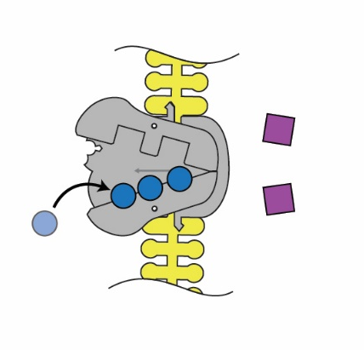
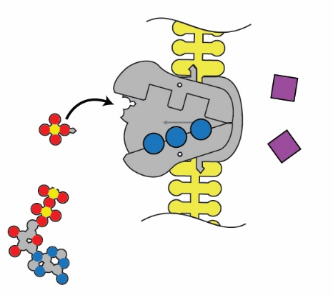
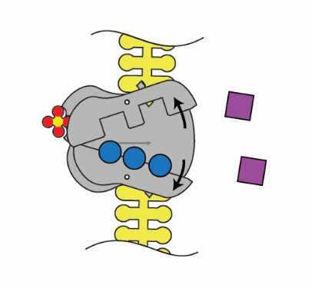
1. Sodium binds on intracellular side.
2. The pump is phosphorylated by ATP.
3. The pump shape changes, exposing the sodium to the extracellular space.

Slide 37
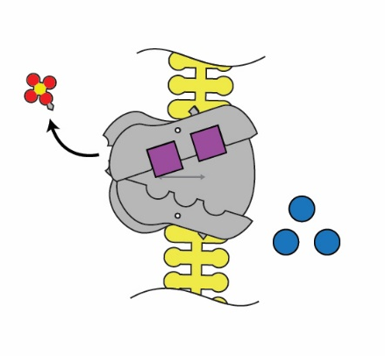
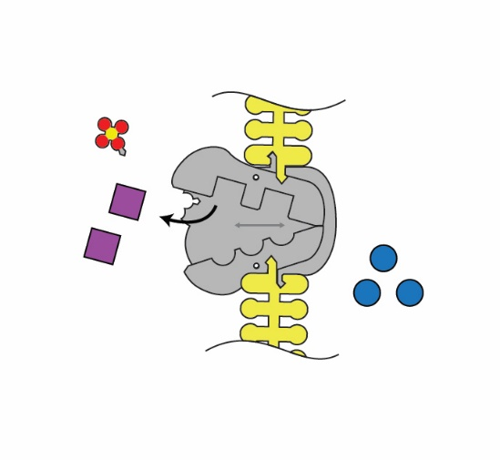
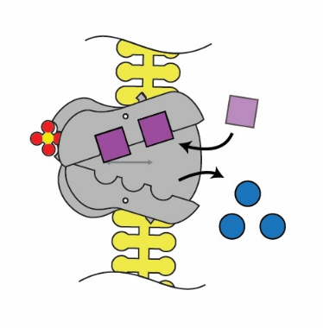
4. Binding affinity changes to release Na+, and take in K+.
5. Phosphate detaches.
6. Original shape is restored, releasing K+ into the cell.

Slide 38
Notes:
Ruth says: Phospholipid and Membrane Transport Kit
[Advance slide]

Slide 39
Final diagnosis and Prognosis
How could this have been prevented? Write a letter explaining what occur and what should be done in the future.
Notes:
I introduce the unit with a case study so that students can relate a real-world scenario with what is going on in their bodies at the molecular level.
[Talk about the time frame, modifications for those on IEPs, and materials at their disposal. Also, give rationale.
This young lady was drinking too much water, too quickly. Ever though kidneys flush out 20 to 29 L of water a day, kidneys can only clear 1 liter of water/hour. Water intoxication can happen more quickly in children than adults so it is important for them to take care to drink a variety of thing slowly and consistently throughout the day. When the total body solutes (sodium and potassium) is lower than the total water solutes, the cell swell. In worse cases, that can lead to edema (water in the extracellular space) because the kidneys cannot flush excess water of the body.

Slide 40
Workshop NGSS Connections
SEPs | CCCs | DCIs
Asking Questions | Patterns | MS-LS1-2
Developing and Using Models | Cause and effect | MS-LS1-3
Constructing Explanations | Structure and Function | HS-LS1-2
Engaging in an Argument from Evidence | Stability and Change | HS-LS1-3
Notes:
Ruth says: Here are the NGSS Connections for this workshop.
Students who demonstrate understanding can:
MS-LS1-2.Develop and use a model to describe the function of a cell as a whole and ways the parts of cells contribute to the function.
MS-LS1-3.Use argument supported by evidence for how the body is a system of interacting subsystems composed of groups of cells
HS-LS1-2. Develop and use a model to illustrate the hierarchical organization of interacting systems that provide specific functions within multicellular organisms
HS-LS1-3.Plan and conduct an investigation to provide evidence that feedback mechanisms maintain homeostasis

Slide 41
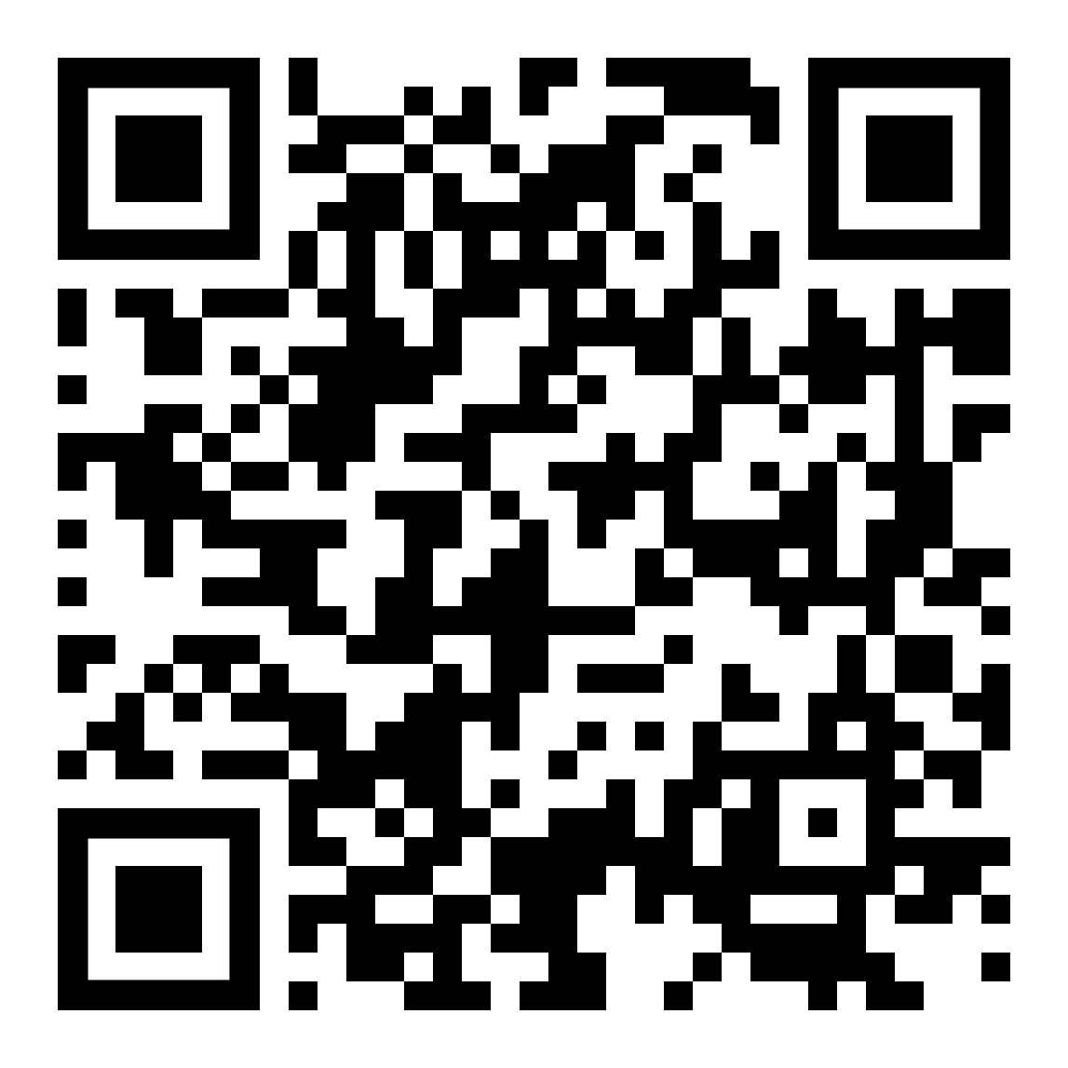
We value your opinion!
Let us know what you think.
Scan the QR Code and complete this short survey.

