Slide 1
Go With the Flow! Modeling DNA to RNA to Proteins and Beyond

Slide 2

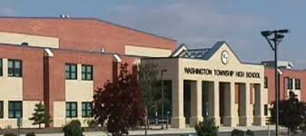
Mary Howard
Science Teacher at Washington Township High School in Sewell, NJ
Notes:
Reach me at mhoward@wtps.org

Slide 3
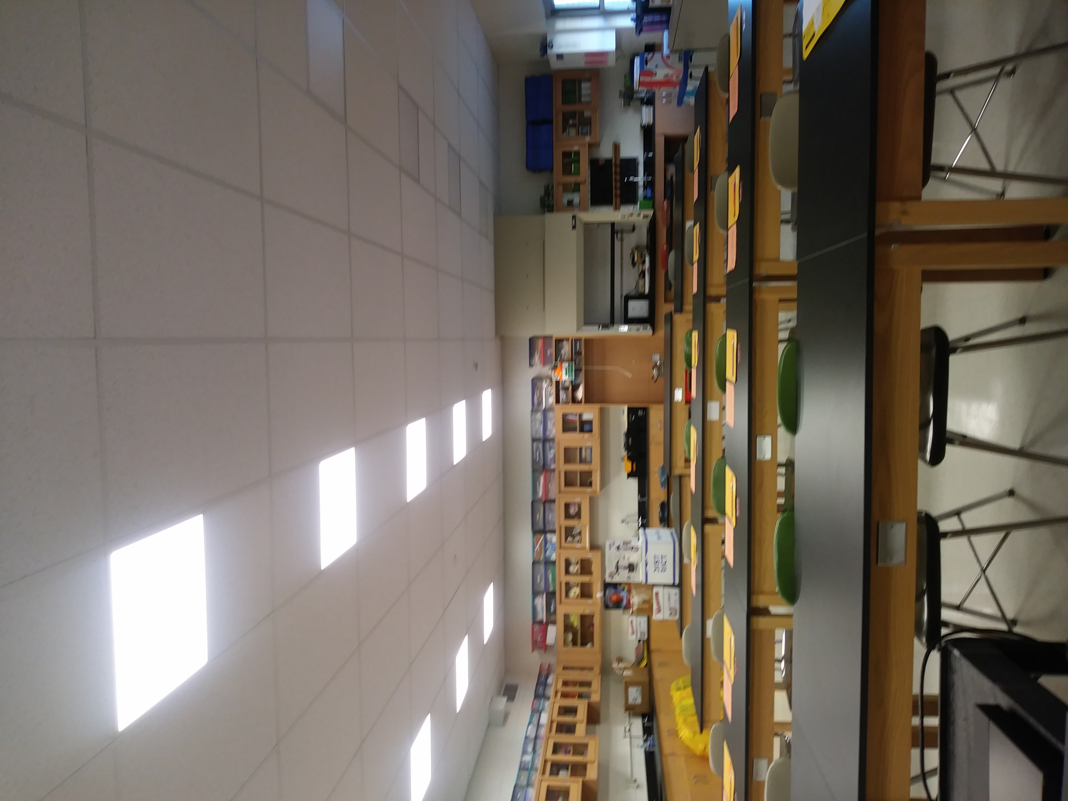
Mary Howard Basic Background
Education:
  Biochemistry
  Physiology
  Education
Experience:
  Researcher
  Instructor
Science Classroom Strategies
  Lectures
  Digital Activities
  Laboratory Activities
  Projects
  Assessments

Slide 4
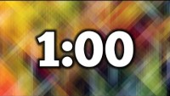
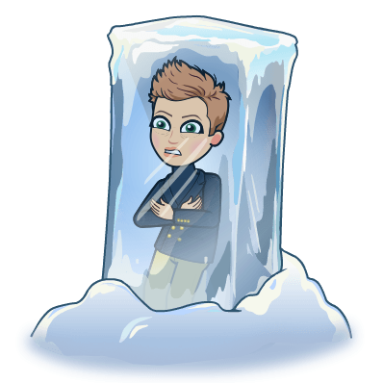
Icebreaker
How do you describe yourself as an educator?
What is your favorite aspect of teaching science?
How would you describe your ideal classroom/activity?
Notes:
Ransom Notes Type Icebreaker Activity. Created with help of Instructional Coach. File available upon request at mhoward@wtps.org

Slide 5
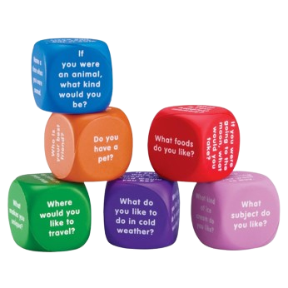

Icebreaker
Let’s Get Talking with Conversation Cubes
Notes:
Ransom Notes Type Icebreaker Activity. Created with help of Instructional Coach. File available upon request at mhoward@wtps.org

Slide 6
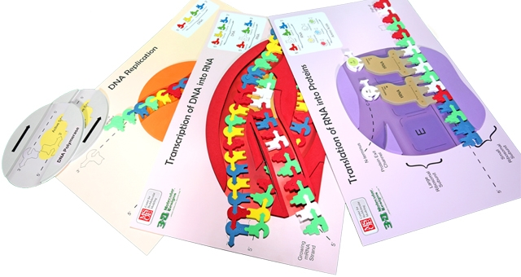
Flow of Genetic Information
Resources found at: https://3dmoleculardesigns.com/classroom_resources/flow-of-genetic-information-kit/

Slide 7
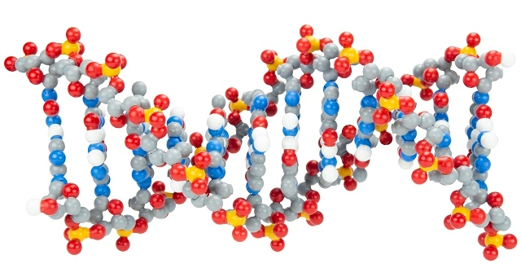
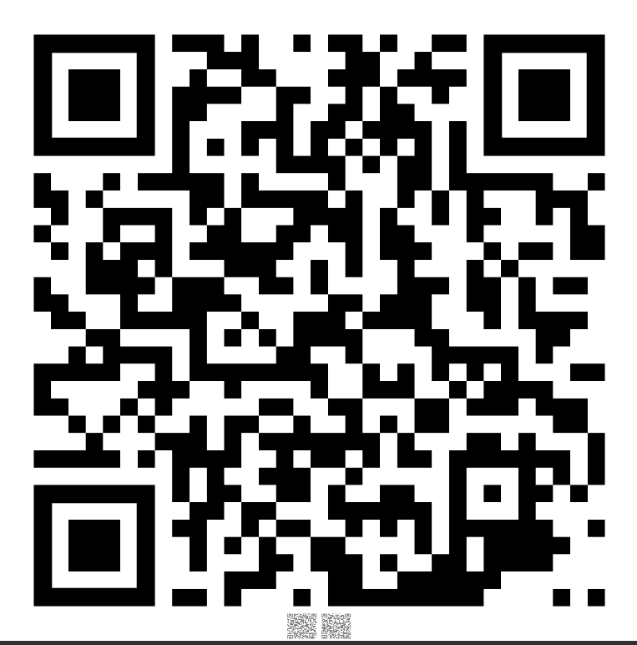
Resources and Materials
Kits Used in this workshop:
Dynamic DNA
Flow of Genetic Information

Slide 8

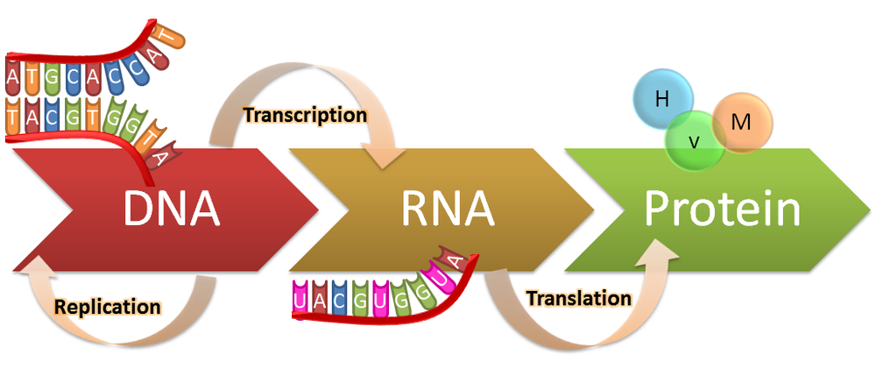
DNA Structure
Central Dogma and Modeling; How do I start?

Slide 9
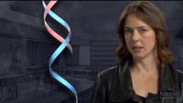
The Double Helix
Video found at: https://www.youtube.com/watch?v=1vm3od_UmFg
Notes:
Resource is HHMI

Slide 10
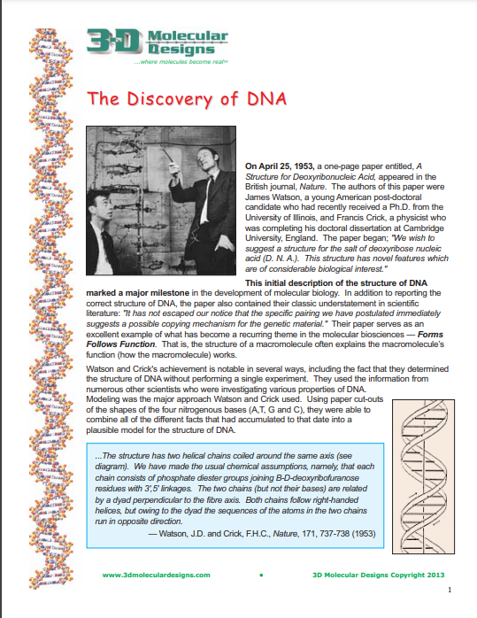
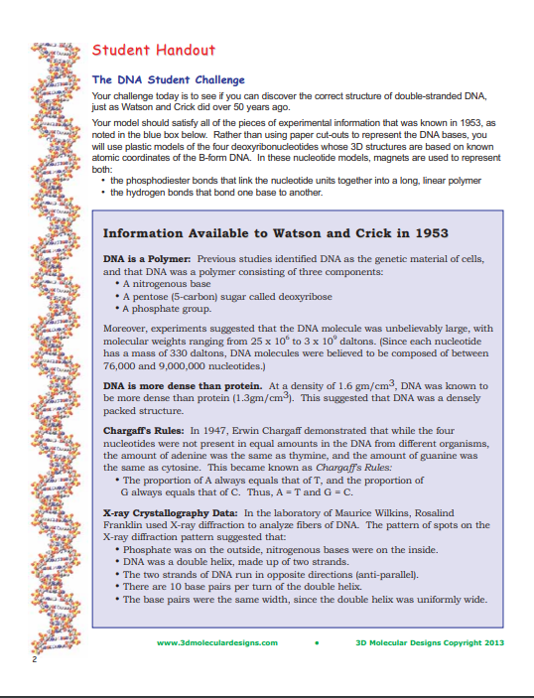
DNA Models
Can you build it?
Dynamic DNA Resources found at: https://3dmoleculardesigns.com/classroom_resources/dynamic-dna-kit/

Slide 11
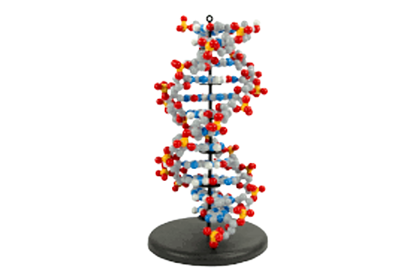
Dynamic DNA
Give it a try!
Dynamic DNA Resources found at: https://www.3dmoleculardesigns.com/Teacher-Resources/Dynamic-DNA-Kit.htm

Slide 12
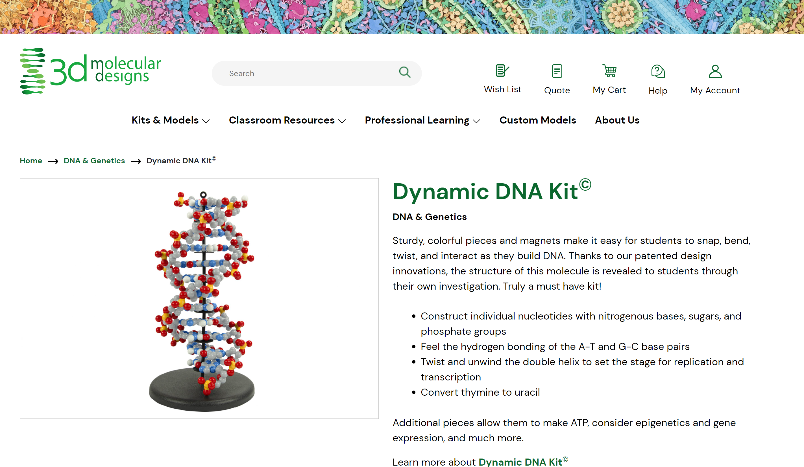

Slide 13


And Beyond!
Additional activities I could pull into my classroom to further engage my students?

Slide 14

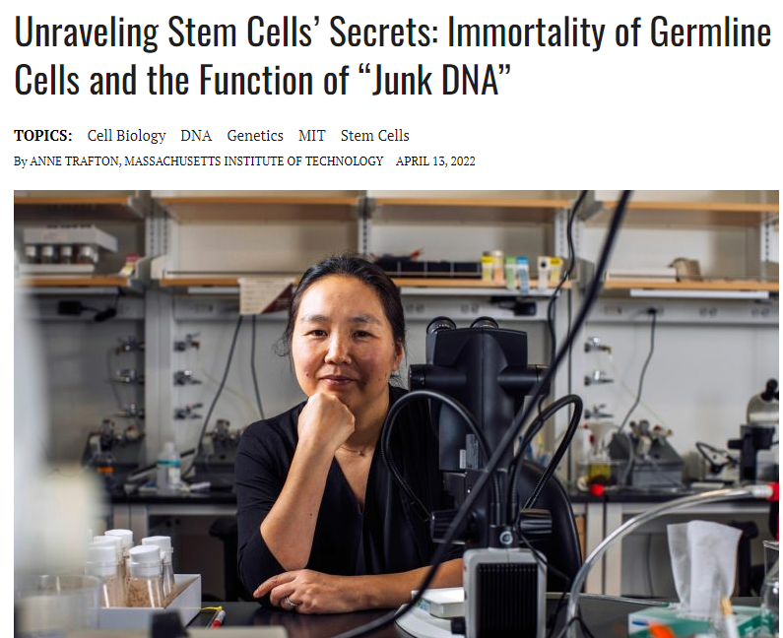
Current Event: DNA
Find a current article focused on DNA
Read the Article
Write a Summary
  One paragraph – What was the article about?
  One paragraph - What did you find most interesting?
Be Prepared to Share

Slide 15
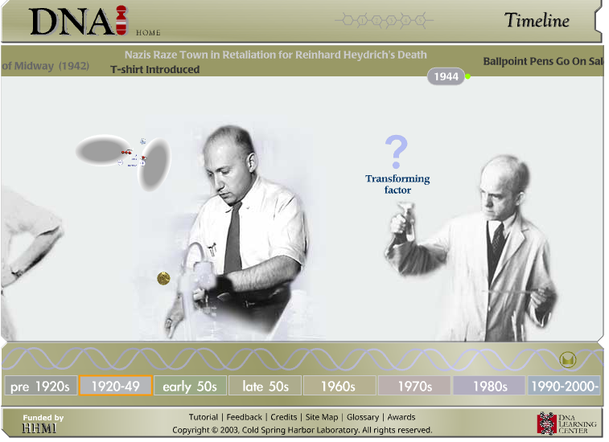
DNA History Challenge
Follow link to DNA Timeline
Pick two scientists from the timeline
  Communicate
  Each person in group MUST have different scientists
Create a Note Card
  What did they discover!
  Find at least three interesting facts
Be Prepared to Share!
Timeline found at: http://www.dnai.org/timeline/

Slide 16
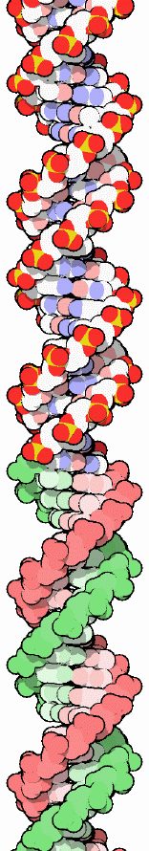
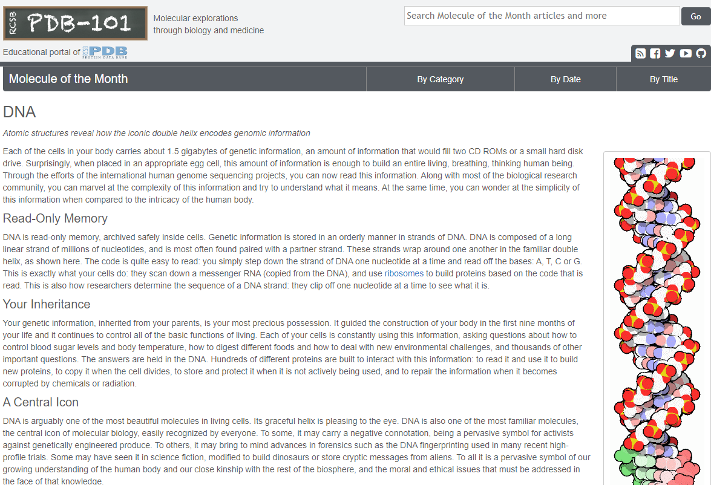
Molecule of the Month
Student Enrichment Activity
Protein Data Bank
PDB Resource Link: https://pdb101.rcsb.org/motm/23

Slide 17


Slide 18
Central Dogma
Replication
Transcription
Translation
How can students learn the concept of the Central Dogma through Modeling?

Slide 19
Flow of Genetic Information
Resources found at: https://3dmoleculardesigns.com/classroom_resources/flow-of-genetic-information-kit/

Slide 20
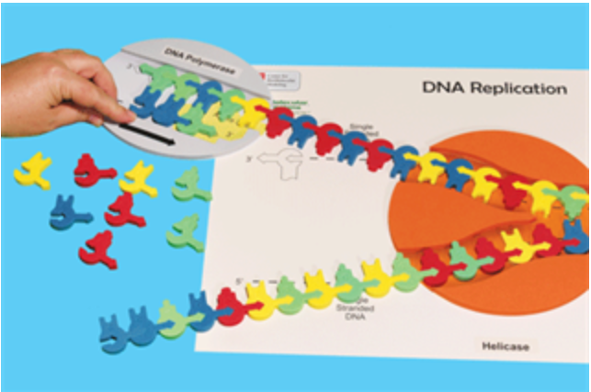
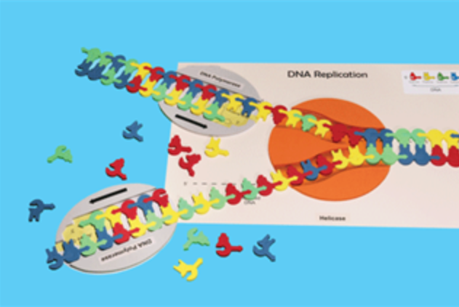
DNA Replication
Components:
DNA Sequence
DNA Replication Mat
DNA Polymerase
Foam Nucleotides

Slide 21
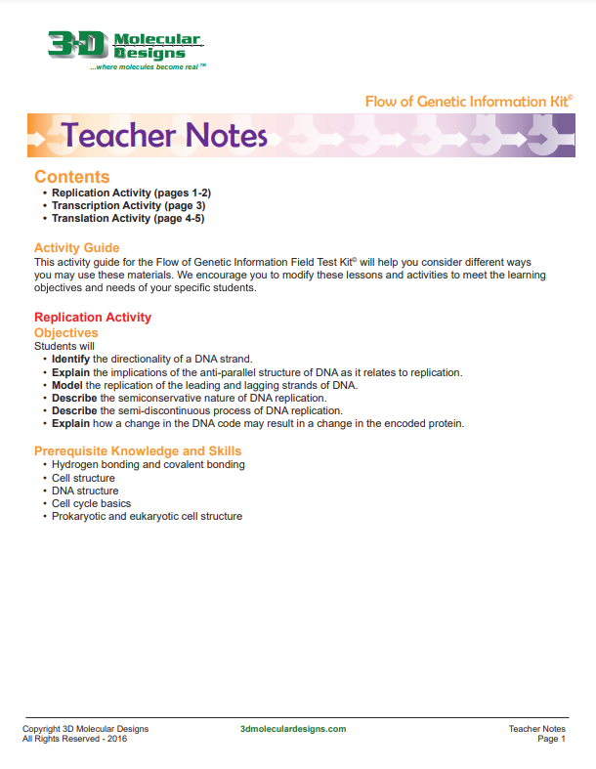
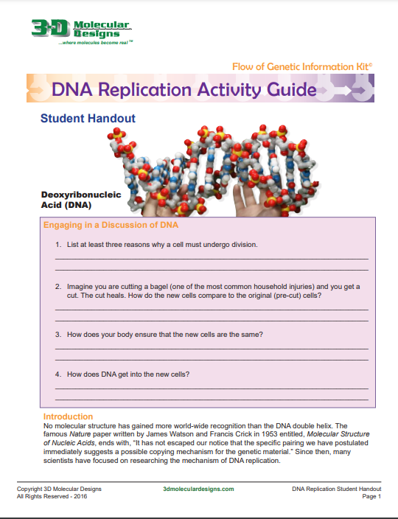
Replication Handouts
Resources and Handouts found at: https://3dmoleculardesigns.com/classroom_resources/flow-of-genetic-information-kit/

Slide 22
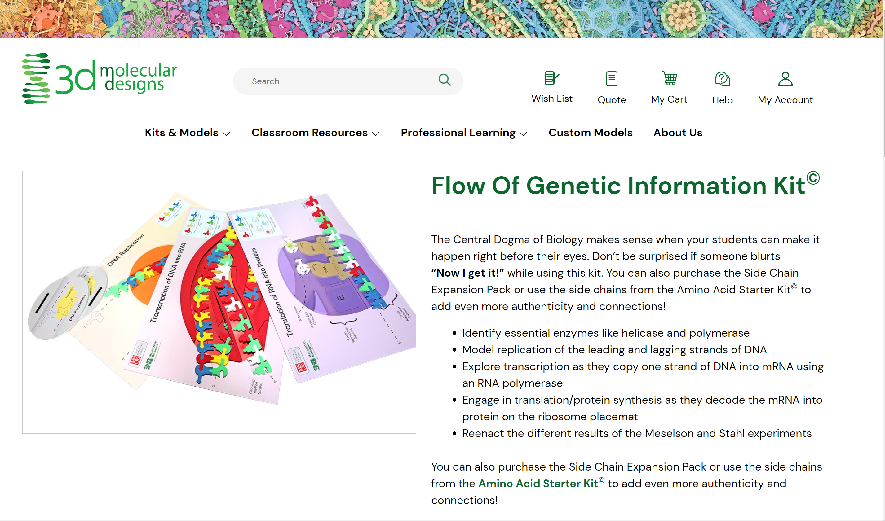

Slide 23
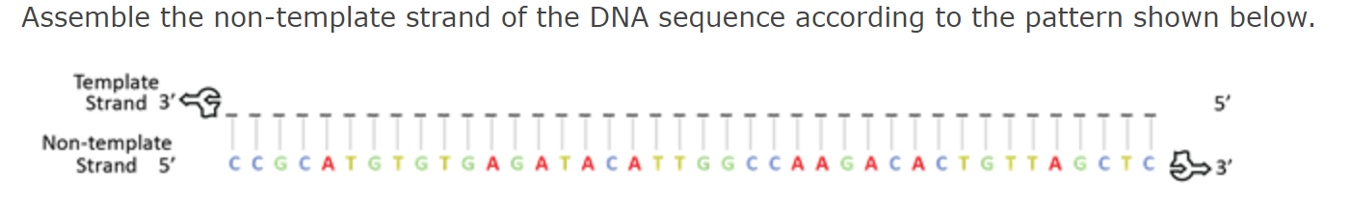
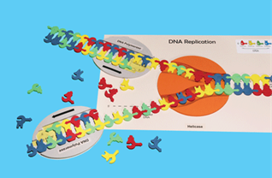
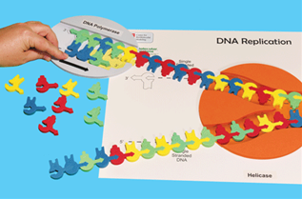
Flow of Genetic Information
Give it a try!

Slide 24
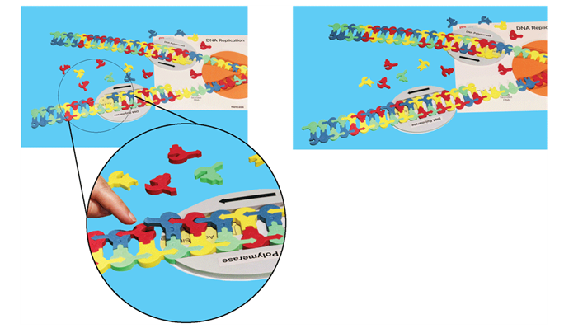
Highlights: Continuous and Discontinuous Replication
Leading Strand
Lagging Strand
Okazaki Fragments

Slide 25
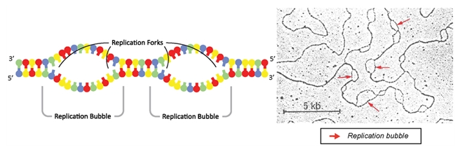
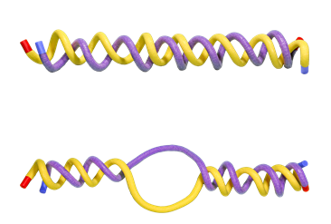
Highlights: Origins of Replication

Slide 26
And Beyond!
What About Assessment?
Any Enrichment?

Slide 27


Show Me What You Know!
Group Activity
  Review what you learned
  Demonstrate DNA Replication
    Make sure to explain each step
    Use all components that are necessary for replication
    Everyone has a role
  Practice
    This is a graded demonstration
    Know Before You Go!

Slide 28
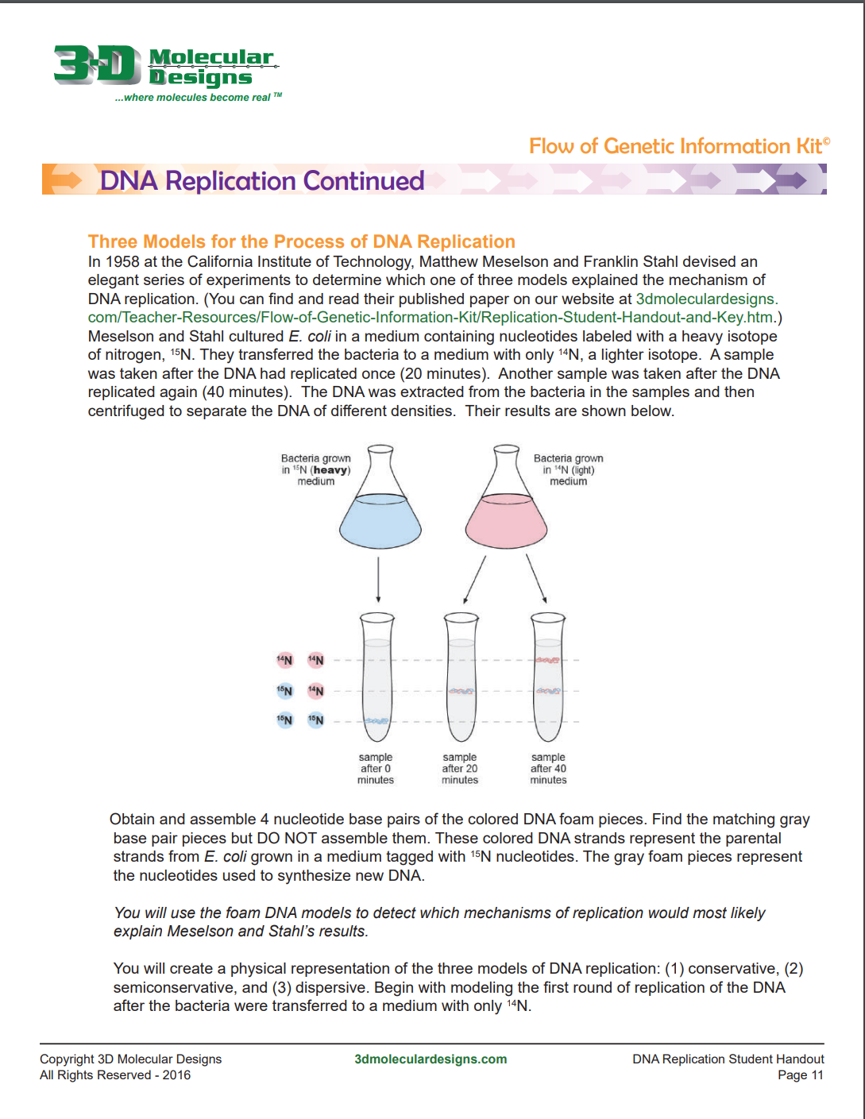
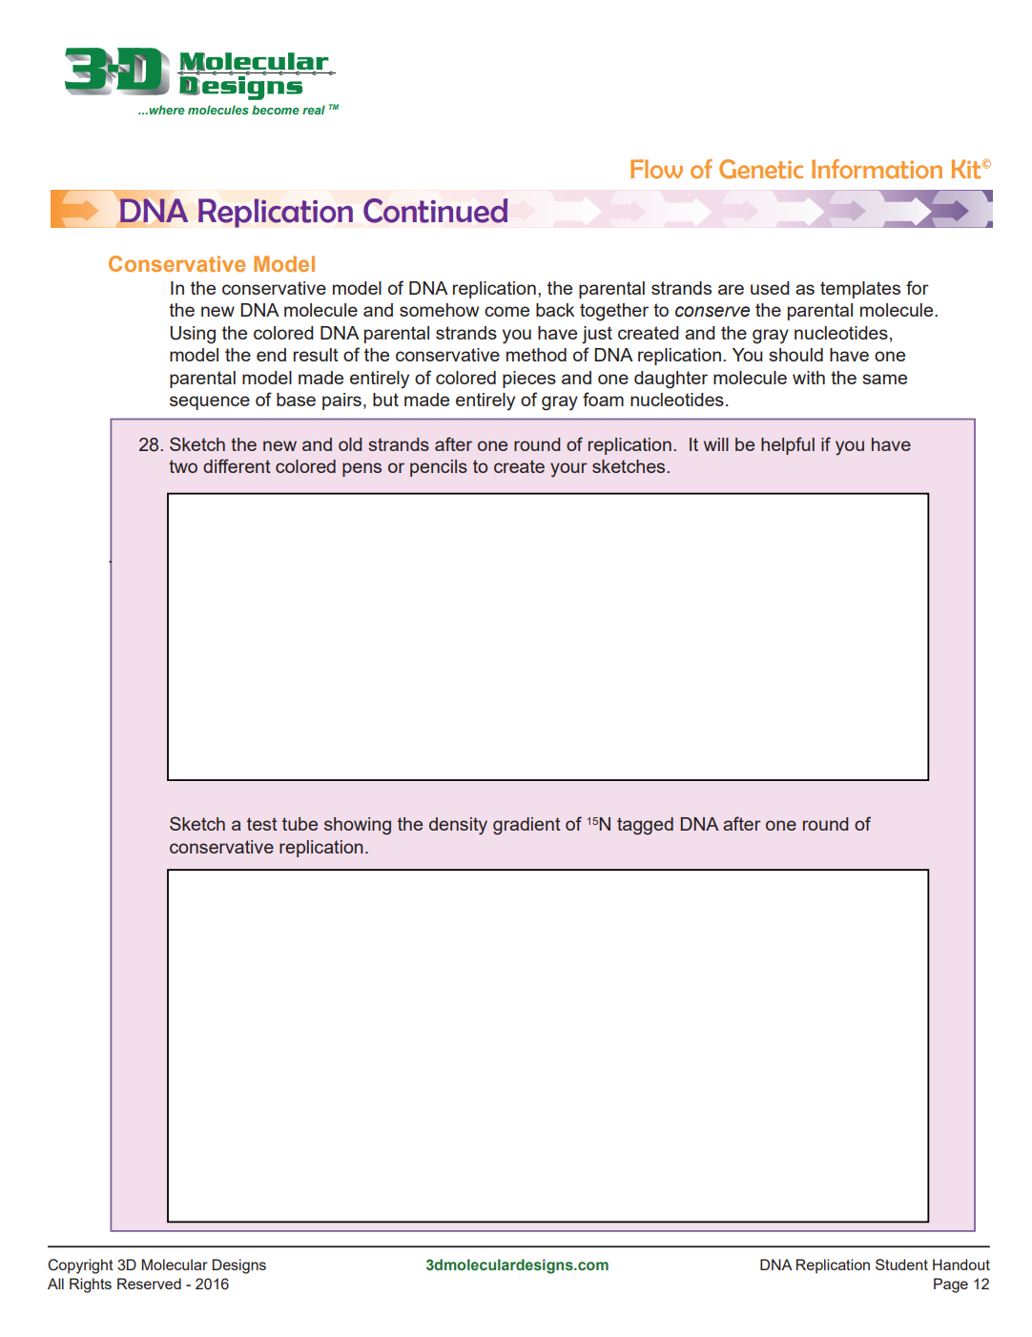
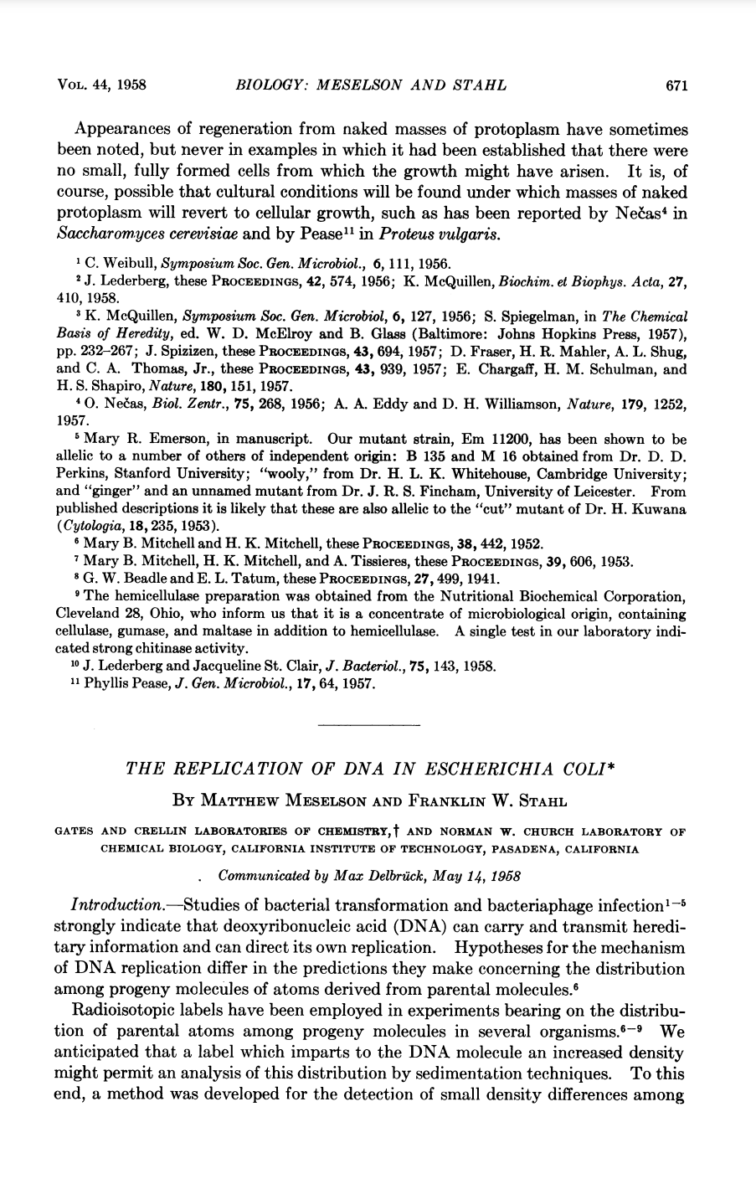
Want to dig deeper?

Slide 29
Central Dogma
Replication
Transcription
Translation
How can students learn the concept of the Central Dogma through Modeling?

Slide 30
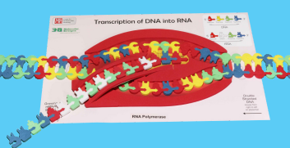
Transcription
Components:
DNA Sequence
Transcription Mat
Foam DNA Nucleotides
Foam RNA Nucleotides

Slide 31
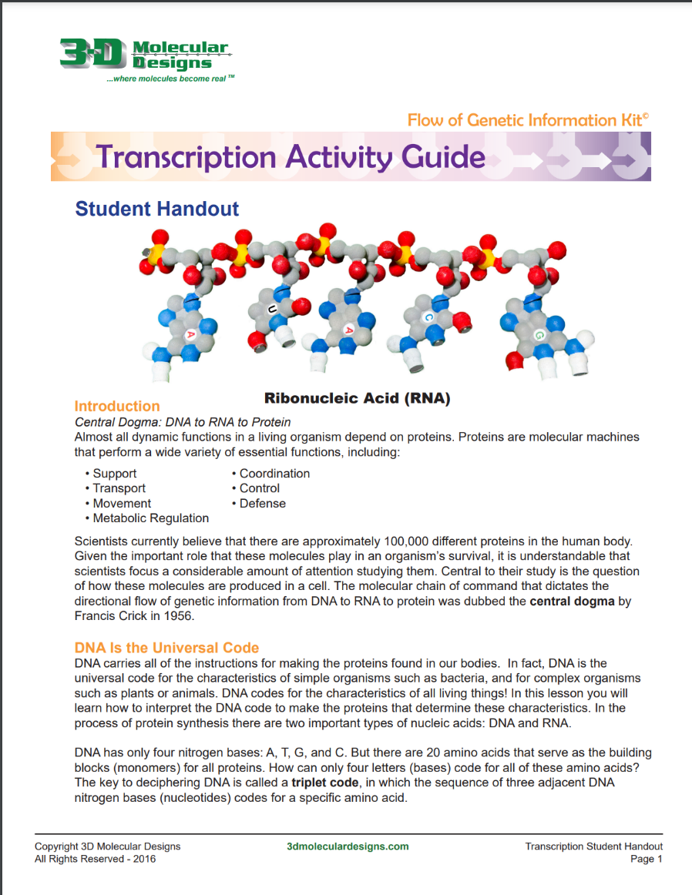
Transcription Handouts
Resources and Handouts found at: https://3dmoleculardesigns.com/classroom_resources/flow-of-genetic-information-kit/

Slide 32
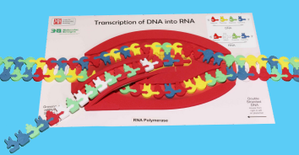
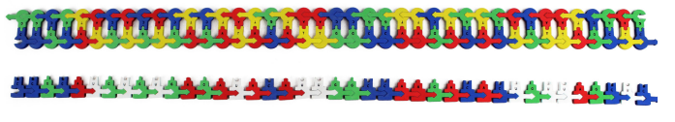
Flow of Genetic Information
Give it a try!

Slide 33
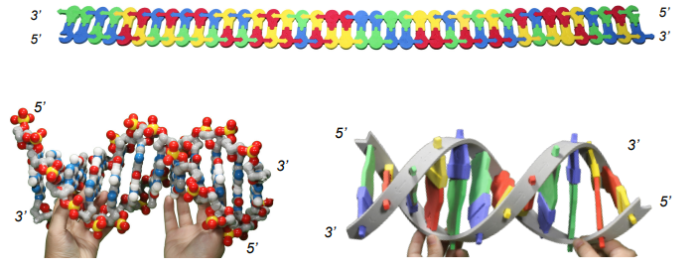
Highlights: Making Connections
Comparing Various Models
  Foam Models
  Any Classroom DNA Models
  Alternate Protein Synthesis Models

Slide 34
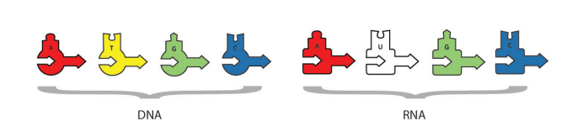
Highlights: DNA vs. RNA Pieces
Consistent Shapes/Similar But Different
  Consistent Across All Products
  Similar Nucleotide Components
  Different Shape

Slide 35
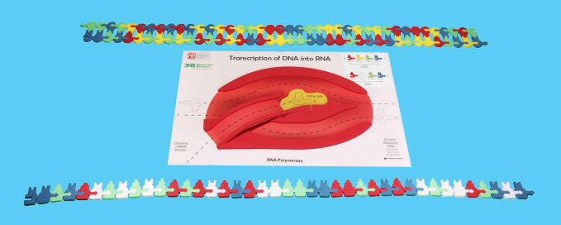
Highlights: Differentiated Instruction
  Provides Understanding of Complex Process at Different Levels
  Include: Initiation, Elongation, Termination
  Ribosome Structure and Function

Slide 36
And Beyond!
Further Engagement?

Slide 37
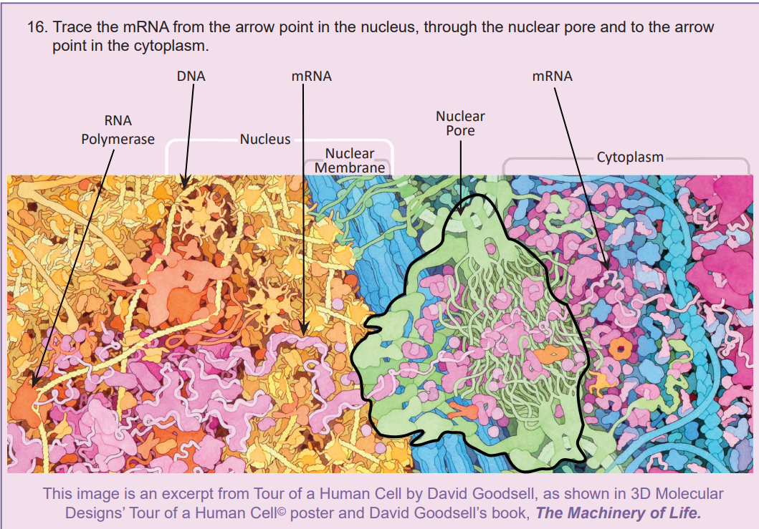
Modeling Transcription
Coloring Pages
  Protein Data Base at: https://pdb101.rcsb.org/learn/coloring-books/coloring-molecular-machinery
  Embedded in Activity found at: https://3dmoleculardesigns.com/classroom_resources/flow-of-genetic-information-kit/

Slide 38
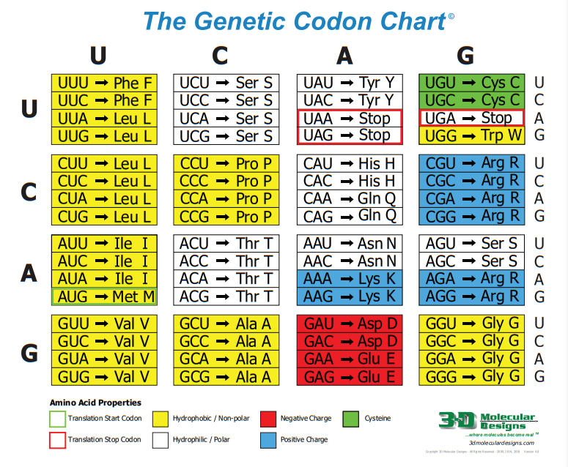
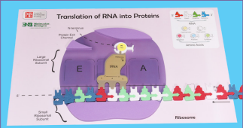
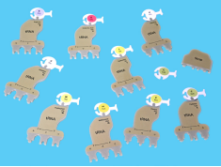
Translation
Components:
Genetic Codon Chart
Translation Mat
Foam RNA Nucleotides
Foam tRNA Nucleotides
Foam Amino Acids

Slide 39
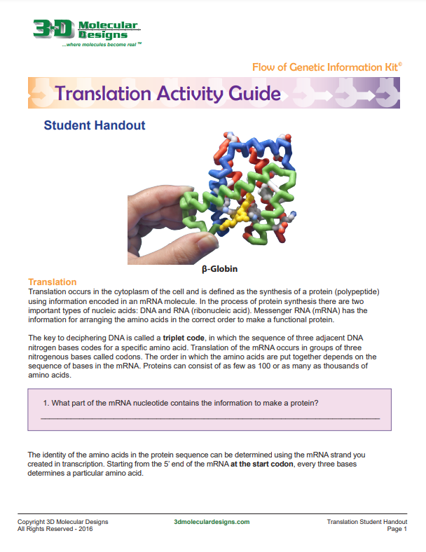
Translation Handouts
Resources and Handouts found at: https://3dmoleculardesigns.com/classroom_resources/flow-of-genetic-information-kit/

Slide 40
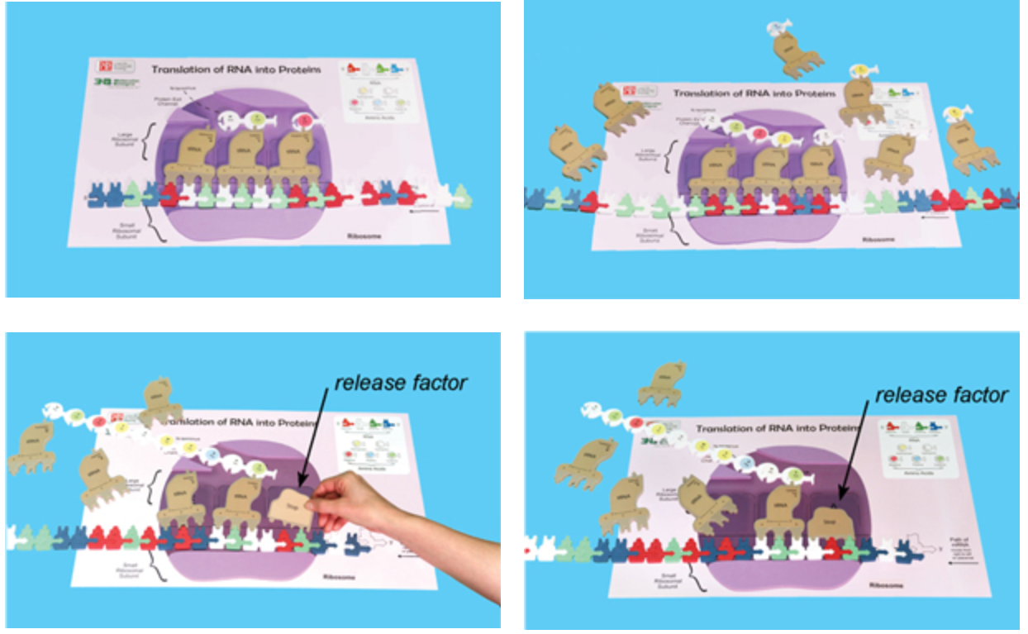
Flow of Genetic Information
Give it a try!

Slide 41
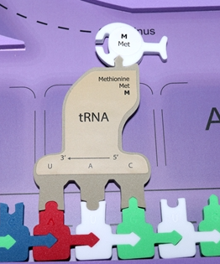
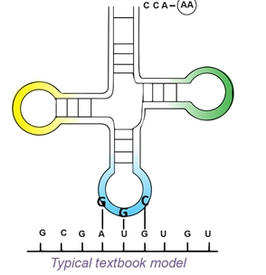
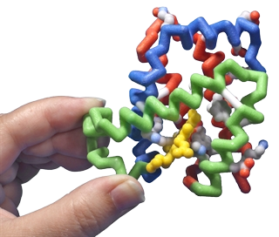
Highlights: Making Connections
Comparing Various Models
  Typical Textbook Models
  3D Printed Models
  Foam Models

Slide 42
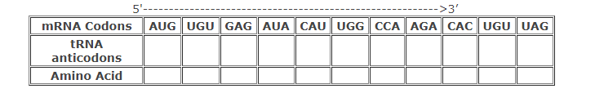
Highlights: Allows to Demonstrate Understanding
  Provides Understanding of Complex Process
  Using Codon Charts
  DNA to RNA to Protein

Slide 43
And Beyond!
I finished the lab, Now What?

Slide 44

Examples and Suggestions
Proteins:
  Structure and Function
  Protein Folding
Enzymes:
  Enzyme Action
  Lactose Intolerance
Hemoglobin:
  Genetics
  Sickle Cell Anemia
Notes:
It is important to be mindful that our district policies and procedures always align with our mission and the district vision …… of promoting
District Vision Statement
The Washington Township school district promotes a safe, inclusive environment that embraces differences and provides varied experiences to help all students build an academic foundation that will develop critical thinking skills, interpersonal skills, social and emotional intelligence, and the confidence to be ethical, responsible, and productive citizens in a global society.
Details located on district website at wtps.org

Slide 45
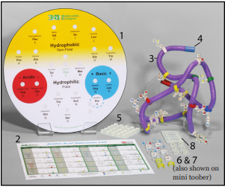

Lab: Protein Folding
Resources for this lab found at: https://3dmoleculardesigns.com/classroom_resources/amino-acid-starter-kit/

Slide 46



Lab: Enzymes in Action
Resources for this lab found at: https://3dmoleculardesigns.com/classroom_resources/enzymes-in-action-kit/

Slide 47



Activity: Genetics of Sickle Cell
Sources for this activity found at: https://www.biointeractive.org/classroom-resources/sickle-cell-disease-and-malaria-lesson-nature-science

Slide 48




Activity: You and the GMO Mosquitoes
Sources for this activity found at: https://www.biointeractive.org/classroom-resources/genetically-modified-mosquitoes and https://www.webmd.com/a-to-z-guides/news/20220309/genetically-modified-mosquitoes-may-be-released-in-fla-and-calif

Slide 50
Reflection Activity
Where do you see this fitting into your curriculum?
What Lingering Questions Do You Still Have?
What Does This Look Like Implemented in Your Classroom?
What Other Resources Would You Use With this topic? (Make a Suggestion!)
Notes:
Wrap Up Activity. Use Large Post It Notes with Questions on Wall/Tables. Have participants use small post it notes to share answers with others. Let participants mingle to see others' ideas.

Slide 51


Give Away!
Flow of Information Kit

Slide 52
Resources and Materials
Kits Used in this workshop:
Dynamic DNA
Flow of Genetic Information
Purchase kits at 3dmoleculardesigns.com.
Receive 20% off most items in our catalog with Discount Code FC23..

Slide 53
Stop by and See Us at the
3d molecular designs
Booth

Slide 54


Summer Course 2024
Modeling the Molecular World
Join us in Milwaukee
for hands-on discovery and professional development
July 29 – Aug 2 OR Aug 5 – 9
Bring an empty suitcase!
You'll take home all these classroom resources!
Scan to register!

Slide 55


