Slide 1
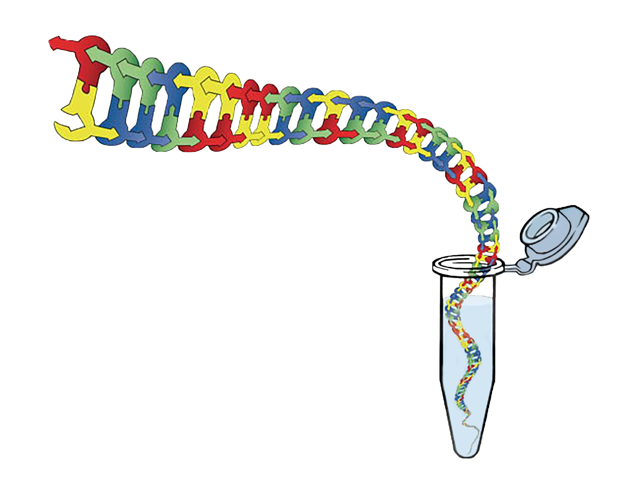
In the Tube Where it Happens:
Using models to support student understanding in biotechnology

Slide 2
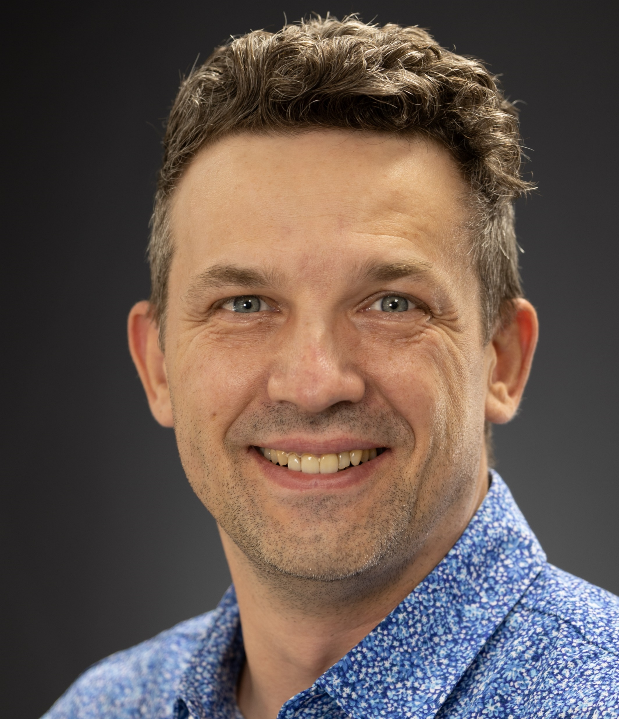

Mark Arnholt
Science Educator
SMART Team Coordinator
3D Molecular Designs
Milwaukee, WI mark.arnholt@3dmoleculardesigns.com
24 years of classroom experience
PLTW BMS Certified (PBS, MI, BI)
Cohort Biology
General Biology (9-10)
Anatomy and Physiology
Biotechnology, Bacteriology, and Genetics
Physical Science(9)
Aviation
After school activities
New Teacher Mentor
SMART team advisor
Wrestling coach
Fishing club advisor
Awards:
Outstanding Science Educator - University of Minnesota – Twin Cities
2014
Educator of the year HUHS
2015
Herb Kohl Fellowship Grant
2016

Slide 3
Workshop Learning Goals
1. Understand the ability to taste PTC
2. Learn the Process of a Polymerase Chain Reaction
3. Understand the potential applications of the technology
4. See how models build student understanding
5. Have fun!

Slide 4
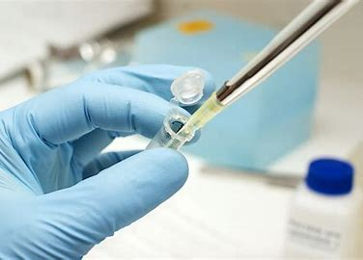
Background Knowledge for Students:
Terminology:
PCR – Polymerase Chain Reaction
Nucleotide (dNTP)
DNA Polymerase
Taq Polymerase
Thermal cycling
Target DNA
Primers
Denature
Anneal
Extend
Electrophoresis
Big Concepts:
DNA Replication
Rules for Base Pairing
Hydrogen and Covalent bonding
DNA Structure
Point Mutations
Chromosomes, Genes, and Alleles

Slide 5
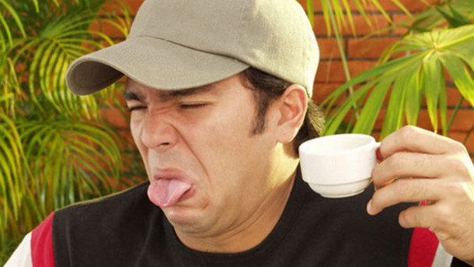
The Science of PTC Tasting

Slide 6
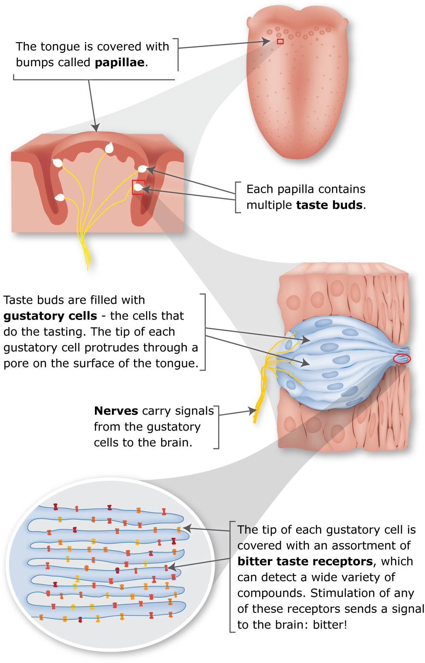
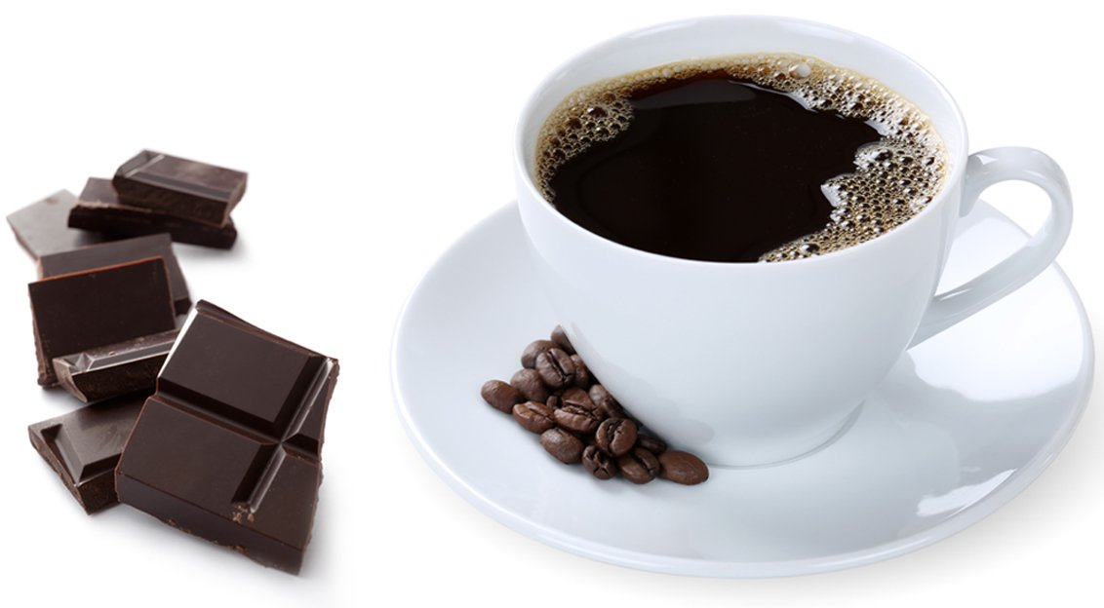
Accidental discovery – 1931 – Arthur Fox

Slide 7
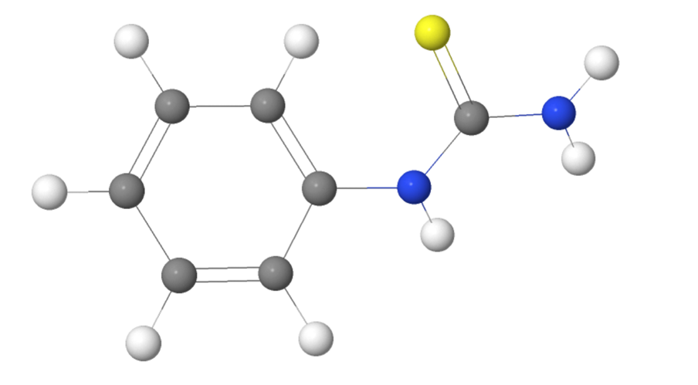
Phenylthiocarbamide
Also known as phenylthiourea
Plant Defense Mechanism
Human ability to taste this plays a role in food choice

Slide 8
Pull out your DNA Sequence.
What are some initial observations you can make?

Slide 9
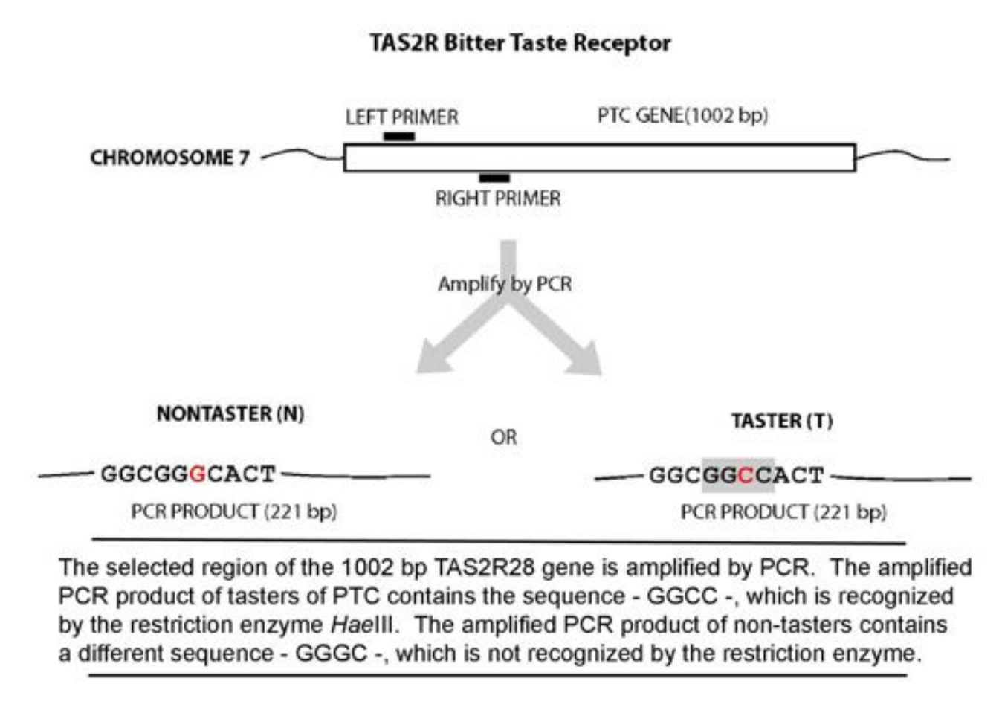
The Genetics

Slide 10
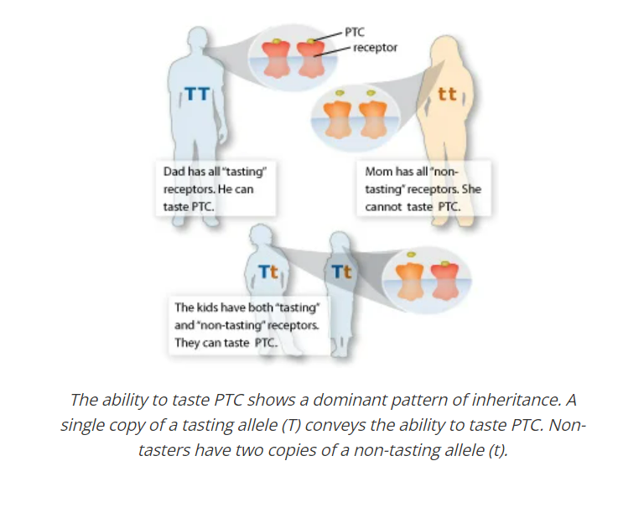
Genotype | Phenotype
TT | Super Taster
Tt | Taster
tt | Non-taster

Slide 11
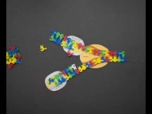
Let’s review DNA replication in a cell

Slide 12
So many enzymes!
What needs to be done | Enzyme
Separate Strands | Helicase / Topoisomerase
Add Primers to DNA | Primase
Extend DNA | DNA Polymerase-ð
Remove RNA / Replace with DNA | DNA Polymerase-α
Ligation of Okazaki fragments | Ligase

Slide 13
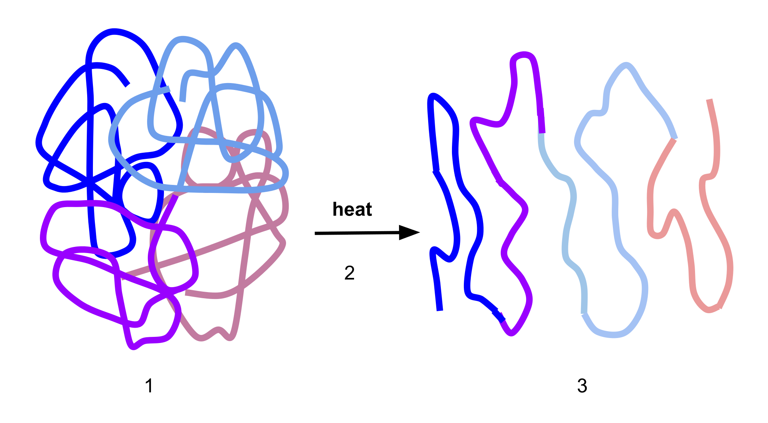
Working with enzymes is difficult!
Problems include:
Denatured enzymes won’t work!
CO$T
Stability
Temperature
pH
Salt (cations)
Buffers

Slide 14
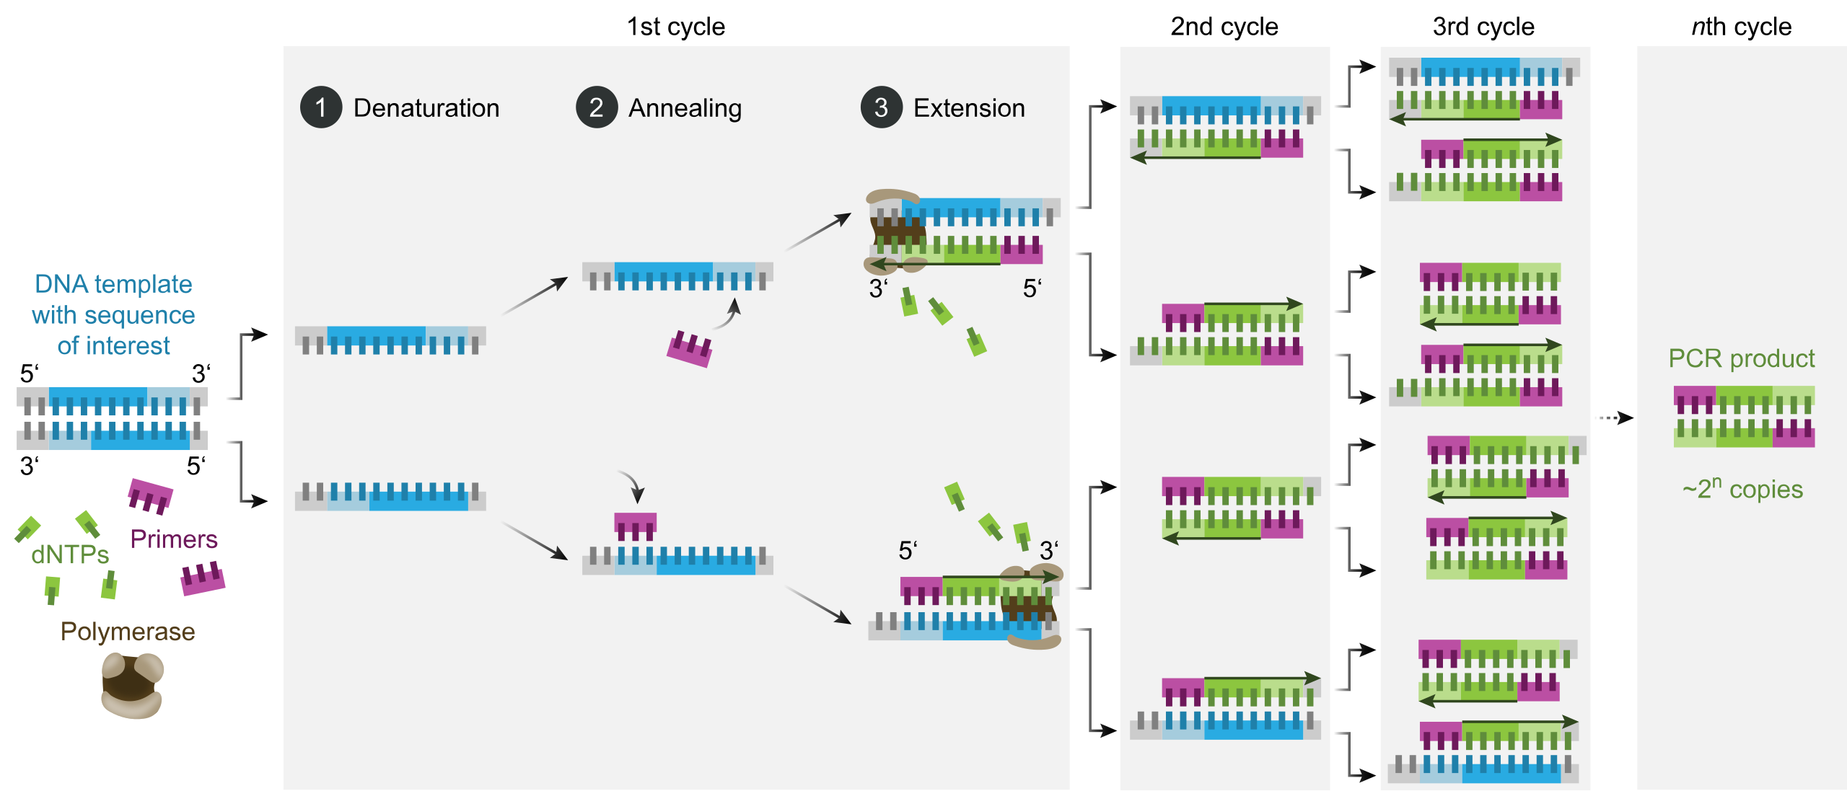
The Process
Image: File:Polymerase chain reaction-en.svg - Wikimedia Commons

Slide 15
In the tube
What needs to be done | Enzyme or process?
Separate Strands | Temperature
Add Primers to DNA | Process - Annealing
Extend DNA | Taq Polymerase*
Remove RNA / Replace with DNA | Not required
Ligation of Okazaki fragments | Not required

Slide 16
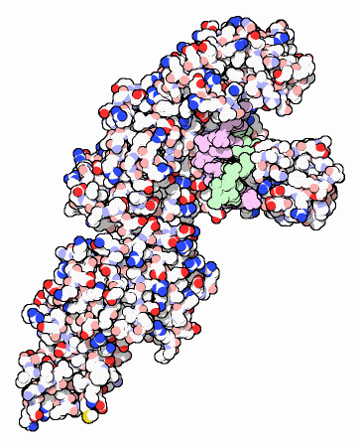
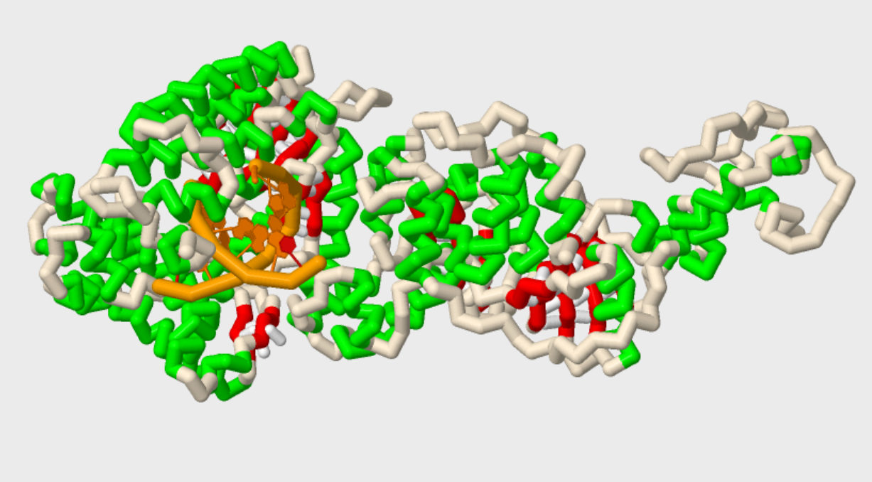
Why do we need to use Taq Polymerase?
Molecule of the Month –
PDB 101
PDB file: 1TAU

Slide 17
Let’s break this down
Image: File:Polymerase chain reaction-en.svg - Wikimedia Commons

Slide 18
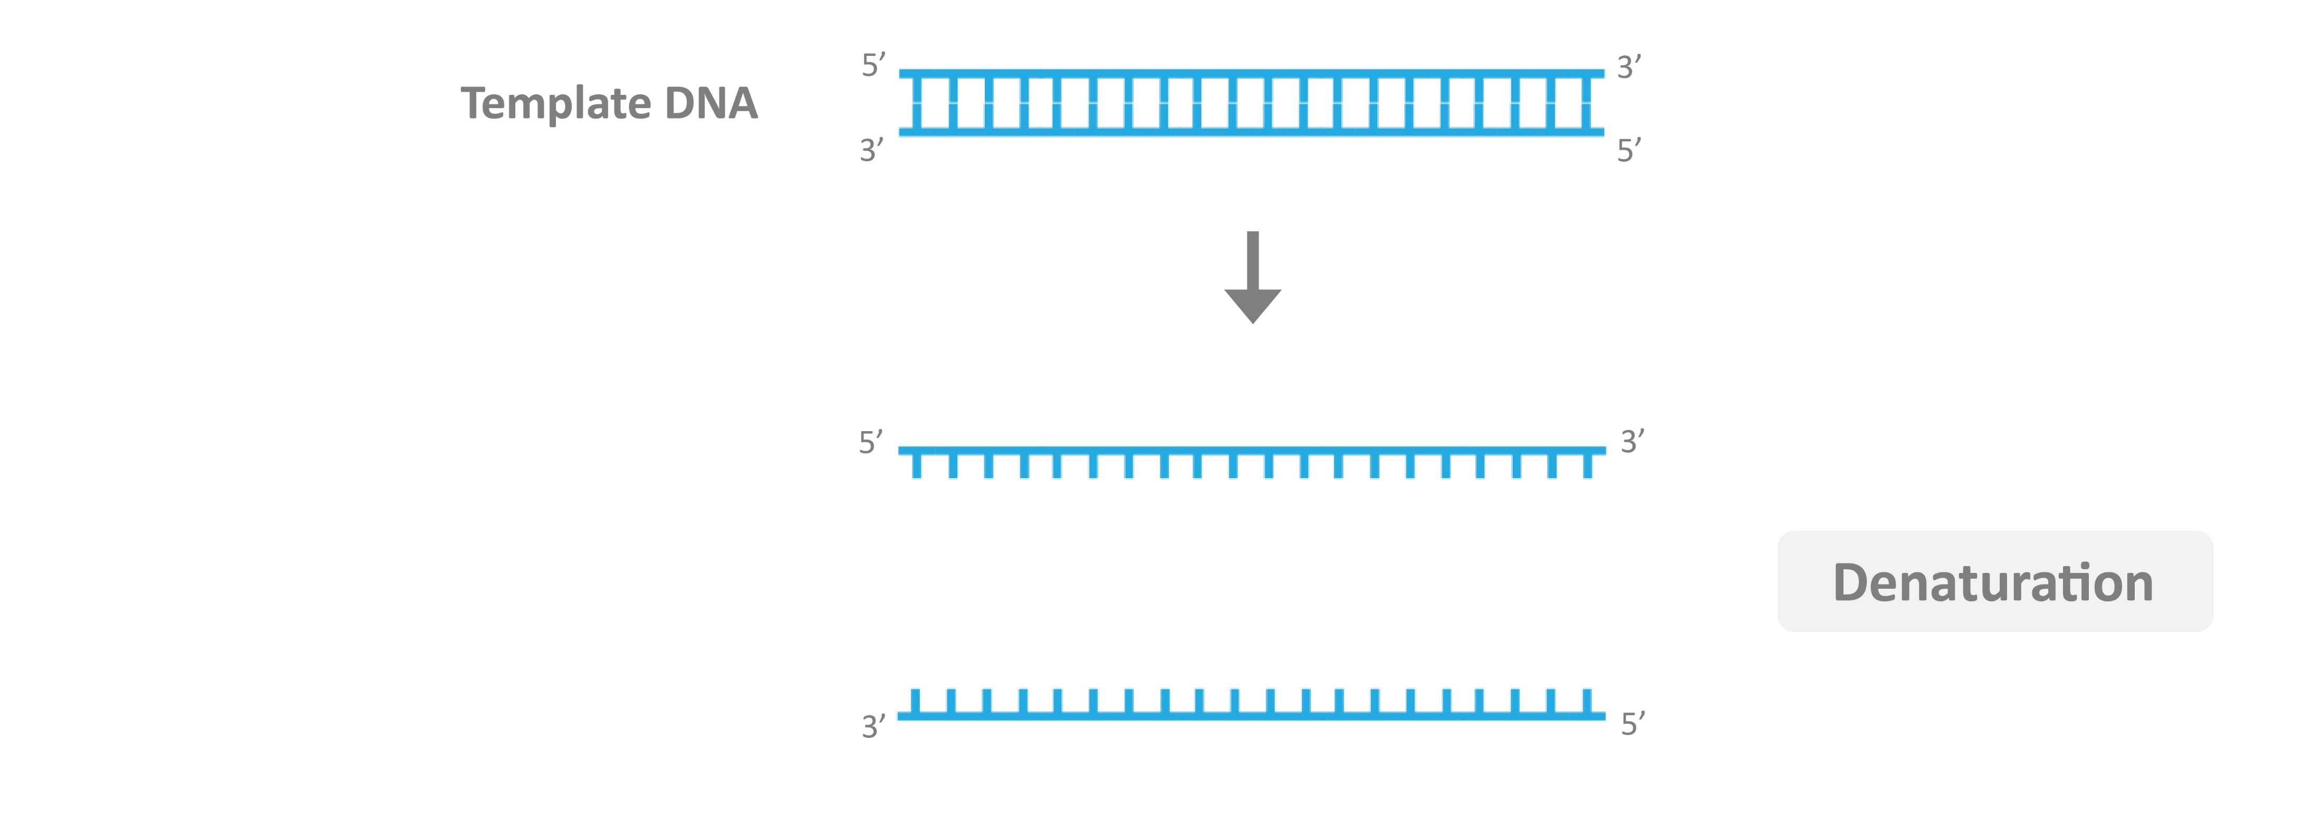
Denature
95ºC – This will break the hydrogen bonds between base pairs

Slide 19

Anneal
50(ish*)ºC – Cooling it down will allow the primers to hydrogen bond to the appropriate targeted sequence

Slide 20
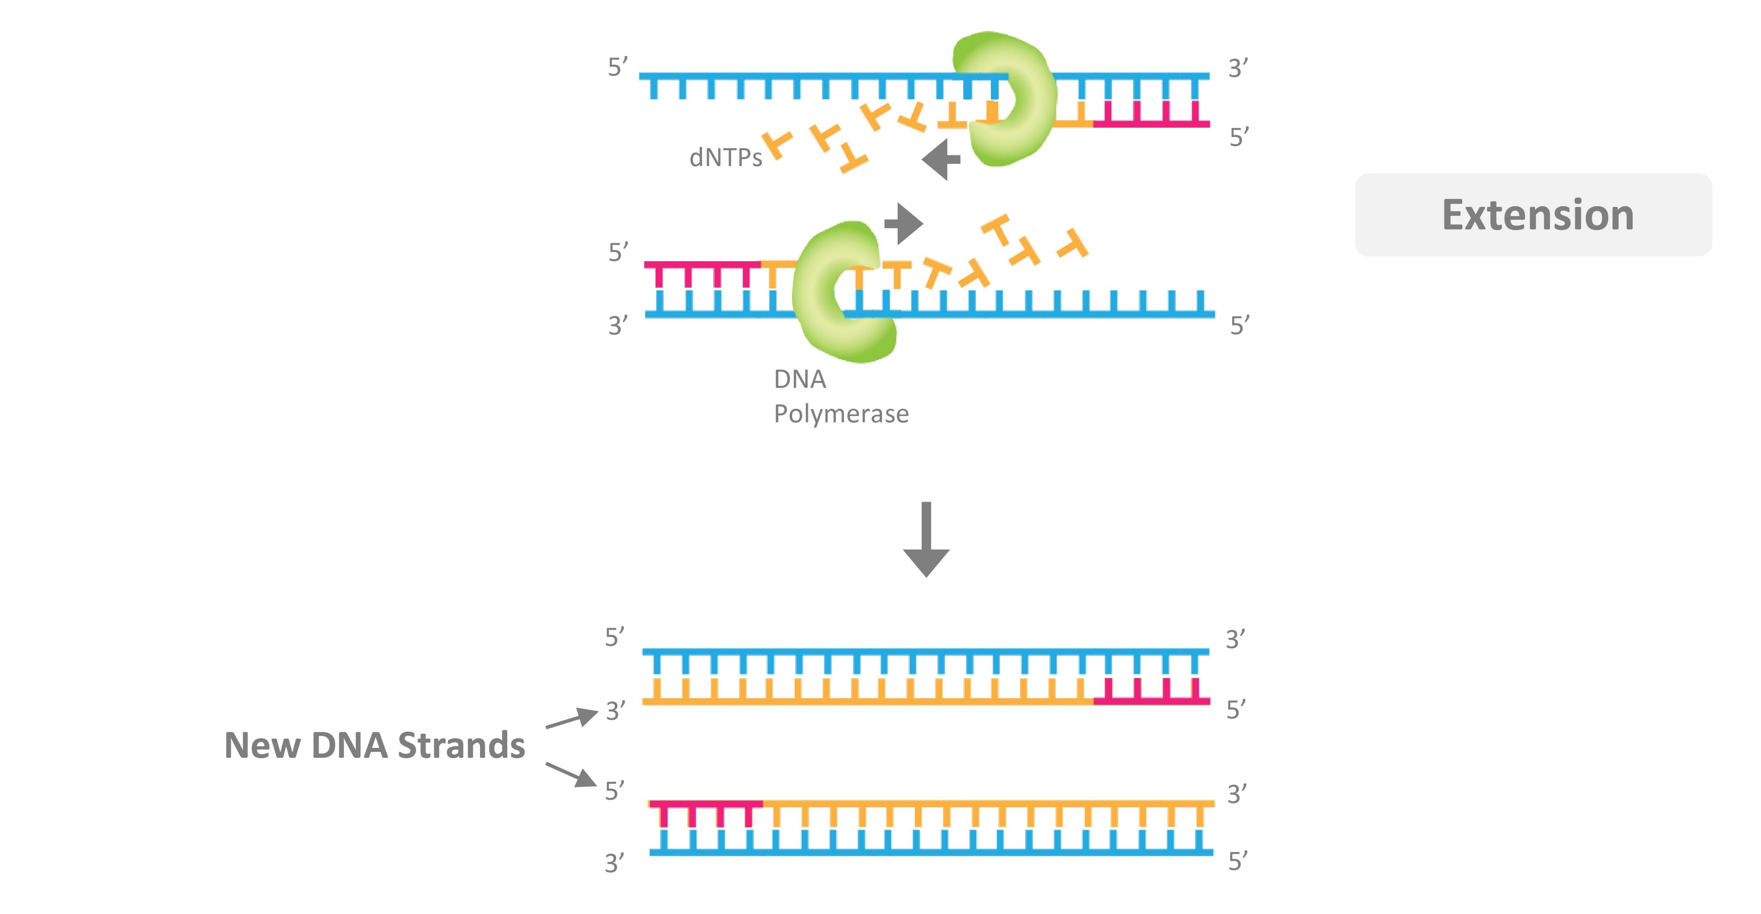
Extend
72ºC – Activates the Taq Polymerase to complete the extension of the target sequence

Slide 21
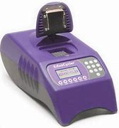
Hurry up...
How do you fill "down time" when you run a Biotechnology or Microbiology lab?
… and wait

Slide 22
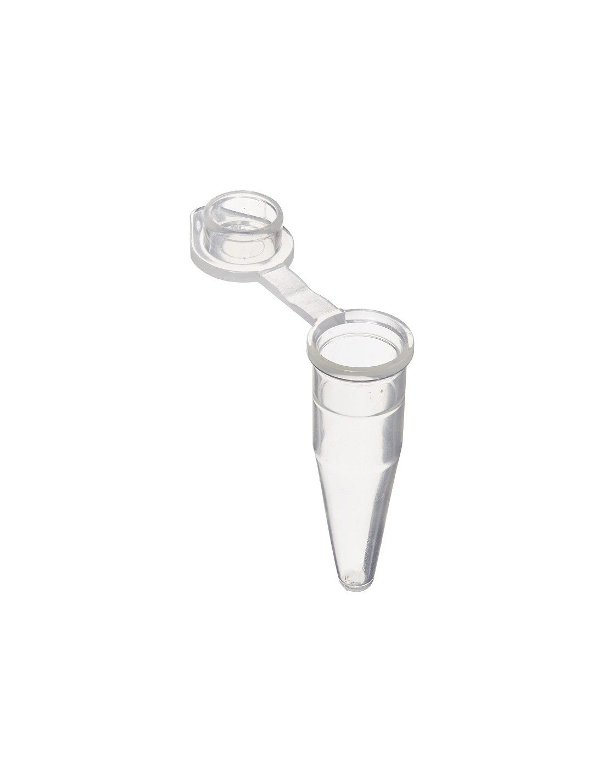
Your table is now a 0.2 mL PCR tube.
We need to add:
Template DNA
2 different Primers
Nucleotides (dNTPs)
Taq Polymerase
We also need 3 temperature regions. 95ºC, 52ºC, and 72ºC

Slide 23
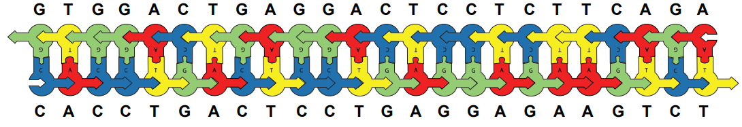
Time to build our Template DNA
* These should be pre-built in your kit. In your classroom, you may have your students assemble them.

Slide 24
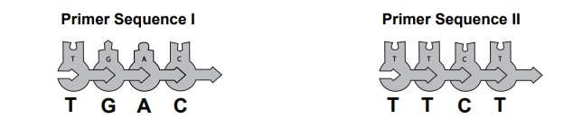
Next, build our Primers. We need 7 of each.
Why do we need 2?

Slide 25
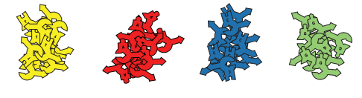
Add a “big pile” of nucleotides

Slide 26
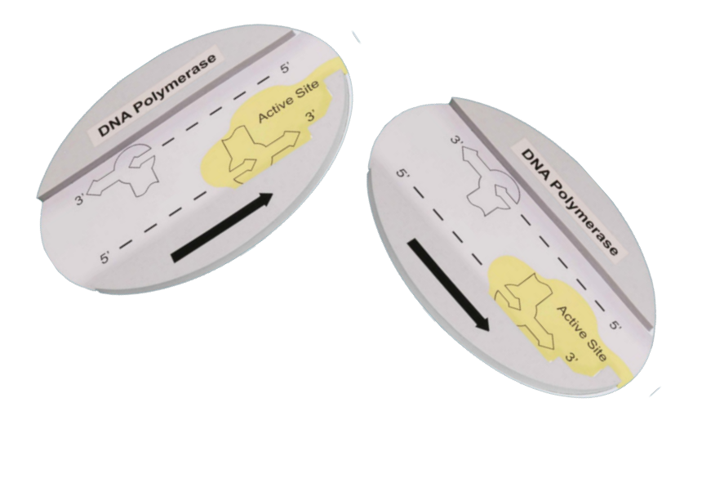
And finally, the Taq Polymerase
If you have our Flow of Genetics Information Kit, pull the DNA Polymerase.
Why do we use Taq Polymerase?

Slide 27
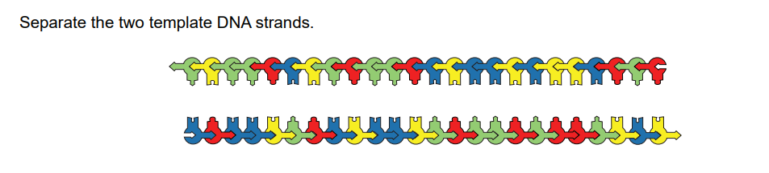
Into the Thermal Cycler - Denature

Slide 28
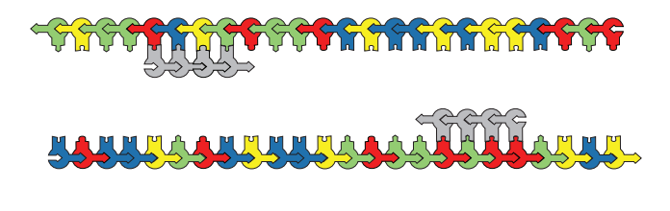
Anneal
Primers will bind according to Watson and Crick base pairing rules

Slide 29
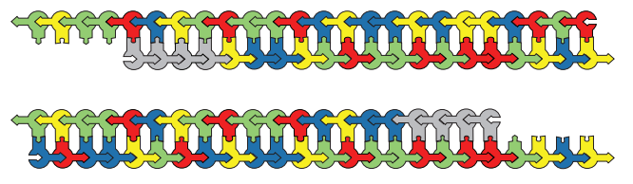
Extend
Starting at the 3’ end of your primer, copy the template strand. Remember that Taq Polymerase can only add nucleotides in one direction (5’ -> 3’)
*Note the unpaired ends here- The targeted sequence is dependent upon the primers
Cycle 1:
Complete

Slide 30
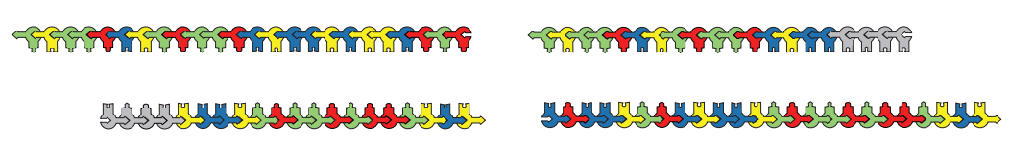
Begin Cycle 2
Denature

Slide 31
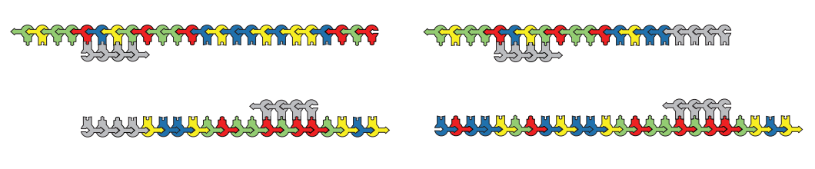
Anneal

Slide 32
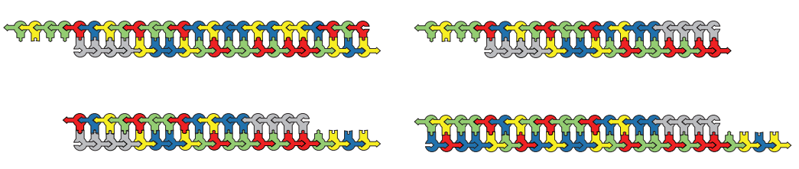
Extension
*Note: Unpaired bases are still present
Cycle 2
Complete

Slide 33
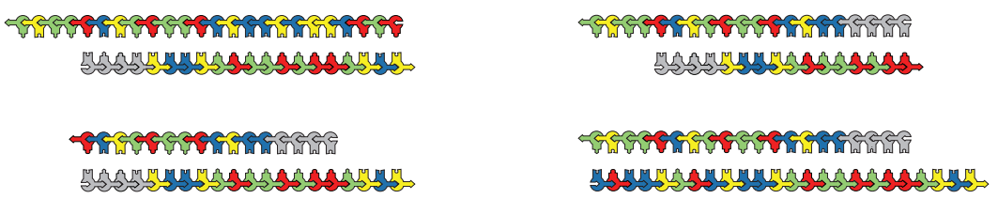
Begin Cycle 3
Denature

Slide 34
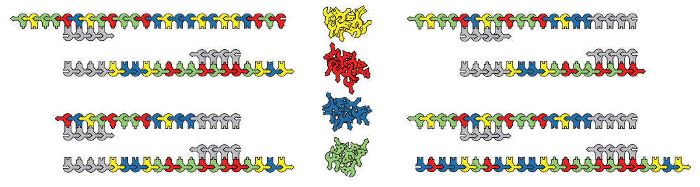
Anneal

Slide 35
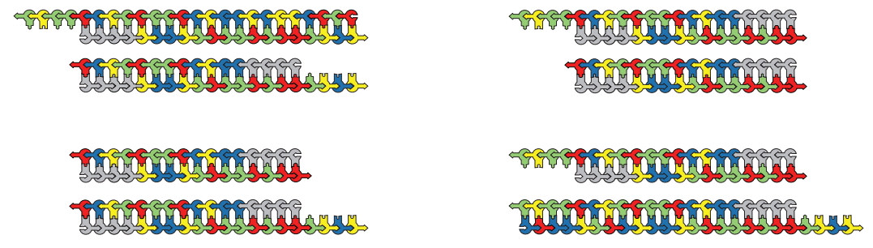
Extend

Slide 36
Lather, rinse, repeat…
The goal? Make as many copies of a specific sequence of DNA as possible.
How many copies of the sequence will we make if we run 30 cycles?
2 ³⁰ = 1.02 x 10 ⁹
60 will have unmatched base pairs
All of the rest will be the targeted DNA sequence

Slide 37
Lather, rinse, repeat…
The goal? Make as many copies of a specific sequence of DNA as possible.
How many copies of the sequence will we make if we run 30 cycles?
2 ³⁰ = 1.02 x 10 ⁹
60 will have unmatched base pairs
All of the rest will be the targeted DNA sequence

Slide 38
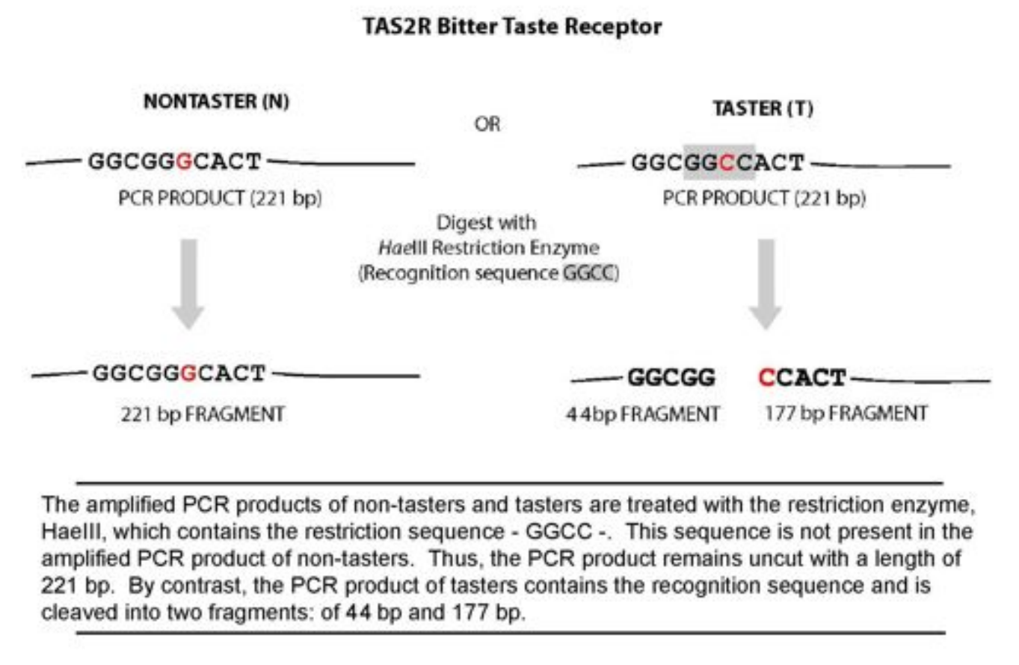
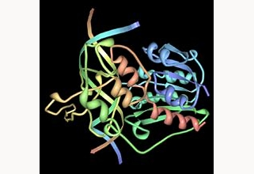
How can we differentiate between the 2 different DNA sequences?
HaeIII

Slide 39
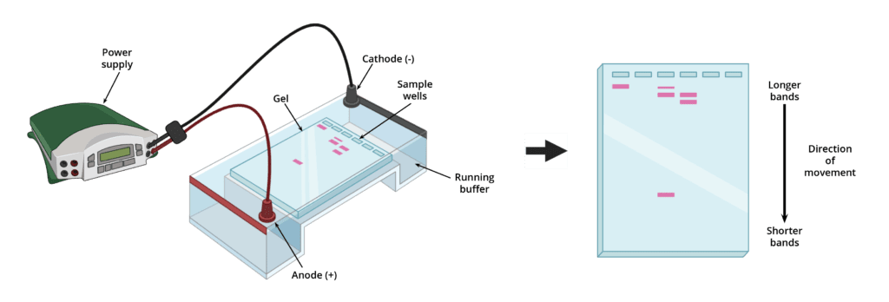
Gel Electrophoresis allows us to separate DNA based upon size.

Slide 40
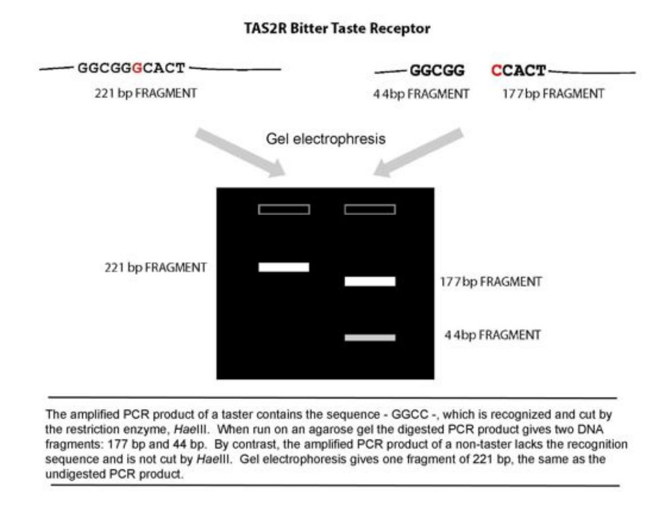
Challenge Question!
What about a heterozygote for this trait?
Predict what their lane would look like.

Slide 41
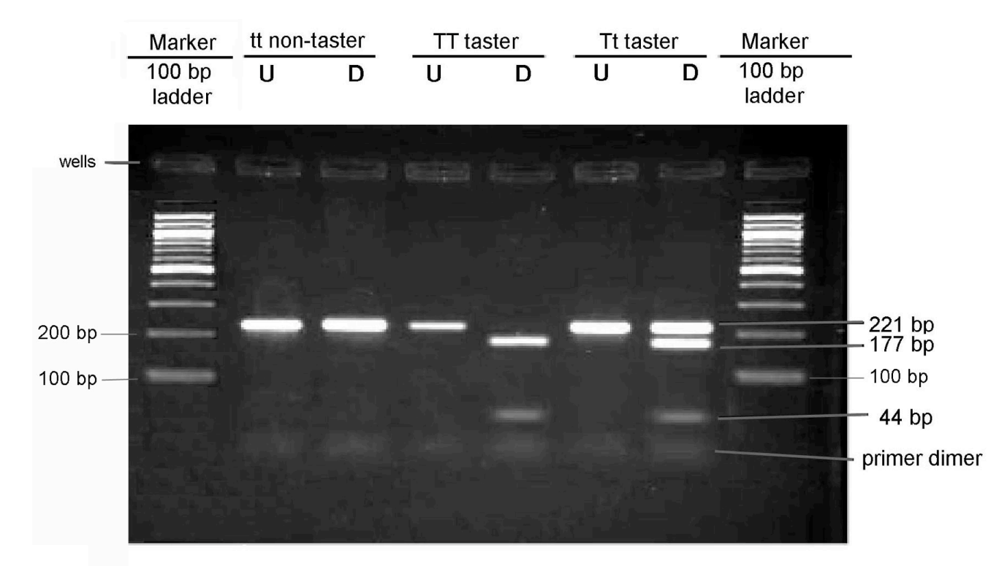
Electrophoresis results

Slide 42
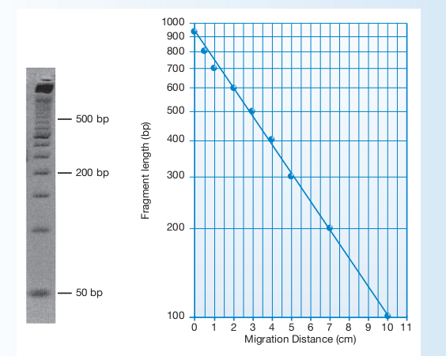
Semi-log graphing:
Why do we make a semi-log graph?

Slide 43
Application of the technology
Diagnosis of Genetic disorders
Sickle Cell Anemia (Single Nucleotide Polymorphism)
BRCA mutations (Short Tandem Repeats)
Bacterial Contaminants in Food or Water Samples
Amplification of crime scene DNA – suspect identification
Genotyping
Synthetic Biology – Recombinant DNA
Cloning
DNA Sequencing

Slide 44
Assessment Ideas
Research a Single Nucleotide Polymorphism (SNP) Disease and determine if an enzyme exists to differentiate between them
Explain how Short Tandem Repeats (STR) could be used to identify BRCA mutations
Demonstrate how a plasmid could be constructed with a gene of interest inserted (GFP Lab)
Demonstrate how a Multiplex PCR would allow identification of biological contaminants
Create a video explaining PCR – Live action or stop motion

Slide 45
Citations
Additional reading / resources:
PCR Overview | GoldBio
Wet Lab resources - Carolina
Wet Lab resources - Edvotek
HHMI – Genetics of Bitter Taste
Images:
Denatured protein
File:Polymerase chain reaction Wikimedia Commons
Coffee face
Taste bud / tongue
PTC image

Slide 46
Workshop NGSS Connections
SEPs | CCCs | DCIs
Asking Questions and Defining Problems (HS-LS3-1) | Cause and Effect (HS-LS3-2) | Structure and Function (HS-LS1-1)
Developing and Using Models (HS-LS1-4) | Scale Proportion, and Quantity (HS-LS3-3) | Inheritance of traits (HS-LS3-1)
Analyzing and Interpreting Data (HS-LS3-3) | Systems and System Models (HS-LS3-3) | Variation of Traits (HS-LS3-2)
 | Science is a Human Endeavor (HS-LS3-3)

Slide 47
We put teachers first!
Your opinions are important to us.
We will email you
the digital resources associated
with this session.

Slide 48
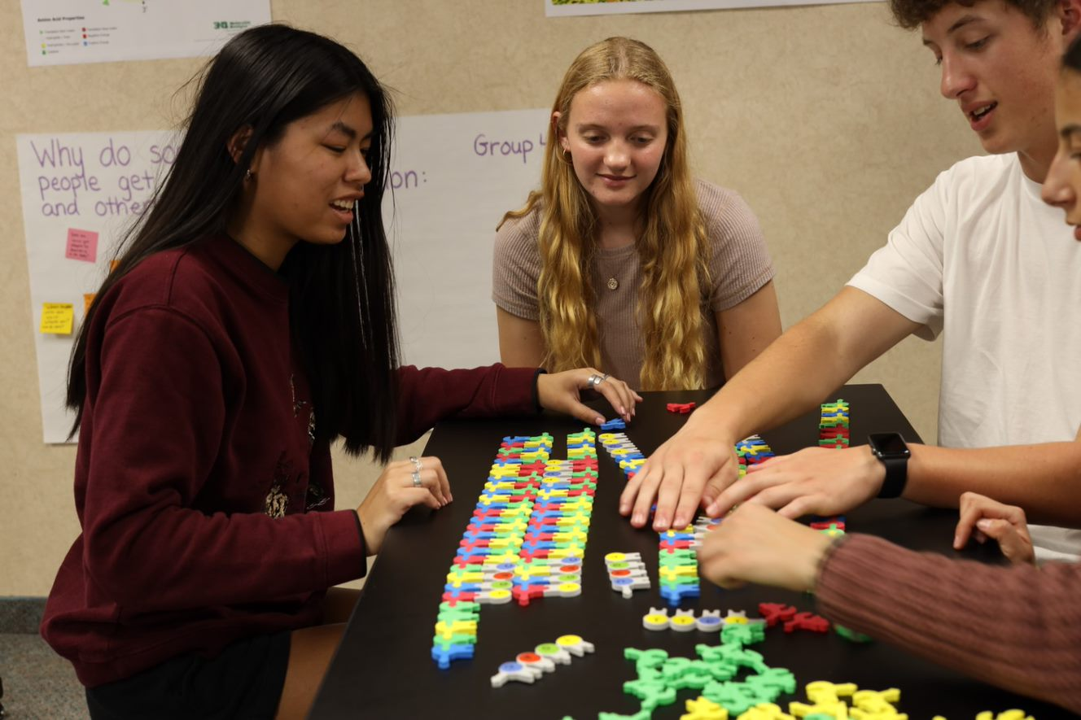
THANK YOU FOR ATTENDING!
Purchase kits at 3dmoleculardesigns.com.
Use discount code STATE22 to receive 20% off most items in our catalog. Student Modeling Packs are not eligible for discount.
Kits and models used in this session:
Biotechnology Kit

