Slide 1
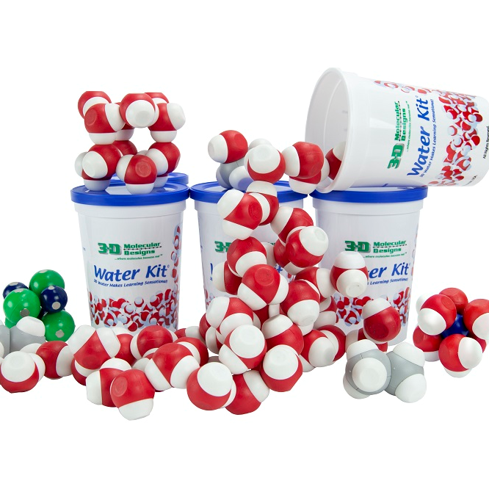
It All Begins with Water
Ruth Hutson, MSSE
Notes:
For this presentation we will use the Water Kit and the NaCl Lattice.

Slide 2

It All Begins with Water
Ruth Hutson, MSSE

Slide 3
Workshop Outcomes
Use models to compare the structure of water at the macroscopic level to infer the strength of electrical forces between particles.
Understand and apply factors that influence the behavior of solutions using models.
Model pH and predict the products in acid-base reactions that form water.
Have fun!

Slide 4
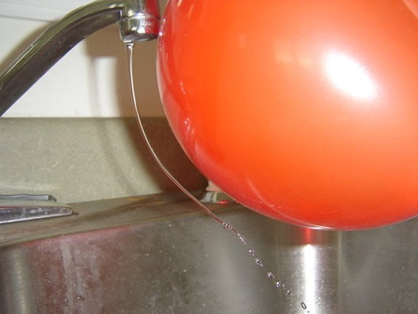
What's going on in this picture?​
​
Describe five details that you see. ​
​
How does this differ from how water normally runs out of a faucet?
Notes:
This discrepant event uses a charged balloon. Inflate a balloon and then rub it will a silk cloth or your hair. Turn on a faucet so that it has a slow continuous stream of water. Observe what happens to the water stream as the balloon is placed near the stream of water and then pulled away.

Slide 5
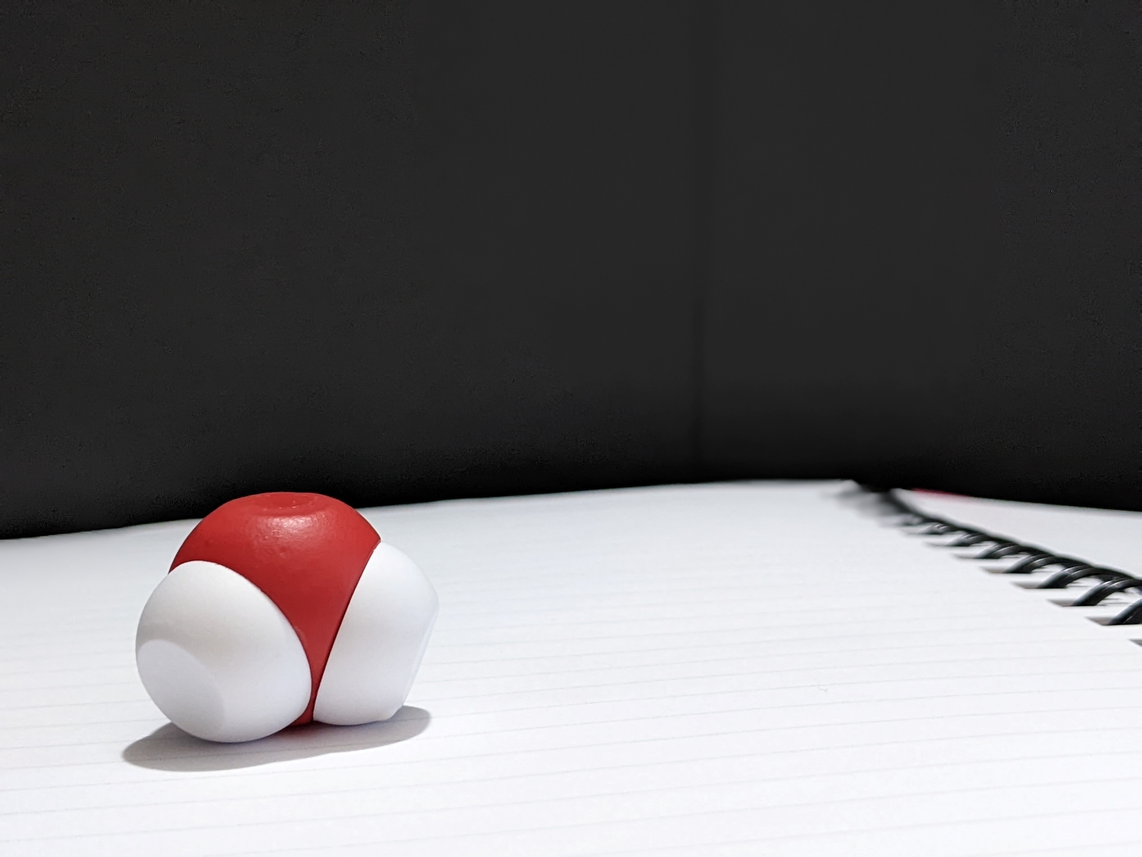
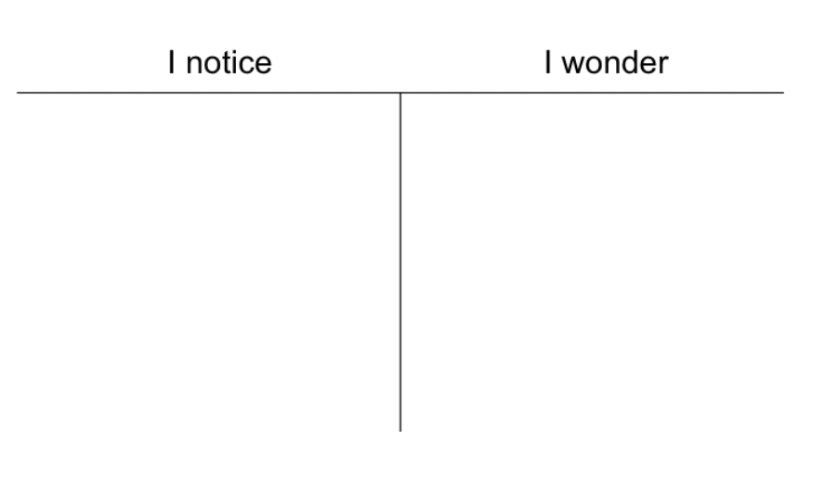
Notes:
Materials management is a must for my classes. I start by having students look at one molecule of water. Please open your cup of water and retrieve one water molecule from it. Each of my students or student group (depending on class size) have a cup of water to work with. I first ask my students to observe a single water molecule and then they get out a second molecule. Would you put your student hat on and observe how you think your students would play with the kit?

Slide 6
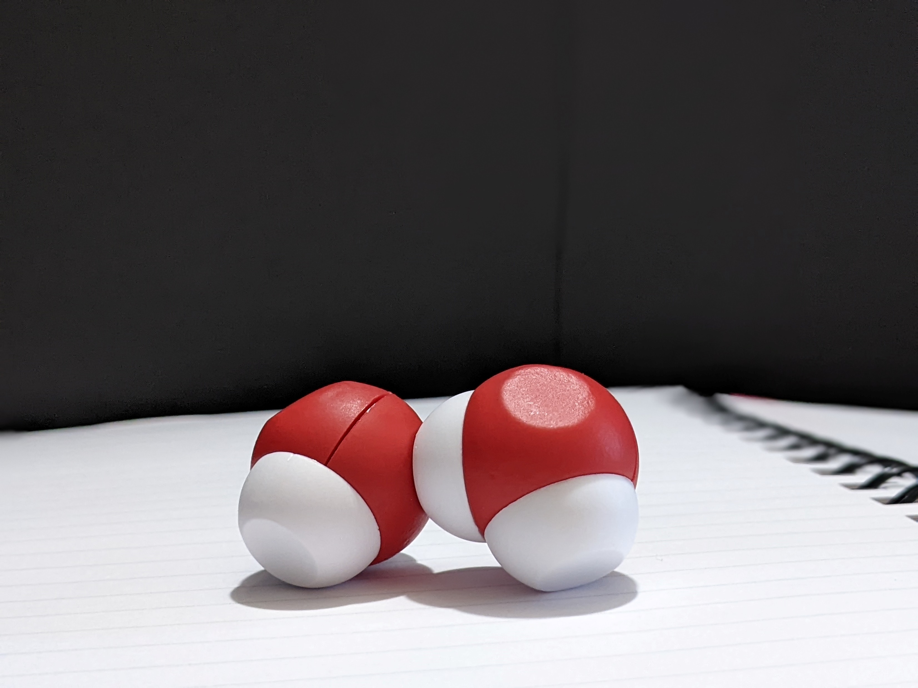
Remove four molecules of water from your Water Kit and observe how they interact with each other. ​
​
Record your observations in your lab notebook. ​
​
What occurs as you add more molecules of water until you have added all twelve molecules?
Notes:
[Give 1 minute to see how the two molecules interact and walk around the room giving feedback to participants.] After students’ initial observations, I ask them to complete a notice|wonder chart. Because this is one of the first modeling experiences they would have at the beginning of the year, use a notice|wonder chart as it is low risk and it encourages students to write what they observe without attaching any scientific vocabulary to it.

Slide 7
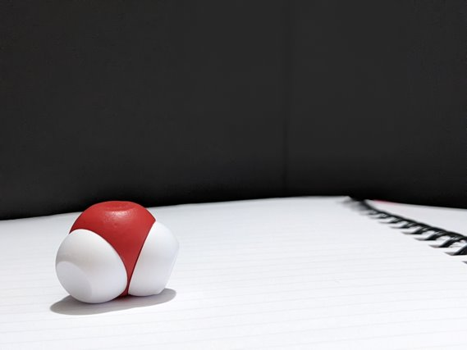
Let's take a closer look at the water molecule. Very carefully separate a hydrogen from an oxygen. ​
What do you see? ​
Do both hydrogens connect to the oxygen in a similar fashion?​
Compare the difficulty in separating a hydrogen from an oxygen within a water molecule to separating two water molecules from each other.

Slide 8
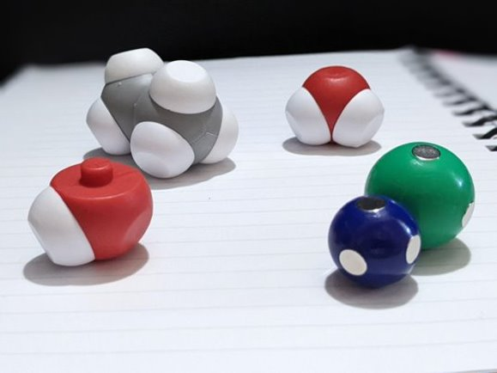
Look at the other contents of the Water Kit.
What other substances contain posts that would represent covalent bonding? ​
​
How many separate covalent bonds can you find?

Slide 9
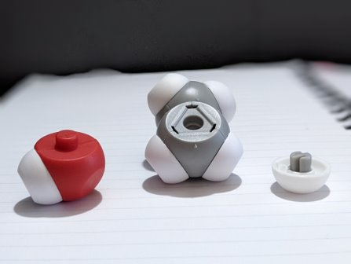
Modify the ethane molecule to make an ethanol molecule.
What is the chemical formula of ethanol? ​
​
How does ethanol interact with water?​
How does that compare to how ethane interacts with water?

Slide 10
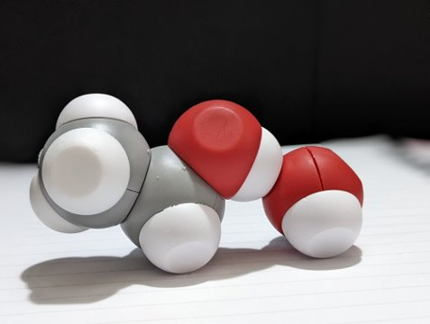
Identify the location of the covalent bonds in the ethanol molecule. ​
Where do you find hydrogen bonding?

Slide 11
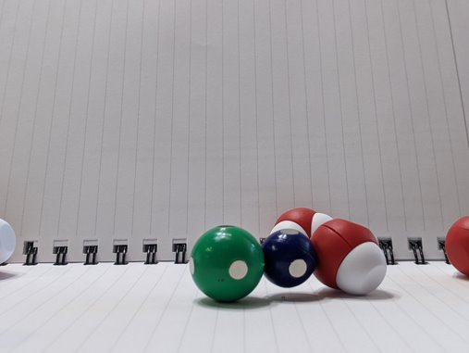
How does sodium chloride interact with water? ​
How do the sodium ion and the chloride ion interact with each other? ​
​
Compare the three types of chemical bonds about which you have learned. Rank them in order of strength of the bond.​

Slide 12
Comparing Types of Forces | COVALENT BONDING | IONIC BONDING | HYDROGEN BONDING
What is it? | Formed when two atoms share a bond within one molecule, can be partially charged or without charge. | Complete transfer of electrons between two atoms resulting in one that is positively charged, and one negatively charged. | A weak attraction of a hydrogen atom that is covalently bound to a more electronegative “donor” atom or group.
How is it represented by the model? | The plastic post connecting the oxygen and the hydrogen in water | The magnet in the sodium atom connecting to the magnet of chlorine atom | The hydrogen of one water molecule attracted to the oxygen of another water molecule
Type of force | Intramolecular Force | Intramolecular Force | Intermolecular Force
Notes:
This ends the first day of using this kit. Use this graphic to summarize what students should know about the model.
Does anyone have a better way that they use when they summarize using this kit?

Slide 13
Based on what you have learned about hydrogen bonding and covalent bonds, use the Water Kit to help explain what is happening in this picture.
Notes:
Student takeaways from this demonstration
Polarity describes the partial positive charge found on the hydrogen atoms in water and the partial negative charge found on the oxygen atom in water. Molecules that have partial charges are polar molecules.
The atoms in the water molecules form covalent bonds which can be polar or nonpolar and are intramolecular forces. Hydrogen bonds are intermolecular forces that occur between two molecules where a positively charged hydrogen atom interacts with a negatively charged fluorine, nitrogen, or oxygen atom in a second molecule. Hydrogen bonding is responsible for cohesion which is the attraction between two like molecules. In this case, water molecules are attracted to each other. Through the intermolecular force of cohesion, they form the stream of water coming out of the faucet.
Explaining the phenomenon
Rubbing the balloon with the cloth or the hair causes it to gain an electrostatic charge. Extra electrons are deposited on the surface of the balloon. The stream of water in the demonstration is formed because water molecules hydrogen bond with each other. Since water has a dipole (an unequal distribution of charges), the stream can be attracted to the charged balloon and move toward it.

Slide 14
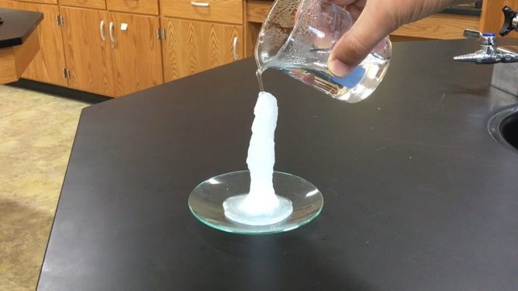
Notes:
This is a great discrepant event to use when introducing solubility and types of solutions—unsaturated, saturated, and supersaturated. It uses a supersaturated solution of sodium acetate.
Crystallization from a Supersaturated Solution (rutgers.edu) explains the necessary supplies and reasoning.

Slide 15

Let’s start by modeling sodium chloride’s interaction with water​
Describe what occurs when water interacts with sodium chloride. ​
Which ion interacts with oxygen? Why?​
Which ion interacts with hydrogen?
Why?

Slide 16
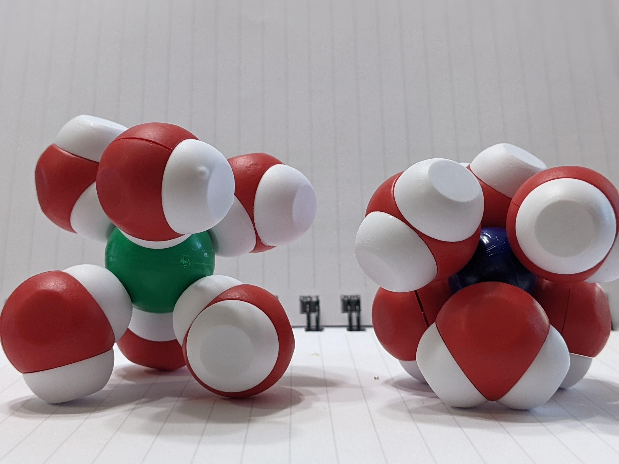
Let’s start by modeling sodium chloride’s interaction with water​
Describe what occurs when water interacts with sodium chloride. ​
Which ion interacts with oxygen? Why?​
Which ion interacts with hydrogen?
Why?
Notes:
Explain to students what a solvation shell is. In the case of water, it is known as a hydration shell.

Slide 17
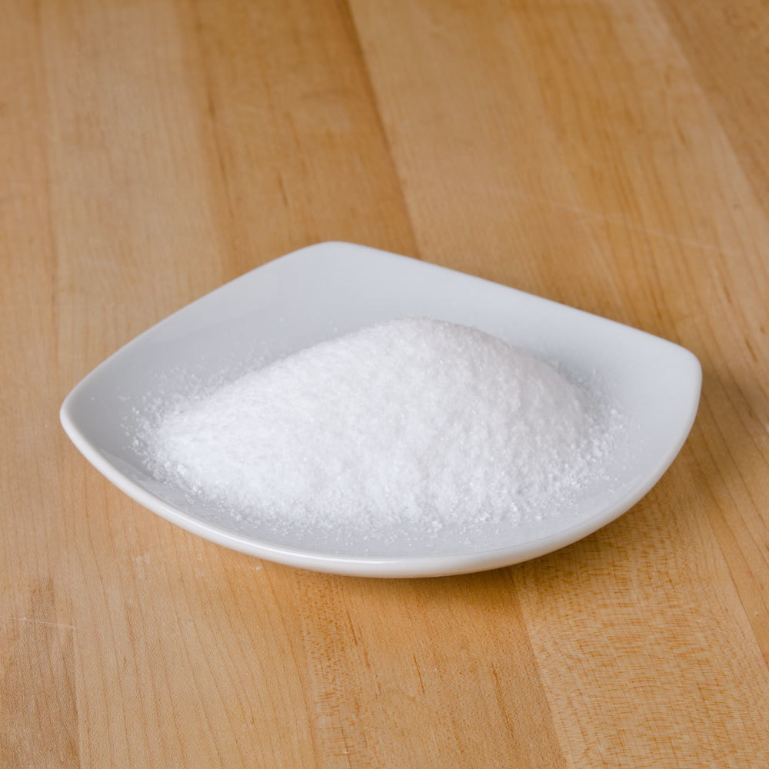
Misconception Alert
Sodium chloride does not appear as a single molecule.
Sodium chloride presents itself as crystals in nature.

Slide 18
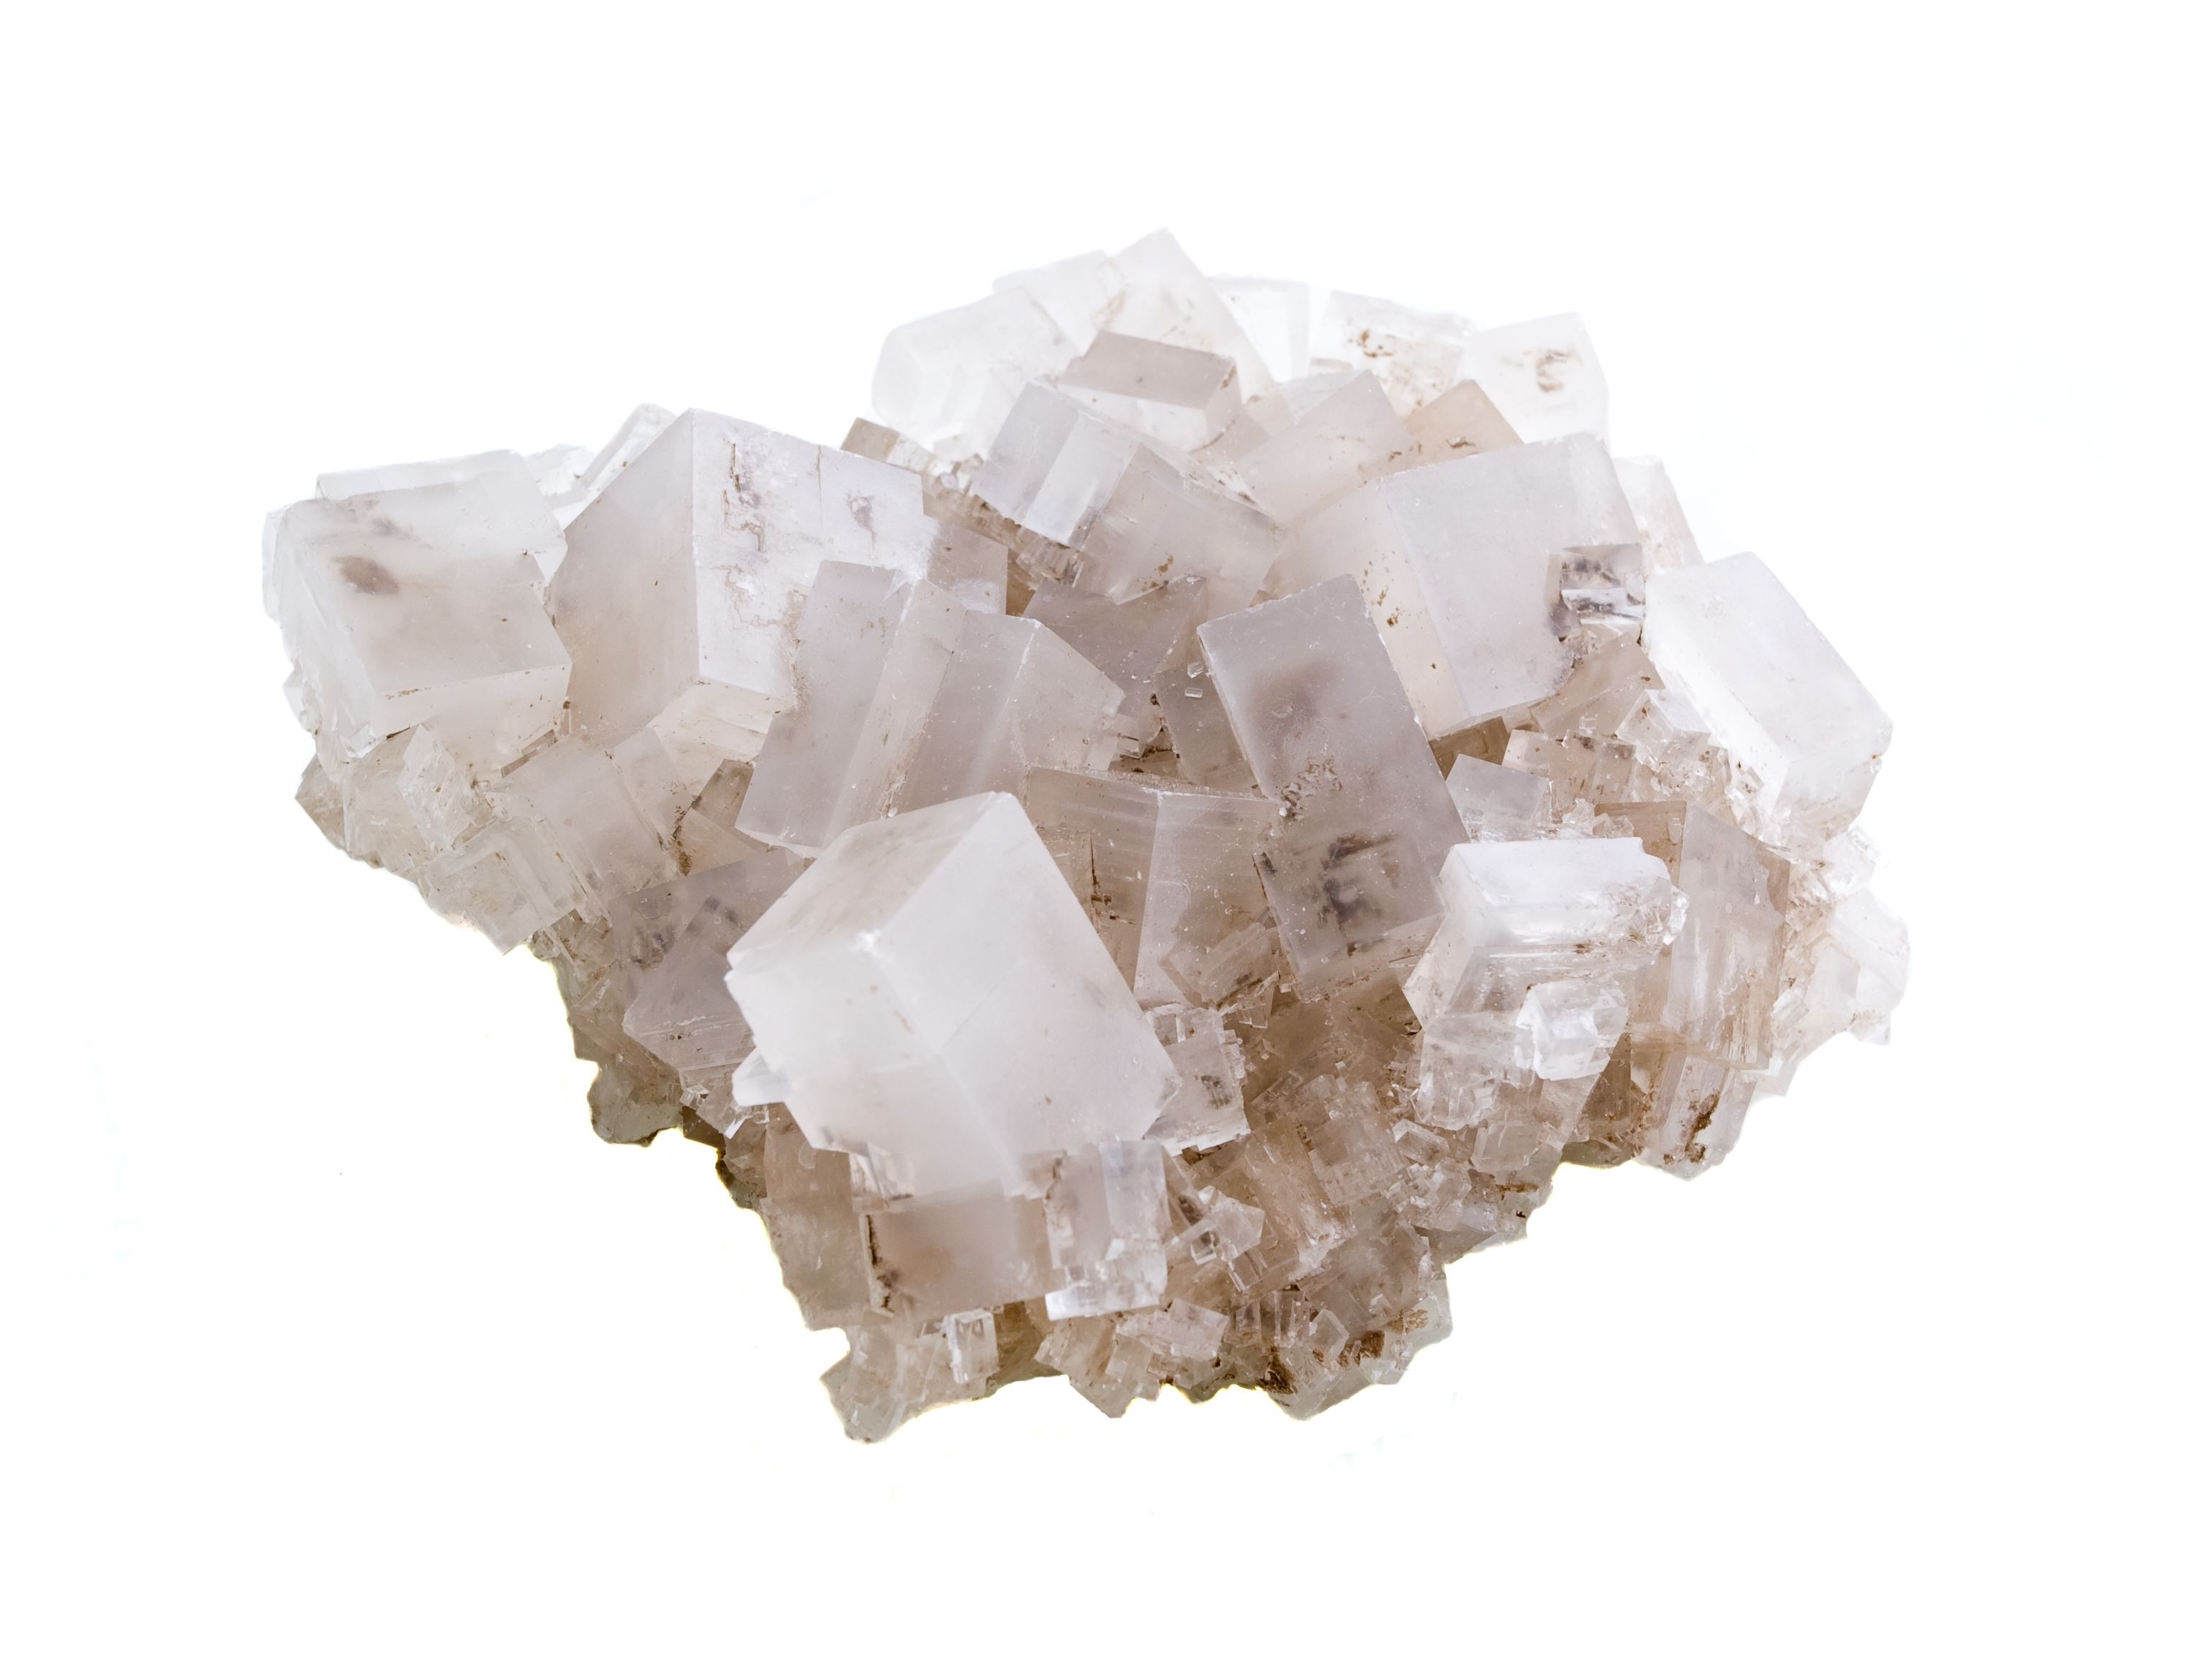
Notes:
After looking at the rock salt, students should model what they see with the NaCl lattice to determine how it might appear at the molecular level.

Slide 19
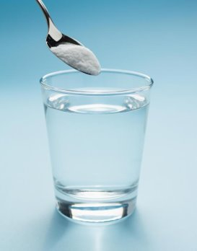
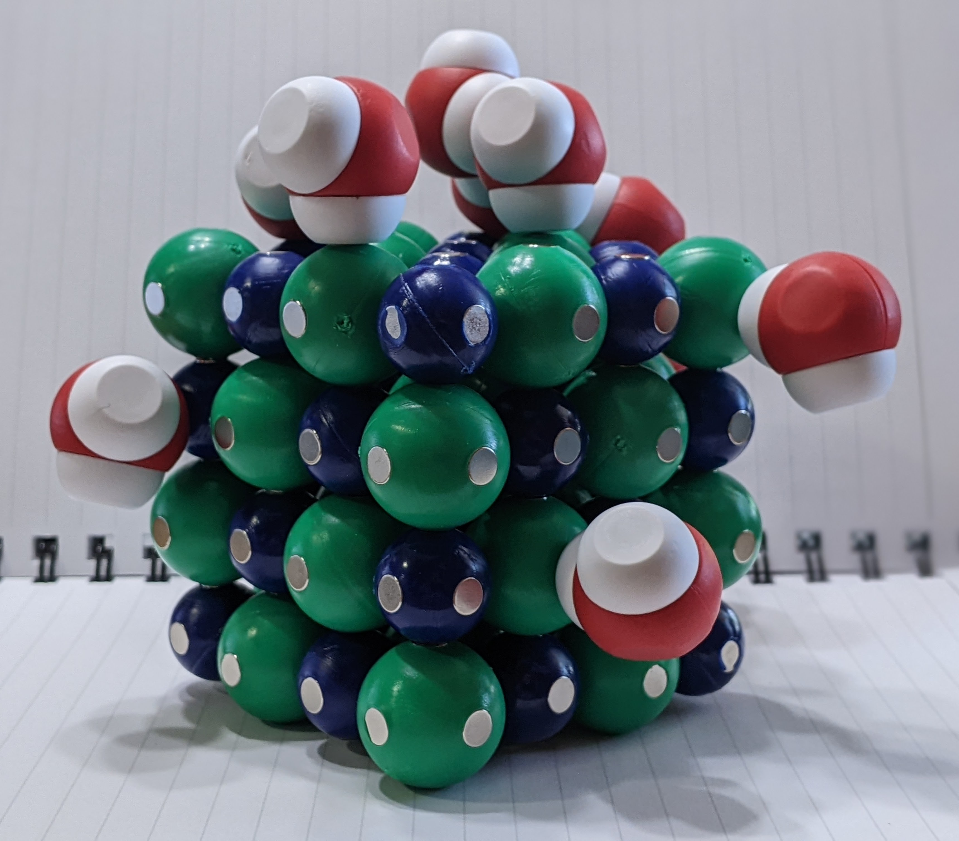
Let’s model a sodium chloride lattice dissolving in water
Notes:
Assess students’ understanding by asking them to model another scenario. Make a saturated solution together. After discussing the characteristics of an unsaturated solution and supersaturated solution, allow students create those models.

Slide 20
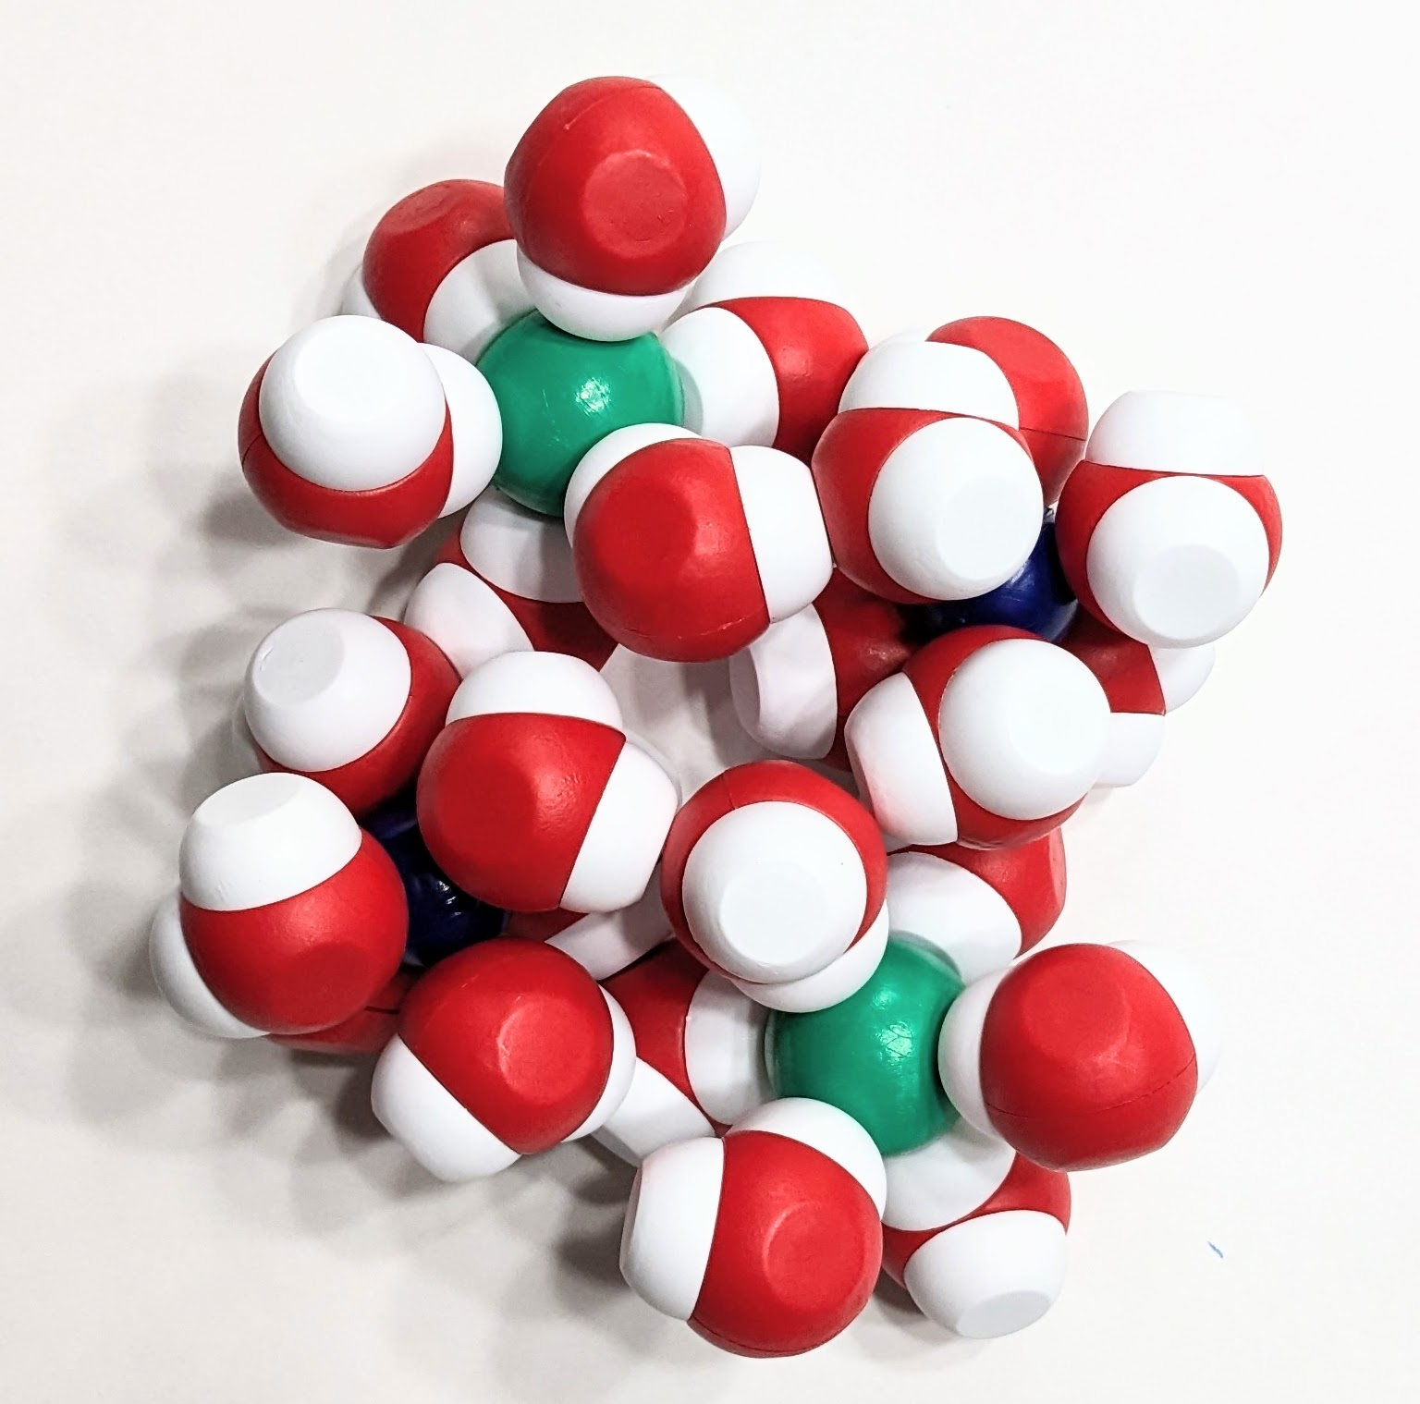
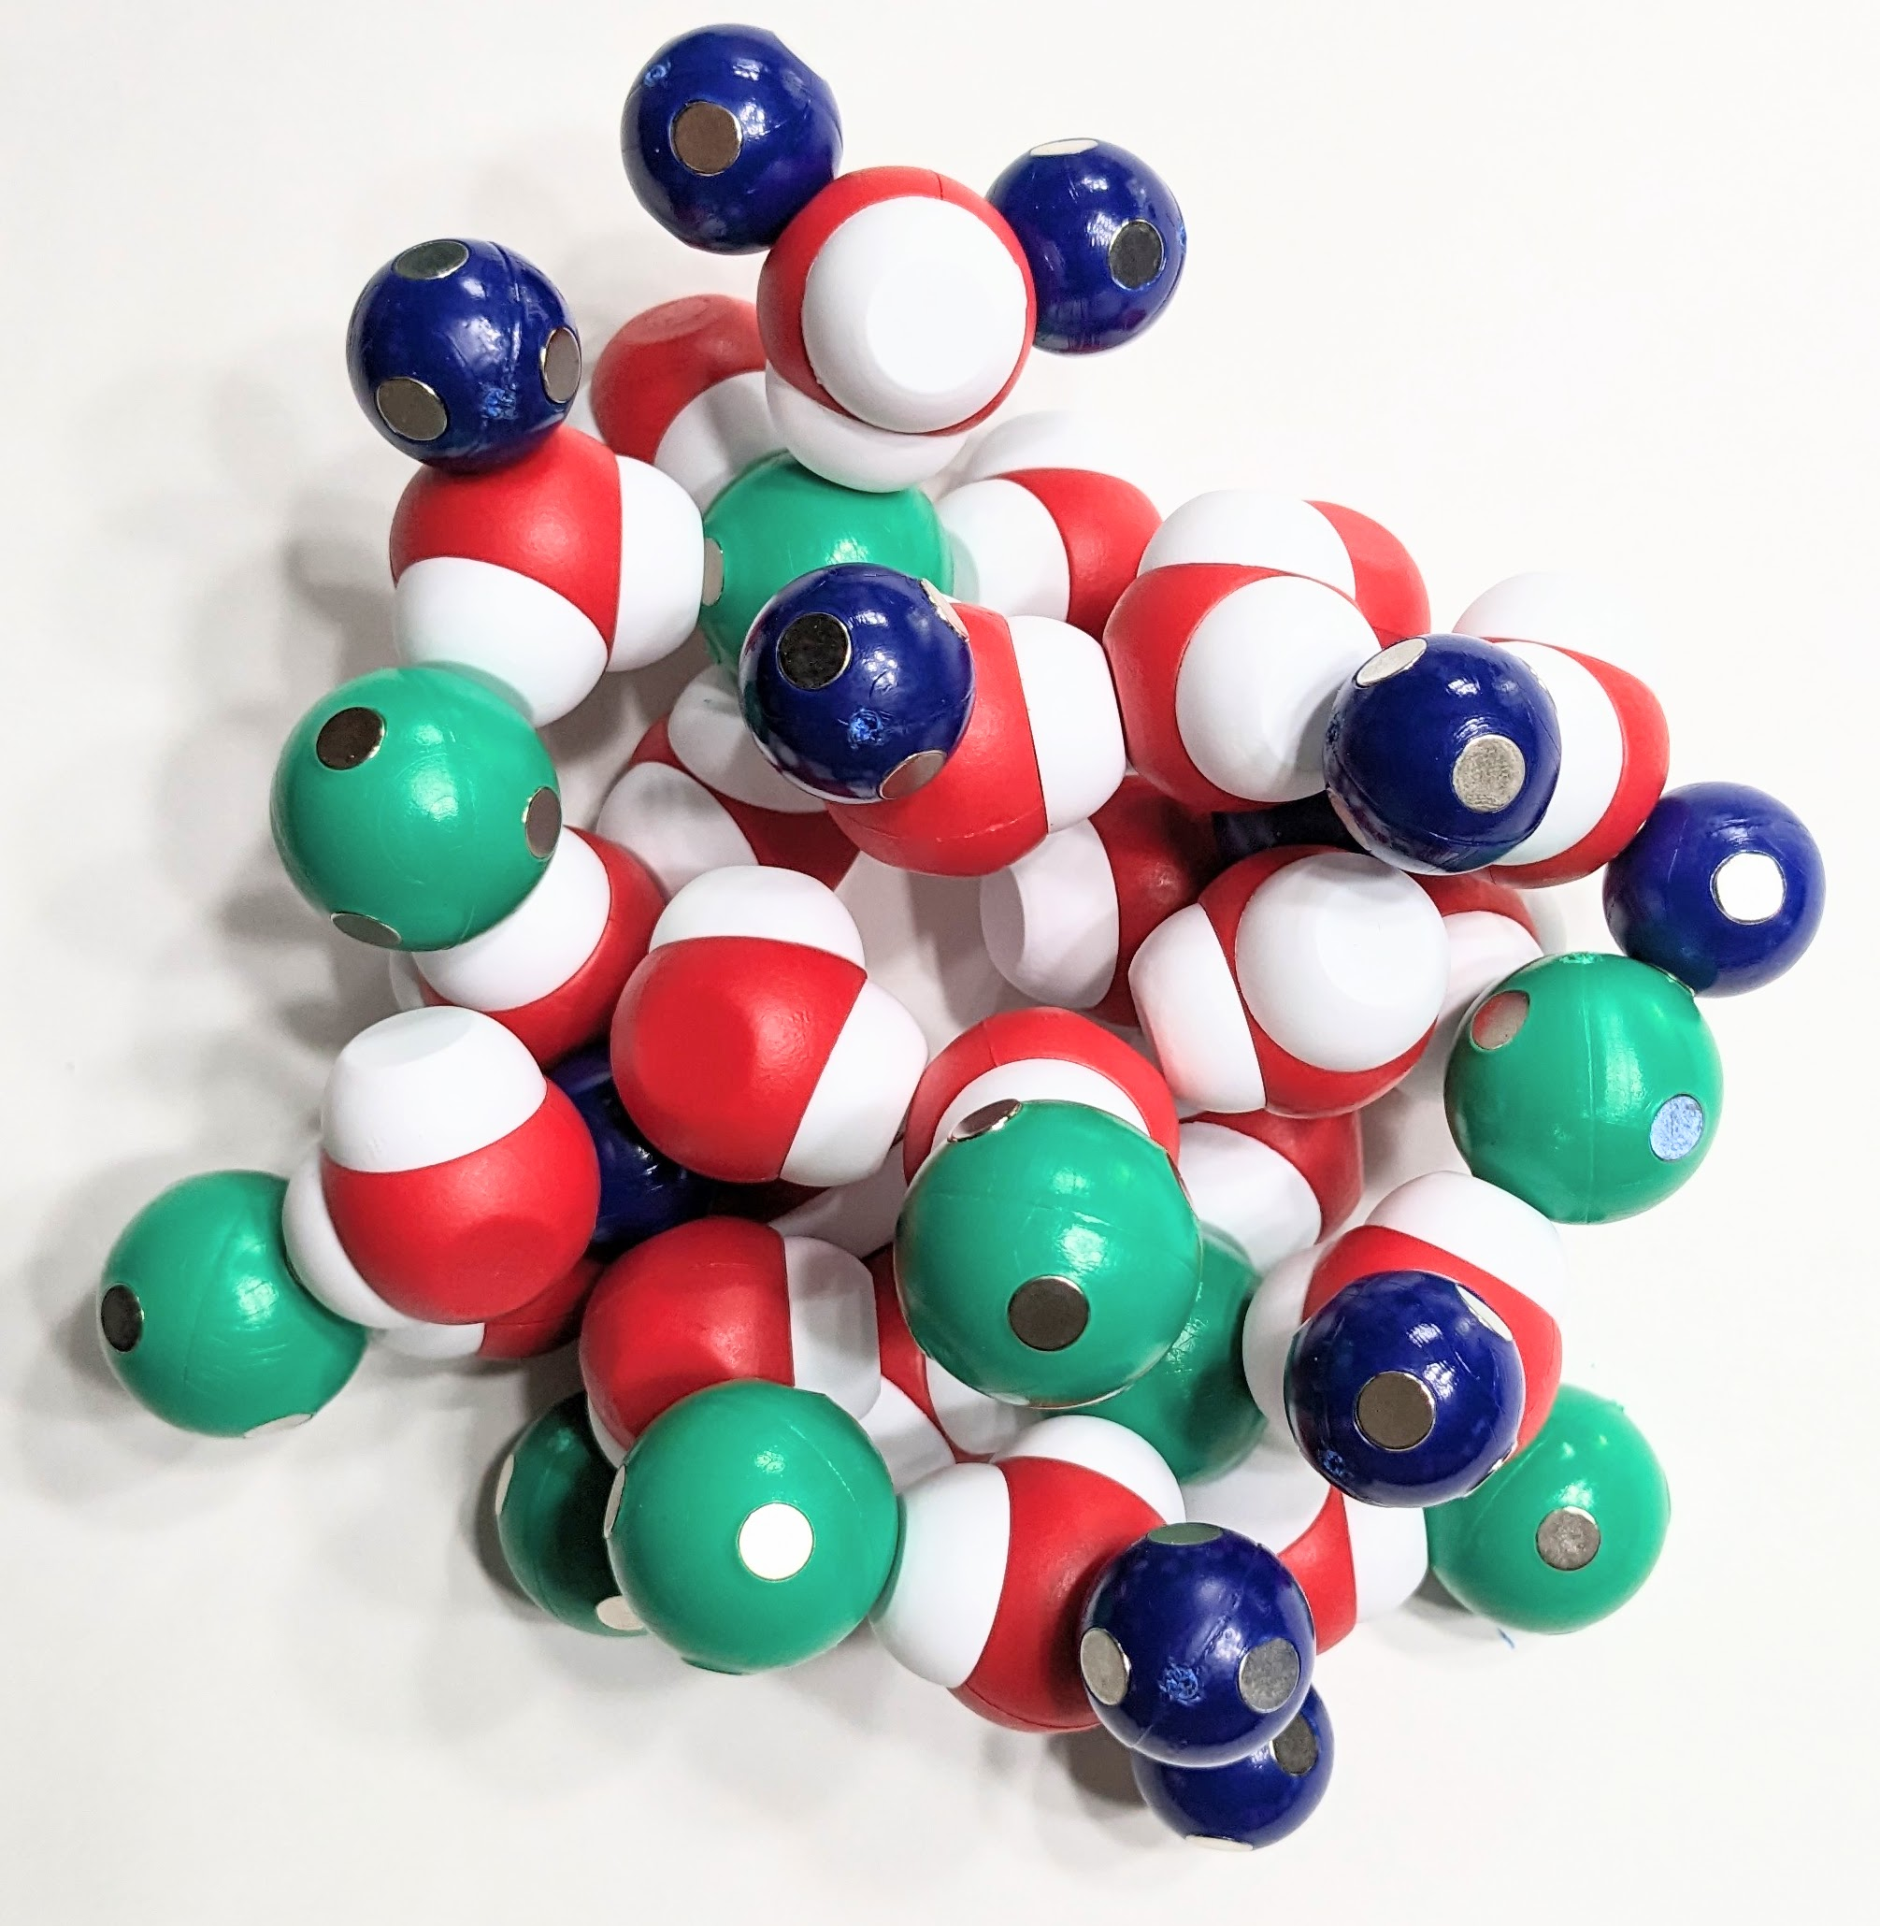
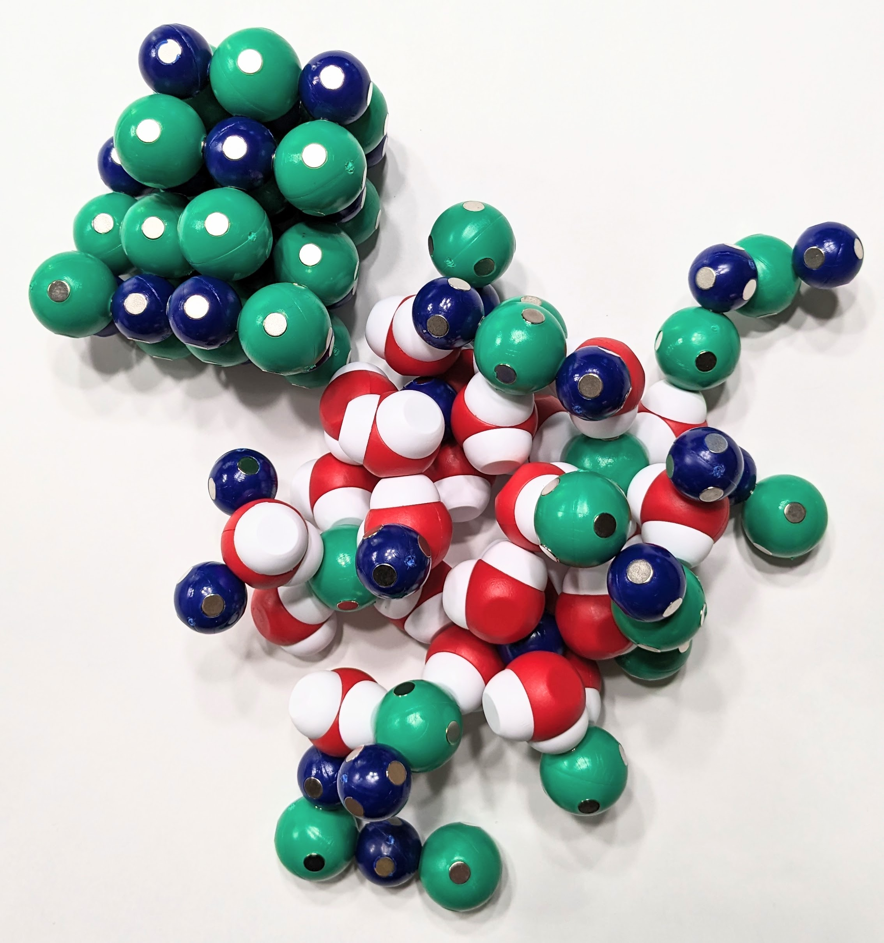
Modeling Solutions
Unsaturated | Saturated | Supersaturated
A solution that contains less than the maximum amount of solute that is capable of being dissolved. | A solution that contains the maximum amount of solute that is capable of dissolving. | A solution that contains more than the maximum amount of solute that is capable of being dissolved at a given temperature. By adding a seed crystal, the solution recrystallizes.

Slide 21
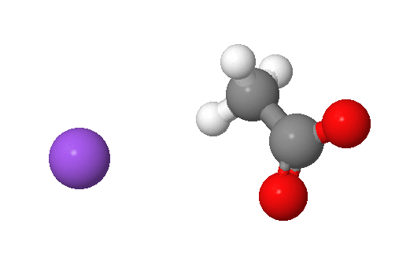
Based on what you have learned about interactions between salt and water, use the Water Kit to help explain what is happening in this picture.
Notes:
At temperatures below 58° C, solutions that are saturated with respect to anhydrous sodium acetate are supersaturated with respect to the trihydrate. The composition of the solution prepared corresponds to 88 g NaC₂H₃^{O}₂ per 100 g water. The 100 g of water includes both added water and water of hydration. When this solution is cooled to 20° C, it is unsaturated with respect to NaC₂H₃O₂, but supersaturated with respect to NaC₂H₃O₂.3H₂O. “Seeding” the solution with the trihydrate thus causes formation of crystals of hydrated sodium acetate. Crystallization is exothermic, and the resulting solid is warm to the touch.
Explanation from Crystallization from a Supersaturated Solution (rutgers.edu)

Slide 22
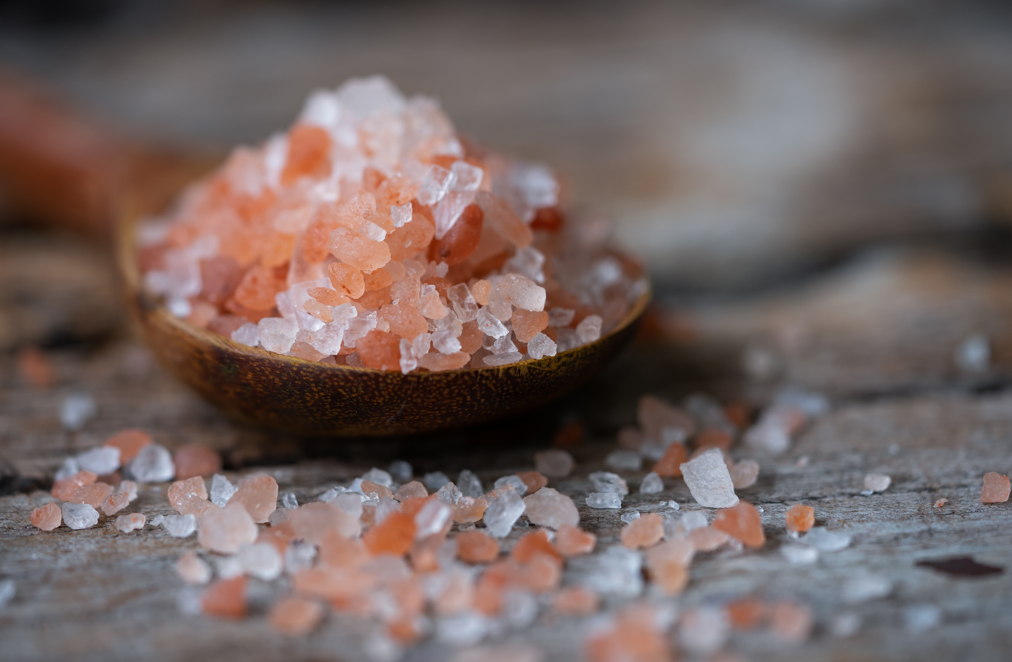
A closer look by other factors affecting solubility
Notes:
Solubility in water is affected by:
Temperature (Solubility increases with temperature for most solids dissolved in liquid water. Higher temperatures increase the vibration or kinetic energy of the solute molecules.)
Pressure (gaseous substances are much more influenced by pressure than solids and liquids)
Polarity (like dissolves like)
Molecular size (Smaller molecules are generally more soluble in water than larger molecules.)

Slide 23
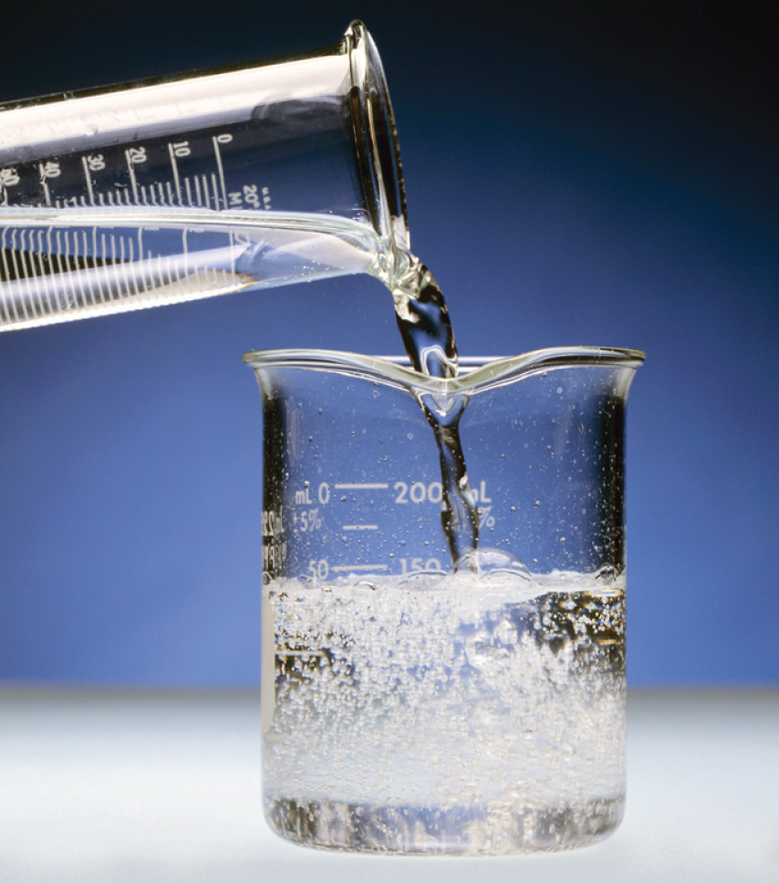
How does the polarity of a substance affect its solubility in water?
Alcohol | Observations in Lab | Modeling
Methanol
Ethanol
Butanol
Octanol
Notes:
Do a simple wet lab where they add equal parts of four different alcohols to equal parts of distilled water. Before moving to the lab, introduce what an SDS sheet is. Do this in the lab in microscale (typically between 5 mL to 10 mL). Students mix the chemicals, record their observations, they clean their glassware, and return to their seats in the classroom.

Slide 24

What is going on in this beaker at the molecular scale?
Unknown Solution | Observations in Lab | Modeling
Methanol
Ethanol
Butanol
Octanol
Notes:
To do modeling this at the molecular scale, first must build a model of alcohol. Use the 'broken' water part from the kit and the ethane molecule.
Review the parts of the molecules. Students will make all four molecules or assign groups and have them share their findings. Remove the hydrogen atom that has the S-bond. I've shown it on the screen. It is the hydrogen that has a star beside it. Once that hydrogen and the post is removed, the hydroxyl group can be covalently bonded to the remaining structure.

Slide 25
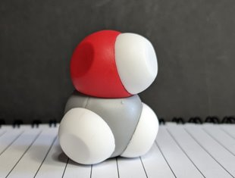
What is going on in this beaker at the molecular scale?
Unknown Solution | Observations in Lab | Modeling
Methanol
Ethanol
Butanol
Octanol
Notes:
Test methanol's solubility in water by placing the methanol molecule in an empty cup with three or four water molecules. Place the lid on tightly and shake to mix. [Shake cup with flourish and pour the contents on the table.] Now pour the contents on the table.

Slide 26
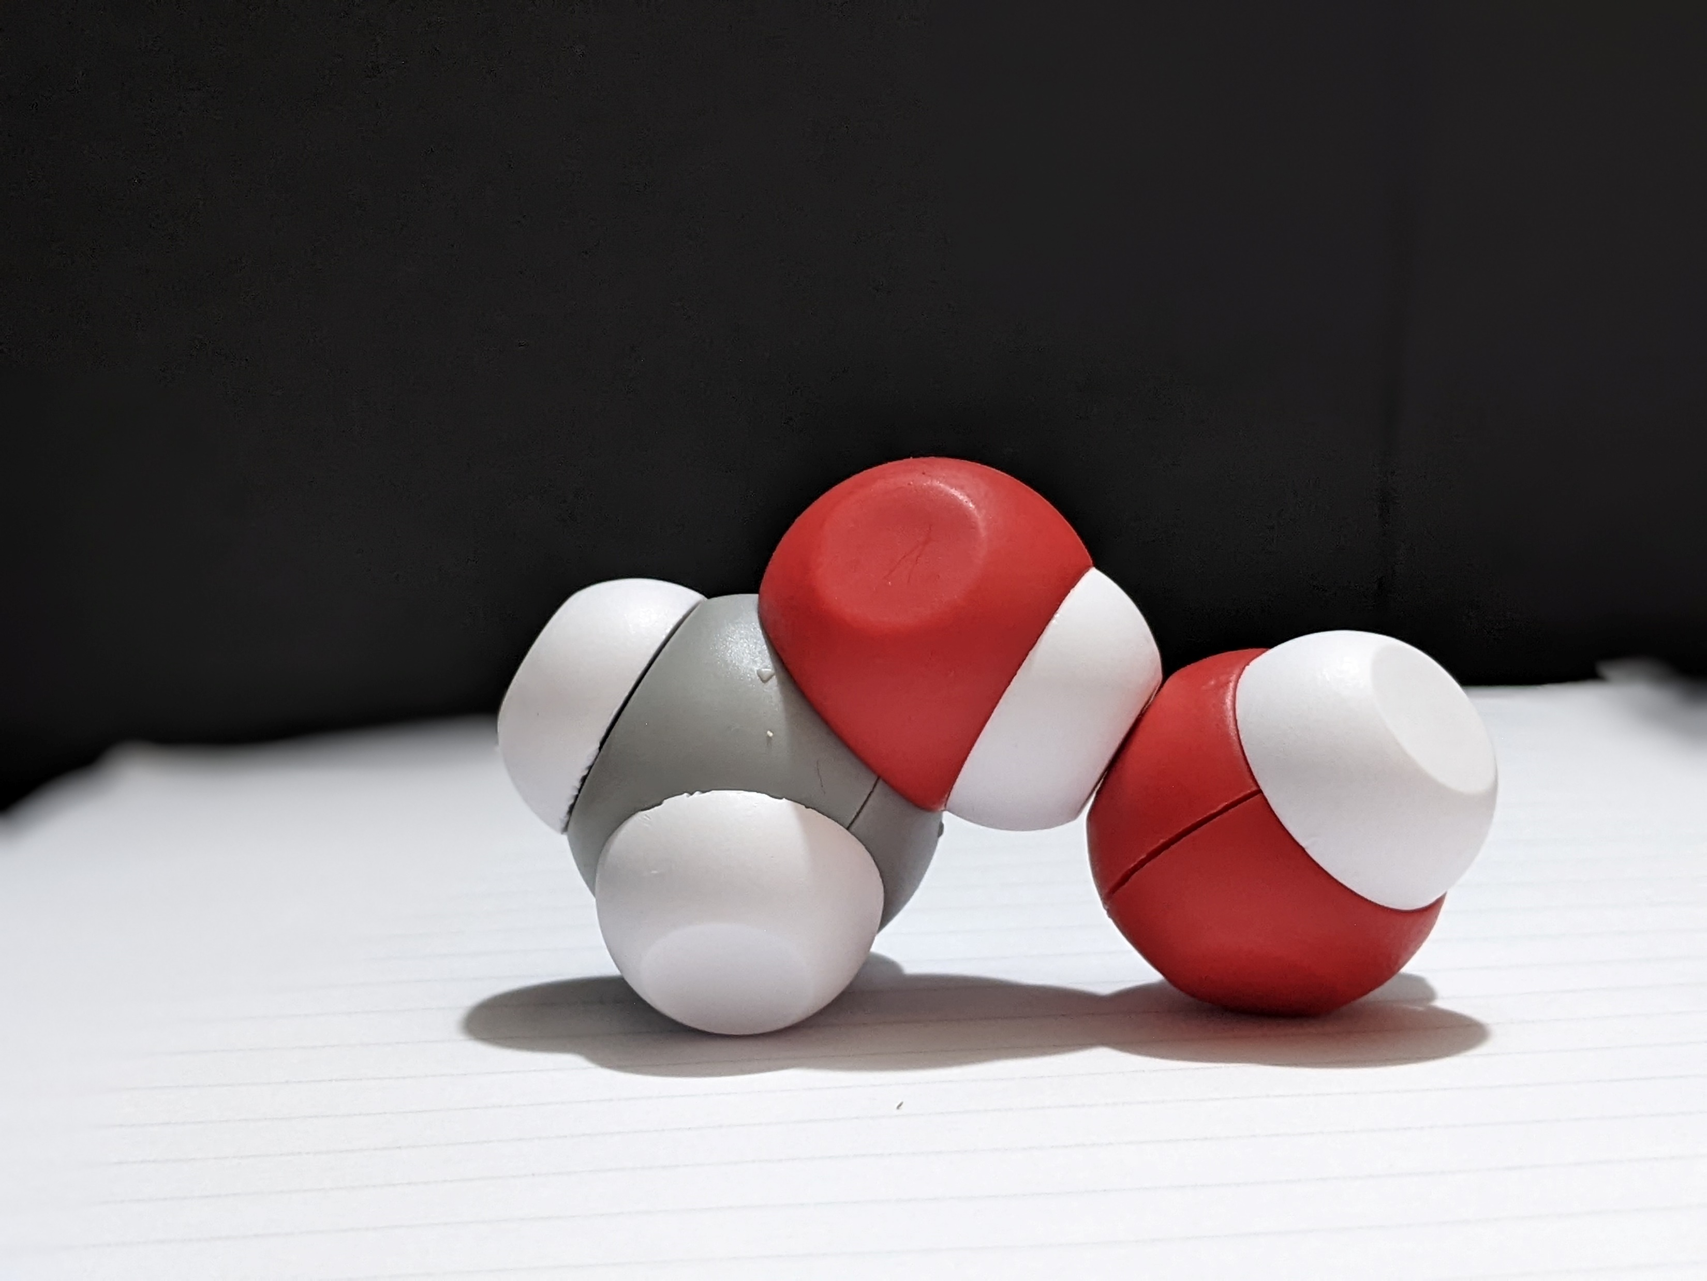
What is going on in this beaker at the molecular scale?
Unknown Solution | Observations in Lab | Modeling
Methanol
Ethanol
Butanol
Octanol
Notes:
Discuss findings.

Slide 27
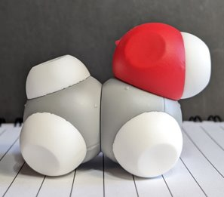
What is going on in this beaker at the molecular scale?
Unknown Solution | Observations in Lab | Modeling
Methanol
Ethanol
Butanol
Octanol
Notes:
Do the same thing for ethanol.

Slide 28
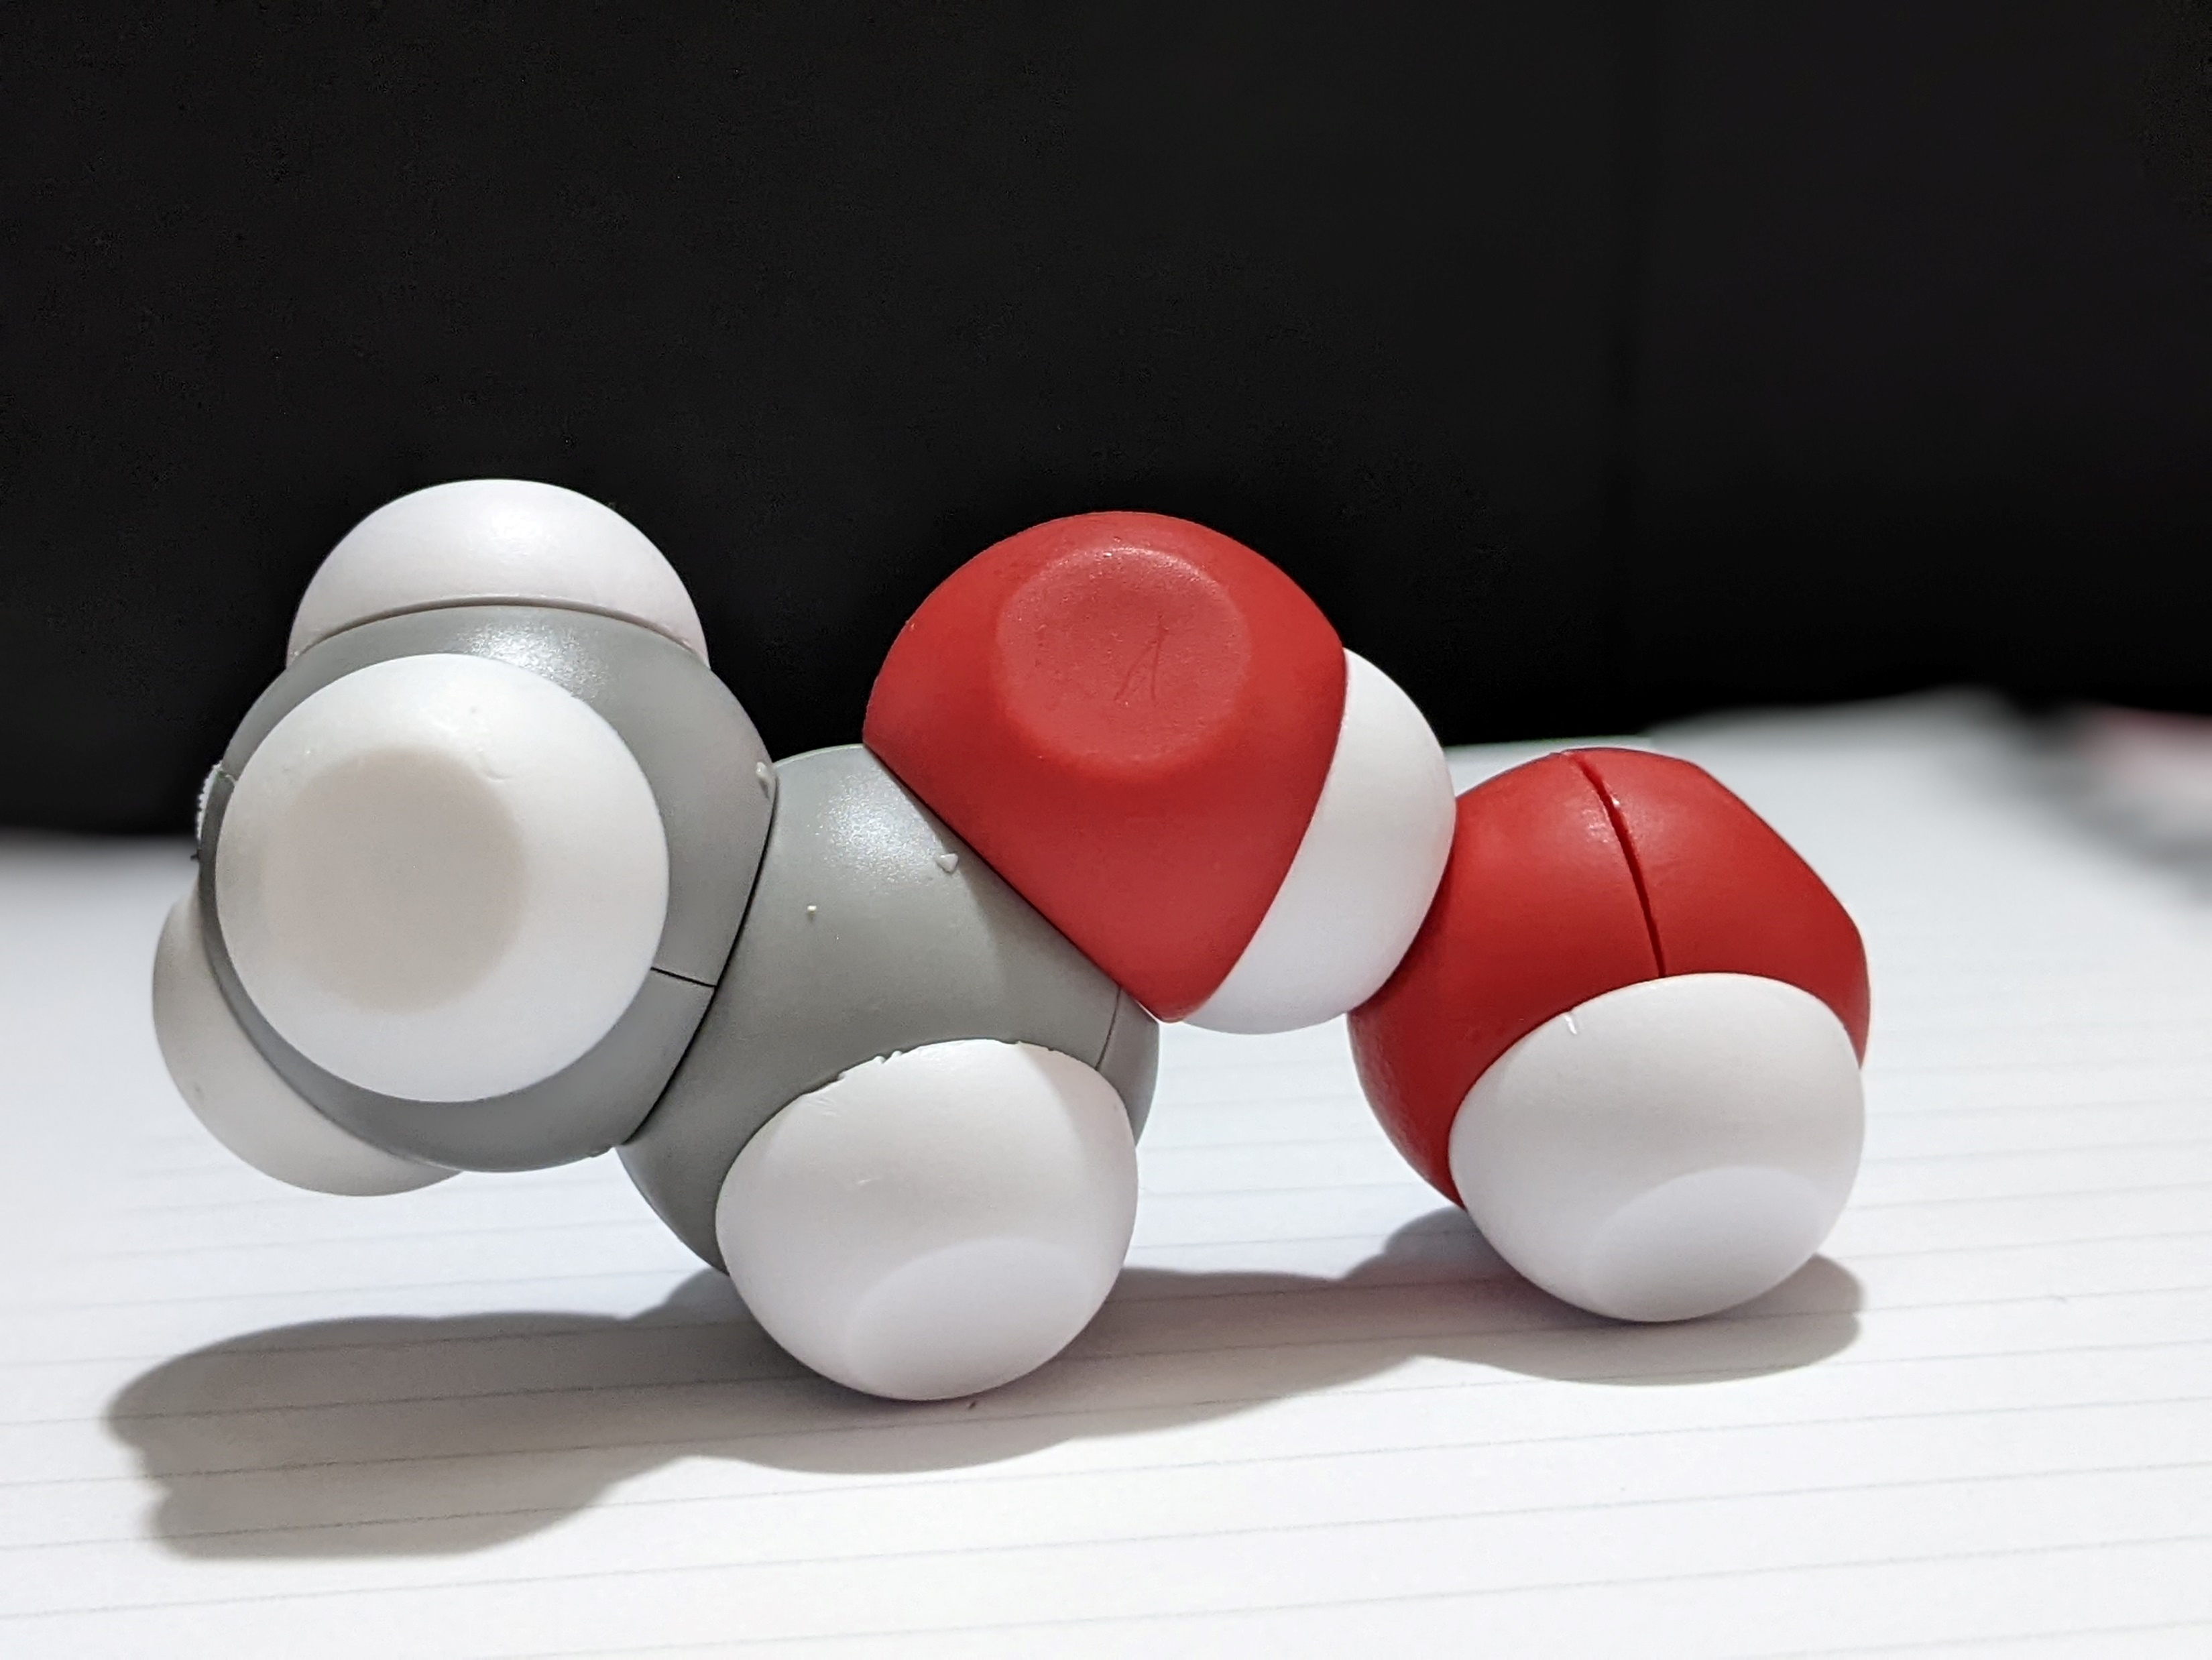
What is going on in this beaker at the molecular scale?
Unknown Solution | Observations in Lab | Modeling
Methanol
Ethanol
Butanol
Octanol
Notes:
Discuss findings.

Slide 29
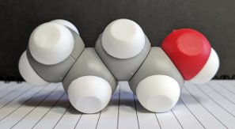
What is going on in this beaker at the molecular scale?
Unknown Solution | Observations in Lab | Modeling
Methanol
Ethanol
Butanol
Octanol
Notes:
To build butanol with a partner. Test butanol’s solubility and discuss findings.
How can we explain what is happening as the carbon and hydrogen chain gets longer?

Slide 30
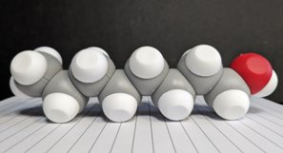
What is going on in this beaker at the molecular scale?
Unknown Solution | Observations in Lab | Modeling
Methanol
Ethanol
Butanol
Octanol
Notes:
Take apart their butanol molecule and return to your seats with the parts you used to make it. Assemble the ethane molecules and return it to the cup.
Ask for a volunteer and test a pre-made octanol molecule. Make a prediction based on what you already know about methanol, ethanol, and butanol? Test octanol’s solubility.

Slide 31
Based on what you have learned about polarity use the Water Kit to help explain why alcohols become less soluble in water as their carbon chain increases in length.
Notes:
Summarize what was discovered in the lab. As the carbon chain on the alcohol increases, the alcohol becomes less soluble in water.

Slide 32
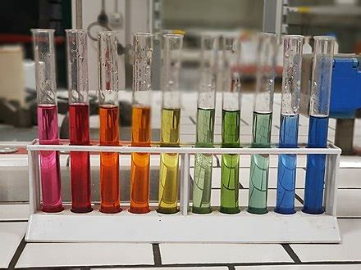
Notes:
The Water Kit can be used to help students model acid-base reactions and autoionization of water. Start by having students make a serial dilution and test it with indicators. Discuss why indicators are necessary for viewing reactions.

Slide 33
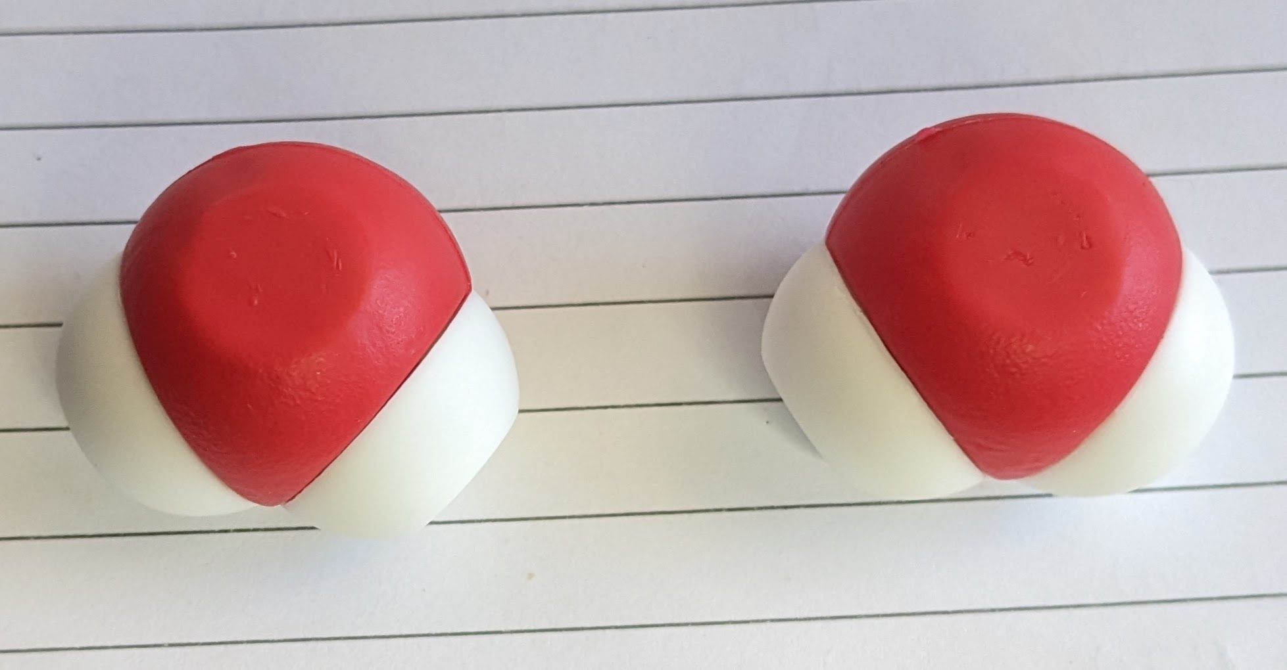
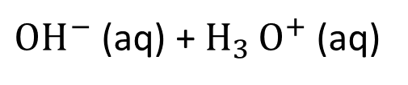
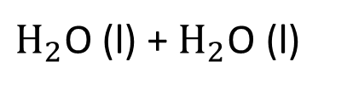
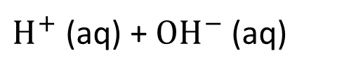
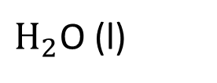
Switching to acid-base models
Create physical representation of the autoionization of water.
$H_{2}$O (l)
$H^{+}$ (aq) + ${OH}^{−}$ (aq)
$H_{2}$O (l) + $H_{2}$O (l)
${OH}^{−}$ (aq) + $H_{3 }O^{+}$ (aq)
Notes:
Model this with two water molecules from the Water Kit.

Slide 34
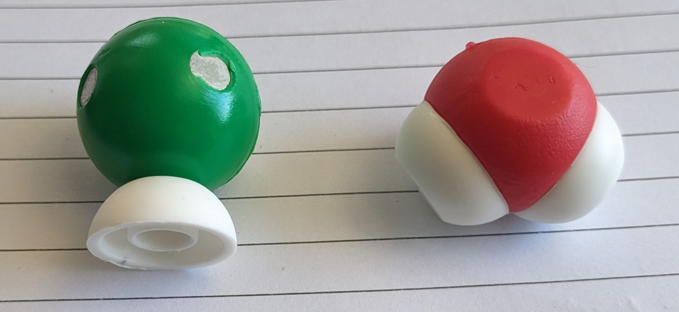
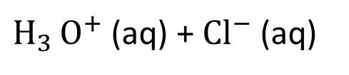
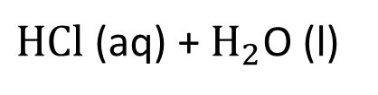
Switching to acid-base models
Create physical representation of the dissociation of hydrochloric acid in water.
$HCl$(aq) + $H_{2}$O (l)
$H_{3 }O^{+}$ (aq) + ${Cl}^{−}$ (aq)
Notes:
Model this reaction.

Slide 35
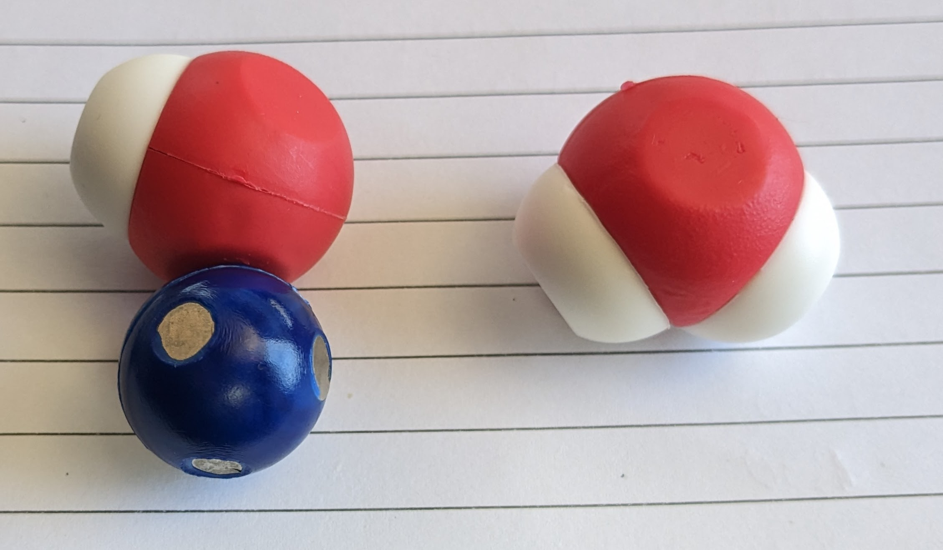

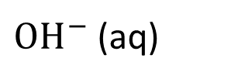
Switching to acid-base models
Create physical representation of the dissociation of sodium hydroxide in water.
NaOH (s)
$${Na}^{+}\left(aq\right)+$$
${OH}^{−}$ (aq)
Notes:
The oldest Arrhenius theory identifies a base as a hydroxide ion anion donor. There are other definitions of a base like the Bronsted-Lowry theory which defines a base as a proton (hydrogen cation) acceptor. The Lewis theory defines a base as an electron pair donor.

Slide 36
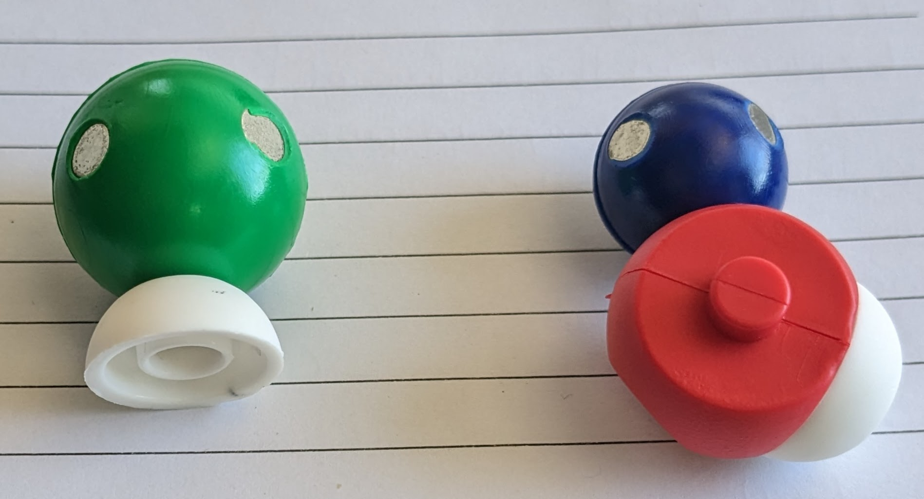
Switching to acid-base models
Create physical representation of a neutralization reaction using the parts from the Water Kit.
Notes:
Students should model that hydrochloric acid reacts with sodium hydroxide to make water and sodium chloride.

Slide 37
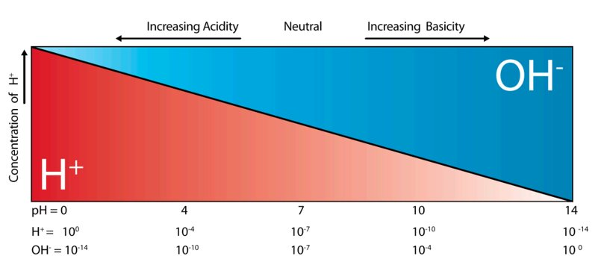
Notes:
The pH of a solution is a measure of the concentration of hydrogen ions in the solution and describes how acidic or basic a solution is. The letters “pH” stand for “power of hydrogen”. The usual range of pH values most commonly encountered is between 0 and 14. Solutions with a pH less than 7 are said to be acidic and solutions with a pH greater than 7 are said to be basic or alkaline. A solution with a pH of 7 is considered to be neutral.
Each pH unit represents a tenfold change in the concentration of H3 O+ cations. For example, lemon juice at a pH of 2 has 10 times more H3 O+ cations than an equal amount of orange juice at pH 3.

Slide 38
Based on what you have learned about acids and bases, use the Water Kit to help explain the difference between a strong acid like HCl in water and a strong base like NaOH in water.
Notes:
Using the Water Kit, students can sketch in their notebook and represent the relative amounts of hydronium and hydroxide ions along with chloride ions for hydrochloric acid. The same can be done with the sodium ion, hydroxide ions, and hydronium ions for sodium hydroxide.

Slide 39

We value your opinion!
Let us know what you think.
Scan the QR Code and complete this short survey.

Slide 40
Workshop NGSS Connections
SEPs | CCCs | DCIs
Asking Questions and Defining Problems | Scale, Proportion, and Quantity | MS-PS1-1
Developing and Using Models | Patterns | MS-PS1-5
Planning and Carrying Out Investigations | Cause and Effect | HS-PS1-3
Constructing Explanations and Designing Solutions |  | HS-PS1-7
Notes:
Here are the NGSS Connections for this workshop.

