Slide 1
Amino Acids

Slide 2





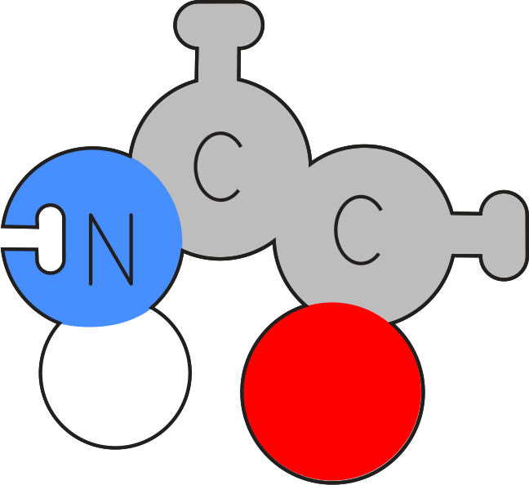



Slide 7
Phospholipids

Slide 8

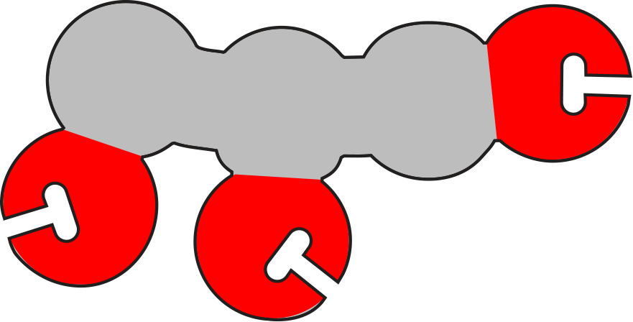

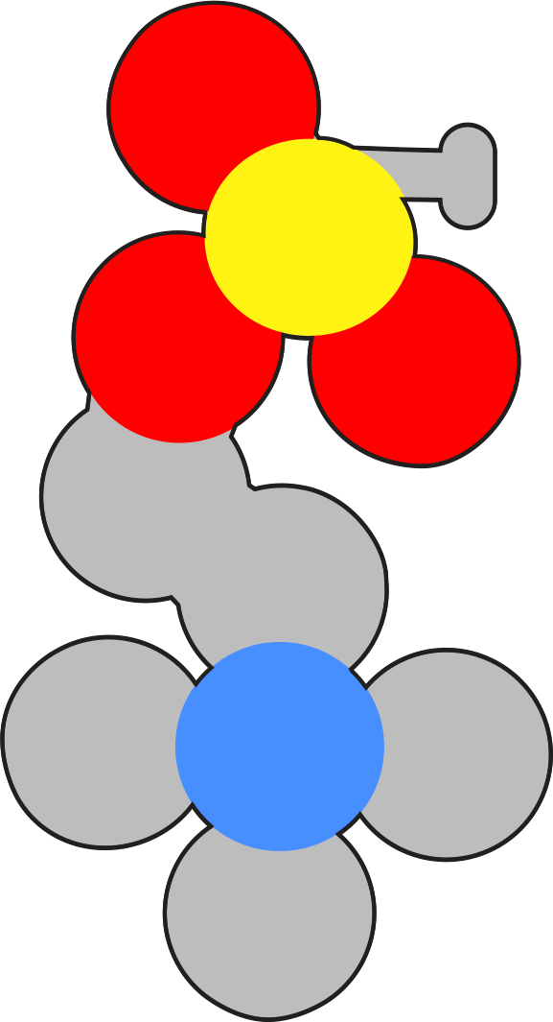

Slide 17
Nucleotides

Slide 18
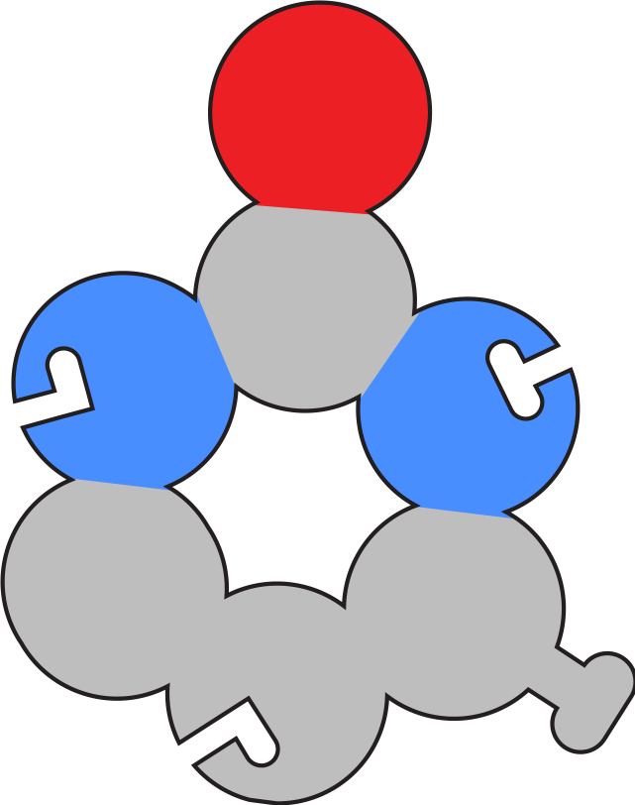
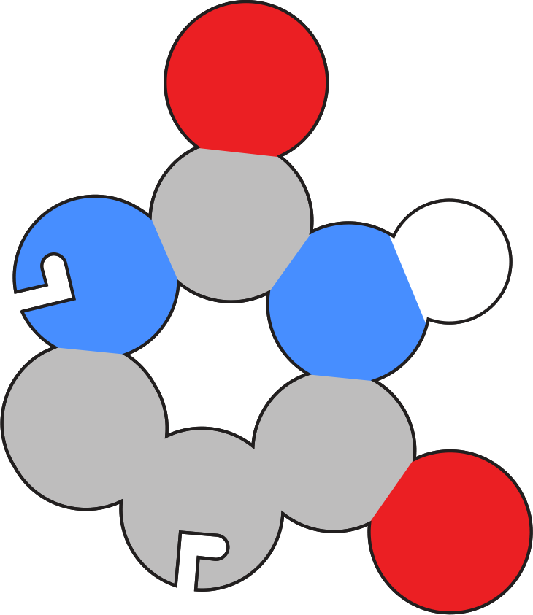
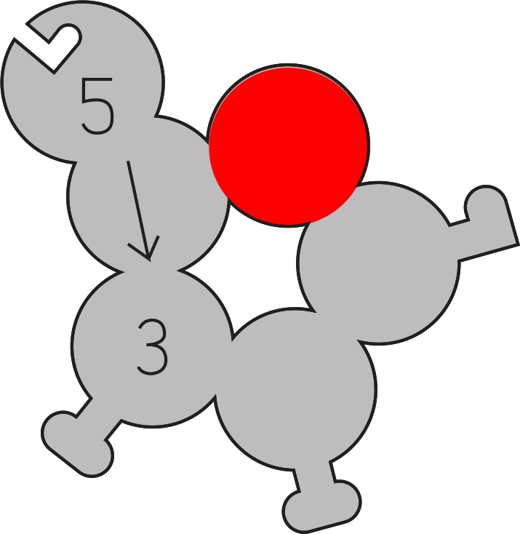
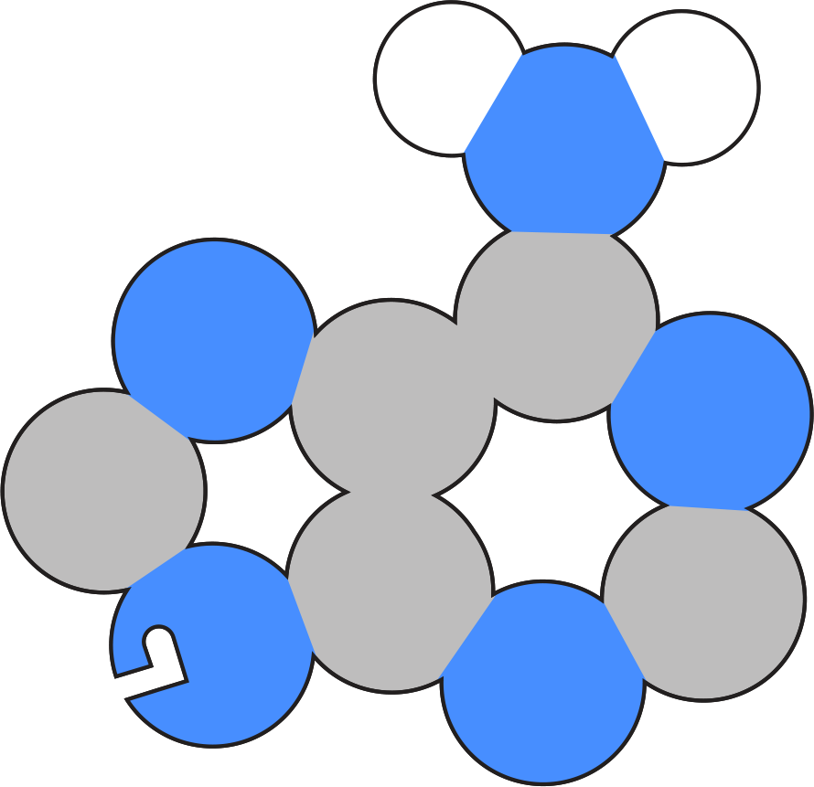

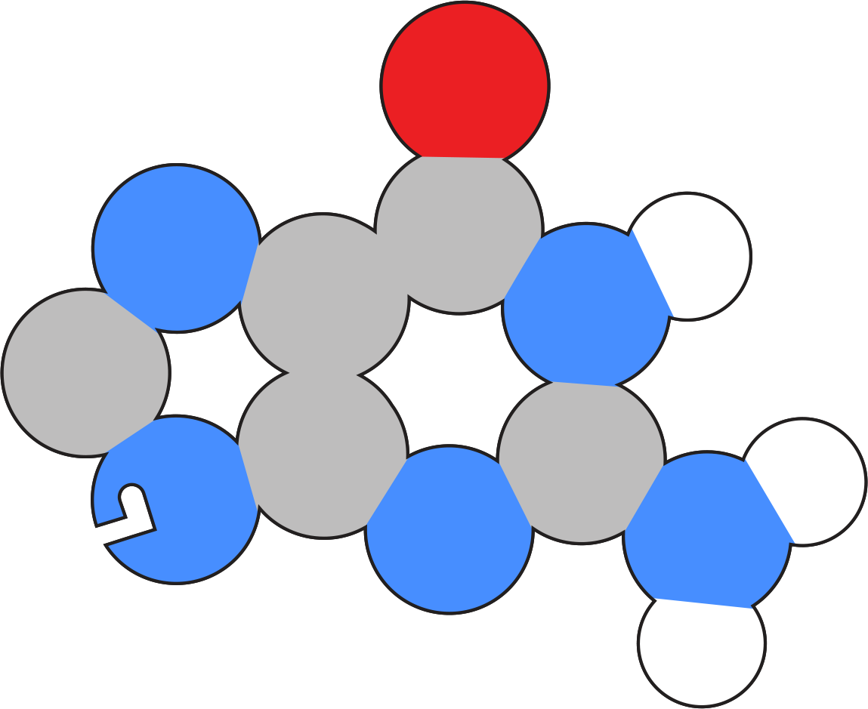


Slide 19


Slide 21
C

Slide 22
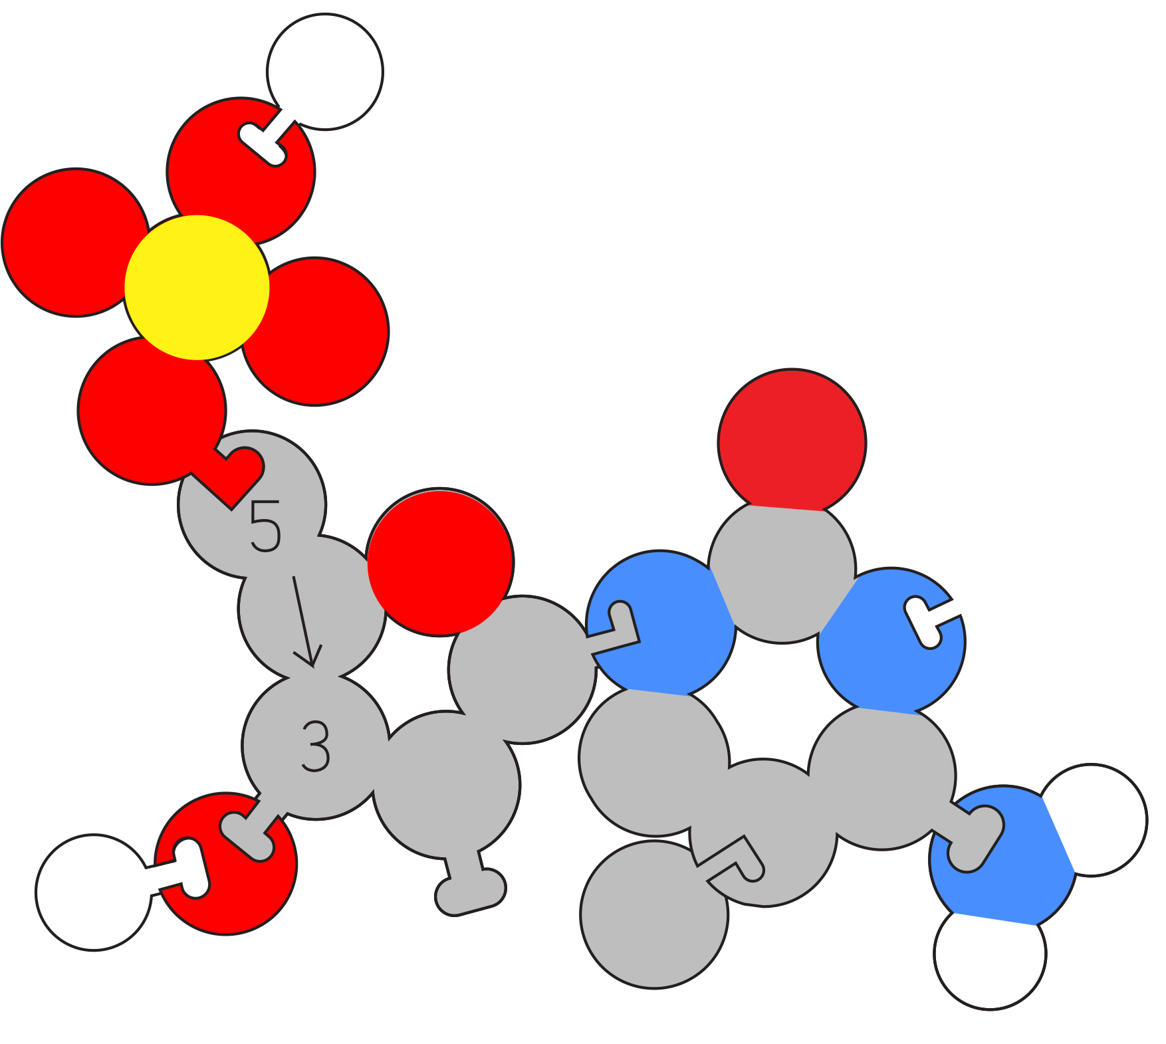
C
Methyl-C

Slide 24
T

Slide 26
G

Slide 28
A

Slide 29
A
T

Slide 30
C
G

Slide 31
A
G

Slide 32
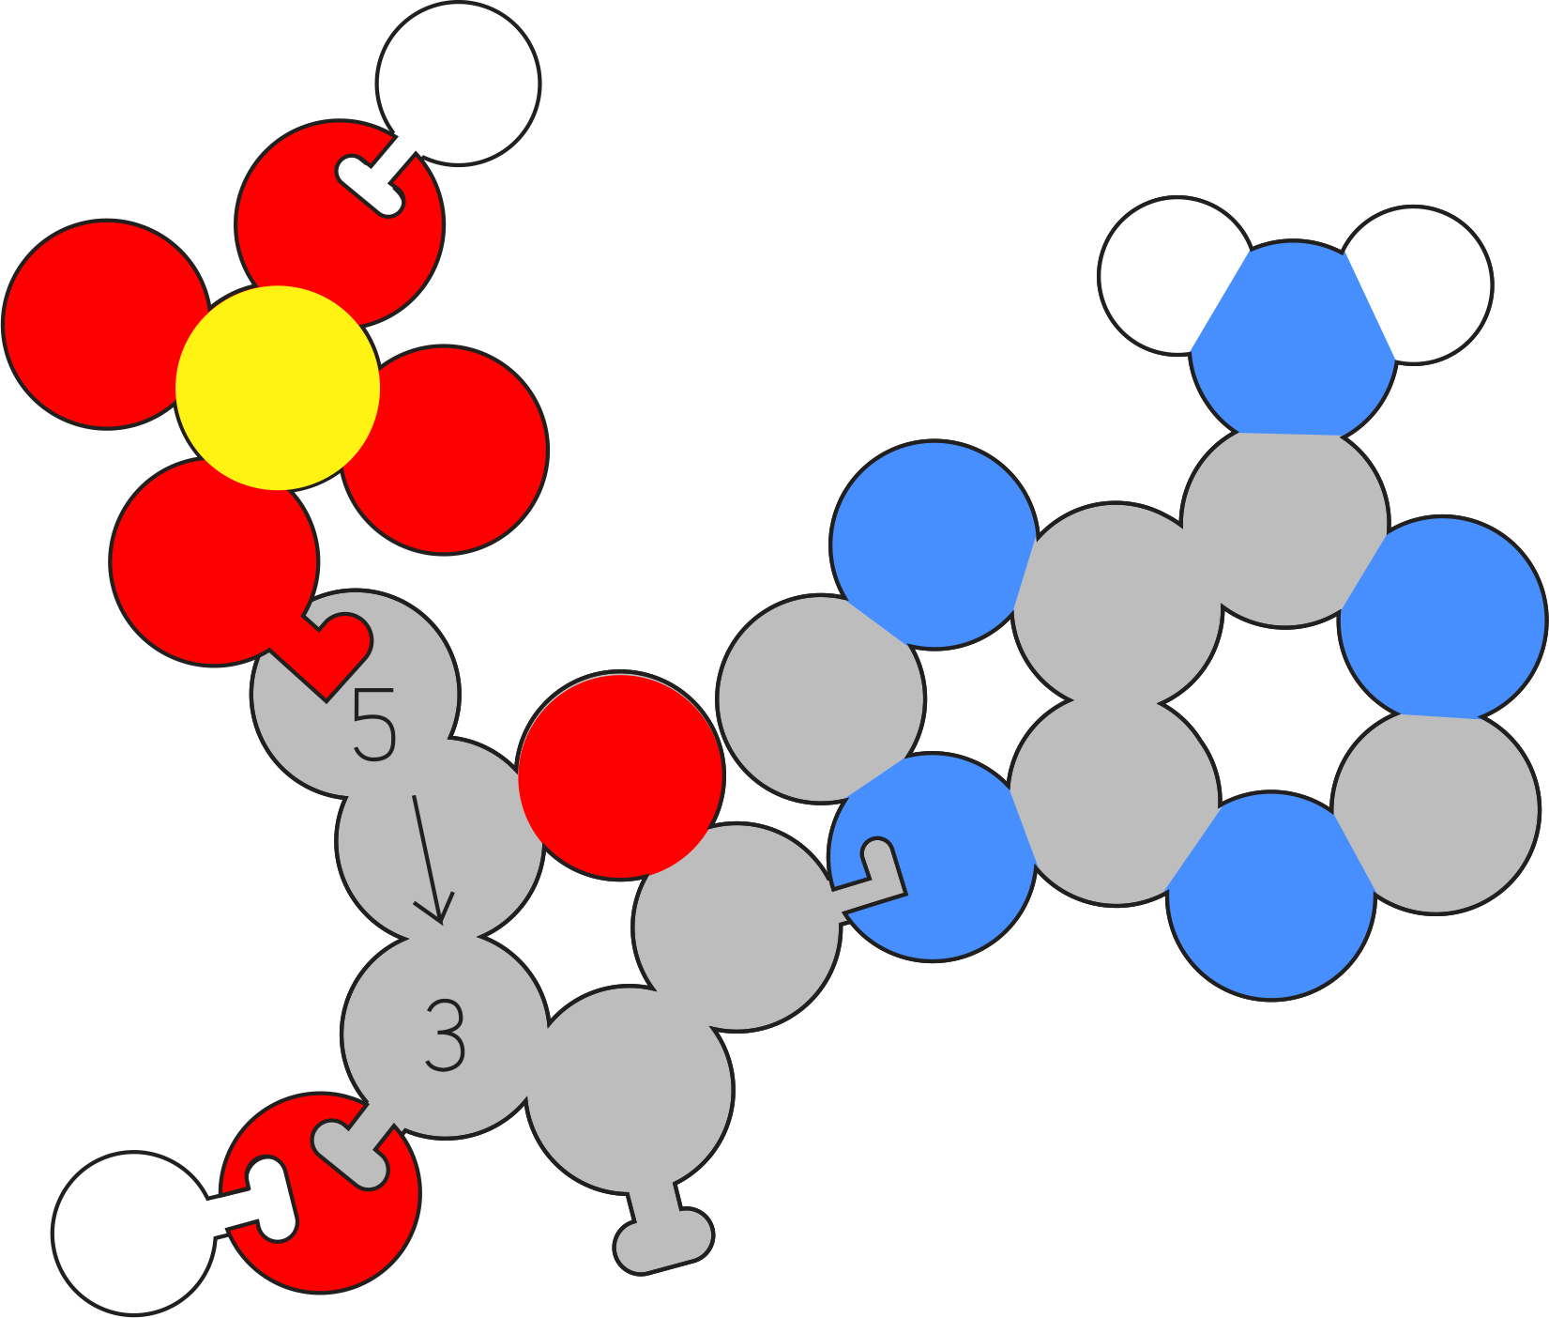

Slide 34
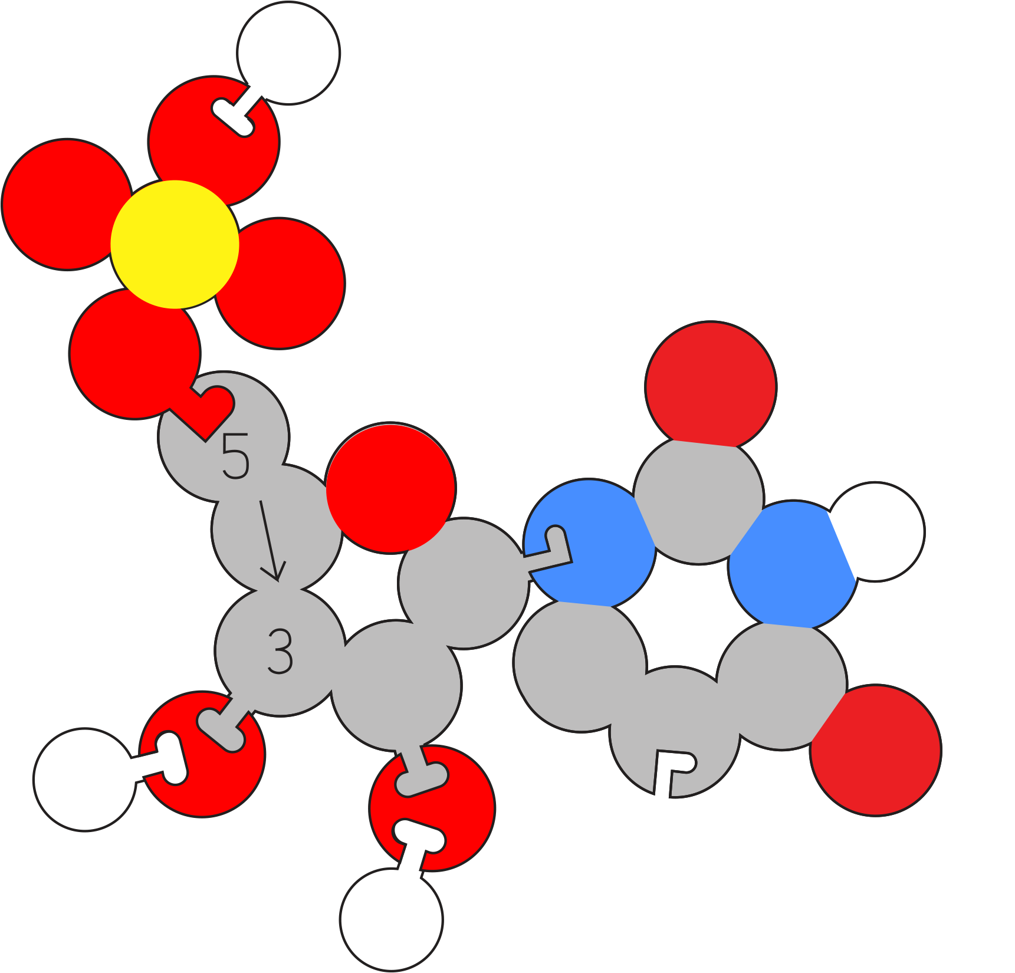
U

Slide 35
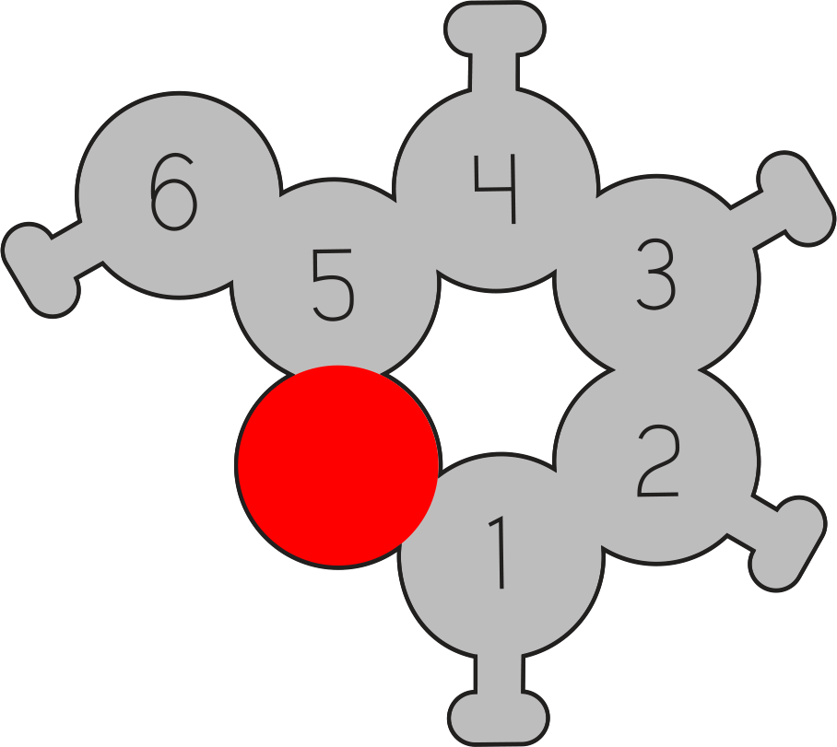
6,4,3
1,2

Slide 38
Starch, Glycogen
A 1,4

Slide 40
Cellulose
B-1,4

Slide 41
B-1,3 Glycosidic bond

Slide 42
B-1,6 Gycosidic Bond

Slide 43
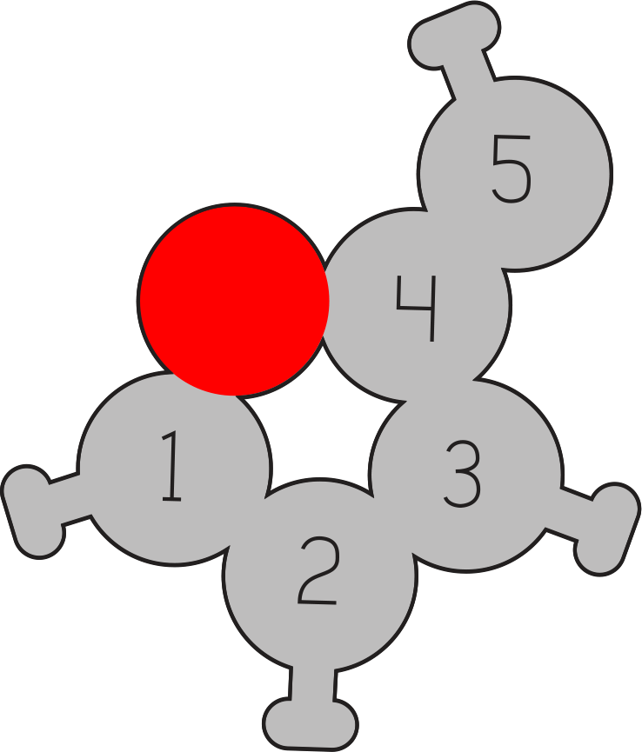
1,2,3,5

