Slide 1

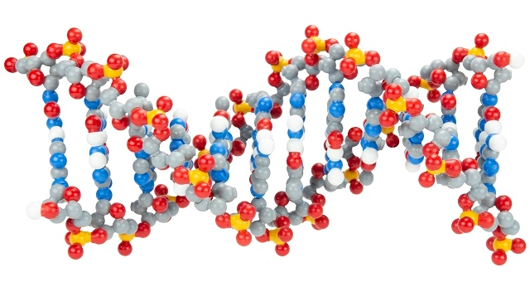
Discovering Dynamic DNA: More than Just As, Ts, Gs, and Cs

Slide 2






Mark Arnholt
Science Educator
3D Molecular Designs
BA Secondary Education
BS Biology
Broadfield certification
PLTW Instructor (PBS,MI, BI)
SMART Team Advisor
Fishing Club Advisor
24 years in the classroom
Hartford Union High School
2001-2022

Slide 3
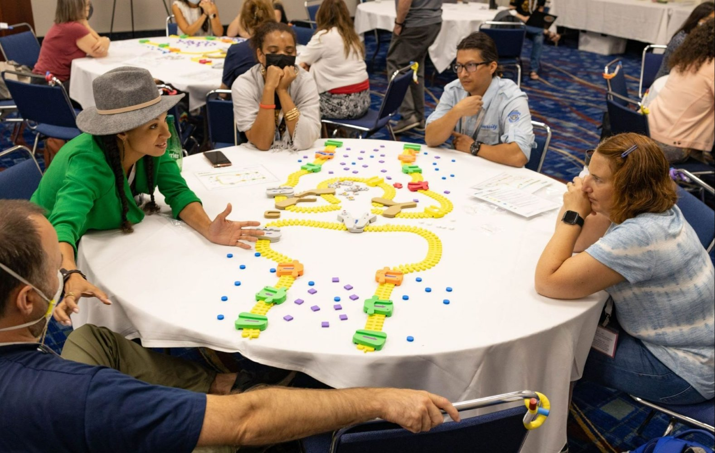
Workshop Learning Goals
1. Facilitate DNA exploration and question generation
2. Use models to help students develop a deeper understanding of DNA Structure
3. Discover other uses for the Dynamic DNA kit
4. Have fun!

Slide 4
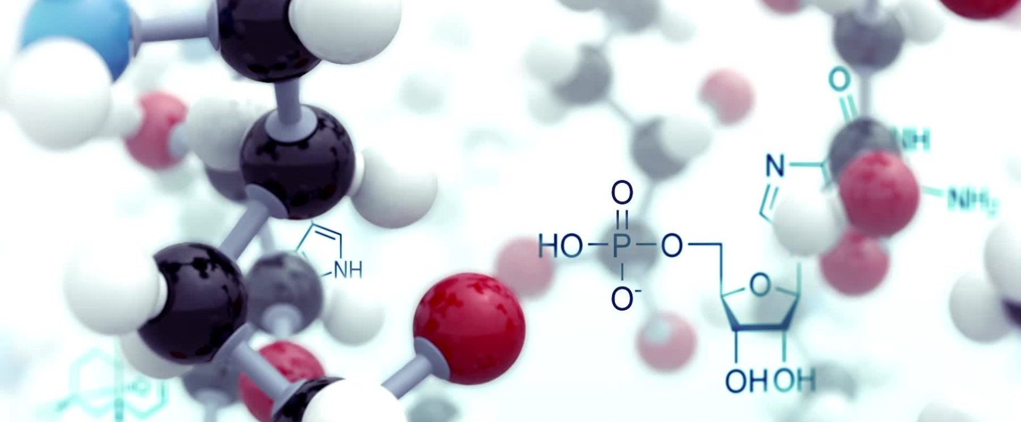

Slide 5
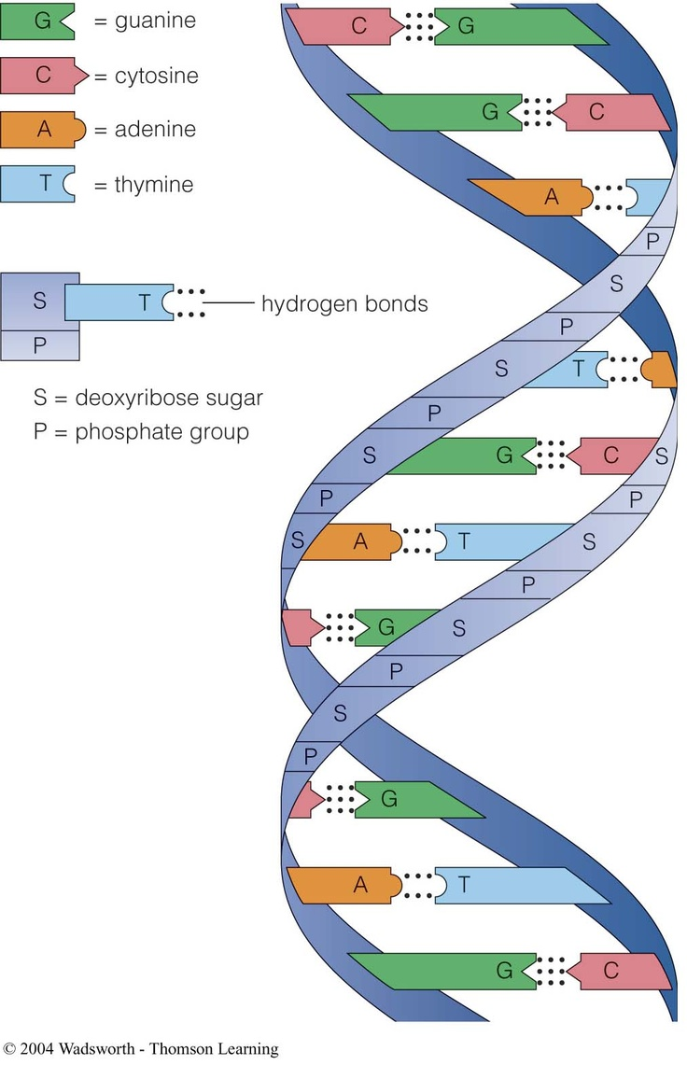
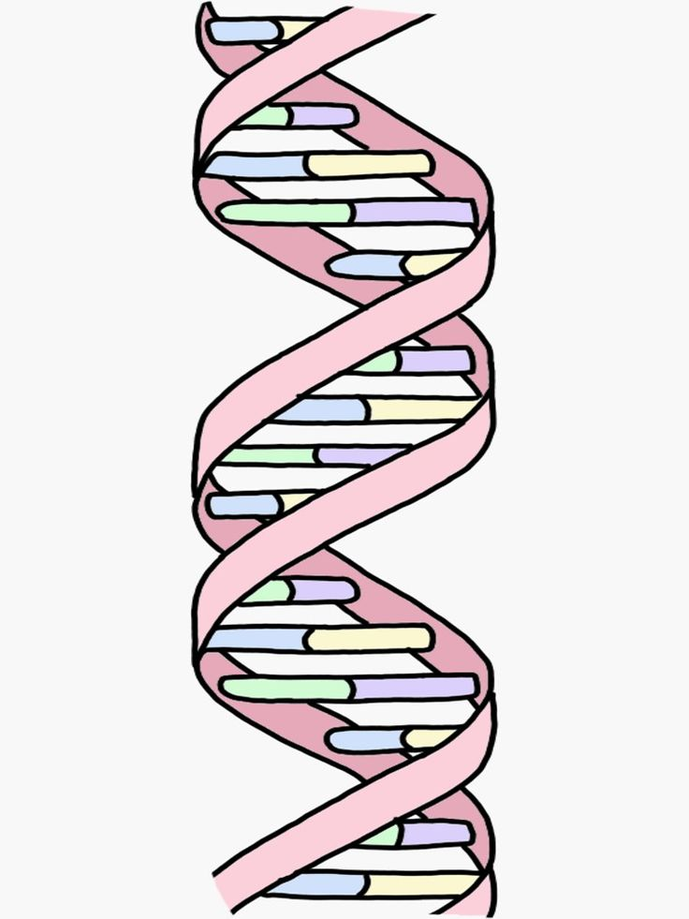
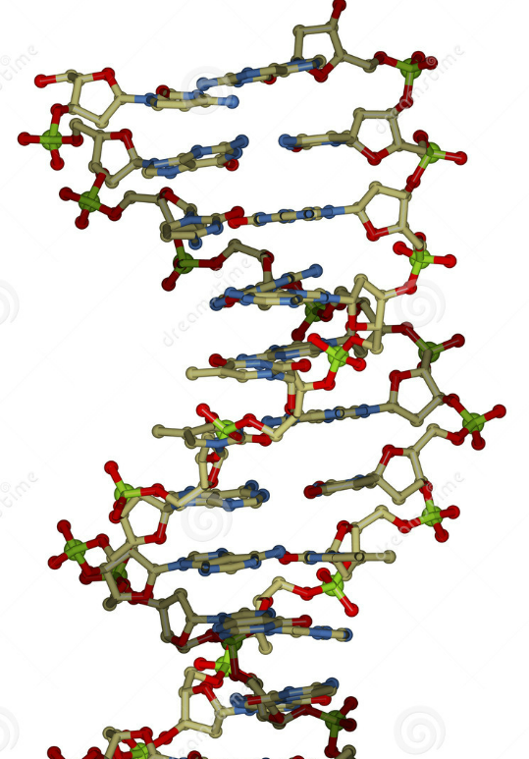
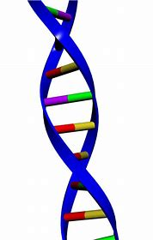
Which of these models do you use in your classroom?
1 2 3 4

Slide 6
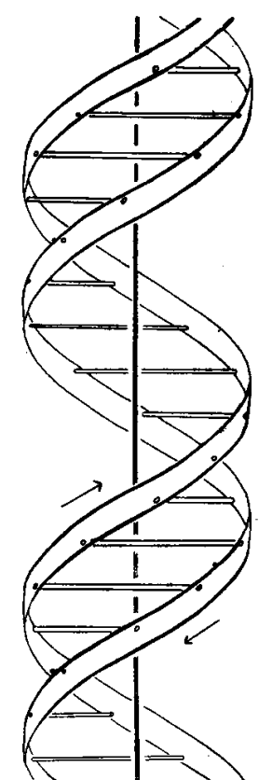
Where it all began…
April 25, 1952 – Publication in Nature by Watson and Crick suggesting a double helix structure

Slide 7
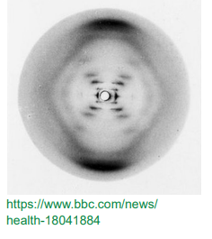
Rosalind Franklin’s Photo 51
DNA is way too small to see with
light!
X-ray Diffraction of a crystal
is used to determine the structure

Slide 8
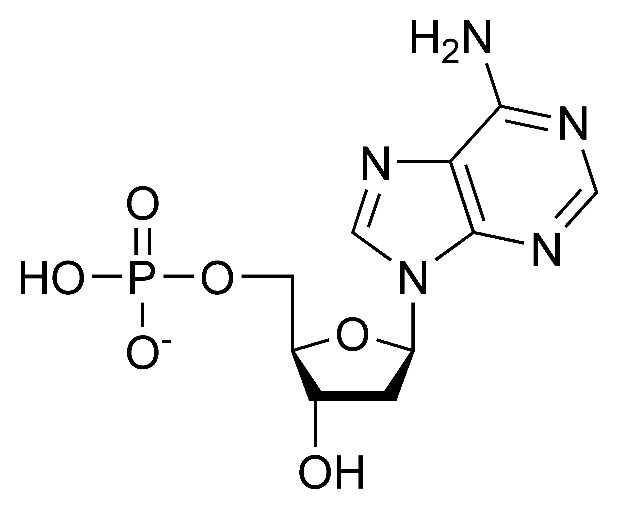
Take a look at a single nucleotide.
What are some observations you can make?

Slide 9
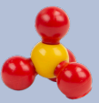
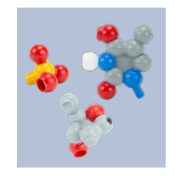
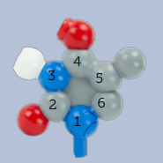
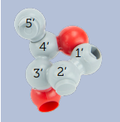
Let’s deconstruct a single nucleotide
Phosphate group
Nitrogenous Base (Thymine)
Sugar - Deoxyribose

Slide 10
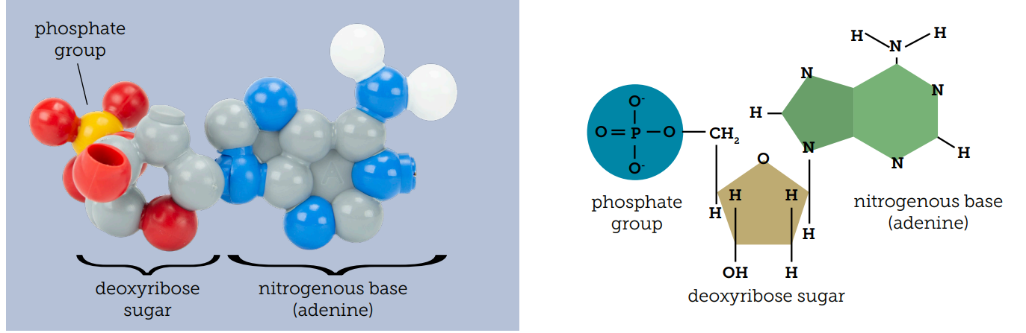

Slide 11
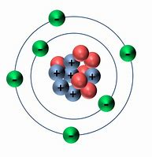
What color is a carbon atom?

Slide 12
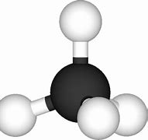
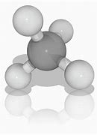
Your response gives us a hint to your background.
Chemist
BLACK
Biochemist
GREY
Note this to your students if you use Moly-mods!

Slide 13

This model uses the CPK color scheme.
This color scheme became standardized because of the work by Corey, Pauling, and Koltun

Slide 14
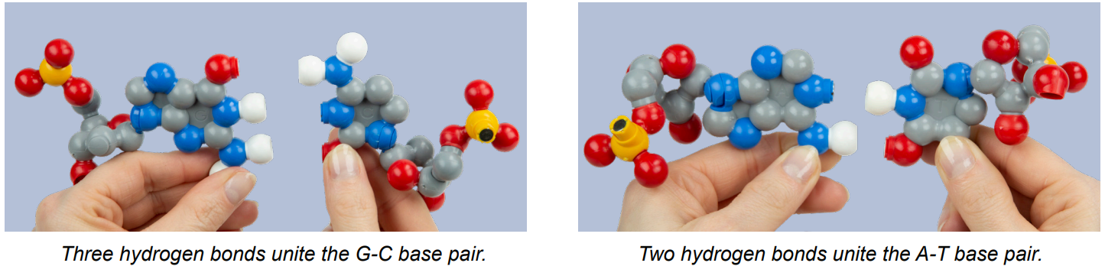
Base pair with a complimentary nucleotide. A-T and C-G.
* Notice the difference in the number of hydrogen bonds created.

Slide 15
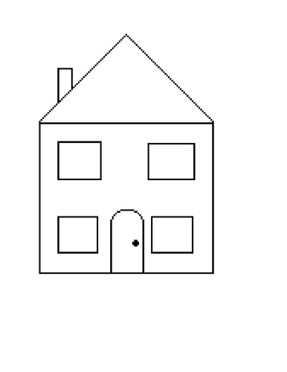
How is Deoxyribose like a house?

Slide 16
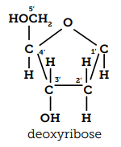
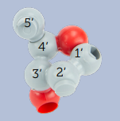
These are 2 different models of deoxyribose.
How are they similar?
What makes them different?
Which one is “better”?

Slide 17
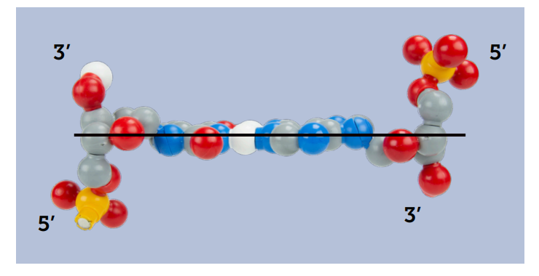
DNA is anti-parallel

Slide 18
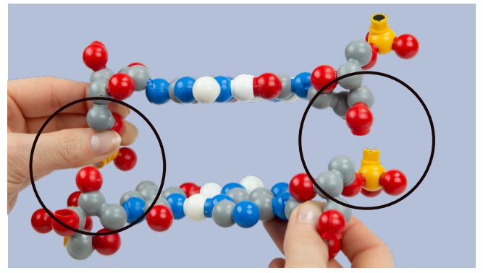

Slide 19
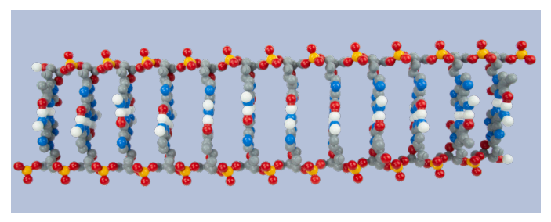
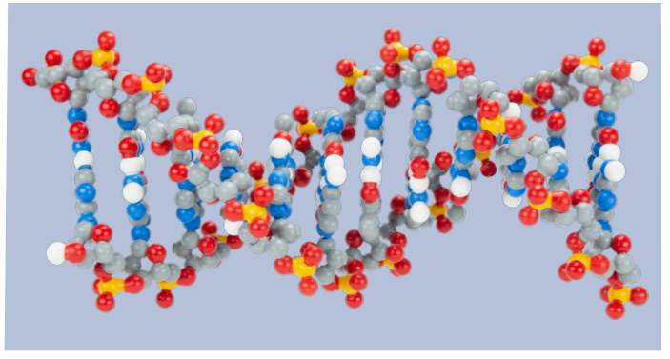
Double helix-
Right-handed helix
Major / minor groove
DNA Methylation
Linear format-
Replication / Transcription
Directionality
What else could you teach with this model?

Slide 20
What is the difference between Deoxyribose and Ribose?

Slide 21
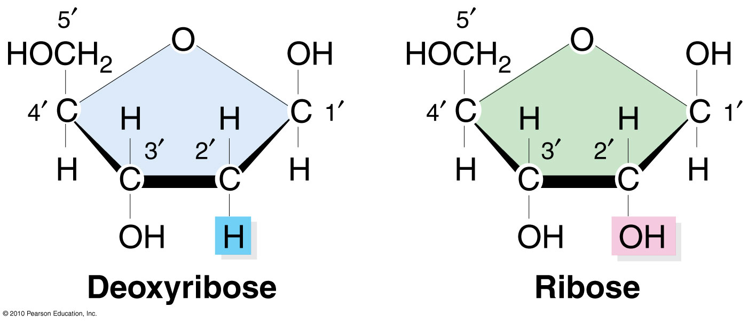
How can we model this for students?

Slide 22
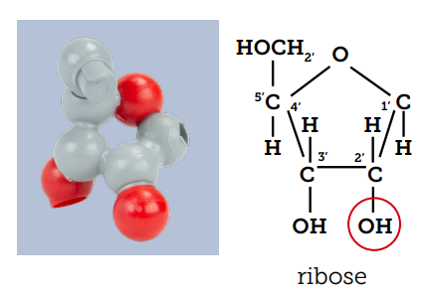
Add on Oxygen to the 2’C and you have Ribose!

Slide 23
Where's the Hydrogen?

Slide 24
What are we still missing to model RNA?
How can we make it?

Slide 25
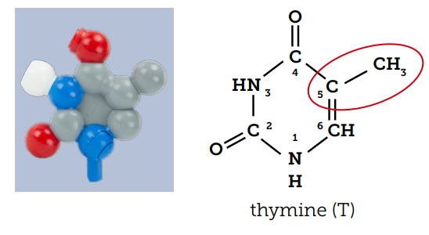

Slide 26
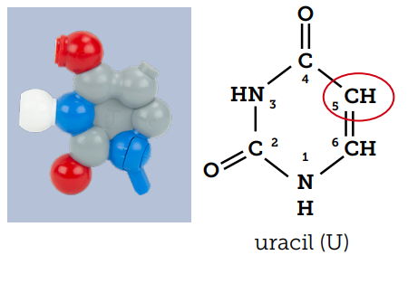
Remove a methyl group from the 5C of Thymine!

Slide 27
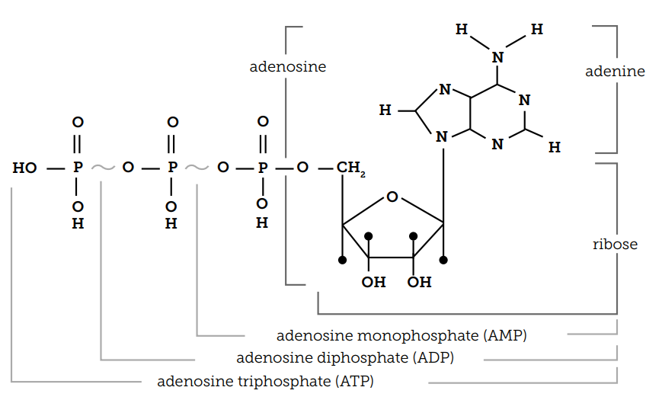

Slide 28
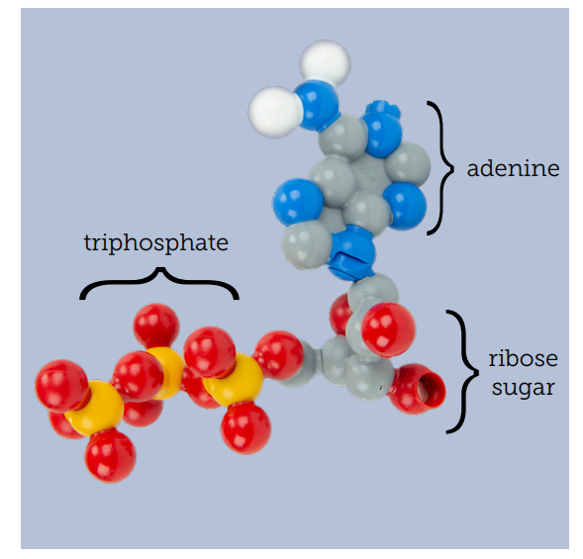
ATP & GTP
Find an adenine or guanine nucleotide
Add 2 phosphate groups
Add an Oxygen to the terminal Phosphorus
You can also remove phosphate groups to make ADP, GDP, GMP, and AMP.

Slide 29
Resources and acknowledgements
Additional reading:
Watson and Crick 1952
Watson and Crick 1953
DNA-Molecule of the month
Image Citations
Nucleotide
Ribose vs Deoxyribose
3D Molecular Designs
Teacher resources
Dynamic DNA – Teacher Guide
Dynamic DNA – Replication
Dynamic DNA - Transcription

Slide 30
Workshop NGSS Connections
SEPs | CCCs | DCIs
Asking Questions and Defining Problems (HS-LS3-1) | Cause and Effect (HS-LS3-2) | Structure and Function (HS-LS1-1)
Developing and Using Models (HS-LS1-4) | Scale Proportion, and Quantity (HS-LS3-3)
Analyzing and Interpreting Data (HS-LS3-3) | Systems and System Models (HS-LS3-3)
 | Science is a Human Endeavor (HS-LS3-3)

Slide 31

We put teachers first!
Your opinions are important to us.
We will email you
the resources associated
with this session.

Slide 32
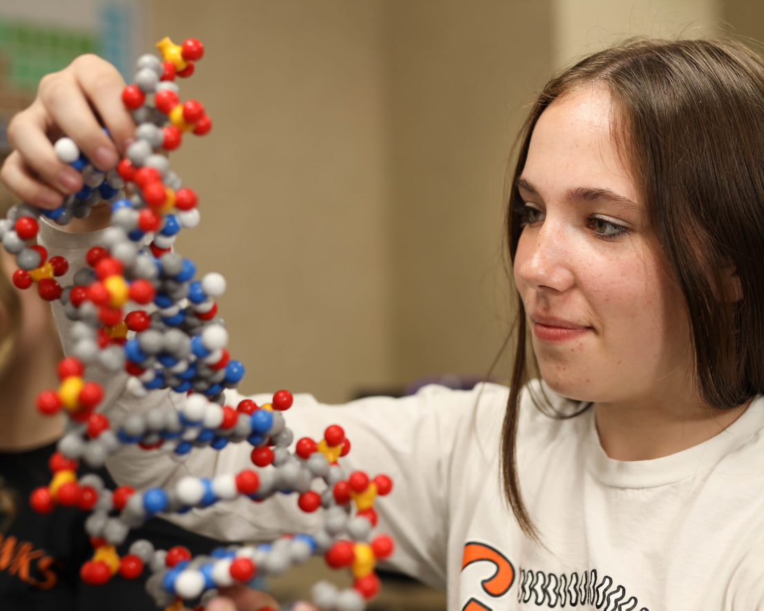
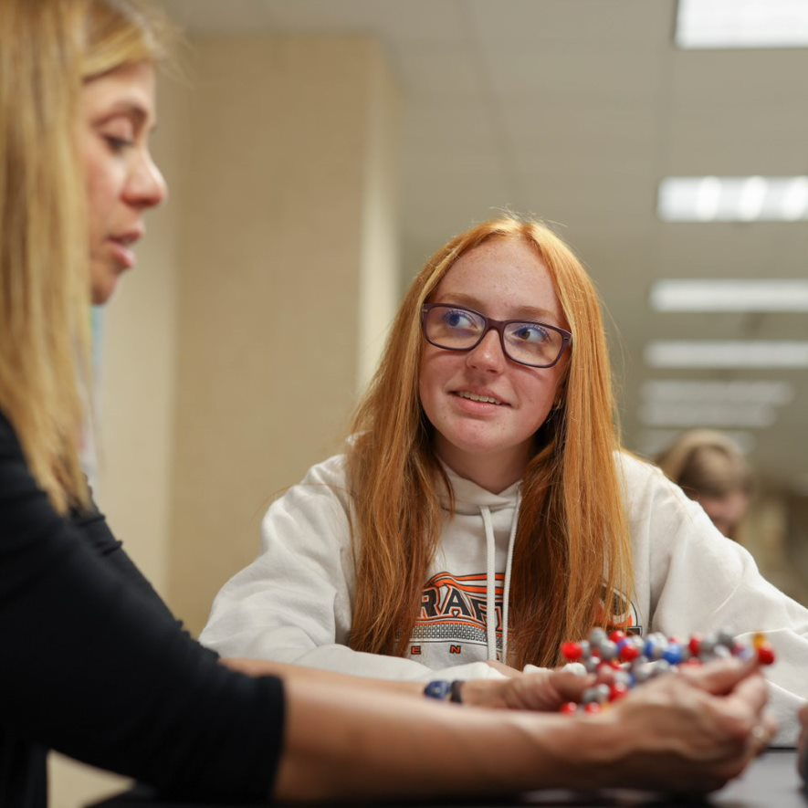
THANK YOU FOR ATTENDING!
Kits and models used in this session:
Dynamic DNA Kit
Purchase kits at 3dmoleculardesigns.com.
Use discount code STATE22 to receive 20% off most items in our catalog.
Student Modeling Packs are not eligible for discount.

