Slide 1
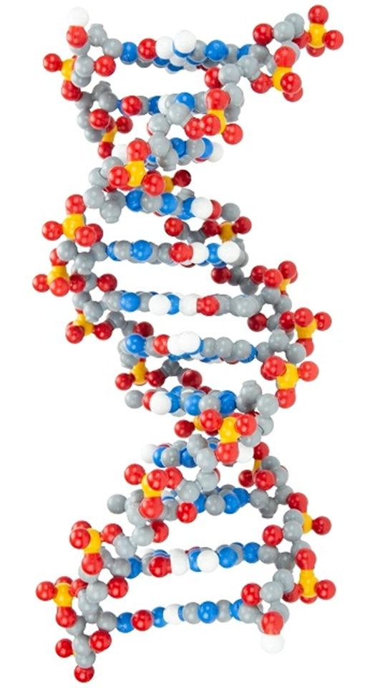
Discovering Dynamic DNA: More than Just As, Ts, Gs, and Cs

Slide 2
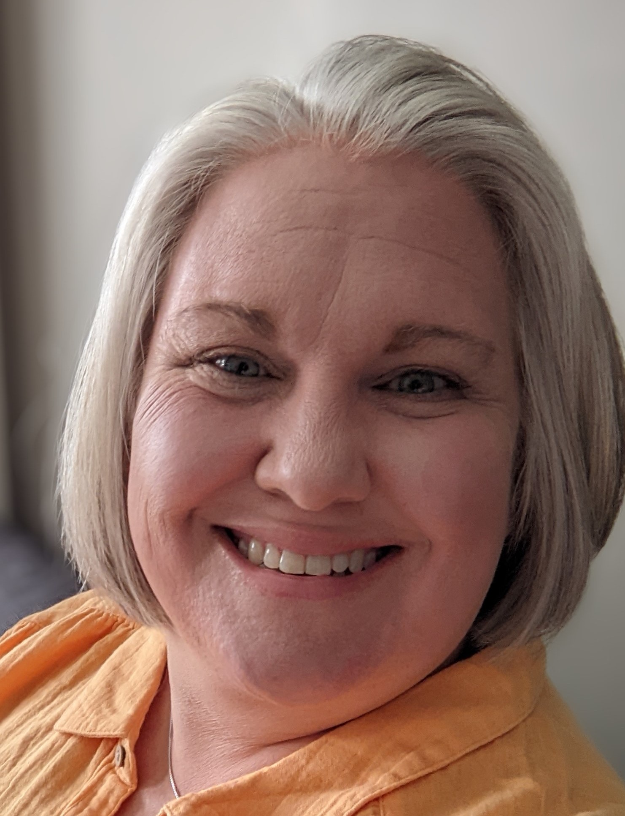
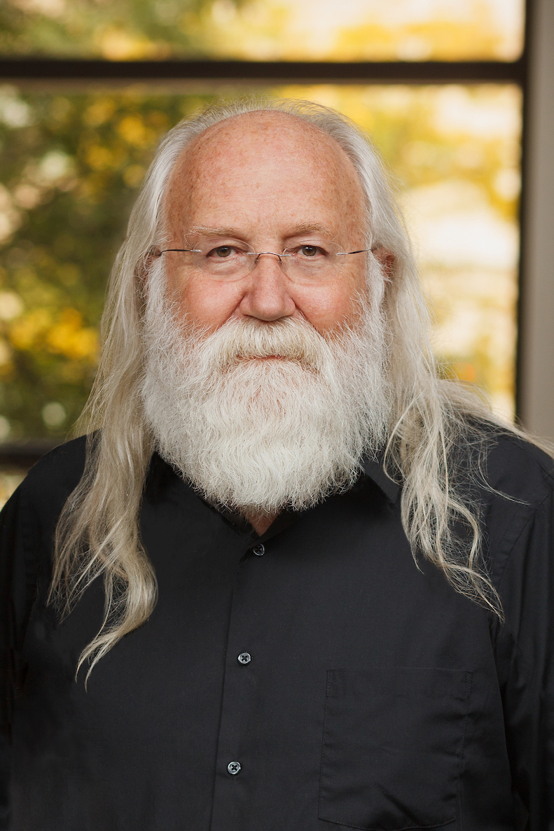
Presenters:
RUTH HUTSON,MSSE
3D Molecular Designs Science Educator
TIM HERMAN, PH.D.
3D Molecular Designs Chief Science Officer

Slide 3
Workshop Learning Goals
Use multiple models to better understand the structure of DNA
Ask questions to clarify relationships between DNA, the proteins it codes for, and the resulting traits seen in an organism.
Explain how the expression of genes can be regulated.
Have fun!
Notes:
Ruth says We are going to be modeling with the DNA Starter Kit, Dynamic DNA Kit, and some 3d printed models.. At the end of this session, you should be able to… read goals from slide).
So let’s get started with some modeling [Advance slide]

Slide 4
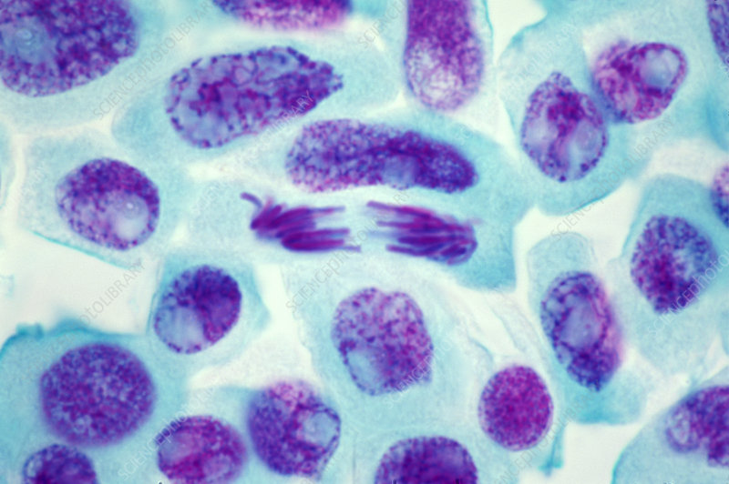
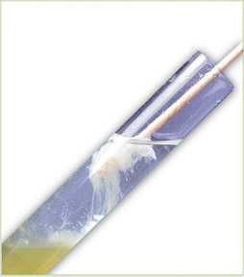
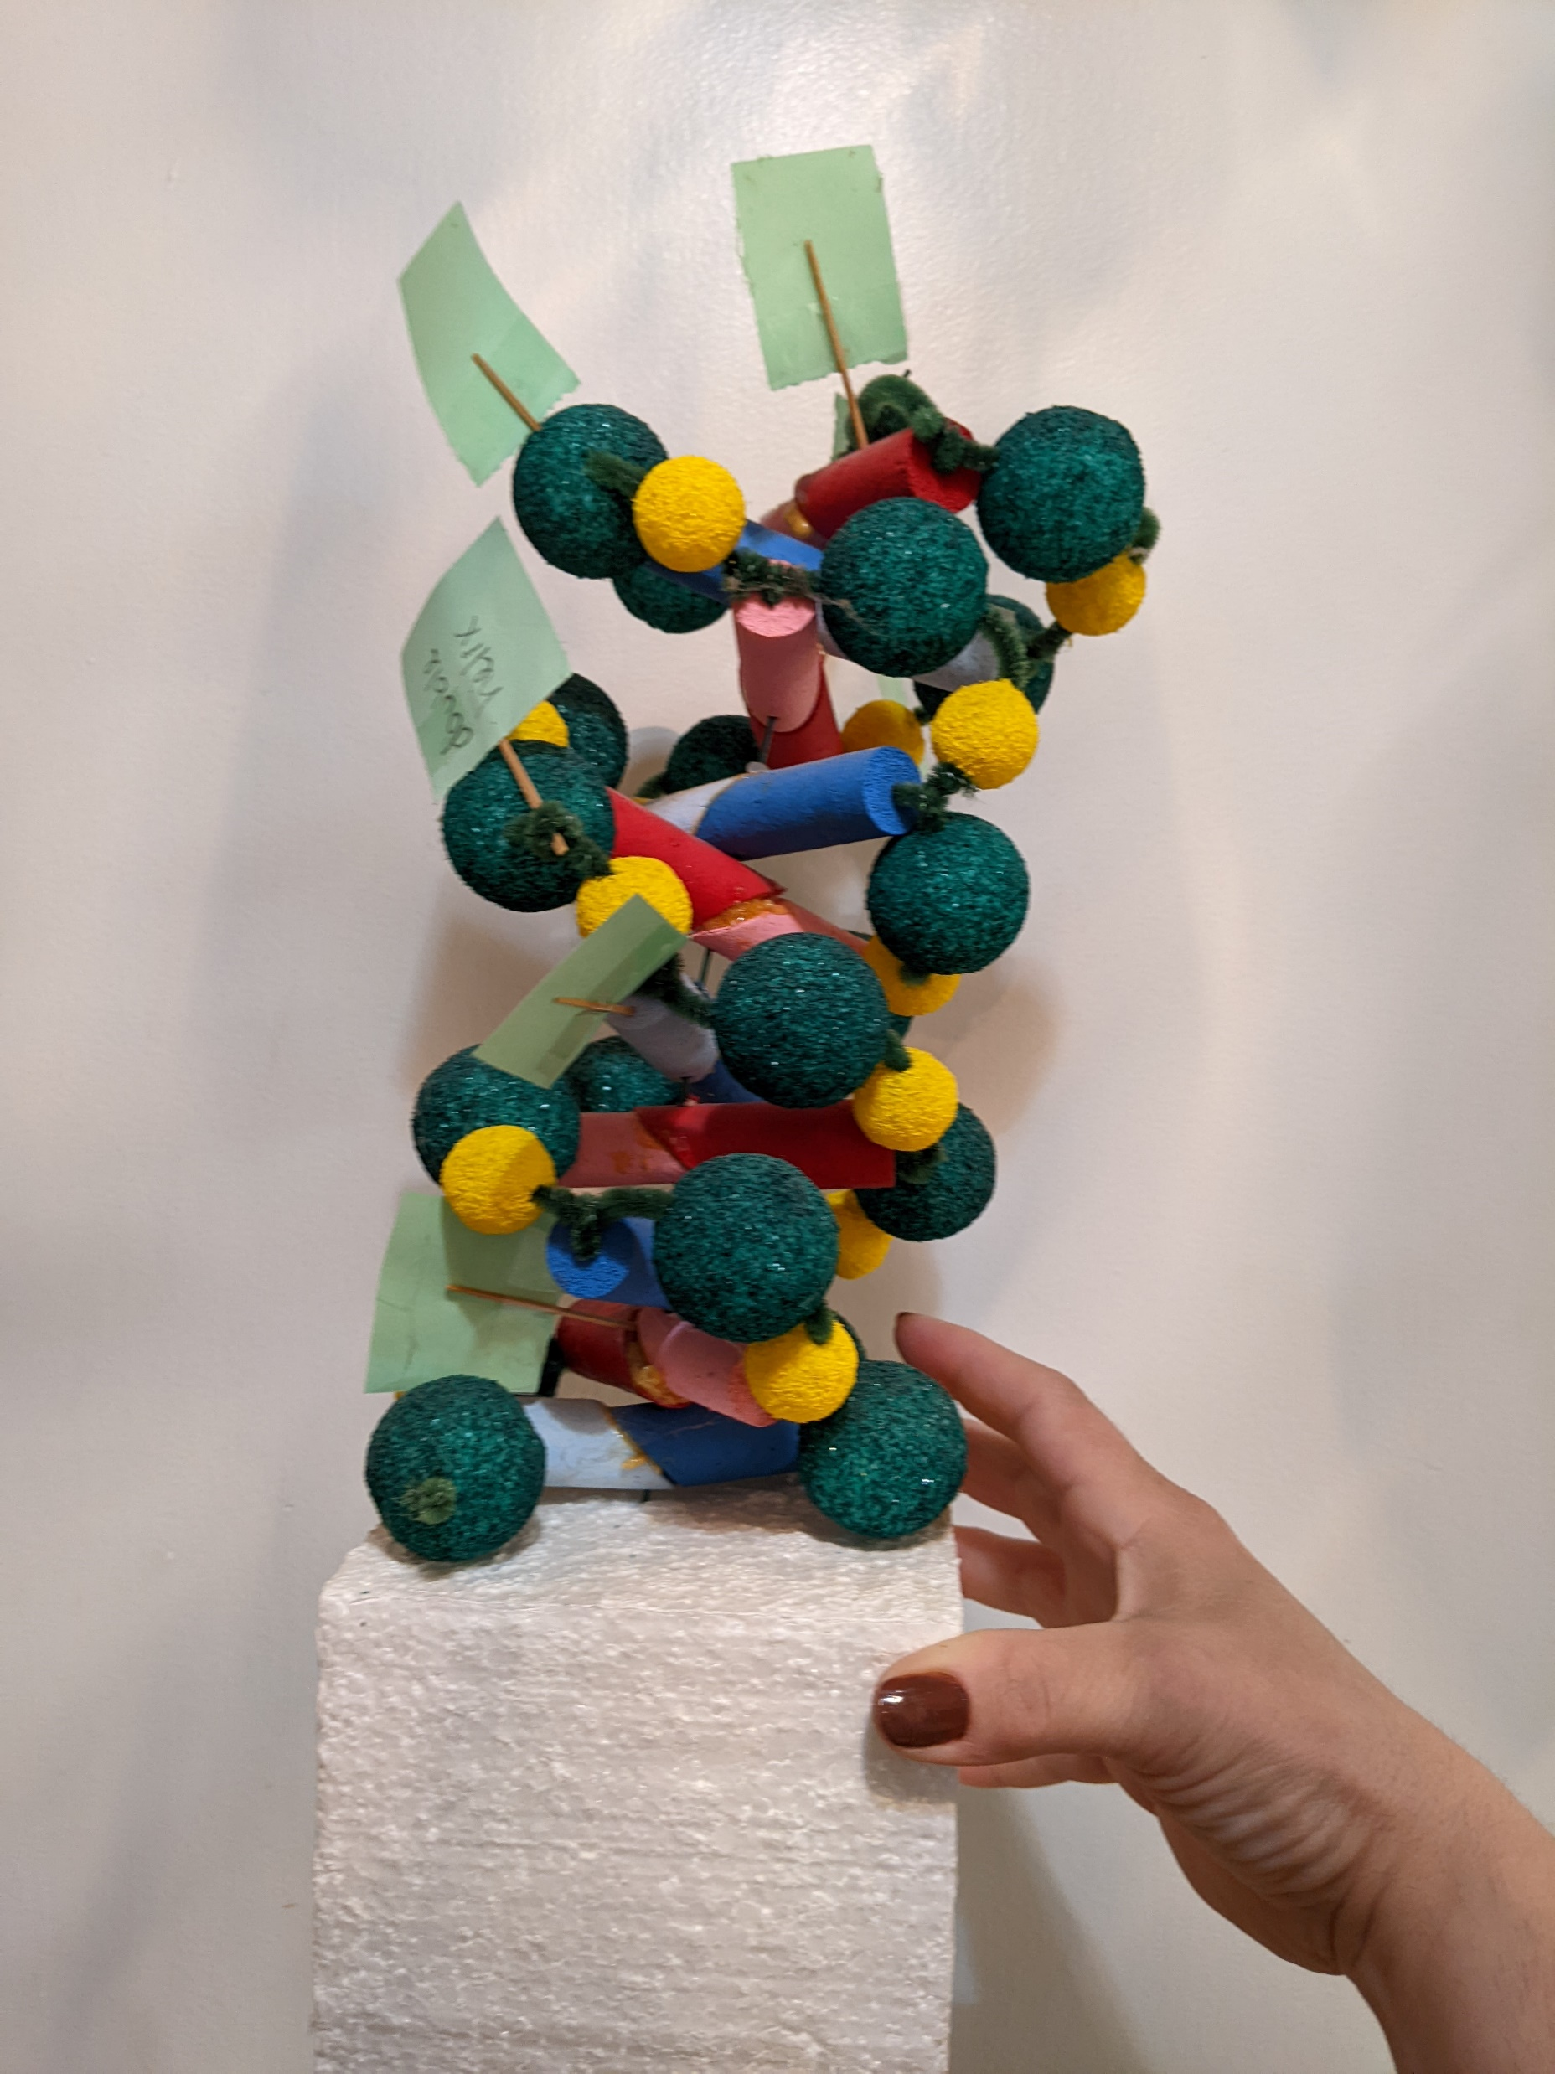
What do you do to help your students understand DNA’s role and structure?
Onion-root-Mitosis-scaled.jpg (2560×1918) (valleymicroscope.com)
LiveScience.com
Notes:
Poll the participants to determine what types of DNA models they use in their classroom.

Slide 5
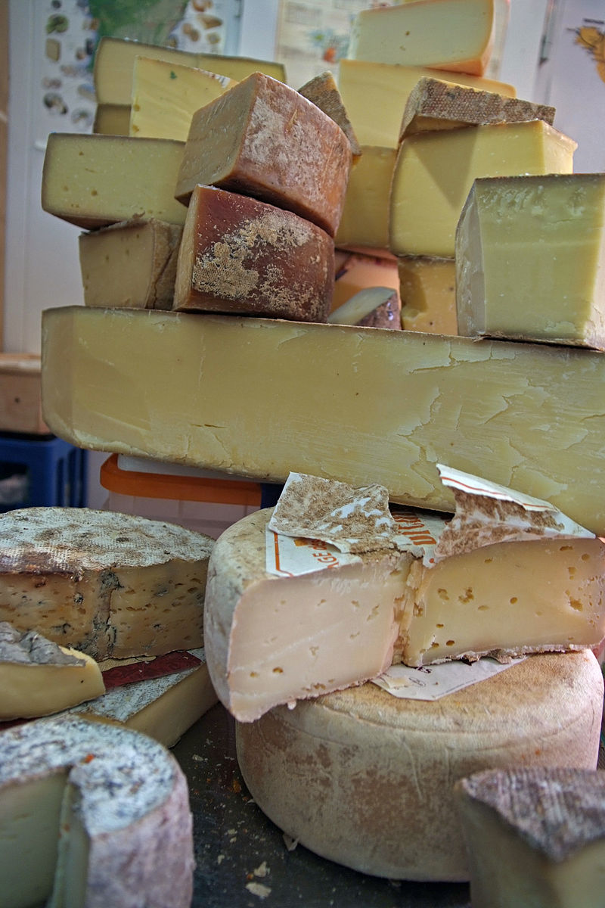
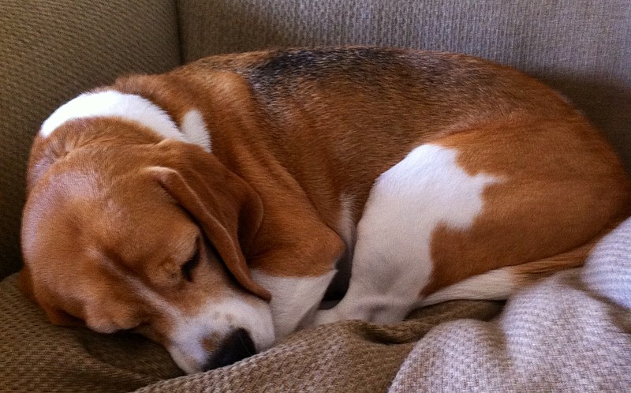
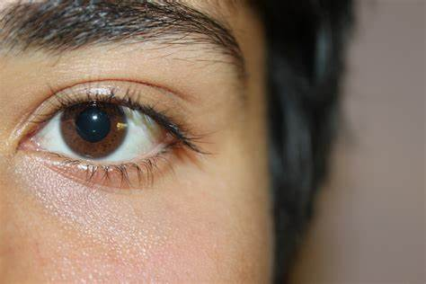
What questions do your students have about DNA and its role in inheritance?
File:Young beagle at rest.jpg - Wikimedia Commons
File:A sample of brown eyes.jpg - Wikipedia
Hartkaese HardCheeses - Cheese - Wikipedia
Notes:
Ask teachers what questions their students have? Explain how these questions can be used as anchoring phenomenon and are mush better than anything that we could possibly come up with to engage their brains.
Some questions my students have had in the past:
How can there be some many dog breeds, but they are all related to the wolf?
How can I have brown eyes, but my mom and dad have blue eyes?
Why could I eat cheese when I was younger, but now it makes me sick?
(I think I am going to add different images here.)

Slide 6
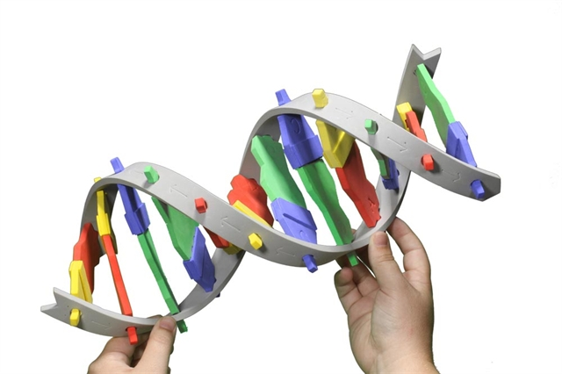
Using the DNA Starter Kit:
What do I notice about the model?
What do I wonder?
What two questions do I have?
Notes:
Using their student lens, participants will explore the DNA Starter Kit and consider the following questions. Once they have test to look deeply at the model, have them discuss the model using their teacher lens. How would this model be useful to students as an introduction? (5 minutes)

Slide 7
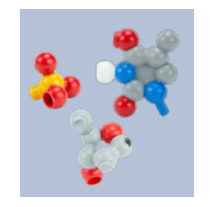
Without using magnets, assemble the model
What do you notice about the model?
Compare it with those at your table. How are they the same?
How are they different?
Notes:
Moving onto the Dynamic DNA model, ask participants to construct a single nucleotide. They should compare their nucleotide with other participants at the table. Each table should have four DNA different DNA nucleotides. (5 minutes)

Slide 8
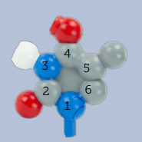
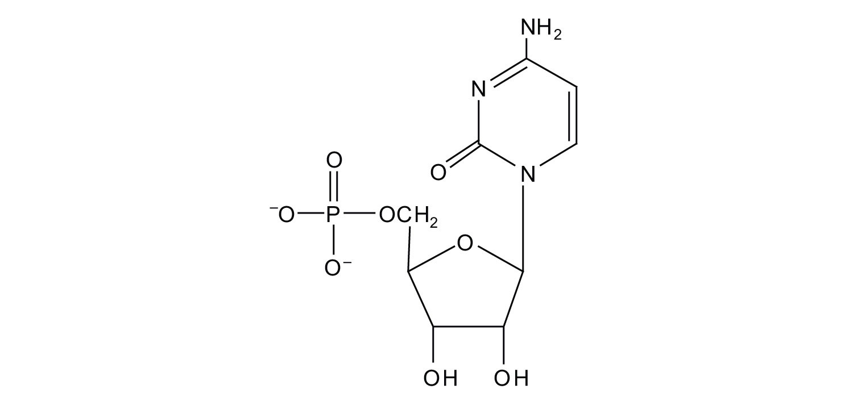
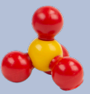
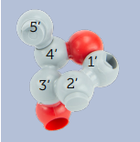
Let’s have a closer look at the structure
Notes:
Lead participants in the identification of the nucleotide parts and comparison of the two models. Give them hints as to how to distinguish between the different atoms in the ring structures and why that might be important for older students. Why is it important to use multiple models? (6 minutes)

Slide 9
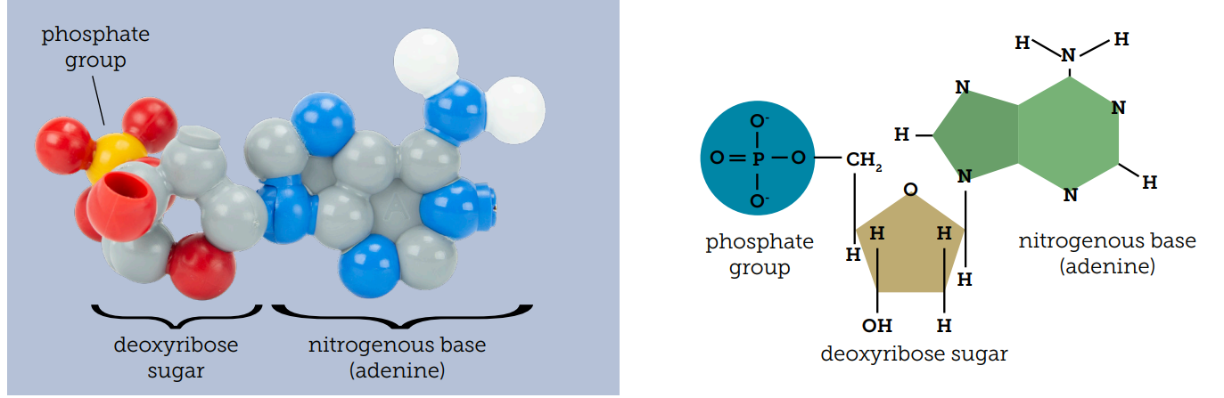
Let’s have a closer look at the structure
Notes:
Continue the discussion from the previous slide. Use Arnie's house analogy to identify the carbon on the deoxyribose.

Slide 10
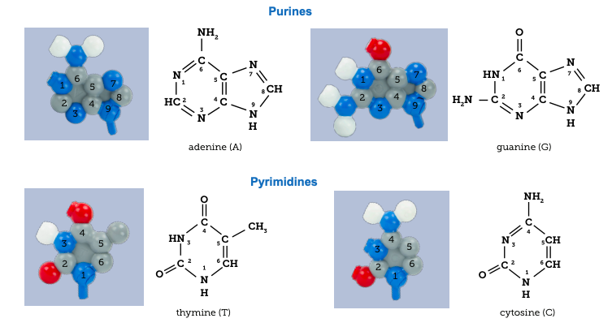
Using the magnets, find your nucleotide pair
Notes:
Participants will build a model to explore base pairing. (7 minutes)

Slide 11
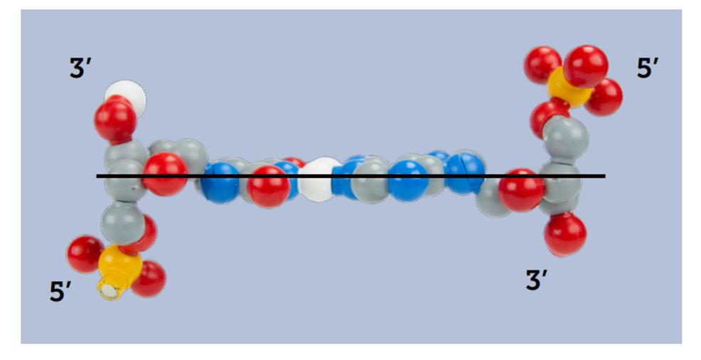
A closer look at the model
Notes:
What do you notice about where the nucleotides connect?
Explain and elaborate about the hydrogen bonding between base pairs. Remember that there is another way of viewing that might cause some confusion. Be aware of the orientation of your model. It is easy to see the antiparallel nature of DNA if it is held a certain way. Otherwise, it can be confusing to students. (5 minutes)
Now take two pairs and stack them. Continue to stack them until you have all of the pairs stacked at your table.

Slide 12
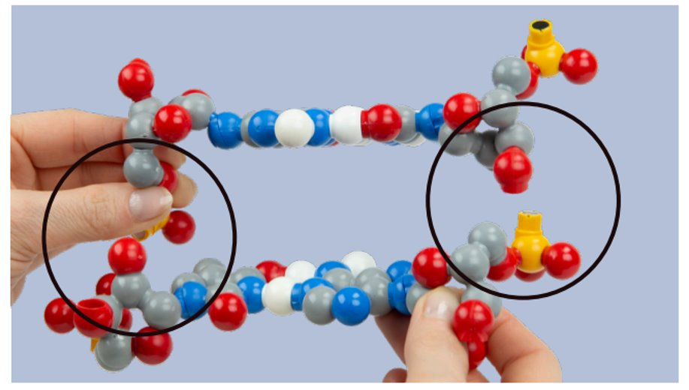
Notes:
Participants will construct a model of the alpha helix (7 minutes)

Slide 13
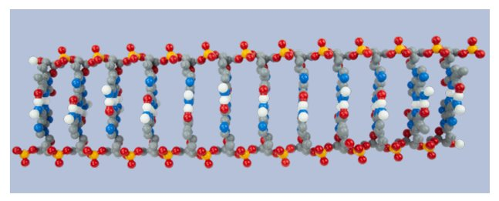
What do you notice? What do you wonder?
Notes:
Participants will compare the linear form's structure to the double helix structure. (5 minutes)

Slide 14
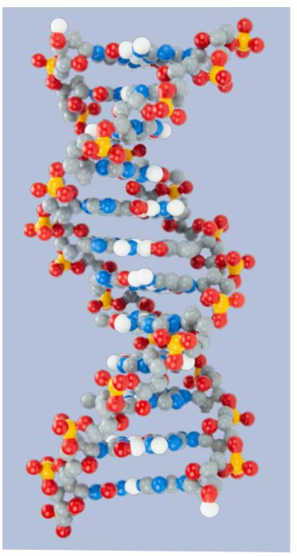
Comparing models
Why is it necessary to use multiple models?
What do each of these model represent?
What did the model do well?
What was lacking in the model?
How can the model be improved?
Notes:
Regroup and discuss the importance of using multiple models with students.
(Note: Point out that the chimney doesn't point "up" or "down" in this configuration. It points "away.")

Slide 15
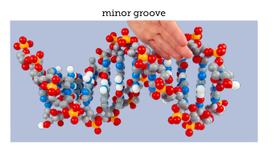
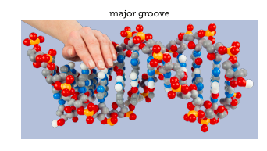
A closer look at the model
Notes:
Model and identify the major and minor grooves of DNA.

Slide 16
A closer look at the model
The alpha helix of a protein can fit in the groove
Amino acid side chains can interact with the nucleotides
Leads to Sequence-specific interactions
  DNA binding proteins
  Transcription factors
Notes:
Elaborate why the major is important in regulating gene expression. (3 minutes)

Slide 17
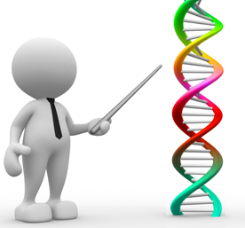
Genetics…
The Flow of Genetic Information…
The Genetic Code…
Replication…
Transcription…
Protein Synthesis…
Bioinformatics…
Genomics…
Editing Genomes...with CRISPR…
Epigenetics…
DNA Structure

Slide 18
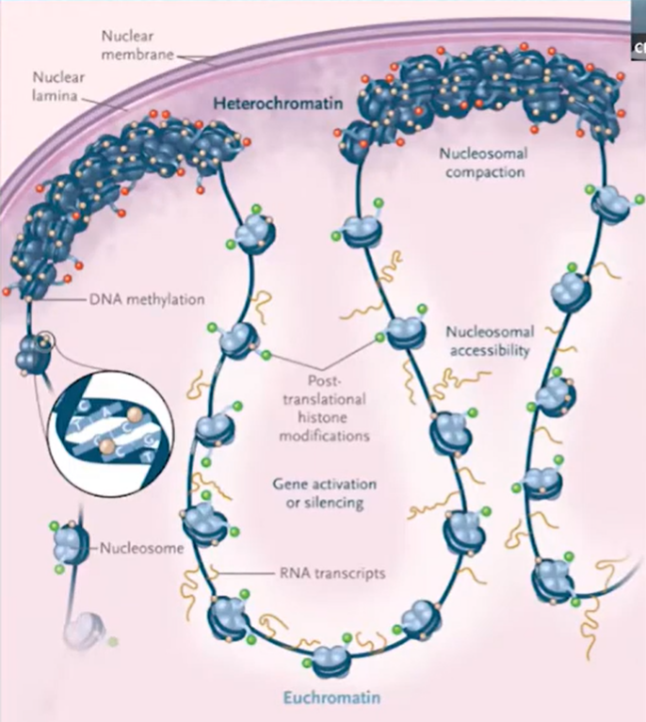
Epigenetics is....
...the chemical modification of
both DNA and histones...
...to regulate gene expression.

Slide 19
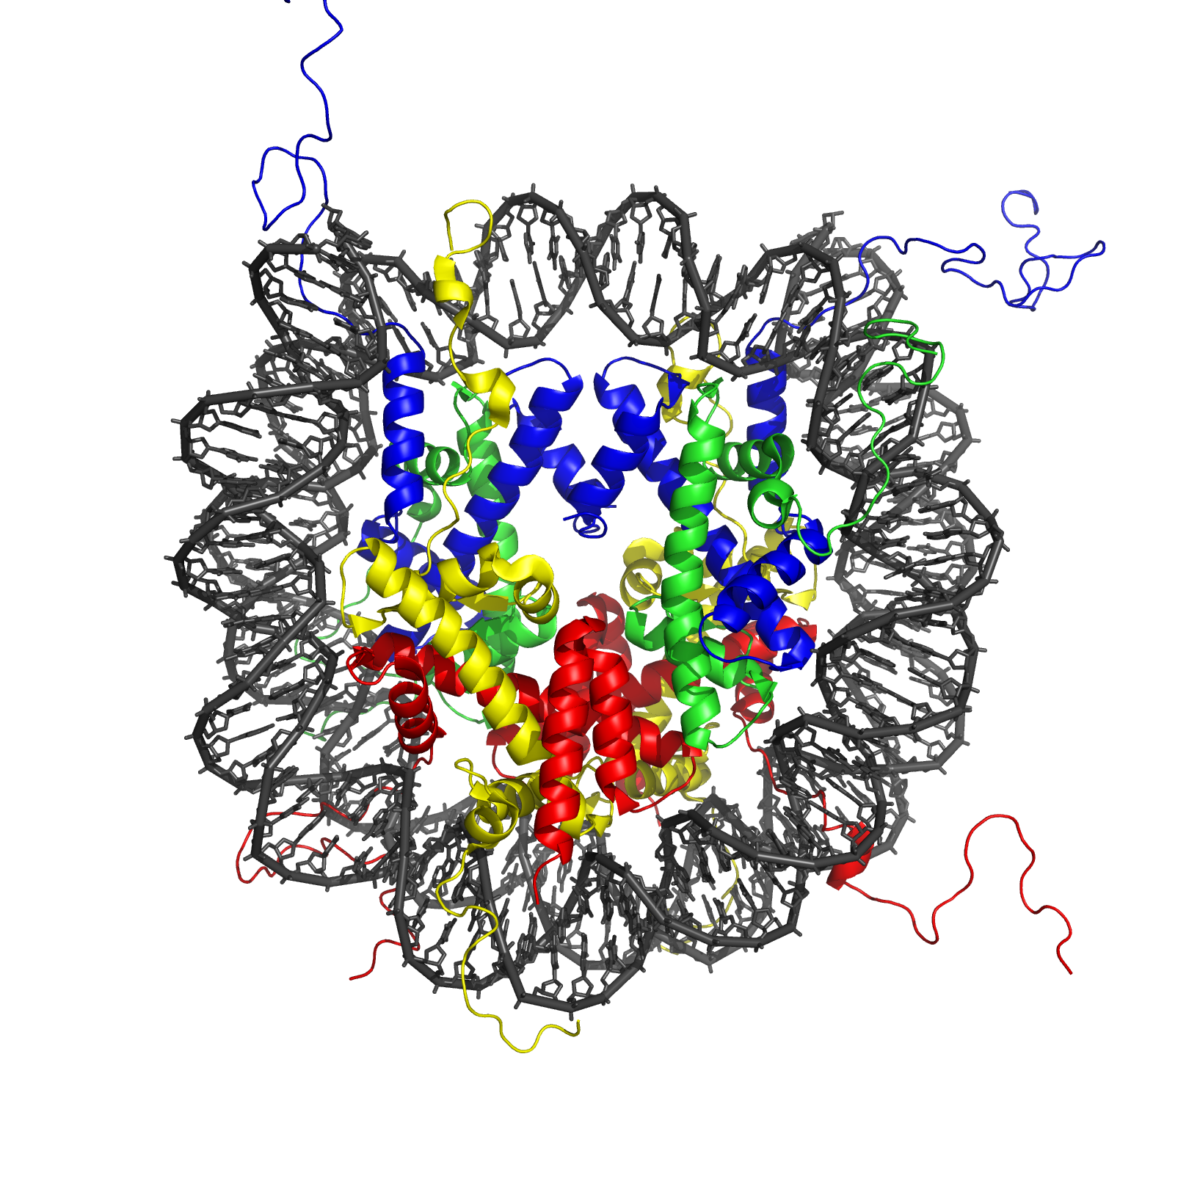
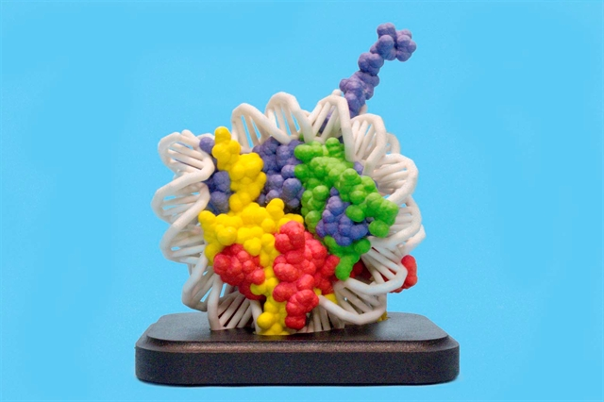
Nucleosome_1KX5_colour_coded.png (1620×1620)
Notes:
Ruth hands off the presentation to Tim. Tim and participants will explore the importance of the major and minor groove to epigenetics using a nucleosome model. (7 minutes)

Slide 20
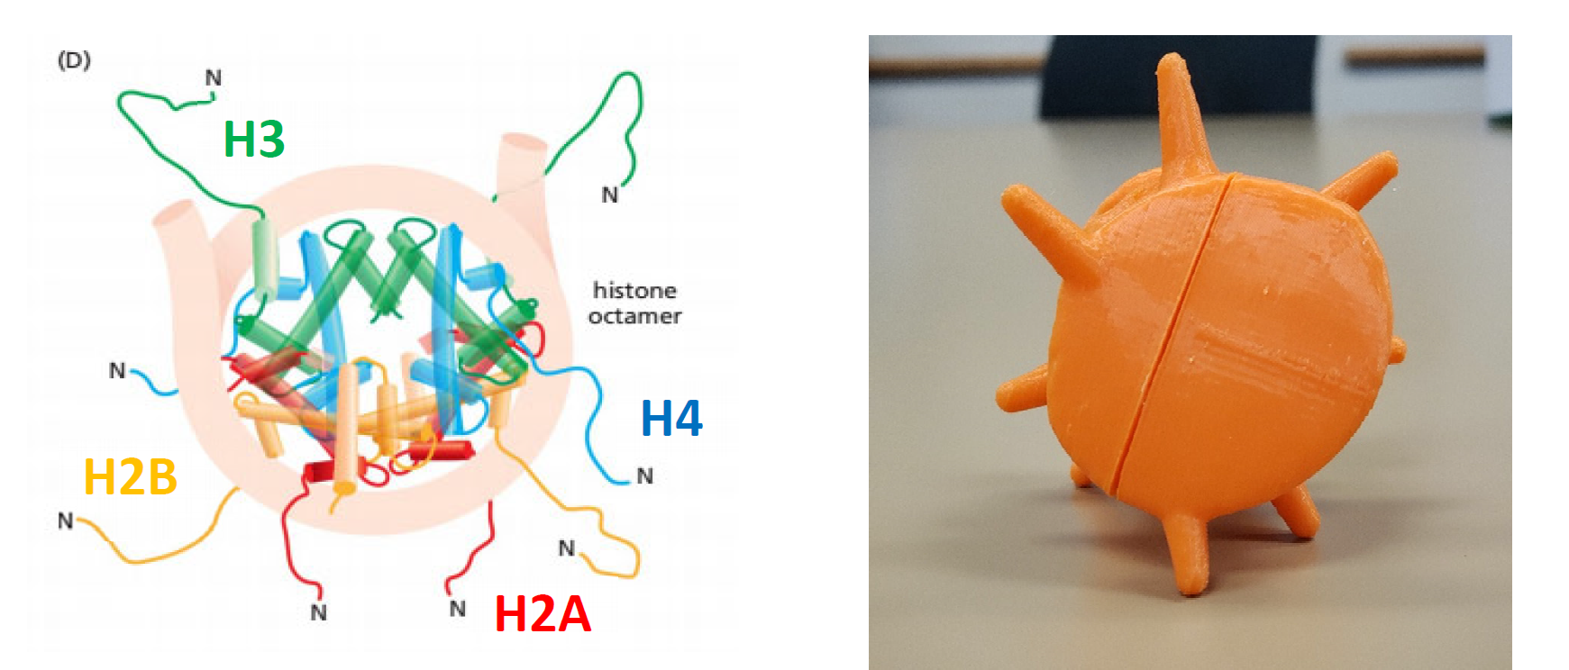

Slide 21
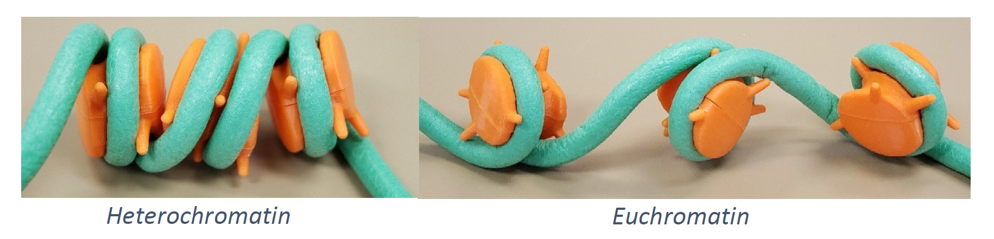

Slide 22
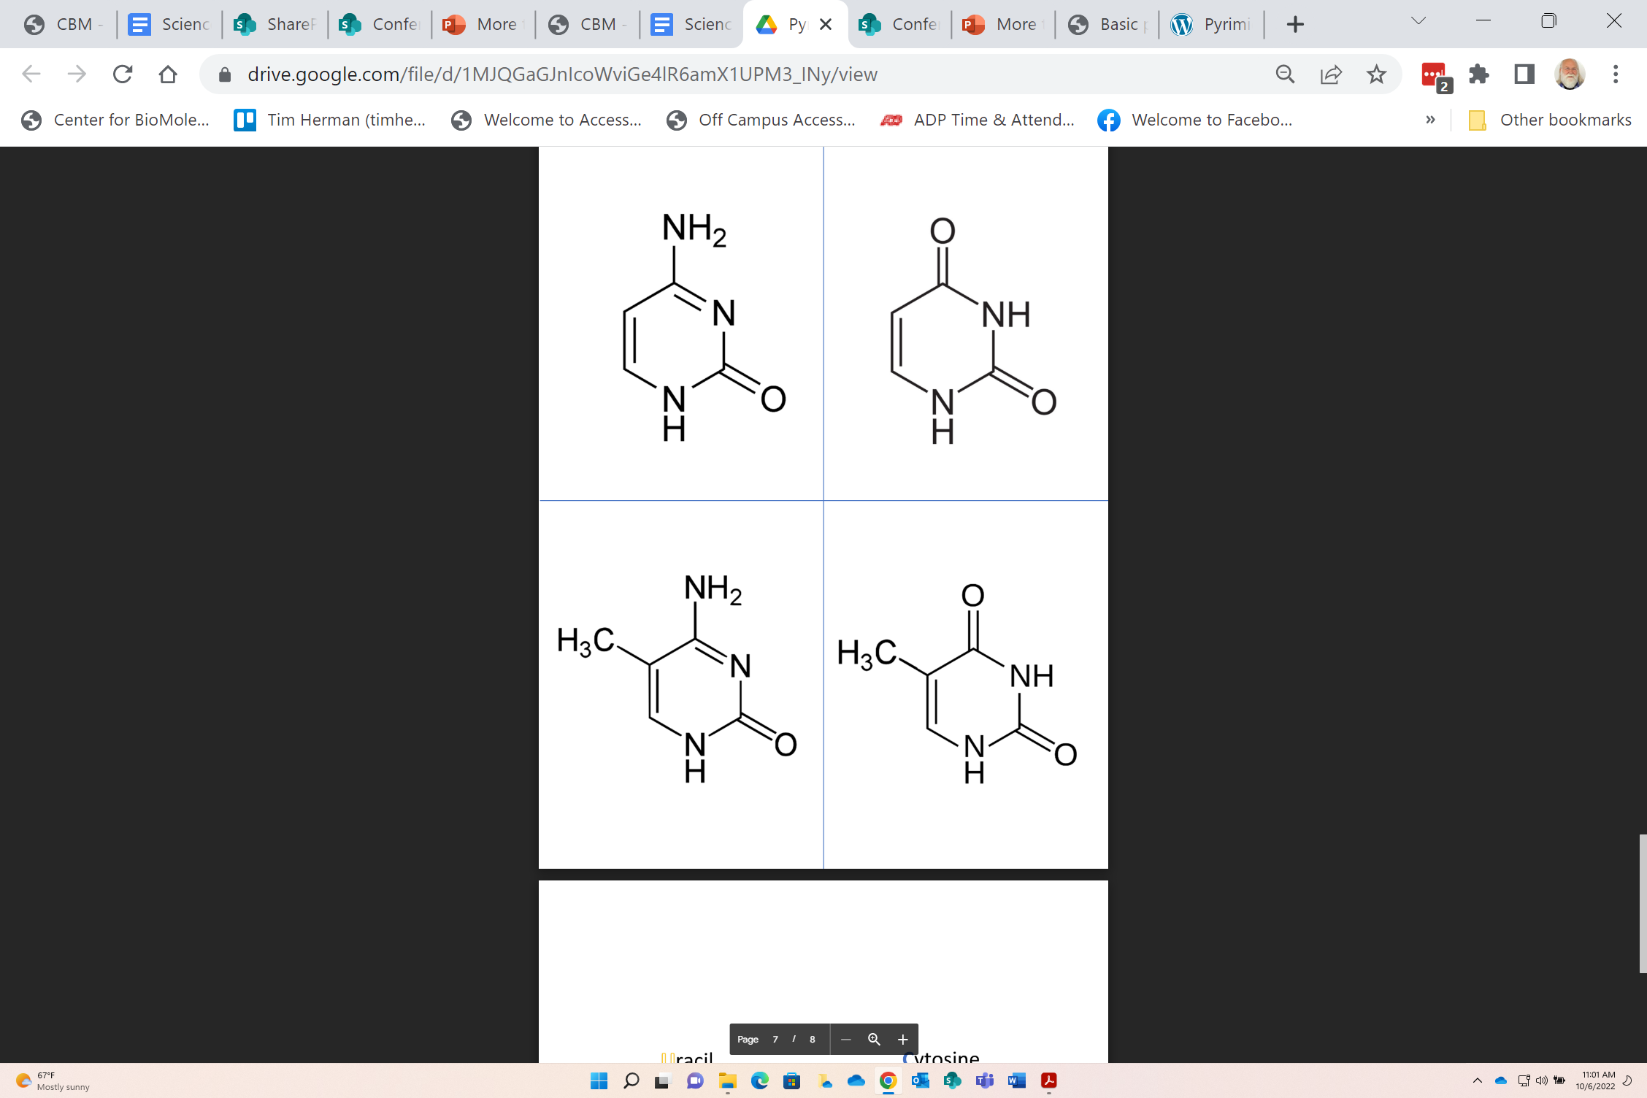
spontaneous
spontaneous
deamination
deamination
C
U
T
5MC
Cytosine
Uracil
Thymine
5-Me-Cytosine
Uracil N-glycosidase removes U’s from DNA

Slide 23
Methylation of CpG.....
Me
5'…ApGpTpCpGpTpApCpTpGpCpA…3'
3'…TpCpApGpCpApTpGpApCpGpT…5'
Me
Where are these methyl groups…in double-stranded DNA???
Notes:
(10 minutes)

Slide 24
DNA Methylation
The dinucleotide CpG should occur every 16 nucleotides in DNA.
In fact, it is only found once in every 100 nucleotides.
So,… where have all the CpG’s gone?
… long time passing.
https://www.youtube.com/watch?v=9yWt4IYoQoI
Notes:
(10 minutes)

Slide 25
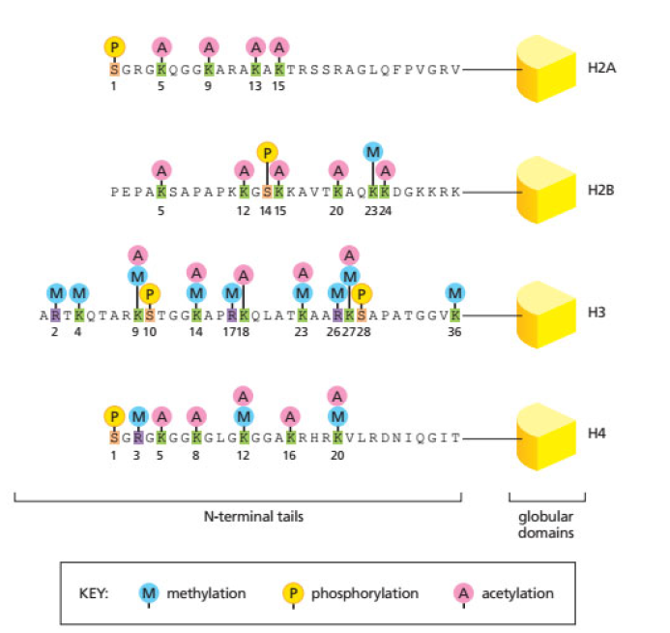
Histone Modifications.....
Life is Complicated.....

Slide 26
spontaneous
spontaneous
deamination
deamination
C
U
T
5MC
Cytosine
Uracil
Thymine
5-Me-Cytosine
Uracil N-glycosidase removes U’s from DNA

Slide 27
Workshop NGSS Connections
SEPs | CCCs | DCIs
Asking Questions and Defining Problems | Cause and Effect | HS-LS1-1 Structure and Function
Developing and Using Models | Scale, Proportion, and Quantity | HS-LS3-1: Inheritance of traits
Constructing Explanations and Designing Solutions | Structure and Function
 | Science As a Human Endeavor
Notes:
Ruth says: Here are the NGSS Connections for this workshop.

