Slide 1
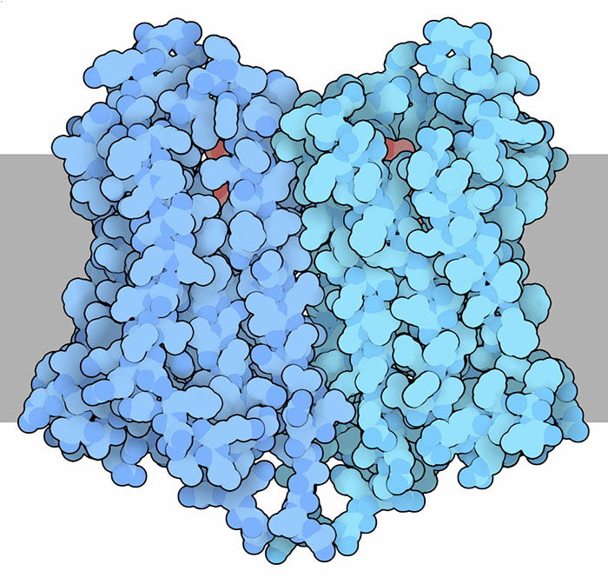
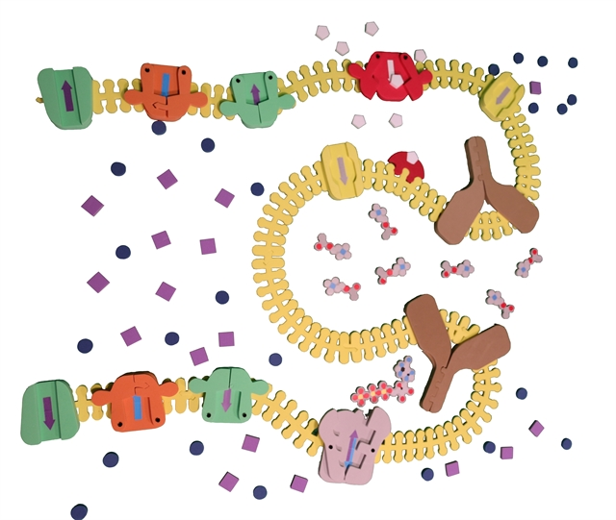

It’s time to talk about it
Opioids, Narcan, and Mu-Opioid receptors interactions in the nervous system
Ruth Hutson
Mark Arnholt

Slide 2
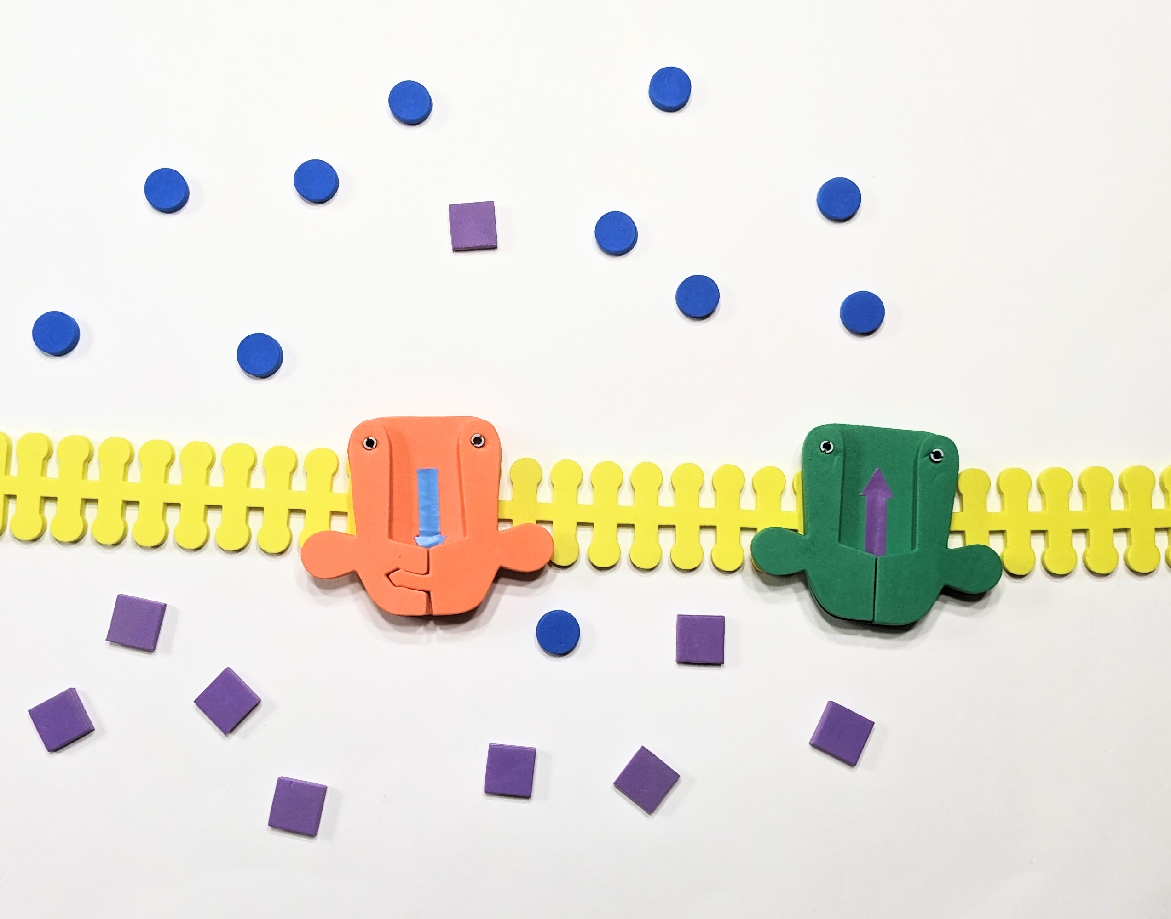
The Action Potential
Notes:
Model an action potential using three membrane pieces, 10 sodium ions (blue circles), 10 potassium ions (purple squares), 1 orange voltage-gated sodium pump, and 1 green voltage-gated potassium pump

Slide 3
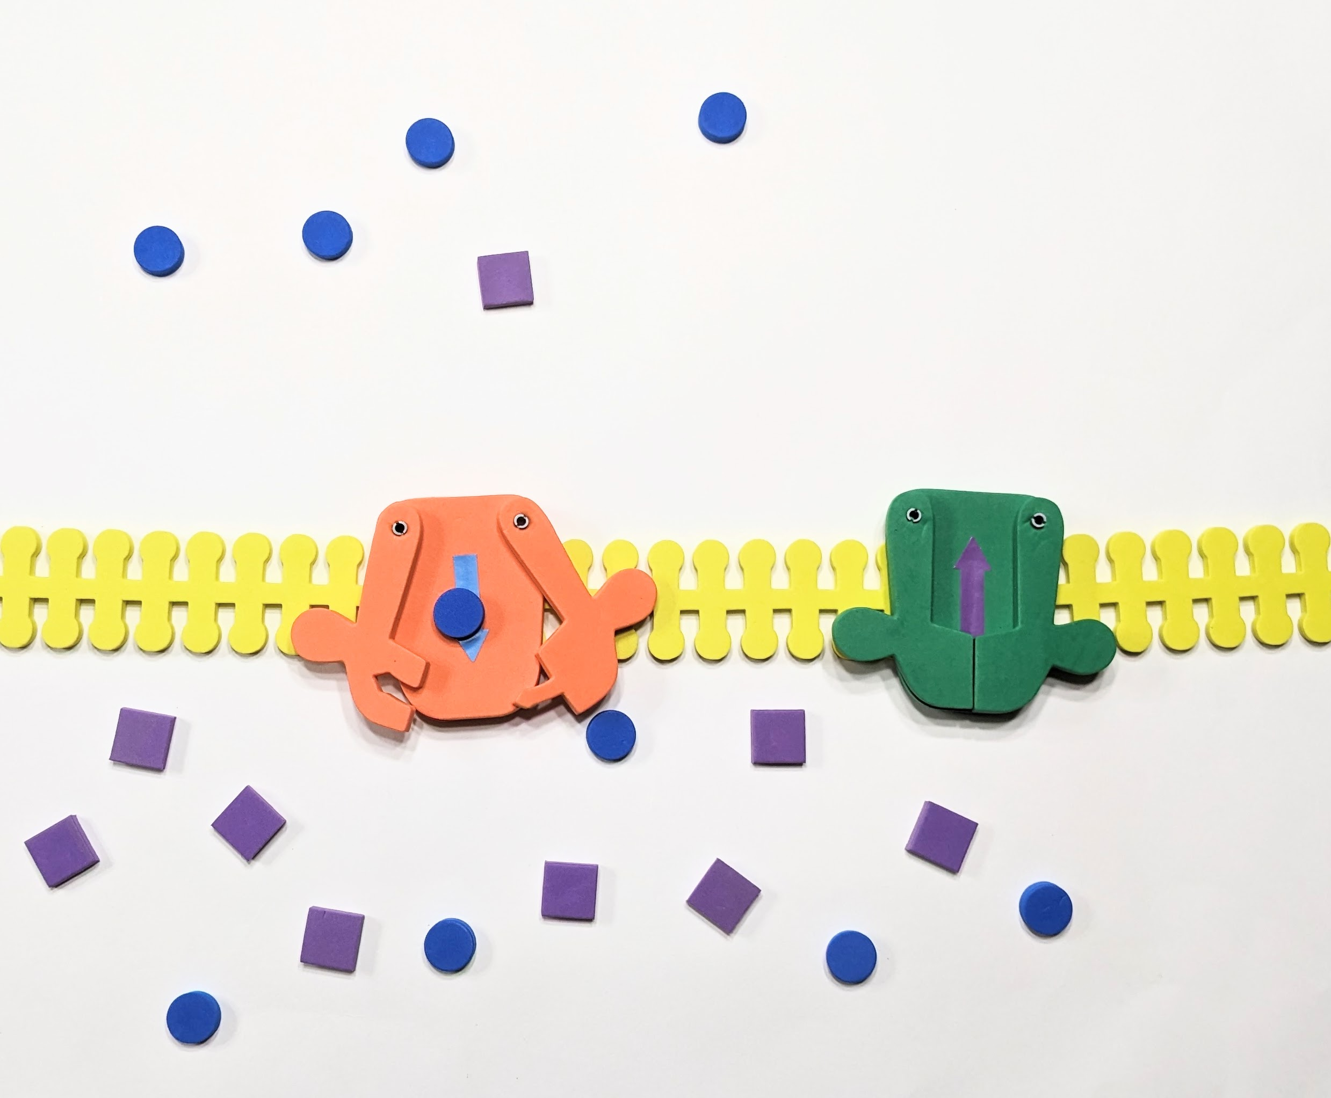
Sodium moves into the cell

Slide 4
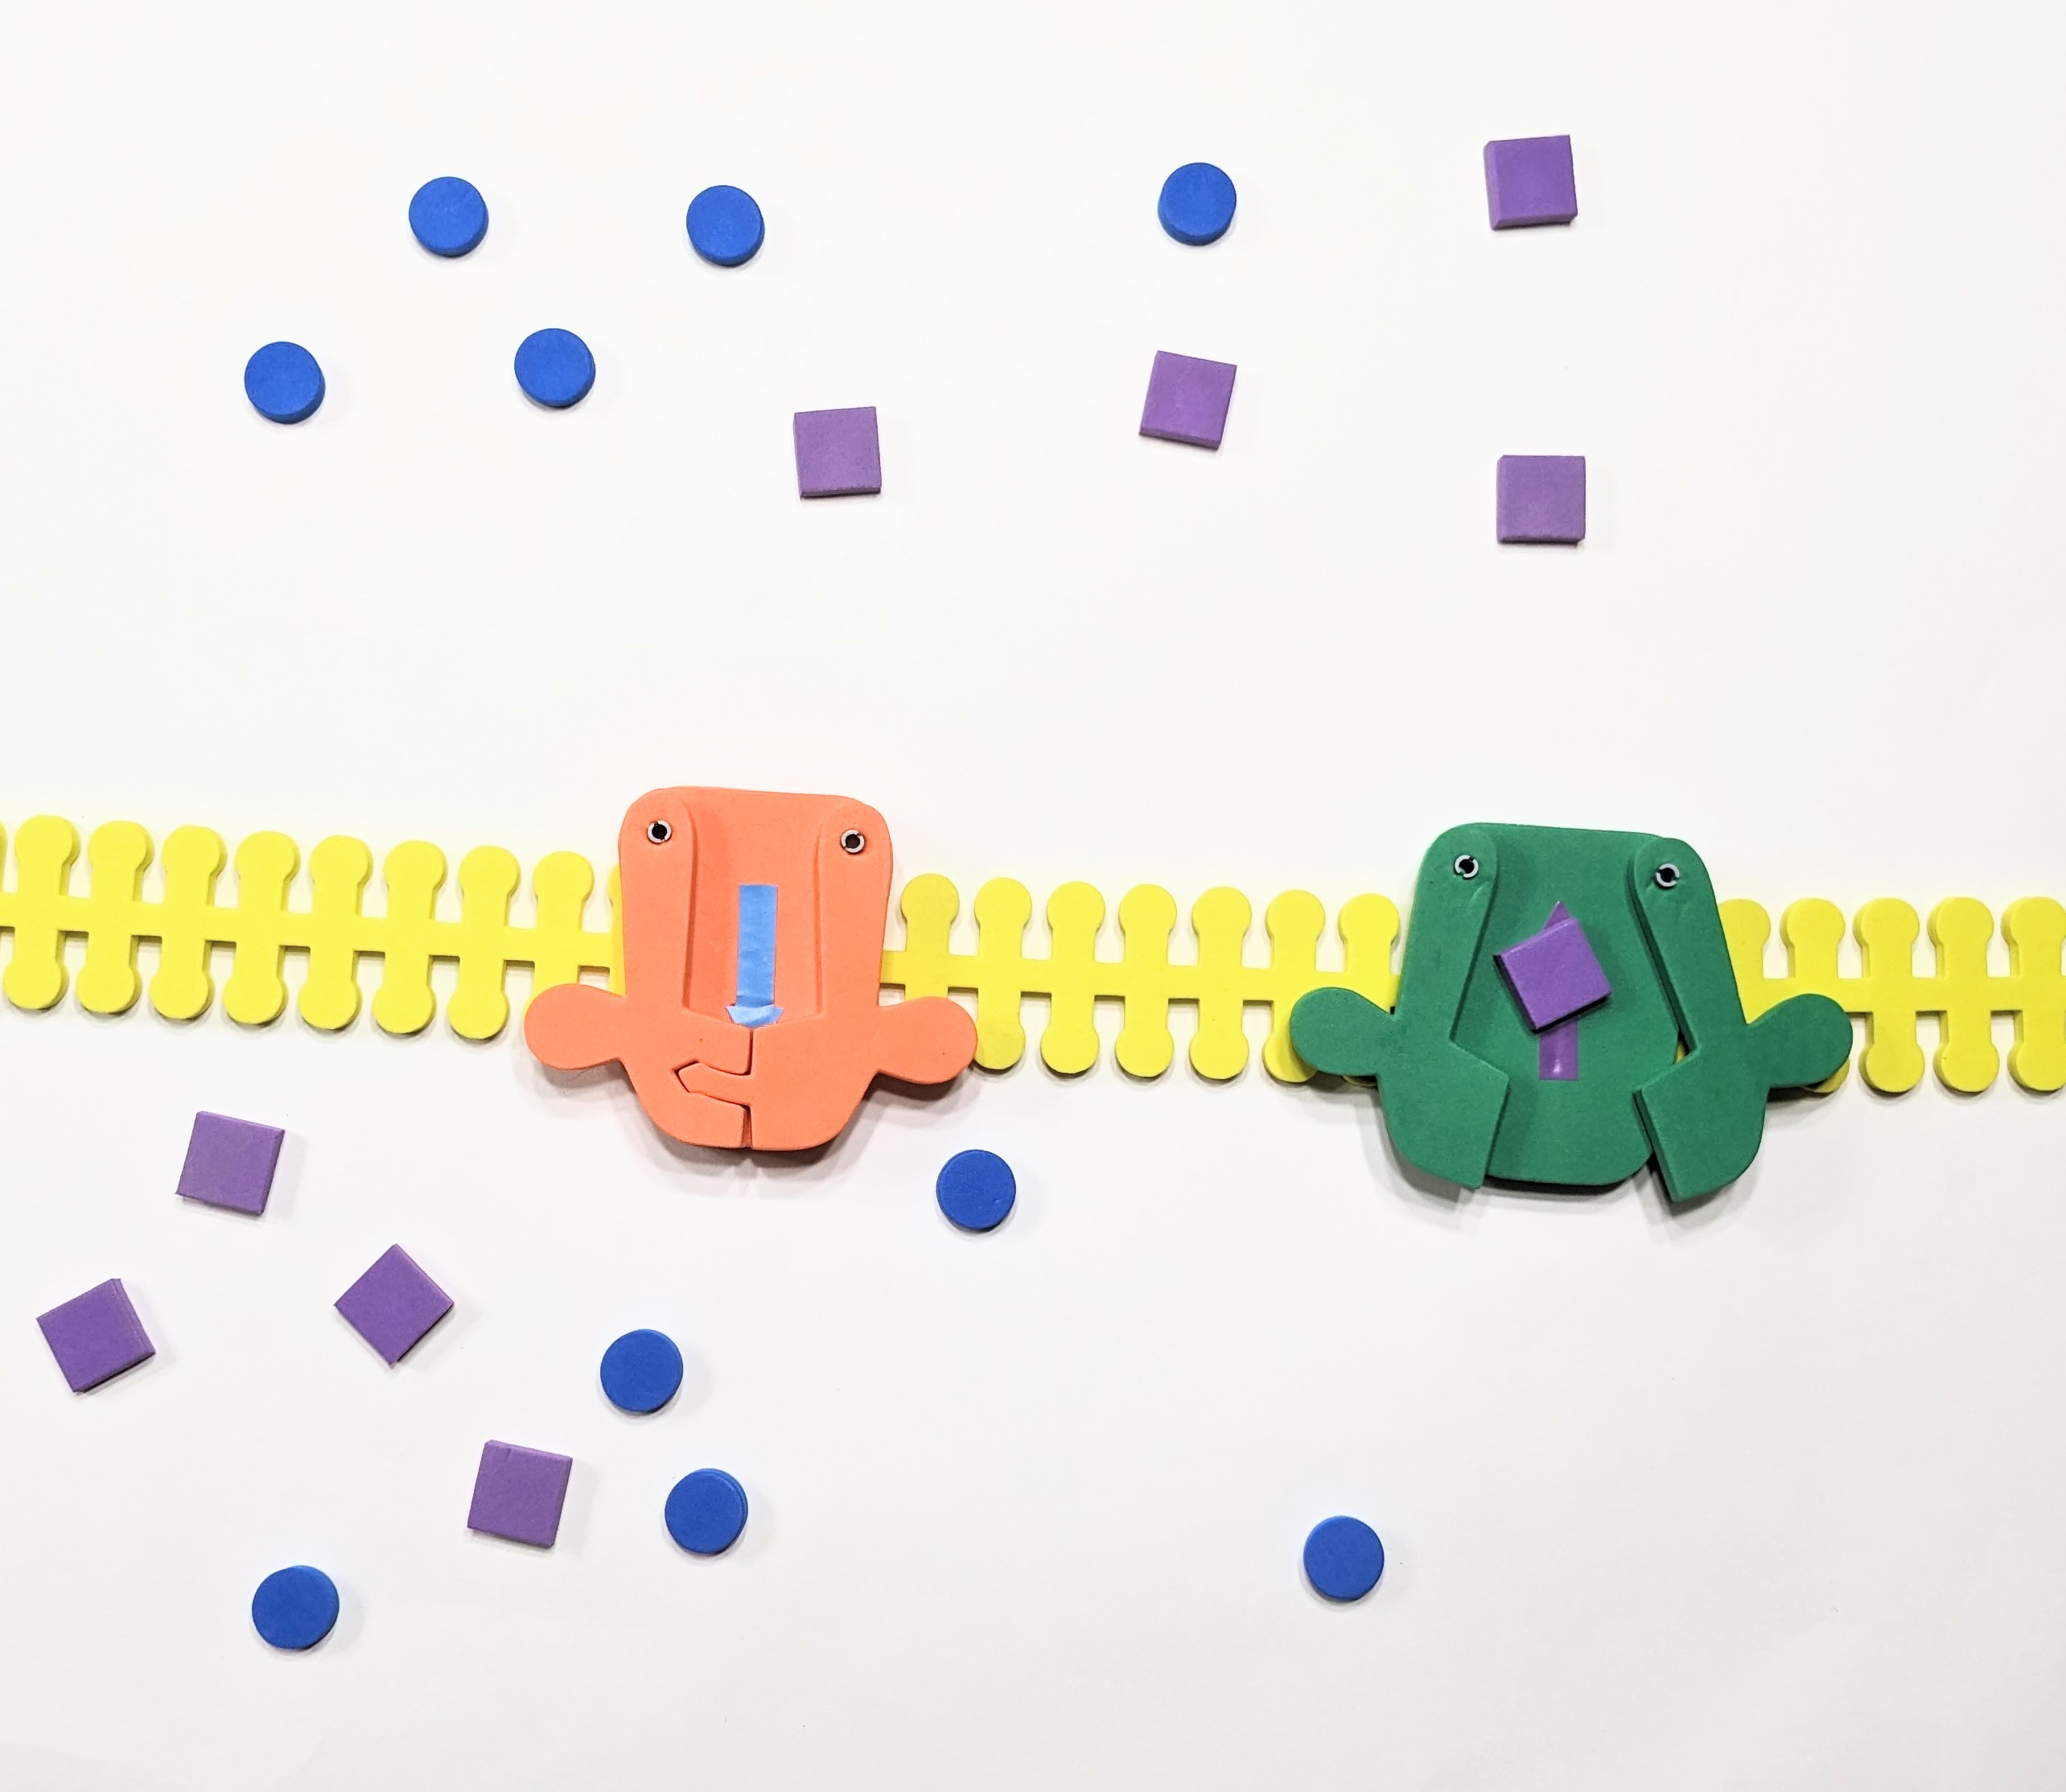
Potassium moves out!

Slide 5
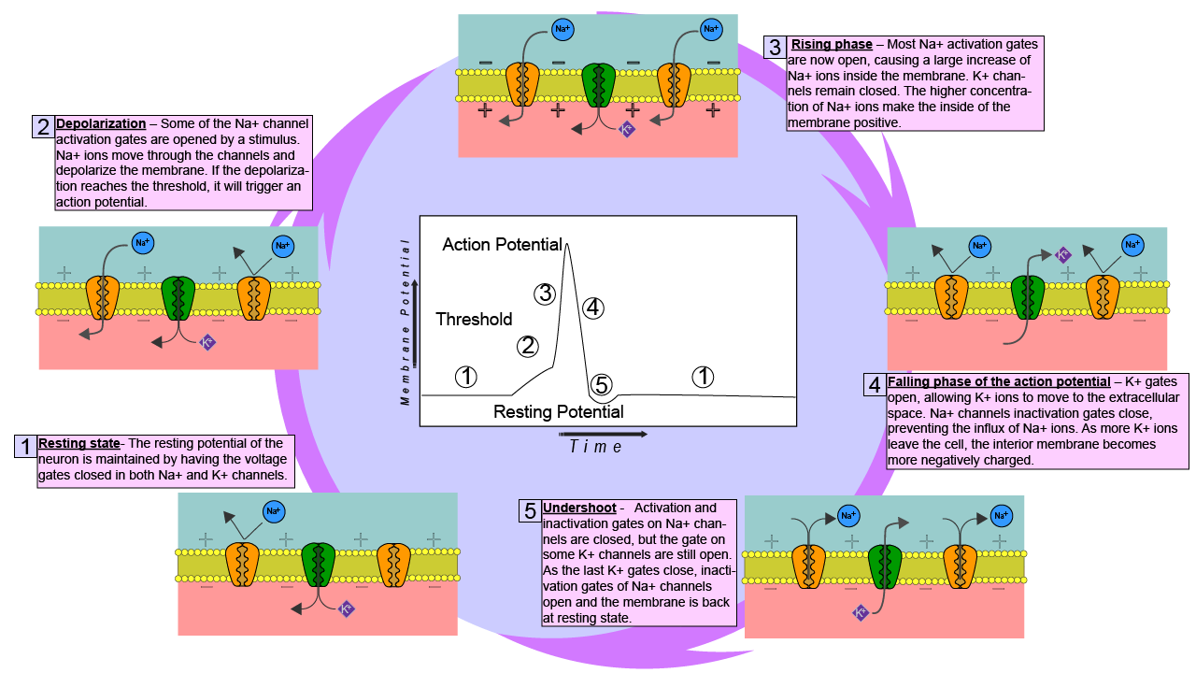
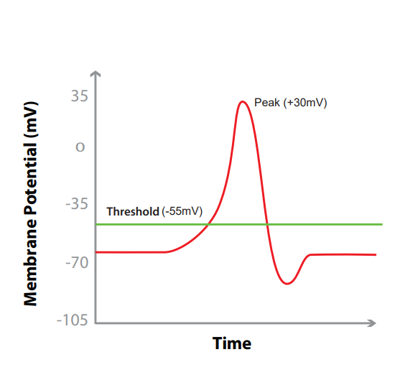
Link
Notes:
What the teacher is doing: Point out that action potentials are critical in many multicellular organisms. They signal critical functions such as respiration and muscle movement to escape a predator. Optional activity: Use the Phospholipid and Membrane Transport Kit or Synapse Kit to have students model an action potential.
Encourage students to consider the following question: why would a cell need transport proteins? This may be a time to expand upon the phospholipid bilayer of the cell and explain why they are necessary in living systems.
What the student is doing: Students should model the movement of K+ and Na+ ions in the Phospholipid and Membrane Transport Kit or Synapse Kit. Resources to do this are available by clicking on the link on the slide. Students DO NOT need all the pieces to model this.

Slide 6
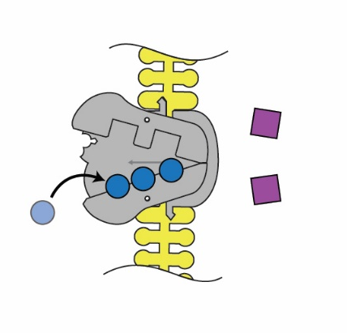
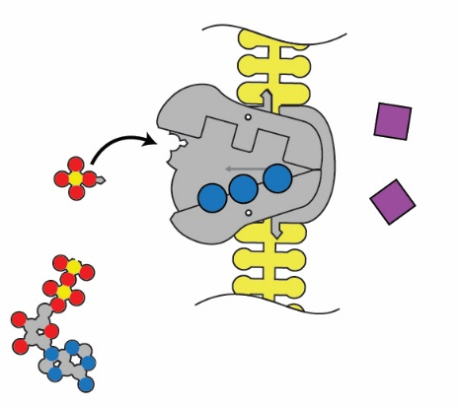
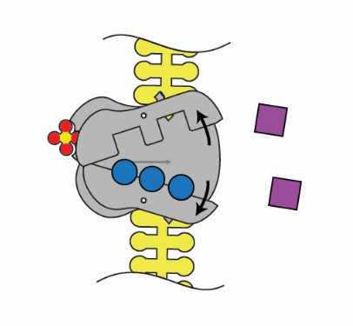
How do we get back to a resting potential?
1. Sodium binds on intracellular side.
2. The pump is phosphorylated by ATP.
3. The pump shape changes, exposing the sodium to the extracellular space.

Slide 7
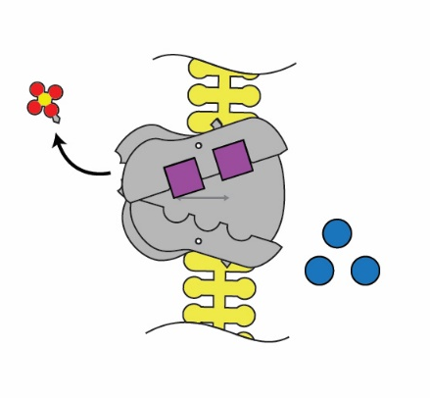
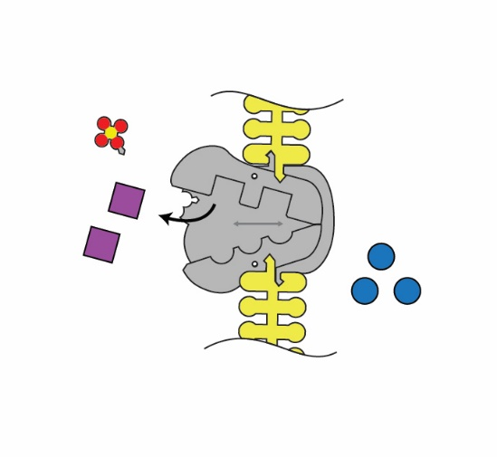
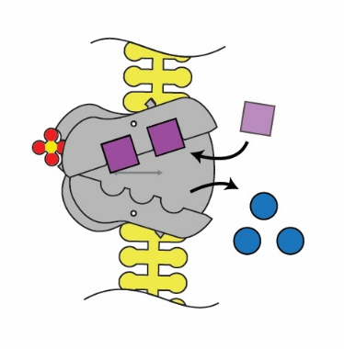
4. Binding affinity changes to release Na+, and take in K+.
5. Phosphate detaches.
6. Original shape is restored, releasing K+ into the cell.

Slide 8
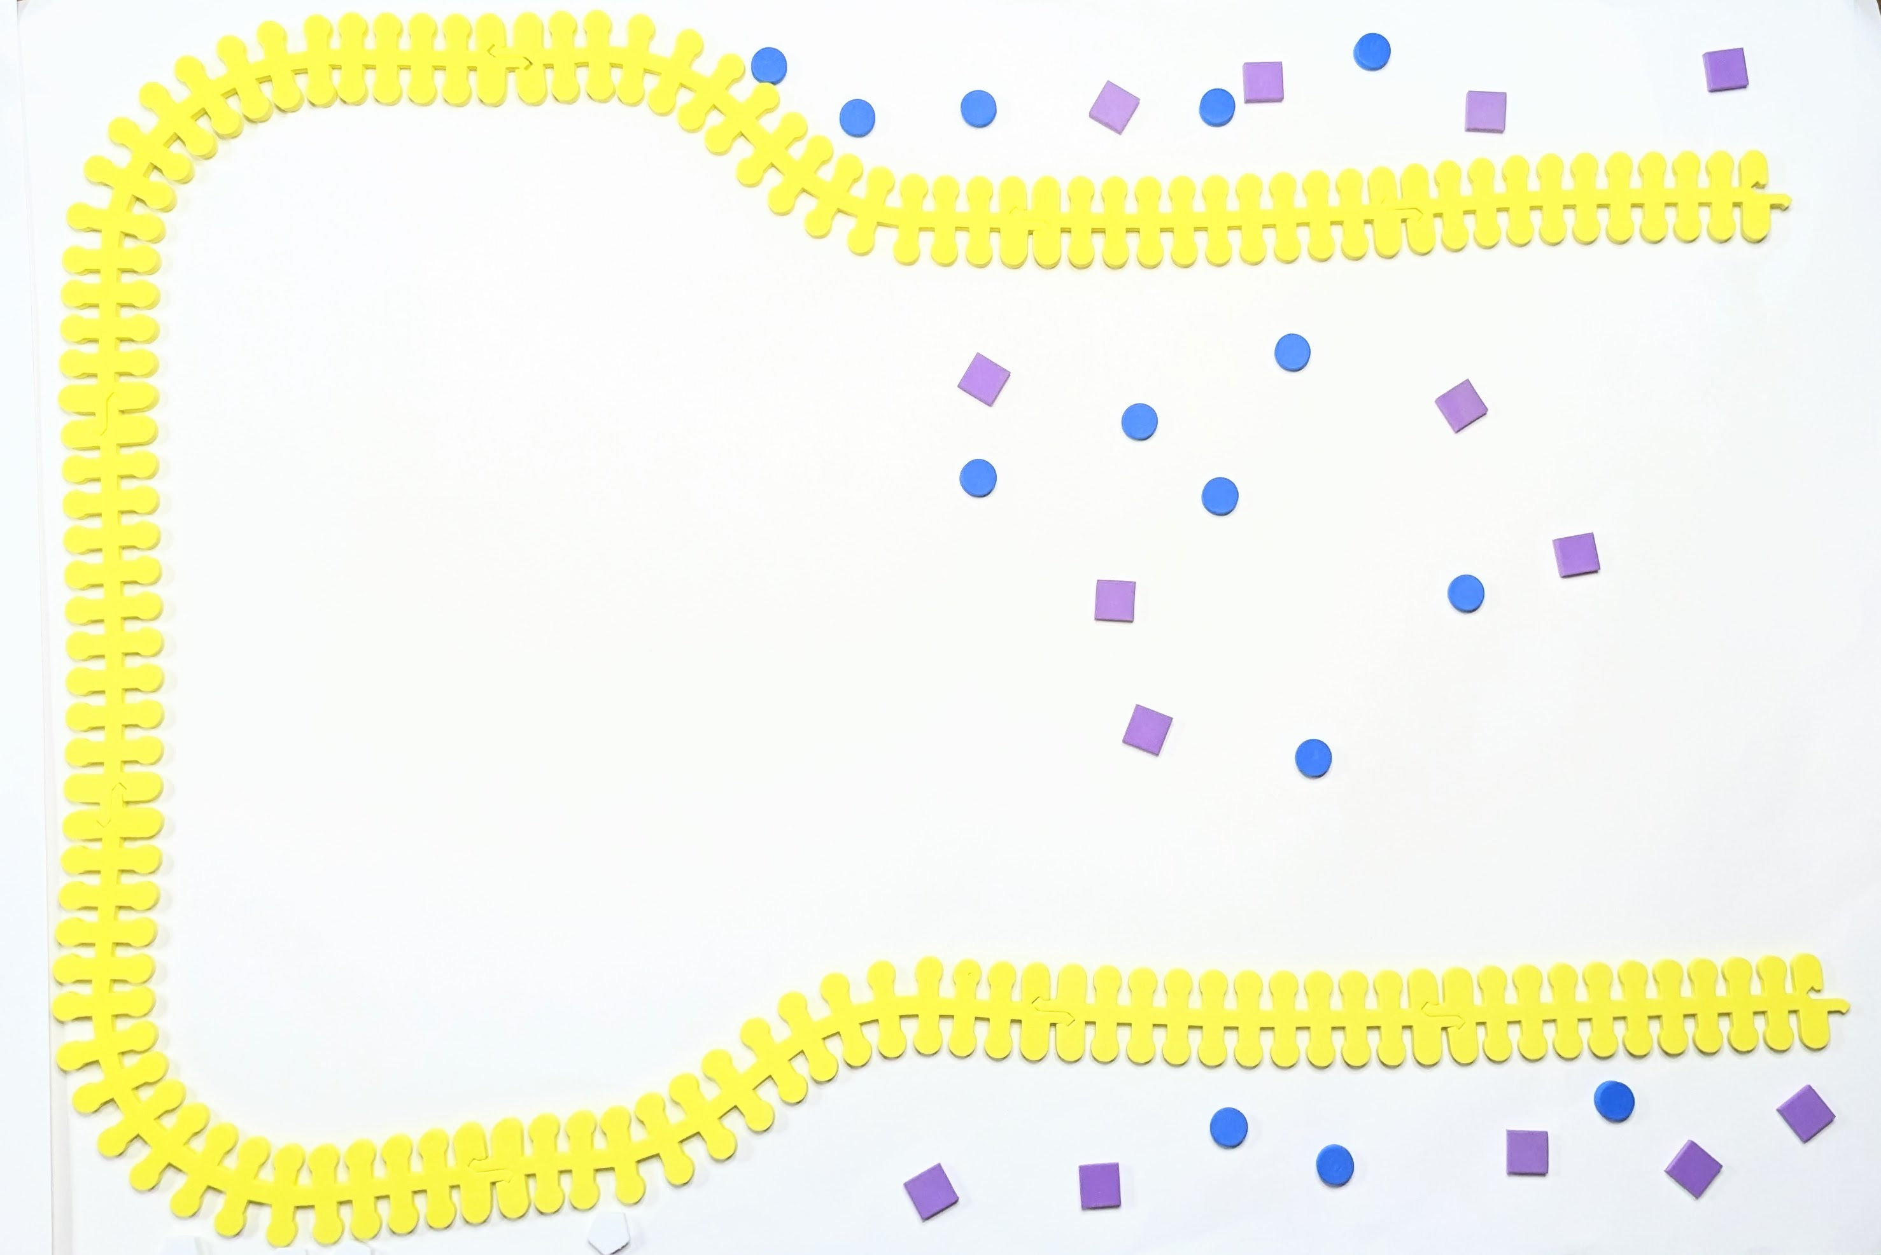
Snap Snares and Neurotransmitters
Make the neuronal membrane with:
5 straight yellow membrane pieces
2 wavy yellow membrane pieces
2 curved membrane pieces
Notes:
StudentHandout_PartVII_ModelingaNeurotransmissionAGABAergicSynapse_10-23-17.pdf
(3dmoleculardesigns.com)

Slide 9
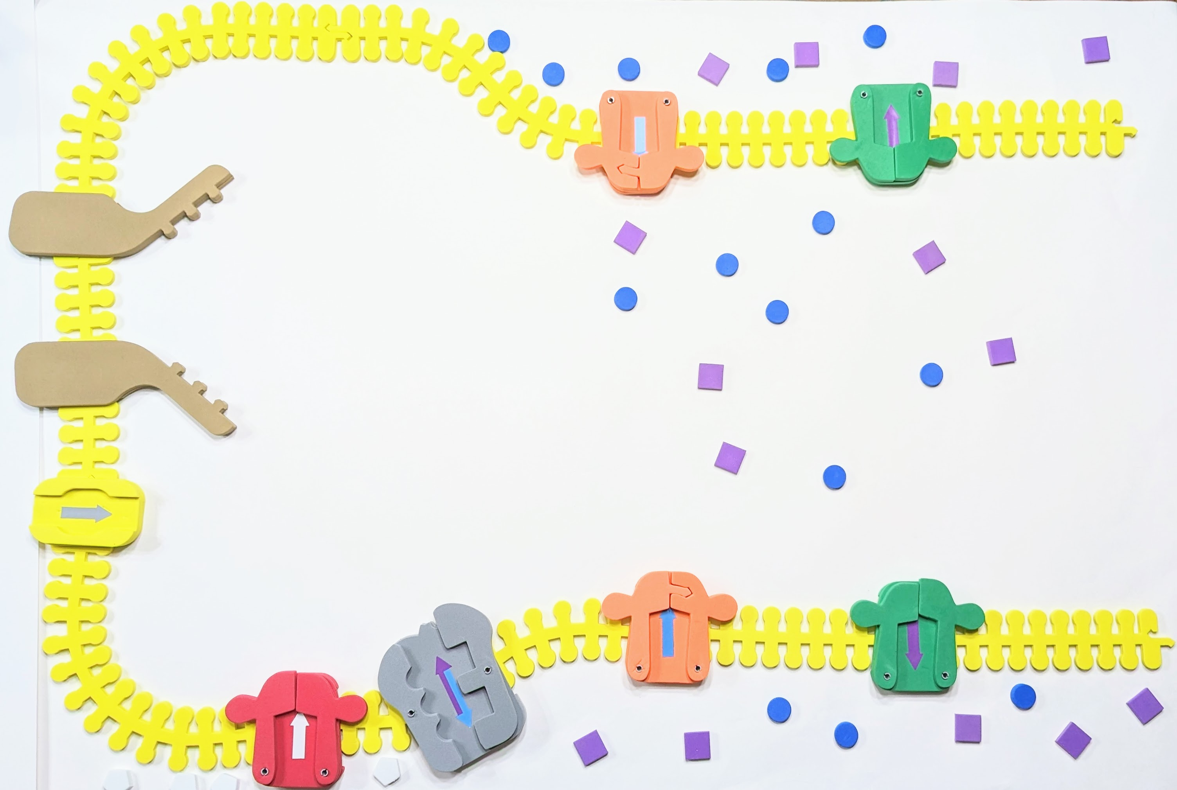
Snap Snares and Neurotransmitters
Add :
2 green voltage-gated potassium pumps
2 orange voltage-gated sodium pumps
1 red voltage gated calcium pump
1 brown SNAP/SNARE protein
1 yellow transport protein
Notes:
StudentHandout_PartVII_ModelingaNeurotransmissionAGABAergicSynapse_10-23-17.pdf
(3dmoleculardesigns.com)
Place 2 green voltage-gated potassium pumps, 2 orange voltage-gated sodium pumps, 1 grey sodium-potassium pump, 1 red voltage-gated calcium pump, 1 brown SNAP/SNARE protein, and one yellow transport protein on the neuronal membrane
To make vesicle: 4 straight membrane pieces, then add 4 GABA, 1 red calmoldin, 1 yellow transport protein, and 1 brown SNAP/SNARE protein

Slide 10
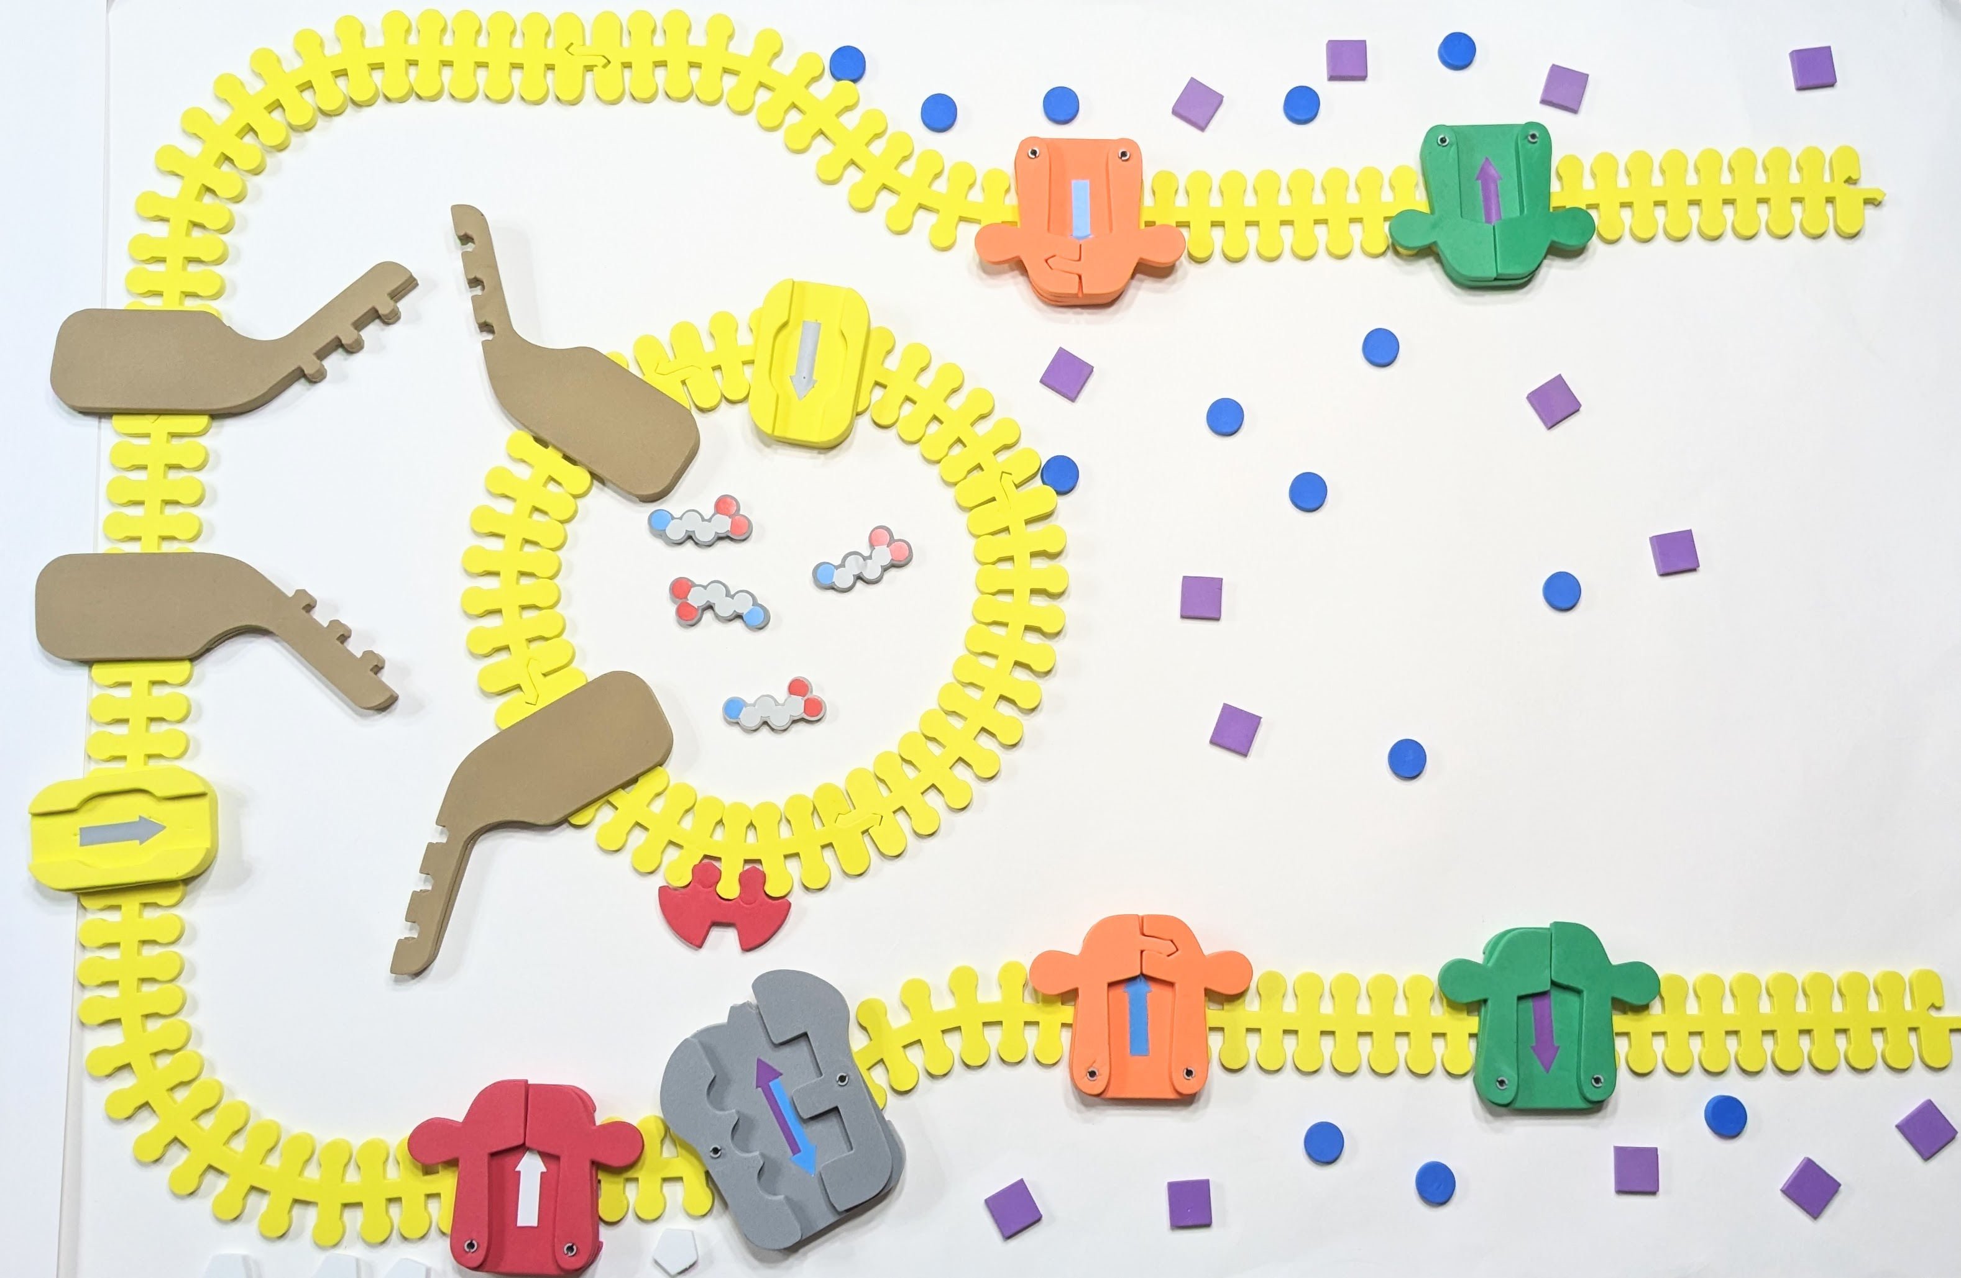
Snap Snares and Neurotransmitters
To make vesicle:
Join 4 straight yellow membrane pieces
Then add
4 GABA
1 red calmoldin
1 yellow transport protein 1 brown SNAP/SNARE protein
Notes:
StudentHandout_PartVII_ModelingaNeurotransmissionAGABAergicSynapse_10-23-17.pdf
(3dmoleculardesigns.com)

Slide 11
Snap Snares and Neurotransmitters
Let's model the GABAergic Synapse
Show action potential arriving at terminal end
Calcium channels open
What direction does Ca ion move?
Where do Ca ions bind?
3) SNAP/SNARE proteins interact to bring vesicle to membrane
4) GABA released into synaptic cleft.
Notes:
StudentHandout_PartVII_ModelingaNeurotransmissionAGABAergicSynapse_10-23-17.pdf
(3dmoleculardesigns.com)
Place 2 green voltage-gated potassium pumps, 2 orange voltage-gated sodium pumps, 1 grey sodium-potassium pump, 1 red voltage-gated calcium pump, 1 brown SNAP/SNARE protein, and one yellow transport protein on the neuronal membrane
To make vesicle: 4 straight membrane pieces, then add 4 GABA, 1 red calmoldin, 1 yellow transport protein, and 1 brown SNAP/SNARE protein

Slide 12
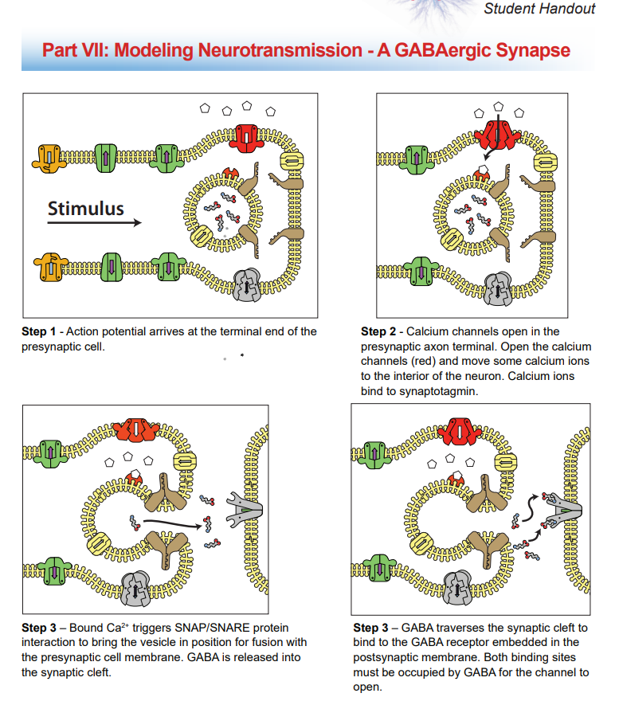
Snap Snares and Neurotransmitters
Notes:
StudentHandout_PartVII_ModelingaNeurotransmissionAGABAergicSynapse_10-23-17.pdf (3dmoleculardesigns.com)

Slide 13
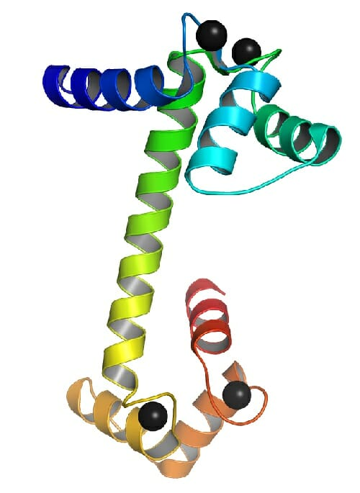
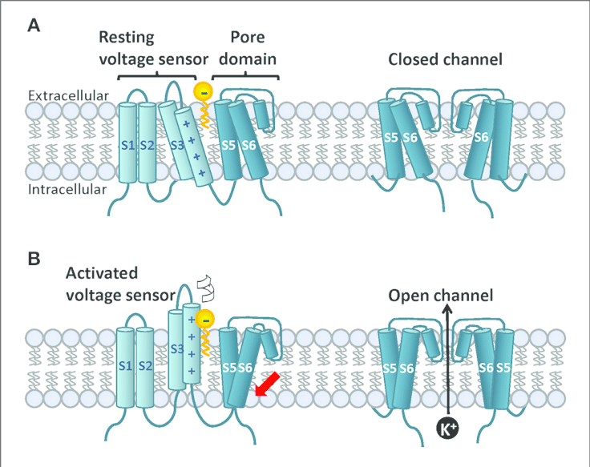
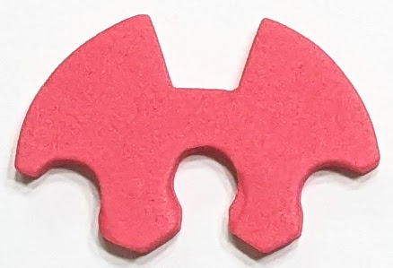
Calcium Channels and Calmodulin

Slide 14
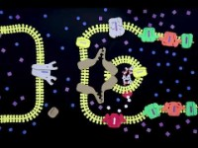
Snap Snares and Neurotransmitters

Slide 15
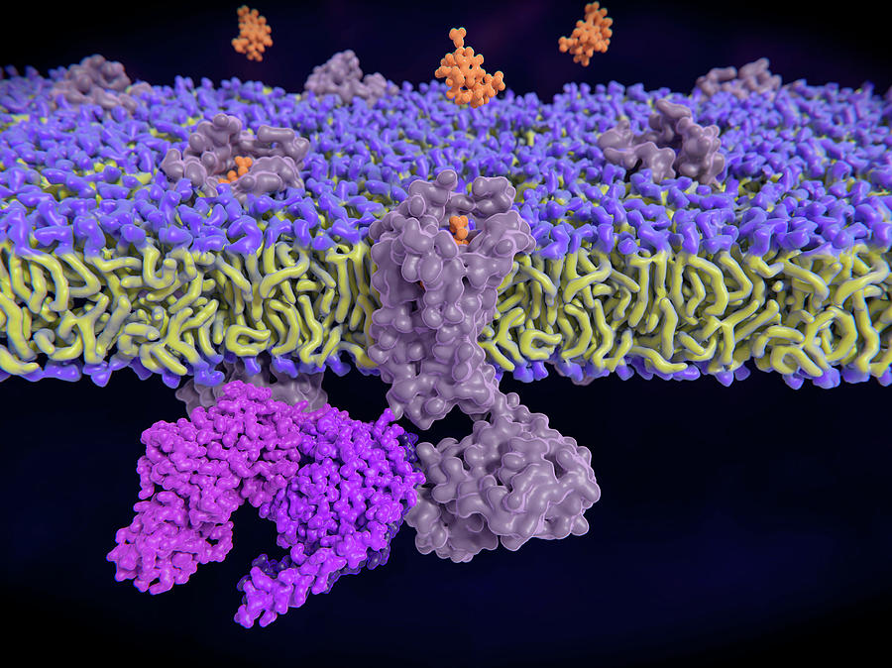
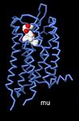
Mu- Opioid receptor and Enkephalins

Slide 16
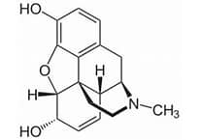
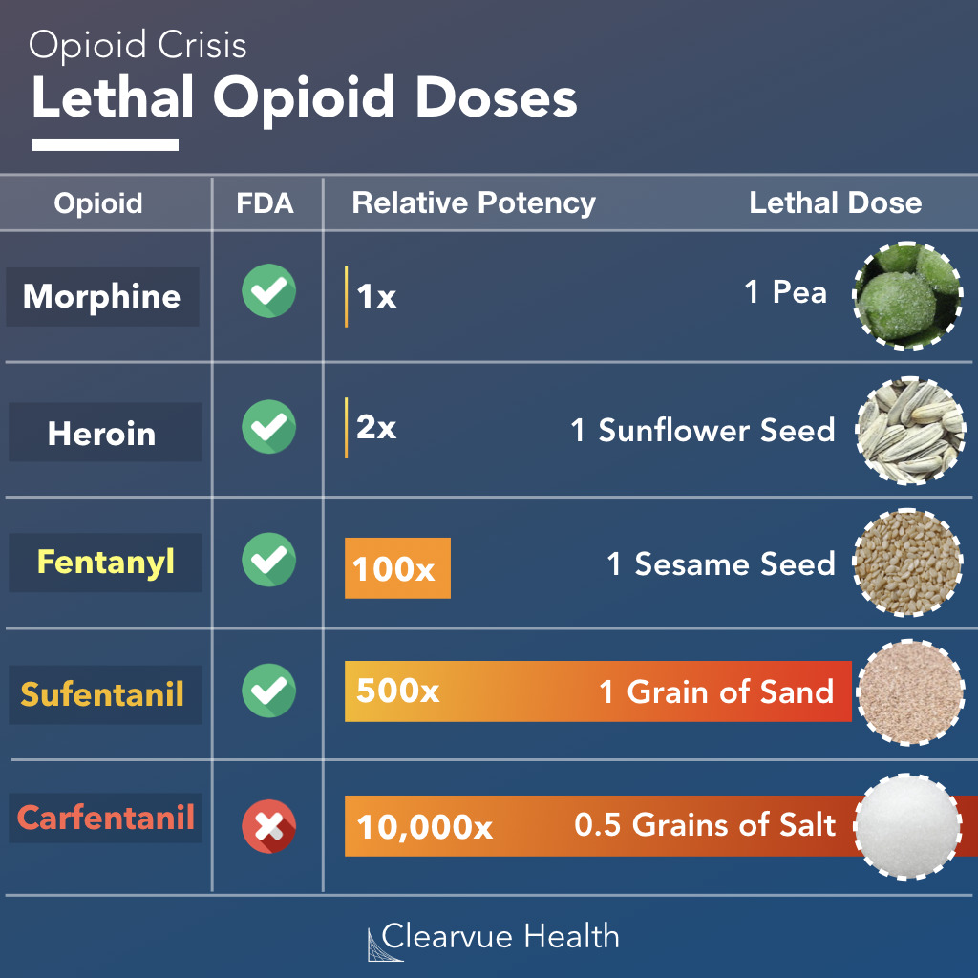
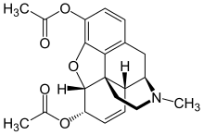
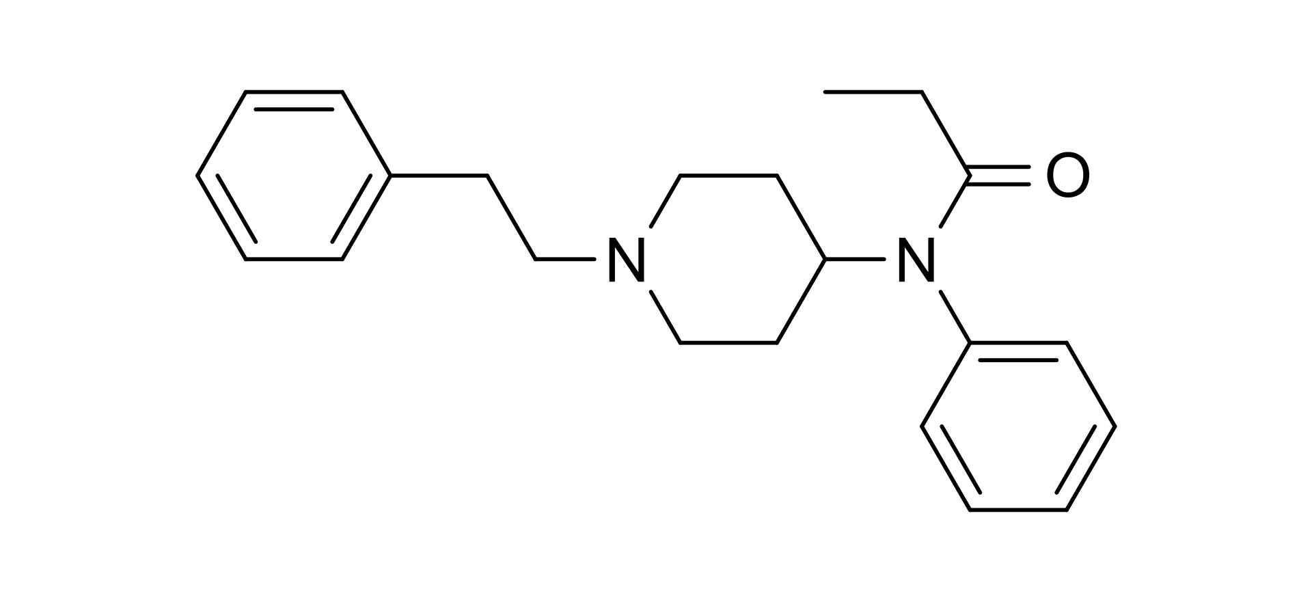
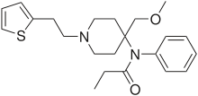
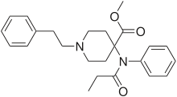
Opioid Analogs

Slide 17
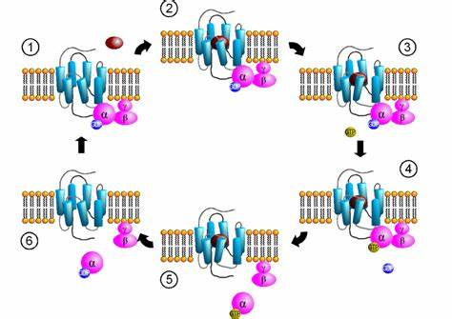
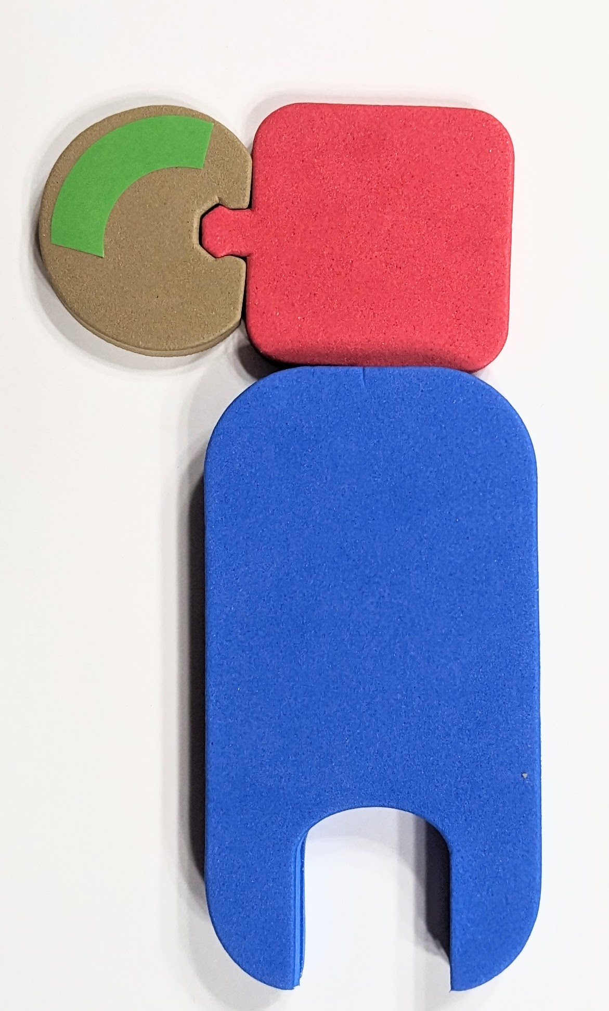
G-coupled proteins

Slide 18
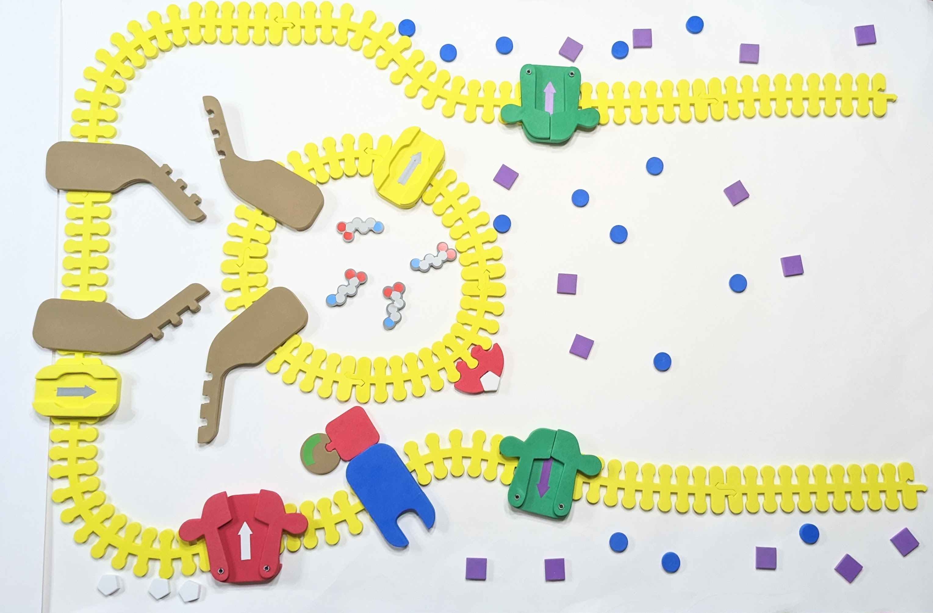
Let’s model this!

Slide 19
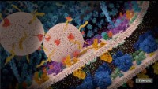
Downstream interactions
Notes:
If you’re interested… adenyl cyclase/phosphodiesterase, Protein Kinase A, and target proteins…

Slide 20
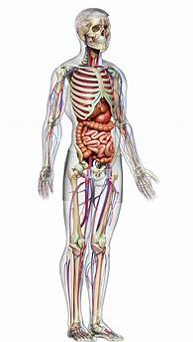
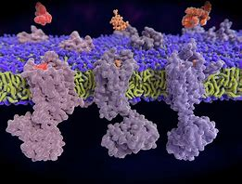

Slide 21
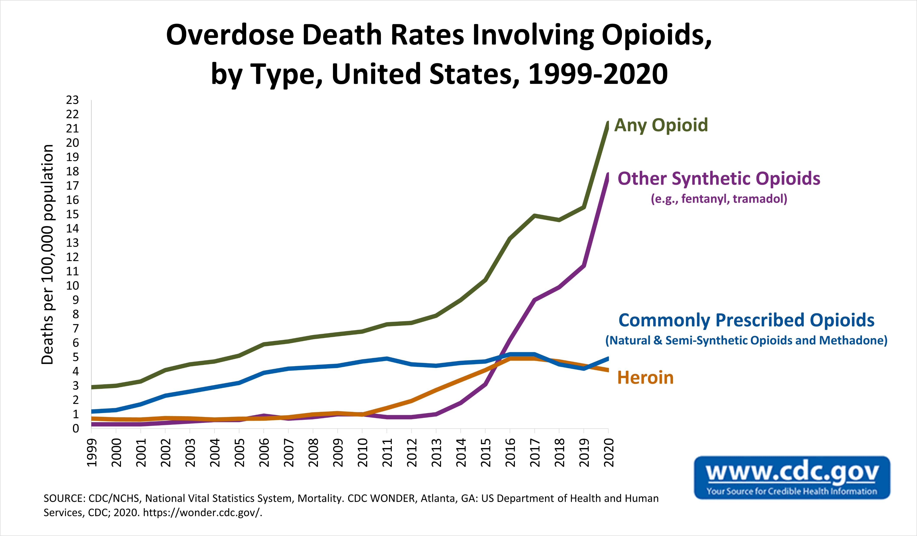

Slide 22
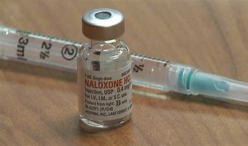
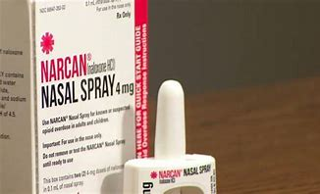
Naloxone

Slide 23
How do you think Narcan works?
Let’s model!

Slide 24
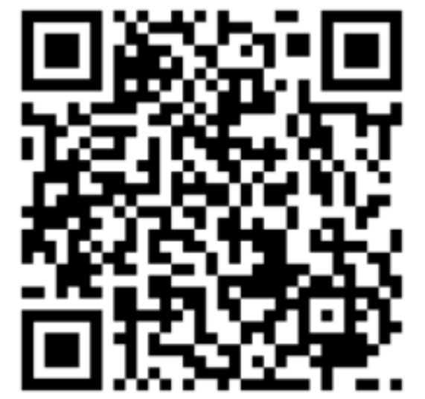
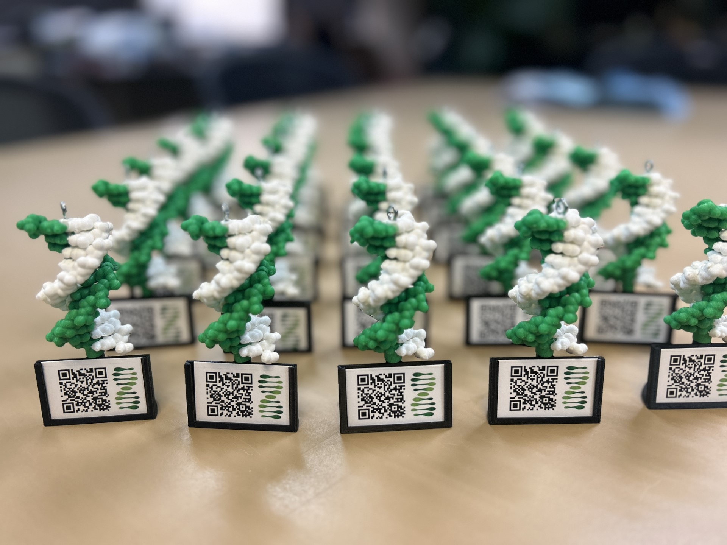
Scan this QR code and fill out our survey!
Show me your DNA molecule image and I’ll give you a model with AR enhancement as a thank-you gift!

