Slide 1
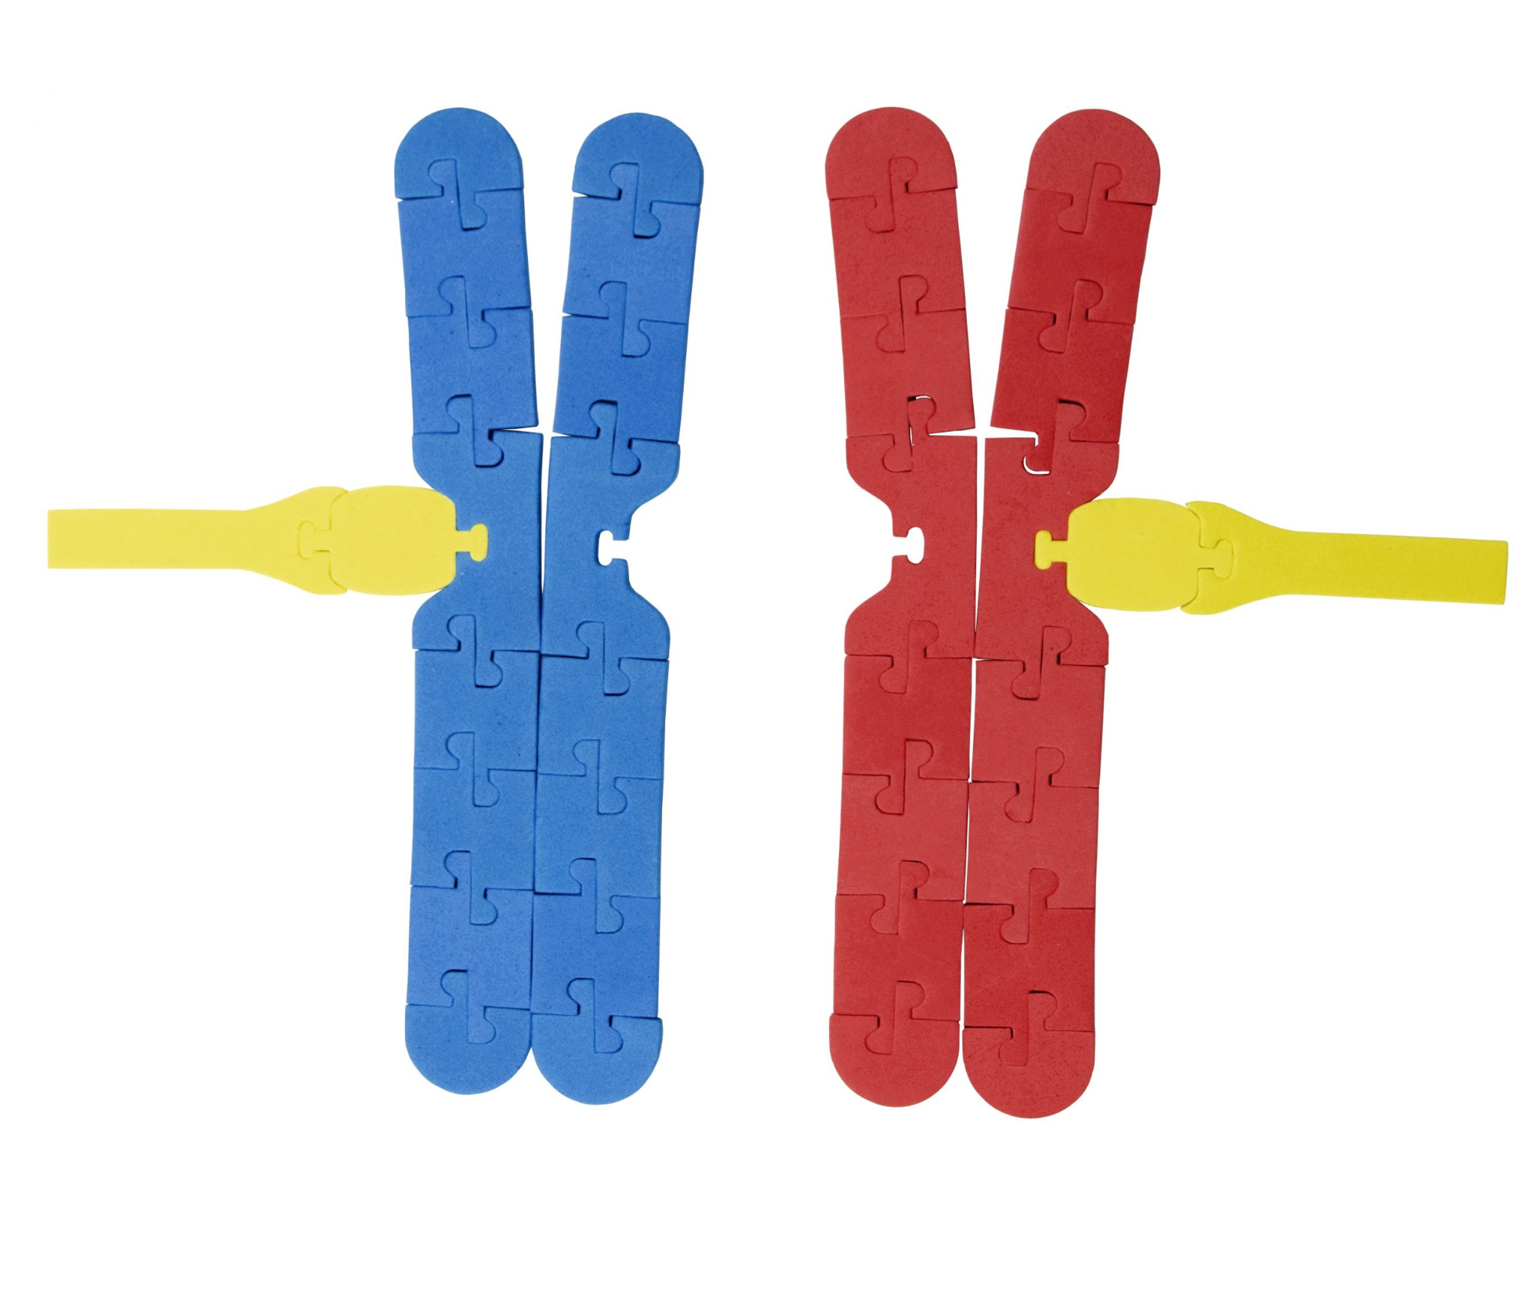
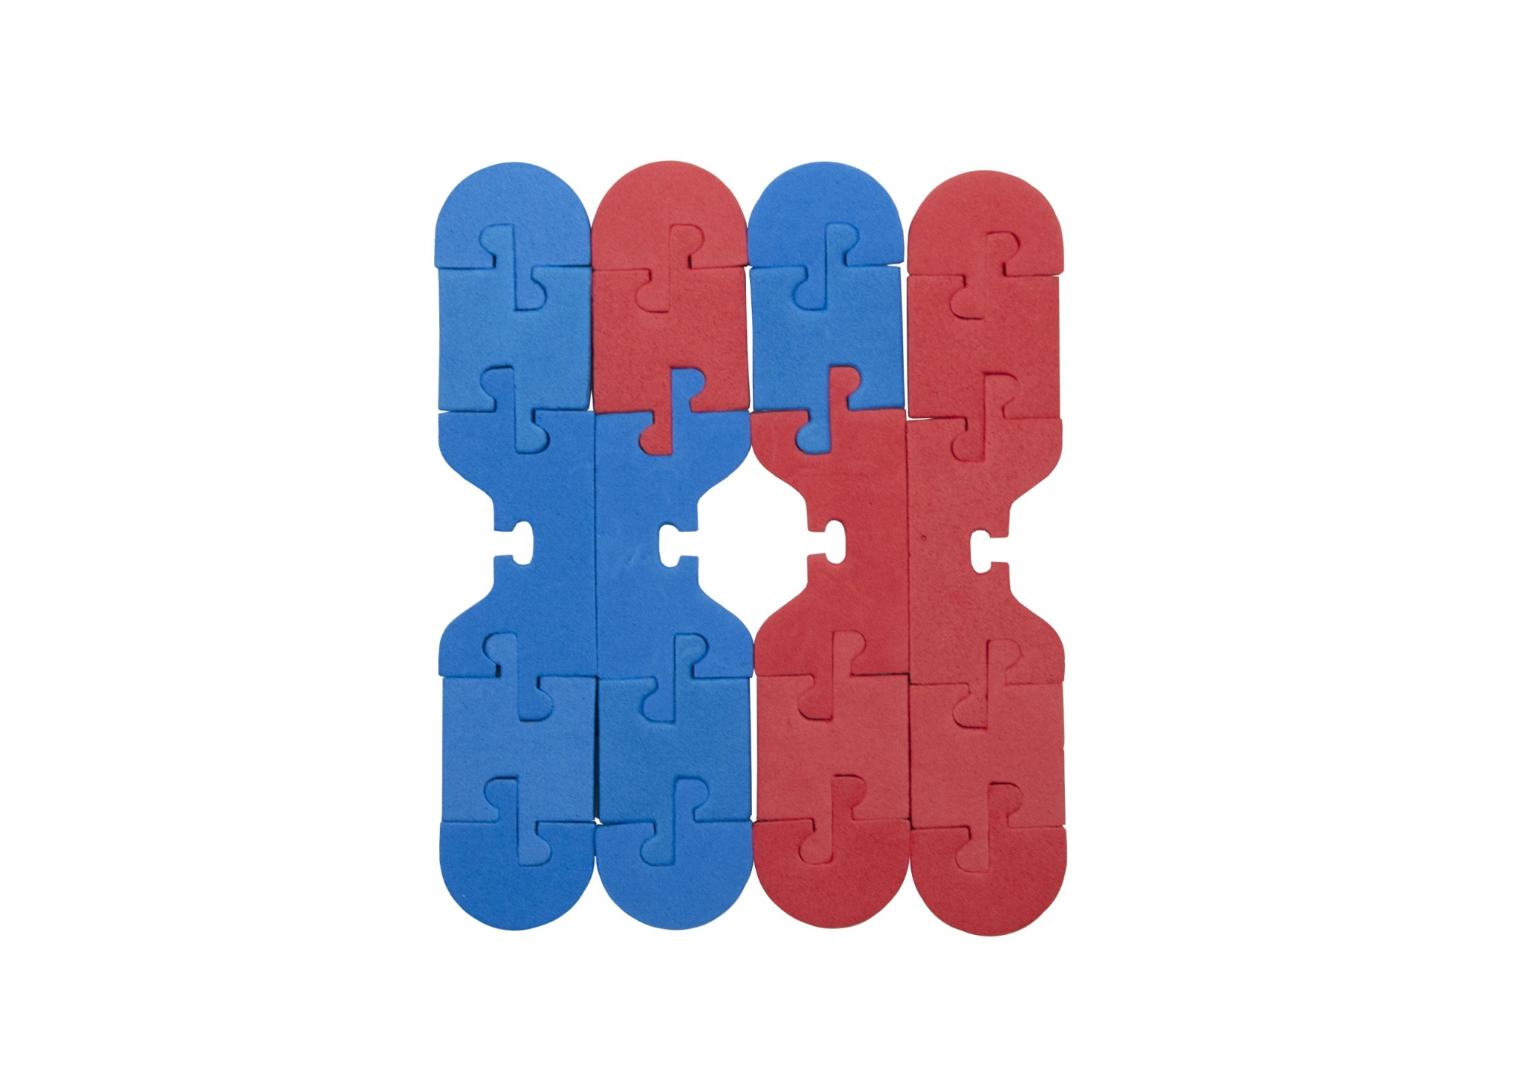
Oh Meiosis! Modeling the Processes that Create Genetic Diversity
Chromosome Connections Kit
Sue Remshak
NABT Baltimore 2023

Slide 2

Sue Remshak
MA Curriculum & Instruction, BA Biology & Secondary Instruction
Grayslake North High School, Grayslake IL
31 years as a biology educator
3DMD model teacher
Classes taught: AP Biology, Biology Honors, Biology, Zoology
Email: sremshak@d127.org

Slide 3
Workshop Goals
Model the processes of meiosis that lead to genetic diversity.
Address common student misconceptions

Slide 4
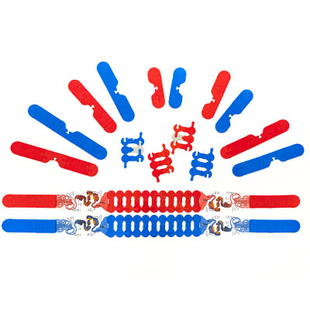
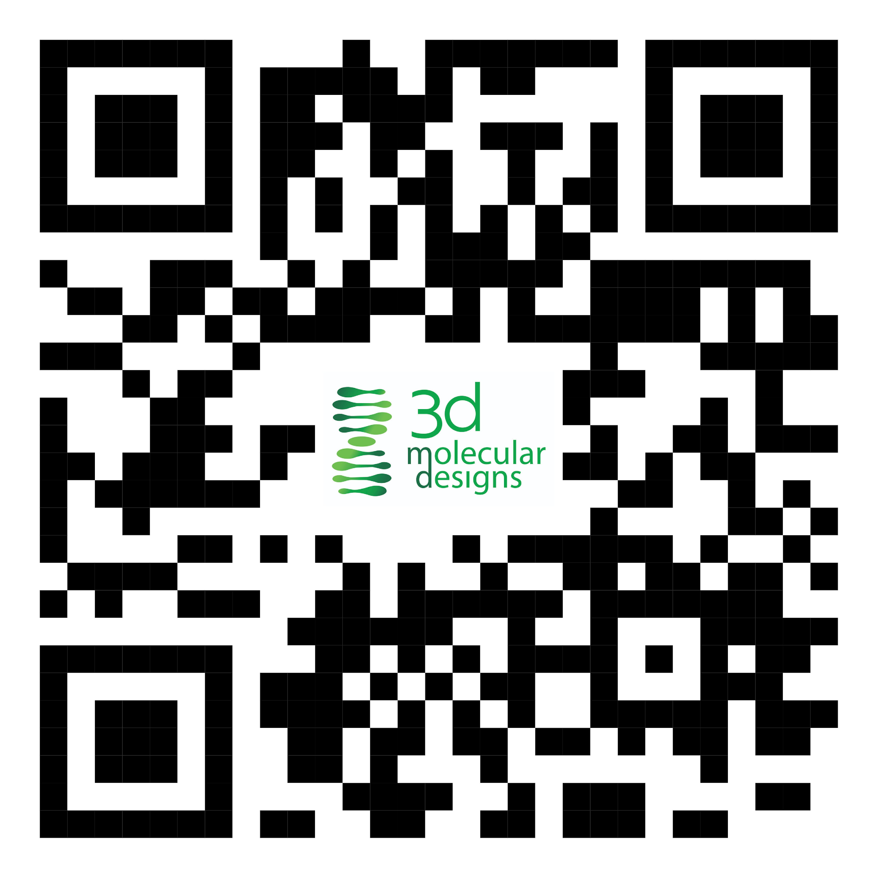
Chromosome Connections Kit
Build homologous chromosome pairs and sister chromatids
Identify chromosome structure and anatomy
Construct Punnett squares with gene sequences as alleles
Compare and contrast mitosis and meiosis
Explore how genes can cross over during prophase
Investigate chromosomal nondisjunctions, translocations, inversions, deletions and duplications
Online resources

Slide 5
General Misconceptions: Meiosis
Students remember the names of stages but have difficulties with the events in these stages
They fail to understand the mechanisms of diversity
Understanding of the difference in chromosome numbers at the end of division
Students often remember names of only some concepts—such as tetrad, synapsis, chromatid, and chromosome—but have problems remembering the meanings
Notes:
General misconceptions regarding the process of meiosis as summarized in an ABT article based on Sankaya et al, 2004 and Gungor & Ozkan, 2017

Slide 6
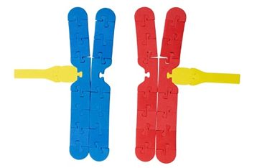
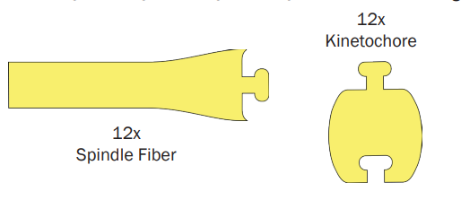
Let’s Model!
Materials:
Blue long paternal chromosome (2)
Red long maternal chromosome (2)
Blue short paternal chromosome (2)
Red short maternal chromosome (2)
Kinetochores (8)
Spindle fibers (8)
Red and blue colored pencils
Table marker or chalk

Slide 7
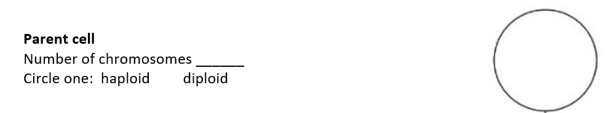
Modeling Directions
Parent Cell
Draw a circle with the table marker/chalk on the lab table to model the cell membrane. Draw a nucleus inside the cell.
Place one type of each chromosome inside the nucleus.
On your modeling meiosis data sheet, use colored pencils to draw the parent cell and answer the questions.

Slide 8
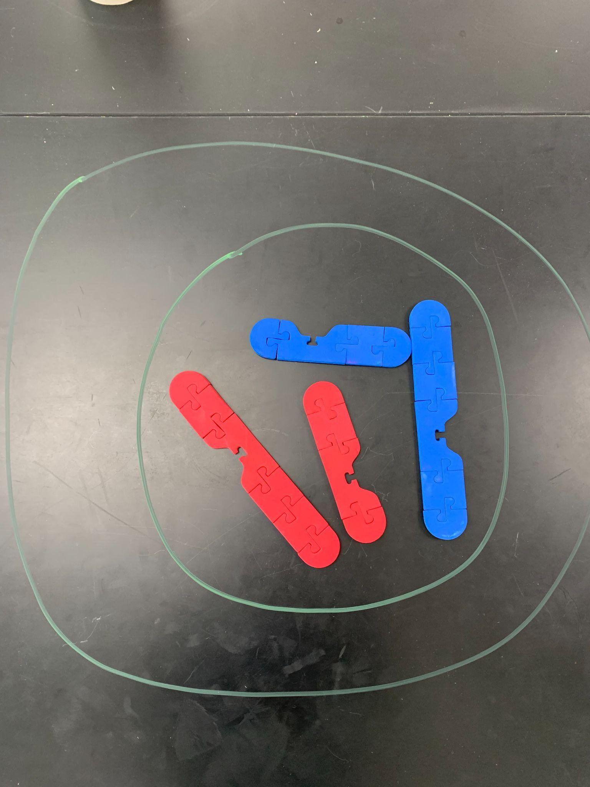
Parent Cell Model

Slide 9
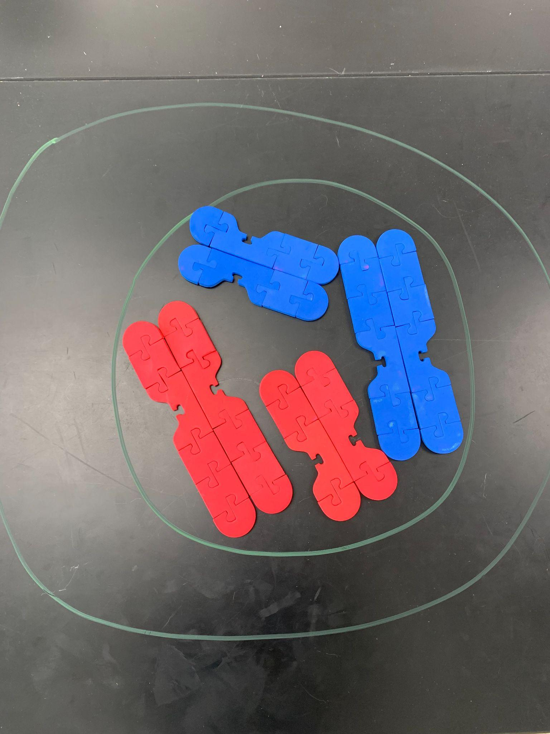
Modeling Directions
S phase: DNA Replication
Replicate each chromosome by adding a copy of each one to your table top model. Put the duplicated chromosomes next to each other as shown in the picture above. Meiosis I begins following G₂ phase of the cell cycle.

Slide 10
Modeling Directions
Prophase I
In this first stage of meiosis I, the homologous chromosomes will move toward one another and form a tetrad. Recall that homologous chromosomes are the same length, have the same centromere position, and have genes in the same locations. Align your homologous chromosomes to form two tetrads inside the nucleus. The alignment of the homologous chromosomes is known as synapsis.
During synapsis, crossing over may occur. In each pair of homologous chromosomes, exchange one segment of a blue paternal chromosome with a red maternal chromosome.
Notes:
“Although hundreds of recombination events are started in each cell, only one or two crossovers will form between any given pair of chromosomes.” https://www.sciencedaily.com/releases/2013/02/130213152420.htm

Slide 11
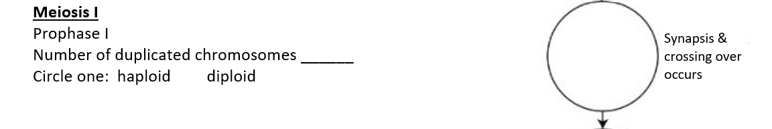
Modeling Directions
Prophase I
Towards the end of this stage, the nuclear membrane also breaks apart. Make your nuclear membrane a dotted line to show this event.
On your data sheet, use colored pencils to draw prophase I. Make sure that evidence of crossing over is shown in your drawings.

Slide 12
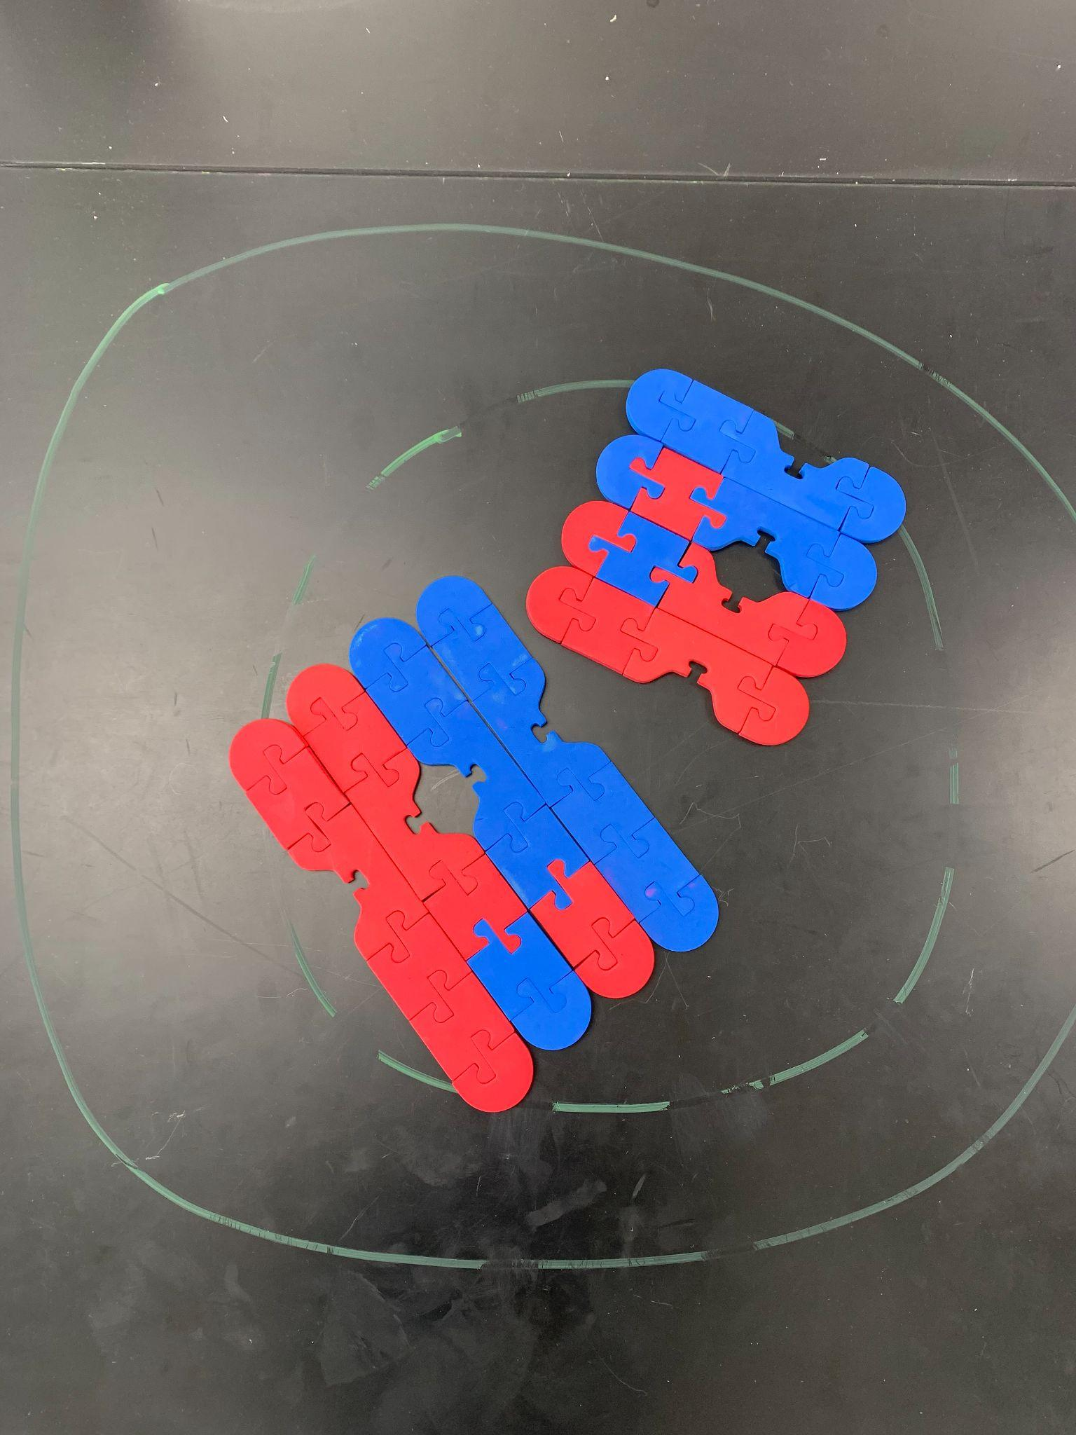
Prophase I Model

Slide 13
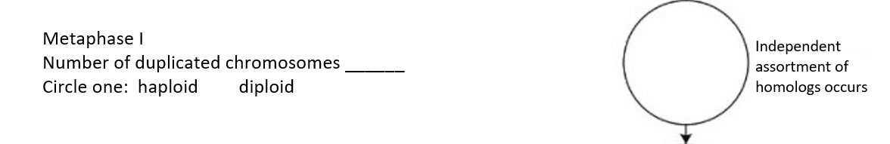
Modeling Directions
Metaphase I
Next, the homologous chromosome pairs line up in the middle of the cell. Move each tetrad to the middle of your cell on the lab table. Recall that this is when the homologous chromosomes undergo independent assortment. In other words, each pair may orient with either its maternal or paternal copy closer to a give pole.
Using colored pencils, draw metaphase I on the data sheet.
Notes:
2^{n} (where n = haploid number) combinations from independent assortment. For this simulation with n = 2, there are 4 combos. For humans 2²³

Slide 14
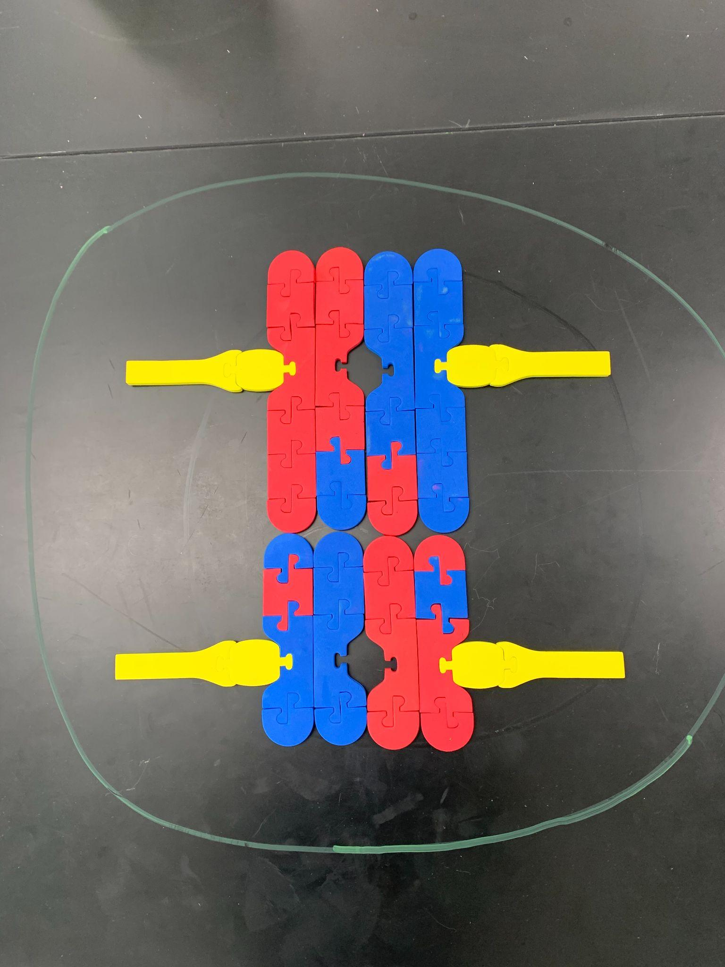
Metaphase I Model

Slide 15
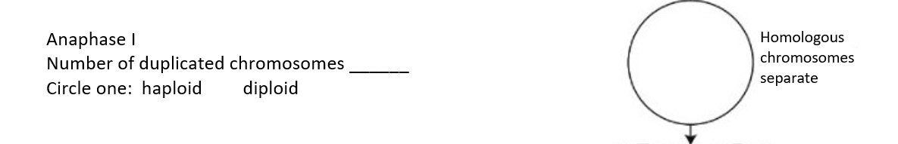
Modeling Directions
Anaphase I
Now the tetrads separate so that one pair of homologous chromosomes moves to the opposite sides of the cell. Model this process on your lab table and draw the anaphase I on your data sheet.

Slide 16
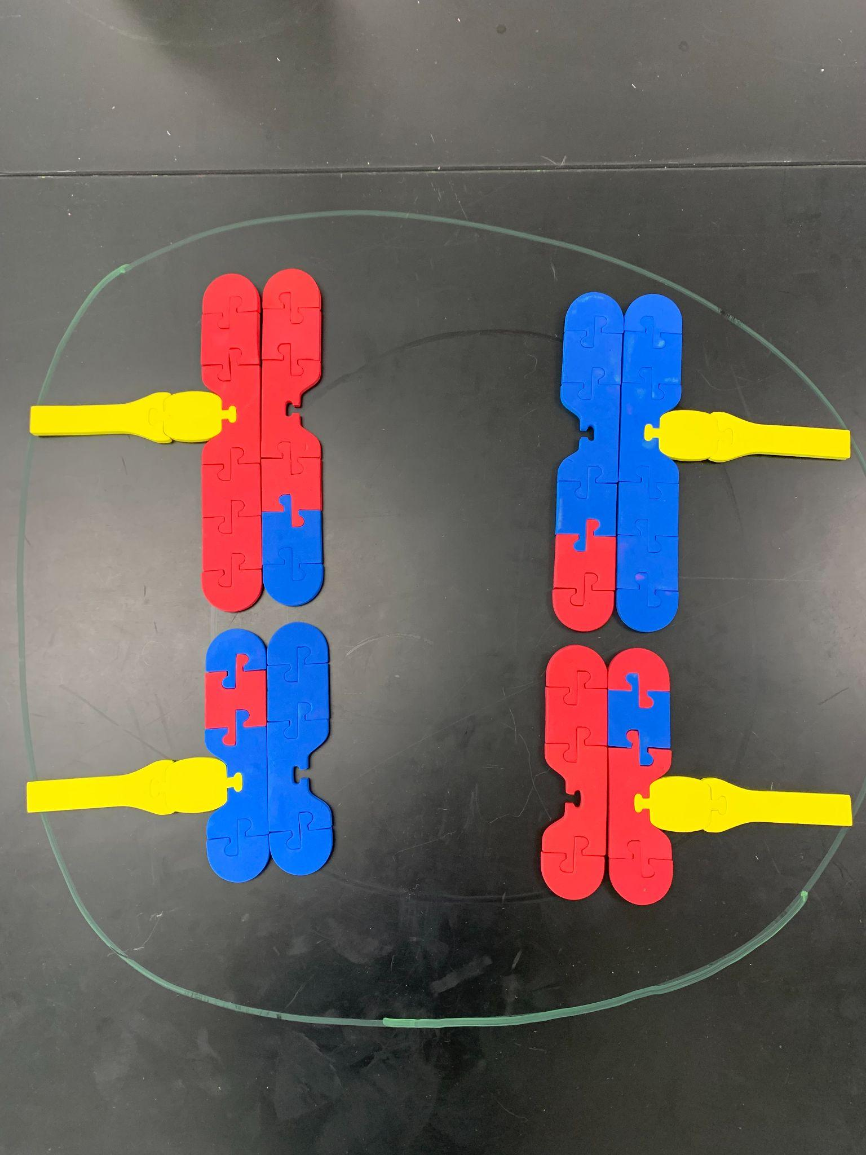
Anaphase I Model

Slide 17
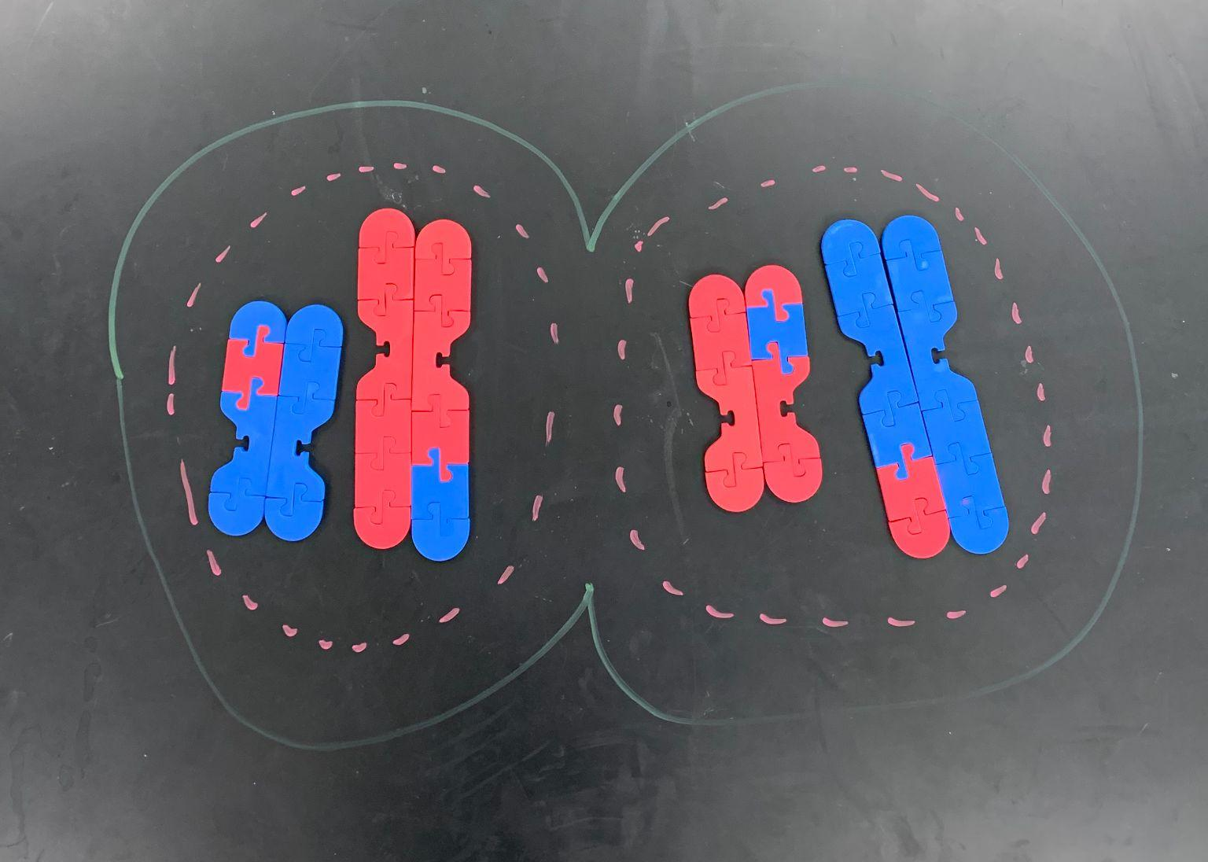
Modeling Directions
Telophase I
The nuclear membranes reform around the chromosomes. Using the table marker/chalk, draw and model this phase and draw telophase I on your data sheet.

Slide 18
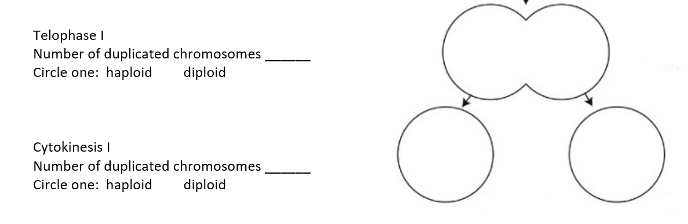
Modeling Directions
Cytokinesis I
Draw a model of two cells on your table to show cytokinesis and draw cytokinesis I on your data sheet.
Answer questions 1 – 4 on the data sheet.

Slide 19
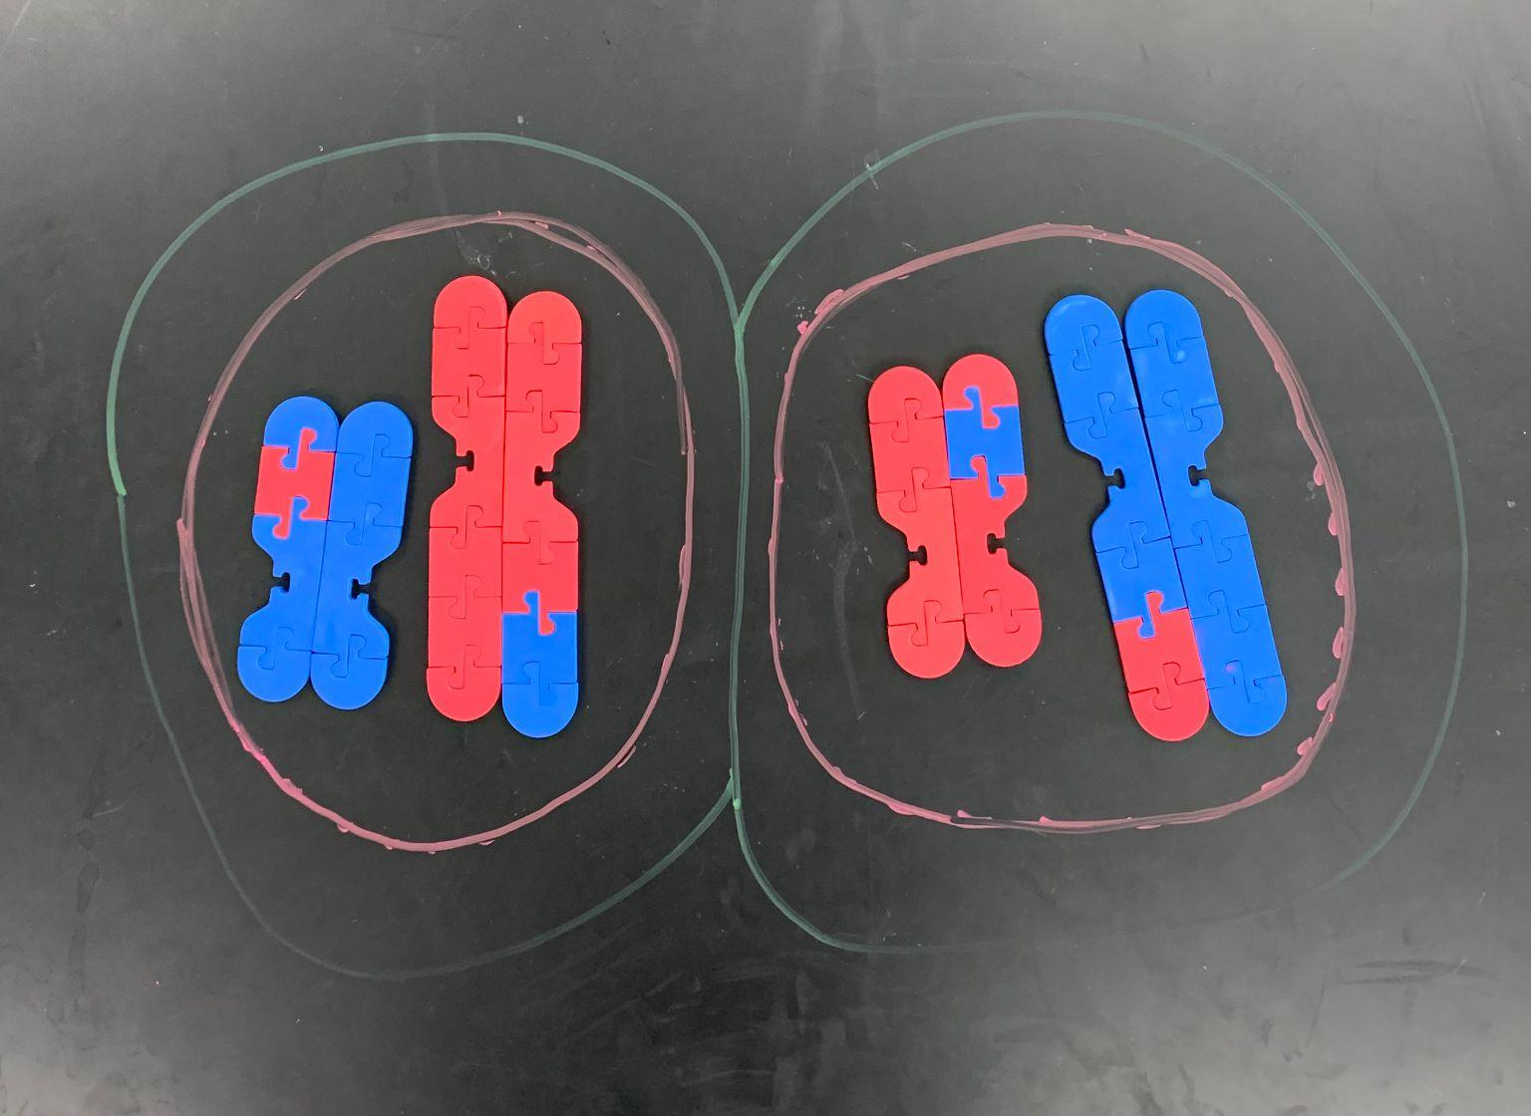
Cytokinesis I Model

Slide 20
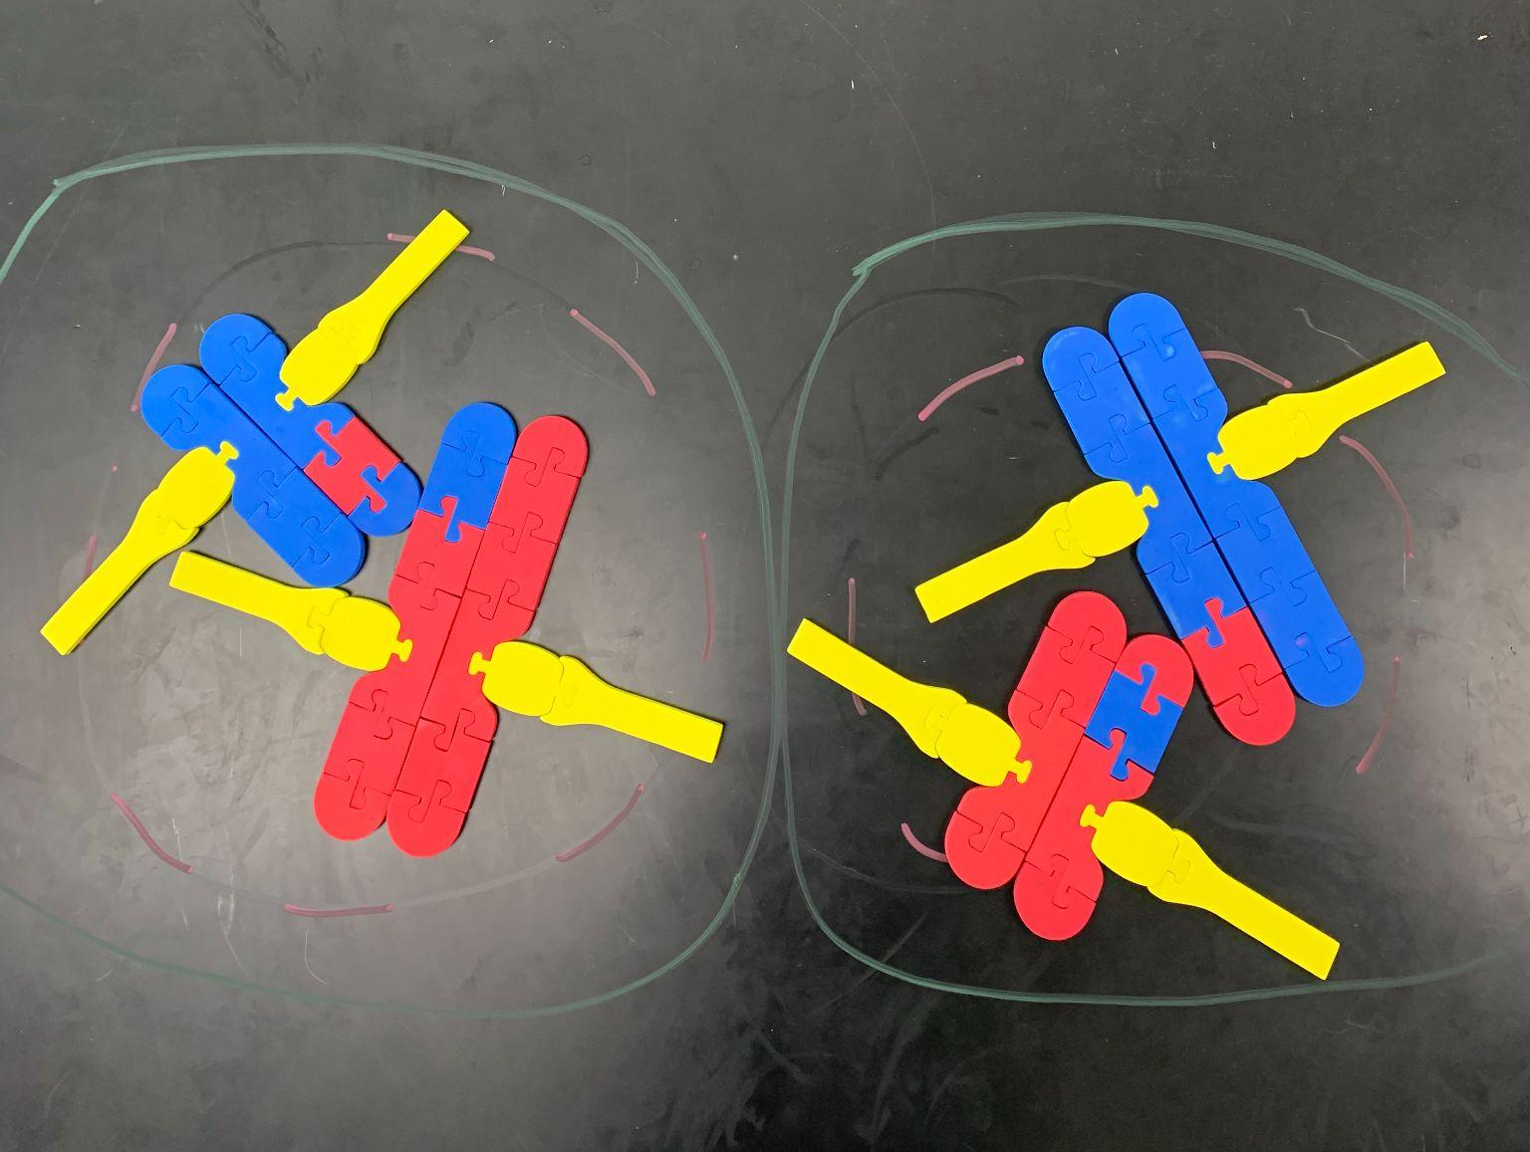
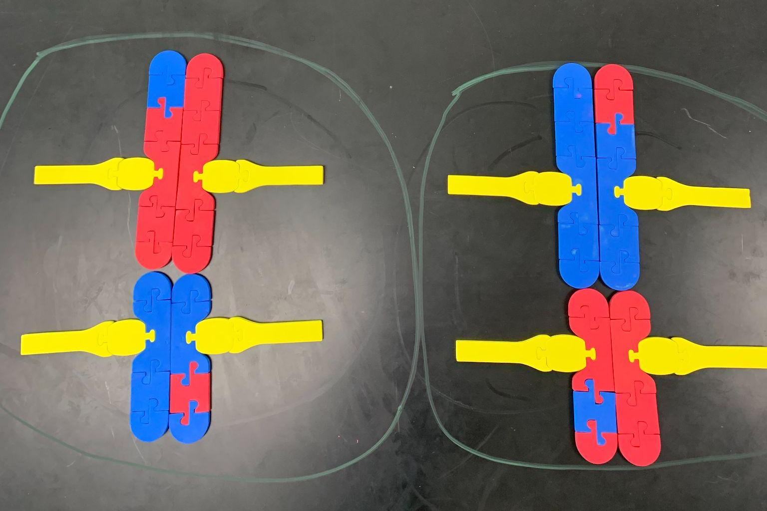
Meiosis II Models
Prophase II
Metaphase II

Slide 21
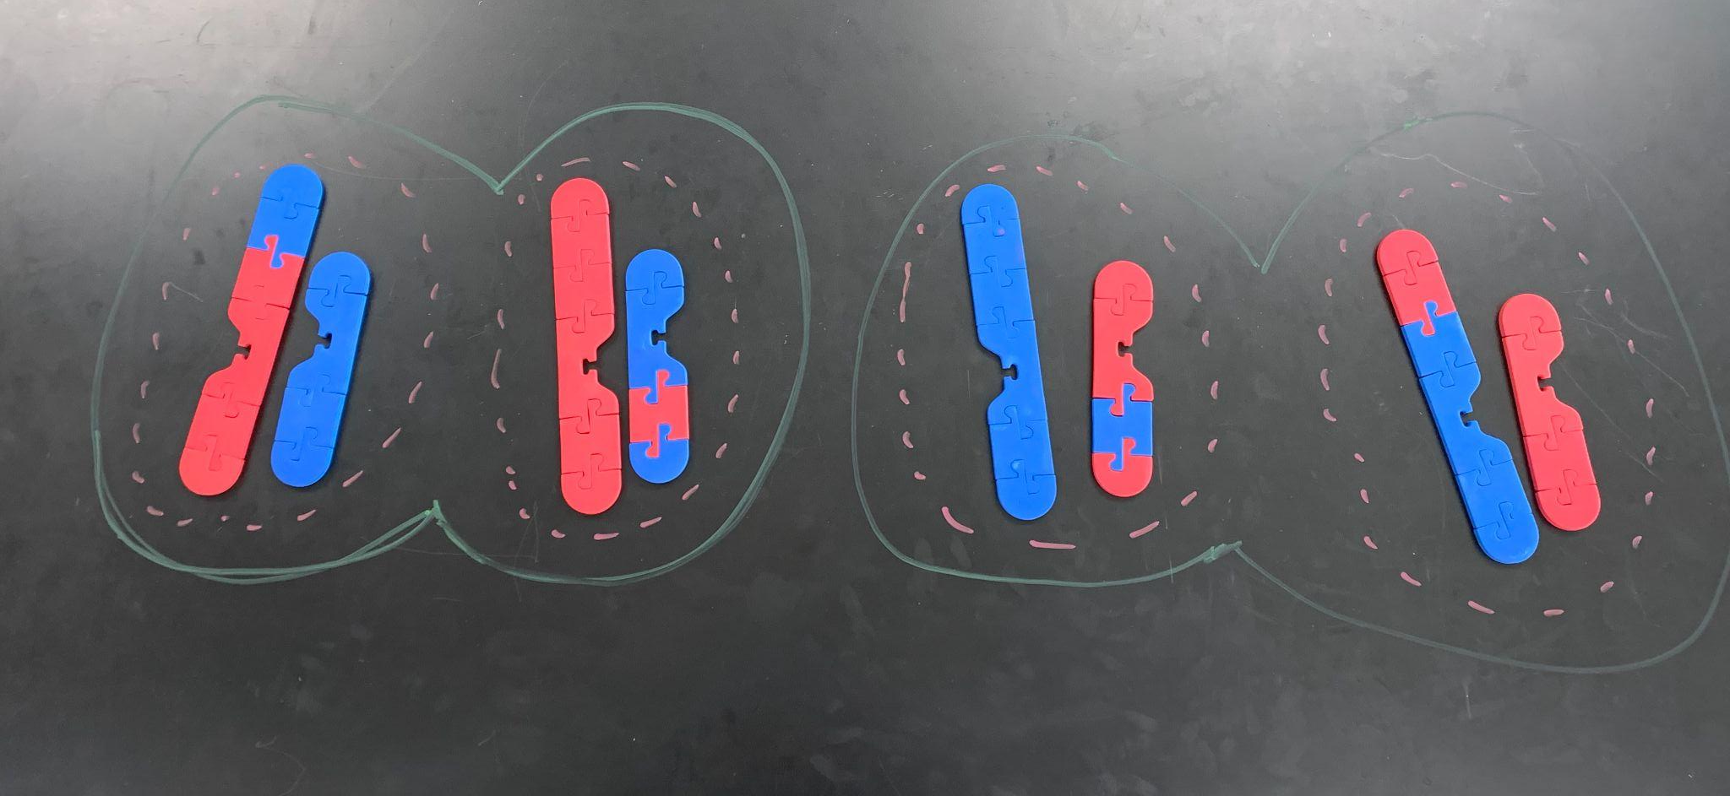
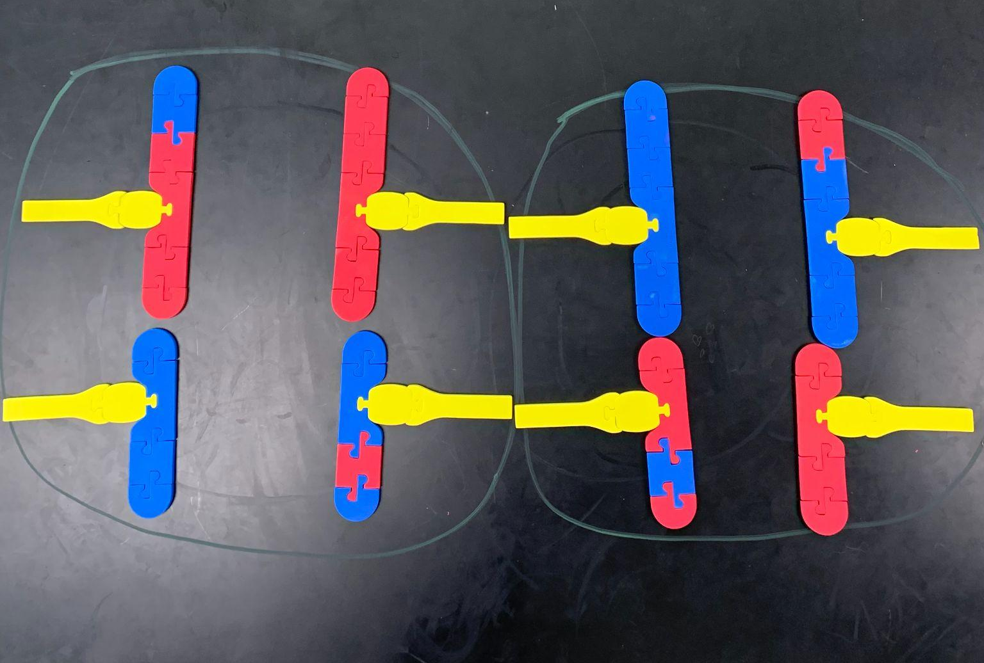
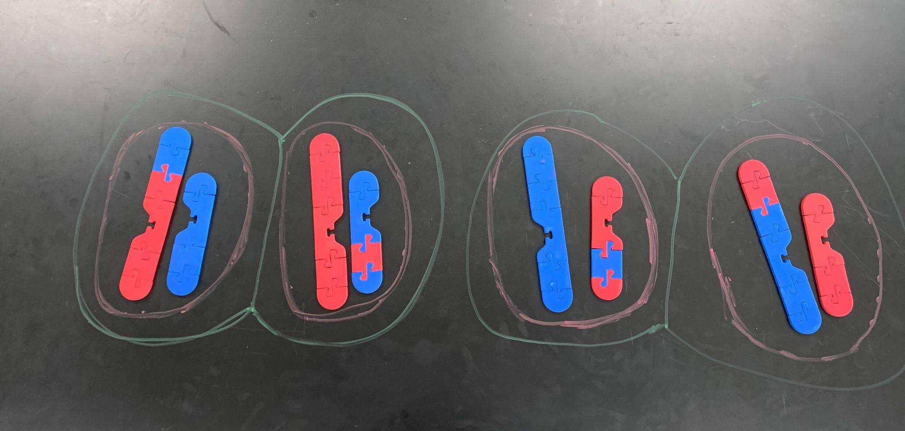
Meiosis II Models Continued
Anaphase II
Telophase II
Chromosome combinations due to independent assortment alone
2^{n} (n = haploid #)
2² = 4 combinations
Humans 2²³ = 8,388,608
Cytokinesis II
Notes:
2^{n} (where n = haploid number) combinations from independent assortment. For this simulation with n = 2, there are 4 combos. For humans 2²³

Slide 22
Sources of Genetic Diversity
Crossing over
Independent assortment
Random fertilization
Notes:
Independent assortment and random fertilization in humans would lead to more than 64 trillion combinations! This doesn’t take into account crossing over.

Slide 23
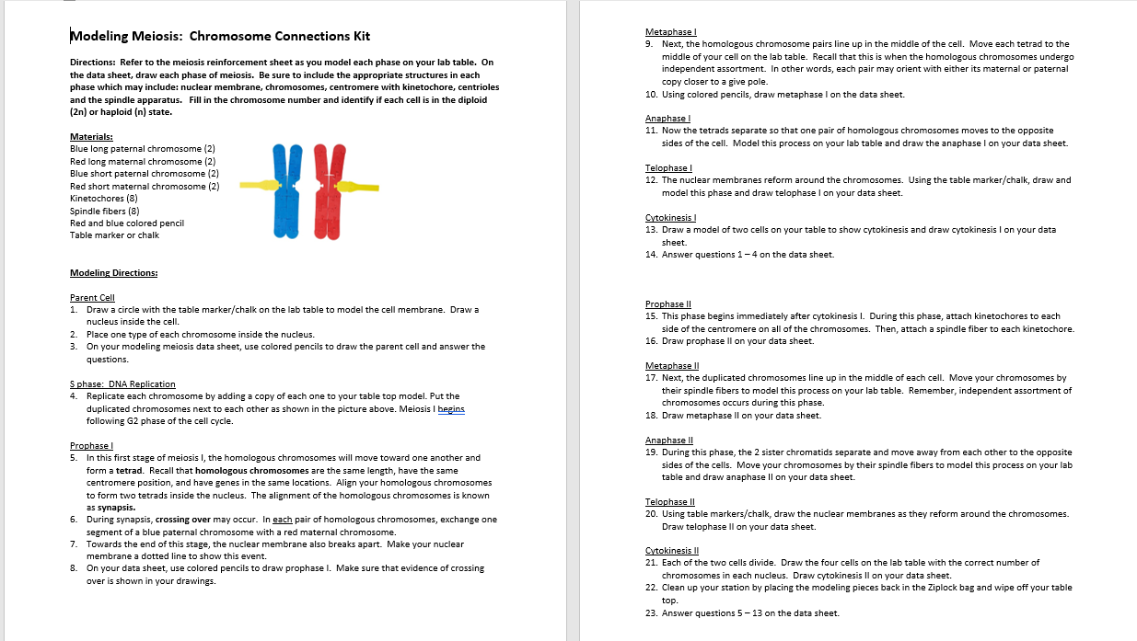
Modeling Meiosis Directions

Slide 24
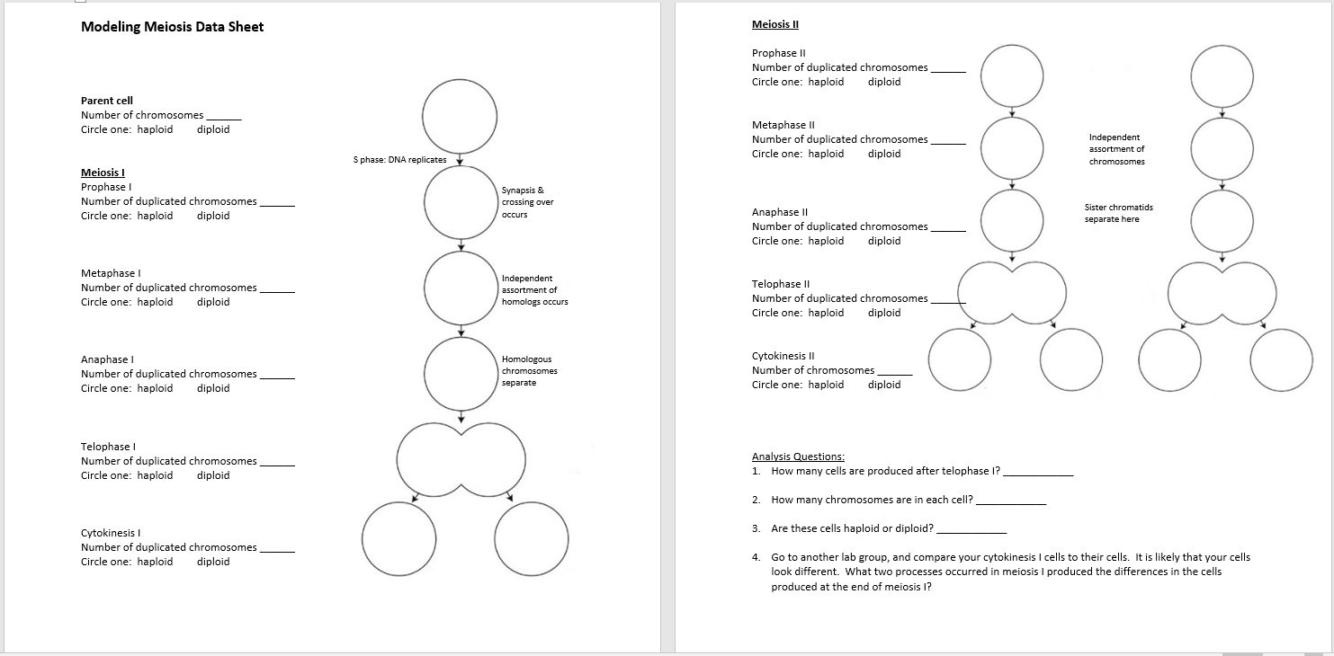
Student Data Sheet

Slide 25
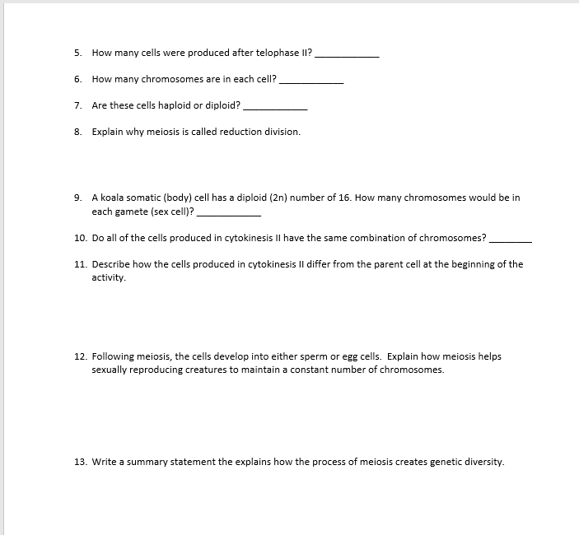
Student Data Sheet Continued

Slide 26

Survey and Discount
Purchase kits at 3dmoleculardesigns.com.
Use code FC23 & order by December 31st to receive 20% off most of our kits and models.
Scan this QR code to fill out a survey for a chance to win a $50 gift card!

Slide 27
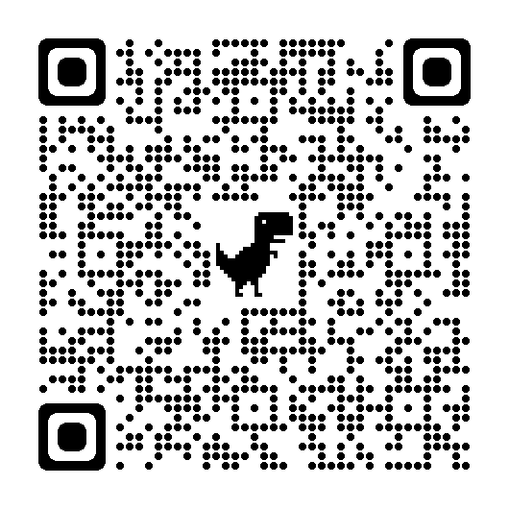
Link to Today’s Presentation & Raffle
Thanks for attending!

Slide 28
Join Us For The Next Session
Teaching the Molecular Mechanisms of Addiction with Physical Models with Alan Allmen here in the Grand Ballroom at 11:15
Modeling the Molecular World in Milwaukee this summer:
July 29 – August 2 OR August 5 – 9

