Slide 1
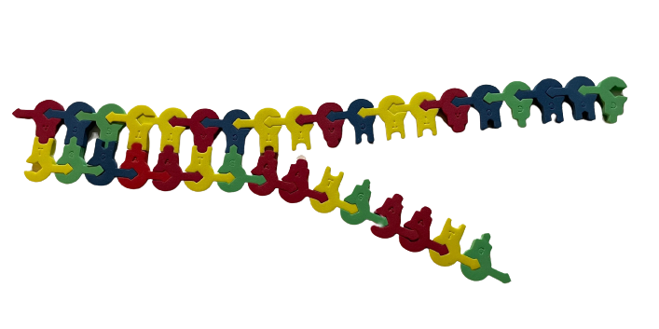
Uncovering the Truth:
Modeling a
DNA Replication Error
Sherry Annee: sannee@brebeuf.org NABT 2023
Brebeuf Jesuit Preparatory School Baltimore

Slide 2
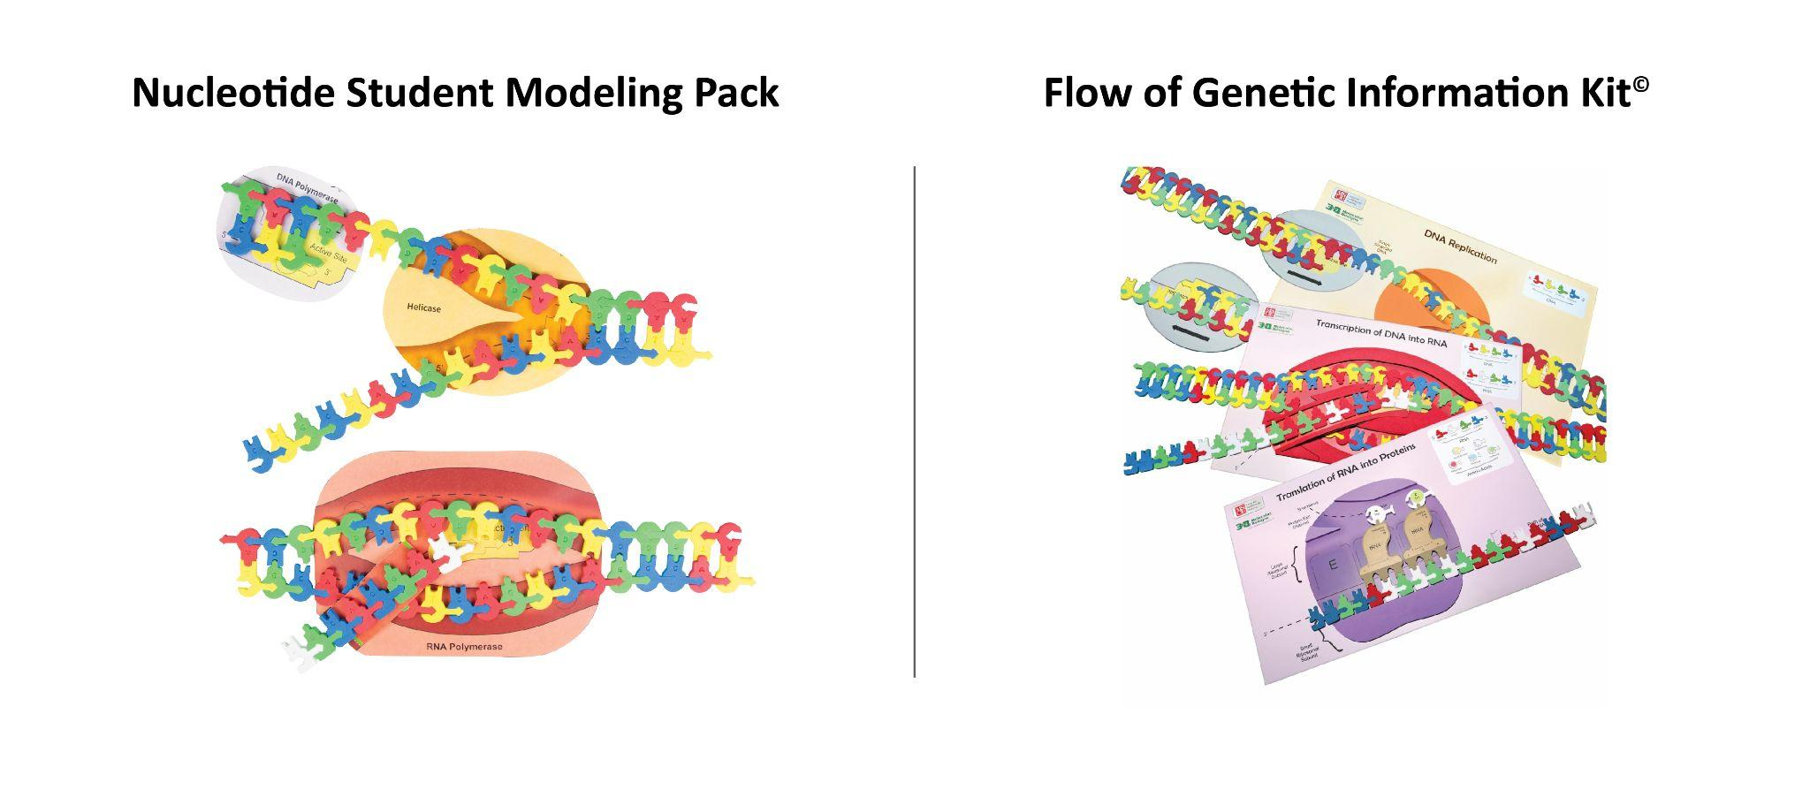

Slide 3
Workshop Goals
Use the foam nucleotides to model DNA replication
Use the model to learn about one type of DNA replication error
Apply the DNA replication error in the context of a story

Slide 4


The Crime
A 26-year-old woman drove into a parking lot to park her car and return to work. She approached a man in the lot, thinking he was the parking attendant. The man told her that she had to move her car immediately or it would be towed, and he followed her back to the car. As she got in the car to leave, the man told her she could stay.
As she got back out, the man attacked her with a screwdriver and told her to give him the keys and her purse. She struggled with him and then decided to flee; she threw her purse on the seat and jumped out of the car. As she was exiting the car, she noticed that the man was bleeding and that there was blood inside the driver’s side door.
She ran into a nearby parking garage and called the police.

Slide 5
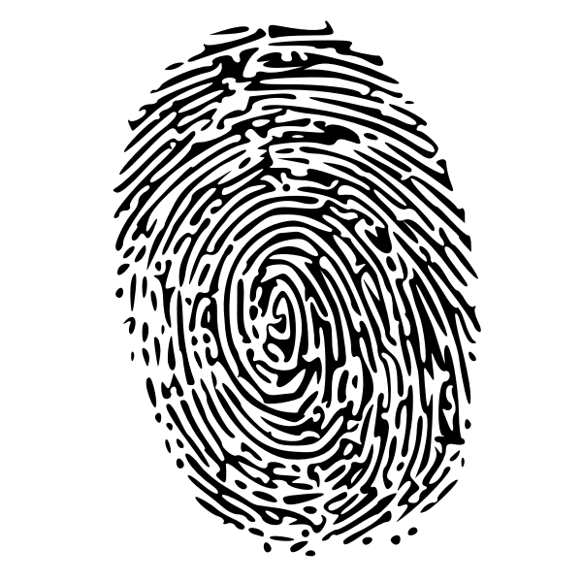
The Arrest
The victim described her attacker to police as a clean-shaven man wearing a baseball cap. She said the man was 5’10’’ tall and had a gap between his teeth. The next day, the victim helped police draw a composite sketch of the attacker.
Meanwhile, police recovered the victim’s car in another part of town. Latent fingerprints and swabs of the blood stain inside the driver’s side door were collected.
Six days later, a detective arrested Antonio B. because he thought Antonio resembled the composite sketch in this case. The same detective prepared a live lineup including Antonio and three other men – two of them police officers. The victim identified Antonio and he was charged with first-degree robbery.

Slide 6
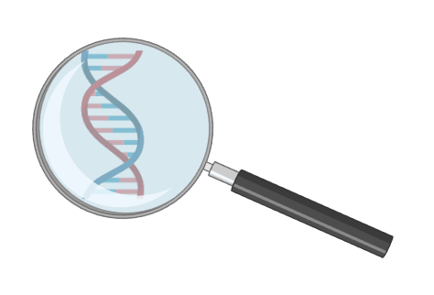
Is Antonio guilty of the carjacking?

Slide 7
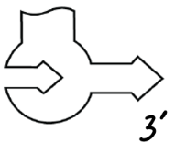
DNA replication
Important Reference:
What is the purpose of each of the following?
Helicase -
Primers -
Nucleotides -
DNA Polymerase -

Slide 8
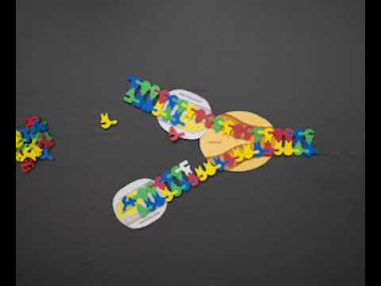
DNA replication

Slide 9
DNA replication
What is the purpose of each of the following?
Helicase - breaks H bonds
Primers - short nucleotide sequence required for polymerase to begin replication, or extension, of the new strand of DNA
Nucleotides - added by polymerase to extend the new strand of DNA
DNA Polymerase - enzyme that adds nucleotides to to the growing strand of DNA in order to replicate DNA

Slide 10
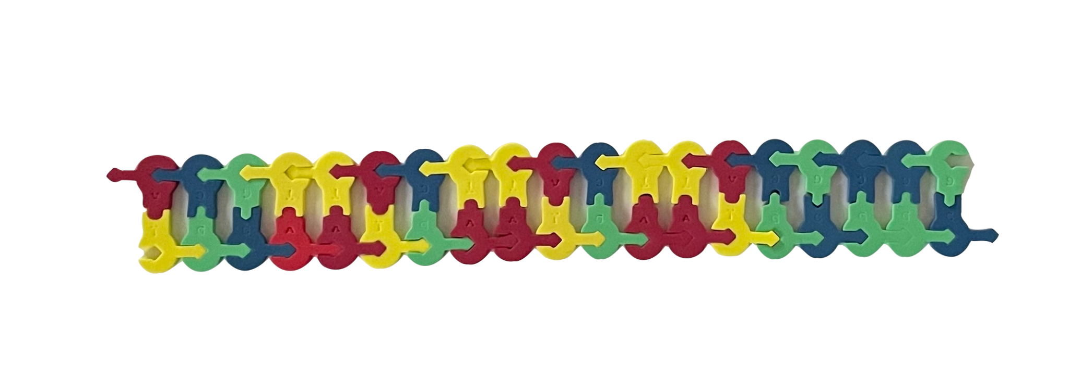
Let’s Make a DNA Model!
3′
A C G T T A C T T A C T T A C G C C G
5′
5′
T G C A A T G A A T G A A T G C G G C
3′
A = Red
T = Yellow
C = Blue
G = Green

Slide 11
Observe your DNA model. What do you notice?
3′
A C G T T A C T T A C T T A C G C C G
5′
5′
T G C A A T G A A T G A A T G C G G C
3′

Slide 12
Observe your DNA model. What do you notice?
3′
A C G T T A C T T A C T T A C G C C G
5′
5′
T G C A A T G A A T G A A T G C G G C
3′
The unit of bases, AATG, is repeated three times along the bottom strand.
Genetic shorthand: [AATG]₃

Slide 13
Flanking Regions
3′
A C G T T A C T T A C T T A C G C C G
5′
5′
T G C A A T G A A T G A A T G C G G C
3′
The unit of bases, AATG, is repeated three times along the bottom strand.
Genetic shorthand: [AATG]₃
Notes:
Flanking regions are not necessarily G/C rich; these were chosen based upon the student modeling pack and the number of each nucleotide available in case instructor wants students to replicate this sequence.

Slide 14
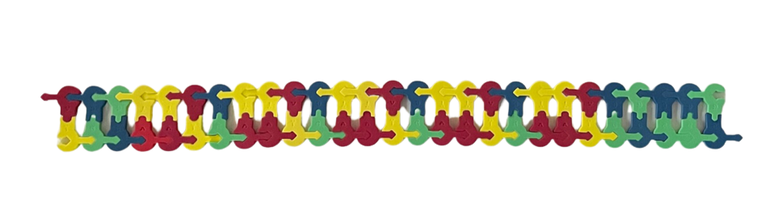
Observe this DNA model. What do you notice?
A C G T T A C T T A C T T A C T T A C T T A C G C C G
3′
5′
5′
3′
T G C A A T G A A T G A A T G A A T G A A T G C G G C
Notes:
insert letters for bottom strand

Slide 15
Five repeated AATG units: [AATG]₅
A C G T T A C T T A C T T A C T T A C T T A C G C C G
3′
5′
5′
3′
T G C A A T G A A T G A A T G A A T G A A T G C G G C
Notes:
insert animation for each of the 5 boxes

Slide 16
Short Tandem Repeats (STRs) = short repetitive units of nucleotides. The number of “repeats” can vary at a particular locus in the genome. For example, TPOX on Chromosome 2:
[AATG]₅
[AATG]₃
Notes:
Add 3’ and 5’?

Slide 17
Compare both DNA molecules. What do you notice?
[AATG]₅
[AATG]₃
The flanking regions are identical
Notes:
flanking regions are identical; are all flanking regions identical? No but many are, which helps scientists design primers to amplify these regions of the genome.
Larger molecule is 27 bp, smaller is 19 bp

Slide 18

Pub Med Central: https://www.ncbi.nlm.nih.gov/pmc/articles/PMC5054066/
What Causes a Different Number of Repeated Nucleotide Units?
Notes:
Pub Med Central: https://www.ncbi.nlm.nih.gov/pmc/articles/PMC5054066/

Slide 19
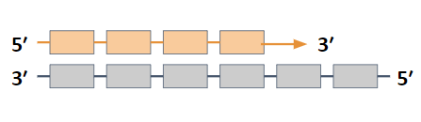
Typical Replication
6 Repeat Units on Template Strand (Gray)
1
Replication
Newly synthesized strand is orange
Notes:
Blocks represent STR

Slide 20
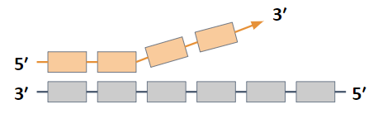
Typical Replication…
1
Replication
2
Strand Dissociation
Polymerase pauses and can be temporarily released. The end of the newly synthesized strand can dissociate from the template
Newly synthesized strand is orange
Notes:
Blocks represent STR

Slide 21
Original blocks and lines that can be coped
5′
3′
3′
5′
Notes:
Blocks represent STR

Slide 22
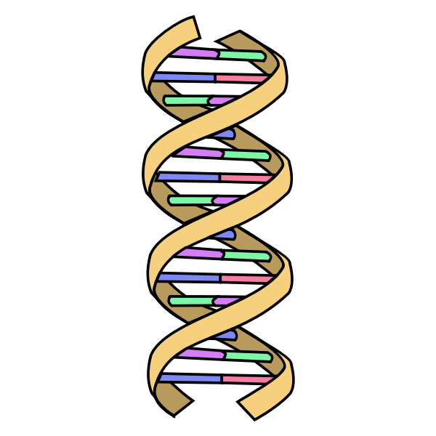
Hmmm…
How might this result in an inserted repeat (ex: AATG) in the newly synthesized strand?

Slide 23
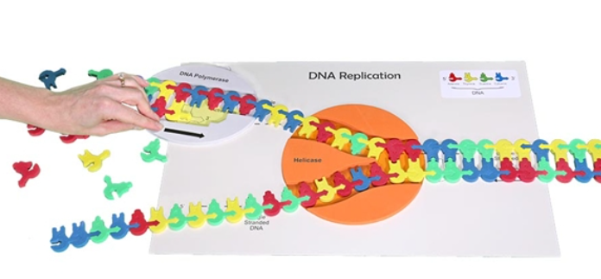
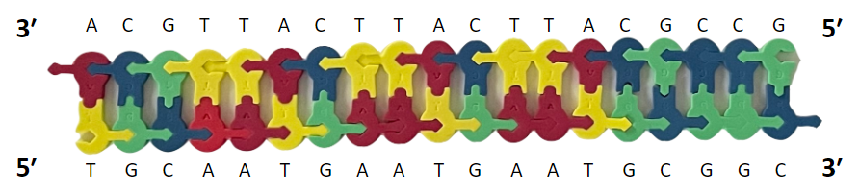
Let’s Replicate!
You will need your DNA model, DNA replication mat, and one DNA polymerase.

Slide 24
Let’s Replicate!
We will focus on replicating ONLY the top strand and we will not incorporate primers.
Continue replicating the top strand of DNA in the 5’ to 3’ direction, until you have added 15 nucleotides to the new strand of DNA.

Slide 25
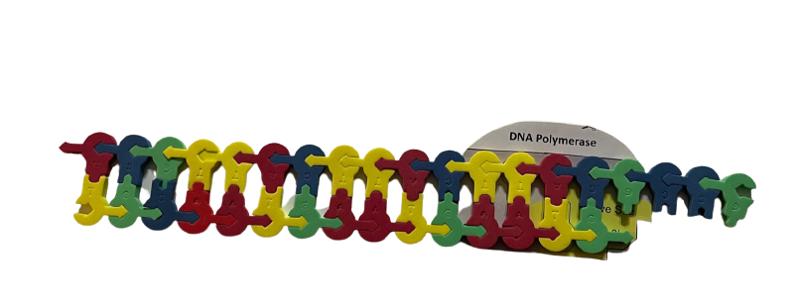
New Strand of DNA
Notes:
Schematic illustration of slipped-strand mispairing or strand slippage. During replication, the DNA sequences are associated, and the DNA polymerase can recognise and bind to the 3’ end of the DNA strand, allowing it to synthesise an identical complementary copy (1). Sometimes the strands will dissociate, the DNA polymerase complex falls off, and replication stops (2). When the two DNA strands pair up again, they will align correct most of the time (1). Sometimes, because of the repeated sequences (GATA), the strand will mispair to create a shorter ’copy’ (3) or more rarely a longer ’copy’

Slide 26
Polymerase pauses and is temporarily released…and the newly synthesized strand dissociates…
We will pause here to give you a few minutes to think about this “mistake”

Slide 27
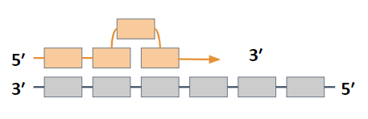

Replication Mistake: Slipped-Strand Mispairing*
Use your model of DNA and polymerase to demonstrate slipped-strand mispairing
*Slipped-Strand Mispairing (a.k.a DNA Slippage, Polymerase Slippage, Replication Slippage, or Strand Slippage)

Slide 28
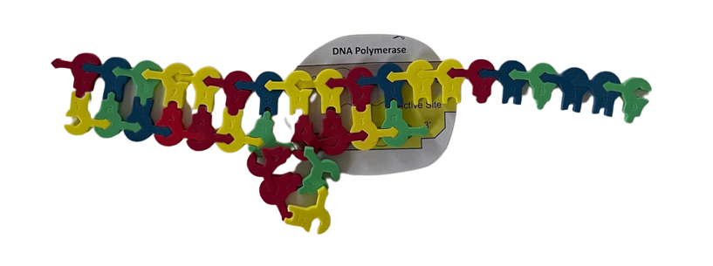
Replication Mistake: Mispairing Due to Repeated Unit
Notes:
Pub Med Central: https://www.ncbi.nlm.nih.gov/pmc/articles/PMC5054066/

Slide 29
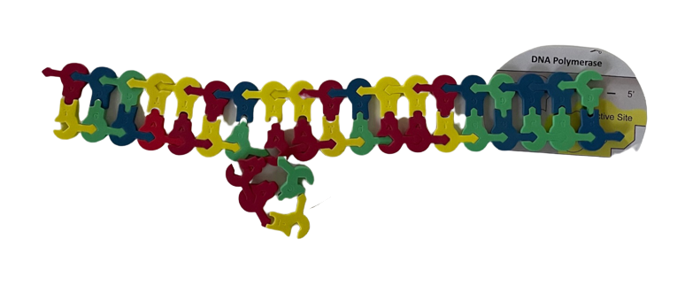
Replication Mistake: Polymerase Continues to Extend the New Strand

Slide 30
What will happen if the replication error isn’t repaired?

Slide 31
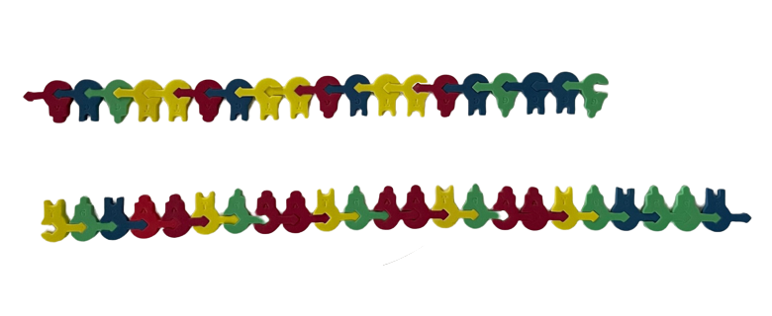
A mutation has occurred and will continue to be copied in subsequent DNA molecules
[AATG]₃
[AATG]₄

Slide 32
Replication Mistake: Short Tandem Repeats (STRs)
Subject to high mutation rates
Mutation rate can be up to 100,000x greater than a point mutation
Account for approximately 3% of the genome
Occurs in introns and exons
DNA polymerase more likely to pause in an STR region (unsure why)
Prone to slipped-strand mispairing
Tandem repeats contain many copies of the same short sequence over and over, so it is easy for the two strands of DNA to become misaligned in this local region
Results in multiple alleles for each STR
Citation: Myers, P. (2007) Tandem repeats and morphological variation. Nature Education 1(1):1
Notes:
Pub Med Central: https://www.ncbi.nlm.nih.gov/pmc/articles/PMC5054066/

Slide 33
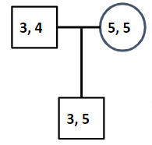
Genetic Inheritance of STRs
Example: TPOX on Chromosome 2 (AATG)
heterozygous
homozygous
[AATG]₃
[AATG]₅

Slide 34
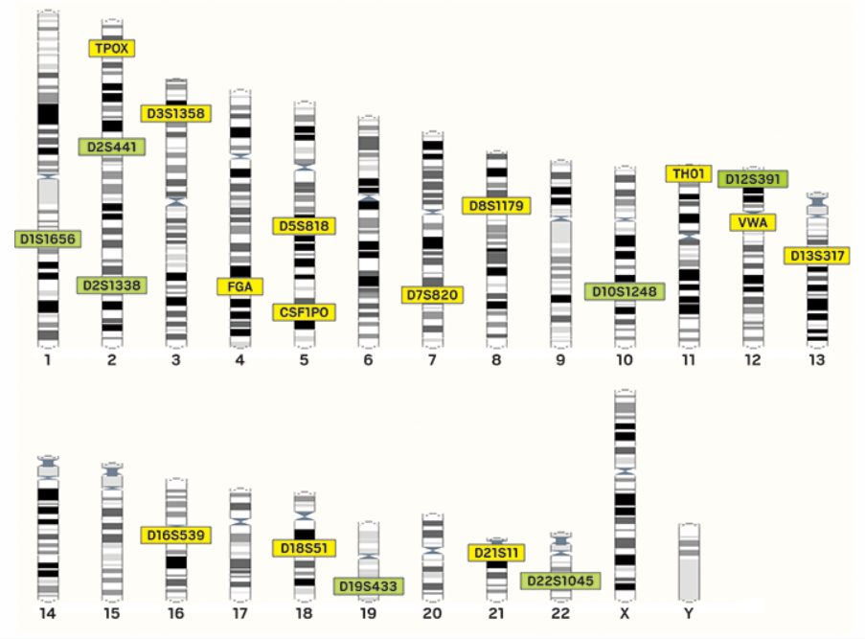
DNA
Profiling
20 Core Loci
https://cen.acs.org/analytical-chemistry/Thirty-years-DNA-forensics-DNA/95/i37
Notes:
https://cen.acs.org/analytical-chemistry/Thirty-years-DNA-forensics-DNA/95/i37

Slide 35
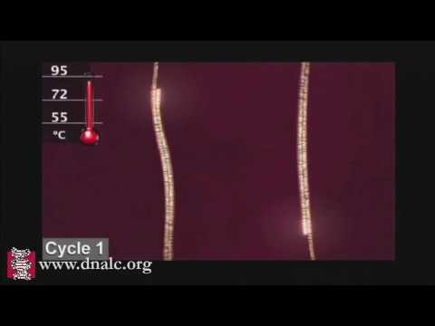
flanking regions serve as primer attachment
We learned how replication occurs in the cell, what will we need to make copies of DNA in the lab?
Notes:
flanking regions serve as primer attachment

Slide 36
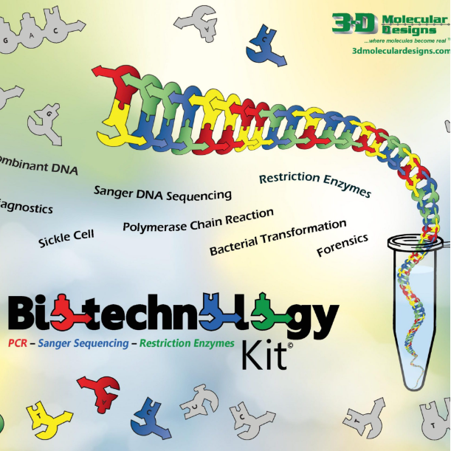
Kit Connection

Slide 37
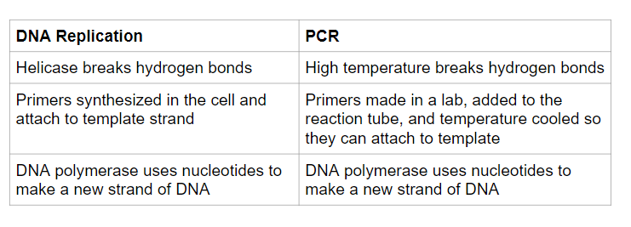

Slide 38
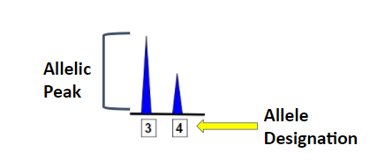
Electropherogram
TPOX (AATG repeat)

Slide 39
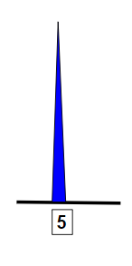

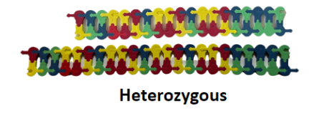
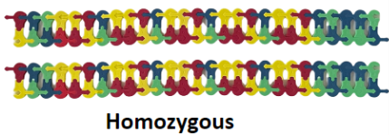
Let’s Revisit our Pedigree

Slide 40
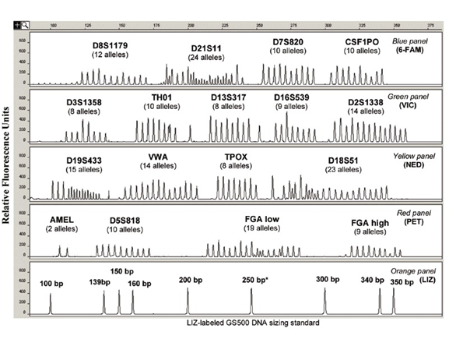
Allelic Ladder: Each allele represents a different number of repeat units at that locus
Diagram citation: Supplement to Vol. 43 ı No. 4 | 2007 www.biotechniques.com

Slide 41
Knowing that STRs are a powerful forensic tool, let’s return to the scene of the crime…
Imagine DNA has been isolated and amplified from the blood found in the car…
The electropherogram report is ready to be analyzed!

Slide 42
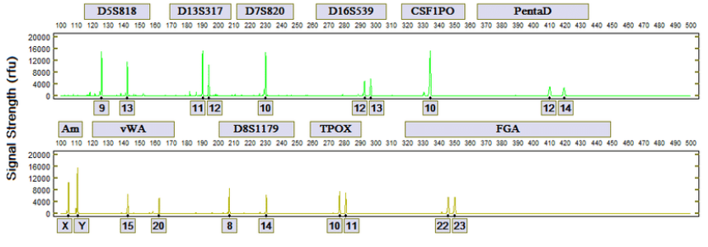
Electropherogram of the Evidence:
citation: https://www.researchgate.net/figure/Representative-electropherogram-developed-by-the-DNAscan-Expert-System_fig2_307556395
Notes:
citation: https://www.researchgate.net/figure/Representative-electropherogram-developed-by-the-DNAscan-Expert-System_fig2_307556395

Slide 43
Is Antonio guilty of the carjacking? Cite one piece of evidence to support your answer.
Antonio
D5S818: 9, 13
D7S820: 10
D16S539: 11, 14
TPOX: 9, 12
Electropherogram of the Evidence:
citation: https://www.researchgate.net/figure/Representative-electropherogram-developed-by-the-DNAscan-Expert-System_fig2_307556395
Notes:
citation: https://www.researchgate.net/figure/Representative-electropherogram-developed-by-the-DNAscan-Expert-System_fig2_307556395

Slide 44
The Trial
Antonio was charged with first-degree robbery and tried in April 1997. The victim testified that Antonio was the man who attacked her, the prosecution argued that the victim’s clear memory of the crime meant that she was better able to identify the perpetrator.
The defense presented evidence showing that fingerprints collected from the victim’s car – including prints from the driver’s side and the rearview mirror – did not match the victim or Antonio. They argued that prints left on the rearview mirror indicated that the person who left them must have driven the car.

Slide 45
The Verdict
After several hours of deliberations over two days, the jury convicted Antonio of first-degree robbery.
He was sentenced to 18 years in prison.

Slide 46
The DNA Evidence
In 2001, Antonio filed a motion on his own behalf requesting DNA testing. The state opposed the motion, but the court granted a hearing on the issue in 2005.
The Innocence Project accepted Antonio’s case and filed another brief on his behalf in 2006. The state agreed to testing on the blood swab from inside the car door in October 2006 and the results proved that Antonio could not have committed this crime. The DNA testing not only excluded Antonio as the source of the blood, but led to the identification of another man already incarcerated for other crimes.
Antonio was exonerated on March 29, 2007. He was 41 years old at the time of his exoneration and had served more than a decade in prison.

Slide 47

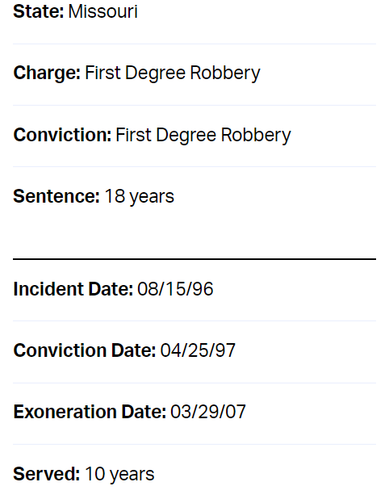
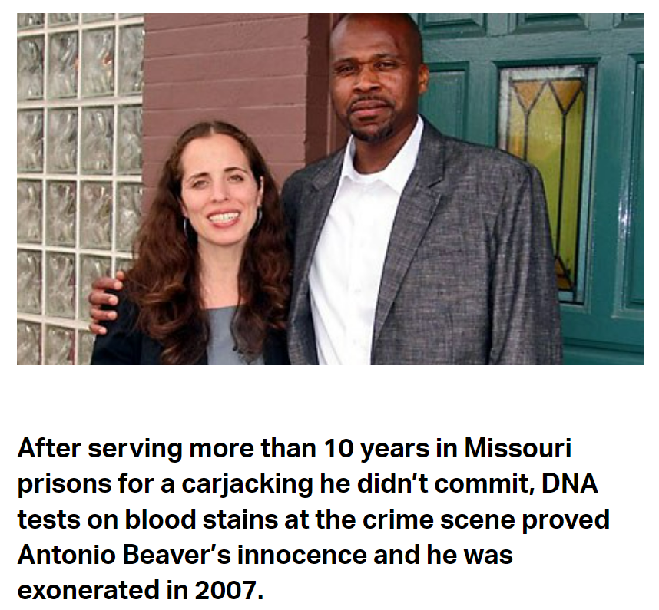

Slide 48
Workshop NGSS Connections
SEPs | CCCs | DCIs
Asking questions | Patterns | LS3.A: Inheritance and Variation
Developing and using models | Cause and effect | LS3.B: Inheritance and Variation
Constructing explanations supported by evidence

Slide 49
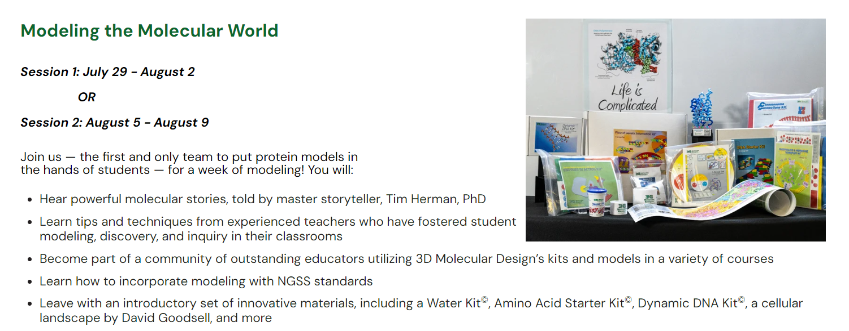
https://3dmd.3dmoleculardesigns.com/summer-courses

Slide 50
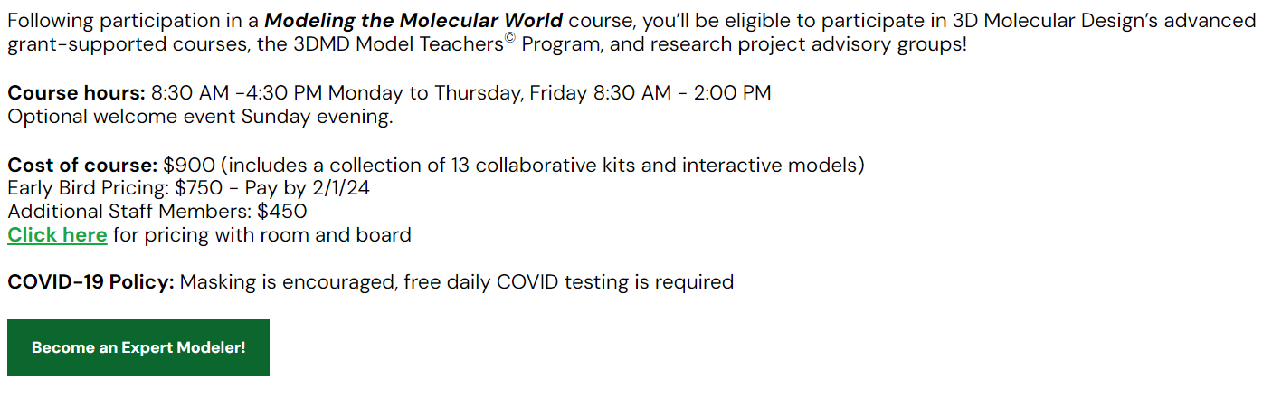
https://3dmd.3dmoleculardesigns.com/summer-courses

Slide 51
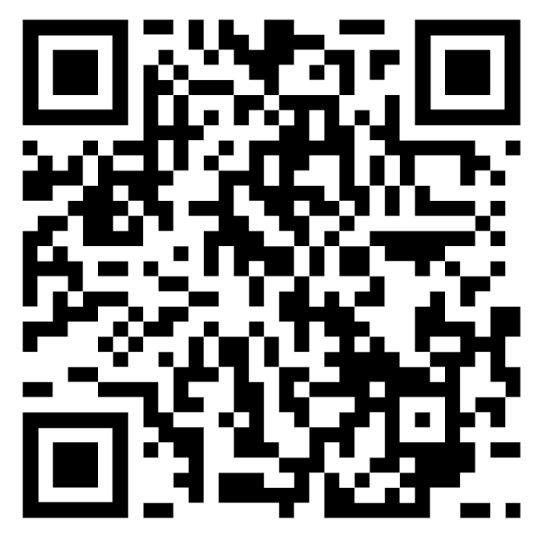
Thank you for attending today’s workshop!
Please use this QR code to complete a survey:
Use discount code FC23 for a 20% off most kits!
Join us for the next session from 3:30 - 4:00 pm: “Hydrophobic Marvels: Using Water Models to Unravel the Self-Cleaning Secrets of Lotus Leaves”

