Slide 1
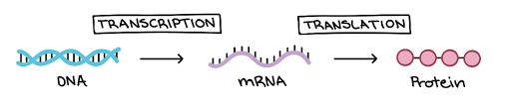
Going With the Flow
From Genes to Proteins
Mark Eberhard
NABT Baltimore 2023

Slide 2




Mark Eberhard
St. Clair High School in St. Clair, MI
38 years in the biology classroom
3DMD Model Teacher, Board of Directors for Michigan Association of Biology Teachers, HHMI Biointeractive Ambassador, Writing Team for College Board’s Pre-AP Biology, AP Biology Reader
NABT Outstanding Biology Teacher 2020 for Michigan
Email = meberhard@ecsd.us

Slide 3

Who is With Us Today?
Where are you from?
What is your role in science education?
How long have you been in science education?
How familiar are you with modeling kits from 3D Molecular Designs and the Center for Biomolecular Modeling?

Slide 4
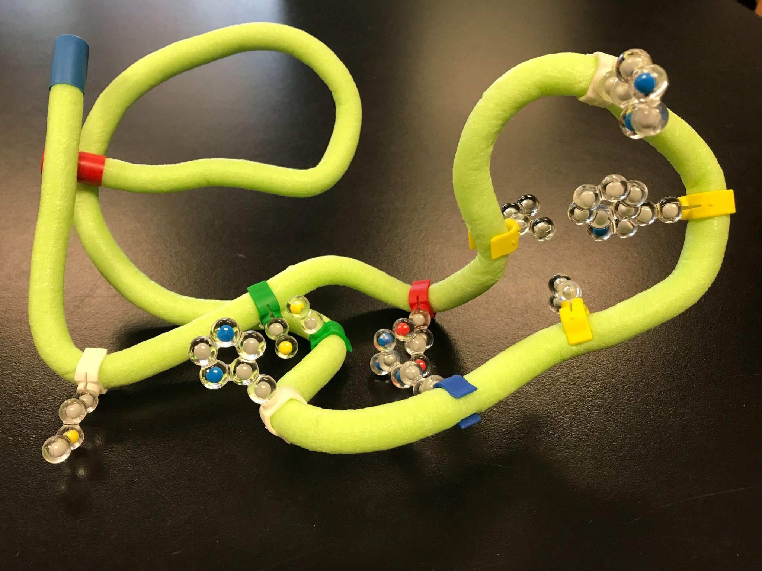
Workshop Goals
Model and explain how the information stored in genes is transcribed and translated into a functional protein
Recognize and address a weakness found in a model
Connect knowledge from your current modeling activity to a previous modeling activity: help students make connections between newly acquired knowledge and prior knowledge
Describe how a mutation in the DNA may lead to a change in its 3D shape that may alter its function

Slide 5
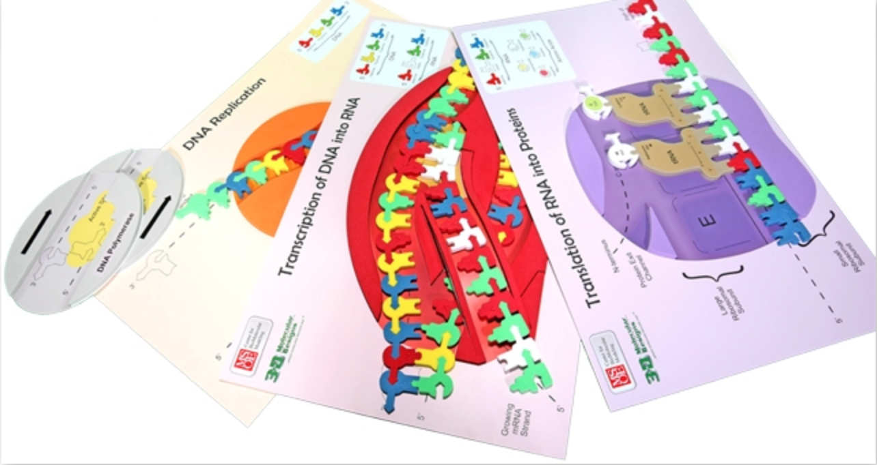
Flow of Genetic Information Kit
(FGIK)

Slide 6

3D Molecular Designs and the Center for Biomolecular Modeling Merged
Summer, 2022

Slide 7


cbm.mose.edu
SMART Teams (3dmoleculardesigns.com)

Slide 8
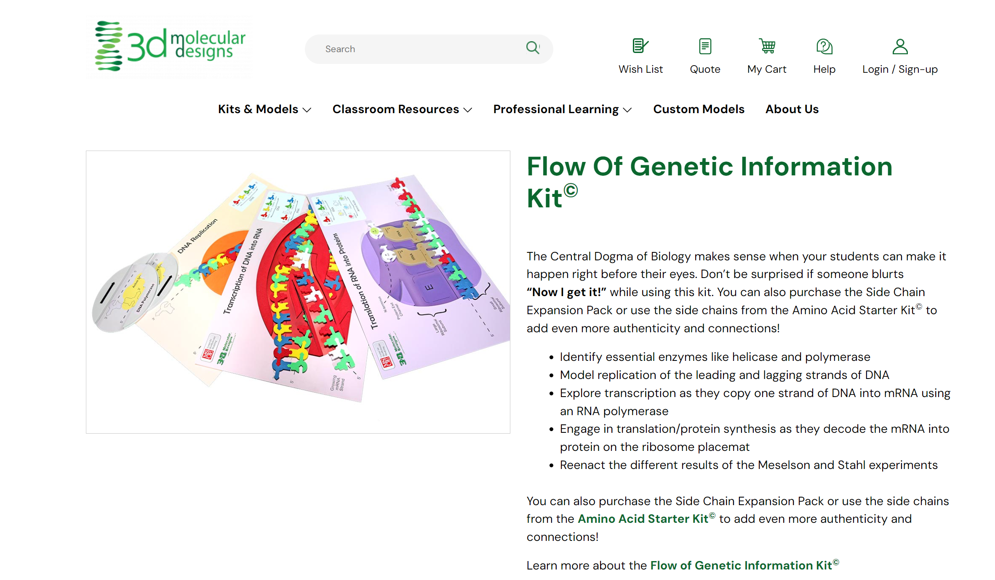
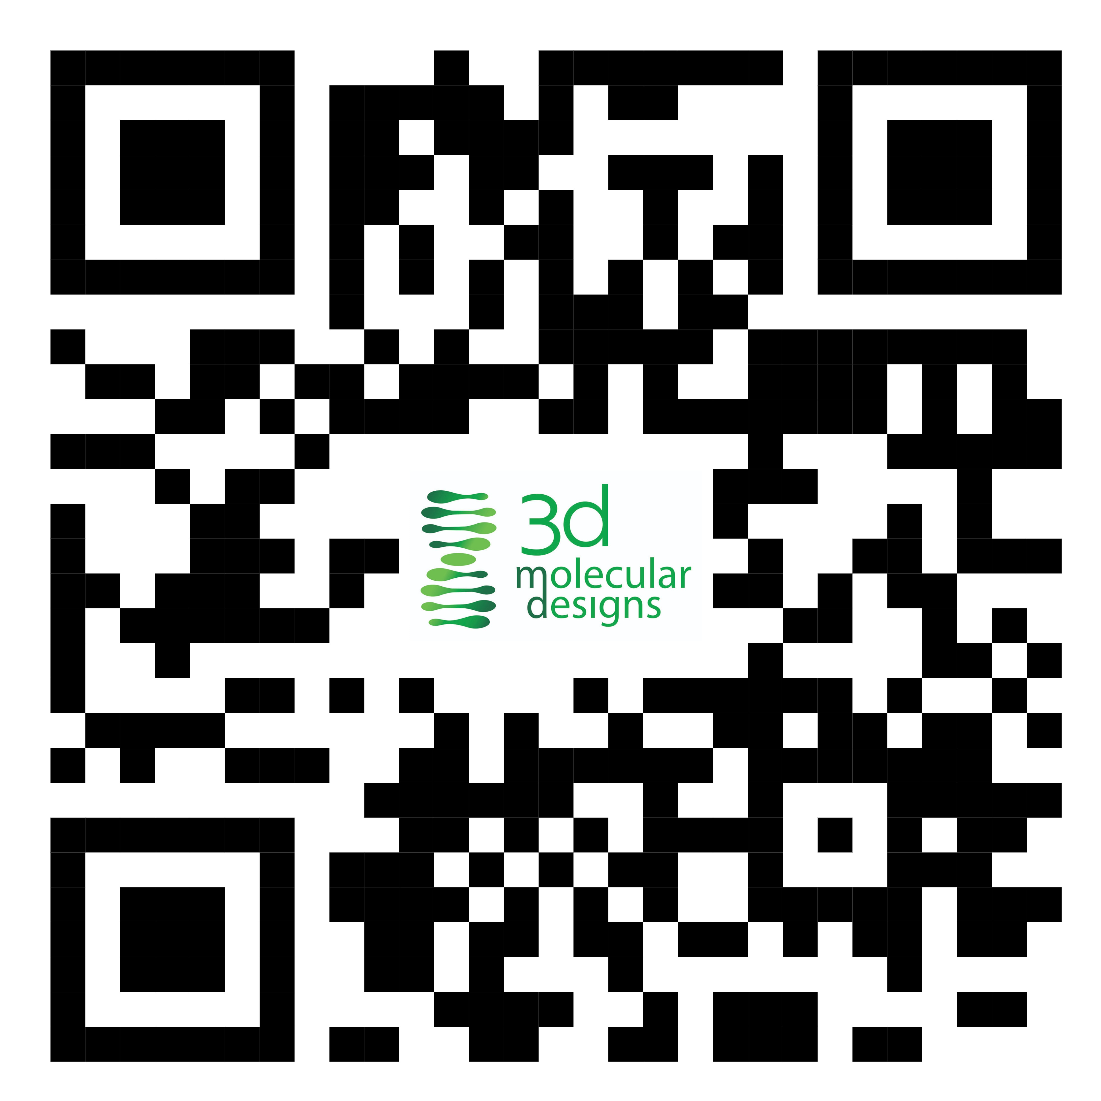
Each Kit has links:
Teacher notes
Lessons
Digital modeling activities
Animations and videos
Online resources
NGSS Standards
www.3dmoleculardesigns.com

Slide 9
Let’s Get Ready to Begin!
Prior to this activity my students have learned about DNA structure, and protein folding and have used the Replication component of this model kit.

Slide 10
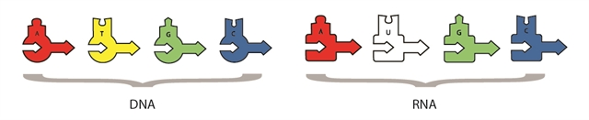
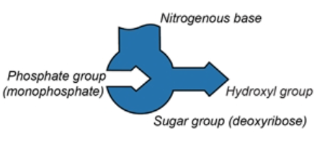

Nucleotides - DNA versus RNA
5’
3’

Slide 11
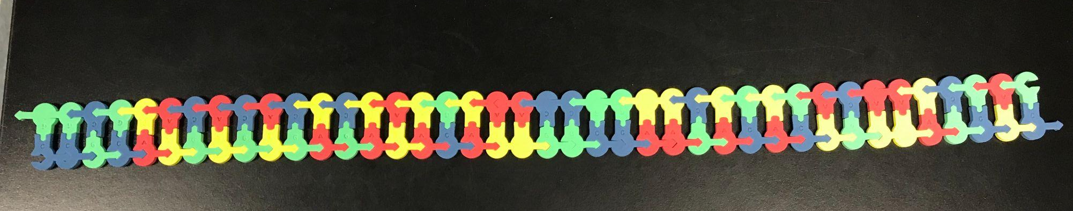
Please Orientate Your DNA Sequence …
Top DNA strand (3’—>5”) arrow points to the LEFT,
Bottom strand (5’—>3”) arrow points to the RIGHT

Slide 12
Transcription

Slide 13
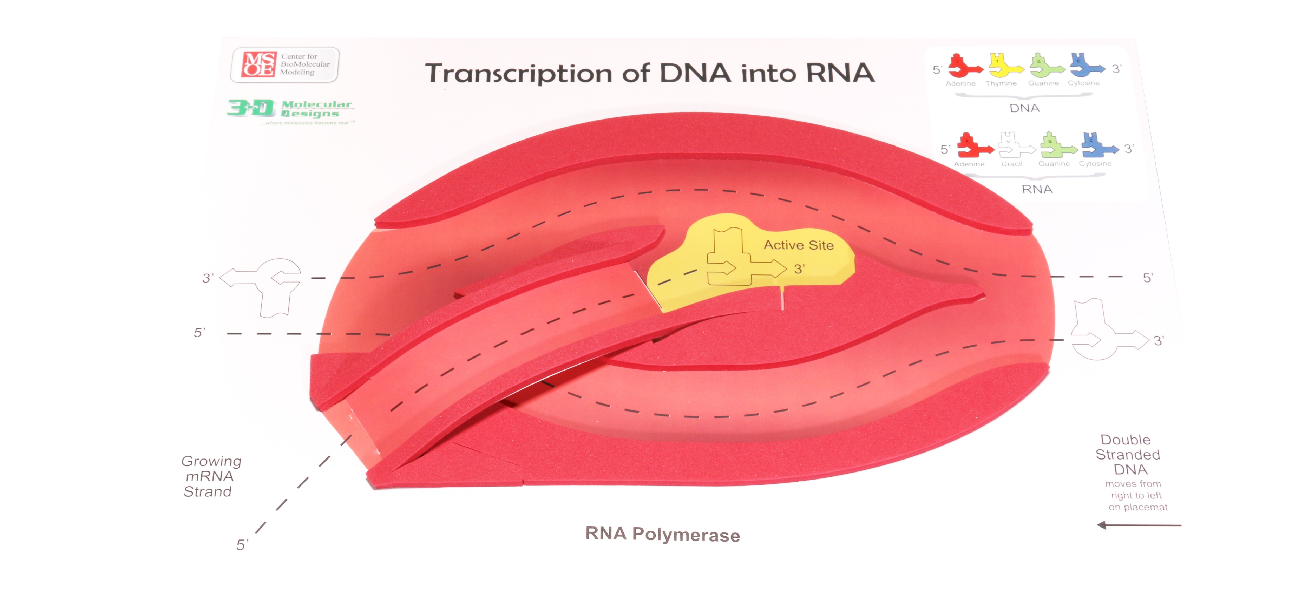
Transcription Placemat …

Slide 14
Nucleotides - DNA versus RNA

Slide 15
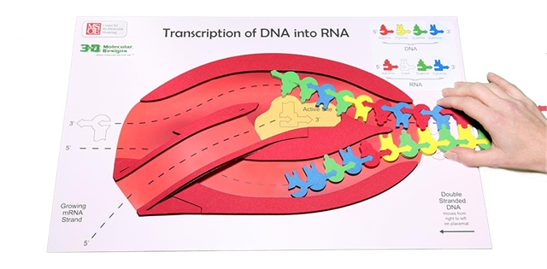
Initiation

Slide 16
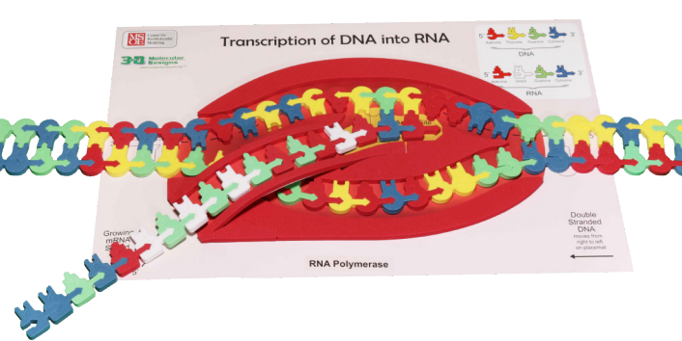
Elongation

Slide 17
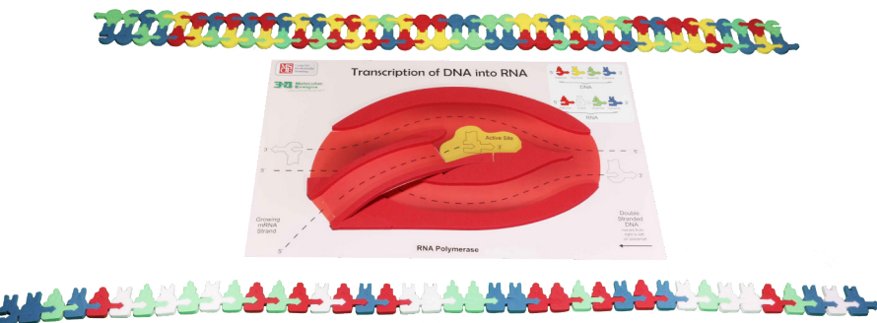
Termination

Slide 18
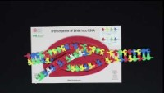
Student Products
Stop Motion
Video
Photos & Google Slides
Peer Review Presentations

Slide 19
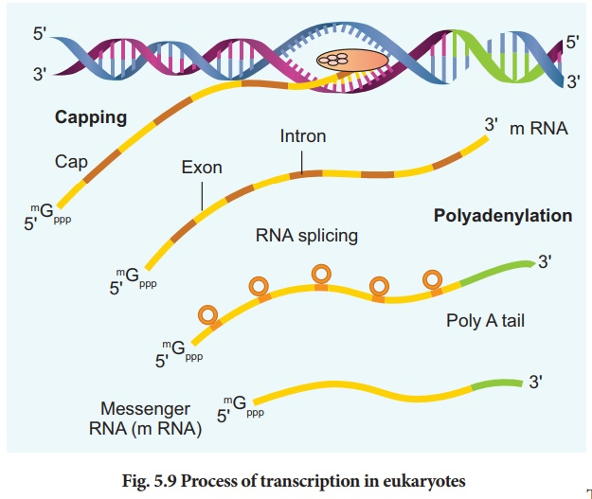
ALL Models have weaknesses!
What if I want my students to model mRNA processing of introns and exons?
What if I want my students to model the 5” G-cap or the poly-A tail?
Put the challenge to your students!
https://www.brainkart.com/article/Transcription_38062/

Slide 20
Translation

Slide 21
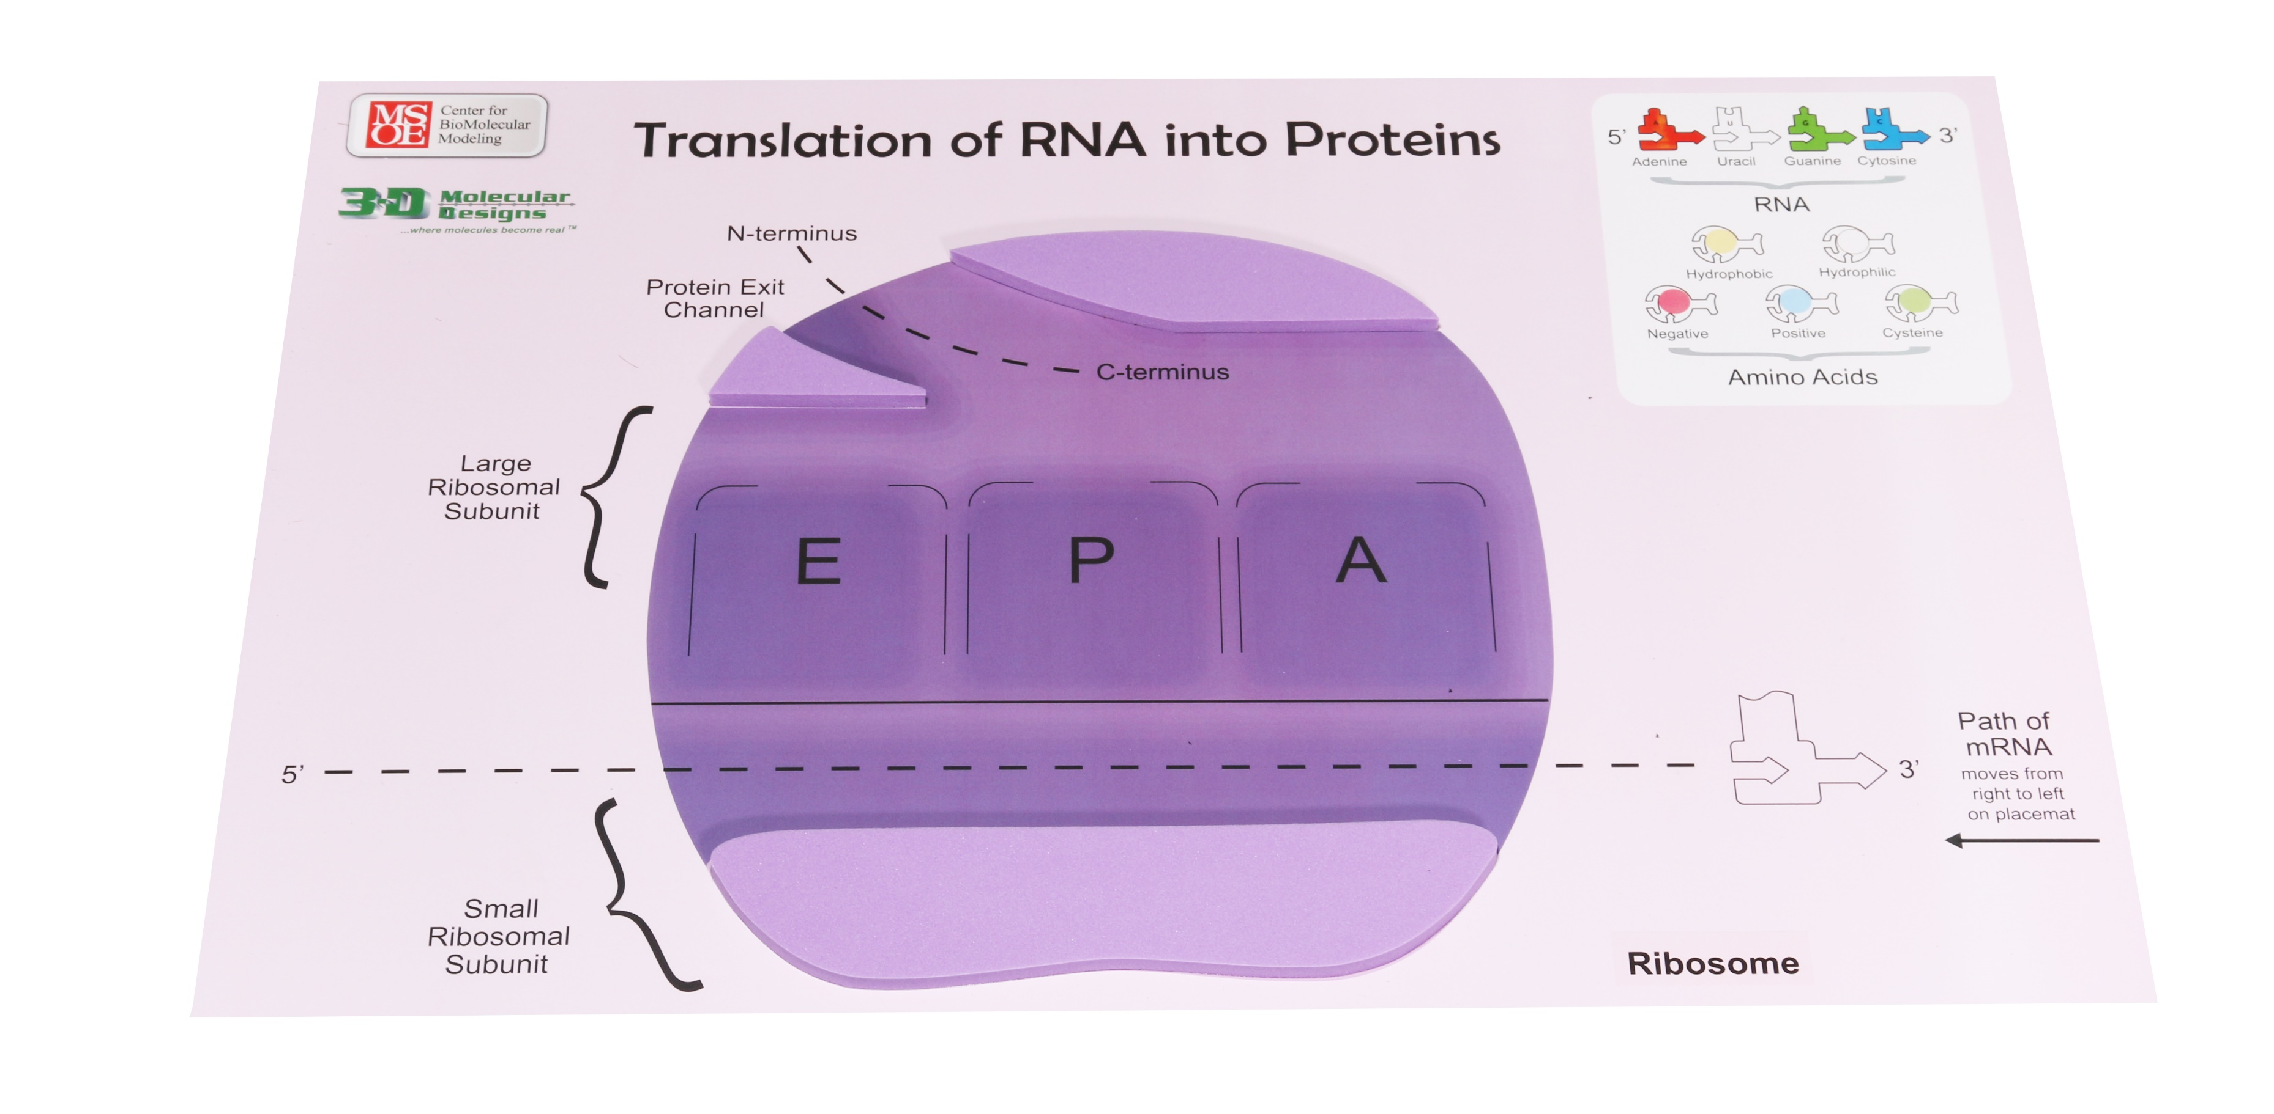
Translation Placemat …

Slide 22
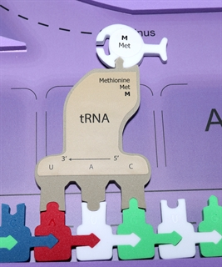
tRNA’s &
Amino Acids

Slide 23
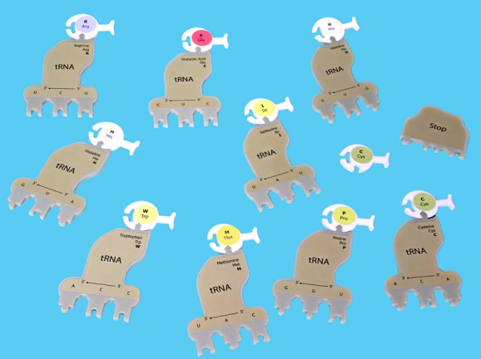
5’ ---------------------------------------------------------------------------------------------- > 3’
mRNA Codons | AUG | UGU | GAG | AUA | CAU | UGG | CCA | AGA | CAC | UGU | UAG
tRNA anitcodons | UAU | ACA | CUC | UUA | GUA | ACC | GGU | UCU | GUG | ACA | AUC
Amino Acid | Met | Cys | Glu | Ile | His | Trp | Pro | Arg | His | Cys | STOP

Slide 24
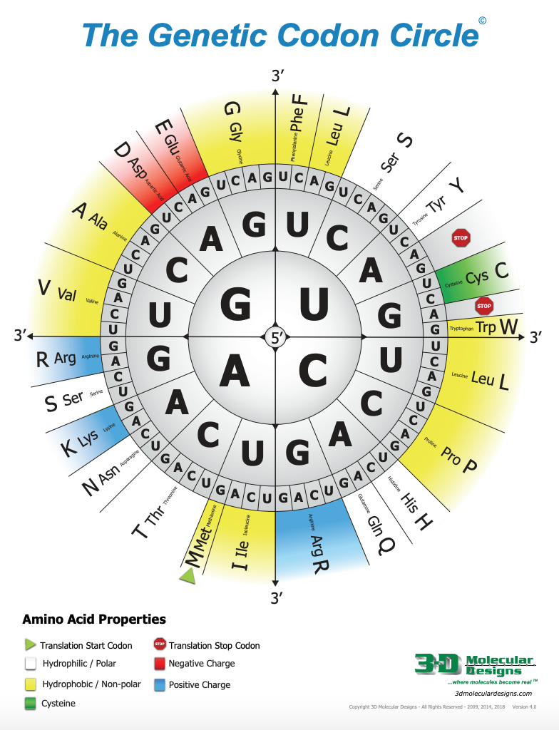

Slide 25
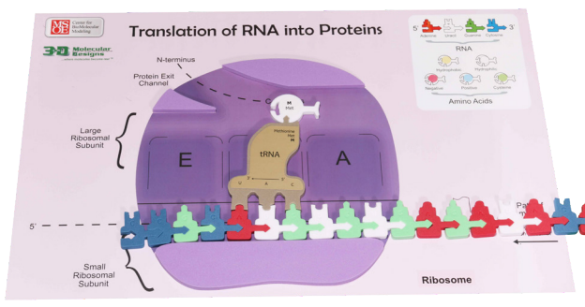
Initiation

Slide 26
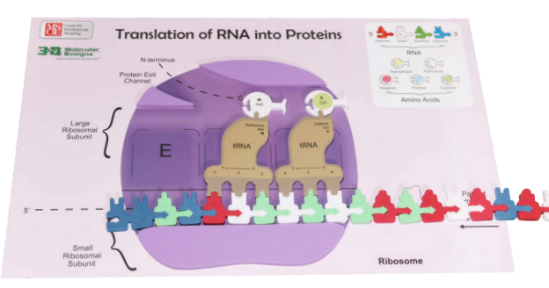
Elongation

Slide 27
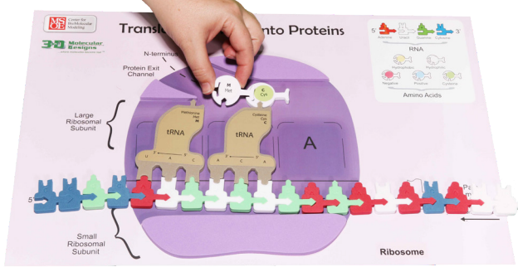
A-Site, P-Site, E-Site

Slide 28
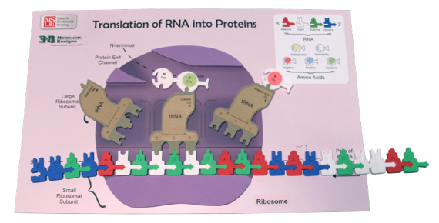
A-Site, P-Site, E-Site

Slide 29
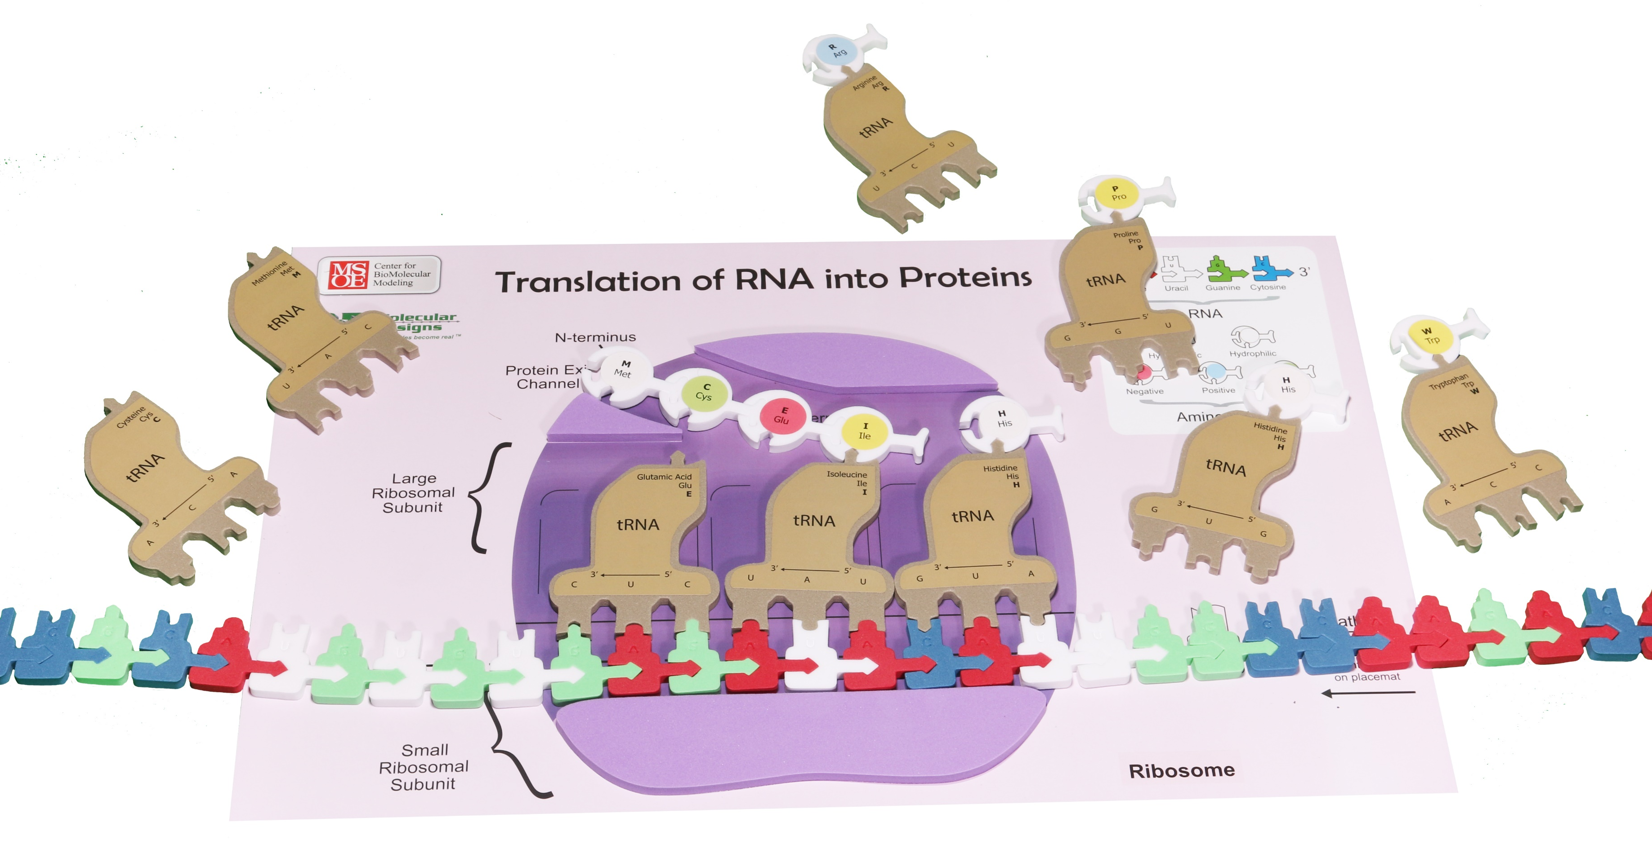
Elongation Continues

Slide 30
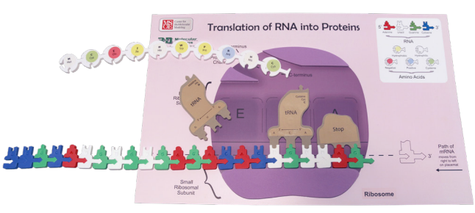
Termination

Slide 31
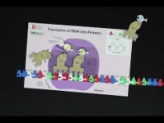

Slide 32
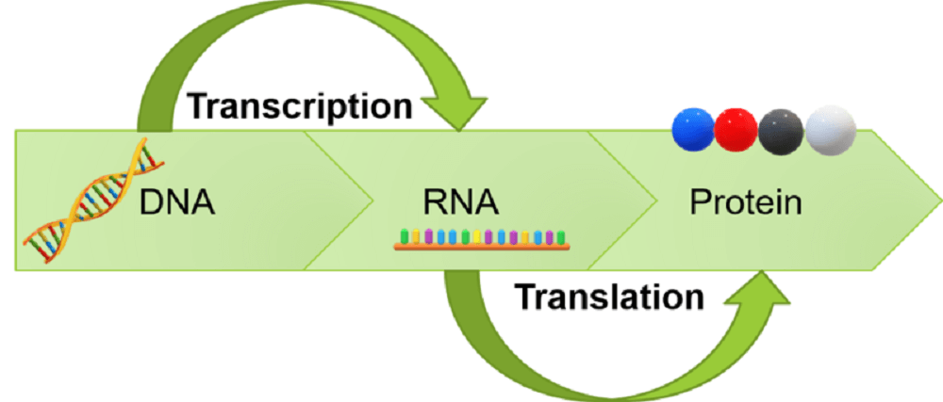
Where is each molecule now?
DNA
mRNA
tRNA
Polypeptide Chain

Slide 33
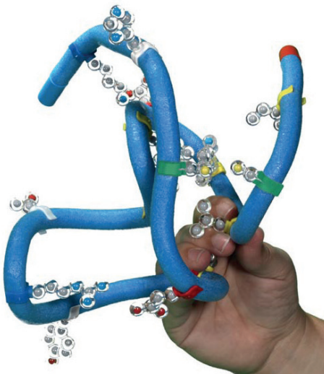
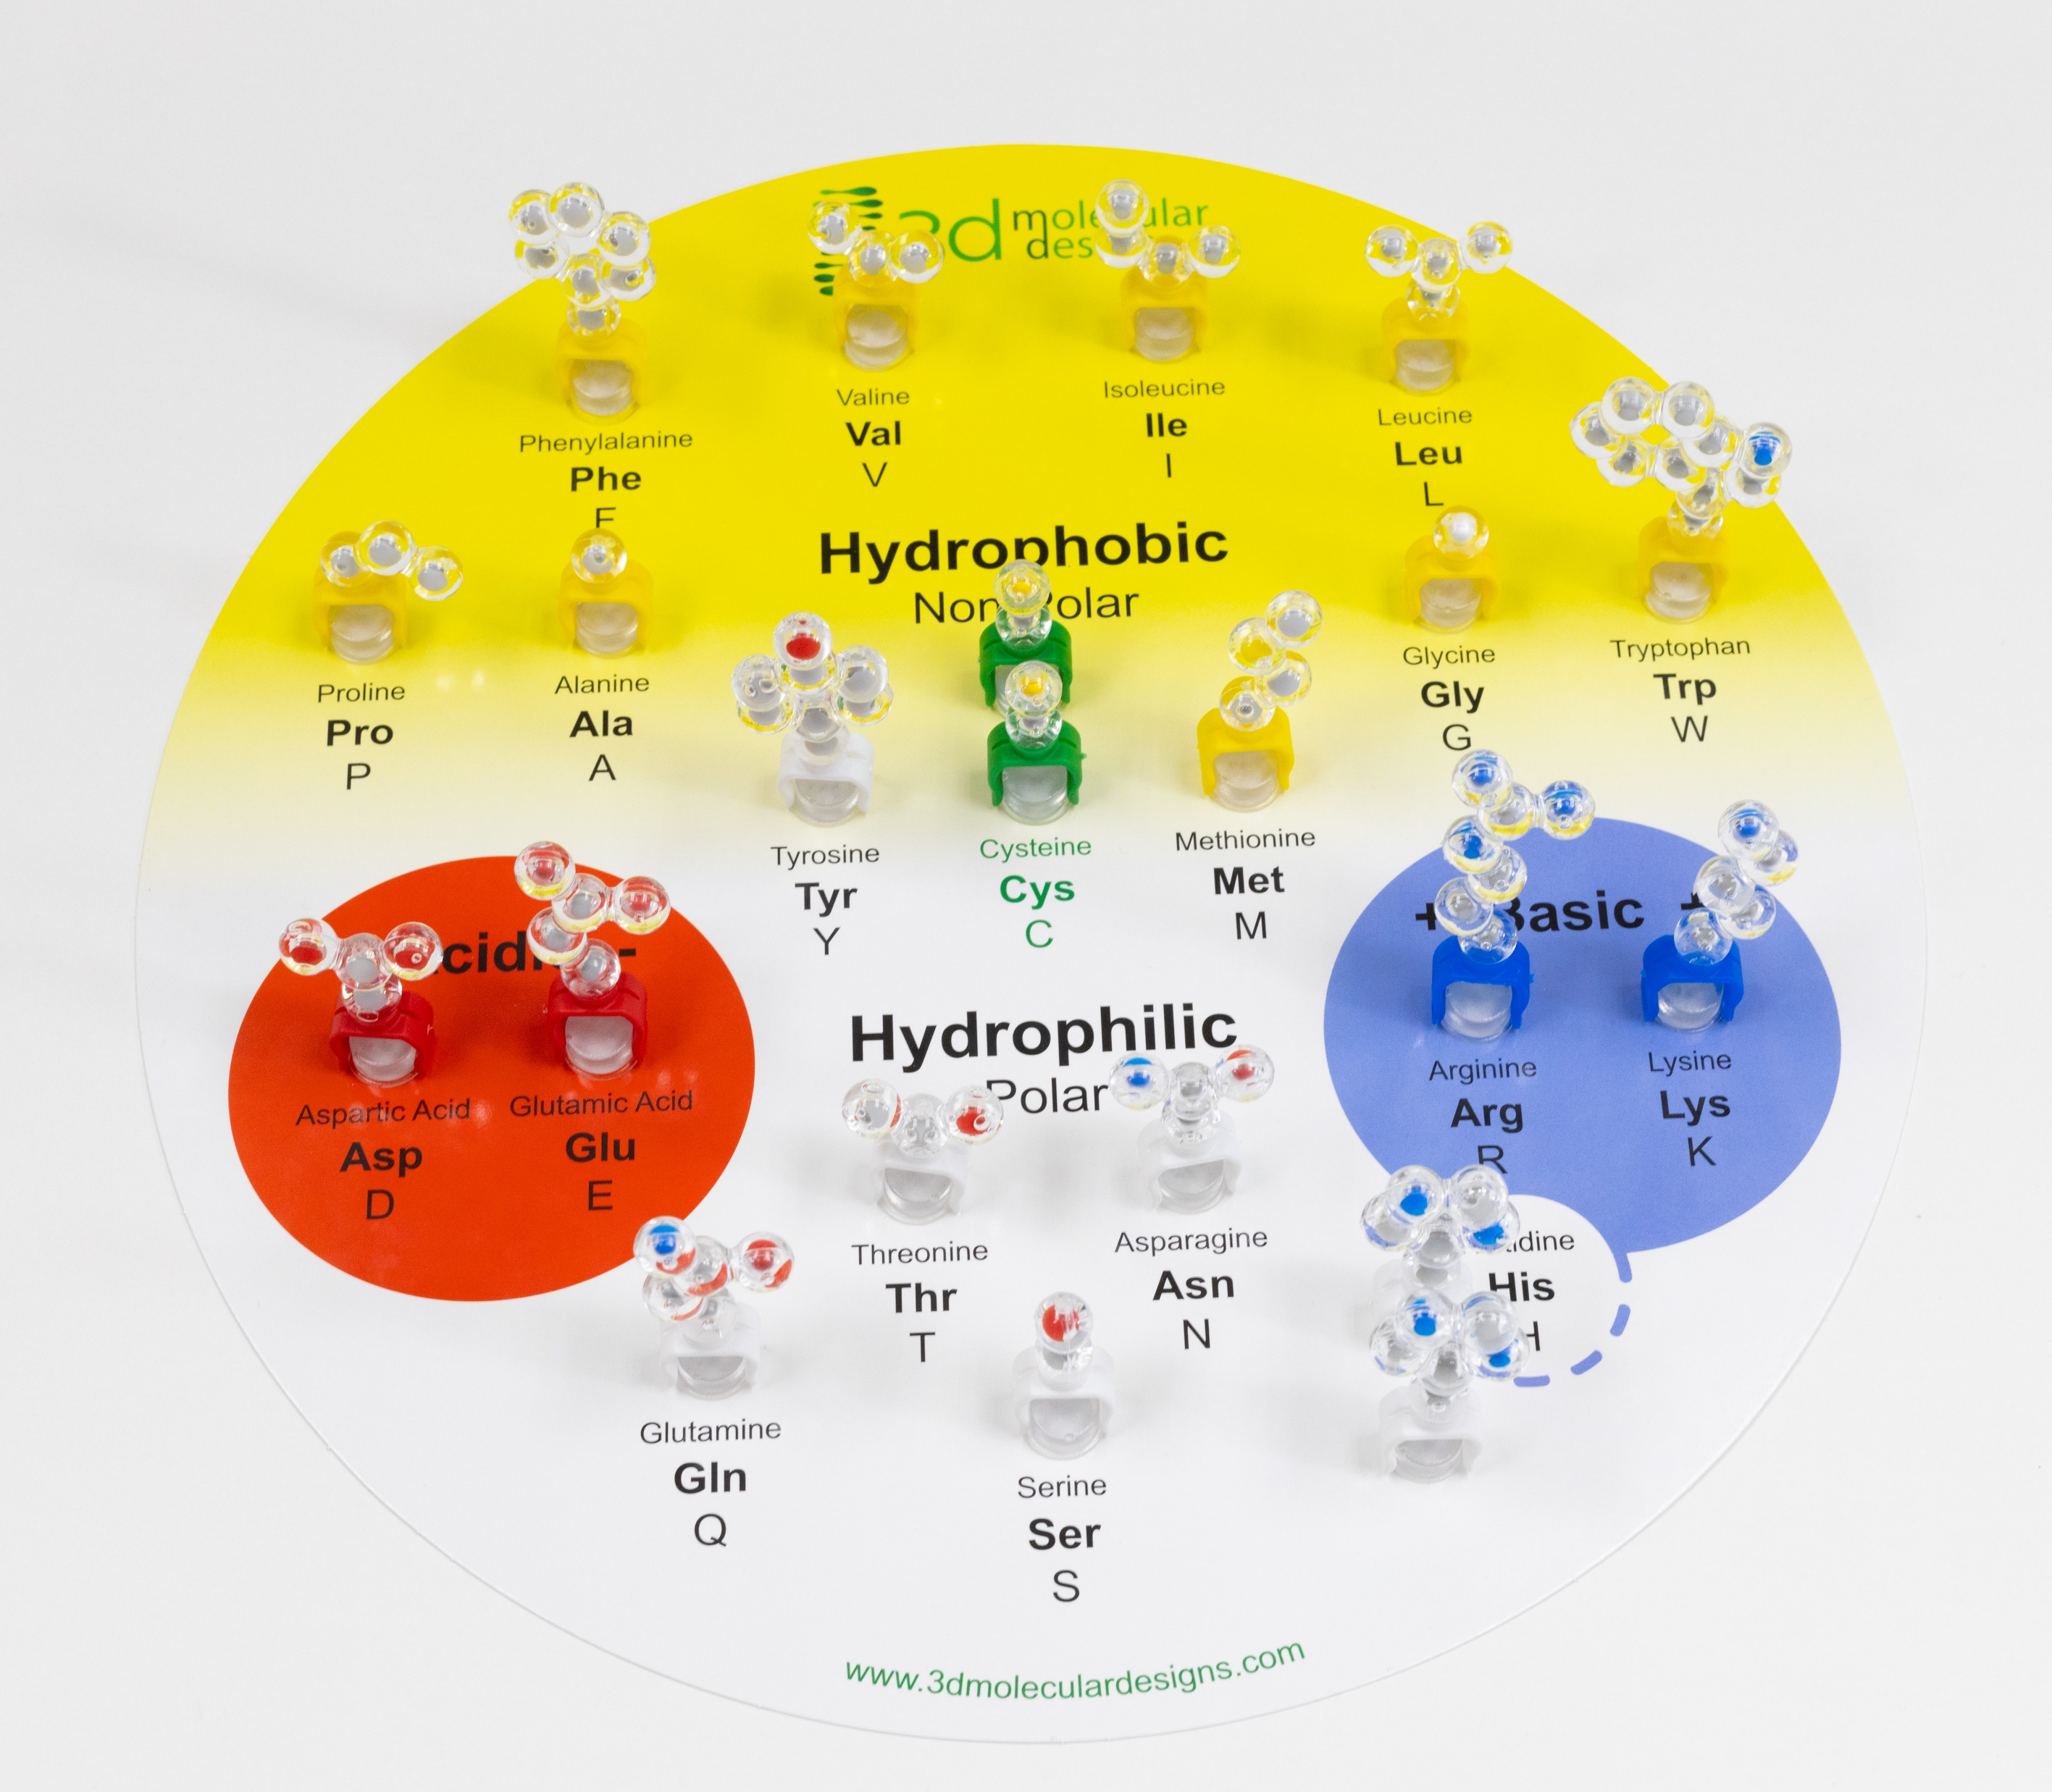
Connecting FGIK to the Amino Acid Starter Kit

Slide 34
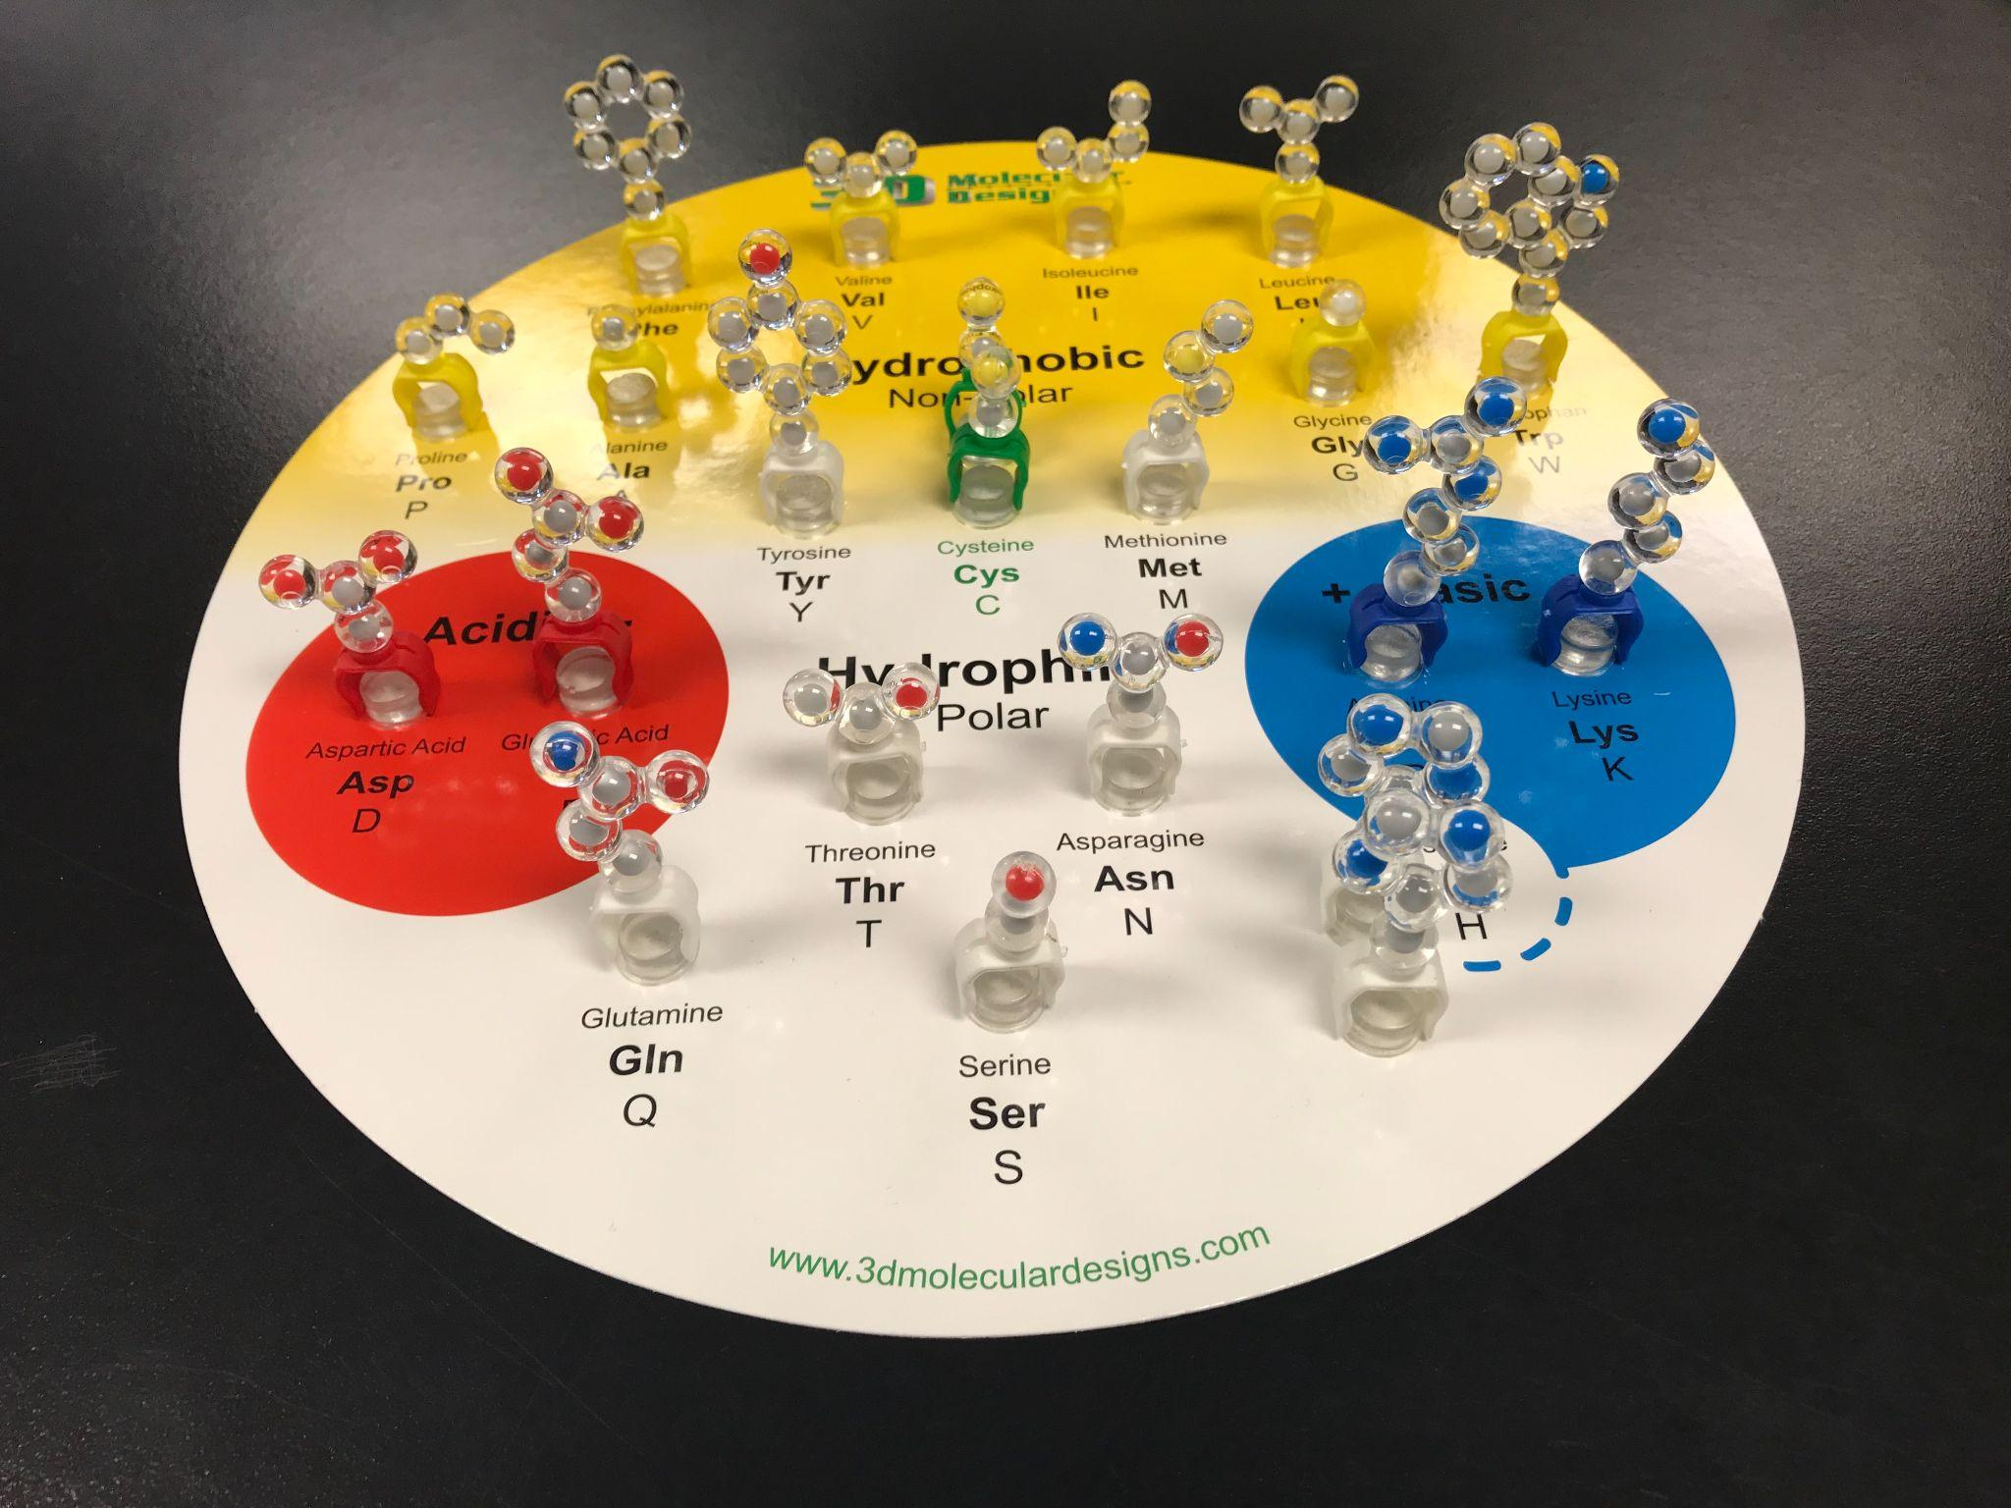
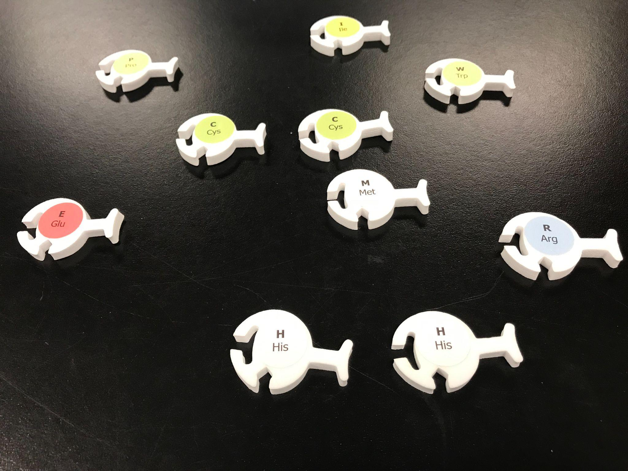
Amino Acid Starter Kit Meets the FGIK

Slide 35
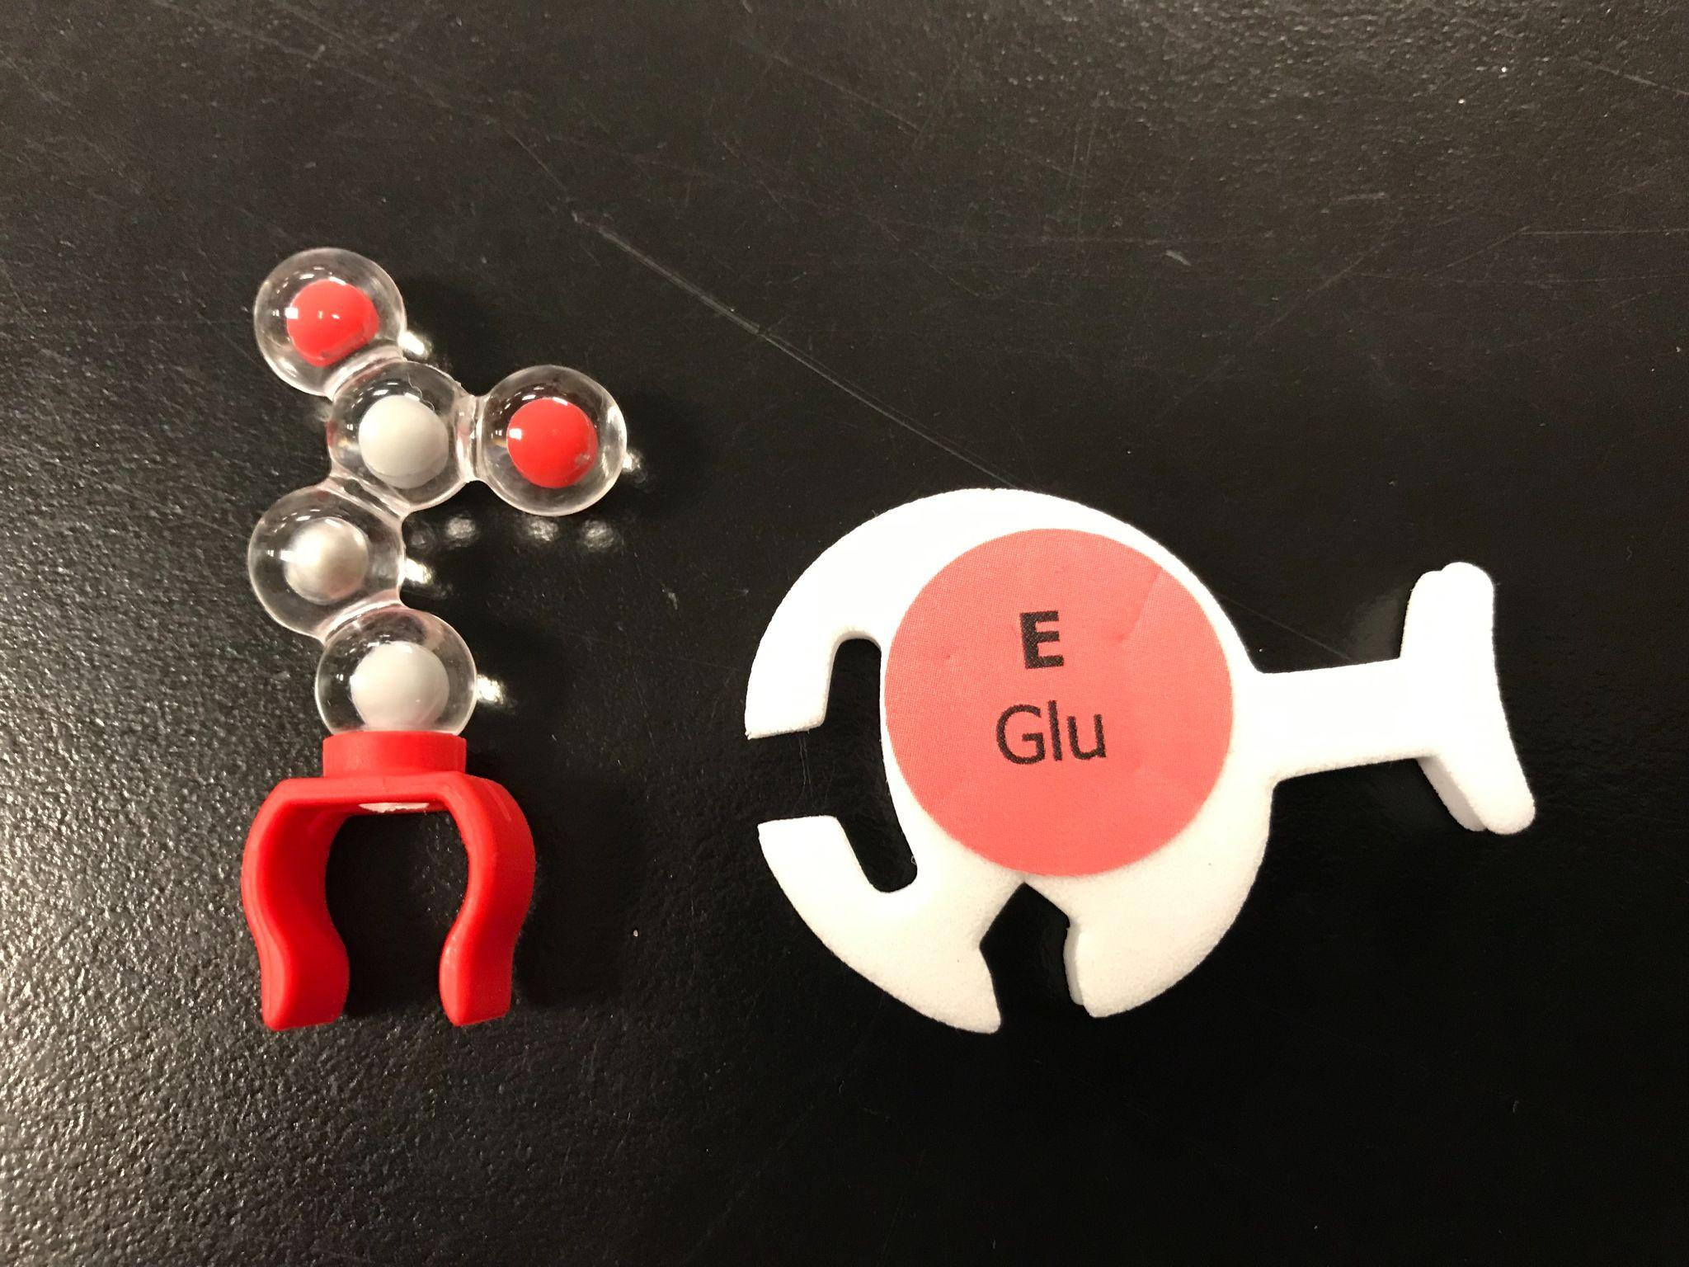
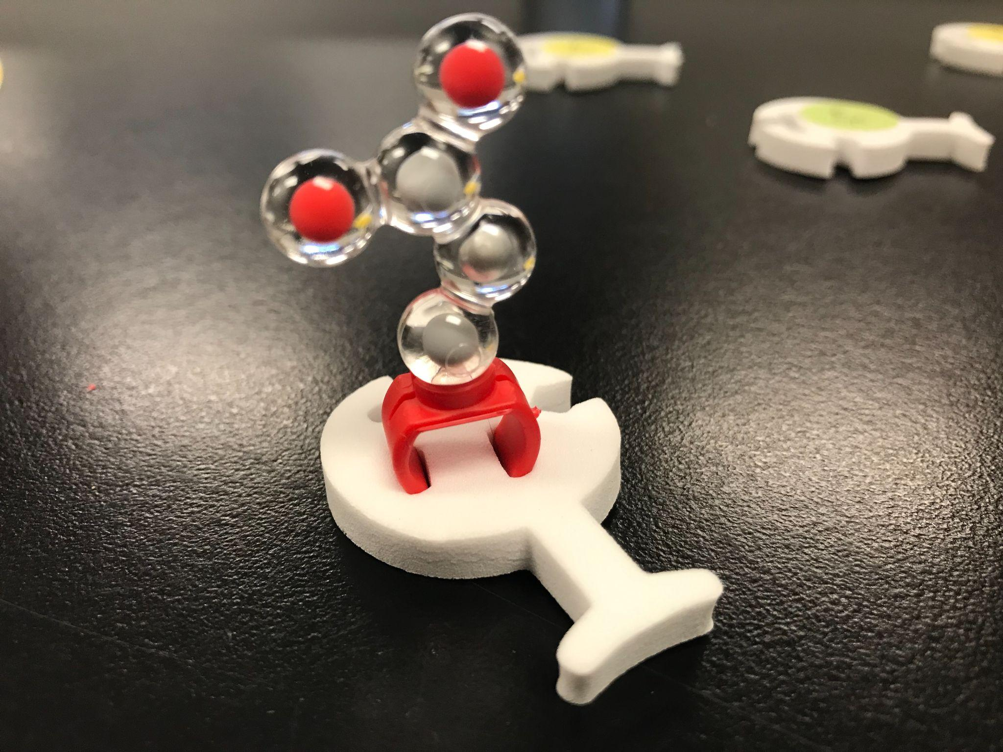

Slide 36
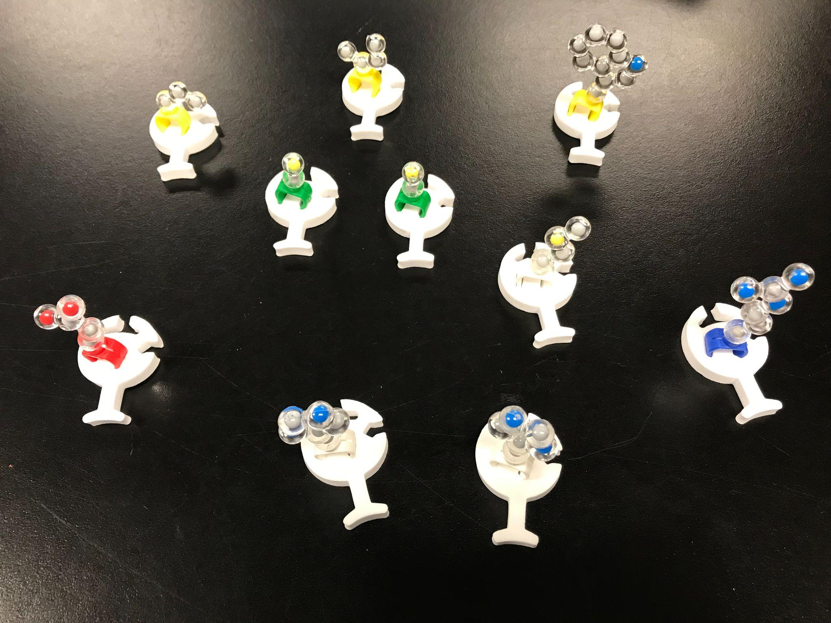
Match the 3D Amino Acids to their foam counterparts!

Slide 37
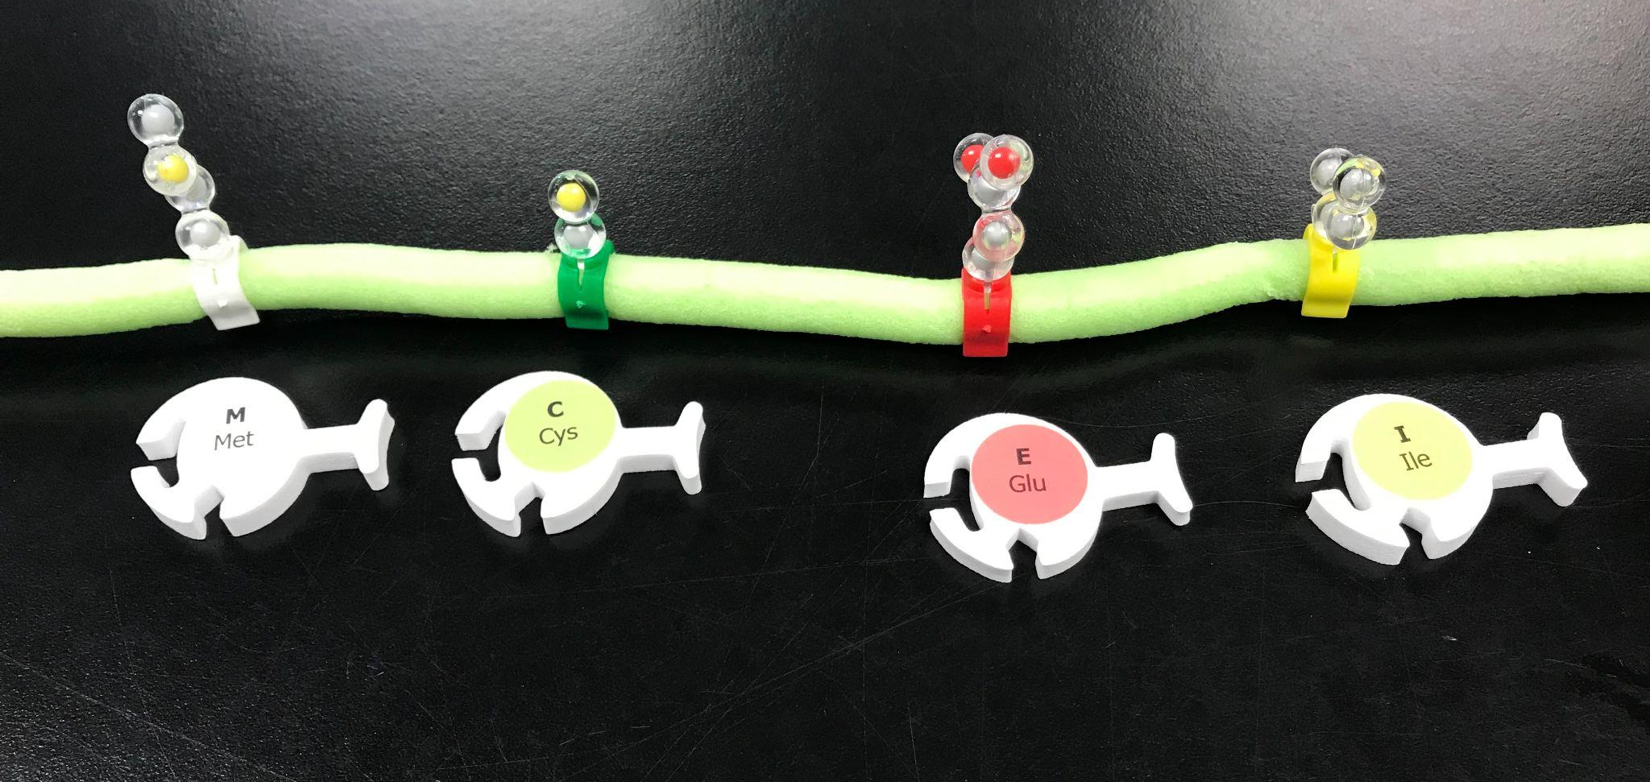
Place the Amino Acid R-groups on the Protein “Backbone”
Based on the sequence of “dictated” by the mRNA

Slide 38
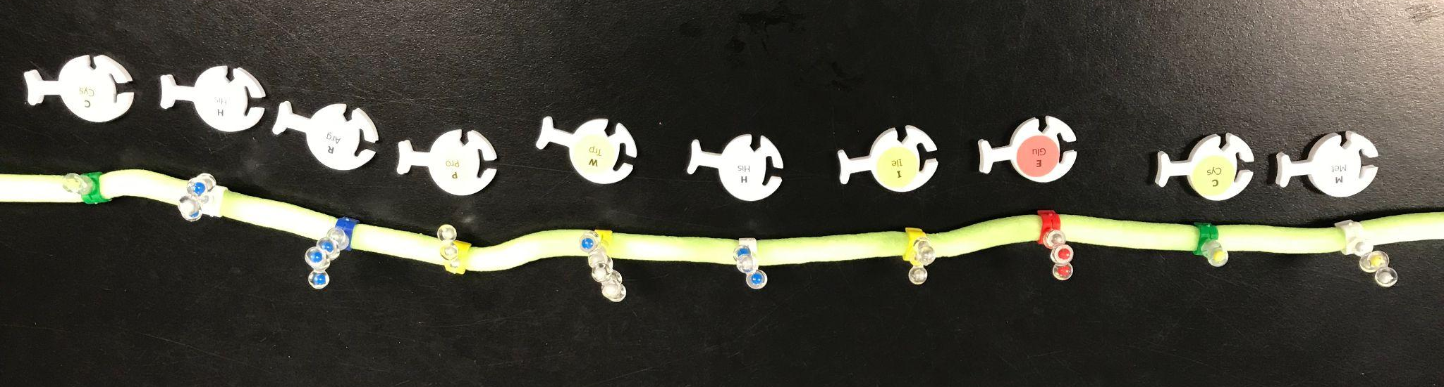
The Complete 10 Amino Acid Sequence
= Primary Structure

Slide 39
The Tertiary Structure of our Protein built based on our original DNA sequence!

Slide 40
Mutations

Slide 41
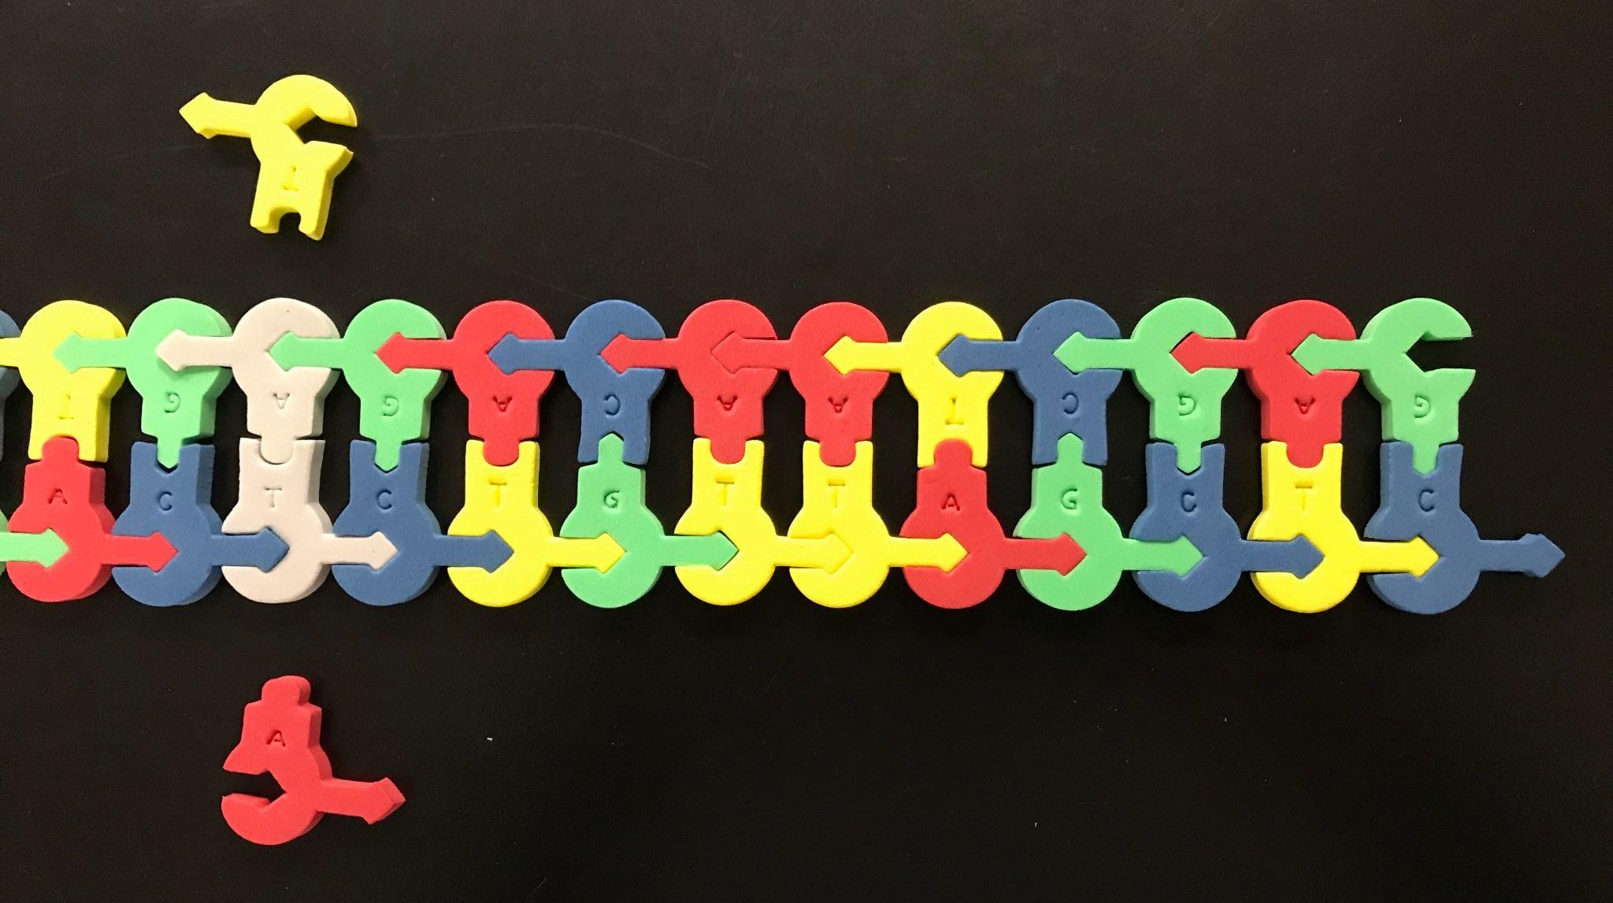
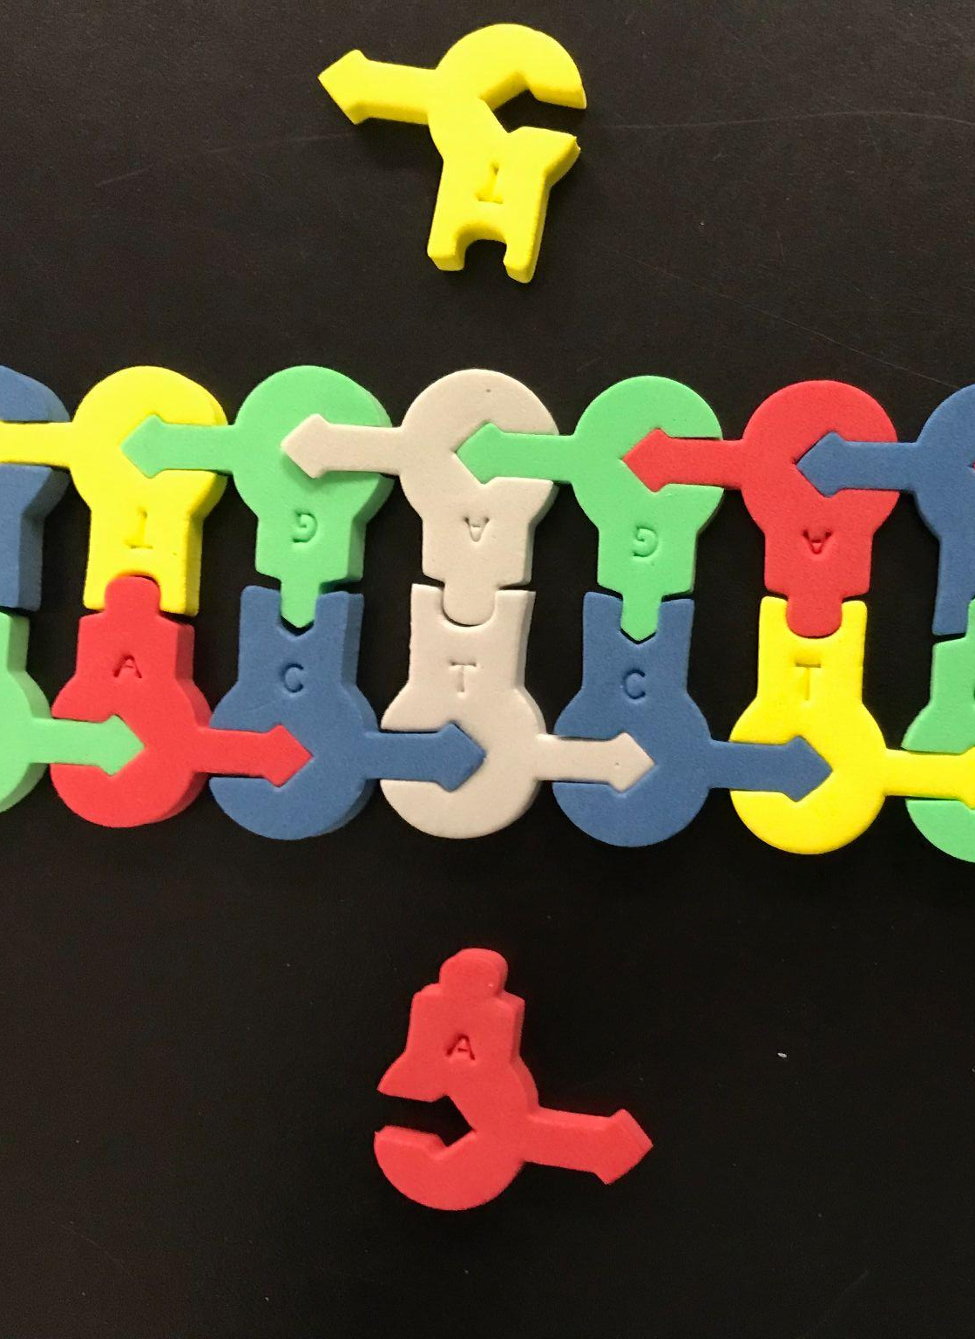
What happens if we add a mutation, say a base substitution, to our original DNA Strand at BP 30?

Slide 42
TEACHER REFLECTION
Where in your curriculum might you be able to use these models?
How might you adapt these models to help meet your students’ needs?
What type of support could you provide your students to help them successfully model key concepts in the life science classroom?

Slide 43

Link to today’s presentation!

Slide 44
Kits and models used in this session:
Flow of Genetic Information Kit
Amino Acid Starter Kit
Purchase and Borrow Kits from
3DMolecularDesigns.com

Slide 45


