Slide 1

Teaching the Molecular Mechanisms of Addiction with Physical Models
2023 NBTA National Conference
Alan Allmen, NBCT
Whitney Young Magnet High School
Chicago Public Schools
Link to slides
https://tinyurl.com/2023nbta-addiction

Slide 2
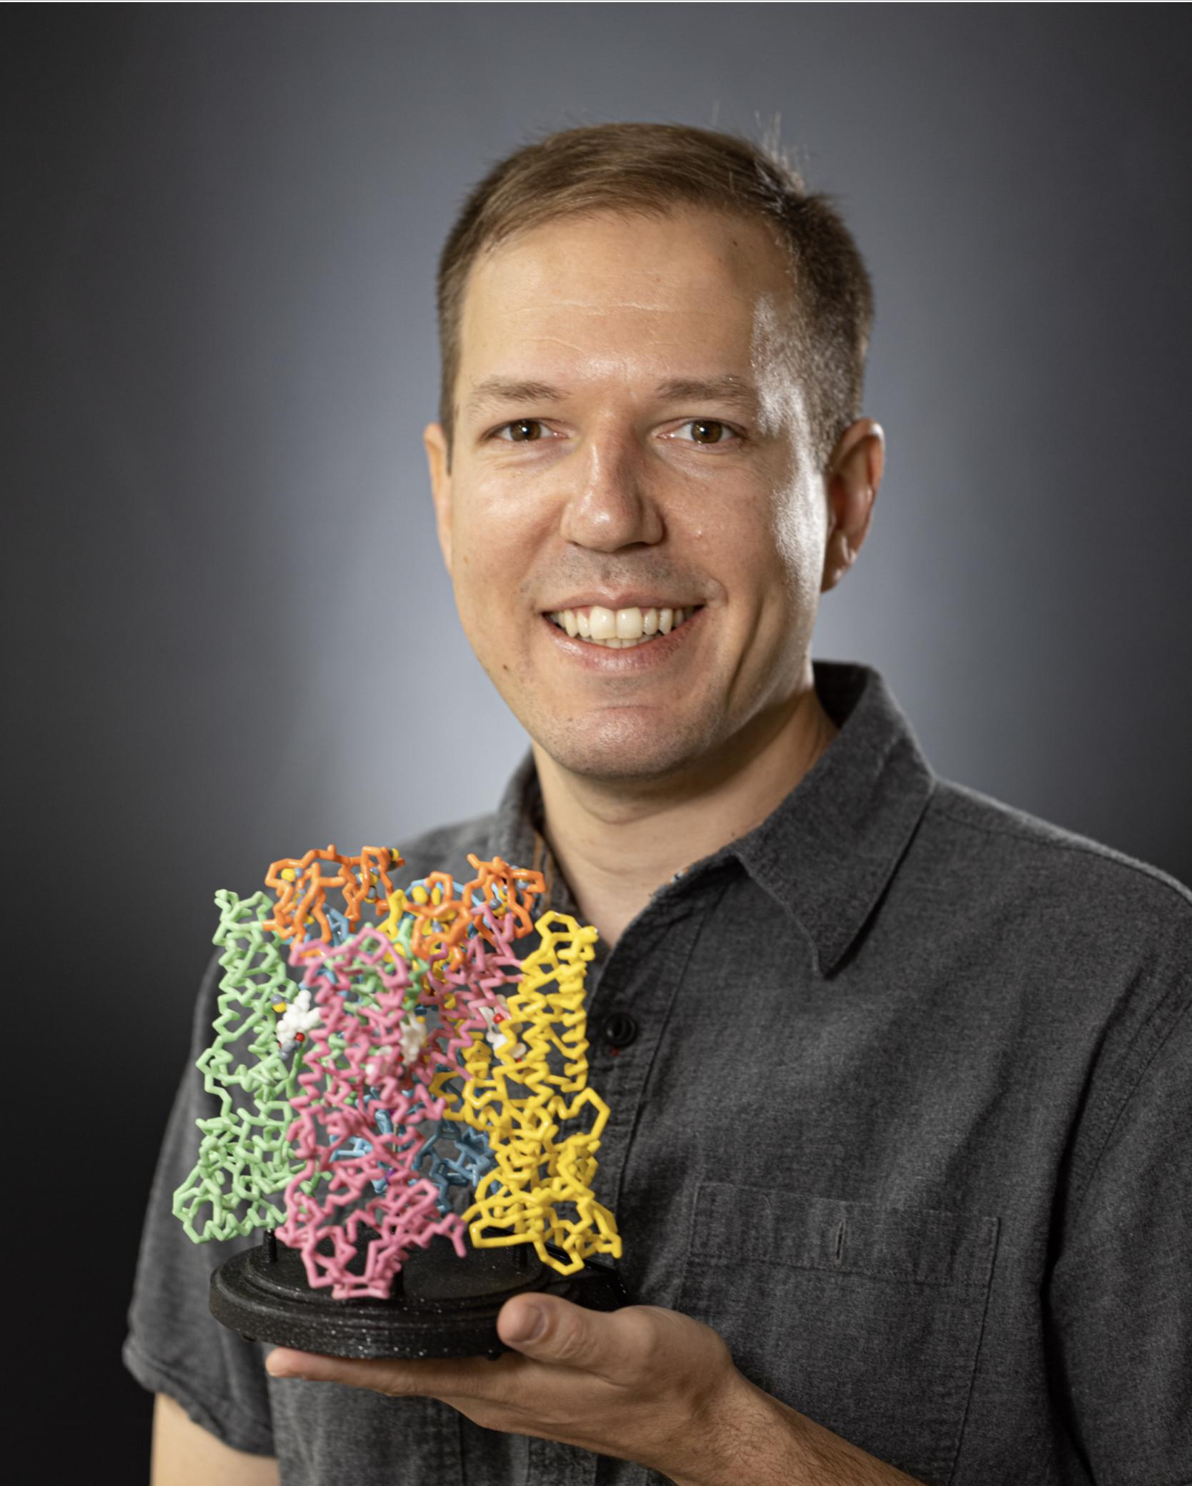



Alan Allmen, NBCT
Whitney M Young Magnet High School
Chicago, IL
TRPV1 receptor

Slide 3
Workshop Learning Goals
Experience the value of physical modeling of biological processes
Model the basic biology of synaptic transmission
Model the impact of psychoactive drugs on synaptic transmission

Slide 4
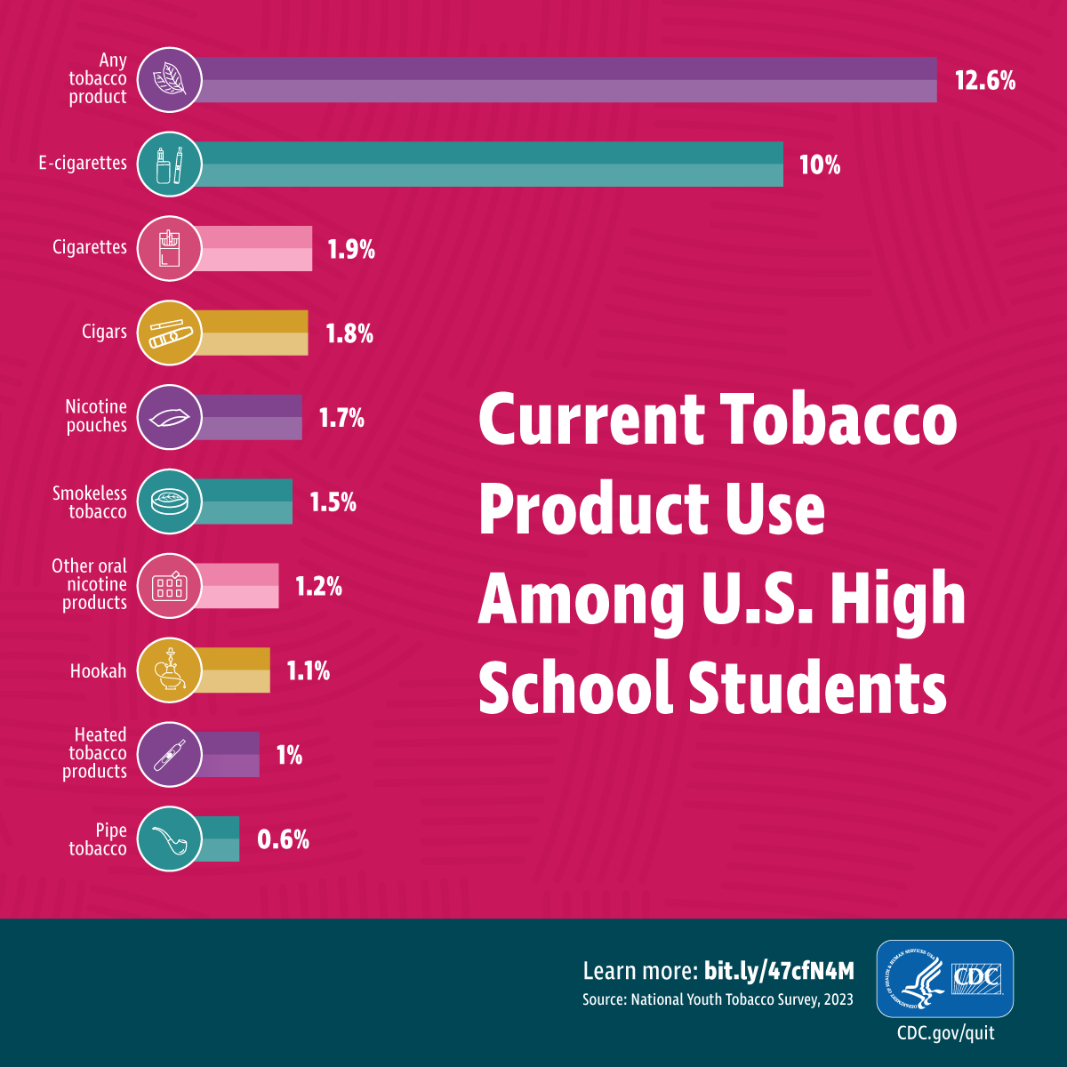
Why teach addiction pathways?
In 2023, 1 in 10 teens reported using e-cigarettes in the past month.
12.6% percent of teens reported using tobacco products containing nicotine.
Source: CDC

Slide 5
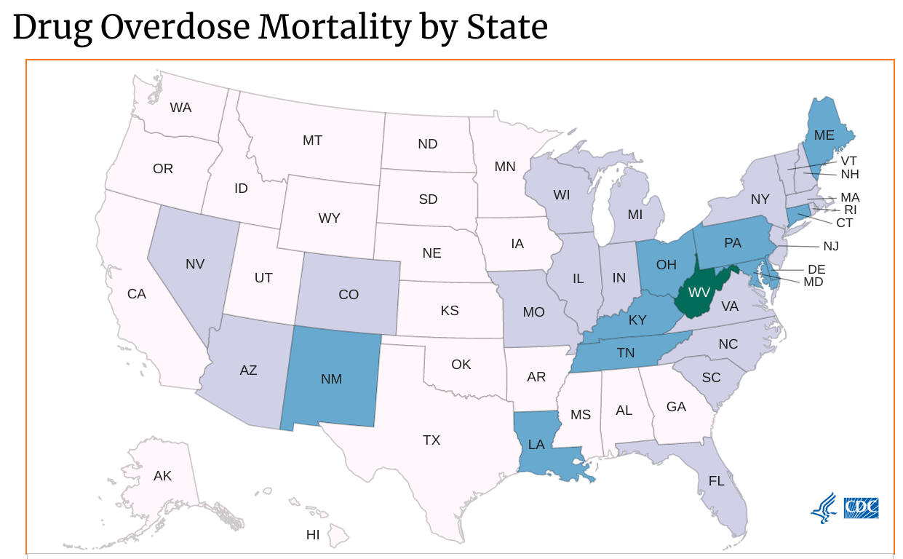
Why teach addiction pathways?
Illinois saw 3,717 drug overdose deaths in 2021
Death rates, particularly due to opioids, have been rising
Among leading causes of death for teenagers and young adults
Sources: CDC, IDPH

Slide 6
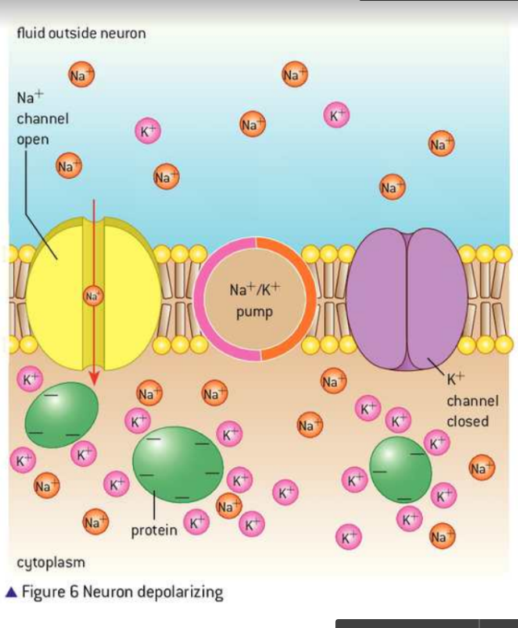
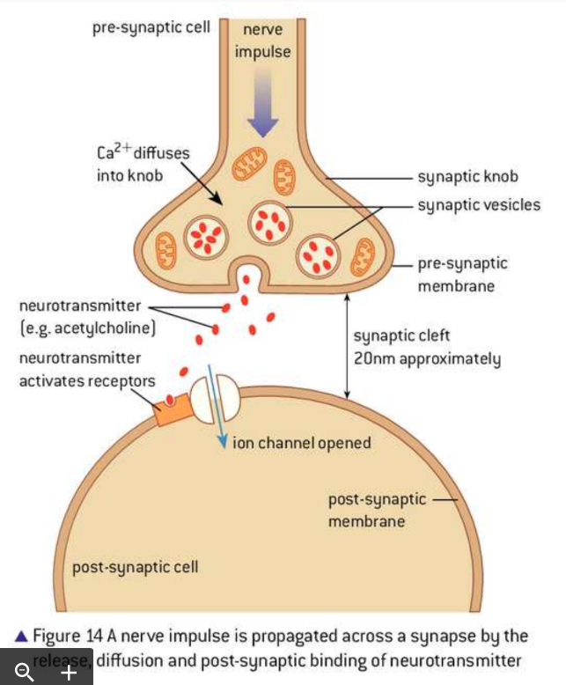
Why physical models?
Sample textbook pictures of synaptic transmission
Physical models
dynamic
interactive
adaptable

Slide 7
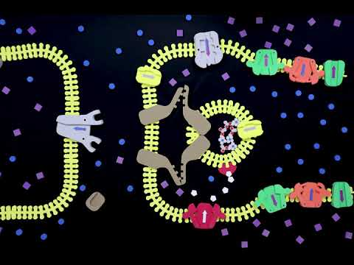
Stop-motion animation of synaptic transmission in a cholinergic synapse

Slide 8
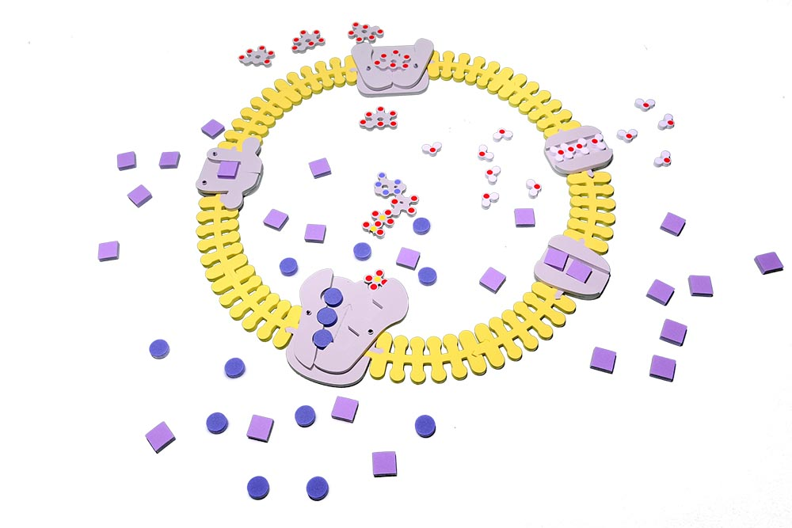
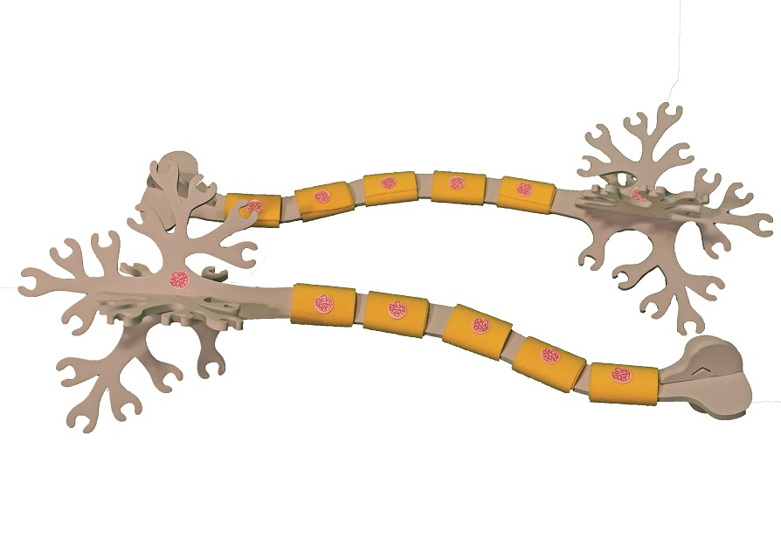
Previously taught:
Membrane transport with the Phospholipid and Membrane Transport Kit
Neuron structure with the Neuron Modeling Kit

Slide 9
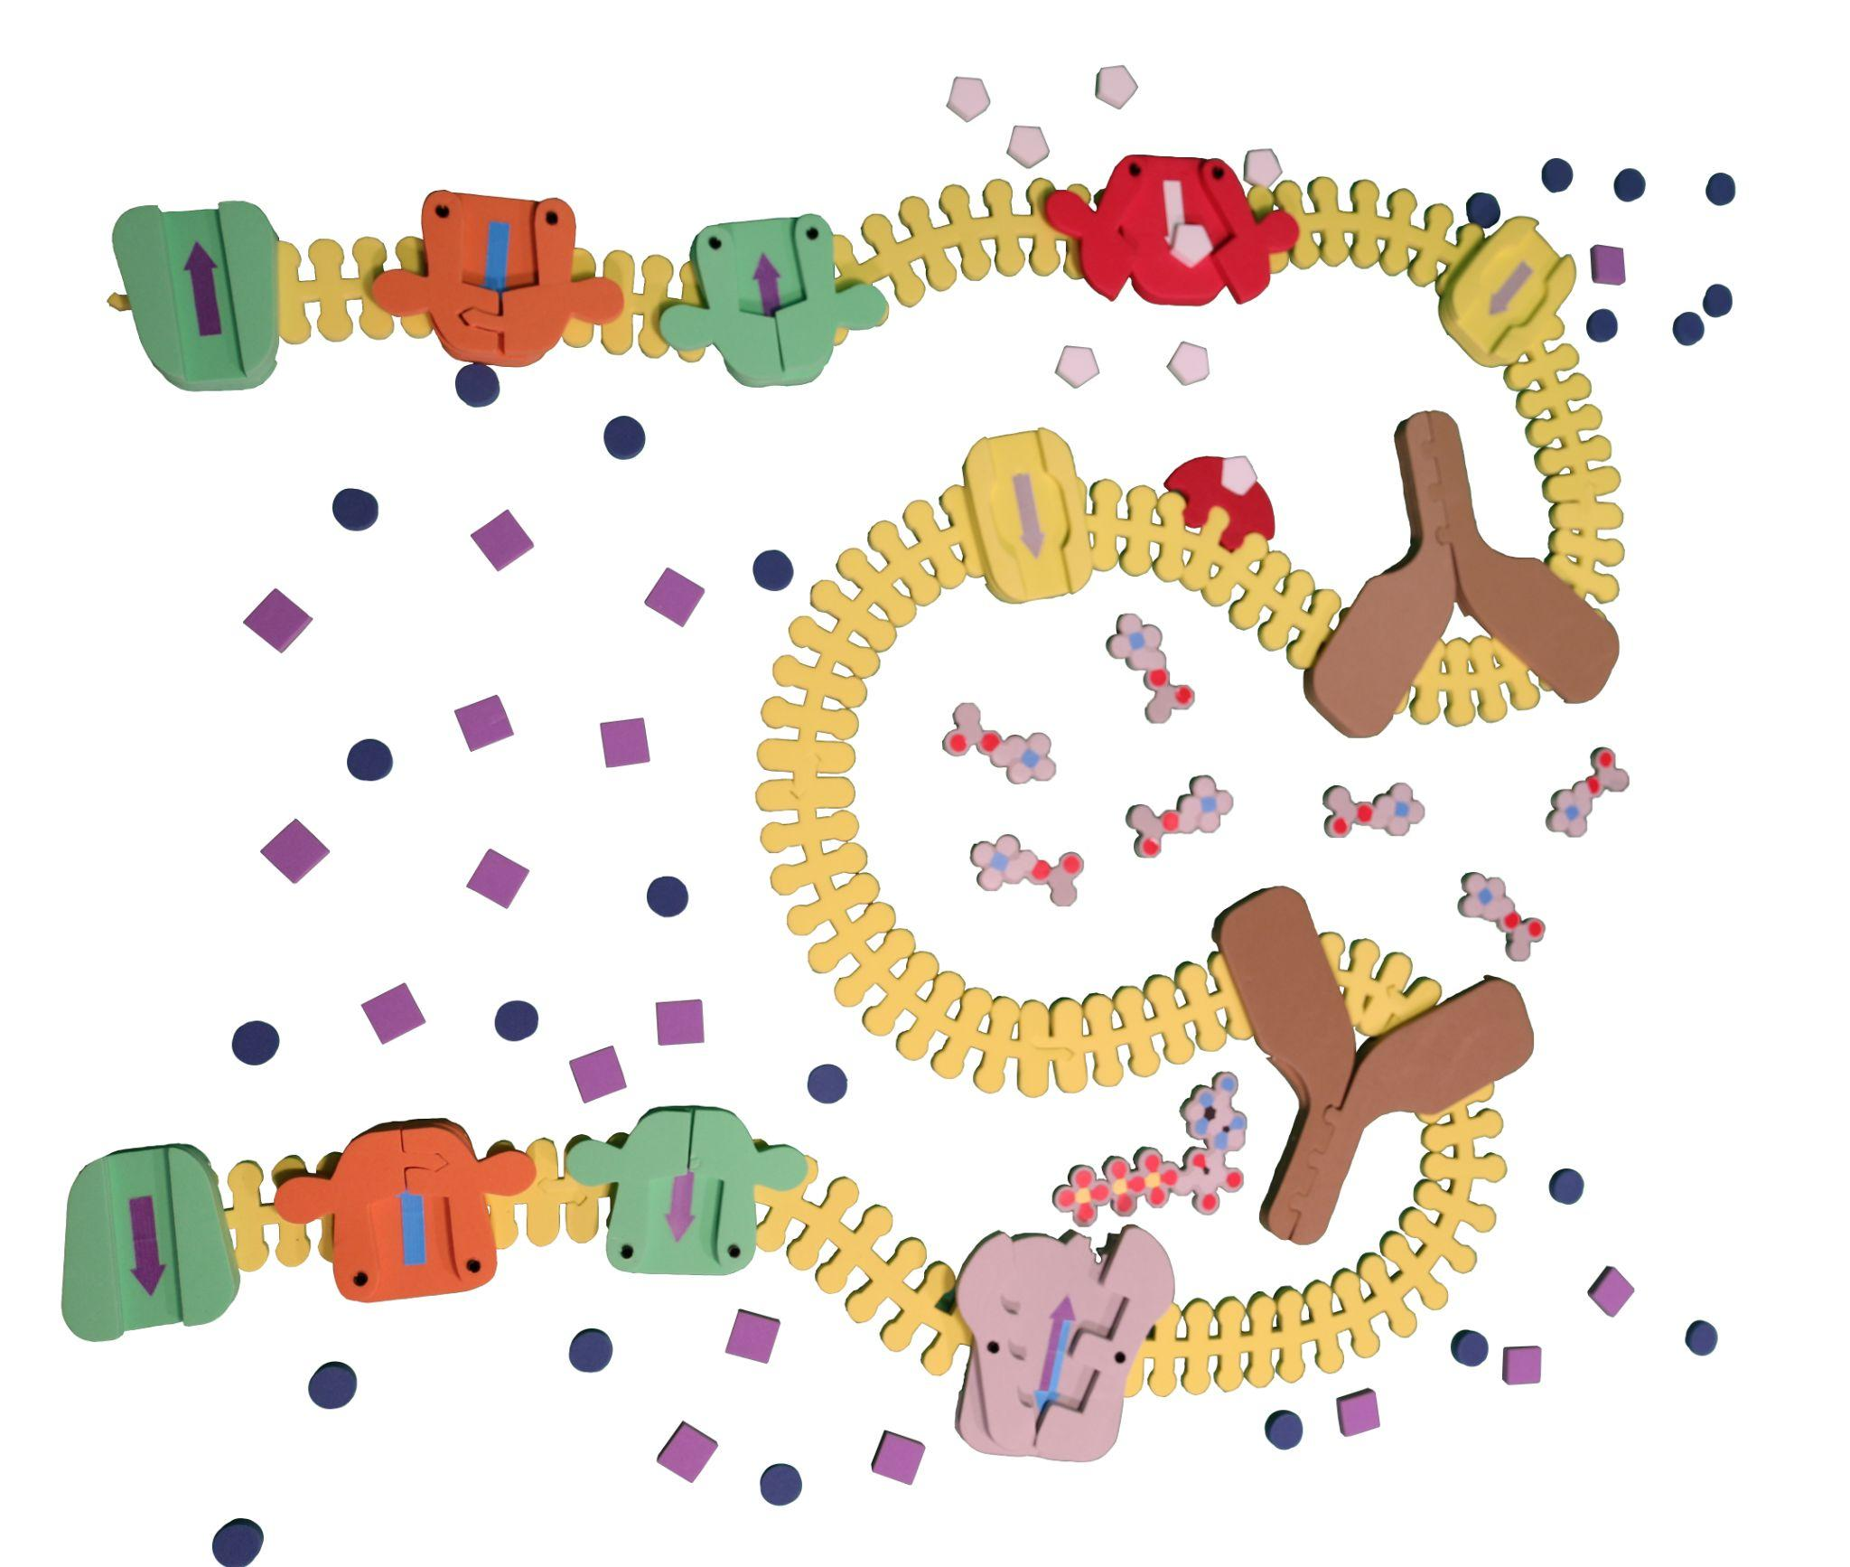
Synapse Kit Introduction
3D Molecular Design’s Synapse Construction Kit
Allows modeling of:
action potential
acetylcholine synapse
GABA synapse
dopamine synapse

Slide 10
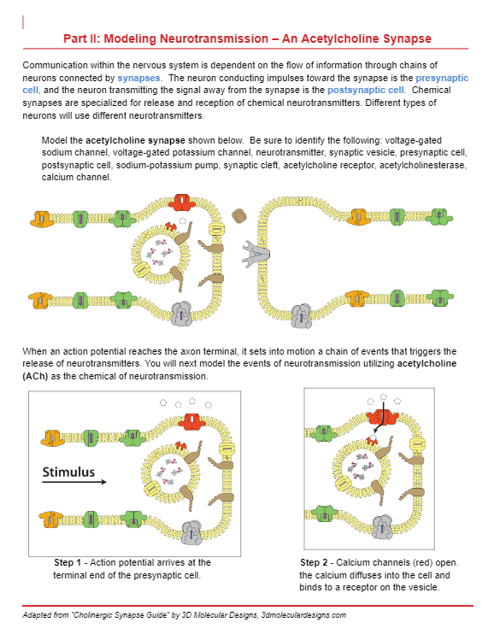

Synapse Kit Introduction
Follow the student handout to model synaptic transmission at an acetylcholine synapse: Steps 1-6.
Link to handout

Slide 11
Implementation ideas
Follow my lead
Show me
Model, then write
Stop motion animation as assessment

Slide 12
Teaching Synaptic Transmission
Reflections on the kit so far?
How could it be useful in your context?
What questions do you have so far?

Slide 13
Addiction
Basic biological principles that can be taught using models:
Drugs manipulate natural pathways in the brain
Effect may amplify (stimulant) or slow (depressant) chemical communication in the brain
Most psychoactive drugs are linked to dopamine secretion (generates the high)
Down-regulation explains drug tolerance

Slide 14
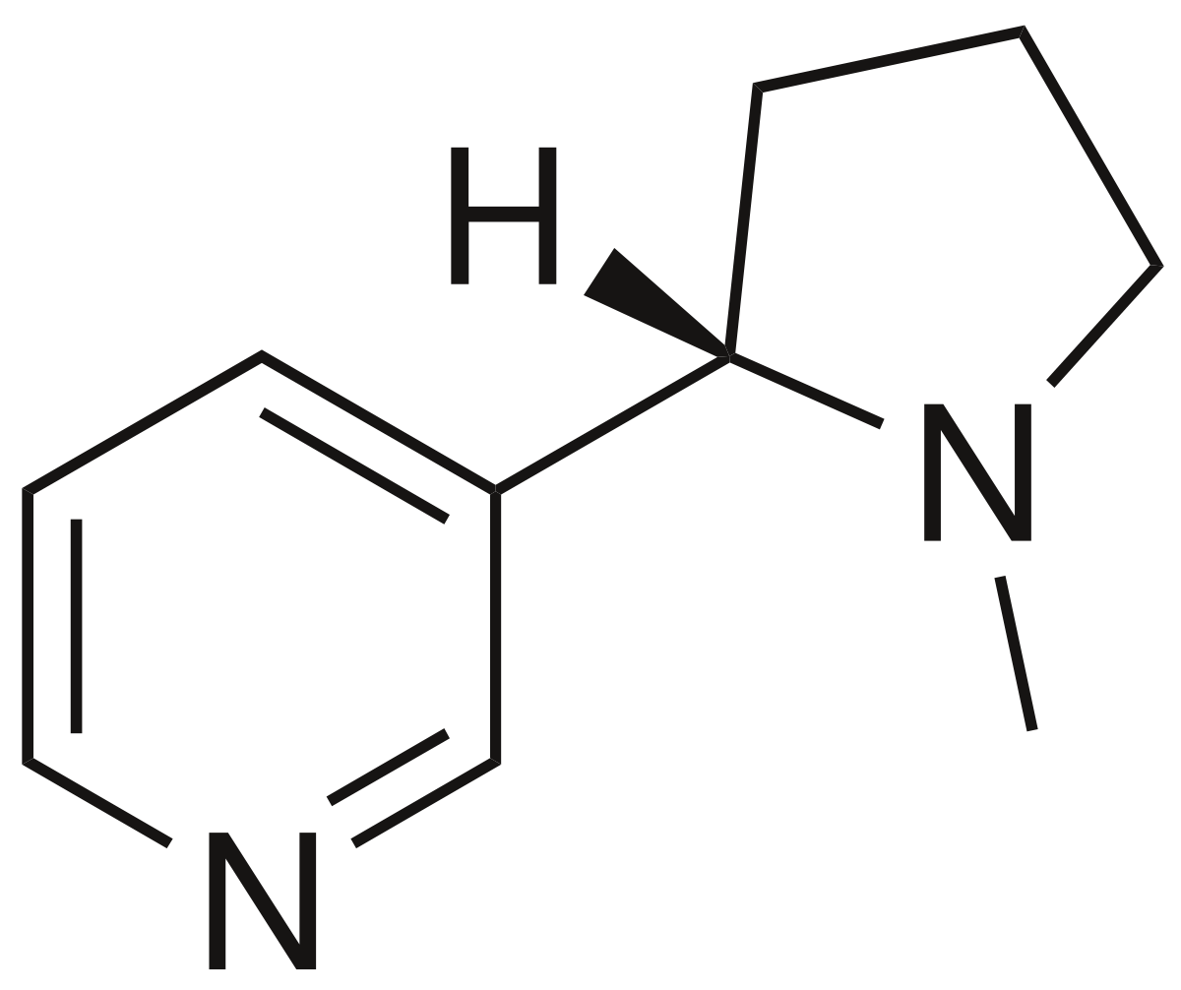
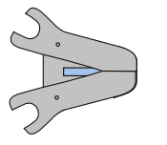
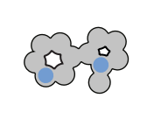
Example #1: Nicotine
Binds irreversibly to the acetylcholine receptor (agonist)
Over-stimulates the pathway
Nicotine

Slide 15
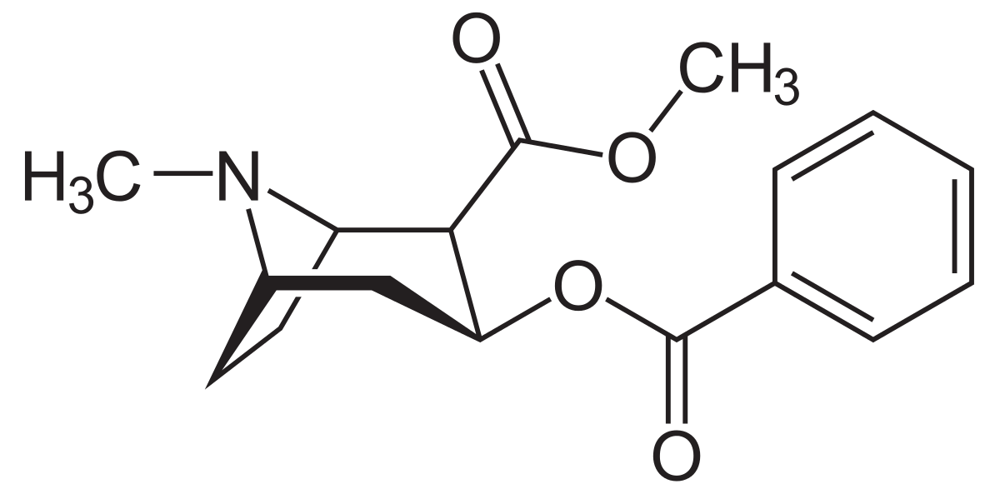
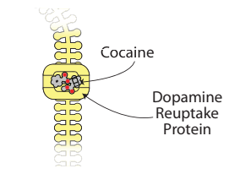
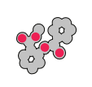
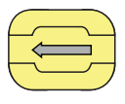
Example #2: Cocaine
Binds to dopamine reuptake transporters
Dopamine persists in the synapse, continuing to stimulate
Cocaine

Slide 16

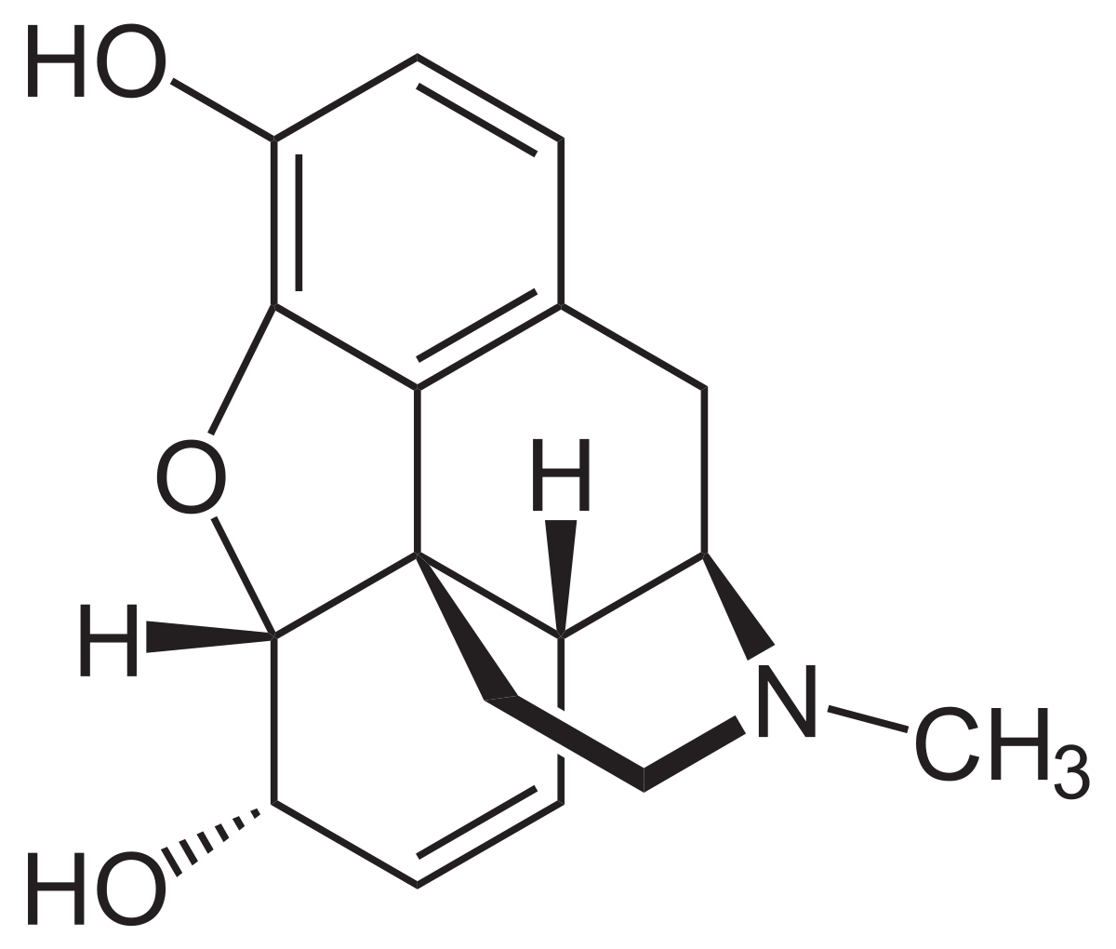
Example #3 - Opioids
Naturally-occurring chemical messengers (endorphins)
Act as powerful analgesics (pain killers)
Opioids can be found elsewhere in nature (morphine)
Synthetic opioids (Fentanyl) bind stronger to receptors
Morphine (right) can be extracted from the poppy plant (left)
References: Untangling the complexity of opioid receptor function, Physiology of opioid receptor

Slide 17
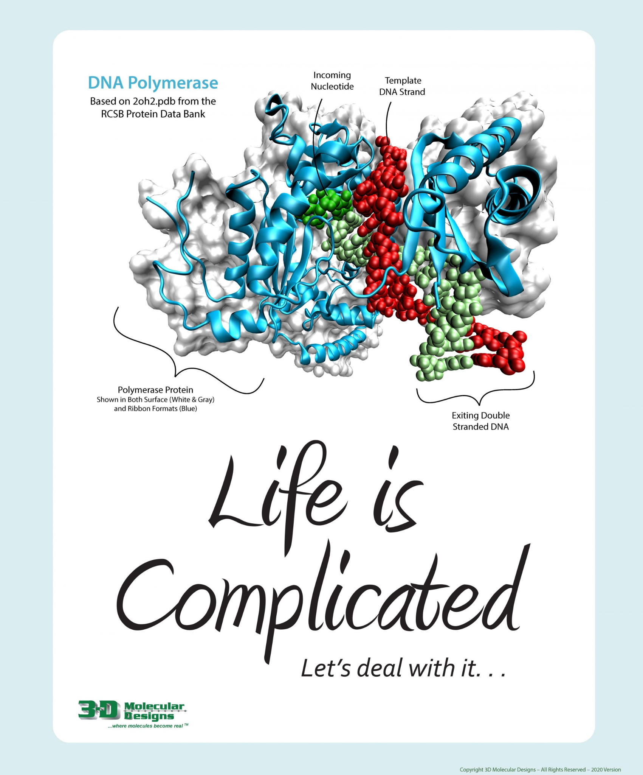
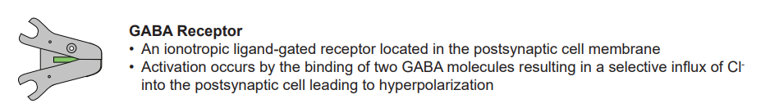
Opioid addiction
One simplification:
Opioids inhibit GABA receptors in the reward center of the brain, leading to increased dopamine release
References: Untangling the complexity of opioid receptor function, Physiology of opioid receptor

Slide 18
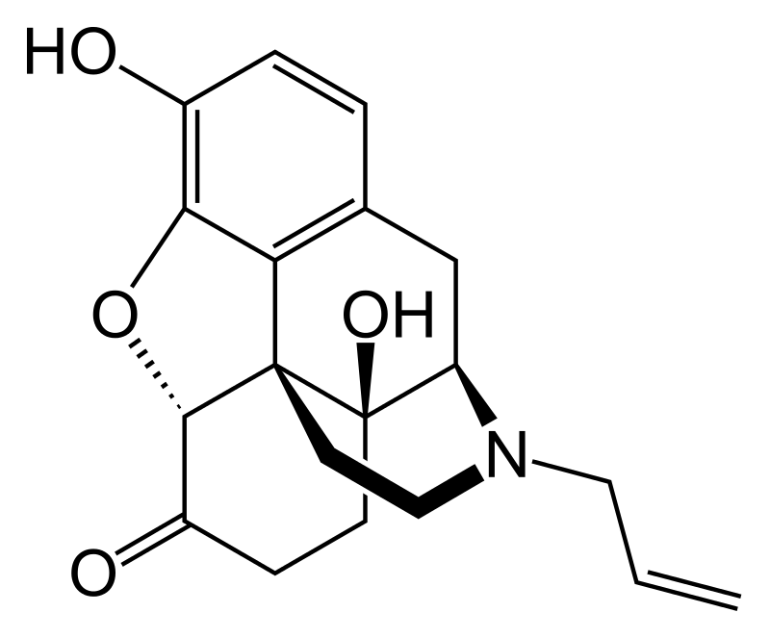
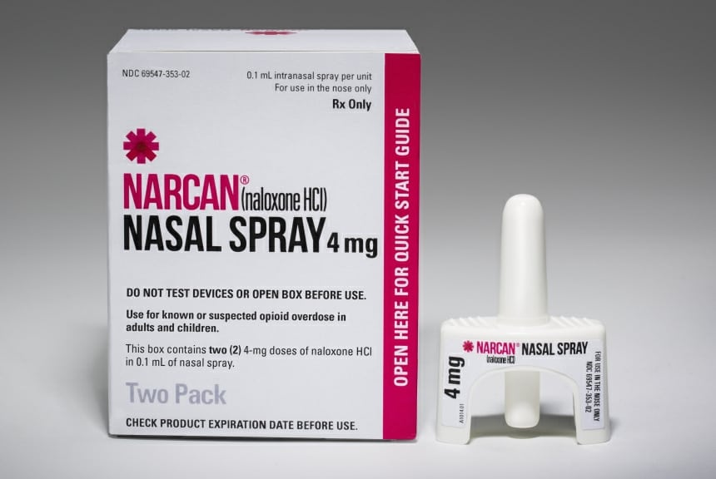
Opioid treatment
Naloxone (Narcan):
Antagonist of the opioid receptors; blocks the binding sites for opioids
References: Naloxone drug facts

Slide 19
Implementation ideas
Scale appropriately!
Demo and discuss
Jigsaw - students prepare different drug mechanisms
Research - choose drug and develop your own model

Slide 20
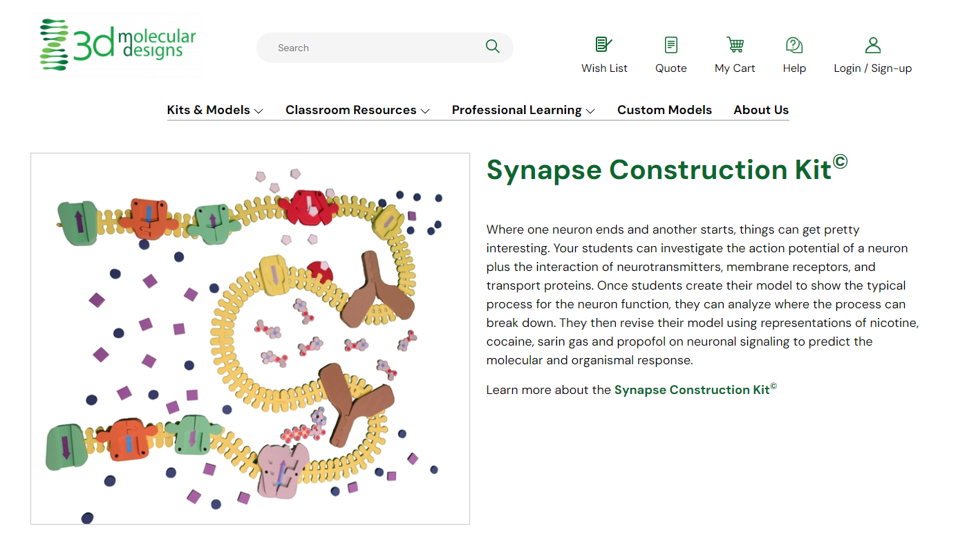
20+ resources for this kit are available on the 3d Molecular Designs website.
https://3dmoleculardesigns.com/classroom_resources/synapse-construction-kit/

Slide 21

Uncovering the Truth: Modeling a DNA Replication Error
Sherry Annee
2:00-3:15

Slide 22
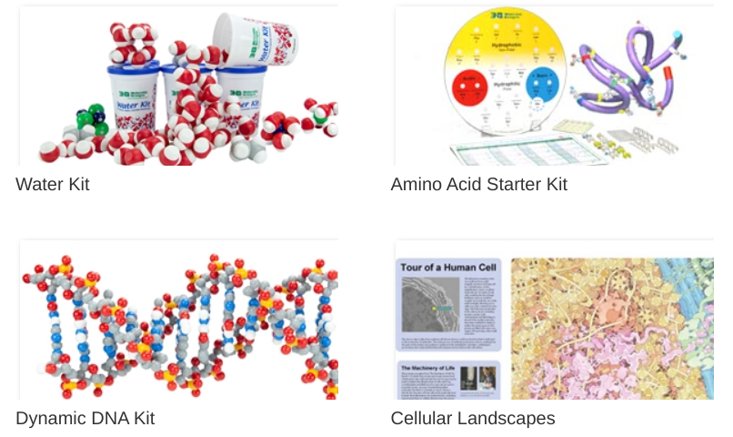
Modeling Kits
3D Molecular Designs has a variety of modeling kits suitable for teaching a wide range of topics.
See their website to view their catalog.

Slide 23
Professional Development Opportunities
Multi-day summer courses offered in-person in Milwaukee, WI.
July 29-Aug 2
Aug 5-9
See the 3D Molecular Designs website for further information!
https://www.3dmoleculardesigns.com/
Modeling the Molecular World

Slide 24
Time to raffle!!

Slide 25

THANK YOU FOR ATTENDING!
Kits and models used in this session:
Synapse Construction Kit (SCK-01)
Neuromuscular Synapse Poster (DGSP)
Purchase kits at 3dmoleculardesigns.com.
Scan this QR code to fill out a survey for a 20% coupon code off most kits and a chance to win a $50 gift card!

Slide 26
Workshop NGSS Connections
SEPs | CCCs | DCIs
1. Asking questions and defining problems | 1. Patterns | LS1: From Molecules to Organisms: Structures and Processes
2. Developing and using models | 2. Cause and effect: Mechanism and explanation | LS1.A: Structure and Function
6. Constructing explanations and designing solutions | 4. Systems and system models | LS1.D: Information Processing
 | 6. Structure and function
 | 7. Stability and change

