Slide 1


From Code to Construction:
Modeling
Transcription and Translation Essentials
Ruth Hutson, MSSE

Slide 2
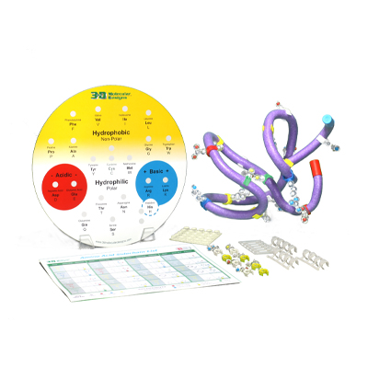
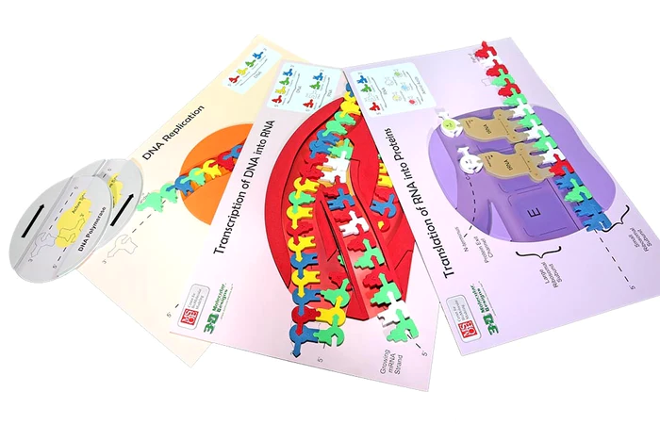
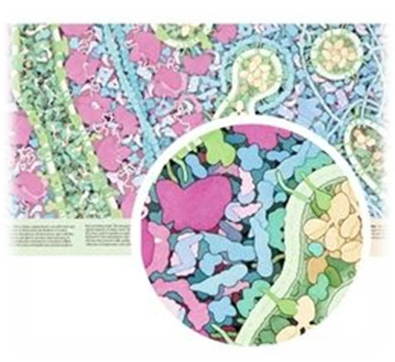
Notes:
In this 50-minute session, educators will use the Flow of Genetic Information Kit©, Amino Acid Starter Kit©, and Tour of the Human Cell Poster© to model cell processes. Augmented Reality modules will further enhance student understanding of the dynamic nature of the cell.

Slide 3
Workshop Outcomes
Model how DNA is transcribed into mRNA and how mRNA is translated into a protein -- the final stages of the flow of genetic information.
Construct an explanation based on evidence for how the structure of DNA determines the structure of proteins, which carry out the essential functions of life through systems of specialized cells by explaining the purpose and process of transcription and translation using models of DNA and RNA.
Examine patterns within and between side chains of amino acids.
Model protein secondary and tertiary structure based on the primary structure of amino acid sequence.
Have fun!

Slide 4
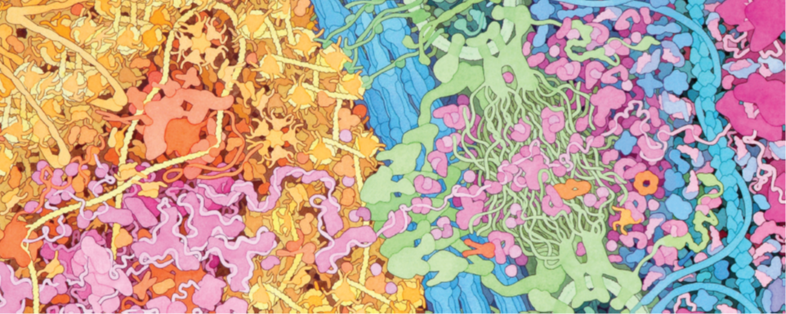
A Brief Tour Through the Cell​
This image is an excerpt from Tour of a Human Cell by David Goodsell, as shown in 3D Molecular​
Designs’ Tour of a Human Cell© poster and David Goodsell’s book, The Machinery of Life
Notes:
This is one of the many molecular landscapes by Dr. David Goodsell who is affiliated with the Protein Data Bank. You can more of these at PDB-101: Goodsell Gallery (rcsb.org). I love using them in conjunction with the kit because they demonstrate to students that we are only touching on a fraction of the cell’s complexity.

Slide 5
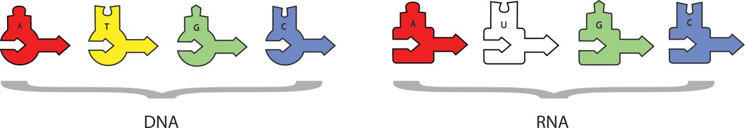
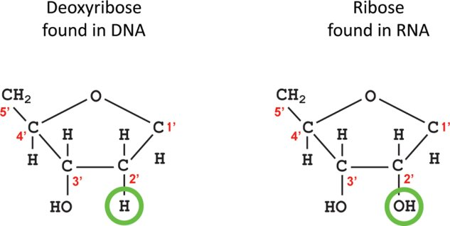
Transcription ​
Notice:
The DNA pieces are different than the RNA pieces.

Slide 6
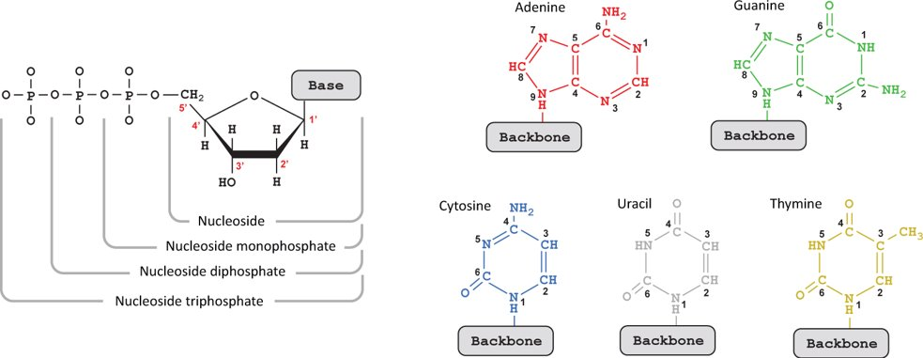
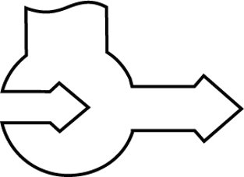
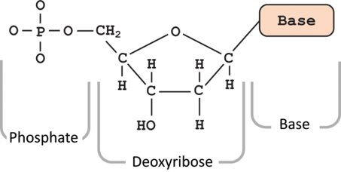
Transcription ​
Helpful Hints:
Take care when loading the DNA in the RNA polymerase.
Remember RNA is synthesized from the 5’ to the 3’ end.
5’
3’

Slide 7
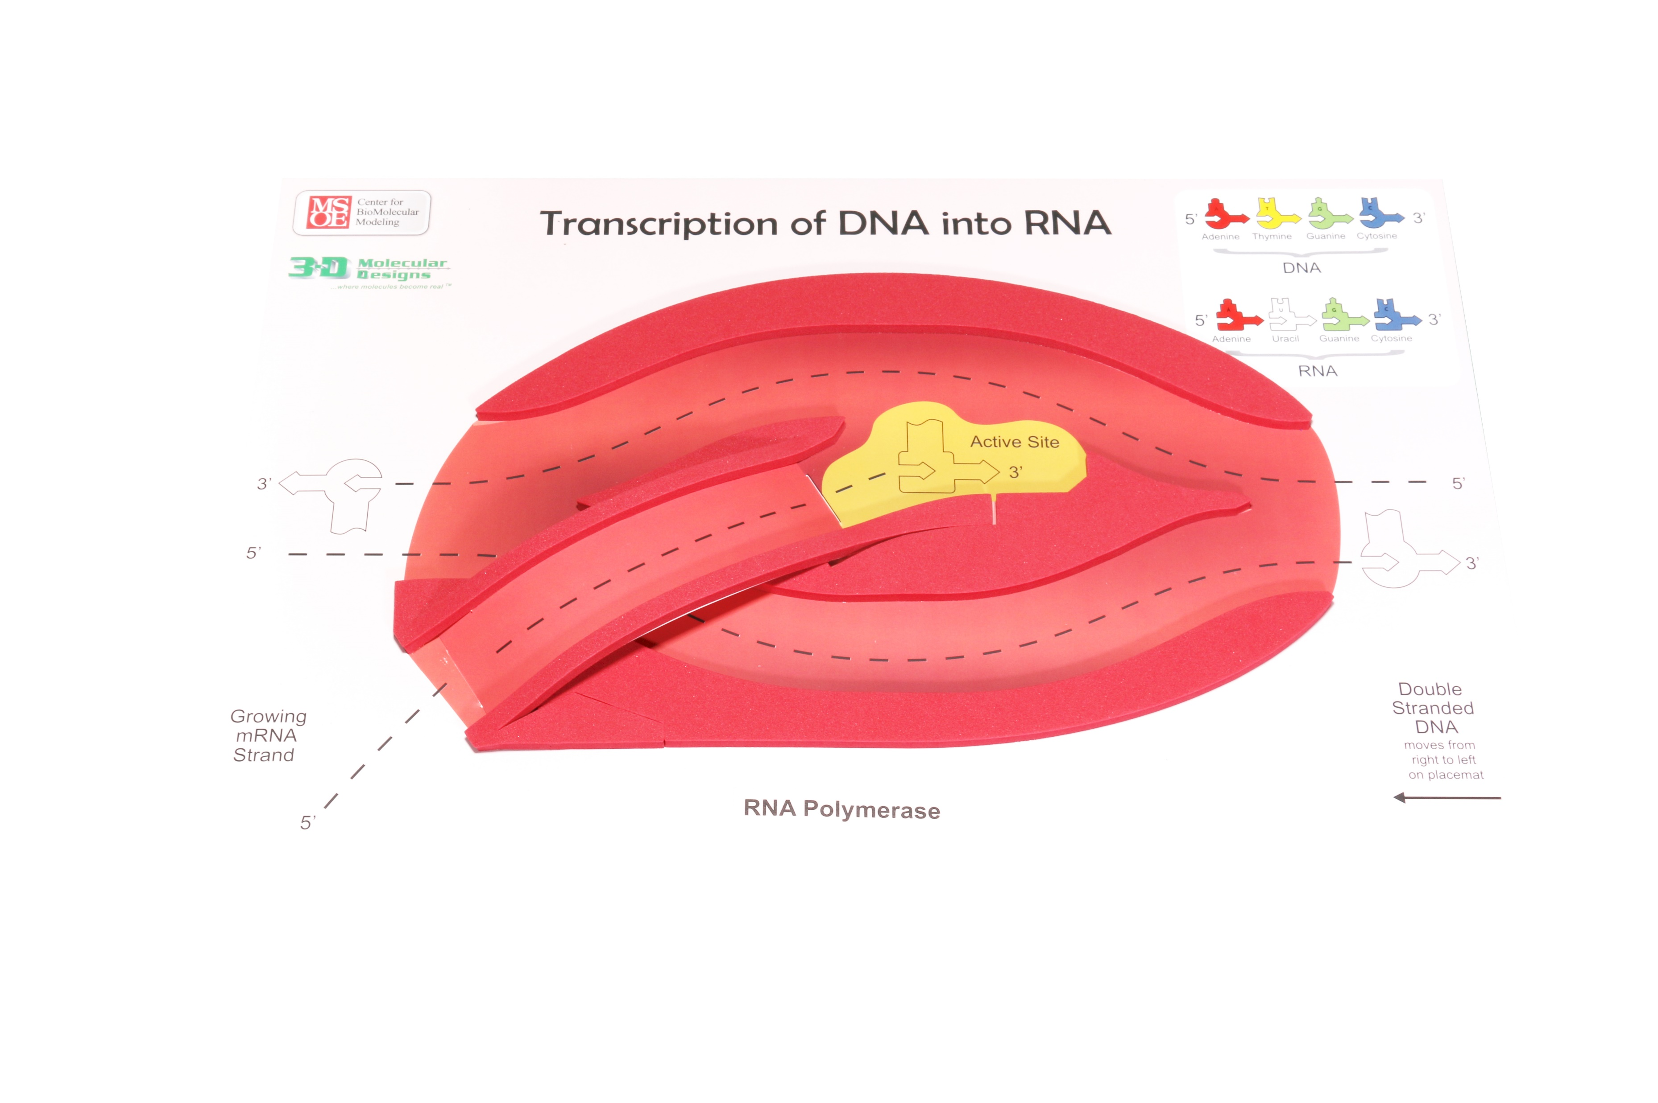
RNA Polymerase
Notes:
Have your students look closely at the transcription placemat. Discuss the important information given on the placemat: active site, directionality, DNA nucleotides, and RNA nucleotides.

Slide 8
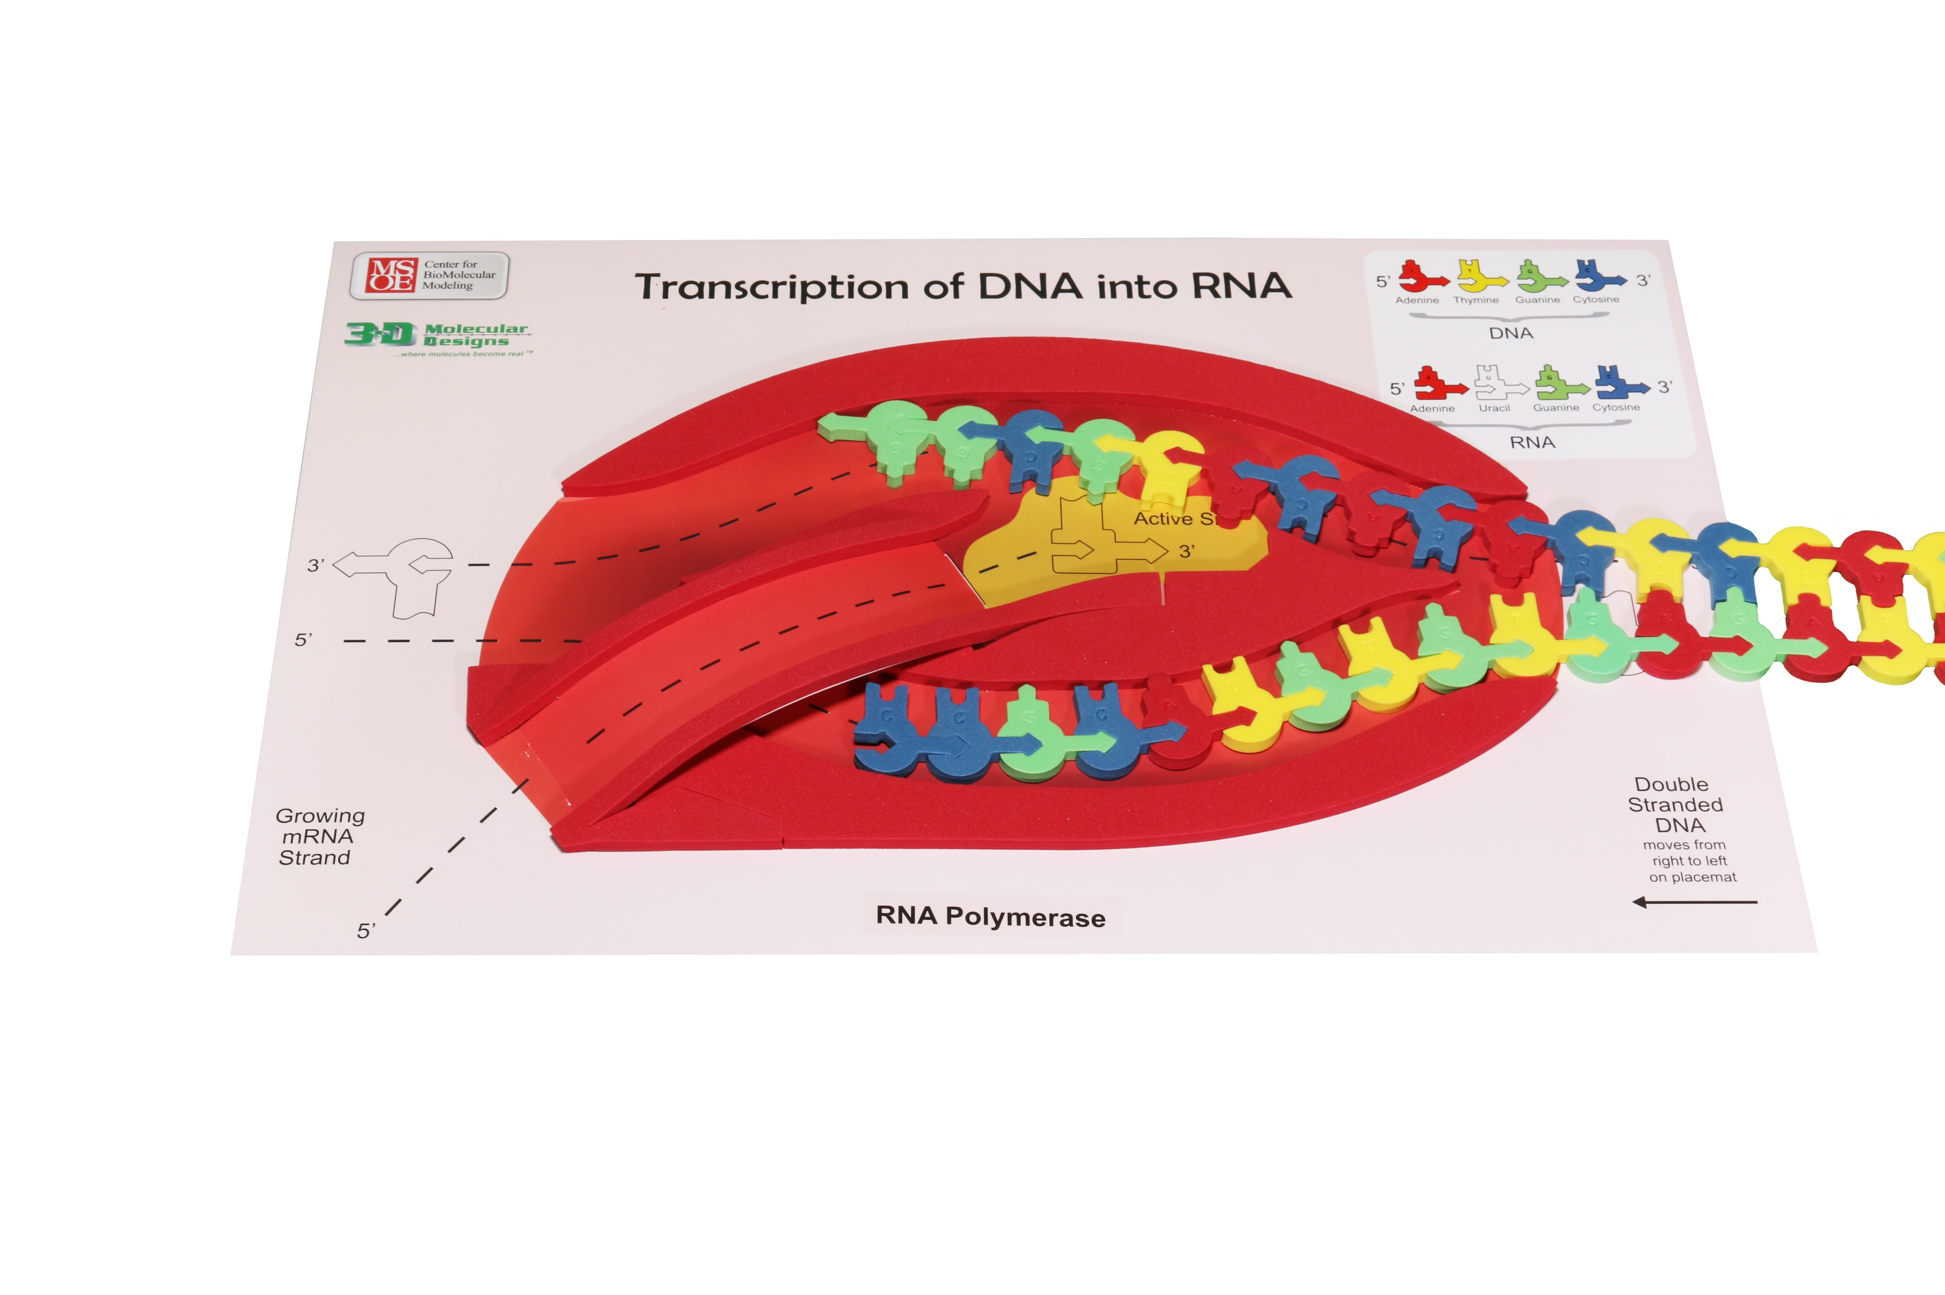
Transcription: Initiation ​
Notes:
For our first activity, you need the transcription mat, the pre-made DNA sequence, and the RNA nucleotides. ​
​
Set the scene: The nucleus of the eukaryotic cell. There are two major stages in making a protein: transcription in which DNA is used as a template to make a single-stranded mRNA and translation where RNA is used to create a sequence of linked amino acids that make a polypeptide which is later folded into a 3-D protein. At rise, we see RNA polymerase ready to start gene expression through transcription. The first phase of transcription is initiation. ​
​
Helpful hints: Point out to students the differences between RNA structure and DNA structure. Use Dynamic DNA to show differences between deoxyribose and ribose and the thymine and uracil. How are those differences denoted on the foam nucleotides? Notice the pointed edges on the foam enzymes ​
​
What is not shown in the model ​
A collection of proteins known as transcription factors facilitate the binding of the RNA polymerase to the DNA ​
​
What is shown in the model​
The DNA strands are separated. RNA polymerase joins the RNA nucleotides as they pair along one of the strands of the DNA template. In this model, the template strand is the top strand, and the non-template strand is the bottom strand. Notice the directionality of the template and non-template strands. RNA polymerases can only assemble mRNA in the 5’to3’direction. On the model the template strand of DNA should be oriented in the top slot with the 3’ end (arrow end) entering first. ​
​

Slide 9
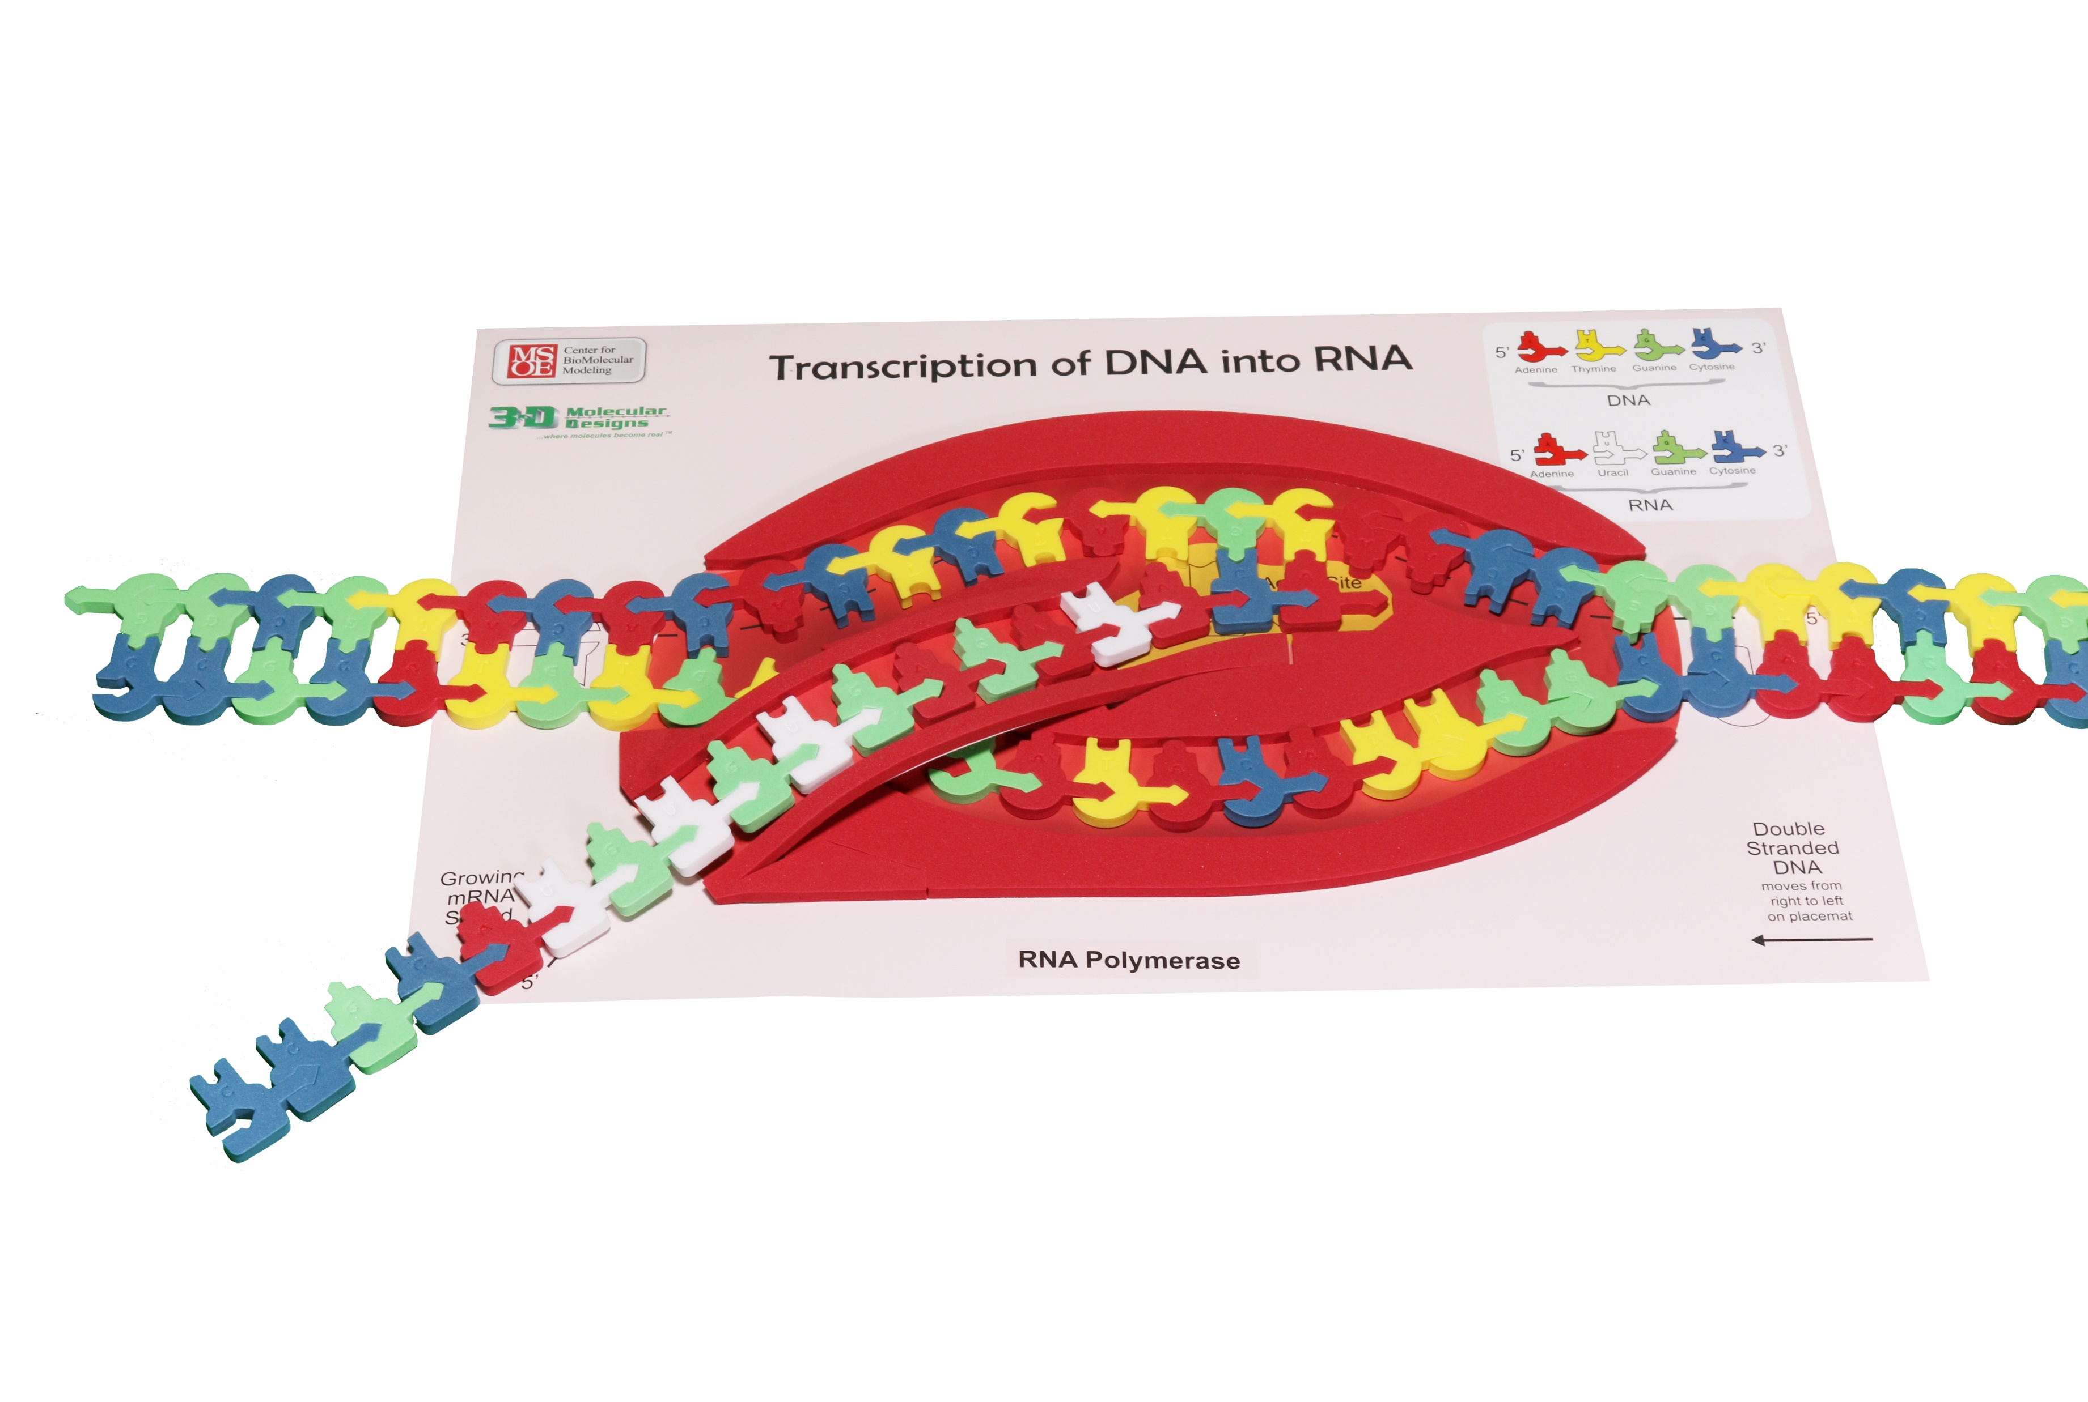
Transcription: Elongation ​
Notes:
The second phase is elongation. ​
​
Helpful hints: Put students into groups of three of four to complete this process because you need many hands to complete this in a timely fashion. After sprinkling the area with RNA nucleotides, feed the double stranded DNA into the RNA polymerase. Notice the pointed edges that help split apart the hydrogen bonds between both DNA and RNA nucleotides. Also, notice the RNA of the exit ramp in the RNA polymerase. ​
​
What is in the model: The model shows the base pairing between nucleotides using hydrogen bonds. The model shows directionality. There are keys on the mat that guide students in reinforcing the base pairing rules. ​
​
What is not in the model: We don’t make a mRNA of 900 nucleotides that would represent the smallest mRNA. It is important to point out that complexity to the students without having them modeling it for time's sake.

Slide 10
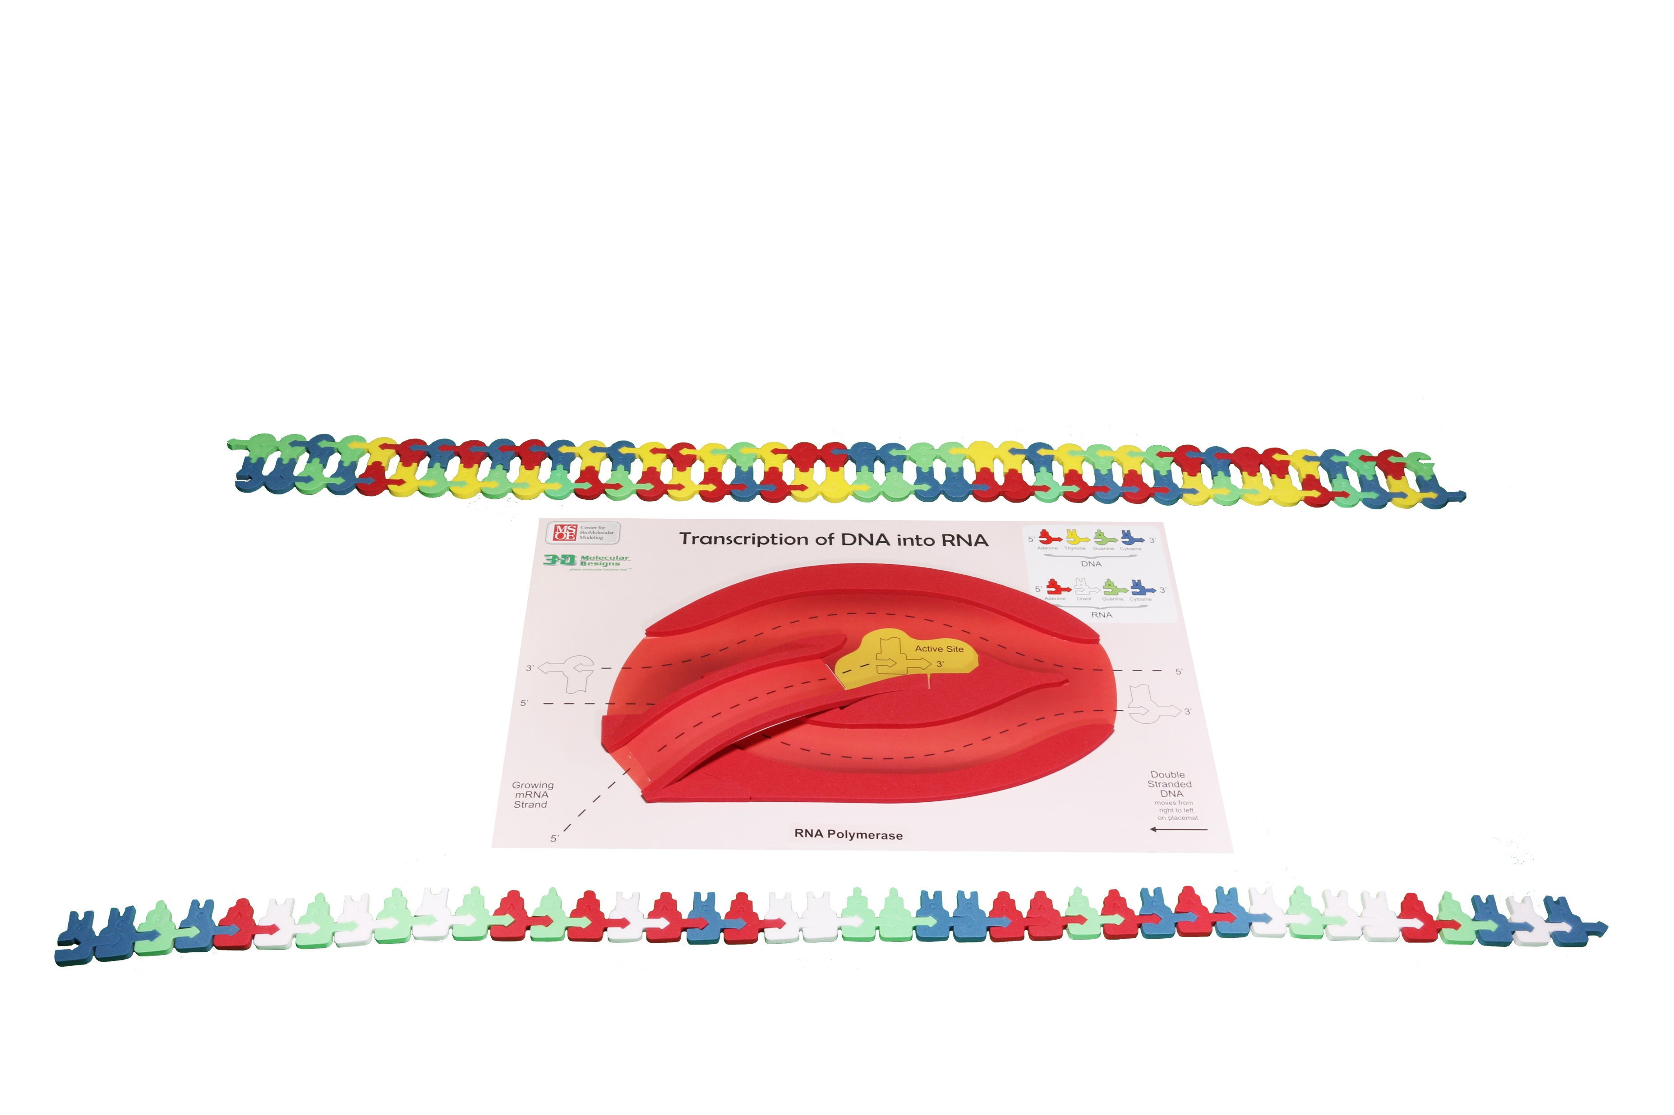
Transcription: Termination ​
Notes:
The third phase is termination.​
​
Helpful hints: At the end of this activity, save the RNA sequence you made for later and use it as a tool to assess your students’ understanding. ​
​
A student handout detailing this activity can be found at the link below: ​
​
FGIKTranscriptionStudentHandout6-19-15.compressed.pdf (3dmoleculardesigns.com)​
​
Take time to compare the mRNA with the DNA. Look for template vs. non-template strand, coding vs. non-coding, and sense vs. antisense strands of DNA. ​
The sense strand is also called the coding strand, plus strand,, or non-template strand. The coding strand is same as the mRNA except that thymine in DNA is replaced by uracil in RNA. ​
The coding strand contains the codons.

Slide 11
Nucleus
Nuclear Membrane
Cytoplasm
This image is an excerpt from Tour of a Human Cell by David Goodsell, as shown in 3D Molecular
Designs’ Tour of a Human Cell© poster and David Goodsell’s book, The Machinery of Life.
Notes:
Let’s note where we have been and where we are going.

Slide 12


DNA
mRNA
mRNA
Nuclear Pore
RNA Polymerase
This image is an excerpt from Tour of a Human Cell by David Goodsell, as shown in 3D Molecular
Designs’ Tour of a Human Cell© poster and David Goodsell’s book, The Machinery of Life.
Notes:
Let’s also identify some structures. You can print these landscapes as a pdf in black and white or greyscale and have them color them in. I would have my students insert them in their lab notebooks so they could reference them later.
Look down in the lower left to see the capping enzyme which is adding methylguanosine to the 5”end of the mRNA. It is by the RNA polymerase.
Let’s also identify some structures. You can print these landscapes as a pdf in black and white or greyscale and have them color them in. I would have my students insert them in their lab notebooks so they could reference them later.
The mRNA that is still in the nucleus nearest the nuclear pore is having the introns removed by a spliceosome. Only exons will be left in the mature
messenger RNA.

Slide 13
Pair the tRNA with the amino acids
Notes:
Helpful hints: Walk students through reading the charts and them time to pair the amino acids with their tRNA. Then revisit the chart and talk about all the possibilities for anticodons.

Slide 14
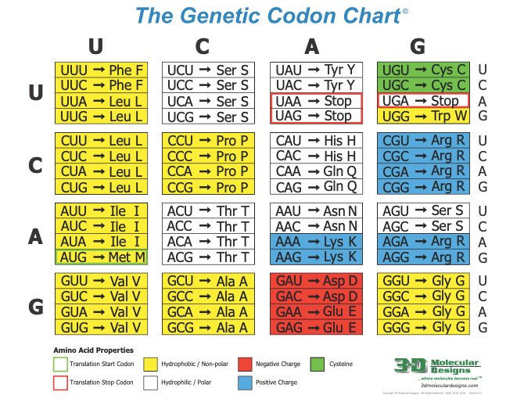

Slide 15
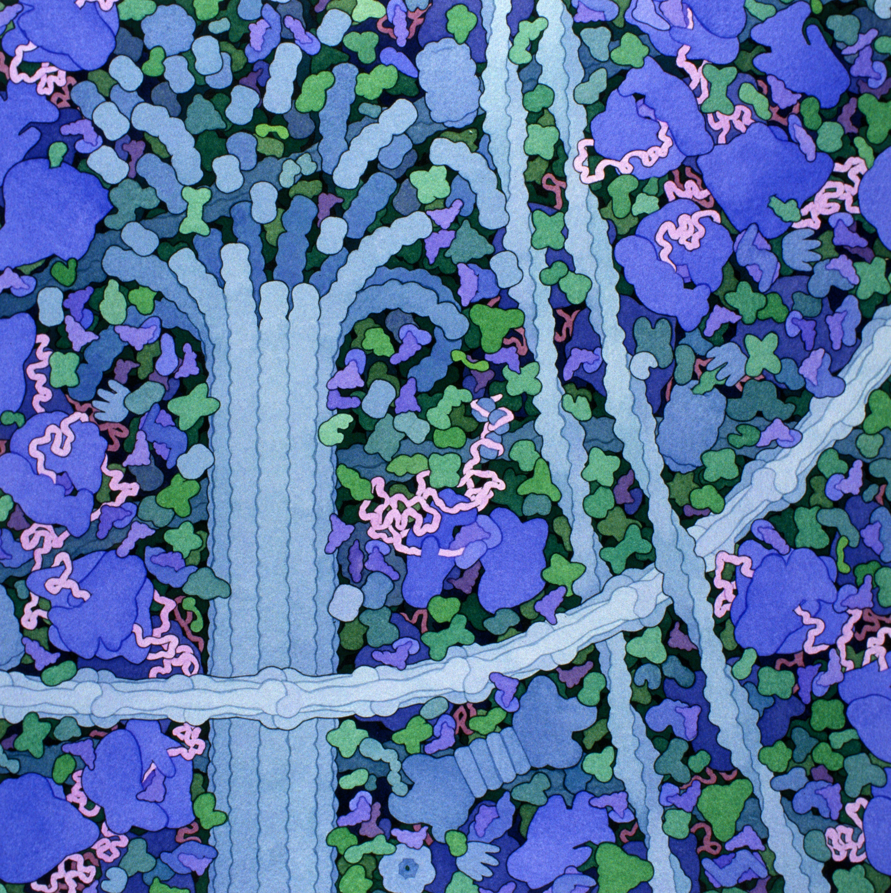
Translation
Acknowledgement: Illustration by David S. Goodsell. doi: 10.2210/rcsb_pdb/goodsell-gallery-006
15
Notes:
Set the scene: In the cytoplasm of the cell, in the ribosome.
Helpful hints: Start by explaining the role of each of the tools needed for translation: tRNA, ribosome, and mRNA. I first start with the structure of transfer RNA. Students in my class would have learned about the structure of proteins earlier in the year so now we are just adding complexity to the process.

Slide 16
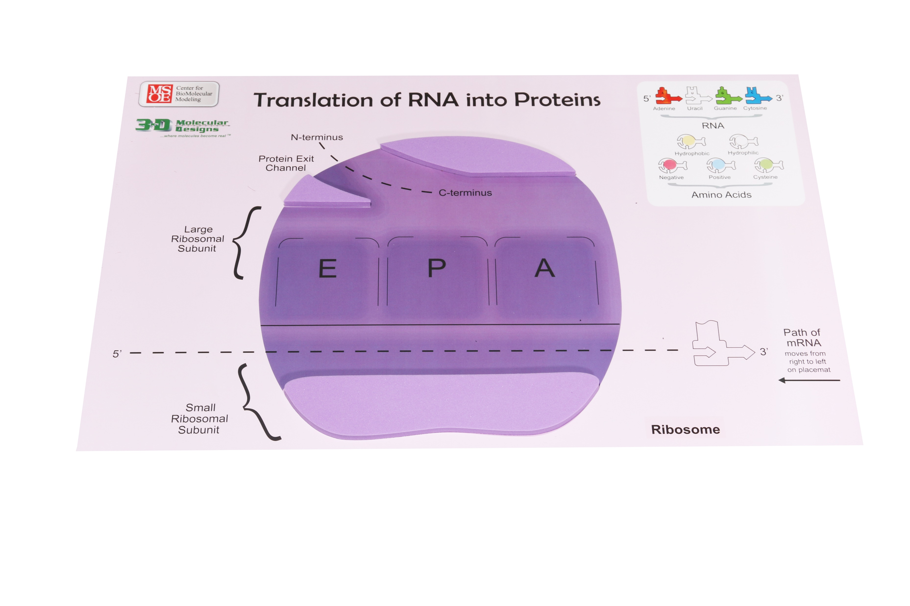
Translation
16
Notes:
Guide your students through noticing the two subunits of the ribosome, the EPA sites, the direction the mRNA enters the ribosome, the RNA nucleotides, and the amino acids found on the ends of tRNAs.

Slide 17
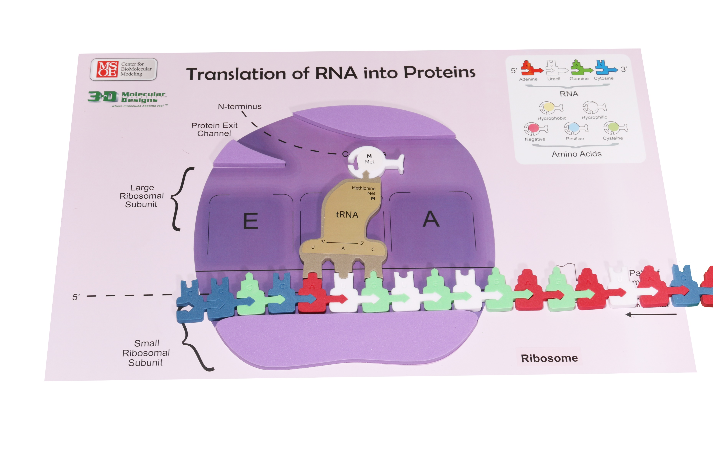
Translation: Initiation
17
Notes:
Set the scene: The first phase is initiation.
Helpful hints: Starting from the 5”end of the mRNA at the start codon (AUG), every three bases determines a particular amino.
What is in the model:
mRNA enters the ribosome (shown in purple). The top is the large subunit, while the small unit is shown under the EPA sites.
tRNA bring the amino acid to the ribosome

Slide 18
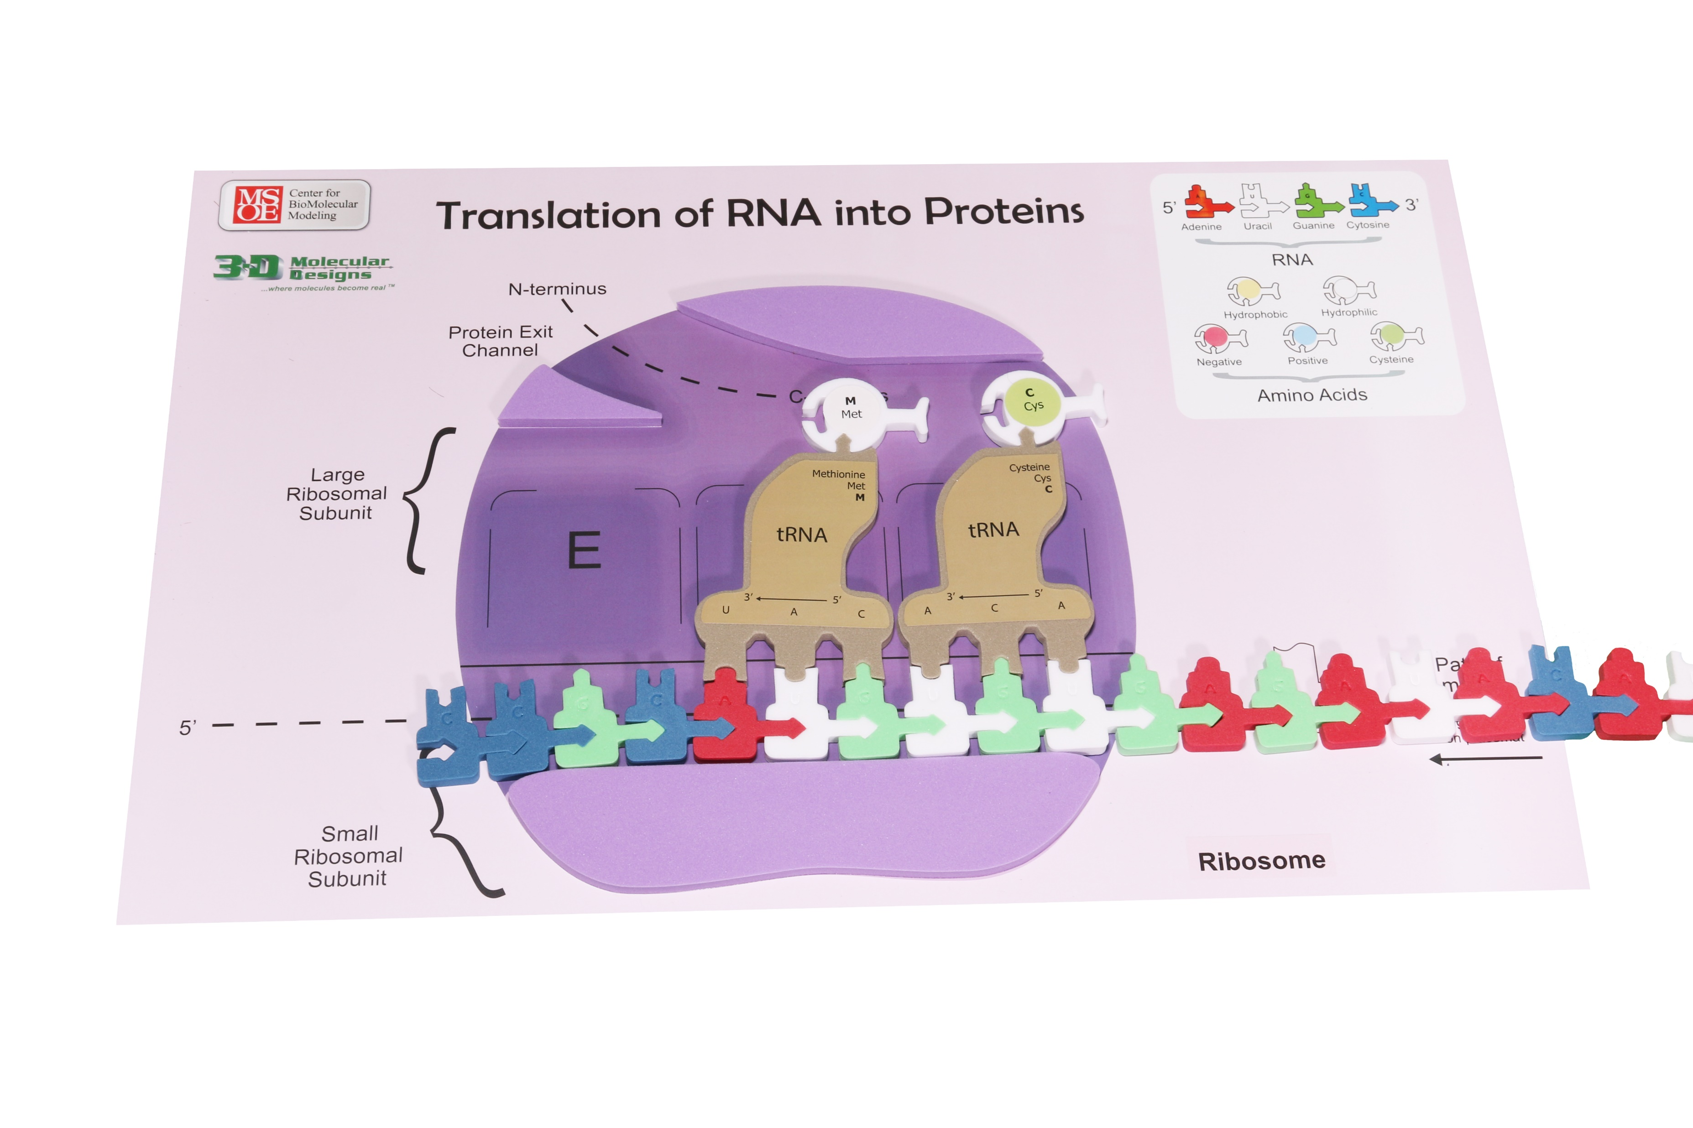
Translation: Elongation
18
Notes:
The second phase is elongation. The anticodon of another tRNA base pairs with the mRNA in the A site. The new protein is made in the N-terminal to C-terminal direction. A rRNA found in the large ribosomal subunit catalyzes the formation of a peptide bond between the amino group in the A site and the carboxyl end of the amino acid in the P site.
Helpful hints: Have multiple students work together for smooth transition of the process. There are a lot of parts to move so groups of 3 to 4 are best.
What is in the model
The important parts of the small and large ribosomal subunits are labeled.
The E (Exit), P (peptidyl), and A (aminoacyl) sites are shown.
What is not in the model
This is a two-dimensional model.

Slide 19
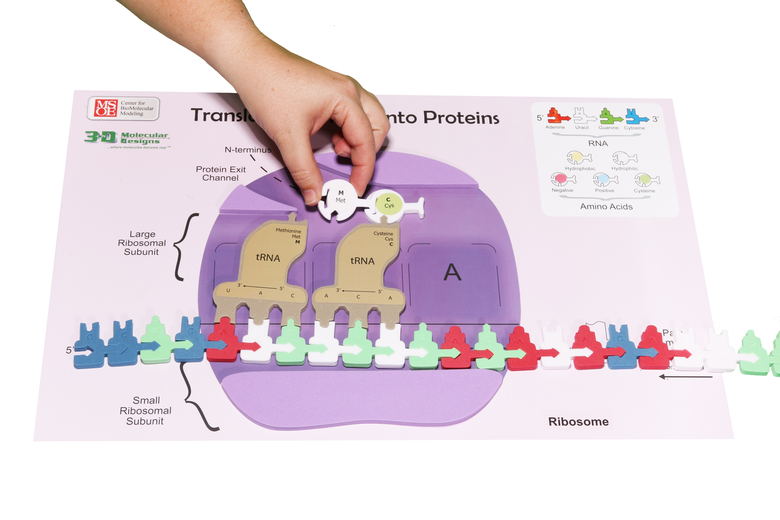
Translation: Elongation
19
Notes:
The second phase is elongation. The anticodon of another tRNA base pairs with the mRNA in the A site. The new protein is made in the N-terminal to C-terminal direction. A rRNA found in the large ribosomal subunit catalyzes the formation of a peptide bond between the amino group in the A site and the carboxyl end of the amino acid in the P site.
Helpful hints: Have multiple students work together for smooth transition of the process. There are a lot of parts to move so groups of 3 to 4 are best.
What is in the model
The important parts of the small and large ribosomal subunits are labeled.
The E (Exit), P (peptidyl), and A (aminoacyl) sites are shown.
What is not in the model
This is a two-dimensional model.

Slide 20
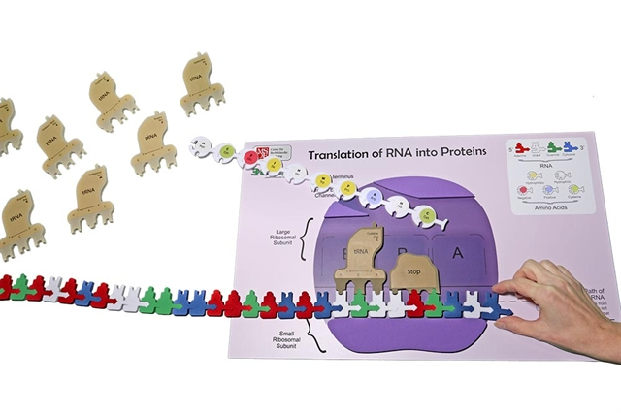
Translation: Termination
20
Notes:
The third phase is termination. The developing polypeptide will exit the ribosome through the opening in the large ribosomal subunit.
What is in the model
The ribosome reaches a stop codon on the mRNA. The A site of the ribosomes accepts a release factor.

Slide 21
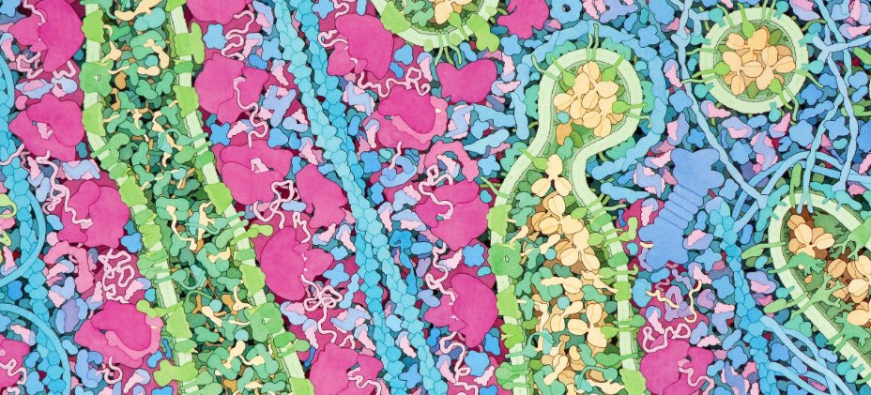
Revisit the panorama
21
Notes:
What is the difference structurally between the rough ER and the Golgi? Where is the mRNA? Where is the polypeptide? What is happening to the polypeptide in the rough ER? ​
What is the role of the green transporter proteins? ​
​
Sorting and Transporting: How does a vesicle bud off the rough ER? ​
What proteins help the polypeptide fold correctly?​
What is the fate of a misfolded protein? ​
​
How does the vesicle get to the Golgi?

Slide 22
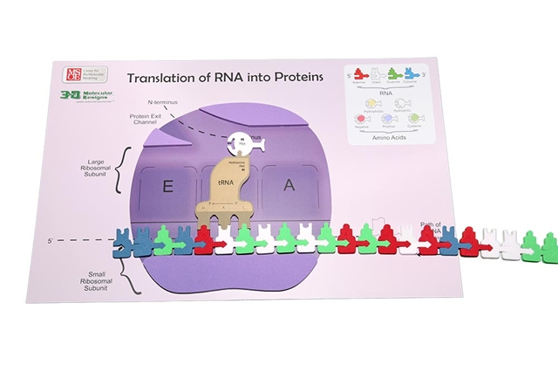
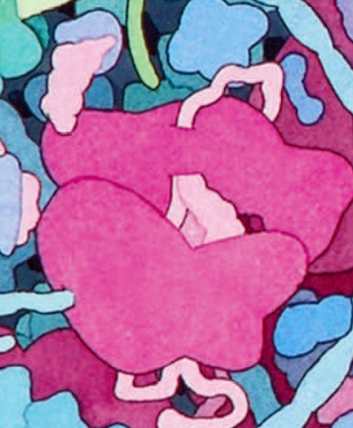
Ribosome-Ribosomal RNA and protein biological machine

Slide 23
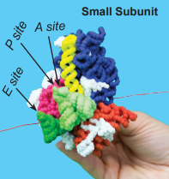
Ribosome-Ribosomal RNA and protein biological machine
Notes:
On the plaster model of the small subunit, one will find sites: E, P, and A for the docking of transfer RNAs. The P site stands for peptidyl. The A site stands for aminoacyl. The E site stands for exit. The initiation tRNA - charged with Met - base pairs with the AUG codon, and the large ribosomal subunit joins the small subunit to form a functional ribosome. Each ribosome has three binding sites for tRNA. The P site (peptidyl-tRNA binding site) holds the tRNA carrying the growing polypeptide chain. The A site (aminoacyl-tRNA binding site) holds the tRNA carrying the next amino acid to be added to the chain. Discharged tRNAs leave the ribosome from the E site (exit site)
The key for the small subunit:
Protein is white
RNA domains shown in blue, orange, yellow, magenta, and red
tRNA in A site- light green
tRNA in P site- green
tRNA in E site- dark green

Slide 24
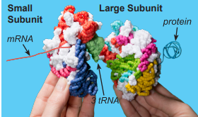
Ribosome-Ribosomal RNA and protein biological machine
Notes:
Teacher notes: After the tRNA and mRNA bind to the small subunit, it attaches to the large subunit. Once the small and large subunits are fully attached, the growing polypeptide passes through a channel in the large subunit. The polypeptide is represented by a fuzzy stick. It will immediately start folding into a protein based on basic properties of chemistry and physics.
The key for the large subunit:
Protein is white
Catalytic residues are shown in yellow
RNA domains are light blue, magenta, red, yellow green and grey.
PDB-101: Molecule of the Month: Ribosome (rcsb.org)
The link above will give you some detailed information about the structure of the ribosome.

Slide 25
Revisit the panorama
25
Notes:
What is the difference structurally between the rough ER and the Golgi? Where is the mRNA? Where is the polypeptide? What is happening to the polypeptide in the rough ER? ​
What is the role of the green transporter proteins? ​
​
Sorting and Transporting: How does a vesicle bud off the rough ER? ​
What proteins help the polypeptide fold correctly?​
What is the fate of a misfolded protein? ​
​
How does the vesicle get to the Golgi?

Slide 26
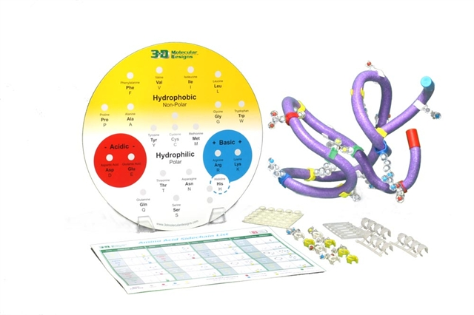
Protein Folding Activity

Slide 27
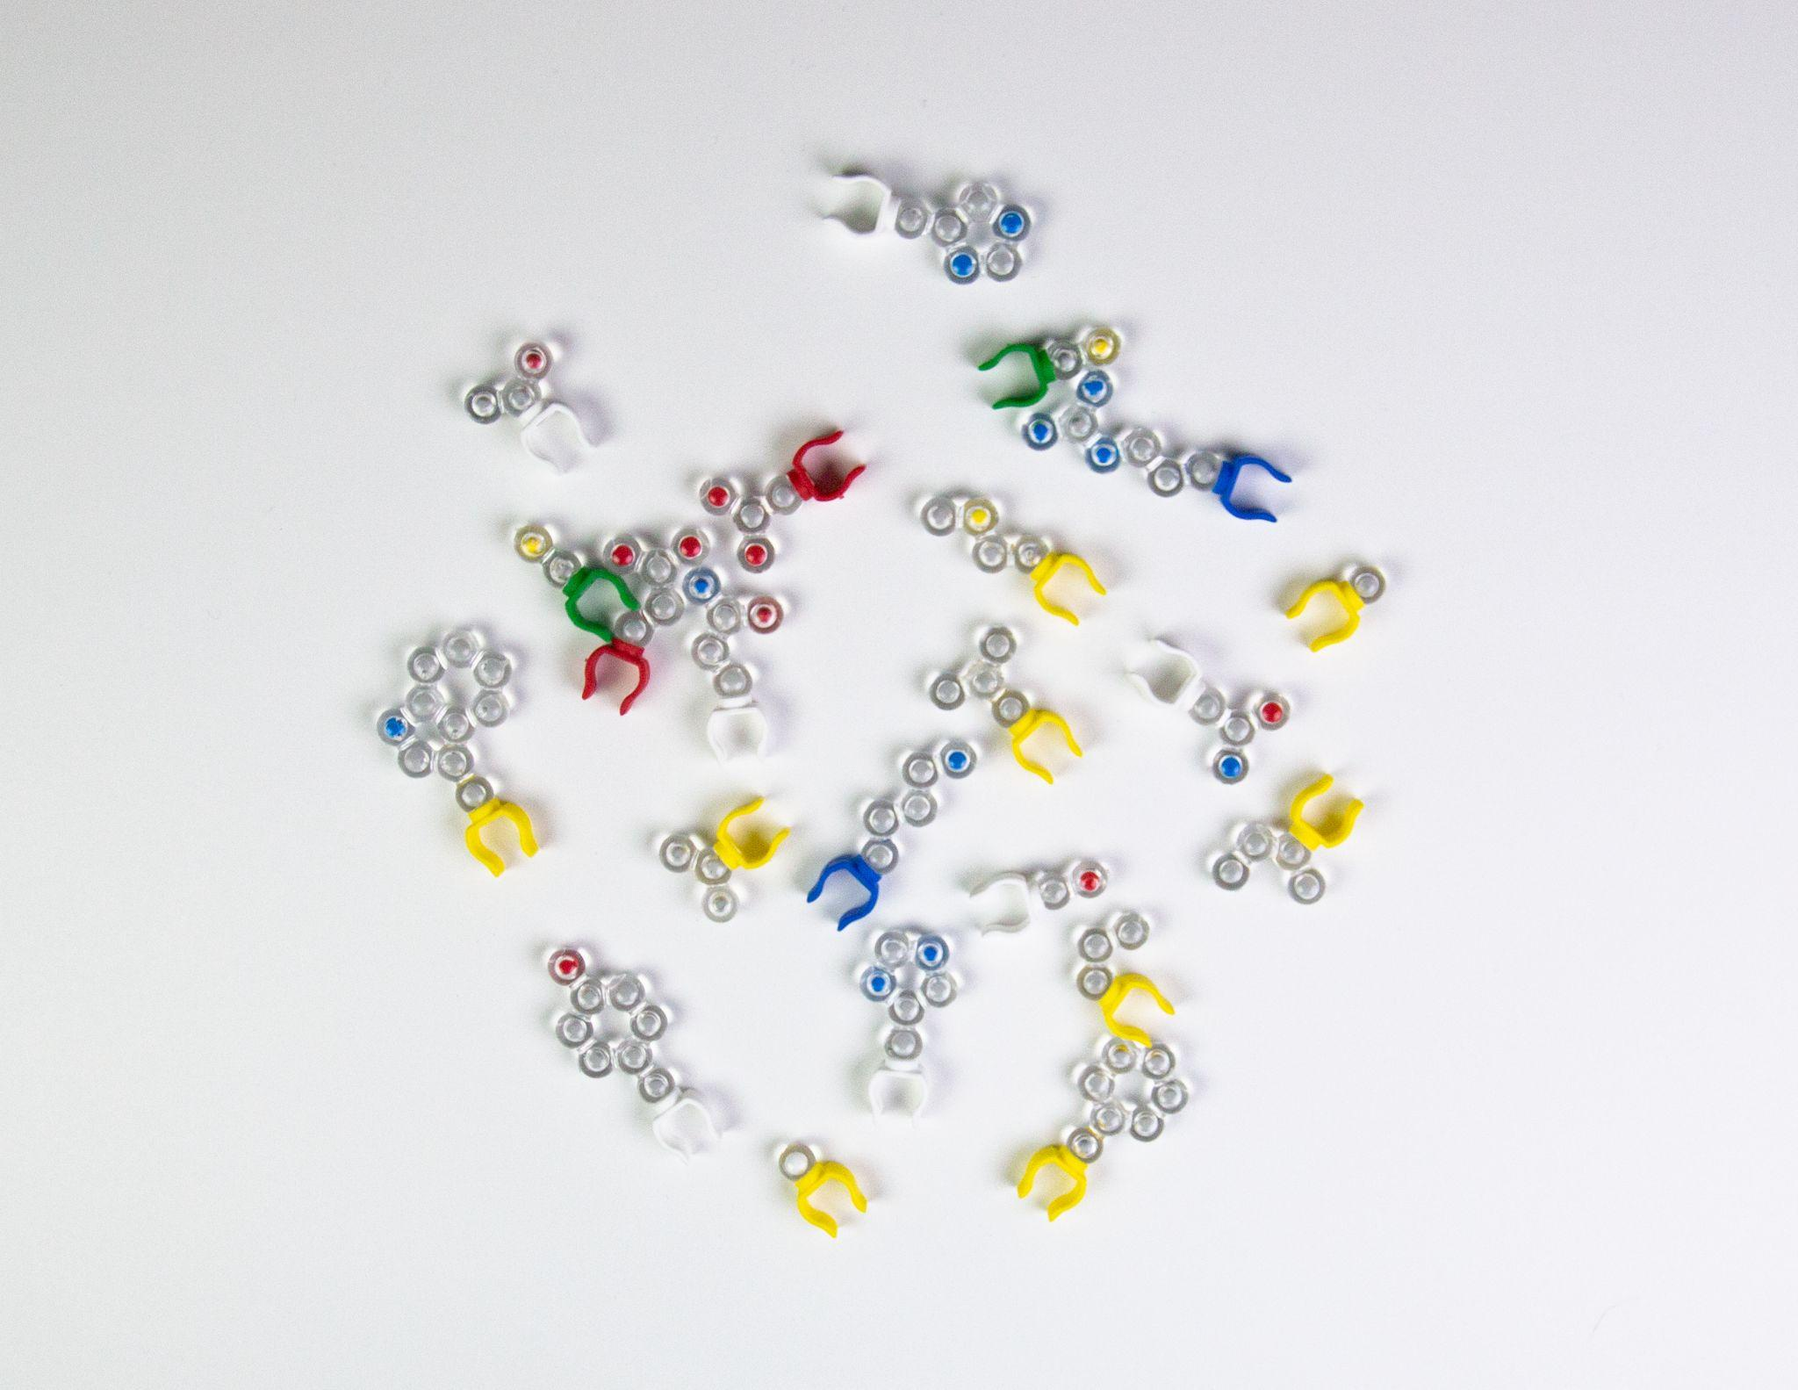
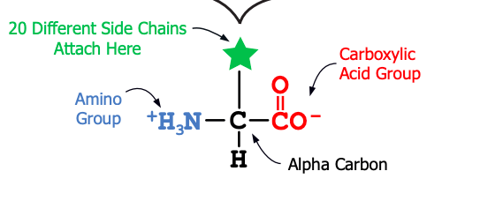
Notes:
Please get out the amino acid side chains from your kit. Each of my students or student groups (depending on class size) get a bag of the 20 amino acid side chains. I first ask my students to sort these side chains into a meaningful pattern. Would you do this for me with the amino acids that you have in your kit? [Give about 2 minutes to sort amino acids; walk around the room and give feedback to participants.] Hopefully, I’ve given you enough time to sort your amino acids.

Slide 28
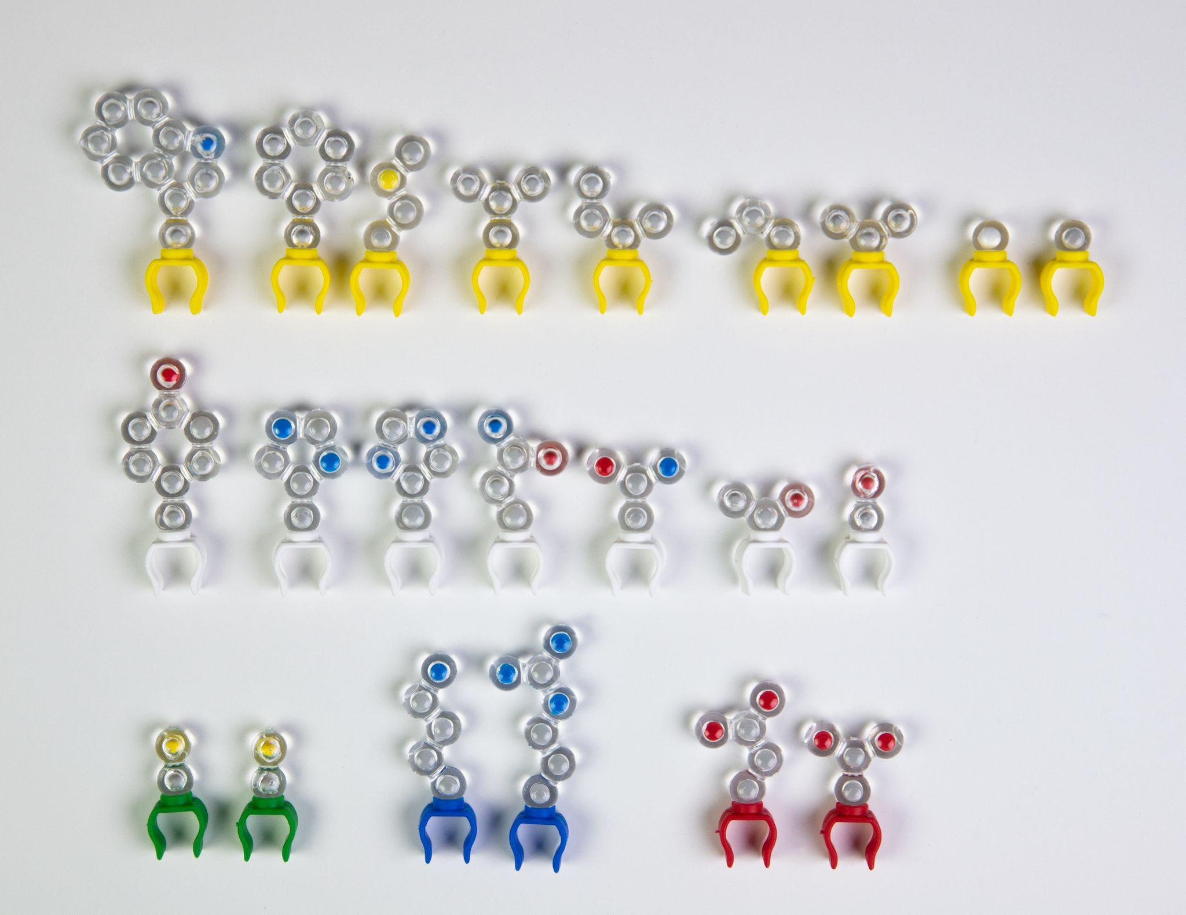
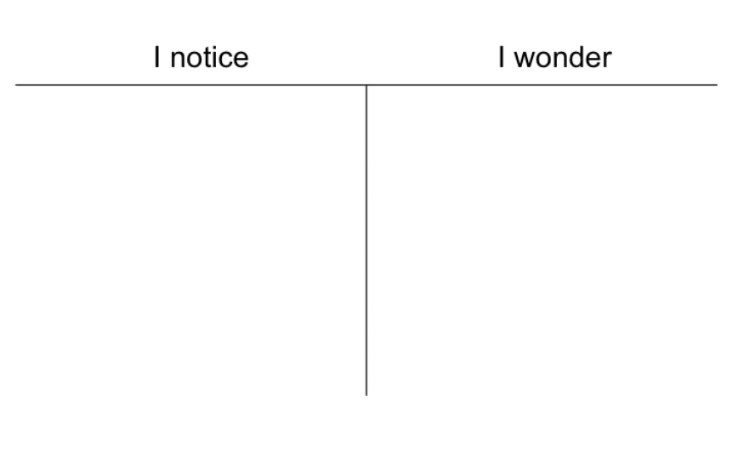
Notes:
Next I have my students make a Notice|Wonder t-chart so that they can record their ideas and questions in their lab notebook. Please do this a sheet of paper that you have handy. [Advance slide]

Slide 29
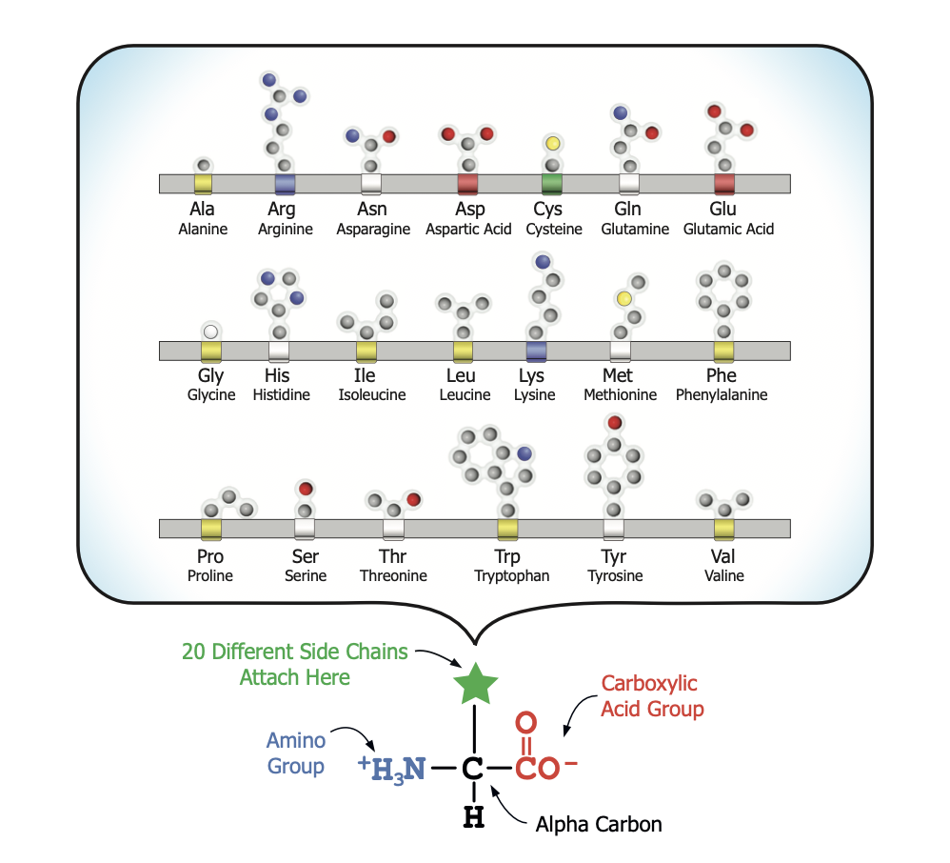
Notes:
Ruth says: You should have been given a copy of this in your student modeling pack. This side shows all twenty amino acids in alphabetical order as they appear in model form. The opposite side has both the structural formulas and an image of the models so that you can compared them. [Answer student question about the structural formula.] I have my students use the amino acid side chain chart, identify and place the side chains in their proper location on the amino acid organizer. [Advance slide.]

Slide 30
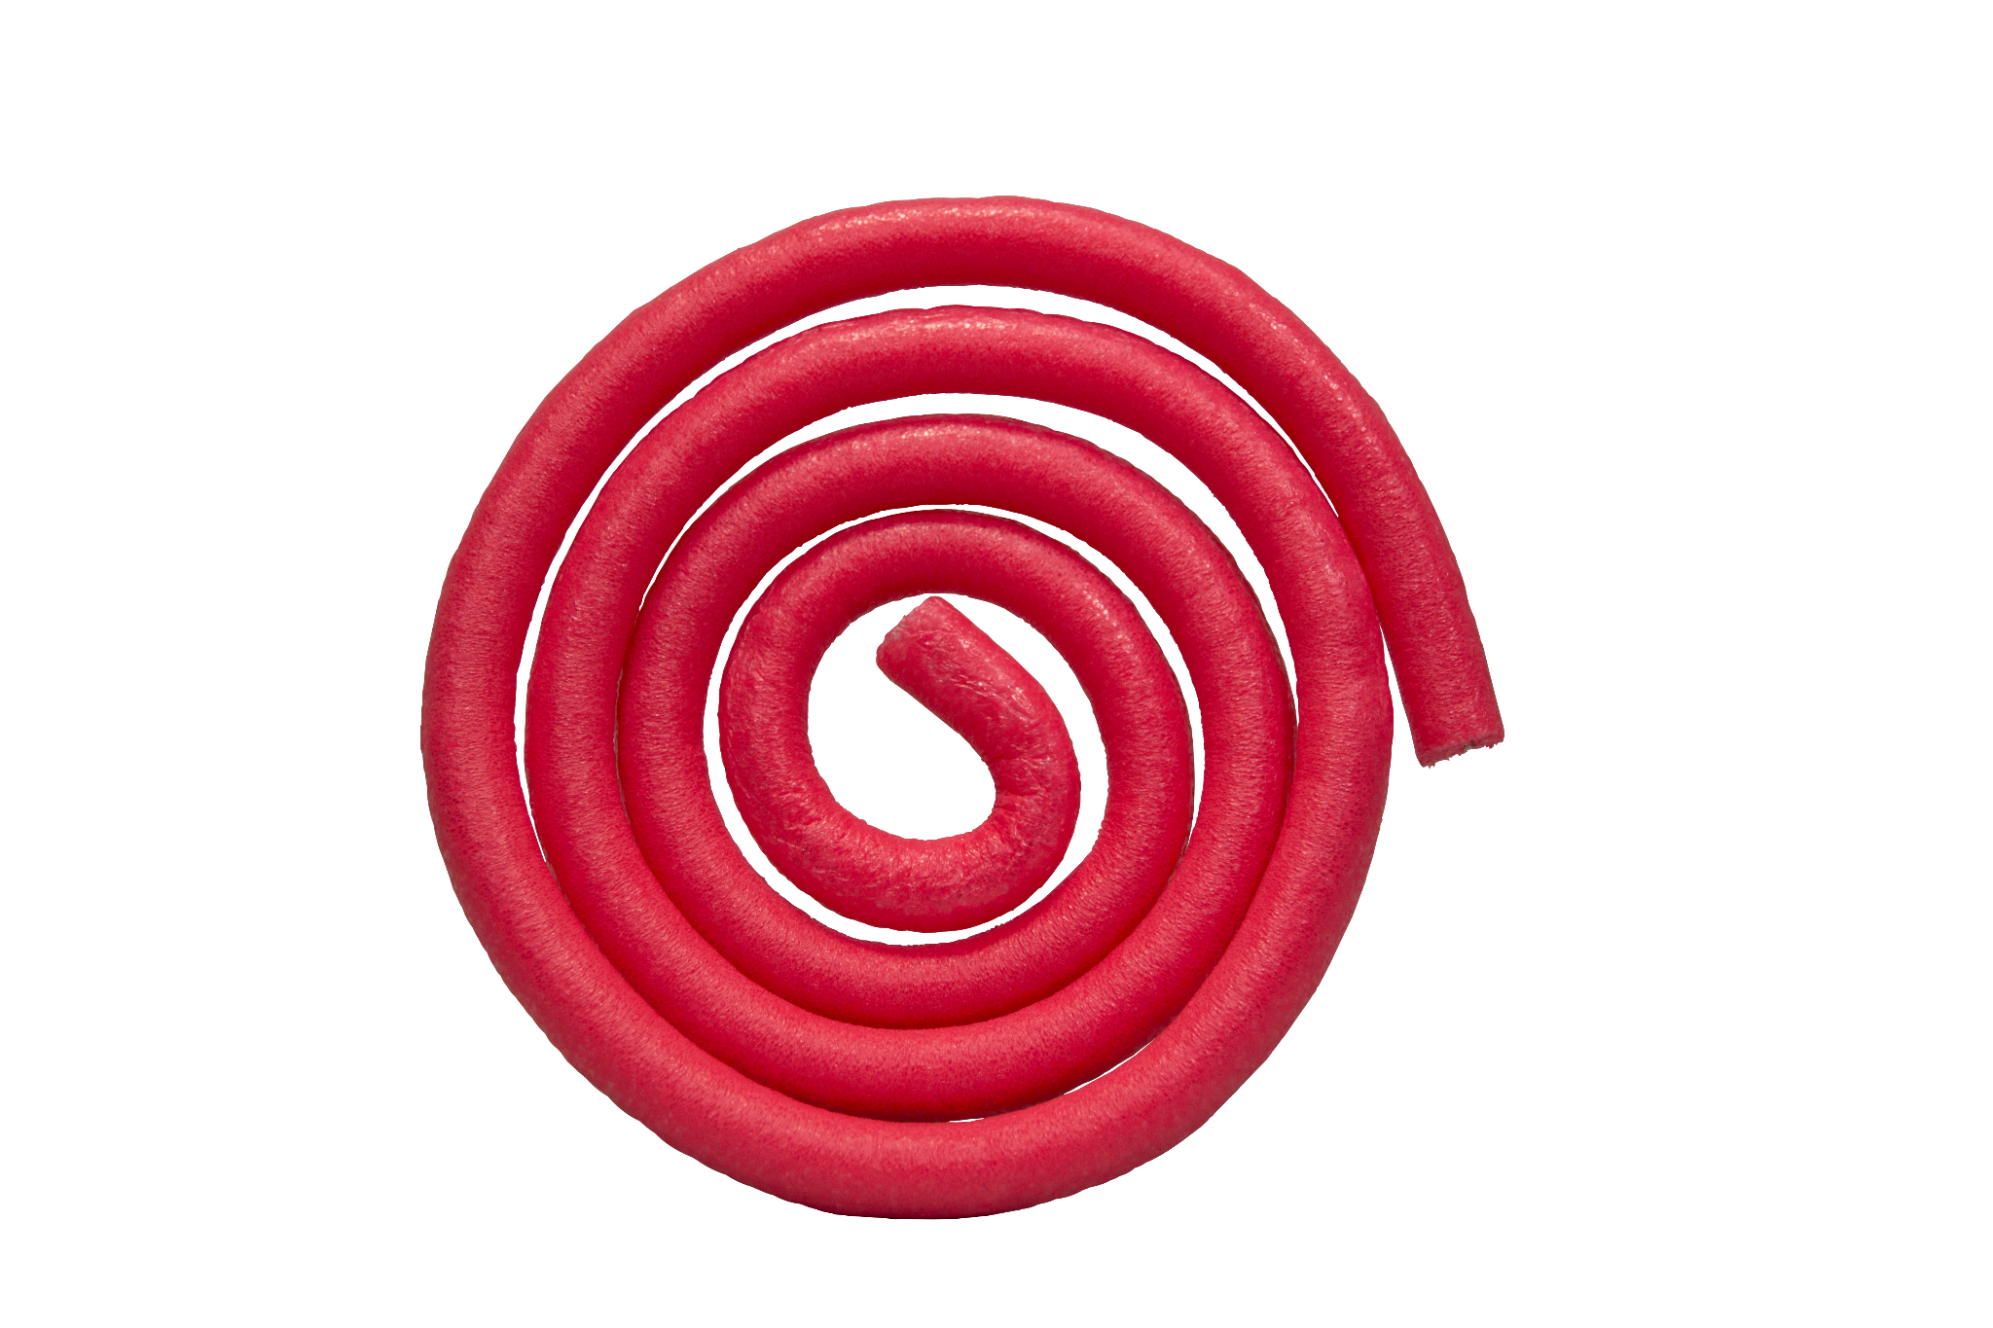
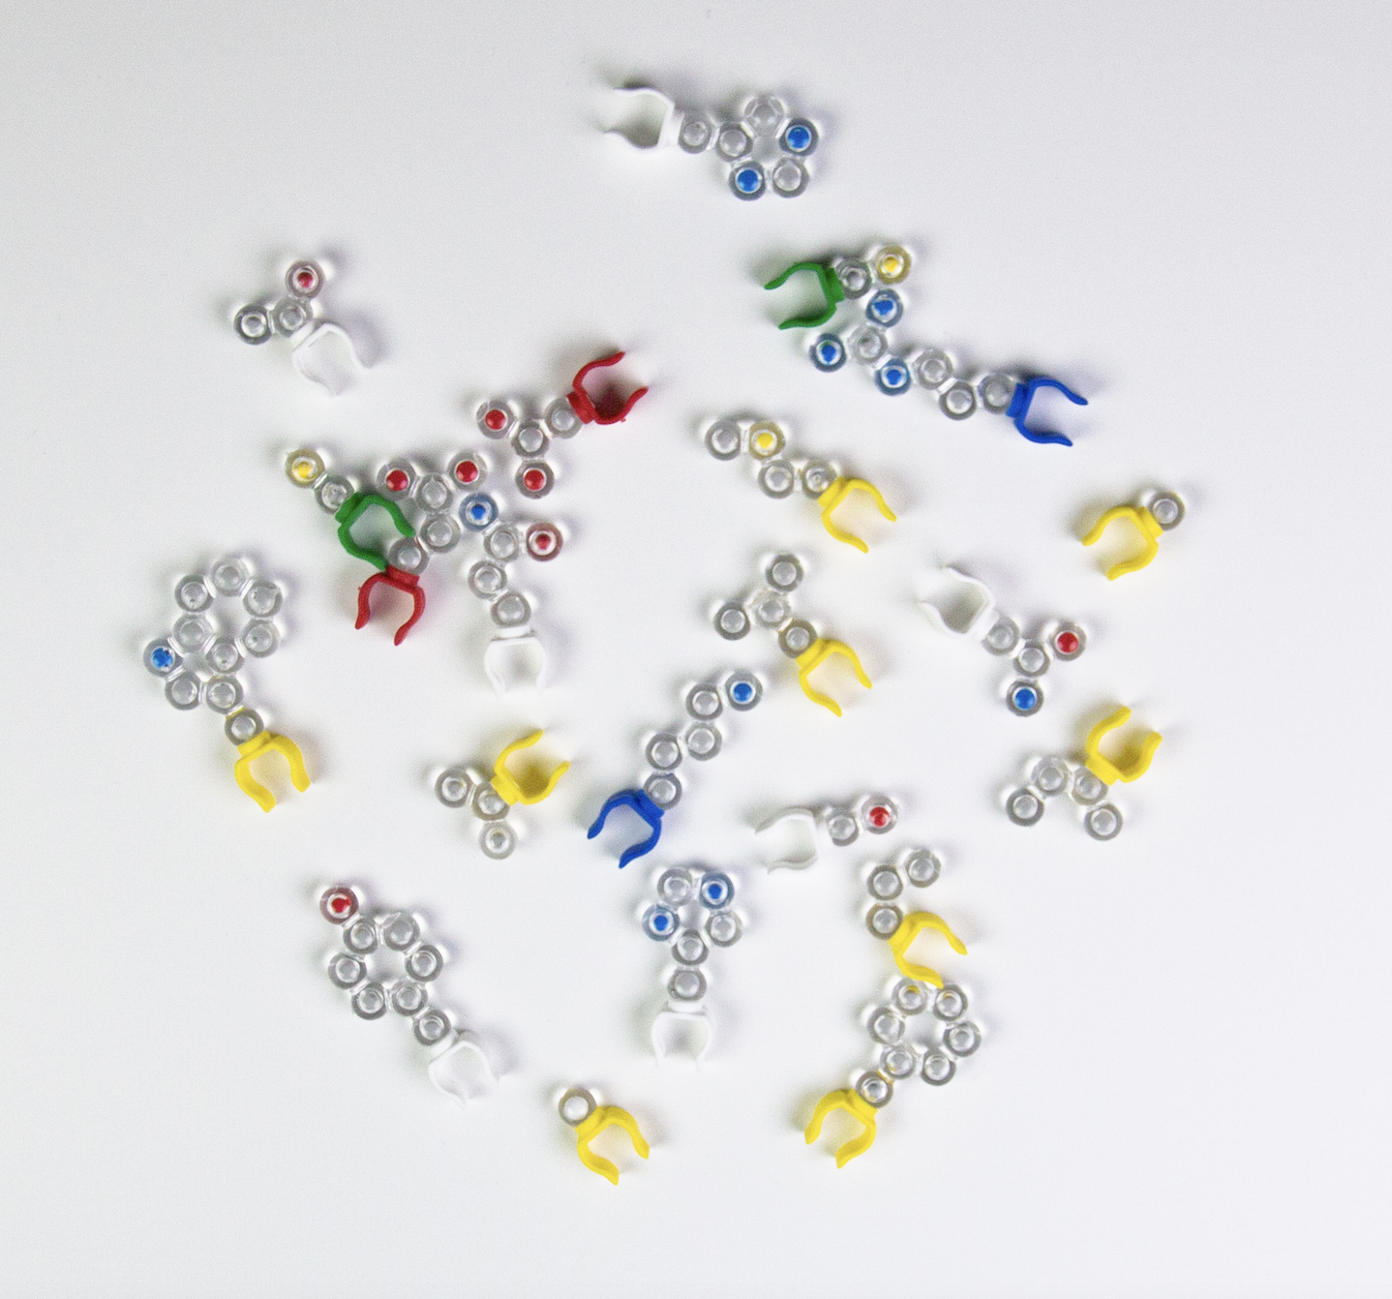
Notes:
Now let’s do some more modeling, for this exercise you will next the mini-toober and 10 amino acid side chains in your modeling pack. The mini-toober represents the backbone (amino group, carboxyl group, and alpha carbon.

Slide 31
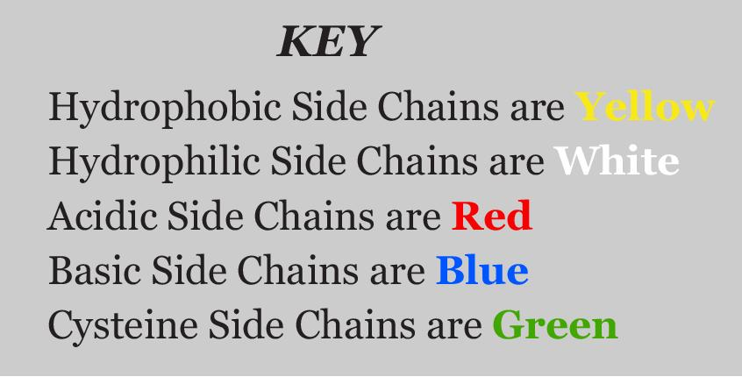
Notes:
Ruth says: [Explain the key for the colors on the side chains models.] You will use all ten of the amino acids in your kit, but remember there are 20 amino acids. [Advance slide.]

Slide 32
SIX HYDROPHOBIC
THREE HYDROPHILIC
TWO ACIDIC
TWO BASIC
TWO CYSTEINE
A TOTAL OF FIFTEEN SIDE CHAINS

Slide 33
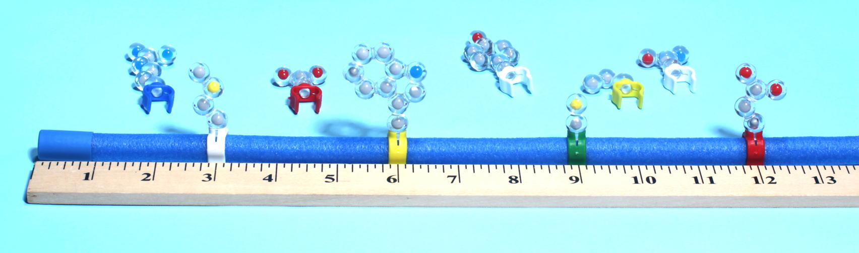
In any order arrange your amino acids equidistant from each other.
You have made a polypeptide.
Notes:
Ruth says: [Explain how my students conduct the exercise.] Place your 10 amino acids in any order just make sure they are equidistant for each other. You have now made a polypeptide which is the primary structure of a protein. [Advance slide.]

Slide 34
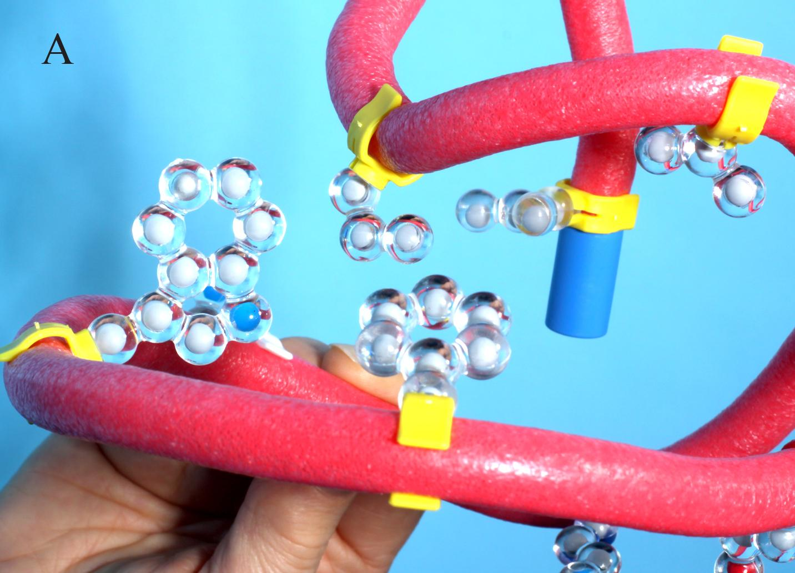
Let’s “FOLD” it into a Protein
Rotate the hydrophobic amino acids to the inside.
Notes:
Ruth says: Now let’s fold our polypeptide into a protein. [Explain what we mean by “fold.”] Why do the hydrophobic amino acids rotate to the inside? Exactly, they are trying to get away from the water. They are non-polar and water is a slightly polar molecule. Next we will focus on the acidic and basic side chains. [Advance slide.]

Slide 35
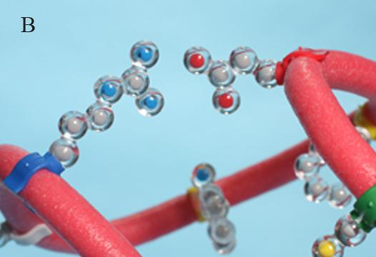
Continue “FOLDING”
Bring the acidic and basic side chains together until they are two cm from each other.
Notes:
Continue to fold by bringing the acidic and basic side chains together until they are about two centimeters from each other. [Explain the interaction between the acidic and basic side chains.] I should bring up that there is one caveat to this folding exercise.

Slide 36
Make sure that you also rotate any hydrophobic side chains that move out of place.
Throughout this whole activity find a shape in which all the properties apply.
Notes:
Continue to fold by bringing the acidic and basic side chains together until they are about two centimeters from each other. [Explain the interaction between the acidic and basic side chains.] I should bring up there is one caveat to this folding exercise.

Slide 37
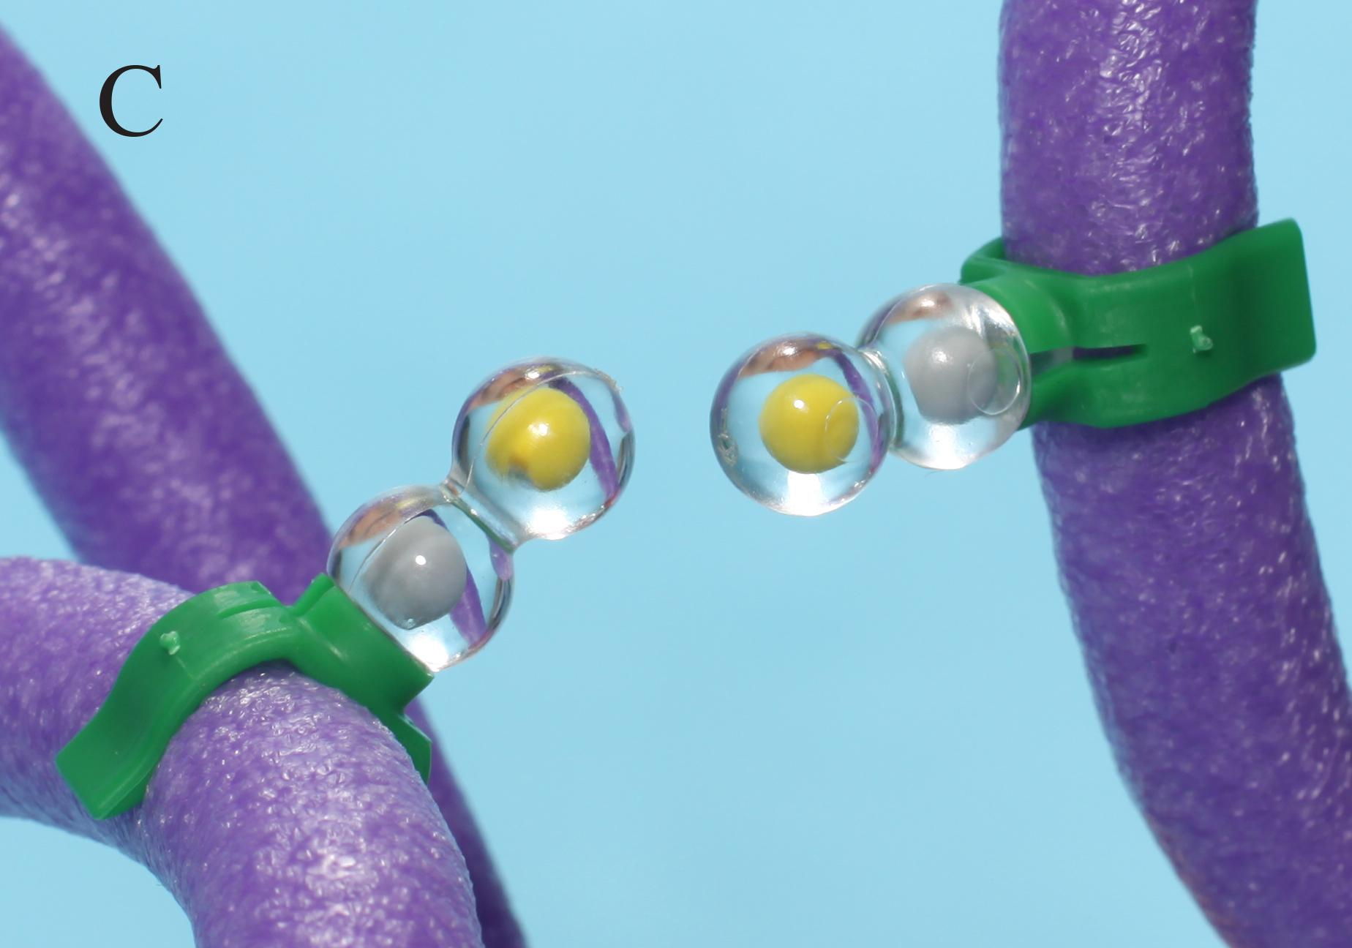
Continue “FOLDING”
Position the cysteines so they are opposite each other.

Slide 38
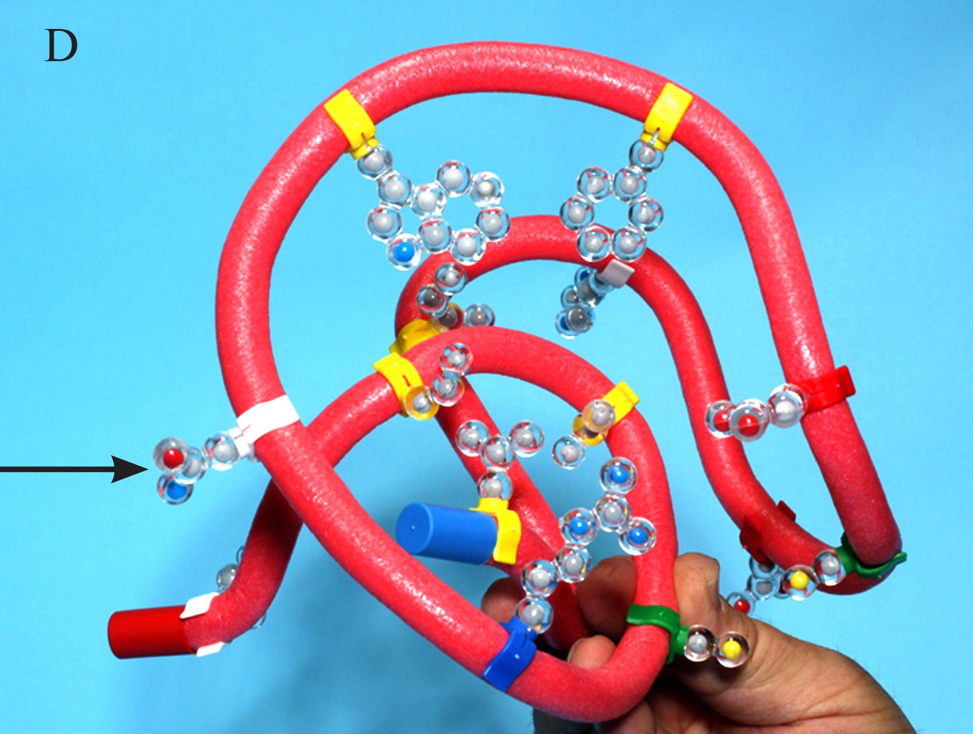
Continue “FOLDING”
Finally, rotate the hydrophilic side chains so they are on the outer surface.

Slide 39
Why didn’t your proteins all look the same?

Slide 40
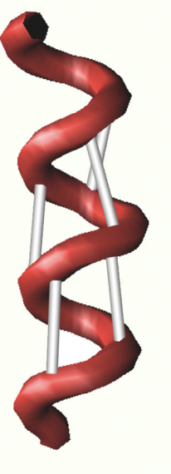
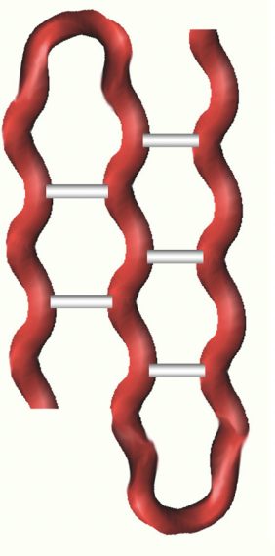
The Importance of Secondary Structure
Alpha Helix
HOW DO SECONDARY STRUCTURES STABILIZE A PROTEIN?
Beta Sheet

Slide 41
WHAT ABOUT QUATERNARY STRUCTURE?

Slide 42
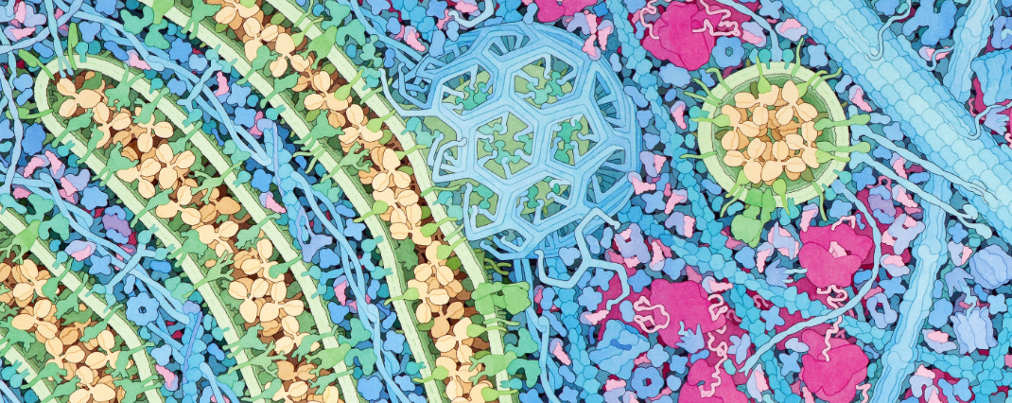
Revisit the panorama
42
Notes:
Why would it be important to continue to modify the structure of the antibody? What do sugars or other substances do for the antibody’s 3-D structure?
Look closely at the antibody in the Golgi. The Golgi is the processing and sorting area in the cell. Sugars and lipids attach to the proteins that need them like this antibody.
Look at vesicle fusion at the Golgi and compare it to the cell membrane. The protein that aid in binding with the membrane are SNAP receptors on the vesicle and SNARE receptors on the Golgi.
How do vesicles bud off the Golgi. Look more closely at clathrin. Identify several clathrin monomers within the geodesic dome. Notice how clathrin interconnects. It takes as many as 36 clathrin triskelions to make one Clathrin dome.
How do cells determine which direction vesicles move?

Slide 43
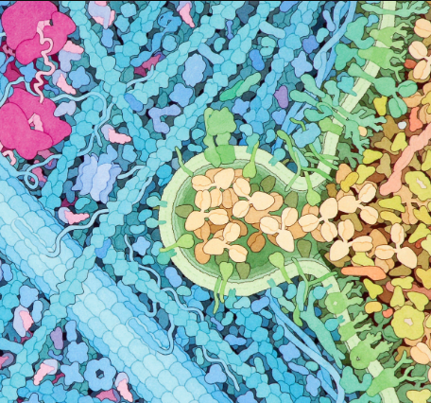
Revisit the panorama
43
Notes:
The vesicle fuses and the newly folded and glycosylated protein moves out of the cell.

Slide 44
Helpful Resources
Tracking the Resolution of Student Misconceptions about the Central Dogma of Molecular Biology - PubMed (nih.gov)​
DNA → RNA: What Do Students Think the Arrow Means? - PMC (nih.gov)​
What's in a cell? — young people's understanding of the genetic relationship between cells, within an individual: Journal of Biological Education: Vol 34, No 3 (tandfonline.com)​
Teaching More by Lecturing Less | CBE—Life Sciences Education (lifescied.org)
Eukaryotic cell panorama - Goodsell - 2011 - Biochemistry and Molecular Biology Education - Wiley Online Library

Slide 45
Workshop NGSS Connections
SEPs | CCCs | DCIs
Asking Questions | Scale, Proportion, and Quantity | HS-LS1-1
Developing and Using Models | Patterns | MS-LS1-2
Constructing Explanations and Designing Solutions | Structure and Function
Notes:
Here are the NGSS Connections for this workshop.

Slide 46
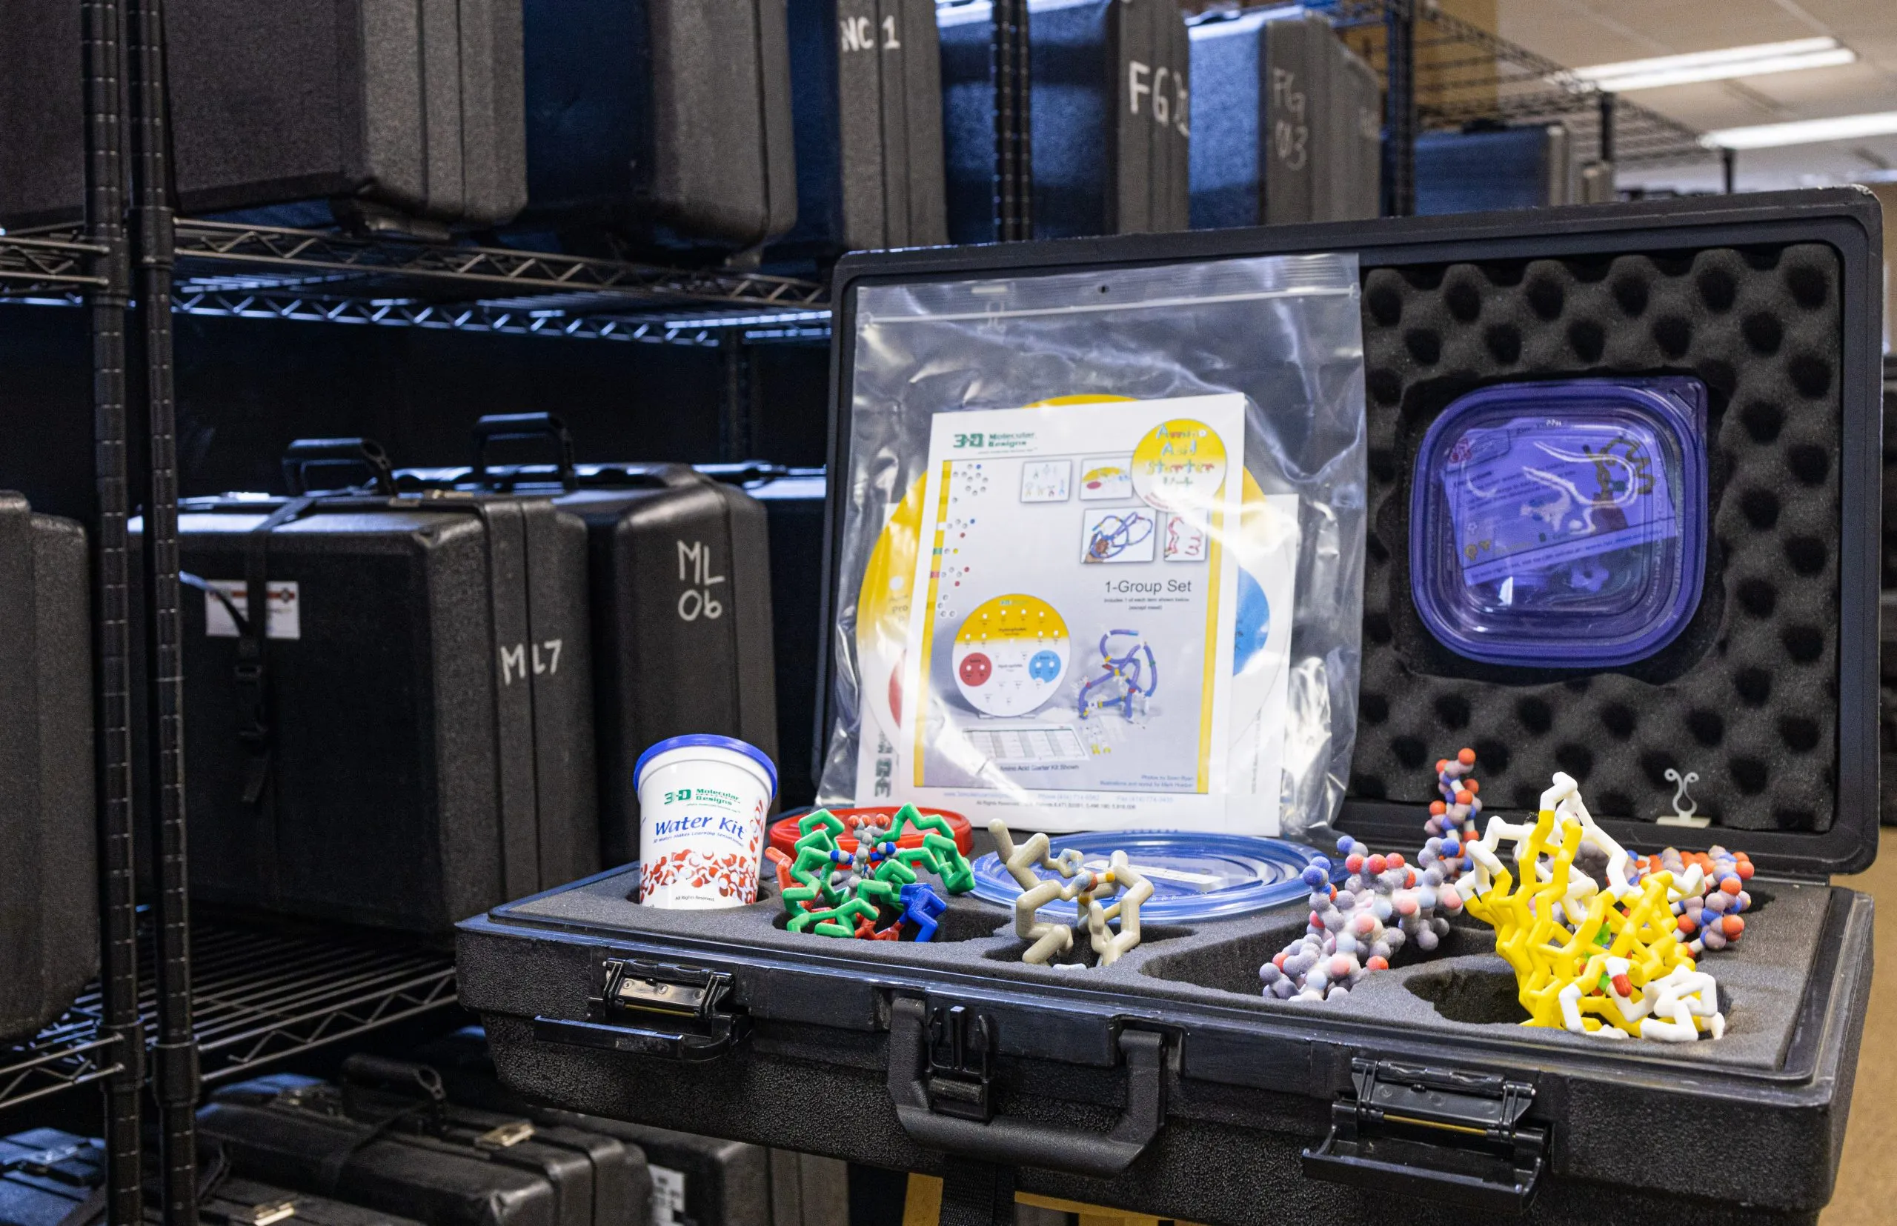
Want to try things out first?
Visit our Lending Library at
3DMD Lending Library – 3D Molecular Designs.

Slide 47
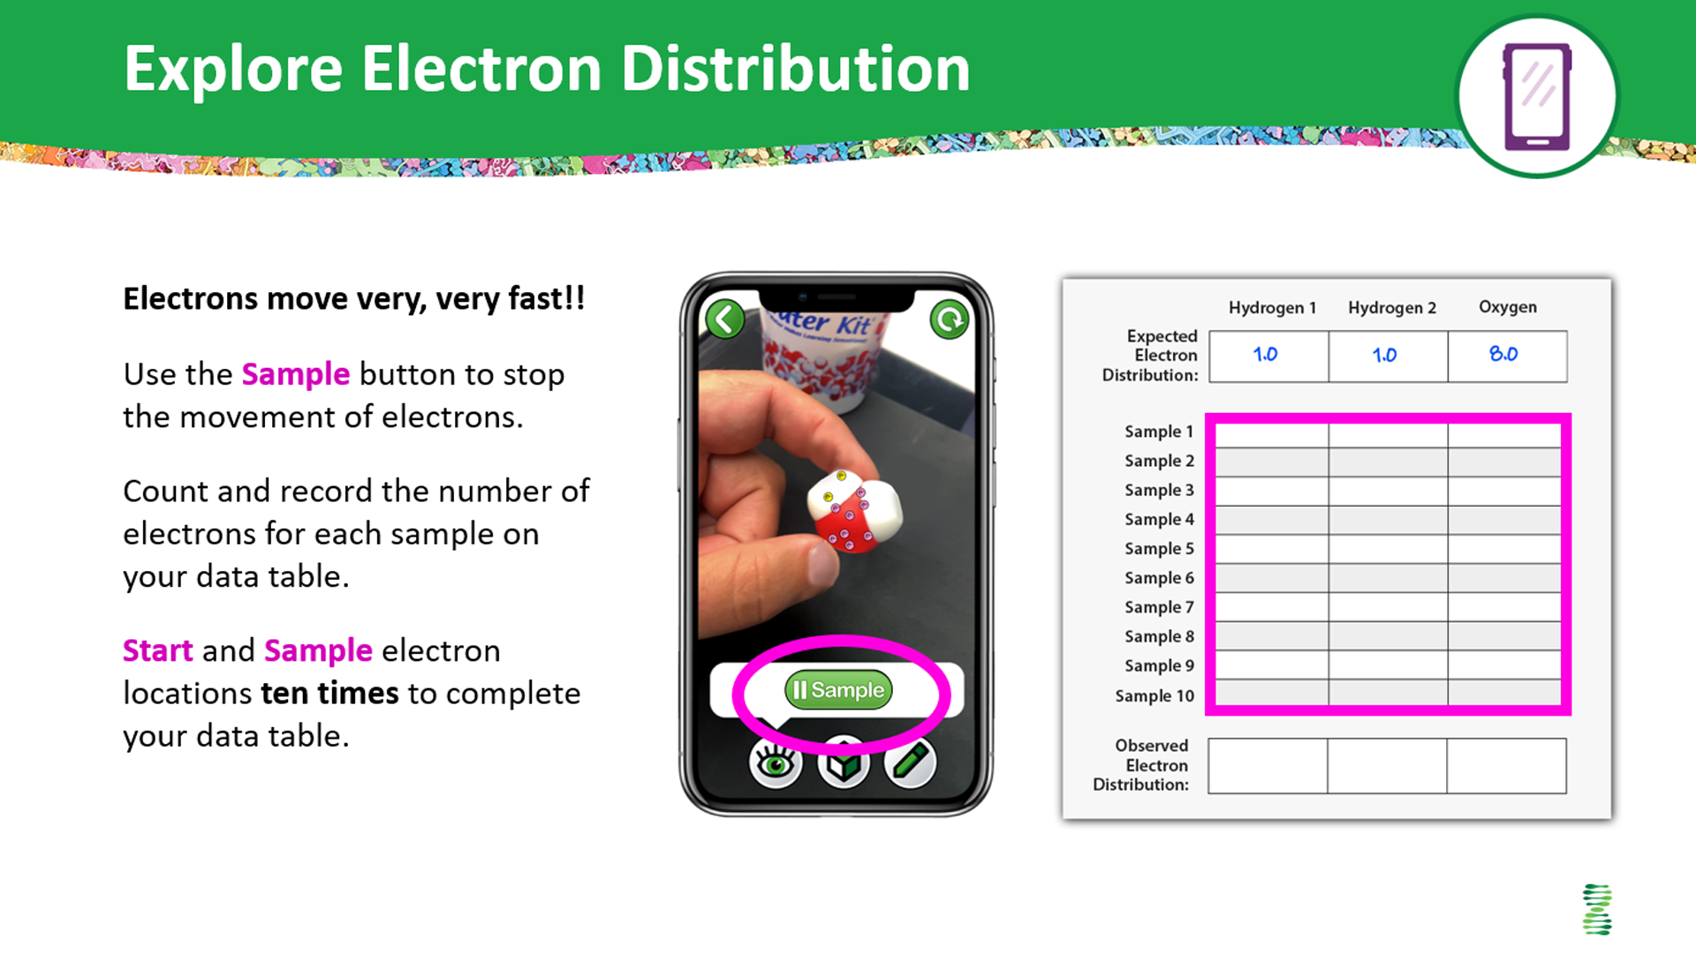
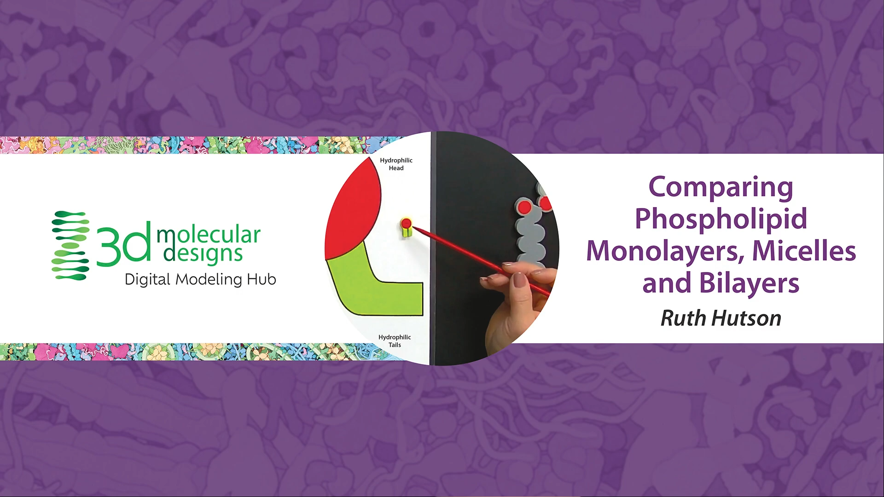
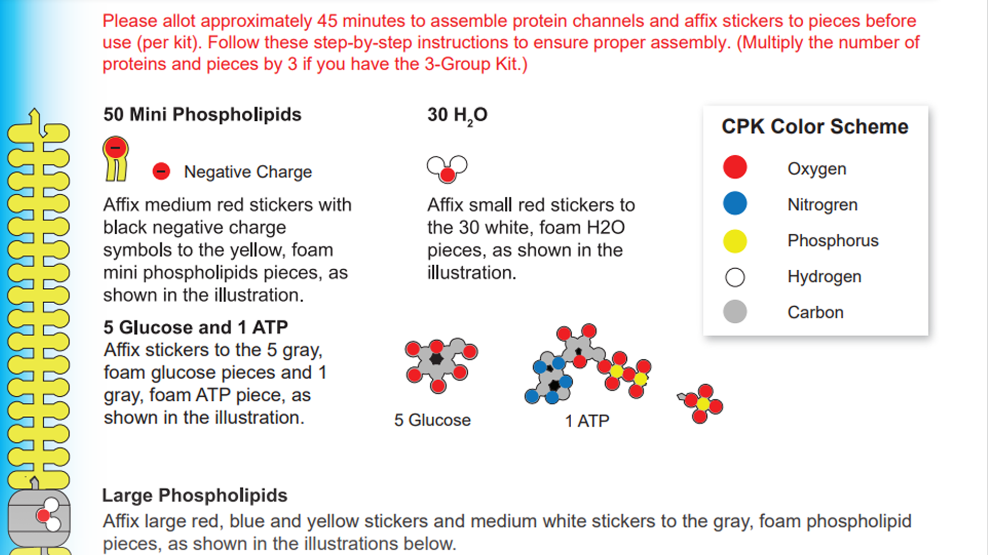
Digital Modeling Hub
We're enhancing our kits and models to inspire more hands-on learning with our classic content, Interactables, short content videos, and much more!! Check it out!
Look at our new
Digital Modeling Hub for additional resources to use with the Water Kit and Phospholipid and Membrane Transport Kit.
Get your access code by responding to our survey!

Slide 48
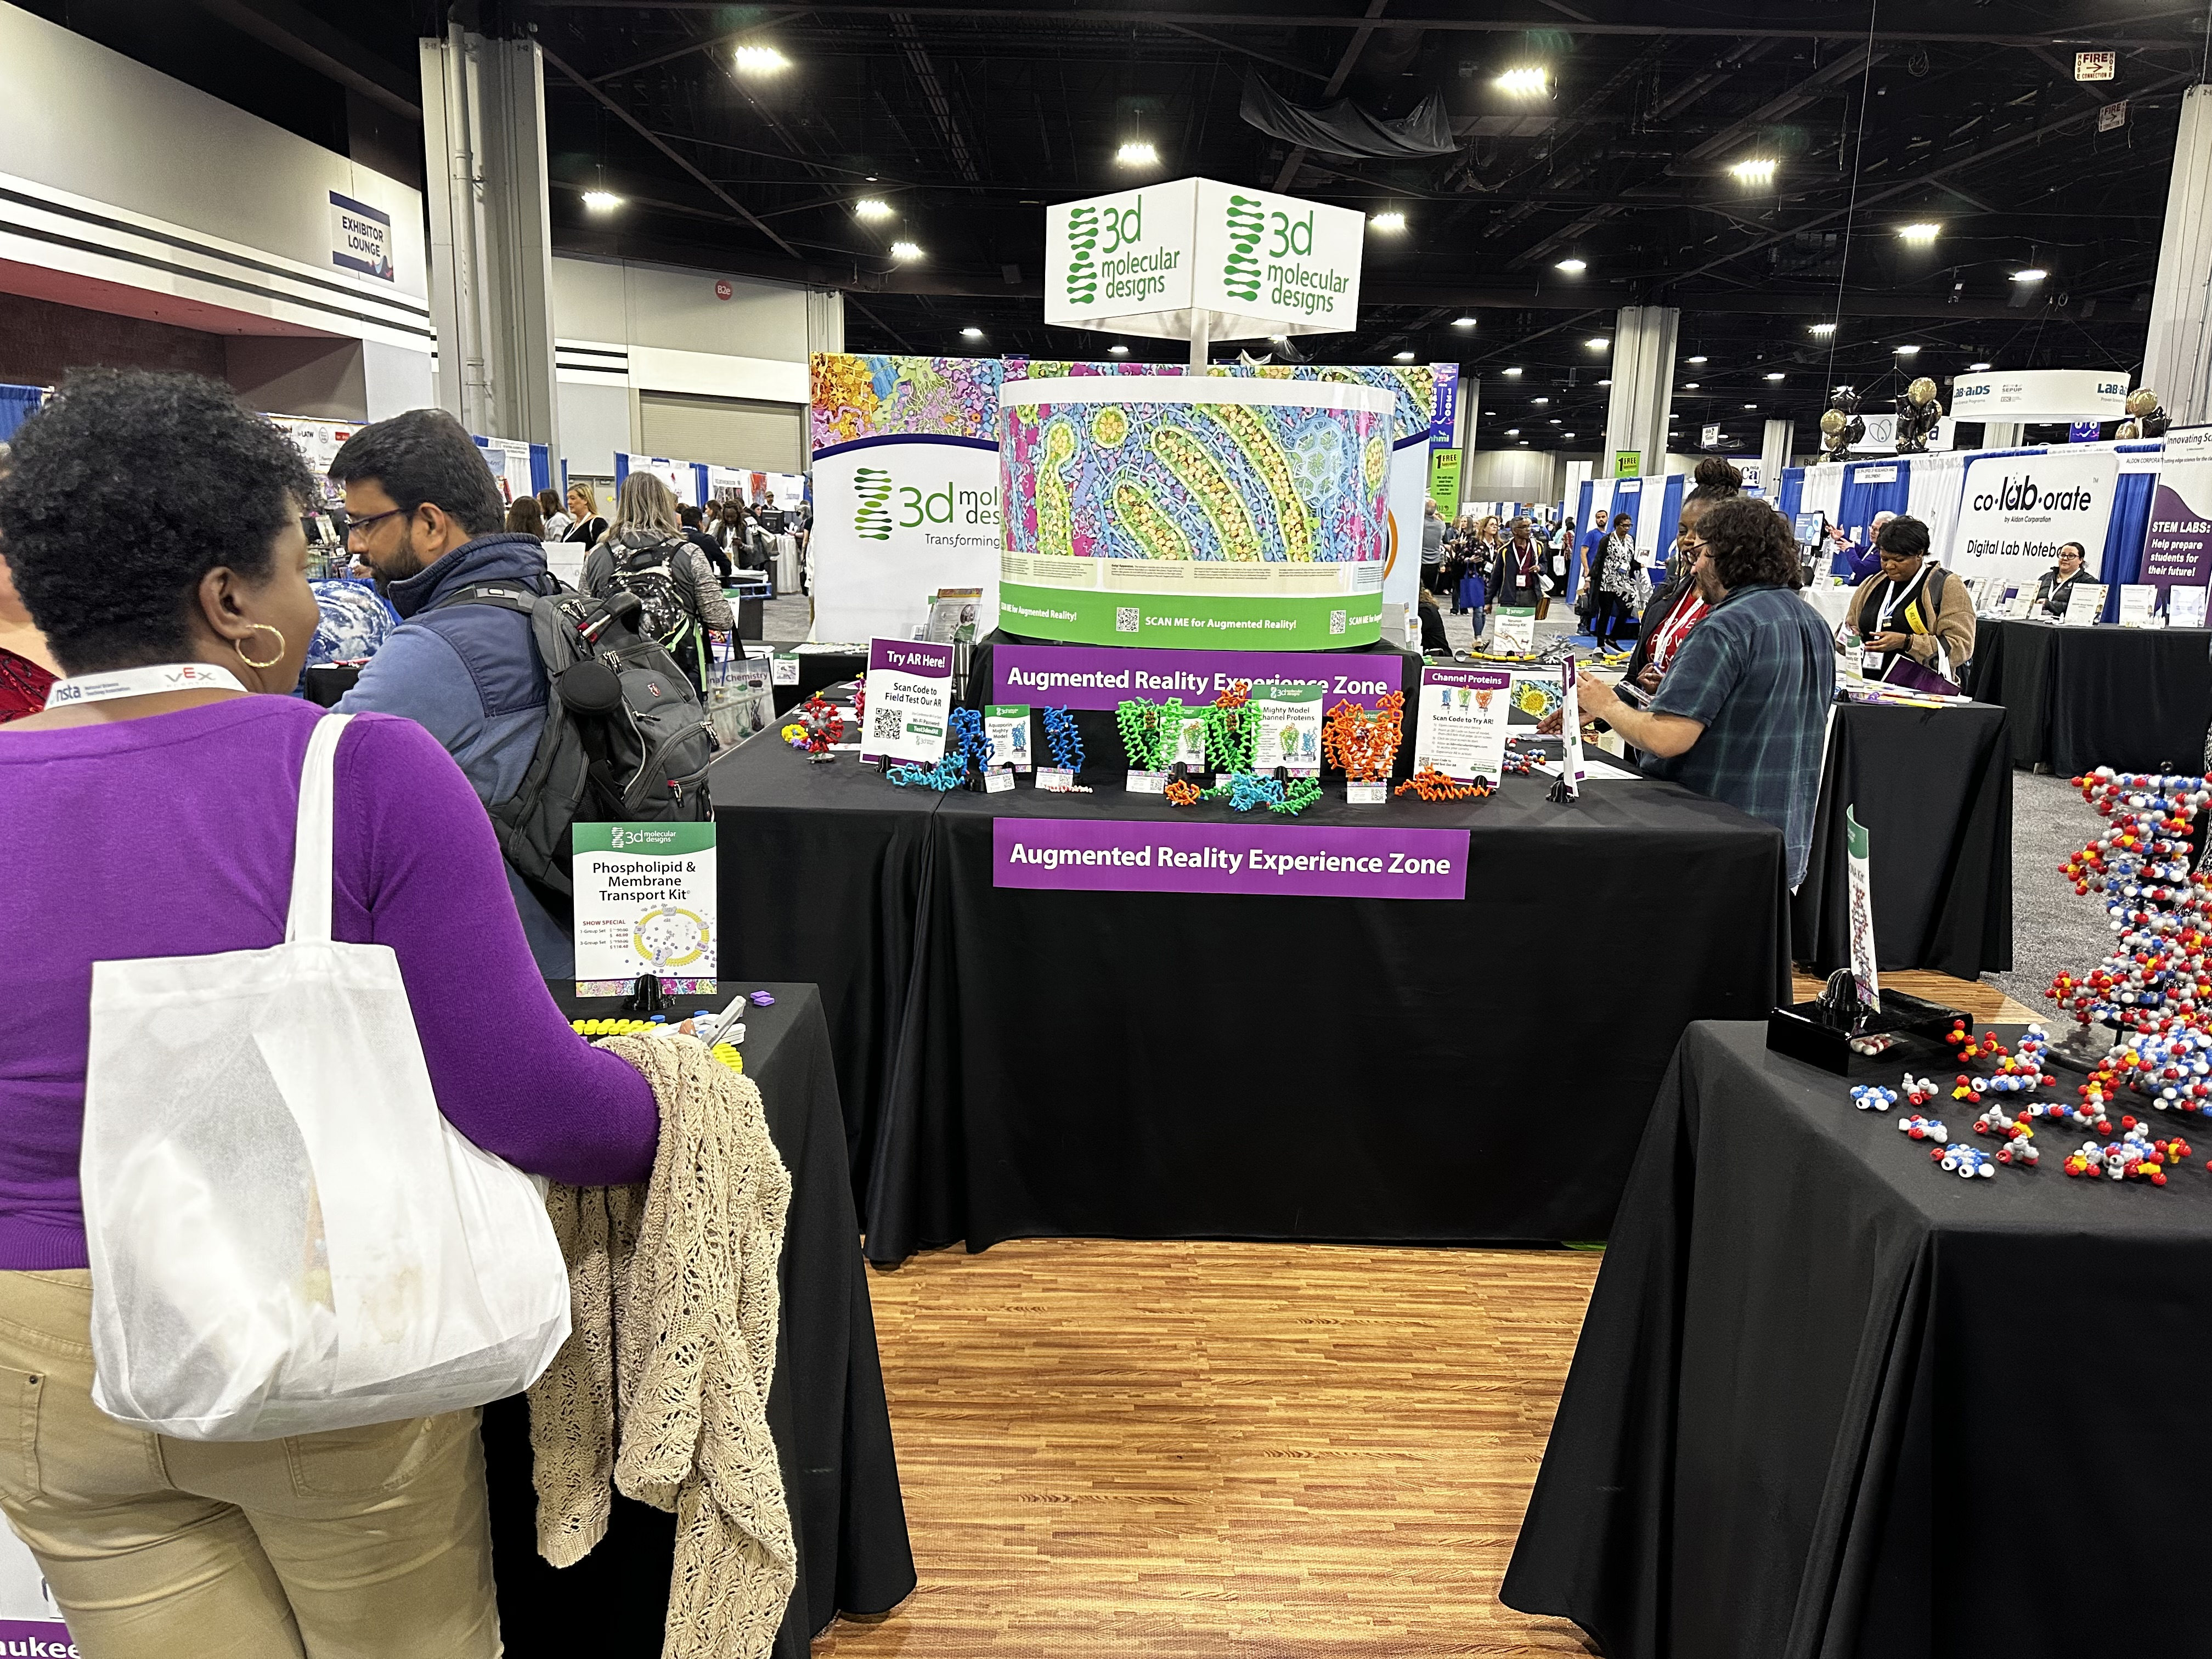
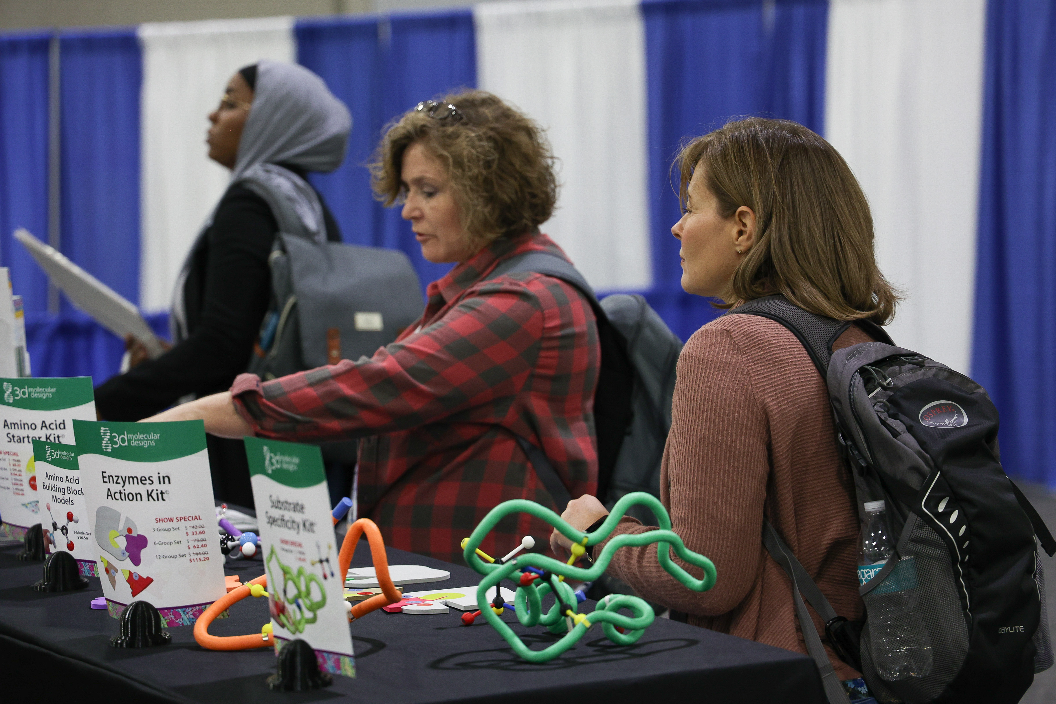
Visit Our Booth!
Continue your exploration of our dynamic kits and models at our Booth!

Slide 49
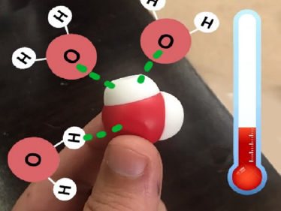


AR Enhancements
We're enhancing our kits and models to inspire more hands-on learning with new augmented reality features!
Look at our table to
check out our new
Augmented Reality Enhancements!

Slide 50

Summer Course 2025 – Modeling the Molecular World
Join us in Milwaukee for hands-on discovery and professional development on July 7 – 11.
Registration begins in October. Check out 3D Molecular Designs website for more information.
Bring an empty suitcase!
You'll take home all these classroom resources!
Notes:
Scholarships are available. If you have questions, you can contact Ruth Hutson at ruth.hutson@3dmoleculardesigns.com.

Slide 51

We value your opinion!
Let us know what you think.
Scan the QR Code and complete this short survey.

