Slide 1
Make the Complex Easy!
Modeling Proteins and Protein Structure
Mary Howard
Washington Township High School
Sewell, NJ 08080
Notes:
Engage your students! Use molecular models as a tool that Makes the Complex Easy and enables your students to realize that DNA is a code for amino acid sequences that determine protein structure

Slide 2

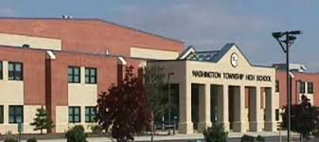
Mary Howard
Science Teacher at Washington Township High School in Sewell, NJ
Notes:
Reach me at mhoward@wtps.org

Slide 3
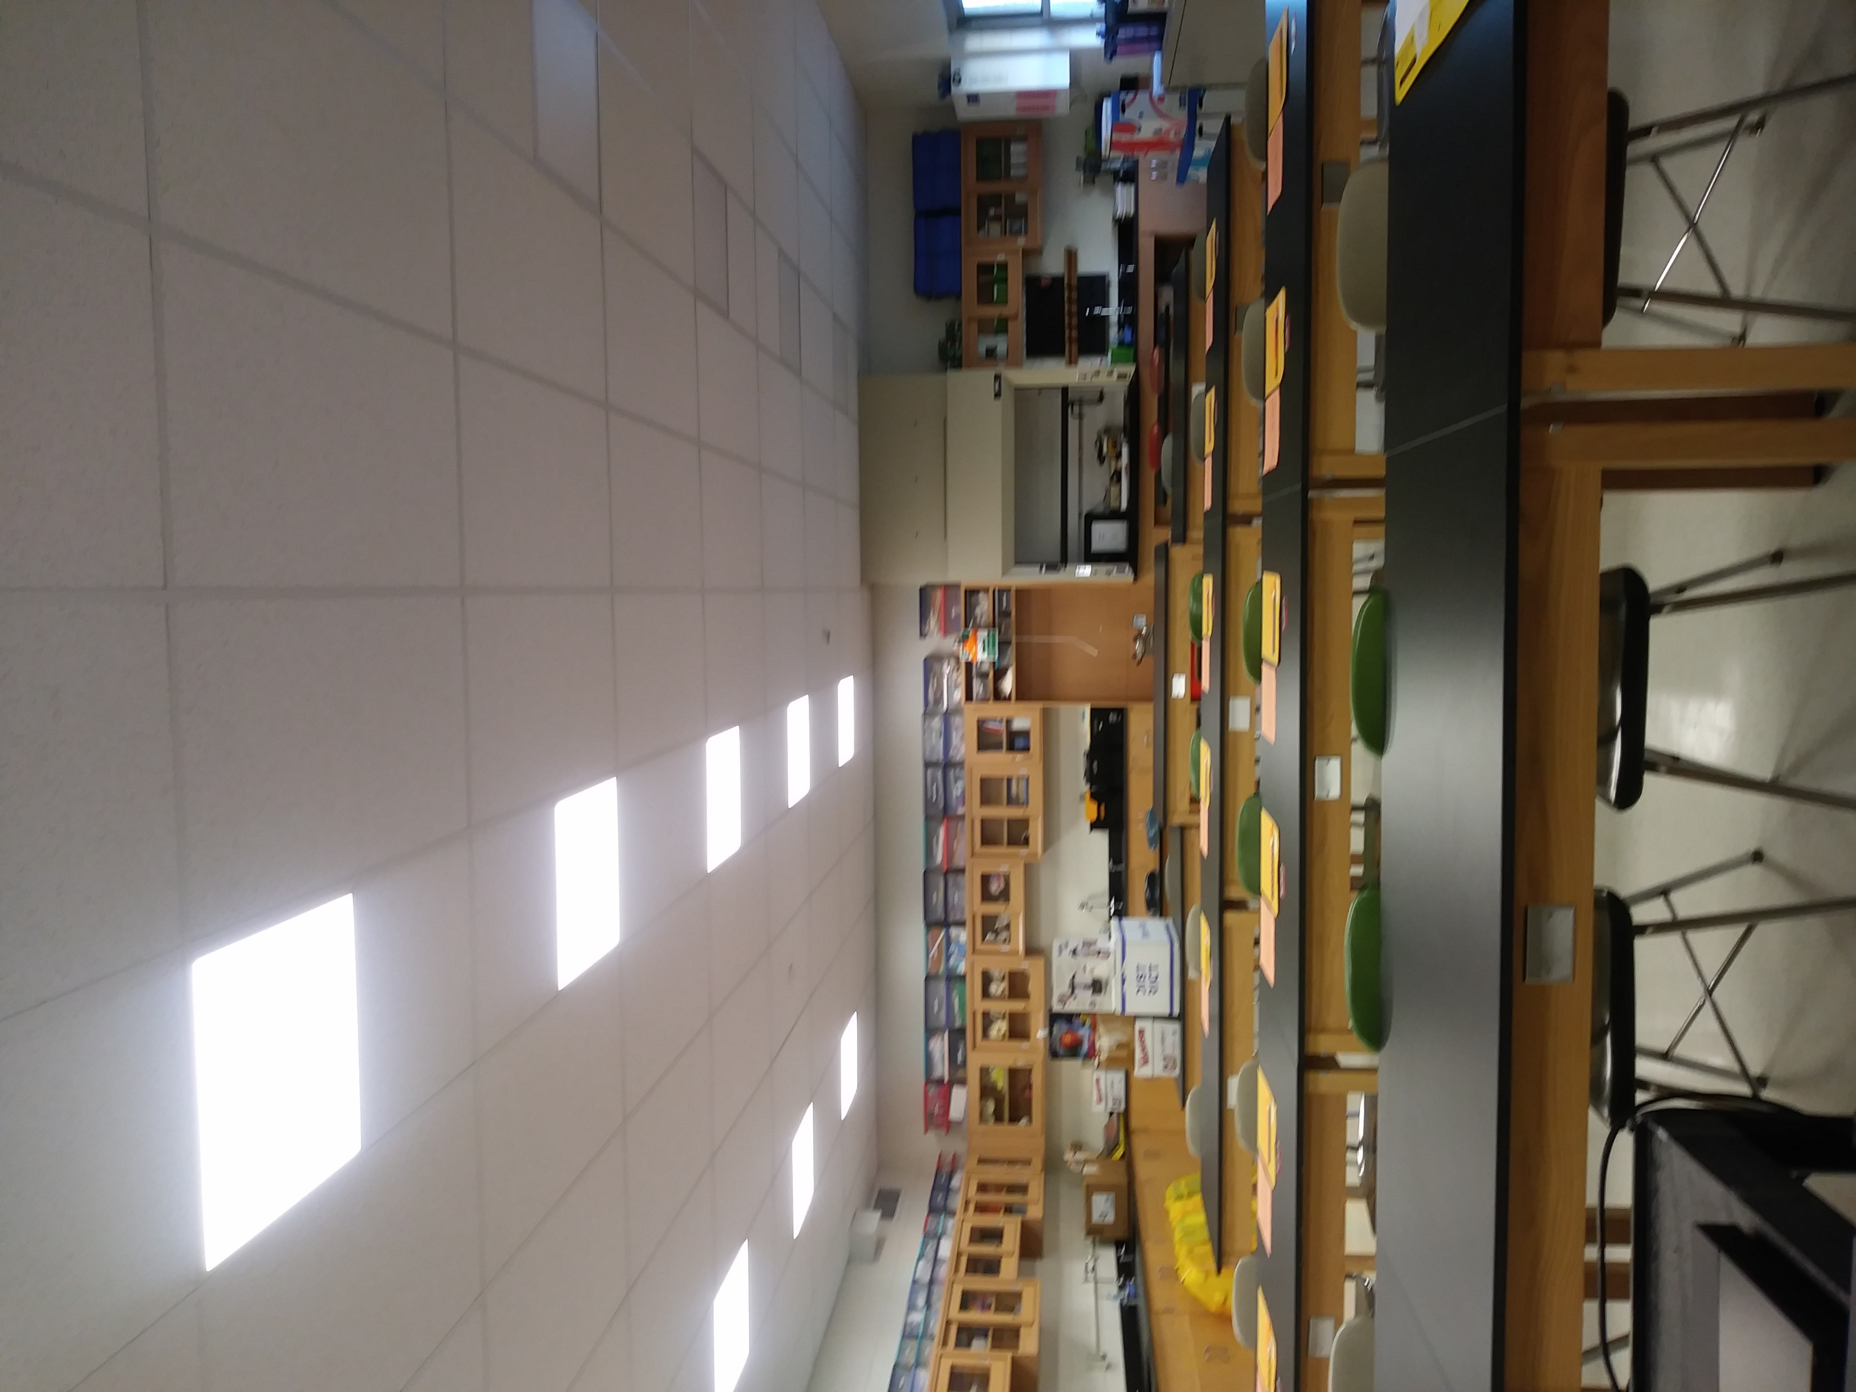
Mary Howard Basic Background
Education:
  Biochemistry
  Physiology
  Education
Experience:
  Researcher
  Instructor
Science Classroom Strategies
  Lectures
  Digital Activities
  Laboratory Activities
  Projects
  Assessments

Slide 4



Icebreaker
Let’s Get Talking with Conversation Cubes
Notes:
Ransom Notes Type Icebreaker Activity. Created with help of Instructional Coach. File available upon request at mhoward@wtps.org

Slide 5
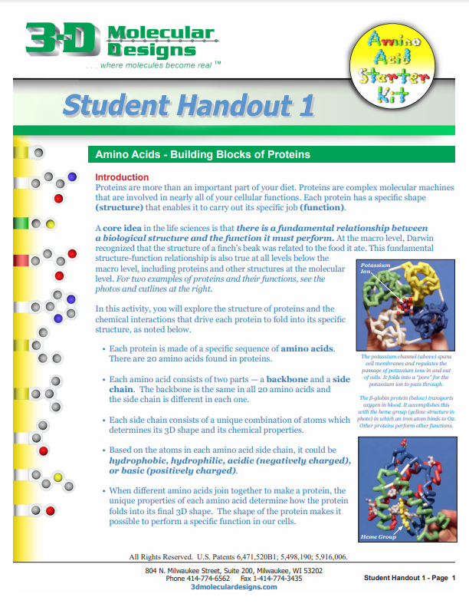
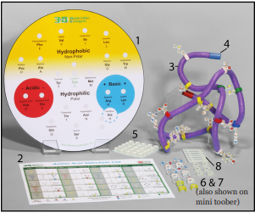
Amino Acid Starter Kit
Resources found at: https://3dmoleculardesigns.com/classroom_resources/flow-of-genetic-information-kit/

Slide 6
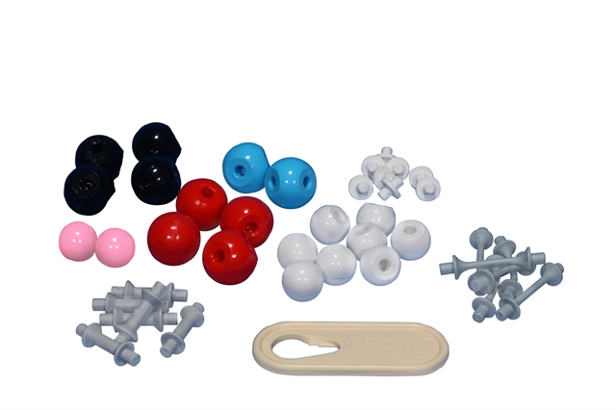

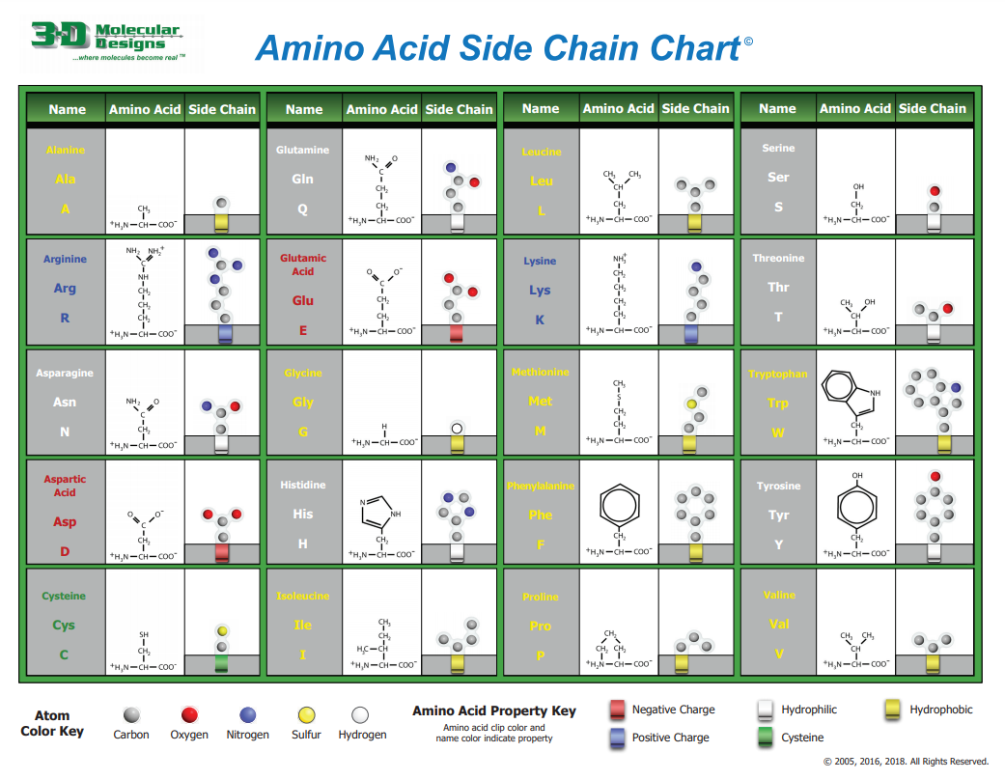
Resources and Materials
Kits Used in this workshop:
Amino Acid Building Block Models
Amino Acid Starter Kit
Codon Chart
Handouts

Slide 7

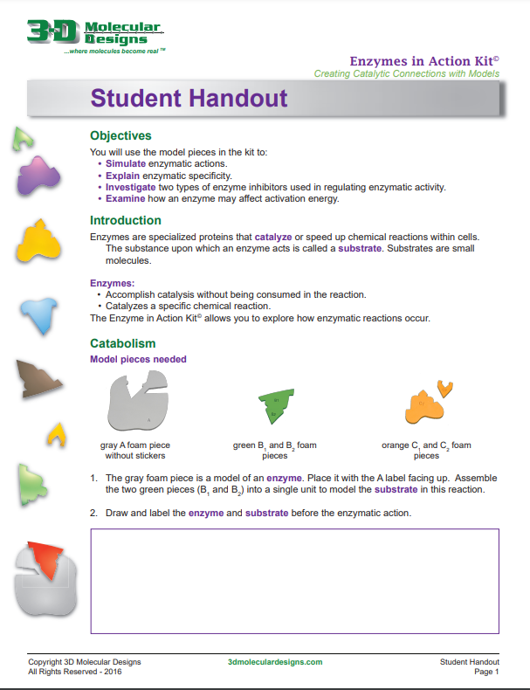
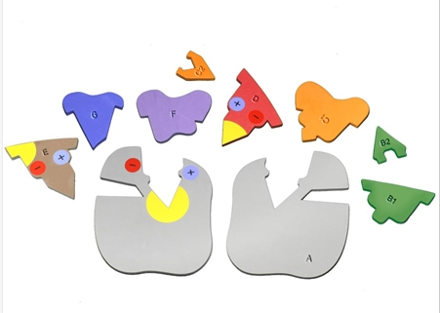
Lab:
Enzymes in Action
Let’s Take A Peek!
Resources for this lab found at: https://3dmoleculardesigns.com/classroom_resources/enzymes-in-action-kit/

Slide 8
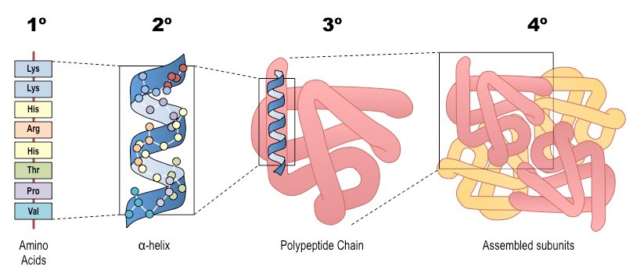

Protein Structure
How can students learn the concept of the Protein Structure through Modeling?

Slide 9
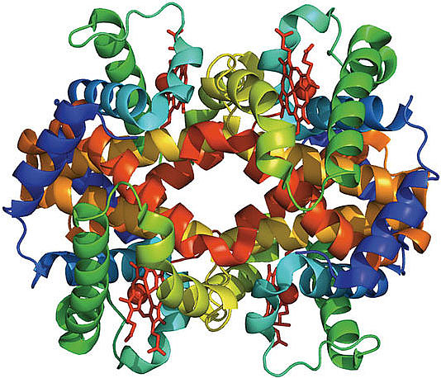
Protein Structure
Primary Structure
Secondary Structure
Tertiary Structure
Quaternary Structure
How can students learn the concept of the Protein Structure through Modeling?

Slide 10

Amino Acid Structure
Protein Structure; How do I start?

Slide 11
Amino Acid Building Block Kit
Resources found at: https://3dmoleculardesigns.com/classroom_resources/flow-of-genetic-information-kit/

Slide 12
Can you Build an Amino Acid?

Slide 13
Model Color Coding Key
Carbon (black)
Oxygen (red)
Nitrogen (blue)
R-Groups Representing Side Chains
Hydrogen (white)
Hydrogen Bonds (short white posts)
Single Covalent Bonds (short, gray, thick post)
Double Covalent Bonds (long, gray, thin post)
Link Remover

Slide 14
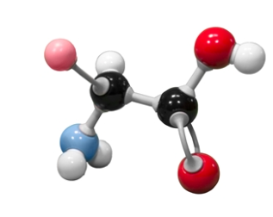
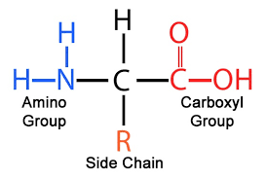
Proteins Are Made of Amino Acids

Slide 15
Can you Build Polypeptides?

Slide 16

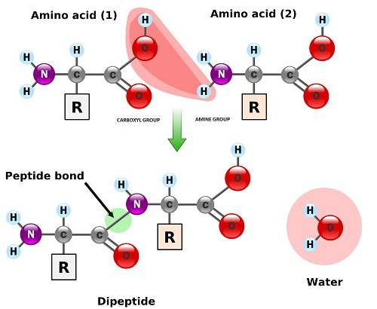
My Favorite:
Listen for whispers of “Whoa” as your students notice the water molecules that appear when peptide bonds form!

Slide 17
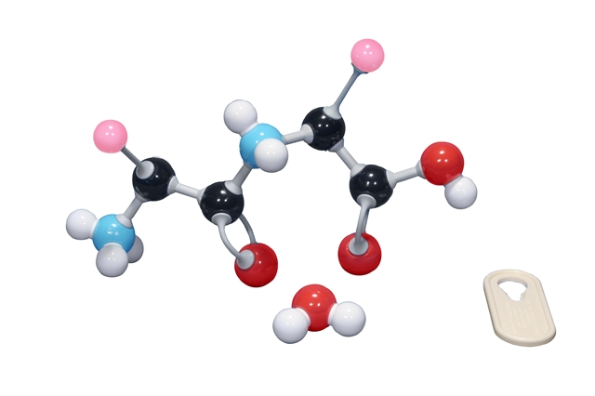
Challenge your students:
Can you make a dipeptide? Polypeptide?

Slide 18
Highlights: Versatility
Topics to Explore
  Dehydration Synthesis and Hydrolysis
  Covalent Bonding
  Amino Acid Side Chains
Notes:
Your students will thank you as dehydration synthesis and hydrolysis finally make sense! Students will build two amino acids as they:
Discover the repeating structure of amino acid backbones
Create covalent bonds between carbon, hydrogen, carbon, and nitrogen atoms
Explore the CPK color scheme and how bonds and side chains are represented in models

Slide 19


Slide 20
Protein Structure
Primary Structure
Secondary Structure
Tertiary Structure
Quaternary Structure
How can students learn the concept of the Protein Structure through Modeling?

Slide 21
Protein Structure

Slide 22
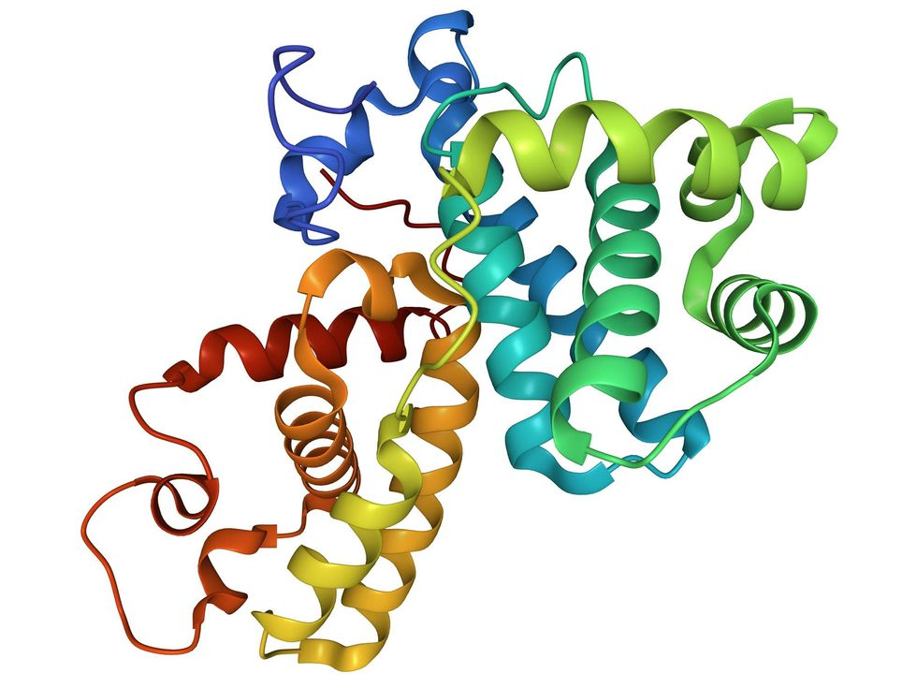
Why and How Do Polypeptides Fold into their Protein Structure?

Slide 23
Amino Acid Starter Kit
Resources found at: https://3dmoleculardesigns.com/classroom_resources/flow-of-genetic-information-kit/

Slide 24
Classroom Tips:
Supplies:
  Protein Folding Kit
    Amino Acid Side Chain Chart
  Meter/Yard Stick
  Lab Handout

Slide 25
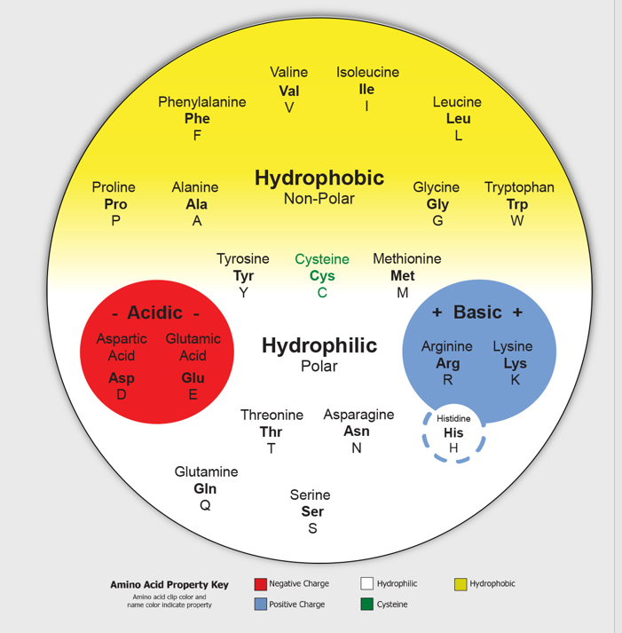
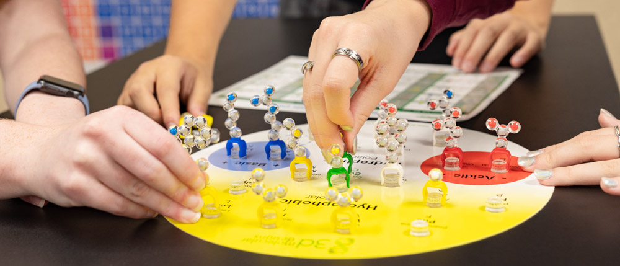
Amino Acid Starter Kit
Give it a try!

Slide 27
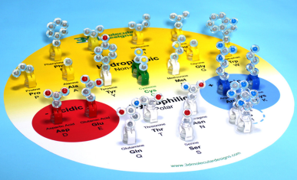
Highlights: Students See Side Chains Sorted by Their Chemical Properties

Slide 28
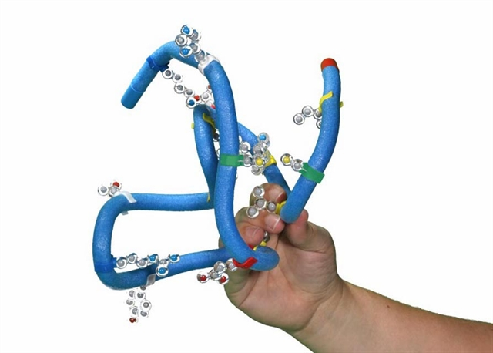
Protein Folding
Give it a try!

Slide 29
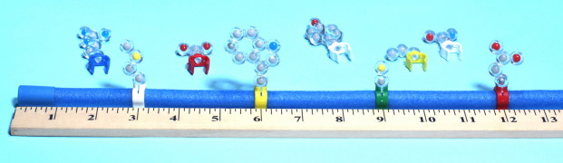
Classroom Tips:
Pick:
  6 Hydrophobic side chains
  2 Acidic side chains
  2 Basic side chains
  2 Cysteine
  3 Hydrophilic

Slide 30

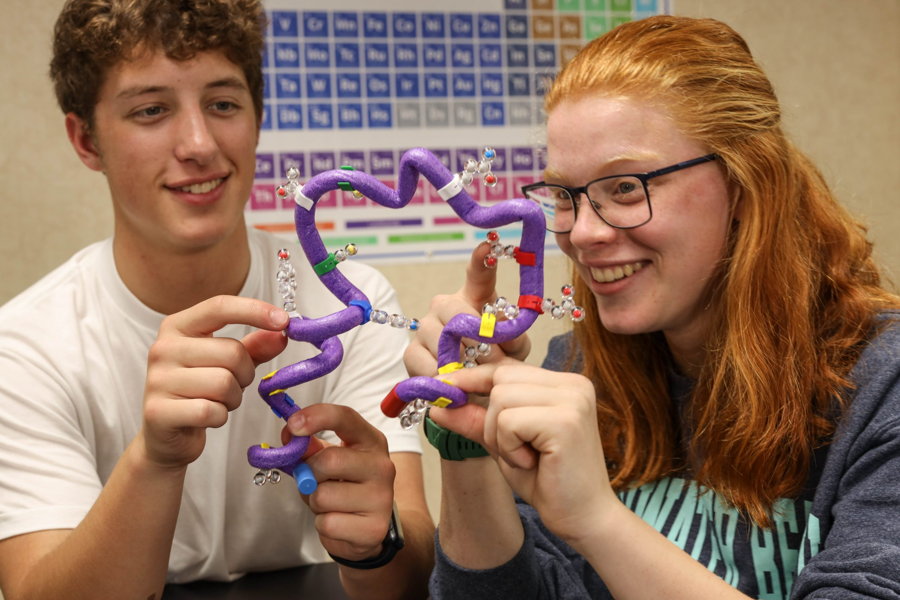
My Favorite:
Listen for whispers of “Whoa” as your students notice the water molecules that appear when peptide bonds form!

Slide 31
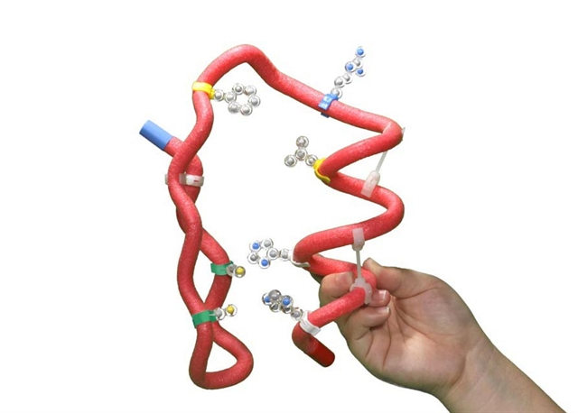
Highlights:
Concept of Structure/Function
Topics to Explore
  Patterns Within and Between Side Chains
  Discuss Chemical Properties of Side Chains
  Examine Different Secondary Structure
Notes:
Your students will thank you as dehydration synthesis and hydrolysis finally make sense! Students will build two amino acids as they:
Discover the repeating structure of amino acid backbones
Create covalent bonds between carbon, hydrogen, carbon, and nitrogen atoms
Explore the CPK color scheme and how bonds and side chains are represented in models

Slide 32

What’s Next?
I finished the lab, Now What?

Slide 33
Examples and Suggestions
Enzymes:
  Enzyme Action
  Lactose Intolerance
Hemoglobin:
  Genetics
  Hemoglobin Disorders
Notes:
It is important to be mindful that our district policies and procedures always align with our mission and the district vision …… of promoting
District Vision Statement
The Washington Township school district promotes a safe, inclusive environment that embraces differences and provides varied experiences to help all students build an academic foundation that will develop critical thinking skills, interpersonal skills, social and emotional intelligence, and the confidence to be ethical, responsible, and productive citizens in a global society.
Details located on district website at wtps.org

Slide 34
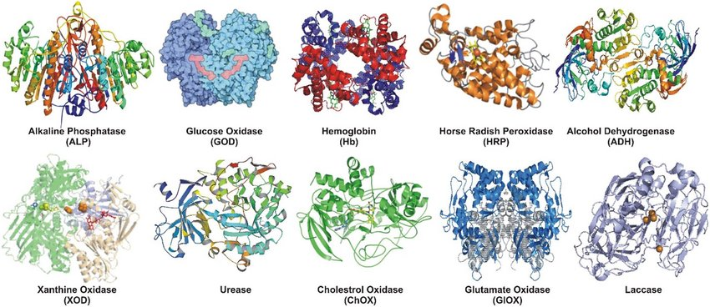
Lab: Enzymes in Action
Resources for this lab found at: https://3dmoleculardesigns.com/classroom_resources/enzymes-in-action-kit/

Slide 35

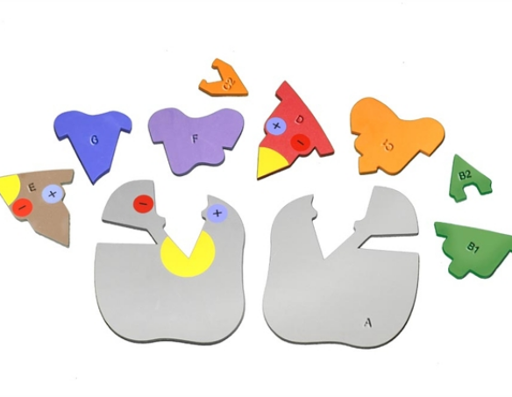
Lab: Enzymes in Action
Highlights:
Enzyme Substrate Interaction
Active Sites and Specificity
Competitive/Allosteric Inhibition
Lock-and-Key/Induced Fit

Slide 36
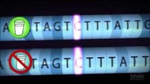
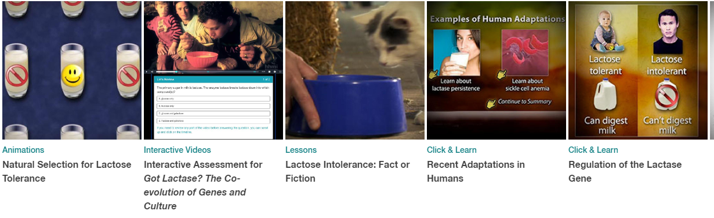
Activity: Lactose Intolerance
Got Lactase? Making of the Fittest
The Co-evolution of Genes and Culture
Sources for this activity found at: https://www.biointeractive.org/classroom-resources/making-fittest-got-lactase-co-evolution-genes-and-culture

Slide 37
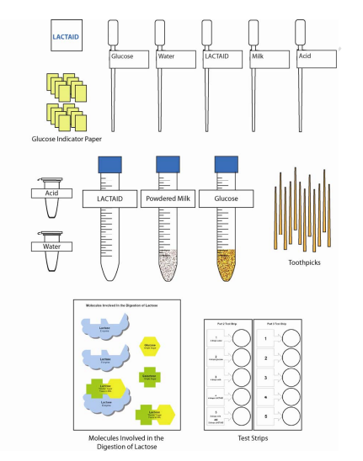
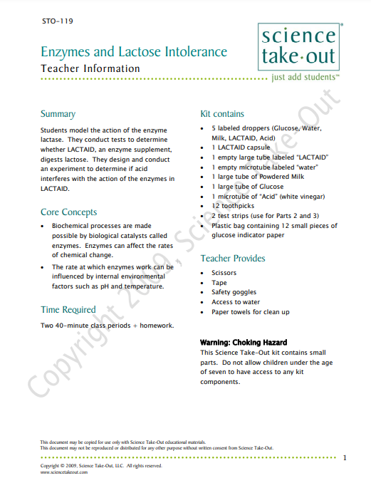
Activity: Lactose Lab
Science Take-Out
Enzymes and Lactose Intolerance
Sources for this activity found at: https://www.sciencetakeout.com/product/enzymes-and-lactose-intolerance-group/

Slide 38
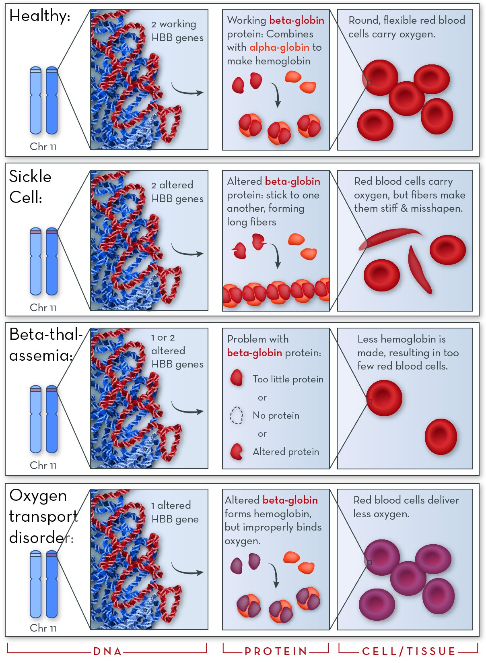
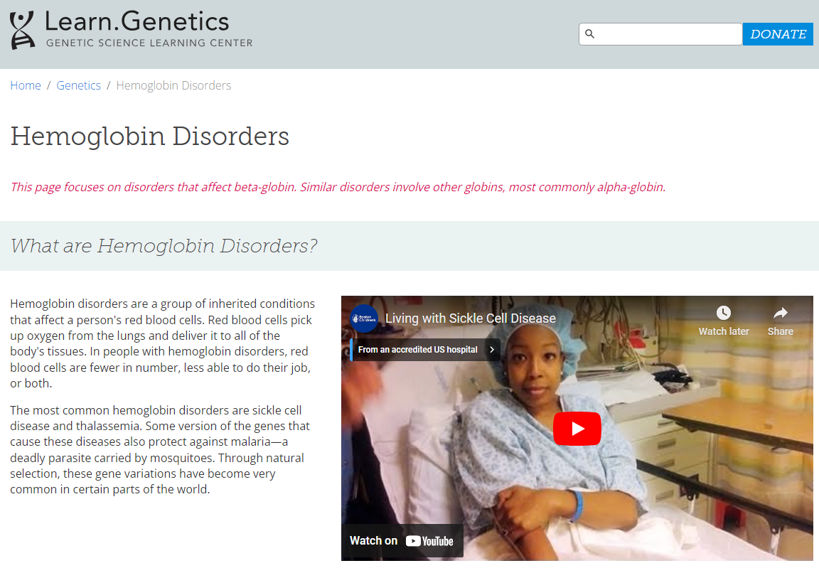
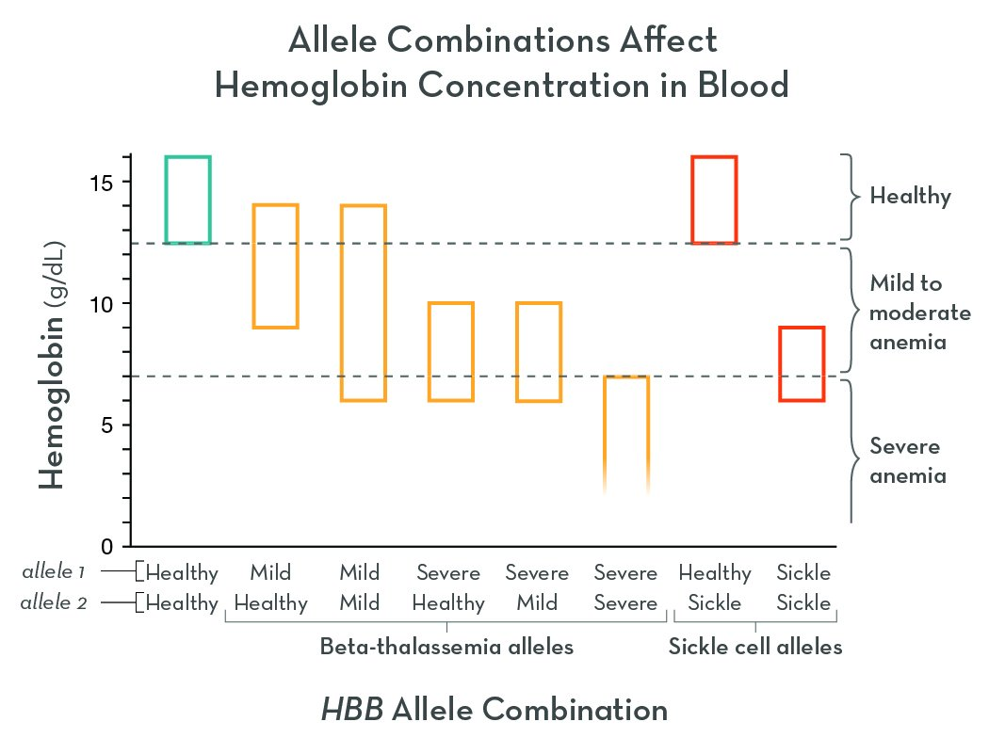
Activity: Hemoglobin Disorders
Sources for this activity found at: https://learn.genetics.utah.edu/content/genetics/hemoglobin

Slide 39

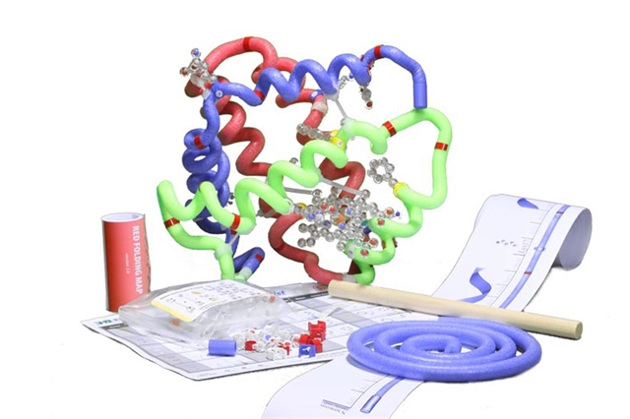
Activity:
Resources for this lab found at: https://3dmoleculardesigns.com/classroom_resources/s-globin-folding-kit/

Slide 41
Reflection Activity
Where do you see this fitting into your curriculum?
What Lingering Questions Do You Still Have?
What Does This Look Like Implemented in Your Classroom?
What Other Resources Would You Use With this topic? (Make a Suggestion!)
Notes:
Wrap Up Activity. Use Large Post It Notes with Questions on Wall/Tables. Have participants use small post it notes to share answers with others. Let participants mingle to see others' ideas.

Slide 42
Give Away!
Enzyme in Action Kit
Purchase kits at 3dmoleculardesigns.com.
Receive 20% off most items in our catalog with Discount Code FC23..

Slide 43
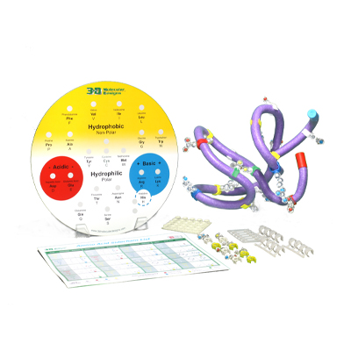
Resources and Materials
Kits Used in this workshop:
Amino Acid Building Blocks Amino Acid Starter Kit
Enzymes in Action Kit
Purchase kits at 3dmoleculardesigns.com.
Receive 10% off most items in our catalog. Student Modeling Packs are not eligible for discount.

Slide 44


Summer Course 2024
Modeling the Molecular World
Join us in Milwaukee
for hands-on discovery and professional development
July 29 – Aug 2 OR Aug 5 – 9
Bring an empty suitcase!
You'll take home all these classroom resources!
Scan to register!

Slide 46
Stop by and See Us at the
3d molecular designs
Booth

